Slide 1
ELECTRIC POTENTIAL · POINT-CHARGE POTENTIAL
GIOPHYSICS LESSON
12 · Electric Potential
An inverse-distance scalar field
Point-Charge Potential
A point charge creates potential that fades as 1/r. Its sign follows the source charge, and its zero is conventionally placed at infinity.
POSITION
Lesson 3 of 7 in Electric Potential
PLAN
16 slides in the 45-minute core run, about 43.5 minutes of it
LESSON PAGE
https://giophysics.com/chapter-21/point-charge-potential/
Built by GioPhysics from the lesson's own page. Every word on these slides is the lesson's; nothing here is re-authored. Teaching material, not an awarding body's document.
Electric Potential — Point-Charge Potential. Built by GioPhysics from the lesson's own copy; nothing on these slides is re-authored.
1 / 32
Notes:
[Lesson] Electric Potential — Point-Charge Potential. Lesson 3 of 7.
[Intro] A point charge creates potential that fades as 1/r. Its sign follows the source charge, and its zero is conventionally placed at infinity.
[Source] https://giophysics.com/chapter-21/point-charge-potential/
[Disclaimer] Built by GioPhysics from the lesson's own page. Every word on these slides is the lesson's; nothing here is re-authored. Teaching material, not an awarding body's document.

Slide 2
ELECTRIC POTENTIAL · POINT-CHARGE POTENTIAL
GIOPHYSICS LESSON
WHAT THIS NEEDS
What you already know
Starter — Recall what this lesson stands on
Recall
Coulomb's law
https://giophysics.com/chapter-19/coulombs-law/
Recall
Point-charge fields
https://giophysics.com/chapter-20/point-charge-fields/
Electric Potential — Point-Charge Potential. Built by GioPhysics from the lesson's own copy; nothing on these slides is re-authored.
2 / 32
Notes:
[Phase] Starter: Recall what this lesson stands on (minutes 0–5 of 45)
[Starter] Recall: Coulomb's law; Point-charge fields

Slide 3
ELECTRIC POTENTIAL · POINT-CHARGE POTENTIAL
GIOPHYSICS LESSON
THINK FIRST
Move twice as far from a point charge and the field drops to a quarter. Does the potential drop to a quarter as well?
Take answers before you click — the point is the commitment
Every inverse-square law met so far — gravity, Coulomb's law, the brightness of a lamp — quarters when the distance doubles.
THE ANSWER
No: the potential only halves. V = kQ/r is an inverse-FIRST-power law, because it is what you get by integrating an inverse-square field over distance, and integrating lowers the power of r in the denominator by one. Field and potential are one calculus step apart, so they can never share a falloff.
Electric Potential — Point-Charge Potential. Built by GioPhysics from the lesson's own copy; nothing on these slides is re-authored.
3 / 32
Notes:
[Phase] Starter: Recall what this lesson stands on (minutes 0–5 of 45)
[Hook] Move twice as far from a point charge and the field drops to a quarter. Does the potential drop to a quarter as well? Every inverse-square law met so far — gravity, Coulomb's law, the brightness of a lamp — quarters when the distance doubles.
[Answer] No: the potential only halves. V = kQ/r is an inverse-FIRST-power law, because it is what you get by integrating an inverse-square field over distance, and integrating lowers the power of r in the denominator by one. Field and potential are one calculus step apart, so they can never share a falloff.

Slide 4
ELECTRIC POTENTIAL · POINT-CHARGE POTENTIAL
GIOPHYSICS LESSON
EXPLAINED SIMPLY
In one sentence
Introduce the idea — The big idea and the definition
Point-charge potential is the signed electric potential created by one point charge, equal to kQ/r when zero potential is chosen at infinity.
Electric Potential — Point-Charge Potential. Built by GioPhysics from the lesson's own copy; nothing on these slides is re-authored.
4 / 32
Notes:
[Phase] Introduce the idea: The big idea and the definition (minutes 5–13 of 45)
[Definition] Point-charge potential is the signed electric potential created by one point charge, equal to kQ/r when zero potential is chosen at infinity.

Slide 5
ELECTRIC POTENTIAL · POINT-CHARGE POTENTIAL
GIOPHYSICS LESSON
EXPLAINED SIMPLY
What that looks like
Introduce the idea — The big idea and the definition
FOR EXAMPLE
Doubling the distance from a positive point charge halves its positive potential, while the field magnitude falls to one quarter.
Electric Potential — Point-Charge Potential. Built by GioPhysics from the lesson's own copy; nothing on these slides is re-authored.
5 / 32
Notes:
[Phase] Introduce the idea: The big idea and the definition (minutes 5–13 of 45)
[Worked illustration] Doubling the distance from a positive point charge halves its positive potential, while the field magnitude falls to one quarter.

Slide 6
ELECTRIC POTENTIAL · POINT-CHARGE POTENTIAL
GIOPHYSICS LESSON
THE BIG IDEA
An inverse-distance scalar field
Introduce the idea — The big idea and the definition
For an isolated point charge Q, electric potential depends only on radial distance r. Positive Q creates positive V and negative Q creates negative V. The 1/r potential changes more slowly with distance than the 1/r² electric-field magnitude.
Electric Potential — Point-Charge Potential. Built by GioPhysics from the lesson's own copy; nothing on these slides is re-authored.
6 / 32
Notes:
[Phase] Introduce the idea: The big idea and the definition (minutes 5–13 of 45)
[Big idea] For an isolated point charge Q, electric potential depends only on radial distance r. Positive Q creates positive V and negative Q creates negative V. The 1/r potential changes more slowly with distance than the 1/r² electric-field magnitude.

Slide 7
ELECTRIC POTENTIAL · POINT-CHARGE POTENTIAL
GIOPHYSICS LESSON
THE PHYSICS · 1 OF 3
Use distance, not direction
Build the model — The formulae, one at a time, in plain English
All points the same distance from one point charge have the same potential, forming spherical equipotential surfaces.
Electric Potential — Point-Charge Potential. Built by GioPhysics from the lesson's own copy; nothing on these slides is re-authored.
7 / 32
Notes:
[Phase] Build the model: The formulae, one at a time, in plain English (minutes 13–22 of 45)
[Section] All points the same distance from one point charge have the same potential, forming spherical equipotential surfaces.

Slide 8
ELECTRIC POTENTIAL · POINT-CHARGE POTENTIAL
GIOPHYSICS LESSON
THE PHYSICS · 2 OF 3
Keep the sign
Build the model — The formulae, one at a time, in plain English
V is negative around a negative source charge. Do not replace Q with |Q| in a potential calculation.
Electric Potential — Point-Charge Potential. Built by GioPhysics from the lesson's own copy; nothing on these slides is re-authored.
8 / 32
Notes:
[Phase] Build the model: The formulae, one at a time, in plain English (minutes 13–22 of 45)
[Section] V is negative around a negative source charge. Do not replace Q with |Q| in a potential calculation.

Slide 9
ELECTRIC POTENTIAL · POINT-CHARGE POTENTIAL
GIOPHYSICS LESSON
THE PHYSICS · 3 OF 3
Watch the scaling
Build the model — The formulae, one at a time, in plain English
Doubling r halves |V| but reduces |E| to one quarter. The two quantities do not follow the same inverse power.
Electric Potential — Point-Charge Potential. Built by GioPhysics from the lesson's own copy; nothing on these slides is re-authored.
9 / 32
Notes:
[Phase] Build the model: The formulae, one at a time, in plain English (minutes 13–22 of 45)
[Section] Doubling r halves |V| but reduces |E| to one quarter. The two quantities do not follow the same inverse power.

Slide 10
ELECTRIC POTENTIAL · POINT-CHARGE POTENTIAL
GIOPHYSICS LESSON
FORMULA 1 OF 3
Point-charge potential
Build the model — The formulae, one at a time, in plain English
V = kQ/r
Use Q with its sign; take V = 0 at infinity
IN PLAIN ENGLISH
The potential around a single charge: positive charges raise it, negative charges lower it, and it fades with distance.
Electric Potential — Point-Charge Potential. Built by GioPhysics from the lesson's own copy; nothing on these slides is re-authored.
10 / 32
Notes:
[Phase] Build the model: The formulae, one at a time, in plain English (minutes 13–22 of 45)
[Formula] Point-charge potential: V = kQ/r
[In plain English] The potential around a single charge: positive charges raise it, negative charges lower it, and it fades with distance.
[Note] Use Q with its sign; take V = 0 at infinity

Slide 11
ELECTRIC POTENTIAL · POINT-CHARGE POTENTIAL
GIOPHYSICS LESSON
FORMULA 2 OF 3
Energy at a point
Build the model — The formulae, one at a time, in plain English
U = qV
Now the test-charge sign enters
IN PLAIN ENGLISH
Place a charge where the potential is V and its stored energy is simply charge times potential.
Electric Potential — Point-Charge Potential. Built by GioPhysics from the lesson's own copy; nothing on these slides is re-authored.
11 / 32
Notes:
[Phase] Build the model: The formulae, one at a time, in plain English (minutes 13–22 of 45)
[Formula] Energy at a point: U = qV
[In plain English] Place a charge where the potential is V and its stored energy is simply charge times potential.
[Note] Now the test-charge sign enters

Slide 12
ELECTRIC POTENTIAL · POINT-CHARGE POTENTIAL
GIOPHYSICS LESSON
FORMULA 3 OF 3
Field comparison
Build the model — The formulae, one at a time, in plain English
|E| = k|Q|/r²
Potential is scalar; electric field is vector
IN PLAIN ENGLISH
Note the contrast: potential fades as 1/r but field fades faster, as 1/r² — and only the field has a direction.
Electric Potential — Point-Charge Potential. Built by GioPhysics from the lesson's own copy; nothing on these slides is re-authored.
12 / 32
Notes:
[Phase] Build the model: The formulae, one at a time, in plain English (minutes 13–22 of 45)
[Formula] Field comparison: |E| = k|Q|/r²
[In plain English] Note the contrast: potential fades as 1/r but field fades faster, as 1/r² — and only the field has a direction.
[Note] Potential is scalar; electric field is vector

Slide 13
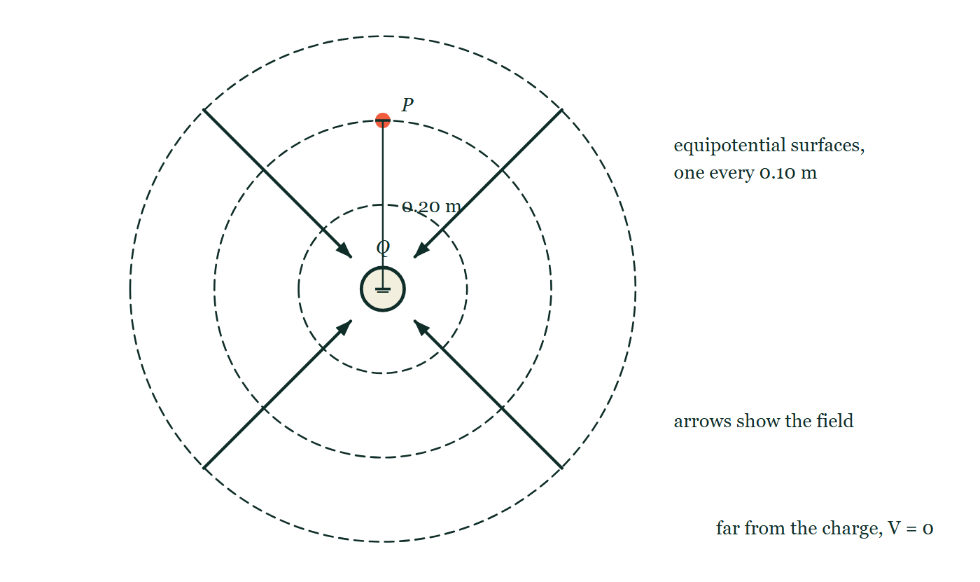
ELECTRIC POTENTIAL · POINT-CHARGE POTENTIAL
GIOPHYSICS LESSON
PICTURE 1 OF 2
Around a negative charge
Drawn for this lesson
A negative point charge with three dashed spherical equipotentials at 0.10 m, 0.20 m and 0.30 m, and four field arrows running inward from the outer surface toward the charge.
The live version of this figure — click here
Electric Potential — Point-Charge Potential. Built by GioPhysics from the lesson's own copy; nothing on these slides is re-authored.
13 / 32
Notes:
[Phase] Build the model: The formulae, one at a time, in plain English (minutes 13–22 of 45)
[Figure] A negative point charge with three dashed spherical equipotentials at 0.10 m, 0.20 m and 0.30 m, and four field arrows running inward from the outer surface toward the charge.

Slide 14
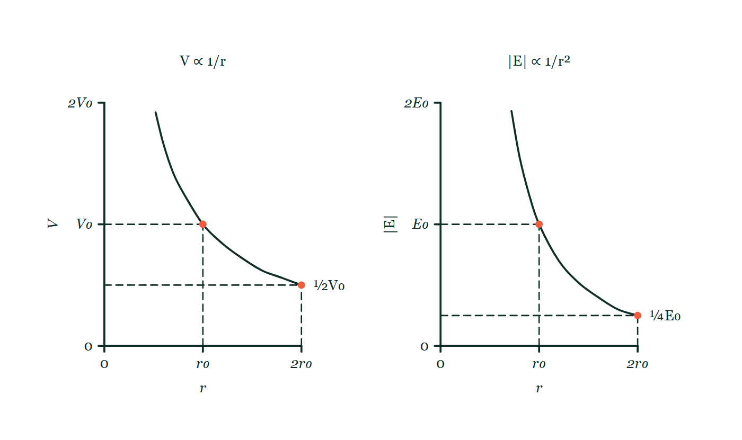
ELECTRIC POTENTIAL · POINT-CHARGE POTENTIAL
GIOPHYSICS LESSON
PICTURE 2 OF 2
Two different falloffs
Drawn for this lesson
Two graphs drawn on the same distance scale: potential falling as 1/r beside field strength falling as 1/r², each marked with a point at r₀ and another at twice that distance.
The live version of this figure — click here
Electric Potential — Point-Charge Potential. Built by GioPhysics from the lesson's own copy; nothing on these slides is re-authored.
14 / 32
Notes:
[Phase] Build the model: The formulae, one at a time, in plain English (minutes 13–22 of 45)
[Figure] Two graphs drawn on the same distance scale: potential falling as 1/r beside field strength falling as 1/r², each marked with a point at r₀ and another at twice that distance.

Slide 15
ELECTRIC POTENTIAL · POINT-CHARGE POTENTIAL
GIOPHYSICS LESSON
WATCH OUT
The common trap
Check and misconception — The quick check and the trap
The sign of point-charge potential comes from the source charge Q, not from whichever test charge you later place at the point.
Electric Potential — Point-Charge Potential. Built by GioPhysics from the lesson's own copy; nothing on these slides is re-authored.
15 / 32
Notes:
[Phase] Check and misconception: The quick check and the trap (minutes 35–41 of 45)
[Misconception] The sign of point-charge potential comes from the source charge Q, not from whichever test charge you later place at the point.

Slide 16
ELECTRIC POTENTIAL · POINT-CHARGE POTENTIAL
GIOPHYSICS LESSON
WORKED EXAMPLE 1 OF 2 · EASY
The question
Easy
Worked examples — I do, we do — one step revealed at a time
Find the potential 0.50 m from a +6.0 μC charge.
Electric Potential — Point-Charge Potential. Built by GioPhysics from the lesson's own copy; nothing on these slides is re-authored.
16 / 32
Notes:
[Phase] Worked examples: I do, we do — one step revealed at a time (minutes 22–35 of 45)
[Question] Find the potential 0.50 m from a +6.0 μC charge.
[Answer] V ≈ 1.1 × 10⁵ V

Slide 17
ELECTRIC POTENTIAL · POINT-CHARGE POTENTIAL
GIOPHYSICS LESSON
WORKED EXAMPLE 1 OF 2 · EASY · THE WORKING
How to solve it
Easy
Worked examples — I do, we do — one step revealed at a time
Find the potential 0.50 m from a +6.0 μC charge.
1.
V = kQ/r = 8.99 × 10⁹ × 6.0 × 10⁻⁶ ÷ 0.50.
2.
V ≈ 1.1 × 10⁵ V.
Electric Potential — Point-Charge Potential. Built by GioPhysics from the lesson's own copy; nothing on these slides is re-authored.
17 / 32
Notes:
[Phase] Worked examples: I do, we do — one step revealed at a time (minutes 22–35 of 45)
[Reveal] One click per step. The class works each line before the next appears.
[Step 1] V = kQ/r = 8.99 × 10⁹ × 6.0 × 10⁻⁶ ÷ 0.50.
[Step 2] V ≈ 1.1 × 10⁵ V.

Slide 18
ELECTRIC POTENTIAL · POINT-CHARGE POTENTIAL
GIOPHYSICS LESSON
WORKED EXAMPLE 1 OF 2 · EASY
Answer
Easy
Worked examples — I do, we do — one step revealed at a time
V ≈ 1.1 × 10⁵ V
Electric Potential — Point-Charge Potential. Built by GioPhysics from the lesson's own copy; nothing on these slides is re-authored.
18 / 32
Notes:
[Phase] Worked examples: I do, we do — one step revealed at a time (minutes 22–35 of 45)
[Answer] V ≈ 1.1 × 10⁵ V

Slide 19
ELECTRIC POTENTIAL · POINT-CHARGE POTENTIAL
GIOPHYSICS LESSON
WORKED EXAMPLE 2 OF 2 · MEDIUM
The question
Medium
Worked examples — I do, we do — one step revealed at a time
Find the potential 0.30 m from a −4.0 μC point charge. Then find the potential energy of a +2.0 nC charge placed there.
Electric Potential — Point-Charge Potential. Built by GioPhysics from the lesson's own copy; nothing on these slides is re-authored.
19 / 32
Notes:
[Phase] Worked examples: I do, we do — one step revealed at a time (minutes 22–35 of 45)
[Question] Find the potential 0.30 m from a −4.0 μC point charge. Then find the potential energy of a +2.0 nC charge placed there.
[Answer] V = −1.20 × 10⁵ V; U = −2.40 × 10⁻⁴ J

Slide 20
ELECTRIC POTENTIAL · POINT-CHARGE POTENTIAL
GIOPHYSICS LESSON
WORKED EXAMPLE 2 OF 2 · MEDIUM · THE WORKING
How to solve it
Medium
Worked examples — I do, we do — one step revealed at a time
Find the potential 0.30 m from a −4.0 μC point charge. Then find the potential energy of a +2.0 nC charge placed there.
1.
V = kQ/r = (8.99 × 10⁹)(−4.0 × 10⁻⁶)/(0.30).
2.
Keep the source-charge sign: V = −1.20 × 10⁵ V.
3.
U = qV = (+2.0 × 10⁻⁹)(−1.20 × 10⁵).
Electric Potential — Point-Charge Potential. Built by GioPhysics from the lesson's own copy; nothing on these slides is re-authored.
20 / 32
Notes:
[Phase] Worked examples: I do, we do — one step revealed at a time (minutes 22–35 of 45)
[Reveal] One click per step. The class works each line before the next appears.
[Step 1] V = kQ/r = (8.99 × 10⁹)(−4.0 × 10⁻⁶)/(0.30).
[Step 2] Keep the source-charge sign: V = −1.20 × 10⁵ V.
[Step 3] U = qV = (+2.0 × 10⁻⁹)(−1.20 × 10⁵).

Slide 21
ELECTRIC POTENTIAL · POINT-CHARGE POTENTIAL
GIOPHYSICS LESSON
WORKED EXAMPLE 2 OF 2 · MEDIUM
Answer
Medium
Worked examples — I do, we do — one step revealed at a time
V = −1.20 × 10⁵ V; U = −2.40 × 10⁻⁴ J
Electric Potential — Point-Charge Potential. Built by GioPhysics from the lesson's own copy; nothing on these slides is re-authored.
21 / 32
Notes:
[Phase] Worked examples: I do, we do — one step revealed at a time (minutes 22–35 of 45)
[Answer] V = −1.20 × 10⁵ V; U = −2.40 × 10⁻⁴ J

Slide 22
ELECTRIC POTENTIAL · POINT-CHARGE POTENTIAL
GIOPHYSICS LESSON
PREDICT · TAKE THE VOTE
Commit before you are told
Hands up for each option, then click
With V = 0 taken far away, what is the sign of the potential at P, 0.20 m from this negative charge?
A Positive — potential is stored energy, and energy cannot be negative
B Negative
C It depends on the sign of the charge you later put at P
A negative point charge with three dashed spherical equipotentials at 0.10 m, 0.20 m and 0.30 m, and four field arrows running inward from the outer surface toward the charge.
The live version of this figure — click here
Electric Potential — Point-Charge Potential. Built by GioPhysics from the lesson's own copy; nothing on these slides is re-authored.
22 / 32
Notes:
[Phase] Build the model: The formulae, one at a time, in plain English (minutes 13–22 of 45)
[Predict] With V = 0 taken far away, what is the sign of the potential at P, 0.20 m from this negative charge?
[Options] A Positive — potential is stored energy, and energy cannot be negative B Negative C It depends on the sign of the charge you later put at P
[Figure] A negative point charge with three dashed spherical equipotentials at 0.10 m, 0.20 m and 0.30 m, and four field arrows running inward from the outer surface toward the charge.

Slide 23
ELECTRIC POTENTIAL · POINT-CHARGE POTENTIAL
GIOPHYSICS LESSON
PREDICT · THE OUTCOME
What actually happens
Ask the room who changed their mind, and why
B Negative
WHY
V = kQ/r takes its sign from the SOURCE charge, and r is always positive — so a negative source makes a negative potential everywhere around it. The inward field arrows say the same thing: V keeps falling as you approach. Note that nothing has been placed at P at all, so no test charge can come into it.
Electric Potential — Point-Charge Potential. Built by GioPhysics from the lesson's own copy; nothing on these slides is re-authored.
23 / 32
Notes:
[Phase] Build the model: The formulae, one at a time, in plain English (minutes 13–22 of 45)
[Answer] B — Negative. V = kQ/r takes its sign from the SOURCE charge, and r is always positive — so a negative source makes a negative potential everywhere around it. The inward field arrows say the same thing: V keeps falling as you approach. Note that nothing has been placed at P at all, so no test charge can come into it.

Slide 24
ELECTRIC POTENTIAL · POINT-CHARGE POTENTIAL
GIOPHYSICS LESSON
QUICK CHECK
Decide before the answer goes up
Check and misconception — The quick check and the trap
What is the electric potential near an isolated negative point charge when V = 0 at infinity?
A
Positive
B
Negative
C
Always zero
Electric Potential — Point-Charge Potential. Built by GioPhysics from the lesson's own copy; nothing on these slides is re-authored.
24 / 32
Notes:
[Phase] Check and misconception: The quick check and the trap (minutes 35–41 of 45)
[Question] What is the electric potential near an isolated negative point charge when V = 0 at infinity?
[Options] A Positive B Negative C Always zero

Slide 25
ELECTRIC POTENTIAL · POINT-CHARGE POTENTIAL
GIOPHYSICS LESSON
QUICK CHECK · THE ANSWER
The answer, and why
Check and misconception — The quick check and the trap
B Negative
HOW TO GET THERE
V = kQ/r, and r is positive, so V has the sign of Q.
WHY THE OTHERS TEMPT
A This is potential imagined as a stock of energy, which of course cannot be negative. But V is measured from a chosen zero out at infinity, and every point around a negative charge lies below that zero.
B Right. In V = kQ/r the distance r is always positive, so V carries the sign of Q and nothing else.
C Zero is what the potential is far away, not near the charge. Close in is where |V| is largest — and 'always' is doing a lot of work in an answer that the formula V = kQ/r contradicts at every finite r.
Electric Potential — Point-Charge Potential. Built by GioPhysics from the lesson's own copy; nothing on these slides is re-authored.
25 / 32
Notes:
[Phase] Check and misconception: The quick check and the trap (minutes 35–41 of 45)
[Question] What is the electric potential near an isolated negative point charge when V = 0 at infinity?
[Option by option] A: This is potential imagined as a stock of energy, which of course cannot be negative. But V is measured from a chosen zero out at infinity, and every point around a negative charge lies below that zero. B: Right. In V = kQ/r the distance r is always positive, so V carries the sign of Q and nothing else. C: Zero is what the potential is far away, not near the charge. Close in is where |V| is largest — and 'always' is doing a lot of work in an answer that the formula V = kQ/r contradicts at every finite r.
[Answer] B — Negative
[Why] V = kQ/r, and r is positive, so V has the sign of Q.
[Reveal] One click for the answer, then one for the reason.

Slide 26
ELECTRIC POTENTIAL · POINT-CHARGE POTENTIAL
GIOPHYSICS LESSON
EXTENSION 1 OF 2 · HARD
The question
Hard
Worked examples — I do, we do — one step revealed at a time
How much work is needed to bring a +2.0 nC charge from very far away to 0.40 m from a +5.0 μC charge?
Electric Potential — Point-Charge Potential. Built by GioPhysics from the lesson's own copy; nothing on these slides is re-authored.
26 / 32
Notes:
[Phase] Worked examples: I do, we do — one step revealed at a time (minutes 22–35 of 45)
[Question] How much work is needed to bring a +2.0 nC charge from very far away to 0.40 m from a +5.0 μC charge?
[Answer] W ≈ 0.22 mJ

Slide 27
ELECTRIC POTENTIAL · POINT-CHARGE POTENTIAL
GIOPHYSICS LESSON
EXTENSION 1 OF 2 · HARD · THE WORKING
How to solve it
Hard
Worked examples — I do, we do — one step revealed at a time
How much work is needed to bring a +2.0 nC charge from very far away to 0.40 m from a +5.0 μC charge?
1.
V at 0.40 m = 8.99 × 10⁹ × 5.0 × 10⁻⁶ ÷ 0.40 ≈ 1.12 × 10⁵ V.
2.
W = qV = 2.0 × 10⁻⁹ × 1.12 × 10⁵.
3.
W ≈ 2.2 × 10⁻⁴ J.
Electric Potential — Point-Charge Potential. Built by GioPhysics from the lesson's own copy; nothing on these slides is re-authored.
27 / 32
Notes:
[Phase] Worked examples: I do, we do — one step revealed at a time (minutes 22–35 of 45)
[Reveal] One click per step. The class works each line before the next appears.
[Step 1] V at 0.40 m = 8.99 × 10⁹ × 5.0 × 10⁻⁶ ÷ 0.40 ≈ 1.12 × 10⁵ V.
[Step 2] W = qV = 2.0 × 10⁻⁹ × 1.12 × 10⁵.
[Step 3] W ≈ 2.2 × 10⁻⁴ J.

Slide 28
ELECTRIC POTENTIAL · POINT-CHARGE POTENTIAL
GIOPHYSICS LESSON
EXTENSION 1 OF 2 · HARD
Answer
Hard
Worked examples — I do, we do — one step revealed at a time
W ≈ 0.22 mJ
Electric Potential — Point-Charge Potential. Built by GioPhysics from the lesson's own copy; nothing on these slides is re-authored.
28 / 32
Notes:
[Phase] Worked examples: I do, we do — one step revealed at a time (minutes 22–35 of 45)
[Answer] W ≈ 0.22 mJ

Slide 29
ELECTRIC POTENTIAL · POINT-CHARGE POTENTIAL
GIOPHYSICS LESSON
EXTENSION 2 OF 2 · CHALLENGING
The question
Challenging
Worked examples — I do, we do — one step revealed at a time
A Van de Graaff dome (radius 0.15 m) is charged until the field at its surface reaches air breakdown (3.0 × 10⁶ V/m). Find the dome's potential and stored charge at that moment.
Electric Potential — Point-Charge Potential. Built by GioPhysics from the lesson's own copy; nothing on these slides is re-authored.
29 / 32
Notes:
[Phase] Worked examples: I do, we do — one step revealed at a time (minutes 22–35 of 45)
[Question] A Van de Graaff dome (radius 0.15 m) is charged until the field at its surface reaches air breakdown (3.0 × 10⁶ V/m). Find the dome's potential and stored charge at that moment.
[Answer] ≈ 450 kV holding ≈ 7.5 μC — then it sparks

Slide 30
ELECTRIC POTENTIAL · POINT-CHARGE POTENTIAL
GIOPHYSICS LESSON
EXTENSION 2 OF 2 · CHALLENGING · THE WORKING
How to solve it
Challenging
Worked examples — I do, we do — one step revealed at a time
A Van de Graaff dome (radius 0.15 m) is charged until the field at its surface reaches air breakdown (3.0 × 10⁶ V/m). Find the dome's potential and stored charge at that moment.
1.
At a sphere's surface V = Er (since V = kQ/r and E = kQ/r²).
2.
V = 3.0 × 10⁶ × 0.15 = 4.5 × 10⁵ V.
3.
Q = Er²/k = 3.0 × 10⁶ × 0.0225 ÷ 8.99 × 10⁹ ≈ 7.5 μC.
Electric Potential — Point-Charge Potential. Built by GioPhysics from the lesson's own copy; nothing on these slides is re-authored.
30 / 32
Notes:
[Phase] Worked examples: I do, we do — one step revealed at a time (minutes 22–35 of 45)
[Reveal] One click per step. The class works each line before the next appears.
[Step 1] At a sphere's surface V = Er (since V = kQ/r and E = kQ/r²).
[Step 2] V = 3.0 × 10⁶ × 0.15 = 4.5 × 10⁵ V.
[Step 3] Q = Er²/k = 3.0 × 10⁶ × 0.0225 ÷ 8.99 × 10⁹ ≈ 7.5 μC.

Slide 31
ELECTRIC POTENTIAL · POINT-CHARGE POTENTIAL
GIOPHYSICS LESSON
EXTENSION 2 OF 2 · CHALLENGING
Answer
Challenging
Worked examples — I do, we do — one step revealed at a time
≈ 450 kV holding ≈ 7.5 μC — then it sparks
Electric Potential — Point-Charge Potential. Built by GioPhysics from the lesson's own copy; nothing on these slides is re-authored.
31 / 32
Notes:
[Phase] Worked examples: I do, we do — one step revealed at a time (minutes 22–35 of 45)
[Answer] ≈ 450 kV holding ≈ 7.5 μC — then it sparks

Slide 32
ELECTRIC POTENTIAL · POINT-CHARGE POTENTIAL
GIOPHYSICS LESSON
ELECTRIC POTENTIAL
Where to go next
Plenary — What to take away, what to practise next
Next
12.4 Potential Superposition
https://giophysics.com/chapter-21/potential-superposition/
Lesson
This lesson on giophysics.com
https://giophysics.com/chapter-21/point-charge-potential/
Live
The live, interactive version of these slides
https://giophysics.com/chapter-21/presentation/?lesson=point
Chapter
All Electric Potential lessons
https://giophysics.com/chapter-21/
PDF
Download the lesson PDF
https://giophysics.com/downloads/21-3-point-charge-potential.pdf
Electric Potential — Point-Charge Potential. Built by GioPhysics from the lesson's own copy; nothing on these slides is re-authored.
32 / 32
Notes:
[Phase] Plenary: What to take away, what to practise next (minutes 41–45 of 45)
[Interactive] The graphs and the circuit topology on these slides are frozen. The live version at https://giophysics.com/chapter-21/presentation/?lesson=point moves them.

