Slide 1
CIRCUITS · CURRENT CALCULUS
GIOPHYSICS LESSON
13 · Circuits
Gradients and areas on circuit graphs
Current Calculus
A steady flow is just ΔQ/Δt. When the flow changes from moment to moment, calculus takes over: current becomes a derivative of charge, and charge and energy become areas under a graph.
POSITION
Lesson 8 of 8 in Circuits
PLAN
16 slides in the 45-minute core run, about 43.5 minutes of it
LESSON PAGE
https://giophysics.com/chapter-22/current-calculus/
Built by GioPhysics from the lesson's own page. Every word on these slides is the lesson's; nothing here is re-authored. Teaching material, not an awarding body's document.
Circuits — Current Calculus. Built by GioPhysics from the lesson's own copy; nothing on these slides is re-authored.
1 / 34
Notes:
[Lesson] Circuits — Current Calculus. Lesson 8 of 8.
[Intro] A steady flow is just ΔQ/Δt. When the flow changes from moment to moment, calculus takes over: current becomes a derivative of charge, and charge and energy become areas under a graph.
[Source] https://giophysics.com/chapter-22/current-calculus/
[Disclaimer] Built by GioPhysics from the lesson's own page. Every word on these slides is the lesson's; nothing here is re-authored. Teaching material, not an awarding body's document.

Slide 2
CIRCUITS · CURRENT CALCULUS
GIOPHYSICS LESSON
WHAT THIS NEEDS
What you already know
Starter — Recall what this lesson stands on
Recall
Current & charge
https://giophysics.com/chapter-22/electric-current-charge/
Recall
Electric power
https://giophysics.com/chapter-22/electric-power/
Circuits — Current Calculus. Built by GioPhysics from the lesson's own copy; nothing on these slides is re-authored.
2 / 34
Notes:
[Phase] Starter: Recall what this lesson stands on (minutes 0–5 of 45)
[Starter] Recall: Current & charge; Electric power

Slide 3
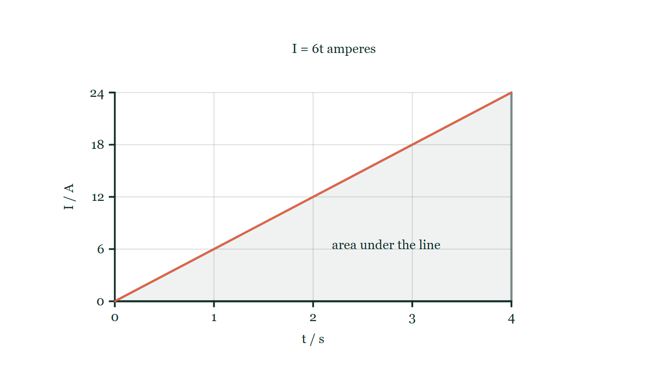
CIRCUITS · CURRENT CALCULUS
GIOPHYSICS LESSON
THINK FIRST
A charging current climbs steadily from zero to 24 A over four seconds. How much charge has passed?
Take answers before you click — the point is the commitment
The ammeter needle sweeps smoothly up the scale the whole time and finishes on 24 A at exactly 4.0 s.
THE ANSWER
48 C, not 96 C. The circuit only reached 24 A at the last instant; over the four seconds the current averaged 12 A. On the current–time graph the charge is the area beneath the line, and that triangle is half the rectangle you get by multiplying the final reading by the whole time.
A current–time graph rising as a straight line from zero to 24 A at t = 4.0 s, with the triangle between that line and the time axis shaded and labelled as the area under the line.
The live version of this figure — click here
Circuits — Current Calculus. Built by GioPhysics from the lesson's own copy; nothing on these slides is re-authored.
3 / 34
Notes:
[Phase] Starter: Recall what this lesson stands on (minutes 0–5 of 45)
[Hook] A charging current climbs steadily from zero to 24 A over four seconds. How much charge has passed? The ammeter needle sweeps smoothly up the scale the whole time and finishes on 24 A at exactly 4.0 s.
[Answer] 48 C, not 96 C. The circuit only reached 24 A at the last instant; over the four seconds the current averaged 12 A. On the current–time graph the charge is the area beneath the line, and that triangle is half the rectangle you get by multiplying the final reading by the whole time.
[Figure] A current–time graph rising as a straight line from zero to 24 A at t = 4.0 s, with the triangle between that line and the time axis shaded and labelled as the area under the line.

Slide 4
CIRCUITS · CURRENT CALCULUS
GIOPHYSICS LESSON
EXPLAINED SIMPLY
In one sentence
Introduce the idea — The big idea and the definition
Instantaneous current is the rate of change of charge — the slope of the Q–t graph at a single moment.
Circuits — Current Calculus. Built by GioPhysics from the lesson's own copy; nothing on these slides is re-authored.
4 / 34
Notes:
[Phase] Introduce the idea: The big idea and the definition (minutes 5–13 of 45)
[Definition] Instantaneous current is the rate of change of charge — the slope of the Q–t graph at a single moment.

Slide 5
CIRCUITS · CURRENT CALCULUS
GIOPHYSICS LESSON
EXPLAINED SIMPLY
What that looks like
Introduce the idea — The big idea and the definition
FOR EXAMPLE
If Q(t) = 3t² coulombs, then I = dQ/dt = 6t: the current is 6 A one second in and 12 A a second later — the flow is speeding up.
Circuits — Current Calculus. Built by GioPhysics from the lesson's own copy; nothing on these slides is re-authored.
5 / 34
Notes:
[Phase] Introduce the idea: The big idea and the definition (minutes 5–13 of 45)
[Worked illustration] If Q(t) = 3t² coulombs, then I = dQ/dt = 6t: the current is 6 A one second in and 12 A a second later — the flow is speeding up.

Slide 6
CIRCUITS · CURRENT CALCULUS
GIOPHYSICS LESSON
THE BIG IDEA
Gradients and areas on circuit graphs
Introduce the idea — The big idea and the definition
Current at an instant is the gradient of the charge–time graph: I = dQ/dt. Run the idea backwards and the charge that flowed is the area under the current–time graph, ΔQ = ∫I dt — and the same pairing turns power into energy, E = ∫P dt. The chord between two points gives the average current; the tangent at one point gives the instantaneous current.
Circuits — Current Calculus. Built by GioPhysics from the lesson's own copy; nothing on these slides is re-authored.
6 / 34
Notes:
[Phase] Introduce the idea: The big idea and the definition (minutes 5–13 of 45)
[Big idea] Current at an instant is the gradient of the charge–time graph: I = dQ/dt. Run the idea backwards and the charge that flowed is the area under the current–time graph, ΔQ = ∫I dt — and the same pairing turns power into energy, E = ∫P dt. The chord between two points gives the average current; the tangent at one point gives the instantaneous current.

Slide 7
CIRCUITS · CURRENT CALCULUS
GIOPHYSICS LESSON
THE PHYSICS · 1 OF 3
Shrink the interval
Build the model — The formulae, one at a time, in plain English
ΔQ/Δt over a shorter and shorter interval turns the chord of the Q–t graph into the tangent. That limit is the derivative — the current right now, not the average so far.
Circuits — Current Calculus. Built by GioPhysics from the lesson's own copy; nothing on these slides is re-authored.
7 / 34
Notes:
[Phase] Build the model: The formulae, one at a time, in plain English (minutes 13–22 of 45)
[Section] ΔQ/Δt over a shorter and shorter interval turns the chord of the Q–t graph into the tangent. That limit is the derivative — the current right now, not the average so far.

Slide 8
CIRCUITS · CURRENT CALCULUS
GIOPHYSICS LESSON
THE PHYSICS · 2 OF 3
Reverse with an area
Build the model — The formulae, one at a time, in plain English
If you know I(t) instead, integrate: each thin strip of the I–t graph is I × dt, a sliver of charge. The whole area between two times is the charge that flowed between them.
Circuits — Current Calculus. Built by GioPhysics from the lesson's own copy; nothing on these slides is re-authored.
8 / 34
Notes:
[Phase] Build the model: The formulae, one at a time, in plain English (minutes 13–22 of 45)
[Section] If you know I(t) instead, integrate: each thin strip of the I–t graph is I × dt, a sliver of charge. The whole area between two times is the charge that flowed between them.

Slide 9
CIRCUITS · CURRENT CALCULUS
GIOPHYSICS LESSON
THE PHYSICS · 3 OF 3
Same trick for energy
Build the model — The formulae, one at a time, in plain English
P = dE/dt, so E = ∫P dt. A device warming up transfers the area under its power–time curve — average power times time only works when P is constant.
Circuits — Current Calculus. Built by GioPhysics from the lesson's own copy; nothing on these slides is re-authored.
9 / 34
Notes:
[Phase] Build the model: The formulae, one at a time, in plain English (minutes 13–22 of 45)
[Section] P = dE/dt, so E = ∫P dt. A device warming up transfers the area under its power–time curve — average power times time only works when P is constant.

Slide 10
CIRCUITS · CURRENT CALCULUS
GIOPHYSICS LESSON
FORMULA 1 OF 4
Instantaneous current
Build the model — The formulae, one at a time, in plain English
I = dQ/dt
The tangent slope of the Q–t graph
IN PLAIN ENGLISH
Differentiate the charge–time function and you get the current at every instant — for a polynomial Q(t), just bring each power down and reduce it by one.
Circuits — Current Calculus. Built by GioPhysics from the lesson's own copy; nothing on these slides is re-authored.
10 / 34
Notes:
[Phase] Build the model: The formulae, one at a time, in plain English (minutes 13–22 of 45)
[Formula] Instantaneous current: I = dQ/dt
[In plain English] Differentiate the charge–time function and you get the current at every instant — for a polynomial Q(t), just bring each power down and reduce it by one.
[Note] The tangent slope of the Q–t graph

Slide 11
CIRCUITS · CURRENT CALCULUS
GIOPHYSICS LESSON
FORMULA 2 OF 4
Charge from current
Build the model — The formulae, one at a time, in plain English
ΔQ = ∫ I dt
The area under the I–t graph
IN PLAIN ENGLISH
Integration undoes the derivative: summing current × tiny time-step over an interval gives the total charge that passed — the area under the current–time curve.
Circuits — Current Calculus. Built by GioPhysics from the lesson's own copy; nothing on these slides is re-authored.
11 / 34
Notes:
[Phase] Build the model: The formulae, one at a time, in plain English (minutes 13–22 of 45)
[Formula] Charge from current: ΔQ = ∫ I dt
[In plain English] Integration undoes the derivative: summing current × tiny time-step over an interval gives the total charge that passed — the area under the current–time curve.
[Note] The area under the I–t graph

Slide 12
CIRCUITS · CURRENT CALCULUS
GIOPHYSICS LESSON
FORMULA 3 OF 4
Energy from power
Build the model — The formulae, one at a time, in plain English
E = ∫ P dt
The area under the P–t graph
IN PLAIN ENGLISH
When power varies, multiply-by-time fails; instead the energy transferred is the accumulated area under the power–time graph.
Circuits — Current Calculus. Built by GioPhysics from the lesson's own copy; nothing on these slides is re-authored.
12 / 34
Notes:
[Phase] Build the model: The formulae, one at a time, in plain English (minutes 13–22 of 45)
[Formula] Energy from power: E = ∫ P dt
[In plain English] When power varies, multiply-by-time fails; instead the energy transferred is the accumulated area under the power–time graph.
[Note] The area under the P–t graph

Slide 13
CIRCUITS · CURRENT CALCULUS
GIOPHYSICS LESSON
FORMULA 4 OF 4
Average current
Build the model — The formulae, one at a time, in plain English
I(avg) = ΔQ/Δt
The chord slope of the Q–t graph
IN PLAIN ENGLISH
Total charge over total time is a single average rate for the whole interval — it equals the instantaneous value only if the current never changes.
Circuits — Current Calculus. Built by GioPhysics from the lesson's own copy; nothing on these slides is re-authored.
13 / 34
Notes:
[Phase] Build the model: The formulae, one at a time, in plain English (minutes 13–22 of 45)
[Formula] Average current: I(avg) = ΔQ/Δt
[In plain English] Total charge over total time is a single average rate for the whole interval — it equals the instantaneous value only if the current never changes.
[Note] The chord slope of the Q–t graph

Slide 14
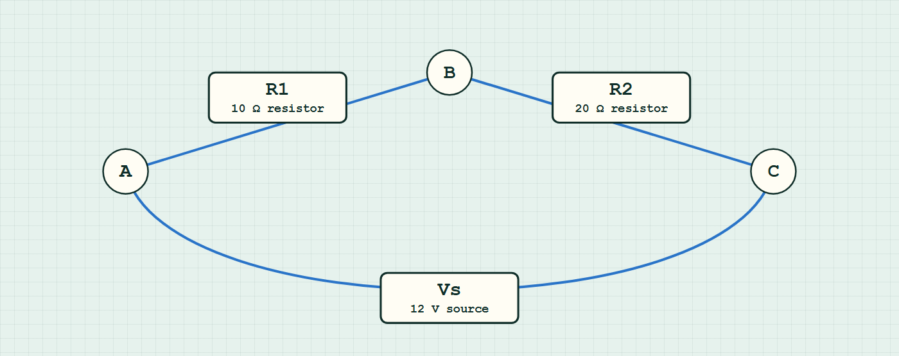
CIRCUITS · CURRENT CALCULUS
GIOPHYSICS LESSON
CIRCUIT MODEL
Read the topology before the values
Build the model — nodes are where connections meet, branches are what lies between them
series network — components are branches between nodes.
Switch topology and hide the values on the live version — click here
Circuits — Current Calculus. Built by GioPhysics from the lesson's own copy; nothing on these slides is re-authored.
14 / 34
Notes:
[Phase] Build the model: The formulae, one at a time, in plain English (minutes 13–22 of 45)
[Topology] Nodes are the points where connections meet; branches are the components between them. The live version switches between series, parallel and bridge and can hide the values.

Slide 15
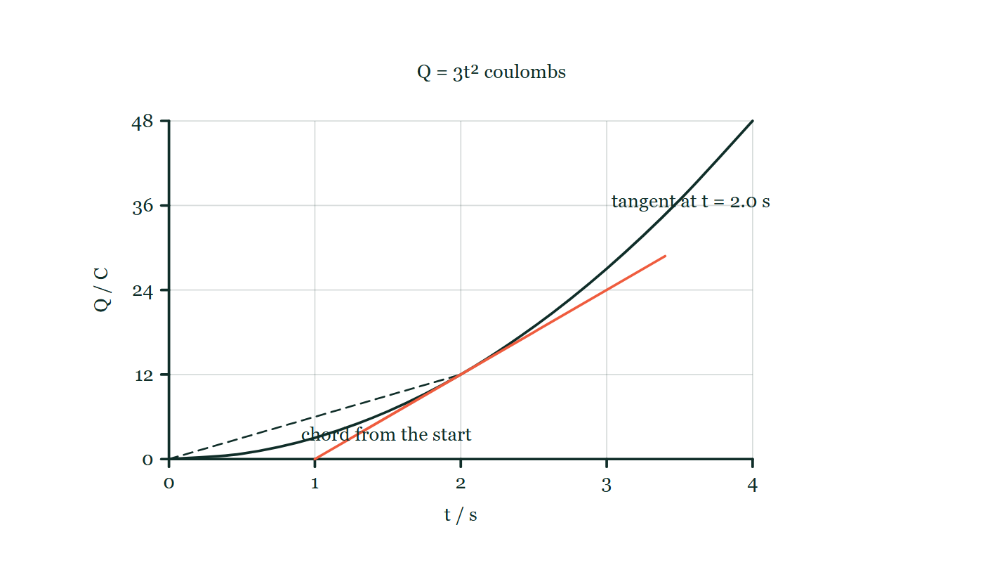
CIRCUITS · CURRENT CALCULUS
GIOPHYSICS LESSON
THE PICTURE
Chord and tangent on a charge–time graph
Drawn for this lesson
Charge plotted against time as the upward-curving graph of Q = 3t², with a dashed chord drawn from the origin to the point at t = 2.0 s and a visibly steeper tangent drawn touching the curve at that same instant.
The live version of this figure — click here
Circuits — Current Calculus. Built by GioPhysics from the lesson's own copy; nothing on these slides is re-authored.
15 / 34
Notes:
[Phase] Build the model: The formulae, one at a time, in plain English (minutes 13–22 of 45)
[Figure] Charge plotted against time as the upward-curving graph of Q = 3t², with a dashed chord drawn from the origin to the point at t = 2.0 s and a visibly steeper tangent drawn touching the curve at that same instant.

Slide 16
CIRCUITS · CURRENT CALCULUS
GIOPHYSICS LESSON
WATCH OUT
The common trap
Check and misconception — The quick check and the trap
ΔQ/Δt gives the average current over an interval, not the current at an instant. On a curved Q–t graph the chord and the tangent have different slopes — only for a straight-line graph (constant current) do the two agree.
Circuits — Current Calculus. Built by GioPhysics from the lesson's own copy; nothing on these slides is re-authored.
16 / 34
Notes:
[Phase] Check and misconception: The quick check and the trap (minutes 35–41 of 45)
[Misconception] ΔQ/Δt gives the average current over an interval, not the current at an instant. On a curved Q–t graph the chord and the tangent have different slopes — only for a straight-line graph (constant current) do the two agree.

Slide 17
CIRCUITS · CURRENT CALCULUS
GIOPHYSICS LESSON
WORKED EXAMPLE 1 OF 2 · EASY
The question
Easy
Worked examples — I do, we do — one step revealed at a time
The charge through a lamp follows Q(t) = 5t + 2t² (coulombs, t in seconds). Find I(t) and the current at t = 3.0 s.
Circuits — Current Calculus. Built by GioPhysics from the lesson's own copy; nothing on these slides is re-authored.
17 / 34
Notes:
[Phase] Worked examples: I do, we do — one step revealed at a time (minutes 22–35 of 45)
[Question] The charge through a lamp follows Q(t) = 5t + 2t² (coulombs, t in seconds). Find I(t) and the current at t = 3.0 s.
[Answer] I = 5 + 4t; I(3.0 s) = 17 A

Slide 18
CIRCUITS · CURRENT CALCULUS
GIOPHYSICS LESSON
WORKED EXAMPLE 1 OF 2 · EASY · THE WORKING
How to solve it
Easy
Worked examples — I do, we do — one step revealed at a time
The charge through a lamp follows Q(t) = 5t + 2t² (coulombs, t in seconds). Find I(t) and the current at t = 3.0 s.
1.
Differentiate term by term: I = dQ/dt = 5 + 4t.
2.
At t = 3.0 s: I = 5 + 4 × 3.0 = 17 A.
Circuits — Current Calculus. Built by GioPhysics from the lesson's own copy; nothing on these slides is re-authored.
18 / 34
Notes:
[Phase] Worked examples: I do, we do — one step revealed at a time (minutes 22–35 of 45)
[Reveal] One click per step. The class works each line before the next appears.
[Step 1] Differentiate term by term: I = dQ/dt = 5 + 4t.
[Step 2] At t = 3.0 s: I = 5 + 4 × 3.0 = 17 A.

Slide 19
CIRCUITS · CURRENT CALCULUS
GIOPHYSICS LESSON
WORKED EXAMPLE 1 OF 2 · EASY
Answer
Easy
Worked examples — I do, we do — one step revealed at a time
I = 5 + 4t; I(3.0 s) = 17 A
Circuits — Current Calculus. Built by GioPhysics from the lesson's own copy; nothing on these slides is re-authored.
19 / 34
Notes:
[Phase] Worked examples: I do, we do — one step revealed at a time (minutes 22–35 of 45)
[Answer] I = 5 + 4t; I(3.0 s) = 17 A

Slide 20
CIRCUITS · CURRENT CALCULUS
GIOPHYSICS LESSON
WORKED EXAMPLE 2 OF 2 · MEDIUM
The question
Medium
Worked examples — I do, we do — one step revealed at a time
A current ramps up as I(t) = 6t (amperes) from t = 0 to t = 4.0 s. Find the charge that flows and the average current, and check the charge against the triangle area.
Circuits — Current Calculus. Built by GioPhysics from the lesson's own copy; nothing on these slides is re-authored.
20 / 34
Notes:
[Phase] Worked examples: I do, we do — one step revealed at a time (minutes 22–35 of 45)
[Question] A current ramps up as I(t) = 6t (amperes) from t = 0 to t = 4.0 s. Find the charge that flows and the average current, and check the charge against the triangle area.
[Answer] ΔQ = 48 C; average current 12 A

Slide 21
CIRCUITS · CURRENT CALCULUS
GIOPHYSICS LESSON
WORKED EXAMPLE 2 OF 2 · MEDIUM · THE WORKING
How to solve it
Medium
Worked examples — I do, we do — one step revealed at a time
A current ramps up as I(t) = 6t (amperes) from t = 0 to t = 4.0 s. Find the charge that flows and the average current, and check the charge against the triangle area.
1.
ΔQ = ∫₀⁴ 6t dt = [3t²]₀⁴ = 3 × 16 = 48 C.
2.
Geometry check: the I–t graph is a triangle of base 4.0 s and height 24 A — area ½ × 4.0 × 24 = 48 C. ✔
3.
I(avg) = ΔQ/Δt = 48 ÷ 4.0 = 12 A — the instantaneous value at the midpoint, because the ramp is linear.
Circuits — Current Calculus. Built by GioPhysics from the lesson's own copy; nothing on these slides is re-authored.
21 / 34
Notes:
[Phase] Worked examples: I do, we do — one step revealed at a time (minutes 22–35 of 45)
[Reveal] One click per step. The class works each line before the next appears.
[Step 1] ΔQ = ∫₀⁴ 6t dt = [3t²]₀⁴ = 3 × 16 = 48 C.
[Step 2] Geometry check: the I–t graph is a triangle of base 4.0 s and height 24 A — area ½ × 4.0 × 24 = 48 C. ✔
[Step 3] I(avg) = ΔQ/Δt = 48 ÷ 4.0 = 12 A — the instantaneous value at the midpoint, because the ramp is linear.

Slide 22
CIRCUITS · CURRENT CALCULUS
GIOPHYSICS LESSON
WORKED EXAMPLE 2 OF 2 · MEDIUM
Answer
Medium
Worked examples — I do, we do — one step revealed at a time
ΔQ = 48 C; average current 12 A
Circuits — Current Calculus. Built by GioPhysics from the lesson's own copy; nothing on these slides is re-authored.
22 / 34
Notes:
[Phase] Worked examples: I do, we do — one step revealed at a time (minutes 22–35 of 45)
[Answer] ΔQ = 48 C; average current 12 A

Slide 23
CIRCUITS · CURRENT CALCULUS
GIOPHYSICS LESSON
SPOT THE MISTAKE
One line here is wrong
The whole working is up — find the bad line before you click
1.
A current ramps up as I(t) = 6t amperes from t = 0 to t = 4.0 s. Find the charge that flows.
2.
ΔQ = ∫₀⁴ 6t dt
3.
ΔQ = [3t²]₀⁴
4.
ΔQ = 3 × 4.0 = 12 C
5.
So 12 C flows in the four seconds.
LINE 4 IS WRONG
The limit has been put into 3t² without being squared. It is easy to lose because the square brackets have already done their job by that line and the eye reads [3t²]₀⁴ as "three times four". The graph is the fastest check available: the area under I = 6t up to 4.0 s is a triangle of base 4.0 s and height 24 A, so ½ × 4 × 24 = 48 C.
IT SHOULD SAY
ΔQ = 3 × 4.0² = 3 × 16 = 48 C
Circuits — Current Calculus. Built by GioPhysics from the lesson's own copy; nothing on these slides is re-authored.
23 / 34
Notes:
[Phase] Worked examples: I do, we do — one step revealed at a time (minutes 22–35 of 45)
[Spot the mistake] The working is complete and one line of it is wrong. Let the room hunt: one click names the line, a second shows it done correctly.
[Line 4 is wrong] The limit has been put into 3t² without being squared. It is easy to lose because the square brackets have already done their job by that line and the eye reads [3t²]₀⁴ as "three times four". The graph is the fastest check available: the area under I = 6t up to 4.0 s is a triangle of base 4.0 s and height 24 A, so ½ × 4 × 24 = 48 C.
[It should say] ΔQ = 3 × 4.0² = 3 × 16 = 48 C

Slide 24
CIRCUITS · CURRENT CALCULUS
GIOPHYSICS LESSON
PREDICT · TAKE THE VOTE
Commit before you are told
Hands up for each option, then click
Q = 3t², so 12 C has flowed by t = 2.0 s. Is the current at that instant 6 A?
A Yes — 12 C in 2.0 s is 6 A
B No, it is larger than 6 A
C No, it is smaller than 6 A
Charge plotted against time as the upward-curving graph of Q = 3t², with a dashed chord drawn from the origin to the point at t = 2.0 s and a visibly steeper tangent drawn touching the curve at that same instant.
The live version of this figure — click here
Circuits — Current Calculus. Built by GioPhysics from the lesson's own copy; nothing on these slides is re-authored.
24 / 34
Notes:
[Phase] Build the model: The formulae, one at a time, in plain English (minutes 13–22 of 45)
[Predict] Q = 3t², so 12 C has flowed by t = 2.0 s. Is the current at that instant 6 A?
[Options] A Yes — 12 C in 2.0 s is 6 A B No, it is larger than 6 A C No, it is smaller than 6 A
[Figure] Charge plotted against time as the upward-curving graph of Q = 3t², with a dashed chord drawn from the origin to the point at t = 2.0 s and a visibly steeper tangent drawn touching the curve at that same instant.

Slide 25
CIRCUITS · CURRENT CALCULUS
GIOPHYSICS LESSON
PREDICT · THE OUTCOME
What actually happens
Ask the room who changed their mind, and why
B No, it is larger than 6 A
WHY
6 A is the slope of the dashed chord, and a chord answers a different question: it gives the average over the whole two seconds, when the current started at nothing and finished large. The current right now is the slope of the tangent drawn at that point, and the drawing shows it climbing far more steeply — dQ/dt = 6t, which is 12 A at t = 2.0 s, exactly twice the average. Only on a straight Q–t graph, where the current never changes, do chord and tangent agree.
Circuits — Current Calculus. Built by GioPhysics from the lesson's own copy; nothing on these slides is re-authored.
25 / 34
Notes:
[Phase] Build the model: The formulae, one at a time, in plain English (minutes 13–22 of 45)
[Answer] B — No, it is larger than 6 A. 6 A is the slope of the dashed chord, and a chord answers a different question: it gives the average over the whole two seconds, when the current started at nothing and finished large. The current right now is the slope of the tangent drawn at that point, and the drawing shows it climbing far more steeply — dQ/dt = 6t, which is 12 A at t = 2.0 s, exactly twice the average. Only on a straight Q–t graph, where the current never changes, do chord and tangent agree.

Slide 26
CIRCUITS · CURRENT CALCULUS
GIOPHYSICS LESSON
QUICK CHECK
Decide before the answer goes up
Check and misconception — The quick check and the trap
The charge through a component follows Q(t) = 3t² (coulombs). What is the instantaneous current at t = 2.0 s?
A
6 A
B
12 A
C
24 A
Circuits — Current Calculus. Built by GioPhysics from the lesson's own copy; nothing on these slides is re-authored.
26 / 34
Notes:
[Phase] Check and misconception: The quick check and the trap (minutes 35–41 of 45)
[Question] The charge through a component follows Q(t) = 3t² (coulombs). What is the instantaneous current at t = 2.0 s?
[Options] A 6 A B 12 A C 24 A

Slide 27
CIRCUITS · CURRENT CALCULUS
GIOPHYSICS LESSON
QUICK CHECK · THE ANSWER
The answer, and why
Check and misconception — The quick check and the trap
B 12 A
HOW TO GET THERE
I = dQ/dt = 6t = 12 A at t = 2.0 s. Dividing Q(2) = 12 C by 2.0 s gives only the 6 A average since the start.
WHY THE OTHERS TEMPT
A 6 A is Q(2)/2 = 12 ÷ 2 — the average current since t = 0, which is the slope of the chord in the figure and not of the tangent. On a curved graph those two are never equal.
B Correct. I = dQ/dt = 6t, so at t = 2.0 s the current is 12 A.
C 24 A is 6t², from bringing the power down as a multiplier but leaving the t² untouched. Differentiating 3t² gives 6t¹: the exponent drops by one, so the answer carries a single factor of t.
Circuits — Current Calculus. Built by GioPhysics from the lesson's own copy; nothing on these slides is re-authored.
27 / 34
Notes:
[Phase] Check and misconception: The quick check and the trap (minutes 35–41 of 45)
[Question] The charge through a component follows Q(t) = 3t² (coulombs). What is the instantaneous current at t = 2.0 s?
[Option by option] A: 6 A is Q(2)/2 = 12 ÷ 2 — the average current since t = 0, which is the slope of the chord in the figure and not of the tangent. On a curved graph those two are never equal. B: Correct. I = dQ/dt = 6t, so at t = 2.0 s the current is 12 A. C: 24 A is 6t², from bringing the power down as a multiplier but leaving the t² untouched. Differentiating 3t² gives 6t¹: the exponent drops by one, so the answer carries a single factor of t.
[Answer] B — 12 A
[Why] I = dQ/dt = 6t = 12 A at t = 2.0 s. Dividing Q(2) = 12 C by 2.0 s gives only the 6 A average since the start.
[Reveal] One click for the answer, then one for the reason.

Slide 28
CIRCUITS · CURRENT CALCULUS
GIOPHYSICS LESSON
EXTENSION 1 OF 2 · HARD
The question
Hard
Worked examples — I do, we do — one step revealed at a time
The charge through a sensor follows Q(t) = 2t³ − 9t² + 12t (millicoulombs, t in seconds). Find I(t), the times when the current is zero, and compare I at t = 3.0 s with the average current over 0–3.0 s.
Circuits — Current Calculus. Built by GioPhysics from the lesson's own copy; nothing on these slides is re-authored.
28 / 34
Notes:
[Phase] Worked examples: I do, we do — one step revealed at a time (minutes 22–35 of 45)
[Question] The charge through a sensor follows Q(t) = 2t³ − 9t² + 12t (millicoulombs, t in seconds). Find I(t), the times when the current is zero, and compare I at t = 3.0 s with the average current over 0–3.0 s.
[Answer] I = 0 at 1.0 s and 2.0 s; I(3.0 s) = 12 mA vs 3.0 mA average

Slide 29
CIRCUITS · CURRENT CALCULUS
GIOPHYSICS LESSON
EXTENSION 1 OF 2 · HARD · THE WORKING
How to solve it
Hard
Worked examples — I do, we do — one step revealed at a time
The charge through a sensor follows Q(t) = 2t³ − 9t² + 12t (millicoulombs, t in seconds). Find I(t), the times when the current is zero, and compare I at t = 3.0 s with the average current over 0–3.0 s.
1.
I = dQ/dt = 6t² − 18t + 12 = 6(t − 1)(t − 2) mA — zero at t = 1.0 s and t = 2.0 s.
2.
At t = 3.0 s: I = 6 × 2 × 1 = 12 mA.
3.
Q(3.0) = 54 − 81 + 36 = 9.0 mC, so I(avg) = 9.0 ÷ 3.0 = 3.0 mA — a quarter of the instantaneous value.
Circuits — Current Calculus. Built by GioPhysics from the lesson's own copy; nothing on these slides is re-authored.
29 / 34
Notes:
[Phase] Worked examples: I do, we do — one step revealed at a time (minutes 22–35 of 45)
[Reveal] One click per step. The class works each line before the next appears.
[Step 1] I = dQ/dt = 6t² − 18t + 12 = 6(t − 1)(t − 2) mA — zero at t = 1.0 s and t = 2.0 s.
[Step 2] At t = 3.0 s: I = 6 × 2 × 1 = 12 mA.
[Step 3] Q(3.0) = 54 − 81 + 36 = 9.0 mC, so I(avg) = 9.0 ÷ 3.0 = 3.0 mA — a quarter of the instantaneous value.

Slide 30
CIRCUITS · CURRENT CALCULUS
GIOPHYSICS LESSON
EXTENSION 1 OF 2 · HARD
Answer
Hard
Worked examples — I do, we do — one step revealed at a time
I = 0 at 1.0 s and 2.0 s; I(3.0 s) = 12 mA vs 3.0 mA average
Circuits — Current Calculus. Built by GioPhysics from the lesson's own copy; nothing on these slides is re-authored.
30 / 34
Notes:
[Phase] Worked examples: I do, we do — one step revealed at a time (minutes 22–35 of 45)
[Answer] I = 0 at 1.0 s and 2.0 s; I(3.0 s) = 12 mA vs 3.0 mA average

Slide 31
CIRCUITS · CURRENT CALCULUS
GIOPHYSICS LESSON
EXTENSION 2 OF 2 · CHALLENGING
The question
Challenging
Worked examples — I do, we do — one step revealed at a time
During a 10 s motor run-up the electrical power drawn is P(t) = 400t − 20t² (watts). Find the energy transferred, the average power, and the power at the end of the run.
Circuits — Current Calculus. Built by GioPhysics from the lesson's own copy; nothing on these slides is re-authored.
31 / 34
Notes:
[Phase] Worked examples: I do, we do — one step revealed at a time (minutes 22–35 of 45)
[Question] During a 10 s motor run-up the electrical power drawn is P(t) = 400t − 20t² (watts). Find the energy transferred, the average power, and the power at the end of the run.
[Answer] E ≈ 13.3 kJ; average ≈ 1.3 kW vs 2.0 kW at t = 10 s

Slide 32
CIRCUITS · CURRENT CALCULUS
GIOPHYSICS LESSON
EXTENSION 2 OF 2 · CHALLENGING · THE WORKING
How to solve it
Challenging
Worked examples — I do, we do — one step revealed at a time
During a 10 s motor run-up the electrical power drawn is P(t) = 400t − 20t² (watts). Find the energy transferred, the average power, and the power at the end of the run.
1.
E = ∫₀¹⁰ (400t − 20t²) dt = [200t² − (20/3)t³]₀¹⁰.
2.
E = 20 000 − 6 667 ≈ 1.33 × 10⁴ J ≈ 13.3 kJ.
3.
P(avg) = E/t = 13 333 ÷ 10 ≈ 1.3 kW, while P(10) = 4 000 − 2 000 = 2.0 kW — the power climbs throughout, so the average sits below the final value.
Circuits — Current Calculus. Built by GioPhysics from the lesson's own copy; nothing on these slides is re-authored.
32 / 34
Notes:
[Phase] Worked examples: I do, we do — one step revealed at a time (minutes 22–35 of 45)
[Reveal] One click per step. The class works each line before the next appears.
[Step 1] E = ∫₀¹⁰ (400t − 20t²) dt = [200t² − (20/3)t³]₀¹⁰.
[Step 2] E = 20 000 − 6 667 ≈ 1.33 × 10⁴ J ≈ 13.3 kJ.
[Step 3] P(avg) = E/t = 13 333 ÷ 10 ≈ 1.3 kW, while P(10) = 4 000 − 2 000 = 2.0 kW — the power climbs throughout, so the average sits below the final value.

Slide 33
CIRCUITS · CURRENT CALCULUS
GIOPHYSICS LESSON
EXTENSION 2 OF 2 · CHALLENGING
Answer
Challenging
Worked examples — I do, we do — one step revealed at a time
E ≈ 13.3 kJ; average ≈ 1.3 kW vs 2.0 kW at t = 10 s
Circuits — Current Calculus. Built by GioPhysics from the lesson's own copy; nothing on these slides is re-authored.
33 / 34
Notes:
[Phase] Worked examples: I do, we do — one step revealed at a time (minutes 22–35 of 45)
[Answer] E ≈ 13.3 kJ; average ≈ 1.3 kW vs 2.0 kW at t = 10 s

Slide 34
CIRCUITS · CURRENT CALCULUS
GIOPHYSICS LESSON
CIRCUITS
Where to go next
Plenary — What to take away, what to practise next
Lesson
This lesson on giophysics.com
https://giophysics.com/chapter-22/current-calculus/
Live
The live, interactive version of these slides
https://giophysics.com/chapter-22/presentation/?lesson=currentCalculus
Chapter
All Circuits lessons
https://giophysics.com/chapter-22/
PDF
Download the lesson PDF
https://giophysics.com/downloads/22-8-current-calculus.pdf
Circuits — Current Calculus. Built by GioPhysics from the lesson's own copy; nothing on these slides is re-authored.
34 / 34
Notes:
[Phase] Plenary: What to take away, what to practise next (minutes 41–45 of 45)
[Interactive] The graphs and the circuit topology on these slides are frozen. The live version at https://giophysics.com/chapter-22/presentation/?lesson=currentCalculus moves them.

