Slide 1
CIRCUITS · ELECTRIC CURRENT & CHARGE
GIOPHYSICS LESSON
13 · Circuits
Counting charge as it flows
Electric Current & Charge
Electrons in a wire normally drift at random with no net movement. Apply a potential difference and a steady net flow of charge appears: an electric current.
POSITION
Lesson 2 of 8 in Circuits
PLAN
16 slides in the 45-minute core run, about 43.5 minutes of it
LESSON PAGE
https://giophysics.com/chapter-22/electric-current-charge/
Built by GioPhysics from the lesson's own page. Every word on these slides is the lesson's; nothing here is re-authored. Teaching material, not an awarding body's document.
Circuits — Electric Current & Charge. Built by GioPhysics from the lesson's own copy; nothing on these slides is re-authored.
1 / 37
Notes:
[Lesson] Circuits — Electric Current & Charge. Lesson 2 of 8.
[Intro] Electrons in a wire normally drift at random with no net movement. Apply a potential difference and a steady net flow of charge appears: an electric current.
[Source] https://giophysics.com/chapter-22/electric-current-charge/
[Disclaimer] Built by GioPhysics from the lesson's own page. Every word on these slides is the lesson's; nothing here is re-authored. Teaching material, not an awarding body's document.

Slide 2
CIRCUITS · ELECTRIC CURRENT & CHARGE
GIOPHYSICS LESSON
WHAT THIS NEEDS
What you already know
Starter — Recall what this lesson stands on
Recall
Charge & quantisation
https://giophysics.com/chapter-19/charge-conservation-quantisation/
Circuits — Electric Current & Charge. Built by GioPhysics from the lesson's own copy; nothing on these slides is re-authored.
2 / 37
Notes:
[Phase] Starter: Recall what this lesson stands on (minutes 0–5 of 45)
[Starter] Recall: Charge & quantisation

Slide 3
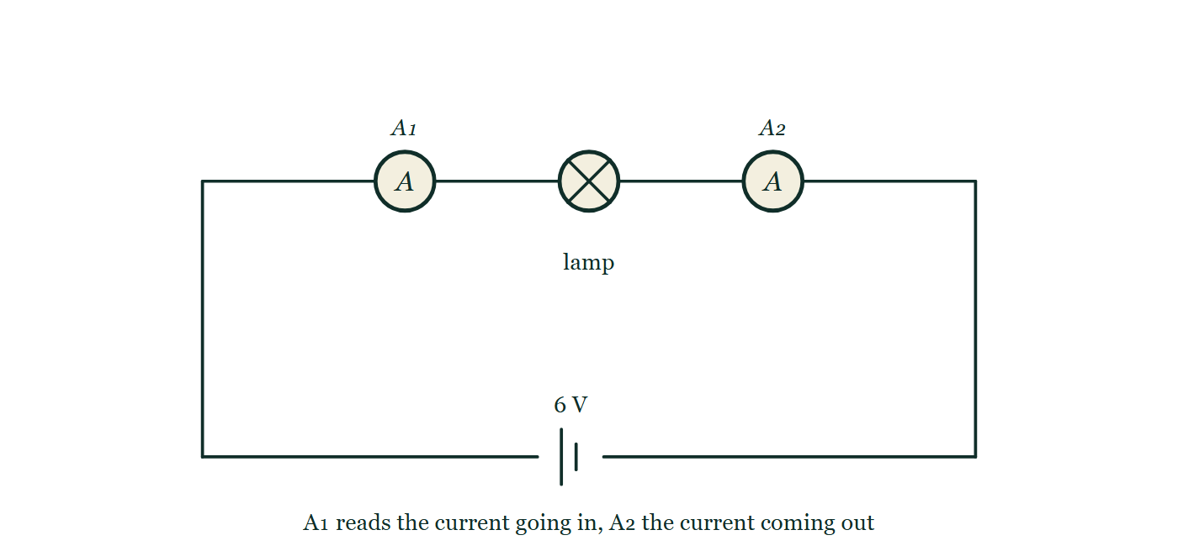
CIRCUITS · ELECTRIC CURRENT & CHARGE
GIOPHYSICS LESSON
THINK FIRST
You flick the switch and the lamp lights at once. How fast are the electrons travelling down the wire?
Take answers before you click — the point is the commitment
The wire from the switch to the ceiling rose is a few metres of ordinary copper, and the lamp comes on with no delay you could ever detect.
THE ANSWER
About half a millimetre per second — slower than a snail. The lamp lights instantly because the electric field is set up all the way round the loop at nearly the speed of light, so every electron in the filament starts drifting at the same moment. Nothing had to travel from the switch to the lamp.
One loop from a 6 V cell through a lamp, with ammeter A₁ in the wire going into the lamp and ammeter A₂ in the wire coming out of it; neither meter's reading is printed on the drawing.
The live version of this figure — click here
Circuits — Electric Current & Charge. Built by GioPhysics from the lesson's own copy; nothing on these slides is re-authored.
3 / 37
Notes:
[Phase] Starter: Recall what this lesson stands on (minutes 0–5 of 45)
[Hook] You flick the switch and the lamp lights at once. How fast are the electrons travelling down the wire? The wire from the switch to the ceiling rose is a few metres of ordinary copper, and the lamp comes on with no delay you could ever detect.
[Answer] About half a millimetre per second — slower than a snail. The lamp lights instantly because the electric field is set up all the way round the loop at nearly the speed of light, so every electron in the filament starts drifting at the same moment. Nothing had to travel from the switch to the lamp.
[Figure] One loop from a 6 V cell through a lamp, with ammeter A₁ in the wire going into the lamp and ammeter A₂ in the wire coming out of it; neither meter's reading is printed on the drawing.

Slide 4
CIRCUITS · ELECTRIC CURRENT & CHARGE
GIOPHYSICS LESSON
EXPLAINED SIMPLY
In one sentence
Introduce the idea — The big idea and the definition
Electric current is the amount of charge passing a point in a circuit each second.
Circuits — Electric Current & Charge. Built by GioPhysics from the lesson's own copy; nothing on these slides is re-authored.
4 / 37
Notes:
[Phase] Introduce the idea: The big idea and the definition (minutes 5–13 of 45)
[Definition] Electric current is the amount of charge passing a point in a circuit each second.

Slide 5
CIRCUITS · ELECTRIC CURRENT & CHARGE
GIOPHYSICS LESSON
EXPLAINED SIMPLY
What that looks like
Introduce the idea — The big idea and the definition
FOR EXAMPLE
If 6 coulombs of charge pass through a lamp in 3 seconds, the current in the lamp is 2 amperes.
Circuits — Electric Current & Charge. Built by GioPhysics from the lesson's own copy; nothing on these slides is re-authored.
5 / 37
Notes:
[Phase] Introduce the idea: The big idea and the definition (minutes 5–13 of 45)
[Worked illustration] If 6 coulombs of charge pass through a lamp in 3 seconds, the current in the lamp is 2 amperes.

Slide 6
CIRCUITS · ELECTRIC CURRENT & CHARGE
GIOPHYSICS LESSON
THE BIG IDEA
Counting charge as it flows
Introduce the idea — The big idea and the definition
Current is the rate of flow of charge: how many coulombs pass a point each second. Electrons actually drift from the negative terminal to the positive terminal, but conventional current is drawn from + to −, and every circuit rule uses that convention.
Circuits — Electric Current & Charge. Built by GioPhysics from the lesson's own copy; nothing on these slides is re-authored.
6 / 37
Notes:
[Phase] Introduce the idea: The big idea and the definition (minutes 5–13 of 45)
[Big idea] Current is the rate of flow of charge: how many coulombs pass a point each second. Electrons actually drift from the negative terminal to the positive terminal, but conventional current is drawn from + to −, and every circuit rule uses that convention.

Slide 7
CIRCUITS · ELECTRIC CURRENT & CHARGE
GIOPHYSICS LESSON
THE PHYSICS · 1 OF 3
Random drift alone
Build the model — The formulae, one at a time, in plain English
Without a supply, electrons move fast but at random — equal numbers pass each way, so no net charge is transferred.
Circuits — Electric Current & Charge. Built by GioPhysics from the lesson's own copy; nothing on these slides is re-authored.
7 / 37
Notes:
[Phase] Build the model: The formulae, one at a time, in plain English (minutes 13–22 of 45)
[Section] Without a supply, electrons move fast but at random — equal numbers pass each way, so no net charge is transferred.

Slide 8
CIRCUITS · ELECTRIC CURRENT & CHARGE
GIOPHYSICS LESSON
THE PHYSICS · 2 OF 3
Add a potential difference
Build the model — The formulae, one at a time, in plain English
A supply superimposes a slow steady drift on the random motion. That net one-way drift of charge is the current.
Circuits — Electric Current & Charge. Built by GioPhysics from the lesson's own copy; nothing on these slides is re-authored.
8 / 37
Notes:
[Phase] Build the model: The formulae, one at a time, in plain English (minutes 13–22 of 45)
[Section] A supply superimposes a slow steady drift on the random motion. That net one-way drift of charge is the current.

Slide 9
CIRCUITS · ELECTRIC CURRENT & CHARGE
GIOPHYSICS LESSON
THE PHYSICS · 3 OF 3
Conventional current
Build the model — The formulae, one at a time, in plain English
Historically current was drawn from + to −, opposite to the electron drift. All circuit rules and diagrams use this conventional direction.
Circuits — Electric Current & Charge. Built by GioPhysics from the lesson's own copy; nothing on these slides is re-authored.
9 / 37
Notes:
[Phase] Build the model: The formulae, one at a time, in plain English (minutes 13–22 of 45)
[Section] Historically current was drawn from + to −, opposite to the electron drift. All circuit rules and diagrams use this conventional direction.

Slide 10
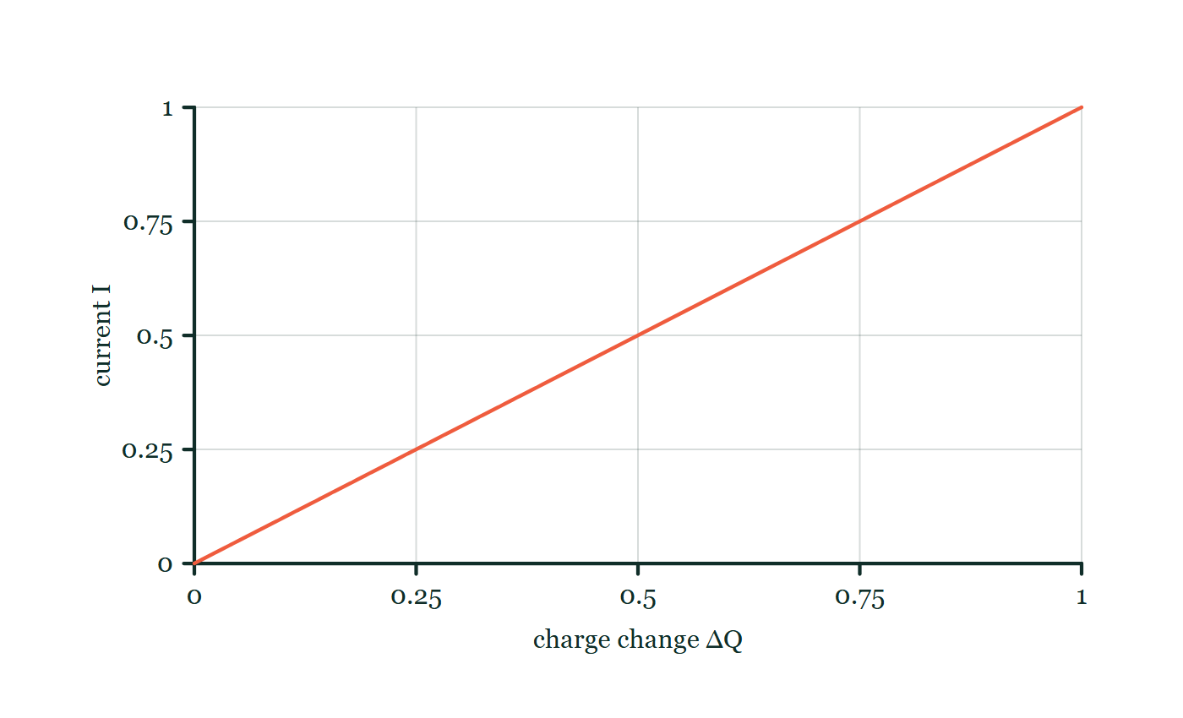
CIRCUITS · ELECTRIC CURRENT & CHARGE
GIOPHYSICS LESSON
FORMULA 1 OF 3
Current
Build the model — The formulae, one at a time, in plain English
I = ΔQ/Δt
1 A = 1 C/s
IN PLAIN ENGLISH
Current is charge divided by time — how many coulombs flow past each second.
Current–charge explorer
Move this graph on the live version — click here
Circuits — Electric Current & Charge. Built by GioPhysics from the lesson's own copy; nothing on these slides is re-authored.
10 / 37
Notes:
[Phase] Build the model: The formulae, one at a time, in plain English (minutes 13–22 of 45)
[Formula] Current: I = ΔQ/Δt
[In plain English] Current is charge divided by time — how many coulombs flow past each second.
[Note] 1 A = 1 C/s
[Graph] Current–charge explorer. Over a fixed time interval Δt, current is directly proportional to the charge transferred.
[Axes] Horizontal: charge change ΔQ. Vertical: current I. Values are normalised — the graph teaches the shape, not a measurement.

Slide 11
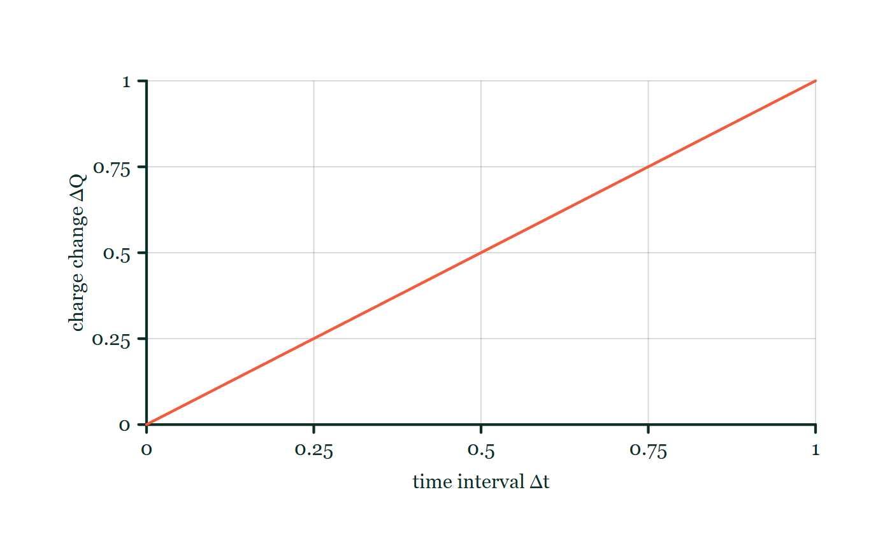
CIRCUITS · ELECTRIC CURRENT & CHARGE
GIOPHYSICS LESSON
FORMULA 2 OF 3
Charge moved
Build the model — The formulae, one at a time, in plain English
ΔQ = IΔt
Charge is measured in coulombs, C
IN PLAIN ENGLISH
Rearranged: a steady current running for some time moves current × time worth of charge.
Charge-flow explorer
Move this graph on the live version — click here
Circuits — Electric Current & Charge. Built by GioPhysics from the lesson's own copy; nothing on these slides is re-authored.
11 / 37
Notes:
[Phase] Build the model: The formulae, one at a time, in plain English (minutes 13–22 of 45)
[Formula] Charge moved: ΔQ = IΔt
[In plain English] Rearranged: a steady current running for some time moves current × time worth of charge.
[Note] Charge is measured in coulombs, C
[Graph] Charge-flow explorer. At constant current, transferred charge is directly proportional to the time interval.
[Axes] Horizontal: time interval Δt. Vertical: charge change ΔQ. Values are normalised — the graph teaches the shape, not a measurement.

Slide 12
CIRCUITS · ELECTRIC CURRENT & CHARGE
GIOPHYSICS LESSON
FORMULA 3 OF 3
Elementary charge
Build the model — The formulae, one at a time, in plain English
ΔQ = ne
e = 1.60 × 10⁻¹⁹ C
IN PLAIN ENGLISH
Charge comes in electron-sized packets, so any flowed charge is a whole number of elementary charges.
Circuits — Electric Current & Charge. Built by GioPhysics from the lesson's own copy; nothing on these slides is re-authored.
12 / 37
Notes:
[Phase] Build the model: The formulae, one at a time, in plain English (minutes 13–22 of 45)
[Formula] Elementary charge: ΔQ = ne
[In plain English] Charge comes in electron-sized packets, so any flowed charge is a whole number of elementary charges.
[Note] e = 1.60 × 10⁻¹⁹ C

Slide 13
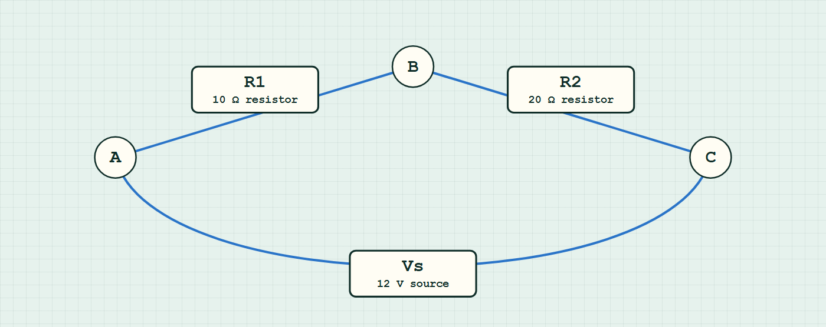
CIRCUITS · ELECTRIC CURRENT & CHARGE
GIOPHYSICS LESSON
CIRCUIT MODEL
Read the topology before the values
Build the model — nodes are where connections meet, branches are what lies between them
series network — components are branches between nodes.
Switch topology and hide the values on the live version — click here
Circuits — Electric Current & Charge. Built by GioPhysics from the lesson's own copy; nothing on these slides is re-authored.
13 / 37
Notes:
[Phase] Build the model: The formulae, one at a time, in plain English (minutes 13–22 of 45)
[Topology] Nodes are the points where connections meet; branches are the components between them. The live version switches between series, parallel and bridge and can hide the values.

Slide 14
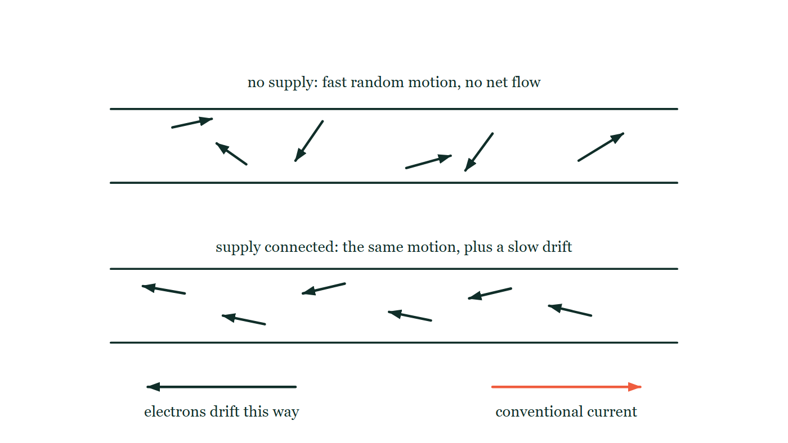
CIRCUITS · ELECTRIC CURRENT & CHARGE
GIOPHYSICS LESSON
THE PICTURE
Random motion, then drift
Drawn for this lesson
The same length of wire drawn twice: in the upper panel six electron arrows point every which way with no supply connected, and in the lower panel the same six all lean the same way, with the electron drift arrow pointing left and the conventional current arrow pointing right beneath them.
The live version of this figure — click here
Circuits — Electric Current & Charge. Built by GioPhysics from the lesson's own copy; nothing on these slides is re-authored.
14 / 37
Notes:
[Phase] Build the model: The formulae, one at a time, in plain English (minutes 13–22 of 45)
[Figure] The same length of wire drawn twice: in the upper panel six electron arrows point every which way with no supply connected, and in the lower panel the same six all lean the same way, with the electron drift arrow pointing left and the conventional current arrow pointing right beneath them.

Slide 15
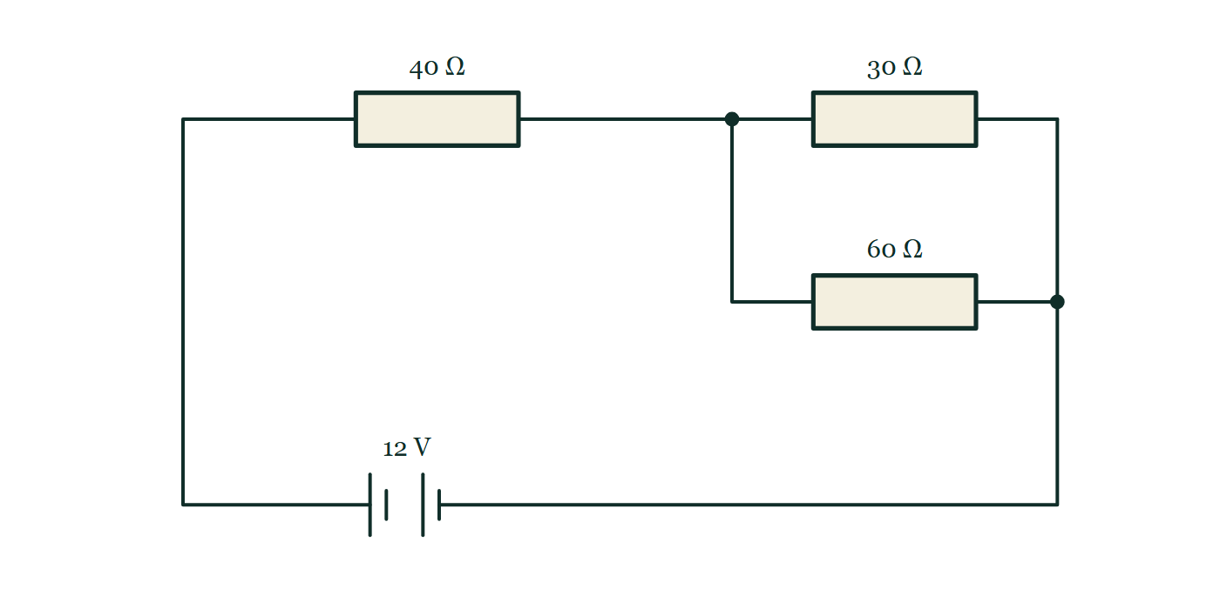
CIRCUITS · ELECTRIC CURRENT & CHARGE
GIOPHYSICS LESSON
FIGURE 1 OF 4
Fig. 7.1 — IGCSE Topic 4 · Electricity and magnetism
Drawn for question 7 of that paper · syllabus 4.2, 4.3
Circuit diagram. From the positive terminal of the 12 V battery, drawn at the foot of the circuit with its long plate on the left, the wire runs round to a resistor labelled 40 ohm. Beyond that resistor the circuit reaches a junction and divides into two parallel branches, the upper one containing a resistor labelled 30 ohm and the lower one a resistor labelled 60 ohm. The branches rejoin at a second junction, and a single wire returns from there to the negative terminal of the battery.
See the question this was drawn for — click here
Circuits — Electric Current & Charge. Built by GioPhysics from the lesson's own copy; nothing on these slides is re-authored.
15 / 37
Notes:
[Phase] Build the model: The formulae, one at a time, in plain English (minutes 13–22 of 45)
[Figure] Fig. 7.1. Circuit diagram. From the positive terminal of the 12 V battery, drawn at the foot of the circuit with its long plate on the left, the wire runs round to a resistor labelled 40 ohm. Beyond that resistor the circuit reaches a junction and divides into two parallel branches, the upper one containing a resistor labelled 30 ohm and the lower one a resistor labelled 60 ohm. The branches rejoin at a second junction, and a single wire returns from there to the negative terminal of the battery.
[Where it came from] IGCSE Topic 4 · Electricity and magnetism, question 7; syllabus 4.2, 4.3.

Slide 16
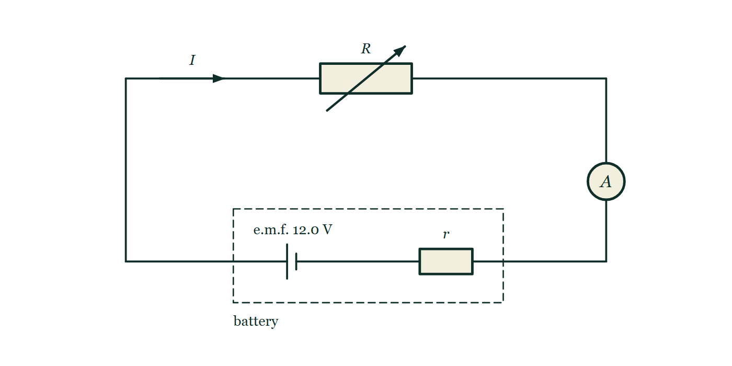
CIRCUITS · ELECTRIC CURRENT & CHARGE
GIOPHYSICS LESSON
FIGURE 2 OF 4
Fig. 10.1 — A Level AS · Topics 1–11
Drawn for question 10 of that paper · syllabus 9, 10
A single series loop. Along the bottom, a cell with its long plate on the left and a small resistor labelled r sit together inside a dashed rectangle labelled battery, the cell marked e.m.f. 12.0 V. From the dashed box the wire runs to the left, up the left-hand side and along the top through a resistor labelled R that has an arrow drawn across it to show that it is variable, then down the right-hand side through a circle marked A, and back along the bottom into the box. An arrow on the top wire labelled I shows the direction of the conventional current.
See the question this was drawn for — click here
Circuits — Electric Current & Charge. Built by GioPhysics from the lesson's own copy; nothing on these slides is re-authored.
16 / 37
Notes:
[Phase] Build the model: The formulae, one at a time, in plain English (minutes 13–22 of 45)
[Figure] Fig. 10.1. A single series loop. Along the bottom, a cell with its long plate on the left and a small resistor labelled r sit together inside a dashed rectangle labelled battery, the cell marked e.m.f. 12.0 V. From the dashed box the wire runs to the left, up the left-hand side and along the top through a resistor labelled R that has an arrow drawn across it to show that it is variable, then down the right-hand side through a circle marked A, and back along the bottom into the box. An arrow on the top wire labelled I shows the direction of the conventional current.
[Where it came from] A Level AS · Topics 1–11, question 10; syllabus 9, 10.

Slide 17
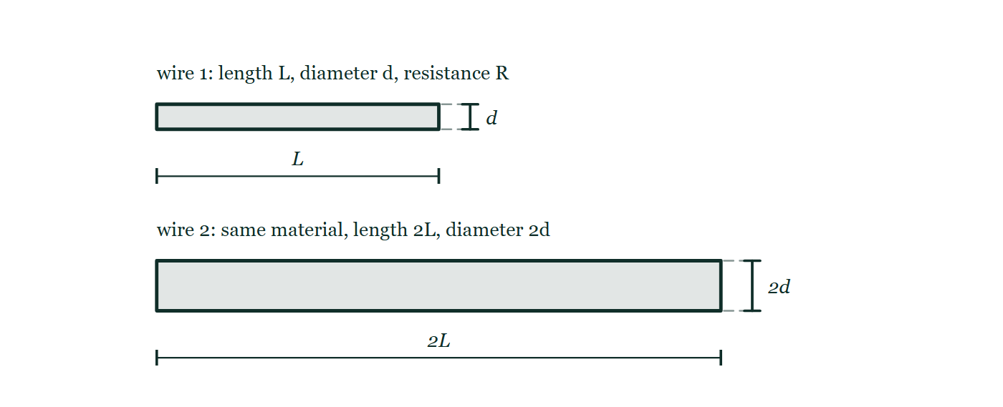
CIRCUITS · ELECTRIC CURRENT & CHARGE
GIOPHYSICS LESSON
FIGURE 3 OF 4
Figure 1 — IB Theme B · The particulate nature of matter
Drawn for question 4 of that paper · syllabus B.5
Two wires of the same material are drawn one above the other, each as a long bar seen from the side. The upper one is labelled wire 1: length L, diameter d, resistance R, with a dimension line under it marking L and a small dimension at its end marking the diameter d. The lower one is drawn twice as long and twice as thick and labelled wire 2: same material, with dimension lines marking 2L along it and 2d across its end.
See the question this was drawn for — click here
Circuits — Electric Current & Charge. Built by GioPhysics from the lesson's own copy; nothing on these slides is re-authored.
17 / 37
Notes:
[Phase] Build the model: The formulae, one at a time, in plain English (minutes 13–22 of 45)
[Figure] Figure 1. Two wires of the same material are drawn one above the other, each as a long bar seen from the side. The upper one is labelled wire 1: length L, diameter d, resistance R, with a dimension line under it marking L and a small dimension at its end marking the diameter d. The lower one is drawn twice as long and twice as thick and labelled wire 2: same material, with dimension lines marking 2L along it and 2d across its end.
[Where it came from] IB Theme B · The particulate nature of matter, question 4; syllabus B.5.

Slide 18
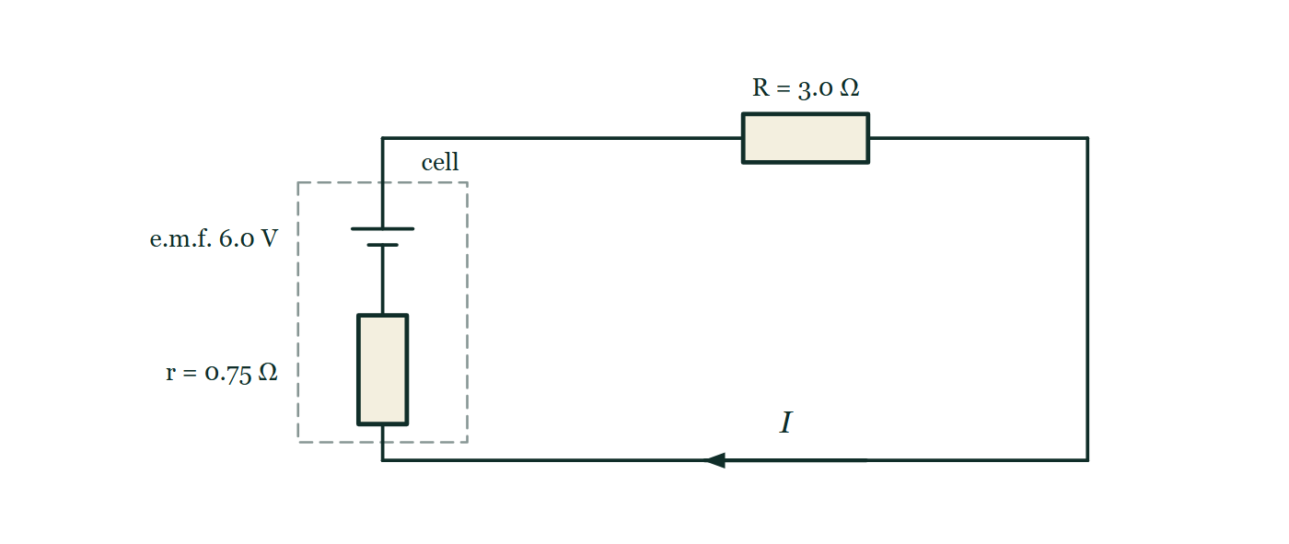
CIRCUITS · ELECTRIC CURRENT & CHARGE
GIOPHYSICS LESSON
FIGURE 4 OF 4
Figure 4 — IB Theme B · The particulate nature of matter
Drawn for question 10 of that paper · syllabus B.4, B.5
Circuit diagram of a single series loop. On the left a dashed boundary encloses the cell itself: a cell symbol with its long positive plate uppermost, labelled e.m.f. 6.0 V, in series with a resistor labelled r = 0.75 Ω. The two terminals cross the dashed boundary and the loop continues round to a resistor in the upper wire labelled R = 3.0 Ω. An arrow on the lower wire, labelled I, marks the direction of the conventional current.
See the question this was drawn for — click here
Circuits — Electric Current & Charge. Built by GioPhysics from the lesson's own copy; nothing on these slides is re-authored.
18 / 37
Notes:
[Phase] Build the model: The formulae, one at a time, in plain English (minutes 13–22 of 45)
[Figure] Figure 4. Circuit diagram of a single series loop. On the left a dashed boundary encloses the cell itself: a cell symbol with its long positive plate uppermost, labelled e.m.f. 6.0 V, in series with a resistor labelled r = 0.75 Ω. The two terminals cross the dashed boundary and the loop continues round to a resistor in the upper wire labelled R = 3.0 Ω. An arrow on the lower wire, labelled I, marks the direction of the conventional current.
[Where it came from] IB Theme B · The particulate nature of matter, question 10; syllabus B.4, B.5.

Slide 19
CIRCUITS · ELECTRIC CURRENT & CHARGE
GIOPHYSICS LESSON
WATCH OUT
The common trap
Check and misconception — The quick check and the trap
Current is not used up around a circuit. The same current enters and leaves a lamp — the lamp transfers energy carried by the charge, not the charge itself.
Circuits — Electric Current & Charge. Built by GioPhysics from the lesson's own copy; nothing on these slides is re-authored.
19 / 37
Notes:
[Phase] Check and misconception: The quick check and the trap (minutes 35–41 of 45)
[Misconception] Current is not used up around a circuit. The same current enters and leaves a lamp — the lamp transfers energy carried by the charge, not the charge itself.

Slide 20
CIRCUITS · ELECTRIC CURRENT & CHARGE
GIOPHYSICS LESSON
WORKED EXAMPLE 1 OF 2 · EASY
The question
Easy
Worked examples — I do, we do — one step revealed at a time
A current of 0.50 A flows for 60 s. How much charge passes?
Circuits — Electric Current & Charge. Built by GioPhysics from the lesson's own copy; nothing on these slides is re-authored.
20 / 37
Notes:
[Phase] Worked examples: I do, we do — one step revealed at a time (minutes 22–35 of 45)
[Question] A current of 0.50 A flows for 60 s. How much charge passes?
[Answer] 30 C

Slide 21
CIRCUITS · ELECTRIC CURRENT & CHARGE
GIOPHYSICS LESSON
WORKED EXAMPLE 1 OF 2 · EASY · THE WORKING
How to solve it
Easy
Worked examples — I do, we do — one step revealed at a time
A current of 0.50 A flows for 60 s. How much charge passes?
1.
ΔQ = IΔt = 0.50 × 60.
2.
ΔQ = 30 C.
Circuits — Electric Current & Charge. Built by GioPhysics from the lesson's own copy; nothing on these slides is re-authored.
21 / 37
Notes:
[Phase] Worked examples: I do, we do — one step revealed at a time (minutes 22–35 of 45)
[Reveal] One click per step. The class works each line before the next appears.
[Step 1] ΔQ = IΔt = 0.50 × 60.
[Step 2] ΔQ = 30 C.

Slide 22
CIRCUITS · ELECTRIC CURRENT & CHARGE
GIOPHYSICS LESSON
WORKED EXAMPLE 1 OF 2 · EASY
Answer
Easy
Worked examples — I do, we do — one step revealed at a time
30 C
Circuits — Electric Current & Charge. Built by GioPhysics from the lesson's own copy; nothing on these slides is re-authored.
22 / 37
Notes:
[Phase] Worked examples: I do, we do — one step revealed at a time (minutes 22–35 of 45)
[Answer] 30 C

Slide 23
CIRCUITS · ELECTRIC CURRENT & CHARGE
GIOPHYSICS LESSON
WORKED EXAMPLE 2 OF 2 · MEDIUM
The question
Medium
Worked examples — I do, we do — one step revealed at a time
A phone charger delivers 1.5 A for 40 minutes. How much charge flows, and how many electrons is that?
Circuits — Electric Current & Charge. Built by GioPhysics from the lesson's own copy; nothing on these slides is re-authored.
23 / 37
Notes:
[Phase] Worked examples: I do, we do — one step revealed at a time (minutes 22–35 of 45)
[Question] A phone charger delivers 1.5 A for 40 minutes. How much charge flows, and how many electrons is that?
[Answer] ΔQ = 3600 C, about 2.3 × 10²² electrons

Slide 24
CIRCUITS · ELECTRIC CURRENT & CHARGE
GIOPHYSICS LESSON
WORKED EXAMPLE 2 OF 2 · MEDIUM · THE WORKING
How to solve it
Medium
Worked examples — I do, we do — one step revealed at a time
A phone charger delivers 1.5 A for 40 minutes. How much charge flows, and how many electrons is that?
1.
Δt = 40 × 60 = 2400 s.
2.
ΔQ = IΔt = 1.5 × 2400 = 3600 C.
3.
n = ΔQ/e = 3600 ÷ 1.60 × 10⁻¹⁹ ≈ 2.3 × 10²² electrons.
Circuits — Electric Current & Charge. Built by GioPhysics from the lesson's own copy; nothing on these slides is re-authored.
24 / 37
Notes:
[Phase] Worked examples: I do, we do — one step revealed at a time (minutes 22–35 of 45)
[Reveal] One click per step. The class works each line before the next appears.
[Step 1] Δt = 40 × 60 = 2400 s.
[Step 2] ΔQ = IΔt = 1.5 × 2400 = 3600 C.
[Step 3] n = ΔQ/e = 3600 ÷ 1.60 × 10⁻¹⁹ ≈ 2.3 × 10²² electrons.

Slide 25
CIRCUITS · ELECTRIC CURRENT & CHARGE
GIOPHYSICS LESSON
WORKED EXAMPLE 2 OF 2 · MEDIUM
Answer
Medium
Worked examples — I do, we do — one step revealed at a time
ΔQ = 3600 C, about 2.3 × 10²² electrons
Circuits — Electric Current & Charge. Built by GioPhysics from the lesson's own copy; nothing on these slides is re-authored.
25 / 37
Notes:
[Phase] Worked examples: I do, we do — one step revealed at a time (minutes 22–35 of 45)
[Answer] ΔQ = 3600 C, about 2.3 × 10²² electrons

Slide 26
CIRCUITS · ELECTRIC CURRENT & CHARGE
GIOPHYSICS LESSON
SPOT THE MISTAKE
One line here is wrong
The whole working is up — find the bad line before you click
1.
A torch bulb draws 0.25 A for 4.0 minutes. How many electrons pass through it?
2.
ΔQ = IΔt = 0.25 × 4.0 = 1.0 C
3.
n = ΔQ/e = 1.0 / (1.6 × 10⁻¹⁹)
4.
n = 6.3 × 10¹⁸ electrons
LINE 2 IS WRONG
The time is in minutes. It is the easiest slip in the whole chapter because the numbers stay tidy either way — 0.25 × 4.0 = 1.0 is a satisfying line to write, and nothing about it looks wrong. The unit is what catches it: an ampere is a coulomb per second, so anything multiplied by a current must be in seconds.
IT SHOULD SAY
ΔQ = IΔt = 0.25 × 240 = 60 C, giving n = 60 / (1.6 × 10⁻¹⁹) = 3.8 × 10²⁰ electrons
Circuits — Electric Current & Charge. Built by GioPhysics from the lesson's own copy; nothing on these slides is re-authored.
26 / 37
Notes:
[Phase] Worked examples: I do, we do — one step revealed at a time (minutes 22–35 of 45)
[Spot the mistake] The working is complete and one line of it is wrong. Let the room hunt: one click names the line, a second shows it done correctly.
[Line 2 is wrong] The time is in minutes. It is the easiest slip in the whole chapter because the numbers stay tidy either way — 0.25 × 4.0 = 1.0 is a satisfying line to write, and nothing about it looks wrong. The unit is what catches it: an ampere is a coulomb per second, so anything multiplied by a current must be in seconds.
[It should say] ΔQ = IΔt = 0.25 × 240 = 60 C, giving n = 60 / (1.6 × 10⁻¹⁹) = 3.8 × 10²⁰ electrons

Slide 27
CIRCUITS · ELECTRIC CURRENT & CHARGE
GIOPHYSICS LESSON
PREDICT · TAKE THE VOTE
Commit before you are told
Hands up for each option, then click
A₁ sits before the lamp and A₂ after it. What do the two meters read?
A A₁ reads more than A₂ — the lamp uses some of the current up
B Both read the same
C A₂ reads more than A₁ — the lamp is hot, so more charge leaves it
One loop from a 6 V cell through a lamp, with ammeter A₁ in the wire going into the lamp and ammeter A₂ in the wire coming out of it; neither meter's reading is printed on the drawing.
The live version of this figure — click here
Circuits — Electric Current & Charge. Built by GioPhysics from the lesson's own copy; nothing on these slides is re-authored.
27 / 37
Notes:
[Phase] Build the model: The formulae, one at a time, in plain English (minutes 13–22 of 45)
[Predict] A₁ sits before the lamp and A₂ after it. What do the two meters read?
[Options] A A₁ reads more than A₂ — the lamp uses some of the current up B Both read the same C A₂ reads more than A₁ — the lamp is hot, so more charge leaves it
[Figure] One loop from a 6 V cell through a lamp, with ammeter A₁ in the wire going into the lamp and ammeter A₂ in the wire coming out of it; neither meter's reading is printed on the drawing.

Slide 28
CIRCUITS · ELECTRIC CURRENT & CHARGE
GIOPHYSICS LESSON
PREDICT · THE OUTCOME
What actually happens
Ask the room who changed their mind, and why
B Both read the same
WHY
Charge is not consumed anywhere in the drawing: there is one path, so every coulomb that passes A₁ has nowhere to go but through the lamp and on through A₂. What the lamp takes is energy, not charge — each coulomb arrives with a ration of energy and leaves with less of it, but it leaves. If A₁ really did read more, coulombs would be piling up inside the filament, and after a second of that the lamp would carry a charge big enough to be felt across the room.
Circuits — Electric Current & Charge. Built by GioPhysics from the lesson's own copy; nothing on these slides is re-authored.
28 / 37
Notes:
[Phase] Build the model: The formulae, one at a time, in plain English (minutes 13–22 of 45)
[Answer] B — Both read the same. Charge is not consumed anywhere in the drawing: there is one path, so every coulomb that passes A₁ has nowhere to go but through the lamp and on through A₂. What the lamp takes is energy, not charge — each coulomb arrives with a ration of energy and leaves with less of it, but it leaves. If A₁ really did read more, coulombs would be piling up inside the filament, and after a second of that the lamp would carry a charge big enough to be felt across the room.

Slide 29
CIRCUITS · ELECTRIC CURRENT & CHARGE
GIOPHYSICS LESSON
QUICK CHECK
Decide before the answer goes up
Check and misconception — The quick check and the trap
A charge of 240 C passes a point in 2.0 minutes. What is the current?
A
120 A
B
2.0 A
C
0.5 A
Circuits — Electric Current & Charge. Built by GioPhysics from the lesson's own copy; nothing on these slides is re-authored.
29 / 37
Notes:
[Phase] Check and misconception: The quick check and the trap (minutes 35–41 of 45)
[Question] A charge of 240 C passes a point in 2.0 minutes. What is the current?
[Options] A 120 A B 2.0 A C 0.5 A

Slide 30
CIRCUITS · ELECTRIC CURRENT & CHARGE
GIOPHYSICS LESSON
QUICK CHECK · THE ANSWER
The answer, and why
Check and misconception — The quick check and the trap
B 2.0 A
HOW TO GET THERE
Convert time first: I = ΔQ/Δt = 240 C ÷ 120 s = 2.0 A.
WHY THE OTHERS TEMPT
A 120 A is 240 ÷ 2, with the 2.0 minutes left as minutes. An ampere is a coulomb per second, so the time has to be in seconds before the division: 2.0 minutes is 120 s.
B Correct. I = ΔQ/Δt = 240 C ÷ 120 s = 2.0 A.
C 0.5 A is 120 ÷ 240 — the division done upside down. Current is charge per second, so the charge goes on top and the time underneath.
Circuits — Electric Current & Charge. Built by GioPhysics from the lesson's own copy; nothing on these slides is re-authored.
30 / 37
Notes:
[Phase] Check and misconception: The quick check and the trap (minutes 35–41 of 45)
[Question] A charge of 240 C passes a point in 2.0 minutes. What is the current?
[Option by option] A: 120 A is 240 ÷ 2, with the 2.0 minutes left as minutes. An ampere is a coulomb per second, so the time has to be in seconds before the division: 2.0 minutes is 120 s. B: Correct. I = ΔQ/Δt = 240 C ÷ 120 s = 2.0 A. C: 0.5 A is 120 ÷ 240 — the division done upside down. Current is charge per second, so the charge goes on top and the time underneath.
[Answer] B — 2.0 A
[Why] Convert time first: I = ΔQ/Δt = 240 C ÷ 120 s = 2.0 A.
[Reveal] One click for the answer, then one for the reason.

Slide 31
CIRCUITS · ELECTRIC CURRENT & CHARGE
GIOPHYSICS LESSON
EXTENSION 1 OF 2 · HARD
The question
Hard
Worked examples — I do, we do — one step revealed at a time
A car battery is rated 40 A·h. How much charge is that in coulombs, and for how long could it supply a steady 2.5 A?
Circuits — Electric Current & Charge. Built by GioPhysics from the lesson's own copy; nothing on these slides is re-authored.
31 / 37
Notes:
[Phase] Worked examples: I do, we do — one step revealed at a time (minutes 22–35 of 45)
[Question] A car battery is rated 40 A·h. How much charge is that in coulombs, and for how long could it supply a steady 2.5 A?
[Answer] 1.44 × 10⁵ C — 16 h at 2.5 A

Slide 32
CIRCUITS · ELECTRIC CURRENT & CHARGE
GIOPHYSICS LESSON
EXTENSION 1 OF 2 · HARD · THE WORKING
How to solve it
Hard
Worked examples — I do, we do — one step revealed at a time
A car battery is rated 40 A·h. How much charge is that in coulombs, and for how long could it supply a steady 2.5 A?
1.
40 A·h = 40 × 3600 = 1.44 × 10⁵ C.
2.
t = Q/I = 1.44 × 10⁵ ÷ 2.5 = 5.76 × 10⁴ s.
3.
= 16 hours.
Circuits — Electric Current & Charge. Built by GioPhysics from the lesson's own copy; nothing on these slides is re-authored.
32 / 37
Notes:
[Phase] Worked examples: I do, we do — one step revealed at a time (minutes 22–35 of 45)
[Reveal] One click per step. The class works each line before the next appears.
[Step 1] 40 A·h = 40 × 3600 = 1.44 × 10⁵ C.
[Step 2] t = Q/I = 1.44 × 10⁵ ÷ 2.5 = 5.76 × 10⁴ s.
[Step 3] = 16 hours.

Slide 33
CIRCUITS · ELECTRIC CURRENT & CHARGE
GIOPHYSICS LESSON
EXTENSION 1 OF 2 · HARD
Answer
Hard
Worked examples — I do, we do — one step revealed at a time
1.44 × 10⁵ C — 16 h at 2.5 A
Circuits — Electric Current & Charge. Built by GioPhysics from the lesson's own copy; nothing on these slides is re-authored.
33 / 37
Notes:
[Phase] Worked examples: I do, we do — one step revealed at a time (minutes 22–35 of 45)
[Answer] 1.44 × 10⁵ C — 16 h at 2.5 A

Slide 34
CIRCUITS · ELECTRIC CURRENT & CHARGE
GIOPHYSICS LESSON
EXTENSION 2 OF 2 · CHALLENGING
The question
Challenging
Worked examples — I do, we do — one step revealed at a time
A copper wire of cross-section 1.0 mm² carries 5.0 A. With 8.5 × 10²⁸ free electrons per m³, estimate the electron drift speed and reconcile it with a light switching on 'instantly'.
Circuits — Electric Current & Charge. Built by GioPhysics from the lesson's own copy; nothing on these slides is re-authored.
34 / 37
Notes:
[Phase] Worked examples: I do, we do — one step revealed at a time (minutes 22–35 of 45)
[Question] A copper wire of cross-section 1.0 mm² carries 5.0 A. With 8.5 × 10²⁸ free electrons per m³, estimate the electron drift speed and reconcile it with a light switching on 'instantly'.
[Answer] v ≈ 0.4 mm/s; the field, not the electrons, travels fast

Slide 35
CIRCUITS · ELECTRIC CURRENT & CHARGE
GIOPHYSICS LESSON
EXTENSION 2 OF 2 · CHALLENGING · THE WORKING
How to solve it
Challenging
Worked examples — I do, we do — one step revealed at a time
A copper wire of cross-section 1.0 mm² carries 5.0 A. With 8.5 × 10²⁸ free electrons per m³, estimate the electron drift speed and reconcile it with a light switching on 'instantly'.
1.
I = nAve → v = I/(nAe) = 5.0 ÷ (8.5 × 10²⁸ × 10⁻⁶ × 1.6 × 10⁻¹⁹).
2.
v ≈ 3.7 × 10⁻⁴ m/s — about a third of a millimetre per second.
3.
The electric field propagates near light speed, setting ALL the wire's electrons drifting at once — the marching column starts everywhere simultaneously.
Circuits — Electric Current & Charge. Built by GioPhysics from the lesson's own copy; nothing on these slides is re-authored.
35 / 37
Notes:
[Phase] Worked examples: I do, we do — one step revealed at a time (minutes 22–35 of 45)
[Reveal] One click per step. The class works each line before the next appears.
[Step 1] I = nAve → v = I/(nAe) = 5.0 ÷ (8.5 × 10²⁸ × 10⁻⁶ × 1.6 × 10⁻¹⁹).
[Step 2] v ≈ 3.7 × 10⁻⁴ m/s — about a third of a millimetre per second.
[Step 3] The electric field propagates near light speed, setting ALL the wire's electrons drifting at once — the marching column starts everywhere simultaneously.

Slide 36
CIRCUITS · ELECTRIC CURRENT & CHARGE
GIOPHYSICS LESSON
EXTENSION 2 OF 2 · CHALLENGING
Answer
Challenging
Worked examples — I do, we do — one step revealed at a time
v ≈ 0.4 mm/s; the field, not the electrons, travels fast
Circuits — Electric Current & Charge. Built by GioPhysics from the lesson's own copy; nothing on these slides is re-authored.
36 / 37
Notes:
[Phase] Worked examples: I do, we do — one step revealed at a time (minutes 22–35 of 45)
[Answer] v ≈ 0.4 mm/s; the field, not the electrons, travels fast

Slide 37
CIRCUITS · ELECTRIC CURRENT & CHARGE
GIOPHYSICS LESSON
CIRCUITS
Where to go next
Plenary — What to take away, what to practise next
Next
13.3 Voltage & Potential Difference
https://giophysics.com/chapter-22/voltage-potential-difference/
Lesson
This lesson on giophysics.com
https://giophysics.com/chapter-22/electric-current-charge/
Live
The live, interactive version of these slides
https://giophysics.com/chapter-22/presentation/?lesson=current
Chapter
All Circuits lessons
https://giophysics.com/chapter-22/
PDF
Download the lesson PDF
https://giophysics.com/downloads/22-2-electric-current-charge.pdf
Circuits — Electric Current & Charge. Built by GioPhysics from the lesson's own copy; nothing on these slides is re-authored.
37 / 37
Notes:
[Phase] Plenary: What to take away, what to practise next (minutes 41–45 of 45)
[Interactive] The graphs and the circuit topology on these slides are frozen. The live version at https://giophysics.com/chapter-22/presentation/?lesson=current moves them.

