Slide 1
CIRCUITS · RESISTANCE & OHM'S LAW
GIOPHYSICS LESSON
13 · Circuits
Opposition to the flow of charge
Resistance & Ohm's Law
Resistance measures how strongly a component opposes current. For a metallic conductor at constant temperature, current is proportional to voltage — that special case is Ohm's law.
POSITION
Lesson 4 of 8 in Circuits
PLAN
16 slides in the 45-minute core run, about 44.5 minutes of it
LESSON PAGE
https://giophysics.com/chapter-22/resistance-ohms-law/
Built by GioPhysics from the lesson's own page. Every word on these slides is the lesson's; nothing here is re-authored. Teaching material, not an awarding body's document.
Circuits — Resistance & Ohm's Law. Built by GioPhysics from the lesson's own copy; nothing on these slides is re-authored.
1 / 32
Notes:
[Lesson] Circuits — Resistance & Ohm's Law. Lesson 4 of 8.
[Intro] Resistance measures how strongly a component opposes current. For a metallic conductor at constant temperature, current is proportional to voltage — that special case is Ohm's law.
[Source] https://giophysics.com/chapter-22/resistance-ohms-law/
[Disclaimer] Built by GioPhysics from the lesson's own page. Every word on these slides is the lesson's; nothing here is re-authored. Teaching material, not an awarding body's document.

Slide 2
CIRCUITS · RESISTANCE & OHM'S LAW
GIOPHYSICS LESSON
WHAT THIS NEEDS
What you already know
Starter — Recall what this lesson stands on
Recall
Current & charge
https://giophysics.com/chapter-22/electric-current-charge/
Recall
Potential difference
https://giophysics.com/chapter-22/voltage-potential-difference/
Circuits — Resistance & Ohm's Law. Built by GioPhysics from the lesson's own copy; nothing on these slides is re-authored.
2 / 32
Notes:
[Phase] Starter: Recall what this lesson stands on (minutes 0–5 of 45)
[Starter] Recall: Current & charge; Potential difference

Slide 3
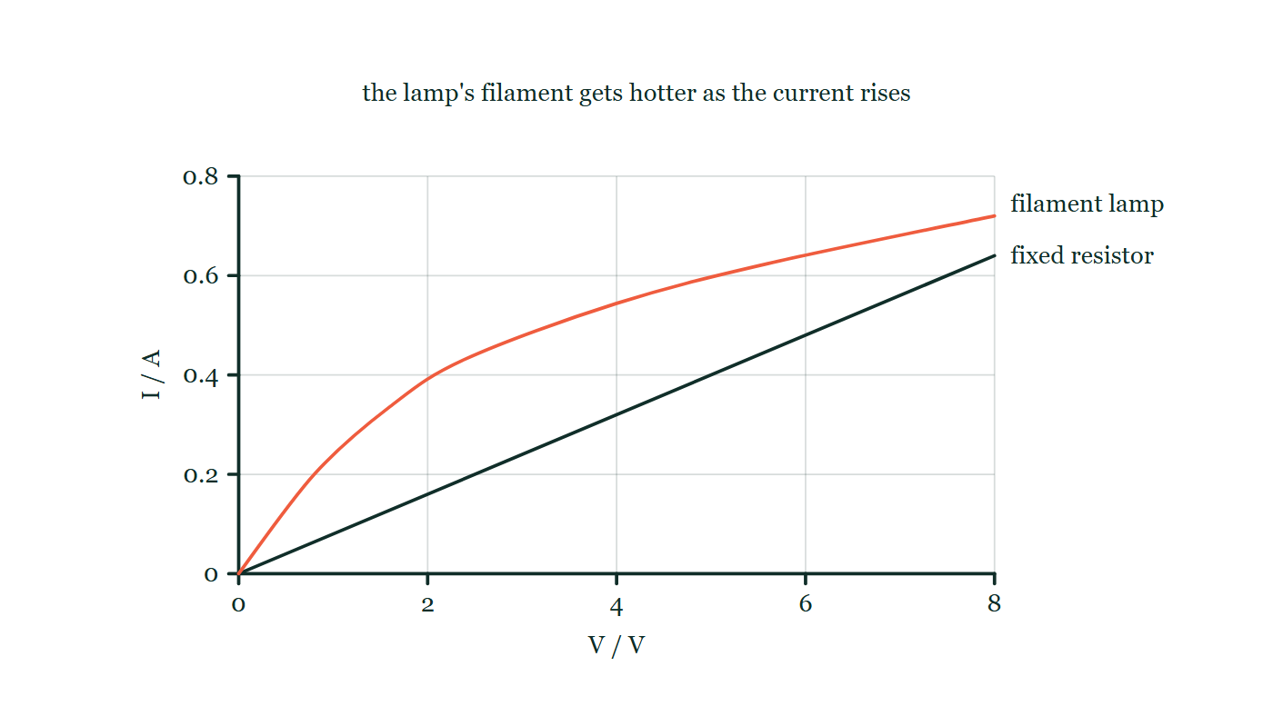
CIRCUITS · RESISTANCE & OHM'S LAW
GIOPHYSICS LESSON
THINK FIRST
A filament lamp is a coil of metal wire. Metals obey Ohm's law. So does a lamp?
Take answers before you click — the point is the commitment
Put a lamp on a variable supply, take current and p.d. readings up to full brightness, and plot them. The points do not fall on a straight line.
THE ANSWER
No — and the reason is hidden in the small print of the law. Ohm's law holds for a metal at constant temperature, and a working filament runs at about 2500 °C. Turn the supply up and the wire gets hotter, its resistance climbs, and each extra volt buys less extra current than the one before.
The same current-against-p.d. axes carrying two traces: a fixed resistor drawn as a straight line to 0.64 A at 8 V, and a filament lamp that leaves the origin more steeply than the resistor and then bends over, flattening as the p.d. grows.
The live version of this figure — click here
Circuits — Resistance & Ohm's Law. Built by GioPhysics from the lesson's own copy; nothing on these slides is re-authored.
3 / 32
Notes:
[Phase] Starter: Recall what this lesson stands on (minutes 0–5 of 45)
[Hook] A filament lamp is a coil of metal wire. Metals obey Ohm's law. So does a lamp? Put a lamp on a variable supply, take current and p.d. readings up to full brightness, and plot them. The points do not fall on a straight line.
[Answer] No — and the reason is hidden in the small print of the law. Ohm's law holds for a metal at constant temperature, and a working filament runs at about 2500 °C. Turn the supply up and the wire gets hotter, its resistance climbs, and each extra volt buys less extra current than the one before.
[Figure] The same current-against-p.d. axes carrying two traces: a fixed resistor drawn as a straight line to 0.64 A at 8 V, and a filament lamp that leaves the origin more steeply than the resistor and then bends over, flattening as the p.d. grows.

Slide 4
CIRCUITS · RESISTANCE & OHM'S LAW
GIOPHYSICS LESSON
EXPLAINED SIMPLY
In one sentence
Introduce the idea — The big idea and the definition
Resistance is the ratio of the potential difference across a component to the current through it.
Circuits — Resistance & Ohm's Law. Built by GioPhysics from the lesson's own copy; nothing on these slides is re-authored.
4 / 32
Notes:
[Phase] Introduce the idea: The big idea and the definition (minutes 5–13 of 45)
[Definition] Resistance is the ratio of the potential difference across a component to the current through it.

Slide 5
CIRCUITS · RESISTANCE & OHM'S LAW
GIOPHYSICS LESSON
EXPLAINED SIMPLY
What that looks like
Introduce the idea — The big idea and the definition
FOR EXAMPLE
If 9.7 V across a resistor drives 3.2 A through it, its resistance is 9.7 ÷ 3.2 ≈ 3.0 Ω.
Circuits — Resistance & Ohm's Law. Built by GioPhysics from the lesson's own copy; nothing on these slides is re-authored.
5 / 32
Notes:
[Phase] Introduce the idea: The big idea and the definition (minutes 5–13 of 45)
[Worked illustration] If 9.7 V across a resistor drives 3.2 A through it, its resistance is 9.7 ÷ 3.2 ≈ 3.0 Ω.

Slide 6
CIRCUITS · RESISTANCE & OHM'S LAW
GIOPHYSICS LESSON
THE BIG IDEA
Opposition to the flow of charge
Introduce the idea — The big idea and the definition
Resistance is defined by R = V/I for any component, always. Ohm's law is the further claim — true only for metals at constant temperature — that this ratio stays constant, giving a straight-line I–V graph through the origin.
Circuits — Resistance & Ohm's Law. Built by GioPhysics from the lesson's own copy; nothing on these slides is re-authored.
6 / 32
Notes:
[Phase] Introduce the idea: The big idea and the definition (minutes 5–13 of 45)
[Big idea] Resistance is defined by R = V/I for any component, always. Ohm's law is the further claim — true only for metals at constant temperature — that this ratio stays constant, giving a straight-line I–V graph through the origin.

Slide 7
CIRCUITS · RESISTANCE & OHM'S LAW
GIOPHYSICS LESSON
THE PHYSICS · 1 OF 3
Define it
Build the model — The formulae, one at a time, in plain English
R = V/I applies to every component at every operating point — it is a definition, not a law.
Circuits — Resistance & Ohm's Law. Built by GioPhysics from the lesson's own copy; nothing on these slides is re-authored.
7 / 32
Notes:
[Phase] Build the model: The formulae, one at a time, in plain English (minutes 13–22 of 45)
[Section] R = V/I applies to every component at every operating point — it is a definition, not a law.

Slide 8
CIRCUITS · RESISTANCE & OHM'S LAW
GIOPHYSICS LESSON
THE PHYSICS · 2 OF 3
Ohmic components
Build the model — The formulae, one at a time, in plain English
Fixed resistors and wires at constant temperature keep R constant, so their I–V characteristic is a straight line through the origin.
Circuits — Resistance & Ohm's Law. Built by GioPhysics from the lesson's own copy; nothing on these slides is re-authored.
8 / 32
Notes:
[Phase] Build the model: The formulae, one at a time, in plain English (minutes 13–22 of 45)
[Section] Fixed resistors and wires at constant temperature keep R constant, so their I–V characteristic is a straight line through the origin.

Slide 9
CIRCUITS · RESISTANCE & OHM'S LAW
GIOPHYSICS LESSON
THE PHYSICS · 3 OF 3
Temperature matters
Build the model — The formulae, one at a time, in plain English
Heat a metal and its lattice vibrates more, scattering electrons: resistance rises. That is why Ohm's law specifies constant temperature.
Circuits — Resistance & Ohm's Law. Built by GioPhysics from the lesson's own copy; nothing on these slides is re-authored.
9 / 32
Notes:
[Phase] Build the model: The formulae, one at a time, in plain English (minutes 13–22 of 45)
[Section] Heat a metal and its lattice vibrates more, scattering electrons: resistance rises. That is why Ohm's law specifies constant temperature.

Slide 10
CIRCUITS · RESISTANCE & OHM'S LAW
GIOPHYSICS LESSON
FORMULA 1 OF 3
Resistance
Build the model — The formulae, one at a time, in plain English
R = V/I
Unit: ohm, 1 Ω = 1 V/A
IN PLAIN ENGLISH
Resistance is volts needed per ampere of current — a bigger ratio means a stronger opposition to flow.
Circuits — Resistance & Ohm's Law. Built by GioPhysics from the lesson's own copy; nothing on these slides is re-authored.
10 / 32
Notes:
[Phase] Build the model: The formulae, one at a time, in plain English (minutes 13–22 of 45)
[Formula] Resistance: R = V/I
[In plain English] Resistance is volts needed per ampere of current — a bigger ratio means a stronger opposition to flow.
[Note] Unit: ohm, 1 Ω = 1 V/A

Slide 11
CIRCUITS · RESISTANCE & OHM'S LAW
GIOPHYSICS LESSON
FORMULA 2 OF 3
Ohm's law
Build the model — The formulae, one at a time, in plain English
I ∝ V (metal, constant T)
Straight I–V line through the origin
IN PLAIN ENGLISH
For a metal at steady temperature, doubling the voltage doubles the current — the resistance does not change.
Circuits — Resistance & Ohm's Law. Built by GioPhysics from the lesson's own copy; nothing on these slides is re-authored.
11 / 32
Notes:
[Phase] Build the model: The formulae, one at a time, in plain English (minutes 13–22 of 45)
[Formula] Ohm's law: I ∝ V (metal, constant T)
[In plain English] For a metal at steady temperature, doubling the voltage doubles the current — the resistance does not change.
[Note] Straight I–V line through the origin

Slide 12
CIRCUITS · RESISTANCE & OHM'S LAW
GIOPHYSICS LESSON
FORMULA 3 OF 3
Graph reading
Build the model — The formulae, one at a time, in plain English
R = 1/gradient of I–V
Only for a straight line through the origin
IN PLAIN ENGLISH
On a current–voltage graph, a steeper line means less resistance; the gradient method works only while the line is straight.
Circuits — Resistance & Ohm's Law. Built by GioPhysics from the lesson's own copy; nothing on these slides is re-authored.
12 / 32
Notes:
[Phase] Build the model: The formulae, one at a time, in plain English (minutes 13–22 of 45)
[Formula] Graph reading: R = 1/gradient of I–V
[In plain English] On a current–voltage graph, a steeper line means less resistance; the gradient method works only while the line is straight.
[Note] Only for a straight line through the origin

Slide 13
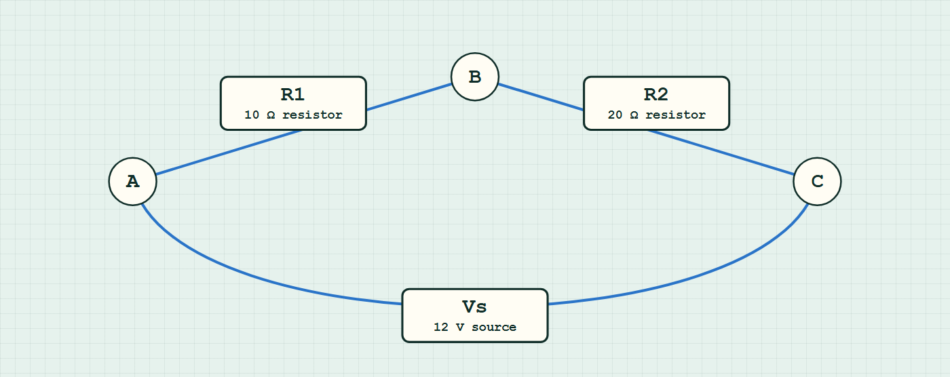
CIRCUITS · RESISTANCE & OHM'S LAW
GIOPHYSICS LESSON
CIRCUIT MODEL
Read the topology before the values
Build the model — nodes are where connections meet, branches are what lies between them
series network — components are branches between nodes.
Switch topology and hide the values on the live version — click here
Circuits — Resistance & Ohm's Law. Built by GioPhysics from the lesson's own copy; nothing on these slides is re-authored.
13 / 32
Notes:
[Phase] Build the model: The formulae, one at a time, in plain English (minutes 13–22 of 45)
[Topology] Nodes are the points where connections meet; branches are the components between them. The live version switches between series, parallel and bridge and can hide the values.

Slide 14
CIRCUITS · RESISTANCE & OHM'S LAW
GIOPHYSICS LESSON
WATCH OUT
The common trap
Check and misconception — The quick check and the trap
R = V/I always gives the resistance at that operating point, but that does not make every component ohmic. Ohmic means the ratio stays constant as V changes.
Circuits — Resistance & Ohm's Law. Built by GioPhysics from the lesson's own copy; nothing on these slides is re-authored.
14 / 32
Notes:
[Phase] Check and misconception: The quick check and the trap (minutes 35–41 of 45)
[Misconception] R = V/I always gives the resistance at that operating point, but that does not make every component ohmic. Ohmic means the ratio stays constant as V changes.

Slide 15
CIRCUITS · RESISTANCE & OHM'S LAW
GIOPHYSICS LESSON
WORKED EXAMPLE 1 OF 2 · EASY
The question
Easy
Worked examples — I do, we do — one step revealed at a time
A resistor passes 0.30 A when 6.0 V is applied. Find its resistance.
Circuits — Resistance & Ohm's Law. Built by GioPhysics from the lesson's own copy; nothing on these slides is re-authored.
15 / 32
Notes:
[Phase] Worked examples: I do, we do — one step revealed at a time (minutes 22–35 of 45)
[Question] A resistor passes 0.30 A when 6.0 V is applied. Find its resistance.
[Answer] 20 Ω

Slide 16
CIRCUITS · RESISTANCE & OHM'S LAW
GIOPHYSICS LESSON
WORKED EXAMPLE 1 OF 2 · EASY · THE WORKING
How to solve it
Easy
Worked examples — I do, we do — one step revealed at a time
A resistor passes 0.30 A when 6.0 V is applied. Find its resistance.
1.
R = V/I = 6.0 ÷ 0.30.
2.
R = 20 Ω.
Circuits — Resistance & Ohm's Law. Built by GioPhysics from the lesson's own copy; nothing on these slides is re-authored.
16 / 32
Notes:
[Phase] Worked examples: I do, we do — one step revealed at a time (minutes 22–35 of 45)
[Reveal] One click per step. The class works each line before the next appears.
[Step 1] R = V/I = 6.0 ÷ 0.30.
[Step 2] R = 20 Ω.

Slide 17
CIRCUITS · RESISTANCE & OHM'S LAW
GIOPHYSICS LESSON
WORKED EXAMPLE 1 OF 2 · EASY
Answer
Easy
Worked examples — I do, we do — one step revealed at a time
20 Ω
Circuits — Resistance & Ohm's Law. Built by GioPhysics from the lesson's own copy; nothing on these slides is re-authored.
17 / 32
Notes:
[Phase] Worked examples: I do, we do — one step revealed at a time (minutes 22–35 of 45)
[Answer] 20 Ω

Slide 18
CIRCUITS · RESISTANCE & OHM'S LAW
GIOPHYSICS LESSON
WORKED EXAMPLE 2 OF 2 · MEDIUM
The question
Medium
Worked examples — I do, we do — one step revealed at a time
A resistor passes 0.50 A when 5.0 V is applied. Predict the current at 8.0 V, assuming constant temperature.
Circuits — Resistance & Ohm's Law. Built by GioPhysics from the lesson's own copy; nothing on these slides is re-authored.
18 / 32
Notes:
[Phase] Worked examples: I do, we do — one step revealed at a time (minutes 22–35 of 45)
[Question] A resistor passes 0.50 A when 5.0 V is applied. Predict the current at 8.0 V, assuming constant temperature.
[Answer] I = 0.80 A

Slide 19
CIRCUITS · RESISTANCE & OHM'S LAW
GIOPHYSICS LESSON
WORKED EXAMPLE 2 OF 2 · MEDIUM · THE WORKING
How to solve it
Medium
Worked examples — I do, we do — one step revealed at a time
A resistor passes 0.50 A when 5.0 V is applied. Predict the current at 8.0 V, assuming constant temperature.
1.
R = V/I = 5.0 ÷ 0.50 = 10 Ω.
2.
Ohm's law: R stays constant for a metal at constant temperature.
3.
I = V/R = 8.0 ÷ 10 = 0.80 A.
Circuits — Resistance & Ohm's Law. Built by GioPhysics from the lesson's own copy; nothing on these slides is re-authored.
19 / 32
Notes:
[Phase] Worked examples: I do, we do — one step revealed at a time (minutes 22–35 of 45)
[Reveal] One click per step. The class works each line before the next appears.
[Step 1] R = V/I = 5.0 ÷ 0.50 = 10 Ω.
[Step 2] Ohm's law: R stays constant for a metal at constant temperature.
[Step 3] I = V/R = 8.0 ÷ 10 = 0.80 A.

Slide 20
CIRCUITS · RESISTANCE & OHM'S LAW
GIOPHYSICS LESSON
WORKED EXAMPLE 2 OF 2 · MEDIUM
Answer
Medium
Worked examples — I do, we do — one step revealed at a time
I = 0.80 A
Circuits — Resistance & Ohm's Law. Built by GioPhysics from the lesson's own copy; nothing on these slides is re-authored.
20 / 32
Notes:
[Phase] Worked examples: I do, we do — one step revealed at a time (minutes 22–35 of 45)
[Answer] I = 0.80 A

Slide 21
CIRCUITS · RESISTANCE & OHM'S LAW
GIOPHYSICS LESSON
SPOT THE MISTAKE
One line here is wrong
The whole working is up — find the bad line before you click
1.
A filament lamp passes 0.30 A at 2.0 V. Find the current it will pass at 8.0 V.
2.
R = V/I = 2.0 / 0.30 = 6.7 Ω
3.
At 8.0 V, I = V/R = 8.0 / 6.7
4.
I = 1.2 A
5.
So the lamp will pass 1.2 A at 8.0 V.
LINE 3 IS WRONG
The 6.7 Ω is honest — it is the lamp's resistance at that one operating point. Carrying it up to 8.0 V is not, because it assumes the ratio stays put, which is precisely what a filament lamp does not do. Four times the p.d. means far more heating, a much hotter filament and a much larger resistance, so the real current is well under 1.2 A. The same working would be perfectly sound for a fixed resistor at constant temperature.
IT SHOULD SAY
The lamp is non-ohmic, so R at 2.0 V cannot be used at 8.0 V: read the current off the lamp's own I–V characteristic at 8.0 V instead.
Circuits — Resistance & Ohm's Law. Built by GioPhysics from the lesson's own copy; nothing on these slides is re-authored.
21 / 32
Notes:
[Phase] Worked examples: I do, we do — one step revealed at a time (minutes 22–35 of 45)
[Spot the mistake] The working is complete and one line of it is wrong. Let the room hunt: one click names the line, a second shows it done correctly.
[Line 3 is wrong] The 6.7 Ω is honest — it is the lamp's resistance at that one operating point. Carrying it up to 8.0 V is not, because it assumes the ratio stays put, which is precisely what a filament lamp does not do. Four times the p.d. means far more heating, a much hotter filament and a much larger resistance, so the real current is well under 1.2 A. The same working would be perfectly sound for a fixed resistor at constant temperature.
[It should say] The lamp is non-ohmic, so R at 2.0 V cannot be used at 8.0 V: read the current off the lamp's own I–V characteristic at 8.0 V instead.

Slide 22
CIRCUITS · RESISTANCE & OHM'S LAW
GIOPHYSICS LESSON
PREDICT · TAKE THE VOTE
Commit before you are told
Hands up for each option, then click
Take a point near the top of the lamp's bent curve. Does R = V/I still give its resistance there?
A No — R = V/I only works for components that obey Ohm's law
B Yes, and it gives the same value as a point low down the curve
C Yes, and it gives a larger value than a point low down the curve
The same current-against-p.d. axes carrying two traces: a fixed resistor drawn as a straight line to 0.64 A at 8 V, and a filament lamp that leaves the origin more steeply than the resistor and then bends over, flattening as the p.d. grows.
The live version of this figure — click here
Circuits — Resistance & Ohm's Law. Built by GioPhysics from the lesson's own copy; nothing on these slides is re-authored.
22 / 32
Notes:
[Phase] Build the model: The formulae, one at a time, in plain English (minutes 13–22 of 45)
[Predict] Take a point near the top of the lamp's bent curve. Does R = V/I still give its resistance there?
[Options] A No — R = V/I only works for components that obey Ohm's law B Yes, and it gives the same value as a point low down the curve C Yes, and it gives a larger value than a point low down the curve
[Figure] The same current-against-p.d. axes carrying two traces: a fixed resistor drawn as a straight line to 0.64 A at 8 V, and a filament lamp that leaves the origin more steeply than the resistor and then bends over, flattening as the p.d. grows.

Slide 23
CIRCUITS · RESISTANCE & OHM'S LAW
GIOPHYSICS LESSON
PREDICT · THE OUTCOME
What actually happens
Ask the room who changed their mind, and why
C Yes, and it gives a larger value than a point low down the curve
WHY
R = V/I is the definition of resistance, not a law that a component can break: it is valid at every point on every characteristic. What a bent curve tells you is that the value changes as you move along it. Read the drawing at two heights — near the origin the p.d. is small and the current already substantial, while at the top the p.d. has grown far more than the current has, so V/I is bigger there. That growing ratio is the hot filament resisting more, and it is exactly what "non-ohmic" means.
Circuits — Resistance & Ohm's Law. Built by GioPhysics from the lesson's own copy; nothing on these slides is re-authored.
23 / 32
Notes:
[Phase] Build the model: The formulae, one at a time, in plain English (minutes 13–22 of 45)
[Answer] C — Yes, and it gives a larger value than a point low down the curve. R = V/I is the definition of resistance, not a law that a component can break: it is valid at every point on every characteristic. What a bent curve tells you is that the value changes as you move along it. Read the drawing at two heights — near the origin the p.d. is small and the current already substantial, while at the top the p.d. has grown far more than the current has, so V/I is bigger there. That growing ratio is the hot filament resisting more, and it is exactly what "non-ohmic" means.

Slide 24
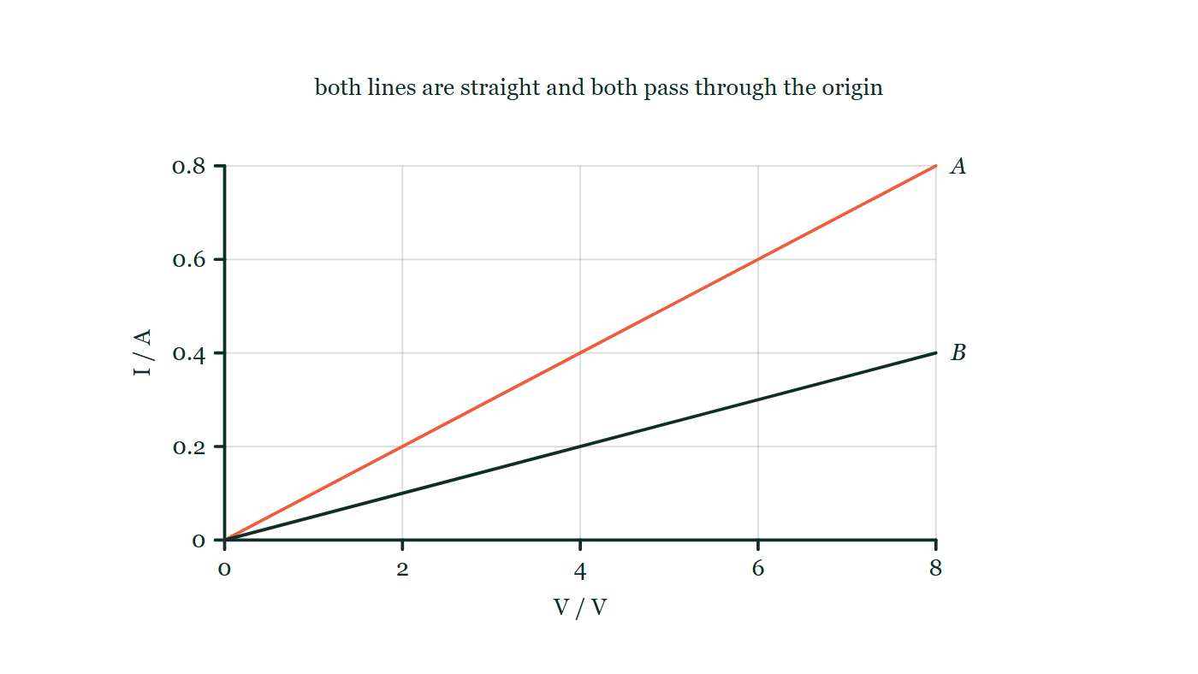
CIRCUITS · RESISTANCE & OHM'S LAW
GIOPHYSICS LESSON
QUICK CHECK
Decide before the answer goes up
Check and misconception — The quick check and the trap
Component A's I–V line is steeper than component B's. Which has the greater resistance?
A
A
B
B
C
They are equal
Current plotted up the page against potential difference across it, with two straight lines both starting at the origin: A rises to 0.8 A at 8 V and B, drawn shallower, reaches only half as far up the current axis.
The live version of this figure — click here
Circuits — Resistance & Ohm's Law. Built by GioPhysics from the lesson's own copy; nothing on these slides is re-authored.
24 / 32
Notes:
[Phase] Check and misconception: The quick check and the trap (minutes 35–41 of 45)
[Question] Component A's I–V line is steeper than component B's. Which has the greater resistance?
[Figure] Current plotted up the page against potential difference across it, with two straight lines both starting at the origin: A rises to 0.8 A at 8 V and B, drawn shallower, reaches only half as far up the current axis.
[Options] A A B B C They are equal

Slide 25
CIRCUITS · RESISTANCE & OHM'S LAW
GIOPHYSICS LESSON
QUICK CHECK · THE ANSWER
The answer, and why
Check and misconception — The quick check and the trap
B
HOW TO GET THERE
On I–V axes a steeper line means more current per volt — less resistance. The shallower line, B, resists more.
WHY THE OTHERS TEMPT
A This is steepness read as resistance. Check which quantity is up the page: it is current, so a steeper line means more amps for every volt — an easier path, not a harder one. On these axes resistance is one over the gradient.
B Correct. B's shallower line means fewer amps per volt, so V/I is larger for B at every point.
C Both lines are straight and both pass through the origin, so both components are ohmic — each holds its own resistance constant as the p.d. changes. Ohmic does not mean identical, and the two constants differ, which is why the lines have different steepness.
Circuits — Resistance & Ohm's Law. Built by GioPhysics from the lesson's own copy; nothing on these slides is re-authored.
25 / 32
Notes:
[Phase] Check and misconception: The quick check and the trap (minutes 35–41 of 45)
[Question] Component A's I–V line is steeper than component B's. Which has the greater resistance?
[Option by option] A: This is steepness read as resistance. Check which quantity is up the page: it is current, so a steeper line means more amps for every volt — an easier path, not a harder one. On these axes resistance is one over the gradient. B: Correct. B's shallower line means fewer amps per volt, so V/I is larger for B at every point. C: Both lines are straight and both pass through the origin, so both components are ohmic — each holds its own resistance constant as the p.d. changes. Ohmic does not mean identical, and the two constants differ, which is why the lines have different steepness.
[Answer] B
[Why] On I–V axes a steeper line means more current per volt — less resistance. The shallower line, B, resists more.
[Reveal] One click for the answer, then one for the reason.

Slide 26
CIRCUITS · RESISTANCE & OHM'S LAW
GIOPHYSICS LESSON
EXTENSION 1 OF 2 · HARD
The question
Hard
Worked examples — I do, we do — one step revealed at a time
An I–V experiment gives points (2.0 V, 0.10 A), (4.0 V, 0.20 A), (8.0 V, 0.41 A). Is the component ohmic? Justify quantitatively.
Circuits — Resistance & Ohm's Law. Built by GioPhysics from the lesson's own copy; nothing on these slides is re-authored.
26 / 32
Notes:
[Phase] Worked examples: I do, we do — one step revealed at a time (minutes 22–35 of 45)
[Question] An I–V experiment gives points (2.0 V, 0.10 A), (4.0 V, 0.20 A), (8.0 V, 0.41 A). Is the component ohmic? Justify quantitatively.
[Answer] Yes — R stays ≈ 20 Ω throughout

Slide 27
CIRCUITS · RESISTANCE & OHM'S LAW
GIOPHYSICS LESSON
EXTENSION 1 OF 2 · HARD · THE WORKING
How to solve it
Hard
Worked examples — I do, we do — one step revealed at a time
An I–V experiment gives points (2.0 V, 0.10 A), (4.0 V, 0.20 A), (8.0 V, 0.41 A). Is the component ohmic? Justify quantitatively.
1.
R values: 20 Ω, 20 Ω, and 19.5 Ω.
2.
Constant within ~2% across a fourfold voltage range.
3.
Effectively ohmic in this range — a straight I–V line through the origin within experimental error.
Circuits — Resistance & Ohm's Law. Built by GioPhysics from the lesson's own copy; nothing on these slides is re-authored.
27 / 32
Notes:
[Phase] Worked examples: I do, we do — one step revealed at a time (minutes 22–35 of 45)
[Reveal] One click per step. The class works each line before the next appears.
[Step 1] R values: 20 Ω, 20 Ω, and 19.5 Ω.
[Step 2] Constant within ~2% across a fourfold voltage range.
[Step 3] Effectively ohmic in this range — a straight I–V line through the origin within experimental error.

Slide 28
CIRCUITS · RESISTANCE & OHM'S LAW
GIOPHYSICS LESSON
EXTENSION 1 OF 2 · HARD
Answer
Hard
Worked examples — I do, we do — one step revealed at a time
Yes — R stays ≈ 20 Ω throughout
Circuits — Resistance & Ohm's Law. Built by GioPhysics from the lesson's own copy; nothing on these slides is re-authored.
28 / 32
Notes:
[Phase] Worked examples: I do, we do — one step revealed at a time (minutes 22–35 of 45)
[Answer] Yes — R stays ≈ 20 Ω throughout

Slide 29
CIRCUITS · RESISTANCE & OHM'S LAW
GIOPHYSICS LESSON
EXTENSION 2 OF 2 · CHALLENGING
The question
Challenging
Worked examples — I do, we do — one step revealed at a time
Two resistors have I–V gradients of 0.05 A/V and 0.20 A/V. Which dissipates more power when each carries 0.10 A, and by what factor?
Circuits — Resistance & Ohm's Law. Built by GioPhysics from the lesson's own copy; nothing on these slides is re-authored.
29 / 32
Notes:
[Phase] Worked examples: I do, we do — one step revealed at a time (minutes 22–35 of 45)
[Question] Two resistors have I–V gradients of 0.05 A/V and 0.20 A/V. Which dissipates more power when each carries 0.10 A, and by what factor?
[Answer] The 20 Ω resistor — 4× the power at the same current

Slide 30
CIRCUITS · RESISTANCE & OHM'S LAW
GIOPHYSICS LESSON
EXTENSION 2 OF 2 · CHALLENGING · THE WORKING
How to solve it
Challenging
Worked examples — I do, we do — one step revealed at a time
Two resistors have I–V gradients of 0.05 A/V and 0.20 A/V. Which dissipates more power when each carries 0.10 A, and by what factor?
1.
Gradient = 1/R: R₁ = 20 Ω, R₂ = 5.0 Ω.
2.
At equal current, P = I²R ∝ R.
3.
P₁/P₂ = 20/5 = 4 — the shallower line (bigger R) heats four times more.
Circuits — Resistance & Ohm's Law. Built by GioPhysics from the lesson's own copy; nothing on these slides is re-authored.
30 / 32
Notes:
[Phase] Worked examples: I do, we do — one step revealed at a time (minutes 22–35 of 45)
[Reveal] One click per step. The class works each line before the next appears.
[Step 1] Gradient = 1/R: R₁ = 20 Ω, R₂ = 5.0 Ω.
[Step 2] At equal current, P = I²R ∝ R.
[Step 3] P₁/P₂ = 20/5 = 4 — the shallower line (bigger R) heats four times more.

Slide 31
CIRCUITS · RESISTANCE & OHM'S LAW
GIOPHYSICS LESSON
EXTENSION 2 OF 2 · CHALLENGING
Answer
Challenging
Worked examples — I do, we do — one step revealed at a time
The 20 Ω resistor — 4× the power at the same current
Circuits — Resistance & Ohm's Law. Built by GioPhysics from the lesson's own copy; nothing on these slides is re-authored.
31 / 32
Notes:
[Phase] Worked examples: I do, we do — one step revealed at a time (minutes 22–35 of 45)
[Answer] The 20 Ω resistor — 4× the power at the same current

Slide 32
CIRCUITS · RESISTANCE & OHM'S LAW
GIOPHYSICS LESSON
CIRCUITS
Where to go next
Plenary — What to take away, what to practise next
Next
13.5 Resistivity
https://giophysics.com/chapter-22/resistivity/
Lesson
This lesson on giophysics.com
https://giophysics.com/chapter-22/resistance-ohms-law/
Live
The live, interactive version of these slides
https://giophysics.com/chapter-22/presentation/?lesson=ohm
Chapter
All Circuits lessons
https://giophysics.com/chapter-22/
PDF
Download the lesson PDF
https://giophysics.com/downloads/22-4-resistance-ohms-law.pdf
Circuits — Resistance & Ohm's Law. Built by GioPhysics from the lesson's own copy; nothing on these slides is re-authored.
32 / 32
Notes:
[Phase] Plenary: What to take away, what to practise next (minutes 41–45 of 45)
[Interactive] The graphs and the circuit topology on these slides are frozen. The live version at https://giophysics.com/chapter-22/presentation/?lesson=ohm moves them.

