Slide 1
CIRCUITS · SERIES & PARALLEL CIRCUITS
GIOPHYSICS LESSON
13 · Circuits
Two ways to connect, two sets of rules
Series & Parallel Circuits
Components in series share the supply voltage and carry the same current. Components in parallel share the same voltage and split the current. Every real circuit combines the two.
POSITION
Lesson 6 of 8 in Circuits
PLAN
16 slides in the 45-minute core run, about 44.5 minutes of it
LESSON PAGE
https://giophysics.com/chapter-22/series-parallel-circuits/
Built by GioPhysics from the lesson's own page. Every word on these slides is the lesson's; nothing here is re-authored. Teaching material, not an awarding body's document.
Circuits — Series & Parallel Circuits. Built by GioPhysics from the lesson's own copy; nothing on these slides is re-authored.
1 / 32
Notes:
[Lesson] Circuits — Series & Parallel Circuits. Lesson 6 of 8.
[Intro] Components in series share the supply voltage and carry the same current. Components in parallel share the same voltage and split the current. Every real circuit combines the two.
[Source] https://giophysics.com/chapter-22/series-parallel-circuits/
[Disclaimer] Built by GioPhysics from the lesson's own page. Every word on these slides is the lesson's; nothing here is re-authored. Teaching material, not an awarding body's document.

Slide 2
CIRCUITS · SERIES & PARALLEL CIRCUITS
GIOPHYSICS LESSON
WHAT THIS NEEDS
What you already know
Starter — Recall what this lesson stands on
Recall
Resistance & Ohm's law
https://giophysics.com/chapter-22/resistance-ohms-law/
Circuits — Series & Parallel Circuits. Built by GioPhysics from the lesson's own copy; nothing on these slides is re-authored.
2 / 32
Notes:
[Phase] Starter: Recall what this lesson stands on (minutes 0–5 of 45)
[Starter] Recall: Resistance & Ohm's law

Slide 3
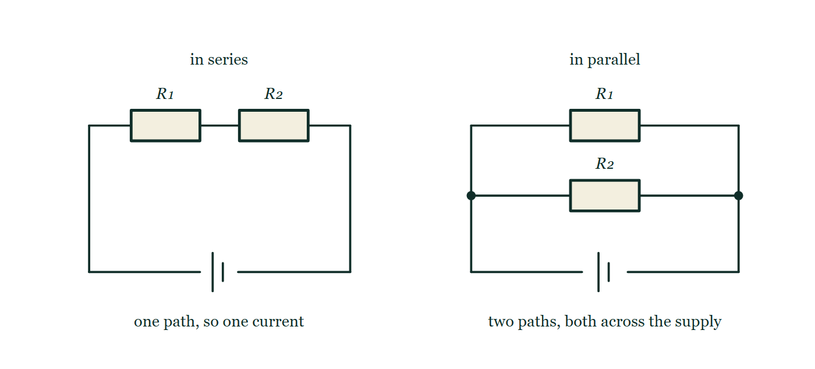
CIRCUITS · SERIES & PARALLEL CIRCUITS
GIOPHYSICS LESSON
THINK FIRST
Ten things are already plugged in around your house. You plug in an eleventh. Has the house's total resistance gone up or down?
Take answers before you click — the point is the commitment
Every socket in a house is wired across the same 230 V. Plug in one appliance too many and the breaker trips — which sounds like the wiring was asked to do more, not less.
THE ANSWER
Down. Every socket is another branch straight across the supply, so an eleventh appliance is an eleventh path, not an eleventh obstacle. The total resistance falls, the total current rises, and that rising current is what trips the breaker.
The same pair of resistors wired two ways on identical cells: on the left they sit end to end in a single loop, and on the right each of them runs from the top rail to the bottom rail with junction dots where the second branch joins.
The live version of this figure — click here
Circuits — Series & Parallel Circuits. Built by GioPhysics from the lesson's own copy; nothing on these slides is re-authored.
3 / 32
Notes:
[Phase] Starter: Recall what this lesson stands on (minutes 0–5 of 45)
[Hook] Ten things are already plugged in around your house. You plug in an eleventh. Has the house's total resistance gone up or down? Every socket in a house is wired across the same 230 V. Plug in one appliance too many and the breaker trips — which sounds like the wiring was asked to do more, not less.
[Answer] Down. Every socket is another branch straight across the supply, so an eleventh appliance is an eleventh path, not an eleventh obstacle. The total resistance falls, the total current rises, and that rising current is what trips the breaker.
[Figure] The same pair of resistors wired two ways on identical cells: on the left they sit end to end in a single loop, and on the right each of them runs from the top rail to the bottom rail with junction dots where the second branch joins.

Slide 4
CIRCUITS · SERIES & PARALLEL CIRCUITS
GIOPHYSICS LESSON
EXPLAINED SIMPLY
In one sentence
Introduce the idea — The big idea and the definition
Series components form one loop carrying the same current; parallel components sit on separate branches sharing the same potential difference.
Circuits — Series & Parallel Circuits. Built by GioPhysics from the lesson's own copy; nothing on these slides is re-authored.
4 / 32
Notes:
[Phase] Introduce the idea: The big idea and the definition (minutes 5–13 of 45)
[Definition] Series components form one loop carrying the same current; parallel components sit on separate branches sharing the same potential difference.

Slide 5
CIRCUITS · SERIES & PARALLEL CIRCUITS
GIOPHYSICS LESSON
EXPLAINED SIMPLY
What that looks like
Introduce the idea — The big idea and the definition
FOR EXAMPLE
Two 10 Ω resistors give 20 Ω in series but only 5 Ω in parallel — the parallel pair offers two paths for the current.
Circuits — Series & Parallel Circuits. Built by GioPhysics from the lesson's own copy; nothing on these slides is re-authored.
5 / 32
Notes:
[Phase] Introduce the idea: The big idea and the definition (minutes 5–13 of 45)
[Worked illustration] Two 10 Ω resistors give 20 Ω in series but only 5 Ω in parallel — the parallel pair offers two paths for the current.

Slide 6
CIRCUITS · SERIES & PARALLEL CIRCUITS
GIOPHYSICS LESSON
THE BIG IDEA
Two ways to connect, two sets of rules
Introduce the idea — The big idea and the definition
In series, resistances simply add and everything carries one current. In parallel, each branch feels the full supply voltage, branch currents add, and the combined resistance is always smaller than the smallest branch.
Circuits — Series & Parallel Circuits. Built by GioPhysics from the lesson's own copy; nothing on these slides is re-authored.
6 / 32
Notes:
[Phase] Introduce the idea: The big idea and the definition (minutes 5–13 of 45)
[Big idea] In series, resistances simply add and everything carries one current. In parallel, each branch feels the full supply voltage, branch currents add, and the combined resistance is always smaller than the smallest branch.

Slide 7
CIRCUITS · SERIES & PARALLEL CIRCUITS
GIOPHYSICS LESSON
THE PHYSICS · 1 OF 3
Series
Build the model — The formulae, one at a time, in plain English
The same charge passes every component in turn, so I is common and the supply p.d. is shared: V = V₁ + V₂. The larger resistance takes the larger share.
Circuits — Series & Parallel Circuits. Built by GioPhysics from the lesson's own copy; nothing on these slides is re-authored.
7 / 32
Notes:
[Phase] Build the model: The formulae, one at a time, in plain English (minutes 13–22 of 45)
[Section] The same charge passes every component in turn, so I is common and the supply p.d. is shared: V = V₁ + V₂. The larger resistance takes the larger share.

Slide 8
CIRCUITS · SERIES & PARALLEL CIRCUITS
GIOPHYSICS LESSON
THE PHYSICS · 2 OF 3
Parallel
Build the model — The formulae, one at a time, in plain English
Each branch connects directly across the supply, so V is common and the current splits: I = I₁ + I₂. The smaller resistance takes the larger current.
Circuits — Series & Parallel Circuits. Built by GioPhysics from the lesson's own copy; nothing on these slides is re-authored.
8 / 32
Notes:
[Phase] Build the model: The formulae, one at a time, in plain English (minutes 13–22 of 45)
[Section] Each branch connects directly across the supply, so V is common and the current splits: I = I₁ + I₂. The smaller resistance takes the larger current.

Slide 9
CIRCUITS · SERIES & PARALLEL CIRCUITS
GIOPHYSICS LESSON
THE PHYSICS · 3 OF 3
Why lights are parallel
Build the model — The formulae, one at a time, in plain English
Parallel branches operate independently at full voltage — one failed lamp leaves the others lit, unlike a series chain.
Circuits — Series & Parallel Circuits. Built by GioPhysics from the lesson's own copy; nothing on these slides is re-authored.
9 / 32
Notes:
[Phase] Build the model: The formulae, one at a time, in plain English (minutes 13–22 of 45)
[Section] Parallel branches operate independently at full voltage — one failed lamp leaves the others lit, unlike a series chain.

Slide 10
CIRCUITS · SERIES & PARALLEL CIRCUITS
GIOPHYSICS LESSON
FORMULA 1 OF 3
Series resistance
Build the model — The formulae, one at a time, in plain English
R = R₁ + R₂ + …
Same current through every component
IN PLAIN ENGLISH
One path: each resistor adds its own opposition, so resistances pile up and the shared current shrinks.
Circuits — Series & Parallel Circuits. Built by GioPhysics from the lesson's own copy; nothing on these slides is re-authored.
10 / 32
Notes:
[Phase] Build the model: The formulae, one at a time, in plain English (minutes 13–22 of 45)
[Formula] Series resistance: R = R₁ + R₂ + …
[In plain English] One path: each resistor adds its own opposition, so resistances pile up and the shared current shrinks.
[Note] Same current through every component

Slide 11
CIRCUITS · SERIES & PARALLEL CIRCUITS
GIOPHYSICS LESSON
FORMULA 2 OF 3
Parallel resistance
Build the model — The formulae, one at a time, in plain English
1/R = 1/R₁ + 1/R₂ + …
Same p.d. across every branch
IN PLAIN ENGLISH
More branches means more ways through, so the combined resistance is smaller than any single branch.
Circuits — Series & Parallel Circuits. Built by GioPhysics from the lesson's own copy; nothing on these slides is re-authored.
11 / 32
Notes:
[Phase] Build the model: The formulae, one at a time, in plain English (minutes 13–22 of 45)
[Formula] Parallel resistance: 1/R = 1/R₁ + 1/R₂ + …
[In plain English] More branches means more ways through, so the combined resistance is smaller than any single branch.
[Note] Same p.d. across every branch

Slide 12
CIRCUITS · SERIES & PARALLEL CIRCUITS
GIOPHYSICS LESSON
FORMULA 3 OF 3
Two in parallel
Build the model — The formulae, one at a time, in plain English
R = R₁R₂/(R₁ + R₂)
Product over sum — two branches only
IN PLAIN ENGLISH
The handy shortcut for exactly two branches: multiply, add, divide.
Circuits — Series & Parallel Circuits. Built by GioPhysics from the lesson's own copy; nothing on these slides is re-authored.
12 / 32
Notes:
[Phase] Build the model: The formulae, one at a time, in plain English (minutes 13–22 of 45)
[Formula] Two in parallel: R = R₁R₂/(R₁ + R₂)
[In plain English] The handy shortcut for exactly two branches: multiply, add, divide.
[Note] Product over sum — two branches only

Slide 13
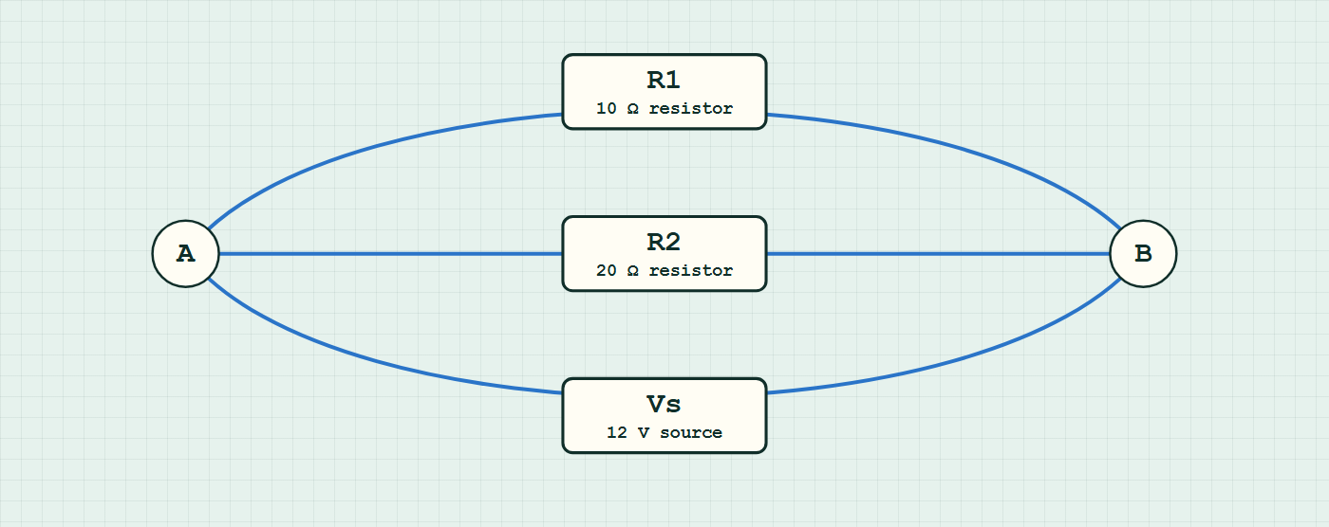
CIRCUITS · SERIES & PARALLEL CIRCUITS
GIOPHYSICS LESSON
CIRCUIT MODEL
Read the topology before the values
Build the model — nodes are where connections meet, branches are what lies between them
parallel network — components are branches between nodes.
Switch topology and hide the values on the live version — click here
Circuits — Series & Parallel Circuits. Built by GioPhysics from the lesson's own copy; nothing on these slides is re-authored.
13 / 32
Notes:
[Phase] Build the model: The formulae, one at a time, in plain English (minutes 13–22 of 45)
[Topology] Nodes are the points where connections meet; branches are the components between them. The live version switches between series, parallel and bridge and can hide the values.

Slide 14
CIRCUITS · SERIES & PARALLEL CIRCUITS
GIOPHYSICS LESSON
WATCH OUT
The common trap
Check and misconception — The quick check and the trap
Adding a resistor in parallel decreases the total resistance. It cannot 'block' anything extra — it opens another path, so more total current flows from the supply.
Circuits — Series & Parallel Circuits. Built by GioPhysics from the lesson's own copy; nothing on these slides is re-authored.
14 / 32
Notes:
[Phase] Check and misconception: The quick check and the trap (minutes 35–41 of 45)
[Misconception] Adding a resistor in parallel decreases the total resistance. It cannot 'block' anything extra — it opens another path, so more total current flows from the supply.

Slide 15
CIRCUITS · SERIES & PARALLEL CIRCUITS
GIOPHYSICS LESSON
WORKED EXAMPLE 1 OF 2 · EASY
The question
Easy
Worked examples — I do, we do — one step revealed at a time
Find the combined resistance of 6.0 Ω and 12 Ω in series, and in parallel.
Circuits — Series & Parallel Circuits. Built by GioPhysics from the lesson's own copy; nothing on these slides is re-authored.
15 / 32
Notes:
[Phase] Worked examples: I do, we do — one step revealed at a time (minutes 22–35 of 45)
[Question] Find the combined resistance of 6.0 Ω and 12 Ω in series, and in parallel.
[Answer] 18 Ω series; 4.0 Ω parallel

Slide 16
CIRCUITS · SERIES & PARALLEL CIRCUITS
GIOPHYSICS LESSON
WORKED EXAMPLE 1 OF 2 · EASY · THE WORKING
How to solve it
Easy
Worked examples — I do, we do — one step revealed at a time
Find the combined resistance of 6.0 Ω and 12 Ω in series, and in parallel.
1.
Series: 6.0 + 12 = 18 Ω.
2.
Parallel: (6 × 12)/(6 + 12) = 4.0 Ω.
Circuits — Series & Parallel Circuits. Built by GioPhysics from the lesson's own copy; nothing on these slides is re-authored.
16 / 32
Notes:
[Phase] Worked examples: I do, we do — one step revealed at a time (minutes 22–35 of 45)
[Reveal] One click per step. The class works each line before the next appears.
[Step 1] Series: 6.0 + 12 = 18 Ω.
[Step 2] Parallel: (6 × 12)/(6 + 12) = 4.0 Ω.

Slide 17
CIRCUITS · SERIES & PARALLEL CIRCUITS
GIOPHYSICS LESSON
WORKED EXAMPLE 1 OF 2 · EASY
Answer
Easy
Worked examples — I do, we do — one step revealed at a time
18 Ω series; 4.0 Ω parallel
Circuits — Series & Parallel Circuits. Built by GioPhysics from the lesson's own copy; nothing on these slides is re-authored.
17 / 32
Notes:
[Phase] Worked examples: I do, we do — one step revealed at a time (minutes 22–35 of 45)
[Answer] 18 Ω series; 4.0 Ω parallel

Slide 18
CIRCUITS · SERIES & PARALLEL CIRCUITS
GIOPHYSICS LESSON
WORKED EXAMPLE 2 OF 2 · MEDIUM
The question
Medium
Worked examples — I do, we do — one step revealed at a time
A 6.0 Ω and a 3.0 Ω resistor are connected in parallel, then in series with a 4.0 Ω resistor across 12 V. Find the supply current.
Circuits — Series & Parallel Circuits. Built by GioPhysics from the lesson's own copy; nothing on these slides is re-authored.
18 / 32
Notes:
[Phase] Worked examples: I do, we do — one step revealed at a time (minutes 22–35 of 45)
[Question] A 6.0 Ω and a 3.0 Ω resistor are connected in parallel, then in series with a 4.0 Ω resistor across 12 V. Find the supply current.
[Answer] I = 2.0 A

Slide 19
CIRCUITS · SERIES & PARALLEL CIRCUITS
GIOPHYSICS LESSON
WORKED EXAMPLE 2 OF 2 · MEDIUM · THE WORKING
How to solve it
Medium
Worked examples — I do, we do — one step revealed at a time
A 6.0 Ω and a 3.0 Ω resistor are connected in parallel, then in series with a 4.0 Ω resistor across 12 V. Find the supply current.
1.
Parallel pair: R = (6.0 × 3.0)/(6.0 + 3.0) = 2.0 Ω.
2.
Total: R = 2.0 + 4.0 = 6.0 Ω.
3.
I = V/R = 12 ÷ 6.0 = 2.0 A.
Circuits — Series & Parallel Circuits. Built by GioPhysics from the lesson's own copy; nothing on these slides is re-authored.
19 / 32
Notes:
[Phase] Worked examples: I do, we do — one step revealed at a time (minutes 22–35 of 45)
[Reveal] One click per step. The class works each line before the next appears.
[Step 1] Parallel pair: R = (6.0 × 3.0)/(6.0 + 3.0) = 2.0 Ω.
[Step 2] Total: R = 2.0 + 4.0 = 6.0 Ω.
[Step 3] I = V/R = 12 ÷ 6.0 = 2.0 A.

Slide 20
CIRCUITS · SERIES & PARALLEL CIRCUITS
GIOPHYSICS LESSON
WORKED EXAMPLE 2 OF 2 · MEDIUM
Answer
Medium
Worked examples — I do, we do — one step revealed at a time
I = 2.0 A
Circuits — Series & Parallel Circuits. Built by GioPhysics from the lesson's own copy; nothing on these slides is re-authored.
20 / 32
Notes:
[Phase] Worked examples: I do, we do — one step revealed at a time (minutes 22–35 of 45)
[Answer] I = 2.0 A

Slide 21
CIRCUITS · SERIES & PARALLEL CIRCUITS
GIOPHYSICS LESSON
SPOT THE MISTAKE
One line here is wrong
The whole working is up — find the bad line before you click
1.
Find the combined resistance of 6.0 Ω and 3.0 Ω in parallel.
2.
1/R = 1/6.0 + 1/3.0
3.
1/R = 0.167 + 0.333 = 0.500
4.
R = 0.500 Ω
5.
So the pair behaves as 0.50 Ω.
LINE 4 IS WRONG
The reciprocal has not been undone. It is the single most common slip in the topic, because 0.500 is a clean-looking number and the working stops feeling unfinished. The size test catches it instantly: a parallel combination must come out smaller than the smallest branch but larger than nothing, so the answer has to lie between 0 and 3.0 Ω — and 2.0 Ω does, while 0.50 Ω is suspiciously far below both branches.
IT SHOULD SAY
R = 1/0.500 = 2.0 Ω
Circuits — Series & Parallel Circuits. Built by GioPhysics from the lesson's own copy; nothing on these slides is re-authored.
21 / 32
Notes:
[Phase] Worked examples: I do, we do — one step revealed at a time (minutes 22–35 of 45)
[Spot the mistake] The working is complete and one line of it is wrong. Let the room hunt: one click names the line, a second shows it done correctly.
[Line 4 is wrong] The reciprocal has not been undone. It is the single most common slip in the topic, because 0.500 is a clean-looking number and the working stops feeling unfinished. The size test catches it instantly: a parallel combination must come out smaller than the smallest branch but larger than nothing, so the answer has to lie between 0 and 3.0 Ω — and 2.0 Ω does, while 0.50 Ω is suspiciously far below both branches.
[It should say] R = 1/0.500 = 2.0 Ω

Slide 22
CIRCUITS · SERIES & PARALLEL CIRCUITS
GIOPHYSICS LESSON
PREDICT · TAKE THE VOTE
Commit before you are told
Hands up for each option, then click
The same two resistors are wired both ways on identical cells. Which cell delivers the larger current?
A The series one
B The parallel one
C The same — it is the same two resistors in both circuits
The same pair of resistors wired two ways on identical cells: on the left they sit end to end in a single loop, and on the right each of them runs from the top rail to the bottom rail with junction dots where the second branch joins.
The live version of this figure — click here
Circuits — Series & Parallel Circuits. Built by GioPhysics from the lesson's own copy; nothing on these slides is re-authored.
22 / 32
Notes:
[Phase] Build the model: The formulae, one at a time, in plain English (minutes 13–22 of 45)
[Predict] The same two resistors are wired both ways on identical cells. Which cell delivers the larger current?
[Options] A The series one B The parallel one C The same — it is the same two resistors in both circuits
[Figure] The same pair of resistors wired two ways on identical cells: on the left they sit end to end in a single loop, and on the right each of them runs from the top rail to the bottom rail with junction dots where the second branch joins.

Slide 23
CIRCUITS · SERIES & PARALLEL CIRCUITS
GIOPHYSICS LESSON
PREDICT · THE OUTCOME
What actually happens
Ask the room who changed their mind, and why
B The parallel one
WHY
Look at where the resistors reach in each drawing. On the right, each of them runs from one rail to the other, so each has the whole supply p.d. across it and each carries the current it would carry if it were alone in the circuit — and the cell has to supply both of those at once. On the left there is a single path, so the two resistances add and one current threads through both. Two paths always carry more than one, which is why a parallel combination is smaller than either of its branches.
Circuits — Series & Parallel Circuits. Built by GioPhysics from the lesson's own copy; nothing on these slides is re-authored.
23 / 32
Notes:
[Phase] Build the model: The formulae, one at a time, in plain English (minutes 13–22 of 45)
[Answer] B — The parallel one. Look at where the resistors reach in each drawing. On the right, each of them runs from one rail to the other, so each has the whole supply p.d. across it and each carries the current it would carry if it were alone in the circuit — and the cell has to supply both of those at once. On the left there is a single path, so the two resistances add and one current threads through both. Two paths always carry more than one, which is why a parallel combination is smaller than either of its branches.

Slide 24
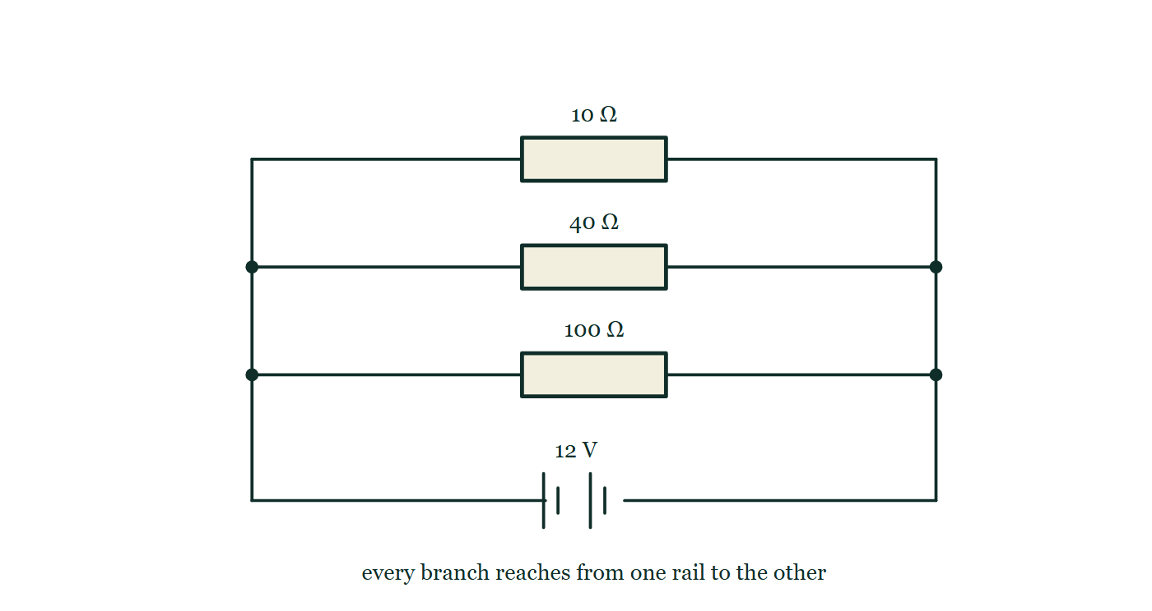
CIRCUITS · SERIES & PARALLEL CIRCUITS
GIOPHYSICS LESSON
QUICK CHECK
Decide before the answer goes up
Check and misconception — The quick check and the trap
A 12 V supply feeds 10 Ω, 40 Ω, and 100 Ω resistors in parallel. What is the total current?
A
1.62 A
B
0.08 A
C
12 A
A 12 V battery with three horizontal branches between two vertical rails, carrying 10 Ω, 40 Ω and 100 Ω, with junction dots on both rails where the second and third branches join them.
The live version of this figure — click here
Circuits — Series & Parallel Circuits. Built by GioPhysics from the lesson's own copy; nothing on these slides is re-authored.
24 / 32
Notes:
[Phase] Check and misconception: The quick check and the trap (minutes 35–41 of 45)
[Question] A 12 V supply feeds 10 Ω, 40 Ω, and 100 Ω resistors in parallel. What is the total current?
[Figure] A 12 V battery with three horizontal branches between two vertical rails, carrying 10 Ω, 40 Ω and 100 Ω, with junction dots on both rails where the second and third branches join them.
[Options] A 1.62 A B 0.08 A C 12 A

Slide 25
CIRCUITS · SERIES & PARALLEL CIRCUITS
GIOPHYSICS LESSON
QUICK CHECK · THE ANSWER
The answer, and why
Check and misconception — The quick check and the trap
A 1.62 A
HOW TO GET THERE
Branch currents: 1.2 A + 0.3 A + 0.12 A = 1.62 A — each branch feels the full 12 V.
WHY THE OTHERS TEMPT
A Correct. Each branch has the whole 12 V across it: 1.2 A + 0.3 A + 0.12 A = 1.62 A.
B 0.08 A is 12 ÷ 150 — the three resistances added as though they sat one after another in a single loop. In parallel they are not in each other's way at all; what adds is the three branch currents, at the junction.
C 12 A is the supply's 12 carried straight across from volts to amps. Something has to divide it, and it is each branch's own resistance that does: even the easiest branch, 10 Ω, only carries 1.2 A.
Circuits — Series & Parallel Circuits. Built by GioPhysics from the lesson's own copy; nothing on these slides is re-authored.
25 / 32
Notes:
[Phase] Check and misconception: The quick check and the trap (minutes 35–41 of 45)
[Question] A 12 V supply feeds 10 Ω, 40 Ω, and 100 Ω resistors in parallel. What is the total current?
[Option by option] A: Correct. Each branch has the whole 12 V across it: 1.2 A + 0.3 A + 0.12 A = 1.62 A. B: 0.08 A is 12 ÷ 150 — the three resistances added as though they sat one after another in a single loop. In parallel they are not in each other's way at all; what adds is the three branch currents, at the junction. C: 12 A is the supply's 12 carried straight across from volts to amps. Something has to divide it, and it is each branch's own resistance that does: even the easiest branch, 10 Ω, only carries 1.2 A.
[Answer] A — 1.62 A
[Why] Branch currents: 1.2 A + 0.3 A + 0.12 A = 1.62 A — each branch feels the full 12 V.
[Reveal] One click for the answer, then one for the reason.

Slide 26
CIRCUITS · SERIES & PARALLEL CIRCUITS
GIOPHYSICS LESSON
EXTENSION 1 OF 2 · HARD
The question
Hard
Worked examples — I do, we do — one step revealed at a time
A 12 V supply feeds a 4.0 Ω resistor in series with a parallel pair of 6.0 Ω and 12 Ω. Find the current in each resistor.
Circuits — Series & Parallel Circuits. Built by GioPhysics from the lesson's own copy; nothing on these slides is re-authored.
26 / 32
Notes:
[Phase] Worked examples: I do, we do — one step revealed at a time (minutes 22–35 of 45)
[Question] A 12 V supply feeds a 4.0 Ω resistor in series with a parallel pair of 6.0 Ω and 12 Ω. Find the current in each resistor.
[Answer] 1.5 A in the 4 Ω; 1.0 A and 0.5 A in the pair

Slide 27
CIRCUITS · SERIES & PARALLEL CIRCUITS
GIOPHYSICS LESSON
EXTENSION 1 OF 2 · HARD · THE WORKING
How to solve it
Hard
Worked examples — I do, we do — one step revealed at a time
A 12 V supply feeds a 4.0 Ω resistor in series with a parallel pair of 6.0 Ω and 12 Ω. Find the current in each resistor.
1.
Pair: 4.0 Ω; total 8.0 Ω; supply current I = 12 ÷ 8.0 = 1.5 A (this flows in the 4.0 Ω).
2.
P.d. across the pair: 1.5 × 4.0 = 6.0 V.
3.
I(6Ω) = 1.0 A; I(12Ω) = 0.5 A — splitting inversely with resistance.
Circuits — Series & Parallel Circuits. Built by GioPhysics from the lesson's own copy; nothing on these slides is re-authored.
27 / 32
Notes:
[Phase] Worked examples: I do, we do — one step revealed at a time (minutes 22–35 of 45)
[Reveal] One click per step. The class works each line before the next appears.
[Step 1] Pair: 4.0 Ω; total 8.0 Ω; supply current I = 12 ÷ 8.0 = 1.5 A (this flows in the 4.0 Ω).
[Step 2] P.d. across the pair: 1.5 × 4.0 = 6.0 V.
[Step 3] I(6Ω) = 1.0 A; I(12Ω) = 0.5 A — splitting inversely with resistance.

Slide 28
CIRCUITS · SERIES & PARALLEL CIRCUITS
GIOPHYSICS LESSON
EXTENSION 1 OF 2 · HARD
Answer
Hard
Worked examples — I do, we do — one step revealed at a time
1.5 A in the 4 Ω; 1.0 A and 0.5 A in the pair
Circuits — Series & Parallel Circuits. Built by GioPhysics from the lesson's own copy; nothing on these slides is re-authored.
28 / 32
Notes:
[Phase] Worked examples: I do, we do — one step revealed at a time (minutes 22–35 of 45)
[Answer] 1.5 A in the 4 Ω; 1.0 A and 0.5 A in the pair

Slide 29
CIRCUITS · SERIES & PARALLEL CIRCUITS
GIOPHYSICS LESSON
EXTENSION 2 OF 2 · CHALLENGING
The question
Challenging
Worked examples — I do, we do — one step revealed at a time
You have three 6.0 Ω resistors. List every distinct total resistance you can build using ALL three, with the configurations.
Circuits — Series & Parallel Circuits. Built by GioPhysics from the lesson's own copy; nothing on these slides is re-authored.
29 / 32
Notes:
[Phase] Worked examples: I do, we do — one step revealed at a time (minutes 22–35 of 45)
[Question] You have three 6.0 Ω resistors. List every distinct total resistance you can build using ALL three, with the configurations.
[Answer] 2.0, 4.0, 9.0, and 18 Ω

Slide 30
CIRCUITS · SERIES & PARALLEL CIRCUITS
GIOPHYSICS LESSON
EXTENSION 2 OF 2 · CHALLENGING · THE WORKING
How to solve it
Challenging
Worked examples — I do, we do — one step revealed at a time
You have three 6.0 Ω resistors. List every distinct total resistance you can build using ALL three, with the configurations.
1.
All series: 18 Ω. All parallel: 2.0 Ω.
2.
One in series with a parallel pair: 6 + 3 = 9.0 Ω.
3.
One in parallel with a series pair: (6 × 12)/18 = 4.0 Ω. Four distinct values.
Circuits — Series & Parallel Circuits. Built by GioPhysics from the lesson's own copy; nothing on these slides is re-authored.
30 / 32
Notes:
[Phase] Worked examples: I do, we do — one step revealed at a time (minutes 22–35 of 45)
[Reveal] One click per step. The class works each line before the next appears.
[Step 1] All series: 18 Ω. All parallel: 2.0 Ω.
[Step 2] One in series with a parallel pair: 6 + 3 = 9.0 Ω.
[Step 3] One in parallel with a series pair: (6 × 12)/18 = 4.0 Ω. Four distinct values.

Slide 31
CIRCUITS · SERIES & PARALLEL CIRCUITS
GIOPHYSICS LESSON
EXTENSION 2 OF 2 · CHALLENGING
Answer
Challenging
Worked examples — I do, we do — one step revealed at a time
2.0, 4.0, 9.0, and 18 Ω
Circuits — Series & Parallel Circuits. Built by GioPhysics from the lesson's own copy; nothing on these slides is re-authored.
31 / 32
Notes:
[Phase] Worked examples: I do, we do — one step revealed at a time (minutes 22–35 of 45)
[Answer] 2.0, 4.0, 9.0, and 18 Ω

Slide 32
CIRCUITS · SERIES & PARALLEL CIRCUITS
GIOPHYSICS LESSON
CIRCUITS
Where to go next
Plenary — What to take away, what to practise next
Next
13.7 Electric Power
https://giophysics.com/chapter-22/electric-power/
Lesson
This lesson on giophysics.com
https://giophysics.com/chapter-22/series-parallel-circuits/
Live
The live, interactive version of these slides
https://giophysics.com/chapter-22/presentation/?lesson=seriesParallel
Chapter
All Circuits lessons
https://giophysics.com/chapter-22/
PDF
Download the lesson PDF
https://giophysics.com/downloads/22-6-series-parallel-circuits.pdf
Circuits — Series & Parallel Circuits. Built by GioPhysics from the lesson's own copy; nothing on these slides is re-authored.
32 / 32
Notes:
[Phase] Plenary: What to take away, what to practise next (minutes 41–45 of 45)
[Interactive] The graphs and the circuit topology on these slides are frozen. The live version at https://giophysics.com/chapter-22/presentation/?lesson=seriesParallel moves them.

