Slide 1
CIRCUITS · CIRCUIT SYMBOLS & DIAGRAMS
GIOPHYSICS LESSON
13 · Circuits
A shared language for circuits
Circuit Symbols & Diagrams
Engineers and scientists record circuits with standard symbols so any complex arrangement can be drawn — and read — clearly and precisely by anyone.
POSITION
Lesson 1 of 8 in Circuits
PLAN
16 slides in the 45-minute core run, about 45 minutes of it
LESSON PAGE
https://giophysics.com/chapter-22/circuit-symbols-diagrams/
Built by GioPhysics from the lesson's own page. Every word on these slides is the lesson's; nothing here is re-authored. Teaching material, not an awarding body's document.
Circuits — Circuit Symbols & Diagrams. Built by GioPhysics from the lesson's own copy; nothing on these slides is re-authored.
1 / 35
Notes:
[Lesson] Circuits — Circuit Symbols & Diagrams. Lesson 1 of 8.
[Intro] Engineers and scientists record circuits with standard symbols so any complex arrangement can be drawn — and read — clearly and precisely by anyone.
[Source] https://giophysics.com/chapter-22/circuit-symbols-diagrams/
[Disclaimer] Built by GioPhysics from the lesson's own page. Every word on these slides is the lesson's; nothing here is re-authored. Teaching material, not an awarding body's document.

Slide 2
CIRCUITS · CIRCUIT SYMBOLS & DIAGRAMS
GIOPHYSICS LESSON
WHAT THIS NEEDS
What you already know
Starter — Recall what this lesson stands on
Recall
SI units & prefixes
https://giophysics.com/chapter-1/units/
Circuits — Circuit Symbols & Diagrams. Built by GioPhysics from the lesson's own copy; nothing on these slides is re-authored.
2 / 35
Notes:
[Phase] Starter: Recall what this lesson stands on (minutes 0–5 of 45)
[Starter] Recall: SI units & prefixes

Slide 3
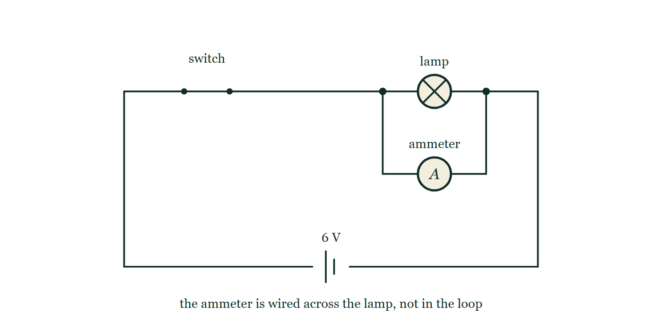
CIRCUITS · CIRCUIT SYMBOLS & DIAGRAMS
GIOPHYSICS LESSON
THINK FIRST
Two students wire the same circuit — one with 10 cm leads, one with two metres of the same wire. Whose lamp is brighter?
Take answers before you click — the point is the commitment
Same cell, same lamp, same connections. The second student's leads loop twice round the bench before they reach anything.
THE ANSWER
Both the same, to anything an eye can see. Connecting wire is thick copper and its resistance is a tiny fraction of the lamp's, so a circuit diagram is a map of what is joined to what — the length of the lines on it carries no meaning at all.
A 6 V cell, a closed switch and a lamp form a single loop, but the ammeter has been wired from a junction on one side of the lamp to a junction on the other, so it bridges the lamp instead of sitting in the loop with it.
The live version of this figure — click here
Circuits — Circuit Symbols & Diagrams. Built by GioPhysics from the lesson's own copy; nothing on these slides is re-authored.
3 / 35
Notes:
[Phase] Starter: Recall what this lesson stands on (minutes 0–5 of 45)
[Hook] Two students wire the same circuit — one with 10 cm leads, one with two metres of the same wire. Whose lamp is brighter? Same cell, same lamp, same connections. The second student's leads loop twice round the bench before they reach anything.
[Answer] Both the same, to anything an eye can see. Connecting wire is thick copper and its resistance is a tiny fraction of the lamp's, so a circuit diagram is a map of what is joined to what — the length of the lines on it carries no meaning at all.
[Figure] A 6 V cell, a closed switch and a lamp form a single loop, but the ammeter has been wired from a junction on one side of the lamp to a junction on the other, so it bridges the lamp instead of sitting in the loop with it.

Slide 4
CIRCUITS · CIRCUIT SYMBOLS & DIAGRAMS
GIOPHYSICS LESSON
EXPLAINED SIMPLY
In one sentence
Introduce the idea — The big idea and the definition
A circuit diagram uses standard symbols and straight lines to show how components are connected into loops.
Circuits — Circuit Symbols & Diagrams. Built by GioPhysics from the lesson's own copy; nothing on these slides is re-authored.
4 / 35
Notes:
[Phase] Introduce the idea: The big idea and the definition (minutes 5–13 of 45)
[Definition] A circuit diagram uses standard symbols and straight lines to show how components are connected into loops.

Slide 5
CIRCUITS · CIRCUIT SYMBOLS & DIAGRAMS
GIOPHYSICS LESSON
EXPLAINED SIMPLY
What that looks like
Introduce the idea — The big idea and the definition
FOR EXAMPLE
A cell, a switch, and a lamp drawn in one rectangle of lines means: close the switch and charge can flow around one complete loop, lighting the lamp.
Circuits — Circuit Symbols & Diagrams. Built by GioPhysics from the lesson's own copy; nothing on these slides is re-authored.
5 / 35
Notes:
[Phase] Introduce the idea: The big idea and the definition (minutes 5–13 of 45)
[Worked illustration] A cell, a switch, and a lamp drawn in one rectangle of lines means: close the switch and charge can flow around one complete loop, lighting the lamp.

Slide 6
CIRCUITS · CIRCUIT SYMBOLS & DIAGRAMS
GIOPHYSICS LESSON
THE BIG IDEA
A shared language for circuits
Introduce the idea — The big idea and the definition
A circuit diagram is a map, not a picture. Each standard symbol stands for a component; straight lines stand for connecting wire assumed to have no resistance. A circuit only works when the loop from one terminal of the supply to the other is complete.
Circuits — Circuit Symbols & Diagrams. Built by GioPhysics from the lesson's own copy; nothing on these slides is re-authored.
6 / 35
Notes:
[Phase] Introduce the idea: The big idea and the definition (minutes 5–13 of 45)
[Big idea] A circuit diagram is a map, not a picture. Each standard symbol stands for a component; straight lines stand for connecting wire assumed to have no resistance. A circuit only works when the loop from one terminal of the supply to the other is complete.

Slide 7
CIRCUITS · CIRCUIT SYMBOLS & DIAGRAMS
GIOPHYSICS LESSON
THE PHYSICS · 1 OF 4
Sources
Build the model — The formulae, one at a time, in plain English
A cell is one unit; a battery is two or more cells. The longer line marks the positive terminal. A power supply symbol stands for mains-driven sources.
Circuits — Circuit Symbols & Diagrams. Built by GioPhysics from the lesson's own copy; nothing on these slides is re-authored.
7 / 35
Notes:
[Phase] Build the model: The formulae, one at a time, in plain English (minutes 13–22 of 45)
[Section] A cell is one unit; a battery is two or more cells. The longer line marks the positive terminal. A power supply symbol stands for mains-driven sources.

Slide 8
CIRCUITS · CIRCUIT SYMBOLS & DIAGRAMS
GIOPHYSICS LESSON
THE PHYSICS · 2 OF 4
Control and protection
Build the model — The formulae, one at a time, in plain English
Switches break the loop; fuses melt to break it automatically when current is too large; variable resistors adjust current smoothly.
Circuits — Circuit Symbols & Diagrams. Built by GioPhysics from the lesson's own copy; nothing on these slides is re-authored.
8 / 35
Notes:
[Phase] Build the model: The formulae, one at a time, in plain English (minutes 13–22 of 45)
[Section] Switches break the loop; fuses melt to break it automatically when current is too large; variable resistors adjust current smoothly.

Slide 9
CIRCUITS · CIRCUIT SYMBOLS & DIAGRAMS
GIOPHYSICS LESSON
THE PHYSICS · 3 OF 4
Measurement and output
Build the model — The formulae, one at a time, in plain English
Ammeters read current in series, voltmeters read potential difference in parallel, and lamps, motors, buzzers, and resistors transfer energy out of the circuit.
Circuits — Circuit Symbols & Diagrams. Built by GioPhysics from the lesson's own copy; nothing on these slides is re-authored.
9 / 35
Notes:
[Phase] Build the model: The formulae, one at a time, in plain English (minutes 13–22 of 45)
[Section] Ammeters read current in series, voltmeters read potential difference in parallel, and lamps, motors, buzzers, and resistors transfer energy out of the circuit.

Slide 10
CIRCUITS · CIRCUIT SYMBOLS & DIAGRAMS
GIOPHYSICS LESSON
THE PHYSICS · 4 OF 4
Sensing and one-way components
Build the model — The formulae, one at a time, in plain English
A thermistor is a resistor rectangle with a diagonal bar across it. The kind used at this level is NTC: its resistance falls sharply as it gets hotter. A light-dependent resistor is the same rectangle with two arrows pointing in at it, and its resistance falls as the light on it grows brighter.
Both are input components — they turn a temperature or a light level into a resistance the rest of the loop can respond to. A diode is a triangle pointing into a bar: it passes conventional current only in the direction the triangle points, and blocks it the other way, which is what makes it useful for turning alternating current into direct. A light-emitting diode is the same symbol with two arrows pointing away from it.
Circuits — Circuit Symbols & Diagrams. Built by GioPhysics from the lesson's own copy; nothing on these slides is re-authored.
10 / 35
Notes:
[Phase] Build the model: The formulae, one at a time, in plain English (minutes 13–22 of 45)
[Section] A thermistor is a resistor rectangle with a diagonal bar across it. The kind used at this level is NTC: its resistance falls sharply as it gets hotter. A light-dependent resistor is the same rectangle with two arrows pointing in at it, and its resistance falls as the light on it grows brighter. Both are input components — they turn a temperature or a light level into a resistance the rest of the loop can respond to. A diode is a triangle pointing into a bar: it passes conventional current only in the direction the triangle points, and blocks it the other way, which is what makes it useful for turning alternating current into direct. A light-emitting diode is the same symbol with two arrows pointing away from it.

Slide 11
CIRCUITS · CIRCUIT SYMBOLS & DIAGRAMS
GIOPHYSICS LESSON
FORMULA 1 OF 3
Complete loop
Build the model — The formulae, one at a time, in plain English
supply → components → supply
Current needs an unbroken conducting path
IN PLAIN ENGLISH
Charge can only flow when there is an unbroken path from one terminal of the supply, through the components, and back to the other terminal.
Circuits — Circuit Symbols & Diagrams. Built by GioPhysics from the lesson's own copy; nothing on these slides is re-authored.
11 / 35
Notes:
[Phase] Build the model: The formulae, one at a time, in plain English (minutes 13–22 of 45)
[Formula] Complete loop: supply → components → supply
[In plain English] Charge can only flow when there is an unbroken path from one terminal of the supply, through the components, and back to the other terminal.
[Note] Current needs an unbroken conducting path

Slide 12
CIRCUITS · CIRCUIT SYMBOLS & DIAGRAMS
GIOPHYSICS LESSON
FORMULA 2 OF 3
Ammeter placement
Build the model — The formulae, one at a time, in plain English
in series
An ideal ammeter has zero resistance
IN PLAIN ENGLISH
An ammeter counts the charge flowing through a point, so it sits in the path of the current — in series with the component.
Circuits — Circuit Symbols & Diagrams. Built by GioPhysics from the lesson's own copy; nothing on these slides is re-authored.
12 / 35
Notes:
[Phase] Build the model: The formulae, one at a time, in plain English (minutes 13–22 of 45)
[Formula] Ammeter placement: in series
[In plain English] An ammeter counts the charge flowing through a point, so it sits in the path of the current — in series with the component.
[Note] An ideal ammeter has zero resistance

Slide 13
CIRCUITS · CIRCUIT SYMBOLS & DIAGRAMS
GIOPHYSICS LESSON
FORMULA 3 OF 3
Voltmeter placement
Build the model — The formulae, one at a time, in plain English
in parallel
An ideal voltmeter has infinite resistance
IN PLAIN ENGLISH
A voltmeter compares the energy per charge between two points, so it connects across a component — in parallel with it.
Circuits — Circuit Symbols & Diagrams. Built by GioPhysics from the lesson's own copy; nothing on these slides is re-authored.
13 / 35
Notes:
[Phase] Build the model: The formulae, one at a time, in plain English (minutes 13–22 of 45)
[Formula] Voltmeter placement: in parallel
[In plain English] A voltmeter compares the energy per charge between two points, so it connects across a component — in parallel with it.
[Note] An ideal voltmeter has infinite resistance

Slide 14
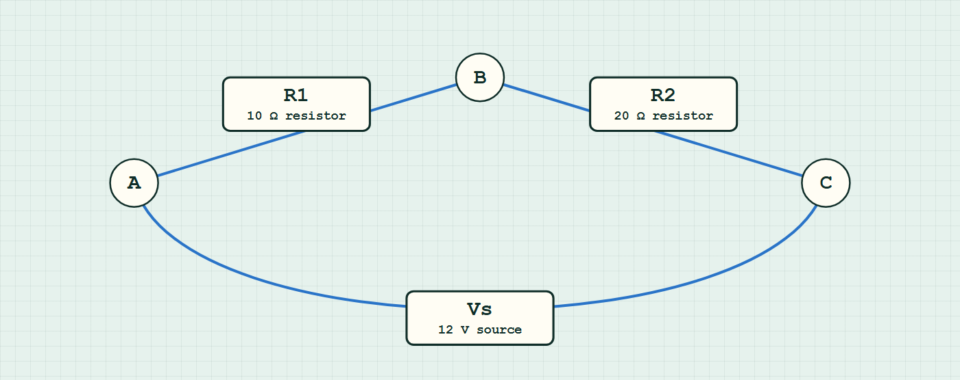
CIRCUITS · CIRCUIT SYMBOLS & DIAGRAMS
GIOPHYSICS LESSON
CIRCUIT MODEL
Read the topology before the values
Build the model — nodes are where connections meet, branches are what lies between them
series network — components are branches between nodes.
Switch topology and hide the values on the live version — click here
Circuits — Circuit Symbols & Diagrams. Built by GioPhysics from the lesson's own copy; nothing on these slides is re-authored.
14 / 35
Notes:
[Phase] Build the model: The formulae, one at a time, in plain English (minutes 13–22 of 45)
[Topology] Nodes are the points where connections meet; branches are the components between them. The live version switches between series, parallel and bridge and can hide the values.

Slide 15
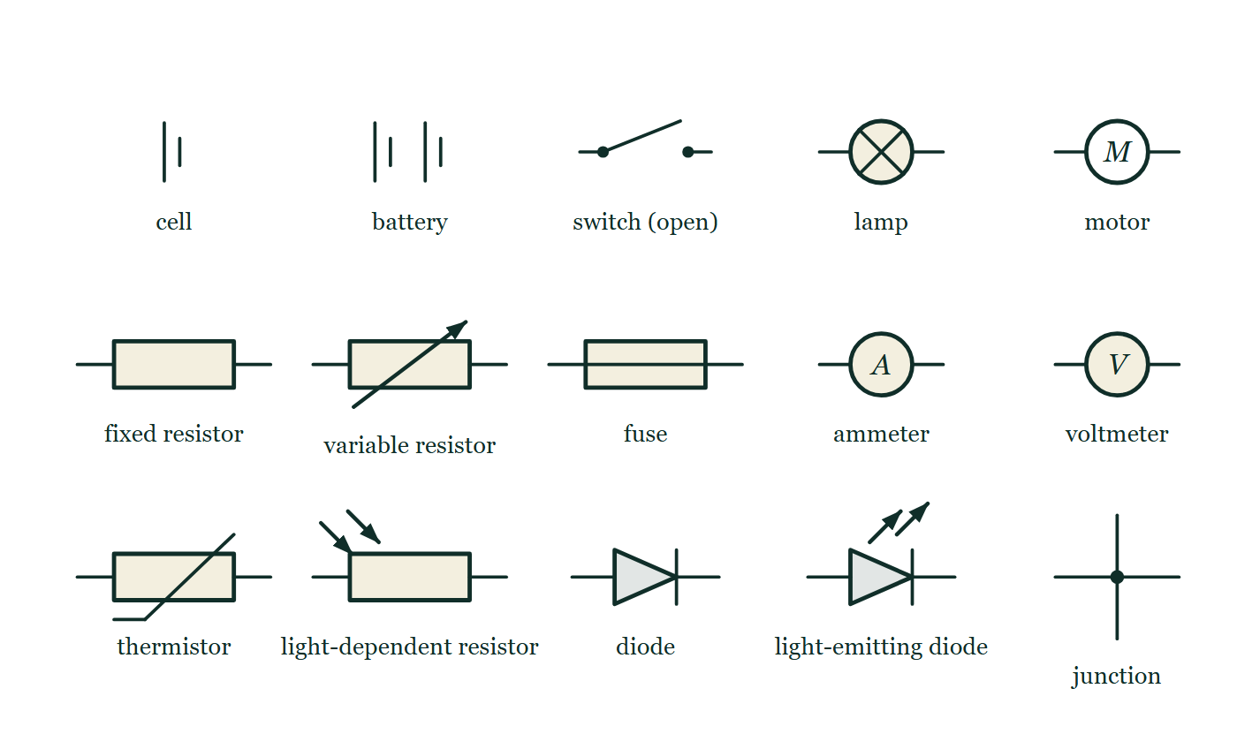
CIRCUITS · CIRCUIT SYMBOLS & DIAGRAMS
GIOPHYSICS LESSON
THE PICTURE
The alphabet of a circuit
Drawn for this lesson
Fifteen standard symbols set out in three rows with their names beneath: cell, battery, open switch, lamp and motor along the top, then resistor, variable resistor, fuse, ammeter and voltmeter, and finally thermistor, light-dependent resistor, diode, light-emitting diode and a junction dot.
The live version of this figure — click here
Circuits — Circuit Symbols & Diagrams. Built by GioPhysics from the lesson's own copy; nothing on these slides is re-authored.
15 / 35
Notes:
[Phase] Build the model: The formulae, one at a time, in plain English (minutes 13–22 of 45)
[Figure] Fifteen standard symbols set out in three rows with their names beneath: cell, battery, open switch, lamp and motor along the top, then resistor, variable resistor, fuse, ammeter and voltmeter, and finally thermistor, light-dependent resistor, diode, light-emitting diode and a junction dot.

Slide 16
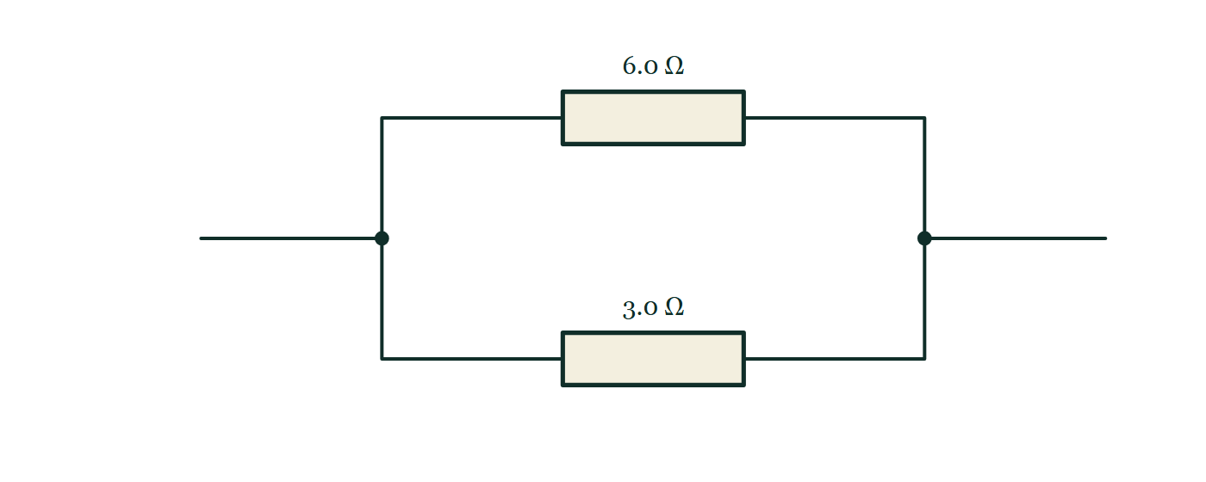
CIRCUITS · CIRCUIT SYMBOLS & DIAGRAMS
GIOPHYSICS LESSON
FIGURE 1 OF 2
Fig. 3.1 — IGCSE Topic 4 · Electricity and magnetism
Drawn for question 3 of that paper · syllabus 4.3
A circuit diagram of two resistors connected side by side between the same pair of points. A wire arrives from the left and reaches a junction, marked with a dot, where it divides into two branches. The upper branch contains a resistor labelled 6.0 ohm and the lower branch a resistor labelled 3.0 ohm. The two branches rejoin at a second junction dot on the right, from which a single wire continues away to the right.
See the question this was drawn for — click here
Circuits — Circuit Symbols & Diagrams. Built by GioPhysics from the lesson's own copy; nothing on these slides is re-authored.
16 / 35
Notes:
[Phase] Build the model: The formulae, one at a time, in plain English (minutes 13–22 of 45)
[Figure] Fig. 3.1. A circuit diagram of two resistors connected side by side between the same pair of points. A wire arrives from the left and reaches a junction, marked with a dot, where it divides into two branches. The upper branch contains a resistor labelled 6.0 ohm and the lower branch a resistor labelled 3.0 ohm. The two branches rejoin at a second junction dot on the right, from which a single wire continues away to the right.
[Where it came from] IGCSE Topic 4 · Electricity and magnetism, question 3; syllabus 4.3.

Slide 17
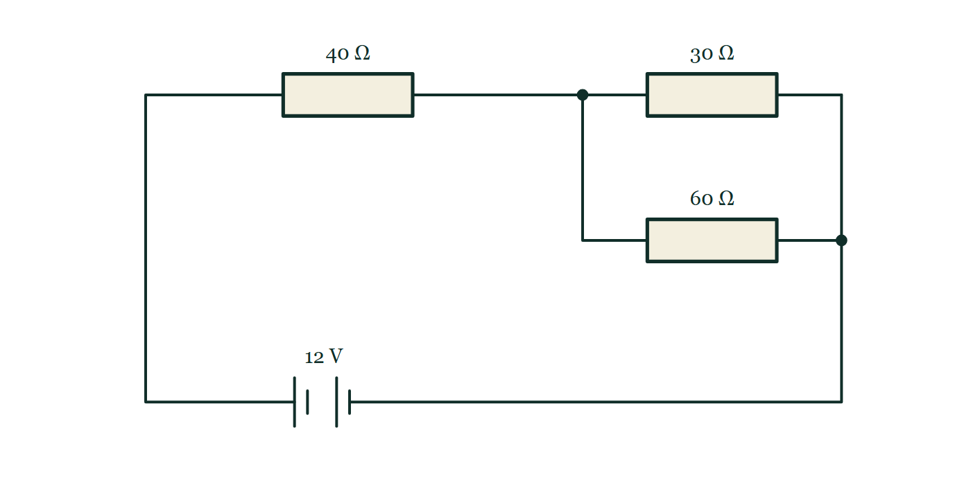
CIRCUITS · CIRCUIT SYMBOLS & DIAGRAMS
GIOPHYSICS LESSON
FIGURE 2 OF 2
Fig. 7.1 — IGCSE Topic 4 · Electricity and magnetism
Drawn for question 7 of that paper · syllabus 4.2, 4.3
Circuit diagram. From the positive terminal of the 12 V battery, drawn at the foot of the circuit with its long plate on the left, the wire runs round to a resistor labelled 40 ohm. Beyond that resistor the circuit reaches a junction and divides into two parallel branches, the upper one containing a resistor labelled 30 ohm and the lower one a resistor labelled 60 ohm. The branches rejoin at a second junction, and a single wire returns from there to the negative terminal of the battery.
See the question this was drawn for — click here
Circuits — Circuit Symbols & Diagrams. Built by GioPhysics from the lesson's own copy; nothing on these slides is re-authored.
17 / 35
Notes:
[Phase] Build the model: The formulae, one at a time, in plain English (minutes 13–22 of 45)
[Figure] Fig. 7.1. Circuit diagram. From the positive terminal of the 12 V battery, drawn at the foot of the circuit with its long plate on the left, the wire runs round to a resistor labelled 40 ohm. Beyond that resistor the circuit reaches a junction and divides into two parallel branches, the upper one containing a resistor labelled 30 ohm and the lower one a resistor labelled 60 ohm. The branches rejoin at a second junction, and a single wire returns from there to the negative terminal of the battery.
[Where it came from] IGCSE Topic 4 · Electricity and magnetism, question 7; syllabus 4.2, 4.3.

Slide 18
CIRCUITS · CIRCUIT SYMBOLS & DIAGRAMS
GIOPHYSICS LESSON
WATCH OUT
The common trap
Check and misconception — The quick check and the trap
The lines in a diagram are not drawn to scale and their length does not matter. Connecting wire is treated as resistance-free, so only the components and how the loops connect them change the physics.
Circuits — Circuit Symbols & Diagrams. Built by GioPhysics from the lesson's own copy; nothing on these slides is re-authored.
18 / 35
Notes:
[Phase] Check and misconception: The quick check and the trap (minutes 35–41 of 45)
[Misconception] The lines in a diagram are not drawn to scale and their length does not matter. Connecting wire is treated as resistance-free, so only the components and how the loops connect them change the physics.

Slide 19
CIRCUITS · CIRCUIT SYMBOLS & DIAGRAMS
GIOPHYSICS LESSON
WORKED EXAMPLE 1 OF 2 · EASY
The question
Easy
Worked examples — I do, we do — one step revealed at a time
Name the two meters in a test circuit and how each must be connected to a lamp.
Circuits — Circuit Symbols & Diagrams. Built by GioPhysics from the lesson's own copy; nothing on these slides is re-authored.
19 / 35
Notes:
[Phase] Worked examples: I do, we do — one step revealed at a time (minutes 22–35 of 45)
[Question] Name the two meters in a test circuit and how each must be connected to a lamp.
[Answer] Ammeter in series, voltmeter in parallel

Slide 20
CIRCUITS · CIRCUIT SYMBOLS & DIAGRAMS
GIOPHYSICS LESSON
WORKED EXAMPLE 1 OF 2 · EASY · THE WORKING
How to solve it
Easy
Worked examples — I do, we do — one step revealed at a time
Name the two meters in a test circuit and how each must be connected to a lamp.
1.
The ammeter reads current: in series, in the lamp's loop.
2.
The voltmeter reads p.d.: in parallel, across the lamp.
Circuits — Circuit Symbols & Diagrams. Built by GioPhysics from the lesson's own copy; nothing on these slides is re-authored.
20 / 35
Notes:
[Phase] Worked examples: I do, we do — one step revealed at a time (minutes 22–35 of 45)
[Reveal] One click per step. The class works each line before the next appears.
[Step 1] The ammeter reads current: in series, in the lamp's loop.
[Step 2] The voltmeter reads p.d.: in parallel, across the lamp.

Slide 21
CIRCUITS · CIRCUIT SYMBOLS & DIAGRAMS
GIOPHYSICS LESSON
WORKED EXAMPLE 1 OF 2 · EASY
Answer
Easy
Worked examples — I do, we do — one step revealed at a time
Ammeter in series, voltmeter in parallel
Circuits — Circuit Symbols & Diagrams. Built by GioPhysics from the lesson's own copy; nothing on these slides is re-authored.
21 / 35
Notes:
[Phase] Worked examples: I do, we do — one step revealed at a time (minutes 22–35 of 45)
[Answer] Ammeter in series, voltmeter in parallel

Slide 22
CIRCUITS · CIRCUIT SYMBOLS & DIAGRAMS
GIOPHYSICS LESSON
WORKED EXAMPLE 2 OF 2 · MEDIUM
The question
Medium
Worked examples — I do, we do — one step revealed at a time
Draw a circuit to measure the resistance of a lamp using a cell, a switch, an ammeter, and a voltmeter.
Circuits — Circuit Symbols & Diagrams. Built by GioPhysics from the lesson's own copy; nothing on these slides is re-authored.
22 / 35
Notes:
[Phase] Worked examples: I do, we do — one step revealed at a time (minutes 22–35 of 45)
[Question] Draw a circuit to measure the resistance of a lamp using a cell, a switch, an ammeter, and a voltmeter.
[Answer] Series loop of cell, switch, ammeter, and lamp, with the voltmeter across the lamp

Slide 23
CIRCUITS · CIRCUIT SYMBOLS & DIAGRAMS
GIOPHYSICS LESSON
WORKED EXAMPLE 2 OF 2 · MEDIUM · THE WORKING
How to solve it
Medium
Worked examples — I do, we do — one step revealed at a time
Draw a circuit to measure the resistance of a lamp using a cell, a switch, an ammeter, and a voltmeter.
1.
Draw one loop: cell → switch → ammeter → lamp → back to the cell.
2.
Connect the voltmeter in parallel across the lamp only.
3.
Close the switch, read I and V, then use R = V/I.
Circuits — Circuit Symbols & Diagrams. Built by GioPhysics from the lesson's own copy; nothing on these slides is re-authored.
23 / 35
Notes:
[Phase] Worked examples: I do, we do — one step revealed at a time (minutes 22–35 of 45)
[Reveal] One click per step. The class works each line before the next appears.
[Step 1] Draw one loop: cell → switch → ammeter → lamp → back to the cell.
[Step 2] Connect the voltmeter in parallel across the lamp only.
[Step 3] Close the switch, read I and V, then use R = V/I.

Slide 24
CIRCUITS · CIRCUIT SYMBOLS & DIAGRAMS
GIOPHYSICS LESSON
WORKED EXAMPLE 2 OF 2 · MEDIUM
Answer
Medium
Worked examples — I do, we do — one step revealed at a time
Series loop of cell, switch, ammeter, and lamp, with the voltmeter across the lamp
Circuits — Circuit Symbols & Diagrams. Built by GioPhysics from the lesson's own copy; nothing on these slides is re-authored.
24 / 35
Notes:
[Phase] Worked examples: I do, we do — one step revealed at a time (minutes 22–35 of 45)
[Answer] Series loop of cell, switch, ammeter, and lamp, with the voltmeter across the lamp

Slide 25
CIRCUITS · CIRCUIT SYMBOLS & DIAGRAMS
GIOPHYSICS LESSON
PREDICT · TAKE THE VOTE
Commit before you are told
Hands up for each option, then click
The ammeter has been wired across the lamp. What happens when the switch is closed?
A The lamp lights normally and the ammeter reads the current through it
B The lamp goes dark and a dangerously large current flows through the ammeter
C Nothing happens — the ammeter blocks the loop
A 6 V cell, a closed switch and a lamp form a single loop, but the ammeter has been wired from a junction on one side of the lamp to a junction on the other, so it bridges the lamp instead of sitting in the loop with it.
The live version of this figure — click here
Circuits — Circuit Symbols & Diagrams. Built by GioPhysics from the lesson's own copy; nothing on these slides is re-authored.
25 / 35
Notes:
[Phase] Build the model: The formulae, one at a time, in plain English (minutes 13–22 of 45)
[Predict] The ammeter has been wired across the lamp. What happens when the switch is closed?
[Options] A The lamp lights normally and the ammeter reads the current through it B The lamp goes dark and a dangerously large current flows through the ammeter C Nothing happens — the ammeter blocks the loop
[Figure] A 6 V cell, a closed switch and a lamp form a single loop, but the ammeter has been wired from a junction on one side of the lamp to a junction on the other, so it bridges the lamp instead of sitting in the loop with it.

Slide 26
CIRCUITS · CIRCUIT SYMBOLS & DIAGRAMS
GIOPHYSICS LESSON
PREDICT · THE OUTCOME
What actually happens
Ask the room who changed their mind, and why
B The lamp goes dark and a dangerously large current flows through the ammeter
WHY
An ammeter is deliberately built with almost no resistance, so that dropping it into a loop barely disturbs what it came to measure. Wired across the lamp, as in the drawing, that near-zero resistance is a second path in parallel with the lamp: almost every coulomb takes the meter instead, the p.d. across the lamp collapses and it goes out, while the current the cell drives is limited by little more than its own internal resistance.
Circuits — Circuit Symbols & Diagrams. Built by GioPhysics from the lesson's own copy; nothing on these slides is re-authored.
26 / 35
Notes:
[Phase] Build the model: The formulae, one at a time, in plain English (minutes 13–22 of 45)
[Answer] B — The lamp goes dark and a dangerously large current flows through the ammeter. An ammeter is deliberately built with almost no resistance, so that dropping it into a loop barely disturbs what it came to measure. Wired across the lamp, as in the drawing, that near-zero resistance is a second path in parallel with the lamp: almost every coulomb takes the meter instead, the p.d. across the lamp collapses and it goes out, while the current the cell drives is limited by little more than its own internal resistance.

Slide 27
CIRCUITS · CIRCUIT SYMBOLS & DIAGRAMS
GIOPHYSICS LESSON
QUICK CHECK
Decide before the answer goes up
Check and misconception — The quick check and the trap
How must an ammeter and a voltmeter be connected to measure a lamp's current and potential difference?
A
Both in series with the lamp
B
Ammeter in series, voltmeter in parallel with the lamp
C
Ammeter in parallel, voltmeter in series with the lamp
Circuits — Circuit Symbols & Diagrams. Built by GioPhysics from the lesson's own copy; nothing on these slides is re-authored.
27 / 35
Notes:
[Phase] Check and misconception: The quick check and the trap (minutes 35–41 of 45)
[Question] How must an ammeter and a voltmeter be connected to measure a lamp's current and potential difference?
[Options] A Both in series with the lamp B Ammeter in series, voltmeter in parallel with the lamp C Ammeter in parallel, voltmeter in series with the lamp

Slide 28
CIRCUITS · CIRCUIT SYMBOLS & DIAGRAMS
GIOPHYSICS LESSON
QUICK CHECK · THE ANSWER
The answer, and why
Check and misconception — The quick check and the trap
B Ammeter in series, voltmeter in parallel with the lamp
HOW TO GET THERE
Current must pass through the ammeter, while the voltmeter compares the potential on either side of the lamp.
WHY THE OTHERS TEMPT
A The ammeter half of this is right. The voltmeter half is not: a voltmeter's resistance is enormous by design, so putting it in the loop is close to leaving the switch open — the current would fall to almost nothing and the lamp would stay dark.
B Correct. Every coulomb has to pass through the ammeter for it to be counted, and the voltmeter has to reach both sides of the lamp to compare the potential there.
C This is exactly the wiring drawn in the figure, and both halves are the dangerous ones: the near-zero-resistance ammeter short-circuits the lamp, and the near-infinite-resistance voltmeter stops the loop. Reverse them both and the circuit works.
Circuits — Circuit Symbols & Diagrams. Built by GioPhysics from the lesson's own copy; nothing on these slides is re-authored.
28 / 35
Notes:
[Phase] Check and misconception: The quick check and the trap (minutes 35–41 of 45)
[Question] How must an ammeter and a voltmeter be connected to measure a lamp's current and potential difference?
[Option by option] A: The ammeter half of this is right. The voltmeter half is not: a voltmeter's resistance is enormous by design, so putting it in the loop is close to leaving the switch open — the current would fall to almost nothing and the lamp would stay dark. B: Correct. Every coulomb has to pass through the ammeter for it to be counted, and the voltmeter has to reach both sides of the lamp to compare the potential there. C: This is exactly the wiring drawn in the figure, and both halves are the dangerous ones: the near-zero-resistance ammeter short-circuits the lamp, and the near-infinite-resistance voltmeter stops the loop. Reverse them both and the circuit works.
[Answer] B — Ammeter in series, voltmeter in parallel with the lamp
[Why] Current must pass through the ammeter, while the voltmeter compares the potential on either side of the lamp.
[Reveal] One click for the answer, then one for the reason.

Slide 29
CIRCUITS · CIRCUIT SYMBOLS & DIAGRAMS
GIOPHYSICS LESSON
EXTENSION 1 OF 2 · HARD
The question
Hard
Worked examples — I do, we do — one step revealed at a time
Two wiring faults, each made on its own. (a) The ammeter is connected in parallel with the lamp. (b) In a separate attempt, the voltmeter is connected in series in the loop. Predict the meter readings and the lamp in each case, treating the faults separately.
Circuits — Circuit Symbols & Diagrams. Built by GioPhysics from the lesson's own copy; nothing on these slides is re-authored.
29 / 35
Notes:
[Phase] Worked examples: I do, we do — one step revealed at a time (minutes 22–35 of 45)
[Question] Two wiring faults, each made on its own. (a) The ammeter is connected in parallel with the lamp. (b) In a separate attempt, the voltmeter is connected in series in the loop. Predict the meter readings and the lamp in each case, treating the faults separately.
[Answer] (a) lamp out, ammeter passes a dangerously large current; (b) current ≈ 0, lamp dark, voltmeter reads ≈ the e.m.f.

Slide 30
CIRCUITS · CIRCUIT SYMBOLS & DIAGRAMS
GIOPHYSICS LESSON
EXTENSION 1 OF 2 · HARD · THE WORKING
How to solve it
Hard
Worked examples — I do, we do — one step revealed at a time
Two wiring faults, each made on its own. (a) The ammeter is connected in parallel with the lamp. (b) In a separate attempt, the voltmeter is connected in series in the loop. Predict the meter readings and the lamp in each case, treating the faults separately.
1.
Fault (a) alone: the ammeter's near-zero resistance short-circuits the lamp, so almost all the current bypasses it. The lamp goes out and the ammeter carries a dangerously large current, limited only by the cell and the leads.
2.
Fault (b) alone: the voltmeter's near-infinite resistance now sits in the only loop, so the current falls to almost nothing. The lamp stays dark and the voltmeter reads close to the full e.m.f., because nearly all of it is dropped across the voltmeter itself.
3.
Judge each fault on its own. If both were made at the same time the series voltmeter would still choke the loop, so the parallel ammeter would not draw a large current — the danger in (a) exists only while the rest of the circuit is wired correctly.
Circuits — Circuit Symbols & Diagrams. Built by GioPhysics from the lesson's own copy; nothing on these slides is re-authored.
30 / 35
Notes:
[Phase] Worked examples: I do, we do — one step revealed at a time (minutes 22–35 of 45)
[Reveal] One click per step. The class works each line before the next appears.
[Step 1] Fault (a) alone: the ammeter's near-zero resistance short-circuits the lamp, so almost all the current bypasses it. The lamp goes out and the ammeter carries a dangerously large current, limited only by the cell and the leads.
[Step 2] Fault (b) alone: the voltmeter's near-infinite resistance now sits in the only loop, so the current falls to almost nothing. The lamp stays dark and the voltmeter reads close to the full e.m.f., because nearly all of it is dropped across the voltmeter itself.
[Step 3] Judge each fault on its own. If both were made at the same time the series voltmeter would still choke the loop, so the parallel ammeter would not draw a large current — the danger in (a) exists only while the rest of the circuit is wired correctly.

Slide 31
CIRCUITS · CIRCUIT SYMBOLS & DIAGRAMS
GIOPHYSICS LESSON
EXTENSION 1 OF 2 · HARD
Answer
Hard
Worked examples — I do, we do — one step revealed at a time
(a) lamp out, ammeter passes a dangerously large current; (b) current ≈ 0, lamp dark, voltmeter reads ≈ the e.m.f.
Circuits — Circuit Symbols & Diagrams. Built by GioPhysics from the lesson's own copy; nothing on these slides is re-authored.
31 / 35
Notes:
[Phase] Worked examples: I do, we do — one step revealed at a time (minutes 22–35 of 45)
[Answer] (a) lamp out, ammeter passes a dangerously large current; (b) current ≈ 0, lamp dark, voltmeter reads ≈ the e.m.f.

Slide 32
CIRCUITS · CIRCUIT SYMBOLS & DIAGRAMS
GIOPHYSICS LESSON
EXTENSION 2 OF 2 · CHALLENGING
The question
Challenging
Worked examples — I do, we do — one step revealed at a time
Design a circuit to measure a lamp's resistance at three different brightnesses using one cell, one variable resistor, an ammeter, and a voltmeter. Explain each component's role.
Circuits — Circuit Symbols & Diagrams. Built by GioPhysics from the lesson's own copy; nothing on these slides is re-authored.
32 / 35
Notes:
[Phase] Worked examples: I do, we do — one step revealed at a time (minutes 22–35 of 45)
[Question] Design a circuit to measure a lamp's resistance at three different brightnesses using one cell, one variable resistor, an ammeter, and a voltmeter. Explain each component's role.
[Answer] Rheostat in series to set current; R = V/I from each (I, V) pair, rising as the lamp brightens

Slide 33
CIRCUITS · CIRCUIT SYMBOLS & DIAGRAMS
GIOPHYSICS LESSON
EXTENSION 2 OF 2 · CHALLENGING · THE WORKING
How to solve it
Challenging
Worked examples — I do, we do — one step revealed at a time
Design a circuit to measure a lamp's resistance at three different brightnesses using one cell, one variable resistor, an ammeter, and a voltmeter. Explain each component's role.
1.
Series loop: cell → variable resistor → ammeter → lamp → cell; voltmeter across the lamp only.
2.
The variable resistor sets the loop current, giving three operating points; the meters record (I, V) pairs at each.
3.
R = V/I at each point — expect R to rise with brightness as the filament heats.
Circuits — Circuit Symbols & Diagrams. Built by GioPhysics from the lesson's own copy; nothing on these slides is re-authored.
33 / 35
Notes:
[Phase] Worked examples: I do, we do — one step revealed at a time (minutes 22–35 of 45)
[Reveal] One click per step. The class works each line before the next appears.
[Step 1] Series loop: cell → variable resistor → ammeter → lamp → cell; voltmeter across the lamp only.
[Step 2] The variable resistor sets the loop current, giving three operating points; the meters record (I, V) pairs at each.
[Step 3] R = V/I at each point — expect R to rise with brightness as the filament heats.

Slide 34
CIRCUITS · CIRCUIT SYMBOLS & DIAGRAMS
GIOPHYSICS LESSON
EXTENSION 2 OF 2 · CHALLENGING
Answer
Challenging
Worked examples — I do, we do — one step revealed at a time
Rheostat in series to set current; R = V/I from each (I, V) pair, rising as the lamp brightens
Circuits — Circuit Symbols & Diagrams. Built by GioPhysics from the lesson's own copy; nothing on these slides is re-authored.
34 / 35
Notes:
[Phase] Worked examples: I do, we do — one step revealed at a time (minutes 22–35 of 45)
[Answer] Rheostat in series to set current; R = V/I from each (I, V) pair, rising as the lamp brightens

Slide 35
CIRCUITS · CIRCUIT SYMBOLS & DIAGRAMS
GIOPHYSICS LESSON
CIRCUITS
Where to go next
Plenary — What to take away, what to practise next
Next
13.2 Electric Current & Charge
https://giophysics.com/chapter-22/electric-current-charge/
Lesson
This lesson on giophysics.com
https://giophysics.com/chapter-22/circuit-symbols-diagrams/
Live
The live, interactive version of these slides
https://giophysics.com/chapter-22/presentation/?lesson=symbols
Chapter
All Circuits lessons
https://giophysics.com/chapter-22/
PDF
Download the lesson PDF
https://giophysics.com/downloads/22-1-circuit-symbols-diagrams.pdf
Circuits — Circuit Symbols & Diagrams. Built by GioPhysics from the lesson's own copy; nothing on these slides is re-authored.
35 / 35
Notes:
[Phase] Plenary: What to take away, what to practise next (minutes 41–45 of 45)
[Interactive] The graphs and the circuit topology on these slides are frozen. The live version at https://giophysics.com/chapter-22/presentation/?lesson=symbols moves them.

