Slide 1
CIRCUITS · VOLTAGE & POTENTIAL DIFFERENCE
GIOPHYSICS LESSON
13 · Circuits
Energy carried per unit of charge
Voltage & Potential Difference
Voltage measures the energy given to, or taken from, each coulomb of charge. It is always a difference between two points — which is why a voltmeter connects across a component.
POSITION
Lesson 3 of 8 in Circuits
PLAN
16 slides in the 45-minute core run, about 44.5 minutes of it
LESSON PAGE
https://giophysics.com/chapter-22/voltage-potential-difference/
Built by GioPhysics from the lesson's own page. Every word on these slides is the lesson's; nothing here is re-authored. Teaching material, not an awarding body's document.
Circuits — Voltage & Potential Difference. Built by GioPhysics from the lesson's own copy; nothing on these slides is re-authored.
1 / 32
Notes:
[Lesson] Circuits — Voltage & Potential Difference. Lesson 3 of 8.
[Intro] Voltage measures the energy given to, or taken from, each coulomb of charge. It is always a difference between two points — which is why a voltmeter connects across a component.
[Source] https://giophysics.com/chapter-22/voltage-potential-difference/
[Disclaimer] Built by GioPhysics from the lesson's own page. Every word on these slides is the lesson's; nothing here is re-authored. Teaching material, not an awarding body's document.

Slide 2
CIRCUITS · VOLTAGE & POTENTIAL DIFFERENCE
GIOPHYSICS LESSON
WHAT THIS NEEDS
What you already know
Starter — Recall what this lesson stands on
Recall
Electric potential
https://giophysics.com/chapter-21/electric-potential-voltage/
Recall
Energy conservation
https://giophysics.com/chapter-6/energy-conversion-conservation/
Circuits — Voltage & Potential Difference. Built by GioPhysics from the lesson's own copy; nothing on these slides is re-authored.
2 / 32
Notes:
[Phase] Starter: Recall what this lesson stands on (minutes 0–5 of 45)
[Starter] Recall: Electric potential; Energy conservation

Slide 3
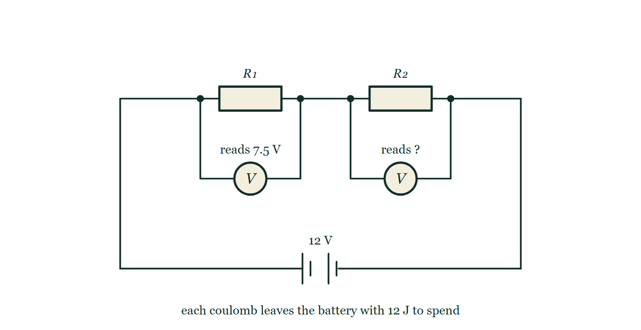
CIRCUITS · VOLTAGE & POTENTIAL DIFFERENCE
GIOPHYSICS LESSON
THINK FIRST
A bird lands on a 400 000 V power line and is completely unharmed. Why?
Take answers before you click — the point is the commitment
The same line will kill anything that touches it from a ladder. The bird sits on it, preens itself, and flies off.
THE ANSWER
Because both its feet are on the same wire. Voltage is always a difference between two places, and between two points a few centimetres apart on one good conductor that difference is a tiny fraction of a volt — so almost no work is done per coulomb through the bird and almost no current flows. It is not the 400 000 V that is dangerous; it is being the connection between two places that differ by it.
Two resistors R₁ and R₂ in series across a 12 V battery, each bridged by its own voltmeter; the first meter is labelled as reading 7.5 V and the second is labelled only "reads ?".
The live version of this figure — click here
Circuits — Voltage & Potential Difference. Built by GioPhysics from the lesson's own copy; nothing on these slides is re-authored.
3 / 32
Notes:
[Phase] Starter: Recall what this lesson stands on (minutes 0–5 of 45)
[Hook] A bird lands on a 400 000 V power line and is completely unharmed. Why? The same line will kill anything that touches it from a ladder. The bird sits on it, preens itself, and flies off.
[Answer] Because both its feet are on the same wire. Voltage is always a difference between two places, and between two points a few centimetres apart on one good conductor that difference is a tiny fraction of a volt — so almost no work is done per coulomb through the bird and almost no current flows. It is not the 400 000 V that is dangerous; it is being the connection between two places that differ by it.
[Figure] Two resistors R₁ and R₂ in series across a 12 V battery, each bridged by its own voltmeter; the first meter is labelled as reading 7.5 V and the second is labelled only "reads ?".

Slide 4
CIRCUITS · VOLTAGE & POTENTIAL DIFFERENCE
GIOPHYSICS LESSON
EXPLAINED SIMPLY
In one sentence
Introduce the idea — The big idea and the definition
Potential difference (voltage) is the work done, or energy transferred, per unit of charge between two points.
Circuits — Voltage & Potential Difference. Built by GioPhysics from the lesson's own copy; nothing on these slides is re-authored.
4 / 32
Notes:
[Phase] Introduce the idea: The big idea and the definition (minutes 5–13 of 45)
[Definition] Potential difference (voltage) is the work done, or energy transferred, per unit of charge between two points.

Slide 5
CIRCUITS · VOLTAGE & POTENTIAL DIFFERENCE
GIOPHYSICS LESSON
EXPLAINED SIMPLY
What that looks like
Introduce the idea — The big idea and the definition
FOR EXAMPLE
A 12 V battery gives every coulomb of charge 12 joules of energy to spend around the circuit.
Circuits — Voltage & Potential Difference. Built by GioPhysics from the lesson's own copy; nothing on these slides is re-authored.
5 / 32
Notes:
[Phase] Introduce the idea: The big idea and the definition (minutes 5–13 of 45)
[Worked illustration] A 12 V battery gives every coulomb of charge 12 joules of energy to spend around the circuit.

Slide 6
CIRCUITS · VOLTAGE & POTENTIAL DIFFERENCE
GIOPHYSICS LESSON
THE BIG IDEA
Energy carried per unit of charge
Introduce the idea — The big idea and the definition
A supply gives each coulomb a ration of energy; components spend it. Potential difference is the work done per unit charge between two points, so the same current through a larger p.d. transfers more energy.
Circuits — Voltage & Potential Difference. Built by GioPhysics from the lesson's own copy; nothing on these slides is re-authored.
6 / 32
Notes:
[Phase] Introduce the idea: The big idea and the definition (minutes 5–13 of 45)
[Big idea] A supply gives each coulomb a ration of energy; components spend it. Potential difference is the work done per unit charge between two points, so the same current through a larger p.d. transfers more energy.

Slide 7
CIRCUITS · VOLTAGE & POTENTIAL DIFFERENCE
GIOPHYSICS LESSON
THE PHYSICS · 1 OF 3
Source or component?
Build the model — The formulae, one at a time, in plain English
Across a source, charge gains energy (an e.m.f.). Across a lamp or resistor, charge loses energy to heat and light (a potential difference).
Circuits — Voltage & Potential Difference. Built by GioPhysics from the lesson's own copy; nothing on these slides is re-authored.
7 / 32
Notes:
[Phase] Build the model: The formulae, one at a time, in plain English (minutes 13–22 of 45)
[Section] Across a source, charge gains energy (an e.m.f.). Across a lamp or resistor, charge loses energy to heat and light (a potential difference).

Slide 8
CIRCUITS · VOLTAGE & POTENTIAL DIFFERENCE
GIOPHYSICS LESSON
THE PHYSICS · 2 OF 3
Always two points
Build the model — The formulae, one at a time, in plain English
Voltage compares two places. Saying 'the voltage at a point' only makes sense once a zero reference has been chosen.
Circuits — Voltage & Potential Difference. Built by GioPhysics from the lesson's own copy; nothing on these slides is re-authored.
8 / 32
Notes:
[Phase] Build the model: The formulae, one at a time, in plain English (minutes 13–22 of 45)
[Section] Voltage compares two places. Saying 'the voltage at a point' only makes sense once a zero reference has been chosen.

Slide 9
CIRCUITS · VOLTAGE & POTENTIAL DIFFERENCE
GIOPHYSICS LESSON
THE PHYSICS · 3 OF 3
Measuring it
Build the model — The formulae, one at a time, in plain English
A voltmeter connects in parallel and reads the difference in potential across the component — ideally drawing no current itself.
Circuits — Voltage & Potential Difference. Built by GioPhysics from the lesson's own copy; nothing on these slides is re-authored.
9 / 32
Notes:
[Phase] Build the model: The formulae, one at a time, in plain English (minutes 13–22 of 45)
[Section] A voltmeter connects in parallel and reads the difference in potential across the component — ideally drawing no current itself.

Slide 10
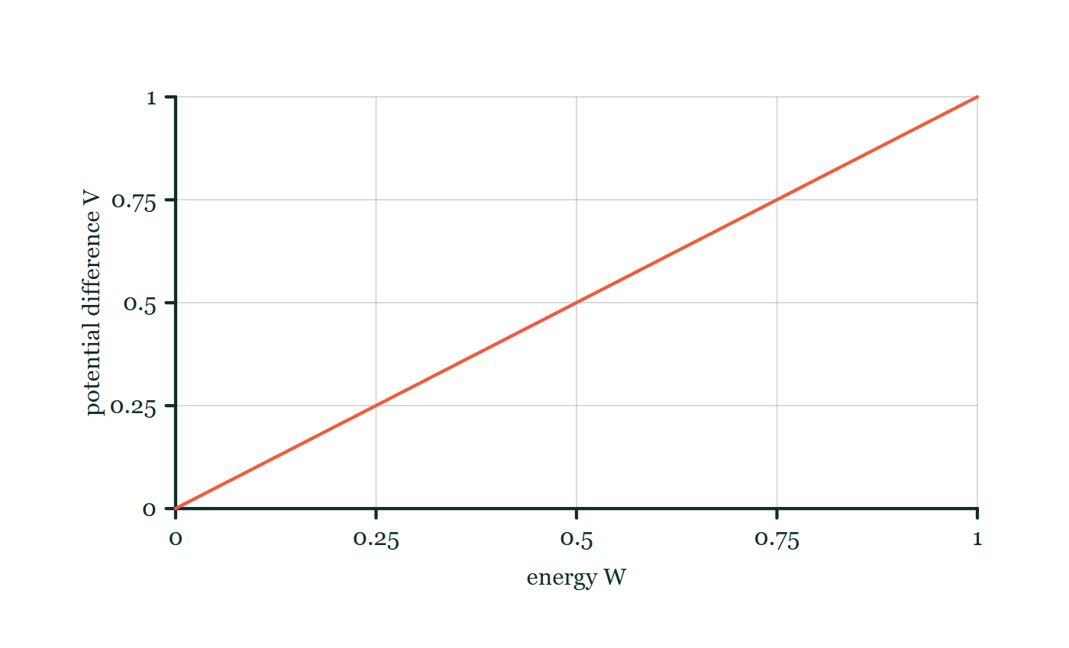
CIRCUITS · VOLTAGE & POTENTIAL DIFFERENCE
GIOPHYSICS LESSON
FORMULA 1 OF 3
Potential difference
Build the model — The formulae, one at a time, in plain English
V = W/Q
1 V = 1 J/C
IN PLAIN ENGLISH
Voltage is energy divided by charge — the joules carried by each coulomb between two points.
Energy-per-charge explorer
Move this graph on the live version — click here
Circuits — Voltage & Potential Difference. Built by GioPhysics from the lesson's own copy; nothing on these slides is re-authored.
10 / 32
Notes:
[Phase] Build the model: The formulae, one at a time, in plain English (minutes 13–22 of 45)
[Formula] Potential difference: V = W/Q
[In plain English] Voltage is energy divided by charge — the joules carried by each coulomb between two points.
[Note] 1 V = 1 J/C
[Graph] Energy-per-charge explorer. For a fixed charge, potential difference is directly proportional to transferred energy.
[Axes] Horizontal: energy W. Vertical: potential difference V. Values are normalised — the graph teaches the shape, not a measurement.

Slide 11
CIRCUITS · VOLTAGE & POTENTIAL DIFFERENCE
GIOPHYSICS LESSON
FORMULA 2 OF 3
Energy transferred
Build the model — The formulae, one at a time, in plain English
W = QV
Also W = VIt using Q = It
IN PLAIN ENGLISH
Rearranged: charge moved times volts crossed gives the energy transferred.
Circuits — Voltage & Potential Difference. Built by GioPhysics from the lesson's own copy; nothing on these slides is re-authored.
11 / 32
Notes:
[Phase] Build the model: The formulae, one at a time, in plain English (minutes 13–22 of 45)
[Formula] Energy transferred: W = QV
[In plain English] Rearranged: charge moved times volts crossed gives the energy transferred.
[Note] Also W = VIt using Q = It

Slide 12
CIRCUITS · VOLTAGE & POTENTIAL DIFFERENCE
GIOPHYSICS LESSON
FORMULA 3 OF 3
Uniform-field link
Build the model — The formulae, one at a time, in plain English
E = V/d
Field strength between parallel plates
IN PLAIN ENGLISH
The same voltage idea from electric fields: potential difference divided by separation gives field strength.
Circuits — Voltage & Potential Difference. Built by GioPhysics from the lesson's own copy; nothing on these slides is re-authored.
12 / 32
Notes:
[Phase] Build the model: The formulae, one at a time, in plain English (minutes 13–22 of 45)
[Formula] Uniform-field link: E = V/d
[In plain English] The same voltage idea from electric fields: potential difference divided by separation gives field strength.
[Note] Field strength between parallel plates

Slide 13
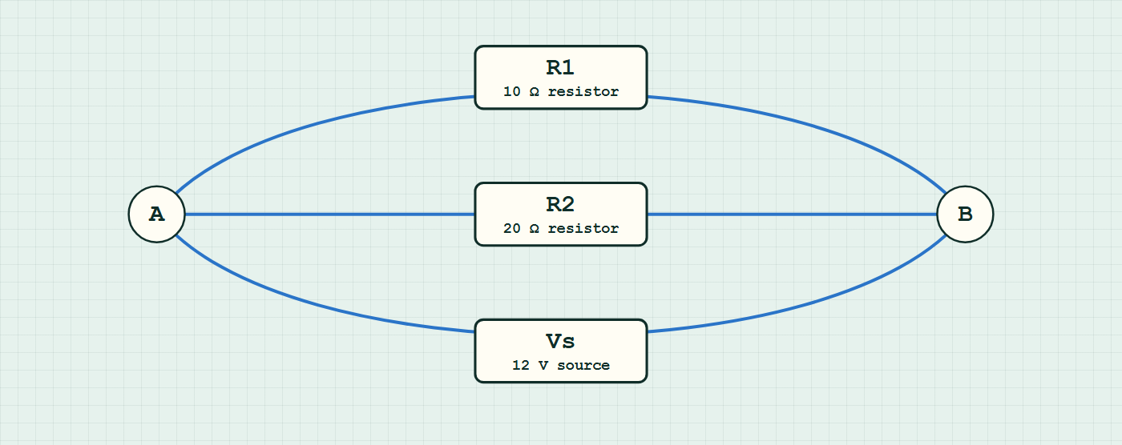
CIRCUITS · VOLTAGE & POTENTIAL DIFFERENCE
GIOPHYSICS LESSON
CIRCUIT MODEL
Read the topology before the values
Build the model — nodes are where connections meet, branches are what lies between them
parallel network — components are branches between nodes.
Switch topology and hide the values on the live version — click here
Circuits — Voltage & Potential Difference. Built by GioPhysics from the lesson's own copy; nothing on these slides is re-authored.
13 / 32
Notes:
[Phase] Build the model: The formulae, one at a time, in plain English (minutes 13–22 of 45)
[Topology] Nodes are the points where connections meet; branches are the components between them. The live version switches between series, parallel and bridge and can hide the values.

Slide 14
CIRCUITS · VOLTAGE & POTENTIAL DIFFERENCE
GIOPHYSICS LESSON
WATCH OUT
The common trap
Check and misconception — The quick check and the trap
Voltage does not flow. Charge flows; voltage is the energy-per-charge difference that drives the flow and is measured across, not through, a component.
Circuits — Voltage & Potential Difference. Built by GioPhysics from the lesson's own copy; nothing on these slides is re-authored.
14 / 32
Notes:
[Phase] Check and misconception: The quick check and the trap (minutes 35–41 of 45)
[Misconception] Voltage does not flow. Charge flows; voltage is the energy-per-charge difference that drives the flow and is measured across, not through, a component.

Slide 15
CIRCUITS · VOLTAGE & POTENTIAL DIFFERENCE
GIOPHYSICS LESSON
WORKED EXAMPLE 1 OF 2 · EASY
The question
Easy
Worked examples — I do, we do — one step revealed at a time
A 9.0 V battery drives 2.0 C of charge around a circuit. How much energy does the charge deliver?
Circuits — Voltage & Potential Difference. Built by GioPhysics from the lesson's own copy; nothing on these slides is re-authored.
15 / 32
Notes:
[Phase] Worked examples: I do, we do — one step revealed at a time (minutes 22–35 of 45)
[Question] A 9.0 V battery drives 2.0 C of charge around a circuit. How much energy does the charge deliver?
[Answer] 18 J

Slide 16
CIRCUITS · VOLTAGE & POTENTIAL DIFFERENCE
GIOPHYSICS LESSON
WORKED EXAMPLE 1 OF 2 · EASY · THE WORKING
How to solve it
Easy
Worked examples — I do, we do — one step revealed at a time
A 9.0 V battery drives 2.0 C of charge around a circuit. How much energy does the charge deliver?
1.
W = QV = 2.0 × 9.0.
2.
W = 18 J.
Circuits — Voltage & Potential Difference. Built by GioPhysics from the lesson's own copy; nothing on these slides is re-authored.
16 / 32
Notes:
[Phase] Worked examples: I do, we do — one step revealed at a time (minutes 22–35 of 45)
[Reveal] One click per step. The class works each line before the next appears.
[Step 1] W = QV = 2.0 × 9.0.
[Step 2] W = 18 J.

Slide 17
CIRCUITS · VOLTAGE & POTENTIAL DIFFERENCE
GIOPHYSICS LESSON
WORKED EXAMPLE 1 OF 2 · EASY
Answer
Easy
Worked examples — I do, we do — one step revealed at a time
18 J
Circuits — Voltage & Potential Difference. Built by GioPhysics from the lesson's own copy; nothing on these slides is re-authored.
17 / 32
Notes:
[Phase] Worked examples: I do, we do — one step revealed at a time (minutes 22–35 of 45)
[Answer] 18 J

Slide 18
CIRCUITS · VOLTAGE & POTENTIAL DIFFERENCE
GIOPHYSICS LESSON
WORKED EXAMPLE 2 OF 2 · MEDIUM
The question
Medium
Worked examples — I do, we do — one step revealed at a time
A 6.0 V supply drives 0.50 A through a lamp for 2.0 minutes. How much energy does the lamp transfer?
Circuits — Voltage & Potential Difference. Built by GioPhysics from the lesson's own copy; nothing on these slides is re-authored.
18 / 32
Notes:
[Phase] Worked examples: I do, we do — one step revealed at a time (minutes 22–35 of 45)
[Question] A 6.0 V supply drives 0.50 A through a lamp for 2.0 minutes. How much energy does the lamp transfer?
[Answer] W = 360 J

Slide 19
CIRCUITS · VOLTAGE & POTENTIAL DIFFERENCE
GIOPHYSICS LESSON
WORKED EXAMPLE 2 OF 2 · MEDIUM · THE WORKING
How to solve it
Medium
Worked examples — I do, we do — one step revealed at a time
A 6.0 V supply drives 0.50 A through a lamp for 2.0 minutes. How much energy does the lamp transfer?
1.
Charge moved: Q = It = 0.50 × 120 = 60 C.
2.
Energy per coulomb: 6.0 J.
3.
W = QV = 60 × 6.0 = 360 J.
Circuits — Voltage & Potential Difference. Built by GioPhysics from the lesson's own copy; nothing on these slides is re-authored.
19 / 32
Notes:
[Phase] Worked examples: I do, we do — one step revealed at a time (minutes 22–35 of 45)
[Reveal] One click per step. The class works each line before the next appears.
[Step 1] Charge moved: Q = It = 0.50 × 120 = 60 C.
[Step 2] Energy per coulomb: 6.0 J.
[Step 3] W = QV = 60 × 6.0 = 360 J.

Slide 20
CIRCUITS · VOLTAGE & POTENTIAL DIFFERENCE
GIOPHYSICS LESSON
WORKED EXAMPLE 2 OF 2 · MEDIUM
Answer
Medium
Worked examples — I do, we do — one step revealed at a time
W = 360 J
Circuits — Voltage & Potential Difference. Built by GioPhysics from the lesson's own copy; nothing on these slides is re-authored.
20 / 32
Notes:
[Phase] Worked examples: I do, we do — one step revealed at a time (minutes 22–35 of 45)
[Answer] W = 360 J

Slide 21
CIRCUITS · VOLTAGE & POTENTIAL DIFFERENCE
GIOPHYSICS LESSON
SPOT THE MISTAKE
One line here is wrong
The whole working is up — find the bad line before you click
1.
A 9.0 V battery drives 0.40 A through a resistor for 30 s. Find the energy transferred.
2.
Q = It = 0.40 × 30 = 12 C
3.
W = QV
4.
W = 12 × 0.40 = 4.8 J
5.
So the resistor transfers 4.8 J.
LINE 4 IS WRONG
The current has been substituted where the voltage belongs. It happens because 0.40 is the number most recently written down and W = QV has two symbols that both feel like "the electrical bit". The check is dimensional: Q is already made of I and t, so using I again means the time has been counted once and the current twice, and the 9.0 V — the only quantity saying how much energy each coulomb carries — has not been used at all.
IT SHOULD SAY
W = QV = 12 × 9.0 = 108 J
Circuits — Voltage & Potential Difference. Built by GioPhysics from the lesson's own copy; nothing on these slides is re-authored.
21 / 32
Notes:
[Phase] Worked examples: I do, we do — one step revealed at a time (minutes 22–35 of 45)
[Spot the mistake] The working is complete and one line of it is wrong. Let the room hunt: one click names the line, a second shows it done correctly.
[Line 4 is wrong] The current has been substituted where the voltage belongs. It happens because 0.40 is the number most recently written down and W = QV has two symbols that both feel like "the electrical bit". The check is dimensional: Q is already made of I and t, so using I again means the time has been counted once and the current twice, and the 9.0 V — the only quantity saying how much energy each coulomb carries — has not been used at all.
[It should say] W = QV = 12 × 9.0 = 108 J

Slide 22
CIRCUITS · VOLTAGE & POTENTIAL DIFFERENCE
GIOPHYSICS LESSON
PREDICT · TAKE THE VOTE
Commit before you are told
Hands up for each option, then click
The first voltmeter reads 7.5 V. What does the second one read?
A 4.5 V
B 7.5 V — the same current flows through both, so both share alike
C 12 V — the full battery voltage reaches R₂ as well
Two resistors R₁ and R₂ in series across a 12 V battery, each bridged by its own voltmeter; the first meter is labelled as reading 7.5 V and the second is labelled only "reads ?".
The live version of this figure — click here
Circuits — Voltage & Potential Difference. Built by GioPhysics from the lesson's own copy; nothing on these slides is re-authored.
22 / 32
Notes:
[Phase] Build the model: The formulae, one at a time, in plain English (minutes 13–22 of 45)
[Predict] The first voltmeter reads 7.5 V. What does the second one read?
[Options] A 4.5 V B 7.5 V — the same current flows through both, so both share alike C 12 V — the full battery voltage reaches R₂ as well
[Figure] Two resistors R₁ and R₂ in series across a 12 V battery, each bridged by its own voltmeter; the first meter is labelled as reading 7.5 V and the second is labelled only "reads ?".

Slide 23
CIRCUITS · VOLTAGE & POTENTIAL DIFFERENCE
GIOPHYSICS LESSON
PREDICT · THE OUTCOME
What actually happens
Ask the room who changed their mind, and why
A 4.5 V
WHY
Follow one coulomb round the loop in the drawing. It leaves the battery with 12 J. It spends 7.5 J crossing R₁ — that is what the first meter is reporting — and it must arrive back at the battery with nothing left over, because the battery is where it gets refilled. So 4.5 J remain to be spent in R₂, and 4.5 J per coulomb is 4.5 V. The two drops have to add up to what the supply gave out, no more and no less.
Circuits — Voltage & Potential Difference. Built by GioPhysics from the lesson's own copy; nothing on these slides is re-authored.
23 / 32
Notes:
[Phase] Build the model: The formulae, one at a time, in plain English (minutes 13–22 of 45)
[Answer] A — 4.5 V. Follow one coulomb round the loop in the drawing. It leaves the battery with 12 J. It spends 7.5 J crossing R₁ — that is what the first meter is reporting — and it must arrive back at the battery with nothing left over, because the battery is where it gets refilled. So 4.5 J remain to be spent in R₂, and 4.5 J per coulomb is 4.5 V. The two drops have to add up to what the supply gave out, no more and no less.

Slide 24
CIRCUITS · VOLTAGE & POTENTIAL DIFFERENCE
GIOPHYSICS LESSON
QUICK CHECK
Decide before the answer goes up
Check and misconception — The quick check and the trap
A cell supplies 23 C of charge with 776 J of energy. What is its voltage?
A
33.7 V
B
0.03 V
C
17800 V
Circuits — Voltage & Potential Difference. Built by GioPhysics from the lesson's own copy; nothing on these slides is re-authored.
24 / 32
Notes:
[Phase] Check and misconception: The quick check and the trap (minutes 35–41 of 45)
[Question] A cell supplies 23 C of charge with 776 J of energy. What is its voltage?
[Options] A 33.7 V B 0.03 V C 17800 V

Slide 25
CIRCUITS · VOLTAGE & POTENTIAL DIFFERENCE
GIOPHYSICS LESSON
QUICK CHECK · THE ANSWER
The answer, and why
Check and misconception — The quick check and the trap
A 33.7 V
HOW TO GET THERE
V = W/Q = 776 ÷ 23 ≈ 33.7 V — energy per unit of charge.
WHY THE OTHERS TEMPT
A Correct. V = W/Q = 776 ÷ 23 ≈ 33.7 V — the energy each single coulomb is given.
B 0.03 V is 23 ÷ 776, the division inverted: that is coulombs per joule. The unit settles it, because a volt is defined as a joule per coulomb, so the joules go on top.
C 17 800 V is 776 × 23. Multiplying works out the energy 23 coulombs would carry if each of them separately had 776 J. The question says 776 J was what the whole 23 C received, so it is shared out among them, not stacked up.
Circuits — Voltage & Potential Difference. Built by GioPhysics from the lesson's own copy; nothing on these slides is re-authored.
25 / 32
Notes:
[Phase] Check and misconception: The quick check and the trap (minutes 35–41 of 45)
[Question] A cell supplies 23 C of charge with 776 J of energy. What is its voltage?
[Option by option] A: Correct. V = W/Q = 776 ÷ 23 ≈ 33.7 V — the energy each single coulomb is given. B: 0.03 V is 23 ÷ 776, the division inverted: that is coulombs per joule. The unit settles it, because a volt is defined as a joule per coulomb, so the joules go on top. C: 17 800 V is 776 × 23. Multiplying works out the energy 23 coulombs would carry if each of them separately had 776 J. The question says 776 J was what the whole 23 C received, so it is shared out among them, not stacked up.
[Answer] A — 33.7 V
[Why] V = W/Q = 776 ÷ 23 ≈ 33.7 V — energy per unit of charge.
[Reveal] One click for the answer, then one for the reason.

Slide 26
CIRCUITS · VOLTAGE & POTENTIAL DIFFERENCE
GIOPHYSICS LESSON
EXTENSION 1 OF 2 · HARD
The question
Hard
Worked examples — I do, we do — one step revealed at a time
Across one lamp in a circuit a voltmeter reads 6.0 V while 0.25 A flows for 2.0 minutes. Find the charge through the lamp and the energy it transfers.
Circuits — Voltage & Potential Difference. Built by GioPhysics from the lesson's own copy; nothing on these slides is re-authored.
26 / 32
Notes:
[Phase] Worked examples: I do, we do — one step revealed at a time (minutes 22–35 of 45)
[Question] Across one lamp in a circuit a voltmeter reads 6.0 V while 0.25 A flows for 2.0 minutes. Find the charge through the lamp and the energy it transfers.
[Answer] Q = 30 C; W = 180 J

Slide 27
CIRCUITS · VOLTAGE & POTENTIAL DIFFERENCE
GIOPHYSICS LESSON
EXTENSION 1 OF 2 · HARD · THE WORKING
How to solve it
Hard
Worked examples — I do, we do — one step revealed at a time
Across one lamp in a circuit a voltmeter reads 6.0 V while 0.25 A flows for 2.0 minutes. Find the charge through the lamp and the energy it transfers.
1.
Q = It = 0.25 × 120 = 30 C.
2.
W = QV = 30 × 6.0.
3.
W = 180 J — mostly heat and light.
Circuits — Voltage & Potential Difference. Built by GioPhysics from the lesson's own copy; nothing on these slides is re-authored.
27 / 32
Notes:
[Phase] Worked examples: I do, we do — one step revealed at a time (minutes 22–35 of 45)
[Reveal] One click per step. The class works each line before the next appears.
[Step 1] Q = It = 0.25 × 120 = 30 C.
[Step 2] W = QV = 30 × 6.0.
[Step 3] W = 180 J — mostly heat and light.

Slide 28
CIRCUITS · VOLTAGE & POTENTIAL DIFFERENCE
GIOPHYSICS LESSON
EXTENSION 1 OF 2 · HARD
Answer
Hard
Worked examples — I do, we do — one step revealed at a time
Q = 30 C; W = 180 J
Circuits — Voltage & Potential Difference. Built by GioPhysics from the lesson's own copy; nothing on these slides is re-authored.
28 / 32
Notes:
[Phase] Worked examples: I do, we do — one step revealed at a time (minutes 22–35 of 45)
[Answer] Q = 30 C; W = 180 J

Slide 29
CIRCUITS · VOLTAGE & POTENTIAL DIFFERENCE
GIOPHYSICS LESSON
EXTENSION 2 OF 2 · CHALLENGING
The question
Challenging
Worked examples — I do, we do — one step revealed at a time
A 12 V battery moves charge through two series components with p.d.s 7.5 V and 4.5 V. Show the energy account balances per coulomb, and explain what would be wrong with readings of 7.5 V and 5.5 V.
Circuits — Voltage & Potential Difference. Built by GioPhysics from the lesson's own copy; nothing on these slides is re-authored.
29 / 32
Notes:
[Phase] Worked examples: I do, we do — one step revealed at a time (minutes 22–35 of 45)
[Question] A 12 V battery moves charge through two series components with p.d.s 7.5 V and 4.5 V. Show the energy account balances per coulomb, and explain what would be wrong with readings of 7.5 V and 5.5 V.
[Answer] 7.5 + 4.5 = 12 V balances; 13 V worth of drops around a 12 V loop is impossible

Slide 30
CIRCUITS · VOLTAGE & POTENTIAL DIFFERENCE
GIOPHYSICS LESSON
EXTENSION 2 OF 2 · CHALLENGING · THE WORKING
How to solve it
Challenging
Worked examples — I do, we do — one step revealed at a time
A 12 V battery moves charge through two series components with p.d.s 7.5 V and 4.5 V. Show the energy account balances per coulomb, and explain what would be wrong with readings of 7.5 V and 5.5 V.
1.
Per coulomb the source supplies 12 J; the components take 7.5 + 4.5 = 12 J — balanced (Kirchhoff's loop rule).
2.
Readings totalling 13 V would create 1 J/C from nowhere, violating energy conservation.
3.
Real 'extra' readings usually mean a measurement error or an unaccounted component (e.g. internal resistance).
Circuits — Voltage & Potential Difference. Built by GioPhysics from the lesson's own copy; nothing on these slides is re-authored.
30 / 32
Notes:
[Phase] Worked examples: I do, we do — one step revealed at a time (minutes 22–35 of 45)
[Reveal] One click per step. The class works each line before the next appears.
[Step 1] Per coulomb the source supplies 12 J; the components take 7.5 + 4.5 = 12 J — balanced (Kirchhoff's loop rule).
[Step 2] Readings totalling 13 V would create 1 J/C from nowhere, violating energy conservation.
[Step 3] Real 'extra' readings usually mean a measurement error or an unaccounted component (e.g. internal resistance).

Slide 31
CIRCUITS · VOLTAGE & POTENTIAL DIFFERENCE
GIOPHYSICS LESSON
EXTENSION 2 OF 2 · CHALLENGING
Answer
Challenging
Worked examples — I do, we do — one step revealed at a time
7.5 + 4.5 = 12 V balances; 13 V worth of drops around a 12 V loop is impossible
Circuits — Voltage & Potential Difference. Built by GioPhysics from the lesson's own copy; nothing on these slides is re-authored.
31 / 32
Notes:
[Phase] Worked examples: I do, we do — one step revealed at a time (minutes 22–35 of 45)
[Answer] 7.5 + 4.5 = 12 V balances; 13 V worth of drops around a 12 V loop is impossible

Slide 32
CIRCUITS · VOLTAGE & POTENTIAL DIFFERENCE
GIOPHYSICS LESSON
CIRCUITS
Where to go next
Plenary — What to take away, what to practise next
Next
13.4 Resistance & Ohm's Law
https://giophysics.com/chapter-22/resistance-ohms-law/
Lesson
This lesson on giophysics.com
https://giophysics.com/chapter-22/voltage-potential-difference/
Live
The live, interactive version of these slides
https://giophysics.com/chapter-22/presentation/?lesson=voltage
Chapter
All Circuits lessons
https://giophysics.com/chapter-22/
PDF
Download the lesson PDF
https://giophysics.com/downloads/22-3-voltage-potential-difference.pdf
Circuits — Voltage & Potential Difference. Built by GioPhysics from the lesson's own copy; nothing on these slides is re-authored.
32 / 32
Notes:
[Phase] Plenary: What to take away, what to practise next (minutes 41–45 of 45)
[Interactive] The graphs and the circuit topology on these slides are frozen. The live version at https://giophysics.com/chapter-22/presentation/?lesson=voltage moves them.

