Slide 1
ADVANCED CIRCUITS · CIRCUIT CALCULUS
GIOPHYSICS LESSON
14 · Advanced Circuits
Rates, areas, and exponential decay
Circuit Calculus
Current is a derivative and charge is an integral. Treat them that way and time-varying circuits open up — including the exponential charge and discharge of a capacitor through a resistor.
POSITION
Lesson 7 of 7 in Advanced Circuits
PLAN
16 slides in the 45-minute core run, about 44.5 minutes of it
LESSON PAGE
https://giophysics.com/chapter-23/circuit-calculus/
Built by GioPhysics from the lesson's own page. Every word on these slides is the lesson's; nothing here is re-authored. Teaching material, not an awarding body's document.
Advanced Circuits — Circuit Calculus. Built by GioPhysics from the lesson's own copy; nothing on these slides is re-authored.
1 / 32
Notes:
[Lesson] Advanced Circuits — Circuit Calculus. Lesson 7 of 7.
[Intro] Current is a derivative and charge is an integral. Treat them that way and time-varying circuits open up — including the exponential charge and discharge of a capacitor through a resistor.
[Source] https://giophysics.com/chapter-23/circuit-calculus/
[Disclaimer] Built by GioPhysics from the lesson's own page. Every word on these slides is the lesson's; nothing here is re-authored. Teaching material, not an awarding body's document.

Slide 2
ADVANCED CIRCUITS · CIRCUIT CALCULUS
GIOPHYSICS LESSON
WHAT THIS NEEDS
What you already know
Starter — Recall what this lesson stands on
Recall
Capacitance
https://giophysics.com/chapter-21/parallel-plates-capacitors/
Recall
Current & charge
https://giophysics.com/chapter-22/electric-current-charge/
Recall
Calculus methods
https://giophysics.com/chapter-1/kinematics-calculus/
Advanced Circuits — Circuit Calculus. Built by GioPhysics from the lesson's own copy; nothing on these slides is re-authored.
2 / 32
Notes:
[Phase] Starter: Recall what this lesson stands on (minutes 0–5 of 45)
[Starter] Recall: Capacitance; Current & charge; Calculus methods

Slide 3
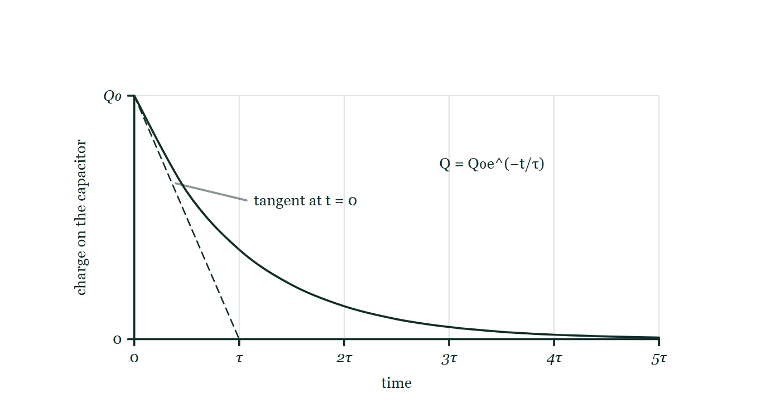
ADVANCED CIRCUITS · CIRCUIT CALCULUS
GIOPHYSICS LESSON
THINK FIRST
A capacitor discharges through a resistor. When is it empty?
Take answers before you click — the point is the commitment
The current is largest at the start and visibly dies away. Watch a discharge on an oscilloscope and the trace flattens out along the axis.
THE ANSWER
Never, in the model. The charge falls by the same fraction in every equal interval, so it halves every 0.69τ and halves again — approaching zero without ever arriving. In practice, after five time constants less than 1% is left and everyone calls the capacitor discharged, but that is a decision about what counts as empty, not an event in the physics.
Charge falling exponentially from Q₀ with time marked in multiples of τ, with the tangent to the curve at t = 0 drawn dashed and running straight down to meet the time axis at exactly one time constant while the curve itself is still well above it.
The live version of this figure — click here
Advanced Circuits — Circuit Calculus. Built by GioPhysics from the lesson's own copy; nothing on these slides is re-authored.
3 / 32
Notes:
[Phase] Starter: Recall what this lesson stands on (minutes 0–5 of 45)
[Hook] A capacitor discharges through a resistor. When is it empty? The current is largest at the start and visibly dies away. Watch a discharge on an oscilloscope and the trace flattens out along the axis.
[Answer] Never, in the model. The charge falls by the same fraction in every equal interval, so it halves every 0.69τ and halves again — approaching zero without ever arriving. In practice, after five time constants less than 1% is left and everyone calls the capacitor discharged, but that is a decision about what counts as empty, not an event in the physics.
[Figure] Charge falling exponentially from Q₀ with time marked in multiples of τ, with the tangent to the curve at t = 0 drawn dashed and running straight down to meet the time axis at exactly one time constant while the curve itself is still well above it.

Slide 4
ADVANCED CIRCUITS · CIRCUIT CALCULUS
GIOPHYSICS LESSON
EXPLAINED SIMPLY
In one sentence
Introduce the idea — The big idea and the definition
Circuit calculus reads current as the rate of change of charge and charge as the accumulated area under a current–time graph.
Advanced Circuits — Circuit Calculus. Built by GioPhysics from the lesson's own copy; nothing on these slides is re-authored.
4 / 32
Notes:
[Phase] Introduce the idea: The big idea and the definition (minutes 5–13 of 45)
[Definition] Circuit calculus reads current as the rate of change of charge and charge as the accumulated area under a current–time graph.

Slide 5
ADVANCED CIRCUITS · CIRCUIT CALCULUS
GIOPHYSICS LESSON
EXPLAINED SIMPLY
What that looks like
Introduce the idea — The big idea and the definition
FOR EXAMPLE
If the charge on a capacitor falls twice as fast at one instant, the discharge current at that instant is exactly twice as large.
Advanced Circuits — Circuit Calculus. Built by GioPhysics from the lesson's own copy; nothing on these slides is re-authored.
5 / 32
Notes:
[Phase] Introduce the idea: The big idea and the definition (minutes 5–13 of 45)
[Worked illustration] If the charge on a capacitor falls twice as fast at one instant, the discharge current at that instant is exactly twice as large.

Slide 6
ADVANCED CIRCUITS · CIRCUIT CALCULUS
GIOPHYSICS LESSON
THE BIG IDEA
Rates, areas, and exponential decay
Introduce the idea — The big idea and the definition
I = dQ/dt makes current the gradient of a charge–time graph, and ΔQ = ∫I dt makes charge the area under a current–time graph. Apply both to a capacitor discharging through a resistor and calculus predicts the exponential decay Q = Q₀e^(−t/RC), with the time constant τ = RC setting the pace.
Advanced Circuits — Circuit Calculus. Built by GioPhysics from the lesson's own copy; nothing on these slides is re-authored.
6 / 32
Notes:
[Phase] Introduce the idea: The big idea and the definition (minutes 5–13 of 45)
[Big idea] I = dQ/dt makes current the gradient of a charge–time graph, and ΔQ = ∫I dt makes charge the area under a current–time graph. Apply both to a capacitor discharging through a resistor and calculus predicts the exponential decay Q = Q₀e^(−t/RC), with the time constant τ = RC setting the pace.

Slide 7
ADVANCED CIRCUITS · CIRCUIT CALCULUS
GIOPHYSICS LESSON
THE PHYSICS · 1 OF 3
Set up the equation
Build the model — The formulae, one at a time, in plain English
During discharge the capacitor drives current I = V/R = Q/(RC) while I = −dQ/dt. Equating them gives dQ/dt = −Q/RC — the decay is proportional to what remains.
Advanced Circuits — Circuit Calculus. Built by GioPhysics from the lesson's own copy; nothing on these slides is re-authored.
7 / 32
Notes:
[Phase] Build the model: The formulae, one at a time, in plain English (minutes 13–22 of 45)
[Section] During discharge the capacitor drives current I = V/R = Q/(RC) while I = −dQ/dt. Equating them gives dQ/dt = −Q/RC — the decay is proportional to what remains.

Slide 8
ADVANCED CIRCUITS · CIRCUIT CALCULUS
GIOPHYSICS LESSON
THE PHYSICS · 2 OF 3
Solve it
Build the model — The formulae, one at a time, in plain English
The only function whose rate of change is proportional to itself is the exponential: Q(t) = Q₀e^(−t/RC). Current and voltage inherit the same shape.
Advanced Circuits — Circuit Calculus. Built by GioPhysics from the lesson's own copy; nothing on these slides is re-authored.
8 / 32
Notes:
[Phase] Build the model: The formulae, one at a time, in plain English (minutes 13–22 of 45)
[Section] The only function whose rate of change is proportional to itself is the exponential: Q(t) = Q₀e^(−t/RC). Current and voltage inherit the same shape.

Slide 9
ADVANCED CIRCUITS · CIRCUIT CALCULUS
GIOPHYSICS LESSON
THE PHYSICS · 3 OF 3
Read the time constant
Build the model — The formulae, one at a time, in plain English
τ = RC has units of seconds (ohms × farads). It is where the initial tangent hits zero, and the 37%-remaining mark — larger R or C means a slower decay.
Advanced Circuits — Circuit Calculus. Built by GioPhysics from the lesson's own copy; nothing on these slides is re-authored.
9 / 32
Notes:
[Phase] Build the model: The formulae, one at a time, in plain English (minutes 13–22 of 45)
[Section] τ = RC has units of seconds (ohms × farads). It is where the initial tangent hits zero, and the 37%-remaining mark — larger R or C means a slower decay.

Slide 10
ADVANCED CIRCUITS · CIRCUIT CALCULUS
GIOPHYSICS LESSON
FORMULA 1 OF 3
Current as a rate
Build the model — The formulae, one at a time, in plain English
I = dQ/dt
The gradient of the Q–t graph
IN PLAIN ENGLISH
Current at an instant is how quickly charge is passing right then — the slope of the charge–time graph at that moment.
Advanced Circuits — Circuit Calculus. Built by GioPhysics from the lesson's own copy; nothing on these slides is re-authored.
10 / 32
Notes:
[Phase] Build the model: The formulae, one at a time, in plain English (minutes 13–22 of 45)
[Formula] Current as a rate: I = dQ/dt
[In plain English] Current at an instant is how quickly charge is passing right then — the slope of the charge–time graph at that moment.
[Note] The gradient of the Q–t graph

Slide 11
ADVANCED CIRCUITS · CIRCUIT CALCULUS
GIOPHYSICS LESSON
FORMULA 2 OF 3
Charge as an area
Build the model — The formulae, one at a time, in plain English
ΔQ = ∫ I dt
The area under the I–t graph
IN PLAIN ENGLISH
Add up current × tiny time-step over the whole interval and you get the total charge that flowed — the area under the current–time curve.
Advanced Circuits — Circuit Calculus. Built by GioPhysics from the lesson's own copy; nothing on these slides is re-authored.
11 / 32
Notes:
[Phase] Build the model: The formulae, one at a time, in plain English (minutes 13–22 of 45)
[Formula] Charge as an area: ΔQ = ∫ I dt
[In plain English] Add up current × tiny time-step over the whole interval and you get the total charge that flowed — the area under the current–time curve.
[Note] The area under the I–t graph

Slide 12
ADVANCED CIRCUITS · CIRCUIT CALCULUS
GIOPHYSICS LESSON
FORMULA 3 OF 3
RC discharge
Build the model — The formulae, one at a time, in plain English
Q = Q₀e^(−t/RC)
τ = RC; also I = I₀e^(−t/τ) and V = V₀e^(−t/τ)
IN PLAIN ENGLISH
A capacitor emptying through a resistor loses a fixed fraction of its charge in each time constant τ — about 37% remains after one τ, and under 1% after five.
Advanced Circuits — Circuit Calculus. Built by GioPhysics from the lesson's own copy; nothing on these slides is re-authored.
12 / 32
Notes:
[Phase] Build the model: The formulae, one at a time, in plain English (minutes 13–22 of 45)
[Formula] RC discharge: Q = Q₀e^(−t/RC)
[In plain English] A capacitor emptying through a resistor loses a fixed fraction of its charge in each time constant τ — about 37% remains after one τ, and under 1% after five.
[Note] τ = RC; also I = I₀e^(−t/τ) and V = V₀e^(−t/τ)

Slide 13
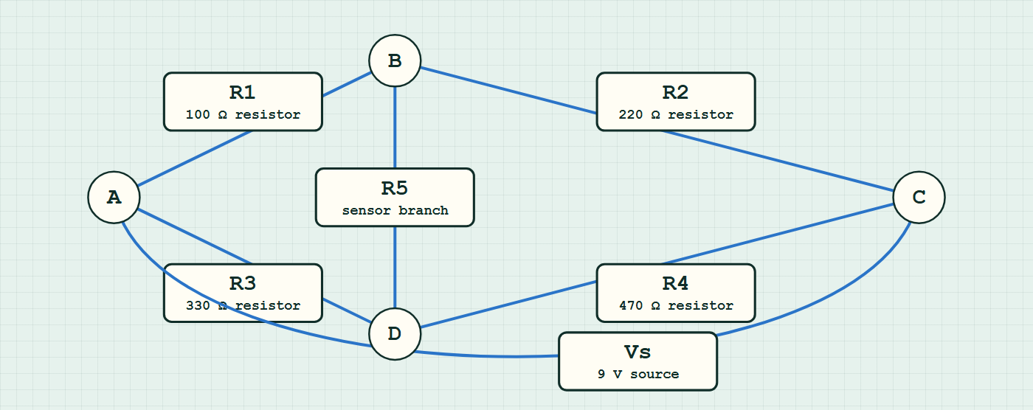
ADVANCED CIRCUITS · CIRCUIT CALCULUS
GIOPHYSICS LESSON
CIRCUIT MODEL
Read the topology before the values
Build the model — nodes are where connections meet, branches are what lies between them
bridge network — components are branches between nodes.
Switch topology and hide the values on the live version — click here
Advanced Circuits — Circuit Calculus. Built by GioPhysics from the lesson's own copy; nothing on these slides is re-authored.
13 / 32
Notes:
[Phase] Build the model: The formulae, one at a time, in plain English (minutes 13–22 of 45)
[Topology] Nodes are the points where connections meet; branches are the components between them. The live version switches between series, parallel and bridge and can hide the values.

Slide 14
ADVANCED CIRCUITS · CIRCUIT CALCULUS
GIOPHYSICS LESSON
WATCH OUT
The common trap
Check and misconception — The quick check and the trap
The discharge never finishes in the exponential model — the charge halves every 0.69τ but never reaches exactly zero. In practice, after 5τ less than 1% remains and the capacitor is treated as discharged.
Advanced Circuits — Circuit Calculus. Built by GioPhysics from the lesson's own copy; nothing on these slides is re-authored.
14 / 32
Notes:
[Phase] Check and misconception: The quick check and the trap (minutes 35–41 of 45)
[Misconception] The discharge never finishes in the exponential model — the charge halves every 0.69τ but never reaches exactly zero. In practice, after 5τ less than 1% remains and the capacitor is treated as discharged.

Slide 15
ADVANCED CIRCUITS · CIRCUIT CALCULUS
GIOPHYSICS LESSON
WORKED EXAMPLE 1 OF 2 · EASY
The question
Easy
Worked examples — I do, we do — one step revealed at a time
A capacitor discharge has τ = 2.0 s. What fraction of the initial charge remains after 2.0 s and after 4.0 s?
Advanced Circuits — Circuit Calculus. Built by GioPhysics from the lesson's own copy; nothing on these slides is re-authored.
15 / 32
Notes:
[Phase] Worked examples: I do, we do — one step revealed at a time (minutes 22–35 of 45)
[Question] A capacitor discharge has τ = 2.0 s. What fraction of the initial charge remains after 2.0 s and after 4.0 s?
[Answer] ≈ 37% then ≈ 14%

Slide 16
ADVANCED CIRCUITS · CIRCUIT CALCULUS
GIOPHYSICS LESSON
WORKED EXAMPLE 1 OF 2 · EASY · THE WORKING
How to solve it
Easy
Worked examples — I do, we do — one step revealed at a time
A capacitor discharge has τ = 2.0 s. What fraction of the initial charge remains after 2.0 s and after 4.0 s?
1.
After one τ: e⁻¹ ≈ 37%.
2.
After 2τ: e⁻² ≈ 13.5%.
Advanced Circuits — Circuit Calculus. Built by GioPhysics from the lesson's own copy; nothing on these slides is re-authored.
16 / 32
Notes:
[Phase] Worked examples: I do, we do — one step revealed at a time (minutes 22–35 of 45)
[Reveal] One click per step. The class works each line before the next appears.
[Step 1] After one τ: e⁻¹ ≈ 37%.
[Step 2] After 2τ: e⁻² ≈ 13.5%.

Slide 17
ADVANCED CIRCUITS · CIRCUIT CALCULUS
GIOPHYSICS LESSON
WORKED EXAMPLE 1 OF 2 · EASY
Answer
Easy
Worked examples — I do, we do — one step revealed at a time
≈ 37% then ≈ 14%
Advanced Circuits — Circuit Calculus. Built by GioPhysics from the lesson's own copy; nothing on these slides is re-authored.
17 / 32
Notes:
[Phase] Worked examples: I do, we do — one step revealed at a time (minutes 22–35 of 45)
[Answer] ≈ 37% then ≈ 14%

Slide 18
ADVANCED CIRCUITS · CIRCUIT CALCULUS
GIOPHYSICS LESSON
WORKED EXAMPLE 2 OF 2 · MEDIUM
The question
Medium
Worked examples — I do, we do — one step revealed at a time
A 1000 μF capacitor charged to 9.0 V discharges through a 4.7 kΩ resistor. Find τ, the initial current, and the voltage after 6.0 s.
Advanced Circuits — Circuit Calculus. Built by GioPhysics from the lesson's own copy; nothing on these slides is re-authored.
18 / 32
Notes:
[Phase] Worked examples: I do, we do — one step revealed at a time (minutes 22–35 of 45)
[Question] A 1000 μF capacitor charged to 9.0 V discharges through a 4.7 kΩ resistor. Find τ, the initial current, and the voltage after 6.0 s.
[Answer] τ = 4.7 s, I₀ ≈ 1.9 mA, V(6 s) ≈ 2.5 V

Slide 19
ADVANCED CIRCUITS · CIRCUIT CALCULUS
GIOPHYSICS LESSON
WORKED EXAMPLE 2 OF 2 · MEDIUM · THE WORKING
How to solve it
Medium
Worked examples — I do, we do — one step revealed at a time
A 1000 μF capacitor charged to 9.0 V discharges through a 4.7 kΩ resistor. Find τ, the initial current, and the voltage after 6.0 s.
1.
τ = RC = 4700 × 1000 × 10⁻⁶ = 4.7 s.
2.
I₀ = V₀/R = 9.0 ÷ 4700 ≈ 1.9 mA.
3.
V = V₀e^(−t/τ) = 9.0 × e^(−6.0/4.7) ≈ 9.0 × 0.279 ≈ 2.5 V.
Advanced Circuits — Circuit Calculus. Built by GioPhysics from the lesson's own copy; nothing on these slides is re-authored.
19 / 32
Notes:
[Phase] Worked examples: I do, we do — one step revealed at a time (minutes 22–35 of 45)
[Reveal] One click per step. The class works each line before the next appears.
[Step 1] τ = RC = 4700 × 1000 × 10⁻⁶ = 4.7 s.
[Step 2] I₀ = V₀/R = 9.0 ÷ 4700 ≈ 1.9 mA.
[Step 3] V = V₀e^(−t/τ) = 9.0 × e^(−6.0/4.7) ≈ 9.0 × 0.279 ≈ 2.5 V.

Slide 20
ADVANCED CIRCUITS · CIRCUIT CALCULUS
GIOPHYSICS LESSON
WORKED EXAMPLE 2 OF 2 · MEDIUM
Answer
Medium
Worked examples — I do, we do — one step revealed at a time
τ = 4.7 s, I₀ ≈ 1.9 mA, V(6 s) ≈ 2.5 V
Advanced Circuits — Circuit Calculus. Built by GioPhysics from the lesson's own copy; nothing on these slides is re-authored.
20 / 32
Notes:
[Phase] Worked examples: I do, we do — one step revealed at a time (minutes 22–35 of 45)
[Answer] τ = 4.7 s, I₀ ≈ 1.9 mA, V(6 s) ≈ 2.5 V

Slide 21
ADVANCED CIRCUITS · CIRCUIT CALCULUS
GIOPHYSICS LESSON
SPOT THE MISTAKE
One line here is wrong
The whole working is up — find the bad line before you click
1.
A 1000 μF capacitor charged to 9.0 V discharges through a 4.7 kΩ resistor. Find the voltage after 6.0 s.
2.
τ = RC = 4700 × 1000 × 10⁻⁶ = 4.7 s
3.
V = V₀e^(−t/τ)
4.
V = 9.0 × e^(−4.7/6.0)
5.
V = 9.0 × 0.457 = 4.1 V
LINE 4 IS WRONG
The exponent is upside down: it should be t/τ, and τ/t has been substituted. The two numbers are close enough here that the answer stays believable, which is the trap — 4.1 V looks like a perfectly sensible reading part-way through a discharge. The check is that t/τ must be dimensionless and must grow with time, so more elapsed time has to mean a more negative exponent and a smaller voltage.
IT SHOULD SAY
V = 9.0 × e^(−6.0/4.7) = 9.0 × 0.279 = 2.5 V
Advanced Circuits — Circuit Calculus. Built by GioPhysics from the lesson's own copy; nothing on these slides is re-authored.
21 / 32
Notes:
[Phase] Worked examples: I do, we do — one step revealed at a time (minutes 22–35 of 45)
[Spot the mistake] The working is complete and one line of it is wrong. Let the room hunt: one click names the line, a second shows it done correctly.
[Line 4 is wrong] The exponent is upside down: it should be t/τ, and τ/t has been substituted. The two numbers are close enough here that the answer stays believable, which is the trap — 4.1 V looks like a perfectly sensible reading part-way through a discharge. The check is that t/τ must be dimensionless and must grow with time, so more elapsed time has to mean a more negative exponent and a smaller voltage.
[It should say] V = 9.0 × e^(−6.0/4.7) = 9.0 × 0.279 = 2.5 V

Slide 22
ADVANCED CIRCUITS · CIRCUIT CALCULUS
GIOPHYSICS LESSON
PREDICT · TAKE THE VOTE
Commit before you are told
Hands up for each option, then click
The dashed tangent drawn at t = 0 meets the axis at one time constant. How much charge is actually left at that moment?
A None — the tangent shows it reaching zero at τ
B About a third of what it started with
C About two thirds of what it started with
Charge falling exponentially from Q₀ with time marked in multiples of τ, with the tangent to the curve at t = 0 drawn dashed and running straight down to meet the time axis at exactly one time constant while the curve itself is still well above it.
The live version of this figure — click here
Advanced Circuits — Circuit Calculus. Built by GioPhysics from the lesson's own copy; nothing on these slides is re-authored.
22 / 32
Notes:
[Phase] Build the model: The formulae, one at a time, in plain English (minutes 13–22 of 45)
[Predict] The dashed tangent drawn at t = 0 meets the axis at one time constant. How much charge is actually left at that moment?
[Options] A None — the tangent shows it reaching zero at τ B About a third of what it started with C About two thirds of what it started with
[Figure] Charge falling exponentially from Q₀ with time marked in multiples of τ, with the tangent to the curve at t = 0 drawn dashed and running straight down to meet the time axis at exactly one time constant while the curve itself is still well above it.

Slide 23
ADVANCED CIRCUITS · CIRCUIT CALCULUS
GIOPHYSICS LESSON
PREDICT · THE OUTCOME
What actually happens
Ask the room who changed their mind, and why
B About a third of what it started with
WHY
The tangent is the line the charge would follow if the current never slackened — τ is exactly how long the capacitor would take to empty at its initial rate. But the current is Q/RC, so as the charge falls the current falls with it, and the real curve bends away from the tangent from the first instant. At t = τ it is at Q₀/e, which is 37% — a little over a third. The gap between the dashed line and the curve on this drawing is the whole difference between a constant rate and a proportional one.
Advanced Circuits — Circuit Calculus. Built by GioPhysics from the lesson's own copy; nothing on these slides is re-authored.
23 / 32
Notes:
[Phase] Build the model: The formulae, one at a time, in plain English (minutes 13–22 of 45)
[Answer] B — About a third of what it started with. The tangent is the line the charge would follow if the current never slackened — τ is exactly how long the capacitor would take to empty at its initial rate. But the current is Q/RC, so as the charge falls the current falls with it, and the real curve bends away from the tangent from the first instant. At t = τ it is at Q₀/e, which is 37% — a little over a third. The gap between the dashed line and the curve on this drawing is the whole difference between a constant rate and a proportional one.

Slide 24
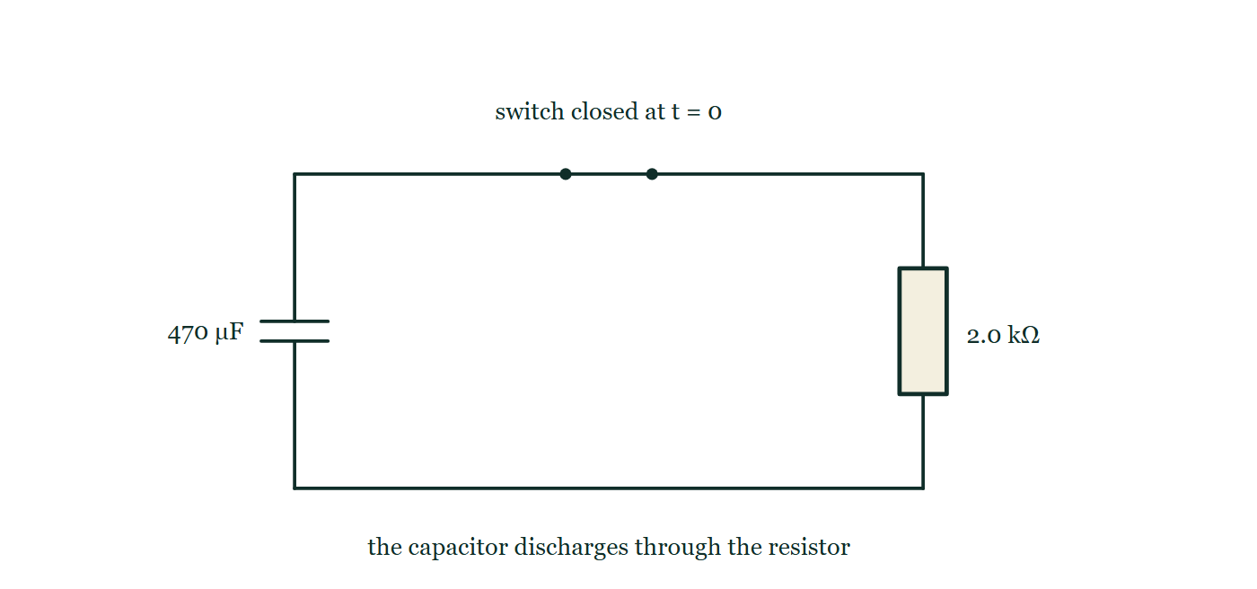
ADVANCED CIRCUITS · CIRCUIT CALCULUS
GIOPHYSICS LESSON
QUICK CHECK
Decide before the answer goes up
Check and misconception — The quick check and the trap
A 470 μF capacitor discharges through a 2.0 kΩ resistor. What is the time constant?
A
0.94 s
B
4.3 s
C
0.24 s
A charged 470 μF capacitor and a 2.0 kΩ resistor form a loop closed by a switch marked as closing at t = 0; no time constant and no readings are printed anywhere on the drawing.
The live version of this figure — click here
Advanced Circuits — Circuit Calculus. Built by GioPhysics from the lesson's own copy; nothing on these slides is re-authored.
24 / 32
Notes:
[Phase] Check and misconception: The quick check and the trap (minutes 35–41 of 45)
[Question] A 470 μF capacitor discharges through a 2.0 kΩ resistor. What is the time constant?
[Figure] A charged 470 μF capacitor and a 2.0 kΩ resistor form a loop closed by a switch marked as closing at t = 0; no time constant and no readings are printed anywhere on the drawing.
[Options] A 0.94 s B 4.3 s C 0.24 s

Slide 25
ADVANCED CIRCUITS · CIRCUIT CALCULUS
GIOPHYSICS LESSON
QUICK CHECK · THE ANSWER
The answer, and why
Check and misconception — The quick check and the trap
A 0.94 s
HOW TO GET THERE
τ = RC = 2000 × 470 × 10⁻⁶ = 0.94 s — after roughly a second, 37% of the charge remains.
WHY THE OTHERS TEMPT
A Correct. τ = RC = 2000 × 470 × 10⁻⁶ = 0.94 s.
B 4.3 s is 2000 ÷ 470 — R divided by C rather than multiplied by it, with the micro prefix dropped on the way. Only the product has units of seconds: ohms times farads is a second, and neither quotient is a time at all.
C 0.24 s is 470 ÷ 2000, the same division the other way up and the same lost prefix. The unit test settles both: multiply, do not divide, and keep the 10⁻⁶.
Advanced Circuits — Circuit Calculus. Built by GioPhysics from the lesson's own copy; nothing on these slides is re-authored.
25 / 32
Notes:
[Phase] Check and misconception: The quick check and the trap (minutes 35–41 of 45)
[Question] A 470 μF capacitor discharges through a 2.0 kΩ resistor. What is the time constant?
[Option by option] A: Correct. τ = RC = 2000 × 470 × 10⁻⁶ = 0.94 s. B: 4.3 s is 2000 ÷ 470 — R divided by C rather than multiplied by it, with the micro prefix dropped on the way. Only the product has units of seconds: ohms times farads is a second, and neither quotient is a time at all. C: 0.24 s is 470 ÷ 2000, the same division the other way up and the same lost prefix. The unit test settles both: multiply, do not divide, and keep the 10⁻⁶.
[Answer] A — 0.94 s
[Why] τ = RC = 2000 × 470 × 10⁻⁶ = 0.94 s — after roughly a second, 37% of the charge remains.
[Reveal] One click for the answer, then one for the reason.

Slide 26
ADVANCED CIRCUITS · CIRCUIT CALCULUS
GIOPHYSICS LESSON
EXTENSION 1 OF 2 · HARD
The question
Hard
Worked examples — I do, we do — one step revealed at a time
A 2200 μF capacitor charged to 6.0 V discharges through a 15 kΩ resistor. Find τ, and the time for the voltage to fall to 1.0 V.
Advanced Circuits — Circuit Calculus. Built by GioPhysics from the lesson's own copy; nothing on these slides is re-authored.
26 / 32
Notes:
[Phase] Worked examples: I do, we do — one step revealed at a time (minutes 22–35 of 45)
[Question] A 2200 μF capacitor charged to 6.0 V discharges through a 15 kΩ resistor. Find τ, and the time for the voltage to fall to 1.0 V.
[Answer] τ = 33 s; t ≈ 59 s

Slide 27
ADVANCED CIRCUITS · CIRCUIT CALCULUS
GIOPHYSICS LESSON
EXTENSION 1 OF 2 · HARD · THE WORKING
How to solve it
Hard
Worked examples — I do, we do — one step revealed at a time
A 2200 μF capacitor charged to 6.0 V discharges through a 15 kΩ resistor. Find τ, and the time for the voltage to fall to 1.0 V.
1.
τ = RC = 15 000 × 2.2 × 10⁻³ = 33 s.
2.
V = V₀e^(−t/τ) → t = τ ln(V₀/V) = 33 × ln6.
3.
t ≈ 33 × 1.79 ≈ 59 s.
Advanced Circuits — Circuit Calculus. Built by GioPhysics from the lesson's own copy; nothing on these slides is re-authored.
27 / 32
Notes:
[Phase] Worked examples: I do, we do — one step revealed at a time (minutes 22–35 of 45)
[Reveal] One click per step. The class works each line before the next appears.
[Step 1] τ = RC = 15 000 × 2.2 × 10⁻³ = 33 s.
[Step 2] V = V₀e^(−t/τ) → t = τ ln(V₀/V) = 33 × ln6.
[Step 3] t ≈ 33 × 1.79 ≈ 59 s.

Slide 28
ADVANCED CIRCUITS · CIRCUIT CALCULUS
GIOPHYSICS LESSON
EXTENSION 1 OF 2 · HARD
Answer
Hard
Worked examples — I do, we do — one step revealed at a time
τ = 33 s; t ≈ 59 s
Advanced Circuits — Circuit Calculus. Built by GioPhysics from the lesson's own copy; nothing on these slides is re-authored.
28 / 32
Notes:
[Phase] Worked examples: I do, we do — one step revealed at a time (minutes 22–35 of 45)
[Answer] τ = 33 s; t ≈ 59 s

Slide 29
ADVANCED CIRCUITS · CIRCUIT CALCULUS
GIOPHYSICS LESSON
EXTENSION 2 OF 2 · CHALLENGING
The question
Challenging
Worked examples — I do, we do — one step revealed at a time
A heart pacemaker fires each time its capacitor charges to 63% of the supply through R = 2.0 MΩ. What C gives 72 beats per minute, and why is 63% a natural choice?
Advanced Circuits — Circuit Calculus. Built by GioPhysics from the lesson's own copy; nothing on these slides is re-authored.
29 / 32
Notes:
[Phase] Worked examples: I do, we do — one step revealed at a time (minutes 22–35 of 45)
[Question] A heart pacemaker fires each time its capacitor charges to 63% of the supply through R = 2.0 MΩ. What C gives 72 beats per minute, and why is 63% a natural choice?
[Answer] C ≈ 0.42 μF; 63% is one time constant by definition

Slide 30
ADVANCED CIRCUITS · CIRCUIT CALCULUS
GIOPHYSICS LESSON
EXTENSION 2 OF 2 · CHALLENGING · THE WORKING
How to solve it
Challenging
Worked examples — I do, we do — one step revealed at a time
A heart pacemaker fires each time its capacitor charges to 63% of the supply through R = 2.0 MΩ. What C gives 72 beats per minute, and why is 63% a natural choice?
1.
72 bpm → one beat per 0.833 s; charging to 63% takes exactly one time constant τ.
2.
C = τ/R = 0.833 ÷ 2.0 × 10⁶.
3.
C ≈ 0.42 μF; 63% = 1 − e⁻¹ falls out of the exponential — the RC clock's built-in milestone.
Advanced Circuits — Circuit Calculus. Built by GioPhysics from the lesson's own copy; nothing on these slides is re-authored.
30 / 32
Notes:
[Phase] Worked examples: I do, we do — one step revealed at a time (minutes 22–35 of 45)
[Reveal] One click per step. The class works each line before the next appears.
[Step 1] 72 bpm → one beat per 0.833 s; charging to 63% takes exactly one time constant τ.
[Step 2] C = τ/R = 0.833 ÷ 2.0 × 10⁶.
[Step 3] C ≈ 0.42 μF; 63% = 1 − e⁻¹ falls out of the exponential — the RC clock's built-in milestone.

Slide 31
ADVANCED CIRCUITS · CIRCUIT CALCULUS
GIOPHYSICS LESSON
EXTENSION 2 OF 2 · CHALLENGING
Answer
Challenging
Worked examples — I do, we do — one step revealed at a time
C ≈ 0.42 μF; 63% is one time constant by definition
Advanced Circuits — Circuit Calculus. Built by GioPhysics from the lesson's own copy; nothing on these slides is re-authored.
31 / 32
Notes:
[Phase] Worked examples: I do, we do — one step revealed at a time (minutes 22–35 of 45)
[Answer] C ≈ 0.42 μF; 63% is one time constant by definition

Slide 32
ADVANCED CIRCUITS · CIRCUIT CALCULUS
GIOPHYSICS LESSON
ADVANCED CIRCUITS
Where to go next
Plenary — What to take away, what to practise next
Lesson
This lesson on giophysics.com
https://giophysics.com/chapter-23/circuit-calculus/
Live
The live, interactive version of these slides
https://giophysics.com/chapter-23/presentation/?lesson=calculus
Chapter
All Advanced Circuits lessons
https://giophysics.com/chapter-23/
PDF
Download the lesson PDF
https://giophysics.com/downloads/23-7-circuit-calculus.pdf
Advanced Circuits — Circuit Calculus. Built by GioPhysics from the lesson's own copy; nothing on these slides is re-authored.
32 / 32
Notes:
[Phase] Plenary: What to take away, what to practise next (minutes 41–45 of 45)
[Interactive] The graphs and the circuit topology on these slides are frozen. The live version at https://giophysics.com/chapter-23/presentation/?lesson=calculus moves them.

