Slide 1
ADVANCED CIRCUITS · POTENTIAL DIVIDERS
GIOPHYSICS LESSON
14 · Advanced Circuits
Share a voltage in a chosen ratio
Potential Dividers
Two resistors in series split a supply voltage in proportion to their resistances. Choose the resistors — or let a sensor be one of them — and you choose the output voltage.
POSITION
Lesson 5 of 7 in Advanced Circuits
PLAN
16 slides in the 45-minute core run, about 44.5 minutes of it
LESSON PAGE
https://giophysics.com/chapter-23/potential-dividers/
Built by GioPhysics from the lesson's own page. Every word on these slides is the lesson's; nothing here is re-authored. Teaching material, not an awarding body's document.
Advanced Circuits — Potential Dividers. Built by GioPhysics from the lesson's own copy; nothing on these slides is re-authored.
1 / 32
Notes:
[Lesson] Advanced Circuits — Potential Dividers. Lesson 5 of 7.
[Intro] Two resistors in series split a supply voltage in proportion to their resistances. Choose the resistors — or let a sensor be one of them — and you choose the output voltage.
[Source] https://giophysics.com/chapter-23/potential-dividers/
[Disclaimer] Built by GioPhysics from the lesson's own page. Every word on these slides is the lesson's; nothing here is re-authored. Teaching material, not an awarding body's document.

Slide 2
ADVANCED CIRCUITS · POTENTIAL DIVIDERS
GIOPHYSICS LESSON
WHAT THIS NEEDS
What you already know
Starter — Recall what this lesson stands on
Recall
Series circuits
https://giophysics.com/chapter-22/series-parallel-circuits/
Recall
Thermistors & LDRs
https://giophysics.com/chapter-23/thermistors-ldrs/
Advanced Circuits — Potential Dividers. Built by GioPhysics from the lesson's own copy; nothing on these slides is re-authored.
2 / 32
Notes:
[Phase] Starter: Recall what this lesson stands on (minutes 0–5 of 45)
[Starter] Recall: Series circuits; Thermistors & LDRs

Slide 3
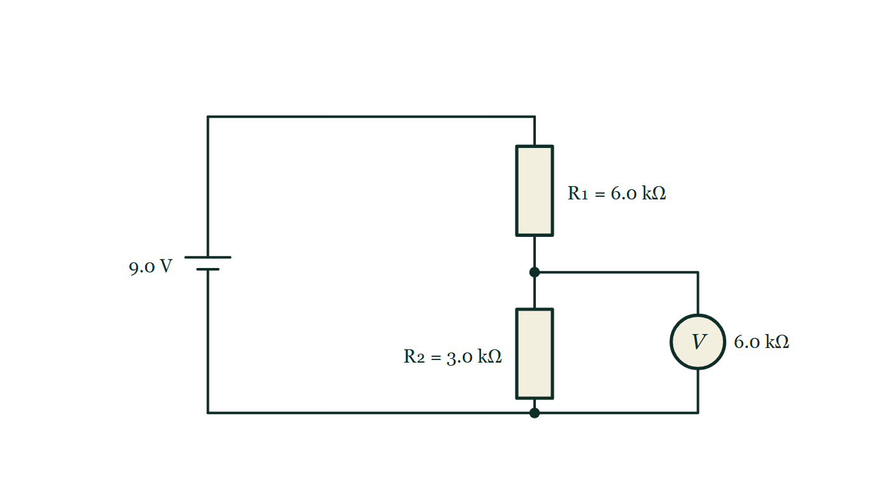
ADVANCED CIRCUITS · POTENTIAL DIVIDERS
GIOPHYSICS LESSON
THINK FIRST
A divider is built to give exactly 5.0 V. You connect it to the thing it was designed to drive and it reads 3.3 V. Nothing is broken. What happened?
Take answers before you click — the point is the commitment
Ten volts in, two equal 1 kΩ resistors, output taken across the lower one. On the bench with a meter it read 5.0 V all afternoon.
THE ANSWER
The load. Hanging 1 kΩ across the lower resistor puts two 1 kΩ resistors in parallel there, so the bottom of the divider is now 500 Ω, not 1000 Ω — and 500 out of 1500 is a third of the supply, which is 3.3 V. The formula never promised otherwise: it assumes the output draws no current, and a load comparable with R₂ makes that assumption false.
A 9.0 V divider of 6.0 kΩ over 3.0 kΩ with a voltmeter of stated resistance 6.0 kΩ wired across the lower resistor, drawn as a branch of the circuit rather than as an observer of it.
The live version of this figure — click here
Advanced Circuits — Potential Dividers. Built by GioPhysics from the lesson's own copy; nothing on these slides is re-authored.
3 / 32
Notes:
[Phase] Starter: Recall what this lesson stands on (minutes 0–5 of 45)
[Hook] A divider is built to give exactly 5.0 V. You connect it to the thing it was designed to drive and it reads 3.3 V. Nothing is broken. What happened? Ten volts in, two equal 1 kΩ resistors, output taken across the lower one. On the bench with a meter it read 5.0 V all afternoon.
[Answer] The load. Hanging 1 kΩ across the lower resistor puts two 1 kΩ resistors in parallel there, so the bottom of the divider is now 500 Ω, not 1000 Ω — and 500 out of 1500 is a third of the supply, which is 3.3 V. The formula never promised otherwise: it assumes the output draws no current, and a load comparable with R₂ makes that assumption false.
[Figure] A 9.0 V divider of 6.0 kΩ over 3.0 kΩ with a voltmeter of stated resistance 6.0 kΩ wired across the lower resistor, drawn as a branch of the circuit rather than as an observer of it.

Slide 4
ADVANCED CIRCUITS · POTENTIAL DIVIDERS
GIOPHYSICS LESSON
EXPLAINED SIMPLY
In one sentence
Introduce the idea — The big idea and the definition
A potential divider is a pair of series resistors used to produce an output voltage that is a chosen fraction of the input voltage.
Advanced Circuits — Potential Dividers. Built by GioPhysics from the lesson's own copy; nothing on these slides is re-authored.
4 / 32
Notes:
[Phase] Introduce the idea: The big idea and the definition (minutes 5–13 of 45)
[Definition] A potential divider is a pair of series resistors used to produce an output voltage that is a chosen fraction of the input voltage.

Slide 5
ADVANCED CIRCUITS · POTENTIAL DIVIDERS
GIOPHYSICS LESSON
EXPLAINED SIMPLY
What that looks like
Introduce the idea — The big idea and the definition
FOR EXAMPLE
With R₁ = R₂ across 12 V, the output across R₂ is exactly 6 V — the voltage divides evenly between equal resistors.
Advanced Circuits — Potential Dividers. Built by GioPhysics from the lesson's own copy; nothing on these slides is re-authored.
5 / 32
Notes:
[Phase] Introduce the idea: The big idea and the definition (minutes 5–13 of 45)
[Worked illustration] With R₁ = R₂ across 12 V, the output across R₂ is exactly 6 V — the voltage divides evenly between equal resistors.

Slide 6
ADVANCED CIRCUITS · POTENTIAL DIVIDERS
GIOPHYSICS LESSON
THE BIG IDEA
Share a voltage in a chosen ratio
Introduce the idea — The big idea and the definition
The same current flows through both resistors, so each takes a share of the input voltage proportional to its resistance: Vout = Vin × R₂/(R₁ + R₂). Replace R₁ or R₂ with a thermistor or LDR and Vout becomes a signal that follows temperature or light.
Advanced Circuits — Potential Dividers. Built by GioPhysics from the lesson's own copy; nothing on these slides is re-authored.
6 / 32
Notes:
[Phase] Introduce the idea: The big idea and the definition (minutes 5–13 of 45)
[Big idea] The same current flows through both resistors, so each takes a share of the input voltage proportional to its resistance: Vout = Vin × R₂/(R₁ + R₂). Replace R₁ or R₂ with a thermistor or LDR and Vout becomes a signal that follows temperature or light.

Slide 7
ADVANCED CIRCUITS · POTENTIAL DIVIDERS
GIOPHYSICS LESSON
THE PHYSICS · 1 OF 3
Slide the tap
Build the model — The formulae, one at a time, in plain English
A potentiometer (three-terminal variable resistor) is a continuously adjustable divider: the wiper taps any fraction from 0 to Vin.
Advanced Circuits — Potential Dividers. Built by GioPhysics from the lesson's own copy; nothing on these slides is re-authored.
7 / 32
Notes:
[Phase] Build the model: The formulae, one at a time, in plain English (minutes 13–22 of 45)
[Section] A potentiometer (three-terminal variable resistor) is a continuously adjustable divider: the wiper taps any fraction from 0 to Vin.

Slide 8
ADVANCED CIRCUITS · POTENTIAL DIVIDERS
GIOPHYSICS LESSON
THE PHYSICS · 2 OF 3
Design the ratio
Build the model — The formulae, one at a time, in plain English
Need 4 V from 12 V? Make R₂ half of R₁... no — make R₂/(R₁+R₂) = 1/3, for example 470 Ω and 940 Ω. State the ratio first, then pick values.
Advanced Circuits — Potential Dividers. Built by GioPhysics from the lesson's own copy; nothing on these slides is re-authored.
8 / 32
Notes:
[Phase] Build the model: The formulae, one at a time, in plain English (minutes 13–22 of 45)
[Section] Need 4 V from 12 V? Make R₂ half of R₁... no — make R₂/(R₁+R₂) = 1/3, for example 470 Ω and 940 Ω. State the ratio first, then pick values.

Slide 9
ADVANCED CIRCUITS · POTENTIAL DIVIDERS
GIOPHYSICS LESSON
THE PHYSICS · 3 OF 3
Loading warning
Build the model — The formulae, one at a time, in plain English
Connecting a load across R₂ reduces the effective bottom resistance, so the real output dips below the unloaded formula's prediction.
Advanced Circuits — Potential Dividers. Built by GioPhysics from the lesson's own copy; nothing on these slides is re-authored.
9 / 32
Notes:
[Phase] Build the model: The formulae, one at a time, in plain English (minutes 13–22 of 45)
[Section] Connecting a load across R₂ reduces the effective bottom resistance, so the real output dips below the unloaded formula's prediction.

Slide 10
ADVANCED CIRCUITS · POTENTIAL DIVIDERS
GIOPHYSICS LESSON
FORMULA 1 OF 3
Divider equation
Build the model — The formulae, one at a time, in plain English
Vout = Vin·R₂/(R₁+R₂)
Vout is taken across R₂
IN PLAIN ENGLISH
The output is the input times R₂'s share of the total resistance — a bigger R₂ keeps a bigger share of the volts.
Advanced Circuits — Potential Dividers. Built by GioPhysics from the lesson's own copy; nothing on these slides is re-authored.
10 / 32
Notes:
[Phase] Build the model: The formulae, one at a time, in plain English (minutes 13–22 of 45)
[Formula] Divider equation: Vout = Vin·R₂/(R₁+R₂)
[In plain English] The output is the input times R₂'s share of the total resistance — a bigger R₂ keeps a bigger share of the volts.
[Note] Vout is taken across R₂

Slide 11
ADVANCED CIRCUITS · POTENTIAL DIVIDERS
GIOPHYSICS LESSON
FORMULA 2 OF 3
Voltage ratio
Build the model — The formulae, one at a time, in plain English
V₁/V₂ = R₁/R₂
Same current through both
IN PLAIN ENGLISH
Series resistors split the voltage in the exact ratio of their resistances, because the same current flows in each.
Advanced Circuits — Potential Dividers. Built by GioPhysics from the lesson's own copy; nothing on these slides is re-authored.
11 / 32
Notes:
[Phase] Build the model: The formulae, one at a time, in plain English (minutes 13–22 of 45)
[Formula] Voltage ratio: V₁/V₂ = R₁/R₂
[In plain English] Series resistors split the voltage in the exact ratio of their resistances, because the same current flows in each.
[Note] Same current through both

Slide 12
ADVANCED CIRCUITS · POTENTIAL DIVIDERS
GIOPHYSICS LESSON
FORMULA 3 OF 3
Sensor divider
Build the model — The formulae, one at a time, in plain English
R_sensor changes ⇒ Vout changes
Thermistor or LDR as R₁ or R₂
IN PLAIN ENGLISH
When one resistor is a sensor, the output voltage automatically tracks temperature or light — the basis of most sensing circuits.
Advanced Circuits — Potential Dividers. Built by GioPhysics from the lesson's own copy; nothing on these slides is re-authored.
12 / 32
Notes:
[Phase] Build the model: The formulae, one at a time, in plain English (minutes 13–22 of 45)
[Formula] Sensor divider: R_sensor changes ⇒ Vout changes
[In plain English] When one resistor is a sensor, the output voltage automatically tracks temperature or light — the basis of most sensing circuits.
[Note] Thermistor or LDR as R₁ or R₂

Slide 13
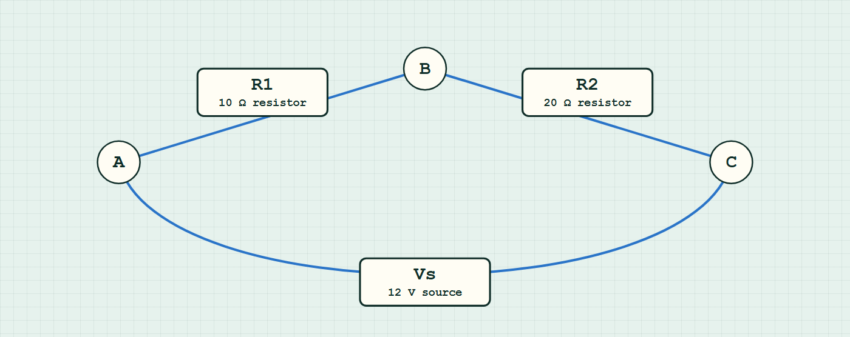
ADVANCED CIRCUITS · POTENTIAL DIVIDERS
GIOPHYSICS LESSON
CIRCUIT MODEL
Read the topology before the values
Build the model — nodes are where connections meet, branches are what lies between them
series network — components are branches between nodes.
Switch topology and hide the values on the live version — click here
Advanced Circuits — Potential Dividers. Built by GioPhysics from the lesson's own copy; nothing on these slides is re-authored.
13 / 32
Notes:
[Phase] Build the model: The formulae, one at a time, in plain English (minutes 13–22 of 45)
[Topology] Nodes are the points where connections meet; branches are the components between them. The live version switches between series, parallel and bridge and can hide the values.

Slide 14
ADVANCED CIRCUITS · POTENTIAL DIVIDERS
GIOPHYSICS LESSON
WATCH OUT
The common trap
Check and misconception — The quick check and the trap
The divider formula assumes (nearly) no current is drawn from the output. A low-resistance load in parallel with R₂ changes the ratio — always check the load is much larger than R₂.
Advanced Circuits — Potential Dividers. Built by GioPhysics from the lesson's own copy; nothing on these slides is re-authored.
14 / 32
Notes:
[Phase] Check and misconception: The quick check and the trap (minutes 35–41 of 45)
[Misconception] The divider formula assumes (nearly) no current is drawn from the output. A low-resistance load in parallel with R₂ changes the ratio — always check the load is much larger than R₂.

Slide 15
ADVANCED CIRCUITS · POTENTIAL DIVIDERS
GIOPHYSICS LESSON
WORKED EXAMPLE 1 OF 2 · EASY
The question
Easy
Worked examples — I do, we do — one step revealed at a time
A 10 kΩ and a 30 kΩ resistor divide 8.0 V, output across the 30 kΩ. Find Vout.
Advanced Circuits — Potential Dividers. Built by GioPhysics from the lesson's own copy; nothing on these slides is re-authored.
15 / 32
Notes:
[Phase] Worked examples: I do, we do — one step revealed at a time (minutes 22–35 of 45)
[Question] A 10 kΩ and a 30 kΩ resistor divide 8.0 V, output across the 30 kΩ. Find Vout.
[Answer] 6.0 V

Slide 16
ADVANCED CIRCUITS · POTENTIAL DIVIDERS
GIOPHYSICS LESSON
WORKED EXAMPLE 1 OF 2 · EASY · THE WORKING
How to solve it
Easy
Worked examples — I do, we do — one step revealed at a time
A 10 kΩ and a 30 kΩ resistor divide 8.0 V, output across the 30 kΩ. Find Vout.
1.
Vout = 8.0 × 30/(10 + 30).
2.
Vout = 6.0 V.
Advanced Circuits — Potential Dividers. Built by GioPhysics from the lesson's own copy; nothing on these slides is re-authored.
16 / 32
Notes:
[Phase] Worked examples: I do, we do — one step revealed at a time (minutes 22–35 of 45)
[Reveal] One click per step. The class works each line before the next appears.
[Step 1] Vout = 8.0 × 30/(10 + 30).
[Step 2] Vout = 6.0 V.

Slide 17
ADVANCED CIRCUITS · POTENTIAL DIVIDERS
GIOPHYSICS LESSON
WORKED EXAMPLE 1 OF 2 · EASY
Answer
Easy
Worked examples — I do, we do — one step revealed at a time
6.0 V
Advanced Circuits — Potential Dividers. Built by GioPhysics from the lesson's own copy; nothing on these slides is re-authored.
17 / 32
Notes:
[Phase] Worked examples: I do, we do — one step revealed at a time (minutes 22–35 of 45)
[Answer] 6.0 V

Slide 18
ADVANCED CIRCUITS · POTENTIAL DIVIDERS
GIOPHYSICS LESSON
WORKED EXAMPLE 2 OF 2 · MEDIUM
The question
Medium
Worked examples — I do, we do — one step revealed at a time
A 10 kΩ resistor and an NTC thermistor (10 kΩ cold, 1 kΩ hot) divide 6.0 V, output across the thermistor. Find Vout cold and hot.
Advanced Circuits — Potential Dividers. Built by GioPhysics from the lesson's own copy; nothing on these slides is re-authored.
18 / 32
Notes:
[Phase] Worked examples: I do, we do — one step revealed at a time (minutes 22–35 of 45)
[Question] A 10 kΩ resistor and an NTC thermistor (10 kΩ cold, 1 kΩ hot) divide 6.0 V, output across the thermistor. Find Vout cold and hot.
[Answer] ≈3.0 V cold, ≈0.55 V hot

Slide 19
ADVANCED CIRCUITS · POTENTIAL DIVIDERS
GIOPHYSICS LESSON
WORKED EXAMPLE 2 OF 2 · MEDIUM · THE WORKING
How to solve it
Medium
Worked examples — I do, we do — one step revealed at a time
A 10 kΩ resistor and an NTC thermistor (10 kΩ cold, 1 kΩ hot) divide 6.0 V, output across the thermistor. Find Vout cold and hot.
1.
Cold: Vout = 6.0 × 10/(10+10) = 3.0 V.
2.
Hot: Vout = 6.0 × 1/(10+1) ≈ 0.55 V.
3.
The output falls as temperature rises — a temperature-to-voltage signal.
Advanced Circuits — Potential Dividers. Built by GioPhysics from the lesson's own copy; nothing on these slides is re-authored.
19 / 32
Notes:
[Phase] Worked examples: I do, we do — one step revealed at a time (minutes 22–35 of 45)
[Reveal] One click per step. The class works each line before the next appears.
[Step 1] Cold: Vout = 6.0 × 10/(10+10) = 3.0 V.
[Step 2] Hot: Vout = 6.0 × 1/(10+1) ≈ 0.55 V.
[Step 3] The output falls as temperature rises — a temperature-to-voltage signal.

Slide 20
ADVANCED CIRCUITS · POTENTIAL DIVIDERS
GIOPHYSICS LESSON
WORKED EXAMPLE 2 OF 2 · MEDIUM
Answer
Medium
Worked examples — I do, we do — one step revealed at a time
≈3.0 V cold, ≈0.55 V hot
Advanced Circuits — Potential Dividers. Built by GioPhysics from the lesson's own copy; nothing on these slides is re-authored.
20 / 32
Notes:
[Phase] Worked examples: I do, we do — one step revealed at a time (minutes 22–35 of 45)
[Answer] ≈3.0 V cold, ≈0.55 V hot

Slide 21
ADVANCED CIRCUITS · POTENTIAL DIVIDERS
GIOPHYSICS LESSON
SPOT THE MISTAKE
One line here is wrong
The whole working is up — find the bad line before you click
1.
A 10 kΩ resistor sits above a 30 kΩ resistor across 8.0 V. Find the output across the 30 kΩ.
2.
Vout = Vin × R₂/(R₁ + R₂)
3.
Vout = 8.0 × 30 / 10
4.
Vout = 24 V
5.
So the output is 24 V.
LINE 3 IS WRONG
The denominator is the wrong resistance: the formula wants the total, R₁ + R₂ = 40 kΩ, and the ratio R₂/R₁ has been substituted instead. A divider can only ever hand out a fraction of what it is given, so any answer above the input voltage is wrong before it is checked — this one claims the pair of resistors produced 24 V from an 8.0 V cell.
IT SHOULD SAY
Vout = 8.0 × 30/(10 + 30) = 8.0 × 0.75 = 6.0 V
Advanced Circuits — Potential Dividers. Built by GioPhysics from the lesson's own copy; nothing on these slides is re-authored.
21 / 32
Notes:
[Phase] Worked examples: I do, we do — one step revealed at a time (minutes 22–35 of 45)
[Spot the mistake] The working is complete and one line of it is wrong. Let the room hunt: one click names the line, a second shows it done correctly.
[Line 3 is wrong] The denominator is the wrong resistance: the formula wants the total, R₁ + R₂ = 40 kΩ, and the ratio R₂/R₁ has been substituted instead. A divider can only ever hand out a fraction of what it is given, so any answer above the input voltage is wrong before it is checked — this one claims the pair of resistors produced 24 V from an 8.0 V cell.
[It should say] Vout = 8.0 × 30/(10 + 30) = 8.0 × 0.75 = 6.0 V

Slide 22
ADVANCED CIRCUITS · POTENTIAL DIVIDERS
GIOPHYSICS LESSON
PREDICT · TAKE THE VOTE
Commit before you are told
Hands up for each option, then click
Unloaded, this divider puts 3.0 V across R₂. A voltmeter of 6.0 kΩ is now connected across R₂. What does it read?
A 3.0 V — a voltmeter reports what is there without changing it
B Less than 3.0 V
C More than 3.0 V
A 9.0 V divider of 6.0 kΩ over 3.0 kΩ with a voltmeter of stated resistance 6.0 kΩ wired across the lower resistor, drawn as a branch of the circuit rather than as an observer of it.
The live version of this figure — click here
Advanced Circuits — Potential Dividers. Built by GioPhysics from the lesson's own copy; nothing on these slides is re-authored.
22 / 32
Notes:
[Phase] Build the model: The formulae, one at a time, in plain English (minutes 13–22 of 45)
[Predict] Unloaded, this divider puts 3.0 V across R₂. A voltmeter of 6.0 kΩ is now connected across R₂. What does it read?
[Options] A 3.0 V — a voltmeter reports what is there without changing it B Less than 3.0 V C More than 3.0 V
[Figure] A 9.0 V divider of 6.0 kΩ over 3.0 kΩ with a voltmeter of stated resistance 6.0 kΩ wired across the lower resistor, drawn as a branch of the circuit rather than as an observer of it.

Slide 23
ADVANCED CIRCUITS · POTENTIAL DIVIDERS
GIOPHYSICS LESSON
PREDICT · THE OUTCOME
What actually happens
Ask the room who changed their mind, and why
B Less than 3.0 V
WHY
The meter is drawn as a branch of the circuit because that is what it is. Its 6.0 kΩ sits in parallel with the 3.0 kΩ it came to measure, and that pair combines to 2.0 kΩ — so the divider the supply now sees is 6.0 kΩ over 2.0 kΩ, and the lower share falls to 9.0 × 2/8 = 2.25 V. The reading is honest about the circuit that exists while the meter is attached; it is the circuit that has changed. Use a meter whose resistance is far larger than R₂ and the disturbance becomes negligible.
Advanced Circuits — Potential Dividers. Built by GioPhysics from the lesson's own copy; nothing on these slides is re-authored.
23 / 32
Notes:
[Phase] Build the model: The formulae, one at a time, in plain English (minutes 13–22 of 45)
[Answer] B — Less than 3.0 V. The meter is drawn as a branch of the circuit because that is what it is. Its 6.0 kΩ sits in parallel with the 3.0 kΩ it came to measure, and that pair combines to 2.0 kΩ — so the divider the supply now sees is 6.0 kΩ over 2.0 kΩ, and the lower share falls to 9.0 × 2/8 = 2.25 V. The reading is honest about the circuit that exists while the meter is attached; it is the circuit that has changed. Use a meter whose resistance is far larger than R₂ and the disturbance becomes negligible.

Slide 24
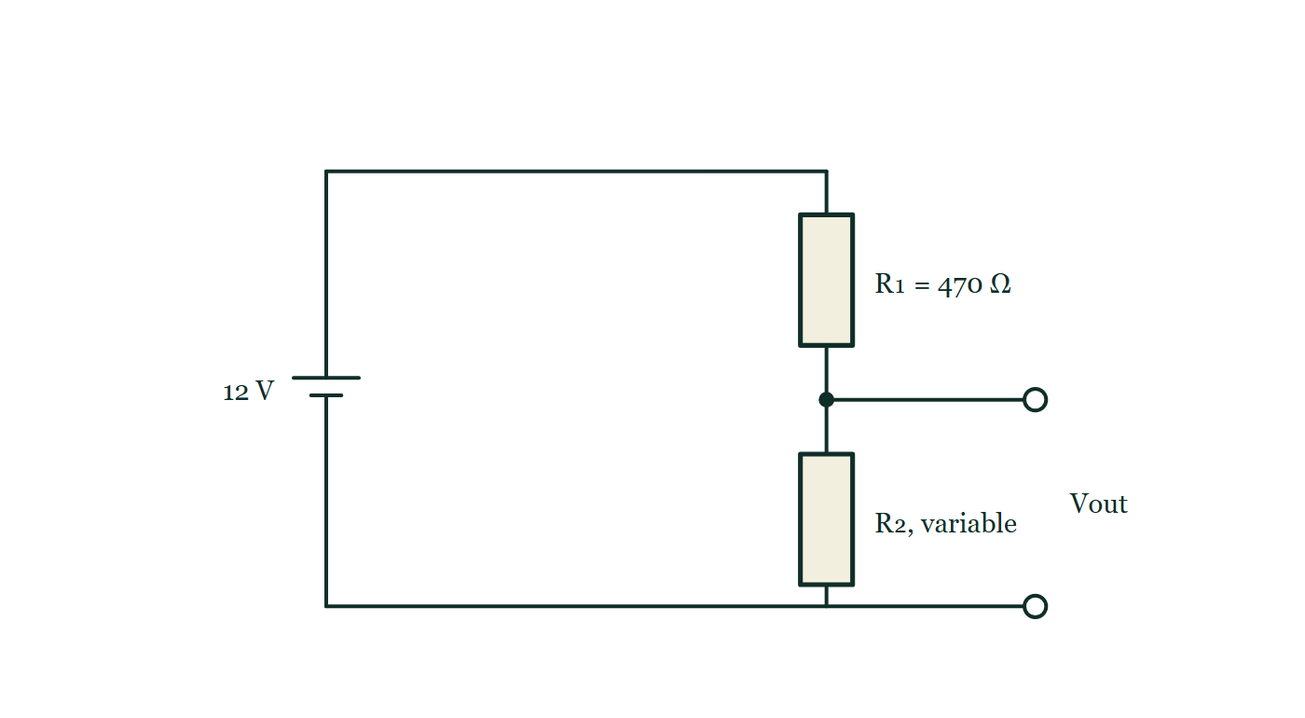
ADVANCED CIRCUITS · POTENTIAL DIVIDERS
GIOPHYSICS LESSON
QUICK CHECK
Decide before the answer goes up
Check and misconception — The quick check and the trap
R₁ = 470 Ω sits on top of variable R₂ across 12 V. What must R₂ be for the output across it to read 4.0 V?
A
235 Ω
B
940 Ω
C
1645 Ω
A 12 V cell across a fixed 470 Ω resistor sitting above a variable resistor R₂, with the output terminals tapped from the junction between the two and from the bottom rail, so Vout is the share taken by R₂ alone.
The live version of this figure — click here
Advanced Circuits — Potential Dividers. Built by GioPhysics from the lesson's own copy; nothing on these slides is re-authored.
24 / 32
Notes:
[Phase] Check and misconception: The quick check and the trap (minutes 35–41 of 45)
[Question] R₁ = 470 Ω sits on top of variable R₂ across 12 V. What must R₂ be for the output across it to read 4.0 V?
[Figure] A 12 V cell across a fixed 470 Ω resistor sitting above a variable resistor R₂, with the output terminals tapped from the junction between the two and from the bottom rail, so Vout is the share taken by R₂ alone.
[Options] A 235 Ω B 940 Ω C 1645 Ω

Slide 25
ADVANCED CIRCUITS · POTENTIAL DIVIDERS
GIOPHYSICS LESSON
QUICK CHECK · THE ANSWER
The answer, and why
Check and misconception — The quick check and the trap
A 235 Ω
HOW TO GET THERE
Vout/Vin = 1/3, so R₂/(R₁+R₂) = 1/3 giving R₂ = R₁/2 = 235 Ω.
WHY THE OTHERS TEMPT
A Correct. Vout/Vin = 4/12 = 1/3, so R₂/(R₁ + R₂) = 1/3, which makes R₂ half of R₁: 235 Ω.
B 940 Ω is 2 × 470 — the right ratio applied to the wrong resistor. R₁ takes the 8 V and R₂ the 4 V, so it is R₁ that must be twice R₂. Put 940 Ω underneath and the output would come out at 8.0 V.
C 1645 Ω would put 9.3 V across the lower resistor, more than three quarters of the supply. The sanity check that catches this needs no algebra at all: 4.0 V is less than half of 12 V, so the lower resistor has to be the smaller of the two.
Advanced Circuits — Potential Dividers. Built by GioPhysics from the lesson's own copy; nothing on these slides is re-authored.
25 / 32
Notes:
[Phase] Check and misconception: The quick check and the trap (minutes 35–41 of 45)
[Question] R₁ = 470 Ω sits on top of variable R₂ across 12 V. What must R₂ be for the output across it to read 4.0 V?
[Option by option] A: Correct. Vout/Vin = 4/12 = 1/3, so R₂/(R₁ + R₂) = 1/3, which makes R₂ half of R₁: 235 Ω. B: 940 Ω is 2 × 470 — the right ratio applied to the wrong resistor. R₁ takes the 8 V and R₂ the 4 V, so it is R₁ that must be twice R₂. Put 940 Ω underneath and the output would come out at 8.0 V. C: 1645 Ω would put 9.3 V across the lower resistor, more than three quarters of the supply. The sanity check that catches this needs no algebra at all: 4.0 V is less than half of 12 V, so the lower resistor has to be the smaller of the two.
[Answer] A — 235 Ω
[Why] Vout/Vin = 1/3, so R₂/(R₁+R₂) = 1/3 giving R₂ = R₁/2 = 235 Ω.
[Reveal] One click for the answer, then one for the reason.

Slide 26
ADVANCED CIRCUITS · POTENTIAL DIVIDERS
GIOPHYSICS LESSON
EXTENSION 1 OF 2 · HARD
The question
Hard
Worked examples — I do, we do — one step revealed at a time
A divider (R₁ = 6.0 kΩ over R₂ = 3.0 kΩ, Vin = 9.0 V) is measured with a voltmeter of resistance 6.0 kΩ across R₂. What does the meter read, and what was the unloaded value?
Advanced Circuits — Potential Dividers. Built by GioPhysics from the lesson's own copy; nothing on these slides is re-authored.
26 / 32
Notes:
[Phase] Worked examples: I do, we do — one step revealed at a time (minutes 22–35 of 45)
[Question] A divider (R₁ = 6.0 kΩ over R₂ = 3.0 kΩ, Vin = 9.0 V) is measured with a voltmeter of resistance 6.0 kΩ across R₂. What does the meter read, and what was the unloaded value?
[Answer] 2.25 V measured vs 3.0 V unloaded — loading error

Slide 27
ADVANCED CIRCUITS · POTENTIAL DIVIDERS
GIOPHYSICS LESSON
EXTENSION 1 OF 2 · HARD · THE WORKING
How to solve it
Hard
Worked examples — I do, we do — one step revealed at a time
A divider (R₁ = 6.0 kΩ over R₂ = 3.0 kΩ, Vin = 9.0 V) is measured with a voltmeter of resistance 6.0 kΩ across R₂. What does the meter read, and what was the unloaded value?
1.
Unloaded: 9.0 × 3/9 = 3.0 V.
2.
Meter loads R₂: 3k ∥ 6k = 2.0 kΩ.
3.
Reading = 9.0 × 2/(6 + 2) = 2.25 V — the act of measuring dropped it 25%.
Advanced Circuits — Potential Dividers. Built by GioPhysics from the lesson's own copy; nothing on these slides is re-authored.
27 / 32
Notes:
[Phase] Worked examples: I do, we do — one step revealed at a time (minutes 22–35 of 45)
[Reveal] One click per step. The class works each line before the next appears.
[Step 1] Unloaded: 9.0 × 3/9 = 3.0 V.
[Step 2] Meter loads R₂: 3k ∥ 6k = 2.0 kΩ.
[Step 3] Reading = 9.0 × 2/(6 + 2) = 2.25 V — the act of measuring dropped it 25%.

Slide 28
ADVANCED CIRCUITS · POTENTIAL DIVIDERS
GIOPHYSICS LESSON
EXTENSION 1 OF 2 · HARD
Answer
Hard
Worked examples — I do, we do — one step revealed at a time
2.25 V measured vs 3.0 V unloaded — loading error
Advanced Circuits — Potential Dividers. Built by GioPhysics from the lesson's own copy; nothing on these slides is re-authored.
28 / 32
Notes:
[Phase] Worked examples: I do, we do — one step revealed at a time (minutes 22–35 of 45)
[Answer] 2.25 V measured vs 3.0 V unloaded — loading error

Slide 29
ADVANCED CIRCUITS · POTENTIAL DIVIDERS
GIOPHYSICS LESSON
EXTENSION 2 OF 2 · CHALLENGING
The question
Challenging
Worked examples — I do, we do — one step revealed at a time
Design a divider from a 12 V supply giving 5.0 V output that sags less than 0.25 V when a 10 kΩ load connects. Choose sensible resistor values and verify.
Advanced Circuits — Potential Dividers. Built by GioPhysics from the lesson's own copy; nothing on these slides is re-authored.
29 / 32
Notes:
[Phase] Worked examples: I do, we do — one step revealed at a time (minutes 22–35 of 45)
[Question] Design a divider from a 12 V supply giving 5.0 V output that sags less than 0.25 V when a 10 kΩ load connects. Choose sensible resistor values and verify.
[Answer] R₁ = 700 Ω, R₂ = 500 Ω: 5.0 V unloaded, ≈ 4.86 V loaded

Slide 30
ADVANCED CIRCUITS · POTENTIAL DIVIDERS
GIOPHYSICS LESSON
EXTENSION 2 OF 2 · CHALLENGING · THE WORKING
How to solve it
Challenging
Worked examples — I do, we do — one step revealed at a time
Design a divider from a 12 V supply giving 5.0 V output that sags less than 0.25 V when a 10 kΩ load connects. Choose sensible resistor values and verify.
1.
Rule of thumb: divider current ≫ load current → make R₂ ≪ load. Try R₂ = 1.0 kΩ: need R₁ = R₂(12 − 5)/5 = 1.4 kΩ.
2.
Loaded: R₂ ∥ 10k = 0.909 kΩ → Vout = 12 × 0.909/(1.4 + 0.909) ≈ 4.72 V — sag 0.28 V, marginal.
3.
Halve to R₂ = 500 Ω, R₁ = 700 Ω: loaded R₂′ = 476 Ω → Vout = 12 × 476/1176 ≈ 4.86 V — sag 0.14 V ✓.
Advanced Circuits — Potential Dividers. Built by GioPhysics from the lesson's own copy; nothing on these slides is re-authored.
30 / 32
Notes:
[Phase] Worked examples: I do, we do — one step revealed at a time (minutes 22–35 of 45)
[Reveal] One click per step. The class works each line before the next appears.
[Step 1] Rule of thumb: divider current ≫ load current → make R₂ ≪ load. Try R₂ = 1.0 kΩ: need R₁ = R₂(12 − 5)/5 = 1.4 kΩ.
[Step 2] Loaded: R₂ ∥ 10k = 0.909 kΩ → Vout = 12 × 0.909/(1.4 + 0.909) ≈ 4.72 V — sag 0.28 V, marginal.
[Step 3] Halve to R₂ = 500 Ω, R₁ = 700 Ω: loaded R₂′ = 476 Ω → Vout = 12 × 476/1176 ≈ 4.86 V — sag 0.14 V ✓.

Slide 31
ADVANCED CIRCUITS · POTENTIAL DIVIDERS
GIOPHYSICS LESSON
EXTENSION 2 OF 2 · CHALLENGING
Answer
Challenging
Worked examples — I do, we do — one step revealed at a time
R₁ = 700 Ω, R₂ = 500 Ω: 5.0 V unloaded, ≈ 4.86 V loaded
Advanced Circuits — Potential Dividers. Built by GioPhysics from the lesson's own copy; nothing on these slides is re-authored.
31 / 32
Notes:
[Phase] Worked examples: I do, we do — one step revealed at a time (minutes 22–35 of 45)
[Answer] R₁ = 700 Ω, R₂ = 500 Ω: 5.0 V unloaded, ≈ 4.86 V loaded

Slide 32
ADVANCED CIRCUITS · POTENTIAL DIVIDERS
GIOPHYSICS LESSON
ADVANCED CIRCUITS
Where to go next
Plenary — What to take away, what to practise next
Next
14.6 Potentiometer Circuits
https://giophysics.com/chapter-23/potentiometer-circuits/
Lesson
This lesson on giophysics.com
https://giophysics.com/chapter-23/potential-dividers/
Live
The live, interactive version of these slides
https://giophysics.com/chapter-23/presentation/?lesson=dividers
Chapter
All Advanced Circuits lessons
https://giophysics.com/chapter-23/
PDF
Download the lesson PDF
https://giophysics.com/downloads/23-5-potential-dividers.pdf
Advanced Circuits — Potential Dividers. Built by GioPhysics from the lesson's own copy; nothing on these slides is re-authored.
32 / 32
Notes:
[Phase] Plenary: What to take away, what to practise next (minutes 41–45 of 45)
[Interactive] The graphs and the circuit topology on these slides are frozen. The live version at https://giophysics.com/chapter-23/presentation/?lesson=dividers moves them.

