Slide 1
ADVANCED CIRCUITS · KIRCHHOFF'S LAWS
GIOPHYSICS LESSON
14 · Advanced Circuits
Conservation, written for circuits
Kirchhoff's Laws
Kirchhoff's two laws are conservation of charge and conservation of energy translated into circuit language — and they solve any network that the series and parallel rules cannot.
POSITION
Lesson 1 of 7 in Advanced Circuits
PLAN
16 slides in the 45-minute core run, about 44.5 minutes of it
LESSON PAGE
https://giophysics.com/chapter-23/kirchhoffs-laws/
Built by GioPhysics from the lesson's own page. Every word on these slides is the lesson's; nothing here is re-authored. Teaching material, not an awarding body's document.
Advanced Circuits — Kirchhoff's Laws. Built by GioPhysics from the lesson's own copy; nothing on these slides is re-authored.
1 / 32
Notes:
[Lesson] Advanced Circuits — Kirchhoff's Laws. Lesson 1 of 7.
[Intro] Kirchhoff's two laws are conservation of charge and conservation of energy translated into circuit language — and they solve any network that the series and parallel rules cannot.
[Source] https://giophysics.com/chapter-23/kirchhoffs-laws/
[Disclaimer] Built by GioPhysics from the lesson's own page. Every word on these slides is the lesson's; nothing here is re-authored. Teaching material, not an awarding body's document.

Slide 2
ADVANCED CIRCUITS · KIRCHHOFF'S LAWS
GIOPHYSICS LESSON
WHAT THIS NEEDS
What you already know
Starter — Recall what this lesson stands on
Recall
Series & parallel
https://giophysics.com/chapter-22/series-parallel-circuits/
Recall
Energy conservation
https://giophysics.com/chapter-6/energy-conversion-conservation/
Advanced Circuits — Kirchhoff's Laws. Built by GioPhysics from the lesson's own copy; nothing on these slides is re-authored.
2 / 32
Notes:
[Phase] Starter: Recall what this lesson stands on (minutes 0–5 of 45)
[Starter] Recall: Series & parallel; Energy conservation

Slide 3
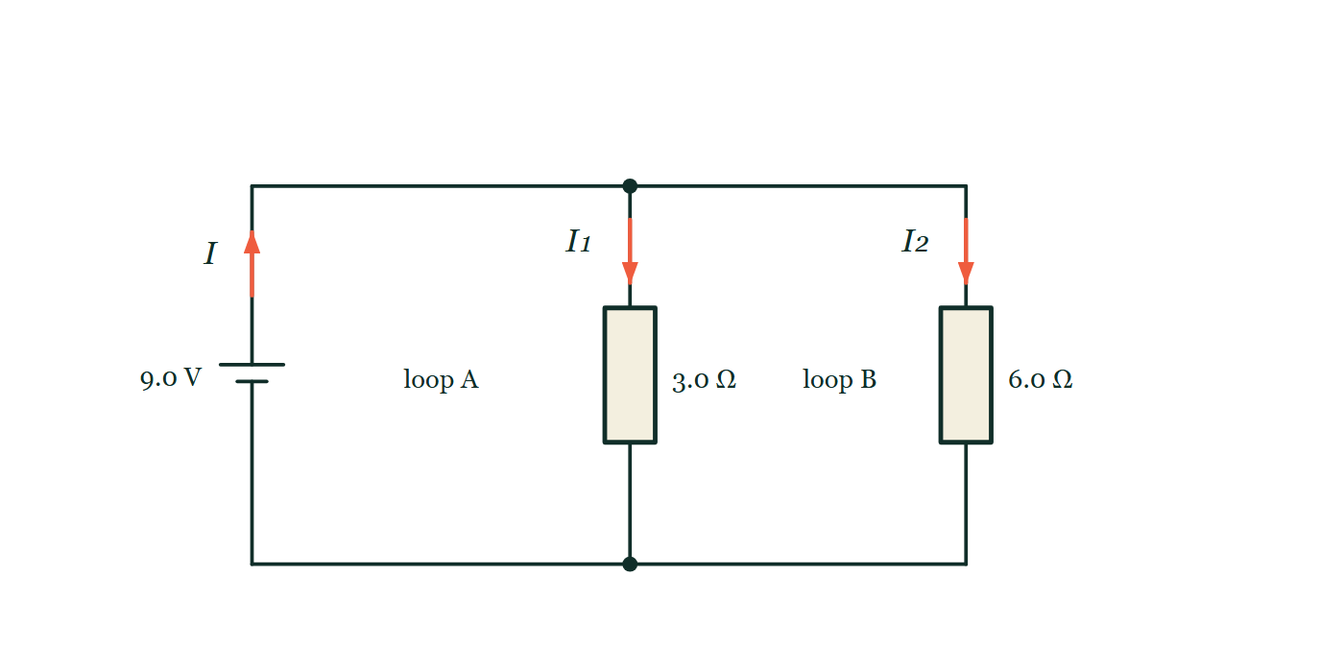
ADVANCED CIRCUITS · KIRCHHOFF'S LAWS
GIOPHYSICS LESSON
THINK FIRST
Two identical lamps are lit in parallel. You unscrew one. What happens to the current in the other?
Take answers before you click — the point is the commitment
Both lamps were drawing the same current a moment ago. Now there is only one path left for the battery to push charge through.
THE ANSWER
Nothing at all. The remaining lamp still has the whole supply p.d. across it, so it still carries exactly the current it did before and glows exactly as brightly. What changes is the total the battery has to deliver, which halves. The current was never a fixed ration being shared out between the two.
A 9.0 V cell between two horizontal rails, with a 3.0 Ω resistor and a 6.0 Ω resistor each bridging the rails on its own branch; the battery current is marked I and the two branch currents I₁ and I₂, with the regions labelled loop A and loop B.
The live version of this figure — click here
Advanced Circuits — Kirchhoff's Laws. Built by GioPhysics from the lesson's own copy; nothing on these slides is re-authored.
3 / 32
Notes:
[Phase] Starter: Recall what this lesson stands on (minutes 0–5 of 45)
[Hook] Two identical lamps are lit in parallel. You unscrew one. What happens to the current in the other? Both lamps were drawing the same current a moment ago. Now there is only one path left for the battery to push charge through.
[Answer] Nothing at all. The remaining lamp still has the whole supply p.d. across it, so it still carries exactly the current it did before and glows exactly as brightly. What changes is the total the battery has to deliver, which halves. The current was never a fixed ration being shared out between the two.
[Figure] A 9.0 V cell between two horizontal rails, with a 3.0 Ω resistor and a 6.0 Ω resistor each bridging the rails on its own branch; the battery current is marked I and the two branch currents I₁ and I₂, with the regions labelled loop A and loop B.

Slide 4
ADVANCED CIRCUITS · KIRCHHOFF'S LAWS
GIOPHYSICS LESSON
EXPLAINED SIMPLY
In one sentence
Introduce the idea — The big idea and the definition
Kirchhoff's first law: currents into a junction sum to the currents out. Second law: around any loop, supplied e.m.f. equals the sum of potential drops.
Advanced Circuits — Kirchhoff's Laws. Built by GioPhysics from the lesson's own copy; nothing on these slides is re-authored.
4 / 32
Notes:
[Phase] Introduce the idea: The big idea and the definition (minutes 5–13 of 45)
[Definition] Kirchhoff's first law: currents into a junction sum to the currents out. Second law: around any loop, supplied e.m.f. equals the sum of potential drops.

Slide 5
ADVANCED CIRCUITS · KIRCHHOFF'S LAWS
GIOPHYSICS LESSON
EXPLAINED SIMPLY
What that looks like
Introduce the idea — The big idea and the definition
FOR EXAMPLE
If 5 A enters a junction and 2 A leaves along one wire, the other wire must carry 3 A away — charge is conserved.
Advanced Circuits — Kirchhoff's Laws. Built by GioPhysics from the lesson's own copy; nothing on these slides is re-authored.
5 / 32
Notes:
[Phase] Introduce the idea: The big idea and the definition (minutes 5–13 of 45)
[Worked illustration] If 5 A enters a junction and 2 A leaves along one wire, the other wire must carry 3 A away — charge is conserved.

Slide 6
ADVANCED CIRCUITS · KIRCHHOFF'S LAWS
GIOPHYSICS LESSON
THE BIG IDEA
Conservation, written for circuits
Introduce the idea — The big idea and the definition
At any junction, the current in equals the current out, because charge cannot pile up or vanish. Around any closed loop, the e.m.f.s equal the sum of the potential drops, because each coulomb must spend exactly the energy it was given.
Advanced Circuits — Kirchhoff's Laws. Built by GioPhysics from the lesson's own copy; nothing on these slides is re-authored.
6 / 32
Notes:
[Phase] Introduce the idea: The big idea and the definition (minutes 5–13 of 45)
[Big idea] At any junction, the current in equals the current out, because charge cannot pile up or vanish. Around any closed loop, the e.m.f.s equal the sum of the potential drops, because each coulomb must spend exactly the energy it was given.

Slide 7
ADVANCED CIRCUITS · KIRCHHOFF'S LAWS
GIOPHYSICS LESSON
THE PHYSICS · 1 OF 3
Choose directions
Build the model — The formulae, one at a time, in plain English
Assign a direction to each unknown current. A negative answer simply means the true current flows the other way.
Advanced Circuits — Kirchhoff's Laws. Built by GioPhysics from the lesson's own copy; nothing on these slides is re-authored.
7 / 32
Notes:
[Phase] Build the model: The formulae, one at a time, in plain English (minutes 13–22 of 45)
[Section] Assign a direction to each unknown current. A negative answer simply means the true current flows the other way.

Slide 8
ADVANCED CIRCUITS · KIRCHHOFF'S LAWS
GIOPHYSICS LESSON
THE PHYSICS · 2 OF 3
Write the equations
Build the model — The formulae, one at a time, in plain English
One junction equation per junction (minus one), one loop equation per independent loop. Cross a component against the current and the p.d. counts negative.
Advanced Circuits — Kirchhoff's Laws. Built by GioPhysics from the lesson's own copy; nothing on these slides is re-authored.
8 / 32
Notes:
[Phase] Build the model: The formulae, one at a time, in plain English (minutes 13–22 of 45)
[Section] One junction equation per junction (minus one), one loop equation per independent loop. Cross a component against the current and the p.d. counts negative.

Slide 9
ADVANCED CIRCUITS · KIRCHHOFF'S LAWS
GIOPHYSICS LESSON
THE PHYSICS · 3 OF 3
Solve simultaneously
Build the model — The formulae, one at a time, in plain English
Two unknowns need two equations; three need three. The laws always supply exactly enough.
Advanced Circuits — Kirchhoff's Laws. Built by GioPhysics from the lesson's own copy; nothing on these slides is re-authored.
9 / 32
Notes:
[Phase] Build the model: The formulae, one at a time, in plain English (minutes 13–22 of 45)
[Section] Two unknowns need two equations; three need three. The laws always supply exactly enough.

Slide 10
ADVANCED CIRCUITS · KIRCHHOFF'S LAWS
GIOPHYSICS LESSON
FORMULA 1 OF 3
First law (junctions)
Build the model — The formulae, one at a time, in plain English
ΣI in = ΣI out
Conservation of charge at every junction
IN PLAIN ENGLISH
Whatever current arrives at a junction must leave it — charge cannot be created, destroyed, or stored at a wire joint.
Advanced Circuits — Kirchhoff's Laws. Built by GioPhysics from the lesson's own copy; nothing on these slides is re-authored.
10 / 32
Notes:
[Phase] Build the model: The formulae, one at a time, in plain English (minutes 13–22 of 45)
[Formula] First law (junctions): ΣI in = ΣI out
[In plain English] Whatever current arrives at a junction must leave it — charge cannot be created, destroyed, or stored at a wire joint.
[Note] Conservation of charge at every junction

Slide 11
ADVANCED CIRCUITS · KIRCHHOFF'S LAWS
GIOPHYSICS LESSON
FORMULA 2 OF 3
Second law (loops)
Build the model — The formulae, one at a time, in plain English
ΣE = ΣIR
Conservation of energy around every loop
IN PLAIN ENGLISH
Travel any complete loop and the energy given per coulomb by sources equals the energy dropped per coulomb across components.
Advanced Circuits — Kirchhoff's Laws. Built by GioPhysics from the lesson's own copy; nothing on these slides is re-authored.
11 / 32
Notes:
[Phase] Build the model: The formulae, one at a time, in plain English (minutes 13–22 of 45)
[Formula] Second law (loops): ΣE = ΣIR
[In plain English] Travel any complete loop and the energy given per coulomb by sources equals the energy dropped per coulomb across components.
[Note] Conservation of energy around every loop

Slide 12
ADVANCED CIRCUITS · KIRCHHOFF'S LAWS
GIOPHYSICS LESSON
FORMULA 3 OF 3
Loop bookkeeping
Build the model — The formulae, one at a time, in plain English
V_IN = V₁ + V₂ + …
One equation per independent loop
IN PLAIN ENGLISH
The supply's voltage is shared out across the components of the loop — nothing is left over and nothing extra appears.
Advanced Circuits — Kirchhoff's Laws. Built by GioPhysics from the lesson's own copy; nothing on these slides is re-authored.
12 / 32
Notes:
[Phase] Build the model: The formulae, one at a time, in plain English (minutes 13–22 of 45)
[Formula] Loop bookkeeping: V_IN = V₁ + V₂ + …
[In plain English] The supply's voltage is shared out across the components of the loop — nothing is left over and nothing extra appears.
[Note] One equation per independent loop

Slide 13
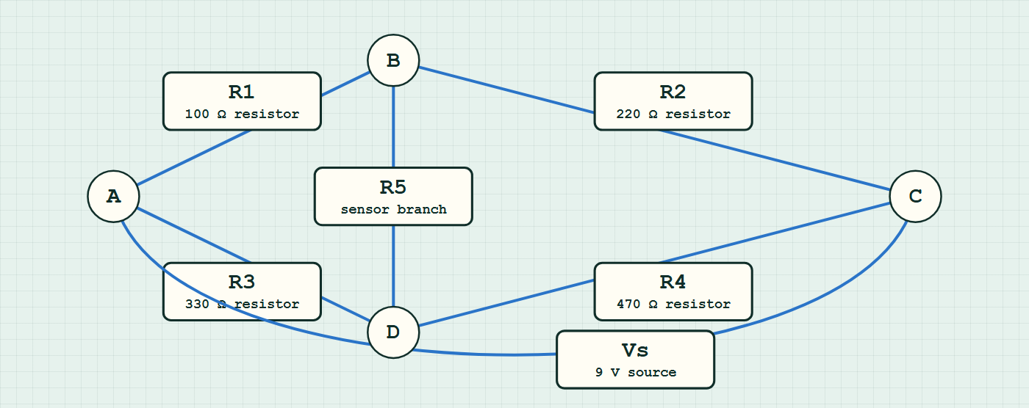
ADVANCED CIRCUITS · KIRCHHOFF'S LAWS
GIOPHYSICS LESSON
CIRCUIT MODEL
Read the topology before the values
Build the model — nodes are where connections meet, branches are what lies between them
bridge network — components are branches between nodes.
Switch topology and hide the values on the live version — click here
Advanced Circuits — Kirchhoff's Laws. Built by GioPhysics from the lesson's own copy; nothing on these slides is re-authored.
13 / 32
Notes:
[Phase] Build the model: The formulae, one at a time, in plain English (minutes 13–22 of 45)
[Topology] Nodes are the points where connections meet; branches are the components between them. The live version switches between series, parallel and bridge and can hide the values.

Slide 14
ADVANCED CIRCUITS · KIRCHHOFF'S LAWS
GIOPHYSICS LESSON
WATCH OUT
The common trap
Check and misconception — The quick check and the trap
Kirchhoff's second law does not say every loop has the same current — it says the energy per coulomb balances. Parallel branches of one supply each obey the loop rule separately at their own currents.
Advanced Circuits — Kirchhoff's Laws. Built by GioPhysics from the lesson's own copy; nothing on these slides is re-authored.
14 / 32
Notes:
[Phase] Check and misconception: The quick check and the trap (minutes 35–41 of 45)
[Misconception] Kirchhoff's second law does not say every loop has the same current — it says the energy per coulomb balances. Parallel branches of one supply each obey the loop rule separately at their own currents.

Slide 15
ADVANCED CIRCUITS · KIRCHHOFF'S LAWS
GIOPHYSICS LESSON
WORKED EXAMPLE 1 OF 2 · EASY
The question
Easy
Worked examples — I do, we do — one step revealed at a time
Currents of 3.0 A and 2.0 A flow into a junction; one wire carries 4.0 A out. What does the remaining wire carry?
Advanced Circuits — Kirchhoff's Laws. Built by GioPhysics from the lesson's own copy; nothing on these slides is re-authored.
15 / 32
Notes:
[Phase] Worked examples: I do, we do — one step revealed at a time (minutes 22–35 of 45)
[Question] Currents of 3.0 A and 2.0 A flow into a junction; one wire carries 4.0 A out. What does the remaining wire carry?
[Answer] 1.0 A outward

Slide 16
ADVANCED CIRCUITS · KIRCHHOFF'S LAWS
GIOPHYSICS LESSON
WORKED EXAMPLE 1 OF 2 · EASY · THE WORKING
How to solve it
Easy
Worked examples — I do, we do — one step revealed at a time
Currents of 3.0 A and 2.0 A flow into a junction; one wire carries 4.0 A out. What does the remaining wire carry?
1.
ΣI in = ΣI out: 5.0 = 4.0 + I.
2.
I = 1.0 A out.
Advanced Circuits — Kirchhoff's Laws. Built by GioPhysics from the lesson's own copy; nothing on these slides is re-authored.
16 / 32
Notes:
[Phase] Worked examples: I do, we do — one step revealed at a time (minutes 22–35 of 45)
[Reveal] One click per step. The class works each line before the next appears.
[Step 1] ΣI in = ΣI out: 5.0 = 4.0 + I.
[Step 2] I = 1.0 A out.

Slide 17
ADVANCED CIRCUITS · KIRCHHOFF'S LAWS
GIOPHYSICS LESSON
WORKED EXAMPLE 1 OF 2 · EASY
Answer
Easy
Worked examples — I do, we do — one step revealed at a time
1.0 A outward
Advanced Circuits — Kirchhoff's Laws. Built by GioPhysics from the lesson's own copy; nothing on these slides is re-authored.
17 / 32
Notes:
[Phase] Worked examples: I do, we do — one step revealed at a time (minutes 22–35 of 45)
[Answer] 1.0 A outward

Slide 18
ADVANCED CIRCUITS · KIRCHHOFF'S LAWS
GIOPHYSICS LESSON
WORKED EXAMPLE 2 OF 2 · MEDIUM
The question
Medium
Worked examples — I do, we do — one step revealed at a time
A 12 V supply drives two series resistors, 10 Ω and 30 Ω. Use the loop law to find the current and each p.d.
Advanced Circuits — Kirchhoff's Laws. Built by GioPhysics from the lesson's own copy; nothing on these slides is re-authored.
18 / 32
Notes:
[Phase] Worked examples: I do, we do — one step revealed at a time (minutes 22–35 of 45)
[Question] A 12 V supply drives two series resistors, 10 Ω and 30 Ω. Use the loop law to find the current and each p.d.
[Answer] I = 0.30 A, with 3.0 V and 9.0 V across the resistors

Slide 19
ADVANCED CIRCUITS · KIRCHHOFF'S LAWS
GIOPHYSICS LESSON
WORKED EXAMPLE 2 OF 2 · MEDIUM · THE WORKING
How to solve it
Medium
Worked examples — I do, we do — one step revealed at a time
A 12 V supply drives two series resistors, 10 Ω and 30 Ω. Use the loop law to find the current and each p.d.
1.
Loop law: 12 = I × 10 + I × 30 = 40I.
2.
I = 0.30 A everywhere in the single loop (first law).
3.
V₁ = 3.0 V and V₂ = 9.0 V; check 3.0 + 9.0 = 12 V.
Advanced Circuits — Kirchhoff's Laws. Built by GioPhysics from the lesson's own copy; nothing on these slides is re-authored.
19 / 32
Notes:
[Phase] Worked examples: I do, we do — one step revealed at a time (minutes 22–35 of 45)
[Reveal] One click per step. The class works each line before the next appears.
[Step 1] Loop law: 12 = I × 10 + I × 30 = 40I.
[Step 2] I = 0.30 A everywhere in the single loop (first law).
[Step 3] V₁ = 3.0 V and V₂ = 9.0 V; check 3.0 + 9.0 = 12 V.

Slide 20
ADVANCED CIRCUITS · KIRCHHOFF'S LAWS
GIOPHYSICS LESSON
WORKED EXAMPLE 2 OF 2 · MEDIUM
Answer
Medium
Worked examples — I do, we do — one step revealed at a time
I = 0.30 A, with 3.0 V and 9.0 V across the resistors
Advanced Circuits — Kirchhoff's Laws. Built by GioPhysics from the lesson's own copy; nothing on these slides is re-authored.
20 / 32
Notes:
[Phase] Worked examples: I do, we do — one step revealed at a time (minutes 22–35 of 45)
[Answer] I = 0.30 A, with 3.0 V and 9.0 V across the resistors

Slide 21
ADVANCED CIRCUITS · KIRCHHOFF'S LAWS
GIOPHYSICS LESSON
SPOT THE MISTAKE
One line here is wrong
The whole working is up — find the bad line before you click
1.
A 12 V supply drives two series resistors, 10 Ω and 30 Ω. Find the p.d. across each.
2.
Total resistance = 10 + 30 = 40 Ω
3.
I = V/R = 12 / 40 = 0.30 A
4.
V across the 10 Ω = 0.30 × 10 = 3.0 V
5.
V across the 30 Ω = 12 − 0.30 = 11.7 V
LINE 5 IS WRONG
The last line subtracts a current from a voltage. The intention was right — the two drops must add to 12 V, so finding the second by subtraction is a perfectly good move — but the quantity subtracted is the current instead of the first p.d. Mixed units are the tell: volts minus amps is not a quantity at all, and 3.0 + 11.7 does not come to 12 either.
IT SHOULD SAY
V across the 30 Ω = 0.30 × 30 = 9.0 V, and 3.0 + 9.0 = 12 V as the loop rule demands
Advanced Circuits — Kirchhoff's Laws. Built by GioPhysics from the lesson's own copy; nothing on these slides is re-authored.
21 / 32
Notes:
[Phase] Worked examples: I do, we do — one step revealed at a time (minutes 22–35 of 45)
[Spot the mistake] The working is complete and one line of it is wrong. Let the room hunt: one click names the line, a second shows it done correctly.
[Line 5 is wrong] The last line subtracts a current from a voltage. The intention was right — the two drops must add to 12 V, so finding the second by subtraction is a perfectly good move — but the quantity subtracted is the current instead of the first p.d. Mixed units are the tell: volts minus amps is not a quantity at all, and 3.0 + 11.7 does not come to 12 either.
[It should say] V across the 30 Ω = 0.30 × 30 = 9.0 V, and 3.0 + 9.0 = 12 V as the loop rule demands

Slide 22
ADVANCED CIRCUITS · KIRCHHOFF'S LAWS
GIOPHYSICS LESSON
PREDICT · TAKE THE VOTE
Commit before you are told
Hands up for each option, then click
Loop A carries I₁ through 3.0 Ω and loop B carries I₂ through 6.0 Ω, both across the same 9.0 V. What does the loop rule require?
A I₁ = I₂ — one loop rule means one current round the circuit
B 3.0 I₁ = 6.0 I₂ = 9.0 V, so I₁ is twice I₂
C The two branches share the 9.0 V between them
A 9.0 V cell between two horizontal rails, with a 3.0 Ω resistor and a 6.0 Ω resistor each bridging the rails on its own branch; the battery current is marked I and the two branch currents I₁ and I₂, with the regions labelled loop A and loop B.
The live version of this figure — click here
Advanced Circuits — Kirchhoff's Laws. Built by GioPhysics from the lesson's own copy; nothing on these slides is re-authored.
22 / 32
Notes:
[Phase] Build the model: The formulae, one at a time, in plain English (minutes 13–22 of 45)
[Predict] Loop A carries I₁ through 3.0 Ω and loop B carries I₂ through 6.0 Ω, both across the same 9.0 V. What does the loop rule require?
[Options] A I₁ = I₂ — one loop rule means one current round the circuit B 3.0 I₁ = 6.0 I₂ = 9.0 V, so I₁ is twice I₂ C The two branches share the 9.0 V between them
[Figure] A 9.0 V cell between two horizontal rails, with a 3.0 Ω resistor and a 6.0 Ω resistor each bridging the rails on its own branch; the battery current is marked I and the two branch currents I₁ and I₂, with the regions labelled loop A and loop B.

Slide 23
ADVANCED CIRCUITS · KIRCHHOFF'S LAWS
GIOPHYSICS LESSON
PREDICT · THE OUTCOME
What actually happens
Ask the room who changed their mind, and why
B 3.0 I₁ = 6.0 I₂ = 9.0 V, so I₁ is twice I₂
WHY
The second law is an energy statement, not a current statement: it says that a coulomb going round any closed loop must spend exactly what it was given. Trace loop A in the drawing — battery, 3.0 Ω, back to the battery — and the whole 9.0 V is spent in that one resistor, giving I₁ = 3.0 A. Trace loop B the same way and the same 9.0 V is spent in 6.0 Ω, giving I₂ = 1.5 A. Two different currents, both obeying the same rule, and the junction dots on the rails are where they add back together into the 4.5 A the battery supplies.
Advanced Circuits — Kirchhoff's Laws. Built by GioPhysics from the lesson's own copy; nothing on these slides is re-authored.
23 / 32
Notes:
[Phase] Build the model: The formulae, one at a time, in plain English (minutes 13–22 of 45)
[Answer] B — 3.0 I₁ = 6.0 I₂ = 9.0 V, so I₁ is twice I₂. The second law is an energy statement, not a current statement: it says that a coulomb going round any closed loop must spend exactly what it was given. Trace loop A in the drawing — battery, 3.0 Ω, back to the battery — and the whole 9.0 V is spent in that one resistor, giving I₁ = 3.0 A. Trace loop B the same way and the same 9.0 V is spent in 6.0 Ω, giving I₂ = 1.5 A. Two different currents, both obeying the same rule, and the junction dots on the rails are where they add back together into the 4.5 A the battery supplies.

Slide 24
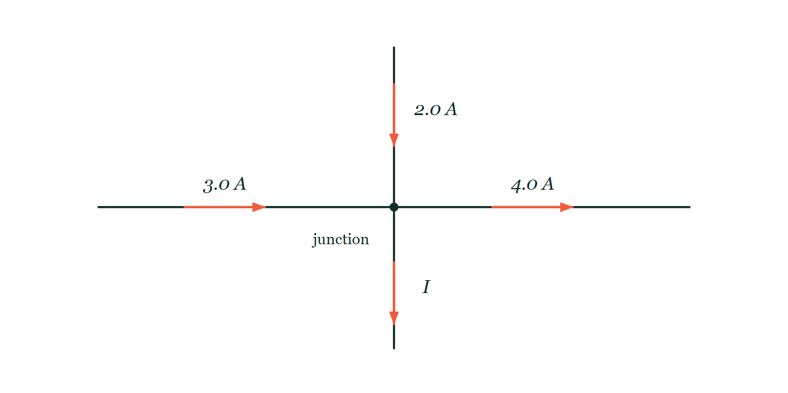
ADVANCED CIRCUITS · KIRCHHOFF'S LAWS
GIOPHYSICS LESSON
QUICK CHECK
Decide before the answer goes up
Check and misconception — The quick check and the trap
A 12 V battery feeds three parallel resistors: 10 Ω, 100 Ω, 40 Ω. What total current does the battery supply?
A
1.62 A
B
0.08 A
C
3.0 A
Four wires meeting at a single junction dot: arrows show 3.0 A arriving from the left and 2.0 A arriving from above, 4.0 A leaving to the right, and the downward wire carries an arrow labelled only I.
The live version of this figure — click here
Advanced Circuits — Kirchhoff's Laws. Built by GioPhysics from the lesson's own copy; nothing on these slides is re-authored.
24 / 32
Notes:
[Phase] Check and misconception: The quick check and the trap (minutes 35–41 of 45)
[Question] A 12 V battery feeds three parallel resistors: 10 Ω, 100 Ω, 40 Ω. What total current does the battery supply?
[Figure] Four wires meeting at a single junction dot: arrows show 3.0 A arriving from the left and 2.0 A arriving from above, 4.0 A leaving to the right, and the downward wire carries an arrow labelled only I.
[Options] A 1.62 A B 0.08 A C 3.0 A

Slide 25
ADVANCED CIRCUITS · KIRCHHOFF'S LAWS
GIOPHYSICS LESSON
QUICK CHECK · THE ANSWER
The answer, and why
Check and misconception — The quick check and the trap
A 1.62 A
HOW TO GET THERE
Each branch sees 12 V: 1.2 + 0.12 + 0.3 = 1.62 A into the junction, so 1.62 A from the battery.
WHY THE OTHERS TEMPT
A Correct. Each branch has the full 12 V across it: 1.2 A + 0.12 A + 0.3 A = 1.62 A arriving at the junction, so 1.62 A leaves the battery.
B 0.08 A is 12 ÷ 150, with the three resistances added as though they lay one after another in a single loop. Kirchhoff's first law runs the other way here — it is the three branch currents that add, where the branches meet.
C 3.0 A treats each extra branch as though it roughly doubled the current. A branch's share is fixed by its own resistance and nothing else: 12/10 = 1.2 A, 12/40 = 0.3 A, and 12/100 = 0.12 A, so the 100 Ω branch is very nearly an open circuit beside the 10 Ω one. The three add to 1.62 A.
Advanced Circuits — Kirchhoff's Laws. Built by GioPhysics from the lesson's own copy; nothing on these slides is re-authored.
25 / 32
Notes:
[Phase] Check and misconception: The quick check and the trap (minutes 35–41 of 45)
[Question] A 12 V battery feeds three parallel resistors: 10 Ω, 100 Ω, 40 Ω. What total current does the battery supply?
[Option by option] A: Correct. Each branch has the full 12 V across it: 1.2 A + 0.12 A + 0.3 A = 1.62 A arriving at the junction, so 1.62 A leaves the battery. B: 0.08 A is 12 ÷ 150, with the three resistances added as though they lay one after another in a single loop. Kirchhoff's first law runs the other way here — it is the three branch currents that add, where the branches meet. C: 3.0 A treats each extra branch as though it roughly doubled the current. A branch's share is fixed by its own resistance and nothing else: 12/10 = 1.2 A, 12/40 = 0.3 A, and 12/100 = 0.12 A, so the 100 Ω branch is very nearly an open circuit beside the 10 Ω one. The three add to 1.62 A.
[Answer] A — 1.62 A
[Why] Each branch sees 12 V: 1.2 + 0.12 + 0.3 = 1.62 A into the junction, so 1.62 A from the battery.
[Reveal] One click for the answer, then one for the reason.

Slide 26
ADVANCED CIRCUITS · KIRCHHOFF'S LAWS
GIOPHYSICS LESSON
EXTENSION 1 OF 2 · HARD
The question
Hard
Worked examples — I do, we do — one step revealed at a time
A 9.0 V battery feeds two parallel branches: 3.0 Ω and 6.0 Ω. Use both of Kirchhoff's laws to find all three currents.
Advanced Circuits — Kirchhoff's Laws. Built by GioPhysics from the lesson's own copy; nothing on these slides is re-authored.
26 / 32
Notes:
[Phase] Worked examples: I do, we do — one step revealed at a time (minutes 22–35 of 45)
[Question] A 9.0 V battery feeds two parallel branches: 3.0 Ω and 6.0 Ω. Use both of Kirchhoff's laws to find all three currents.
[Answer] 3.0 A, 1.5 A, and 4.5 A from the battery

Slide 27
ADVANCED CIRCUITS · KIRCHHOFF'S LAWS
GIOPHYSICS LESSON
EXTENSION 1 OF 2 · HARD · THE WORKING
How to solve it
Hard
Worked examples — I do, we do — one step revealed at a time
A 9.0 V battery feeds two parallel branches: 3.0 Ω and 6.0 Ω. Use both of Kirchhoff's laws to find all three currents.
1.
Loop law per branch: I₁ = 9/3 = 3.0 A; I₂ = 9/6 = 1.5 A.
2.
Junction law: supply current = 3.0 + 1.5.
3.
I = 4.5 A.
Advanced Circuits — Kirchhoff's Laws. Built by GioPhysics from the lesson's own copy; nothing on these slides is re-authored.
27 / 32
Notes:
[Phase] Worked examples: I do, we do — one step revealed at a time (minutes 22–35 of 45)
[Reveal] One click per step. The class works each line before the next appears.
[Step 1] Loop law per branch: I₁ = 9/3 = 3.0 A; I₂ = 9/6 = 1.5 A.
[Step 2] Junction law: supply current = 3.0 + 1.5.
[Step 3] I = 4.5 A.

Slide 28
ADVANCED CIRCUITS · KIRCHHOFF'S LAWS
GIOPHYSICS LESSON
EXTENSION 1 OF 2 · HARD
Answer
Hard
Worked examples — I do, we do — one step revealed at a time
3.0 A, 1.5 A, and 4.5 A from the battery
Advanced Circuits — Kirchhoff's Laws. Built by GioPhysics from the lesson's own copy; nothing on these slides is re-authored.
28 / 32
Notes:
[Phase] Worked examples: I do, we do — one step revealed at a time (minutes 22–35 of 45)
[Answer] 3.0 A, 1.5 A, and 4.5 A from the battery

Slide 29
ADVANCED CIRCUITS · KIRCHHOFF'S LAWS
GIOPHYSICS LESSON
EXTENSION 2 OF 2 · CHALLENGING
The question
Challenging
Worked examples — I do, we do — one step revealed at a time
Two batteries face each other: E₁ = 12 V (r = 1.0 Ω) and E₂ = 9.0 V (r = 0.5 Ω) drive a 4.5 Ω resistor in one loop, e.m.f.s opposing. Find the current and each battery's terminal p.d.
Advanced Circuits — Kirchhoff's Laws. Built by GioPhysics from the lesson's own copy; nothing on these slides is re-authored.
29 / 32
Notes:
[Phase] Worked examples: I do, we do — one step revealed at a time (minutes 22–35 of 45)
[Question] Two batteries face each other: E₁ = 12 V (r = 1.0 Ω) and E₂ = 9.0 V (r = 0.5 Ω) drive a 4.5 Ω resistor in one loop, e.m.f.s opposing. Find the current and each battery's terminal p.d.
[Answer] I = 0.50 A; terminals read 11.5 V and 9.25 V

Slide 30
ADVANCED CIRCUITS · KIRCHHOFF'S LAWS
GIOPHYSICS LESSON
EXTENSION 2 OF 2 · CHALLENGING · THE WORKING
How to solve it
Challenging
Worked examples — I do, we do — one step revealed at a time
Two batteries face each other: E₁ = 12 V (r = 1.0 Ω) and E₂ = 9.0 V (r = 0.5 Ω) drive a 4.5 Ω resistor in one loop, e.m.f.s opposing. Find the current and each battery's terminal p.d.
1.
Net e.m.f. = 12 − 9.0 = 3.0 V around the loop; total resistance = 1.0 + 0.5 + 4.5 = 6.0 Ω.
2.
I = 3.0 ÷ 6.0 = 0.50 A, driven by the stronger battery; the 9 V battery is being charged.
3.
V₁ = 12 − 0.5 × 1.0 = 11.5 V; V₂ = 9.0 + 0.5 × 0.5 = 9.25 V (charging raises its terminal p.d.).
Advanced Circuits — Kirchhoff's Laws. Built by GioPhysics from the lesson's own copy; nothing on these slides is re-authored.
30 / 32
Notes:
[Phase] Worked examples: I do, we do — one step revealed at a time (minutes 22–35 of 45)
[Reveal] One click per step. The class works each line before the next appears.
[Step 1] Net e.m.f. = 12 − 9.0 = 3.0 V around the loop; total resistance = 1.0 + 0.5 + 4.5 = 6.0 Ω.
[Step 2] I = 3.0 ÷ 6.0 = 0.50 A, driven by the stronger battery; the 9 V battery is being charged.
[Step 3] V₁ = 12 − 0.5 × 1.0 = 11.5 V; V₂ = 9.0 + 0.5 × 0.5 = 9.25 V (charging raises its terminal p.d.).

Slide 31
ADVANCED CIRCUITS · KIRCHHOFF'S LAWS
GIOPHYSICS LESSON
EXTENSION 2 OF 2 · CHALLENGING
Answer
Challenging
Worked examples — I do, we do — one step revealed at a time
I = 0.50 A; terminals read 11.5 V and 9.25 V
Advanced Circuits — Kirchhoff's Laws. Built by GioPhysics from the lesson's own copy; nothing on these slides is re-authored.
31 / 32
Notes:
[Phase] Worked examples: I do, we do — one step revealed at a time (minutes 22–35 of 45)
[Answer] I = 0.50 A; terminals read 11.5 V and 9.25 V

Slide 32
ADVANCED CIRCUITS · KIRCHHOFF'S LAWS
GIOPHYSICS LESSON
ADVANCED CIRCUITS
Where to go next
Plenary — What to take away, what to practise next
Next
14.2 Non-Ohmic Components
https://giophysics.com/chapter-23/non-ohmic-components/
Lesson
This lesson on giophysics.com
https://giophysics.com/chapter-23/kirchhoffs-laws/
Live
The live, interactive version of these slides
https://giophysics.com/chapter-23/presentation/?lesson=kirchhoff
Chapter
All Advanced Circuits lessons
https://giophysics.com/chapter-23/
PDF
Download the lesson PDF
https://giophysics.com/downloads/23-1-kirchhoffs-laws.pdf
Advanced Circuits — Kirchhoff's Laws. Built by GioPhysics from the lesson's own copy; nothing on these slides is re-authored.
32 / 32
Notes:
[Phase] Plenary: What to take away, what to practise next (minutes 41–45 of 45)
[Interactive] The graphs and the circuit topology on these slides are frozen. The live version at https://giophysics.com/chapter-23/presentation/?lesson=kirchhoff moves them.

