Slide 1
WAVES · DESCRIBING WAVES
GIOPHYSICS LESSON
15 · Waves
The vocabulary of every wave
Describing Waves
Vibrations produce waves: disturbances that carry energy without carrying the medium. Amplitude, wavelength, frequency, phase, and the wave equation v = fλ describe them all.
POSITION
Lesson 2 of 10 in Waves
PLAN
16 slides in the 45-minute core run, about 44 minutes of it
LESSON PAGE
https://giophysics.com/chapter-24/describing-waves/
Built by GioPhysics from the lesson's own page. Every word on these slides is the lesson's; nothing here is re-authored. Teaching material, not an awarding body's document.
Waves — Describing Waves. Built by GioPhysics from the lesson's own copy; nothing on these slides is re-authored.
1 / 35
Notes:
[Lesson] Waves — Describing Waves. Lesson 2 of 10.
[Intro] Vibrations produce waves: disturbances that carry energy without carrying the medium. Amplitude, wavelength, frequency, phase, and the wave equation v = fλ describe them all.
[Source] https://giophysics.com/chapter-24/describing-waves/
[Disclaimer] Built by GioPhysics from the lesson's own page. Every word on these slides is the lesson's; nothing here is re-authored. Teaching material, not an awarding body's document.

Slide 2
WAVES · DESCRIBING WAVES
GIOPHYSICS LESSON
WHAT THIS NEEDS
What you already know
Starter — Recall what this lesson stands on
Recall
Simple harmonic motion
https://giophysics.com/chapter-24/simple-harmonic-motion/
Waves — Describing Waves. Built by GioPhysics from the lesson's own copy; nothing on these slides is re-authored.
2 / 35
Notes:
[Phase] Starter: Recall what this lesson stands on (minutes 0–5 of 45)
[Starter] Recall: Simple harmonic motion

Slide 3
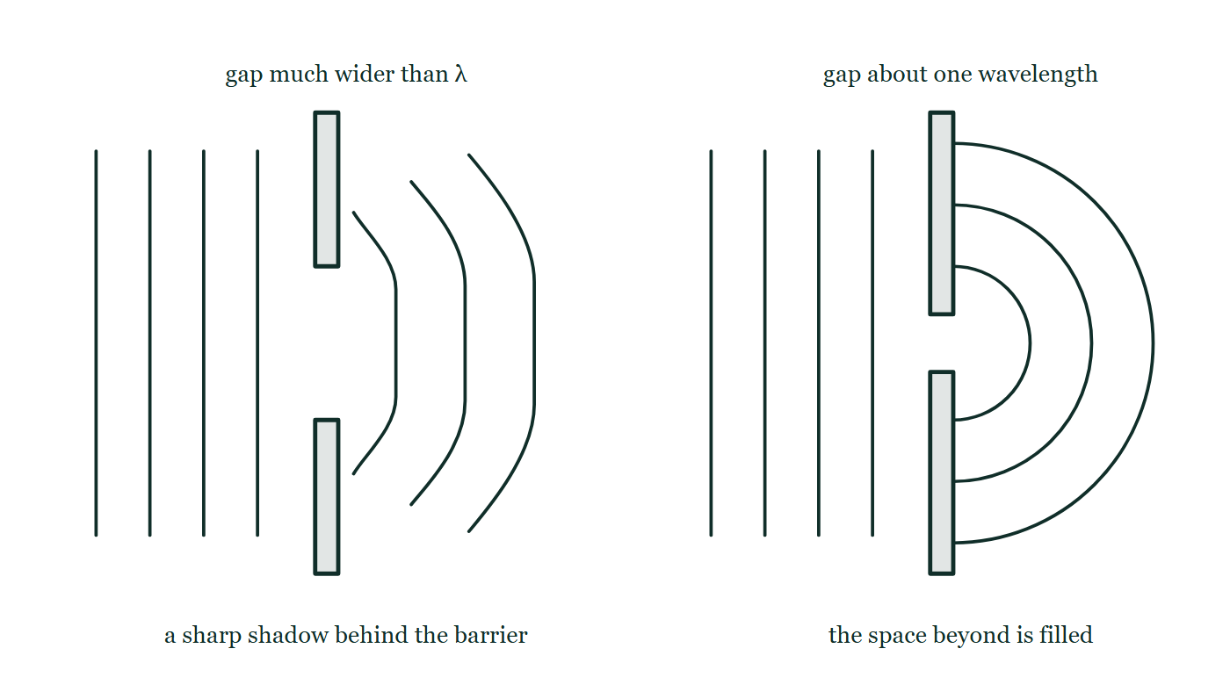
WAVES · DESCRIBING WAVES
GIOPHYSICS LESSON
THINK FIRST
A cork bobs on the sea while wave after wave rolls past it towards the beach. Why doesn't it end up on the beach?
Take answers before you click — the point is the commitment
Waves have been arriving for hours, all travelling the same way, and every one of them passes right under the cork.
THE ANSWER
Because the water does not travel with the wave. Each patch of water goes up and down about its own place while the disturbance moves through it — what crosses the ocean is energy, not water. The cork reports the motion of the medium, which is why it stays put while the wave goes on without it.
Straight wavefronts approach two barriers from the left: through a gap much wider than the wavelength they carry on almost straight with a sharp shadow behind the barrier, and through a gap about one wavelength across they emerge as nearly semicircular arcs filling the space beyond.
The live version of this figure — click here
Waves — Describing Waves. Built by GioPhysics from the lesson's own copy; nothing on these slides is re-authored.
3 / 35
Notes:
[Phase] Starter: Recall what this lesson stands on (minutes 0–5 of 45)
[Hook] A cork bobs on the sea while wave after wave rolls past it towards the beach. Why doesn't it end up on the beach? Waves have been arriving for hours, all travelling the same way, and every one of them passes right under the cork.
[Answer] Because the water does not travel with the wave. Each patch of water goes up and down about its own place while the disturbance moves through it — what crosses the ocean is energy, not water. The cork reports the motion of the medium, which is why it stays put while the wave goes on without it.
[Figure] Straight wavefronts approach two barriers from the left: through a gap much wider than the wavelength they carry on almost straight with a sharp shadow behind the barrier, and through a gap about one wavelength across they emerge as nearly semicircular arcs filling the space beyond.

Slide 4
WAVES · DESCRIBING WAVES
GIOPHYSICS LESSON
EXPLAINED SIMPLY
In one sentence
Introduce the idea — The big idea and the definition
A wave is a disturbance that transfers energy; its speed equals frequency times wavelength.
Waves — Describing Waves. Built by GioPhysics from the lesson's own copy; nothing on these slides is re-authored.
4 / 35
Notes:
[Phase] Introduce the idea: The big idea and the definition (minutes 5–13 of 45)
[Definition] A wave is a disturbance that transfers energy; its speed equals frequency times wavelength.

Slide 5
WAVES · DESCRIBING WAVES
GIOPHYSICS LESSON
EXPLAINED SIMPLY
What that looks like
Introduce the idea — The big idea and the definition
FOR EXAMPLE
Four complete waves fitting on a 20 cm cord at 30 Hz means λ = 5 cm, so the wave moves at 1.5 m/s.
Waves — Describing Waves. Built by GioPhysics from the lesson's own copy; nothing on these slides is re-authored.
5 / 35
Notes:
[Phase] Introduce the idea: The big idea and the definition (minutes 5–13 of 45)
[Worked illustration] Four complete waves fitting on a 20 cm cord at 30 Hz means λ = 5 cm, so the wave moves at 1.5 m/s.

Slide 6
WAVES · DESCRIBING WAVES
GIOPHYSICS LESSON
THE BIG IDEA
The vocabulary of every wave
Introduce the idea — The big idea and the definition
A wave doesn't move the medium — energy travels while each particle oscillates about its own position. Transverse waves vibrate at right angles to travel; longitudinal waves vibrate along it. One wavelength passes in one period, which is exactly v = fλ.
Waves — Describing Waves. Built by GioPhysics from the lesson's own copy; nothing on these slides is re-authored.
6 / 35
Notes:
[Phase] Introduce the idea: The big idea and the definition (minutes 5–13 of 45)
[Big idea] A wave doesn't move the medium — energy travels while each particle oscillates about its own position. Transverse waves vibrate at right angles to travel; longitudinal waves vibrate along it. One wavelength passes in one period, which is exactly v = fλ.

Slide 7
WAVES · DESCRIBING WAVES
GIOPHYSICS LESSON
THE PHYSICS · 1 OF 4
Transverse
Build the model — The formulae, one at a time, in plain English
Particles vibrate at right angles to the direction of travel — waves on strings, water surface waves, and all electromagnetic waves.
Waves — Describing Waves. Built by GioPhysics from the lesson's own copy; nothing on these slides is re-authored.
7 / 35
Notes:
[Phase] Build the model: The formulae, one at a time, in plain English (minutes 13–22 of 45)
[Section] Particles vibrate at right angles to the direction of travel — waves on strings, water surface waves, and all electromagnetic waves.

Slide 8
WAVES · DESCRIBING WAVES
GIOPHYSICS LESSON
THE PHYSICS · 2 OF 4
Longitudinal
Build the model — The formulae, one at a time, in plain English
Particles vibrate along the direction of travel, making compressions and rarefactions — sound is the standard example.
Waves — Describing Waves. Built by GioPhysics from the lesson's own copy; nothing on these slides is re-authored.
8 / 35
Notes:
[Phase] Build the model: The formulae, one at a time, in plain English (minutes 13–22 of 45)
[Section] Particles vibrate along the direction of travel, making compressions and rarefactions — sound is the standard example.

Slide 9
WAVES · DESCRIBING WAVES
GIOPHYSICS LESSON
THE PHYSICS · 3 OF 4
Two graphs, two stories
Build the model — The formulae, one at a time, in plain English
A displacement–distance graph is a snapshot showing wavelength; a displacement–time graph watches one point and shows the period. Do not read λ from a time axis.
Waves — Describing Waves. Built by GioPhysics from the lesson's own copy; nothing on these slides is re-authored.
9 / 35
Notes:
[Phase] Build the model: The formulae, one at a time, in plain English (minutes 13–22 of 45)
[Section] A displacement–distance graph is a snapshot showing wavelength; a displacement–time graph watches one point and shows the period. Do not read λ from a time axis.

Slide 10
WAVES · DESCRIBING WAVES
GIOPHYSICS LESSON
THE PHYSICS · 4 OF 4
Diffraction: spreading at a gap
Build the model — The formulae, one at a time, in plain English
A wave passing through a gap, or round the edge of an obstacle, spreads into the space beyond. Nothing about the wave itself changes: the speed is still set by the medium, the frequency still by the source, and so by v = fλ the wavelength is unchanged too. Only the shape of the wavefronts changes.
In a ripple tank, straight wavefronts meeting a wide gap emerge still mostly straight, curling only at the two ends, and leave a sharp shadow behind the barrier. Narrow the gap towards one wavelength and the emerging wavefronts become almost semicircular, filling the space beyond. The rule is that the spreading is greatest when the gap is about the same size as the wavelength — which is why you hear someone round a corner but cannot see them: metre-long sound waves diffract through a doorway, and half-micron light waves barely notice it.
Waves — Describing Waves. Built by GioPhysics from the lesson's own copy; nothing on these slides is re-authored.
10 / 35
Notes:
[Phase] Build the model: The formulae, one at a time, in plain English (minutes 13–22 of 45)
[Section] A wave passing through a gap, or round the edge of an obstacle, spreads into the space beyond. Nothing about the wave itself changes: the speed is still set by the medium, the frequency still by the source, and so by v = fλ the wavelength is unchanged too. Only the shape of the wavefronts changes. In a ripple tank, straight wavefronts meeting a wide gap emerge still mostly straight, curling only at the two ends, and leave a sharp shadow behind the barrier. Narrow the gap towards one wavelength and the emerging wavefronts become almost semicircular, filling the space beyond. The rule is that the spreading is greatest when the gap is about the same size as the wavelength — which is why you hear someone round a corner but cannot see them: metre-long sound waves diffract through a doorway, and half-micron light waves barely notice it.

Slide 11
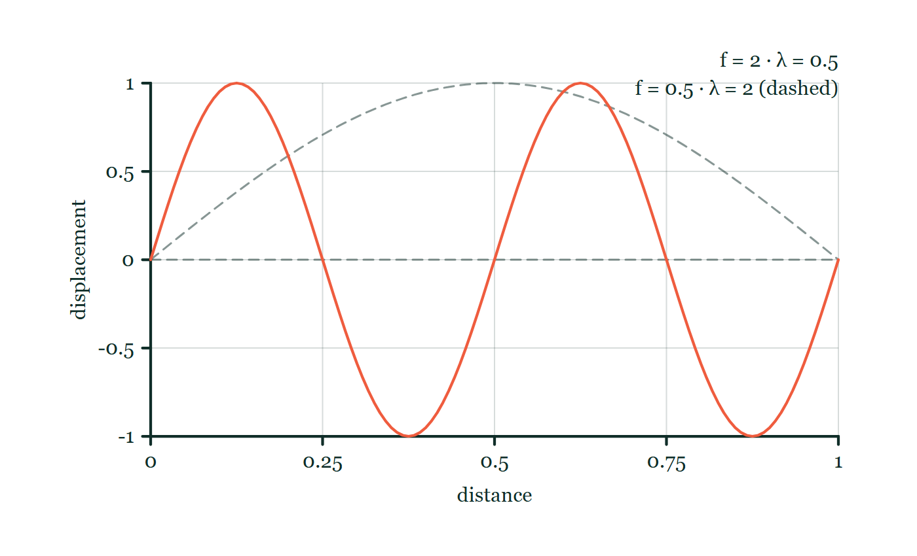
WAVES · DESCRIBING WAVES
GIOPHYSICS LESSON
FORMULA 1 OF 3
Wave equation
Build the model — The formulae, one at a time, in plain English
v = fλ
Speed set by the medium; f set by the source
IN PLAIN ENGLISH
Each cycle pushes the pattern forward one wavelength, f times per second — frequency times wavelength is speed.
Wave-speed explorer
Move this graph on the live version — click here
Waves — Describing Waves. Built by GioPhysics from the lesson's own copy; nothing on these slides is re-authored.
11 / 35
Notes:
[Phase] Build the model: The formulae, one at a time, in plain English (minutes 13–22 of 45)
[Formula] Wave equation: v = fλ
[In plain English] Each cycle pushes the pattern forward one wavelength, f times per second — frequency times wavelength is speed.
[Note] Speed set by the medium; f set by the source
[Graph] Wave-speed explorer. At fixed wave speed, raising frequency shortens wavelength so their product remains constant.
[Axes] Horizontal: distance. Vertical: displacement. Values are normalised — the graph teaches the shape, not a measurement.

Slide 12
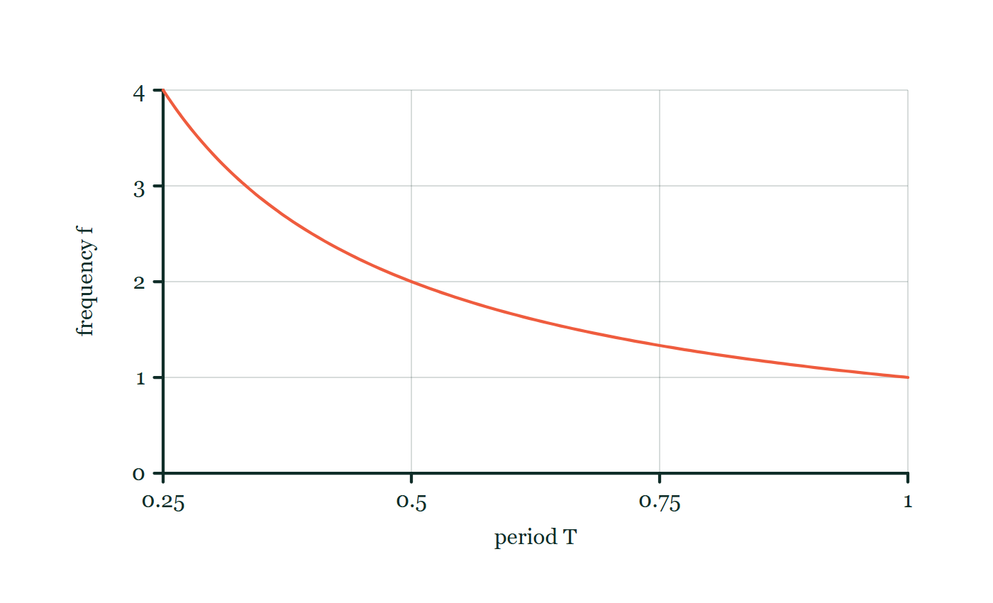
WAVES · DESCRIBING WAVES
GIOPHYSICS LESSON
FORMULA 2 OF 3
Period and frequency
Build the model — The formulae, one at a time, in plain English
f = 1/T
Hz = one oscillation per second
IN PLAIN ENGLISH
Frequency counts oscillations per second; period times how long one takes — each is the other flipped over.
Frequency–period explorer
Move this graph on the live version — click here
Waves — Describing Waves. Built by GioPhysics from the lesson's own copy; nothing on these slides is re-authored.
12 / 35
Notes:
[Phase] Build the model: The formulae, one at a time, in plain English (minutes 13–22 of 45)
[Formula] Period and frequency: f = 1/T
[In plain English] Frequency counts oscillations per second; period times how long one takes — each is the other flipped over.
[Note] Hz = one oscillation per second
[Graph] Frequency–period explorer. Frequency is the reciprocal of period, so a longer period means a lower frequency.
[Axes] Horizontal: period T. Vertical: frequency f. Values are normalised — the graph teaches the shape, not a measurement.

Slide 13
WAVES · DESCRIBING WAVES
GIOPHYSICS LESSON
FORMULA 3 OF 3
Phase difference
Build the model — The formulae, one at a time, in plain English
Δφ = 2πx/λ
Points a whole λ apart are in phase
IN PLAIN ENGLISH
How out-of-step two points are: a full wavelength of separation is a full cycle (360°), half a wavelength is a half cycle (180°).
Waves — Describing Waves. Built by GioPhysics from the lesson's own copy; nothing on these slides is re-authored.
13 / 35
Notes:
[Phase] Build the model: The formulae, one at a time, in plain English (minutes 13–22 of 45)
[Formula] Phase difference: Δφ = 2πx/λ
[In plain English] How out-of-step two points are: a full wavelength of separation is a full cycle (360°), half a wavelength is a half cycle (180°).
[Note] Points a whole λ apart are in phase

Slide 14
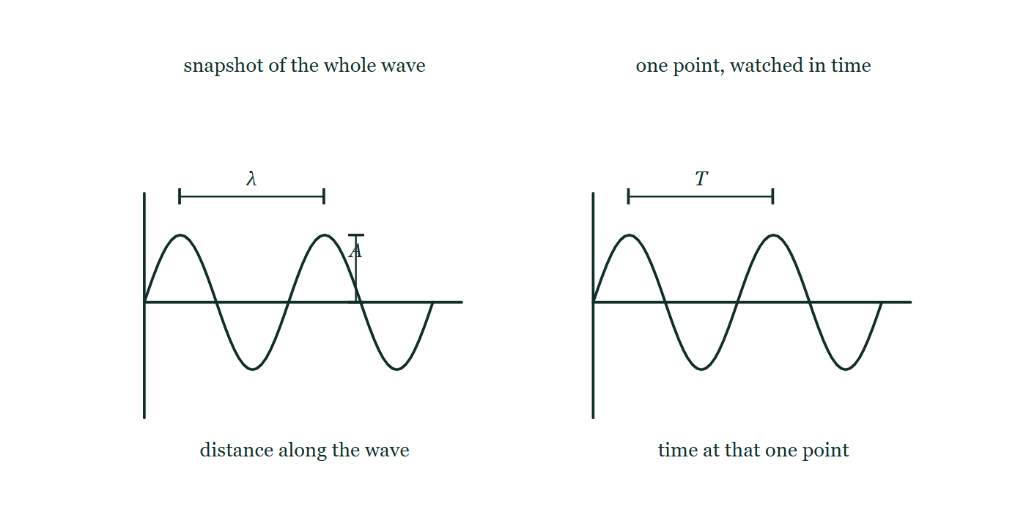
WAVES · DESCRIBING WAVES
GIOPHYSICS LESSON
THE PICTURE
Two graphs that look identical
Drawn for this lesson
The same sinusoid drawn twice side by side: on the left against distance along the wave with the wavelength λ and the amplitude A marked, and on the right against time at one single point with the period T marked instead.
The live version of this figure — click here
Waves — Describing Waves. Built by GioPhysics from the lesson's own copy; nothing on these slides is re-authored.
14 / 35
Notes:
[Phase] Build the model: The formulae, one at a time, in plain English (minutes 13–22 of 45)
[Figure] The same sinusoid drawn twice side by side: on the left against distance along the wave with the wavelength λ and the amplitude A marked, and on the right against time at one single point with the period T marked instead.

Slide 15
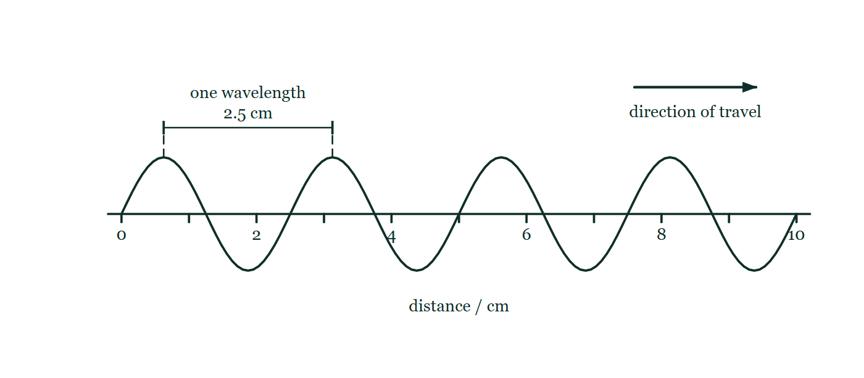
WAVES · DESCRIBING WAVES
GIOPHYSICS LESSON
FIGURE 1 OF 2
Fig. 2.1 — IGCSE Topic 3 · Waves
Drawn for question 2 of that paper · syllabus 3.1
A snapshot of the water surface in the ripple tank at one instant, drawn as a side view. Four complete waves run left to right above a horizontal distance scale that is marked in centimetres from 0 to 10, the scale line itself being the undisturbed water level. A dimension line drawn between two neighbouring crests is labelled one wavelength, 2.5 cm, and a separate arrow above the wave shows the direction in which the waves are travelling.
See the question this was drawn for — click here
Waves — Describing Waves. Built by GioPhysics from the lesson's own copy; nothing on these slides is re-authored.
15 / 35
Notes:
[Phase] Build the model: The formulae, one at a time, in plain English (minutes 13–22 of 45)
[Figure] Fig. 2.1. A snapshot of the water surface in the ripple tank at one instant, drawn as a side view. Four complete waves run left to right above a horizontal distance scale that is marked in centimetres from 0 to 10, the scale line itself being the undisturbed water level. A dimension line drawn between two neighbouring crests is labelled one wavelength, 2.5 cm, and a separate arrow above the wave shows the direction in which the waves are travelling.
[Where it came from] IGCSE Topic 3 · Waves, question 2; syllabus 3.1.

Slide 16
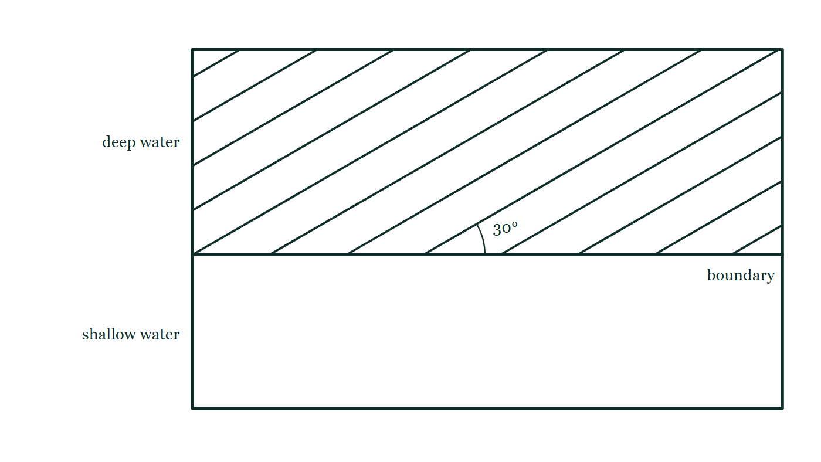
WAVES · DESCRIBING WAVES
GIOPHYSICS LESSON
FIGURE 2 OF 2
Fig. 7.1 — IGCSE Topic 3 · Waves
Drawn for question 7 of that paper · syllabus 3.1
Plan view of the ripple tank, seen from above. A straight boundary runs right across the tank, dividing it into deep water in the upper part and shallow water in the lower part, each region labelled. Twelve straight parallel wavefronts, evenly spaced, fill the deep water and slope up to the right so that each one makes an angle of 30° with the boundary; that angle is marked with an arc where one front meets the boundary. The shallow region is drawn empty.
See the question this was drawn for — click here
Waves — Describing Waves. Built by GioPhysics from the lesson's own copy; nothing on these slides is re-authored.
16 / 35
Notes:
[Phase] Build the model: The formulae, one at a time, in plain English (minutes 13–22 of 45)
[Figure] Fig. 7.1. Plan view of the ripple tank, seen from above. A straight boundary runs right across the tank, dividing it into deep water in the upper part and shallow water in the lower part, each region labelled. Twelve straight parallel wavefronts, evenly spaced, fill the deep water and slope up to the right so that each one makes an angle of 30° with the boundary; that angle is marked with an arc where one front meets the boundary. The shallow region is drawn empty.
[Where it came from] IGCSE Topic 3 · Waves, question 7; syllabus 3.1.

Slide 17
WAVES · DESCRIBING WAVES
GIOPHYSICS LESSON
WATCH OUT
The common trap
Check and misconception — The quick check and the trap
The wave moves; the medium does not travel with it. A floating cork bobs up and down as water waves pass — it does not surf along with the energy.
Waves — Describing Waves. Built by GioPhysics from the lesson's own copy; nothing on these slides is re-authored.
17 / 35
Notes:
[Phase] Check and misconception: The quick check and the trap (minutes 35–41 of 45)
[Misconception] The wave moves; the medium does not travel with it. A floating cork bobs up and down as water waves pass — it does not surf along with the energy.

Slide 18
WAVES · DESCRIBING WAVES
GIOPHYSICS LESSON
WORKED EXAMPLE 1 OF 2 · EASY
The question
Easy
Worked examples — I do, we do — one step revealed at a time
Water waves of frequency 2.0 Hz have wavelength 0.75 m. Find their speed.
Waves — Describing Waves. Built by GioPhysics from the lesson's own copy; nothing on these slides is re-authored.
18 / 35
Notes:
[Phase] Worked examples: I do, we do — one step revealed at a time (minutes 22–35 of 45)
[Question] Water waves of frequency 2.0 Hz have wavelength 0.75 m. Find their speed.
[Answer] 1.5 m/s

Slide 19
WAVES · DESCRIBING WAVES
GIOPHYSICS LESSON
WORKED EXAMPLE 1 OF 2 · EASY · THE WORKING
How to solve it
Easy
Worked examples — I do, we do — one step revealed at a time
Water waves of frequency 2.0 Hz have wavelength 0.75 m. Find their speed.
1.
v = fλ = 2.0 × 0.75.
2.
v = 1.5 m/s.
Waves — Describing Waves. Built by GioPhysics from the lesson's own copy; nothing on these slides is re-authored.
19 / 35
Notes:
[Phase] Worked examples: I do, we do — one step revealed at a time (minutes 22–35 of 45)
[Reveal] One click per step. The class works each line before the next appears.
[Step 1] v = fλ = 2.0 × 0.75.
[Step 2] v = 1.5 m/s.

Slide 20
WAVES · DESCRIBING WAVES
GIOPHYSICS LESSON
WORKED EXAMPLE 1 OF 2 · EASY
Answer
Easy
Worked examples — I do, we do — one step revealed at a time
1.5 m/s
Waves — Describing Waves. Built by GioPhysics from the lesson's own copy; nothing on these slides is re-authored.
20 / 35
Notes:
[Phase] Worked examples: I do, we do — one step revealed at a time (minutes 22–35 of 45)
[Answer] 1.5 m/s

Slide 21
WAVES · DESCRIBING WAVES
GIOPHYSICS LESSON
WORKED EXAMPLE 2 OF 2 · MEDIUM
The question
Medium
Worked examples — I do, we do — one step revealed at a time
An oscillator sends waves down a cord; four complete cycles span 20 cm when driven at 30 Hz. Find λ, f, and v.
Waves — Describing Waves. Built by GioPhysics from the lesson's own copy; nothing on these slides is re-authored.
21 / 35
Notes:
[Phase] Worked examples: I do, we do — one step revealed at a time (minutes 22–35 of 45)
[Question] An oscillator sends waves down a cord; four complete cycles span 20 cm when driven at 30 Hz. Find λ, f, and v.
[Answer] λ = 5.0 cm, f = 30 Hz, v = 1.5 m/s

Slide 22
WAVES · DESCRIBING WAVES
GIOPHYSICS LESSON
WORKED EXAMPLE 2 OF 2 · MEDIUM · THE WORKING
How to solve it
Medium
Worked examples — I do, we do — one step revealed at a time
An oscillator sends waves down a cord; four complete cycles span 20 cm when driven at 30 Hz. Find λ, f, and v.
1.
λ = 20 cm ÷ 4 = 5.0 cm = 0.05 m.
2.
f = 30 Hz (set by the oscillator).
3.
v = fλ = 30 × 0.05 = 1.5 m/s.
Waves — Describing Waves. Built by GioPhysics from the lesson's own copy; nothing on these slides is re-authored.
22 / 35
Notes:
[Phase] Worked examples: I do, we do — one step revealed at a time (minutes 22–35 of 45)
[Reveal] One click per step. The class works each line before the next appears.
[Step 1] λ = 20 cm ÷ 4 = 5.0 cm = 0.05 m.
[Step 2] f = 30 Hz (set by the oscillator).
[Step 3] v = fλ = 30 × 0.05 = 1.5 m/s.

Slide 23
WAVES · DESCRIBING WAVES
GIOPHYSICS LESSON
WORKED EXAMPLE 2 OF 2 · MEDIUM
Answer
Medium
Worked examples — I do, we do — one step revealed at a time
λ = 5.0 cm, f = 30 Hz, v = 1.5 m/s
Waves — Describing Waves. Built by GioPhysics from the lesson's own copy; nothing on these slides is re-authored.
23 / 35
Notes:
[Phase] Worked examples: I do, we do — one step revealed at a time (minutes 22–35 of 45)
[Answer] λ = 5.0 cm, f = 30 Hz, v = 1.5 m/s

Slide 24
WAVES · DESCRIBING WAVES
GIOPHYSICS LESSON
SPOT THE MISTAKE
One line here is wrong
The whole working is up — find the bad line before you click
1.
An oscillator sends waves down a cord at 30 Hz. Four complete cycles span 20 cm. Find the wave speed.
2.
λ = 20 cm = 0.20 m
3.
v = fλ = 30 × 0.20
4.
v = 6.0 m/s
5.
So the wave travels at 6.0 m/s.
LINE 2 IS WRONG
The 20 cm holds four wavelengths, not one. It is a natural misread because 20 cm is the length actually measured on the cord, and the word "span" attaches it to the cycles rather than dividing by them. One wavelength is 5.0 cm, and the answer comes out four times too large — which the snapshot graph would have shown at once, since it is drawn one wave at a time.
IT SHOULD SAY
λ = 0.20/4 = 0.050 m, so v = 30 × 0.050 = 1.5 m/s
Waves — Describing Waves. Built by GioPhysics from the lesson's own copy; nothing on these slides is re-authored.
24 / 35
Notes:
[Phase] Worked examples: I do, we do — one step revealed at a time (minutes 22–35 of 45)
[Spot the mistake] The working is complete and one line of it is wrong. Let the room hunt: one click names the line, a second shows it done correctly.
[Line 2 is wrong] The 20 cm holds four wavelengths, not one. It is a natural misread because 20 cm is the length actually measured on the cord, and the word "span" attaches it to the cycles rather than dividing by them. One wavelength is 5.0 cm, and the answer comes out four times too large — which the snapshot graph would have shown at once, since it is drawn one wave at a time.
[It should say] λ = 0.20/4 = 0.050 m, so v = 30 × 0.050 = 1.5 m/s

Slide 25
WAVES · DESCRIBING WAVES
GIOPHYSICS LESSON
PREDICT · TAKE THE VOTE
Commit before you are told
Hands up for each option, then click
The fronts spread far more at the narrow gap than at the wide one. What has happened to their wavelength?
A It is shorter beyond the narrow gap
B It is unchanged at both gaps
C It is longer beyond the narrow gap
Straight wavefronts approach two barriers from the left: through a gap much wider than the wavelength they carry on almost straight with a sharp shadow behind the barrier, and through a gap about one wavelength across they emerge as nearly semicircular arcs filling the space beyond.
The live version of this figure — click here
Waves — Describing Waves. Built by GioPhysics from the lesson's own copy; nothing on these slides is re-authored.
25 / 35
Notes:
[Phase] Build the model: The formulae, one at a time, in plain English (minutes 13–22 of 45)
[Predict] The fronts spread far more at the narrow gap than at the wide one. What has happened to their wavelength?
[Options] A It is shorter beyond the narrow gap B It is unchanged at both gaps C It is longer beyond the narrow gap
[Figure] Straight wavefronts approach two barriers from the left: through a gap much wider than the wavelength they carry on almost straight with a sharp shadow behind the barrier, and through a gap about one wavelength across they emerge as nearly semicircular arcs filling the space beyond.

Slide 26
WAVES · DESCRIBING WAVES
GIOPHYSICS LESSON
PREDICT · THE OUTCOME
What actually happens
Ask the room who changed their mind, and why
B It is unchanged at both gaps
WHY
Diffraction changes the shape of the wavefronts and nothing else. The speed is fixed by the medium, which is the same water on both sides of the barrier, and the frequency is fixed by whatever is making the waves, which has not been touched — so v = fλ leaves the wavelength no room to move. Look at the arcs beyond each gap in the drawing: they are as far apart as the fronts arriving at it. What the narrow gap changed is where the wave goes, not what it is.
Waves — Describing Waves. Built by GioPhysics from the lesson's own copy; nothing on these slides is re-authored.
26 / 35
Notes:
[Phase] Build the model: The formulae, one at a time, in plain English (minutes 13–22 of 45)
[Answer] B — It is unchanged at both gaps. Diffraction changes the shape of the wavefronts and nothing else. The speed is fixed by the medium, which is the same water on both sides of the barrier, and the frequency is fixed by whatever is making the waves, which has not been touched — so v = fλ leaves the wavelength no room to move. Look at the arcs beyond each gap in the drawing: they are as far apart as the fronts arriving at it. What the narrow gap changed is where the wave goes, not what it is.

Slide 27
WAVES · DESCRIBING WAVES
GIOPHYSICS LESSON
QUICK CHECK
Decide before the answer goes up
Check and misconception — The quick check and the trap
A sound wave has frequency 440 Hz and speed 340 m/s in air. What is its wavelength?
A
0.77 m
B
1.3 m
C
150 000 m
Waves — Describing Waves. Built by GioPhysics from the lesson's own copy; nothing on these slides is re-authored.
27 / 35
Notes:
[Phase] Check and misconception: The quick check and the trap (minutes 35–41 of 45)
[Question] A sound wave has frequency 440 Hz and speed 340 m/s in air. What is its wavelength?
[Options] A 0.77 m B 1.3 m C 150 000 m

Slide 28
WAVES · DESCRIBING WAVES
GIOPHYSICS LESSON
QUICK CHECK · THE ANSWER
The answer, and why
Check and misconception — The quick check and the trap
A 0.77 m
HOW TO GET THERE
λ = v/f = 340 ÷ 440 ≈ 0.77 m.
WHY THE OTHERS TEMPT
A Correct. λ = v/f = 340 ÷ 440 ≈ 0.77 m.
B 1.3 m is 440 ÷ 340, the division inverted. The units settle it: metres per second divided by per-second leaves metres, which is what a wavelength has to be.
C 150 000 m is 340 × 440 — how far the sound travels in 440 seconds. One wavelength is what fits into a single cycle, and 440 of them go past every second.
Waves — Describing Waves. Built by GioPhysics from the lesson's own copy; nothing on these slides is re-authored.
28 / 35
Notes:
[Phase] Check and misconception: The quick check and the trap (minutes 35–41 of 45)
[Question] A sound wave has frequency 440 Hz and speed 340 m/s in air. What is its wavelength?
[Option by option] A: Correct. λ = v/f = 340 ÷ 440 ≈ 0.77 m. B: 1.3 m is 440 ÷ 340, the division inverted. The units settle it: metres per second divided by per-second leaves metres, which is what a wavelength has to be. C: 150 000 m is 340 × 440 — how far the sound travels in 440 seconds. One wavelength is what fits into a single cycle, and 440 of them go past every second.
[Answer] A — 0.77 m
[Why] λ = v/f = 340 ÷ 440 ≈ 0.77 m.
[Reveal] One click for the answer, then one for the reason.

Slide 29
WAVES · DESCRIBING WAVES
GIOPHYSICS LESSON
EXTENSION 1 OF 2 · HARD
The question
Hard
Worked examples — I do, we do — one step revealed at a time
Two points on a wave (λ = 60 cm) are 15 cm apart along the travel direction. Find their phase difference in degrees and radians.
Waves — Describing Waves. Built by GioPhysics from the lesson's own copy; nothing on these slides is re-authored.
29 / 35
Notes:
[Phase] Worked examples: I do, we do — one step revealed at a time (minutes 22–35 of 45)
[Question] Two points on a wave (λ = 60 cm) are 15 cm apart along the travel direction. Find their phase difference in degrees and radians.
[Answer] 90° = π/2 rad

Slide 30
WAVES · DESCRIBING WAVES
GIOPHYSICS LESSON
EXTENSION 1 OF 2 · HARD · THE WORKING
How to solve it
Hard
Worked examples — I do, we do — one step revealed at a time
Two points on a wave (λ = 60 cm) are 15 cm apart along the travel direction. Find their phase difference in degrees and radians.
1.
Fraction of a wavelength: 15/60 = 1/4.
2.
Phase difference = ¼ × 360° = 90°.
3.
= π/2 rad — a quarter cycle out of step.
Waves — Describing Waves. Built by GioPhysics from the lesson's own copy; nothing on these slides is re-authored.
30 / 35
Notes:
[Phase] Worked examples: I do, we do — one step revealed at a time (minutes 22–35 of 45)
[Reveal] One click per step. The class works each line before the next appears.
[Step 1] Fraction of a wavelength: 15/60 = 1/4.
[Step 2] Phase difference = ¼ × 360° = 90°.
[Step 3] = π/2 rad — a quarter cycle out of step.

Slide 31
WAVES · DESCRIBING WAVES
GIOPHYSICS LESSON
EXTENSION 1 OF 2 · HARD
Answer
Hard
Worked examples — I do, we do — one step revealed at a time
90° = π/2 rad
Waves — Describing Waves. Built by GioPhysics from the lesson's own copy; nothing on these slides is re-authored.
31 / 35
Notes:
[Phase] Worked examples: I do, we do — one step revealed at a time (minutes 22–35 of 45)
[Answer] 90° = π/2 rad

Slide 32
WAVES · DESCRIBING WAVES
GIOPHYSICS LESSON
EXTENSION 2 OF 2 · CHALLENGING
The question
Challenging
Worked examples — I do, we do — one step revealed at a time
An earthquake emits P-waves at 8.0 km/s and S-waves at 4.5 km/s. A station records the S-wave 40 s after the P-wave. How far is the epicentre?
Waves — Describing Waves. Built by GioPhysics from the lesson's own copy; nothing on these slides is re-authored.
32 / 35
Notes:
[Phase] Worked examples: I do, we do — one step revealed at a time (minutes 22–35 of 45)
[Question] An earthquake emits P-waves at 8.0 km/s and S-waves at 4.5 km/s. A station records the S-wave 40 s after the P-wave. How far is the epicentre?
[Answer] ≈ 410 km

Slide 33
WAVES · DESCRIBING WAVES
GIOPHYSICS LESSON
EXTENSION 2 OF 2 · CHALLENGING · THE WORKING
How to solve it
Challenging
Worked examples — I do, we do — one step revealed at a time
An earthquake emits P-waves at 8.0 km/s and S-waves at 4.5 km/s. A station records the S-wave 40 s after the P-wave. How far is the epicentre?
1.
Time difference for distance d: d/4.5 − d/8.0 = 40.
2.
d(0.2222 − 0.1250) = 40 → d × 0.0972 = 40.
3.
d ≈ 410 km — the seismologist's ruler.
Waves — Describing Waves. Built by GioPhysics from the lesson's own copy; nothing on these slides is re-authored.
33 / 35
Notes:
[Phase] Worked examples: I do, we do — one step revealed at a time (minutes 22–35 of 45)
[Reveal] One click per step. The class works each line before the next appears.
[Step 1] Time difference for distance d: d/4.5 − d/8.0 = 40.
[Step 2] d(0.2222 − 0.1250) = 40 → d × 0.0972 = 40.
[Step 3] d ≈ 410 km — the seismologist's ruler.

Slide 34
WAVES · DESCRIBING WAVES
GIOPHYSICS LESSON
EXTENSION 2 OF 2 · CHALLENGING
Answer
Challenging
Worked examples — I do, we do — one step revealed at a time
≈ 410 km
Waves — Describing Waves. Built by GioPhysics from the lesson's own copy; nothing on these slides is re-authored.
34 / 35
Notes:
[Phase] Worked examples: I do, we do — one step revealed at a time (minutes 22–35 of 45)
[Answer] ≈ 410 km

Slide 35
WAVES · DESCRIBING WAVES
GIOPHYSICS LESSON
WAVES
Where to go next
Plenary — What to take away, what to practise next
Next
15.3 Electromagnetic Waves
https://giophysics.com/chapter-24/electromagnetic-waves/
Lesson
This lesson on giophysics.com
https://giophysics.com/chapter-24/describing-waves/
Live
The live, interactive version of these slides
https://giophysics.com/chapter-24/presentation/?lesson=describing
Chapter
All Waves lessons
https://giophysics.com/chapter-24/
PDF
Download the lesson PDF
https://giophysics.com/downloads/24-2-describing-waves.pdf
Waves — Describing Waves. Built by GioPhysics from the lesson's own copy; nothing on these slides is re-authored.
35 / 35
Notes:
[Phase] Plenary: What to take away, what to practise next (minutes 41–45 of 45)
[Interactive] The graphs and the circuit topology on these slides are frozen. The live version at https://giophysics.com/chapter-24/presentation/?lesson=describing moves them.

