Slide 1
WAVES · ELECTROMAGNETIC WAVES
GIOPHYSICS LESSON
15 · Waves
Waves that need no medium
Electromagnetic Waves
Maxwell predicted them; light is one of them. Electromagnetic waves are transverse disturbances of electric and magnetic fields, all travelling at the same vacuum speed.
POSITION
Lesson 3 of 10 in Waves
PLAN
16 slides in the 45-minute core run, about 44 minutes of it
LESSON PAGE
https://giophysics.com/chapter-24/electromagnetic-waves/
Built by GioPhysics from the lesson's own page. Every word on these slides is the lesson's; nothing here is re-authored. Teaching material, not an awarding body's document.
Waves — Electromagnetic Waves. Built by GioPhysics from the lesson's own copy; nothing on these slides is re-authored.
1 / 33
Notes:
[Lesson] Waves — Electromagnetic Waves. Lesson 3 of 10.
[Intro] Maxwell predicted them; light is one of them. Electromagnetic waves are transverse disturbances of electric and magnetic fields, all travelling at the same vacuum speed.
[Source] https://giophysics.com/chapter-24/electromagnetic-waves/
[Disclaimer] Built by GioPhysics from the lesson's own page. Every word on these slides is the lesson's; nothing here is re-authored. Teaching material, not an awarding body's document.

Slide 2
WAVES · ELECTROMAGNETIC WAVES
GIOPHYSICS LESSON
WHAT THIS NEEDS
What you already know
Starter — Recall what this lesson stands on
Recall
Describing waves
https://giophysics.com/chapter-24/describing-waves/
Recall
Electric fields
https://giophysics.com/chapter-20/electric-field-lines-direction/
Waves — Electromagnetic Waves. Built by GioPhysics from the lesson's own copy; nothing on these slides is re-authored.
2 / 33
Notes:
[Phase] Starter: Recall what this lesson stands on (minutes 0–5 of 45)
[Starter] Recall: Describing waves; Electric fields

Slide 3
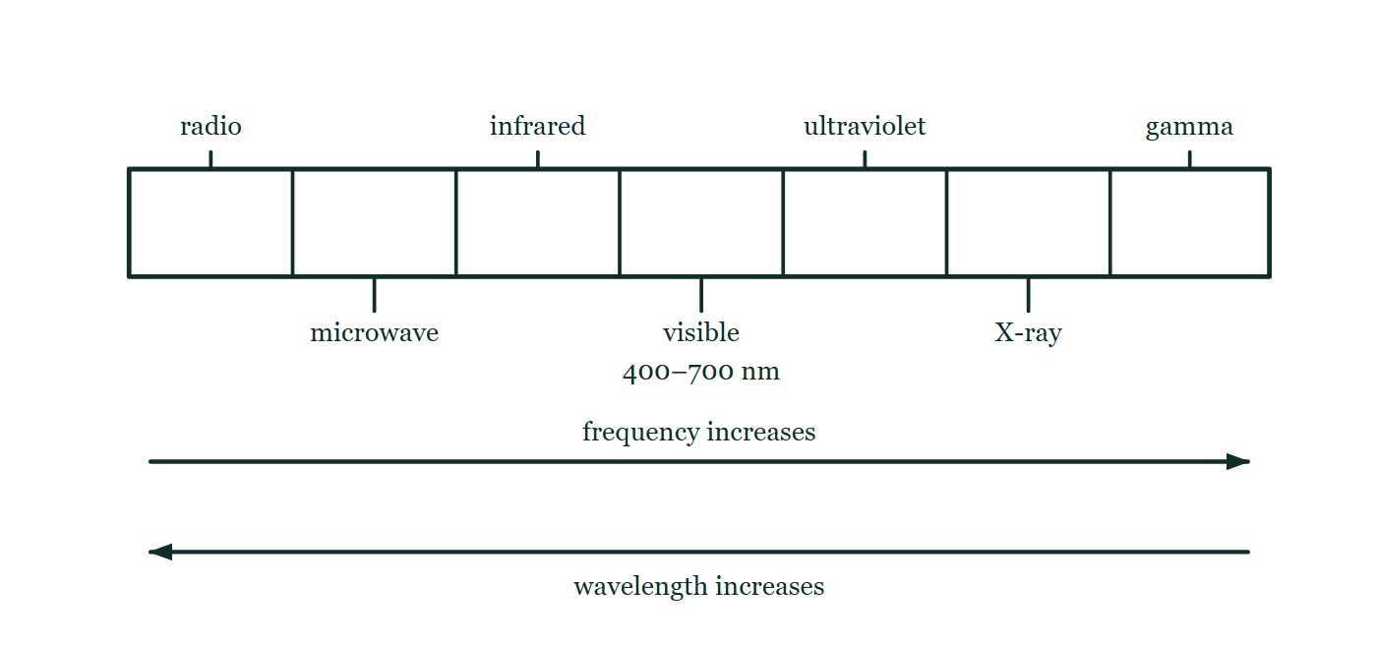
WAVES · ELECTROMAGNETIC WAVES
GIOPHYSICS LESSON
THINK FIRST
Orange light of 600 nm enters glass, where its wavelength is squeezed to 400 nm — the wavelength violet light has in air. Does it look violet?
Take answers before you click — the point is the commitment
The light slows to two thirds of c inside the glass. If the speed drops while the source keeps emitting, something about the wave has to give.
THE ANSWER
No, it stays orange. What gives is the wavelength, not the frequency — the source is still shaking at the same rate, and every crest that arrives at the glass has to set off inside it, so the same number pass a point each second on both sides of the boundary. Colour follows frequency, which is why nothing you look at through a window changes hue.
A single bar divided into seven bands, labelled radio, microwave, infrared, visible at 400–700 nm, ultraviolet, X-ray and gamma; an arrow beneath points right for increasing frequency and a second points left for increasing wavelength.
The live version of this figure — click here
Waves — Electromagnetic Waves. Built by GioPhysics from the lesson's own copy; nothing on these slides is re-authored.
3 / 33
Notes:
[Phase] Starter: Recall what this lesson stands on (minutes 0–5 of 45)
[Hook] Orange light of 600 nm enters glass, where its wavelength is squeezed to 400 nm — the wavelength violet light has in air. Does it look violet? The light slows to two thirds of c inside the glass. If the speed drops while the source keeps emitting, something about the wave has to give.
[Answer] No, it stays orange. What gives is the wavelength, not the frequency — the source is still shaking at the same rate, and every crest that arrives at the glass has to set off inside it, so the same number pass a point each second on both sides of the boundary. Colour follows frequency, which is why nothing you look at through a window changes hue.
[Figure] A single bar divided into seven bands, labelled radio, microwave, infrared, visible at 400–700 nm, ultraviolet, X-ray and gamma; an arrow beneath points right for increasing frequency and a second points left for increasing wavelength.

Slide 4
WAVES · ELECTROMAGNETIC WAVES
GIOPHYSICS LESSON
EXPLAINED SIMPLY
In one sentence
Introduce the idea — The big idea and the definition
An electromagnetic wave is a transverse wave of oscillating electric and magnetic fields that can travel through empty space.
Waves — Electromagnetic Waves. Built by GioPhysics from the lesson's own copy; nothing on these slides is re-authored.
4 / 33
Notes:
[Phase] Introduce the idea: The big idea and the definition (minutes 5–13 of 45)
[Definition] An electromagnetic wave is a transverse wave of oscillating electric and magnetic fields that can travel through empty space.

Slide 5
WAVES · ELECTROMAGNETIC WAVES
GIOPHYSICS LESSON
EXPLAINED SIMPLY
What that looks like
Introduce the idea — The big idea and the definition
FOR EXAMPLE
Sunlight crosses 150 million kilometres of vacuum to reach Earth — no medium carries it.
Waves — Electromagnetic Waves. Built by GioPhysics from the lesson's own copy; nothing on these slides is re-authored.
5 / 33
Notes:
[Phase] Introduce the idea: The big idea and the definition (minutes 5–13 of 45)
[Worked illustration] Sunlight crosses 150 million kilometres of vacuum to reach Earth — no medium carries it.

Slide 6
WAVES · ELECTROMAGNETIC WAVES
GIOPHYSICS LESSON
THE BIG IDEA
Waves that need no medium
Introduce the idea — The big idea and the definition
Vibrating electric and magnetic fields regenerate each other at right angles to the direction of travel — no medium required. Every EM wave moves at c ≈ 3 × 10⁸ m/s in vacuum; what distinguishes radio from gamma rays is only wavelength and frequency.
Waves — Electromagnetic Waves. Built by GioPhysics from the lesson's own copy; nothing on these slides is re-authored.
6 / 33
Notes:
[Phase] Introduce the idea: The big idea and the definition (minutes 5–13 of 45)
[Big idea] Vibrating electric and magnetic fields regenerate each other at right angles to the direction of travel — no medium required. Every EM wave moves at c ≈ 3 × 10⁸ m/s in vacuum; what distinguishes radio from gamma rays is only wavelength and frequency.

Slide 7
WAVES · ELECTROMAGNETIC WAVES
GIOPHYSICS LESSON
THE PHYSICS · 1 OF 4
The spectrum
Build the model — The formulae, one at a time, in plain English
Radio, microwave, infrared, visible, ultraviolet, X-ray, gamma — in order of increasing frequency and decreasing wavelength.
Waves — Electromagnetic Waves. Built by GioPhysics from the lesson's own copy; nothing on these slides is re-authored.
7 / 33
Notes:
[Phase] Build the model: The formulae, one at a time, in plain English (minutes 13–22 of 45)
[Section] Radio, microwave, infrared, visible, ultraviolet, X-ray, gamma — in order of increasing frequency and decreasing wavelength.

Slide 8
WAVES · ELECTROMAGNETIC WAVES
GIOPHYSICS LESSON
THE PHYSICS · 2 OF 4
Transverse nature
Build the model — The formulae, one at a time, in plain English
The E and B fields vibrate at right angles to the travel direction (and to each other) — which is why light can be polarised.
Waves — Electromagnetic Waves. Built by GioPhysics from the lesson's own copy; nothing on these slides is re-authored.
8 / 33
Notes:
[Phase] Build the model: The formulae, one at a time, in plain English (minutes 13–22 of 45)
[Section] The E and B fields vibrate at right angles to the travel direction (and to each other) — which is why light can be polarised.

Slide 9
WAVES · ELECTROMAGNETIC WAVES
GIOPHYSICS LESSON
THE PHYSICS · 3 OF 4
Uses by band
Build the model — The formulae, one at a time, in plain English
Radio for communication, microwaves for cooking and links, IR for heat sensing, UV for sterilising, X-rays for imaging, gamma for treating tumours.
Waves — Electromagnetic Waves. Built by GioPhysics from the lesson's own copy; nothing on these slides is re-authored.
9 / 33
Notes:
[Phase] Build the model: The formulae, one at a time, in plain English (minutes 13–22 of 45)
[Section] Radio for communication, microwaves for cooking and links, IR for heat sensing, UV for sterilising, X-rays for imaging, gamma for treating tumours.

Slide 10
WAVES · ELECTROMAGNETIC WAVES
GIOPHYSICS LESSON
THE PHYSICS · 4 OF 4
The harm each band can do
Build the model — The formulae, one at a time, in plain English
Every band carries energy and each does its damage differently. Microwaves are absorbed by the water in living tissue and heat it from the inside, so excessive exposure cooks internal organs. Infrared and bright visible light heat the surface: skin burns, and a laser or the Sun can burn the retina.
Ultraviolet carries enough energy per photon to damage cells at the surface of the skin and the eye, bringing premature ageing, skin cancer and cataracts. X-rays and gamma rays are ionising — they knock electrons out of atoms inside the body, and the damaged molecules can mutate a cell or kill it, so exposure is kept as low as the job allows. The pattern to remember is that the risk climbs with frequency, because the energy each photon delivers climbs with it.
Waves — Electromagnetic Waves. Built by GioPhysics from the lesson's own copy; nothing on these slides is re-authored.
10 / 33
Notes:
[Phase] Build the model: The formulae, one at a time, in plain English (minutes 13–22 of 45)
[Section] Every band carries energy and each does its damage differently. Microwaves are absorbed by the water in living tissue and heat it from the inside, so excessive exposure cooks internal organs. Infrared and bright visible light heat the surface: skin burns, and a laser or the Sun can burn the retina. Ultraviolet carries enough energy per photon to damage cells at the surface of the skin and the eye, bringing premature ageing, skin cancer and cataracts. X-rays and gamma rays are ionising — they knock electrons out of atoms inside the body, and the damaged molecules can mutate a cell or kill it, so exposure is kept as low as the job allows. The pattern to remember is that the risk climbs with frequency, because the energy each photon delivers climbs with it.

Slide 11
WAVES · ELECTROMAGNETIC WAVES
GIOPHYSICS LESSON
FORMULA 1 OF 3
Vacuum speed
Build the model — The formulae, one at a time, in plain English
c ≈ 3 × 10⁸ m/s
The same for every EM wave in vacuum
IN PLAIN ENGLISH
Radio waves and X-rays race through vacuum at exactly the same speed — the speed of light.
Waves — Electromagnetic Waves. Built by GioPhysics from the lesson's own copy; nothing on these slides is re-authored.
11 / 33
Notes:
[Phase] Build the model: The formulae, one at a time, in plain English (minutes 13–22 of 45)
[Formula] Vacuum speed: c ≈ 3 × 10⁸ m/s
[In plain English] Radio waves and X-rays race through vacuum at exactly the same speed — the speed of light.
[Note] The same for every EM wave in vacuum

Slide 12
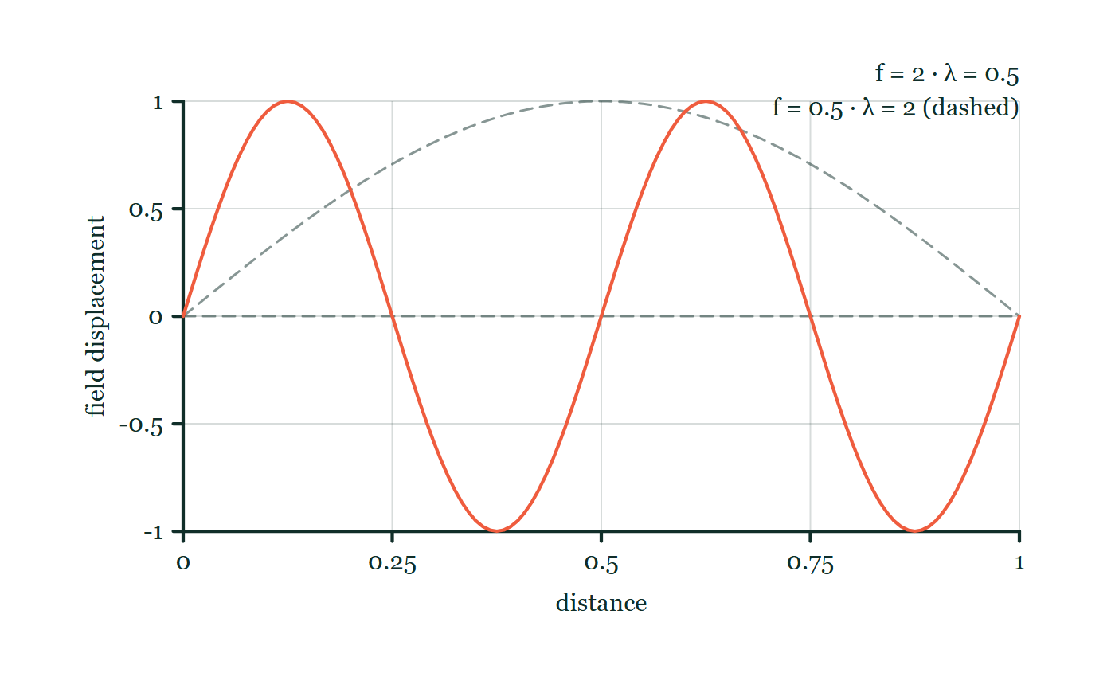
WAVES · ELECTROMAGNETIC WAVES
GIOPHYSICS LESSON
FORMULA 2 OF 3
Wave equation for light
Build the model — The formulae, one at a time, in plain English
c = fλ
Visible: ~400 nm (violet) to ~700 nm (red)
IN PLAIN ENGLISH
With c fixed, longer wavelength always means lower frequency — the whole spectrum is one trade-off.
Electromagnetic wave explorer
Move this graph on the live version — click here
Waves — Electromagnetic Waves. Built by GioPhysics from the lesson's own copy; nothing on these slides is re-authored.
12 / 33
Notes:
[Phase] Build the model: The formulae, one at a time, in plain English (minutes 13–22 of 45)
[Formula] Wave equation for light: c = fλ
[In plain English] With c fixed, longer wavelength always means lower frequency — the whole spectrum is one trade-off.
[Note] Visible: ~400 nm (violet) to ~700 nm (red)
[Graph] Electromagnetic wave explorer. At fixed wave speed c, raising frequency shortens wavelength so fλ stays constant.
[Axes] Horizontal: distance. Vertical: field displacement. Values are normalised — the graph teaches the shape, not a measurement.

Slide 13
WAVES · ELECTROMAGNETIC WAVES
GIOPHYSICS LESSON
FORMULA 3 OF 3
Entering a medium
Build the model — The formulae, one at a time, in plain English
v < c, f unchanged
Wavelength shortens with the speed
IN PLAIN ENGLISH
In glass or water light slows and its wavelength shrinks, but the frequency — set by the source — never changes.
Waves — Electromagnetic Waves. Built by GioPhysics from the lesson's own copy; nothing on these slides is re-authored.
13 / 33
Notes:
[Phase] Build the model: The formulae, one at a time, in plain English (minutes 13–22 of 45)
[Formula] Entering a medium: v < c, f unchanged
[In plain English] In glass or water light slows and its wavelength shrinks, but the frequency — set by the source — never changes.
[Note] Wavelength shortens with the speed

Slide 14
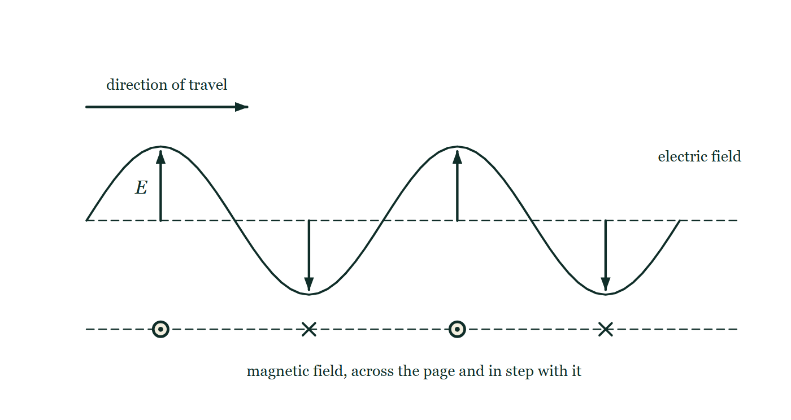
WAVES · ELECTROMAGNETIC WAVES
GIOPHYSICS LESSON
THE PICTURE
Two fields at right angles
Drawn for this lesson
A wave travelling to the right, drawn as a sinusoidal electric field oscillating up and down in the plane of the page with arrows at four points, and beneath it the magnetic field shown as alternating dots and crosses in step with it, pointing out of and into the page.
The live version of this figure — click here
Waves — Electromagnetic Waves. Built by GioPhysics from the lesson's own copy; nothing on these slides is re-authored.
14 / 33
Notes:
[Phase] Build the model: The formulae, one at a time, in plain English (minutes 13–22 of 45)
[Figure] A wave travelling to the right, drawn as a sinusoidal electric field oscillating up and down in the plane of the page with arrows at four points, and beneath it the magnetic field shown as alternating dots and crosses in step with it, pointing out of and into the page.

Slide 15
WAVES · ELECTROMAGNETIC WAVES
GIOPHYSICS LESSON
WATCH OUT
The common trap
Check and misconception — The quick check and the trap
When light enters glass its speed and wavelength drop, but its frequency does not change — frequency is fixed by the vibrating source, and it is what decides the colour.
Waves — Electromagnetic Waves. Built by GioPhysics from the lesson's own copy; nothing on these slides is re-authored.
15 / 33
Notes:
[Phase] Check and misconception: The quick check and the trap (minutes 35–41 of 45)
[Misconception] When light enters glass its speed and wavelength drop, but its frequency does not change — frequency is fixed by the vibrating source, and it is what decides the colour.

Slide 16
WAVES · ELECTROMAGNETIC WAVES
GIOPHYSICS LESSON
WORKED EXAMPLE 1 OF 2 · EASY
The question
Easy
Worked examples — I do, we do — one step revealed at a time
Find the frequency of green light of wavelength 500 nm in vacuum.
Waves — Electromagnetic Waves. Built by GioPhysics from the lesson's own copy; nothing on these slides is re-authored.
16 / 33
Notes:
[Phase] Worked examples: I do, we do — one step revealed at a time (minutes 22–35 of 45)
[Question] Find the frequency of green light of wavelength 500 nm in vacuum.
[Answer] 6.0 × 10¹⁴ Hz

Slide 17
WAVES · ELECTROMAGNETIC WAVES
GIOPHYSICS LESSON
WORKED EXAMPLE 1 OF 2 · EASY · THE WORKING
How to solve it
Easy
Worked examples — I do, we do — one step revealed at a time
Find the frequency of green light of wavelength 500 nm in vacuum.
1.
f = c/λ = 3 × 10⁸ ÷ 5.0 × 10⁻⁷.
2.
f = 6.0 × 10¹⁴ Hz.
Waves — Electromagnetic Waves. Built by GioPhysics from the lesson's own copy; nothing on these slides is re-authored.
17 / 33
Notes:
[Phase] Worked examples: I do, we do — one step revealed at a time (minutes 22–35 of 45)
[Reveal] One click per step. The class works each line before the next appears.
[Step 1] f = c/λ = 3 × 10⁸ ÷ 5.0 × 10⁻⁷.
[Step 2] f = 6.0 × 10¹⁴ Hz.

Slide 18
WAVES · ELECTROMAGNETIC WAVES
GIOPHYSICS LESSON
WORKED EXAMPLE 1 OF 2 · EASY
Answer
Easy
Worked examples — I do, we do — one step revealed at a time
6.0 × 10¹⁴ Hz
Waves — Electromagnetic Waves. Built by GioPhysics from the lesson's own copy; nothing on these slides is re-authored.
18 / 33
Notes:
[Phase] Worked examples: I do, we do — one step revealed at a time (minutes 22–35 of 45)
[Answer] 6.0 × 10¹⁴ Hz

Slide 19
WAVES · ELECTROMAGNETIC WAVES
GIOPHYSICS LESSON
WORKED EXAMPLE 2 OF 2 · MEDIUM
The question
Medium
Worked examples — I do, we do — one step revealed at a time
Red light has wavelength 700 nm in vacuum. Find its frequency, and its wavelength in glass where its speed is 2.0 × 10⁸ m/s.
Waves — Electromagnetic Waves. Built by GioPhysics from the lesson's own copy; nothing on these slides is re-authored.
19 / 33
Notes:
[Phase] Worked examples: I do, we do — one step revealed at a time (minutes 22–35 of 45)
[Question] Red light has wavelength 700 nm in vacuum. Find its frequency, and its wavelength in glass where its speed is 2.0 × 10⁸ m/s.
[Answer] f ≈ 4.3 × 10¹⁴ Hz; λ in glass ≈ 470 nm

Slide 20
WAVES · ELECTROMAGNETIC WAVES
GIOPHYSICS LESSON
WORKED EXAMPLE 2 OF 2 · MEDIUM · THE WORKING
How to solve it
Medium
Worked examples — I do, we do — one step revealed at a time
Red light has wavelength 700 nm in vacuum. Find its frequency, and its wavelength in glass where its speed is 2.0 × 10⁸ m/s.
1.
f = c/λ = 3 × 10⁸ ÷ 700 × 10⁻⁹ ≈ 4.3 × 10¹⁴ Hz.
2.
In glass f is unchanged; λ = v/f = 2.0 × 10⁸ ÷ 4.3 × 10¹⁴.
3.
λ ≈ 470 nm — shorter, because the wave moves slower.
Waves — Electromagnetic Waves. Built by GioPhysics from the lesson's own copy; nothing on these slides is re-authored.
20 / 33
Notes:
[Phase] Worked examples: I do, we do — one step revealed at a time (minutes 22–35 of 45)
[Reveal] One click per step. The class works each line before the next appears.
[Step 1] f = c/λ = 3 × 10⁸ ÷ 700 × 10⁻⁹ ≈ 4.3 × 10¹⁴ Hz.
[Step 2] In glass f is unchanged; λ = v/f = 2.0 × 10⁸ ÷ 4.3 × 10¹⁴.
[Step 3] λ ≈ 470 nm — shorter, because the wave moves slower.

Slide 21
WAVES · ELECTROMAGNETIC WAVES
GIOPHYSICS LESSON
WORKED EXAMPLE 2 OF 2 · MEDIUM
Answer
Medium
Worked examples — I do, we do — one step revealed at a time
f ≈ 4.3 × 10¹⁴ Hz; λ in glass ≈ 470 nm
Waves — Electromagnetic Waves. Built by GioPhysics from the lesson's own copy; nothing on these slides is re-authored.
21 / 33
Notes:
[Phase] Worked examples: I do, we do — one step revealed at a time (minutes 22–35 of 45)
[Answer] f ≈ 4.3 × 10¹⁴ Hz; λ in glass ≈ 470 nm

Slide 22
WAVES · ELECTROMAGNETIC WAVES
GIOPHYSICS LESSON
SPOT THE MISTAKE
One line here is wrong
The whole working is up — find the bad line before you click
1.
Find the frequency of green light of wavelength 500 nm in vacuum.
2.
c = fλ, so f = c/λ
3.
f = 3.0 × 10⁸ / 500
4.
f = 6.0 × 10⁵ Hz
5.
So green light has a frequency of 600 kHz.
LINE 3 IS WRONG
The nanometres were never converted. It is a slip the arithmetic actively hides, because 3.0 divided by 500 gives the clean 6.0 the correct answer also starts with — only the exponent is wrong, by a factor of 10⁹. The result is the giveaway: 600 kHz is a medium-wave radio station, and the bar puts radio nine bands away from visible light.
IT SHOULD SAY
f = 3.0 × 10⁸ / (500 × 10⁻⁹) = 6.0 × 10¹⁴ Hz
Waves — Electromagnetic Waves. Built by GioPhysics from the lesson's own copy; nothing on these slides is re-authored.
22 / 33
Notes:
[Phase] Worked examples: I do, we do — one step revealed at a time (minutes 22–35 of 45)
[Spot the mistake] The working is complete and one line of it is wrong. Let the room hunt: one click names the line, a second shows it done correctly.
[Line 3 is wrong] The nanometres were never converted. It is a slip the arithmetic actively hides, because 3.0 divided by 500 gives the clean 6.0 the correct answer also starts with — only the exponent is wrong, by a factor of 10⁹. The result is the giveaway: 600 kHz is a medium-wave radio station, and the bar puts radio nine bands away from visible light.
[It should say] f = 3.0 × 10⁸ / (500 × 10⁻⁹) = 6.0 × 10¹⁴ Hz

Slide 23
WAVES · ELECTROMAGNETIC WAVES
GIOPHYSICS LESSON
PREDICT · TAKE THE VOTE
Commit before you are told
Hands up for each option, then click
Light passes from air into glass, where its speed falls to two thirds of c. What happens to its frequency and its wavelength?
A Both fall to two thirds
B The wavelength falls to two thirds; the frequency is unchanged
C The frequency falls to two thirds; the wavelength is unchanged
A single bar divided into seven bands, labelled radio, microwave, infrared, visible at 400–700 nm, ultraviolet, X-ray and gamma; an arrow beneath points right for increasing frequency and a second points left for increasing wavelength.
The live version of this figure — click here
Waves — Electromagnetic Waves. Built by GioPhysics from the lesson's own copy; nothing on these slides is re-authored.
23 / 33
Notes:
[Phase] Build the model: The formulae, one at a time, in plain English (minutes 13–22 of 45)
[Predict] Light passes from air into glass, where its speed falls to two thirds of c. What happens to its frequency and its wavelength?
[Options] A Both fall to two thirds B The wavelength falls to two thirds; the frequency is unchanged C The frequency falls to two thirds; the wavelength is unchanged
[Figure] A single bar divided into seven bands, labelled radio, microwave, infrared, visible at 400–700 nm, ultraviolet, X-ray and gamma; an arrow beneath points right for increasing frequency and a second points left for increasing wavelength.

Slide 24
WAVES · ELECTROMAGNETIC WAVES
GIOPHYSICS LESSON
PREDICT · THE OUTCOME
What actually happens
Ask the room who changed their mind, and why
B The wavelength falls to two thirds; the frequency is unchanged
WHY
Crests cannot pile up at the boundary or vanish there: whatever number arrive at the glass each second must set off inside it each second, so the frequency is fixed — by the source, and by nothing that happens on the way. With v = fλ and v cut to two thirds, it is the wavelength that has to follow. That is why the bar's two arrows point opposite ways in vacuum but come uncoupled inside a medium: a band is identified by its frequency, and the wavelength is whatever the local speed makes it.
Waves — Electromagnetic Waves. Built by GioPhysics from the lesson's own copy; nothing on these slides is re-authored.
24 / 33
Notes:
[Phase] Build the model: The formulae, one at a time, in plain English (minutes 13–22 of 45)
[Answer] B — The wavelength falls to two thirds; the frequency is unchanged. Crests cannot pile up at the boundary or vanish there: whatever number arrive at the glass each second must set off inside it each second, so the frequency is fixed — by the source, and by nothing that happens on the way. With v = fλ and v cut to two thirds, it is the wavelength that has to follow. That is why the bar's two arrows point opposite ways in vacuum but come uncoupled inside a medium: a band is identified by its frequency, and the wavelength is whatever the local speed makes it.

Slide 25
WAVES · ELECTROMAGNETIC WAVES
GIOPHYSICS LESSON
QUICK CHECK
Decide before the answer goes up
Check and misconception — The quick check and the trap
Which travels fastest in a vacuum: radio waves, visible light, or X-rays?
A
Radio waves
B
X-rays
C
They all travel at the same speed
Waves — Electromagnetic Waves. Built by GioPhysics from the lesson's own copy; nothing on these slides is re-authored.
25 / 33
Notes:
[Phase] Check and misconception: The quick check and the trap (minutes 35–41 of 45)
[Question] Which travels fastest in a vacuum: radio waves, visible light, or X-rays?
[Options] A Radio waves B X-rays C They all travel at the same speed

Slide 26
WAVES · ELECTROMAGNETIC WAVES
GIOPHYSICS LESSON
QUICK CHECK · THE ANSWER
The answer, and why
Check and misconception — The quick check and the trap
C They all travel at the same speed
HOW TO GET THERE
All electromagnetic waves share the same vacuum speed c — only wavelength and frequency differ.
WHY THE OTHERS TEMPT
A Radio waves sit at the long-wavelength end of the bar, and long wavelength reads as "fast" if speed is being confused with how far one cycle reaches. Speed is wavelength times frequency, and along this spectrum the two trade off exactly: as λ grows, f shrinks in the same proportion.
B X-rays do the most damage of the three, which is what makes this tempting — but energy is not speed. In vacuum an X-ray and a radio wave cross the same metre in the same 3.3 nanoseconds.
C Correct. Every electromagnetic wave travels at c in vacuum; the bands differ only in frequency and wavelength.
Waves — Electromagnetic Waves. Built by GioPhysics from the lesson's own copy; nothing on these slides is re-authored.
26 / 33
Notes:
[Phase] Check and misconception: The quick check and the trap (minutes 35–41 of 45)
[Question] Which travels fastest in a vacuum: radio waves, visible light, or X-rays?
[Option by option] A: Radio waves sit at the long-wavelength end of the bar, and long wavelength reads as "fast" if speed is being confused with how far one cycle reaches. Speed is wavelength times frequency, and along this spectrum the two trade off exactly: as λ grows, f shrinks in the same proportion. B: X-rays do the most damage of the three, which is what makes this tempting — but energy is not speed. In vacuum an X-ray and a radio wave cross the same metre in the same 3.3 nanoseconds. C: Correct. Every electromagnetic wave travels at c in vacuum; the bands differ only in frequency and wavelength.
[Answer] C — They all travel at the same speed
[Why] All electromagnetic waves share the same vacuum speed c — only wavelength and frequency differ.
[Reveal] One click for the answer, then one for the reason.

Slide 27
WAVES · ELECTROMAGNETIC WAVES
GIOPHYSICS LESSON
EXTENSION 1 OF 2 · HARD
The question
Hard
Worked examples — I do, we do — one step revealed at a time
A radio station broadcasts at 98.5 MHz. Find the wavelength, and how many wavelengths fit between the transmitter and a receiver 25 km away.
Waves — Electromagnetic Waves. Built by GioPhysics from the lesson's own copy; nothing on these slides is re-authored.
27 / 33
Notes:
[Phase] Worked examples: I do, we do — one step revealed at a time (minutes 22–35 of 45)
[Question] A radio station broadcasts at 98.5 MHz. Find the wavelength, and how many wavelengths fit between the transmitter and a receiver 25 km away.
[Answer] λ ≈ 3.0 m; ≈ 8200 of them

Slide 28
WAVES · ELECTROMAGNETIC WAVES
GIOPHYSICS LESSON
EXTENSION 1 OF 2 · HARD · THE WORKING
How to solve it
Hard
Worked examples — I do, we do — one step revealed at a time
A radio station broadcasts at 98.5 MHz. Find the wavelength, and how many wavelengths fit between the transmitter and a receiver 25 km away.
1.
λ = c/f = 3 × 10⁸ ÷ 9.85 × 10⁷ ≈ 3.05 m.
2.
n = 25 000 ÷ 3.05.
3.
≈ 8200 wavelengths.
Waves — Electromagnetic Waves. Built by GioPhysics from the lesson's own copy; nothing on these slides is re-authored.
28 / 33
Notes:
[Phase] Worked examples: I do, we do — one step revealed at a time (minutes 22–35 of 45)
[Reveal] One click per step. The class works each line before the next appears.
[Step 1] λ = c/f = 3 × 10⁸ ÷ 9.85 × 10⁷ ≈ 3.05 m.
[Step 2] n = 25 000 ÷ 3.05.
[Step 3] ≈ 8200 wavelengths.

Slide 29
WAVES · ELECTROMAGNETIC WAVES
GIOPHYSICS LESSON
EXTENSION 1 OF 2 · HARD
Answer
Hard
Worked examples — I do, we do — one step revealed at a time
λ ≈ 3.0 m; ≈ 8200 of them
Waves — Electromagnetic Waves. Built by GioPhysics from the lesson's own copy; nothing on these slides is re-authored.
29 / 33
Notes:
[Phase] Worked examples: I do, we do — one step revealed at a time (minutes 22–35 of 45)
[Answer] λ ≈ 3.0 m; ≈ 8200 of them

Slide 30
WAVES · ELECTROMAGNETIC WAVES
GIOPHYSICS LESSON
EXTENSION 2 OF 2 · CHALLENGING
The question
Challenging
Worked examples — I do, we do — one step revealed at a time
Light of 600 nm enters glass of refractive index 1.50. Find its speed, wavelength, and frequency inside — then explain which one determines the colour seen by an underwater diver looking at a red lamp.
Waves — Electromagnetic Waves. Built by GioPhysics from the lesson's own copy; nothing on these slides is re-authored.
30 / 33
Notes:
[Phase] Worked examples: I do, we do — one step revealed at a time (minutes 22–35 of 45)
[Question] Light of 600 nm enters glass of refractive index 1.50. Find its speed, wavelength, and frequency inside — then explain which one determines the colour seen by an underwater diver looking at a red lamp.
[Answer] v = 2 × 10⁸ m/s, λ = 400 nm, f = 5 × 10¹⁴ Hz — colour follows the unchanged frequency

Slide 31
WAVES · ELECTROMAGNETIC WAVES
GIOPHYSICS LESSON
EXTENSION 2 OF 2 · CHALLENGING · THE WORKING
How to solve it
Challenging
Worked examples — I do, we do — one step revealed at a time
Light of 600 nm enters glass of refractive index 1.50. Find its speed, wavelength, and frequency inside — then explain which one determines the colour seen by an underwater diver looking at a red lamp.
1.
v = c/n = 2.0 × 10⁸ m/s; λ = 600/1.5 = 400 nm; f unchanged at 5.0 × 10¹⁴ Hz.
2.
Inside glass the wavelength matches 'violet's vacuum value' — yet the light is still red.
3.
The eye responds to frequency, which never changed; the lamp looks red in any medium.
Waves — Electromagnetic Waves. Built by GioPhysics from the lesson's own copy; nothing on these slides is re-authored.
31 / 33
Notes:
[Phase] Worked examples: I do, we do — one step revealed at a time (minutes 22–35 of 45)
[Reveal] One click per step. The class works each line before the next appears.
[Step 1] v = c/n = 2.0 × 10⁸ m/s; λ = 600/1.5 = 400 nm; f unchanged at 5.0 × 10¹⁴ Hz.
[Step 2] Inside glass the wavelength matches 'violet's vacuum value' — yet the light is still red.
[Step 3] The eye responds to frequency, which never changed; the lamp looks red in any medium.

Slide 32
WAVES · ELECTROMAGNETIC WAVES
GIOPHYSICS LESSON
EXTENSION 2 OF 2 · CHALLENGING
Answer
Challenging
Worked examples — I do, we do — one step revealed at a time
v = 2 × 10⁸ m/s, λ = 400 nm, f = 5 × 10¹⁴ Hz — colour follows the unchanged frequency
Waves — Electromagnetic Waves. Built by GioPhysics from the lesson's own copy; nothing on these slides is re-authored.
32 / 33
Notes:
[Phase] Worked examples: I do, we do — one step revealed at a time (minutes 22–35 of 45)
[Answer] v = 2 × 10⁸ m/s, λ = 400 nm, f = 5 × 10¹⁴ Hz — colour follows the unchanged frequency

Slide 33
WAVES · ELECTROMAGNETIC WAVES
GIOPHYSICS LESSON
WAVES
Where to go next
Plenary — What to take away, what to practise next
Next
15.4 Polarisation
https://giophysics.com/chapter-24/polarisation/
Lesson
This lesson on giophysics.com
https://giophysics.com/chapter-24/electromagnetic-waves/
Live
The live, interactive version of these slides
https://giophysics.com/chapter-24/presentation/?lesson=em
Chapter
All Waves lessons
https://giophysics.com/chapter-24/
PDF
Download the lesson PDF
https://giophysics.com/downloads/24-3-electromagnetic-waves.pdf
Waves — Electromagnetic Waves. Built by GioPhysics from the lesson's own copy; nothing on these slides is re-authored.
33 / 33
Notes:
[Phase] Plenary: What to take away, what to practise next (minutes 41–45 of 45)
[Interactive] The graphs and the circuit topology on these slides are frozen. The live version at https://giophysics.com/chapter-24/presentation/?lesson=em moves them.

