Slide 1
WAVES · POLARISATION
GIOPHYSICS LESSON
15 · Waves
The transverse-wave fingerprint
Polarisation
Only transverse waves can be polarised — which is how we know light is one. A polarising filter passes one vibration plane and blocks the rest, and Malus's law counts the cost.
POSITION
Lesson 4 of 10 in Waves
PLAN
16 slides in the 45-minute core run, about 44.5 minutes of it
LESSON PAGE
https://giophysics.com/chapter-24/polarisation/
Built by GioPhysics from the lesson's own page. Every word on these slides is the lesson's; nothing here is re-authored. Teaching material, not an awarding body's document.
Waves — Polarisation. Built by GioPhysics from the lesson's own copy; nothing on these slides is re-authored.
1 / 31
Notes:
[Lesson] Waves — Polarisation. Lesson 4 of 10.
[Intro] Only transverse waves can be polarised — which is how we know light is one. A polarising filter passes one vibration plane and blocks the rest, and Malus's law counts the cost.
[Source] https://giophysics.com/chapter-24/polarisation/
[Disclaimer] Built by GioPhysics from the lesson's own page. Every word on these slides is the lesson's; nothing here is re-authored. Teaching material, not an awarding body's document.

Slide 2
WAVES · POLARISATION
GIOPHYSICS LESSON
WHAT THIS NEEDS
What you already know
Starter — Recall what this lesson stands on
Recall
Electromagnetic waves
https://giophysics.com/chapter-24/electromagnetic-waves/
Waves — Polarisation. Built by GioPhysics from the lesson's own copy; nothing on these slides is re-authored.
2 / 31
Notes:
[Phase] Starter: Recall what this lesson stands on (minutes 0–5 of 45)
[Starter] Recall: Electromagnetic waves

Slide 3
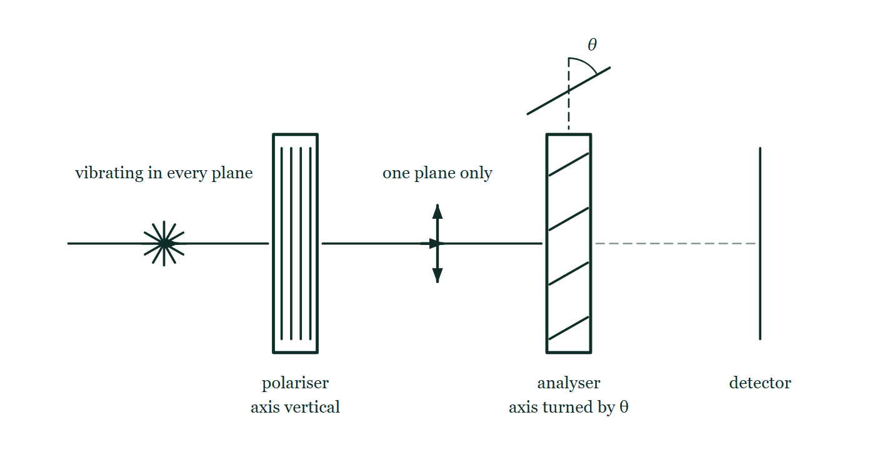
WAVES · POLARISATION
GIOPHYSICS LESSON
THINK FIRST
Hold one sunglasses lens over another and turn it: the pair goes completely black. Why doesn't that happen with ordinary tinted lenses?
Take answers before you click — the point is the commitment
Two tinted lenses stacked just make things darker, and turning them changes nothing at all.
THE ANSWER
Because a polaroid is not a tint. A tint removes a fraction of everything; a polaroid passes only vibrations along its own axis and blocks the rest. The first lens leaves the light vibrating in one plane, and when the second lens's axis is turned across that plane there is nothing left for it to pass. Two filters can hand over half the light or none of it, and the only thing that decides which is the angle between them.
Unpolarised light drawn as a rosette of vibration directions meets a polariser with a vertical axis, leaves it as a single vertical double-headed arrow, and reaches an analyser whose axis is turned through an angle θ from the vertical, beyond which a faint dashed path runs to a detector.
The live version of this figure — click here
Waves — Polarisation. Built by GioPhysics from the lesson's own copy; nothing on these slides is re-authored.
3 / 31
Notes:
[Phase] Starter: Recall what this lesson stands on (minutes 0–5 of 45)
[Hook] Hold one sunglasses lens over another and turn it: the pair goes completely black. Why doesn't that happen with ordinary tinted lenses? Two tinted lenses stacked just make things darker, and turning them changes nothing at all.
[Answer] Because a polaroid is not a tint. A tint removes a fraction of everything; a polaroid passes only vibrations along its own axis and blocks the rest. The first lens leaves the light vibrating in one plane, and when the second lens's axis is turned across that plane there is nothing left for it to pass. Two filters can hand over half the light or none of it, and the only thing that decides which is the angle between them.
[Figure] Unpolarised light drawn as a rosette of vibration directions meets a polariser with a vertical axis, leaves it as a single vertical double-headed arrow, and reaches an analyser whose axis is turned through an angle θ from the vertical, beyond which a faint dashed path runs to a detector.

Slide 4
WAVES · POLARISATION
GIOPHYSICS LESSON
EXPLAINED SIMPLY
In one sentence
Introduce the idea — The big idea and the definition
Polarisation restricts a transverse wave's vibrations to a single plane.
Waves — Polarisation. Built by GioPhysics from the lesson's own copy; nothing on these slides is re-authored.
4 / 31
Notes:
[Phase] Introduce the idea: The big idea and the definition (minutes 5–13 of 45)
[Definition] Polarisation restricts a transverse wave's vibrations to a single plane.

Slide 5
WAVES · POLARISATION
GIOPHYSICS LESSON
EXPLAINED SIMPLY
What that looks like
Introduce the idea — The big idea and the definition
FOR EXAMPLE
Rotate polaroid sunglasses while looking at glare off water — at one angle the reflected glare almost vanishes.
Waves — Polarisation. Built by GioPhysics from the lesson's own copy; nothing on these slides is re-authored.
5 / 31
Notes:
[Phase] Introduce the idea: The big idea and the definition (minutes 5–13 of 45)
[Worked illustration] Rotate polaroid sunglasses while looking at glare off water — at one angle the reflected glare almost vanishes.

Slide 6
WAVES · POLARISATION
GIOPHYSICS LESSON
THE BIG IDEA
The transverse-wave fingerprint
Introduce the idea — The big idea and the definition
Unpolarised light vibrates in every plane at right angles to its travel. A polariser transmits only the component along its axis; a second filter (the analyser) at angle θ passes a fraction cos²θ of that intensity. Crossed filters pass nothing.
Waves — Polarisation. Built by GioPhysics from the lesson's own copy; nothing on these slides is re-authored.
6 / 31
Notes:
[Phase] Introduce the idea: The big idea and the definition (minutes 5–13 of 45)
[Big idea] Unpolarised light vibrates in every plane at right angles to its travel. A polariser transmits only the component along its axis; a second filter (the analyser) at angle θ passes a fraction cos²θ of that intensity. Crossed filters pass nothing.

Slide 7
WAVES · POLARISATION
GIOPHYSICS LESSON
THE PHYSICS · 1 OF 3
Polariser and analyser
Build the model — The formulae, one at a time, in plain English
The first filter fixes the vibration plane; the second tests it. Rotating the analyser fades the light smoothly to darkness at 90°.
Waves — Polarisation. Built by GioPhysics from the lesson's own copy; nothing on these slides is re-authored.
7 / 31
Notes:
[Phase] Build the model: The formulae, one at a time, in plain English (minutes 13–22 of 45)
[Section] The first filter fixes the vibration plane; the second tests it. Rotating the analyser fades the light smoothly to darkness at 90°.

Slide 8
WAVES · POLARISATION
GIOPHYSICS LESSON
THE PHYSICS · 2 OF 3
Polarisation by reflection
Build the model — The formulae, one at a time, in plain English
Light reflecting off water or glass is partially polarised parallel to the surface — polaroid sunglasses mount their axis vertically to block it.
Waves — Polarisation. Built by GioPhysics from the lesson's own copy; nothing on these slides is re-authored.
8 / 31
Notes:
[Phase] Build the model: The formulae, one at a time, in plain English (minutes 13–22 of 45)
[Section] Light reflecting off water or glass is partially polarised parallel to the surface — polaroid sunglasses mount their axis vertically to block it.

Slide 9
WAVES · POLARISATION
GIOPHYSICS LESSON
THE PHYSICS · 3 OF 3
Everyday uses
Build the model — The formulae, one at a time, in plain English
LCD screens, glare-reducing sunglasses, photographic filters, and stress analysis in transparent materials all exploit polarisation.
Waves — Polarisation. Built by GioPhysics from the lesson's own copy; nothing on these slides is re-authored.
9 / 31
Notes:
[Phase] Build the model: The formulae, one at a time, in plain English (minutes 13–22 of 45)
[Section] LCD screens, glare-reducing sunglasses, photographic filters, and stress analysis in transparent materials all exploit polarisation.

Slide 10
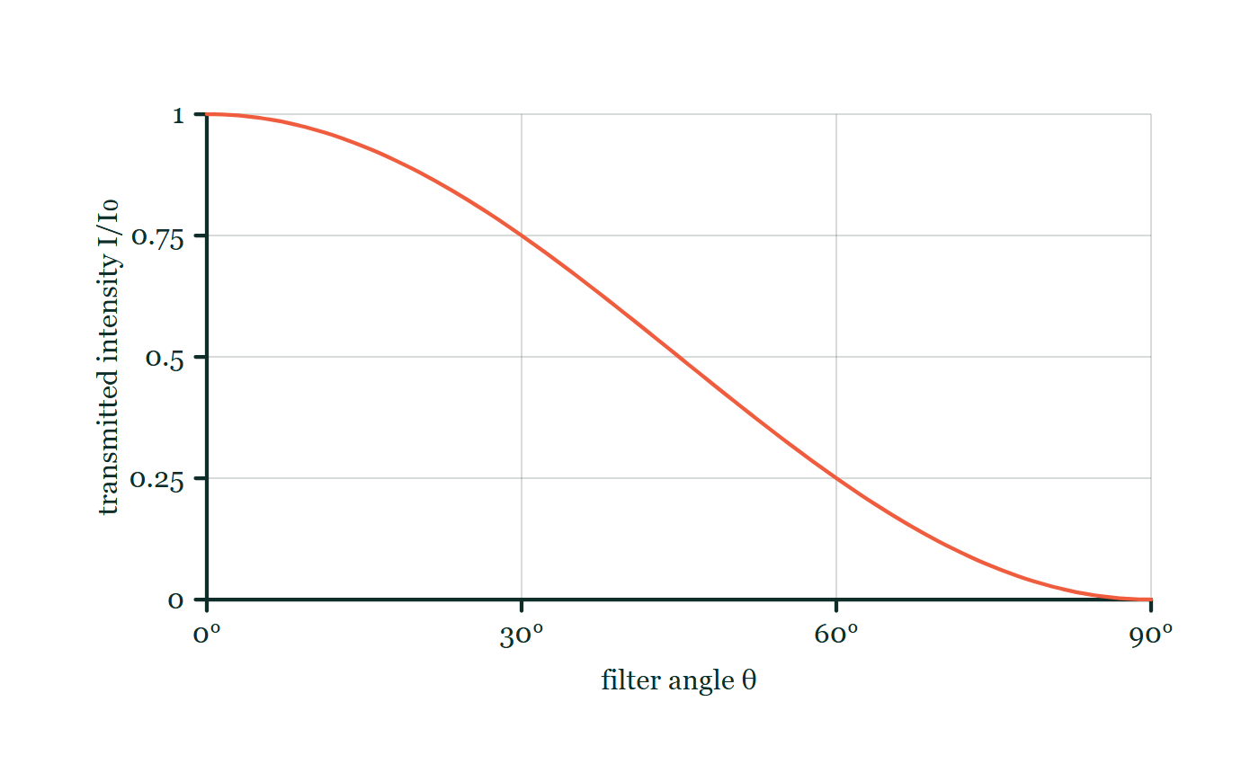
WAVES · POLARISATION
GIOPHYSICS LESSON
FORMULA 1 OF 3
Malus's law
Build the model — The formulae, one at a time, in plain English
I = I₀cos²θ
θ between polariser and analyser axes
IN PLAIN ENGLISH
The transmitted intensity falls with the squared cosine of the angle between the two filter axes — at 90° nothing gets through.
Polarisation explorer
Move this graph on the live version — click here
Waves — Polarisation. Built by GioPhysics from the lesson's own copy; nothing on these slides is re-authored.
10 / 31
Notes:
[Phase] Build the model: The formulae, one at a time, in plain English (minutes 13–22 of 45)
[Formula] Malus's law: I = I₀cos²θ
[In plain English] The transmitted intensity falls with the squared cosine of the angle between the two filter axes — at 90° nothing gets through.
[Note] θ between polariser and analyser axes
[Graph] Polarisation explorer. Malus' law falls from full transmission at 0° to zero at 90° as cos²θ.
[Axes] Horizontal: filter angle θ. Vertical: transmitted intensity I/I₀. Values are normalised — the graph teaches the shape, not a measurement.

Slide 11
WAVES · POLARISATION
GIOPHYSICS LESSON
FORMULA 2 OF 3
Unpolarised through one filter
Build the model — The formulae, one at a time, in plain English
I = I₀/2
Average of cos²θ over all planes
IN PLAIN ENGLISH
A single polariser cuts unpolarised light to half, whatever its orientation, because it averages over every vibration plane.
Waves — Polarisation. Built by GioPhysics from the lesson's own copy; nothing on these slides is re-authored.
11 / 31
Notes:
[Phase] Build the model: The formulae, one at a time, in plain English (minutes 13–22 of 45)
[Formula] Unpolarised through one filter: I = I₀/2
[In plain English] A single polariser cuts unpolarised light to half, whatever its orientation, because it averages over every vibration plane.
[Note] Average of cos²θ over all planes

Slide 12
WAVES · POLARISATION
GIOPHYSICS LESSON
FORMULA 3 OF 3
Transverse-only test
Build the model — The formulae, one at a time, in plain English
longitudinal ⇒ no polarisation
Sound cannot be polarised
IN PLAIN ENGLISH
Vibrations along the travel direction have no plane to select — so polarisation proves a wave is transverse.
Waves — Polarisation. Built by GioPhysics from the lesson's own copy; nothing on these slides is re-authored.
12 / 31
Notes:
[Phase] Build the model: The formulae, one at a time, in plain English (minutes 13–22 of 45)
[Formula] Transverse-only test: longitudinal ⇒ no polarisation
[In plain English] Vibrations along the travel direction have no plane to select — so polarisation proves a wave is transverse.
[Note] Sound cannot be polarised

Slide 13
WAVES · POLARISATION
GIOPHYSICS LESSON
WATCH OUT
The common trap
Check and misconception — The quick check and the trap
A polarising filter does not colour or merely dim light like sunglasses tint — it selects a vibration plane. Two identical filters can pass light or block it completely depending only on their relative angle.
Waves — Polarisation. Built by GioPhysics from the lesson's own copy; nothing on these slides is re-authored.
13 / 31
Notes:
[Phase] Check and misconception: The quick check and the trap (minutes 35–41 of 45)
[Misconception] A polarising filter does not colour or merely dim light like sunglasses tint — it selects a vibration plane. Two identical filters can pass light or block it completely depending only on their relative angle.

Slide 14
WAVES · POLARISATION
GIOPHYSICS LESSON
WORKED EXAMPLE 1 OF 2 · EASY
The question
Easy
Worked examples — I do, we do — one step revealed at a time
Unpolarised light of intensity 600 W/m² passes one ideal polariser. What intensity emerges?
Waves — Polarisation. Built by GioPhysics from the lesson's own copy; nothing on these slides is re-authored.
14 / 31
Notes:
[Phase] Worked examples: I do, we do — one step revealed at a time (minutes 22–35 of 45)
[Question] Unpolarised light of intensity 600 W/m² passes one ideal polariser. What intensity emerges?
[Answer] 300 W/m²

Slide 15
WAVES · POLARISATION
GIOPHYSICS LESSON
WORKED EXAMPLE 1 OF 2 · EASY · THE WORKING
How to solve it
Easy
Worked examples — I do, we do — one step revealed at a time
Unpolarised light of intensity 600 W/m² passes one ideal polariser. What intensity emerges?
1.
A single polariser passes half of unpolarised light.
2.
I = 300 W/m².
Waves — Polarisation. Built by GioPhysics from the lesson's own copy; nothing on these slides is re-authored.
15 / 31
Notes:
[Phase] Worked examples: I do, we do — one step revealed at a time (minutes 22–35 of 45)
[Reveal] One click per step. The class works each line before the next appears.
[Step 1] A single polariser passes half of unpolarised light.
[Step 2] I = 300 W/m².

Slide 16
WAVES · POLARISATION
GIOPHYSICS LESSON
WORKED EXAMPLE 1 OF 2 · EASY
Answer
Easy
Worked examples — I do, we do — one step revealed at a time
300 W/m²
Waves — Polarisation. Built by GioPhysics from the lesson's own copy; nothing on these slides is re-authored.
16 / 31
Notes:
[Phase] Worked examples: I do, we do — one step revealed at a time (minutes 22–35 of 45)
[Answer] 300 W/m²

Slide 17
WAVES · POLARISATION
GIOPHYSICS LESSON
WORKED EXAMPLE 2 OF 2 · MEDIUM
The question
Medium
Worked examples — I do, we do — one step revealed at a time
Unpolarised light of intensity 800 W/m² passes a polariser, then an analyser at 30°. Find the final intensity.
Waves — Polarisation. Built by GioPhysics from the lesson's own copy; nothing on these slides is re-authored.
17 / 31
Notes:
[Phase] Worked examples: I do, we do — one step revealed at a time (minutes 22–35 of 45)
[Question] Unpolarised light of intensity 800 W/m² passes a polariser, then an analyser at 30°. Find the final intensity.
[Answer] 300 W/m²

Slide 18
WAVES · POLARISATION
GIOPHYSICS LESSON
WORKED EXAMPLE 2 OF 2 · MEDIUM · THE WORKING
How to solve it
Medium
Worked examples — I do, we do — one step revealed at a time
Unpolarised light of intensity 800 W/m² passes a polariser, then an analyser at 30°. Find the final intensity.
1.
After the polariser: I₁ = 800/2 = 400 W/m².
2.
Malus's law: I₂ = 400 × cos²30° = 400 × 0.75.
3.
I₂ = 300 W/m².
Waves — Polarisation. Built by GioPhysics from the lesson's own copy; nothing on these slides is re-authored.
18 / 31
Notes:
[Phase] Worked examples: I do, we do — one step revealed at a time (minutes 22–35 of 45)
[Reveal] One click per step. The class works each line before the next appears.
[Step 1] After the polariser: I₁ = 800/2 = 400 W/m².
[Step 2] Malus's law: I₂ = 400 × cos²30° = 400 × 0.75.
[Step 3] I₂ = 300 W/m².

Slide 19
WAVES · POLARISATION
GIOPHYSICS LESSON
WORKED EXAMPLE 2 OF 2 · MEDIUM
Answer
Medium
Worked examples — I do, we do — one step revealed at a time
300 W/m²
Waves — Polarisation. Built by GioPhysics from the lesson's own copy; nothing on these slides is re-authored.
19 / 31
Notes:
[Phase] Worked examples: I do, we do — one step revealed at a time (minutes 22–35 of 45)
[Answer] 300 W/m²

Slide 20
WAVES · POLARISATION
GIOPHYSICS LESSON
SPOT THE MISTAKE
One line here is wrong
The whole working is up — find the bad line before you click
1.
Unpolarised light of intensity 800 W/m² passes a polariser, then an analyser at 30°. Find the final intensity.
2.
Through the polariser: I = 800 × cos²0° = 800 W/m²
3.
Through the analyser: I = 800 × cos²30° = 600 W/m²
4.
So 600 W/m² emerges.
LINE 2 IS WRONG
Malus's law has been used at the first filter, where it does not apply. Unpolarised light has no plane, so there is no angle to take a cosine of: it arrives vibrating every way at once and exactly half of it survives, whatever the filter's orientation. Treating the first filter as though the light were already aligned with it means nothing is lost there at all, which would make a single polaroid useless.
IT SHOULD SAY
Through the polariser: I = 800/2 = 400 W/m², then I = 400 × cos²30° = 300 W/m²
Waves — Polarisation. Built by GioPhysics from the lesson's own copy; nothing on these slides is re-authored.
20 / 31
Notes:
[Phase] Worked examples: I do, we do — one step revealed at a time (minutes 22–35 of 45)
[Spot the mistake] The working is complete and one line of it is wrong. Let the room hunt: one click names the line, a second shows it done correctly.
[Line 2 is wrong] Malus's law has been used at the first filter, where it does not apply. Unpolarised light has no plane, so there is no angle to take a cosine of: it arrives vibrating every way at once and exactly half of it survives, whatever the filter's orientation. Treating the first filter as though the light were already aligned with it means nothing is lost there at all, which would make a single polaroid useless.
[It should say] Through the polariser: I = 800/2 = 400 W/m², then I = 400 × cos²30° = 300 W/m²

Slide 21
WAVES · POLARISATION
GIOPHYSICS LESSON
PREDICT · TAKE THE VOTE
Commit before you are told
Hands up for each option, then click
The analyser is turned to θ = 90°, so the detector sees nothing. A third filter at 45° is now slipped between the two. What reaches the detector?
A Still nothing — adding a filter cannot let more light through
B A quarter of what leaves the first filter
C Half of what leaves the first filter
Unpolarised light drawn as a rosette of vibration directions meets a polariser with a vertical axis, leaves it as a single vertical double-headed arrow, and reaches an analyser whose axis is turned through an angle θ from the vertical, beyond which a faint dashed path runs to a detector.
The live version of this figure — click here
Waves — Polarisation. Built by GioPhysics from the lesson's own copy; nothing on these slides is re-authored.
21 / 31
Notes:
[Phase] Build the model: The formulae, one at a time, in plain English (minutes 13–22 of 45)
[Predict] The analyser is turned to θ = 90°, so the detector sees nothing. A third filter at 45° is now slipped between the two. What reaches the detector?
[Options] A Still nothing — adding a filter cannot let more light through B A quarter of what leaves the first filter C Half of what leaves the first filter
[Figure] Unpolarised light drawn as a rosette of vibration directions meets a polariser with a vertical axis, leaves it as a single vertical double-headed arrow, and reaches an analyser whose axis is turned through an angle θ from the vertical, beyond which a faint dashed path runs to a detector.

Slide 22
WAVES · POLARISATION
GIOPHYSICS LESSON
PREDICT · THE OUTCOME
What actually happens
Ask the room who changed their mind, and why
B A quarter of what leaves the first filter
WHY
A filter does not only subtract; everything that gets through it comes out vibrating along its axis. So the middle filter takes cos²45° = ½ of the vertical light and re-plants it at 45° — and the last filter is then only 45° away from that, not 90°, so it passes half again. A quarter arrives where nothing did before, and the light was let through by adding an obstacle. Nothing about it is a trick: each step is Malus's law applied to the plane the light is actually in when it arrives.
Waves — Polarisation. Built by GioPhysics from the lesson's own copy; nothing on these slides is re-authored.
22 / 31
Notes:
[Phase] Build the model: The formulae, one at a time, in plain English (minutes 13–22 of 45)
[Answer] B — A quarter of what leaves the first filter. A filter does not only subtract; everything that gets through it comes out vibrating along its axis. So the middle filter takes cos²45° = ½ of the vertical light and re-plants it at 45° — and the last filter is then only 45° away from that, not 90°, so it passes half again. A quarter arrives where nothing did before, and the light was let through by adding an obstacle. Nothing about it is a trick: each step is Malus's law applied to the plane the light is actually in when it arrives.

Slide 23
WAVES · POLARISATION
GIOPHYSICS LESSON
QUICK CHECK
Decide before the answer goes up
Check and misconception — The quick check and the trap
Vertically polarised light of intensity I₀ meets an analyser at 60° to vertical. What intensity passes?
A
I₀/2
B
I₀/4
C
0.75 I₀
Waves — Polarisation. Built by GioPhysics from the lesson's own copy; nothing on these slides is re-authored.
23 / 31
Notes:
[Phase] Check and misconception: The quick check and the trap (minutes 35–41 of 45)
[Question] Vertically polarised light of intensity I₀ meets an analyser at 60° to vertical. What intensity passes?
[Options] A I₀/2 B I₀/4 C 0.75 I₀

Slide 24
WAVES · POLARISATION
GIOPHYSICS LESSON
QUICK CHECK · THE ANSWER
The answer, and why
Check and misconception — The quick check and the trap
B I₀/4
HOW TO GET THERE
I = I₀cos²60° = I₀ × (0.5)² = I₀/4.
WHY THE OTHERS TEMPT
A I₀/2 is the rule for unpolarised light meeting its first filter, where half of every plane survives on average. This light has already been polarised by the time it reaches the analyser, so Malus's law applies instead and the angle decides the answer.
B Correct. I = I₀cos²60° = I₀ × 0.5² = I₀/4.
C 0.75 I₀ is cos²30° — the angle taken from the analyser's own axis rather than from the vertical. It is also sin²60°, which is the same slip wearing different clothes. Turning further from the transmission direction must pass less, and 60° is already past the halfway point at 45°.
Waves — Polarisation. Built by GioPhysics from the lesson's own copy; nothing on these slides is re-authored.
24 / 31
Notes:
[Phase] Check and misconception: The quick check and the trap (minutes 35–41 of 45)
[Question] Vertically polarised light of intensity I₀ meets an analyser at 60° to vertical. What intensity passes?
[Option by option] A: I₀/2 is the rule for unpolarised light meeting its first filter, where half of every plane survives on average. This light has already been polarised by the time it reaches the analyser, so Malus's law applies instead and the angle decides the answer. B: Correct. I = I₀cos²60° = I₀ × 0.5² = I₀/4. C: 0.75 I₀ is cos²30° — the angle taken from the analyser's own axis rather than from the vertical. It is also sin²60°, which is the same slip wearing different clothes. Turning further from the transmission direction must pass less, and 60° is already past the halfway point at 45°.
[Answer] B — I₀/4
[Why] I = I₀cos²60° = I₀ × (0.5)² = I₀/4.
[Reveal] One click for the answer, then one for the reason.

Slide 25
WAVES · POLARISATION
GIOPHYSICS LESSON
EXTENSION 1 OF 2 · HARD
The question
Hard
Worked examples — I do, we do — one step revealed at a time
Vertically polarised light meets two analysers: the first at 45°, the second at 90° to vertical. Find the transmitted fraction, and the paradox if the middle filter is removed.
Waves — Polarisation. Built by GioPhysics from the lesson's own copy; nothing on these slides is re-authored.
25 / 31
Notes:
[Phase] Worked examples: I do, we do — one step revealed at a time (minutes 22–35 of 45)
[Question] Vertically polarised light meets two analysers: the first at 45°, the second at 90° to vertical. Find the transmitted fraction, and the paradox if the middle filter is removed.
[Answer] 25% with three filters; 0% with two — the middle filter rotates the plane stepwise

Slide 26
WAVES · POLARISATION
GIOPHYSICS LESSON
EXTENSION 1 OF 2 · HARD · THE WORKING
How to solve it
Hard
Worked examples — I do, we do — one step revealed at a time
Vertically polarised light meets two analysers: the first at 45°, the second at 90° to vertical. Find the transmitted fraction, and the paradox if the middle filter is removed.
1.
After 45°: cos²45° = ½. After the second (45° further): another ½.
2.
Total = ¼ of the polarised input gets through.
3.
Remove the middle filter: the pair is crossed (90°) — NOTHING passes. Inserting a filter increased transmission.
Waves — Polarisation. Built by GioPhysics from the lesson's own copy; nothing on these slides is re-authored.
26 / 31
Notes:
[Phase] Worked examples: I do, we do — one step revealed at a time (minutes 22–35 of 45)
[Reveal] One click per step. The class works each line before the next appears.
[Step 1] After 45°: cos²45° = ½. After the second (45° further): another ½.
[Step 2] Total = ¼ of the polarised input gets through.
[Step 3] Remove the middle filter: the pair is crossed (90°) — NOTHING passes. Inserting a filter increased transmission.

Slide 27
WAVES · POLARISATION
GIOPHYSICS LESSON
EXTENSION 1 OF 2 · HARD
Answer
Hard
Worked examples — I do, we do — one step revealed at a time
25% with three filters; 0% with two — the middle filter rotates the plane stepwise
Waves — Polarisation. Built by GioPhysics from the lesson's own copy; nothing on these slides is re-authored.
27 / 31
Notes:
[Phase] Worked examples: I do, we do — one step revealed at a time (minutes 22–35 of 45)
[Answer] 25% with three filters; 0% with two — the middle filter rotates the plane stepwise

Slide 28
WAVES · POLARISATION
GIOPHYSICS LESSON
EXTENSION 2 OF 2 · CHALLENGING
The question
Challenging
Worked examples — I do, we do — one step revealed at a time
Sunlight reflecting off a lake is partially polarised horizontally. Polaroid sunglasses cut the glare. At what angle of reflection is the polarisation complete (n(water) = 1.33), and how should the glasses' axis be oriented?
Waves — Polarisation. Built by GioPhysics from the lesson's own copy; nothing on these slides is re-authored.
28 / 31
Notes:
[Phase] Worked examples: I do, we do — one step revealed at a time (minutes 22–35 of 45)
[Question] Sunlight reflecting off a lake is partially polarised horizontally. Polaroid sunglasses cut the glare. At what angle of reflection is the polarisation complete (n(water) = 1.33), and how should the glasses' axis be oriented?
[Answer] θ ≈ 53° (Brewster); vertical transmission axis

Slide 29
WAVES · POLARISATION
GIOPHYSICS LESSON
EXTENSION 2 OF 2 · CHALLENGING · THE WORKING
How to solve it
Challenging
Worked examples — I do, we do — one step revealed at a time
Sunlight reflecting off a lake is partially polarised horizontally. Polaroid sunglasses cut the glare. At what angle of reflection is the polarisation complete (n(water) = 1.33), and how should the glasses' axis be oriented?
1.
Complete polarisation at Brewster's angle: tanθ = n → θ = tan⁻¹1.33 ≈ 53°.
2.
At that angle the reflected light is fully horizontal-polarised.
3.
The glasses' transmission axis must be vertical to block it.
Waves — Polarisation. Built by GioPhysics from the lesson's own copy; nothing on these slides is re-authored.
29 / 31
Notes:
[Phase] Worked examples: I do, we do — one step revealed at a time (minutes 22–35 of 45)
[Reveal] One click per step. The class works each line before the next appears.
[Step 1] Complete polarisation at Brewster's angle: tanθ = n → θ = tan⁻¹1.33 ≈ 53°.
[Step 2] At that angle the reflected light is fully horizontal-polarised.
[Step 3] The glasses' transmission axis must be vertical to block it.

Slide 30
WAVES · POLARISATION
GIOPHYSICS LESSON
EXTENSION 2 OF 2 · CHALLENGING
Answer
Challenging
Worked examples — I do, we do — one step revealed at a time
θ ≈ 53° (Brewster); vertical transmission axis
Waves — Polarisation. Built by GioPhysics from the lesson's own copy; nothing on these slides is re-authored.
30 / 31
Notes:
[Phase] Worked examples: I do, we do — one step revealed at a time (minutes 22–35 of 45)
[Answer] θ ≈ 53° (Brewster); vertical transmission axis

Slide 31
WAVES · POLARISATION
GIOPHYSICS LESSON
WAVES
Where to go next
Plenary — What to take away, what to practise next
Next
15.5 Superposition & Interference
https://giophysics.com/chapter-24/superposition-interference/
Lesson
This lesson on giophysics.com
https://giophysics.com/chapter-24/polarisation/
Live
The live, interactive version of these slides
https://giophysics.com/chapter-24/presentation/?lesson=polarisation
Chapter
All Waves lessons
https://giophysics.com/chapter-24/
PDF
Download the lesson PDF
https://giophysics.com/downloads/24-4-polarisation.pdf
Waves — Polarisation. Built by GioPhysics from the lesson's own copy; nothing on these slides is re-authored.
31 / 31
Notes:
[Phase] Plenary: What to take away, what to practise next (minutes 41–45 of 45)
[Interactive] The graphs and the circuit topology on these slides are frozen. The live version at https://giophysics.com/chapter-24/presentation/?lesson=polarisation moves them.

