Slide 1
WAVES · SIMPLE HARMONIC MOTION
GIOPHYSICS LESSON
15 · Waves
The oscillation behind every wave
Simple Harmonic Motion
A mass on a spring, a swinging pendulum, a vibrating string — all repeat the same motion. Simple harmonic motion is the model, and every wave carries it from place to place.
POSITION
Lesson 1 of 10 in Waves
PLAN
16 slides in the 45-minute core run, about 44.5 minutes of it
LESSON PAGE
https://giophysics.com/chapter-24/simple-harmonic-motion/
Built by GioPhysics from the lesson's own page. Every word on these slides is the lesson's; nothing here is re-authored. Teaching material, not an awarding body's document.
Waves — Simple Harmonic Motion. Built by GioPhysics from the lesson's own copy; nothing on these slides is re-authored.
1 / 31
Notes:
[Lesson] Waves — Simple Harmonic Motion. Lesson 1 of 10.
[Intro] A mass on a spring, a swinging pendulum, a vibrating string — all repeat the same motion. Simple harmonic motion is the model, and every wave carries it from place to place.
[Source] https://giophysics.com/chapter-24/simple-harmonic-motion/
[Disclaimer] Built by GioPhysics from the lesson's own page. Every word on these slides is the lesson's; nothing here is re-authored. Teaching material, not an awarding body's document.

Slide 2
WAVES · SIMPLE HARMONIC MOTION
GIOPHYSICS LESSON
WHAT THIS NEEDS
What you already know
Starter — Recall what this lesson stands on
Recall
Newton's laws
https://giophysics.com/chapter-3/newtons-laws-of-motion/
Recall
Elastic energy
https://giophysics.com/chapter-6/elastic-potential-energy/
Waves — Simple Harmonic Motion. Built by GioPhysics from the lesson's own copy; nothing on these slides is re-authored.
2 / 31
Notes:
[Phase] Starter: Recall what this lesson stands on (minutes 0–5 of 45)
[Starter] Recall: Newton's laws; Elastic energy

Slide 3
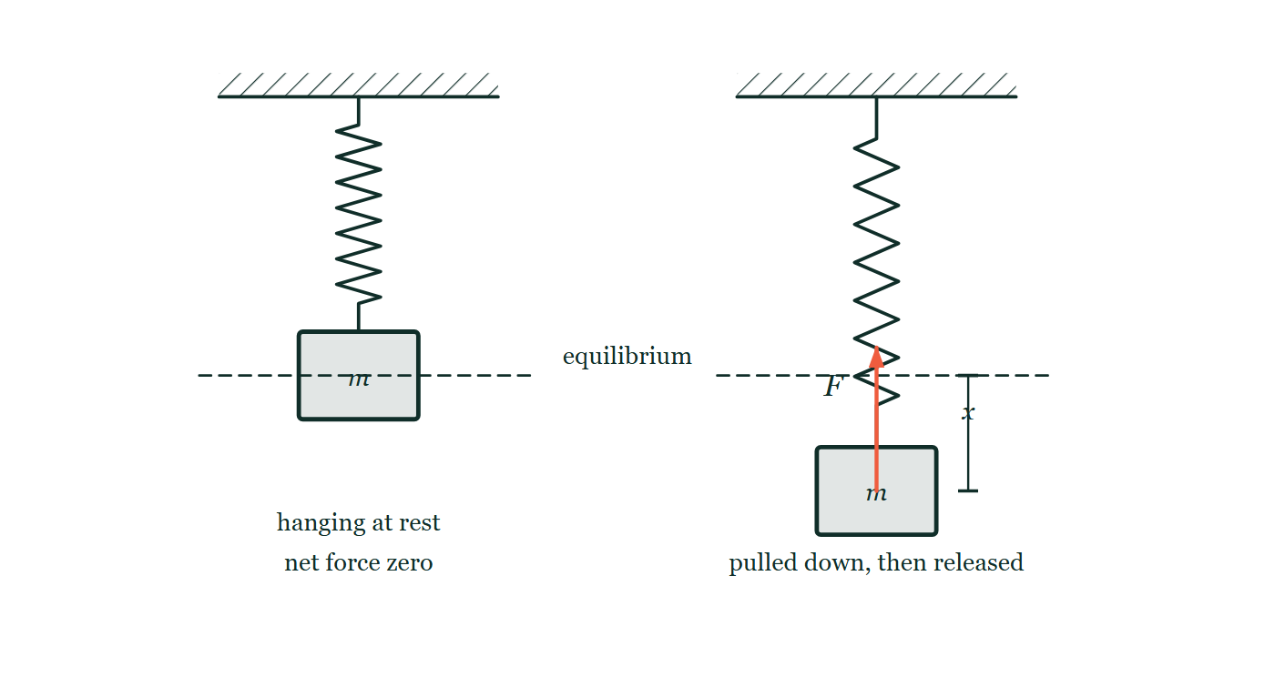
WAVES · SIMPLE HARMONIC MOTION
GIOPHYSICS LESSON
THINK FIRST
A pendulum clock is running down, so its swing narrows a little each day. Shouldn't it start gaining time?
Take answers before you click — the point is the commitment
A narrower swing is a shorter journey for the bob. The clock counts swings, and a good one keeps time to the second for months on end.
THE ANSWER
No — the period of simple harmonic motion does not depend on the amplitude. A smaller swing covers less distance, but the restoring force is proportionally smaller too, so the bob moves proportionally more slowly and arrives at the same moment. It is only an approximation for a pendulum, which is why clock pendulums are kept to a few degrees: at a wide 20° swing the period is already about 0.7% long.
A mass hangs from a spring at rest on a dashed equilibrium line; beside it the same mass hangs from the same spring but pulled down a distance x below that line, with a force arrow from the centre of the mass pointing back up towards equilibrium.
The live version of this figure — click here
Waves — Simple Harmonic Motion. Built by GioPhysics from the lesson's own copy; nothing on these slides is re-authored.
3 / 31
Notes:
[Phase] Starter: Recall what this lesson stands on (minutes 0–5 of 45)
[Hook] A pendulum clock is running down, so its swing narrows a little each day. Shouldn't it start gaining time? A narrower swing is a shorter journey for the bob. The clock counts swings, and a good one keeps time to the second for months on end.
[Answer] No — the period of simple harmonic motion does not depend on the amplitude. A smaller swing covers less distance, but the restoring force is proportionally smaller too, so the bob moves proportionally more slowly and arrives at the same moment. It is only an approximation for a pendulum, which is why clock pendulums are kept to a few degrees: at a wide 20° swing the period is already about 0.7% long.
[Figure] A mass hangs from a spring at rest on a dashed equilibrium line; beside it the same mass hangs from the same spring but pulled down a distance x below that line, with a force arrow from the centre of the mass pointing back up towards equilibrium.

Slide 4
WAVES · SIMPLE HARMONIC MOTION
GIOPHYSICS LESSON
EXPLAINED SIMPLY
In one sentence
Introduce the idea — The big idea and the definition
Simple harmonic motion is oscillation in which acceleration is proportional to displacement and always directed toward the equilibrium position.
Waves — Simple Harmonic Motion. Built by GioPhysics from the lesson's own copy; nothing on these slides is re-authored.
4 / 31
Notes:
[Phase] Introduce the idea: The big idea and the definition (minutes 5–13 of 45)
[Definition] Simple harmonic motion is oscillation in which acceleration is proportional to displacement and always directed toward the equilibrium position.

Slide 5
WAVES · SIMPLE HARMONIC MOTION
GIOPHYSICS LESSON
EXPLAINED SIMPLY
What that looks like
Introduce the idea — The big idea and the definition
FOR EXAMPLE
Pull a mass on a spring down twice as far and the restoring force doubles — it oscillates with the same period, just a larger swing.
Waves — Simple Harmonic Motion. Built by GioPhysics from the lesson's own copy; nothing on these slides is re-authored.
5 / 31
Notes:
[Phase] Introduce the idea: The big idea and the definition (minutes 5–13 of 45)
[Worked illustration] Pull a mass on a spring down twice as far and the restoring force doubles — it oscillates with the same period, just a larger swing.

Slide 6
WAVES · SIMPLE HARMONIC MOTION
GIOPHYSICS LESSON
THE BIG IDEA
The oscillation behind every wave
Introduce the idea — The big idea and the definition
Motion is simple harmonic when the restoring force — and so the acceleration — is proportional to the displacement and points back toward equilibrium. That single condition produces sinusoidal motion whose period, for ideal simple harmonic motion, does not depend on amplitude.
Waves — Simple Harmonic Motion. Built by GioPhysics from the lesson's own copy; nothing on these slides is re-authored.
6 / 31
Notes:
[Phase] Introduce the idea: The big idea and the definition (minutes 5–13 of 45)
[Big idea] Motion is simple harmonic when the restoring force — and so the acceleration — is proportional to the displacement and points back toward equilibrium. That single condition produces sinusoidal motion whose period, for ideal simple harmonic motion, does not depend on amplitude.

Slide 7
WAVES · SIMPLE HARMONIC MOTION
GIOPHYSICS LESSON
THE PHYSICS · 1 OF 3
Restoring force
Build the model — The formulae, one at a time, in plain English
At equilibrium the net force is zero. Displace the object and a force appears pulling it back — overshooting equilibrium keeps the cycle going.
Waves — Simple Harmonic Motion. Built by GioPhysics from the lesson's own copy; nothing on these slides is re-authored.
7 / 31
Notes:
[Phase] Build the model: The formulae, one at a time, in plain English (minutes 13–22 of 45)
[Section] At equilibrium the net force is zero. Displace the object and a force appears pulling it back — overshooting equilibrium keeps the cycle going.

Slide 8
WAVES · SIMPLE HARMONIC MOTION
GIOPHYSICS LESSON
THE PHYSICS · 2 OF 3
Energy exchange
Build the model — The formulae, one at a time, in plain English
Kinetic energy peaks at the centre; potential energy peaks at the extremes. The total stays constant in the ideal, undamped case.
Waves — Simple Harmonic Motion. Built by GioPhysics from the lesson's own copy; nothing on these slides is re-authored.
8 / 31
Notes:
[Phase] Build the model: The formulae, one at a time, in plain English (minutes 13–22 of 45)
[Section] Kinetic energy peaks at the centre; potential energy peaks at the extremes. The total stays constant in the ideal, undamped case.

Slide 9
WAVES · SIMPLE HARMONIC MOTION
GIOPHYSICS LESSON
THE PHYSICS · 3 OF 3
Why it matters for waves
Build the model — The formulae, one at a time, in plain English
In a mechanical wave — sound, a string, a ripple — each particle of the medium performs SHM about its own equilibrium, and the wave is the pattern of those oscillations passing energy along. An electromagnetic wave needs no medium: there the electric and magnetic fields oscillate instead, but the same sinusoidal mathematics applies.
Waves — Simple Harmonic Motion. Built by GioPhysics from the lesson's own copy; nothing on these slides is re-authored.
9 / 31
Notes:
[Phase] Build the model: The formulae, one at a time, in plain English (minutes 13–22 of 45)
[Section] In a mechanical wave — sound, a string, a ripple — each particle of the medium performs SHM about its own equilibrium, and the wave is the pattern of those oscillations passing energy along. An electromagnetic wave needs no medium: there the electric and magnetic fields oscillate instead, but the same sinusoidal mathematics applies.

Slide 10
WAVES · SIMPLE HARMONIC MOTION
GIOPHYSICS LESSON
FORMULA 1 OF 3
Defining condition
Build the model — The formulae, one at a time, in plain English
a = −ω²x
ω = 2πf = 2π/T
IN PLAIN ENGLISH
Acceleration mirrors displacement with a minus sign: the further from centre, the harder it is pulled back.
Waves — Simple Harmonic Motion. Built by GioPhysics from the lesson's own copy; nothing on these slides is re-authored.
10 / 31
Notes:
[Phase] Build the model: The formulae, one at a time, in plain English (minutes 13–22 of 45)
[Formula] Defining condition: a = −ω²x
[In plain English] Acceleration mirrors displacement with a minus sign: the further from centre, the harder it is pulled back.
[Note] ω = 2πf = 2π/T

Slide 11
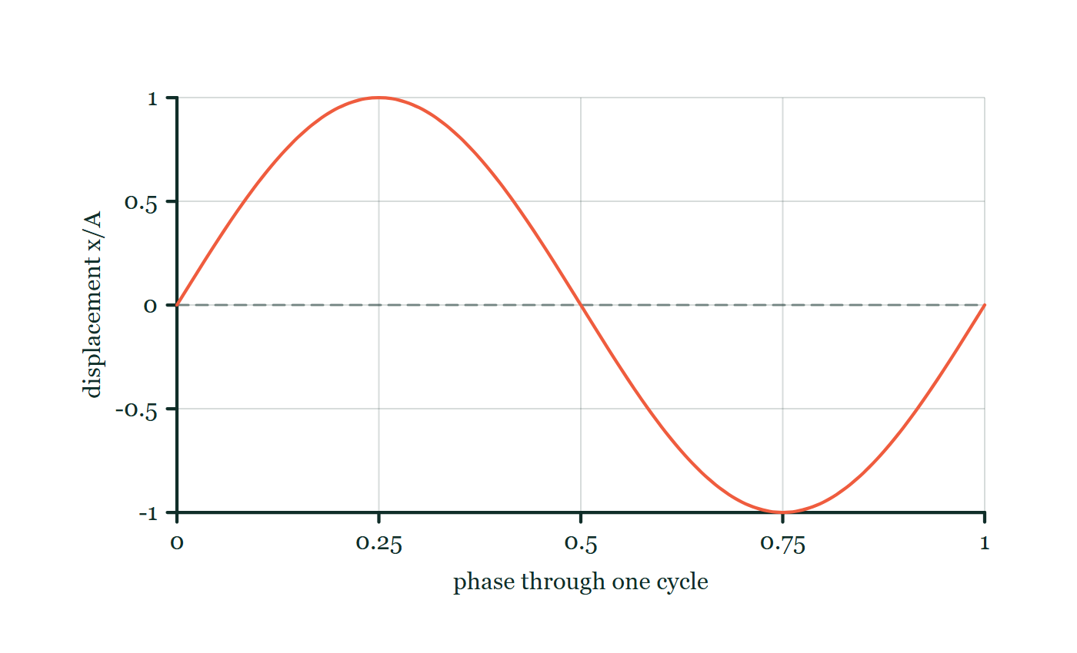
WAVES · SIMPLE HARMONIC MOTION
GIOPHYSICS LESSON
FORMULA 2 OF 3
Displacement
Build the model — The formulae, one at a time, in plain English
x = A sin(ωt)
Or A cos(ωt), depending on the start
IN PLAIN ENGLISH
The position traces a sine curve in time — A is the amplitude, the largest displacement reached.
Oscillation phase explorer
Move this graph on the live version — click here
Waves — Simple Harmonic Motion. Built by GioPhysics from the lesson's own copy; nothing on these slides is re-authored.
11 / 31
Notes:
[Phase] Build the model: The formulae, one at a time, in plain English (minutes 13–22 of 45)
[Formula] Displacement: x = A sin(ωt)
[In plain English] The position traces a sine curve in time — A is the amplitude, the largest displacement reached.
[Note] Or A cos(ωt), depending on the start
[Graph] Oscillation phase explorer. The marker follows one complete sinusoidal cycle from zero displacement, through both extremes, and back.
[Axes] Horizontal: phase through one cycle. Vertical: displacement x/A. Values are normalised — the graph teaches the shape, not a measurement.

Slide 12
WAVES · SIMPLE HARMONIC MOTION
GIOPHYSICS LESSON
FORMULA 3 OF 3
Mass–spring and pendulum
Build the model — The formulae, one at a time, in plain English
T = 2π√(m/k), T = 2π√(L/g)
For ideal SHM the period is independent of amplitude. A simple pendulum behaves approximately as SHM for small angular displacements
IN PLAIN ENGLISH
Heavier masses and softer springs swing slower; longer pendulums swing slower, and amplitude appears in neither expression. For the pendulum that holds only while the swing stays small — at large angles the period creeps up.
Waves — Simple Harmonic Motion. Built by GioPhysics from the lesson's own copy; nothing on these slides is re-authored.
12 / 31
Notes:
[Phase] Build the model: The formulae, one at a time, in plain English (minutes 13–22 of 45)
[Formula] Mass–spring and pendulum: T = 2π√(m/k), T = 2π√(L/g)
[In plain English] Heavier masses and softer springs swing slower; longer pendulums swing slower, and amplitude appears in neither expression. For the pendulum that holds only while the swing stays small — at large angles the period creeps up.
[Note] For ideal SHM the period is independent of amplitude. A simple pendulum behaves approximately as SHM for small angular displacements

Slide 13
WAVES · SIMPLE HARMONIC MOTION
GIOPHYSICS LESSON
WATCH OUT
The common trap
Check and misconception — The quick check and the trap
Larger amplitude does not mean a longer period: in SHM the object travels further but proportionally faster, so the period depends on the system rather than on how hard you start it. That is exact for a mass on an ideal spring. A pendulum only approximates SHM, and once the swing is large its period does grow — about 0.7% longer at 20°.
Waves — Simple Harmonic Motion. Built by GioPhysics from the lesson's own copy; nothing on these slides is re-authored.
13 / 31
Notes:
[Phase] Check and misconception: The quick check and the trap (minutes 35–41 of 45)
[Misconception] Larger amplitude does not mean a longer period: in SHM the object travels further but proportionally faster, so the period depends on the system rather than on how hard you start it. That is exact for a mass on an ideal spring. A pendulum only approximates SHM, and once the swing is large its period does grow — about 0.7% longer at 20°.

Slide 14
WAVES · SIMPLE HARMONIC MOTION
GIOPHYSICS LESSON
WORKED EXAMPLE 1 OF 2 · EASY
The question
Easy
Worked examples — I do, we do — one step revealed at a time
A pendulum completes 20 swings in 30 s. Find its period and frequency.
Waves — Simple Harmonic Motion. Built by GioPhysics from the lesson's own copy; nothing on these slides is re-authored.
14 / 31
Notes:
[Phase] Worked examples: I do, we do — one step revealed at a time (minutes 22–35 of 45)
[Question] A pendulum completes 20 swings in 30 s. Find its period and frequency.
[Answer] T = 1.5 s, f ≈ 0.67 Hz

Slide 15
WAVES · SIMPLE HARMONIC MOTION
GIOPHYSICS LESSON
WORKED EXAMPLE 1 OF 2 · EASY · THE WORKING
How to solve it
Easy
Worked examples — I do, we do — one step revealed at a time
A pendulum completes 20 swings in 30 s. Find its period and frequency.
1.
T = 30 ÷ 20 = 1.5 s.
2.
f = 1/T ≈ 0.67 Hz.
Waves — Simple Harmonic Motion. Built by GioPhysics from the lesson's own copy; nothing on these slides is re-authored.
15 / 31
Notes:
[Phase] Worked examples: I do, we do — one step revealed at a time (minutes 22–35 of 45)
[Reveal] One click per step. The class works each line before the next appears.
[Step 1] T = 30 ÷ 20 = 1.5 s.
[Step 2] f = 1/T ≈ 0.67 Hz.

Slide 16
WAVES · SIMPLE HARMONIC MOTION
GIOPHYSICS LESSON
WORKED EXAMPLE 1 OF 2 · EASY
Answer
Easy
Worked examples — I do, we do — one step revealed at a time
T = 1.5 s, f ≈ 0.67 Hz
Waves — Simple Harmonic Motion. Built by GioPhysics from the lesson's own copy; nothing on these slides is re-authored.
16 / 31
Notes:
[Phase] Worked examples: I do, we do — one step revealed at a time (minutes 22–35 of 45)
[Answer] T = 1.5 s, f ≈ 0.67 Hz

Slide 17
WAVES · SIMPLE HARMONIC MOTION
GIOPHYSICS LESSON
WORKED EXAMPLE 2 OF 2 · MEDIUM
The question
Medium
Worked examples — I do, we do — one step revealed at a time
A 0.50 kg mass on a spring of constant k = 20 N/m oscillates. Find the period and frequency.
Waves — Simple Harmonic Motion. Built by GioPhysics from the lesson's own copy; nothing on these slides is re-authored.
17 / 31
Notes:
[Phase] Worked examples: I do, we do — one step revealed at a time (minutes 22–35 of 45)
[Question] A 0.50 kg mass on a spring of constant k = 20 N/m oscillates. Find the period and frequency.
[Answer] T ≈ 0.99 s, f ≈ 1.0 Hz

Slide 18
WAVES · SIMPLE HARMONIC MOTION
GIOPHYSICS LESSON
WORKED EXAMPLE 2 OF 2 · MEDIUM · THE WORKING
How to solve it
Medium
Worked examples — I do, we do — one step revealed at a time
A 0.50 kg mass on a spring of constant k = 20 N/m oscillates. Find the period and frequency.
1.
T = 2π√(m/k) = 2π√(0.50/20).
2.
T = 2π × 0.158 ≈ 0.99 s.
3.
f = 1/T ≈ 1.0 Hz.
Waves — Simple Harmonic Motion. Built by GioPhysics from the lesson's own copy; nothing on these slides is re-authored.
18 / 31
Notes:
[Phase] Worked examples: I do, we do — one step revealed at a time (minutes 22–35 of 45)
[Reveal] One click per step. The class works each line before the next appears.
[Step 1] T = 2π√(m/k) = 2π√(0.50/20).
[Step 2] T = 2π × 0.158 ≈ 0.99 s.
[Step 3] f = 1/T ≈ 1.0 Hz.

Slide 19
WAVES · SIMPLE HARMONIC MOTION
GIOPHYSICS LESSON
WORKED EXAMPLE 2 OF 2 · MEDIUM
Answer
Medium
Worked examples — I do, we do — one step revealed at a time
T ≈ 0.99 s, f ≈ 1.0 Hz
Waves — Simple Harmonic Motion. Built by GioPhysics from the lesson's own copy; nothing on these slides is re-authored.
19 / 31
Notes:
[Phase] Worked examples: I do, we do — one step revealed at a time (minutes 22–35 of 45)
[Answer] T ≈ 0.99 s, f ≈ 1.0 Hz

Slide 20
WAVES · SIMPLE HARMONIC MOTION
GIOPHYSICS LESSON
SPOT THE MISTAKE
One line here is wrong
The whole working is up — find the bad line before you click
1.
A 0.20 kg mass on a spring oscillates with amplitude 5.0 cm and period 0.80 s. Find its maximum speed.
2.
ω = 2π/T = 2π/0.80 = 7.85 rad/s
3.
v(max) = Aω
4.
v(max) = 5.0 × 7.85 = 39 m/s
5.
So the mass reaches 39 m/s.
LINE 4 IS WRONG
The amplitude is in centimetres. Everything else is right, and the working reads convincingly all the way down — which is how 39 m/s, a speed no bench-top spring will ever produce, gets written down and underlined. The size test is the one to build the habit on: a mass covering 5 cm in something like a fifth of a second is doing tens of centimetres per second, so an answer in the tens of metres per second is a hundred times too big.
IT SHOULD SAY
v(max) = 0.050 × 7.85 = 0.39 m/s
Waves — Simple Harmonic Motion. Built by GioPhysics from the lesson's own copy; nothing on these slides is re-authored.
20 / 31
Notes:
[Phase] Worked examples: I do, we do — one step revealed at a time (minutes 22–35 of 45)
[Spot the mistake] The working is complete and one line of it is wrong. Let the room hunt: one click names the line, a second shows it done correctly.
[Line 4 is wrong] The amplitude is in centimetres. Everything else is right, and the working reads convincingly all the way down — which is how 39 m/s, a speed no bench-top spring will ever produce, gets written down and underlined. The size test is the one to build the habit on: a mass covering 5 cm in something like a fifth of a second is doing tens of centimetres per second, so an answer in the tens of metres per second is a hundred times too big.
[It should say] v(max) = 0.050 × 7.85 = 0.39 m/s

Slide 21
WAVES · SIMPLE HARMONIC MOTION
GIOPHYSICS LESSON
PREDICT · TAKE THE VOTE
Commit before you are told
Hands up for each option, then click
The mass is pulled down twice as far before release. What happens to the restoring force, and to the time for one oscillation?
A The force doubles and the period doubles with it
B The force doubles, but the period is unchanged
C The force is unchanged, and the period doubles
A mass hangs from a spring at rest on a dashed equilibrium line; beside it the same mass hangs from the same spring but pulled down a distance x below that line, with a force arrow from the centre of the mass pointing back up towards equilibrium.
The live version of this figure — click here
Waves — Simple Harmonic Motion. Built by GioPhysics from the lesson's own copy; nothing on these slides is re-authored.
21 / 31
Notes:
[Phase] Build the model: The formulae, one at a time, in plain English (minutes 13–22 of 45)
[Predict] The mass is pulled down twice as far before release. What happens to the restoring force, and to the time for one oscillation?
[Options] A The force doubles and the period doubles with it B The force doubles, but the period is unchanged C The force is unchanged, and the period doubles
[Figure] A mass hangs from a spring at rest on a dashed equilibrium line; beside it the same mass hangs from the same spring but pulled down a distance x below that line, with a force arrow from the centre of the mass pointing back up towards equilibrium.

Slide 22
WAVES · SIMPLE HARMONIC MOTION
GIOPHYSICS LESSON
PREDICT · THE OUTCOME
What actually happens
Ask the room who changed their mind, and why
B The force doubles, but the period is unchanged
WHY
The arrow in the drawing is F = −kx, so pulling down twice as far does exactly double it. But it also doubles the distance the mass has to travel to get back. The extra force delivers extra acceleration in precisely the proportion needed to cover the extra distance in the same time, which is why T = 2π√(m/k) contains the mass and the spring and no amplitude at all. That proportionality is the definition of simple harmonic motion, not a coincidence of springs.
Waves — Simple Harmonic Motion. Built by GioPhysics from the lesson's own copy; nothing on these slides is re-authored.
22 / 31
Notes:
[Phase] Build the model: The formulae, one at a time, in plain English (minutes 13–22 of 45)
[Answer] B — The force doubles, but the period is unchanged. The arrow in the drawing is F = −kx, so pulling down twice as far does exactly double it. But it also doubles the distance the mass has to travel to get back. The extra force delivers extra acceleration in precisely the proportion needed to cover the extra distance in the same time, which is why T = 2π√(m/k) contains the mass and the spring and no amplitude at all. That proportionality is the definition of simple harmonic motion, not a coincidence of springs.

Slide 23
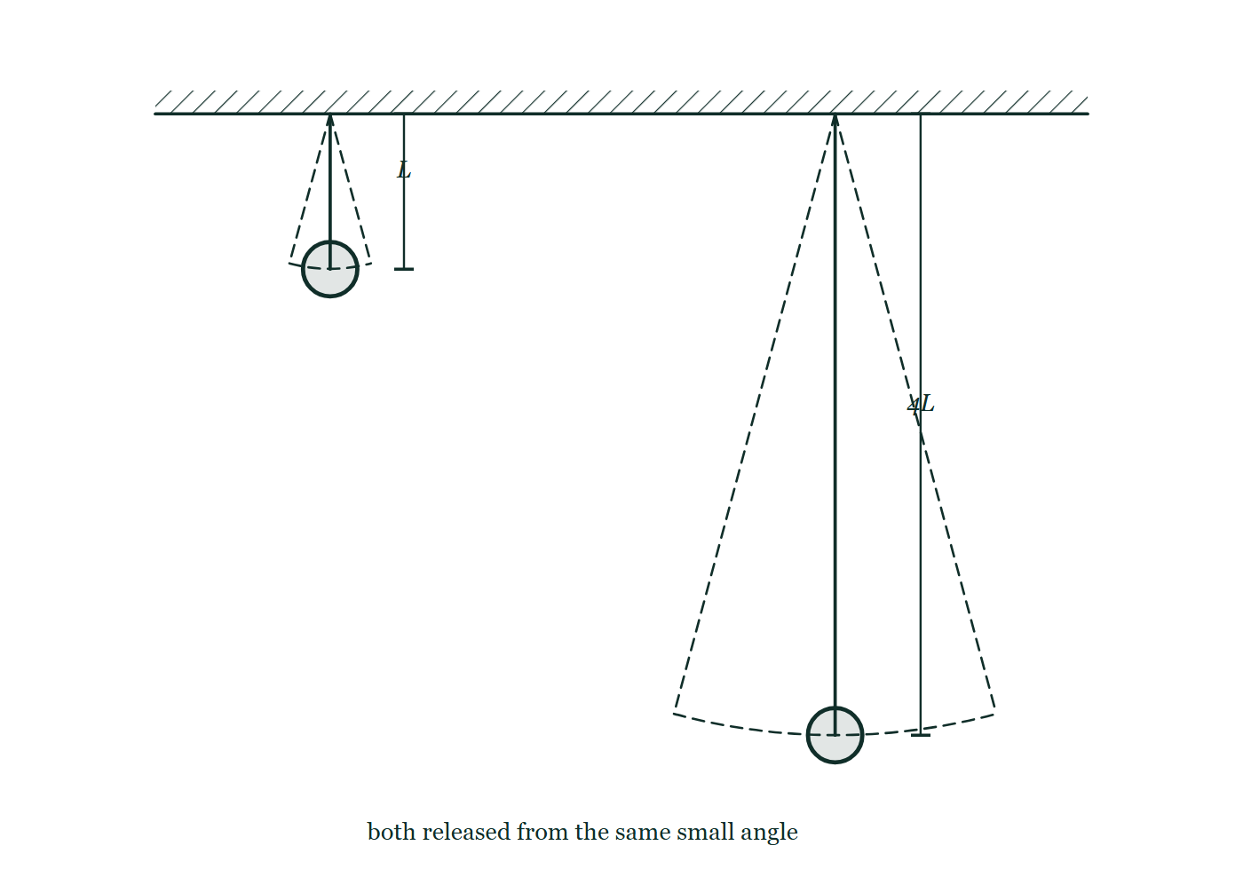
WAVES · SIMPLE HARMONIC MOTION
GIOPHYSICS LESSON
QUICK CHECK
Decide before the answer goes up
Check and misconception — The quick check and the trap
A pendulum's length is quadrupled. What happens to its period?
A
It quadruples
B
It doubles
C
It stays the same
Two pendulums hang from the same beam and are drawn to scale: the first of length L, the second four times as long, each shown with dashed lines and an arc marking the same small angle of release.
The live version of this figure — click here
Waves — Simple Harmonic Motion. Built by GioPhysics from the lesson's own copy; nothing on these slides is re-authored.
23 / 31
Notes:
[Phase] Check and misconception: The quick check and the trap (minutes 35–41 of 45)
[Question] A pendulum's length is quadrupled. What happens to its period?
[Figure] Two pendulums hang from the same beam and are drawn to scale: the first of length L, the second four times as long, each shown with dashed lines and an arc marking the same small angle of release.
[Options] A It quadruples B It doubles C It stays the same

Slide 24
WAVES · SIMPLE HARMONIC MOTION
GIOPHYSICS LESSON
QUICK CHECK · THE ANSWER
The answer, and why
Check and misconception — The quick check and the trap
B It doubles
HOW TO GET THERE
T = 2π√(L/g) for small swings: the period grows with the square root of length, so 4× the length gives 2× the period.
WHY THE OTHERS TEMPT
A This reads the period as proportional to the length. The length sits under a square root in T = 2π√(L/g), so four times the length gives √4 = 2 times the period — which is why the long pendulum in the drawing swings twice as slowly, not four times.
B Correct. T = 2π√(L/g), so quadrupling L doubles T.
C This is the amplitude rule applied to the wrong variable. The period really is independent of how far the bob is pulled aside — but it is not independent of the pendulum itself. Change L, or take it somewhere with a different g, and T changes.
Waves — Simple Harmonic Motion. Built by GioPhysics from the lesson's own copy; nothing on these slides is re-authored.
24 / 31
Notes:
[Phase] Check and misconception: The quick check and the trap (minutes 35–41 of 45)
[Question] A pendulum's length is quadrupled. What happens to its period?
[Option by option] A: This reads the period as proportional to the length. The length sits under a square root in T = 2π√(L/g), so four times the length gives √4 = 2 times the period — which is why the long pendulum in the drawing swings twice as slowly, not four times. B: Correct. T = 2π√(L/g), so quadrupling L doubles T. C: This is the amplitude rule applied to the wrong variable. The period really is independent of how far the bob is pulled aside — but it is not independent of the pendulum itself. Change L, or take it somewhere with a different g, and T changes.
[Answer] B — It doubles
[Why] T = 2π√(L/g) for small swings: the period grows with the square root of length, so 4× the length gives 2× the period.
[Reveal] One click for the answer, then one for the reason.

Slide 25
WAVES · SIMPLE HARMONIC MOTION
GIOPHYSICS LESSON
EXTENSION 1 OF 2 · HARD
The question
Hard
Worked examples — I do, we do — one step revealed at a time
A 0.20 kg mass on a spring oscillates with amplitude 5.0 cm and period 0.80 s. Find its maximum speed and maximum acceleration.
Waves — Simple Harmonic Motion. Built by GioPhysics from the lesson's own copy; nothing on these slides is re-authored.
25 / 31
Notes:
[Phase] Worked examples: I do, we do — one step revealed at a time (minutes 22–35 of 45)
[Question] A 0.20 kg mass on a spring oscillates with amplitude 5.0 cm and period 0.80 s. Find its maximum speed and maximum acceleration.
[Answer] v(max) ≈ 0.39 m/s; a(max) ≈ 3.1 m/s²

Slide 26
WAVES · SIMPLE HARMONIC MOTION
GIOPHYSICS LESSON
EXTENSION 1 OF 2 · HARD · THE WORKING
How to solve it
Hard
Worked examples — I do, we do — one step revealed at a time
A 0.20 kg mass on a spring oscillates with amplitude 5.0 cm and period 0.80 s. Find its maximum speed and maximum acceleration.
1.
ω = 2π/T = 7.85 rad/s.
2.
v(max) = Aω = 0.05 × 7.85 ≈ 0.39 m/s (at the centre).
3.
a(max) = Aω² = 0.05 × 61.7 ≈ 3.1 m/s² (at the extremes).
Waves — Simple Harmonic Motion. Built by GioPhysics from the lesson's own copy; nothing on these slides is re-authored.
26 / 31
Notes:
[Phase] Worked examples: I do, we do — one step revealed at a time (minutes 22–35 of 45)
[Reveal] One click per step. The class works each line before the next appears.
[Step 1] ω = 2π/T = 7.85 rad/s.
[Step 2] v(max) = Aω = 0.05 × 7.85 ≈ 0.39 m/s (at the centre).
[Step 3] a(max) = Aω² = 0.05 × 61.7 ≈ 3.1 m/s² (at the extremes).

Slide 27
WAVES · SIMPLE HARMONIC MOTION
GIOPHYSICS LESSON
EXTENSION 1 OF 2 · HARD
Answer
Hard
Worked examples — I do, we do — one step revealed at a time
v(max) ≈ 0.39 m/s; a(max) ≈ 3.1 m/s²
Waves — Simple Harmonic Motion. Built by GioPhysics from the lesson's own copy; nothing on these slides is re-authored.
27 / 31
Notes:
[Phase] Worked examples: I do, we do — one step revealed at a time (minutes 22–35 of 45)
[Answer] v(max) ≈ 0.39 m/s; a(max) ≈ 3.1 m/s²

Slide 28
WAVES · SIMPLE HARMONIC MOTION
GIOPHYSICS LESSON
EXTENSION 2 OF 2 · CHALLENGING
The question
Challenging
Worked examples — I do, we do — one step revealed at a time
A 'seconds pendulum' (T = 2.000 s) is moved to a mountain where g is 0.20% smaller. How much time does the clock lose per day?
Waves — Simple Harmonic Motion. Built by GioPhysics from the lesson's own copy; nothing on these slides is re-authored.
28 / 31
Notes:
[Phase] Worked examples: I do, we do — one step revealed at a time (minutes 22–35 of 45)
[Question] A 'seconds pendulum' (T = 2.000 s) is moved to a mountain where g is 0.20% smaller. How much time does the clock lose per day?
[Answer] ≈ 86 s/day slow

Slide 29
WAVES · SIMPLE HARMONIC MOTION
GIOPHYSICS LESSON
EXTENSION 2 OF 2 · CHALLENGING · THE WORKING
How to solve it
Challenging
Worked examples — I do, we do — one step revealed at a time
A 'seconds pendulum' (T = 2.000 s) is moved to a mountain where g is 0.20% smaller. How much time does the clock lose per day?
1.
T ∝ 1/√g: fractional period change = ½ × 0.20% = 0.10%.
2.
Slower tick by 1.001 factor → loses 0.10% of 86 400 s.
3.
≈ 86 s — nearly a minute and a half per day.
Waves — Simple Harmonic Motion. Built by GioPhysics from the lesson's own copy; nothing on these slides is re-authored.
29 / 31
Notes:
[Phase] Worked examples: I do, we do — one step revealed at a time (minutes 22–35 of 45)
[Reveal] One click per step. The class works each line before the next appears.
[Step 1] T ∝ 1/√g: fractional period change = ½ × 0.20% = 0.10%.
[Step 2] Slower tick by 1.001 factor → loses 0.10% of 86 400 s.
[Step 3] ≈ 86 s — nearly a minute and a half per day.

Slide 30
WAVES · SIMPLE HARMONIC MOTION
GIOPHYSICS LESSON
EXTENSION 2 OF 2 · CHALLENGING
Answer
Challenging
Worked examples — I do, we do — one step revealed at a time
≈ 86 s/day slow
Waves — Simple Harmonic Motion. Built by GioPhysics from the lesson's own copy; nothing on these slides is re-authored.
30 / 31
Notes:
[Phase] Worked examples: I do, we do — one step revealed at a time (minutes 22–35 of 45)
[Answer] ≈ 86 s/day slow

Slide 31
WAVES · SIMPLE HARMONIC MOTION
GIOPHYSICS LESSON
WAVES
Where to go next
Plenary — What to take away, what to practise next
Next
15.2 Describing Waves
https://giophysics.com/chapter-24/describing-waves/
Lesson
This lesson on giophysics.com
https://giophysics.com/chapter-24/simple-harmonic-motion/
Live
The live, interactive version of these slides
https://giophysics.com/chapter-24/presentation/?lesson=shm
Chapter
All Waves lessons
https://giophysics.com/chapter-24/
PDF
Download the lesson PDF
https://giophysics.com/downloads/24-1-simple-harmonic-motion.pdf
Waves — Simple Harmonic Motion. Built by GioPhysics from the lesson's own copy; nothing on these slides is re-authored.
31 / 31
Notes:
[Phase] Plenary: What to take away, what to practise next (minutes 41–45 of 45)
[Interactive] The graphs and the circuit topology on these slides are frozen. The live version at https://giophysics.com/chapter-24/presentation/?lesson=shm moves them.

