Slide 1
WAVES · SOUND & THE DOPPLER EFFECT
GIOPHYSICS LESSON
15 · Waves
Longitudinal waves you can hear
Sound & the Doppler Effect
Sound is a longitudinal pressure wave: frequency sets pitch, amplitude sets loudness. When source and listener move relative to each other, the received pitch shifts — the Doppler effect.
POSITION
Lesson 9 of 10 in Waves
PLAN
15 slides in the 45-minute core run, about 43 minutes of it
LESSON PAGE
https://giophysics.com/chapter-24/sound-doppler/
Built by GioPhysics from the lesson's own page. Every word on these slides is the lesson's; nothing here is re-authored. Teaching material, not an awarding body's document.
Waves — Sound & the Doppler Effect. Built by GioPhysics from the lesson's own copy; nothing on these slides is re-authored.
1 / 36
Notes:
[Lesson] Waves — Sound & the Doppler Effect. Lesson 9 of 10.
[Intro] Sound is a longitudinal pressure wave: frequency sets pitch, amplitude sets loudness. When source and listener move relative to each other, the received pitch shifts — the Doppler effect.
[Source] https://giophysics.com/chapter-24/sound-doppler/
[Disclaimer] Built by GioPhysics from the lesson's own page. Every word on these slides is the lesson's; nothing here is re-authored. Teaching material, not an awarding body's document.

Slide 2
WAVES · SOUND & THE DOPPLER EFFECT
GIOPHYSICS LESSON
WHAT THIS NEEDS
What you already know
Starter — Recall what this lesson stands on
Recall
Describing waves
https://giophysics.com/chapter-24/describing-waves/
Recall
Stationary waves
https://giophysics.com/chapter-24/stationary-waves/
Waves — Sound & the Doppler Effect. Built by GioPhysics from the lesson's own copy; nothing on these slides is re-authored.
2 / 36
Notes:
[Phase] Starter: Recall what this lesson stands on (minutes 0–5 of 45)
[Starter] Recall: Describing waves; Stationary waves

Slide 3
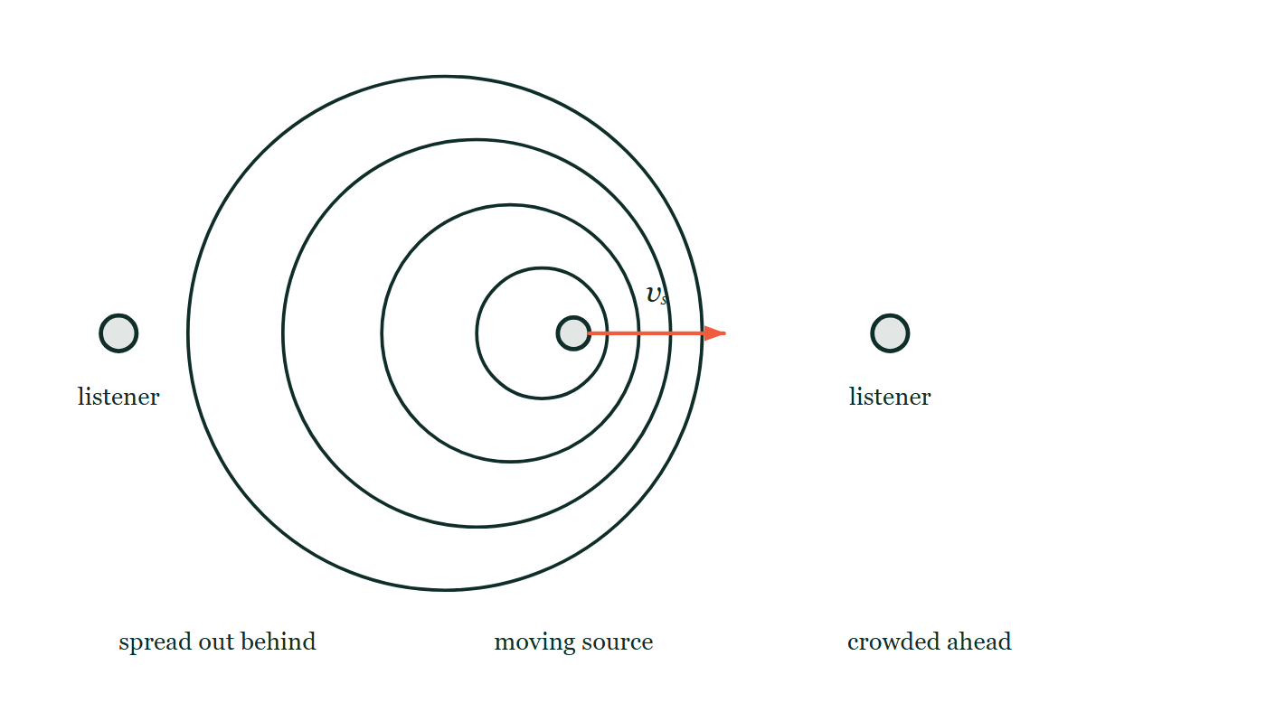
WAVES · SOUND & THE DOPPLER EFFECT
GIOPHYSICS LESSON
THINK FIRST
An ambulance races past you with its siren on and the note drops. What does the driver hear?
Take answers before you click — the point is the commitment
You hear the pitch fall the instant it passes. The driver has that same siren a metre behind their head for the whole journey.
THE ANSWER
No change whatever. The siren's own frequency never alters — the driver is not moving relative to it, so the wavefronts reach them at exactly the rate they were made. What changed for you is the spacing of the fronts in the air, because the source was chasing its own sound on the way in and running away from it on the way out.
Four circular wavefronts each drawn from where the source was when it emitted them, so they crowd together to a third of their spacing ahead of the moving source and stretch out behind it, with a listener marked on each side and the source's velocity arrow pointing right.
The live version of this figure — click here
Waves — Sound & the Doppler Effect. Built by GioPhysics from the lesson's own copy; nothing on these slides is re-authored.
3 / 36
Notes:
[Phase] Starter: Recall what this lesson stands on (minutes 0–5 of 45)
[Hook] An ambulance races past you with its siren on and the note drops. What does the driver hear? You hear the pitch fall the instant it passes. The driver has that same siren a metre behind their head for the whole journey.
[Answer] No change whatever. The siren's own frequency never alters — the driver is not moving relative to it, so the wavefronts reach them at exactly the rate they were made. What changed for you is the spacing of the fronts in the air, because the source was chasing its own sound on the way in and running away from it on the way out.
[Figure] Four circular wavefronts each drawn from where the source was when it emitted them, so they crowd together to a third of their spacing ahead of the moving source and stretch out behind it, with a listener marked on each side and the source's velocity arrow pointing right.

Slide 4
WAVES · SOUND & THE DOPPLER EFFECT
GIOPHYSICS LESSON
EXPLAINED SIMPLY
In one sentence
Introduce the idea — The big idea and the definition
The Doppler effect is the change in observed frequency when a wave source and an observer move relative to each other.
Waves — Sound & the Doppler Effect. Built by GioPhysics from the lesson's own copy; nothing on these slides is re-authored.
4 / 36
Notes:
[Phase] Introduce the idea: The big idea and the definition (minutes 5–13 of 45)
[Definition] The Doppler effect is the change in observed frequency when a wave source and an observer move relative to each other.

Slide 5
WAVES · SOUND & THE DOPPLER EFFECT
GIOPHYSICS LESSON
EXPLAINED SIMPLY
What that looks like
Introduce the idea — The big idea and the definition
FOR EXAMPLE
An ambulance siren drops in pitch the instant it passes you — same siren, changed relative motion.
Waves — Sound & the Doppler Effect. Built by GioPhysics from the lesson's own copy; nothing on these slides is re-authored.
5 / 36
Notes:
[Phase] Introduce the idea: The big idea and the definition (minutes 5–13 of 45)
[Worked illustration] An ambulance siren drops in pitch the instant it passes you — same siren, changed relative motion.

Slide 6
WAVES · SOUND & THE DOPPLER EFFECT
GIOPHYSICS LESSON
THE BIG IDEA
Longitudinal waves you can hear
Introduce the idea — The big idea and the definition
A moving source squeezes wavefronts ahead of it and stretches them behind, so an approaching siren sounds higher and a receding one lower. Two slightly different frequencies played together beat at their difference frequency — both effects are everyday wave physics.
Waves — Sound & the Doppler Effect. Built by GioPhysics from the lesson's own copy; nothing on these slides is re-authored.
6 / 36
Notes:
[Phase] Introduce the idea: The big idea and the definition (minutes 5–13 of 45)
[Big idea] A moving source squeezes wavefronts ahead of it and stretches them behind, so an approaching siren sounds higher and a receding one lower. Two slightly different frequencies played together beat at their difference frequency — both effects are everyday wave physics.

Slide 7
WAVES · SOUND & THE DOPPLER EFFECT
GIOPHYSICS LESSON
THE PHYSICS · 1 OF 5
What sound is
Build the model — The formulae, one at a time, in plain English
Vibrating objects push compressions and rarefactions through the air at about 343 m/s (15 °C). No medium, no sound — unlike light.
Waves — Sound & the Doppler Effect. Built by GioPhysics from the lesson's own copy; nothing on these slides is re-authored.
7 / 36
Notes:
[Phase] Build the model: The formulae, one at a time, in plain English (minutes 13–22 of 45)
[Section] Vibrating objects push compressions and rarefactions through the air at about 343 m/s (15 °C). No medium, no sound — unlike light.

Slide 8
WAVES · SOUND & THE DOPPLER EFFECT
GIOPHYSICS LESSON
THE PHYSICS · 2 OF 5
Hearing range
Build the model — The formulae, one at a time, in plain English
Humans hear roughly 20 Hz to 20 kHz. Above is ultrasound — used for imaging and sonar; below is infrasound.
Waves — Sound & the Doppler Effect. Built by GioPhysics from the lesson's own copy; nothing on these slides is re-authored.
8 / 36
Notes:
[Phase] Build the model: The formulae, one at a time, in plain English (minutes 13–22 of 45)
[Section] Humans hear roughly 20 Hz to 20 kHz. Above is ultrasound — used for imaging and sonar; below is infrasound.

Slide 9
WAVES · SOUND & THE DOPPLER EFFECT
GIOPHYSICS LESSON
THE PHYSICS · 3 OF 5
Doppler in use
Build the model — The formulae, one at a time, in plain English
Radar speed guns, medical blood-flow ultrasound, and the redshift of distant galaxies all read velocities from frequency shifts.
Waves — Sound & the Doppler Effect. Built by GioPhysics from the lesson's own copy; nothing on these slides is re-authored.
9 / 36
Notes:
[Phase] Build the model: The formulae, one at a time, in plain English (minutes 13–22 of 45)
[Section] Radar speed guns, medical blood-flow ultrasound, and the redshift of distant galaxies all read velocities from frequency shifts.

Slide 10
WAVES · SOUND & THE DOPPLER EFFECT
GIOPHYSICS LESSON
THE PHYSICS · 4 OF 5
The same effect for light
Build the model — The formulae, one at a time, in plain English
A light source moving away stretches the wave it emits, so the wavelength received is longer than the wavelength emitted — a redshift; moving towards you it compresses the wave into a blueshift. Provided the relative speed is far below c, the fractional change in wavelength equals the fractional change in frequency, and both equal v/c: Δλ/λ = Δf/f ≈ v/c, where v is the speed along the line of sight. A spectral line at 656.3 nm seen at 656.8 nm has Δλ/λ = 0.5/656.3, so v ≈ 2.3 × 10⁵ m/s of recession.
Waves — Sound & the Doppler Effect. Built by GioPhysics from the lesson's own copy; nothing on these slides is re-authored.
10 / 36
Notes:
[Phase] Build the model: The formulae, one at a time, in plain English (minutes 13–22 of 45)
[Section] A light source moving away stretches the wave it emits, so the wavelength received is longer than the wavelength emitted — a redshift; moving towards you it compresses the wave into a blueshift. Provided the relative speed is far below c, the fractional change in wavelength equals the fractional change in frequency, and both equal v/c: Δλ/λ = Δf/f ≈ v/c, where v is the speed along the line of sight. A spectral line at 656.3 nm seen at 656.8 nm has Δλ/λ = 0.5/656.3, so v ≈ 2.3 × 10⁵ m/s of recession.

Slide 11
WAVES · SOUND & THE DOPPLER EFFECT
GIOPHYSICS LESSON
THE PHYSICS · 5 OF 5
Light has no medium
Build the model — The formulae, one at a time, in plain English
Notice what changes from the sound case. Sound travels in air, so it matters whether the source moves through that air or the observer does — the two give slightly different shifts.
Light has no medium, so only the relative velocity of source and observer counts, and there is one formula rather than two. Only the component of that velocity along the line of sight produces a shift: a star moving directly across your field of view, however fast, shows none.
Waves — Sound & the Doppler Effect. Built by GioPhysics from the lesson's own copy; nothing on these slides is re-authored.
11 / 36
Notes:
[Phase] Build the model: The formulae, one at a time, in plain English (minutes 13–22 of 45)
[Section] Notice what changes from the sound case. Sound travels in air, so it matters whether the source moves through that air or the observer does — the two give slightly different shifts. Light has no medium, so only the relative velocity of source and observer counts, and there is one formula rather than two. Only the component of that velocity along the line of sight produces a shift: a star moving directly across your field of view, however fast, shows none.

Slide 12
WAVES · SOUND & THE DOPPLER EFFECT
GIOPHYSICS LESSON
FORMULA 1 OF 3
Moving source
Build the model — The formulae, one at a time, in plain English
f' = f·v/(v ∓ vₛ)
− approaching, + receding
IN PLAIN ENGLISH
An approaching source crowds its wavefronts together, raising the heard frequency; moving away spreads them and lowers it.
Waves — Sound & the Doppler Effect. Built by GioPhysics from the lesson's own copy; nothing on these slides is re-authored.
12 / 36
Notes:
[Phase] Build the model: The formulae, one at a time, in plain English (minutes 13–22 of 45)
[Formula] Moving source: f' = f·v/(v ∓ vₛ)
[In plain English] An approaching source crowds its wavefronts together, raising the heard frequency; moving away spreads them and lowers it.
[Note] − approaching, + receding

Slide 13
WAVES · SOUND & THE DOPPLER EFFECT
GIOPHYSICS LESSON
FORMULA 2 OF 3
Beats
Build the model — The formulae, one at a time, in plain English
f_beat = |f₁ − f₂|
Loudness pulses at the difference
IN PLAIN ENGLISH
Two close frequencies drift in and out of step, so the loudness throbs at exactly the difference between them — how instruments are tuned.
Waves — Sound & the Doppler Effect. Built by GioPhysics from the lesson's own copy; nothing on these slides is re-authored.
13 / 36
Notes:
[Phase] Build the model: The formulae, one at a time, in plain English (minutes 13–22 of 45)
[Formula] Beats: f_beat = |f₁ − f₂|
[In plain English] Two close frequencies drift in and out of step, so the loudness throbs at exactly the difference between them — how instruments are tuned.
[Note] Loudness pulses at the difference

Slide 14
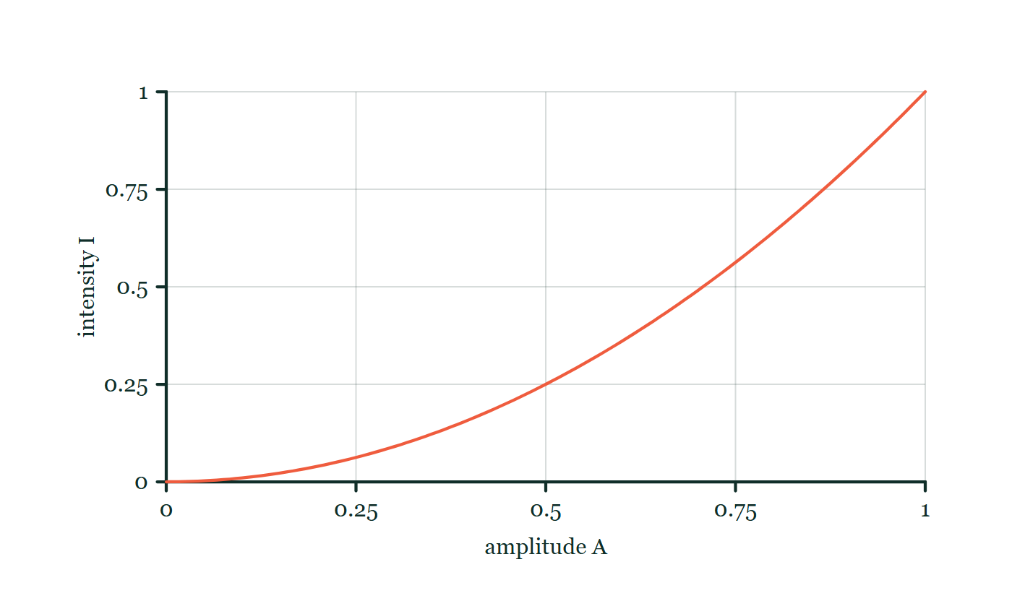
WAVES · SOUND & THE DOPPLER EFFECT
GIOPHYSICS LESSON
FORMULA 3 OF 3
Sound intensity
Build the model — The formulae, one at a time, in plain English
I ∝ A²
Pitch ← frequency; loudness ← amplitude
IN PLAIN ENGLISH
Doubling a sound wave's amplitude quadruples its intensity — loudness and pitch are controlled by different wave properties.
Intensity–amplitude explorer
Move this graph on the live version — click here
Waves — Sound & the Doppler Effect. Built by GioPhysics from the lesson's own copy; nothing on these slides is re-authored.
14 / 36
Notes:
[Phase] Build the model: The formulae, one at a time, in plain English (minutes 13–22 of 45)
[Formula] Sound intensity: I ∝ A²
[In plain English] Doubling a sound wave's amplitude quadruples its intensity — loudness and pitch are controlled by different wave properties.
[Note] Pitch ← frequency; loudness ← amplitude
[Graph] Intensity–amplitude explorer. Intensity follows the square of amplitude: doubling amplitude makes four times the intensity.
[Axes] Horizontal: amplitude A. Vertical: intensity I. Values are normalised — the graph teaches the shape, not a measurement.

Slide 15
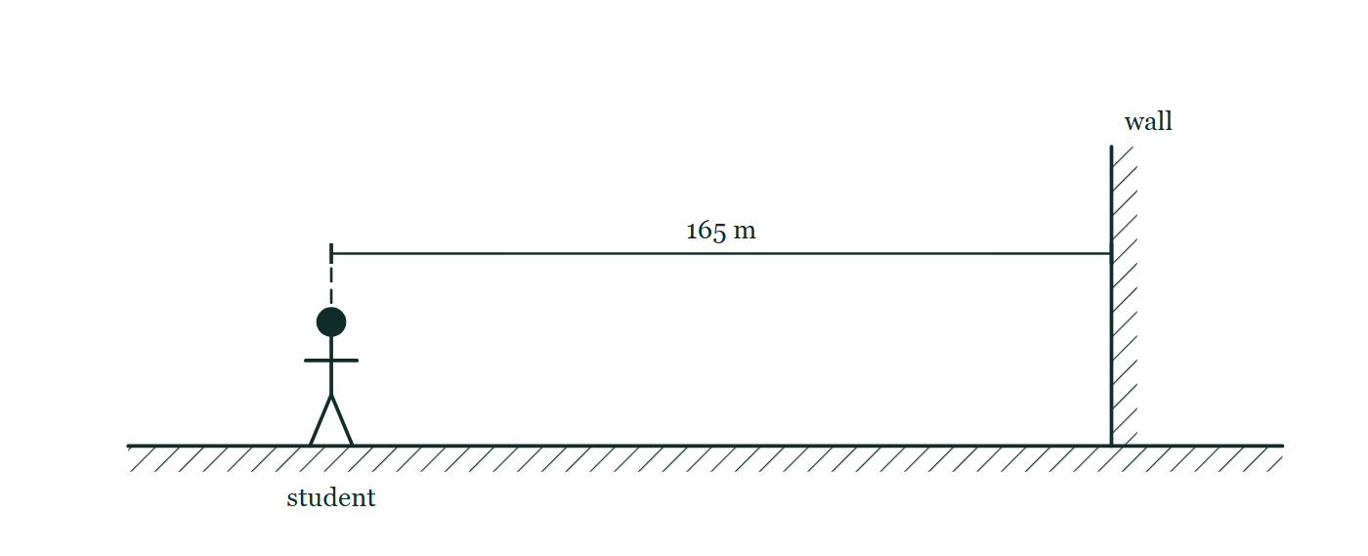
WAVES · SOUND & THE DOPPLER EFFECT
GIOPHYSICS LESSON
FIGURE 1 OF 3
Fig. 5.1 — IGCSE Topic 3 · Waves
Drawn for question 5 of that paper · syllabus 3.4
A side view of the arrangement. The student stands on level hatched ground on the left, facing a tall wall drawn as a hatched vertical slab standing on the same ground well to her right. A dimension line above her head runs horizontally from the student across to the face of the wall and is labelled 165 m. No sound path is drawn on the figure.
See the question this was drawn for — click here
Waves — Sound & the Doppler Effect. Built by GioPhysics from the lesson's own copy; nothing on these slides is re-authored.
15 / 36
Notes:
[Phase] Build the model: The formulae, one at a time, in plain English (minutes 13–22 of 45)
[Figure] Fig. 5.1. A side view of the arrangement. The student stands on level hatched ground on the left, facing a tall wall drawn as a hatched vertical slab standing on the same ground well to her right. A dimension line above her head runs horizontally from the student across to the face of the wall and is labelled 165 m. No sound path is drawn on the figure.
[Where it came from] IGCSE Topic 3 · Waves, question 5; syllabus 3.4.

Slide 16
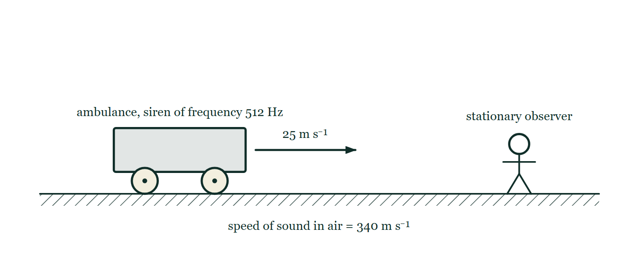
WAVES · SOUND & THE DOPPLER EFFECT
GIOPHYSICS LESSON
FIGURE 2 OF 3
Figure 2 — IB Theme C · Wave behaviour
Drawn for question 4 of that paper · syllabus C.5
Side view along a straight road, drawn as a hatched ground line. On the left an ambulance stands on the road, labelled 'ambulance, siren of frequency 512 Hz'. A horizontal arrow leaves the front of the ambulance and points to the right, labelled 25 m s⁻¹. Well ahead of it, on the same road, a person stands still, labelled 'stationary observer'. A note below the road reads 'speed of sound in air = 340 m s⁻¹'.
See the question this was drawn for — click here
Waves — Sound & the Doppler Effect. Built by GioPhysics from the lesson's own copy; nothing on these slides is re-authored.
16 / 36
Notes:
[Phase] Build the model: The formulae, one at a time, in plain English (minutes 13–22 of 45)
[Figure] Figure 2. Side view along a straight road, drawn as a hatched ground line. On the left an ambulance stands on the road, labelled 'ambulance, siren of frequency 512 Hz'. A horizontal arrow leaves the front of the ambulance and points to the right, labelled 25 m s⁻¹. Well ahead of it, on the same road, a person stands still, labelled 'stationary observer'. A note below the road reads 'speed of sound in air = 340 m s⁻¹'.
[Where it came from] IB Theme C · Wave behaviour, question 4; syllabus C.5.

Slide 17
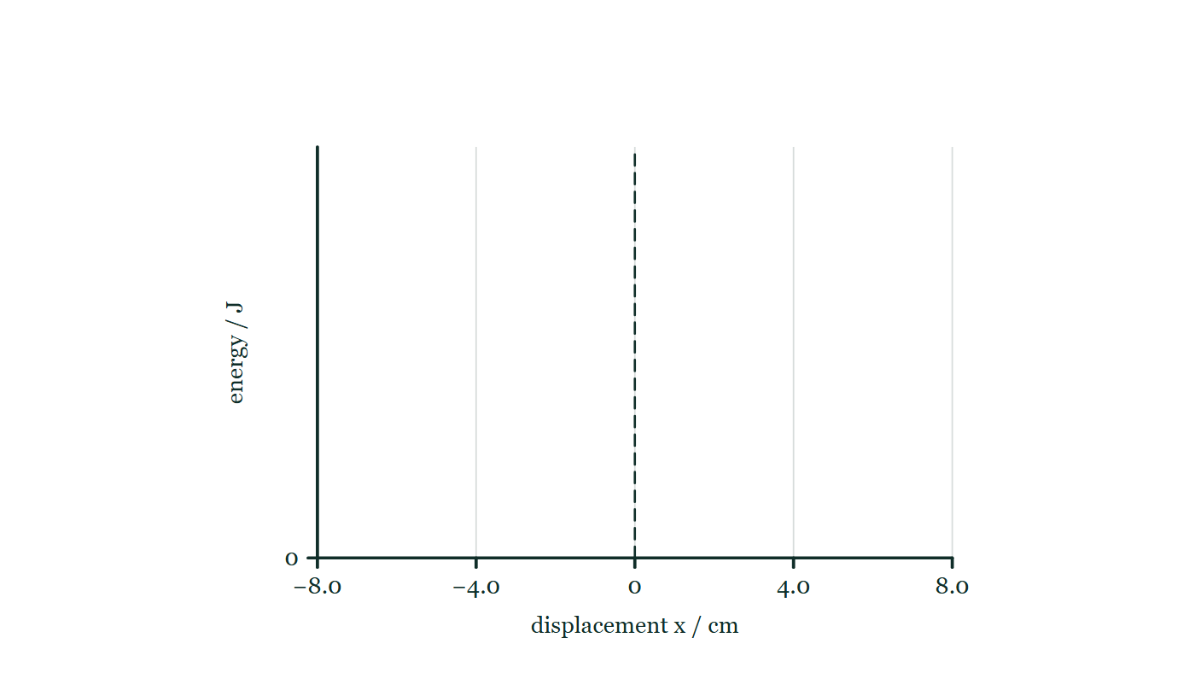
WAVES · SOUND & THE DOPPLER EFFECT
GIOPHYSICS LESSON
FIGURE 3 OF 3
Figure 6 — IB Theme C · Wave behaviour
Drawn for question 10 of that paper · syllabus C.1, C.5
A pair of empty axes provided for the sketch. The horizontal axis is labelled 'displacement x / cm' and is scaled from −8.0 through 0 to +8.0, with faint gridlines at −8.0, −4.0, 0, +4.0 and +8.0 and a dashed vertical line drawn at x = 0. The vertical axis is labelled 'energy / J' and carries only a zero at its foot, so no numerical scale is imposed. No curve of any kind is drawn on the axes.
See the question this was drawn for — click here
Waves — Sound & the Doppler Effect. Built by GioPhysics from the lesson's own copy; nothing on these slides is re-authored.
17 / 36
Notes:
[Phase] Build the model: The formulae, one at a time, in plain English (minutes 13–22 of 45)
[Figure] Figure 6. A pair of empty axes provided for the sketch. The horizontal axis is labelled 'displacement x / cm' and is scaled from −8.0 through 0 to +8.0, with faint gridlines at −8.0, −4.0, 0, +4.0 and +8.0 and a dashed vertical line drawn at x = 0. The vertical axis is labelled 'energy / J' and carries only a zero at its foot, so no numerical scale is imposed. No curve of any kind is drawn on the axes.
[Where it came from] IB Theme C · Wave behaviour, question 10; syllabus C.1, C.5.

Slide 18
WAVES · SOUND & THE DOPPLER EFFECT
GIOPHYSICS LESSON
WATCH OUT
The common trap
Check and misconception — The quick check and the trap
The source's own frequency never changes — the shift is in what the observer receives. And loudness does not affect pitch: amplitude and frequency are independent properties.
Waves — Sound & the Doppler Effect. Built by GioPhysics from the lesson's own copy; nothing on these slides is re-authored.
18 / 36
Notes:
[Phase] Check and misconception: The quick check and the trap (minutes 35–41 of 45)
[Misconception] The source's own frequency never changes — the shift is in what the observer receives. And loudness does not affect pitch: amplitude and frequency are independent properties.

Slide 19
WAVES · SOUND & THE DOPPLER EFFECT
GIOPHYSICS LESSON
WORKED EXAMPLE 1 OF 2 · EASY
The question
Easy
Worked examples — I do, we do — one step revealed at a time
Thunder arrives 4.0 s after the lightning flash (v = 340 m/s). How far away was the strike?
Waves — Sound & the Doppler Effect. Built by GioPhysics from the lesson's own copy; nothing on these slides is re-authored.
19 / 36
Notes:
[Phase] Worked examples: I do, we do — one step revealed at a time (minutes 22–35 of 45)
[Question] Thunder arrives 4.0 s after the lightning flash (v = 340 m/s). How far away was the strike?
[Answer] ≈ 1.4 km

Slide 20
WAVES · SOUND & THE DOPPLER EFFECT
GIOPHYSICS LESSON
WORKED EXAMPLE 1 OF 2 · EASY · THE WORKING
How to solve it
Easy
Worked examples — I do, we do — one step revealed at a time
Thunder arrives 4.0 s after the lightning flash (v = 340 m/s). How far away was the strike?
1.
d = vt = 340 × 4.0.
2.
d ≈ 1.4 km.
Waves — Sound & the Doppler Effect. Built by GioPhysics from the lesson's own copy; nothing on these slides is re-authored.
20 / 36
Notes:
[Phase] Worked examples: I do, we do — one step revealed at a time (minutes 22–35 of 45)
[Reveal] One click per step. The class works each line before the next appears.
[Step 1] d = vt = 340 × 4.0.
[Step 2] d ≈ 1.4 km.

Slide 21
WAVES · SOUND & THE DOPPLER EFFECT
GIOPHYSICS LESSON
WORKED EXAMPLE 1 OF 2 · EASY
Answer
Easy
Worked examples — I do, we do — one step revealed at a time
≈ 1.4 km
Waves — Sound & the Doppler Effect. Built by GioPhysics from the lesson's own copy; nothing on these slides is re-authored.
21 / 36
Notes:
[Phase] Worked examples: I do, we do — one step revealed at a time (minutes 22–35 of 45)
[Answer] ≈ 1.4 km

Slide 22
WAVES · SOUND & THE DOPPLER EFFECT
GIOPHYSICS LESSON
WORKED EXAMPLE 2 OF 2 · MEDIUM
The question
Medium
Worked examples — I do, we do — one step revealed at a time
A siren emits 700 Hz while approaching you at 30 m/s (v = 343 m/s). What frequency do you hear?
Waves — Sound & the Doppler Effect. Built by GioPhysics from the lesson's own copy; nothing on these slides is re-authored.
22 / 36
Notes:
[Phase] Worked examples: I do, we do — one step revealed at a time (minutes 22–35 of 45)
[Question] A siren emits 700 Hz while approaching you at 30 m/s (v = 343 m/s). What frequency do you hear?
[Answer] f' ≈ 767 Hz

Slide 23
WAVES · SOUND & THE DOPPLER EFFECT
GIOPHYSICS LESSON
WORKED EXAMPLE 2 OF 2 · MEDIUM · THE WORKING
How to solve it
Medium
Worked examples — I do, we do — one step revealed at a time
A siren emits 700 Hz while approaching you at 30 m/s (v = 343 m/s). What frequency do you hear?
1.
Approaching source: f' = f·v/(v − vₛ).
2.
f' = 700 × 343/(343 − 30) = 700 × 343/313.
3.
f' ≈ 767 Hz — noticeably sharper.
Waves — Sound & the Doppler Effect. Built by GioPhysics from the lesson's own copy; nothing on these slides is re-authored.
23 / 36
Notes:
[Phase] Worked examples: I do, we do — one step revealed at a time (minutes 22–35 of 45)
[Reveal] One click per step. The class works each line before the next appears.
[Step 1] Approaching source: f' = f·v/(v − vₛ).
[Step 2] f' = 700 × 343/(343 − 30) = 700 × 343/313.
[Step 3] f' ≈ 767 Hz — noticeably sharper.

Slide 24
WAVES · SOUND & THE DOPPLER EFFECT
GIOPHYSICS LESSON
WORKED EXAMPLE 2 OF 2 · MEDIUM
Answer
Medium
Worked examples — I do, we do — one step revealed at a time
f' ≈ 767 Hz
Waves — Sound & the Doppler Effect. Built by GioPhysics from the lesson's own copy; nothing on these slides is re-authored.
24 / 36
Notes:
[Phase] Worked examples: I do, we do — one step revealed at a time (minutes 22–35 of 45)
[Answer] f' ≈ 767 Hz

Slide 25
WAVES · SOUND & THE DOPPLER EFFECT
GIOPHYSICS LESSON
SPOT THE MISTAKE
One line here is wrong
The whole working is up — find the bad line before you click
1.
A siren emits 700 Hz while approaching you at 30 m/s. Take v = 343 m/s. What frequency do you hear?
2.
f' = f v/(v ∓ vₛ)
3.
Approaching, so f' = 700 × 343/(343 + 30)
4.
f' = 700 × 0.920
5.
f' = 644 Hz
LINE 3 IS WRONG
The sign has gone the wrong way. Both signs live in the same formula, which is why it is worth deciding the direction of the answer before choosing one: an approaching source must sound higher, so the answer has to exceed 700 Hz and the denominator must therefore be the smaller of the two options. The version written here gives a lower note, which is what a receding siren does.
IT SHOULD SAY
f' = 700 × 343/(343 − 30) = 700 × 1.096 = 767 Hz
Waves — Sound & the Doppler Effect. Built by GioPhysics from the lesson's own copy; nothing on these slides is re-authored.
25 / 36
Notes:
[Phase] Worked examples: I do, we do — one step revealed at a time (minutes 22–35 of 45)
[Spot the mistake] The working is complete and one line of it is wrong. Let the room hunt: one click names the line, a second shows it done correctly.
[Line 3 is wrong] The sign has gone the wrong way. Both signs live in the same formula, which is why it is worth deciding the direction of the answer before choosing one: an approaching source must sound higher, so the answer has to exceed 700 Hz and the denominator must therefore be the smaller of the two options. The version written here gives a lower note, which is what a receding siren does.
[It should say] f' = 700 × 343/(343 − 30) = 700 × 1.096 = 767 Hz

Slide 26
WAVES · SOUND & THE DOPPLER EFFECT
GIOPHYSICS LESSON
PREDICT · TAKE THE VOTE
Commit before you are told
Hands up for each option, then click
The source is moving right at half the speed of the waves. What does the listener ahead of it hear?
A A little higher than the emitted note — a few per cent
B One and a half times the emitted frequency
C Twice the emitted frequency
Four circular wavefronts each drawn from where the source was when it emitted them, so they crowd together to a third of their spacing ahead of the moving source and stretch out behind it, with a listener marked on each side and the source's velocity arrow pointing right.
The live version of this figure — click here
Waves — Sound & the Doppler Effect. Built by GioPhysics from the lesson's own copy; nothing on these slides is re-authored.
26 / 36
Notes:
[Phase] Build the model: The formulae, one at a time, in plain English (minutes 13–22 of 45)
[Predict] The source is moving right at half the speed of the waves. What does the listener ahead of it hear?
[Options] A A little higher than the emitted note — a few per cent B One and a half times the emitted frequency C Twice the emitted frequency
[Figure] Four circular wavefronts each drawn from where the source was when it emitted them, so they crowd together to a third of their spacing ahead of the moving source and stretch out behind it, with a listener marked on each side and the source's velocity arrow pointing right.

Slide 27
WAVES · SOUND & THE DOPPLER EFFECT
GIOPHYSICS LESSON
PREDICT · THE OUTCOME
What actually happens
Ask the room who changed their mind, and why
C Twice the emitted frequency
WHY
In the time between emitting one front and the next, the wave has travelled v while the source has travelled v/2 after it — so the gap left between them is only half the usual wavelength. The sound still crosses the air at v, so half the spacing means twice as many fronts arriving per second. Count them on the drawing: ahead of the source they are a third of their spacing behind it, which is (v − vₛ) against (v + vₛ), a half against one and a half. Half the wavelength, double the frequency.
Waves — Sound & the Doppler Effect. Built by GioPhysics from the lesson's own copy; nothing on these slides is re-authored.
27 / 36
Notes:
[Phase] Build the model: The formulae, one at a time, in plain English (minutes 13–22 of 45)
[Answer] C — Twice the emitted frequency. In the time between emitting one front and the next, the wave has travelled v while the source has travelled v/2 after it — so the gap left between them is only half the usual wavelength. The sound still crosses the air at v, so half the spacing means twice as many fronts arriving per second. Count them on the drawing: ahead of the source they are a third of their spacing behind it, which is (v − vₛ) against (v + vₛ), a half against one and a half. Half the wavelength, double the frequency.

Slide 28
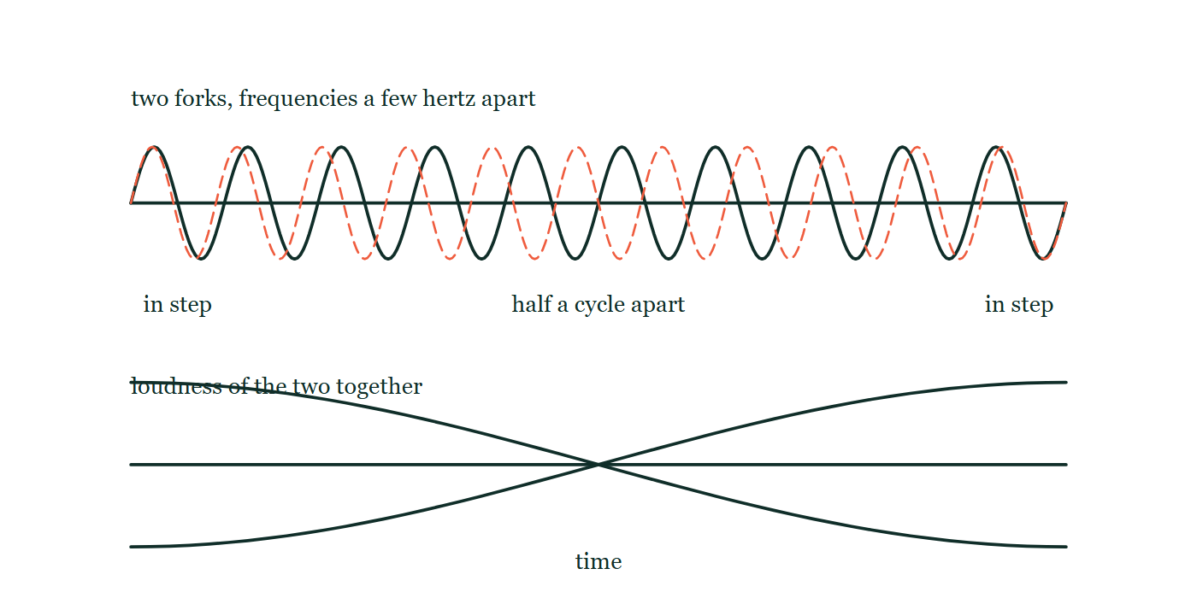
WAVES · SOUND & THE DOPPLER EFFECT
GIOPHYSICS LESSON
QUICK CHECK
Decide before the answer goes up
Check and misconception — The quick check and the trap
Two tuning forks of 440 Hz and 444 Hz sound together. What do you hear?
A
A steady 442 Hz tone
B
A tone beating 4 times per second
C
Silence
Ten cycles of one note and eleven of another drawn on the same axis, starting in step, falling half a cycle apart in the middle and returning to step at the end, with the loudness of the pair plotted beneath as a single slow swell.
The live version of this figure — click here
Waves — Sound & the Doppler Effect. Built by GioPhysics from the lesson's own copy; nothing on these slides is re-authored.
28 / 36
Notes:
[Phase] Check and misconception: The quick check and the trap (minutes 35–41 of 45)
[Question] Two tuning forks of 440 Hz and 444 Hz sound together. What do you hear?
[Figure] Ten cycles of one note and eleven of another drawn on the same axis, starting in step, falling half a cycle apart in the middle and returning to step at the end, with the loudness of the pair plotted beneath as a single slow swell.
[Options] A A steady 442 Hz tone B A tone beating 4 times per second C Silence

Slide 29
WAVES · SOUND & THE DOPPLER EFFECT
GIOPHYSICS LESSON
QUICK CHECK · THE ANSWER
The answer, and why
Check and misconception — The quick check and the trap
B A tone beating 4 times per second
HOW TO GET THERE
Beats pulse at |f₁ − f₂| = 4 Hz — a tone near 442 Hz whose loudness throbs four times each second.
WHY THE OTHERS TEMPT
A The pitch you hear really is about 442 Hz, the average of the two, so half of this is right. What it misses is that the two waves slide in and out of step: they reinforce, cancel, and reinforce again, four times every second.
B Correct. Beats pulse at |f₁ − f₂| = 4 Hz — a note near 442 Hz whose loudness throbs four times a second.
C Cancellation does happen, but only at the instants when the two are half a cycle apart, and they do not stay there: 444 cycles against 440 means the pair slips one whole cycle four times a second, passing through in-step just as often as out-of-step.
Waves — Sound & the Doppler Effect. Built by GioPhysics from the lesson's own copy; nothing on these slides is re-authored.
29 / 36
Notes:
[Phase] Check and misconception: The quick check and the trap (minutes 35–41 of 45)
[Question] Two tuning forks of 440 Hz and 444 Hz sound together. What do you hear?
[Option by option] A: The pitch you hear really is about 442 Hz, the average of the two, so half of this is right. What it misses is that the two waves slide in and out of step: they reinforce, cancel, and reinforce again, four times every second. B: Correct. Beats pulse at |f₁ − f₂| = 4 Hz — a note near 442 Hz whose loudness throbs four times a second. C: Cancellation does happen, but only at the instants when the two are half a cycle apart, and they do not stay there: 444 cycles against 440 means the pair slips one whole cycle four times a second, passing through in-step just as often as out-of-step.
[Answer] B — A tone beating 4 times per second
[Why] Beats pulse at |f₁ − f₂| = 4 Hz — a tone near 442 Hz whose loudness throbs four times each second.
[Reveal] One click for the answer, then one for the reason.

Slide 30
WAVES · SOUND & THE DOPPLER EFFECT
GIOPHYSICS LESSON
EXTENSION 1 OF 2 · HARD
The question
Hard
Worked examples — I do, we do — one step revealed at a time
A stationary siren emits 800 Hz. You drive toward it at 25 m/s (v(sound) = 343 m/s). What frequency do you hear? (Moving observer: f′ = f(v + vₒ)/v)
Waves — Sound & the Doppler Effect. Built by GioPhysics from the lesson's own copy; nothing on these slides is re-authored.
30 / 36
Notes:
[Phase] Worked examples: I do, we do — one step revealed at a time (minutes 22–35 of 45)
[Question] A stationary siren emits 800 Hz. You drive toward it at 25 m/s (v(sound) = 343 m/s). What frequency do you hear? (Moving observer: f′ = f(v + vₒ)/v)
[Answer] ≈ 858 Hz

Slide 31
WAVES · SOUND & THE DOPPLER EFFECT
GIOPHYSICS LESSON
EXTENSION 1 OF 2 · HARD · THE WORKING
How to solve it
Hard
Worked examples — I do, we do — one step revealed at a time
A stationary siren emits 800 Hz. You drive toward it at 25 m/s (v(sound) = 343 m/s). What frequency do you hear? (Moving observer: f′ = f(v + vₒ)/v)
1.
Moving observer formula: f′ = 800 × (343 + 25)/343.
2.
f′ = 800 × 1.0729.
3.
f′ ≈ 858 Hz.
Waves — Sound & the Doppler Effect. Built by GioPhysics from the lesson's own copy; nothing on these slides is re-authored.
31 / 36
Notes:
[Phase] Worked examples: I do, we do — one step revealed at a time (minutes 22–35 of 45)
[Reveal] One click per step. The class works each line before the next appears.
[Step 1] Moving observer formula: f′ = 800 × (343 + 25)/343.
[Step 2] f′ = 800 × 1.0729.
[Step 3] f′ ≈ 858 Hz.

Slide 32
WAVES · SOUND & THE DOPPLER EFFECT
GIOPHYSICS LESSON
EXTENSION 1 OF 2 · HARD
Answer
Hard
Worked examples — I do, we do — one step revealed at a time
≈ 858 Hz
Waves — Sound & the Doppler Effect. Built by GioPhysics from the lesson's own copy; nothing on these slides is re-authored.
32 / 36
Notes:
[Phase] Worked examples: I do, we do — one step revealed at a time (minutes 22–35 of 45)
[Answer] ≈ 858 Hz

Slide 33
WAVES · SOUND & THE DOPPLER EFFECT
GIOPHYSICS LESSON
EXTENSION 2 OF 2 · CHALLENGING
The question
Challenging
Worked examples — I do, we do — one step revealed at a time
A bat flying at 6.0 m/s toward a wall emits 40.0 kHz and hears its echo. Taking v = 340 m/s, find the echo frequency the bat detects (two Doppler shifts).
Waves — Sound & the Doppler Effect. Built by GioPhysics from the lesson's own copy; nothing on these slides is re-authored.
33 / 36
Notes:
[Phase] Worked examples: I do, we do — one step revealed at a time (minutes 22–35 of 45)
[Question] A bat flying at 6.0 m/s toward a wall emits 40.0 kHz and hears its echo. Taking v = 340 m/s, find the echo frequency the bat detects (two Doppler shifts).
[Answer] ≈ 41.4 kHz — a double Doppler shift

Slide 34
WAVES · SOUND & THE DOPPLER EFFECT
GIOPHYSICS LESSON
EXTENSION 2 OF 2 · CHALLENGING · THE WORKING
How to solve it
Challenging
Worked examples — I do, we do — one step revealed at a time
A bat flying at 6.0 m/s toward a wall emits 40.0 kHz and hears its echo. Taking v = 340 m/s, find the echo frequency the bat detects (two Doppler shifts).
1.
Wall receives (moving source): f₁ = 40.0 × 340/(340 − 6) ≈ 40.72 kHz.
2.
The wall re-emits f₁; the bat is a moving observer: f₂ = f₁ × (340 + 6)/340.
3.
f₂ ≈ 40.72 × 1.0176 ≈ 41.4 kHz — the ~1.4 kHz shift encodes closing speed.
Waves — Sound & the Doppler Effect. Built by GioPhysics from the lesson's own copy; nothing on these slides is re-authored.
34 / 36
Notes:
[Phase] Worked examples: I do, we do — one step revealed at a time (minutes 22–35 of 45)
[Reveal] One click per step. The class works each line before the next appears.
[Step 1] Wall receives (moving source): f₁ = 40.0 × 340/(340 − 6) ≈ 40.72 kHz.
[Step 2] The wall re-emits f₁; the bat is a moving observer: f₂ = f₁ × (340 + 6)/340.
[Step 3] f₂ ≈ 40.72 × 1.0176 ≈ 41.4 kHz — the ~1.4 kHz shift encodes closing speed.

Slide 35
WAVES · SOUND & THE DOPPLER EFFECT
GIOPHYSICS LESSON
EXTENSION 2 OF 2 · CHALLENGING
Answer
Challenging
Worked examples — I do, we do — one step revealed at a time
≈ 41.4 kHz — a double Doppler shift
Waves — Sound & the Doppler Effect. Built by GioPhysics from the lesson's own copy; nothing on these slides is re-authored.
35 / 36
Notes:
[Phase] Worked examples: I do, we do — one step revealed at a time (minutes 22–35 of 45)
[Answer] ≈ 41.4 kHz — a double Doppler shift

Slide 36
WAVES · SOUND & THE DOPPLER EFFECT
GIOPHYSICS LESSON
WAVES
Where to go next
Plenary — What to take away, what to practise next
Next
15.10 Waves Calculus
https://giophysics.com/chapter-24/waves-calculus/
Lesson
This lesson on giophysics.com
https://giophysics.com/chapter-24/sound-doppler/
Live
The live, interactive version of these slides
https://giophysics.com/chapter-24/presentation/?lesson=sound
Chapter
All Waves lessons
https://giophysics.com/chapter-24/
PDF
Download the lesson PDF
https://giophysics.com/downloads/24-9-sound-doppler.pdf
Waves — Sound & the Doppler Effect. Built by GioPhysics from the lesson's own copy; nothing on these slides is re-authored.
36 / 36
Notes:
[Phase] Plenary: What to take away, what to practise next (minutes 41–45 of 45)
[Interactive] The graphs and the circuit topology on these slides are frozen. The live version at https://giophysics.com/chapter-24/presentation/?lesson=sound moves them.

