Slide 1
WAVES · STATIONARY WAVES
GIOPHYSICS LESSON
15 · Waves
Waves that stand still
Stationary Waves
Reflect a wave back on itself and the two travelling waves superpose into a pattern that stays put: nodes that never move, antinodes that swing hardest — the physics of every musical instrument.
POSITION
Lesson 8 of 10 in Waves
PLAN
16 slides in the 45-minute core run, about 43.5 minutes of it
LESSON PAGE
https://giophysics.com/chapter-24/stationary-waves/
Built by GioPhysics from the lesson's own page. Every word on these slides is the lesson's; nothing here is re-authored. Teaching material, not an awarding body's document.
Waves — Stationary Waves. Built by GioPhysics from the lesson's own copy; nothing on these slides is re-authored.
1 / 33
Notes:
[Lesson] Waves — Stationary Waves. Lesson 8 of 10.
[Intro] Reflect a wave back on itself and the two travelling waves superpose into a pattern that stays put: nodes that never move, antinodes that swing hardest — the physics of every musical instrument.
[Source] https://giophysics.com/chapter-24/stationary-waves/
[Disclaimer] Built by GioPhysics from the lesson's own page. Every word on these slides is the lesson's; nothing here is re-authored. Teaching material, not an awarding body's document.

Slide 2
WAVES · STATIONARY WAVES
GIOPHYSICS LESSON
WHAT THIS NEEDS
What you already know
Starter — Recall what this lesson stands on
Recall
Superposition
https://giophysics.com/chapter-24/superposition-interference/
Recall
Wave equation
https://giophysics.com/chapter-24/describing-waves/
Waves — Stationary Waves. Built by GioPhysics from the lesson's own copy; nothing on these slides is re-authored.
2 / 33
Notes:
[Phase] Starter: Recall what this lesson stands on (minutes 0–5 of 45)
[Starter] Recall: Superposition; Wave equation

Slide 3
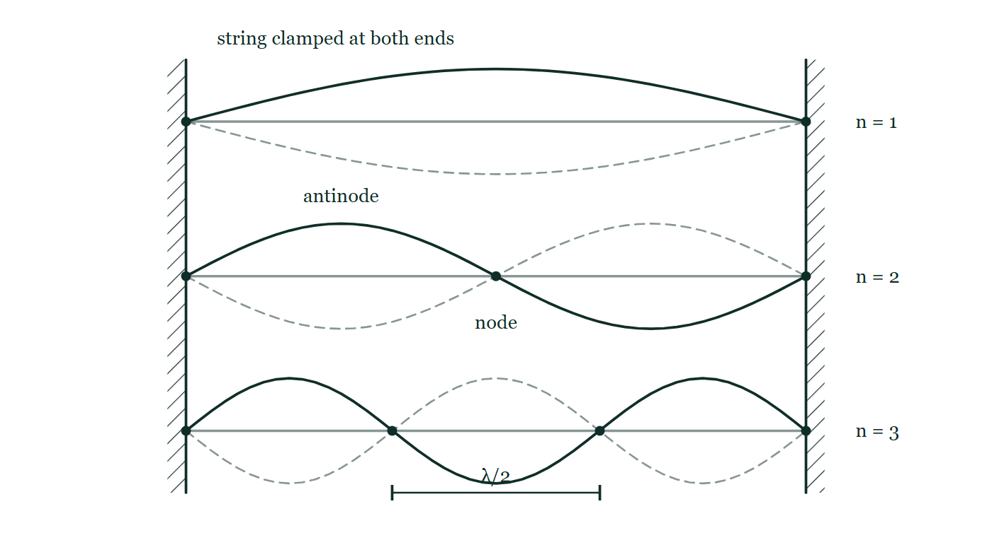
WAVES · STATIONARY WAVES
GIOPHYSICS LESSON
THINK FIRST
A guitar string is vibrating loudly. Which way along the string is the energy travelling?
Take answers before you click — the point is the commitment
It was plucked in the middle, and both ends are clamped tight. The note goes on for several seconds.
THE ANSWER
Neither way. The energy stays in the string, swapping between kinetic as the loops whip through the middle and potential as they stretch out at the extremes. That is what the word stationary means — the pattern does not move, and nothing is carried along the medium. What you hear leaking away is the small amount escaping into the air and the body of the guitar.
A string clamped at both ends drawn in its first three patterns, one above the other, each with its opposite extreme shown faint and dashed; the nodes are marked with dots and one node-to-node gap is labelled λ/2.
The live version of this figure — click here
Waves — Stationary Waves. Built by GioPhysics from the lesson's own copy; nothing on these slides is re-authored.
3 / 33
Notes:
[Phase] Starter: Recall what this lesson stands on (minutes 0–5 of 45)
[Hook] A guitar string is vibrating loudly. Which way along the string is the energy travelling? It was plucked in the middle, and both ends are clamped tight. The note goes on for several seconds.
[Answer] Neither way. The energy stays in the string, swapping between kinetic as the loops whip through the middle and potential as they stretch out at the extremes. That is what the word stationary means — the pattern does not move, and nothing is carried along the medium. What you hear leaking away is the small amount escaping into the air and the body of the guitar.
[Figure] A string clamped at both ends drawn in its first three patterns, one above the other, each with its opposite extreme shown faint and dashed; the nodes are marked with dots and one node-to-node gap is labelled λ/2.

Slide 4
WAVES · STATIONARY WAVES
GIOPHYSICS LESSON
EXPLAINED SIMPLY
In one sentence
Introduce the idea — The big idea and the definition
A stationary wave is the fixed interference pattern of two identical waves travelling in opposite directions, with motionless nodes and maximum-swing antinodes.
Waves — Stationary Waves. Built by GioPhysics from the lesson's own copy; nothing on these slides is re-authored.
4 / 33
Notes:
[Phase] Introduce the idea: The big idea and the definition (minutes 5–13 of 45)
[Definition] A stationary wave is the fixed interference pattern of two identical waves travelling in opposite directions, with motionless nodes and maximum-swing antinodes.

Slide 5
WAVES · STATIONARY WAVES
GIOPHYSICS LESSON
EXPLAINED SIMPLY
What that looks like
Introduce the idea — The big idea and the definition
FOR EXAMPLE
A guitar string clamped at both ends can only vibrate in patterns with nodes at the clamps — that selects its notes.
Waves — Stationary Waves. Built by GioPhysics from the lesson's own copy; nothing on these slides is re-authored.
5 / 33
Notes:
[Phase] Introduce the idea: The big idea and the definition (minutes 5–13 of 45)
[Worked illustration] A guitar string clamped at both ends can only vibrate in patterns with nodes at the clamps — that selects its notes.

Slide 6
WAVES · STATIONARY WAVES
GIOPHYSICS LESSON
THE BIG IDEA
Waves that stand still
Introduce the idea — The big idea and the definition
Two waves of equal frequency and amplitude travelling in opposite directions interfere into a stationary wave. Nodes (zero amplitude) sit half a wavelength apart; antinodes lie between them. Unlike a travelling wave, no energy is transported — and only certain frequencies fit a given string or tube.
Waves — Stationary Waves. Built by GioPhysics from the lesson's own copy; nothing on these slides is re-authored.
6 / 33
Notes:
[Phase] Introduce the idea: The big idea and the definition (minutes 5–13 of 45)
[Big idea] Two waves of equal frequency and amplitude travelling in opposite directions interfere into a stationary wave. Nodes (zero amplitude) sit half a wavelength apart; antinodes lie between them. Unlike a travelling wave, no energy is transported — and only certain frequencies fit a given string or tube.

Slide 7
WAVES · STATIONARY WAVES
GIOPHYSICS LESSON
THE PHYSICS · 1 OF 3
Formation
Build the model — The formulae, one at a time, in plain English
The wave reflects (inverted at a fixed end), and incident plus reflected waves superpose. Where they always cancel: nodes. Where they always reinforce: antinodes.
Waves — Stationary Waves. Built by GioPhysics from the lesson's own copy; nothing on these slides is re-authored.
7 / 33
Notes:
[Phase] Build the model: The formulae, one at a time, in plain English (minutes 13–22 of 45)
[Section] The wave reflects (inverted at a fixed end), and incident plus reflected waves superpose. Where they always cancel: nodes. Where they always reinforce: antinodes.

Slide 8
WAVES · STATIONARY WAVES
GIOPHYSICS LESSON
THE PHYSICS · 2 OF 3
Phase behaviour
Build the model — The formulae, one at a time, in plain English
All points between two nodes move in phase with different amplitudes; crossing a node flips the phase — opposite to a travelling wave, where amplitude is constant and phase varies.
Waves — Stationary Waves. Built by GioPhysics from the lesson's own copy; nothing on these slides is re-authored.
8 / 33
Notes:
[Phase] Build the model: The formulae, one at a time, in plain English (minutes 13–22 of 45)
[Section] All points between two nodes move in phase with different amplitudes; crossing a node flips the phase — opposite to a travelling wave, where amplitude is constant and phase varies.

Slide 9
WAVES · STATIONARY WAVES
GIOPHYSICS LESSON
THE PHYSICS · 3 OF 3
Sound in tubes
Build the model — The formulae, one at a time, in plain English
Air columns resonate the same way: displacement antinodes at open ends, nodes at closed ends. A small end-correction extends the effective length slightly.
Waves — Stationary Waves. Built by GioPhysics from the lesson's own copy; nothing on these slides is re-authored.
9 / 33
Notes:
[Phase] Build the model: The formulae, one at a time, in plain English (minutes 13–22 of 45)
[Section] Air columns resonate the same way: displacement antinodes at open ends, nodes at closed ends. A small end-correction extends the effective length slightly.

Slide 10
WAVES · STATIONARY WAVES
GIOPHYSICS LESSON
FORMULA 1 OF 3
Node spacing
Build the model — The formulae, one at a time, in plain English
node to node = λ/2
Antinodes midway between
IN PLAIN ENGLISH
Adjacent nodes sit exactly half a wavelength apart — measure the node spacing, double it, and you have λ.
Waves — Stationary Waves. Built by GioPhysics from the lesson's own copy; nothing on these slides is re-authored.
10 / 33
Notes:
[Phase] Build the model: The formulae, one at a time, in plain English (minutes 13–22 of 45)
[Formula] Node spacing: node to node = λ/2
[In plain English] Adjacent nodes sit exactly half a wavelength apart — measure the node spacing, double it, and you have λ.
[Note] Antinodes midway between

Slide 11
WAVES · STATIONARY WAVES
GIOPHYSICS LESSON
FORMULA 2 OF 3
String / open tube
Build the model — The formulae, one at a time, in plain English
fₙ = nv/2L
n = 1, 2, 3, …
IN PLAIN ENGLISH
Both ends alike (two nodes, or two antinodes): the harmonics are all whole-number multiples of the fundamental.
Waves — Stationary Waves. Built by GioPhysics from the lesson's own copy; nothing on these slides is re-authored.
11 / 33
Notes:
[Phase] Build the model: The formulae, one at a time, in plain English (minutes 13–22 of 45)
[Formula] String / open tube: fₙ = nv/2L
[In plain English] Both ends alike (two nodes, or two antinodes): the harmonics are all whole-number multiples of the fundamental.
[Note] n = 1, 2, 3, …

Slide 12
WAVES · STATIONARY WAVES
GIOPHYSICS LESSON
FORMULA 3 OF 3
Closed tube
Build the model — The formulae, one at a time, in plain English
fₙ = nv/4L, odd n only
Node at the closed end, antinode at the open end
IN PLAIN ENGLISH
A tube closed at one end fits only a quarter wavelength at fundamental — and skips every even harmonic.
Waves — Stationary Waves. Built by GioPhysics from the lesson's own copy; nothing on these slides is re-authored.
12 / 33
Notes:
[Phase] Build the model: The formulae, one at a time, in plain English (minutes 13–22 of 45)
[Formula] Closed tube: fₙ = nv/4L, odd n only
[In plain English] A tube closed at one end fits only a quarter wavelength at fundamental — and skips every even harmonic.
[Note] Node at the closed end, antinode at the open end

Slide 13
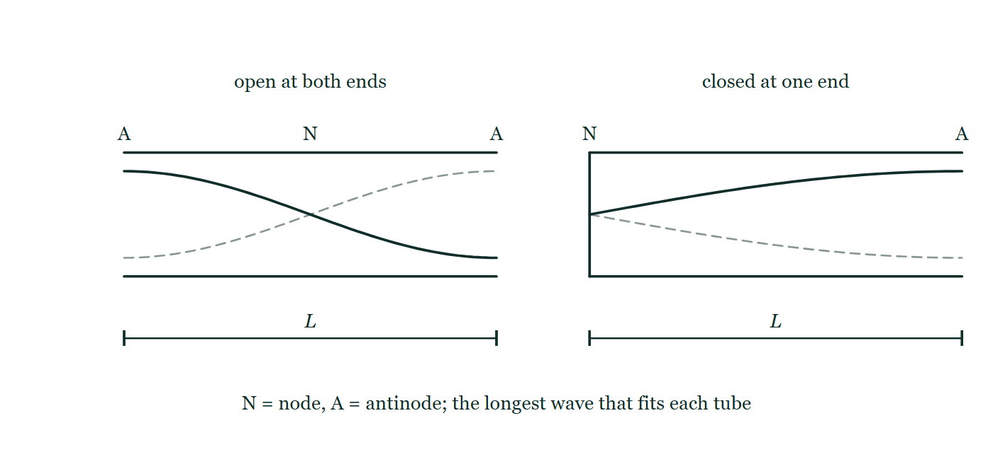
WAVES · STATIONARY WAVES
GIOPHYSICS LESSON
THE PICTURE
Open tube and closed tube
Drawn for this lesson
Two tubes of equal length L side by side, each carrying its fundamental as a displacement curve with the opposite swing dashed: the open tube has antinodes at both ends and a node in the middle, and the closed tube has a node at its sealed end and an antinode at its open one.
The live version of this figure — click here
Waves — Stationary Waves. Built by GioPhysics from the lesson's own copy; nothing on these slides is re-authored.
13 / 33
Notes:
[Phase] Build the model: The formulae, one at a time, in plain English (minutes 13–22 of 45)
[Figure] Two tubes of equal length L side by side, each carrying its fundamental as a displacement curve with the opposite swing dashed: the open tube has antinodes at both ends and a node in the middle, and the closed tube has a node at its sealed end and an antinode at its open one.

Slide 14
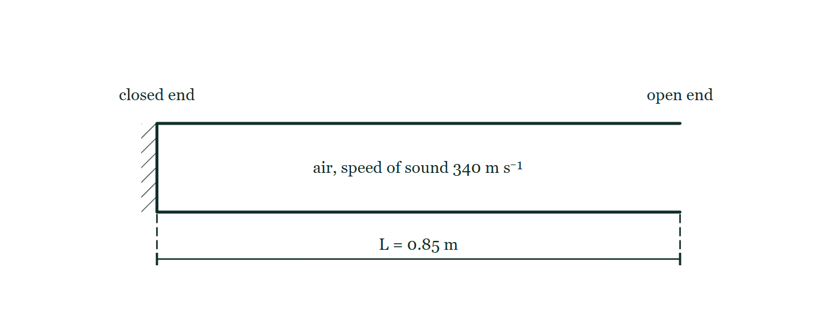
WAVES · STATIONARY WAVES
GIOPHYSICS LESSON
FIGURE
Figure 1 — IB Theme C · Wave behaviour
Drawn for question 3 of that paper · syllabus C.4
Side view of a horizontal pipe drawn as a long rectangle lying on its side. Its left-hand end is sealed by a wall drawn with hatching behind it and labelled 'closed end'; its right-hand end has no wall drawn across it and is labelled 'open end'. The air column inside carries the note 'air, speed of sound 340 m s⁻¹', and a dimension line beneath the pipe, with a tick at each end, marks its length as L = 0.85 m from the closed end to the open end.
See the question this was drawn for — click here
Waves — Stationary Waves. Built by GioPhysics from the lesson's own copy; nothing on these slides is re-authored.
14 / 33
Notes:
[Phase] Build the model: The formulae, one at a time, in plain English (minutes 13–22 of 45)
[Figure] Figure 1. Side view of a horizontal pipe drawn as a long rectangle lying on its side. Its left-hand end is sealed by a wall drawn with hatching behind it and labelled 'closed end'; its right-hand end has no wall drawn across it and is labelled 'open end'. The air column inside carries the note 'air, speed of sound 340 m s⁻¹', and a dimension line beneath the pipe, with a tick at each end, marks its length as L = 0.85 m from the closed end to the open end.
[Where it came from] IB Theme C · Wave behaviour, question 3; syllabus C.4.

Slide 15
WAVES · STATIONARY WAVES
GIOPHYSICS LESSON
WATCH OUT
The common trap
Check and misconception — The quick check and the trap
A stationary wave transfers no energy along the medium — energy is stored, swapping between kinetic and potential in each loop. A travelling wave of the same amplitude continuously carries energy forward.
Waves — Stationary Waves. Built by GioPhysics from the lesson's own copy; nothing on these slides is re-authored.
15 / 33
Notes:
[Phase] Check and misconception: The quick check and the trap (minutes 35–41 of 45)
[Misconception] A stationary wave transfers no energy along the medium — energy is stored, swapping between kinetic and potential in each loop. A travelling wave of the same amplitude continuously carries energy forward.

Slide 16
WAVES · STATIONARY WAVES
GIOPHYSICS LESSON
WORKED EXAMPLE 1 OF 2 · EASY
The question
Easy
Worked examples — I do, we do — one step revealed at a time
Adjacent nodes on a vibrating string are 0.25 m apart. Find the wavelength.
Waves — Stationary Waves. Built by GioPhysics from the lesson's own copy; nothing on these slides is re-authored.
16 / 33
Notes:
[Phase] Worked examples: I do, we do — one step revealed at a time (minutes 22–35 of 45)
[Question] Adjacent nodes on a vibrating string are 0.25 m apart. Find the wavelength.
[Answer] λ = 0.50 m

Slide 17
WAVES · STATIONARY WAVES
GIOPHYSICS LESSON
WORKED EXAMPLE 1 OF 2 · EASY · THE WORKING
How to solve it
Easy
Worked examples — I do, we do — one step revealed at a time
Adjacent nodes on a vibrating string are 0.25 m apart. Find the wavelength.
1.
Node spacing = λ/2.
2.
λ = 0.50 m.
Waves — Stationary Waves. Built by GioPhysics from the lesson's own copy; nothing on these slides is re-authored.
17 / 33
Notes:
[Phase] Worked examples: I do, we do — one step revealed at a time (minutes 22–35 of 45)
[Reveal] One click per step. The class works each line before the next appears.
[Step 1] Node spacing = λ/2.
[Step 2] λ = 0.50 m.

Slide 18
WAVES · STATIONARY WAVES
GIOPHYSICS LESSON
WORKED EXAMPLE 1 OF 2 · EASY
Answer
Easy
Worked examples — I do, we do — one step revealed at a time
λ = 0.50 m
Waves — Stationary Waves. Built by GioPhysics from the lesson's own copy; nothing on these slides is re-authored.
18 / 33
Notes:
[Phase] Worked examples: I do, we do — one step revealed at a time (minutes 22–35 of 45)
[Answer] λ = 0.50 m

Slide 19
WAVES · STATIONARY WAVES
GIOPHYSICS LESSON
WORKED EXAMPLE 2 OF 2 · MEDIUM
The question
Medium
Worked examples — I do, we do — one step revealed at a time
A tube closed at one end resonates with a tuning fork at air-column lengths 39 cm and next at 65 cm (v = 343 m/s). Find the frequency.
Waves — Stationary Waves. Built by GioPhysics from the lesson's own copy; nothing on these slides is re-authored.
19 / 33
Notes:
[Phase] Worked examples: I do, we do — one step revealed at a time (minutes 22–35 of 45)
[Question] A tube closed at one end resonates with a tuning fork at air-column lengths 39 cm and next at 65 cm (v = 343 m/s). Find the frequency.
[Answer] f ≈ 660 Hz

Slide 20
WAVES · STATIONARY WAVES
GIOPHYSICS LESSON
WORKED EXAMPLE 2 OF 2 · MEDIUM · THE WORKING
How to solve it
Medium
Worked examples — I do, we do — one step revealed at a time
A tube closed at one end resonates with a tuning fork at air-column lengths 39 cm and next at 65 cm (v = 343 m/s). Find the frequency.
1.
Successive resonances of a closed tube differ by λ/2: λ/2 = 65 − 39 = 26 cm.
2.
λ = 0.52 m.
3.
f = v/λ = 343 ÷ 0.52 ≈ 660 Hz.
Waves — Stationary Waves. Built by GioPhysics from the lesson's own copy; nothing on these slides is re-authored.
20 / 33
Notes:
[Phase] Worked examples: I do, we do — one step revealed at a time (minutes 22–35 of 45)
[Reveal] One click per step. The class works each line before the next appears.
[Step 1] Successive resonances of a closed tube differ by λ/2: λ/2 = 65 − 39 = 26 cm.
[Step 2] λ = 0.52 m.
[Step 3] f = v/λ = 343 ÷ 0.52 ≈ 660 Hz.

Slide 21
WAVES · STATIONARY WAVES
GIOPHYSICS LESSON
WORKED EXAMPLE 2 OF 2 · MEDIUM
Answer
Medium
Worked examples — I do, we do — one step revealed at a time
f ≈ 660 Hz
Waves — Stationary Waves. Built by GioPhysics from the lesson's own copy; nothing on these slides is re-authored.
21 / 33
Notes:
[Phase] Worked examples: I do, we do — one step revealed at a time (minutes 22–35 of 45)
[Answer] f ≈ 660 Hz

Slide 22
WAVES · STATIONARY WAVES
GIOPHYSICS LESSON
SPOT THE MISTAKE
One line here is wrong
The whole working is up — find the bad line before you click
1.
A tube closed at one end resonates at column lengths 39 cm and then 65 cm, with v = 343 m/s. Find the frequency.
2.
The first resonance is a quarter wavelength, so λ = 4 × 0.39 = 1.56 m
3.
f = v/λ = 343/1.56 = 220 Hz
4.
So the tuning fork is 220 Hz.
LINE 2 IS WRONG
The quarter-wave relation is right in principle but it leans on the end correction, which is exactly what the second reading was taken to avoid. The gap between successive resonances is always half a wavelength and carries no end correction at all: 65 − 39 = 26 cm, so λ = 0.52 m. Using the first length alone is what makes the answer come out around 15% low, and it is why the experiment always asks for two.
IT SHOULD SAY
λ = 2 × (0.65 − 0.39) = 0.52 m, so f = 343/0.52 ≈ 660 Hz
Waves — Stationary Waves. Built by GioPhysics from the lesson's own copy; nothing on these slides is re-authored.
22 / 33
Notes:
[Phase] Worked examples: I do, we do — one step revealed at a time (minutes 22–35 of 45)
[Spot the mistake] The working is complete and one line of it is wrong. Let the room hunt: one click names the line, a second shows it done correctly.
[Line 2 is wrong] The quarter-wave relation is right in principle but it leans on the end correction, which is exactly what the second reading was taken to avoid. The gap between successive resonances is always half a wavelength and carries no end correction at all: 65 − 39 = 26 cm, so λ = 0.52 m. Using the first length alone is what makes the answer come out around 15% low, and it is why the experiment always asks for two.
[It should say] λ = 2 × (0.65 − 0.39) = 0.52 m, so f = 343/0.52 ≈ 660 Hz

Slide 23
WAVES · STATIONARY WAVES
GIOPHYSICS LESSON
PREDICT · TAKE THE VOTE
Commit before you are told
Hands up for each option, then click
The string is at full amplitude in the second pattern. How much energy per second travels from the left-hand clamp towards the right-hand one?
A All of it — carrying energy along is what a wave does
B None
C Half of it, since the other half is going the other way
A string clamped at both ends drawn in its first three patterns, one above the other, each with its opposite extreme shown faint and dashed; the nodes are marked with dots and one node-to-node gap is labelled λ/2.
The live version of this figure — click here
Waves — Stationary Waves. Built by GioPhysics from the lesson's own copy; nothing on these slides is re-authored.
23 / 33
Notes:
[Phase] Build the model: The formulae, one at a time, in plain English (minutes 13–22 of 45)
[Predict] The string is at full amplitude in the second pattern. How much energy per second travels from the left-hand clamp towards the right-hand one?
[Options] A All of it — carrying energy along is what a wave does B None C Half of it, since the other half is going the other way
[Figure] A string clamped at both ends drawn in its first three patterns, one above the other, each with its opposite extreme shown faint and dashed; the nodes are marked with dots and one node-to-node gap is labelled λ/2.

Slide 24
WAVES · STATIONARY WAVES
GIOPHYSICS LESSON
PREDICT · THE OUTCOME
What actually happens
Ask the room who changed their mind, and why
B None
WHY
A stationary wave is two identical travelling waves crossing in opposite directions, and they carry equal energy the two opposite ways, so the transports cancel exactly. Nothing crosses a node — the dots on the drawing never move at all, and the string on one side of a node is always doing the mirror image of the string on the other. The energy is stored where it is, sloshing between kinetic and potential twice per cycle, which is why it is called stationary rather than slow.
Waves — Stationary Waves. Built by GioPhysics from the lesson's own copy; nothing on these slides is re-authored.
24 / 33
Notes:
[Phase] Build the model: The formulae, one at a time, in plain English (minutes 13–22 of 45)
[Answer] B — None. A stationary wave is two identical travelling waves crossing in opposite directions, and they carry equal energy the two opposite ways, so the transports cancel exactly. Nothing crosses a node — the dots on the drawing never move at all, and the string on one side of a node is always doing the mirror image of the string on the other. The energy is stored where it is, sloshing between kinetic and potential twice per cycle, which is why it is called stationary rather than slow.

Slide 25
WAVES · STATIONARY WAVES
GIOPHYSICS LESSON
QUICK CHECK
Decide before the answer goes up
Check and misconception — The quick check and the trap
Two 300 Hz waves superpose into a stationary wave with adjacent nodes 1.5 m apart. What is the travelling waves' speed?
A
450 m/s
B
900 m/s
C
200 m/s
Waves — Stationary Waves. Built by GioPhysics from the lesson's own copy; nothing on these slides is re-authored.
25 / 33
Notes:
[Phase] Check and misconception: The quick check and the trap (minutes 35–41 of 45)
[Question] Two 300 Hz waves superpose into a stationary wave with adjacent nodes 1.5 m apart. What is the travelling waves' speed?
[Options] A 450 m/s B 900 m/s C 200 m/s

Slide 26
WAVES · STATIONARY WAVES
GIOPHYSICS LESSON
QUICK CHECK · THE ANSWER
The answer, and why
Check and misconception — The quick check and the trap
B 900 m/s
HOW TO GET THERE
λ = 2 × 1.5 = 3.0 m, so v = fλ = 300 × 3.0 = 900 m/s.
WHY THE OTHERS TEMPT
A 450 is 300 × 1.5, using the node spacing as the wavelength. Node to node is only half a wavelength, which is why the figure marks that gap λ/2 and not λ.
B Correct. λ = 2 × 1.5 = 3.0 m, so v = fλ = 300 × 3.0 = 900 m/s.
C 200 is 300 ÷ 1.5, the wave equation inverted. v = fλ multiplies — and a size check settles it too, since a wave with 3 m between crests, passing 300 times a second, must be covering 900 m in that second.
Waves — Stationary Waves. Built by GioPhysics from the lesson's own copy; nothing on these slides is re-authored.
26 / 33
Notes:
[Phase] Check and misconception: The quick check and the trap (minutes 35–41 of 45)
[Question] Two 300 Hz waves superpose into a stationary wave with adjacent nodes 1.5 m apart. What is the travelling waves' speed?
[Option by option] A: 450 is 300 × 1.5, using the node spacing as the wavelength. Node to node is only half a wavelength, which is why the figure marks that gap λ/2 and not λ. B: Correct. λ = 2 × 1.5 = 3.0 m, so v = fλ = 300 × 3.0 = 900 m/s. C: 200 is 300 ÷ 1.5, the wave equation inverted. v = fλ multiplies — and a size check settles it too, since a wave with 3 m between crests, passing 300 times a second, must be covering 900 m in that second.
[Answer] B — 900 m/s
[Why] λ = 2 × 1.5 = 3.0 m, so v = fλ = 300 × 3.0 = 900 m/s.
[Reveal] One click for the answer, then one for the reason.

Slide 27
WAVES · STATIONARY WAVES
GIOPHYSICS LESSON
EXTENSION 1 OF 2 · HARD
The question
Hard
Worked examples — I do, we do — one step revealed at a time
A 0.60 m guitar string plays its fundamental at 330 Hz. Find the wave speed on the string and the frequency of its third harmonic.
Waves — Stationary Waves. Built by GioPhysics from the lesson's own copy; nothing on these slides is re-authored.
27 / 33
Notes:
[Phase] Worked examples: I do, we do — one step revealed at a time (minutes 22–35 of 45)
[Question] A 0.60 m guitar string plays its fundamental at 330 Hz. Find the wave speed on the string and the frequency of its third harmonic.
[Answer] v ≈ 396 m/s; f₃ = 990 Hz

Slide 28
WAVES · STATIONARY WAVES
GIOPHYSICS LESSON
EXTENSION 1 OF 2 · HARD · THE WORKING
How to solve it
Hard
Worked examples — I do, we do — one step revealed at a time
A 0.60 m guitar string plays its fundamental at 330 Hz. Find the wave speed on the string and the frequency of its third harmonic.
1.
Fundamental: λ = 2L = 1.2 m → v = fλ = 330 × 1.2 = 396 m/s.
2.
Harmonics of a string: fₙ = nf₁.
3.
f₃ = 3 × 330 = 990 Hz.
Waves — Stationary Waves. Built by GioPhysics from the lesson's own copy; nothing on these slides is re-authored.
28 / 33
Notes:
[Phase] Worked examples: I do, we do — one step revealed at a time (minutes 22–35 of 45)
[Reveal] One click per step. The class works each line before the next appears.
[Step 1] Fundamental: λ = 2L = 1.2 m → v = fλ = 330 × 1.2 = 396 m/s.
[Step 2] Harmonics of a string: fₙ = nf₁.
[Step 3] f₃ = 3 × 330 = 990 Hz.

Slide 29
WAVES · STATIONARY WAVES
GIOPHYSICS LESSON
EXTENSION 1 OF 2 · HARD
Answer
Hard
Worked examples — I do, we do — one step revealed at a time
v ≈ 396 m/s; f₃ = 990 Hz
Waves — Stationary Waves. Built by GioPhysics from the lesson's own copy; nothing on these slides is re-authored.
29 / 33
Notes:
[Phase] Worked examples: I do, we do — one step revealed at a time (minutes 22–35 of 45)
[Answer] v ≈ 396 m/s; f₃ = 990 Hz

Slide 30
WAVES · STATIONARY WAVES
GIOPHYSICS LESSON
EXTENSION 2 OF 2 · CHALLENGING
The question
Challenging
Worked examples — I do, we do — one step revealed at a time
A tube open at both ends and another closed at one end share the same fundamental frequency. Find the ratio of their lengths, and compare their overtone series.
Waves — Stationary Waves. Built by GioPhysics from the lesson's own copy; nothing on these slides is re-authored.
30 / 33
Notes:
[Phase] Worked examples: I do, we do — one step revealed at a time (minutes 22–35 of 45)
[Question] A tube open at both ends and another closed at one end share the same fundamental frequency. Find the ratio of their lengths, and compare their overtone series.
[Answer] L(closed) : L(open) = 1 : 2; open = all harmonics, closed = odd only

Slide 31
WAVES · STATIONARY WAVES
GIOPHYSICS LESSON
EXTENSION 2 OF 2 · CHALLENGING · THE WORKING
How to solve it
Challenging
Worked examples — I do, we do — one step revealed at a time
A tube open at both ends and another closed at one end share the same fundamental frequency. Find the ratio of their lengths, and compare their overtone series.
1.
Open: f₁ = v/2L(open). Closed: f₁ = v/4L(closed).
2.
Equal fundamentals → L(closed) = L(open)/2.
3.
Open tube plays all harmonics (2f, 3f…); the closed tube only odd ones (3f, 5f…) — same pitch, different timbre.
Waves — Stationary Waves. Built by GioPhysics from the lesson's own copy; nothing on these slides is re-authored.
31 / 33
Notes:
[Phase] Worked examples: I do, we do — one step revealed at a time (minutes 22–35 of 45)
[Reveal] One click per step. The class works each line before the next appears.
[Step 1] Open: f₁ = v/2L(open). Closed: f₁ = v/4L(closed).
[Step 2] Equal fundamentals → L(closed) = L(open)/2.
[Step 3] Open tube plays all harmonics (2f, 3f…); the closed tube only odd ones (3f, 5f…) — same pitch, different timbre.

Slide 32
WAVES · STATIONARY WAVES
GIOPHYSICS LESSON
EXTENSION 2 OF 2 · CHALLENGING
Answer
Challenging
Worked examples — I do, we do — one step revealed at a time
L(closed) : L(open) = 1 : 2; open = all harmonics, closed = odd only
Waves — Stationary Waves. Built by GioPhysics from the lesson's own copy; nothing on these slides is re-authored.
32 / 33
Notes:
[Phase] Worked examples: I do, we do — one step revealed at a time (minutes 22–35 of 45)
[Answer] L(closed) : L(open) = 1 : 2; open = all harmonics, closed = odd only

Slide 33
WAVES · STATIONARY WAVES
GIOPHYSICS LESSON
WAVES
Where to go next
Plenary — What to take away, what to practise next
Next
15.9 Sound & the Doppler Effect
https://giophysics.com/chapter-24/sound-doppler/
Lesson
This lesson on giophysics.com
https://giophysics.com/chapter-24/stationary-waves/
Live
The live, interactive version of these slides
https://giophysics.com/chapter-24/presentation/?lesson=stationary
Chapter
All Waves lessons
https://giophysics.com/chapter-24/
PDF
Download the lesson PDF
https://giophysics.com/downloads/24-8-stationary-waves.pdf
Waves — Stationary Waves. Built by GioPhysics from the lesson's own copy; nothing on these slides is re-authored.
33 / 33
Notes:
[Phase] Plenary: What to take away, what to practise next (minutes 41–45 of 45)
[Interactive] The graphs and the circuit topology on these slides are frozen. The live version at https://giophysics.com/chapter-24/presentation/?lesson=stationary moves them.

