Slide 1
WAVES · SUPERPOSITION & INTERFERENCE
GIOPHYSICS LESSON
15 · Waves
When waves meet, they add
Superposition & Interference
Waves passing through the same point simply add their displacements. With two coherent sources the result is a stable pattern of loud and silent, bright and dark — interference.
POSITION
Lesson 5 of 10 in Waves
PLAN
16 slides in the 45-minute core run, about 43.5 minutes of it
LESSON PAGE
https://giophysics.com/chapter-24/superposition-interference/
Built by GioPhysics from the lesson's own page. Every word on these slides is the lesson's; nothing here is re-authored. Teaching material, not an awarding body's document.
Waves — Superposition & Interference. Built by GioPhysics from the lesson's own copy; nothing on these slides is re-authored.
1 / 36
Notes:
[Lesson] Waves — Superposition & Interference. Lesson 5 of 10.
[Intro] Waves passing through the same point simply add their displacements. With two coherent sources the result is a stable pattern of loud and silent, bright and dark — interference.
[Source] https://giophysics.com/chapter-24/superposition-interference/
[Disclaimer] Built by GioPhysics from the lesson's own page. Every word on these slides is the lesson's; nothing here is re-authored. Teaching material, not an awarding body's document.

Slide 2
WAVES · SUPERPOSITION & INTERFERENCE
GIOPHYSICS LESSON
WHAT THIS NEEDS
What you already know
Starter — Recall what this lesson stands on
Recall
Describing waves
https://giophysics.com/chapter-24/describing-waves/
Waves — Superposition & Interference. Built by GioPhysics from the lesson's own copy; nothing on these slides is re-authored.
2 / 36
Notes:
[Phase] Starter: Recall what this lesson stands on (minutes 0–5 of 45)
[Starter] Recall: Describing waves

Slide 3
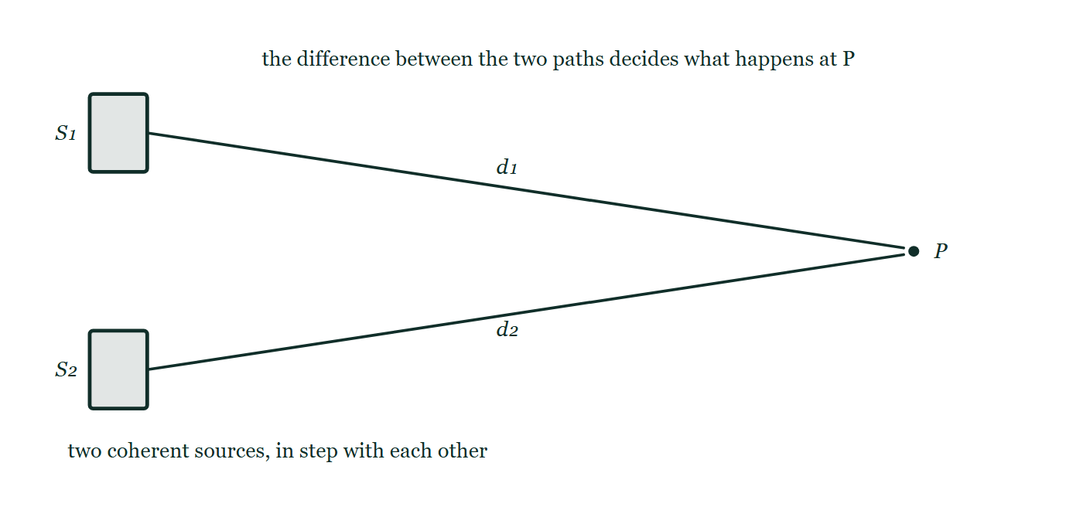
WAVES · SUPERPOSITION & INTERFERENCE
GIOPHYSICS LESSON
THINK FIRST
Two speakers play the same note. You find a spot in the room where it is silent. Where did that sound energy go?
Take answers before you click — the point is the commitment
Both speakers are still working — cover either one and the silence fills with sound.
THE ANSWER
To the loud spots. Interference does not delete energy, it moves it around the room: the maxima receive more than either speaker alone would have delivered, and adding up everything arriving everywhere gives back exactly what the two speakers emitted. Silence at one point is paid for by extra loudness at another.
Two coherent sources S₁ and S₂ one above the other on the left, with straight lines of unequal length labelled d₁ and d₂ running from them to a single marked point P over on the right.
The live version of this figure — click here
Waves — Superposition & Interference. Built by GioPhysics from the lesson's own copy; nothing on these slides is re-authored.
3 / 36
Notes:
[Phase] Starter: Recall what this lesson stands on (minutes 0–5 of 45)
[Hook] Two speakers play the same note. You find a spot in the room where it is silent. Where did that sound energy go? Both speakers are still working — cover either one and the silence fills with sound.
[Answer] To the loud spots. Interference does not delete energy, it moves it around the room: the maxima receive more than either speaker alone would have delivered, and adding up everything arriving everywhere gives back exactly what the two speakers emitted. Silence at one point is paid for by extra loudness at another.
[Figure] Two coherent sources S₁ and S₂ one above the other on the left, with straight lines of unequal length labelled d₁ and d₂ running from them to a single marked point P over on the right.

Slide 4
WAVES · SUPERPOSITION & INTERFERENCE
GIOPHYSICS LESSON
EXPLAINED SIMPLY
In one sentence
Introduce the idea — The big idea and the definition
Interference is the adding of waves from coherent sources, reinforcing where they arrive in phase and cancelling where they arrive in antiphase.
Waves — Superposition & Interference. Built by GioPhysics from the lesson's own copy; nothing on these slides is re-authored.
4 / 36
Notes:
[Phase] Introduce the idea: The big idea and the definition (minutes 5–13 of 45)
[Definition] Interference is the adding of waves from coherent sources, reinforcing where they arrive in phase and cancelling where they arrive in antiphase.

Slide 5
WAVES · SUPERPOSITION & INTERFERENCE
GIOPHYSICS LESSON
EXPLAINED SIMPLY
What that looks like
Introduce the idea — The big idea and the definition
FOR EXAMPLE
Two loudspeakers playing one tone create spots in the room where the sound is doubled — and spots of near silence.
Waves — Superposition & Interference. Built by GioPhysics from the lesson's own copy; nothing on these slides is re-authored.
5 / 36
Notes:
[Phase] Introduce the idea: The big idea and the definition (minutes 5–13 of 45)
[Worked illustration] Two loudspeakers playing one tone create spots in the room where the sound is doubled — and spots of near silence.

Slide 6
WAVES · SUPERPOSITION & INTERFERENCE
GIOPHYSICS LESSON
THE BIG IDEA
When waves meet, they add
Introduce the idea — The big idea and the definition
The principle of superposition says the total displacement is the sum of the individual displacements. Whether two waves reinforce or cancel at a point depends on their path difference: whole wavelengths give constructive interference, odd half-wavelengths give destructive.
Waves — Superposition & Interference. Built by GioPhysics from the lesson's own copy; nothing on these slides is re-authored.
6 / 36
Notes:
[Phase] Introduce the idea: The big idea and the definition (minutes 5–13 of 45)
[Big idea] The principle of superposition says the total displacement is the sum of the individual displacements. Whether two waves reinforce or cancel at a point depends on their path difference: whole wavelengths give constructive interference, odd half-wavelengths give destructive.

Slide 7
WAVES · SUPERPOSITION & INTERFERENCE
GIOPHYSICS LESSON
THE PHYSICS · 1 OF 3
Coherence
Build the model — The formulae, one at a time, in plain English
A stable pattern needs coherent sources: same frequency and a constant phase difference. Two independent light bulbs are incoherent — no fringes.
Waves — Superposition & Interference. Built by GioPhysics from the lesson's own copy; nothing on these slides is re-authored.
7 / 36
Notes:
[Phase] Build the model: The formulae, one at a time, in plain English (minutes 13–22 of 45)
[Section] A stable pattern needs coherent sources: same frequency and a constant phase difference. Two independent light bulbs are incoherent — no fringes.

Slide 8
WAVES · SUPERPOSITION & INTERFERENCE
GIOPHYSICS LESSON
THE PHYSICS · 2 OF 3
Diffraction spreads waves
Build the model — The formulae, one at a time, in plain English
Waves spread as they pass a gap or an edge — strongest when the gap is about one wavelength wide. That spreading lets waves from two slits overlap.
Waves — Superposition & Interference. Built by GioPhysics from the lesson's own copy; nothing on these slides is re-authored.
8 / 36
Notes:
[Phase] Build the model: The formulae, one at a time, in plain English (minutes 13–22 of 45)
[Section] Waves spread as they pass a gap or an edge — strongest when the gap is about one wavelength wide. That spreading lets waves from two slits overlap.

Slide 9
WAVES · SUPERPOSITION & INTERFERENCE
GIOPHYSICS LESSON
THE PHYSICS · 3 OF 3
Huygens' picture
Build the model — The formulae, one at a time, in plain English
Every point on a wavefront acts as a source of secondary wavelets; their envelope is the new wavefront. It explains both diffraction and the slit patterns to come.
Waves — Superposition & Interference. Built by GioPhysics from the lesson's own copy; nothing on these slides is re-authored.
9 / 36
Notes:
[Phase] Build the model: The formulae, one at a time, in plain English (minutes 13–22 of 45)
[Section] Every point on a wavefront acts as a source of secondary wavelets; their envelope is the new wavefront. It explains both diffraction and the slit patterns to come.

Slide 10
WAVES · SUPERPOSITION & INTERFERENCE
GIOPHYSICS LESSON
FORMULA 1 OF 3
Superposition
Build the model — The formulae, one at a time, in plain English
y = y₁ + y₂
Displacements add as vectors
IN PLAIN ENGLISH
Where waves overlap, just add their displacements moment by moment — crest on crest grows, crest on trough cancels.
Waves — Superposition & Interference. Built by GioPhysics from the lesson's own copy; nothing on these slides is re-authored.
10 / 36
Notes:
[Phase] Build the model: The formulae, one at a time, in plain English (minutes 13–22 of 45)
[Formula] Superposition: y = y₁ + y₂
[In plain English] Where waves overlap, just add their displacements moment by moment — crest on crest grows, crest on trough cancels.
[Note] Displacements add as vectors

Slide 11
WAVES · SUPERPOSITION & INTERFERENCE
GIOPHYSICS LESSON
FORMULA 2 OF 3
Constructive
Build the model — The formulae, one at a time, in plain English
path difference = nλ
n = 0, 1, 2, …
IN PLAIN ENGLISH
Arriving a whole number of wavelengths apart means arriving in step — the waves reinforce to double amplitude.
Waves — Superposition & Interference. Built by GioPhysics from the lesson's own copy; nothing on these slides is re-authored.
11 / 36
Notes:
[Phase] Build the model: The formulae, one at a time, in plain English (minutes 13–22 of 45)
[Formula] Constructive: path difference = nλ
[In plain English] Arriving a whole number of wavelengths apart means arriving in step — the waves reinforce to double amplitude.
[Note] n = 0, 1, 2, …

Slide 12
WAVES · SUPERPOSITION & INTERFERENCE
GIOPHYSICS LESSON
FORMULA 3 OF 3
Destructive
Build the model — The formulae, one at a time, in plain English
path difference = (n + ½)λ
Odd half-wavelengths
IN PLAIN ENGLISH
Arriving half a cycle out of step means crest meets trough — equal waves cancel to nothing.
Waves — Superposition & Interference. Built by GioPhysics from the lesson's own copy; nothing on these slides is re-authored.
12 / 36
Notes:
[Phase] Build the model: The formulae, one at a time, in plain English (minutes 13–22 of 45)
[Formula] Destructive: path difference = (n + ½)λ
[In plain English] Arriving half a cycle out of step means crest meets trough — equal waves cancel to nothing.
[Note] Odd half-wavelengths

Slide 13
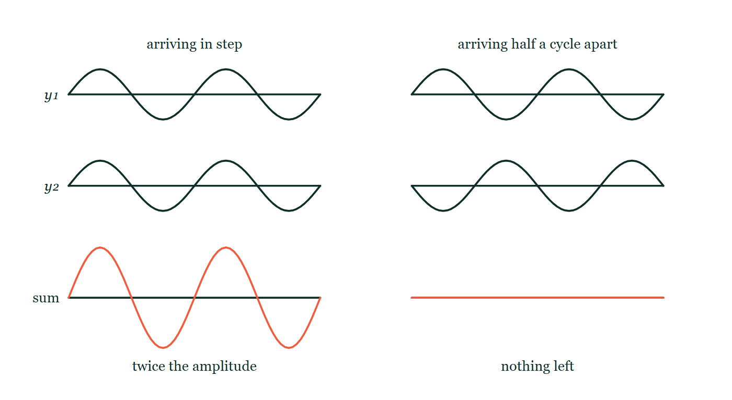
WAVES · SUPERPOSITION & INTERFERENCE
GIOPHYSICS LESSON
THE PICTURE
The same two waves, added twice
Drawn for this lesson
Two stacks of three axes: on the left two identical sinusoids in step and their sum below at twice the amplitude, and on the right the same pair with one shifted half a cycle and their sum below drawn as a flat straight line.
The live version of this figure — click here
Waves — Superposition & Interference. Built by GioPhysics from the lesson's own copy; nothing on these slides is re-authored.
13 / 36
Notes:
[Phase] Build the model: The formulae, one at a time, in plain English (minutes 13–22 of 45)
[Figure] Two stacks of three axes: on the left two identical sinusoids in step and their sum below at twice the amplitude, and on the right the same pair with one shifted half a cycle and their sum below drawn as a flat straight line.

Slide 14
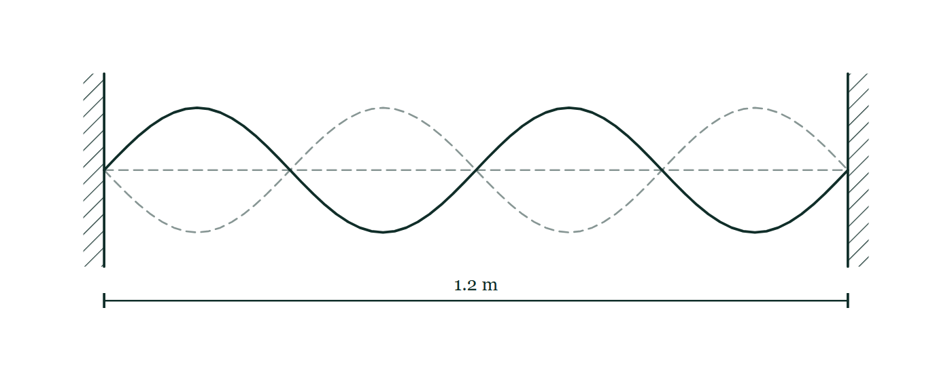
WAVES · SUPERPOSITION & INTERFERENCE
GIOPHYSICS LESSON
FIGURE 1 OF 4
Fig. 4.1 — A Level AS · Topics 1–11
Drawn for question 4 of that paper · syllabus 8
A string is stretched horizontally between two fixed supports drawn as hatched blocks, with the distance between them marked 1.2 m. The stationary wave on the string is drawn as a solid curve showing four loops between the supports, and the opposite extreme of the motion is drawn dashed over it, so the string is still at the two fixed ends and at three points in between while the loops vibrate.
See the question this was drawn for — click here
Waves — Superposition & Interference. Built by GioPhysics from the lesson's own copy; nothing on these slides is re-authored.
14 / 36
Notes:
[Phase] Build the model: The formulae, one at a time, in plain English (minutes 13–22 of 45)
[Figure] Fig. 4.1. A string is stretched horizontally between two fixed supports drawn as hatched blocks, with the distance between them marked 1.2 m. The stationary wave on the string is drawn as a solid curve showing four loops between the supports, and the opposite extreme of the motion is drawn dashed over it, so the string is still at the two fixed ends and at three points in between while the loops vibrate.
[Where it came from] A Level AS · Topics 1–11, question 4; syllabus 8.

Slide 15
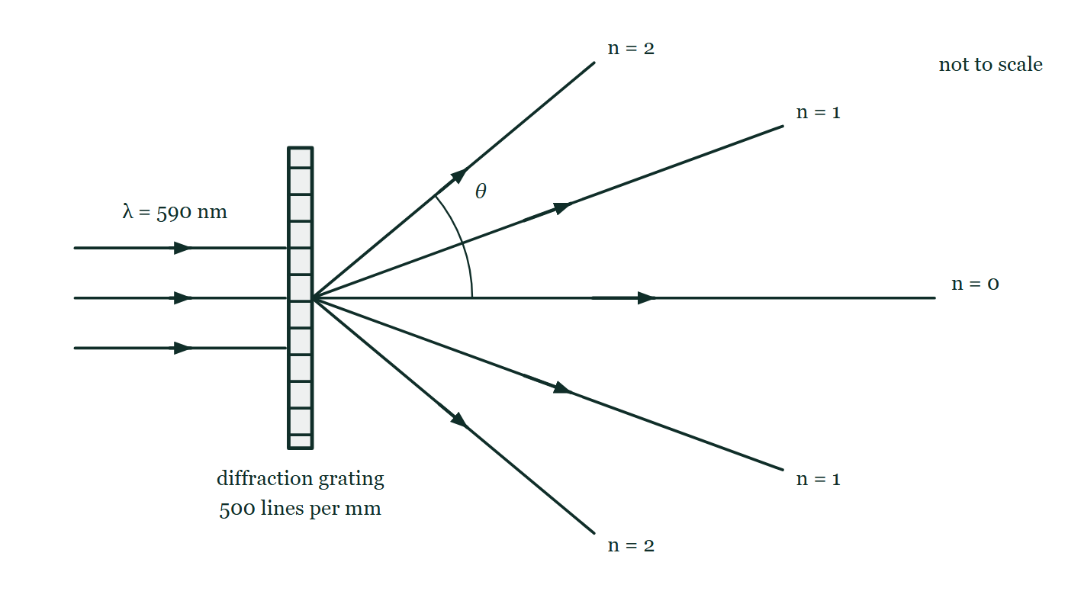
WAVES · SUPERPOSITION & INTERFERENCE
GIOPHYSICS LESSON
FIGURE 2 OF 4
Fig. 9.1 — A Level AS · Topics 1–11
Drawn for question 9 of that paper · syllabus 7, 8
A parallel beam of light of wavelength 590 nm travels from the left and meets a diffraction grating at normal incidence; the grating is drawn edge-on as a narrow ruled strip and labelled 500 lines per mm. On the far side five beams spread from the grating: one continues straight through and is labelled n = 0, and above and below it lie beams labelled n = 1 and, at larger angles, n = 2. An arc marks the angle θ between the straight-through direction and the upper second-order beam. The angles drawn are not to scale.
See the question this was drawn for — click here
Waves — Superposition & Interference. Built by GioPhysics from the lesson's own copy; nothing on these slides is re-authored.
15 / 36
Notes:
[Phase] Build the model: The formulae, one at a time, in plain English (minutes 13–22 of 45)
[Figure] Fig. 9.1. A parallel beam of light of wavelength 590 nm travels from the left and meets a diffraction grating at normal incidence; the grating is drawn edge-on as a narrow ruled strip and labelled 500 lines per mm. On the far side five beams spread from the grating: one continues straight through and is labelled n = 0, and above and below it lie beams labelled n = 1 and, at larger angles, n = 2. An arc marks the angle θ between the straight-through direction and the upper second-order beam. The angles drawn are not to scale.
[Where it came from] A Level AS · Topics 1–11, question 9; syllabus 7, 8.

Slide 16
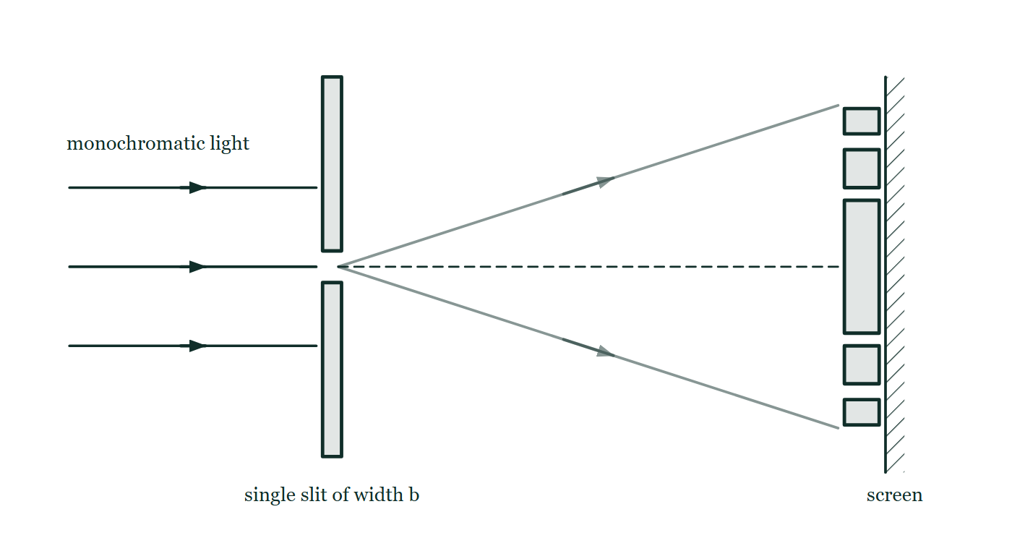
WAVES · SUPERPOSITION & INTERFERENCE
GIOPHYSICS LESSON
FIGURE 3 OF 4
Figure 3 — IB Theme C · Wave behaviour
Drawn for question 5 of that paper · syllabus C.3
Plan view of the arrangement. Three parallel rays of monochromatic light travel from the left towards an opaque barrier drawn as two vertical bars; only the middle ray meets the narrow gap between them, which is labelled 'single slit of width b'. Beyond the slit, two faint rays spread out above and below a dashed straight line that continues from the slit to a screen at the far right. On the screen a row of bright bands is drawn, centred on the dashed line, with the band on the line noticeably taller than the pairs of bands above and below it.
See the question this was drawn for — click here
Waves — Superposition & Interference. Built by GioPhysics from the lesson's own copy; nothing on these slides is re-authored.
16 / 36
Notes:
[Phase] Build the model: The formulae, one at a time, in plain English (minutes 13–22 of 45)
[Figure] Figure 3. Plan view of the arrangement. Three parallel rays of monochromatic light travel from the left towards an opaque barrier drawn as two vertical bars; only the middle ray meets the narrow gap between them, which is labelled 'single slit of width b'. Beyond the slit, two faint rays spread out above and below a dashed straight line that continues from the slit to a screen at the far right. On the screen a row of bright bands is drawn, centred on the dashed line, with the band on the line noticeably taller than the pairs of bands above and below it.
[Where it came from] IB Theme C · Wave behaviour, question 5; syllabus C.3.

Slide 17
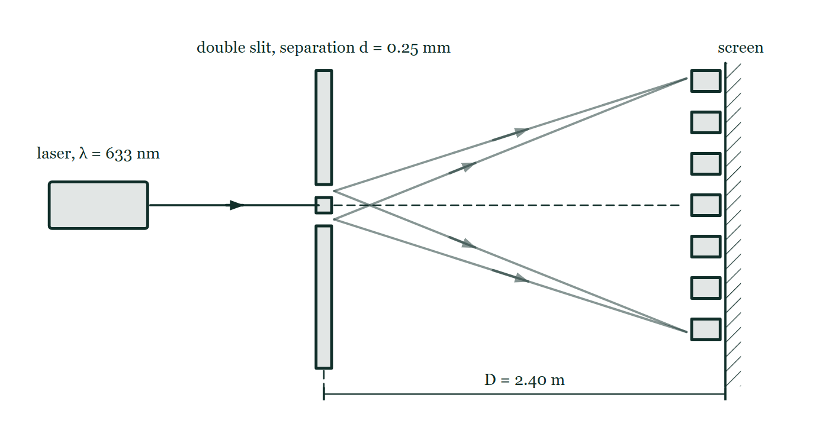
WAVES · SUPERPOSITION & INTERFERENCE
GIOPHYSICS LESSON
FIGURE 4 OF 4
Figure 5 — IB Theme C · Wave behaviour
Drawn for question 9 of that paper · syllabus C.3
Plan view. A laser at the left, labelled 'laser, λ = 633 nm', sends a beam horizontally to an opaque barrier, which has two narrow slits, one just above and one just below the beam line, separated by a short bar; the barrier is labelled 'double slit, separation d = 0.25 mm'. Beyond it, faint lines from the two slits spread out towards a screen at the right, where a column of equally spaced bright fringes is drawn, one of them on the dashed line that continues straight on from the slits. A dimension line beneath marks the slit-to-screen distance as D = 2.40 m.
See the question this was drawn for — click here
Waves — Superposition & Interference. Built by GioPhysics from the lesson's own copy; nothing on these slides is re-authored.
17 / 36
Notes:
[Phase] Build the model: The formulae, one at a time, in plain English (minutes 13–22 of 45)
[Figure] Figure 5. Plan view. A laser at the left, labelled 'laser, λ = 633 nm', sends a beam horizontally to an opaque barrier, which has two narrow slits, one just above and one just below the beam line, separated by a short bar; the barrier is labelled 'double slit, separation d = 0.25 mm'. Beyond it, faint lines from the two slits spread out towards a screen at the right, where a column of equally spaced bright fringes is drawn, one of them on the dashed line that continues straight on from the slits. A dimension line beneath marks the slit-to-screen distance as D = 2.40 m.
[Where it came from] IB Theme C · Wave behaviour, question 9; syllabus C.3.

Slide 18
WAVES · SUPERPOSITION & INTERFERENCE
GIOPHYSICS LESSON
WATCH OUT
The common trap
Check and misconception — The quick check and the trap
Destructive interference does not destroy energy. The energy missing from the quiet points appears at the loud points — the pattern redistributes energy, never deletes it.
Waves — Superposition & Interference. Built by GioPhysics from the lesson's own copy; nothing on these slides is re-authored.
18 / 36
Notes:
[Phase] Check and misconception: The quick check and the trap (minutes 35–41 of 45)
[Misconception] Destructive interference does not destroy energy. The energy missing from the quiet points appears at the loud points — the pattern redistributes energy, never deletes it.

Slide 19
WAVES · SUPERPOSITION & INTERFERENCE
GIOPHYSICS LESSON
WORKED EXAMPLE 1 OF 2 · EASY
The question
Easy
Worked examples — I do, we do — one step revealed at a time
Two crests of equal 2.0 cm amplitude meet. What is the momentary displacement where they overlap?
Waves — Superposition & Interference. Built by GioPhysics from the lesson's own copy; nothing on these slides is re-authored.
19 / 36
Notes:
[Phase] Worked examples: I do, we do — one step revealed at a time (minutes 22–35 of 45)
[Question] Two crests of equal 2.0 cm amplitude meet. What is the momentary displacement where they overlap?
[Answer] 4.0 cm

Slide 20
WAVES · SUPERPOSITION & INTERFERENCE
GIOPHYSICS LESSON
WORKED EXAMPLE 1 OF 2 · EASY · THE WORKING
How to solve it
Easy
Worked examples — I do, we do — one step revealed at a time
Two crests of equal 2.0 cm amplitude meet. What is the momentary displacement where they overlap?
1.
Superposition: displacements add.
2.
2.0 + 2.0 = 4.0 cm.
Waves — Superposition & Interference. Built by GioPhysics from the lesson's own copy; nothing on these slides is re-authored.
20 / 36
Notes:
[Phase] Worked examples: I do, we do — one step revealed at a time (minutes 22–35 of 45)
[Reveal] One click per step. The class works each line before the next appears.
[Step 1] Superposition: displacements add.
[Step 2] 2.0 + 2.0 = 4.0 cm.

Slide 21
WAVES · SUPERPOSITION & INTERFERENCE
GIOPHYSICS LESSON
WORKED EXAMPLE 1 OF 2 · EASY
Answer
Easy
Worked examples — I do, we do — one step revealed at a time
4.0 cm
Waves — Superposition & Interference. Built by GioPhysics from the lesson's own copy; nothing on these slides is re-authored.
21 / 36
Notes:
[Phase] Worked examples: I do, we do — one step revealed at a time (minutes 22–35 of 45)
[Answer] 4.0 cm

Slide 22
WAVES · SUPERPOSITION & INTERFERENCE
GIOPHYSICS LESSON
WORKED EXAMPLE 2 OF 2 · MEDIUM
The question
Medium
Worked examples — I do, we do — one step revealed at a time
Two speakers 2.0 m apart emit 686 Hz in phase (v = 343 m/s). A listener sits 3.0 m from one speaker and 3.75 m from the other. Loud or quiet?
Waves — Superposition & Interference. Built by GioPhysics from the lesson's own copy; nothing on these slides is re-authored.
22 / 36
Notes:
[Phase] Worked examples: I do, we do — one step revealed at a time (minutes 22–35 of 45)
[Question] Two speakers 2.0 m apart emit 686 Hz in phase (v = 343 m/s). A listener sits 3.0 m from one speaker and 3.75 m from the other. Loud or quiet?
[Answer] Quiet — destructive interference

Slide 23
WAVES · SUPERPOSITION & INTERFERENCE
GIOPHYSICS LESSON
WORKED EXAMPLE 2 OF 2 · MEDIUM · THE WORKING
How to solve it
Medium
Worked examples — I do, we do — one step revealed at a time
Two speakers 2.0 m apart emit 686 Hz in phase (v = 343 m/s). A listener sits 3.0 m from one speaker and 3.75 m from the other. Loud or quiet?
1.
λ = v/f = 343 ÷ 686 = 0.50 m.
2.
Path difference = 3.75 − 3.0 = 0.75 m = 1.5λ.
3.
1.5λ is an odd number of half-wavelengths → destructive.
Waves — Superposition & Interference. Built by GioPhysics from the lesson's own copy; nothing on these slides is re-authored.
23 / 36
Notes:
[Phase] Worked examples: I do, we do — one step revealed at a time (minutes 22–35 of 45)
[Reveal] One click per step. The class works each line before the next appears.
[Step 1] λ = v/f = 343 ÷ 686 = 0.50 m.
[Step 2] Path difference = 3.75 − 3.0 = 0.75 m = 1.5λ.
[Step 3] 1.5λ is an odd number of half-wavelengths → destructive.

Slide 24
WAVES · SUPERPOSITION & INTERFERENCE
GIOPHYSICS LESSON
WORKED EXAMPLE 2 OF 2 · MEDIUM
Answer
Medium
Worked examples — I do, we do — one step revealed at a time
Quiet — destructive interference
Waves — Superposition & Interference. Built by GioPhysics from the lesson's own copy; nothing on these slides is re-authored.
24 / 36
Notes:
[Phase] Worked examples: I do, we do — one step revealed at a time (minutes 22–35 of 45)
[Answer] Quiet — destructive interference

Slide 25
WAVES · SUPERPOSITION & INTERFERENCE
GIOPHYSICS LESSON
SPOT THE MISTAKE
One line here is wrong
The whole working is up — find the bad line before you click
1.
Two speakers emit 686 Hz in phase, v = 343 m/s. A listener is 3.00 m from one and 3.75 m from the other. Loud or quiet?
2.
λ = v/f = 343/686 = 0.50 m
3.
Path difference = 3.75 − 3.00 = 0.75 m
4.
0.75 m is more than one wavelength, so it is constructive.
5.
So the listener hears a loud spot.
LINE 4 IS WRONG
The path difference has been compared with a whole wavelength instead of being counted in wavelengths. 0.75 m is 1.5λ — one whole wavelength, which changes nothing, plus a half, which changes everything. Being bigger than λ says nothing on its own; what matters is what is left over after the whole ones are stripped away, and here that leftover is exactly the half that cancels.
IT SHOULD SAY
0.75 m = 1.5λ, an odd number of half-wavelengths, so the waves arrive in antiphase: the listener is at a quiet point.
Waves — Superposition & Interference. Built by GioPhysics from the lesson's own copy; nothing on these slides is re-authored.
25 / 36
Notes:
[Phase] Worked examples: I do, we do — one step revealed at a time (minutes 22–35 of 45)
[Spot the mistake] The working is complete and one line of it is wrong. Let the room hunt: one click names the line, a second shows it done correctly.
[Line 4 is wrong] The path difference has been compared with a whole wavelength instead of being counted in wavelengths. 0.75 m is 1.5λ — one whole wavelength, which changes nothing, plus a half, which changes everything. Being bigger than λ says nothing on its own; what matters is what is left over after the whole ones are stripped away, and here that leftover is exactly the half that cancels.
[It should say] 0.75 m = 1.5λ, an odd number of half-wavelengths, so the waves arrive in antiphase: the listener is at a quiet point.

Slide 26
WAVES · SUPERPOSITION & INTERFERENCE
GIOPHYSICS LESSON
PREDICT · TAKE THE VOTE
Commit before you are told
Hands up for each option, then click
The two paths to P differ by exactly 2.0 wavelengths. Is P loud or quiet?
A Quiet — the waves have travelled different distances, so they cannot arrive in step
B Loud — two whole wavelengths of extra path leaves the wave exactly where it started
C It depends on both distances, not just on the difference between them
Two coherent sources S₁ and S₂ one above the other on the left, with straight lines of unequal length labelled d₁ and d₂ running from them to a single marked point P over on the right.
The live version of this figure — click here
Waves — Superposition & Interference. Built by GioPhysics from the lesson's own copy; nothing on these slides is re-authored.
26 / 36
Notes:
[Phase] Build the model: The formulae, one at a time, in plain English (minutes 13–22 of 45)
[Predict] The two paths to P differ by exactly 2.0 wavelengths. Is P loud or quiet?
[Options] A Quiet — the waves have travelled different distances, so they cannot arrive in step B Loud — two whole wavelengths of extra path leaves the wave exactly where it started C It depends on both distances, not just on the difference between them
[Figure] Two coherent sources S₁ and S₂ one above the other on the left, with straight lines of unequal length labelled d₁ and d₂ running from them to a single marked point P over on the right.

Slide 27
WAVES · SUPERPOSITION & INTERFERENCE
GIOPHYSICS LESSON
PREDICT · THE OUTCOME
What actually happens
Ask the room who changed their mind, and why
B Loud — two whole wavelengths of extra path leaves the wave exactly where it started
WHY
A whole wavelength of extra path is one complete cycle of delay, and a wave delayed by a whole cycle is doing precisely what it would have been doing anyway. Two whole wavelengths is two cycles, still exactly in step — so crest meets crest at P and the displacements add, which is the left-hand column of the other drawing. Only a leftover half wavelength gives the right-hand column. And the individual distances never matter: it is d₁ − d₂ that decides, which is why the figure labels them but measures neither.
Waves — Superposition & Interference. Built by GioPhysics from the lesson's own copy; nothing on these slides is re-authored.
27 / 36
Notes:
[Phase] Build the model: The formulae, one at a time, in plain English (minutes 13–22 of 45)
[Answer] B — Loud — two whole wavelengths of extra path leaves the wave exactly where it started. A whole wavelength of extra path is one complete cycle of delay, and a wave delayed by a whole cycle is doing precisely what it would have been doing anyway. Two whole wavelengths is two cycles, still exactly in step — so crest meets crest at P and the displacements add, which is the left-hand column of the other drawing. Only a leftover half wavelength gives the right-hand column. And the individual distances never matter: it is d₁ − d₂ that decides, which is why the figure labels them but measures neither.

Slide 28
WAVES · SUPERPOSITION & INTERFERENCE
GIOPHYSICS LESSON
QUICK CHECK
Decide before the answer goes up
Check and misconception — The quick check and the trap
Two coherent sources send waves to a point, travelling 3.0λ and 2.5λ. What happens there?
A
Constructive interference
B
Destructive interference
C
No interference
Waves — Superposition & Interference. Built by GioPhysics from the lesson's own copy; nothing on these slides is re-authored.
28 / 36
Notes:
[Phase] Check and misconception: The quick check and the trap (minutes 35–41 of 45)
[Question] Two coherent sources send waves to a point, travelling 3.0λ and 2.5λ. What happens there?
[Options] A Constructive interference B Destructive interference C No interference

Slide 29
WAVES · SUPERPOSITION & INTERFERENCE
GIOPHYSICS LESSON
QUICK CHECK · THE ANSWER
The answer, and why
Check and misconception — The quick check and the trap
B Destructive interference
HOW TO GET THERE
Path difference = 0.5λ — an odd half-wavelength, so the waves arrive in antiphase and cancel.
WHY THE OTHERS TEMPT
A 3.0λ on its own really would arrive exactly in step with the source, so half the instinct here is sound. It is the difference between the two paths that decides what happens at the point: 3.0 − 2.5 = 0.5λ, so one wave arrives half a cycle ahead of the other.
B Correct. The path difference is half a wavelength, so the waves arrive in antiphase and cancel.
C Waves from coherent sources interfere everywhere they overlap — there is no third option at a point both of them reach. What varies from place to place is whether the result is a maximum, a minimum, or something in between.
Waves — Superposition & Interference. Built by GioPhysics from the lesson's own copy; nothing on these slides is re-authored.
29 / 36
Notes:
[Phase] Check and misconception: The quick check and the trap (minutes 35–41 of 45)
[Question] Two coherent sources send waves to a point, travelling 3.0λ and 2.5λ. What happens there?
[Option by option] A: 3.0λ on its own really would arrive exactly in step with the source, so half the instinct here is sound. It is the difference between the two paths that decides what happens at the point: 3.0 − 2.5 = 0.5λ, so one wave arrives half a cycle ahead of the other. B: Correct. The path difference is half a wavelength, so the waves arrive in antiphase and cancel. C: Waves from coherent sources interfere everywhere they overlap — there is no third option at a point both of them reach. What varies from place to place is whether the result is a maximum, a minimum, or something in between.
[Answer] B — Destructive interference
[Why] Path difference = 0.5λ — an odd half-wavelength, so the waves arrive in antiphase and cancel.
[Reveal] One click for the answer, then one for the reason.

Slide 30
WAVES · SUPERPOSITION & INTERFERENCE
GIOPHYSICS LESSON
EXTENSION 1 OF 2 · HARD
The question
Hard
Worked examples — I do, we do — one step revealed at a time
Two speakers 3.4 m and 4.25 m from a listener emit 400 Hz in phase (v = 340 m/s). Loud or quiet at the listener?
Waves — Superposition & Interference. Built by GioPhysics from the lesson's own copy; nothing on these slides is re-authored.
30 / 36
Notes:
[Phase] Worked examples: I do, we do — one step revealed at a time (minutes 22–35 of 45)
[Question] Two speakers 3.4 m and 4.25 m from a listener emit 400 Hz in phase (v = 340 m/s). Loud or quiet at the listener?
[Answer] Loud — path difference is exactly one wavelength

Slide 31
WAVES · SUPERPOSITION & INTERFERENCE
GIOPHYSICS LESSON
EXTENSION 1 OF 2 · HARD · THE WORKING
How to solve it
Hard
Worked examples — I do, we do — one step revealed at a time
Two speakers 3.4 m and 4.25 m from a listener emit 400 Hz in phase (v = 340 m/s). Loud or quiet at the listener?
1.
λ = 340 ÷ 400 = 0.85 m.
2.
Path difference = 0.85 m = exactly 1.0λ.
3.
Whole wavelength → constructive → loud.
Waves — Superposition & Interference. Built by GioPhysics from the lesson's own copy; nothing on these slides is re-authored.
31 / 36
Notes:
[Phase] Worked examples: I do, we do — one step revealed at a time (minutes 22–35 of 45)
[Reveal] One click per step. The class works each line before the next appears.
[Step 1] λ = 340 ÷ 400 = 0.85 m.
[Step 2] Path difference = 0.85 m = exactly 1.0λ.
[Step 3] Whole wavelength → constructive → loud.

Slide 32
WAVES · SUPERPOSITION & INTERFERENCE
GIOPHYSICS LESSON
EXTENSION 1 OF 2 · HARD
Answer
Hard
Worked examples — I do, we do — one step revealed at a time
Loud — path difference is exactly one wavelength
Waves — Superposition & Interference. Built by GioPhysics from the lesson's own copy; nothing on these slides is re-authored.
32 / 36
Notes:
[Phase] Worked examples: I do, we do — one step revealed at a time (minutes 22–35 of 45)
[Answer] Loud — path difference is exactly one wavelength

Slide 33
WAVES · SUPERPOSITION & INTERFERENCE
GIOPHYSICS LESSON
EXTENSION 2 OF 2 · CHALLENGING
The question
Challenging
Worked examples — I do, we do — one step revealed at a time
Noise-cancelling headphones generate 'anti-noise'. Explain the physics, and why the same trick cannot silence a whole room.
Waves — Superposition & Interference. Built by GioPhysics from the lesson's own copy; nothing on these slides is re-authored.
33 / 36
Notes:
[Phase] Worked examples: I do, we do — one step revealed at a time (minutes 22–35 of 45)
[Question] Noise-cancelling headphones generate 'anti-noise'. Explain the physics, and why the same trick cannot silence a whole room.
[Answer] Perfect cancellation exists only near the ear; elsewhere the sound field just rearranges

Slide 34
WAVES · SUPERPOSITION & INTERFERENCE
GIOPHYSICS LESSON
EXTENSION 2 OF 2 · CHALLENGING · THE WORKING
How to solve it
Challenging
Worked examples — I do, we do — one step revealed at a time
Noise-cancelling headphones generate 'anti-noise'. Explain the physics, and why the same trick cannot silence a whole room.
1.
The electronics produce a copy of the incoming sound shifted half a cycle — at the ear, path difference ≈ 0 with 180° phase → destructive interference.
2.
Cancellation is only exact at one point; elsewhere the two waves' path difference varies.
3.
Away from the ear the pair produces loud and quiet patches — energy is redistributed, not destroyed, so a room gains anti-nodes wherever the ears found nodes.
Waves — Superposition & Interference. Built by GioPhysics from the lesson's own copy; nothing on these slides is re-authored.
34 / 36
Notes:
[Phase] Worked examples: I do, we do — one step revealed at a time (minutes 22–35 of 45)
[Reveal] One click per step. The class works each line before the next appears.
[Step 1] The electronics produce a copy of the incoming sound shifted half a cycle — at the ear, path difference ≈ 0 with 180° phase → destructive interference.
[Step 2] Cancellation is only exact at one point; elsewhere the two waves' path difference varies.
[Step 3] Away from the ear the pair produces loud and quiet patches — energy is redistributed, not destroyed, so a room gains anti-nodes wherever the ears found nodes.

Slide 35
WAVES · SUPERPOSITION & INTERFERENCE
GIOPHYSICS LESSON
EXTENSION 2 OF 2 · CHALLENGING
Answer
Challenging
Worked examples — I do, we do — one step revealed at a time
Perfect cancellation exists only near the ear; elsewhere the sound field just rearranges
Waves — Superposition & Interference. Built by GioPhysics from the lesson's own copy; nothing on these slides is re-authored.
35 / 36
Notes:
[Phase] Worked examples: I do, we do — one step revealed at a time (minutes 22–35 of 45)
[Answer] Perfect cancellation exists only near the ear; elsewhere the sound field just rearranges

Slide 36
WAVES · SUPERPOSITION & INTERFERENCE
GIOPHYSICS LESSON
WAVES
Where to go next
Plenary — What to take away, what to practise next
Next
15.6 Young's Double Slit
https://giophysics.com/chapter-24/young-double-slit/
Lesson
This lesson on giophysics.com
https://giophysics.com/chapter-24/superposition-interference/
Live
The live, interactive version of these slides
https://giophysics.com/chapter-24/presentation/?lesson=superposition
Chapter
All Waves lessons
https://giophysics.com/chapter-24/
PDF
Download the lesson PDF
https://giophysics.com/downloads/24-5-superposition-interference.pdf
Waves — Superposition & Interference. Built by GioPhysics from the lesson's own copy; nothing on these slides is re-authored.
36 / 36
Notes:
[Phase] Plenary: What to take away, what to practise next (minutes 41–45 of 45)
[Interactive] The graphs and the circuit topology on these slides are frozen. The live version at https://giophysics.com/chapter-24/presentation/?lesson=superposition moves them.

