Slide 1
LIGHT · THE NATURE OF LIGHT
GIOPHYSICS LESSON
16 · Light
Rays, wavefronts, and energy
The Nature of Light
Light is an electromagnetic wave, but for mirrors and lenses a simpler picture works: rays drawn at right angles to wavefronts, travelling in straight lines until something bends them.
POSITION
Lesson 1 of 6 in Light
PLAN
16 slides in the 45-minute core run, about 44.5 minutes of it
LESSON PAGE
https://giophysics.com/chapter-25/nature-of-light/
Built by GioPhysics from the lesson's own page. Every word on these slides is the lesson's; nothing here is re-authored. Teaching material, not an awarding body's document.
Light — The Nature of Light. Built by GioPhysics from the lesson's own copy; nothing on these slides is re-authored.
1 / 31
Notes:
[Lesson] Light — The Nature of Light. Lesson 1 of 6.
[Intro] Light is an electromagnetic wave, but for mirrors and lenses a simpler picture works: rays drawn at right angles to wavefronts, travelling in straight lines until something bends them.
[Source] https://giophysics.com/chapter-25/nature-of-light/
[Disclaimer] Built by GioPhysics from the lesson's own page. Every word on these slides is the lesson's; nothing here is re-authored. Teaching material, not an awarding body's document.

Slide 2
LIGHT · THE NATURE OF LIGHT
GIOPHYSICS LESSON
WHAT THIS NEEDS
What you already know
Starter — Recall what this lesson stands on
Recall
Electromagnetic waves
https://giophysics.com/chapter-24/electromagnetic-waves/
Light — The Nature of Light. Built by GioPhysics from the lesson's own copy; nothing on these slides is re-authored.
2 / 31
Notes:
[Phase] Starter: Recall what this lesson stands on (minutes 0–5 of 45)
[Starter] Recall: Electromagnetic waves

Slide 3
LIGHT · THE NATURE OF LIGHT
GIOPHYSICS LESSON
THINK FIRST
Sunlight has just crossed 150 million kilometres of vacuum to reach you. What was it travelling through?
Take answers before you click — the point is the commitment
Put a ringing bell inside a jar and pump the air out. You go on seeing it swing; the sound fades to nothing. Something is getting one signal out of that jar and not the other.
THE ANSWER
Nothing at all. Sound is a vibration of a material and dies the moment the material is removed; light needs no medium whatever and crosses empty space at 3 × 10⁸ m/s. It is why the Sun is the brightest thing in the sky and why the most violent explosions in the universe are silent.
Light — The Nature of Light. Built by GioPhysics from the lesson's own copy; nothing on these slides is re-authored.
3 / 31
Notes:
[Phase] Starter: Recall what this lesson stands on (minutes 0–5 of 45)
[Hook] Sunlight has just crossed 150 million kilometres of vacuum to reach you. What was it travelling through? Put a ringing bell inside a jar and pump the air out. You go on seeing it swing; the sound fades to nothing. Something is getting one signal out of that jar and not the other.
[Answer] Nothing at all. Sound is a vibration of a material and dies the moment the material is removed; light needs no medium whatever and crosses empty space at 3 × 10⁸ m/s. It is why the Sun is the brightest thing in the sky and why the most violent explosions in the universe are silent.

Slide 4
LIGHT · THE NATURE OF LIGHT
GIOPHYSICS LESSON
EXPLAINED SIMPLY
In one sentence
Introduce the idea — The big idea and the definition
A light ray is a straight line marking the direction light travels; a beam is a bundle of rays.
Light — The Nature of Light. Built by GioPhysics from the lesson's own copy; nothing on these slides is re-authored.
4 / 31
Notes:
[Phase] Introduce the idea: The big idea and the definition (minutes 5–13 of 45)
[Definition] A light ray is a straight line marking the direction light travels; a beam is a bundle of rays.

Slide 5
LIGHT · THE NATURE OF LIGHT
GIOPHYSICS LESSON
EXPLAINED SIMPLY
What that looks like
Introduce the idea — The big idea and the definition
FOR EXAMPLE
A laser pointer's spot lands exactly along the straight line from the aperture — light travels in straight lines through uniform air.
Light — The Nature of Light. Built by GioPhysics from the lesson's own copy; nothing on these slides is re-authored.
5 / 31
Notes:
[Phase] Introduce the idea: The big idea and the definition (minutes 5–13 of 45)
[Worked illustration] A laser pointer's spot lands exactly along the straight line from the aperture — light travels in straight lines through uniform air.

Slide 6
LIGHT · THE NATURE OF LIGHT
GIOPHYSICS LESSON
THE BIG IDEA
Rays, wavefronts, and energy
Introduce the idea — The big idea and the definition
The ray model treats light as straight lines showing the direction of energy flow. It explains shadows, pinhole images, and eclipses, and it sets up reflection and refraction. Intensity falls with the square of distance from a point source because the energy spreads over a growing sphere.
Light — The Nature of Light. Built by GioPhysics from the lesson's own copy; nothing on these slides is re-authored.
6 / 31
Notes:
[Phase] Introduce the idea: The big idea and the definition (minutes 5–13 of 45)
[Big idea] The ray model treats light as straight lines showing the direction of energy flow. It explains shadows, pinhole images, and eclipses, and it sets up reflection and refraction. Intensity falls with the square of distance from a point source because the energy spreads over a growing sphere.

Slide 7
LIGHT · THE NATURE OF LIGHT
GIOPHYSICS LESSON
THE PHYSICS · 1 OF 3
Straight-line evidence
Build the model — The formulae, one at a time, in plain English
Sharp shadows, pinhole cameras, and eclipses all follow from rectilinear propagation — light does not bend around large objects noticeably.
Light — The Nature of Light. Built by GioPhysics from the lesson's own copy; nothing on these slides is re-authored.
7 / 31
Notes:
[Phase] Build the model: The formulae, one at a time, in plain English (minutes 13–22 of 45)
[Section] Sharp shadows, pinhole cameras, and eclipses all follow from rectilinear propagation — light does not bend around large objects noticeably.

Slide 8
LIGHT · THE NATURE OF LIGHT
GIOPHYSICS LESSON
THE PHYSICS · 2 OF 3
When rays suffice
Build the model — The formulae, one at a time, in plain English
If the objects are much larger than the wavelength, ray optics predicts mirrors, lenses, and prisms accurately. Diffraction only matters near the wavelength scale.
Light — The Nature of Light. Built by GioPhysics from the lesson's own copy; nothing on these slides is re-authored.
8 / 31
Notes:
[Phase] Build the model: The formulae, one at a time, in plain English (minutes 13–22 of 45)
[Section] If the objects are much larger than the wavelength, ray optics predicts mirrors, lenses, and prisms accurately. Diffraction only matters near the wavelength scale.

Slide 9
LIGHT · THE NATURE OF LIGHT
GIOPHYSICS LESSON
THE PHYSICS · 3 OF 3
Luminous or lit
Build the model — The formulae, one at a time, in plain English
Sources like the Sun and lamps emit light; everything else is seen by reflected light — which is why colour depends on what a surface reflects.
Light — The Nature of Light. Built by GioPhysics from the lesson's own copy; nothing on these slides is re-authored.
9 / 31
Notes:
[Phase] Build the model: The formulae, one at a time, in plain English (minutes 13–22 of 45)
[Section] Sources like the Sun and lamps emit light; everything else is seen by reflected light — which is why colour depends on what a surface reflects.

Slide 10
LIGHT · THE NATURE OF LIGHT
GIOPHYSICS LESSON
FORMULA 1 OF 3
Speed of light
Build the model — The formulae, one at a time, in plain English
c ≈ 3 × 10⁸ m/s
In vacuum; slower in any medium
IN PLAIN ENGLISH
Light crosses a metre in about three nanoseconds — the fastest anything can travel.
Light — The Nature of Light. Built by GioPhysics from the lesson's own copy; nothing on these slides is re-authored.
10 / 31
Notes:
[Phase] Build the model: The formulae, one at a time, in plain English (minutes 13–22 of 45)
[Formula] Speed of light: c ≈ 3 × 10⁸ m/s
[In plain English] Light crosses a metre in about three nanoseconds — the fastest anything can travel.
[Note] In vacuum; slower in any medium

Slide 11
LIGHT · THE NATURE OF LIGHT
GIOPHYSICS LESSON
FORMULA 2 OF 3
Inverse square law
Build the model — The formulae, one at a time, in plain English
I ∝ 1/r²
For a point source radiating evenly
IN PLAIN ENGLISH
Twice as far from a small source means the same energy spread over four times the area — a quarter of the brightness.
Light — The Nature of Light. Built by GioPhysics from the lesson's own copy; nothing on these slides is re-authored.
11 / 31
Notes:
[Phase] Build the model: The formulae, one at a time, in plain English (minutes 13–22 of 45)
[Formula] Inverse square law: I ∝ 1/r²
[In plain English] Twice as far from a small source means the same energy spread over four times the area — a quarter of the brightness.
[Note] For a point source radiating evenly

Slide 12
LIGHT · THE NATURE OF LIGHT
GIOPHYSICS LESSON
FORMULA 3 OF 3
Rays ⊥ wavefronts
Build the model — The formulae, one at a time, in plain English
ray ⟂ wavefront
Two views of the same wave
IN PLAIN ENGLISH
A wavefront is a surface of constant phase; a crest is one possible constant-phase surface. Rays are arrows drawn at right angles to those surfaces, showing where the wave is going.
Light — The Nature of Light. Built by GioPhysics from the lesson's own copy; nothing on these slides is re-authored.
12 / 31
Notes:
[Phase] Build the model: The formulae, one at a time, in plain English (minutes 13–22 of 45)
[Formula] Rays ⊥ wavefronts: ray ⟂ wavefront
[In plain English] A wavefront is a surface of constant phase; a crest is one possible constant-phase surface. Rays are arrows drawn at right angles to those surfaces, showing where the wave is going.
[Note] Two views of the same wave

Slide 13
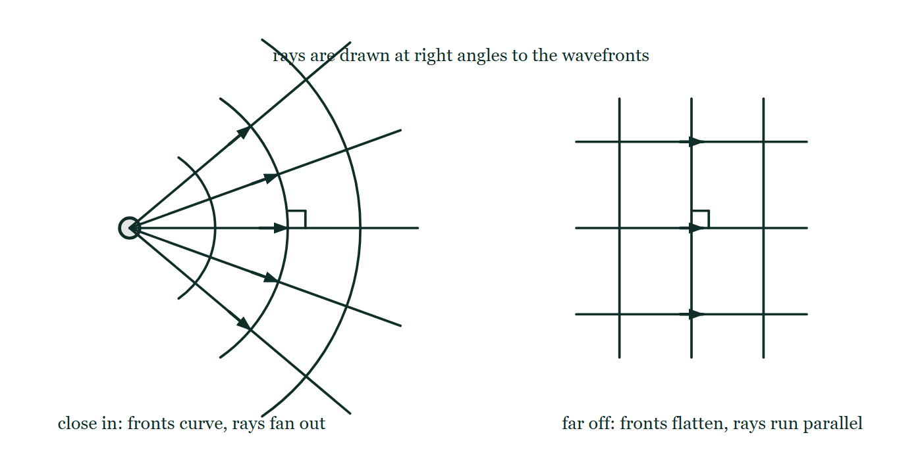
LIGHT · THE NATURE OF LIGHT
GIOPHYSICS LESSON
THE PICTURE
Rays and wavefronts are one picture
Drawn for this lesson
Two views of the same wave side by side. Close to a point source, three curved wavefronts arc round it with five rays fanning out through them; far off, three straight parallel wavefronts are crossed by three parallel rays. A small right-angle mark sits where a ray meets a front on each side.
The live version of this figure — click here
Light — The Nature of Light. Built by GioPhysics from the lesson's own copy; nothing on these slides is re-authored.
13 / 31
Notes:
[Phase] Build the model: The formulae, one at a time, in plain English (minutes 13–22 of 45)
[Figure] Two views of the same wave side by side. Close to a point source, three curved wavefronts arc round it with five rays fanning out through them; far off, three straight parallel wavefronts are crossed by three parallel rays. A small right-angle mark sits where a ray meets a front on each side.

Slide 14
LIGHT · THE NATURE OF LIGHT
GIOPHYSICS LESSON
WATCH OUT
The common trap
Check and misconception — The quick check and the trap
Light needs no medium — it crosses vacuum easily. Sound cannot. In a vacuum jar you see the bell ringing but hear nothing.
Light — The Nature of Light. Built by GioPhysics from the lesson's own copy; nothing on these slides is re-authored.
14 / 31
Notes:
[Phase] Check and misconception: The quick check and the trap (minutes 35–41 of 45)
[Misconception] Light needs no medium — it crosses vacuum easily. Sound cannot. In a vacuum jar you see the bell ringing but hear nothing.

Slide 15
LIGHT · THE NATURE OF LIGHT
GIOPHYSICS LESSON
WORKED EXAMPLE 1 OF 2 · EASY
The question
Easy
Worked examples — I do, we do — one step revealed at a time
How long does light take to travel 1.0 km?
Light — The Nature of Light. Built by GioPhysics from the lesson's own copy; nothing on these slides is re-authored.
15 / 31
Notes:
[Phase] Worked examples: I do, we do — one step revealed at a time (minutes 22–35 of 45)
[Question] How long does light take to travel 1.0 km?
[Answer] ≈ 3.3 μs

Slide 16
LIGHT · THE NATURE OF LIGHT
GIOPHYSICS LESSON
WORKED EXAMPLE 1 OF 2 · EASY · THE WORKING
How to solve it
Easy
Worked examples — I do, we do — one step revealed at a time
How long does light take to travel 1.0 km?
1.
t = d/c = 1000 ÷ 3 × 10⁸.
2.
t ≈ 3.3 μs.
Light — The Nature of Light. Built by GioPhysics from the lesson's own copy; nothing on these slides is re-authored.
16 / 31
Notes:
[Phase] Worked examples: I do, we do — one step revealed at a time (minutes 22–35 of 45)
[Reveal] One click per step. The class works each line before the next appears.
[Step 1] t = d/c = 1000 ÷ 3 × 10⁸.
[Step 2] t ≈ 3.3 μs.

Slide 17
LIGHT · THE NATURE OF LIGHT
GIOPHYSICS LESSON
WORKED EXAMPLE 1 OF 2 · EASY
Answer
Easy
Worked examples — I do, we do — one step revealed at a time
≈ 3.3 μs
Light — The Nature of Light. Built by GioPhysics from the lesson's own copy; nothing on these slides is re-authored.
17 / 31
Notes:
[Phase] Worked examples: I do, we do — one step revealed at a time (minutes 22–35 of 45)
[Answer] ≈ 3.3 μs

Slide 18
LIGHT · THE NATURE OF LIGHT
GIOPHYSICS LESSON
WORKED EXAMPLE 2 OF 2 · MEDIUM
The question
Medium
Worked examples — I do, we do — one step revealed at a time
Sunlight takes 8.3 minutes to reach Earth. Estimate the Earth–Sun distance.
Light — The Nature of Light. Built by GioPhysics from the lesson's own copy; nothing on these slides is re-authored.
18 / 31
Notes:
[Phase] Worked examples: I do, we do — one step revealed at a time (minutes 22–35 of 45)
[Question] Sunlight takes 8.3 minutes to reach Earth. Estimate the Earth–Sun distance.
[Answer] d ≈ 1.5 × 10¹¹ m

Slide 19
LIGHT · THE NATURE OF LIGHT
GIOPHYSICS LESSON
WORKED EXAMPLE 2 OF 2 · MEDIUM · THE WORKING
How to solve it
Medium
Worked examples — I do, we do — one step revealed at a time
Sunlight takes 8.3 minutes to reach Earth. Estimate the Earth–Sun distance.
1.
t = 8.3 × 60 = 498 s.
2.
d = ct = 3 × 10⁸ × 498.
3.
d ≈ 1.5 × 10¹¹ m — one astronomical unit.
Light — The Nature of Light. Built by GioPhysics from the lesson's own copy; nothing on these slides is re-authored.
19 / 31
Notes:
[Phase] Worked examples: I do, we do — one step revealed at a time (minutes 22–35 of 45)
[Reveal] One click per step. The class works each line before the next appears.
[Step 1] t = 8.3 × 60 = 498 s.
[Step 2] d = ct = 3 × 10⁸ × 498.
[Step 3] d ≈ 1.5 × 10¹¹ m — one astronomical unit.

Slide 20
LIGHT · THE NATURE OF LIGHT
GIOPHYSICS LESSON
WORKED EXAMPLE 2 OF 2 · MEDIUM
Answer
Medium
Worked examples — I do, we do — one step revealed at a time
d ≈ 1.5 × 10¹¹ m
Light — The Nature of Light. Built by GioPhysics from the lesson's own copy; nothing on these slides is re-authored.
20 / 31
Notes:
[Phase] Worked examples: I do, we do — one step revealed at a time (minutes 22–35 of 45)
[Answer] d ≈ 1.5 × 10¹¹ m

Slide 21
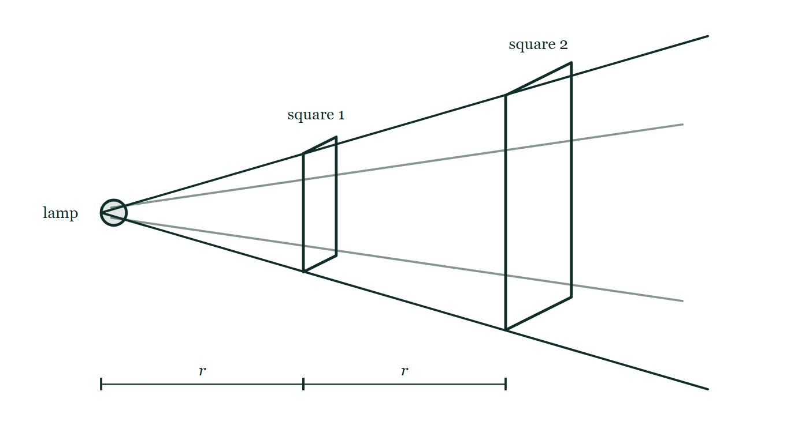
LIGHT · THE NATURE OF LIGHT
GIOPHYSICS LESSON
PREDICT · TAKE THE VOTE
Commit before you are told
Hands up for each option, then click
Square 2 is twice as far from the lamp as square 1, and the same cone of light falls on both. How much bigger is square 2?
A Twice the area of square 1
B Four times the area of square 1
C The same area — the edges of the cone are straight lines
A small lamp at the left with a widening cone of light drawn out from it, and two flat squares standing across the cone — the second at twice the first's distance from the lamp and plainly larger. Equal dimension bars marked r and r run along the bottom from lamp to first square and from first square to second. Neither square carries an area.
The live version of this figure — click here
Light — The Nature of Light. Built by GioPhysics from the lesson's own copy; nothing on these slides is re-authored.
21 / 31
Notes:
[Phase] Build the model: The formulae, one at a time, in plain English (minutes 13–22 of 45)
[Predict] Square 2 is twice as far from the lamp as square 1, and the same cone of light falls on both. How much bigger is square 2?
[Options] A Twice the area of square 1 B Four times the area of square 1 C The same area — the edges of the cone are straight lines
[Figure] A small lamp at the left with a widening cone of light drawn out from it, and two flat squares standing across the cone — the second at twice the first's distance from the lamp and plainly larger. Equal dimension bars marked r and r run along the bottom from lamp to first square and from first square to second. Neither square carries an area.

Slide 22
LIGHT · THE NATURE OF LIGHT
GIOPHYSICS LESSON
PREDICT · THE OUTCOME
What actually happens
Ask the room who changed their mind, and why
B Four times the area of square 1
WHY
The cone widens in two directions at once. Follow the drawing's straight edges out to double the distance and the patch is twice as tall *and* twice as wide, so its area is 2 × 2 = 4 times as big. The same light now has to cover four times the area, so each square metre of it gets a quarter as much — and that is where the square in the inverse square law comes from. It is geometry, not anything happening to the light on the way.
Light — The Nature of Light. Built by GioPhysics from the lesson's own copy; nothing on these slides is re-authored.
22 / 31
Notes:
[Phase] Build the model: The formulae, one at a time, in plain English (minutes 13–22 of 45)
[Answer] B — Four times the area of square 1. The cone widens in two directions at once. Follow the drawing's straight edges out to double the distance and the patch is twice as tall *and* twice as wide, so its area is 2 × 2 = 4 times as big. The same light now has to cover four times the area, so each square metre of it gets a quarter as much — and that is where the square in the inverse square law comes from. It is geometry, not anything happening to the light on the way.

Slide 23
LIGHT · THE NATURE OF LIGHT
GIOPHYSICS LESSON
QUICK CHECK
Decide before the answer goes up
Check and misconception — The quick check and the trap
Moving three times farther from a small lamp changes its brightness by what factor?
A
1/3
B
1/9
C
1/6
A small lamp at the left with a widening cone of light drawn out from it, and two flat squares standing across the cone — the second at twice the first's distance from the lamp and plainly larger. Equal dimension bars marked r and r run along the bottom from lamp to first square and from first square to second. Neither square carries an area.
The live version of this figure — click here
Light — The Nature of Light. Built by GioPhysics from the lesson's own copy; nothing on these slides is re-authored.
23 / 31
Notes:
[Phase] Check and misconception: The quick check and the trap (minutes 35–41 of 45)
[Question] Moving three times farther from a small lamp changes its brightness by what factor?
[Figure] A small lamp at the left with a widening cone of light drawn out from it, and two flat squares standing across the cone — the second at twice the first's distance from the lamp and plainly larger. Equal dimension bars marked r and r run along the bottom from lamp to first square and from first square to second. Neither square carries an area.
[Options] A 1/3 B 1/9 C 1/6

Slide 24
LIGHT · THE NATURE OF LIGHT
GIOPHYSICS LESSON
QUICK CHECK · THE ANSWER
The answer, and why
Check and misconception — The quick check and the trap
B 1/9
HOW TO GET THERE
Intensity follows the inverse square law: 3× the distance spreads the light over 9× the area.
WHY THE OTHERS TEMPT
A 1/3 is the answer if brightness spreads along a line. It does not — it spreads over a surface, and the surface grows in two directions at once. Three times the distance gives a patch three times taller and three times wider, so nine times the area.
B Correct. Nine times the area to cover, so a ninth of the intensity: I ∝ 1/r².
C 1/6 is 3 × 2 — the tripling doubled, which is what "squared" turns into if it is read as "twice as much". Squaring 3 gives 9, not 6; the giveaway is that 1/6 would also be the answer for some other distance, and the law has to give a different factor for every one.
Light — The Nature of Light. Built by GioPhysics from the lesson's own copy; nothing on these slides is re-authored.
24 / 31
Notes:
[Phase] Check and misconception: The quick check and the trap (minutes 35–41 of 45)
[Question] Moving three times farther from a small lamp changes its brightness by what factor?
[Option by option] A: 1/3 is the answer if brightness spreads along a line. It does not — it spreads over a surface, and the surface grows in two directions at once. Three times the distance gives a patch three times taller and three times wider, so nine times the area. B: Correct. Nine times the area to cover, so a ninth of the intensity: I ∝ 1/r². C: 1/6 is 3 × 2 — the tripling doubled, which is what "squared" turns into if it is read as "twice as much". Squaring 3 gives 9, not 6; the giveaway is that 1/6 would also be the answer for some other distance, and the law has to give a different factor for every one.
[Answer] B — 1/9
[Why] Intensity follows the inverse square law: 3× the distance spreads the light over 9× the area.
[Reveal] One click for the answer, then one for the reason.

Slide 25
LIGHT · THE NATURE OF LIGHT
GIOPHYSICS LESSON
EXTENSION 1 OF 2 · HARD
The question
Hard
Worked examples — I do, we do — one step revealed at a time
A lamp delivers 2.0 W/m² of light intensity at 3.0 m. At what distance is the intensity 0.50 W/m², and what is it at 1.5 m?
Light — The Nature of Light. Built by GioPhysics from the lesson's own copy; nothing on these slides is re-authored.
25 / 31
Notes:
[Phase] Worked examples: I do, we do — one step revealed at a time (minutes 22–35 of 45)
[Question] A lamp delivers 2.0 W/m² of light intensity at 3.0 m. At what distance is the intensity 0.50 W/m², and what is it at 1.5 m?
[Answer] 0.50 W/m² at 6.0 m; 8.0 W/m² at 1.5 m

Slide 26
LIGHT · THE NATURE OF LIGHT
GIOPHYSICS LESSON
EXTENSION 1 OF 2 · HARD · THE WORKING
How to solve it
Hard
Worked examples — I do, we do — one step revealed at a time
A lamp delivers 2.0 W/m² of light intensity at 3.0 m. At what distance is the intensity 0.50 W/m², and what is it at 1.5 m?
1.
I ∝ 1/r²: quartering intensity needs double distance → 6.0 m.
2.
Halving the distance to 1.5 m quadruples the intensity.
3.
I = 8.0 W/m².
Light — The Nature of Light. Built by GioPhysics from the lesson's own copy; nothing on these slides is re-authored.
26 / 31
Notes:
[Phase] Worked examples: I do, we do — one step revealed at a time (minutes 22–35 of 45)
[Reveal] One click per step. The class works each line before the next appears.
[Step 1] I ∝ 1/r²: quartering intensity needs double distance → 6.0 m.
[Step 2] Halving the distance to 1.5 m quadruples the intensity.
[Step 3] I = 8.0 W/m².

Slide 27
LIGHT · THE NATURE OF LIGHT
GIOPHYSICS LESSON
EXTENSION 1 OF 2 · HARD
Answer
Hard
Worked examples — I do, we do — one step revealed at a time
0.50 W/m² at 6.0 m; 8.0 W/m² at 1.5 m
Light — The Nature of Light. Built by GioPhysics from the lesson's own copy; nothing on these slides is re-authored.
27 / 31
Notes:
[Phase] Worked examples: I do, we do — one step revealed at a time (minutes 22–35 of 45)
[Answer] 0.50 W/m² at 6.0 m; 8.0 W/m² at 1.5 m

Slide 28
LIGHT · THE NATURE OF LIGHT
GIOPHYSICS LESSON
EXTENSION 2 OF 2 · CHALLENGING
The question
Challenging
Worked examples — I do, we do — one step revealed at a time
A pinhole camera forms a 5.0 cm image of a 10 m tall tree on a screen 20 cm behind the pinhole. How far away is the tree, and why does shrinking the pinhole sharpen then blur the image?
Light — The Nature of Light. Built by GioPhysics from the lesson's own copy; nothing on these slides is re-authored.
28 / 31
Notes:
[Phase] Worked examples: I do, we do — one step revealed at a time (minutes 22–35 of 45)
[Question] A pinhole camera forms a 5.0 cm image of a 10 m tall tree on a screen 20 cm behind the pinhole. How far away is the tree, and why does shrinking the pinhole sharpen then blur the image?
[Answer] 40 m; geometry sharpens, diffraction eventually blurs

Slide 29
LIGHT · THE NATURE OF LIGHT
GIOPHYSICS LESSON
EXTENSION 2 OF 2 · CHALLENGING · THE WORKING
How to solve it
Challenging
Worked examples — I do, we do — one step revealed at a time
A pinhole camera forms a 5.0 cm image of a 10 m tall tree on a screen 20 cm behind the pinhole. How far away is the tree, and why does shrinking the pinhole sharpen then blur the image?
1.
Similar triangles: d(tree)/h(tree) = d(screen)/h(image) → d = 10 × 0.20 ÷ 0.050.
2.
d = 40 m.
3.
A smaller hole narrows each ray bundle (sharper) until the hole nears the wavelength scale — then diffraction spreads the light and blurs it again.
Light — The Nature of Light. Built by GioPhysics from the lesson's own copy; nothing on these slides is re-authored.
29 / 31
Notes:
[Phase] Worked examples: I do, we do — one step revealed at a time (minutes 22–35 of 45)
[Reveal] One click per step. The class works each line before the next appears.
[Step 1] Similar triangles: d(tree)/h(tree) = d(screen)/h(image) → d = 10 × 0.20 ÷ 0.050.
[Step 2] d = 40 m.
[Step 3] A smaller hole narrows each ray bundle (sharper) until the hole nears the wavelength scale — then diffraction spreads the light and blurs it again.

Slide 30
LIGHT · THE NATURE OF LIGHT
GIOPHYSICS LESSON
EXTENSION 2 OF 2 · CHALLENGING
Answer
Challenging
Worked examples — I do, we do — one step revealed at a time
40 m; geometry sharpens, diffraction eventually blurs
Light — The Nature of Light. Built by GioPhysics from the lesson's own copy; nothing on these slides is re-authored.
30 / 31
Notes:
[Phase] Worked examples: I do, we do — one step revealed at a time (minutes 22–35 of 45)
[Answer] 40 m; geometry sharpens, diffraction eventually blurs

Slide 31
LIGHT · THE NATURE OF LIGHT
GIOPHYSICS LESSON
LIGHT
Where to go next
Plenary — What to take away, what to practise next
Next
16.2 Reflection
https://giophysics.com/chapter-25/reflection/
Lesson
This lesson on giophysics.com
https://giophysics.com/chapter-25/nature-of-light/
Live
The live, interactive version of these slides
https://giophysics.com/chapter-25/presentation/?lesson=nature
Chapter
All Light lessons
https://giophysics.com/chapter-25/
PDF
Download the lesson PDF
https://giophysics.com/downloads/25-1-nature-of-light.pdf
Light — The Nature of Light. Built by GioPhysics from the lesson's own copy; nothing on these slides is re-authored.
31 / 31
Notes:
[Phase] Plenary: What to take away, what to practise next (minutes 41–45 of 45)
[Interactive] The graphs and the circuit topology on these slides are frozen. The live version at https://giophysics.com/chapter-25/presentation/?lesson=nature moves them.

