Slide 1
LIGHT · REFLECTION
GIOPHYSICS LESSON
16 · Light
Angles measured from the normal
Reflection
Light striking a smooth surface bounces off at exactly the angle it arrived — measured from the normal. That single law builds every mirror image.
POSITION
Lesson 2 of 6 in Light
PLAN
16 slides in the 45-minute core run, about 44.5 minutes of it
LESSON PAGE
https://giophysics.com/chapter-25/reflection/
Built by GioPhysics from the lesson's own page. Every word on these slides is the lesson's; nothing here is re-authored. Teaching material, not an awarding body's document.
Light — Reflection. Built by GioPhysics from the lesson's own copy; nothing on these slides is re-authored.
1 / 31
Notes:
[Lesson] Light — Reflection. Lesson 2 of 6.
[Intro] Light striking a smooth surface bounces off at exactly the angle it arrived — measured from the normal. That single law builds every mirror image.
[Source] https://giophysics.com/chapter-25/reflection/
[Disclaimer] Built by GioPhysics from the lesson's own page. Every word on these slides is the lesson's; nothing here is re-authored. Teaching material, not an awarding body's document.

Slide 2
LIGHT · REFLECTION
GIOPHYSICS LESSON
WHAT THIS NEEDS
What you already know
Starter — Recall what this lesson stands on
Recall
The ray model
https://giophysics.com/chapter-25/nature-of-light/
Light — Reflection. Built by GioPhysics from the lesson's own copy; nothing on these slides is re-authored.
2 / 31
Notes:
[Phase] Starter: Recall what this lesson stands on (minutes 0–5 of 45)
[Starter] Recall: The ray model

Slide 3
LIGHT · REFLECTION
GIOPHYSICS LESSON
THINK FIRST
You can see yourself from the waist up in the bathroom mirror. Does stepping back show you more of yourself?
Take answers before you click — the point is the commitment
The mirror is screwed to the wall and cannot be moved. Stepping back certainly makes your reflection look smaller, so there ought to be room in the frame for more of you.
THE ANSWER
No — not a millimetre more. A mirror shows you exactly half your height from any distance: step back and your image steps back too, and the two changes cancel exactly. A 1.80 m person needs a mirror 0.90 m tall, hung with its top level with the point midway between eyes and crown, and no more glass helps.
Light — Reflection. Built by GioPhysics from the lesson's own copy; nothing on these slides is re-authored.
3 / 31
Notes:
[Phase] Starter: Recall what this lesson stands on (minutes 0–5 of 45)
[Hook] You can see yourself from the waist up in the bathroom mirror. Does stepping back show you more of yourself? The mirror is screwed to the wall and cannot be moved. Stepping back certainly makes your reflection look smaller, so there ought to be room in the frame for more of you.
[Answer] No — not a millimetre more. A mirror shows you exactly half your height from any distance: step back and your image steps back too, and the two changes cancel exactly. A 1.80 m person needs a mirror 0.90 m tall, hung with its top level with the point midway between eyes and crown, and no more glass helps.

Slide 4
LIGHT · REFLECTION
GIOPHYSICS LESSON
EXPLAINED SIMPLY
In one sentence
Introduce the idea — The big idea and the definition
The angle of incidence equals the angle of reflection, both measured from the normal to the surface.
Light — Reflection. Built by GioPhysics from the lesson's own copy; nothing on these slides is re-authored.
4 / 31
Notes:
[Phase] Introduce the idea: The big idea and the definition (minutes 5–13 of 45)
[Definition] The angle of incidence equals the angle of reflection, both measured from the normal to the surface.

Slide 5
LIGHT · REFLECTION
GIOPHYSICS LESSON
EXPLAINED SIMPLY
What that looks like
Introduce the idea — The big idea and the definition
FOR EXAMPLE
A ray hitting a mirror at 30° from the normal leaves at 30° on the other side of the normal.
Light — Reflection. Built by GioPhysics from the lesson's own copy; nothing on these slides is re-authored.
5 / 31
Notes:
[Phase] Introduce the idea: The big idea and the definition (minutes 5–13 of 45)
[Worked illustration] A ray hitting a mirror at 30° from the normal leaves at 30° on the other side of the normal.

Slide 6
LIGHT · REFLECTION
GIOPHYSICS LESSON
THE BIG IDEA
Angles measured from the normal
Introduce the idea — The big idea and the definition
The law of reflection — angle of incidence equals angle of reflection, both measured from the normal — holds at every point of any surface. A plane mirror forms a virtual image as far behind the mirror as the object is in front, upright and laterally inverted.
Light — Reflection. Built by GioPhysics from the lesson's own copy; nothing on these slides is re-authored.
6 / 31
Notes:
[Phase] Introduce the idea: The big idea and the definition (minutes 5–13 of 45)
[Big idea] The law of reflection — angle of incidence equals angle of reflection, both measured from the normal — holds at every point of any surface. A plane mirror forms a virtual image as far behind the mirror as the object is in front, upright and laterally inverted.

Slide 7
LIGHT · REFLECTION
GIOPHYSICS LESSON
THE PHYSICS · 1 OF 3
Specular vs diffuse
Build the model — The formulae, one at a time, in plain English
Smooth surfaces reflect parallel rays as parallel — you see images. Rough surfaces scatter rays every way — you see the surface, not a reflection.
Light — Reflection. Built by GioPhysics from the lesson's own copy; nothing on these slides is re-authored.
7 / 31
Notes:
[Phase] Build the model: The formulae, one at a time, in plain English (minutes 13–22 of 45)
[Section] Smooth surfaces reflect parallel rays as parallel — you see images. Rough surfaces scatter rays every way — you see the surface, not a reflection.

Slide 8
LIGHT · REFLECTION
GIOPHYSICS LESSON
THE PHYSICS · 2 OF 3
Locating the image
Build the model — The formulae, one at a time, in plain English
Trace two reflected rays back behind the mirror; they meet at the image point. No light actually passes through it — the image is virtual.
Light — Reflection. Built by GioPhysics from the lesson's own copy; nothing on these slides is re-authored.
8 / 31
Notes:
[Phase] Build the model: The formulae, one at a time, in plain English (minutes 13–22 of 45)
[Section] Trace two reflected rays back behind the mirror; they meet at the image point. No light actually passes through it — the image is virtual.

Slide 9
LIGHT · REFLECTION
GIOPHYSICS LESSON
THE PHYSICS · 3 OF 3
Lateral inversion
Build the model — The formulae, one at a time, in plain English
The image swaps left and right (strictly: front and back), which is why ambulance lettering is mirror-written.
Light — Reflection. Built by GioPhysics from the lesson's own copy; nothing on these slides is re-authored.
9 / 31
Notes:
[Phase] Build the model: The formulae, one at a time, in plain English (minutes 13–22 of 45)
[Section] The image swaps left and right (strictly: front and back), which is why ambulance lettering is mirror-written.

Slide 10
LIGHT · REFLECTION
GIOPHYSICS LESSON
FORMULA 1 OF 3
Law of reflection
Build the model — The formulae, one at a time, in plain English
θᵢ = θᵣ
Angles from the normal, not the surface
IN PLAIN ENGLISH
Whatever angle the ray arrives at, it leaves at the same angle on the other side of the perpendicular.
Light — Reflection. Built by GioPhysics from the lesson's own copy; nothing on these slides is re-authored.
10 / 31
Notes:
[Phase] Build the model: The formulae, one at a time, in plain English (minutes 13–22 of 45)
[Formula] Law of reflection: θᵢ = θᵣ
[In plain English] Whatever angle the ray arrives at, it leaves at the same angle on the other side of the perpendicular.
[Note] Angles from the normal, not the surface

Slide 11
LIGHT · REFLECTION
GIOPHYSICS LESSON
FORMULA 2 OF 3
Plane mirror image
Build the model — The formulae, one at a time, in plain English
image distance = object distance
Virtual, upright, same size
IN PLAIN ENGLISH
Your reflection stands as far behind the glass as you stand in front of it — the rays only appear to come from there.
Light — Reflection. Built by GioPhysics from the lesson's own copy; nothing on these slides is re-authored.
11 / 31
Notes:
[Phase] Build the model: The formulae, one at a time, in plain English (minutes 13–22 of 45)
[Formula] Plane mirror image: image distance = object distance
[In plain English] Your reflection stands as far behind the glass as you stand in front of it — the rays only appear to come from there.
[Note] Virtual, upright, same size

Slide 12
LIGHT · REFLECTION
GIOPHYSICS LESSON
FORMULA 3 OF 3
Mirror rotation
Build the model — The formulae, one at a time, in plain English
ray turns 2 × mirror turn
Useful in optical instruments
IN PLAIN ENGLISH
Tilt a mirror by 10° and the reflected beam swings by 20° — both incidence and reflection angles change.
Light — Reflection. Built by GioPhysics from the lesson's own copy; nothing on these slides is re-authored.
12 / 31
Notes:
[Phase] Build the model: The formulae, one at a time, in plain English (minutes 13–22 of 45)
[Formula] Mirror rotation: ray turns 2 × mirror turn
[In plain English] Tilt a mirror by 10° and the reflected beam swings by 20° — both incidence and reflection angles change.
[Note] Useful in optical instruments

Slide 13
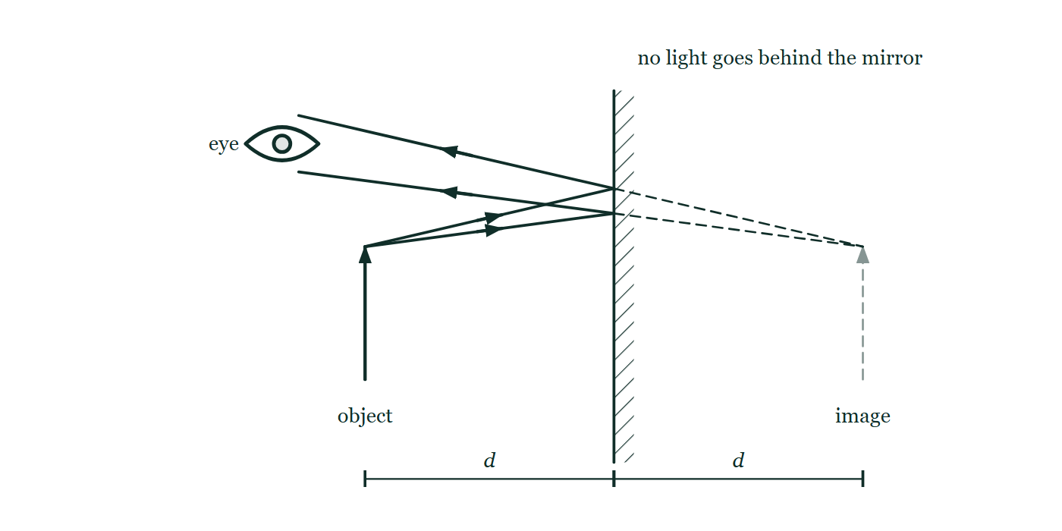
LIGHT · REFLECTION
GIOPHYSICS LESSON
THE PICTURE
Where the image really is
Drawn for this lesson
An upright object arrow in front of a vertical plane mirror, two rays leaving its tip, reflecting off the mirror and running away to an eye at the upper left. Both reflected rays are extended backwards as dashed lines to meet at a faint dashed image arrow behind the glass, and equal distances d are dimensioned from object to mirror and from mirror to image.
The live version of this figure — click here
Light — Reflection. Built by GioPhysics from the lesson's own copy; nothing on these slides is re-authored.
13 / 31
Notes:
[Phase] Build the model: The formulae, one at a time, in plain English (minutes 13–22 of 45)
[Figure] An upright object arrow in front of a vertical plane mirror, two rays leaving its tip, reflecting off the mirror and running away to an eye at the upper left. Both reflected rays are extended backwards as dashed lines to meet at a faint dashed image arrow behind the glass, and equal distances d are dimensioned from object to mirror and from mirror to image.

Slide 14
LIGHT · REFLECTION
GIOPHYSICS LESSON
WATCH OUT
The common trap
Check and misconception — The quick check and the trap
The angles in the law of reflection are measured from the normal, not from the mirror surface. A ray 'hitting at 30°' usually means 30° from the normal — check which angle a problem gives.
Light — Reflection. Built by GioPhysics from the lesson's own copy; nothing on these slides is re-authored.
14 / 31
Notes:
[Phase] Check and misconception: The quick check and the trap (minutes 35–41 of 45)
[Misconception] The angles in the law of reflection are measured from the normal, not from the mirror surface. A ray 'hitting at 30°' usually means 30° from the normal — check which angle a problem gives.

Slide 15
LIGHT · REFLECTION
GIOPHYSICS LESSON
WORKED EXAMPLE 1 OF 2 · EASY
The question
Easy
Worked examples — I do, we do — one step revealed at a time
A ray hits a plane mirror at 40° from the normal. Find the angle between the incident and reflected rays.
Light — Reflection. Built by GioPhysics from the lesson's own copy; nothing on these slides is re-authored.
15 / 31
Notes:
[Phase] Worked examples: I do, we do — one step revealed at a time (minutes 22–35 of 45)
[Question] A ray hits a plane mirror at 40° from the normal. Find the angle between the incident and reflected rays.
[Answer] 80°

Slide 16
LIGHT · REFLECTION
GIOPHYSICS LESSON
WORKED EXAMPLE 1 OF 2 · EASY · THE WORKING
How to solve it
Easy
Worked examples — I do, we do — one step revealed at a time
A ray hits a plane mirror at 40° from the normal. Find the angle between the incident and reflected rays.
1.
Reflection at 40° on the other side of the normal.
2.
Angle between rays = 40 + 40 = 80°.
Light — Reflection. Built by GioPhysics from the lesson's own copy; nothing on these slides is re-authored.
16 / 31
Notes:
[Phase] Worked examples: I do, we do — one step revealed at a time (minutes 22–35 of 45)
[Reveal] One click per step. The class works each line before the next appears.
[Step 1] Reflection at 40° on the other side of the normal.
[Step 2] Angle between rays = 40 + 40 = 80°.

Slide 17
LIGHT · REFLECTION
GIOPHYSICS LESSON
WORKED EXAMPLE 1 OF 2 · EASY
Answer
Easy
Worked examples — I do, we do — one step revealed at a time
80°
Light — Reflection. Built by GioPhysics from the lesson's own copy; nothing on these slides is re-authored.
17 / 31
Notes:
[Phase] Worked examples: I do, we do — one step revealed at a time (minutes 22–35 of 45)
[Answer] 80°

Slide 18
LIGHT · REFLECTION
GIOPHYSICS LESSON
WORKED EXAMPLE 2 OF 2 · MEDIUM
The question
Medium
Worked examples — I do, we do — one step revealed at a time
You stand 1.5 m in front of a plane mirror. How far are you from your image, and what happens when you step 0.5 m closer?
Light — Reflection. Built by GioPhysics from the lesson's own copy; nothing on these slides is re-authored.
18 / 31
Notes:
[Phase] Worked examples: I do, we do — one step revealed at a time (minutes 22–35 of 45)
[Question] You stand 1.5 m in front of a plane mirror. How far are you from your image, and what happens when you step 0.5 m closer?
[Answer] 3.0 m, then 2.0 m

Slide 19
LIGHT · REFLECTION
GIOPHYSICS LESSON
WORKED EXAMPLE 2 OF 2 · MEDIUM · THE WORKING
How to solve it
Medium
Worked examples — I do, we do — one step revealed at a time
You stand 1.5 m in front of a plane mirror. How far are you from your image, and what happens when you step 0.5 m closer?
1.
The image is 1.5 m behind the mirror, so you are 3.0 m from it.
2.
Stepping to 1.0 m puts the image 1.0 m behind.
3.
New separation: 2.0 m — it closes at twice your walking speed.
Light — Reflection. Built by GioPhysics from the lesson's own copy; nothing on these slides is re-authored.
19 / 31
Notes:
[Phase] Worked examples: I do, we do — one step revealed at a time (minutes 22–35 of 45)
[Reveal] One click per step. The class works each line before the next appears.
[Step 1] The image is 1.5 m behind the mirror, so you are 3.0 m from it.
[Step 2] Stepping to 1.0 m puts the image 1.0 m behind.
[Step 3] New separation: 2.0 m — it closes at twice your walking speed.

Slide 20
LIGHT · REFLECTION
GIOPHYSICS LESSON
WORKED EXAMPLE 2 OF 2 · MEDIUM
Answer
Medium
Worked examples — I do, we do — one step revealed at a time
3.0 m, then 2.0 m
Light — Reflection. Built by GioPhysics from the lesson's own copy; nothing on these slides is re-authored.
20 / 31
Notes:
[Phase] Worked examples: I do, we do — one step revealed at a time (minutes 22–35 of 45)
[Answer] 3.0 m, then 2.0 m

Slide 21
LIGHT · REFLECTION
GIOPHYSICS LESSON
PREDICT · TAKE THE VOTE
Commit before you are told
Hands up for each option, then click
You are standing where the object arrow is, 1.5 m in front of the mirror. You step 0.5 m closer. What happens to the distance between you and your image?
A It closes by 0.5 m, from 3.0 m to 2.5 m
B It closes by 1.0 m, from 3.0 m to 2.0 m
C It does not change — the image is on the mirror, and the mirror has not moved
An upright object arrow in front of a vertical plane mirror, two rays leaving its tip, reflecting off the mirror and running away to an eye at the upper left. Both reflected rays are extended backwards as dashed lines to meet at a faint dashed image arrow behind the glass, and equal distances d are dimensioned from object to mirror and from mirror to image.
The live version of this figure — click here
Light — Reflection. Built by GioPhysics from the lesson's own copy; nothing on these slides is re-authored.
21 / 31
Notes:
[Phase] Build the model: The formulae, one at a time, in plain English (minutes 13–22 of 45)
[Predict] You are standing where the object arrow is, 1.5 m in front of the mirror. You step 0.5 m closer. What happens to the distance between you and your image?
[Options] A It closes by 0.5 m, from 3.0 m to 2.5 m B It closes by 1.0 m, from 3.0 m to 2.0 m C It does not change — the image is on the mirror, and the mirror has not moved
[Figure] An upright object arrow in front of a vertical plane mirror, two rays leaving its tip, reflecting off the mirror and running away to an eye at the upper left. Both reflected rays are extended backwards as dashed lines to meet at a faint dashed image arrow behind the glass, and equal distances d are dimensioned from object to mirror and from mirror to image.

Slide 22
LIGHT · REFLECTION
GIOPHYSICS LESSON
PREDICT · THE OUTCOME
What actually happens
Ask the room who changed their mind, and why
B It closes by 1.0 m, from 3.0 m to 2.0 m
WHY
The two lengths marked d in the drawing are always equal: whatever the object does on its side, the image does the mirror of it on the other. Move in 0.5 m and both d's shrink by 0.5 m, so the gap goes 1.5 + 1.5 = 3.0 m down to 1.0 + 1.0 = 2.0 m. The image is not painted on the glass — the dashed lines meet well behind it, which is why your eyes have to focus past the mirror to see your reflection sharply, and why a camera focused on the frame finds your face blurred.
Light — Reflection. Built by GioPhysics from the lesson's own copy; nothing on these slides is re-authored.
22 / 31
Notes:
[Phase] Build the model: The formulae, one at a time, in plain English (minutes 13–22 of 45)
[Answer] B — It closes by 1.0 m, from 3.0 m to 2.0 m. The two lengths marked d in the drawing are always equal: whatever the object does on its side, the image does the mirror of it on the other. Move in 0.5 m and both d's shrink by 0.5 m, so the gap goes 1.5 + 1.5 = 3.0 m down to 1.0 + 1.0 = 2.0 m. The image is not painted on the glass — the dashed lines meet well behind it, which is why your eyes have to focus past the mirror to see your reflection sharply, and why a camera focused on the frame finds your face blurred.

Slide 23
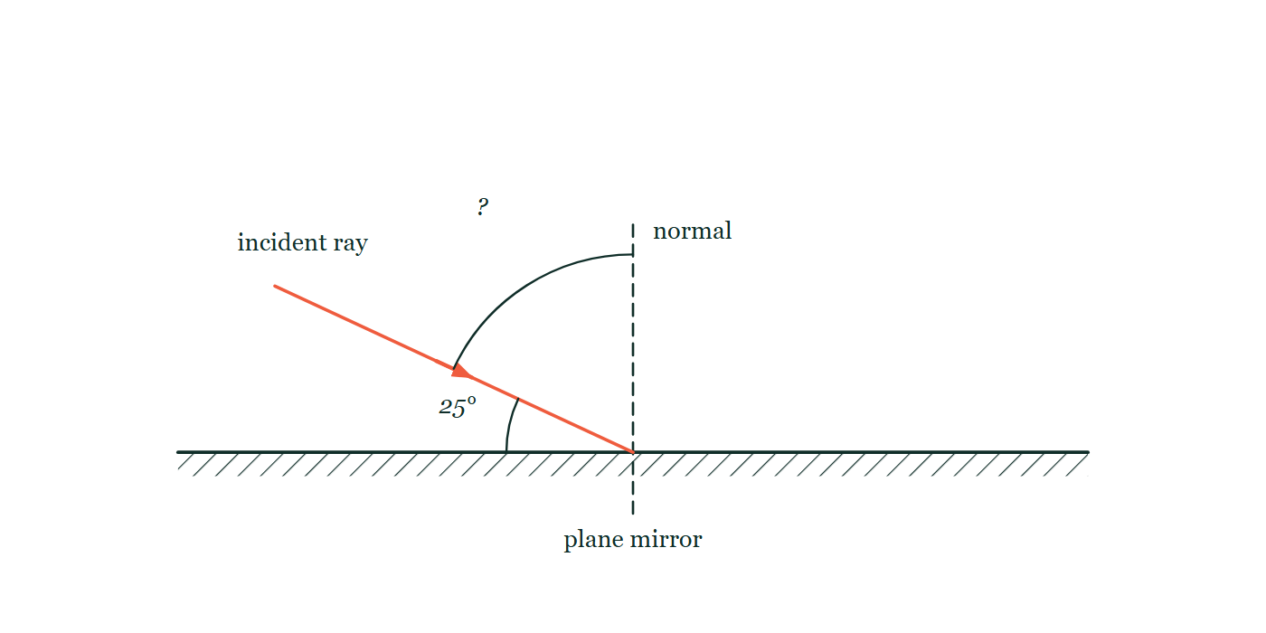
LIGHT · REFLECTION
GIOPHYSICS LESSON
QUICK CHECK
Decide before the answer goes up
Check and misconception — The quick check and the trap
A ray strikes a plane mirror at 25° to the mirror's surface. What is the angle of reflection (from the normal)?
A
25°
B
65°
C
50°
A ray arriving from the upper left onto a plane mirror ruled along the bottom, with a dashed normal standing up from the point where it lands. The angle between the ray and the mirror surface is marked 25°; the angle between the ray and the normal is marked only with a question mark.
The live version of this figure — click here
Light — Reflection. Built by GioPhysics from the lesson's own copy; nothing on these slides is re-authored.
23 / 31
Notes:
[Phase] Check and misconception: The quick check and the trap (minutes 35–41 of 45)
[Question] A ray strikes a plane mirror at 25° to the mirror's surface. What is the angle of reflection (from the normal)?
[Figure] A ray arriving from the upper left onto a plane mirror ruled along the bottom, with a dashed normal standing up from the point where it lands. The angle between the ray and the mirror surface is marked 25°; the angle between the ray and the normal is marked only with a question mark.
[Options] A 25° B 65° C 50°

Slide 24
LIGHT · REFLECTION
GIOPHYSICS LESSON
QUICK CHECK · THE ANSWER
The answer, and why
Check and misconception — The quick check and the trap
B 65°
HOW TO GET THERE
The incidence angle from the normal is 90° − 25° = 65°, so the reflection angle is also 65°.
WHY THE OTHERS TEMPT
A 25° is the number the question hands you, and it is the angle from the mirror SURFACE — the drawing marks it there on purpose. The law of reflection is written for angles from the normal, and the two are complementary, never equal.
B Correct. From the normal the incidence angle is 90° − 25° = 65°, and reflection matches it at 65°.
C 50° is 2 × 25°, which is the angle between the incident and reflected rays if the 25° really had been measured from the normal. It is an angle you can compute in this figure, but not this one: with 65° either side of the normal, the two rays are 130° apart.
Light — Reflection. Built by GioPhysics from the lesson's own copy; nothing on these slides is re-authored.
24 / 31
Notes:
[Phase] Check and misconception: The quick check and the trap (minutes 35–41 of 45)
[Question] A ray strikes a plane mirror at 25° to the mirror's surface. What is the angle of reflection (from the normal)?
[Option by option] A: 25° is the number the question hands you, and it is the angle from the mirror SURFACE — the drawing marks it there on purpose. The law of reflection is written for angles from the normal, and the two are complementary, never equal. B: Correct. From the normal the incidence angle is 90° − 25° = 65°, and reflection matches it at 65°. C: 50° is 2 × 25°, which is the angle between the incident and reflected rays if the 25° really had been measured from the normal. It is an angle you can compute in this figure, but not this one: with 65° either side of the normal, the two rays are 130° apart.
[Answer] B — 65°
[Why] The incidence angle from the normal is 90° − 25° = 65°, so the reflection angle is also 65°.
[Reveal] One click for the answer, then one for the reason.

Slide 25
LIGHT · REFLECTION
GIOPHYSICS LESSON
EXTENSION 1 OF 2 · HARD
The question
Hard
Worked examples — I do, we do — one step revealed at a time
What is the minimum vertical mirror length that lets a 1.80 m tall person see their full height, and does the answer depend on their distance from the mirror?
Light — Reflection. Built by GioPhysics from the lesson's own copy; nothing on these slides is re-authored.
25 / 31
Notes:
[Phase] Worked examples: I do, we do — one step revealed at a time (minutes 22–35 of 45)
[Question] What is the minimum vertical mirror length that lets a 1.80 m tall person see their full height, and does the answer depend on their distance from the mirror?
[Answer] 0.90 m — at any distance

Slide 26
LIGHT · REFLECTION
GIOPHYSICS LESSON
EXTENSION 1 OF 2 · HARD · THE WORKING
How to solve it
Hard
Worked examples — I do, we do — one step revealed at a time
What is the minimum vertical mirror length that lets a 1.80 m tall person see their full height, and does the answer depend on their distance from the mirror?
1.
Each body point's ray reflects at the midpoint between the point and its image height.
2.
The mirror needs to span only half the person: 0.90 m, positioned between eye level and half of foot-to-eye.
3.
The geometry is distance-independent — the half-height rule holds anywhere.
Light — Reflection. Built by GioPhysics from the lesson's own copy; nothing on these slides is re-authored.
26 / 31
Notes:
[Phase] Worked examples: I do, we do — one step revealed at a time (minutes 22–35 of 45)
[Reveal] One click per step. The class works each line before the next appears.
[Step 1] Each body point's ray reflects at the midpoint between the point and its image height.
[Step 2] The mirror needs to span only half the person: 0.90 m, positioned between eye level and half of foot-to-eye.
[Step 3] The geometry is distance-independent — the half-height rule holds anywhere.

Slide 27
LIGHT · REFLECTION
GIOPHYSICS LESSON
EXTENSION 1 OF 2 · HARD
Answer
Hard
Worked examples — I do, we do — one step revealed at a time
0.90 m — at any distance
Light — Reflection. Built by GioPhysics from the lesson's own copy; nothing on these slides is re-authored.
27 / 31
Notes:
[Phase] Worked examples: I do, we do — one step revealed at a time (minutes 22–35 of 45)
[Answer] 0.90 m — at any distance

Slide 28
LIGHT · REFLECTION
GIOPHYSICS LESSON
EXTENSION 2 OF 2 · CHALLENGING
The question
Challenging
Worked examples — I do, we do — one step revealed at a time
Two plane mirrors meet at 60°. How many images does a candle between them form, and why does a 90° corner reflector send light back parallel to its source?
Light — Reflection. Built by GioPhysics from the lesson's own copy; nothing on these slides is re-authored.
28 / 31
Notes:
[Phase] Worked examples: I do, we do — one step revealed at a time (minutes 22–35 of 45)
[Question] Two plane mirrors meet at 60°. How many images does a candle between them form, and why does a 90° corner reflector send light back parallel to its source?
[Answer] 5 images; a right-angle pair returns every ray parallel to its origin

Slide 29
LIGHT · REFLECTION
GIOPHYSICS LESSON
EXTENSION 2 OF 2 · CHALLENGING · THE WORKING
How to solve it
Challenging
Worked examples — I do, we do — one step revealed at a time
Two plane mirrors meet at 60°. How many images does a candle between them form, and why does a 90° corner reflector send light back parallel to its source?
1.
Images: 360°/60° − 1 = 5.
2.
At 90°, two successive reflections reverse both transverse components of the ray direction.
3.
The exit ray is anti-parallel to the entrance ray — the corner-cube principle used on the Moon's retroreflectors.
Light — Reflection. Built by GioPhysics from the lesson's own copy; nothing on these slides is re-authored.
29 / 31
Notes:
[Phase] Worked examples: I do, we do — one step revealed at a time (minutes 22–35 of 45)
[Reveal] One click per step. The class works each line before the next appears.
[Step 1] Images: 360°/60° − 1 = 5.
[Step 2] At 90°, two successive reflections reverse both transverse components of the ray direction.
[Step 3] The exit ray is anti-parallel to the entrance ray — the corner-cube principle used on the Moon's retroreflectors.

Slide 30
LIGHT · REFLECTION
GIOPHYSICS LESSON
EXTENSION 2 OF 2 · CHALLENGING
Answer
Challenging
Worked examples — I do, we do — one step revealed at a time
5 images; a right-angle pair returns every ray parallel to its origin
Light — Reflection. Built by GioPhysics from the lesson's own copy; nothing on these slides is re-authored.
30 / 31
Notes:
[Phase] Worked examples: I do, we do — one step revealed at a time (minutes 22–35 of 45)
[Answer] 5 images; a right-angle pair returns every ray parallel to its origin

Slide 31
LIGHT · REFLECTION
GIOPHYSICS LESSON
LIGHT
Where to go next
Plenary — What to take away, what to practise next
Next
16.3 Refraction & Snell's Law
https://giophysics.com/chapter-25/refraction-snells-law/
Lesson
This lesson on giophysics.com
https://giophysics.com/chapter-25/reflection/
Live
The live, interactive version of these slides
https://giophysics.com/chapter-25/presentation/?lesson=reflection
Chapter
All Light lessons
https://giophysics.com/chapter-25/
PDF
Download the lesson PDF
https://giophysics.com/downloads/25-2-reflection.pdf
Light — Reflection. Built by GioPhysics from the lesson's own copy; nothing on these slides is re-authored.
31 / 31
Notes:
[Phase] Plenary: What to take away, what to practise next (minutes 41–45 of 45)
[Interactive] The graphs and the circuit topology on these slides are frozen. The live version at https://giophysics.com/chapter-25/presentation/?lesson=reflection moves them.

