Slide 1
OPTICS · THIN LENSES
GIOPHYSICS LESSON
17 · Optics
Focusing by refraction
Thin Lenses
A converging lens bends parallel rays to a real focus; a diverging lens spreads them from a virtual one. The thin-lens equation is the same machinery as mirrors — with refraction doing the work.
POSITION
Lesson 2 of 6 in Optics
PLAN
16 slides in the 45-minute core run, about 43.5 minutes of it
LESSON PAGE
https://giophysics.com/chapter-26/thin-lenses/
Built by GioPhysics from the lesson's own page. Every word on these slides is the lesson's; nothing here is re-authored. Teaching material, not an awarding body's document.
Optics — Thin Lenses. Built by GioPhysics from the lesson's own copy; nothing on these slides is re-authored.
1 / 32
Notes:
[Lesson] Optics — Thin Lenses. Lesson 2 of 6.
[Intro] A converging lens bends parallel rays to a real focus; a diverging lens spreads them from a virtual one. The thin-lens equation is the same machinery as mirrors — with refraction doing the work.
[Source] https://giophysics.com/chapter-26/thin-lenses/
[Disclaimer] Built by GioPhysics from the lesson's own page. Every word on these slides is the lesson's; nothing here is re-authored. Teaching material, not an awarding body's document.

Slide 2
OPTICS · THIN LENSES
GIOPHYSICS LESSON
WHAT THIS NEEDS
What you already know
Starter — Recall what this lesson stands on
Recall
Refraction
https://giophysics.com/chapter-25/refraction-snells-law/
Recall
Curved mirrors
https://giophysics.com/chapter-26/curved-mirrors/
Optics — Thin Lenses. Built by GioPhysics from the lesson's own copy; nothing on these slides is re-authored.
2 / 32
Notes:
[Phase] Starter: Recall what this lesson stands on (minutes 0–5 of 45)
[Starter] Recall: Refraction; Curved mirrors

Slide 3
OPTICS · THIN LENSES
GIOPHYSICS LESSON
THINK FIRST
A 50 mm camera lens is focused on a face three metres away. Refocus it on the Moon. How far does the lens have to move?
Take answers before you click — the point is the commitment
Three metres to a quarter of a million miles is about the largest change of subject a camera is ever asked for, and the lens is the only thing that can move.
THE ANSWER
About 0.8 mm. Light from the Moon arrives parallel and comes to a focus at exactly f = 50.0 mm; the face at 3.0 m focuses at 50.8 mm. Everything from three metres out to infinity is crammed into that last millimetre behind the lens — which is why so much of a lens barrel's travel is spent on close-ups and so little on distance.
Optics — Thin Lenses. Built by GioPhysics from the lesson's own copy; nothing on these slides is re-authored.
3 / 32
Notes:
[Phase] Starter: Recall what this lesson stands on (minutes 0–5 of 45)
[Hook] A 50 mm camera lens is focused on a face three metres away. Refocus it on the Moon. How far does the lens have to move? Three metres to a quarter of a million miles is about the largest change of subject a camera is ever asked for, and the lens is the only thing that can move.
[Answer] About 0.8 mm. Light from the Moon arrives parallel and comes to a focus at exactly f = 50.0 mm; the face at 3.0 m focuses at 50.8 mm. Everything from three metres out to infinity is crammed into that last millimetre behind the lens — which is why so much of a lens barrel's travel is spent on close-ups and so little on distance.

Slide 4
OPTICS · THIN LENSES
GIOPHYSICS LESSON
EXPLAINED SIMPLY
In one sentence
Introduce the idea — The big idea and the definition
A thin lens refracts light to converge to, or diverge from, a focal point; the lens equation relates object and image distances to focal length.
Optics — Thin Lenses. Built by GioPhysics from the lesson's own copy; nothing on these slides is re-authored.
4 / 32
Notes:
[Phase] Introduce the idea: The big idea and the definition (minutes 5–13 of 45)
[Definition] A thin lens refracts light to converge to, or diverge from, a focal point; the lens equation relates object and image distances to focal length.

Slide 5
OPTICS · THIN LENSES
GIOPHYSICS LESSON
EXPLAINED SIMPLY
What that looks like
Introduce the idea — The big idea and the definition
FOR EXAMPLE
A camera lens throws a real, inverted, miniature image of the scene onto the sensor.
Optics — Thin Lenses. Built by GioPhysics from the lesson's own copy; nothing on these slides is re-authored.
5 / 32
Notes:
[Phase] Introduce the idea: The big idea and the definition (minutes 5–13 of 45)
[Worked illustration] A camera lens throws a real, inverted, miniature image of the scene onto the sensor.

Slide 6
OPTICS · THIN LENSES
GIOPHYSICS LESSON
THE BIG IDEA
Focusing by refraction
Introduce the idea — The big idea and the definition
Rays refract at both lens surfaces, but a thin lens acts as one plane with a single focal length. 1/f = 1/dₒ + 1/dᵢ locates images exactly as for mirrors: outside the focal length a converging lens projects real inverted images; inside it, it becomes a magnifying glass.
Optics — Thin Lenses. Built by GioPhysics from the lesson's own copy; nothing on these slides is re-authored.
6 / 32
Notes:
[Phase] Introduce the idea: The big idea and the definition (minutes 5–13 of 45)
[Big idea] Rays refract at both lens surfaces, but a thin lens acts as one plane with a single focal length. 1/f = 1/dₒ + 1/dᵢ locates images exactly as for mirrors: outside the focal length a converging lens projects real inverted images; inside it, it becomes a magnifying glass.

Slide 7
OPTICS · THIN LENSES
GIOPHYSICS LESSON
THE PHYSICS · 1 OF 3
Three principal rays
Build the model — The formulae, one at a time, in plain English
Parallel ray refracts through the far focus; central ray passes straight; focal ray exits parallel. Two suffice to find any image.
Optics — Thin Lenses. Built by GioPhysics from the lesson's own copy; nothing on these slides is re-authored.
7 / 32
Notes:
[Phase] Build the model: The formulae, one at a time, in plain English (minutes 13–22 of 45)
[Section] Parallel ray refracts through the far focus; central ray passes straight; focal ray exits parallel. Two suffice to find any image.

Slide 8
OPTICS · THIN LENSES
GIOPHYSICS LESSON
THE PHYSICS · 2 OF 3
Converging cases
Build the model — The formulae, one at a time, in plain English
Beyond 2F: smaller real image (camera). Between 2F and F: larger real image (projector). Inside F: upright virtual magnified image (magnifier).
Optics — Thin Lenses. Built by GioPhysics from the lesson's own copy; nothing on these slides is re-authored.
8 / 32
Notes:
[Phase] Build the model: The formulae, one at a time, in plain English (minutes 13–22 of 45)
[Section] Beyond 2F: smaller real image (camera). Between 2F and F: larger real image (projector). Inside F: upright virtual magnified image (magnifier).

Slide 9
OPTICS · THIN LENSES
GIOPHYSICS LESSON
THE PHYSICS · 3 OF 3
Diverging lenses
Build the model — The formulae, one at a time, in plain English
Always small, upright, virtual images on the object's side — used to correct short sight by weakening incoming light.
Optics — Thin Lenses. Built by GioPhysics from the lesson's own copy; nothing on these slides is re-authored.
9 / 32
Notes:
[Phase] Build the model: The formulae, one at a time, in plain English (minutes 13–22 of 45)
[Section] Always small, upright, virtual images on the object's side — used to correct short sight by weakening incoming light.

Slide 10
OPTICS · THIN LENSES
GIOPHYSICS LESSON
FORMULA 1 OF 3
Thin-lens equation
Build the model — The formulae, one at a time, in plain English
1/f = 1/dₒ + 1/dᵢ
Converging f > 0, diverging f < 0
IN PLAIN ENGLISH
One formula places the image for any object position — with sign conventions carrying which side and which type.
Optics — Thin Lenses. Built by GioPhysics from the lesson's own copy; nothing on these slides is re-authored.
10 / 32
Notes:
[Phase] Build the model: The formulae, one at a time, in plain English (minutes 13–22 of 45)
[Formula] Thin-lens equation: 1/f = 1/dₒ + 1/dᵢ
[In plain English] One formula places the image for any object position — with sign conventions carrying which side and which type.
[Note] Converging f > 0, diverging f < 0

Slide 11
OPTICS · THIN LENSES
GIOPHYSICS LESSON
FORMULA 2 OF 3
Magnification
Build the model — The formulae, one at a time, in plain English
m = −dᵢ/dₒ = hᵢ/hₒ
|m| > 1 enlarges
IN PLAIN ENGLISH
The image-to-object size ratio; negative means inverted, and virtual images (dᵢ < 0) come out upright.
Optics — Thin Lenses. Built by GioPhysics from the lesson's own copy; nothing on these slides is re-authored.
11 / 32
Notes:
[Phase] Build the model: The formulae, one at a time, in plain English (minutes 13–22 of 45)
[Formula] Magnification: m = −dᵢ/dₒ = hᵢ/hₒ
[In plain English] The image-to-object size ratio; negative means inverted, and virtual images (dᵢ < 0) come out upright.
[Note] |m| > 1 enlarges

Slide 12
OPTICS · THIN LENSES
GIOPHYSICS LESSON
FORMULA 3 OF 3
Power of a lens
Build the model — The formulae, one at a time, in plain English
P = 1/f
Dioptres, with f in metres
IN PLAIN ENGLISH
Opticians quote lens strength as 1/f — a +2.0 D prescription is a converging lens of focal length 0.5 m.
Optics — Thin Lenses. Built by GioPhysics from the lesson's own copy; nothing on these slides is re-authored.
12 / 32
Notes:
[Phase] Build the model: The formulae, one at a time, in plain English (minutes 13–22 of 45)
[Formula] Power of a lens: P = 1/f
[In plain English] Opticians quote lens strength as 1/f — a +2.0 D prescription is a converging lens of focal length 0.5 m.
[Note] Dioptres, with f in metres

Slide 13
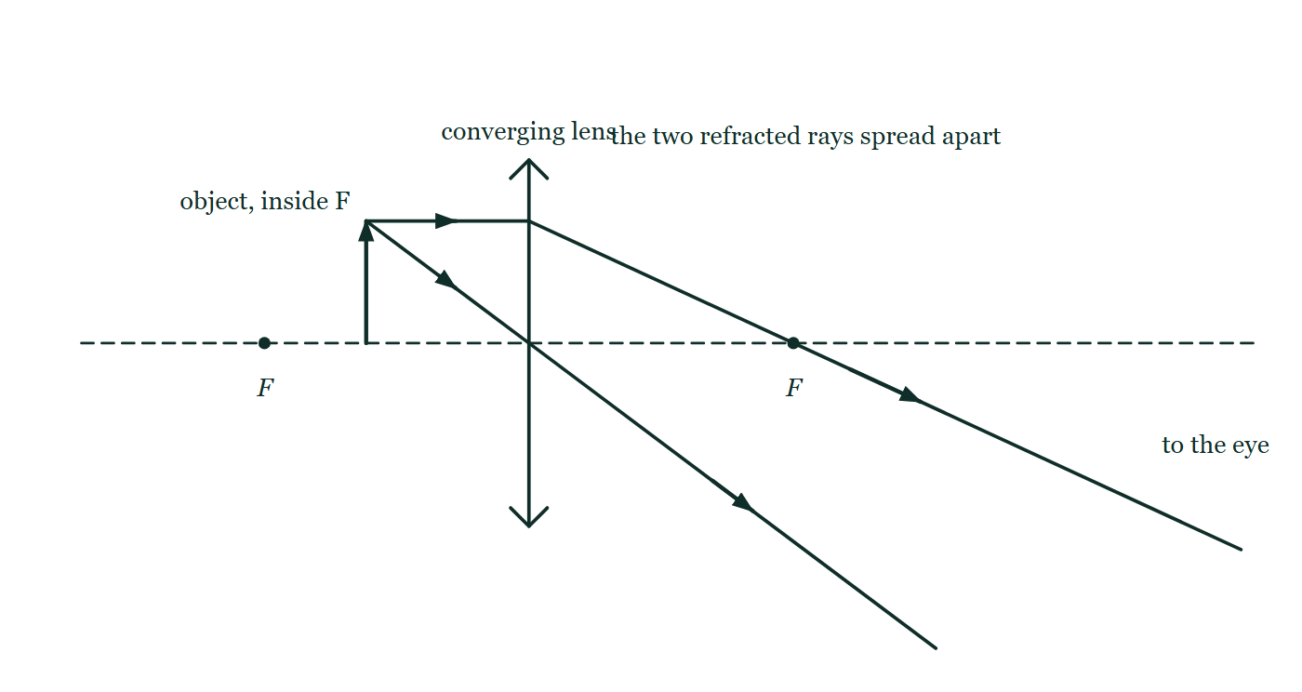
OPTICS · THIN LENSES
GIOPHYSICS LESSON
THE PICTURE
The object moved inside F
Drawn for this lesson
The same converging lens with the object arrow moved closer to the lens than its focal point. The parallel ray is refracted through the far focus and the central ray passes undeviated, and the two leave on paths that spread further apart the further they travel, heading off to the right towards an eye.
The live version of this figure — click here
Optics — Thin Lenses. Built by GioPhysics from the lesson's own copy; nothing on these slides is re-authored.
13 / 32
Notes:
[Phase] Build the model: The formulae, one at a time, in plain English (minutes 13–22 of 45)
[Figure] The same converging lens with the object arrow moved closer to the lens than its focal point. The parallel ray is refracted through the far focus and the central ray passes undeviated, and the two leave on paths that spread further apart the further they travel, heading off to the right towards an eye.

Slide 14
OPTICS · THIN LENSES
GIOPHYSICS LESSON
WATCH OUT
The common trap
Check and misconception — The quick check and the trap
Covering half a lens does not cut the image in half — every part of the lens forms the whole image. The picture just gets dimmer.
Optics — Thin Lenses. Built by GioPhysics from the lesson's own copy; nothing on these slides is re-authored.
14 / 32
Notes:
[Phase] Check and misconception: The quick check and the trap (minutes 35–41 of 45)
[Misconception] Covering half a lens does not cut the image in half — every part of the lens forms the whole image. The picture just gets dimmer.

Slide 15
OPTICS · THIN LENSES
GIOPHYSICS LESSON
WORKED EXAMPLE 1 OF 2 · EASY
The question
Easy
Worked examples — I do, we do — one step revealed at a time
A converging lens has focal length 25 cm. Find its power in dioptres.
Optics — Thin Lenses. Built by GioPhysics from the lesson's own copy; nothing on these slides is re-authored.
15 / 32
Notes:
[Phase] Worked examples: I do, we do — one step revealed at a time (minutes 22–35 of 45)
[Question] A converging lens has focal length 25 cm. Find its power in dioptres.
[Answer] +4.0 D

Slide 16
OPTICS · THIN LENSES
GIOPHYSICS LESSON
WORKED EXAMPLE 1 OF 2 · EASY · THE WORKING
How to solve it
Easy
Worked examples — I do, we do — one step revealed at a time
A converging lens has focal length 25 cm. Find its power in dioptres.
1.
P = 1/f (f in metres) = 1 ÷ 0.25.
2.
P = +4.0 D.
Optics — Thin Lenses. Built by GioPhysics from the lesson's own copy; nothing on these slides is re-authored.
16 / 32
Notes:
[Phase] Worked examples: I do, we do — one step revealed at a time (minutes 22–35 of 45)
[Reveal] One click per step. The class works each line before the next appears.
[Step 1] P = 1/f (f in metres) = 1 ÷ 0.25.
[Step 2] P = +4.0 D.

Slide 17
OPTICS · THIN LENSES
GIOPHYSICS LESSON
WORKED EXAMPLE 1 OF 2 · EASY
Answer
Easy
Worked examples — I do, we do — one step revealed at a time
+4.0 D
Optics — Thin Lenses. Built by GioPhysics from the lesson's own copy; nothing on these slides is re-authored.
17 / 32
Notes:
[Phase] Worked examples: I do, we do — one step revealed at a time (minutes 22–35 of 45)
[Answer] +4.0 D

Slide 18
OPTICS · THIN LENSES
GIOPHYSICS LESSON
WORKED EXAMPLE 2 OF 2 · MEDIUM
The question
Medium
Worked examples — I do, we do — one step revealed at a time
A slide sits 12.5 cm from a converging lens (f = 12 cm). Where must the screen be, and what is the magnification?
Optics — Thin Lenses. Built by GioPhysics from the lesson's own copy; nothing on these slides is re-authored.
18 / 32
Notes:
[Phase] Worked examples: I do, we do — one step revealed at a time (minutes 22–35 of 45)
[Question] A slide sits 12.5 cm from a converging lens (f = 12 cm). Where must the screen be, and what is the magnification?
[Answer] Screen 3.0 m away; m = −24

Slide 19
OPTICS · THIN LENSES
GIOPHYSICS LESSON
WORKED EXAMPLE 2 OF 2 · MEDIUM · THE WORKING
How to solve it
Medium
Worked examples — I do, we do — one step revealed at a time
A slide sits 12.5 cm from a converging lens (f = 12 cm). Where must the screen be, and what is the magnification?
1.
1/dᵢ = 1/12 − 1/12.5 = 0.08333 − 0.08 = 0.00333.
2.
dᵢ = 300 cm = 3.0 m.
3.
m = −300/12.5 = −24 — a large inverted picture, so slides load upside-down.
Optics — Thin Lenses. Built by GioPhysics from the lesson's own copy; nothing on these slides is re-authored.
19 / 32
Notes:
[Phase] Worked examples: I do, we do — one step revealed at a time (minutes 22–35 of 45)
[Reveal] One click per step. The class works each line before the next appears.
[Step 1] 1/dᵢ = 1/12 − 1/12.5 = 0.08333 − 0.08 = 0.00333.
[Step 2] dᵢ = 300 cm = 3.0 m.
[Step 3] m = −300/12.5 = −24 — a large inverted picture, so slides load upside-down.

Slide 20
OPTICS · THIN LENSES
GIOPHYSICS LESSON
WORKED EXAMPLE 2 OF 2 · MEDIUM
Answer
Medium
Worked examples — I do, we do — one step revealed at a time
Screen 3.0 m away; m = −24
Optics — Thin Lenses. Built by GioPhysics from the lesson's own copy; nothing on these slides is re-authored.
20 / 32
Notes:
[Phase] Worked examples: I do, we do — one step revealed at a time (minutes 22–35 of 45)
[Answer] Screen 3.0 m away; m = −24

Slide 21
OPTICS · THIN LENSES
GIOPHYSICS LESSON
SPOT THE MISTAKE
One line here is wrong
The whole working is up — find the bad line before you click
1.
A diverging lens of focal length 20 cm has an object 30 cm in front of it. Find the image distance.
2.
f = 20 cm, dₒ = 30 cm
3.
1/f = 1/dₒ + 1/dᵢ, so 1/dᵢ = 1/f − 1/dₒ
4.
1/dᵢ = 1/20 − 1/30 = 1/60
5.
dᵢ = +60 cm — a real image, 60 cm beyond the lens
LINE 2 IS WRONG
A diverging lens has a NEGATIVE focal length: f = −20 cm. The word "diverging" was in the question and never made it into the numbers, which is the commonest way this equation goes wrong — the algebra afterwards is faultless. The last line is the alarm: a diverging lens cannot form a real image of a real object, ever. Anything that comes out positive has to be wrong before it is even checked.
IT SHOULD SAY
f = −20 cm, dₒ = 30 cm — which makes 1/dᵢ = −1/20 − 1/30 = −5/60 and dᵢ = −12 cm, a virtual image 12 cm out on the same side as the object
Optics — Thin Lenses. Built by GioPhysics from the lesson's own copy; nothing on these slides is re-authored.
21 / 32
Notes:
[Phase] Worked examples: I do, we do — one step revealed at a time (minutes 22–35 of 45)
[Spot the mistake] The working is complete and one line of it is wrong. Let the room hunt: one click names the line, a second shows it done correctly.
[Line 2 is wrong] A diverging lens has a NEGATIVE focal length: f = −20 cm. The word "diverging" was in the question and never made it into the numbers, which is the commonest way this equation goes wrong — the algebra afterwards is faultless. The last line is the alarm: a diverging lens cannot form a real image of a real object, ever. Anything that comes out positive has to be wrong before it is even checked.
[It should say] f = −20 cm, dₒ = 30 cm — which makes 1/dᵢ = −1/20 − 1/30 = −5/60 and dᵢ = −12 cm, a virtual image 12 cm out on the same side as the object

Slide 22
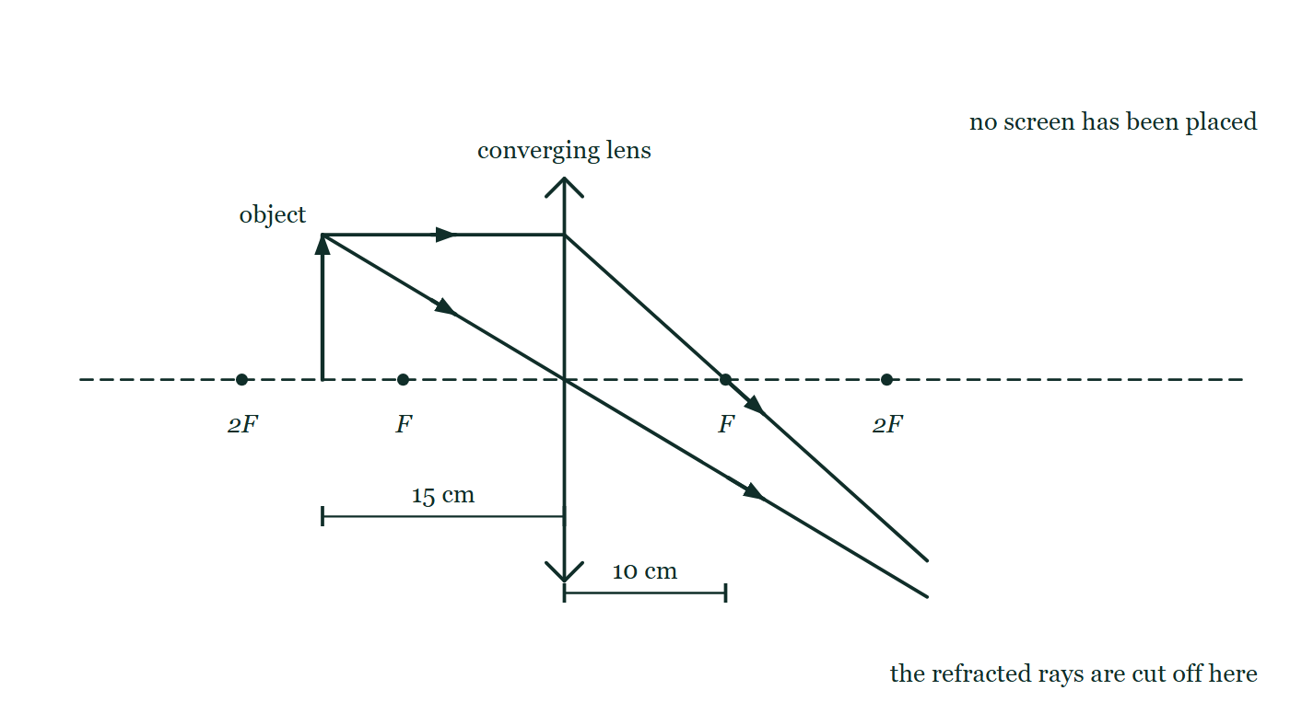
OPTICS · THIN LENSES
GIOPHYSICS LESSON
PREDICT · TAKE THE VOTE
Commit before you are told
Hands up for each option, then click
A card is slid up until it covers the top half of the lens, blocking the parallel ray in the drawing completely. What happens to the image?
A Only the bottom half of the image survives
B The whole image survives, but dimmer
C Nothing changes — the central ray was doing the work anyway
A converging lens of focal length 10 cm on a principal axis with F and 2F marked on both sides, and an upright object arrow standing 15 cm out, between F and 2F. The parallel ray is refracted down through the far focus and the central ray runs straight through the lens centre, and both are cut off short of the point where they would meet. No screen is drawn.
The live version of this figure — click here
Optics — Thin Lenses. Built by GioPhysics from the lesson's own copy; nothing on these slides is re-authored.
22 / 32
Notes:
[Phase] Build the model: The formulae, one at a time, in plain English (minutes 13–22 of 45)
[Predict] A card is slid up until it covers the top half of the lens, blocking the parallel ray in the drawing completely. What happens to the image?
[Options] A Only the bottom half of the image survives B The whole image survives, but dimmer C Nothing changes — the central ray was doing the work anyway
[Figure] A converging lens of focal length 10 cm on a principal axis with F and 2F marked on both sides, and an upright object arrow standing 15 cm out, between F and 2F. The parallel ray is refracted down through the far focus and the central ray runs straight through the lens centre, and both are cut off short of the point where they would meet. No screen is drawn.

Slide 23
OPTICS · THIN LENSES
GIOPHYSICS LESSON
PREDICT · THE OUTCOME
What actually happens
Ask the room who changed their mind, and why
B The whole image survives, but dimmer
WHY
The two rays on the page are a construction, not an inventory. Countless rays leave that arrow's tip, spread across the whole face of the lens, and every one of them is bent so as to arrive at the same point on the other side — that is what a lens is for. Cover half the lens and half of those rays are gone, so half the light arrives and the picture dims; the survivors are still going to the same place, so the picture is still whole. The third answer forgets that blocking glass really does block light: no single ray is carrying the image on its own.
Optics — Thin Lenses. Built by GioPhysics from the lesson's own copy; nothing on these slides is re-authored.
23 / 32
Notes:
[Phase] Build the model: The formulae, one at a time, in plain English (minutes 13–22 of 45)
[Answer] B — The whole image survives, but dimmer. The two rays on the page are a construction, not an inventory. Countless rays leave that arrow's tip, spread across the whole face of the lens, and every one of them is bent so as to arrive at the same point on the other side — that is what a lens is for. Cover half the lens and half of those rays are gone, so half the light arrives and the picture dims; the survivors are still going to the same place, so the picture is still whole. The third answer forgets that blocking glass really does block light: no single ray is carrying the image on its own.

Slide 24
OPTICS · THIN LENSES
GIOPHYSICS LESSON
QUICK CHECK
Decide before the answer goes up
Check and misconception — The quick check and the trap
An object is placed 15 cm from a converging lens of focal length 10 cm. The image is…
A
Real, inverted, magnified
B
Virtual, upright, magnified
C
Real, inverted, smaller
A converging lens of focal length 10 cm on a principal axis with F and 2F marked on both sides, and an upright object arrow standing 15 cm out, between F and 2F. The parallel ray is refracted down through the far focus and the central ray runs straight through the lens centre, and both are cut off short of the point where they would meet. No screen is drawn.
The live version of this figure — click here
Optics — Thin Lenses. Built by GioPhysics from the lesson's own copy; nothing on these slides is re-authored.
24 / 32
Notes:
[Phase] Check and misconception: The quick check and the trap (minutes 35–41 of 45)
[Question] An object is placed 15 cm from a converging lens of focal length 10 cm. The image is…
[Figure] A converging lens of focal length 10 cm on a principal axis with F and 2F marked on both sides, and an upright object arrow standing 15 cm out, between F and 2F. The parallel ray is refracted down through the far focus and the central ray runs straight through the lens centre, and both are cut off short of the point where they would meet. No screen is drawn.
[Options] A Real, inverted, magnified B Virtual, upright, magnified C Real, inverted, smaller

Slide 25
OPTICS · THIN LENSES
GIOPHYSICS LESSON
QUICK CHECK · THE ANSWER
The answer, and why
Check and misconception — The quick check and the trap
A Real, inverted, magnified
HOW TO GET THERE
Between F and 2F: 1/dᵢ = 1/10 − 1/15 gives dᵢ = 30 cm, m = −2 — a projector's arrangement.
WHY THE OTHERS TEMPT
A Correct. The object is between F and 2F, so 1/dᵢ = 1/10 − 1/15 gives dᵢ = 30 cm and m = −2: real, inverted, twice the size. It is the projector's arrangement.
B Virtual, upright and magnified is the magnifying-glass case, and it needs the object INSIDE the focal length. Here 15 cm is outside 10 cm, so the refracted rays converge rather than spread. Check which side of F the object is on before anything else — it decides the answer on its own.
C Real, inverted and smaller is the arrangement beyond 2F, which is 20 cm here — the camera's case. At 15 cm the object is between F and 2F and the image comes out larger, not smaller. The two cases are separated by 2F, and 15 cm falls on the near side of it.
Optics — Thin Lenses. Built by GioPhysics from the lesson's own copy; nothing on these slides is re-authored.
25 / 32
Notes:
[Phase] Check and misconception: The quick check and the trap (minutes 35–41 of 45)
[Question] An object is placed 15 cm from a converging lens of focal length 10 cm. The image is…
[Option by option] A: Correct. The object is between F and 2F, so 1/dᵢ = 1/10 − 1/15 gives dᵢ = 30 cm and m = −2: real, inverted, twice the size. It is the projector's arrangement. B: Virtual, upright and magnified is the magnifying-glass case, and it needs the object INSIDE the focal length. Here 15 cm is outside 10 cm, so the refracted rays converge rather than spread. Check which side of F the object is on before anything else — it decides the answer on its own. C: Real, inverted and smaller is the arrangement beyond 2F, which is 20 cm here — the camera's case. At 15 cm the object is between F and 2F and the image comes out larger, not smaller. The two cases are separated by 2F, and 15 cm falls on the near side of it.
[Answer] A — Real, inverted, magnified
[Why] Between F and 2F: 1/dᵢ = 1/10 − 1/15 gives dᵢ = 30 cm, m = −2 — a projector's arrangement.
[Reveal] One click for the answer, then one for the reason.

Slide 26
OPTICS · THIN LENSES
GIOPHYSICS LESSON
EXTENSION 1 OF 2 · HARD
The question
Hard
Worked examples — I do, we do — one step revealed at a time
A camera lens (f = 50 mm) photographs a person 1.8 m tall standing 3.0 m away. Find the image distance and the image height on the sensor.
Optics — Thin Lenses. Built by GioPhysics from the lesson's own copy; nothing on these slides is re-authored.
26 / 32
Notes:
[Phase] Worked examples: I do, we do — one step revealed at a time (minutes 22–35 of 45)
[Question] A camera lens (f = 50 mm) photographs a person 1.8 m tall standing 3.0 m away. Find the image distance and the image height on the sensor.
[Answer] dᵢ ≈ 50.8 mm; image ≈ 3.0 cm, inverted

Slide 27
OPTICS · THIN LENSES
GIOPHYSICS LESSON
EXTENSION 1 OF 2 · HARD · THE WORKING
How to solve it
Hard
Worked examples — I do, we do — one step revealed at a time
A camera lens (f = 50 mm) photographs a person 1.8 m tall standing 3.0 m away. Find the image distance and the image height on the sensor.
1.
1/dᵢ = 1/0.050 − 1/3.0 = 20 − 0.333 → dᵢ ≈ 50.8 mm.
2.
m = −50.8/3000 ≈ −0.0169.
3.
Image ≈ 1.8 × 0.0169 ≈ 3.1 cm, inverted — filling a full-frame sensor's diagonal.
Optics — Thin Lenses. Built by GioPhysics from the lesson's own copy; nothing on these slides is re-authored.
27 / 32
Notes:
[Phase] Worked examples: I do, we do — one step revealed at a time (minutes 22–35 of 45)
[Reveal] One click per step. The class works each line before the next appears.
[Step 1] 1/dᵢ = 1/0.050 − 1/3.0 = 20 − 0.333 → dᵢ ≈ 50.8 mm.
[Step 2] m = −50.8/3000 ≈ −0.0169.
[Step 3] Image ≈ 1.8 × 0.0169 ≈ 3.1 cm, inverted — filling a full-frame sensor's diagonal.

Slide 28
OPTICS · THIN LENSES
GIOPHYSICS LESSON
EXTENSION 1 OF 2 · HARD
Answer
Hard
Worked examples — I do, we do — one step revealed at a time
dᵢ ≈ 50.8 mm; image ≈ 3.0 cm, inverted
Optics — Thin Lenses. Built by GioPhysics from the lesson's own copy; nothing on these slides is re-authored.
28 / 32
Notes:
[Phase] Worked examples: I do, we do — one step revealed at a time (minutes 22–35 of 45)
[Answer] dᵢ ≈ 50.8 mm; image ≈ 3.0 cm, inverted

Slide 29
OPTICS · THIN LENSES
GIOPHYSICS LESSON
EXTENSION 2 OF 2 · CHALLENGING
The question
Challenging
Worked examples — I do, we do — one step revealed at a time
Two thin lenses, f₁ = +20 cm and f₂ = −50 cm, are placed in contact. Find the combination's focal length and power, and state the general rule.
Optics — Thin Lenses. Built by GioPhysics from the lesson's own copy; nothing on these slides is re-authored.
29 / 32
Notes:
[Phase] Worked examples: I do, we do — one step revealed at a time (minutes 22–35 of 45)
[Question] Two thin lenses, f₁ = +20 cm and f₂ = −50 cm, are placed in contact. Find the combination's focal length and power, and state the general rule.
[Answer] P = +3.0 D, f ≈ 33 cm — powers add

Slide 30
OPTICS · THIN LENSES
GIOPHYSICS LESSON
EXTENSION 2 OF 2 · CHALLENGING · THE WORKING
How to solve it
Challenging
Worked examples — I do, we do — one step revealed at a time
Two thin lenses, f₁ = +20 cm and f₂ = −50 cm, are placed in contact. Find the combination's focal length and power, and state the general rule.
1.
Powers add for thin lenses in contact: P = P₁ + P₂ = 5.0 − 2.0 = 3.0 D.
2.
f = 1/P ≈ 0.33 m.
3.
This additive rule is why opticians think in dioptres — prescriptions stack by simple addition.
Optics — Thin Lenses. Built by GioPhysics from the lesson's own copy; nothing on these slides is re-authored.
30 / 32
Notes:
[Phase] Worked examples: I do, we do — one step revealed at a time (minutes 22–35 of 45)
[Reveal] One click per step. The class works each line before the next appears.
[Step 1] Powers add for thin lenses in contact: P = P₁ + P₂ = 5.0 − 2.0 = 3.0 D.
[Step 2] f = 1/P ≈ 0.33 m.
[Step 3] This additive rule is why opticians think in dioptres — prescriptions stack by simple addition.

Slide 31
OPTICS · THIN LENSES
GIOPHYSICS LESSON
EXTENSION 2 OF 2 · CHALLENGING
Answer
Challenging
Worked examples — I do, we do — one step revealed at a time
P = +3.0 D, f ≈ 33 cm — powers add
Optics — Thin Lenses. Built by GioPhysics from the lesson's own copy; nothing on these slides is re-authored.
31 / 32
Notes:
[Phase] Worked examples: I do, we do — one step revealed at a time (minutes 22–35 of 45)
[Answer] P = +3.0 D, f ≈ 33 cm — powers add

Slide 32
OPTICS · THIN LENSES
GIOPHYSICS LESSON
OPTICS
Where to go next
Plenary — What to take away, what to practise next
Next
17.3 Optical Instruments
https://giophysics.com/chapter-26/optical-instruments/
Lesson
This lesson on giophysics.com
https://giophysics.com/chapter-26/thin-lenses/
Live
The live, interactive version of these slides
https://giophysics.com/chapter-26/presentation/?lesson=lenses
Chapter
All Optics lessons
https://giophysics.com/chapter-26/
PDF
Download the lesson PDF
https://giophysics.com/downloads/26-2-thin-lenses.pdf
Optics — Thin Lenses. Built by GioPhysics from the lesson's own copy; nothing on these slides is re-authored.
32 / 32
Notes:
[Phase] Plenary: What to take away, what to practise next (minutes 41–45 of 45)
[Interactive] The graphs and the circuit topology on these slides are frozen. The live version at https://giophysics.com/chapter-26/presentation/?lesson=lenses moves them.

