Slide 1
OPTICS · CURVED MIRRORS
GIOPHYSICS LESSON
17 · Optics
Focusing by reflection
Curved Mirrors
A concave mirror gathers parallel rays to a focal point; a convex mirror spreads them from one. The mirror equation predicts where every image forms and how large it is.
POSITION
Lesson 1 of 6 in Optics
PLAN
16 slides in the 45-minute core run, about 44.5 minutes of it
LESSON PAGE
https://giophysics.com/chapter-26/curved-mirrors/
Built by GioPhysics from the lesson's own page. Every word on these slides is the lesson's; nothing here is re-authored. Teaching material, not an awarding body's document.
Optics — Curved Mirrors. Built by GioPhysics from the lesson's own copy; nothing on these slides is re-authored.
1 / 31
Notes:
[Lesson] Optics — Curved Mirrors. Lesson 1 of 6.
[Intro] A concave mirror gathers parallel rays to a focal point; a convex mirror spreads them from one. The mirror equation predicts where every image forms and how large it is.
[Source] https://giophysics.com/chapter-26/curved-mirrors/
[Disclaimer] Built by GioPhysics from the lesson's own page. Every word on these slides is the lesson's; nothing here is re-authored. Teaching material, not an awarding body's document.

Slide 2
OPTICS · CURVED MIRRORS
GIOPHYSICS LESSON
WHAT THIS NEEDS
What you already know
Starter — Recall what this lesson stands on
Recall
Law of reflection
https://giophysics.com/chapter-25/reflection/
Optics — Curved Mirrors. Built by GioPhysics from the lesson's own copy; nothing on these slides is re-authored.
2 / 31
Notes:
[Phase] Starter: Recall what this lesson stands on (minutes 0–5 of 45)
[Starter] Recall: Law of reflection

Slide 3
OPTICS · CURVED MIRRORS
GIOPHYSICS LESSON
THINK FIRST
Hold the bowl of a spoon at arm's length and you are upside down in it. Bring it up to your nose and you are the right way up. Where does the flip happen?
Take answers before you click — the point is the commitment
It is the same piece of metal and the same curve the whole way. Somewhere between arm's length and your nose your reflection turns over, and there is a distance at which it is neither.
THE ANSWER
As your face crosses the mirror's focal point — about 2 cm out for a teaspoon. Beyond f the reflected rays genuinely cross and make a real, inverted image; inside f they spread apart instead and the image is virtual and upright. The back of the spoon never manages the first case at all: being convex, it can only ever give the small upright picture.
Optics — Curved Mirrors. Built by GioPhysics from the lesson's own copy; nothing on these slides is re-authored.
3 / 31
Notes:
[Phase] Starter: Recall what this lesson stands on (minutes 0–5 of 45)
[Hook] Hold the bowl of a spoon at arm's length and you are upside down in it. Bring it up to your nose and you are the right way up. Where does the flip happen? It is the same piece of metal and the same curve the whole way. Somewhere between arm's length and your nose your reflection turns over, and there is a distance at which it is neither.
[Answer] As your face crosses the mirror's focal point — about 2 cm out for a teaspoon. Beyond f the reflected rays genuinely cross and make a real, inverted image; inside f they spread apart instead and the image is virtual and upright. The back of the spoon never manages the first case at all: being convex, it can only ever give the small upright picture.

Slide 4
OPTICS · CURVED MIRRORS
GIOPHYSICS LESSON
EXPLAINED SIMPLY
In one sentence
Introduce the idea — The big idea and the definition
A curved mirror focuses or spreads reflected rays; the mirror equation relates object distance, image distance, and focal length.
Optics — Curved Mirrors. Built by GioPhysics from the lesson's own copy; nothing on these slides is re-authored.
4 / 31
Notes:
[Phase] Introduce the idea: The big idea and the definition (minutes 5–13 of 45)
[Definition] A curved mirror focuses or spreads reflected rays; the mirror equation relates object distance, image distance, and focal length.

Slide 5
OPTICS · CURVED MIRRORS
GIOPHYSICS LESSON
EXPLAINED SIMPLY
What that looks like
Introduce the idea — The big idea and the definition
FOR EXAMPLE
A make-up mirror is concave: hold your face inside its focal length and you see a magnified upright reflection.
Optics — Curved Mirrors. Built by GioPhysics from the lesson's own copy; nothing on these slides is re-authored.
5 / 31
Notes:
[Phase] Introduce the idea: The big idea and the definition (minutes 5–13 of 45)
[Worked illustration] A make-up mirror is concave: hold your face inside its focal length and you see a magnified upright reflection.

Slide 6
OPTICS · CURVED MIRRORS
GIOPHYSICS LESSON
THE BIG IDEA
Focusing by reflection
Introduce the idea — The big idea and the definition
For small curvatures the focal length is half the radius, f = R/2. The mirror equation 1/f = 1/dₒ + 1/dᵢ then locates the image, and m = −dᵢ/dₒ gives its size and orientation. Concave mirrors make real or virtual images depending on where the object sits; convex mirrors only ever make small upright virtual ones.
Optics — Curved Mirrors. Built by GioPhysics from the lesson's own copy; nothing on these slides is re-authored.
6 / 31
Notes:
[Phase] Introduce the idea: The big idea and the definition (minutes 5–13 of 45)
[Big idea] For small curvatures the focal length is half the radius, f = R/2. The mirror equation 1/f = 1/dₒ + 1/dᵢ then locates the image, and m = −dᵢ/dₒ gives its size and orientation. Concave mirrors make real or virtual images depending on where the object sits; convex mirrors only ever make small upright virtual ones.

Slide 7
OPTICS · CURVED MIRRORS
GIOPHYSICS LESSON
THE PHYSICS · 1 OF 3
Three principal rays
Build the model — The formulae, one at a time, in plain English
Parallel ray reflects through the focus; focal ray reflects parallel; centre-of-curvature ray returns on itself. Any two locate the image.
Optics — Curved Mirrors. Built by GioPhysics from the lesson's own copy; nothing on these slides is re-authored.
7 / 31
Notes:
[Phase] Build the model: The formulae, one at a time, in plain English (minutes 13–22 of 45)
[Section] Parallel ray reflects through the focus; focal ray reflects parallel; centre-of-curvature ray returns on itself. Any two locate the image.

Slide 8
OPTICS · CURVED MIRRORS
GIOPHYSICS LESSON
THE PHYSICS · 2 OF 3
Concave cases
Build the model — The formulae, one at a time, in plain English
Object beyond C: real, inverted, smaller. Between C and F: real, inverted, larger. Inside F: virtual, upright, magnified — the shaving-mirror setting.
Optics — Curved Mirrors. Built by GioPhysics from the lesson's own copy; nothing on these slides is re-authored.
8 / 31
Notes:
[Phase] Build the model: The formulae, one at a time, in plain English (minutes 13–22 of 45)
[Section] Object beyond C: real, inverted, smaller. Between C and F: real, inverted, larger. Inside F: virtual, upright, magnified — the shaving-mirror setting.

Slide 9
OPTICS · CURVED MIRRORS
GIOPHYSICS LESSON
THE PHYSICS · 3 OF 3
Convex always
Build the model — The formulae, one at a time, in plain English
Diverging mirrors give small, upright, virtual images with a wide field of view — hence shop-security and car door mirrors.
Optics — Curved Mirrors. Built by GioPhysics from the lesson's own copy; nothing on these slides is re-authored.
9 / 31
Notes:
[Phase] Build the model: The formulae, one at a time, in plain English (minutes 13–22 of 45)
[Section] Diverging mirrors give small, upright, virtual images with a wide field of view — hence shop-security and car door mirrors.

Slide 10
OPTICS · CURVED MIRRORS
GIOPHYSICS LESSON
FORMULA 1 OF 3
Focal length
Build the model — The formulae, one at a time, in plain English
f = R/2
Concave: f > 0. Convex: f < 0
IN PLAIN ENGLISH
The focus sits halfway to the centre of curvature — parallel rays meet there (or appear to come from there).
Optics — Curved Mirrors. Built by GioPhysics from the lesson's own copy; nothing on these slides is re-authored.
10 / 31
Notes:
[Phase] Build the model: The formulae, one at a time, in plain English (minutes 13–22 of 45)
[Formula] Focal length: f = R/2
[In plain English] The focus sits halfway to the centre of curvature — parallel rays meet there (or appear to come from there).
[Note] Concave: f > 0. Convex: f < 0

Slide 11
OPTICS · CURVED MIRRORS
GIOPHYSICS LESSON
FORMULA 2 OF 3
Mirror equation
Build the model — The formulae, one at a time, in plain English
1/f = 1/dₒ + 1/dᵢ
dᵢ > 0 real, dᵢ < 0 virtual
IN PLAIN ENGLISH
Given the object's distance and the focal length, solve for where the image forms — signs tell you which side and whether it is real.
Optics — Curved Mirrors. Built by GioPhysics from the lesson's own copy; nothing on these slides is re-authored.
11 / 31
Notes:
[Phase] Build the model: The formulae, one at a time, in plain English (minutes 13–22 of 45)
[Formula] Mirror equation: 1/f = 1/dₒ + 1/dᵢ
[In plain English] Given the object's distance and the focal length, solve for where the image forms — signs tell you which side and whether it is real.
[Note] dᵢ > 0 real, dᵢ < 0 virtual

Slide 12
OPTICS · CURVED MIRRORS
GIOPHYSICS LESSON
FORMULA 3 OF 3
Magnification
Build the model — The formulae, one at a time, in plain English
m = −dᵢ/dₒ
Negative m = inverted image
IN PLAIN ENGLISH
How many times taller the image is than the object; a minus sign means it hangs upside down.
Optics — Curved Mirrors. Built by GioPhysics from the lesson's own copy; nothing on these slides is re-authored.
12 / 31
Notes:
[Phase] Build the model: The formulae, one at a time, in plain English (minutes 13–22 of 45)
[Formula] Magnification: m = −dᵢ/dₒ
[In plain English] How many times taller the image is than the object; a minus sign means it hangs upside down.
[Note] Negative m = inverted image

Slide 13
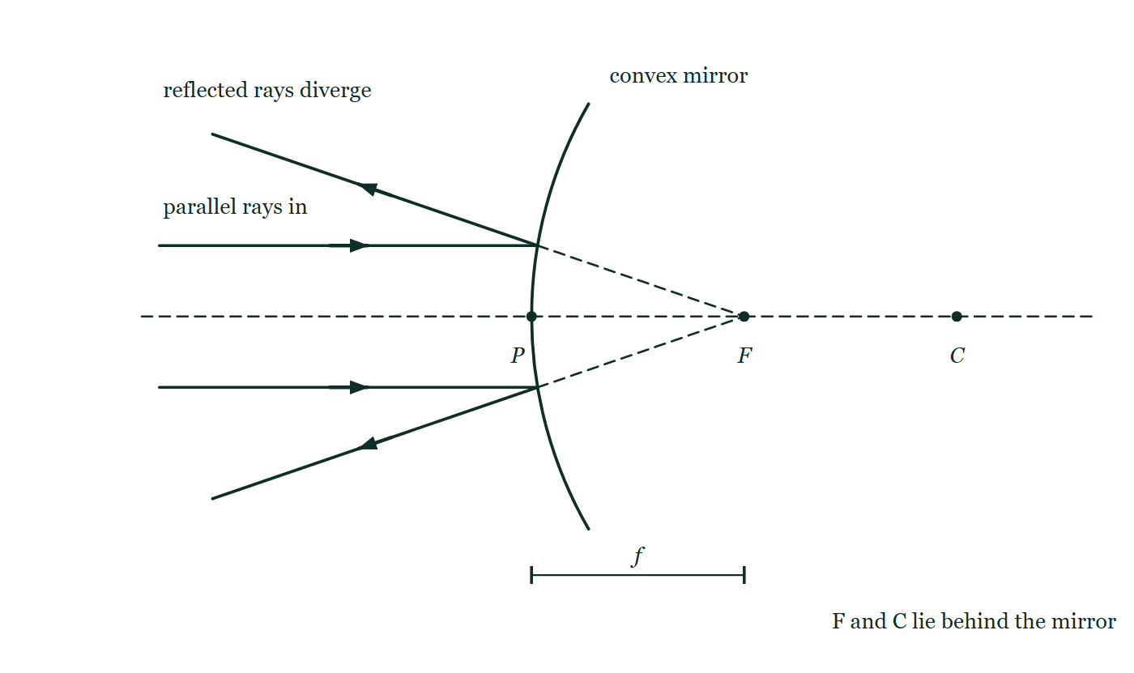
OPTICS · CURVED MIRRORS
GIOPHYSICS LESSON
THE PICTURE
A convex mirror's focus is a fiction
Drawn for this lesson
Two rays arriving parallel to the axis of a convex mirror and reflecting off its bulging face, the reflected rays spreading apart as solid light while dashed construction lines run back through the glass to a focus behind it. P is marked on the surface with F and C both behind the mirror, and f is dimensioned from P to F.
The live version of this figure — click here
Optics — Curved Mirrors. Built by GioPhysics from the lesson's own copy; nothing on these slides is re-authored.
13 / 31
Notes:
[Phase] Build the model: The formulae, one at a time, in plain English (minutes 13–22 of 45)
[Figure] Two rays arriving parallel to the axis of a convex mirror and reflecting off its bulging face, the reflected rays spreading apart as solid light while dashed construction lines run back through the glass to a focus behind it. P is marked on the surface with F and C both behind the mirror, and f is dimensioned from P to F.

Slide 14
OPTICS · CURVED MIRRORS
GIOPHYSICS LESSON
WATCH OUT
The common trap
Check and misconception — The quick check and the trap
A real image needs no screen to exist — it hangs in space where rays actually cross, and a camera aimed there can photograph it. A screen just makes it visible from all directions.
Optics — Curved Mirrors. Built by GioPhysics from the lesson's own copy; nothing on these slides is re-authored.
14 / 31
Notes:
[Phase] Check and misconception: The quick check and the trap (minutes 35–41 of 45)
[Misconception] A real image needs no screen to exist — it hangs in space where rays actually cross, and a camera aimed there can photograph it. A screen just makes it visible from all directions.

Slide 15
OPTICS · CURVED MIRRORS
GIOPHYSICS LESSON
WORKED EXAMPLE 1 OF 2 · EASY
The question
Easy
Worked examples — I do, we do — one step revealed at a time
A concave mirror has radius of curvature 40 cm. Find its focal length.
Optics — Curved Mirrors. Built by GioPhysics from the lesson's own copy; nothing on these slides is re-authored.
15 / 31
Notes:
[Phase] Worked examples: I do, we do — one step revealed at a time (minutes 22–35 of 45)
[Question] A concave mirror has radius of curvature 40 cm. Find its focal length.
[Answer] f = 20 cm

Slide 16
OPTICS · CURVED MIRRORS
GIOPHYSICS LESSON
WORKED EXAMPLE 1 OF 2 · EASY · THE WORKING
How to solve it
Easy
Worked examples — I do, we do — one step revealed at a time
A concave mirror has radius of curvature 40 cm. Find its focal length.
1.
f = R/2 = 40 ÷ 2.
2.
f = 20 cm.
Optics — Curved Mirrors. Built by GioPhysics from the lesson's own copy; nothing on these slides is re-authored.
16 / 31
Notes:
[Phase] Worked examples: I do, we do — one step revealed at a time (minutes 22–35 of 45)
[Reveal] One click per step. The class works each line before the next appears.
[Step 1] f = R/2 = 40 ÷ 2.
[Step 2] f = 20 cm.

Slide 17
OPTICS · CURVED MIRRORS
GIOPHYSICS LESSON
WORKED EXAMPLE 1 OF 2 · EASY
Answer
Easy
Worked examples — I do, we do — one step revealed at a time
f = 20 cm
Optics — Curved Mirrors. Built by GioPhysics from the lesson's own copy; nothing on these slides is re-authored.
17 / 31
Notes:
[Phase] Worked examples: I do, we do — one step revealed at a time (minutes 22–35 of 45)
[Answer] f = 20 cm

Slide 18
OPTICS · CURVED MIRRORS
GIOPHYSICS LESSON
WORKED EXAMPLE 2 OF 2 · MEDIUM
The question
Medium
Worked examples — I do, we do — one step revealed at a time
A convex mirror with f = −20 cm views a car 10 m away. Find the image position and magnification.
Optics — Curved Mirrors. Built by GioPhysics from the lesson's own copy; nothing on these slides is re-authored.
18 / 31
Notes:
[Phase] Worked examples: I do, we do — one step revealed at a time (minutes 22–35 of 45)
[Question] A convex mirror with f = −20 cm views a car 10 m away. Find the image position and magnification.
[Answer] ≈ 19.6 cm behind the mirror, m ≈ +0.02

Slide 19
OPTICS · CURVED MIRRORS
GIOPHYSICS LESSON
WORKED EXAMPLE 2 OF 2 · MEDIUM · THE WORKING
How to solve it
Medium
Worked examples — I do, we do — one step revealed at a time
A convex mirror with f = −20 cm views a car 10 m away. Find the image position and magnification.
1.
1/dᵢ = 1/f − 1/dₒ = −1/20 − 1/1000 (work in cm: −0.05 − 0.001).
2.
dᵢ ≈ −19.6 cm — virtual, just behind the mirror.
3.
m = −dᵢ/dₒ = 19.6/1000 ≈ 0.02 — tiny and upright, so 'objects are closer than they appear'.
Optics — Curved Mirrors. Built by GioPhysics from the lesson's own copy; nothing on these slides is re-authored.
19 / 31
Notes:
[Phase] Worked examples: I do, we do — one step revealed at a time (minutes 22–35 of 45)
[Reveal] One click per step. The class works each line before the next appears.
[Step 1] 1/dᵢ = 1/f − 1/dₒ = −1/20 − 1/1000 (work in cm: −0.05 − 0.001).
[Step 2] dᵢ ≈ −19.6 cm — virtual, just behind the mirror.
[Step 3] m = −dᵢ/dₒ = 19.6/1000 ≈ 0.02 — tiny and upright, so 'objects are closer than they appear'.

Slide 20
OPTICS · CURVED MIRRORS
GIOPHYSICS LESSON
WORKED EXAMPLE 2 OF 2 · MEDIUM
Answer
Medium
Worked examples — I do, we do — one step revealed at a time
≈ 19.6 cm behind the mirror, m ≈ +0.02
Optics — Curved Mirrors. Built by GioPhysics from the lesson's own copy; nothing on these slides is re-authored.
20 / 31
Notes:
[Phase] Worked examples: I do, we do — one step revealed at a time (minutes 22–35 of 45)
[Answer] ≈ 19.6 cm behind the mirror, m ≈ +0.02

Slide 21
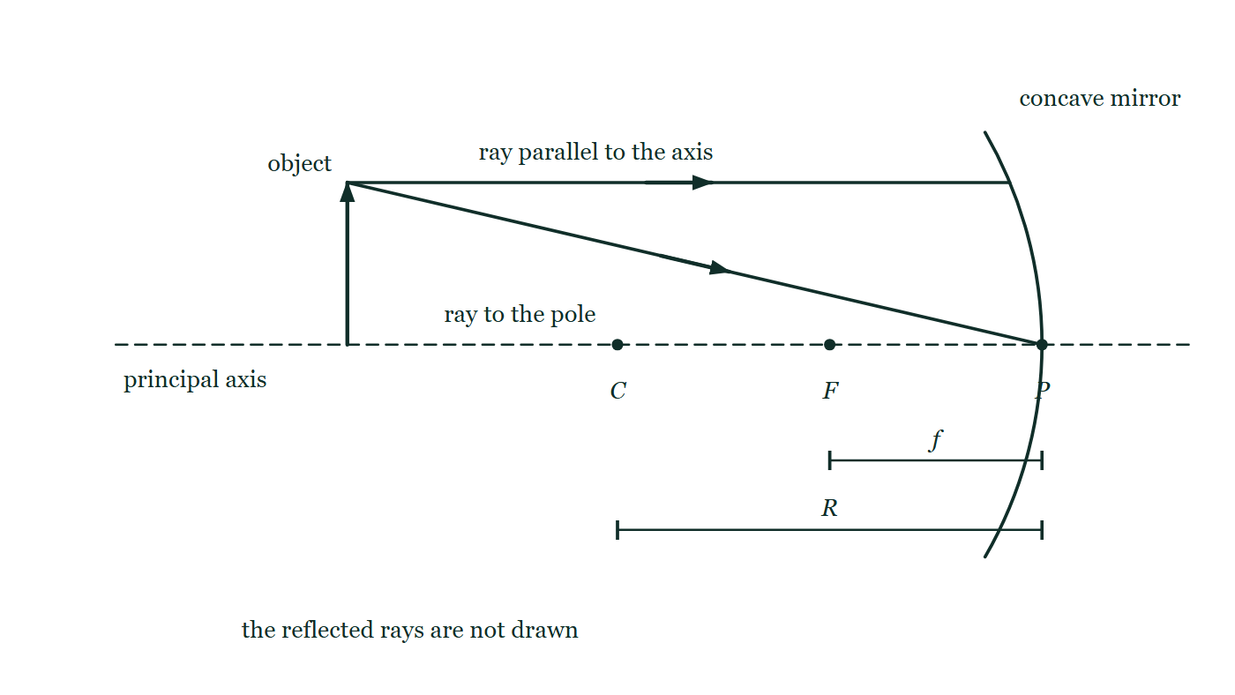
OPTICS · CURVED MIRRORS
GIOPHYSICS LESSON
PREDICT · TAKE THE VOTE
Commit before you are told
Hands up for each option, then click
Complete the construction and the two reflected rays cross 15 cm in front of the mirror — in mid-air, with nothing at all at that point. Is there an image there?
A No — an image has to land on something, and there is nothing there to land on
B Yes — the light really does cross there, and a camera focused on that spot photographs it
C Only if the air is dusty or smoky enough to scatter the light
An upright object arrow standing on the principal axis beyond the centre of curvature of a concave mirror, with the pole P, the focus F and the centre C marked along the axis and f and R dimensioned beneath. Two principal rays leave the arrow's tip — one parallel to the axis, one aimed at the pole — and both stop dead at the mirror surface, with nothing drawn after the reflection.
The live version of this figure — click here
Optics — Curved Mirrors. Built by GioPhysics from the lesson's own copy; nothing on these slides is re-authored.
21 / 31
Notes:
[Phase] Build the model: The formulae, one at a time, in plain English (minutes 13–22 of 45)
[Predict] Complete the construction and the two reflected rays cross 15 cm in front of the mirror — in mid-air, with nothing at all at that point. Is there an image there?
[Options] A No — an image has to land on something, and there is nothing there to land on B Yes — the light really does cross there, and a camera focused on that spot photographs it C Only if the air is dusty or smoky enough to scatter the light
[Figure] An upright object arrow standing on the principal axis beyond the centre of curvature of a concave mirror, with the pole P, the focus F and the centre C marked along the axis and f and R dimensioned beneath. Two principal rays leave the arrow's tip — one parallel to the axis, one aimed at the pole — and both stop dead at the mirror surface, with nothing drawn after the reflection.

Slide 22
OPTICS · CURVED MIRRORS
GIOPHYSICS LESSON
PREDICT · THE OUTCOME
What actually happens
Ask the room who changed their mind, and why
B Yes — the light really does cross there, and a camera focused on that spot photographs it
WHY
The rays are not heading for a screen; they are heading for each other. Where they meet, everything that left the arrow's tip arrives back at one point — and that is the whole definition of an image. A screen at that spot only makes it visible from all around, by scattering the light onwards; the paper adds nothing to the image and takes nothing away. Put a camera there instead, with no screen at all, and it records the image perfectly. Dust lets you see the crossing from the side, which is a separate question from whether it happens.
Optics — Curved Mirrors. Built by GioPhysics from the lesson's own copy; nothing on these slides is re-authored.
22 / 31
Notes:
[Phase] Build the model: The formulae, one at a time, in plain English (minutes 13–22 of 45)
[Answer] B — Yes — the light really does cross there, and a camera focused on that spot photographs it. The rays are not heading for a screen; they are heading for each other. Where they meet, everything that left the arrow's tip arrives back at one point — and that is the whole definition of an image. A screen at that spot only makes it visible from all around, by scattering the light onwards; the paper adds nothing to the image and takes nothing away. Put a camera there instead, with no screen at all, and it records the image perfectly. Dust lets you see the crossing from the side, which is a separate question from whether it happens.

Slide 23
OPTICS · CURVED MIRRORS
GIOPHYSICS LESSON
QUICK CHECK
Decide before the answer goes up
Check and misconception — The quick check and the trap
An object sits 30 cm from a concave mirror of focal length 10 cm. Where is the image?
A
15 cm in front (real)
B
7.5 cm behind (virtual)
C
20 cm in front (real)
An upright object arrow standing on the principal axis beyond the centre of curvature of a concave mirror, with the pole P, the focus F and the centre C marked along the axis and f and R dimensioned beneath. Two principal rays leave the arrow's tip — one parallel to the axis, one aimed at the pole — and both stop dead at the mirror surface, with nothing drawn after the reflection.
The live version of this figure — click here
Optics — Curved Mirrors. Built by GioPhysics from the lesson's own copy; nothing on these slides is re-authored.
23 / 31
Notes:
[Phase] Check and misconception: The quick check and the trap (minutes 35–41 of 45)
[Question] An object sits 30 cm from a concave mirror of focal length 10 cm. Where is the image?
[Figure] An upright object arrow standing on the principal axis beyond the centre of curvature of a concave mirror, with the pole P, the focus F and the centre C marked along the axis and f and R dimensioned beneath. Two principal rays leave the arrow's tip — one parallel to the axis, one aimed at the pole — and both stop dead at the mirror surface, with nothing drawn after the reflection.
[Options] A 15 cm in front (real) B 7.5 cm behind (virtual) C 20 cm in front (real)

Slide 24
OPTICS · CURVED MIRRORS
GIOPHYSICS LESSON
QUICK CHECK · THE ANSWER
The answer, and why
Check and misconception — The quick check and the trap
A 15 cm in front (real)
HOW TO GET THERE
1/dᵢ = 1/10 − 1/30 = 2/30, so dᵢ = 15 cm — a real, inverted image half the object's size.
WHY THE OTHERS TEMPT
A Correct. 1/dᵢ = 1/f − 1/dₒ = 1/10 − 1/30 = 2/30, so dᵢ = 15 cm — real, inverted, and half the object's size.
B 7.5 cm behind is what the mirror equation gives if the two terms are added rather than subtracted: 1/dᵢ = 1/10 + 1/30 = 4/30. That sign is the entire difference between an image in front of the mirror and one behind it, which is to say between an image you can catch on a screen and one you cannot.
C 20 cm in front is R, the centre of curvature — the special case where object and image sit together, the same size and inverted. That happens when the object is AT C. Here the object is further out than C, so its image must fall inside C, somewhere between F and C.
Optics — Curved Mirrors. Built by GioPhysics from the lesson's own copy; nothing on these slides is re-authored.
24 / 31
Notes:
[Phase] Check and misconception: The quick check and the trap (minutes 35–41 of 45)
[Question] An object sits 30 cm from a concave mirror of focal length 10 cm. Where is the image?
[Option by option] A: Correct. 1/dᵢ = 1/f − 1/dₒ = 1/10 − 1/30 = 2/30, so dᵢ = 15 cm — real, inverted, and half the object's size. B: 7.5 cm behind is what the mirror equation gives if the two terms are added rather than subtracted: 1/dᵢ = 1/10 + 1/30 = 4/30. That sign is the entire difference between an image in front of the mirror and one behind it, which is to say between an image you can catch on a screen and one you cannot. C: 20 cm in front is R, the centre of curvature — the special case where object and image sit together, the same size and inverted. That happens when the object is AT C. Here the object is further out than C, so its image must fall inside C, somewhere between F and C.
[Answer] A — 15 cm in front (real)
[Why] 1/dᵢ = 1/10 − 1/30 = 2/30, so dᵢ = 15 cm — a real, inverted image half the object's size.
[Reveal] One click for the answer, then one for the reason.

Slide 25
OPTICS · CURVED MIRRORS
GIOPHYSICS LESSON
EXTENSION 1 OF 2 · HARD
The question
Hard
Worked examples — I do, we do — one step revealed at a time
An object 4.0 cm tall stands 15 cm from a concave mirror (f = 10 cm). Find the image position, size, and nature.
Optics — Curved Mirrors. Built by GioPhysics from the lesson's own copy; nothing on these slides is re-authored.
25 / 31
Notes:
[Phase] Worked examples: I do, we do — one step revealed at a time (minutes 22–35 of 45)
[Question] An object 4.0 cm tall stands 15 cm from a concave mirror (f = 10 cm). Find the image position, size, and nature.
[Answer] 30 cm in front; 8.0 cm, inverted, real

Slide 26
OPTICS · CURVED MIRRORS
GIOPHYSICS LESSON
EXTENSION 1 OF 2 · HARD · THE WORKING
How to solve it
Hard
Worked examples — I do, we do — one step revealed at a time
An object 4.0 cm tall stands 15 cm from a concave mirror (f = 10 cm). Find the image position, size, and nature.
1.
1/dᵢ = 1/10 − 1/15 = 1/30 → dᵢ = 30 cm in front (real).
2.
m = −30/15 = −2.0.
3.
Image: 8.0 cm tall, inverted, real — a projector geometry.
Optics — Curved Mirrors. Built by GioPhysics from the lesson's own copy; nothing on these slides is re-authored.
26 / 31
Notes:
[Phase] Worked examples: I do, we do — one step revealed at a time (minutes 22–35 of 45)
[Reveal] One click per step. The class works each line before the next appears.
[Step 1] 1/dᵢ = 1/10 − 1/15 = 1/30 → dᵢ = 30 cm in front (real).
[Step 2] m = −30/15 = −2.0.
[Step 3] Image: 8.0 cm tall, inverted, real — a projector geometry.

Slide 27
OPTICS · CURVED MIRRORS
GIOPHYSICS LESSON
EXTENSION 1 OF 2 · HARD
Answer
Hard
Worked examples — I do, we do — one step revealed at a time
30 cm in front; 8.0 cm, inverted, real
Optics — Curved Mirrors. Built by GioPhysics from the lesson's own copy; nothing on these slides is re-authored.
27 / 31
Notes:
[Phase] Worked examples: I do, we do — one step revealed at a time (minutes 22–35 of 45)
[Answer] 30 cm in front; 8.0 cm, inverted, real

Slide 28
OPTICS · CURVED MIRRORS
GIOPHYSICS LESSON
EXTENSION 2 OF 2 · CHALLENGING
The question
Challenging
Worked examples — I do, we do — one step revealed at a time
A dentist's concave mirror (f = 2.0 cm) is held 1.5 cm from a tooth. Find the image and explain why this working distance is chosen.
Optics — Curved Mirrors. Built by GioPhysics from the lesson's own copy; nothing on these slides is re-authored.
28 / 31
Notes:
[Phase] Worked examples: I do, we do — one step revealed at a time (minutes 22–35 of 45)
[Question] A dentist's concave mirror (f = 2.0 cm) is held 1.5 cm from a tooth. Find the image and explain why this working distance is chosen.
[Answer] Virtual, upright, ×4 at 6.0 cm behind the mirror — must stay inside f

Slide 29
OPTICS · CURVED MIRRORS
GIOPHYSICS LESSON
EXTENSION 2 OF 2 · CHALLENGING · THE WORKING
How to solve it
Challenging
Worked examples — I do, we do — one step revealed at a time
A dentist's concave mirror (f = 2.0 cm) is held 1.5 cm from a tooth. Find the image and explain why this working distance is chosen.
1.
1/dᵢ = 1/2.0 − 1/1.5 = −1/6 → dᵢ = −6.0 cm (behind the mirror: virtual).
2.
m = −(−6.0)/1.5 = +4.0 — upright and four times life size.
3.
Inside the focal length is the ONLY concave-mirror regime giving an upright magnified image — pull back past 2 cm and the view flips upside down.
Optics — Curved Mirrors. Built by GioPhysics from the lesson's own copy; nothing on these slides is re-authored.
29 / 31
Notes:
[Phase] Worked examples: I do, we do — one step revealed at a time (minutes 22–35 of 45)
[Reveal] One click per step. The class works each line before the next appears.
[Step 1] 1/dᵢ = 1/2.0 − 1/1.5 = −1/6 → dᵢ = −6.0 cm (behind the mirror: virtual).
[Step 2] m = −(−6.0)/1.5 = +4.0 — upright and four times life size.
[Step 3] Inside the focal length is the ONLY concave-mirror regime giving an upright magnified image — pull back past 2 cm and the view flips upside down.

Slide 30
OPTICS · CURVED MIRRORS
GIOPHYSICS LESSON
EXTENSION 2 OF 2 · CHALLENGING
Answer
Challenging
Worked examples — I do, we do — one step revealed at a time
Virtual, upright, ×4 at 6.0 cm behind the mirror — must stay inside f
Optics — Curved Mirrors. Built by GioPhysics from the lesson's own copy; nothing on these slides is re-authored.
30 / 31
Notes:
[Phase] Worked examples: I do, we do — one step revealed at a time (minutes 22–35 of 45)
[Answer] Virtual, upright, ×4 at 6.0 cm behind the mirror — must stay inside f

Slide 31
OPTICS · CURVED MIRRORS
GIOPHYSICS LESSON
OPTICS
Where to go next
Plenary — What to take away, what to practise next
Next
17.2 Thin Lenses
https://giophysics.com/chapter-26/thin-lenses/
Lesson
This lesson on giophysics.com
https://giophysics.com/chapter-26/curved-mirrors/
Live
The live, interactive version of these slides
https://giophysics.com/chapter-26/presentation/?lesson=mirrors
Chapter
All Optics lessons
https://giophysics.com/chapter-26/
PDF
Download the lesson PDF
https://giophysics.com/downloads/26-1-curved-mirrors.pdf
Optics — Curved Mirrors. Built by GioPhysics from the lesson's own copy; nothing on these slides is re-authored.
31 / 31
Notes:
[Phase] Plenary: What to take away, what to practise next (minutes 41–45 of 45)
[Interactive] The graphs and the circuit topology on these slides are frozen. The live version at https://giophysics.com/chapter-26/presentation/?lesson=mirrors moves them.

