Slide 1
OPTICS · THIN-FILM INTERFERENCE
GIOPHYSICS LESSON
17 · Optics
Colours from soap and oil
Thin-Film Interference
Light reflecting off the top and bottom of a soap film travels slightly different paths. The two reflections interfere — and because the condition depends on wavelength, films shimmer with colour.
POSITION
Lesson 5 of 6 in Optics
PLAN
16 slides in the 45-minute core run, about 44.5 minutes of it
LESSON PAGE
https://giophysics.com/chapter-26/thin-film-interference/
Built by GioPhysics from the lesson's own page. Every word on these slides is the lesson's; nothing here is re-authored. Teaching material, not an awarding body's document.
Optics — Thin-Film Interference. Built by GioPhysics from the lesson's own copy; nothing on these slides is re-authored.
1 / 31
Notes:
[Lesson] Optics — Thin-Film Interference. Lesson 5 of 6.
[Intro] Light reflecting off the top and bottom of a soap film travels slightly different paths. The two reflections interfere — and because the condition depends on wavelength, films shimmer with colour.
[Source] https://giophysics.com/chapter-26/thin-film-interference/
[Disclaimer] Built by GioPhysics from the lesson's own page. Every word on these slides is the lesson's; nothing here is re-authored. Teaching material, not an awarding body's document.

Slide 2
OPTICS · THIN-FILM INTERFERENCE
GIOPHYSICS LESSON
WHAT THIS NEEDS
What you already know
Starter — Recall what this lesson stands on
Recall
Interference
https://giophysics.com/chapter-24/superposition-interference/
Recall
Refractive index
https://giophysics.com/chapter-25/refraction-snells-law/
Optics — Thin-Film Interference. Built by GioPhysics from the lesson's own copy; nothing on these slides is re-authored.
2 / 31
Notes:
[Phase] Starter: Recall what this lesson stands on (minutes 0–5 of 45)
[Starter] Recall: Interference; Refractive index

Slide 3
OPTICS · THIN-FILM INTERFERENCE
GIOPHYSICS LESSON
THINK FIRST
A soap bubble's rainbow — is it made the same way a prism's is?
Take answers before you click — the point is the commitment
Both lay the colours of white light out in order, and neither of them has a speck of pigment anywhere in it.
THE ANSWER
No. A prism sorts colours by angle and its spectrum sits still. A bubble's colours come from two reflections — one off the front of the film, one off the back — arriving out of step, so that some wavelengths cancel and others reinforce. Which colour wins depends on the film's thickness and on the angle you are looking through it at, which is why the colours crawl about as the bubble wobbles and drains. No dye has ever done that.
Optics — Thin-Film Interference. Built by GioPhysics from the lesson's own copy; nothing on these slides is re-authored.
3 / 31
Notes:
[Phase] Starter: Recall what this lesson stands on (minutes 0–5 of 45)
[Hook] A soap bubble's rainbow — is it made the same way a prism's is? Both lay the colours of white light out in order, and neither of them has a speck of pigment anywhere in it.
[Answer] No. A prism sorts colours by angle and its spectrum sits still. A bubble's colours come from two reflections — one off the front of the film, one off the back — arriving out of step, so that some wavelengths cancel and others reinforce. Which colour wins depends on the film's thickness and on the angle you are looking through it at, which is why the colours crawl about as the bubble wobbles and drains. No dye has ever done that.

Slide 4
OPTICS · THIN-FILM INTERFERENCE
GIOPHYSICS LESSON
EXPLAINED SIMPLY
In one sentence
Introduce the idea — The big idea and the definition
Thin-film interference is the reinforcement or cancellation of light reflected from the two surfaces of a very thin transparent layer.
Optics — Thin-Film Interference. Built by GioPhysics from the lesson's own copy; nothing on these slides is re-authored.
4 / 31
Notes:
[Phase] Introduce the idea: The big idea and the definition (minutes 5–13 of 45)
[Definition] Thin-film interference is the reinforcement or cancellation of light reflected from the two surfaces of a very thin transparent layer.

Slide 5
OPTICS · THIN-FILM INTERFERENCE
GIOPHYSICS LESSON
EXPLAINED SIMPLY
What that looks like
Introduce the idea — The big idea and the definition
FOR EXAMPLE
An oil film on wet asphalt shows bands of colour: each thickness reinforces a different wavelength.
Optics — Thin-Film Interference. Built by GioPhysics from the lesson's own copy; nothing on these slides is re-authored.
5 / 31
Notes:
[Phase] Introduce the idea: The big idea and the definition (minutes 5–13 of 45)
[Worked illustration] An oil film on wet asphalt shows bands of colour: each thickness reinforces a different wavelength.

Slide 6
OPTICS · THIN-FILM INTERFERENCE
GIOPHYSICS LESSON
THE BIG IDEA
Colours from soap and oil
Introduce the idea — The big idea and the definition
The wave reflected from the film's bottom surface travels an extra distance ≈ 2t inside the film. Add a half-wavelength phase flip whenever light reflects off a denser medium, and the interference condition selects which colours reinforce for each thickness — soap-bubble swirls, oil-slick rainbows, and anti-reflective coatings.
Optics — Thin-Film Interference. Built by GioPhysics from the lesson's own copy; nothing on these slides is re-authored.
6 / 31
Notes:
[Phase] Introduce the idea: The big idea and the definition (minutes 5–13 of 45)
[Big idea] The wave reflected from the film's bottom surface travels an extra distance ≈ 2t inside the film. Add a half-wavelength phase flip whenever light reflects off a denser medium, and the interference condition selects which colours reinforce for each thickness — soap-bubble swirls, oil-slick rainbows, and anti-reflective coatings.

Slide 7
OPTICS · THIN-FILM INTERFERENCE
GIOPHYSICS LESSON
THE PHYSICS · 1 OF 3
Why colours
Build the model — The formulae, one at a time, in plain English
White light contains all wavelengths; a given thickness reinforces some and cancels others, so the film wears the surviving mixture as colour.
Optics — Thin-Film Interference. Built by GioPhysics from the lesson's own copy; nothing on these slides is re-authored.
7 / 31
Notes:
[Phase] Build the model: The formulae, one at a time, in plain English (minutes 13–22 of 45)
[Section] White light contains all wavelengths; a given thickness reinforces some and cancels others, so the film wears the surviving mixture as colour.

Slide 8
OPTICS · THIN-FILM INTERFERENCE
GIOPHYSICS LESSON
THE PHYSICS · 2 OF 3
Wedge fringes
Build the model — The formulae, one at a time, in plain English
A film of varying thickness shows contour lines of equal thickness — the swirling bands on a draining soap bubble, black where it thins to nothing.
Optics — Thin-Film Interference. Built by GioPhysics from the lesson's own copy; nothing on these slides is re-authored.
8 / 31
Notes:
[Phase] Build the model: The formulae, one at a time, in plain English (minutes 13–22 of 45)
[Section] A film of varying thickness shows contour lines of equal thickness — the swirling bands on a draining soap bubble, black where it thins to nothing.

Slide 9
OPTICS · THIN-FILM INTERFERENCE
GIOPHYSICS LESSON
THE PHYSICS · 3 OF 3
Anti-reflection coatings
Build the model — The formulae, one at a time, in plain English
A quarter-wave coating (t = λ/4n) makes the two reflections cancel — camera lenses and glasses transmit more and glare less.
Optics — Thin-Film Interference. Built by GioPhysics from the lesson's own copy; nothing on these slides is re-authored.
9 / 31
Notes:
[Phase] Build the model: The formulae, one at a time, in plain English (minutes 13–22 of 45)
[Section] A quarter-wave coating (t = λ/4n) makes the two reflections cancel — camera lenses and glasses transmit more and glare less.

Slide 10
OPTICS · THIN-FILM INTERFERENCE
GIOPHYSICS LESSON
FORMULA 1 OF 3
Path difference
Build the model — The formulae, one at a time, in plain English
≈ 2nt
t = thickness, n = film's index
IN PLAIN ENGLISH
The lower reflection crosses the film twice; inside the film wavelengths shrink by n, so the film's optical thickness is nt.
Optics — Thin-Film Interference. Built by GioPhysics from the lesson's own copy; nothing on these slides is re-authored.
10 / 31
Notes:
[Phase] Build the model: The formulae, one at a time, in plain English (minutes 13–22 of 45)
[Formula] Path difference: ≈ 2nt
[In plain English] The lower reflection crosses the film twice; inside the film wavelengths shrink by n, so the film's optical thickness is nt.
[Note] t = thickness, n = film's index

Slide 11
OPTICS · THIN-FILM INTERFERENCE
GIOPHYSICS LESSON
FORMULA 2 OF 3
Phase flip on reflection
Build the model — The formulae, one at a time, in plain English
π shift at denser boundary
Air→film: flip. Film→air: none
IN PLAIN ENGLISH
Reflecting off a slower medium flips the wave half a cycle — it swaps the constructive and destructive conditions.
Optics — Thin-Film Interference. Built by GioPhysics from the lesson's own copy; nothing on these slides is re-authored.
11 / 31
Notes:
[Phase] Build the model: The formulae, one at a time, in plain English (minutes 13–22 of 45)
[Formula] Phase flip on reflection: π shift at denser boundary
[In plain English] Reflecting off a slower medium flips the wave half a cycle — it swaps the constructive and destructive conditions.
[Note] Air→film: flip. Film→air: none

Slide 12
OPTICS · THIN-FILM INTERFERENCE
GIOPHYSICS LESSON
FORMULA 3 OF 3
Soap film (one flip)
Build the model — The formulae, one at a time, in plain English
2nt = (m + ½)λ bright
2nt = mλ dark
IN PLAIN ENGLISH
With one phase flip, an extra half wavelength is built in: very thin films go dark, and each colour brightens at its own thickness.
Optics — Thin-Film Interference. Built by GioPhysics from the lesson's own copy; nothing on these slides is re-authored.
12 / 31
Notes:
[Phase] Build the model: The formulae, one at a time, in plain English (minutes 13–22 of 45)
[Formula] Soap film (one flip): 2nt = (m + ½)λ bright
[In plain English] With one phase flip, an extra half wavelength is built in: very thin films go dark, and each colour brightens at its own thickness.
[Note] 2nt = mλ dark

Slide 13
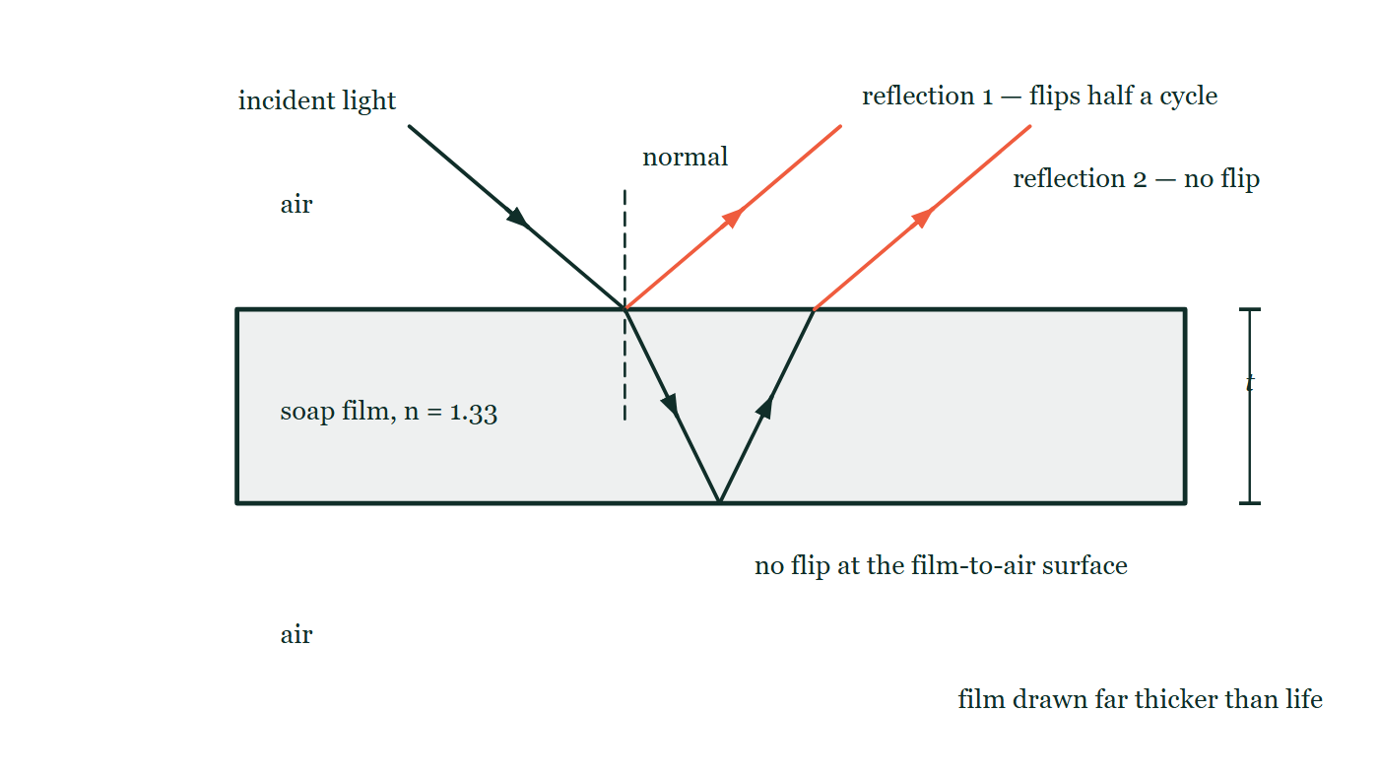
OPTICS · THIN-FILM INTERFERENCE
GIOPHYSICS LESSON
THE PICTURE
Two reflections, one of them flipped
Drawn for this lesson
A section through a soap film of index 1.33 with air above and below, drawn far thicker than life. One ray arrives from the upper left; part of it reflects straight off the top surface and is annotated as flipping half a cycle, and part crosses the film, reflects off the bottom surface with no flip, and leaves the top again on a path parallel to the first reflection.
The live version of this figure — click here
Optics — Thin-Film Interference. Built by GioPhysics from the lesson's own copy; nothing on these slides is re-authored.
13 / 31
Notes:
[Phase] Build the model: The formulae, one at a time, in plain English (minutes 13–22 of 45)
[Figure] A section through a soap film of index 1.33 with air above and below, drawn far thicker than life. One ray arrives from the upper left; part of it reflects straight off the top surface and is annotated as flipping half a cycle, and part crosses the film, reflects off the bottom surface with no flip, and leaves the top again on a path parallel to the first reflection.

Slide 14
OPTICS · THIN-FILM INTERFERENCE
GIOPHYSICS LESSON
WATCH OUT
The common trap
Check and misconception — The quick check and the trap
The colours are not pigment — they are pure interference. Change the viewing angle or the thickness and the colours move, which no dye ever does.
Optics — Thin-Film Interference. Built by GioPhysics from the lesson's own copy; nothing on these slides is re-authored.
14 / 31
Notes:
[Phase] Check and misconception: The quick check and the trap (minutes 35–41 of 45)
[Misconception] The colours are not pigment — they are pure interference. Change the viewing angle or the thickness and the colours move, which no dye ever does.

Slide 15
OPTICS · THIN-FILM INTERFERENCE
GIOPHYSICS LESSON
WORKED EXAMPLE 1 OF 2 · EASY
The question
Easy
Worked examples — I do, we do — one step revealed at a time
Why does an extremely thin soap film (t → 0) look black in reflection?
Optics — Thin-Film Interference. Built by GioPhysics from the lesson's own copy; nothing on these slides is re-authored.
15 / 31
Notes:
[Phase] Worked examples: I do, we do — one step revealed at a time (minutes 22–35 of 45)
[Question] Why does an extremely thin soap film (t → 0) look black in reflection?
[Answer] The half-cycle flip makes all colours cancel

Slide 16
OPTICS · THIN-FILM INTERFERENCE
GIOPHYSICS LESSON
WORKED EXAMPLE 1 OF 2 · EASY · THE WORKING
How to solve it
Easy
Worked examples — I do, we do — one step revealed at a time
Why does an extremely thin soap film (t → 0) look black in reflection?
1.
Only the phase flip at the top surface remains.
2.
The two reflections cancel for every wavelength — no reflected light.
Optics — Thin-Film Interference. Built by GioPhysics from the lesson's own copy; nothing on these slides is re-authored.
16 / 31
Notes:
[Phase] Worked examples: I do, we do — one step revealed at a time (minutes 22–35 of 45)
[Reveal] One click per step. The class works each line before the next appears.
[Step 1] Only the phase flip at the top surface remains.
[Step 2] The two reflections cancel for every wavelength — no reflected light.

Slide 17
OPTICS · THIN-FILM INTERFERENCE
GIOPHYSICS LESSON
WORKED EXAMPLE 1 OF 2 · EASY
Answer
Easy
Worked examples — I do, we do — one step revealed at a time
The half-cycle flip makes all colours cancel
Optics — Thin-Film Interference. Built by GioPhysics from the lesson's own copy; nothing on these slides is re-authored.
17 / 31
Notes:
[Phase] Worked examples: I do, we do — one step revealed at a time (minutes 22–35 of 45)
[Answer] The half-cycle flip makes all colours cancel

Slide 18
OPTICS · THIN-FILM INTERFERENCE
GIOPHYSICS LESSON
WORKED EXAMPLE 2 OF 2 · MEDIUM
The question
Medium
Worked examples — I do, we do — one step revealed at a time
Design the thinnest MgF₂ coating (n = 1.38) to suppress reflection of 550 nm light on glass.
Optics — Thin-Film Interference. Built by GioPhysics from the lesson's own copy; nothing on these slides is re-authored.
18 / 31
Notes:
[Phase] Worked examples: I do, we do — one step revealed at a time (minutes 22–35 of 45)
[Question] Design the thinnest MgF₂ coating (n = 1.38) to suppress reflection of 550 nm light on glass.
[Answer] t ≈ 100 nm

Slide 19
OPTICS · THIN-FILM INTERFERENCE
GIOPHYSICS LESSON
WORKED EXAMPLE 2 OF 2 · MEDIUM · THE WORKING
How to solve it
Medium
Worked examples — I do, we do — one step revealed at a time
Design the thinnest MgF₂ coating (n = 1.38) to suppress reflection of 550 nm light on glass.
1.
Quarter-wave condition: t = λ/(4n).
2.
t = 550 × 10⁻⁹ ÷ (4 × 1.38).
3.
t ≈ 1.0 × 10⁻⁷ m — about 100 nm.
Optics — Thin-Film Interference. Built by GioPhysics from the lesson's own copy; nothing on these slides is re-authored.
19 / 31
Notes:
[Phase] Worked examples: I do, we do — one step revealed at a time (minutes 22–35 of 45)
[Reveal] One click per step. The class works each line before the next appears.
[Step 1] Quarter-wave condition: t = λ/(4n).
[Step 2] t = 550 × 10⁻⁹ ÷ (4 × 1.38).
[Step 3] t ≈ 1.0 × 10⁻⁷ m — about 100 nm.

Slide 20
OPTICS · THIN-FILM INTERFERENCE
GIOPHYSICS LESSON
WORKED EXAMPLE 2 OF 2 · MEDIUM
Answer
Medium
Worked examples — I do, we do — one step revealed at a time
t ≈ 100 nm
Optics — Thin-Film Interference. Built by GioPhysics from the lesson's own copy; nothing on these slides is re-authored.
20 / 31
Notes:
[Phase] Worked examples: I do, we do — one step revealed at a time (minutes 22–35 of 45)
[Answer] t ≈ 100 nm

Slide 21
OPTICS · THIN-FILM INTERFERENCE
GIOPHYSICS LESSON
PREDICT · TAKE THE VOTE
Commit before you are told
Hands up for each option, then click
You are watching one coloured band on the film and you tilt your head so that you view it more obliquely. What happens to that band's colour?
A Nothing — the colour belongs to the film at that thickness
B It changes, because the light's path inside the film depends on the viewing angle
C It vanishes, because the two reflections no longer overlap
A section through a soap film of index 1.33 with air above and below, drawn far thicker than life. One ray arrives from the upper left; part of it reflects straight off the top surface and is annotated as flipping half a cycle, and part crosses the film, reflects off the bottom surface with no flip, and leaves the top again on a path parallel to the first reflection.
The live version of this figure — click here
Optics — Thin-Film Interference. Built by GioPhysics from the lesson's own copy; nothing on these slides is re-authored.
21 / 31
Notes:
[Phase] Build the model: The formulae, one at a time, in plain English (minutes 13–22 of 45)
[Predict] You are watching one coloured band on the film and you tilt your head so that you view it more obliquely. What happens to that band's colour?
[Options] A Nothing — the colour belongs to the film at that thickness B It changes, because the light's path inside the film depends on the viewing angle C It vanishes, because the two reflections no longer overlap
[Figure] A section through a soap film of index 1.33 with air above and below, drawn far thicker than life. One ray arrives from the upper left; part of it reflects straight off the top surface and is annotated as flipping half a cycle, and part crosses the film, reflects off the bottom surface with no flip, and leaves the top again on a path parallel to the first reflection.

Slide 22
OPTICS · THIN-FILM INTERFERENCE
GIOPHYSICS LESSON
PREDICT · THE OUTCOME
What actually happens
Ask the room who changed their mind, and why
B It changes, because the light's path inside the film depends on the viewing angle
WHY
Follow the two accented rays. They can interfere at all because the second one makes an extra journey down through the film and back — and how long that journey is depends on how slanted the path through the film is. Straight on, the extra path is 2nt; obliquely it is less, so a shorter wavelength becomes the one that reinforces and the band shifts towards the blue. The film has not changed thickness. Only your line of sight has, and that is the argument, in one observation, that these colours are interference and not pigment.
Optics — Thin-Film Interference. Built by GioPhysics from the lesson's own copy; nothing on these slides is re-authored.
22 / 31
Notes:
[Phase] Build the model: The formulae, one at a time, in plain English (minutes 13–22 of 45)
[Answer] B — It changes, because the light's path inside the film depends on the viewing angle. Follow the two accented rays. They can interfere at all because the second one makes an extra journey down through the film and back — and how long that journey is depends on how slanted the path through the film is. Straight on, the extra path is 2nt; obliquely it is less, so a shorter wavelength becomes the one that reinforces and the band shifts towards the blue. The film has not changed thickness. Only your line of sight has, and that is the argument, in one observation, that these colours are interference and not pigment.

Slide 23
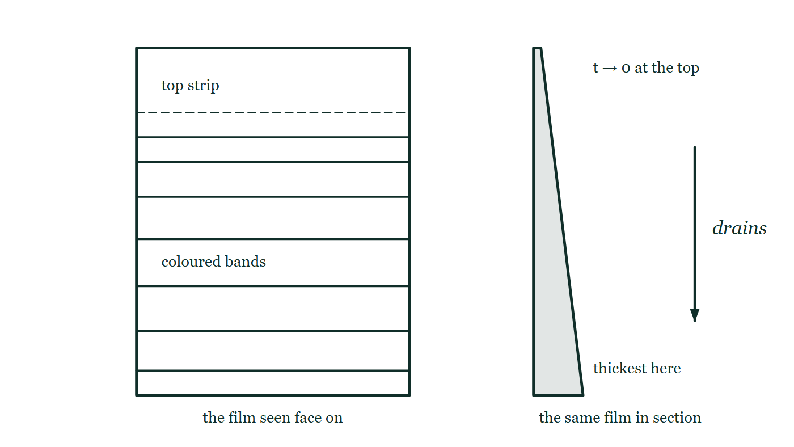
OPTICS · THIN-FILM INTERFERENCE
GIOPHYSICS LESSON
QUICK CHECK
Decide before the answer goes up
Check and misconception — The quick check and the trap
A vertical soap film drains until its top is extremely thin. The top appears…
A
Bright white
B
Black
C
Red
A vertical soap film seen face on, crossed by horizontal bands that crowd closer together towards the top, with the strip above a dashed line left blank and merely named. Beside it the same film is drawn in section as a wedge, thick at the bottom and thinning away to nothing at the top, with an arrow marked drains running downwards.
The live version of this figure — click here
Optics — Thin-Film Interference. Built by GioPhysics from the lesson's own copy; nothing on these slides is re-authored.
23 / 31
Notes:
[Phase] Check and misconception: The quick check and the trap (minutes 35–41 of 45)
[Question] A vertical soap film drains until its top is extremely thin. The top appears…
[Figure] A vertical soap film seen face on, crossed by horizontal bands that crowd closer together towards the top, with the strip above a dashed line left blank and merely named. Beside it the same film is drawn in section as a wedge, thick at the bottom and thinning away to nothing at the top, with an arrow marked drains running downwards.
[Options] A Bright white B Black C Red

Slide 24
OPTICS · THIN-FILM INTERFERENCE
GIOPHYSICS LESSON
QUICK CHECK · THE ANSWER
The answer, and why
Check and misconception — The quick check and the trap
B Black
HOW TO GET THERE
As t → 0 only the phase flip remains: the two reflections cancel for every wavelength — no reflection at all.
WHY THE OTHERS TEMPT
A Bright white comes from thinking that a very thin film reflects every colour equally, so they all come back together as white. Every colour IS treated alike as t → 0 — but they are treated alike by cancelling, not by reinforcing.
B Correct. With t → 0 the two paths are the same length, so only the half-cycle flip at the top surface is left, and that flip cancels every wavelength at once. No reflection at all: black.
C Red is the longest visible wavelength and so the last one a thinning film can still reinforce, which is why a straw or reddish band really does appear a little way down from the top. But right at the top, where the film is a few nanometres thick, no wavelength reinforces — it is past red and out the other side.
Optics — Thin-Film Interference. Built by GioPhysics from the lesson's own copy; nothing on these slides is re-authored.
24 / 31
Notes:
[Phase] Check and misconception: The quick check and the trap (minutes 35–41 of 45)
[Question] A vertical soap film drains until its top is extremely thin. The top appears…
[Option by option] A: Bright white comes from thinking that a very thin film reflects every colour equally, so they all come back together as white. Every colour IS treated alike as t → 0 — but they are treated alike by cancelling, not by reinforcing. B: Correct. With t → 0 the two paths are the same length, so only the half-cycle flip at the top surface is left, and that flip cancels every wavelength at once. No reflection at all: black. C: Red is the longest visible wavelength and so the last one a thinning film can still reinforce, which is why a straw or reddish band really does appear a little way down from the top. But right at the top, where the film is a few nanometres thick, no wavelength reinforces — it is past red and out the other side.
[Answer] B — Black
[Why] As t → 0 only the phase flip remains: the two reflections cancel for every wavelength — no reflection at all.
[Reveal] One click for the answer, then one for the reason.

Slide 25
OPTICS · THIN-FILM INTERFERENCE
GIOPHYSICS LESSON
EXTENSION 1 OF 2 · HARD
The question
Hard
Worked examples — I do, we do — one step revealed at a time
A soap film (n = 1.33) reflects green (530 nm) most strongly at near-normal incidence. Find its two thinnest possible thicknesses.
Optics — Thin-Film Interference. Built by GioPhysics from the lesson's own copy; nothing on these slides is re-authored.
25 / 31
Notes:
[Phase] Worked examples: I do, we do — one step revealed at a time (minutes 22–35 of 45)
[Question] A soap film (n = 1.33) reflects green (530 nm) most strongly at near-normal incidence. Find its two thinnest possible thicknesses.
[Answer] ≈ 100 nm or ≈ 300 nm

Slide 26
OPTICS · THIN-FILM INTERFERENCE
GIOPHYSICS LESSON
EXTENSION 1 OF 2 · HARD · THE WORKING
How to solve it
Hard
Worked examples — I do, we do — one step revealed at a time
A soap film (n = 1.33) reflects green (530 nm) most strongly at near-normal incidence. Find its two thinnest possible thicknesses.
1.
Bright (one phase flip): 2nt = (m + ½)λ.
2.
m = 0: t = λ/4n = 530 ÷ 5.32 ≈ 100 nm.
3.
m = 1: t = 3λ/4n ≈ 300 nm.
Optics — Thin-Film Interference. Built by GioPhysics from the lesson's own copy; nothing on these slides is re-authored.
26 / 31
Notes:
[Phase] Worked examples: I do, we do — one step revealed at a time (minutes 22–35 of 45)
[Reveal] One click per step. The class works each line before the next appears.
[Step 1] Bright (one phase flip): 2nt = (m + ½)λ.
[Step 2] m = 0: t = λ/4n = 530 ÷ 5.32 ≈ 100 nm.
[Step 3] m = 1: t = 3λ/4n ≈ 300 nm.

Slide 27
OPTICS · THIN-FILM INTERFERENCE
GIOPHYSICS LESSON
EXTENSION 1 OF 2 · HARD
Answer
Hard
Worked examples — I do, we do — one step revealed at a time
≈ 100 nm or ≈ 300 nm
Optics — Thin-Film Interference. Built by GioPhysics from the lesson's own copy; nothing on these slides is re-authored.
27 / 31
Notes:
[Phase] Worked examples: I do, we do — one step revealed at a time (minutes 22–35 of 45)
[Answer] ≈ 100 nm or ≈ 300 nm

Slide 28
OPTICS · THIN-FILM INTERFERENCE
GIOPHYSICS LESSON
EXTENSION 2 OF 2 · CHALLENGING
The question
Challenging
Worked examples — I do, we do — one step revealed at a time
An anti-reflective MgF₂ coating (n = 1.38) on glass (n = 1.52) is a quarter-wave for 550 nm. Explain why BOTH reflections flip phase here, and what happens at 400 nm.
Optics — Thin-Film Interference. Built by GioPhysics from the lesson's own copy; nothing on these slides is re-authored.
28 / 31
Notes:
[Phase] Worked examples: I do, we do — one step revealed at a time (minutes 22–35 of 45)
[Question] An anti-reflective MgF₂ coating (n = 1.38) on glass (n = 1.52) is a quarter-wave for 550 nm. Explain why BOTH reflections flip phase here, and what happens at 400 nm.
[Answer] Double phase-flip cancels; off-design wavelengths partially reflect, giving the purple sheen

Slide 29
OPTICS · THIN-FILM INTERFERENCE
GIOPHYSICS LESSON
EXTENSION 2 OF 2 · CHALLENGING · THE WORKING
How to solve it
Challenging
Worked examples — I do, we do — one step revealed at a time
An anti-reflective MgF₂ coating (n = 1.38) on glass (n = 1.52) is a quarter-wave for 550 nm. Explain why BOTH reflections flip phase here, and what happens at 400 nm.
1.
Air→MgF₂ and MgF₂→glass are both low-to-high index: each reflection flips π, so the flips cancel and only the 2nt path difference matters — λ/4 coating gives λ/2 round trip → destructive.
2.
At 400 nm the coating is no longer a quarter wave (2nt = 275 nm vs λ/2 = 200 nm needed).
3.
Cancellation is partial; violet reflects more — why coated lenses glint purple.
Optics — Thin-Film Interference. Built by GioPhysics from the lesson's own copy; nothing on these slides is re-authored.
29 / 31
Notes:
[Phase] Worked examples: I do, we do — one step revealed at a time (minutes 22–35 of 45)
[Reveal] One click per step. The class works each line before the next appears.
[Step 1] Air→MgF₂ and MgF₂→glass are both low-to-high index: each reflection flips π, so the flips cancel and only the 2nt path difference matters — λ/4 coating gives λ/2 round trip → destructive.
[Step 2] At 400 nm the coating is no longer a quarter wave (2nt = 275 nm vs λ/2 = 200 nm needed).
[Step 3] Cancellation is partial; violet reflects more — why coated lenses glint purple.

Slide 30
OPTICS · THIN-FILM INTERFERENCE
GIOPHYSICS LESSON
EXTENSION 2 OF 2 · CHALLENGING
Answer
Challenging
Worked examples — I do, we do — one step revealed at a time
Double phase-flip cancels; off-design wavelengths partially reflect, giving the purple sheen
Optics — Thin-Film Interference. Built by GioPhysics from the lesson's own copy; nothing on these slides is re-authored.
30 / 31
Notes:
[Phase] Worked examples: I do, we do — one step revealed at a time (minutes 22–35 of 45)
[Answer] Double phase-flip cancels; off-design wavelengths partially reflect, giving the purple sheen

Slide 31
OPTICS · THIN-FILM INTERFERENCE
GIOPHYSICS LESSON
OPTICS
Where to go next
Plenary — What to take away, what to practise next
Next
17.6 Optics Calculus
https://giophysics.com/chapter-26/optics-calculus/
Lesson
This lesson on giophysics.com
https://giophysics.com/chapter-26/thin-film-interference/
Live
The live, interactive version of these slides
https://giophysics.com/chapter-26/presentation/?lesson=thinFilm
Chapter
All Optics lessons
https://giophysics.com/chapter-26/
PDF
Download the lesson PDF
https://giophysics.com/downloads/26-5-thin-film-interference.pdf
Optics — Thin-Film Interference. Built by GioPhysics from the lesson's own copy; nothing on these slides is re-authored.
31 / 31
Notes:
[Phase] Plenary: What to take away, what to practise next (minutes 41–45 of 45)
[Interactive] The graphs and the circuit topology on these slides are frozen. The live version at https://giophysics.com/chapter-26/presentation/?lesson=thinFilm moves them.

