Slide 1
MAGNETISM · CURRENTS MAKE FIELDS
GIOPHYSICS LESSON
18 · Magnetism
Oersted's accidental discovery
Currents Make Fields
In 1820 Oersted noticed a compass twitch beside a current-carrying wire: electricity makes magnetism. Wires, loops, and solenoids each produce fields with simple, predictable shapes.
POSITION
Lesson 2 of 6 in Magnetism
PLAN
16 slides in the 45-minute core run, about 43.5 minutes of it
LESSON PAGE
https://giophysics.com/chapter-27/currents-magnetic-fields/
Built by GioPhysics from the lesson's own page. Every word on these slides is the lesson's; nothing here is re-authored. Teaching material, not an awarding body's document.
Magnetism — Currents Make Fields. Built by GioPhysics from the lesson's own copy; nothing on these slides is re-authored.
1 / 32
Notes:
[Lesson] Magnetism — Currents Make Fields. Lesson 2 of 6.
[Intro] In 1820 Oersted noticed a compass twitch beside a current-carrying wire: electricity makes magnetism. Wires, loops, and solenoids each produce fields with simple, predictable shapes.
[Source] https://giophysics.com/chapter-27/currents-magnetic-fields/
[Disclaimer] Built by GioPhysics from the lesson's own page. Every word on these slides is the lesson's; nothing here is re-authored. Teaching material, not an awarding body's document.

Slide 2
MAGNETISM · CURRENTS MAKE FIELDS
GIOPHYSICS LESSON
WHAT THIS NEEDS
What you already know
Starter — Recall what this lesson stands on
Recall
Magnetic fields
https://giophysics.com/chapter-27/magnets-magnetic-fields/
Recall
Electric current
https://giophysics.com/chapter-22/electric-current-charge/
Magnetism — Currents Make Fields. Built by GioPhysics from the lesson's own copy; nothing on these slides is re-authored.
2 / 32
Notes:
[Phase] Starter: Recall what this lesson stands on (minutes 0–5 of 45)
[Starter] Recall: Magnetic fields; Electric current

Slide 3
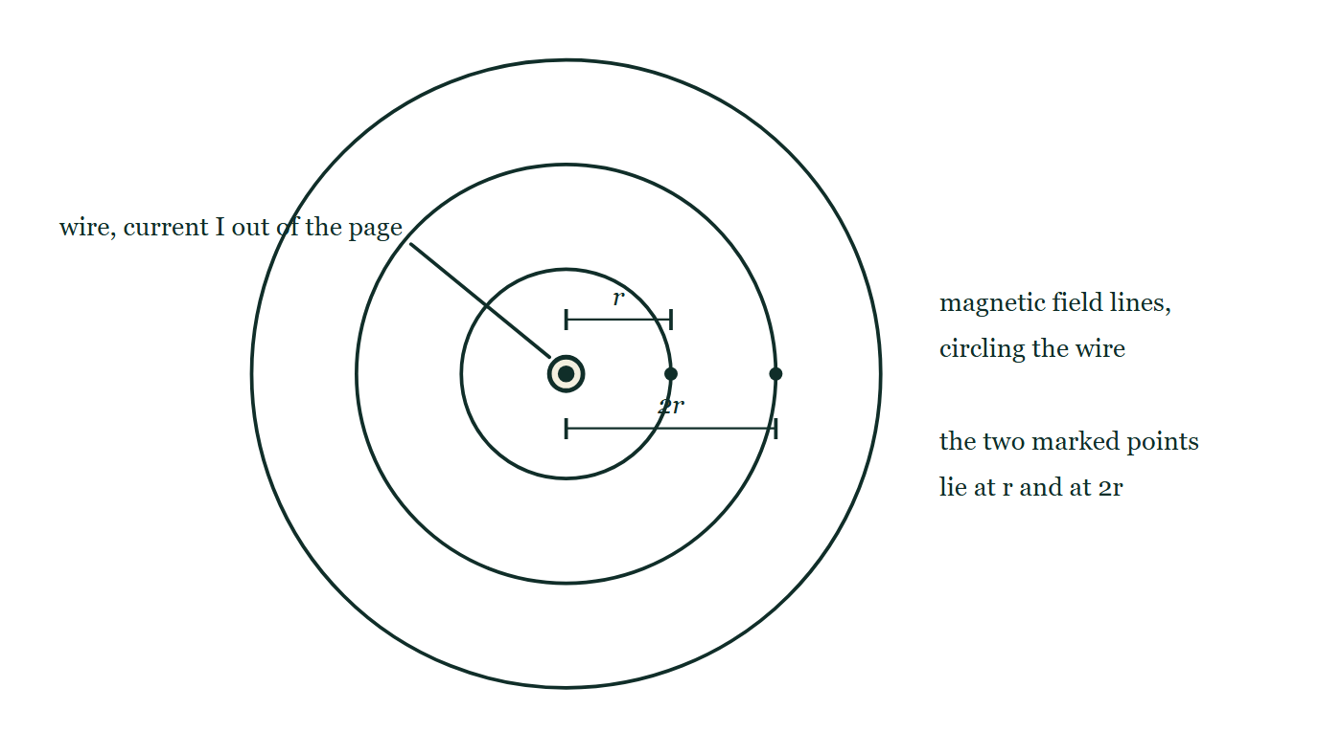
MAGNETISM · CURRENTS MAKE FIELDS
GIOPHYSICS LESSON
THINK FIRST
A charged-up battery sitting in your pocket deflects no compass at all. Oersted's wire, running off the same battery, swings one right round. What is different?
Take answers before you click — the point is the commitment
In 1820 Hans Christian Oersted noticed a compass twitch every time he closed a circuit on his bench, and stop twitching the moment he opened it. Both the battery and the wire are full of charge.
THE ANSWER
The charge has to be moving. Magnetism is what moving charge does — a static charge makes an electric field and nothing else. Close the circuit and the charge drifts along the wire; that drift, and only that drift, wraps a magnetic field round it.
A single straight wire drawn end-on as a dot in a circle, with the current coming out of the page towards the reader. Three field lines are drawn as circles centred on the wire, at increasing radii, deliberately without arrowheads. Two points on the same side of the wire are marked and dimensioned, one at distance r and one at 2r.
The live version of this figure — click here
Magnetism — Currents Make Fields. Built by GioPhysics from the lesson's own copy; nothing on these slides is re-authored.
3 / 32
Notes:
[Phase] Starter: Recall what this lesson stands on (minutes 0–5 of 45)
[Hook] A charged-up battery sitting in your pocket deflects no compass at all. Oersted's wire, running off the same battery, swings one right round. What is different? In 1820 Hans Christian Oersted noticed a compass twitch every time he closed a circuit on his bench, and stop twitching the moment he opened it. Both the battery and the wire are full of charge.
[Answer] The charge has to be moving. Magnetism is what moving charge does — a static charge makes an electric field and nothing else. Close the circuit and the charge drifts along the wire; that drift, and only that drift, wraps a magnetic field round it.
[Figure] A single straight wire drawn end-on as a dot in a circle, with the current coming out of the page towards the reader. Three field lines are drawn as circles centred on the wire, at increasing radii, deliberately without arrowheads. Two points on the same side of the wire are marked and dimensioned, one at distance r and one at 2r.

Slide 4
MAGNETISM · CURRENTS MAKE FIELDS
GIOPHYSICS LESSON
EXPLAINED SIMPLY
In one sentence
Introduce the idea — The big idea and the definition
Every electric current produces a magnetic field circling the current's direction.
Magnetism — Currents Make Fields. Built by GioPhysics from the lesson's own copy; nothing on these slides is re-authored.
4 / 32
Notes:
[Phase] Introduce the idea: The big idea and the definition (minutes 5–13 of 45)
[Definition] Every electric current produces a magnetic field circling the current's direction.

Slide 5
MAGNETISM · CURRENTS MAKE FIELDS
GIOPHYSICS LESSON
EXPLAINED SIMPLY
What that looks like
Introduce the idea — The big idea and the definition
FOR EXAMPLE
Grip a wire with your right thumb along the current — your curled fingers give the field's circular direction.
Magnetism — Currents Make Fields. Built by GioPhysics from the lesson's own copy; nothing on these slides is re-authored.
5 / 32
Notes:
[Phase] Introduce the idea: The big idea and the definition (minutes 5–13 of 45)
[Worked illustration] Grip a wire with your right thumb along the current — your curled fingers give the field's circular direction.

Slide 6
MAGNETISM · CURRENTS MAKE FIELDS
GIOPHYSICS LESSON
THE BIG IDEA
Oersted's accidental discovery
Introduce the idea — The big idea and the definition
A straight current wraps circular field lines around itself — direction by the right-hand grip rule, strength B = μ₀I/2πr. Coiling the wire concentrates the field: a solenoid's interior field is uniform and grows with turns and current, and an iron core multiplies it into an electromagnet.
Magnetism — Currents Make Fields. Built by GioPhysics from the lesson's own copy; nothing on these slides is re-authored.
6 / 32
Notes:
[Phase] Introduce the idea: The big idea and the definition (minutes 5–13 of 45)
[Big idea] A straight current wraps circular field lines around itself — direction by the right-hand grip rule, strength B = μ₀I/2πr. Coiling the wire concentrates the field: a solenoid's interior field is uniform and grows with turns and current, and an iron core multiplies it into an electromagnet.

Slide 7
MAGNETISM · CURRENTS MAKE FIELDS
GIOPHYSICS LESSON
THE PHYSICS · 1 OF 3
Wire field pattern
Build the model — The formulae, one at a time, in plain English
Concentric circles centred on the wire, closer together near it. Reverse the current and every circle reverses direction.
Magnetism — Currents Make Fields. Built by GioPhysics from the lesson's own copy; nothing on these slides is re-authored.
7 / 32
Notes:
[Phase] Build the model: The formulae, one at a time, in plain English (minutes 13–22 of 45)
[Section] Concentric circles centred on the wire, closer together near it. Reverse the current and every circle reverses direction.

Slide 8
MAGNETISM · CURRENTS MAKE FIELDS
GIOPHYSICS LESSON
THE PHYSICS · 2 OF 3
From loop to solenoid
Build the model — The formulae, one at a time, in plain English
A single loop's field looks like a tiny bar magnet's. Stack many loops and the pattern straightens into a solenoid — a controllable magnet with N and S ends.
Magnetism — Currents Make Fields. Built by GioPhysics from the lesson's own copy; nothing on these slides is re-authored.
8 / 32
Notes:
[Phase] Build the model: The formulae, one at a time, in plain English (minutes 13–22 of 45)
[Section] A single loop's field looks like a tiny bar magnet's. Stack many loops and the pattern straightens into a solenoid — a controllable magnet with N and S ends.

Slide 9
MAGNETISM · CURRENTS MAKE FIELDS
GIOPHYSICS LESSON
THE PHYSICS · 3 OF 3
Electromagnets
Build the model — The formulae, one at a time, in plain English
A soft-iron core magnifies the field enormously and switches off with the current — cranes, relays, door locks, and MRI machines all rely on it.
Magnetism — Currents Make Fields. Built by GioPhysics from the lesson's own copy; nothing on these slides is re-authored.
9 / 32
Notes:
[Phase] Build the model: The formulae, one at a time, in plain English (minutes 13–22 of 45)
[Section] A soft-iron core magnifies the field enormously and switches off with the current — cranes, relays, door locks, and MRI machines all rely on it.

Slide 10
MAGNETISM · CURRENTS MAKE FIELDS
GIOPHYSICS LESSON
FORMULA 1 OF 3
Straight wire
Build the model — The formulae, one at a time, in plain English
B = μ₀I/2πr
μ₀ = 4π × 10⁻⁷ T·m/A
IN PLAIN ENGLISH
The field circles the wire, weakening with distance — double the current doubles it, double the distance halves it.
Magnetism — Currents Make Fields. Built by GioPhysics from the lesson's own copy; nothing on these slides is re-authored.
10 / 32
Notes:
[Phase] Build the model: The formulae, one at a time, in plain English (minutes 13–22 of 45)
[Formula] Straight wire: B = μ₀I/2πr
[In plain English] The field circles the wire, weakening with distance — double the current doubles it, double the distance halves it.
[Note] μ₀ = 4π × 10⁻⁷ T·m/A

Slide 11
MAGNETISM · CURRENTS MAKE FIELDS
GIOPHYSICS LESSON
FORMULA 2 OF 3
Solenoid
Build the model — The formulae, one at a time, in plain English
B = μ₀nI
n = turns per metre; uniform inside
IN PLAIN ENGLISH
Inside a long coil the loops' fields add into a uniform field along the axis — more turns per metre or more current strengthens it.
Magnetism — Currents Make Fields. Built by GioPhysics from the lesson's own copy; nothing on these slides is re-authored.
11 / 32
Notes:
[Phase] Build the model: The formulae, one at a time, in plain English (minutes 13–22 of 45)
[Formula] Solenoid: B = μ₀nI
[In plain English] Inside a long coil the loops' fields add into a uniform field along the axis — more turns per metre or more current strengthens it.
[Note] n = turns per metre; uniform inside

Slide 12
MAGNETISM · CURRENTS MAKE FIELDS
GIOPHYSICS LESSON
FORMULA 3 OF 3
Grip rule
Build the model — The formulae, one at a time, in plain English
thumb = I, fingers = B
For loops: fingers = I, thumb = B
IN PLAIN ENGLISH
The right hand converts between current direction and field direction for wires and coils alike.
Magnetism — Currents Make Fields. Built by GioPhysics from the lesson's own copy; nothing on these slides is re-authored.
12 / 32
Notes:
[Phase] Build the model: The formulae, one at a time, in plain English (minutes 13–22 of 45)
[Formula] Grip rule: thumb = I, fingers = B
[In plain English] The right hand converts between current direction and field direction for wires and coils alike.
[Note] For loops: fingers = I, thumb = B

Slide 13
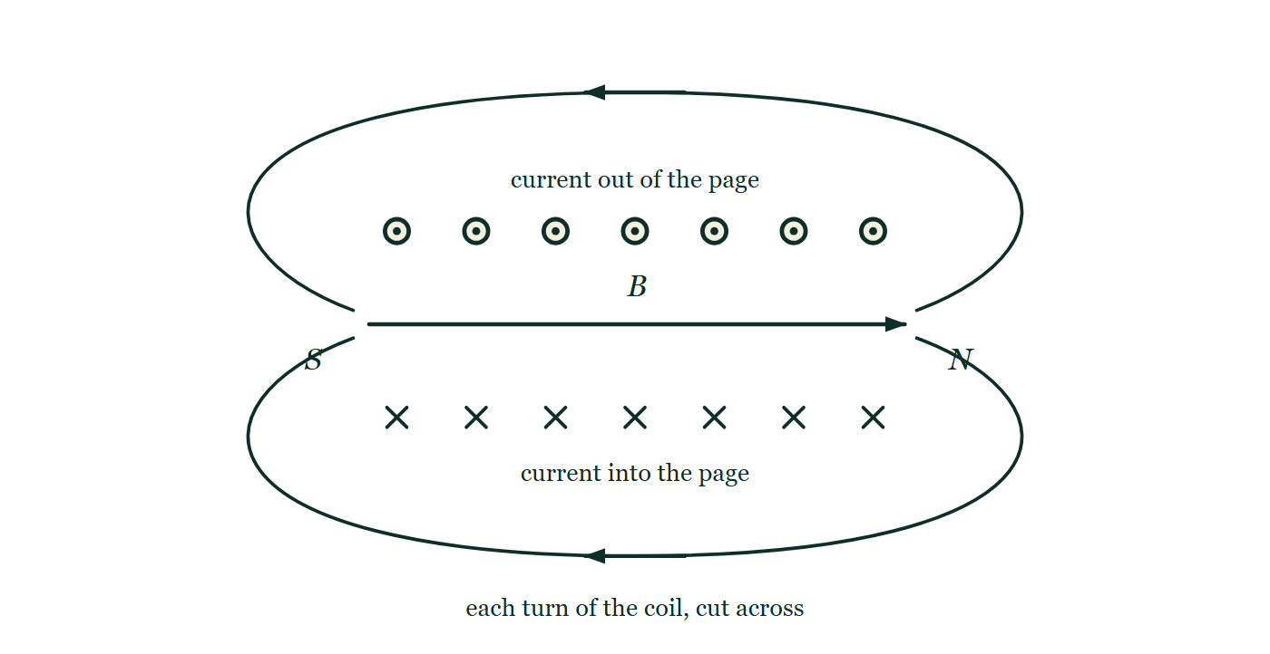
MAGNETISM · CURRENTS MAKE FIELDS
GIOPHYSICS LESSON
THE PICTURE
A solenoid, cut across its turns
Drawn for this lesson
A solenoid sliced lengthwise so each turn appears twice: a row of seven dots above the axis, where the current comes out of the page, and a row of seven crosses below, where it goes back in. A single long arrow runs left to right down the middle for the uniform interior field, and two field lines loop out of the right-hand end, round the outside, and back into the left-hand end.
The live version of this figure — click here
Magnetism — Currents Make Fields. Built by GioPhysics from the lesson's own copy; nothing on these slides is re-authored.
13 / 32
Notes:
[Phase] Build the model: The formulae, one at a time, in plain English (minutes 13–22 of 45)
[Figure] A solenoid sliced lengthwise so each turn appears twice: a row of seven dots above the axis, where the current comes out of the page, and a row of seven crosses below, where it goes back in. A single long arrow runs left to right down the middle for the uniform interior field, and two field lines loop out of the right-hand end, round the outside, and back into the left-hand end.

Slide 14
MAGNETISM · CURRENTS MAKE FIELDS
GIOPHYSICS LESSON
WATCH OUT
The common trap
Check and misconception — The quick check and the trap
A stationary charge makes no magnetic field, and a steady magnet exerts no force on a stationary charge — magnetism is the physics of moving charge.
Magnetism — Currents Make Fields. Built by GioPhysics from the lesson's own copy; nothing on these slides is re-authored.
14 / 32
Notes:
[Phase] Check and misconception: The quick check and the trap (minutes 35–41 of 45)
[Misconception] A stationary charge makes no magnetic field, and a steady magnet exerts no force on a stationary charge — magnetism is the physics of moving charge.

Slide 15
MAGNETISM · CURRENTS MAKE FIELDS
GIOPHYSICS LESSON
WORKED EXAMPLE 1 OF 2 · EASY
The question
Easy
Worked examples — I do, we do — one step revealed at a time
A wire carries current straight toward you. Which way do its magnetic field lines circle?
Magnetism — Currents Make Fields. Built by GioPhysics from the lesson's own copy; nothing on these slides is re-authored.
15 / 32
Notes:
[Phase] Worked examples: I do, we do — one step revealed at a time (minutes 22–35 of 45)
[Question] A wire carries current straight toward you. Which way do its magnetic field lines circle?
[Answer] Anticlockwise (viewed head-on)

Slide 16
MAGNETISM · CURRENTS MAKE FIELDS
GIOPHYSICS LESSON
WORKED EXAMPLE 1 OF 2 · EASY · THE WORKING
How to solve it
Easy
Worked examples — I do, we do — one step revealed at a time
A wire carries current straight toward you. Which way do its magnetic field lines circle?
1.
Point the right thumb at yourself (along I).
2.
The fingers curl anticlockwise — the field circles anticlockwise as you see it.
Magnetism — Currents Make Fields. Built by GioPhysics from the lesson's own copy; nothing on these slides is re-authored.
16 / 32
Notes:
[Phase] Worked examples: I do, we do — one step revealed at a time (minutes 22–35 of 45)
[Reveal] One click per step. The class works each line before the next appears.
[Step 1] Point the right thumb at yourself (along I).
[Step 2] The fingers curl anticlockwise — the field circles anticlockwise as you see it.

Slide 17
MAGNETISM · CURRENTS MAKE FIELDS
GIOPHYSICS LESSON
WORKED EXAMPLE 1 OF 2 · EASY
Answer
Easy
Worked examples — I do, we do — one step revealed at a time
Anticlockwise (viewed head-on)
Magnetism — Currents Make Fields. Built by GioPhysics from the lesson's own copy; nothing on these slides is re-authored.
17 / 32
Notes:
[Phase] Worked examples: I do, we do — one step revealed at a time (minutes 22–35 of 45)
[Answer] Anticlockwise (viewed head-on)

Slide 18
MAGNETISM · CURRENTS MAKE FIELDS
GIOPHYSICS LESSON
WORKED EXAMPLE 2 OF 2 · MEDIUM
The question
Medium
Worked examples — I do, we do — one step revealed at a time
Find the field 5.0 cm from a wire carrying 20 A, and compare it with Earth's ≈ 5 × 10⁻⁵ T.
Magnetism — Currents Make Fields. Built by GioPhysics from the lesson's own copy; nothing on these slides is re-authored.
18 / 32
Notes:
[Phase] Worked examples: I do, we do — one step revealed at a time (minutes 22–35 of 45)
[Question] Find the field 5.0 cm from a wire carrying 20 A, and compare it with Earth's ≈ 5 × 10⁻⁵ T.
[Answer] B = 8 × 10⁻⁵ T, larger than Earth's field

Slide 19
MAGNETISM · CURRENTS MAKE FIELDS
GIOPHYSICS LESSON
WORKED EXAMPLE 2 OF 2 · MEDIUM · THE WORKING
How to solve it
Medium
Worked examples — I do, we do — one step revealed at a time
Find the field 5.0 cm from a wire carrying 20 A, and compare it with Earth's ≈ 5 × 10⁻⁵ T.
1.
B = μ₀I/2πr = (4π × 10⁻⁷ × 20)/(2π × 0.05).
2.
B = (2 × 10⁻⁷ × 20)/0.05 = 8 × 10⁻⁵ T.
3.
About 1.6× Earth's field — enough to deflect a nearby compass, as Oersted saw.
Magnetism — Currents Make Fields. Built by GioPhysics from the lesson's own copy; nothing on these slides is re-authored.
19 / 32
Notes:
[Phase] Worked examples: I do, we do — one step revealed at a time (minutes 22–35 of 45)
[Reveal] One click per step. The class works each line before the next appears.
[Step 1] B = μ₀I/2πr = (4π × 10⁻⁷ × 20)/(2π × 0.05).
[Step 2] B = (2 × 10⁻⁷ × 20)/0.05 = 8 × 10⁻⁵ T.
[Step 3] About 1.6× Earth's field — enough to deflect a nearby compass, as Oersted saw.

Slide 20
MAGNETISM · CURRENTS MAKE FIELDS
GIOPHYSICS LESSON
WORKED EXAMPLE 2 OF 2 · MEDIUM
Answer
Medium
Worked examples — I do, we do — one step revealed at a time
B = 8 × 10⁻⁵ T, larger than Earth's field
Magnetism — Currents Make Fields. Built by GioPhysics from the lesson's own copy; nothing on these slides is re-authored.
20 / 32
Notes:
[Phase] Worked examples: I do, we do — one step revealed at a time (minutes 22–35 of 45)
[Answer] B = 8 × 10⁻⁵ T, larger than Earth's field

Slide 21
MAGNETISM · CURRENTS MAKE FIELDS
GIOPHYSICS LESSON
SPOT THE MISTAKE
One line here is wrong
The whole working is up — find the bad line before you click
1.
B = μ₀I / 2πr, and μ₀/2π = 2 × 10⁻⁷ T·m/A
2.
I = 20 A, r = 5.0 cm from the wire
3.
B = 2 × 10⁻⁷ × 20 ÷ 5.0 = 8 × 10⁻⁷ T
4.
That is far weaker than the Earth's 5 × 10⁻⁵ T, so no compass would notice it
LINE 3 IS WRONG
The distance went into the formula in centimetres. Every quantity in B = μ₀I/2πr is an SI one, and 5.0 cm is 0.050 m — a factor of a hundred, which here is the whole difference between a field a compass ignores and the field Oersted actually saw.
IT SHOULD SAY
B = 2 × 10⁻⁷ × 20 ÷ 0.050 = 8 × 10⁻⁵ T
Magnetism — Currents Make Fields. Built by GioPhysics from the lesson's own copy; nothing on these slides is re-authored.
21 / 32
Notes:
[Phase] Worked examples: I do, we do — one step revealed at a time (minutes 22–35 of 45)
[Spot the mistake] The working is complete and one line of it is wrong. Let the room hunt: one click names the line, a second shows it done correctly.
[Line 3 is wrong] The distance went into the formula in centimetres. Every quantity in B = μ₀I/2πr is an SI one, and 5.0 cm is 0.050 m — a factor of a hundred, which here is the whole difference between a field a compass ignores and the field Oersted actually saw.
[It should say] B = 2 × 10⁻⁷ × 20 ÷ 0.050 = 8 × 10⁻⁵ T

Slide 22
MAGNETISM · CURRENTS MAKE FIELDS
GIOPHYSICS LESSON
PREDICT · TAKE THE VOTE
Commit before you are told
Hands up for each option, then click
The current comes straight out of the page towards you. Which way does the magnetic field go round the wire?
A Clockwise, as you look at the page
B Anticlockwise, as you look at the page
C It does not go round at all — it points straight out from the wire, like the field of a charge
A single straight wire drawn end-on as a dot in a circle, with the current coming out of the page towards the reader. Three field lines are drawn as circles centred on the wire, at increasing radii, deliberately without arrowheads. Two points on the same side of the wire are marked and dimensioned, one at distance r and one at 2r.
The live version of this figure — click here
Magnetism — Currents Make Fields. Built by GioPhysics from the lesson's own copy; nothing on these slides is re-authored.
22 / 32
Notes:
[Phase] Build the model: The formulae, one at a time, in plain English (minutes 13–22 of 45)
[Predict] The current comes straight out of the page towards you. Which way does the magnetic field go round the wire?
[Options] A Clockwise, as you look at the page B Anticlockwise, as you look at the page C It does not go round at all — it points straight out from the wire, like the field of a charge
[Figure] A single straight wire drawn end-on as a dot in a circle, with the current coming out of the page towards the reader. Three field lines are drawn as circles centred on the wire, at increasing radii, deliberately without arrowheads. Two points on the same side of the wire are marked and dimensioned, one at distance r and one at 2r.

Slide 23
MAGNETISM · CURRENTS MAKE FIELDS
GIOPHYSICS LESSON
PREDICT · THE OUTCOME
What actually happens
Ask the room who changed their mind, and why
B Anticlockwise, as you look at the page
WHY
Grip the wire with the right hand, thumb along the current — which here means the thumb pointing at your own face. The fingers then curl anticlockwise as you look down at the page, and the fingers are the field. That is the whole grip rule, and the drawn circles are exactly the paths the fingers trace.
Magnetism — Currents Make Fields. Built by GioPhysics from the lesson's own copy; nothing on these slides is re-authored.
23 / 32
Notes:
[Phase] Build the model: The formulae, one at a time, in plain English (minutes 13–22 of 45)
[Answer] B — Anticlockwise, as you look at the page. Grip the wire with the right hand, thumb along the current — which here means the thumb pointing at your own face. The fingers then curl anticlockwise as you look down at the page, and the fingers are the field. That is the whole grip rule, and the drawn circles are exactly the paths the fingers trace.

Slide 24
MAGNETISM · CURRENTS MAKE FIELDS
GIOPHYSICS LESSON
QUICK CHECK
Decide before the answer goes up
Check and misconception — The quick check and the trap
Doubling the current in a long wire and doubling your distance from it changes B by…
A
×4
B
×1 (no change)
C
×½
Magnetism — Currents Make Fields. Built by GioPhysics from the lesson's own copy; nothing on these slides is re-authored.
24 / 32
Notes:
[Phase] Check and misconception: The quick check and the trap (minutes 35–41 of 45)
[Question] Doubling the current in a long wire and doubling your distance from it changes B by…
[Options] A ×4 B ×1 (no change) C ×½

Slide 25
MAGNETISM · CURRENTS MAKE FIELDS
GIOPHYSICS LESSON
QUICK CHECK · THE ANSWER
The answer, and why
Check and misconception — The quick check and the trap
B ×1 (no change)
HOW TO GET THERE
B ∝ I/r — doubling both leaves the field exactly as it was.
WHY THE OTHERS TEMPT
A This is what you get by multiplying the two changes instead of dividing: doubling the current does double the field, but doubling the distance is a division, not another multiplication.
B Correct. B ∝ I/r, so ×2 on the top and ×2 on the bottom leave the field untouched.
C Halving is what happens if you move to twice the distance and leave the current alone. Here the current was doubled as well, and that doubling cancels the halving exactly.
Magnetism — Currents Make Fields. Built by GioPhysics from the lesson's own copy; nothing on these slides is re-authored.
25 / 32
Notes:
[Phase] Check and misconception: The quick check and the trap (minutes 35–41 of 45)
[Question] Doubling the current in a long wire and doubling your distance from it changes B by…
[Option by option] A: This is what you get by multiplying the two changes instead of dividing: doubling the current does double the field, but doubling the distance is a division, not another multiplication. B: Correct. B ∝ I/r, so ×2 on the top and ×2 on the bottom leave the field untouched. C: Halving is what happens if you move to twice the distance and leave the current alone. Here the current was doubled as well, and that doubling cancels the halving exactly.
[Answer] B — ×1 (no change)
[Why] B ∝ I/r — doubling both leaves the field exactly as it was.
[Reveal] One click for the answer, then one for the reason.

Slide 26
MAGNETISM · CURRENTS MAKE FIELDS
GIOPHYSICS LESSON
EXTENSION 1 OF 2 · HARD
The question
Hard
Worked examples — I do, we do — one step revealed at a time
A solenoid 0.30 m long with 600 turns carries 2.5 A. Find the field inside, and with a soft-iron core of relative permeability 400.
Magnetism — Currents Make Fields. Built by GioPhysics from the lesson's own copy; nothing on these slides is re-authored.
26 / 32
Notes:
[Phase] Worked examples: I do, we do — one step revealed at a time (minutes 22–35 of 45)
[Question] A solenoid 0.30 m long with 600 turns carries 2.5 A. Find the field inside, and with a soft-iron core of relative permeability 400.
[Answer] 6.3 mT air-cored; ≈ 2.5 T with the iron core

Slide 27
MAGNETISM · CURRENTS MAKE FIELDS
GIOPHYSICS LESSON
EXTENSION 1 OF 2 · HARD · THE WORKING
How to solve it
Hard
Worked examples — I do, we do — one step revealed at a time
A solenoid 0.30 m long with 600 turns carries 2.5 A. Find the field inside, and with a soft-iron core of relative permeability 400.
1.
n = 600 ÷ 0.30 = 2000 turns/m; B = μ₀nI = 4π × 10⁻⁷ × 2000 × 2.5 ≈ 6.3 × 10⁻³ T.
2.
The core multiplies it: B ≈ 400 × 6.3 mT.
3.
≈ 2.5 T — electromagnet territory.
Magnetism — Currents Make Fields. Built by GioPhysics from the lesson's own copy; nothing on these slides is re-authored.
27 / 32
Notes:
[Phase] Worked examples: I do, we do — one step revealed at a time (minutes 22–35 of 45)
[Reveal] One click per step. The class works each line before the next appears.
[Step 1] n = 600 ÷ 0.30 = 2000 turns/m; B = μ₀nI = 4π × 10⁻⁷ × 2000 × 2.5 ≈ 6.3 × 10⁻³ T.
[Step 2] The core multiplies it: B ≈ 400 × 6.3 mT.
[Step 3] ≈ 2.5 T — electromagnet territory.

Slide 28
MAGNETISM · CURRENTS MAKE FIELDS
GIOPHYSICS LESSON
EXTENSION 1 OF 2 · HARD
Answer
Hard
Worked examples — I do, we do — one step revealed at a time
6.3 mT air-cored; ≈ 2.5 T with the iron core
Magnetism — Currents Make Fields. Built by GioPhysics from the lesson's own copy; nothing on these slides is re-authored.
28 / 32
Notes:
[Phase] Worked examples: I do, we do — one step revealed at a time (minutes 22–35 of 45)
[Answer] 6.3 mT air-cored; ≈ 2.5 T with the iron core

Slide 29
MAGNETISM · CURRENTS MAKE FIELDS
GIOPHYSICS LESSON
EXTENSION 2 OF 2 · CHALLENGING
The question
Challenging
Worked examples — I do, we do — one step revealed at a time
Two long parallel wires 0.10 m apart each carry 15 A in the same direction. Find the force per metre between them and its direction; state what happens if one current reverses.
Magnetism — Currents Make Fields. Built by GioPhysics from the lesson's own copy; nothing on these slides is re-authored.
29 / 32
Notes:
[Phase] Worked examples: I do, we do — one step revealed at a time (minutes 22–35 of 45)
[Question] Two long parallel wires 0.10 m apart each carry 15 A in the same direction. Find the force per metre between them and its direction; state what happens if one current reverses.
[Answer] 4.5 × 10⁻⁴ N/m attraction; reversal makes it repulsion

Slide 30
MAGNETISM · CURRENTS MAKE FIELDS
GIOPHYSICS LESSON
EXTENSION 2 OF 2 · CHALLENGING · THE WORKING
How to solve it
Challenging
Worked examples — I do, we do — one step revealed at a time
Two long parallel wires 0.10 m apart each carry 15 A in the same direction. Find the force per metre between them and its direction; state what happens if one current reverses.
1.
Field of one at the other: B = μ₀I/2πr = 2 × 10⁻⁷ × 15 ÷ 0.10 = 3.0 × 10⁻⁵ T.
2.
F/L = BI = 3.0 × 10⁻⁵ × 15 = 4.5 × 10⁻⁴ N/m.
3.
Same-direction currents attract; reversing one turns it into an equal repulsion — the historical definition of the ampere.
Magnetism — Currents Make Fields. Built by GioPhysics from the lesson's own copy; nothing on these slides is re-authored.
30 / 32
Notes:
[Phase] Worked examples: I do, we do — one step revealed at a time (minutes 22–35 of 45)
[Reveal] One click per step. The class works each line before the next appears.
[Step 1] Field of one at the other: B = μ₀I/2πr = 2 × 10⁻⁷ × 15 ÷ 0.10 = 3.0 × 10⁻⁵ T.
[Step 2] F/L = BI = 3.0 × 10⁻⁵ × 15 = 4.5 × 10⁻⁴ N/m.
[Step 3] Same-direction currents attract; reversing one turns it into an equal repulsion — the historical definition of the ampere.

Slide 31
MAGNETISM · CURRENTS MAKE FIELDS
GIOPHYSICS LESSON
EXTENSION 2 OF 2 · CHALLENGING
Answer
Challenging
Worked examples — I do, we do — one step revealed at a time
4.5 × 10⁻⁴ N/m attraction; reversal makes it repulsion
Magnetism — Currents Make Fields. Built by GioPhysics from the lesson's own copy; nothing on these slides is re-authored.
31 / 32
Notes:
[Phase] Worked examples: I do, we do — one step revealed at a time (minutes 22–35 of 45)
[Answer] 4.5 × 10⁻⁴ N/m attraction; reversal makes it repulsion

Slide 32
MAGNETISM · CURRENTS MAKE FIELDS
GIOPHYSICS LESSON
MAGNETISM
Where to go next
Plenary — What to take away, what to practise next
Next
18.3 Force on Currents
https://giophysics.com/chapter-27/force-on-currents/
Lesson
This lesson on giophysics.com
https://giophysics.com/chapter-27/currents-magnetic-fields/
Live
The live, interactive version of these slides
https://giophysics.com/chapter-27/presentation/?lesson=currents
Chapter
All Magnetism lessons
https://giophysics.com/chapter-27/
PDF
Download the lesson PDF
https://giophysics.com/downloads/27-2-currents-magnetic-fields.pdf
Magnetism — Currents Make Fields. Built by GioPhysics from the lesson's own copy; nothing on these slides is re-authored.
32 / 32
Notes:
[Phase] Plenary: What to take away, what to practise next (minutes 41–45 of 45)
[Interactive] The graphs and the circuit topology on these slides are frozen. The live version at https://giophysics.com/chapter-27/presentation/?lesson=currents moves them.

