Slide 1
MAGNETISM · MAGNETS & MAGNETIC FIELDS
GIOPHYSICS LESSON
18 · Magnetism
Poles, field lines, and the Earth
Magnets & Magnetic Fields
Every magnet has two inseparable poles. Field lines map the force it would exert — emerging from north, entering south — and the Earth itself carries a field that compasses follow.
POSITION
Lesson 1 of 6 in Magnetism
PLAN
16 slides in the 45-minute core run, about 44.5 minutes of it
LESSON PAGE
https://giophysics.com/chapter-27/magnets-magnetic-fields/
Built by GioPhysics from the lesson's own page. Every word on these slides is the lesson's; nothing here is re-authored. Teaching material, not an awarding body's document.
Magnetism — Magnets & Magnetic Fields. Built by GioPhysics from the lesson's own copy; nothing on these slides is re-authored.
1 / 33
Notes:
[Lesson] Magnetism — Magnets & Magnetic Fields. Lesson 1 of 6.
[Intro] Every magnet has two inseparable poles. Field lines map the force it would exert — emerging from north, entering south — and the Earth itself carries a field that compasses follow.
[Source] https://giophysics.com/chapter-27/magnets-magnetic-fields/
[Disclaimer] Built by GioPhysics from the lesson's own page. Every word on these slides is the lesson's; nothing here is re-authored. Teaching material, not an awarding body's document.

Slide 2
MAGNETISM · MAGNETS & MAGNETIC FIELDS
GIOPHYSICS LESSON
WHAT THIS NEEDS
What you already know
Starter — Recall what this lesson stands on
Recall
Field-line ideas
https://giophysics.com/chapter-20/electric-field-lines-direction/
Magnetism — Magnets & Magnetic Fields. Built by GioPhysics from the lesson's own copy; nothing on these slides is re-authored.
2 / 33
Notes:
[Phase] Starter: Recall what this lesson stands on (minutes 0–5 of 45)
[Starter] Recall: Field-line ideas

Slide 3
MAGNETISM · MAGNETS & MAGNETIC FIELDS
GIOPHYSICS LESSON
THINK FIRST
Your compass needle swings to the north — so what kind of magnetic pole is buried up there?
Take answers before you click — the point is the commitment
Every walker's compass on Earth does the same thing: one end of the needle turns towards the Arctic and stays there. The needle is itself a small bar magnet, and it is the end painted red — its north end — that points that way.
THE ANSWER
A magnetic south pole. Unlike poles attract, so the needle's north end can only be pulled towards a south pole. The Earth's geographic north is magnetically a south pole; the naming is a four-hundred-year-old accident nobody has been willing to fix.
Magnetism — Magnets & Magnetic Fields. Built by GioPhysics from the lesson's own copy; nothing on these slides is re-authored.
3 / 33
Notes:
[Phase] Starter: Recall what this lesson stands on (minutes 0–5 of 45)
[Hook] Your compass needle swings to the north — so what kind of magnetic pole is buried up there? Every walker's compass on Earth does the same thing: one end of the needle turns towards the Arctic and stays there. The needle is itself a small bar magnet, and it is the end painted red — its north end — that points that way.
[Answer] A magnetic south pole. Unlike poles attract, so the needle's north end can only be pulled towards a south pole. The Earth's geographic north is magnetically a south pole; the naming is a four-hundred-year-old accident nobody has been willing to fix.

Slide 4
MAGNETISM · MAGNETS & MAGNETIC FIELDS
GIOPHYSICS LESSON
EXPLAINED SIMPLY
In one sentence
Introduce the idea — The big idea and the definition
A magnetic field is the region around a magnet or current where magnetic materials and moving charges experience a force.
Magnetism — Magnets & Magnetic Fields. Built by GioPhysics from the lesson's own copy; nothing on these slides is re-authored.
4 / 33
Notes:
[Phase] Introduce the idea: The big idea and the definition (minutes 5–13 of 45)
[Definition] A magnetic field is the region around a magnet or current where magnetic materials and moving charges experience a force.

Slide 5
MAGNETISM · MAGNETS & MAGNETIC FIELDS
GIOPHYSICS LESSON
EXPLAINED SIMPLY
What that looks like
Introduce the idea — The big idea and the definition
FOR EXAMPLE
Iron filings sprinkled around a bar magnet line up along the field, drawing its shape from pole to pole.
Magnetism — Magnets & Magnetic Fields. Built by GioPhysics from the lesson's own copy; nothing on these slides is re-authored.
5 / 33
Notes:
[Phase] Introduce the idea: The big idea and the definition (minutes 5–13 of 45)
[Worked illustration] Iron filings sprinkled around a bar magnet line up along the field, drawing its shape from pole to pole.

Slide 6
MAGNETISM · MAGNETS & MAGNETIC FIELDS
GIOPHYSICS LESSON
THE BIG IDEA
Poles, field lines, and the Earth
Introduce the idea — The big idea and the definition
Like poles repel, unlike attract, and cutting a magnet always yields two new complete magnets. The field concept replaces action-at-a-distance: a magnet fills space with a field, and other magnets or moving charges respond to the field where they are. Field strength B is measured in tesla.
Magnetism — Magnets & Magnetic Fields. Built by GioPhysics from the lesson's own copy; nothing on these slides is re-authored.
6 / 33
Notes:
[Phase] Introduce the idea: The big idea and the definition (minutes 5–13 of 45)
[Big idea] Like poles repel, unlike attract, and cutting a magnet always yields two new complete magnets. The field concept replaces action-at-a-distance: a magnet fills space with a field, and other magnets or moving charges respond to the field where they are. Field strength B is measured in tesla.

Slide 7
MAGNETISM · MAGNETS & MAGNETIC FIELDS
GIOPHYSICS LESSON
THE PHYSICS · 1 OF 3
Magnetic materials
Build the model — The formulae, one at a time, in plain English
Iron, nickel, cobalt and their alloys are ferromagnetic: their atomic magnets can align into domains. Induced magnetism explains why an unmagnetised nail sticks to a magnet.
Magnetism — Magnets & Magnetic Fields. Built by GioPhysics from the lesson's own copy; nothing on these slides is re-authored.
7 / 33
Notes:
[Phase] Build the model: The formulae, one at a time, in plain English (minutes 13–22 of 45)
[Section] Iron, nickel, cobalt and their alloys are ferromagnetic: their atomic magnets can align into domains. Induced magnetism explains why an unmagnetised nail sticks to a magnet.

Slide 8
MAGNETISM · MAGNETS & MAGNETIC FIELDS
GIOPHYSICS LESSON
THE PHYSICS · 2 OF 3
Hard and soft
Build the model — The formulae, one at a time, in plain English
Steel (hard) keeps its magnetism — good for permanent magnets. Soft iron magnetises and demagnetises easily — good for electromagnet cores.
Magnetism — Magnets & Magnetic Fields. Built by GioPhysics from the lesson's own copy; nothing on these slides is re-authored.
8 / 33
Notes:
[Phase] Build the model: The formulae, one at a time, in plain English (minutes 13–22 of 45)
[Section] Steel (hard) keeps its magnetism — good for permanent magnets. Soft iron magnetises and demagnetises easily — good for electromagnet cores.

Slide 9
MAGNETISM · MAGNETS & MAGNETIC FIELDS
GIOPHYSICS LESSON
THE PHYSICS · 3 OF 3
Earth's field
Build the model — The formulae, one at a time, in plain English
A compass needle is a small magnet aligning with Earth's field. The geographic north pole is magnetically a south pole — that is why the needle's north end points there.
Magnetism — Magnets & Magnetic Fields. Built by GioPhysics from the lesson's own copy; nothing on these slides is re-authored.
9 / 33
Notes:
[Phase] Build the model: The formulae, one at a time, in plain English (minutes 13–22 of 45)
[Section] A compass needle is a small magnet aligning with Earth's field. The geographic north pole is magnetically a south pole — that is why the needle's north end points there.

Slide 10
MAGNETISM · MAGNETS & MAGNETIC FIELDS
GIOPHYSICS LESSON
FORMULA 1 OF 3
Field direction
Build the model — The formulae, one at a time, in plain English
N → S outside the magnet
Closed loops overall
IN PLAIN ENGLISH
Field lines leave the north pole, curve round to the south, and continue inside the magnet — they never start, stop, or cross.
Magnetism — Magnets & Magnetic Fields. Built by GioPhysics from the lesson's own copy; nothing on these slides is re-authored.
10 / 33
Notes:
[Phase] Build the model: The formulae, one at a time, in plain English (minutes 13–22 of 45)
[Formula] Field direction: N → S outside the magnet
[In plain English] Field lines leave the north pole, curve round to the south, and continue inside the magnet — they never start, stop, or cross.
[Note] Closed loops overall

Slide 11
MAGNETISM · MAGNETS & MAGNETIC FIELDS
GIOPHYSICS LESSON
FORMULA 2 OF 3
Field strength
Build the model — The formulae, one at a time, in plain English
B in tesla (T)
Earth ≈ 5 × 10⁻⁵ T; fridge magnet ≈ 10⁻² T
IN PLAIN ENGLISH
Closer field lines mean a stronger field — the tesla is the unit that will connect to force in the next lessons.
Magnetism — Magnets & Magnetic Fields. Built by GioPhysics from the lesson's own copy; nothing on these slides is re-authored.
11 / 33
Notes:
[Phase] Build the model: The formulae, one at a time, in plain English (minutes 13–22 of 45)
[Formula] Field strength: B in tesla (T)
[In plain English] Closer field lines mean a stronger field — the tesla is the unit that will connect to force in the next lessons.
[Note] Earth ≈ 5 × 10⁻⁵ T; fridge magnet ≈ 10⁻² T

Slide 12
MAGNETISM · MAGNETS & MAGNETIC FIELDS
GIOPHYSICS LESSON
FORMULA 3 OF 3
No monopoles
Build the model — The formulae, one at a time, in plain English
poles always come in pairs
Halving a magnet makes two magnets
IN PLAIN ENGLISH
There is no isolated north or south — every cut produces a fresh pair of poles.
Magnetism — Magnets & Magnetic Fields. Built by GioPhysics from the lesson's own copy; nothing on these slides is re-authored.
12 / 33
Notes:
[Phase] Build the model: The formulae, one at a time, in plain English (minutes 13–22 of 45)
[Formula] No monopoles: poles always come in pairs
[In plain English] There is no isolated north or south — every cut produces a fresh pair of poles.
[Note] Halving a magnet makes two magnets

Slide 13
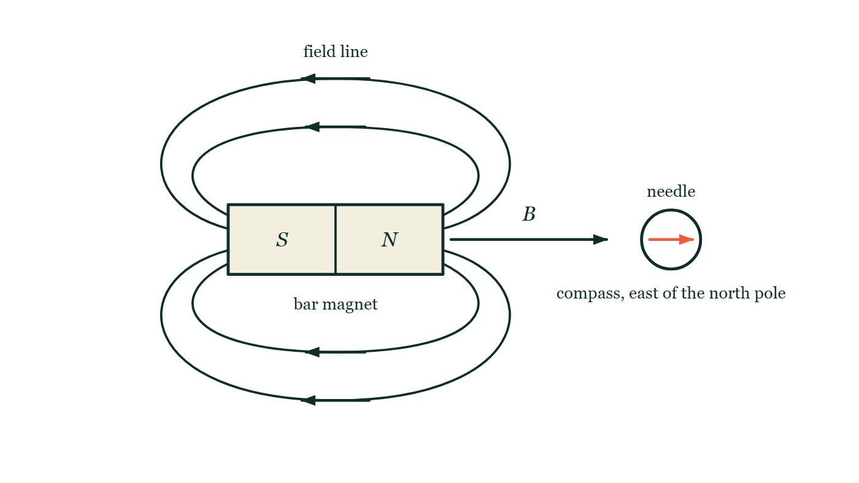
MAGNETISM · MAGNETS & MAGNETIC FIELDS
GIOPHYSICS LESSON
THE PICTURE
The field round a bar magnet
Drawn for this lesson
A bar magnet lying flat with south at the left end and north at the right, four closed field lines drawn round it — two arching over the top and two beneath — each arrowed leftwards along the top and bottom because outside the magnet the field runs from the north pole round to the south. A compass stands to the right of the north pole with its needle lying along the axis, pointing away from the magnet.
The live version of this figure — click here
Magnetism — Magnets & Magnetic Fields. Built by GioPhysics from the lesson's own copy; nothing on these slides is re-authored.
13 / 33
Notes:
[Phase] Build the model: The formulae, one at a time, in plain English (minutes 13–22 of 45)
[Figure] A bar magnet lying flat with south at the left end and north at the right, four closed field lines drawn round it — two arching over the top and two beneath — each arrowed leftwards along the top and bottom because outside the magnet the field runs from the north pole round to the south. A compass stands to the right of the north pole with its needle lying along the axis, pointing away from the magnet.

Slide 14
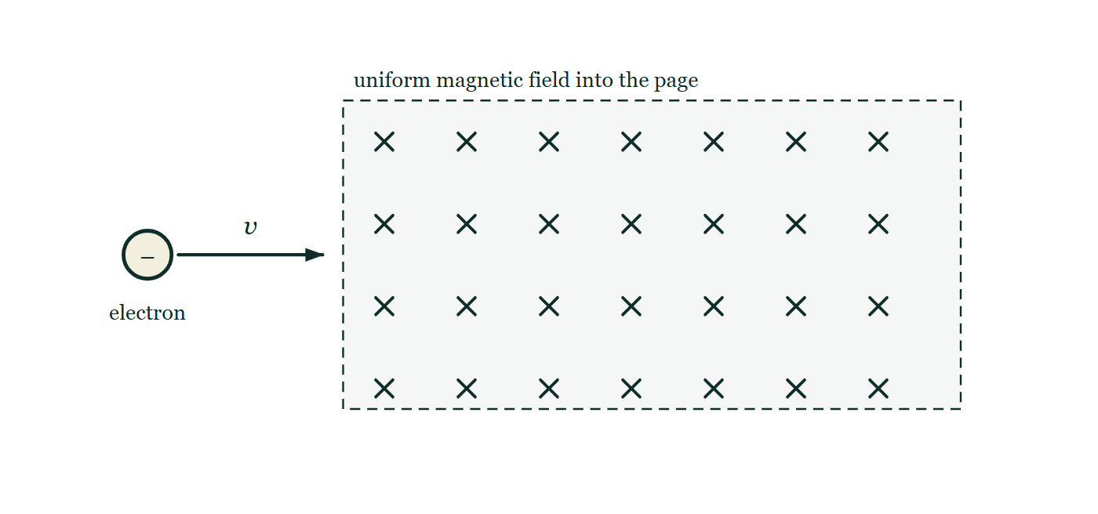
MAGNETISM · MAGNETS & MAGNETIC FIELDS
GIOPHYSICS LESSON
FIGURE 1 OF 2
Fig. 5.1 — A Level · Topics 12–25
Drawn for question 5 of that paper · syllabus 20
An electron, drawn as a small circle marked with a negative sign, travels horizontally to the right, and an arrow labelled v gives its velocity. Ahead of it lies a large rectangular region with a dashed boundary, filled with a regular array of crosses and labelled as a uniform magnetic field directed into the page. The electron is shown outside that region, at the instant before it crosses the boundary, with its velocity lying in the plane of the page.
See the question this was drawn for — click here
Magnetism — Magnets & Magnetic Fields. Built by GioPhysics from the lesson's own copy; nothing on these slides is re-authored.
14 / 33
Notes:
[Phase] Build the model: The formulae, one at a time, in plain English (minutes 13–22 of 45)
[Figure] Fig. 5.1. An electron, drawn as a small circle marked with a negative sign, travels horizontally to the right, and an arrow labelled v gives its velocity. Ahead of it lies a large rectangular region with a dashed boundary, filled with a regular array of crosses and labelled as a uniform magnetic field directed into the page. The electron is shown outside that region, at the instant before it crosses the boundary, with its velocity lying in the plane of the page.
[Where it came from] A Level · Topics 12–25, question 5; syllabus 20.

Slide 15
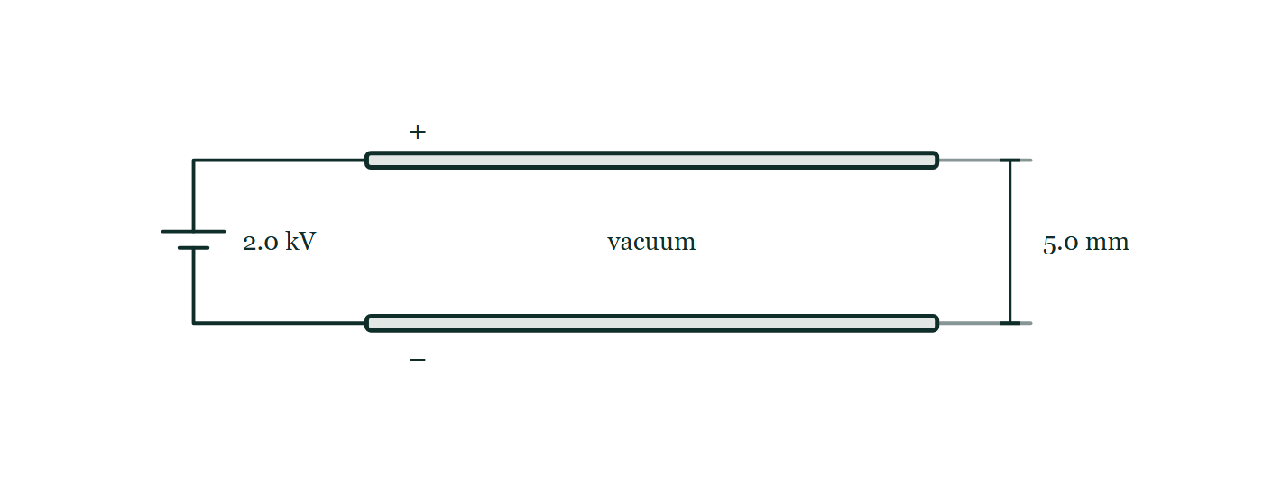
MAGNETISM · MAGNETS & MAGNETIC FIELDS
GIOPHYSICS LESSON
FIGURE 2 OF 2
Fig. 10.1 — A Level · Topics 12–25
Drawn for question 10 of that paper · syllabus 18, 19, 20
Two long horizontal metal plates are drawn one directly above the other and connected by wires at their left-hand ends to a battery labelled 2.0 kV; the upper plate carries a plus sign and the lower plate a minus sign. The space between the plates is empty and labelled vacuum, and a dimension at the right-hand end gives the separation of the plates as 5.0 mm. No field lines are drawn between the plates.
See the question this was drawn for — click here
Magnetism — Magnets & Magnetic Fields. Built by GioPhysics from the lesson's own copy; nothing on these slides is re-authored.
15 / 33
Notes:
[Phase] Build the model: The formulae, one at a time, in plain English (minutes 13–22 of 45)
[Figure] Fig. 10.1. Two long horizontal metal plates are drawn one directly above the other and connected by wires at their left-hand ends to a battery labelled 2.0 kV; the upper plate carries a plus sign and the lower plate a minus sign. The space between the plates is empty and labelled vacuum, and a dimension at the right-hand end gives the separation of the plates as 5.0 mm. No field lines are drawn between the plates.
[Where it came from] A Level · Topics 12–25, question 10; syllabus 18, 19, 20.

Slide 16
MAGNETISM · MAGNETS & MAGNETIC FIELDS
GIOPHYSICS LESSON
WATCH OUT
The common trap
Check and misconception — The quick check and the trap
Field lines are a map, not physical strings. The field exists everywhere in the region; lines simply sketch its direction, with their spacing standing in for strength.
Magnetism — Magnets & Magnetic Fields. Built by GioPhysics from the lesson's own copy; nothing on these slides is re-authored.
16 / 33
Notes:
[Phase] Check and misconception: The quick check and the trap (minutes 35–41 of 45)
[Misconception] Field lines are a map, not physical strings. The field exists everywhere in the region; lines simply sketch its direction, with their spacing standing in for strength.

Slide 17
MAGNETISM · MAGNETS & MAGNETIC FIELDS
GIOPHYSICS LESSON
WORKED EXAMPLE 1 OF 2 · EASY
The question
Easy
Worked examples — I do, we do — one step revealed at a time
Two north poles are brought together. What happens, and what rule does it illustrate?
Magnetism — Magnets & Magnetic Fields. Built by GioPhysics from the lesson's own copy; nothing on these slides is re-authored.
17 / 33
Notes:
[Phase] Worked examples: I do, we do — one step revealed at a time (minutes 22–35 of 45)
[Question] Two north poles are brought together. What happens, and what rule does it illustrate?
[Answer] Repulsion — like poles repel

Slide 18
MAGNETISM · MAGNETS & MAGNETIC FIELDS
GIOPHYSICS LESSON
WORKED EXAMPLE 1 OF 2 · EASY · THE WORKING
How to solve it
Easy
Worked examples — I do, we do — one step revealed at a time
Two north poles are brought together. What happens, and what rule does it illustrate?
1.
They push apart.
2.
Like poles repel; unlike poles attract.
Magnetism — Magnets & Magnetic Fields. Built by GioPhysics from the lesson's own copy; nothing on these slides is re-authored.
18 / 33
Notes:
[Phase] Worked examples: I do, we do — one step revealed at a time (minutes 22–35 of 45)
[Reveal] One click per step. The class works each line before the next appears.
[Step 1] They push apart.
[Step 2] Like poles repel; unlike poles attract.

Slide 19
MAGNETISM · MAGNETS & MAGNETIC FIELDS
GIOPHYSICS LESSON
WORKED EXAMPLE 1 OF 2 · EASY
Answer
Easy
Worked examples — I do, we do — one step revealed at a time
Repulsion — like poles repel
Magnetism — Magnets & Magnetic Fields. Built by GioPhysics from the lesson's own copy; nothing on these slides is re-authored.
19 / 33
Notes:
[Phase] Worked examples: I do, we do — one step revealed at a time (minutes 22–35 of 45)
[Answer] Repulsion — like poles repel

Slide 20
MAGNETISM · MAGNETS & MAGNETIC FIELDS
GIOPHYSICS LESSON
WORKED EXAMPLE 2 OF 2 · MEDIUM
The question
Medium
Worked examples — I do, we do — one step revealed at a time
A compass placed east of a bar magnet's north pole points away from the magnet. Sketch why, and state where the field is strongest.
Magnetism — Magnets & Magnetic Fields. Built by GioPhysics from the lesson's own copy; nothing on these slides is re-authored.
20 / 33
Notes:
[Phase] Worked examples: I do, we do — one step revealed at a time (minutes 22–35 of 45)
[Question] A compass placed east of a bar magnet's north pole points away from the magnet. Sketch why, and state where the field is strongest.
[Answer] The needle follows the outgoing field line; strongest field at the poles

Slide 21
MAGNETISM · MAGNETS & MAGNETIC FIELDS
GIOPHYSICS LESSON
WORKED EXAMPLE 2 OF 2 · MEDIUM · THE WORKING
How to solve it
Medium
Worked examples — I do, we do — one step revealed at a time
A compass placed east of a bar magnet's north pole points away from the magnet. Sketch why, and state where the field is strongest.
1.
Field lines emerge from the north pole, radiating outward; the compass aligns along the local line.
2.
Pointing away from N confirms lines leave north poles.
3.
Lines crowd closest at the poles — the field is strongest there.
Magnetism — Magnets & Magnetic Fields. Built by GioPhysics from the lesson's own copy; nothing on these slides is re-authored.
21 / 33
Notes:
[Phase] Worked examples: I do, we do — one step revealed at a time (minutes 22–35 of 45)
[Reveal] One click per step. The class works each line before the next appears.
[Step 1] Field lines emerge from the north pole, radiating outward; the compass aligns along the local line.
[Step 2] Pointing away from N confirms lines leave north poles.
[Step 3] Lines crowd closest at the poles — the field is strongest there.

Slide 22
MAGNETISM · MAGNETS & MAGNETIC FIELDS
GIOPHYSICS LESSON
WORKED EXAMPLE 2 OF 2 · MEDIUM
Answer
Medium
Worked examples — I do, we do — one step revealed at a time
The needle follows the outgoing field line; strongest field at the poles
Magnetism — Magnets & Magnetic Fields. Built by GioPhysics from the lesson's own copy; nothing on these slides is re-authored.
22 / 33
Notes:
[Phase] Worked examples: I do, we do — one step revealed at a time (minutes 22–35 of 45)
[Answer] The needle follows the outgoing field line; strongest field at the poles

Slide 23
MAGNETISM · MAGNETS & MAGNETIC FIELDS
GIOPHYSICS LESSON
PREDICT · TAKE THE VOTE
Commit before you are told
Hands up for each option, then click
The compass is lifted and set down again midway between two of the drawn field lines. What does the needle do there?
A Nothing — there is no field in the gaps between the lines
B It settles along the field direction at that spot, just as it did before
C It spins freely, because between two lines the field has no direction
A bar magnet lying flat with south at the left end and north at the right, four closed field lines drawn round it — two arching over the top and two beneath — each arrowed leftwards along the top and bottom because outside the magnet the field runs from the north pole round to the south. A compass stands to the right of the north pole with its needle lying along the axis, pointing away from the magnet.
The live version of this figure — click here
Magnetism — Magnets & Magnetic Fields. Built by GioPhysics from the lesson's own copy; nothing on these slides is re-authored.
23 / 33
Notes:
[Phase] Build the model: The formulae, one at a time, in plain English (minutes 13–22 of 45)
[Predict] The compass is lifted and set down again midway between two of the drawn field lines. What does the needle do there?
[Options] A Nothing — there is no field in the gaps between the lines B It settles along the field direction at that spot, just as it did before C It spins freely, because between two lines the field has no direction
[Figure] A bar magnet lying flat with south at the left end and north at the right, four closed field lines drawn round it — two arching over the top and two beneath — each arrowed leftwards along the top and bottom because outside the magnet the field runs from the north pole round to the south. A compass stands to the right of the north pole with its needle lying along the axis, pointing away from the magnet.

Slide 24
MAGNETISM · MAGNETS & MAGNETIC FIELDS
GIOPHYSICS LESSON
PREDICT · THE OUTCOME
What actually happens
Ask the room who changed their mind, and why
B It settles along the field direction at that spot, just as it did before
WHY
The four curves are a map, not a set of wires. The field fills the whole region round the magnet; the lines are where a draughtsman chose to draw it, and their spacing stands in for how strong it is. Set the compass anywhere in the picture and it lines up with the field at that point.
Magnetism — Magnets & Magnetic Fields. Built by GioPhysics from the lesson's own copy; nothing on these slides is re-authored.
24 / 33
Notes:
[Phase] Build the model: The formulae, one at a time, in plain English (minutes 13–22 of 45)
[Answer] B — It settles along the field direction at that spot, just as it did before. The four curves are a map, not a set of wires. The field fills the whole region round the magnet; the lines are where a draughtsman chose to draw it, and their spacing stands in for how strong it is. Set the compass anywhere in the picture and it lines up with the field at that point.

Slide 25
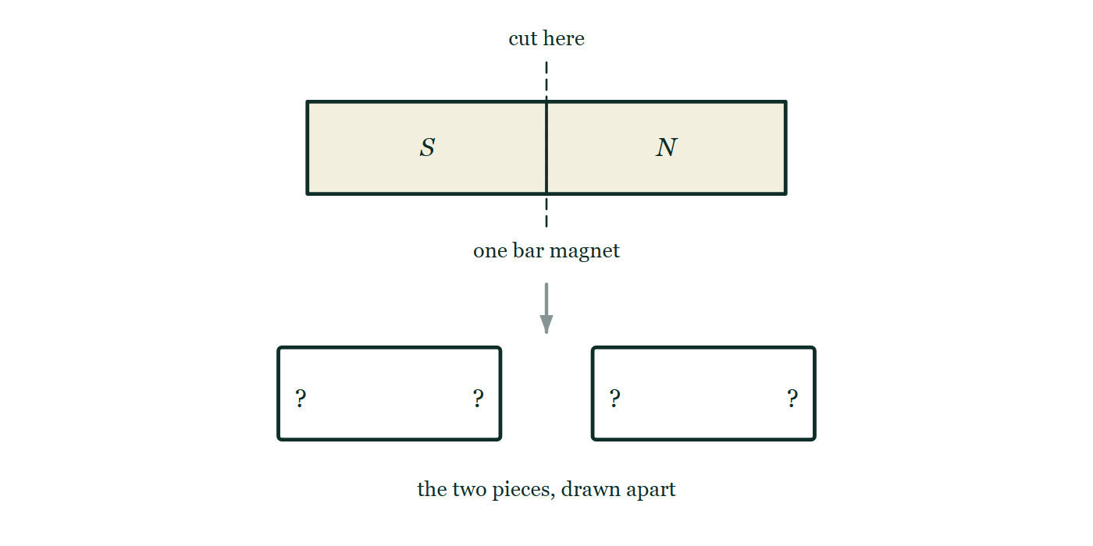
MAGNETISM · MAGNETS & MAGNETIC FIELDS
GIOPHYSICS LESSON
QUICK CHECK
Decide before the answer goes up
Check and misconception — The quick check and the trap
A bar magnet is cut in half between its poles. What results?
A
An isolated N and an isolated S
B
Two complete magnets, each with N and S
C
Two unmagnetised pieces
One bar magnet, north at the right and south at the left, with a dashed saw line ruled down its middle between the poles. Below it the two halves are drawn side by side as blank outlined rectangles, with a question mark at each of their four ends and no pole letters anywhere on them.
The live version of this figure — click here
Magnetism — Magnets & Magnetic Fields. Built by GioPhysics from the lesson's own copy; nothing on these slides is re-authored.
25 / 33
Notes:
[Phase] Check and misconception: The quick check and the trap (minutes 35–41 of 45)
[Question] A bar magnet is cut in half between its poles. What results?
[Figure] One bar magnet, north at the right and south at the left, with a dashed saw line ruled down its middle between the poles. Below it the two halves are drawn side by side as blank outlined rectangles, with a question mark at each of their four ends and no pole letters anywhere on them.
[Options] A An isolated N and an isolated S B Two complete magnets, each with N and S C Two unmagnetised pieces

Slide 26
MAGNETISM · MAGNETS & MAGNETIC FIELDS
GIOPHYSICS LESSON
QUICK CHECK · THE ANSWER
The answer, and why
Check and misconception — The quick check and the trap
B Two complete magnets, each with N and S
HOW TO GET THERE
Magnetism lives in aligned atomic domains — every fragment has both poles. Monopoles have never been found.
WHY THE OTHERS TEMPT
A Tempting, because a pole sounds like something that ought to be separable — you can isolate a positive charge, so why not a north pole? But magnetism comes from atomic magnets aligned inside the material, and the cut simply exposes the aligned ends that were already there. Isolated poles have been hunted for a century and never found.
B Correct. Every fragment, however small, has its own north and south — cut again and you get four magnets, not two poles.
C This is what really happens if you hammer, drop or strongly heat a magnet: the domains are jolted out of alignment and the magnetism goes. But a clean cut does not disturb the alignment at all, so both pieces are still fully magnetised.
Magnetism — Magnets & Magnetic Fields. Built by GioPhysics from the lesson's own copy; nothing on these slides is re-authored.
26 / 33
Notes:
[Phase] Check and misconception: The quick check and the trap (minutes 35–41 of 45)
[Question] A bar magnet is cut in half between its poles. What results?
[Option by option] A: Tempting, because a pole sounds like something that ought to be separable — you can isolate a positive charge, so why not a north pole? But magnetism comes from atomic magnets aligned inside the material, and the cut simply exposes the aligned ends that were already there. Isolated poles have been hunted for a century and never found. B: Correct. Every fragment, however small, has its own north and south — cut again and you get four magnets, not two poles. C: This is what really happens if you hammer, drop or strongly heat a magnet: the domains are jolted out of alignment and the magnetism goes. But a clean cut does not disturb the alignment at all, so both pieces are still fully magnetised.
[Answer] B — Two complete magnets, each with N and S
[Why] Magnetism lives in aligned atomic domains — every fragment has both poles. Monopoles have never been found.
[Reveal] One click for the answer, then one for the reason.

Slide 27
MAGNETISM · MAGNETS & MAGNETIC FIELDS
GIOPHYSICS LESSON
EXTENSION 1 OF 2 · HARD
The question
Hard
Worked examples — I do, we do — one step revealed at a time
A compass needle points north. A bar magnet is placed east of it with its north pole facing the compass. Sketch-reason the needle's final direction for a magnet field at the compass equal in strength to Earth's horizontal field.
Magnetism — Magnets & Magnetic Fields. Built by GioPhysics from the lesson's own copy; nothing on these slides is re-authored.
27 / 33
Notes:
[Phase] Worked examples: I do, we do — one step revealed at a time (minutes 22–35 of 45)
[Question] A compass needle points north. A bar magnet is placed east of it with its north pole facing the compass. Sketch-reason the needle's final direction for a magnet field at the compass equal in strength to Earth's horizontal field.
[Answer] It swings to point northwest (45°)

Slide 28
MAGNETISM · MAGNETS & MAGNETIC FIELDS
GIOPHYSICS LESSON
EXTENSION 1 OF 2 · HARD · THE WORKING
How to solve it
Hard
Worked examples — I do, we do — one step revealed at a time
A compass needle points north. A bar magnet is placed east of it with its north pole facing the compass. Sketch-reason the needle's final direction for a magnet field at the compass equal in strength to Earth's horizontal field.
1.
The magnet's field at the compass points west (away from its N pole, toward the compass).
2.
Earth pulls the needle north with equal strength.
3.
The vector sum points northwest — the needle settles at 45° west of north.
Magnetism — Magnets & Magnetic Fields. Built by GioPhysics from the lesson's own copy; nothing on these slides is re-authored.
28 / 33
Notes:
[Phase] Worked examples: I do, we do — one step revealed at a time (minutes 22–35 of 45)
[Reveal] One click per step. The class works each line before the next appears.
[Step 1] The magnet's field at the compass points west (away from its N pole, toward the compass).
[Step 2] Earth pulls the needle north with equal strength.
[Step 3] The vector sum points northwest — the needle settles at 45° west of north.

Slide 29
MAGNETISM · MAGNETS & MAGNETIC FIELDS
GIOPHYSICS LESSON
EXTENSION 1 OF 2 · HARD
Answer
Hard
Worked examples — I do, we do — one step revealed at a time
It swings to point northwest (45°)
Magnetism — Magnets & Magnetic Fields. Built by GioPhysics from the lesson's own copy; nothing on these slides is re-authored.
29 / 33
Notes:
[Phase] Worked examples: I do, we do — one step revealed at a time (minutes 22–35 of 45)
[Answer] It swings to point northwest (45°)

Slide 30
MAGNETISM · MAGNETS & MAGNETIC FIELDS
GIOPHYSICS LESSON
EXTENSION 2 OF 2 · CHALLENGING
The question
Challenging
Worked examples — I do, we do — one step revealed at a time
A steel ship's hull becomes magnetised during construction. Explain how, and why warships 'deperm' by wrapping current-carrying cables around the hull.
Magnetism — Magnets & Magnetic Fields. Built by GioPhysics from the lesson's own copy; nothing on these slides is re-authored.
30 / 33
Notes:
[Phase] Worked examples: I do, we do — one step revealed at a time (minutes 22–35 of 45)
[Question] A steel ship's hull becomes magnetised during construction. Explain how, and why warships 'deperm' by wrapping current-carrying cables around the hull.
[Answer] Earth-field-aligned domains from construction; alternating decaying fields scramble them

Slide 31
MAGNETISM · MAGNETS & MAGNETIC FIELDS
GIOPHYSICS LESSON
EXTENSION 2 OF 2 · CHALLENGING · THE WORKING
How to solve it
Challenging
Worked examples — I do, we do — one step revealed at a time
A steel ship's hull becomes magnetised during construction. Explain how, and why warships 'deperm' by wrapping current-carrying cables around the hull.
1.
Hammering and vibration in Earth's field lets iron domains settle aligned with it — the hull acquires a permanent magnetic signature.
2.
That signature can trigger magnetic mines and betray the ship's heading history.
3.
Deperming drives decreasing alternating fields through the hull, randomising the domains layer by layer — erasing the signature like degaussing a tape.
Magnetism — Magnets & Magnetic Fields. Built by GioPhysics from the lesson's own copy; nothing on these slides is re-authored.
31 / 33
Notes:
[Phase] Worked examples: I do, we do — one step revealed at a time (minutes 22–35 of 45)
[Reveal] One click per step. The class works each line before the next appears.
[Step 1] Hammering and vibration in Earth's field lets iron domains settle aligned with it — the hull acquires a permanent magnetic signature.
[Step 2] That signature can trigger magnetic mines and betray the ship's heading history.
[Step 3] Deperming drives decreasing alternating fields through the hull, randomising the domains layer by layer — erasing the signature like degaussing a tape.

Slide 32
MAGNETISM · MAGNETS & MAGNETIC FIELDS
GIOPHYSICS LESSON
EXTENSION 2 OF 2 · CHALLENGING
Answer
Challenging
Worked examples — I do, we do — one step revealed at a time
Earth-field-aligned domains from construction; alternating decaying fields scramble them
Magnetism — Magnets & Magnetic Fields. Built by GioPhysics from the lesson's own copy; nothing on these slides is re-authored.
32 / 33
Notes:
[Phase] Worked examples: I do, we do — one step revealed at a time (minutes 22–35 of 45)
[Answer] Earth-field-aligned domains from construction; alternating decaying fields scramble them

Slide 33
MAGNETISM · MAGNETS & MAGNETIC FIELDS
GIOPHYSICS LESSON
MAGNETISM
Where to go next
Plenary — What to take away, what to practise next
Next
18.2 Currents Make Fields
https://giophysics.com/chapter-27/currents-magnetic-fields/
Lesson
This lesson on giophysics.com
https://giophysics.com/chapter-27/magnets-magnetic-fields/
Live
The live, interactive version of these slides
https://giophysics.com/chapter-27/presentation/?lesson=fields
Chapter
All Magnetism lessons
https://giophysics.com/chapter-27/
PDF
Download the lesson PDF
https://giophysics.com/downloads/27-1-magnets-magnetic-fields.pdf
Magnetism — Magnets & Magnetic Fields. Built by GioPhysics from the lesson's own copy; nothing on these slides is re-authored.
33 / 33
Notes:
[Phase] Plenary: What to take away, what to practise next (minutes 41–45 of 45)
[Interactive] The graphs and the circuit topology on these slides are frozen. The live version at https://giophysics.com/chapter-27/presentation/?lesson=fields moves them.

