Slide 1
MAGNETISM · FORCE ON MOVING CHARGES
GIOPHYSICS LESSON
18 · Magnetism
Circles in a magnetic field
Force on Moving Charges
The magnetic force acts on every moving charge: F = qvB, always at right angles to the velocity. It changes direction, never speed — so charges in uniform fields travel in circles.
POSITION
Lesson 4 of 6 in Magnetism
PLAN
16 slides in the 45-minute core run, about 44.5 minutes of it
LESSON PAGE
https://giophysics.com/chapter-27/force-on-moving-charges/
Built by GioPhysics from the lesson's own page. Every word on these slides is the lesson's; nothing here is re-authored. Teaching material, not an awarding body's document.
Magnetism — Force on Moving Charges. Built by GioPhysics from the lesson's own copy; nothing on these slides is re-authored.
1 / 33
Notes:
[Lesson] Magnetism — Force on Moving Charges. Lesson 4 of 6.
[Intro] The magnetic force acts on every moving charge: F = qvB, always at right angles to the velocity. It changes direction, never speed — so charges in uniform fields travel in circles.
[Source] https://giophysics.com/chapter-27/force-on-moving-charges/
[Disclaimer] Built by GioPhysics from the lesson's own page. Every word on these slides is the lesson's; nothing here is re-authored. Teaching material, not an awarding body's document.

Slide 2
MAGNETISM · FORCE ON MOVING CHARGES
GIOPHYSICS LESSON
WHAT THIS NEEDS
What you already know
Starter — Recall what this lesson stands on
Recall
Motor effect
https://giophysics.com/chapter-27/force-on-currents/
Recall
Circular motion
https://giophysics.com/chapter-10/uniform-circular-motion/
Magnetism — Force on Moving Charges. Built by GioPhysics from the lesson's own copy; nothing on these slides is re-authored.
2 / 33
Notes:
[Phase] Starter: Recall what this lesson stands on (minutes 0–5 of 45)
[Starter] Recall: Motor effect; Circular motion

Slide 3
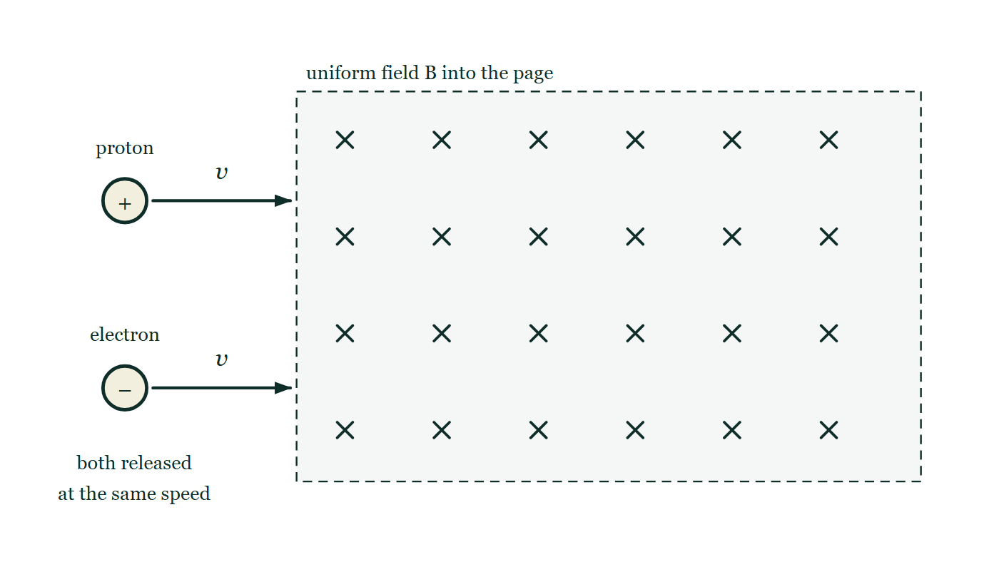
MAGNETISM · FORCE ON MOVING CHARGES
GIOPHYSICS LESSON
THINK FIRST
A magnetic field can bend a beam of electrons right round in a circle — so why can it never make them go faster?
Take answers before you click — the point is the commitment
In an old television tube, coils steer the electron beam all over the screen. The beam arrives at the corners at exactly the speed it left the gun with, however hard the coils bend it.
THE ANSWER
Because the magnetic force is always at right angles to the velocity, it never has a component along the motion, and a force with no component along the motion does no work. It is a perfect steering force: all direction, no energy.
A large rectangular region of uniform field filled with crosses, meaning the field points into the page. A proton, drawn as a circled plus, is fired in from the left edge near the top with a velocity arrow labelled v. An electron, a circled minus, is fired in lower down with an identical arrow. Neither path inside the field is drawn.
The live version of this figure — click here
Magnetism — Force on Moving Charges. Built by GioPhysics from the lesson's own copy; nothing on these slides is re-authored.
3 / 33
Notes:
[Phase] Starter: Recall what this lesson stands on (minutes 0–5 of 45)
[Hook] A magnetic field can bend a beam of electrons right round in a circle — so why can it never make them go faster? In an old television tube, coils steer the electron beam all over the screen. The beam arrives at the corners at exactly the speed it left the gun with, however hard the coils bend it.
[Answer] Because the magnetic force is always at right angles to the velocity, it never has a component along the motion, and a force with no component along the motion does no work. It is a perfect steering force: all direction, no energy.
[Figure] A large rectangular region of uniform field filled with crosses, meaning the field points into the page. A proton, drawn as a circled plus, is fired in from the left edge near the top with a velocity arrow labelled v. An electron, a circled minus, is fired in lower down with an identical arrow. Neither path inside the field is drawn.

Slide 4
MAGNETISM · FORCE ON MOVING CHARGES
GIOPHYSICS LESSON
EXPLAINED SIMPLY
In one sentence
Introduce the idea — The big idea and the definition
A charge q moving at speed v across a field B feels a force F = qvB sinθ perpendicular to its velocity, bending it into a circular path.
Magnetism — Force on Moving Charges. Built by GioPhysics from the lesson's own copy; nothing on these slides is re-authored.
4 / 33
Notes:
[Phase] Introduce the idea: The big idea and the definition (minutes 5–13 of 45)
[Definition] A charge q moving at speed v across a field B feels a force F = qvB sinθ perpendicular to its velocity, bending it into a circular path.

Slide 5
MAGNETISM · FORCE ON MOVING CHARGES
GIOPHYSICS LESSON
EXPLAINED SIMPLY
What that looks like
Introduce the idea — The big idea and the definition
FOR EXAMPLE
Electrons in an old TV tube are steered onto the screen by magnetic coils bending their beam.
Magnetism — Force on Moving Charges. Built by GioPhysics from the lesson's own copy; nothing on these slides is re-authored.
5 / 33
Notes:
[Phase] Introduce the idea: The big idea and the definition (minutes 5–13 of 45)
[Worked illustration] Electrons in an old TV tube are steered onto the screen by magnetic coils bending their beam.

Slide 6
MAGNETISM · FORCE ON MOVING CHARGES
GIOPHYSICS LESSON
THE BIG IDEA
Circles in a magnetic field
Introduce the idea — The big idea and the definition
Because the force stays perpendicular to the motion, it does no work: it is a perfect centripetal force. Setting qvB = mv²/r gives r = mv/qB — faster or heavier particles curve wider, stronger fields curl them tighter. Mass spectrometers, particle accelerators, and the aurora all follow this one equation.
Magnetism — Force on Moving Charges. Built by GioPhysics from the lesson's own copy; nothing on these slides is re-authored.
6 / 33
Notes:
[Phase] Introduce the idea: The big idea and the definition (minutes 5–13 of 45)
[Big idea] Because the force stays perpendicular to the motion, it does no work: it is a perfect centripetal force. Setting qvB = mv²/r gives r = mv/qB — faster or heavier particles curve wider, stronger fields curl them tighter. Mass spectrometers, particle accelerators, and the aurora all follow this one equation.

Slide 7
MAGNETISM · FORCE ON MOVING CHARGES
GIOPHYSICS LESSON
THE PHYSICS · 1 OF 3
Direction rules
Build the model — The formulae, one at a time, in plain English
Fleming's left hand again, with the second finger along a positive charge's velocity. For electrons, reverse the answer.
Magnetism — Force on Moving Charges. Built by GioPhysics from the lesson's own copy; nothing on these slides is re-authored.
7 / 33
Notes:
[Phase] Build the model: The formulae, one at a time, in plain English (minutes 13–22 of 45)
[Section] Fleming's left hand again, with the second finger along a positive charge's velocity. For electrons, reverse the answer.

Slide 8
MAGNETISM · FORCE ON MOVING CHARGES
GIOPHYSICS LESSON
THE PHYSICS · 2 OF 3
Helix in general
Build the model — The formulae, one at a time, in plain English
Velocity along the field is untouched; the cross-field part turns circles. Together they trace a helix — charged particles spiral along field lines, as in the aurora.
Magnetism — Force on Moving Charges. Built by GioPhysics from the lesson's own copy; nothing on these slides is re-authored.
8 / 33
Notes:
[Phase] Build the model: The formulae, one at a time, in plain English (minutes 13–22 of 45)
[Section] Velocity along the field is untouched; the cross-field part turns circles. Together they trace a helix — charged particles spiral along field lines, as in the aurora.

Slide 9
MAGNETISM · FORCE ON MOVING CHARGES
GIOPHYSICS LESSON
THE PHYSICS · 3 OF 3
Velocity selector
Build the model — The formulae, one at a time, in plain English
Cross an electric and a magnetic field so their forces oppose: only particles with v = E/B pass straight — a speed filter for particle beams.
Magnetism — Force on Moving Charges. Built by GioPhysics from the lesson's own copy; nothing on these slides is re-authored.
9 / 33
Notes:
[Phase] Build the model: The formulae, one at a time, in plain English (minutes 13–22 of 45)
[Section] Cross an electric and a magnetic field so their forces oppose: only particles with v = E/B pass straight — a speed filter for particle beams.

Slide 10
MAGNETISM · FORCE ON MOVING CHARGES
GIOPHYSICS LESSON
FORMULA 1 OF 3
Magnetic force
Build the model — The formulae, one at a time, in plain English
F = qvB sinθ
Zero for motion along the field
IN PLAIN ENGLISH
The push grows with charge, speed, and field, and vanishes when the charge runs parallel to the field lines.
Magnetism — Force on Moving Charges. Built by GioPhysics from the lesson's own copy; nothing on these slides is re-authored.
10 / 33
Notes:
[Phase] Build the model: The formulae, one at a time, in plain English (minutes 13–22 of 45)
[Formula] Magnetic force: F = qvB sinθ
[In plain English] The push grows with charge, speed, and field, and vanishes when the charge runs parallel to the field lines.
[Note] Zero for motion along the field

Slide 11
MAGNETISM · FORCE ON MOVING CHARGES
GIOPHYSICS LESSON
FORMULA 2 OF 3
Circular radius
Build the model — The formulae, one at a time, in plain English
r = mv/qB
From qvB = mv²/r
IN PLAIN ENGLISH
The magnetic force plays centripetal: momentum sets the circle's size, field strength curls it tighter.
Magnetism — Force on Moving Charges. Built by GioPhysics from the lesson's own copy; nothing on these slides is re-authored.
11 / 33
Notes:
[Phase] Build the model: The formulae, one at a time, in plain English (minutes 13–22 of 45)
[Formula] Circular radius: r = mv/qB
[In plain English] The magnetic force plays centripetal: momentum sets the circle's size, field strength curls it tighter.
[Note] From qvB = mv²/r

Slide 12
MAGNETISM · FORCE ON MOVING CHARGES
GIOPHYSICS LESSON
FORMULA 3 OF 3
No work done
Build the model — The formulae, one at a time, in plain English
ΔKE = 0
F ⟂ v always
IN PLAIN ENGLISH
Always sideways, never along the motion — a magnetic field redirects a charge but cannot speed it up or slow it down.
Magnetism — Force on Moving Charges. Built by GioPhysics from the lesson's own copy; nothing on these slides is re-authored.
12 / 33
Notes:
[Phase] Build the model: The formulae, one at a time, in plain English (minutes 13–22 of 45)
[Formula] No work done: ΔKE = 0
[In plain English] Always sideways, never along the motion — a magnetic field redirects a charge but cannot speed it up or slow it down.
[Note] F ⟂ v always

Slide 13
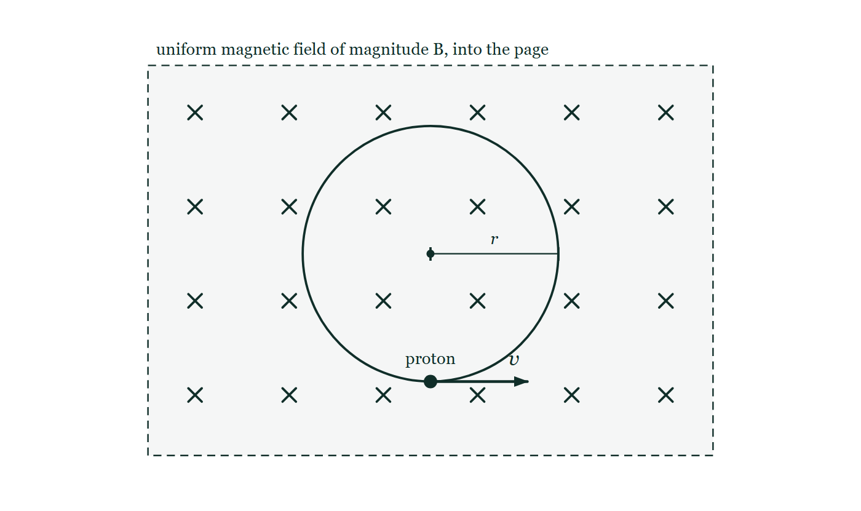
MAGNETISM · FORCE ON MOVING CHARGES
GIOPHYSICS LESSON
FIGURE 1 OF 2
Figure 1 — IB Theme D · Fields
Drawn for question 3 of that paper · syllabus D.3
A rectangular region bounded by a dashed line is filled with an evenly spaced grid of crosses and labelled 'uniform magnetic field of magnitude B, into the page'. Inside the region a complete circle is drawn: the path followed by the proton. A line from the centre of the circle out to the circle is marked with a tick at each end and labelled r. A solid dot on the circle at its lowest point is labelled 'proton', and from that dot an arrow labelled v points horizontally to the right, along the tangent to the circle.
See the question this was drawn for — click here
Magnetism — Force on Moving Charges. Built by GioPhysics from the lesson's own copy; nothing on these slides is re-authored.
13 / 33
Notes:
[Phase] Build the model: The formulae, one at a time, in plain English (minutes 13–22 of 45)
[Figure] Figure 1. A rectangular region bounded by a dashed line is filled with an evenly spaced grid of crosses and labelled 'uniform magnetic field of magnitude B, into the page'. Inside the region a complete circle is drawn: the path followed by the proton. A line from the centre of the circle out to the circle is marked with a tick at each end and labelled r. A solid dot on the circle at its lowest point is labelled 'proton', and from that dot an arrow labelled v points horizontally to the right, along the tangent to the circle.
[Where it came from] IB Theme D · Fields, question 3; syllabus D.3.

Slide 14
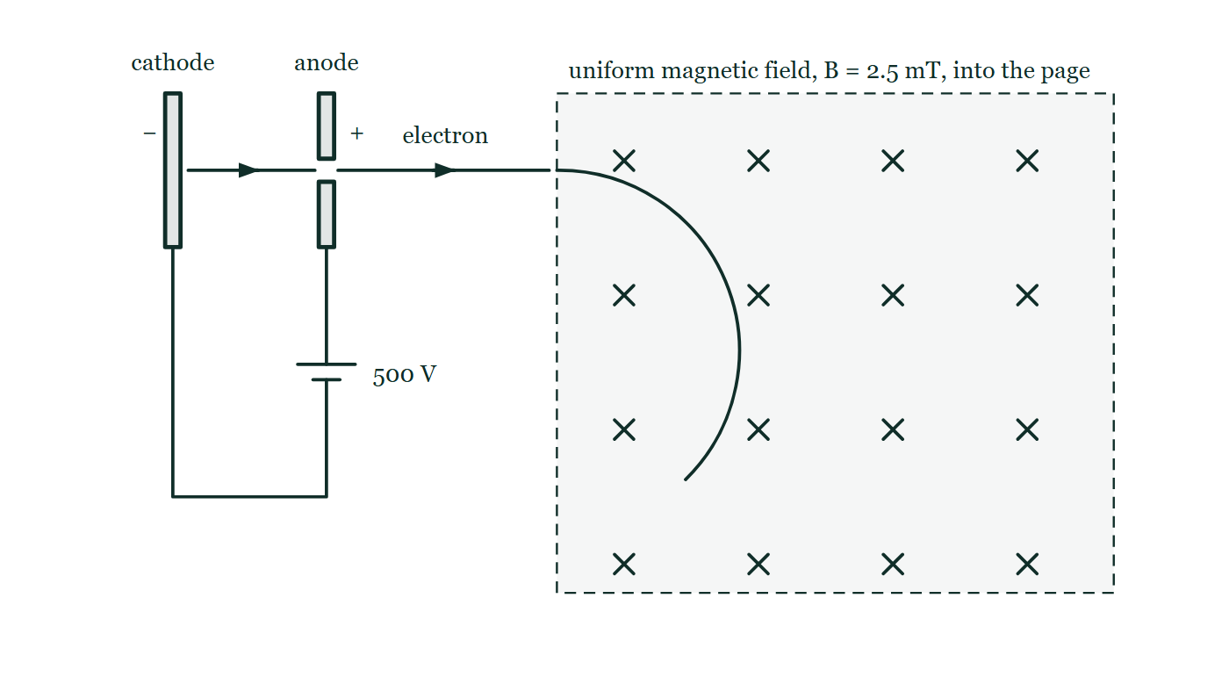
MAGNETISM · FORCE ON MOVING CHARGES
GIOPHYSICS LESSON
FIGURE 2 OF 2
Figure 5 — IB Theme D · Fields
Drawn for question 9 of that paper · syllabus D.2, D.3
Side view of the arrangement. At the left a cathode plate marked − faces an anode plate marked + which has a small hole in it at the level of the beam; below, the two plates are joined by wires through a cell labelled 500 V, whose positive terminal is connected to the anode. Arrows show an electron leaving the cathode, passing through the hole in the anode and travelling on to the right, where it crosses into a large rectangular region drawn with a dashed boundary and filled with crosses, labelled 'uniform magnetic field, B = 2.5 mT, into the page'. Inside that region the electron's path is drawn as an arc that curves steadily downwards away from its original straight line.
See the question this was drawn for — click here
Magnetism — Force on Moving Charges. Built by GioPhysics from the lesson's own copy; nothing on these slides is re-authored.
14 / 33
Notes:
[Phase] Build the model: The formulae, one at a time, in plain English (minutes 13–22 of 45)
[Figure] Figure 5. Side view of the arrangement. At the left a cathode plate marked − faces an anode plate marked + which has a small hole in it at the level of the beam; below, the two plates are joined by wires through a cell labelled 500 V, whose positive terminal is connected to the anode. Arrows show an electron leaving the cathode, passing through the hole in the anode and travelling on to the right, where it crosses into a large rectangular region drawn with a dashed boundary and filled with crosses, labelled 'uniform magnetic field, B = 2.5 mT, into the page'. Inside that region the electron's path is drawn as an arc that curves steadily downwards away from its original straight line.
[Where it came from] IB Theme D · Fields, question 9; syllabus D.2, D.3.

Slide 15
MAGNETISM · FORCE ON MOVING CHARGES
GIOPHYSICS LESSON
WATCH OUT
The common trap
Check and misconception — The quick check and the trap
A magnetic field never changes a charge's speed or kinetic energy — only its direction. Any acceleration it causes is purely centripetal.
Magnetism — Force on Moving Charges. Built by GioPhysics from the lesson's own copy; nothing on these slides is re-authored.
15 / 33
Notes:
[Phase] Check and misconception: The quick check and the trap (minutes 35–41 of 45)
[Misconception] A magnetic field never changes a charge's speed or kinetic energy — only its direction. Any acceleration it causes is purely centripetal.

Slide 16
MAGNETISM · FORCE ON MOVING CHARGES
GIOPHYSICS LESSON
WORKED EXAMPLE 1 OF 2 · EASY
The question
Easy
Worked examples — I do, we do — one step revealed at a time
An electron moves parallel to a magnetic field. What force does it feel?
Magnetism — Force on Moving Charges. Built by GioPhysics from the lesson's own copy; nothing on these slides is re-authored.
16 / 33
Notes:
[Phase] Worked examples: I do, we do — one step revealed at a time (minutes 22–35 of 45)
[Question] An electron moves parallel to a magnetic field. What force does it feel?
[Answer] Zero

Slide 17
MAGNETISM · FORCE ON MOVING CHARGES
GIOPHYSICS LESSON
WORKED EXAMPLE 1 OF 2 · EASY · THE WORKING
How to solve it
Easy
Worked examples — I do, we do — one step revealed at a time
An electron moves parallel to a magnetic field. What force does it feel?
1.
F = qvB sinθ with θ = 0.
2.
F = 0 — motion along the field is force-free.
Magnetism — Force on Moving Charges. Built by GioPhysics from the lesson's own copy; nothing on these slides is re-authored.
17 / 33
Notes:
[Phase] Worked examples: I do, we do — one step revealed at a time (minutes 22–35 of 45)
[Reveal] One click per step. The class works each line before the next appears.
[Step 1] F = qvB sinθ with θ = 0.
[Step 2] F = 0 — motion along the field is force-free.

Slide 18
MAGNETISM · FORCE ON MOVING CHARGES
GIOPHYSICS LESSON
WORKED EXAMPLE 1 OF 2 · EASY
Answer
Easy
Worked examples — I do, we do — one step revealed at a time
Zero
Magnetism — Force on Moving Charges. Built by GioPhysics from the lesson's own copy; nothing on these slides is re-authored.
18 / 33
Notes:
[Phase] Worked examples: I do, we do — one step revealed at a time (minutes 22–35 of 45)
[Answer] Zero

Slide 19
MAGNETISM · FORCE ON MOVING CHARGES
GIOPHYSICS LESSON
WORKED EXAMPLE 2 OF 2 · MEDIUM
The question
Medium
Worked examples — I do, we do — one step revealed at a time
A proton (m = 1.67 × 10⁻²⁷ kg, q = 1.6 × 10⁻¹⁹ C) moves at 3.0 × 10⁶ m/s across a 0.50 T field. Find its path radius.
Magnetism — Force on Moving Charges. Built by GioPhysics from the lesson's own copy; nothing on these slides is re-authored.
19 / 33
Notes:
[Phase] Worked examples: I do, we do — one step revealed at a time (minutes 22–35 of 45)
[Question] A proton (m = 1.67 × 10⁻²⁷ kg, q = 1.6 × 10⁻¹⁹ C) moves at 3.0 × 10⁶ m/s across a 0.50 T field. Find its path radius.
[Answer] r ≈ 6.3 cm

Slide 20
MAGNETISM · FORCE ON MOVING CHARGES
GIOPHYSICS LESSON
WORKED EXAMPLE 2 OF 2 · MEDIUM · THE WORKING
How to solve it
Medium
Worked examples — I do, we do — one step revealed at a time
A proton (m = 1.67 × 10⁻²⁷ kg, q = 1.6 × 10⁻¹⁹ C) moves at 3.0 × 10⁶ m/s across a 0.50 T field. Find its path radius.
1.
r = mv/qB.
2.
r = (1.67 × 10⁻²⁷ × 3.0 × 10⁶)/(1.6 × 10⁻¹⁹ × 0.50).
3.
r = 5.0 × 10⁻²¹ ÷ 8.0 × 10⁻²⁰ ≈ 0.063 m.
Magnetism — Force on Moving Charges. Built by GioPhysics from the lesson's own copy; nothing on these slides is re-authored.
20 / 33
Notes:
[Phase] Worked examples: I do, we do — one step revealed at a time (minutes 22–35 of 45)
[Reveal] One click per step. The class works each line before the next appears.
[Step 1] r = mv/qB.
[Step 2] r = (1.67 × 10⁻²⁷ × 3.0 × 10⁶)/(1.6 × 10⁻¹⁹ × 0.50).
[Step 3] r = 5.0 × 10⁻²¹ ÷ 8.0 × 10⁻²⁰ ≈ 0.063 m.

Slide 21
MAGNETISM · FORCE ON MOVING CHARGES
GIOPHYSICS LESSON
WORKED EXAMPLE 2 OF 2 · MEDIUM
Answer
Medium
Worked examples — I do, we do — one step revealed at a time
r ≈ 6.3 cm
Magnetism — Force on Moving Charges. Built by GioPhysics from the lesson's own copy; nothing on these slides is re-authored.
21 / 33
Notes:
[Phase] Worked examples: I do, we do — one step revealed at a time (minutes 22–35 of 45)
[Answer] r ≈ 6.3 cm

Slide 22
MAGNETISM · FORCE ON MOVING CHARGES
GIOPHYSICS LESSON
SPOT THE MISTAKE
One line here is wrong
The whole working is up — find the bad line before you click
1.
The magnetic force is centripetal, so qvB = mv²/r and r = mv/qB
2.
Top line: mv = 1.67 × 10⁻²⁷ × 3.0 × 10⁶ = 5.0 × 10⁻²¹ kg·m/s
3.
Bottom line: qB = 1.6 × 10⁻¹⁹ × 0.50 = 8.0 × 10⁻¹⁹
4.
r = 5.0 × 10⁻²¹ ÷ 8.0 × 10⁻¹⁹ = 6.3 × 10⁻³ m, about 6 mm
LINE 3 IS WRONG
Halving 1.6 × 10⁻¹⁹ gives 8.0 × 10⁻²⁰, not 8.0 × 10⁻¹⁹ — the exponent was carried over unchanged when the mantissa dropped below one. It costs a factor of ten, and a 6 mm answer instead of 6 cm looks perfectly plausible on the page, which is exactly what makes this slip so hard to catch.
IT SHOULD SAY
Bottom line: qB = 1.6 × 10⁻¹⁹ × 0.50 = 8.0 × 10⁻²⁰
Magnetism — Force on Moving Charges. Built by GioPhysics from the lesson's own copy; nothing on these slides is re-authored.
22 / 33
Notes:
[Phase] Worked examples: I do, we do — one step revealed at a time (minutes 22–35 of 45)
[Spot the mistake] The working is complete and one line of it is wrong. Let the room hunt: one click names the line, a second shows it done correctly.
[Line 3 is wrong] Halving 1.6 × 10⁻¹⁹ gives 8.0 × 10⁻²⁰, not 8.0 × 10⁻¹⁹ — the exponent was carried over unchanged when the mantissa dropped below one. It costs a factor of ten, and a 6 mm answer instead of 6 cm looks perfectly plausible on the page, which is exactly what makes this slip so hard to catch.
[It should say] Bottom line: qB = 1.6 × 10⁻¹⁹ × 0.50 = 8.0 × 10⁻²⁰

Slide 23
MAGNETISM · FORCE ON MOVING CHARGES
GIOPHYSICS LESSON
PREDICT · TAKE THE VOTE
Commit before you are told
Hands up for each option, then click
The proton curves round inside the field region. What happens to its speed while it does so?
A It rises — the magnetic force is accelerating it, and acceleration means speeding up
B It stays exactly the same the whole way round
C It falls, because the field does work against the motion and drains the particle
A large rectangular region of uniform field filled with crosses, meaning the field points into the page. A proton, drawn as a circled plus, is fired in from the left edge near the top with a velocity arrow labelled v. An electron, a circled minus, is fired in lower down with an identical arrow. Neither path inside the field is drawn.
The live version of this figure — click here
Magnetism — Force on Moving Charges. Built by GioPhysics from the lesson's own copy; nothing on these slides is re-authored.
23 / 33
Notes:
[Phase] Build the model: The formulae, one at a time, in plain English (minutes 13–22 of 45)
[Predict] The proton curves round inside the field region. What happens to its speed while it does so?
[Options] A It rises — the magnetic force is accelerating it, and acceleration means speeding up B It stays exactly the same the whole way round C It falls, because the field does work against the motion and drains the particle
[Figure] A large rectangular region of uniform field filled with crosses, meaning the field points into the page. A proton, drawn as a circled plus, is fired in from the left edge near the top with a velocity arrow labelled v. An electron, a circled minus, is fired in lower down with an identical arrow. Neither path inside the field is drawn.

Slide 24
MAGNETISM · FORCE ON MOVING CHARGES
GIOPHYSICS LESSON
PREDICT · THE OUTCOME
What actually happens
Ask the room who changed their mind, and why
B It stays exactly the same the whole way round
WHY
The force stays square to the velocity at every instant of the curve, so it does no work and the kinetic energy cannot change. There is an acceleration — a centripetal one — but it only ever swings the velocity vector round, never lengthens it.
Magnetism — Force on Moving Charges. Built by GioPhysics from the lesson's own copy; nothing on these slides is re-authored.
24 / 33
Notes:
[Phase] Build the model: The formulae, one at a time, in plain English (minutes 13–22 of 45)
[Answer] B — It stays exactly the same the whole way round. The force stays square to the velocity at every instant of the curve, so it does no work and the kinetic energy cannot change. There is an acceleration — a centripetal one — but it only ever swings the velocity vector round, never lengthens it.

Slide 25
MAGNETISM · FORCE ON MOVING CHARGES
GIOPHYSICS LESSON
QUICK CHECK
Decide before the answer goes up
Check and misconception — The quick check and the trap
An electron and a proton enter the same field at the same speed. Compared with the proton's circle, the electron's is…
A
Much smaller
B
The same size
C
Much larger
Magnetism — Force on Moving Charges. Built by GioPhysics from the lesson's own copy; nothing on these slides is re-authored.
25 / 33
Notes:
[Phase] Check and misconception: The quick check and the trap (minutes 35–41 of 45)
[Question] An electron and a proton enter the same field at the same speed. Compared with the proton's circle, the electron's is…
[Options] A Much smaller B The same size C Much larger

Slide 26
MAGNETISM · FORCE ON MOVING CHARGES
GIOPHYSICS LESSON
QUICK CHECK · THE ANSWER
The answer, and why
Check and misconception — The quick check and the trap
A Much smaller
HOW TO GET THERE
r = mv/qB — same speed, same charge size, but the electron's mass is ~1836× smaller, so its radius is too.
WHY THE OTHERS TEMPT
A Correct. r = mv/qB, and with the same v and the same size of charge only the mass is left. An electron is about 1836 times lighter than a proton, so its circle is about 1836 times tighter.
B This is the answer if you assume the field decides the radius on its own. It does not — the momentum mv sets the size of the circle, and the two particles have wildly different masses at the same speed.
C Tempting because the electron feels a negative charge and students often expect it to swing wider, or because 'lighter means harder to hold' sounds right. It is the opposite: less momentum is easier for the field to bend, so the light particle turns tightest.
Magnetism — Force on Moving Charges. Built by GioPhysics from the lesson's own copy; nothing on these slides is re-authored.
26 / 33
Notes:
[Phase] Check and misconception: The quick check and the trap (minutes 35–41 of 45)
[Question] An electron and a proton enter the same field at the same speed. Compared with the proton's circle, the electron's is…
[Option by option] A: Correct. r = mv/qB, and with the same v and the same size of charge only the mass is left. An electron is about 1836 times lighter than a proton, so its circle is about 1836 times tighter. B: This is the answer if you assume the field decides the radius on its own. It does not — the momentum mv sets the size of the circle, and the two particles have wildly different masses at the same speed. C: Tempting because the electron feels a negative charge and students often expect it to swing wider, or because 'lighter means harder to hold' sounds right. It is the opposite: less momentum is easier for the field to bend, so the light particle turns tightest.
[Answer] A — Much smaller
[Why] r = mv/qB — same speed, same charge size, but the electron's mass is ~1836× smaller, so its radius is too.
[Reveal] One click for the answer, then one for the reason.

Slide 27
MAGNETISM · FORCE ON MOVING CHARGES
GIOPHYSICS LESSON
EXTENSION 1 OF 2 · HARD
The question
Hard
Worked examples — I do, we do — one step revealed at a time
An electron at 2.0 × 10⁷ m/s enters a 1.5 mT field at right angles. Find the radius and period of its circular path.
Magnetism — Force on Moving Charges. Built by GioPhysics from the lesson's own copy; nothing on these slides is re-authored.
27 / 33
Notes:
[Phase] Worked examples: I do, we do — one step revealed at a time (minutes 22–35 of 45)
[Question] An electron at 2.0 × 10⁷ m/s enters a 1.5 mT field at right angles. Find the radius and period of its circular path.
[Answer] r ≈ 7.6 cm; T ≈ 24 ns (speed-independent)

Slide 28
MAGNETISM · FORCE ON MOVING CHARGES
GIOPHYSICS LESSON
EXTENSION 1 OF 2 · HARD · THE WORKING
How to solve it
Hard
Worked examples — I do, we do — one step revealed at a time
An electron at 2.0 × 10⁷ m/s enters a 1.5 mT field at right angles. Find the radius and period of its circular path.
1.
r = mv/qB = 9.11 × 10⁻³¹ × 2.0 × 10⁷ ÷ (1.6 × 10⁻¹⁹ × 1.5 × 10⁻³) ≈ 0.076 m.
2.
T = 2πm/qB = 2π × 9.11 × 10⁻³¹ ÷ 2.4 × 10⁻²².
3.
T ≈ 2.4 × 10⁻⁸ s — independent of the speed.
Magnetism — Force on Moving Charges. Built by GioPhysics from the lesson's own copy; nothing on these slides is re-authored.
28 / 33
Notes:
[Phase] Worked examples: I do, we do — one step revealed at a time (minutes 22–35 of 45)
[Reveal] One click per step. The class works each line before the next appears.
[Step 1] r = mv/qB = 9.11 × 10⁻³¹ × 2.0 × 10⁷ ÷ (1.6 × 10⁻¹⁹ × 1.5 × 10⁻³) ≈ 0.076 m.
[Step 2] T = 2πm/qB = 2π × 9.11 × 10⁻³¹ ÷ 2.4 × 10⁻²².
[Step 3] T ≈ 2.4 × 10⁻⁸ s — independent of the speed.

Slide 29
MAGNETISM · FORCE ON MOVING CHARGES
GIOPHYSICS LESSON
EXTENSION 1 OF 2 · HARD
Answer
Hard
Worked examples — I do, we do — one step revealed at a time
r ≈ 7.6 cm; T ≈ 24 ns (speed-independent)
Magnetism — Force on Moving Charges. Built by GioPhysics from the lesson's own copy; nothing on these slides is re-authored.
29 / 33
Notes:
[Phase] Worked examples: I do, we do — one step revealed at a time (minutes 22–35 of 45)
[Answer] r ≈ 7.6 cm; T ≈ 24 ns (speed-independent)

Slide 30
MAGNETISM · FORCE ON MOVING CHARGES
GIOPHYSICS LESSON
EXTENSION 2 OF 2 · CHALLENGING
The question
Challenging
Worked examples — I do, we do — one step revealed at a time
In a mass spectrometer, singly charged ions accelerated through 2.0 kV enter a 0.50 T field and strike a detector after a half-circle. Ion A lands 24.0 cm from the entrance and ion B at 25.2 cm. Find the mass of A and the ratio m(B)/m(A).
Magnetism — Force on Moving Charges. Built by GioPhysics from the lesson's own copy; nothing on these slides is re-authored.
30 / 33
Notes:
[Phase] Worked examples: I do, we do — one step revealed at a time (minutes 22–35 of 45)
[Question] In a mass spectrometer, singly charged ions accelerated through 2.0 kV enter a 0.50 T field and strike a detector after a half-circle. Ion A lands 24.0 cm from the entrance and ion B at 25.2 cm. Find the mass of A and the ratio m(B)/m(A).
[Answer] m(A) ≈ 1.4 × 10⁻²⁵ kg (≈ 87 u); m(B)/m(A) = (1.05)² ≈ 1.10

Slide 31
MAGNETISM · FORCE ON MOVING CHARGES
GIOPHYSICS LESSON
EXTENSION 2 OF 2 · CHALLENGING · THE WORKING
How to solve it
Challenging
Worked examples — I do, we do — one step revealed at a time
In a mass spectrometer, singly charged ions accelerated through 2.0 kV enter a 0.50 T field and strike a detector after a half-circle. Ion A lands 24.0 cm from the entrance and ion B at 25.2 cm. Find the mass of A and the ratio m(B)/m(A).
1.
r = d/2 = 0.120 m; from qV = ½mv² and r = mv/qB: m = qB²r²/2V.
2.
m(A) = 1.6 × 10⁻¹⁹ × 0.25 × 0.0144 ÷ 4000 ≈ 1.44 × 10⁻²⁵ kg (≈ 87 u).
3.
At fixed q, B, and V, m ∝ r²: m(B)/m(A) = (25.2/24.0)² = 1.05² ≈ 1.10 — ion B is about 10% heavier, so the detector separates masses by landing radius.
Magnetism — Force on Moving Charges. Built by GioPhysics from the lesson's own copy; nothing on these slides is re-authored.
31 / 33
Notes:
[Phase] Worked examples: I do, we do — one step revealed at a time (minutes 22–35 of 45)
[Reveal] One click per step. The class works each line before the next appears.
[Step 1] r = d/2 = 0.120 m; from qV = ½mv² and r = mv/qB: m = qB²r²/2V.
[Step 2] m(A) = 1.6 × 10⁻¹⁹ × 0.25 × 0.0144 ÷ 4000 ≈ 1.44 × 10⁻²⁵ kg (≈ 87 u).
[Step 3] At fixed q, B, and V, m ∝ r²: m(B)/m(A) = (25.2/24.0)² = 1.05² ≈ 1.10 — ion B is about 10% heavier, so the detector separates masses by landing radius.

Slide 32
MAGNETISM · FORCE ON MOVING CHARGES
GIOPHYSICS LESSON
EXTENSION 2 OF 2 · CHALLENGING
Answer
Challenging
Worked examples — I do, we do — one step revealed at a time
m(A) ≈ 1.4 × 10⁻²⁵ kg (≈ 87 u); m(B)/m(A) = (1.05)² ≈ 1.10
Magnetism — Force on Moving Charges. Built by GioPhysics from the lesson's own copy; nothing on these slides is re-authored.
32 / 33
Notes:
[Phase] Worked examples: I do, we do — one step revealed at a time (minutes 22–35 of 45)
[Answer] m(A) ≈ 1.4 × 10⁻²⁵ kg (≈ 87 u); m(B)/m(A) = (1.05)² ≈ 1.10

Slide 33
MAGNETISM · FORCE ON MOVING CHARGES
GIOPHYSICS LESSON
MAGNETISM
Where to go next
Plenary — What to take away, what to practise next
Next
18.5 Magnetism Calculus
https://giophysics.com/chapter-27/magnetism-calculus/
Lesson
This lesson on giophysics.com
https://giophysics.com/chapter-27/force-on-moving-charges/
Live
The live, interactive version of these slides
https://giophysics.com/chapter-27/presentation/?lesson=forceCharge
Chapter
All Magnetism lessons
https://giophysics.com/chapter-27/
PDF
Download the lesson PDF
https://giophysics.com/downloads/27-4-force-on-moving-charges.pdf
Magnetism — Force on Moving Charges. Built by GioPhysics from the lesson's own copy; nothing on these slides is re-authored.
33 / 33
Notes:
[Phase] Plenary: What to take away, what to practise next (minutes 41–45 of 45)
[Interactive] The graphs and the circuit topology on these slides are frozen. The live version at https://giophysics.com/chapter-27/presentation/?lesson=forceCharge moves them.

