Slide 1
MAGNETISM · FORCE ON CURRENTS
GIOPHYSICS LESSON
18 · Magnetism
The motor effect
Force on Currents
Put a current-carrying wire across a magnetic field and the wire is pushed sideways — F = BIL. Loop the wire, add a commutator, and the push becomes a motor.
POSITION
Lesson 3 of 6 in Magnetism
PLAN
16 slides in the 45-minute core run, about 44.5 minutes of it
LESSON PAGE
https://giophysics.com/chapter-27/force-on-currents/
Built by GioPhysics from the lesson's own page. Every word on these slides is the lesson's; nothing here is re-authored. Teaching material, not an awarding body's document.
Magnetism — Force on Currents. Built by GioPhysics from the lesson's own copy; nothing on these slides is re-authored.
1 / 31
Notes:
[Lesson] Magnetism — Force on Currents. Lesson 3 of 6.
[Intro] Put a current-carrying wire across a magnetic field and the wire is pushed sideways — F = BIL. Loop the wire, add a commutator, and the push becomes a motor.
[Source] https://giophysics.com/chapter-27/force-on-currents/
[Disclaimer] Built by GioPhysics from the lesson's own page. Every word on these slides is the lesson's; nothing here is re-authored. Teaching material, not an awarding body's document.

Slide 2
MAGNETISM · FORCE ON CURRENTS
GIOPHYSICS LESSON
WHAT THIS NEEDS
What you already know
Starter — Recall what this lesson stands on
Recall
Currents make fields
https://giophysics.com/chapter-27/currents-magnetic-fields/
Recall
Force diagrams
https://giophysics.com/chapter-3/free-body-diagrams-net-forces/
Magnetism — Force on Currents. Built by GioPhysics from the lesson's own copy; nothing on these slides is re-authored.
2 / 31
Notes:
[Phase] Starter: Recall what this lesson stands on (minutes 0–5 of 45)
[Starter] Recall: Currents make fields; Force diagrams

Slide 3
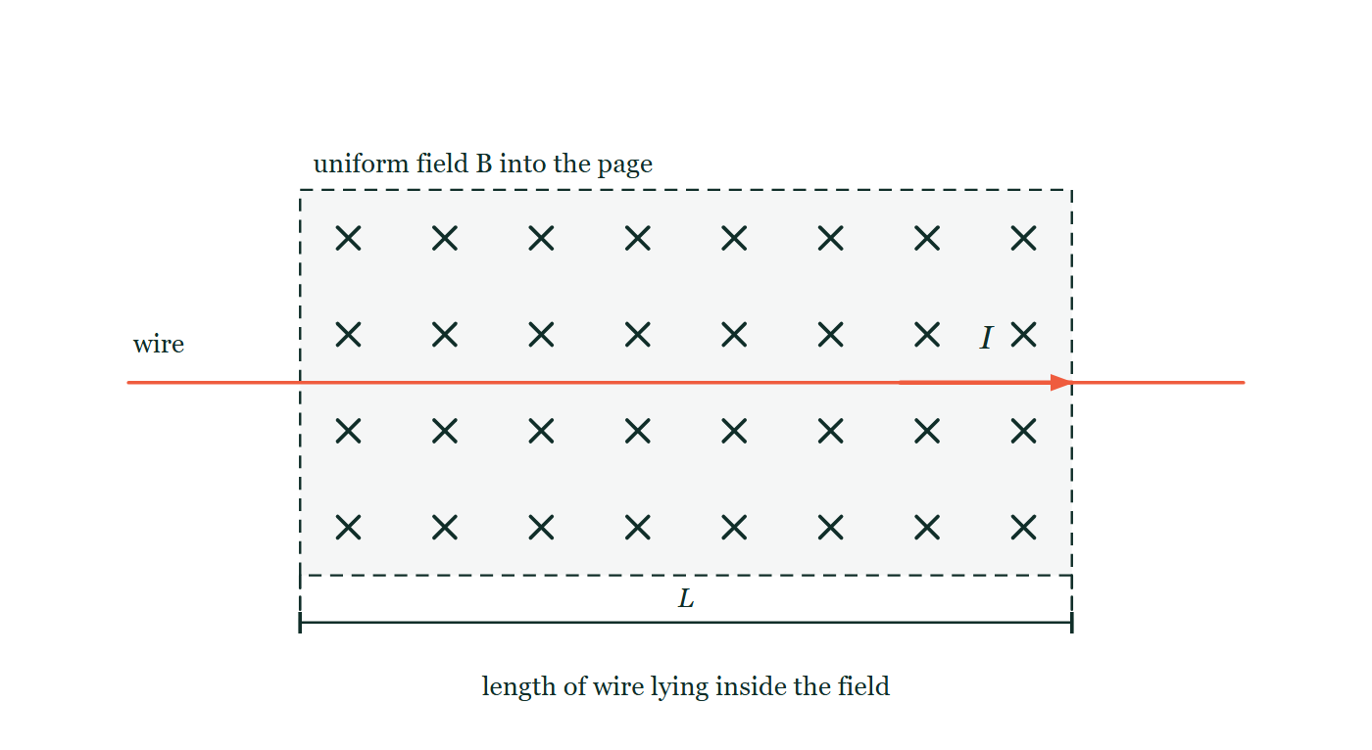
MAGNETISM · FORCE ON CURRENTS
GIOPHYSICS LESSON
THINK FIRST
An iron nail near a magnet is dragged straight at the nearest pole. Switch a current on in a wire in the same place and it flies off sideways instead. Why the difference?
Take answers before you click — the point is the commitment
Hang a bare wire between the poles of a horseshoe magnet and close the switch: the wire kicks out of the gap, not into it. Cut the current and it hangs there as if the magnet were not present.
THE ANSWER
The nail is being magnetised and pulled along the field. The wire is not magnetic at all — the field is acting on the charges drifting through it, and that force is at right angles to both the current and the field. Perpendicular is the whole point: nothing here is ever pulled along a field line.
A rectangular region of uniform field marked with a grid of crosses, meaning the field points into the page. A straight wire runs horizontally right across the region, carrying a current arrowed to the right. The length of wire lying inside the field is dimensioned as L below the region. No force arrow is drawn anywhere.
The live version of this figure — click here
Magnetism — Force on Currents. Built by GioPhysics from the lesson's own copy; nothing on these slides is re-authored.
3 / 31
Notes:
[Phase] Starter: Recall what this lesson stands on (minutes 0–5 of 45)
[Hook] An iron nail near a magnet is dragged straight at the nearest pole. Switch a current on in a wire in the same place and it flies off sideways instead. Why the difference? Hang a bare wire between the poles of a horseshoe magnet and close the switch: the wire kicks out of the gap, not into it. Cut the current and it hangs there as if the magnet were not present.
[Answer] The nail is being magnetised and pulled along the field. The wire is not magnetic at all — the field is acting on the charges drifting through it, and that force is at right angles to both the current and the field. Perpendicular is the whole point: nothing here is ever pulled along a field line.
[Figure] A rectangular region of uniform field marked with a grid of crosses, meaning the field points into the page. A straight wire runs horizontally right across the region, carrying a current arrowed to the right. The length of wire lying inside the field is dimensioned as L below the region. No force arrow is drawn anywhere.

Slide 4
MAGNETISM · FORCE ON CURRENTS
GIOPHYSICS LESSON
EXPLAINED SIMPLY
In one sentence
Introduce the idea — The big idea and the definition
A wire carrying current I of length L across a field B feels a force F = BIL sinθ at right angles to both.
Magnetism — Force on Currents. Built by GioPhysics from the lesson's own copy; nothing on these slides is re-authored.
4 / 31
Notes:
[Phase] Introduce the idea: The big idea and the definition (minutes 5–13 of 45)
[Definition] A wire carrying current I of length L across a field B feels a force F = BIL sinθ at right angles to both.

Slide 5
MAGNETISM · FORCE ON CURRENTS
GIOPHYSICS LESSON
EXPLAINED SIMPLY
What that looks like
Introduce the idea — The big idea and the definition
FOR EXAMPLE
A wire between magnet poles jumps sideways the instant the current switches on — reverse the current and it jumps the other way.
Magnetism — Force on Currents. Built by GioPhysics from the lesson's own copy; nothing on these slides is re-authored.
5 / 31
Notes:
[Phase] Introduce the idea: The big idea and the definition (minutes 5–13 of 45)
[Worked illustration] A wire between magnet poles jumps sideways the instant the current switches on — reverse the current and it jumps the other way.

Slide 6
MAGNETISM · FORCE ON CURRENTS
GIOPHYSICS LESSON
THE BIG IDEA
The motor effect
Introduce the idea — The big idea and the definition
A field exerts force on the moving charges inside a wire, and the wire feels their sum: F = BIL sinθ, maximal when wire and field are perpendicular, zero when parallel. Fleming's left hand gives the direction, and a rectangular coil in a field feels a turning pair of forces — the heart of every DC motor.
Magnetism — Force on Currents. Built by GioPhysics from the lesson's own copy; nothing on these slides is re-authored.
6 / 31
Notes:
[Phase] Introduce the idea: The big idea and the definition (minutes 5–13 of 45)
[Big idea] A field exerts force on the moving charges inside a wire, and the wire feels their sum: F = BIL sinθ, maximal when wire and field are perpendicular, zero when parallel. Fleming's left hand gives the direction, and a rectangular coil in a field feels a turning pair of forces — the heart of every DC motor.

Slide 7
MAGNETISM · FORCE ON CURRENTS
GIOPHYSICS LESSON
THE PHYSICS · 1 OF 3
Why the push
Build the model — The formulae, one at a time, in plain English
Each drifting electron feels a magnetic force; the lattice transmits the sum to the wire. No current, no force — the field alone does nothing to a stationary wire.
Magnetism — Force on Currents. Built by GioPhysics from the lesson's own copy; nothing on these slides is re-authored.
7 / 31
Notes:
[Phase] Build the model: The formulae, one at a time, in plain English (minutes 13–22 of 45)
[Section] Each drifting electron feels a magnetic force; the lattice transmits the sum to the wire. No current, no force — the field alone does nothing to a stationary wire.

Slide 8
MAGNETISM · FORCE ON CURRENTS
GIOPHYSICS LESSON
THE PHYSICS · 2 OF 3
Making it spin
Build the model — The formulae, one at a time, in plain English
Opposite sides of a coil carry current opposite ways, so their forces form a couple. A split-ring commutator reverses the current each half turn to keep the rotation going.
Magnetism — Force on Currents. Built by GioPhysics from the lesson's own copy; nothing on these slides is re-authored.
8 / 31
Notes:
[Phase] Build the model: The formulae, one at a time, in plain English (minutes 13–22 of 45)
[Section] Opposite sides of a coil carry current opposite ways, so their forces form a couple. A split-ring commutator reverses the current each half turn to keep the rotation going.

Slide 9
MAGNETISM · FORCE ON CURRENTS
GIOPHYSICS LESSON
THE PHYSICS · 3 OF 3
Loudspeakers too
Build the model — The formulae, one at a time, in plain English
A coil on a cone sits in a radial field; audio current pushes it in and out, tracking the waveform — the motor effect as sound.
Magnetism — Force on Currents. Built by GioPhysics from the lesson's own copy; nothing on these slides is re-authored.
9 / 31
Notes:
[Phase] Build the model: The formulae, one at a time, in plain English (minutes 13–22 of 45)
[Section] A coil on a cone sits in a radial field; audio current pushes it in and out, tracking the waveform — the motor effect as sound.

Slide 10
MAGNETISM · FORCE ON CURRENTS
GIOPHYSICS LESSON
FORMULA 1 OF 3
Motor-effect force
Build the model — The formulae, one at a time, in plain English
F = BIL sinθ
Max when wire ⟂ field
IN PLAIN ENGLISH
Stronger field, more current, or longer wire in the field all push harder; only the component of the wire across the field counts.
Magnetism — Force on Currents. Built by GioPhysics from the lesson's own copy; nothing on these slides is re-authored.
10 / 31
Notes:
[Phase] Build the model: The formulae, one at a time, in plain English (minutes 13–22 of 45)
[Formula] Motor-effect force: F = BIL sinθ
[In plain English] Stronger field, more current, or longer wire in the field all push harder; only the component of the wire across the field counts.
[Note] Max when wire ⟂ field

Slide 11
MAGNETISM · FORCE ON CURRENTS
GIOPHYSICS LESSON
FORMULA 2 OF 3
Fleming's left hand
Build the model — The formulae, one at a time, in plain English
F ⟂ B ⟂ I
Thumb F, first finger B, second finger I
IN PLAIN ENGLISH
Three perpendicular directions: field along the first finger, conventional current along the second — the thumb reveals the push.
Magnetism — Force on Currents. Built by GioPhysics from the lesson's own copy; nothing on these slides is re-authored.
11 / 31
Notes:
[Phase] Build the model: The formulae, one at a time, in plain English (minutes 13–22 of 45)
[Formula] Fleming's left hand: F ⟂ B ⟂ I
[In plain English] Three perpendicular directions: field along the first finger, conventional current along the second — the thumb reveals the push.
[Note] Thumb F, first finger B, second finger I

Slide 12
MAGNETISM · FORCE ON CURRENTS
GIOPHYSICS LESSON
FORMULA 3 OF 3
Defining the ampere
Build the model — The formulae, one at a time, in plain English
parallel currents attract/repel
Same direction: attract
IN PLAIN ENGLISH
Two parallel wires push on each other through their fields — historically, the size of that force defined the ampere.
Magnetism — Force on Currents. Built by GioPhysics from the lesson's own copy; nothing on these slides is re-authored.
12 / 31
Notes:
[Phase] Build the model: The formulae, one at a time, in plain English (minutes 13–22 of 45)
[Formula] Defining the ampere: parallel currents attract/repel
[In plain English] Two parallel wires push on each other through their fields — historically, the size of that force defined the ampere.
[Note] Same direction: attract

Slide 13
MAGNETISM · FORCE ON CURRENTS
GIOPHYSICS LESSON
WATCH OUT
The common trap
Check and misconception — The quick check and the trap
The force is perpendicular to the current, not along the field lines. A wire is never dragged toward a pole — it is pushed sideways, at right angles to both wire and field.
Magnetism — Force on Currents. Built by GioPhysics from the lesson's own copy; nothing on these slides is re-authored.
13 / 31
Notes:
[Phase] Check and misconception: The quick check and the trap (minutes 35–41 of 45)
[Misconception] The force is perpendicular to the current, not along the field lines. A wire is never dragged toward a pole — it is pushed sideways, at right angles to both wire and field.

Slide 14
MAGNETISM · FORCE ON CURRENTS
GIOPHYSICS LESSON
WORKED EXAMPLE 1 OF 2 · EASY
The question
Easy
Worked examples — I do, we do — one step revealed at a time
A 0.50 m wire carries 3.0 A perpendicular to a 0.20 T field. Find the force on it.
Magnetism — Force on Currents. Built by GioPhysics from the lesson's own copy; nothing on these slides is re-authored.
14 / 31
Notes:
[Phase] Worked examples: I do, we do — one step revealed at a time (minutes 22–35 of 45)
[Question] A 0.50 m wire carries 3.0 A perpendicular to a 0.20 T field. Find the force on it.
[Answer] F = 0.30 N

Slide 15
MAGNETISM · FORCE ON CURRENTS
GIOPHYSICS LESSON
WORKED EXAMPLE 1 OF 2 · EASY · THE WORKING
How to solve it
Easy
Worked examples — I do, we do — one step revealed at a time
A 0.50 m wire carries 3.0 A perpendicular to a 0.20 T field. Find the force on it.
1.
F = BIL = 0.20 × 3.0 × 0.50.
2.
F = 0.30 N.
Magnetism — Force on Currents. Built by GioPhysics from the lesson's own copy; nothing on these slides is re-authored.
15 / 31
Notes:
[Phase] Worked examples: I do, we do — one step revealed at a time (minutes 22–35 of 45)
[Reveal] One click per step. The class works each line before the next appears.
[Step 1] F = BIL = 0.20 × 3.0 × 0.50.
[Step 2] F = 0.30 N.

Slide 16
MAGNETISM · FORCE ON CURRENTS
GIOPHYSICS LESSON
WORKED EXAMPLE 1 OF 2 · EASY
Answer
Easy
Worked examples — I do, we do — one step revealed at a time
F = 0.30 N
Magnetism — Force on Currents. Built by GioPhysics from the lesson's own copy; nothing on these slides is re-authored.
16 / 31
Notes:
[Phase] Worked examples: I do, we do — one step revealed at a time (minutes 22–35 of 45)
[Answer] F = 0.30 N

Slide 17
MAGNETISM · FORCE ON CURRENTS
GIOPHYSICS LESSON
WORKED EXAMPLE 2 OF 2 · MEDIUM
The question
Medium
Worked examples — I do, we do — one step revealed at a time
A 0.30 m wire carries 4.0 A at right angles to a 0.25 T field. Find the force, and the effect of tilting the wire to 30° from the field.
Magnetism — Force on Currents. Built by GioPhysics from the lesson's own copy; nothing on these slides is re-authored.
17 / 31
Notes:
[Phase] Worked examples: I do, we do — one step revealed at a time (minutes 22–35 of 45)
[Question] A 0.30 m wire carries 4.0 A at right angles to a 0.25 T field. Find the force, and the effect of tilting the wire to 30° from the field.
[Answer] 0.30 N perpendicular; 0.15 N at 30°

Slide 18
MAGNETISM · FORCE ON CURRENTS
GIOPHYSICS LESSON
WORKED EXAMPLE 2 OF 2 · MEDIUM · THE WORKING
How to solve it
Medium
Worked examples — I do, we do — one step revealed at a time
A 0.30 m wire carries 4.0 A at right angles to a 0.25 T field. Find the force, and the effect of tilting the wire to 30° from the field.
1.
F = BIL = 0.25 × 4.0 × 0.30 = 0.30 N.
2.
At 30° to the field: F = BIL sin30°.
3.
F = 0.30 × 0.5 = 0.15 N.
Magnetism — Force on Currents. Built by GioPhysics from the lesson's own copy; nothing on these slides is re-authored.
18 / 31
Notes:
[Phase] Worked examples: I do, we do — one step revealed at a time (minutes 22–35 of 45)
[Reveal] One click per step. The class works each line before the next appears.
[Step 1] F = BIL = 0.25 × 4.0 × 0.30 = 0.30 N.
[Step 2] At 30° to the field: F = BIL sin30°.
[Step 3] F = 0.30 × 0.5 = 0.15 N.

Slide 19
MAGNETISM · FORCE ON CURRENTS
GIOPHYSICS LESSON
WORKED EXAMPLE 2 OF 2 · MEDIUM
Answer
Medium
Worked examples — I do, we do — one step revealed at a time
0.30 N perpendicular; 0.15 N at 30°
Magnetism — Force on Currents. Built by GioPhysics from the lesson's own copy; nothing on these slides is re-authored.
19 / 31
Notes:
[Phase] Worked examples: I do, we do — one step revealed at a time (minutes 22–35 of 45)
[Answer] 0.30 N perpendicular; 0.15 N at 30°

Slide 20
MAGNETISM · FORCE ON CURRENTS
GIOPHYSICS LESSON
SPOT THE MISTAKE
One line here is wrong
The whole working is up — find the bad line before you click
1.
F = BIL sinθ, with B = 0.25 T, I = 4.0 A and L = 0.30 m
2.
At right angles to the field: F = 0.25 × 4.0 × 0.30 = 0.30 N
3.
Now tilted to 30° from the field: F = BIL cos30° = 0.30 × 0.866
4.
F = 0.26 N — barely less than before
LINE 3 IS WRONG
The sine has quietly become a cosine. In F = BIL sinθ the angle θ is measured between the wire and the field, so lying along the field (θ = 0) must give zero — and only sinθ does that. Swapping to cosine makes the formula say a wire parallel to the field feels the maximum force, which is exactly backwards.
IT SHOULD SAY
Now tilted to 30° from the field: F = BIL sin30° = 0.30 × 0.5 = 0.15 N
Magnetism — Force on Currents. Built by GioPhysics from the lesson's own copy; nothing on these slides is re-authored.
20 / 31
Notes:
[Phase] Worked examples: I do, we do — one step revealed at a time (minutes 22–35 of 45)
[Spot the mistake] The working is complete and one line of it is wrong. Let the room hunt: one click names the line, a second shows it done correctly.
[Line 3 is wrong] The sine has quietly become a cosine. In F = BIL sinθ the angle θ is measured between the wire and the field, so lying along the field (θ = 0) must give zero — and only sinθ does that. Swapping to cosine makes the formula say a wire parallel to the field feels the maximum force, which is exactly backwards.
[It should say] Now tilted to 30° from the field: F = BIL sin30° = 0.30 × 0.5 = 0.15 N

Slide 21
MAGNETISM · FORCE ON CURRENTS
GIOPHYSICS LESSON
PREDICT · TAKE THE VOTE
Commit before you are told
Hands up for each option, then click
Which way does the wire get pushed the instant the current flows?
A Up the page
B Down the page
C Into the page, along the field lines
D To the right, along the wire itself
A rectangular region of uniform field marked with a grid of crosses, meaning the field points into the page. A straight wire runs horizontally right across the region, carrying a current arrowed to the right. The length of wire lying inside the field is dimensioned as L below the region. No force arrow is drawn anywhere.
The live version of this figure — click here
Magnetism — Force on Currents. Built by GioPhysics from the lesson's own copy; nothing on these slides is re-authored.
21 / 31
Notes:
[Phase] Build the model: The formulae, one at a time, in plain English (minutes 13–22 of 45)
[Predict] Which way does the wire get pushed the instant the current flows?
[Options] A Up the page B Down the page C Into the page, along the field lines D To the right, along the wire itself
[Figure] A rectangular region of uniform field marked with a grid of crosses, meaning the field points into the page. A straight wire runs horizontally right across the region, carrying a current arrowed to the right. The length of wire lying inside the field is dimensioned as L below the region. No force arrow is drawn anywhere.

Slide 22
MAGNETISM · FORCE ON CURRENTS
GIOPHYSICS LESSON
PREDICT · THE OUTCOME
What actually happens
Ask the room who changed their mind, and why
A Up the page
WHY
Fleming's left hand: first finger into the page along the field, second finger to the right along the current, and the thumb — the only direction left that is square to both — points up the page. Notice that the answer is in the plane of the drawing only because the field was drawn into it; that is why exam figures use crosses for the field.
Magnetism — Force on Currents. Built by GioPhysics from the lesson's own copy; nothing on these slides is re-authored.
22 / 31
Notes:
[Phase] Build the model: The formulae, one at a time, in plain English (minutes 13–22 of 45)
[Answer] A — Up the page. Fleming's left hand: first finger into the page along the field, second finger to the right along the current, and the thumb — the only direction left that is square to both — points up the page. Notice that the answer is in the plane of the drawing only because the field was drawn into it; that is why exam figures use crosses for the field.

Slide 23
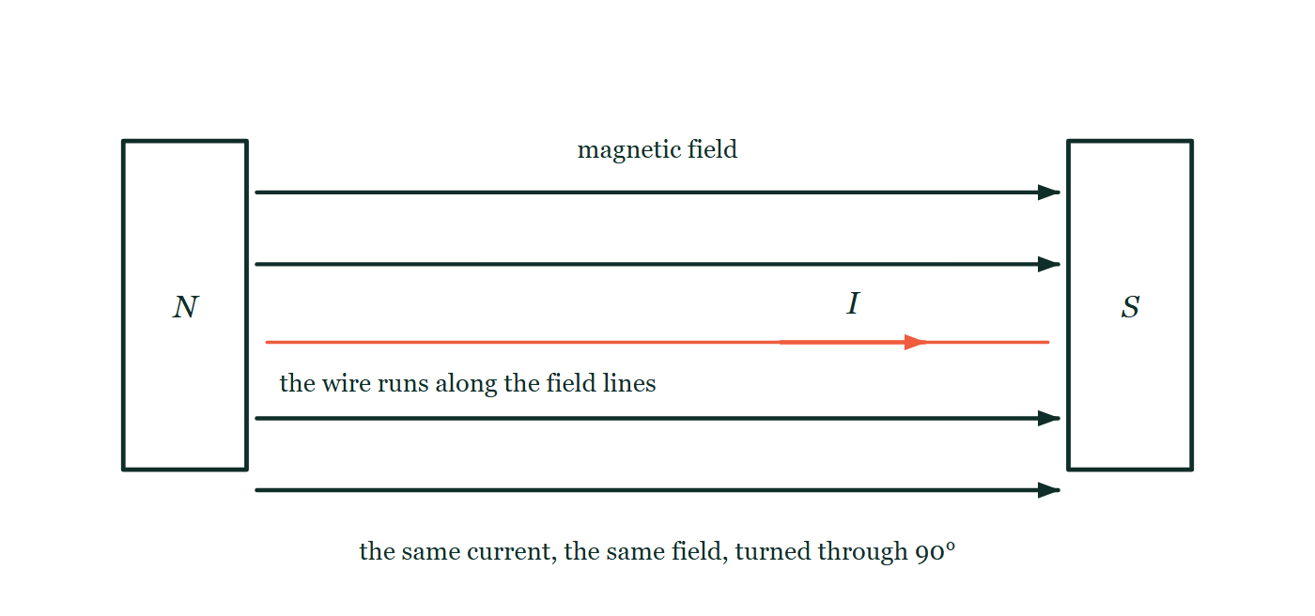
MAGNETISM · FORCE ON CURRENTS
GIOPHYSICS LESSON
QUICK CHECK
Decide before the answer goes up
Check and misconception — The quick check and the trap
A wire carries current parallel to a magnetic field. The force on it is…
A
Maximum
B
Zero
C
Along the field
A north pole on the left and a south pole on the right, with four straight field arrows running across the gap from north to south. A current-carrying wire is drawn between them lying parallel to those arrows, its current arrowed in the same direction as the field, so wire and field are lined up rather than crossed.
The live version of this figure — click here
Magnetism — Force on Currents. Built by GioPhysics from the lesson's own copy; nothing on these slides is re-authored.
23 / 31
Notes:
[Phase] Check and misconception: The quick check and the trap (minutes 35–41 of 45)
[Question] A wire carries current parallel to a magnetic field. The force on it is…
[Figure] A north pole on the left and a south pole on the right, with four straight field arrows running across the gap from north to south. A current-carrying wire is drawn between them lying parallel to those arrows, its current arrowed in the same direction as the field, so wire and field are lined up rather than crossed.
[Options] A Maximum B Zero C Along the field

Slide 24
MAGNETISM · FORCE ON CURRENTS
GIOPHYSICS LESSON
QUICK CHECK · THE ANSWER
The answer, and why
Check and misconception — The quick check and the trap
B Zero
HOW TO GET THERE
F = BIL sinθ with θ = 0 gives zero — only the perpendicular component of current experiences force.
WHY THE OTHERS TEMPT
A This is the answer for a wire at right angles to the field, which is the case most textbook figures show and the one most students carry away. Here the wire has been turned to lie along the field, and sinθ punishes that.
B Correct. F = BIL sinθ with θ = 0 gives sin 0 = 0, so there is no force at all — the wire hangs as though the magnet were switched off.
C The force is never along the field. That is the single most useful thing to remember about the motor effect: the push is square to both the current and the field, so it can never lie along either of them.
Magnetism — Force on Currents. Built by GioPhysics from the lesson's own copy; nothing on these slides is re-authored.
24 / 31
Notes:
[Phase] Check and misconception: The quick check and the trap (minutes 35–41 of 45)
[Question] A wire carries current parallel to a magnetic field. The force on it is…
[Option by option] A: This is the answer for a wire at right angles to the field, which is the case most textbook figures show and the one most students carry away. Here the wire has been turned to lie along the field, and sinθ punishes that. B: Correct. F = BIL sinθ with θ = 0 gives sin 0 = 0, so there is no force at all — the wire hangs as though the magnet were switched off. C: The force is never along the field. That is the single most useful thing to remember about the motor effect: the push is square to both the current and the field, so it can never lie along either of them.
[Answer] B — Zero
[Why] F = BIL sinθ with θ = 0 gives zero — only the perpendicular component of current experiences force.
[Reveal] One click for the answer, then one for the reason.

Slide 25
MAGNETISM · FORCE ON CURRENTS
GIOPHYSICS LESSON
EXTENSION 1 OF 2 · HARD
The question
Hard
Worked examples — I do, we do — one step revealed at a time
A horizontal wire of mass-per-length 0.010 kg/m carries current perpendicular to a horizontal 0.25 T field. What current makes the magnetic force levitate the wire?
Magnetism — Force on Currents. Built by GioPhysics from the lesson's own copy; nothing on these slides is re-authored.
25 / 31
Notes:
[Phase] Worked examples: I do, we do — one step revealed at a time (minutes 22–35 of 45)
[Question] A horizontal wire of mass-per-length 0.010 kg/m carries current perpendicular to a horizontal 0.25 T field. What current makes the magnetic force levitate the wire?
[Answer] I ≈ 0.39 A

Slide 26
MAGNETISM · FORCE ON CURRENTS
GIOPHYSICS LESSON
EXTENSION 1 OF 2 · HARD · THE WORKING
How to solve it
Hard
Worked examples — I do, we do — one step revealed at a time
A horizontal wire of mass-per-length 0.010 kg/m carries current perpendicular to a horizontal 0.25 T field. What current makes the magnetic force levitate the wire?
1.
Levitation: BIL = mgL per unit length → BI = (m/L)g.
2.
I = 0.010 × 9.81 ÷ 0.25.
3.
I ≈ 0.39 A, directed so the force points up (Fleming's left hand).
Magnetism — Force on Currents. Built by GioPhysics from the lesson's own copy; nothing on these slides is re-authored.
26 / 31
Notes:
[Phase] Worked examples: I do, we do — one step revealed at a time (minutes 22–35 of 45)
[Reveal] One click per step. The class works each line before the next appears.
[Step 1] Levitation: BIL = mgL per unit length → BI = (m/L)g.
[Step 2] I = 0.010 × 9.81 ÷ 0.25.
[Step 3] I ≈ 0.39 A, directed so the force points up (Fleming's left hand).

Slide 27
MAGNETISM · FORCE ON CURRENTS
GIOPHYSICS LESSON
EXTENSION 1 OF 2 · HARD
Answer
Hard
Worked examples — I do, we do — one step revealed at a time
I ≈ 0.39 A
Magnetism — Force on Currents. Built by GioPhysics from the lesson's own copy; nothing on these slides is re-authored.
27 / 31
Notes:
[Phase] Worked examples: I do, we do — one step revealed at a time (minutes 22–35 of 45)
[Answer] I ≈ 0.39 A

Slide 28
MAGNETISM · FORCE ON CURRENTS
GIOPHYSICS LESSON
EXTENSION 2 OF 2 · CHALLENGING
The question
Challenging
Worked examples — I do, we do — one step revealed at a time
A motor coil of 50 turns measures 4.0 cm × 6.0 cm in a 0.30 T field carrying 1.2 A. Find the maximum torque, and explain the commutator's role at the moment of zero torque.
Magnetism — Force on Currents. Built by GioPhysics from the lesson's own copy; nothing on these slides is re-authored.
28 / 31
Notes:
[Phase] Worked examples: I do, we do — one step revealed at a time (minutes 22–35 of 45)
[Question] A motor coil of 50 turns measures 4.0 cm × 6.0 cm in a 0.30 T field carrying 1.2 A. Find the maximum torque, and explain the commutator's role at the moment of zero torque.
[Answer] τ(max) ≈ 0.043 N·m; the commutator flips current at dead centre to keep rotation one-way

Slide 29
MAGNETISM · FORCE ON CURRENTS
GIOPHYSICS LESSON
EXTENSION 2 OF 2 · CHALLENGING · THE WORKING
How to solve it
Challenging
Worked examples — I do, we do — one step revealed at a time
A motor coil of 50 turns measures 4.0 cm × 6.0 cm in a 0.30 T field carrying 1.2 A. Find the maximum torque, and explain the commutator's role at the moment of zero torque.
1.
τ(max) = NBIA = 50 × 0.30 × 1.2 × 0.0024 ≈ 0.043 N·m (coil plane parallel to B).
2.
Torque falls to zero when the coil face is perpendicular — the forces then pull outward, not around.
3.
The split-ring reverses the current exactly there so momentum carries the coil through and the torque re-establishes in the same rotational sense.
Magnetism — Force on Currents. Built by GioPhysics from the lesson's own copy; nothing on these slides is re-authored.
29 / 31
Notes:
[Phase] Worked examples: I do, we do — one step revealed at a time (minutes 22–35 of 45)
[Reveal] One click per step. The class works each line before the next appears.
[Step 1] τ(max) = NBIA = 50 × 0.30 × 1.2 × 0.0024 ≈ 0.043 N·m (coil plane parallel to B).
[Step 2] Torque falls to zero when the coil face is perpendicular — the forces then pull outward, not around.
[Step 3] The split-ring reverses the current exactly there so momentum carries the coil through and the torque re-establishes in the same rotational sense.

Slide 30
MAGNETISM · FORCE ON CURRENTS
GIOPHYSICS LESSON
EXTENSION 2 OF 2 · CHALLENGING
Answer
Challenging
Worked examples — I do, we do — one step revealed at a time
τ(max) ≈ 0.043 N·m; the commutator flips current at dead centre to keep rotation one-way
Magnetism — Force on Currents. Built by GioPhysics from the lesson's own copy; nothing on these slides is re-authored.
30 / 31
Notes:
[Phase] Worked examples: I do, we do — one step revealed at a time (minutes 22–35 of 45)
[Answer] τ(max) ≈ 0.043 N·m; the commutator flips current at dead centre to keep rotation one-way

Slide 31
MAGNETISM · FORCE ON CURRENTS
GIOPHYSICS LESSON
MAGNETISM
Where to go next
Plenary — What to take away, what to practise next
Next
18.4 Force on Moving Charges
https://giophysics.com/chapter-27/force-on-moving-charges/
Lesson
This lesson on giophysics.com
https://giophysics.com/chapter-27/force-on-currents/
Live
The live, interactive version of these slides
https://giophysics.com/chapter-27/presentation/?lesson=forceWire
Chapter
All Magnetism lessons
https://giophysics.com/chapter-27/
PDF
Download the lesson PDF
https://giophysics.com/downloads/27-3-force-on-currents.pdf
Magnetism — Force on Currents. Built by GioPhysics from the lesson's own copy; nothing on these slides is re-authored.
31 / 31
Notes:
[Phase] Plenary: What to take away, what to practise next (minutes 41–45 of 45)
[Interactive] The graphs and the circuit topology on these slides are frozen. The live version at https://giophysics.com/chapter-27/presentation/?lesson=forceWire moves them.

