Slide 1
ELECTROMAGNETISM · FARADAY'S LAW
GIOPHYSICS LESSON
19 · Electromagnetism
Changing flux makes voltage
Faraday's Law
Move a magnet near a coil and a voltage appears — only while something changes. Faraday's law makes it exact: the induced e.m.f. equals the rate of change of flux linkage.
POSITION
Lesson 2 of 7 in Electromagnetism
PLAN
16 slides in the 45-minute core run, about 44.5 minutes of it
LESSON PAGE
https://giophysics.com/chapter-28/faradays-law/
Built by GioPhysics from the lesson's own page. Every word on these slides is the lesson's; nothing here is re-authored. Teaching material, not an awarding body's document.
Electromagnetism — Faraday's Law. Built by GioPhysics from the lesson's own copy; nothing on these slides is re-authored.
1 / 31
Notes:
[Lesson] Electromagnetism — Faraday's Law. Lesson 2 of 7.
[Intro] Move a magnet near a coil and a voltage appears — only while something changes. Faraday's law makes it exact: the induced e.m.f. equals the rate of change of flux linkage.
[Source] https://giophysics.com/chapter-28/faradays-law/
[Disclaimer] Built by GioPhysics from the lesson's own page. Every word on these slides is the lesson's; nothing here is re-authored. Teaching material, not an awarding body's document.

Slide 2
ELECTROMAGNETISM · FARADAY'S LAW
GIOPHYSICS LESSON
WHAT THIS NEEDS
What you already know
Starter — Recall what this lesson stands on
Recall
Magnetic flux
https://giophysics.com/chapter-28/magnetic-flux/
Recall
Rates of change
https://giophysics.com/chapter-23/circuit-calculus/
Electromagnetism — Faraday's Law. Built by GioPhysics from the lesson's own copy; nothing on these slides is re-authored.
2 / 31
Notes:
[Phase] Starter: Recall what this lesson stands on (minutes 0–5 of 45)
[Starter] Recall: Magnetic flux; Rates of change

Slide 3
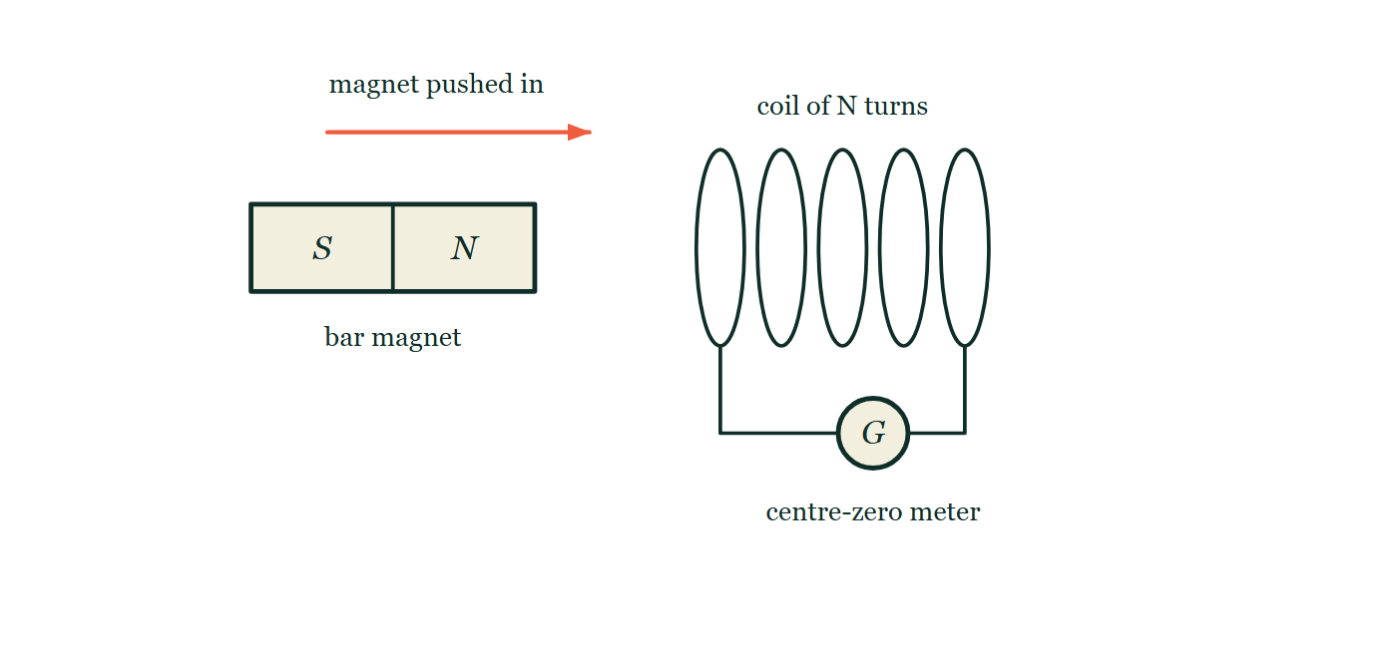
ELECTROMAGNETISM · FARADAY'S LAW
GIOPHYSICS LESSON
THINK FIRST
A coil is left sitting inside the strongest steady magnetic field on Earth for a whole year. How much electricity does it generate?
Take answers before you click — the point is the commitment
The field is enormous, the coil has ten thousand turns of good copper, and nothing in the room moves for twelve months.
THE ANSWER
Not one microvolt, from beginning to end. Flux on its own induces nothing whatever; only a CHANGE of flux does. E.m.f. is a rate — e.m.f. = −N dΦ/dt — so the moment the change stops the voltage stops with it, however large the flux it stopped at.
A bar magnet held horizontally with its north pole facing a coil of five turns, and an arrow above it showing the magnet being pushed in towards the coil. The coil's two ends run down to a centre-zero meter, which is drawn as a plain circle with no needle in it at all.
The live version of this figure — click here
Electromagnetism — Faraday's Law. Built by GioPhysics from the lesson's own copy; nothing on these slides is re-authored.
3 / 31
Notes:
[Phase] Starter: Recall what this lesson stands on (minutes 0–5 of 45)
[Hook] A coil is left sitting inside the strongest steady magnetic field on Earth for a whole year. How much electricity does it generate? The field is enormous, the coil has ten thousand turns of good copper, and nothing in the room moves for twelve months.
[Answer] Not one microvolt, from beginning to end. Flux on its own induces nothing whatever; only a CHANGE of flux does. E.m.f. is a rate — e.m.f. = −N dΦ/dt — so the moment the change stops the voltage stops with it, however large the flux it stopped at.
[Figure] A bar magnet held horizontally with its north pole facing a coil of five turns, and an arrow above it showing the magnet being pushed in towards the coil. The coil's two ends run down to a centre-zero meter, which is drawn as a plain circle with no needle in it at all.

Slide 4
ELECTROMAGNETISM · FARADAY'S LAW
GIOPHYSICS LESSON
EXPLAINED SIMPLY
In one sentence
Introduce the idea — The big idea and the definition
Faraday's law: the induced e.m.f. equals the rate at which flux linkage through the circuit changes.
Electromagnetism — Faraday's Law. Built by GioPhysics from the lesson's own copy; nothing on these slides is re-authored.
4 / 31
Notes:
[Phase] Introduce the idea: The big idea and the definition (minutes 5–13 of 45)
[Definition] Faraday's law: the induced e.m.f. equals the rate at which flux linkage through the circuit changes.

Slide 5
ELECTROMAGNETISM · FARADAY'S LAW
GIOPHYSICS LESSON
EXPLAINED SIMPLY
What that looks like
Introduce the idea — The big idea and the definition
FOR EXAMPLE
Thrusting a magnet quickly into a coil flicks the meter far more than easing it in slowly — same flux change, faster rate.
Electromagnetism — Faraday's Law. Built by GioPhysics from the lesson's own copy; nothing on these slides is re-authored.
5 / 31
Notes:
[Phase] Introduce the idea: The big idea and the definition (minutes 5–13 of 45)
[Worked illustration] Thrusting a magnet quickly into a coil flicks the meter far more than easing it in slowly — same flux change, faster rate.

Slide 6
ELECTROMAGNETISM · FARADAY'S LAW
GIOPHYSICS LESSON
THE BIG IDEA
Changing flux makes voltage
Introduce the idea — The big idea and the definition
E.m.f. is induced only while flux changes: e.m.f. = −N ΔΦ/Δt (in the calculus limit, −N dΦ/dt). Faster change, more turns, or bigger flux swings all raise the voltage. Stop the change and the voltage vanishes instantly — induction is a rate effect.
Electromagnetism — Faraday's Law. Built by GioPhysics from the lesson's own copy; nothing on these slides is re-authored.
6 / 31
Notes:
[Phase] Introduce the idea: The big idea and the definition (minutes 5–13 of 45)
[Big idea] E.m.f. is induced only while flux changes: e.m.f. = −N ΔΦ/Δt (in the calculus limit, −N dΦ/dt). Faster change, more turns, or bigger flux swings all raise the voltage. Stop the change and the voltage vanishes instantly — induction is a rate effect.

Slide 7
ELECTROMAGNETISM · FARADAY'S LAW
GIOPHYSICS LESSON
THE PHYSICS · 1 OF 3
What counts as change
Build the model — The formulae, one at a time, in plain English
Magnet moving, coil moving, field growing or dying, loop rotating or deforming — any route that alters BA cosθ induces e.m.f. while it lasts.
Electromagnetism — Faraday's Law. Built by GioPhysics from the lesson's own copy; nothing on these slides is re-authored.
7 / 31
Notes:
[Phase] Build the model: The formulae, one at a time, in plain English (minutes 13–22 of 45)
[Section] Magnet moving, coil moving, field growing or dying, loop rotating or deforming — any route that alters BA cosθ induces e.m.f. while it lasts.

Slide 8
ELECTROMAGNETISM · FARADAY'S LAW
GIOPHYSICS LESSON
THE PHYSICS · 2 OF 3
The graph view
Build the model — The formulae, one at a time, in plain English
E.m.f. is the gradient of the flux–time graph. Steady flux: zero.
Uniform ramp: constant e.m.f. Sinusoidal flux: sinusoidal e.m.f., a quarter cycle out of step.
Electromagnetism — Faraday's Law. Built by GioPhysics from the lesson's own copy; nothing on these slides is re-authored.
8 / 31
Notes:
[Phase] Build the model: The formulae, one at a time, in plain English (minutes 13–22 of 45)
[Section] E.m.f. is the gradient of the flux–time graph. Steady flux: zero. Uniform ramp: constant e.m.f. Sinusoidal flux: sinusoidal e.m.f., a quarter cycle out of step.

Slide 9
ELECTROMAGNETISM · FARADAY'S LAW
GIOPHYSICS LESSON
THE PHYSICS · 3 OF 3
Microscopic cause
Build the model — The formulae, one at a time, in plain English
Charges in a moving conductor feel the magnetic force qvB along the wire — induction is the motor effect read backwards.
Electromagnetism — Faraday's Law. Built by GioPhysics from the lesson's own copy; nothing on these slides is re-authored.
9 / 31
Notes:
[Phase] Build the model: The formulae, one at a time, in plain English (minutes 13–22 of 45)
[Section] Charges in a moving conductor feel the magnetic force qvB along the wire — induction is the motor effect read backwards.

Slide 10
ELECTROMAGNETISM · FARADAY'S LAW
GIOPHYSICS LESSON
FORMULA 1 OF 3
Faraday's law
Build the model — The formulae, one at a time, in plain English
e.m.f. = −N·ΔΦ/Δt
= −N dΦ/dt in the limit
IN PLAIN ENGLISH
The voltage equals how fast the threading field changes, multiplied by the number of turns catching it.
Electromagnetism — Faraday's Law. Built by GioPhysics from the lesson's own copy; nothing on these slides is re-authored.
10 / 31
Notes:
[Phase] Build the model: The formulae, one at a time, in plain English (minutes 13–22 of 45)
[Formula] Faraday's law: e.m.f. = −N·ΔΦ/Δt
[In plain English] The voltage equals how fast the threading field changes, multiplied by the number of turns catching it.
[Note] = −N dΦ/dt in the limit

Slide 11
ELECTROMAGNETISM · FARADAY'S LAW
GIOPHYSICS LESSON
FORMULA 2 OF 3
Moving rod
Build the model — The formulae, one at a time, in plain English
e.m.f. = BLv
Rod length L sweeping at speed v
IN PLAIN ENGLISH
A conductor sweeping across field lines generates voltage proportional to field, length, and speed — the generator principle in one bar.
Electromagnetism — Faraday's Law. Built by GioPhysics from the lesson's own copy; nothing on these slides is re-authored.
11 / 31
Notes:
[Phase] Build the model: The formulae, one at a time, in plain English (minutes 13–22 of 45)
[Formula] Moving rod: e.m.f. = BLv
[In plain English] A conductor sweeping across field lines generates voltage proportional to field, length, and speed — the generator principle in one bar.
[Note] Rod length L sweeping at speed v

Slide 12
ELECTROMAGNETISM · FARADAY'S LAW
GIOPHYSICS LESSON
FORMULA 3 OF 3
Average e.m.f.
Build the model — The formulae, one at a time, in plain English
e.m.f. = NΔΦ/Δt
Magnitude; direction from Lenz
IN PLAIN ENGLISH
For exam problems: total flux change over the time it took, times the turns.
Electromagnetism — Faraday's Law. Built by GioPhysics from the lesson's own copy; nothing on these slides is re-authored.
12 / 31
Notes:
[Phase] Build the model: The formulae, one at a time, in plain English (minutes 13–22 of 45)
[Formula] Average e.m.f.: e.m.f. = NΔΦ/Δt
[In plain English] For exam problems: total flux change over the time it took, times the turns.
[Note] Magnitude; direction from Lenz

Slide 13
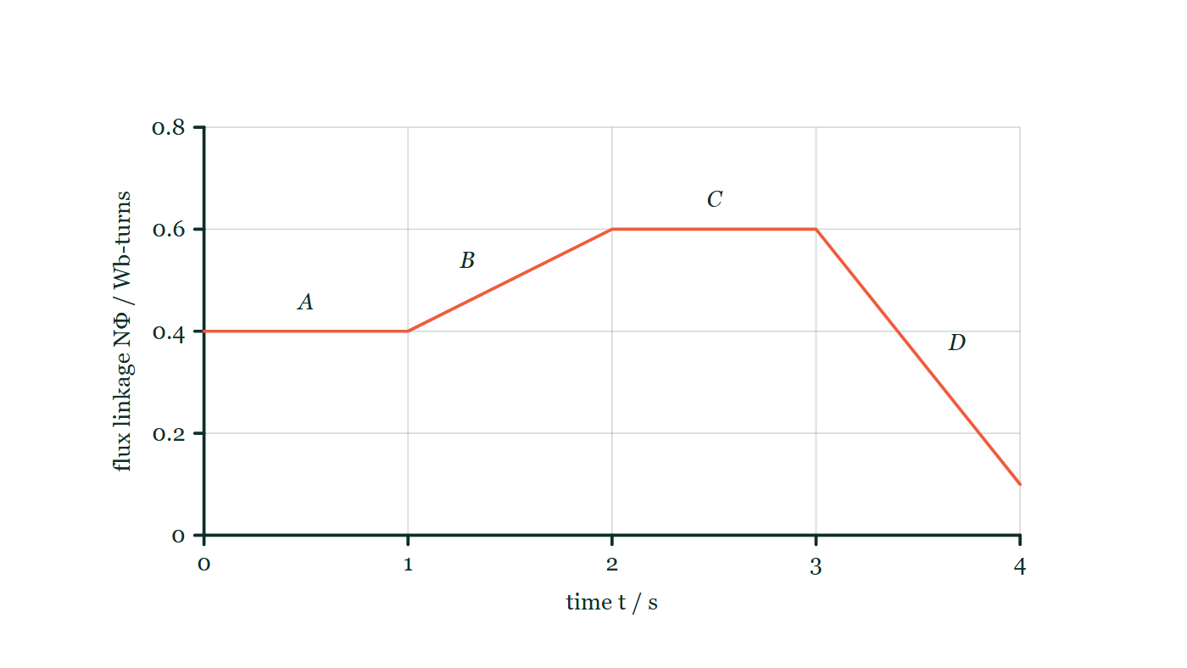
ELECTROMAGNETISM · FARADAY'S LAW
GIOPHYSICS LESSON
THE PICTURE
Value or slope?
Drawn for this lesson
Flux linkage plotted against time for a coil as four straight sections on gridded axes running to 4 s and 0.8 Wb-turns: section A flat, section B rising gently to a higher level, section C flat again at that higher level, and section D falling steeply to finish near the bottom of the graph. Each section is lettered.
The live version of this figure — click here
Electromagnetism — Faraday's Law. Built by GioPhysics from the lesson's own copy; nothing on these slides is re-authored.
13 / 31
Notes:
[Phase] Build the model: The formulae, one at a time, in plain English (minutes 13–22 of 45)
[Figure] Flux linkage plotted against time for a coil as four straight sections on gridded axes running to 4 s and 0.8 Wb-turns: section A flat, section B rising gently to a higher level, section C flat again at that higher level, and section D falling steeply to finish near the bottom of the graph. Each section is lettered.

Slide 14
ELECTROMAGNETISM · FARADAY'S LAW
GIOPHYSICS LESSON
WATCH OUT
The common trap
Check and misconception — The quick check and the trap
Flux itself induces nothing — only its change does. A coil in the strongest steady field ever built produces exactly zero volts.
Electromagnetism — Faraday's Law. Built by GioPhysics from the lesson's own copy; nothing on these slides is re-authored.
14 / 31
Notes:
[Phase] Check and misconception: The quick check and the trap (minutes 35–41 of 45)
[Misconception] Flux itself induces nothing — only its change does. A coil in the strongest steady field ever built produces exactly zero volts.

Slide 15
ELECTROMAGNETISM · FARADAY'S LAW
GIOPHYSICS LESSON
WORKED EXAMPLE 1 OF 2 · EASY
The question
Easy
Worked examples — I do, we do — one step revealed at a time
The flux through a single loop falls steadily from 0.30 Wb to zero in 0.60 s. Find the induced e.m.f.
Electromagnetism — Faraday's Law. Built by GioPhysics from the lesson's own copy; nothing on these slides is re-authored.
15 / 31
Notes:
[Phase] Worked examples: I do, we do — one step revealed at a time (minutes 22–35 of 45)
[Question] The flux through a single loop falls steadily from 0.30 Wb to zero in 0.60 s. Find the induced e.m.f.
[Answer] 0.50 V

Slide 16
ELECTROMAGNETISM · FARADAY'S LAW
GIOPHYSICS LESSON
WORKED EXAMPLE 1 OF 2 · EASY · THE WORKING
How to solve it
Easy
Worked examples — I do, we do — one step revealed at a time
The flux through a single loop falls steadily from 0.30 Wb to zero in 0.60 s. Find the induced e.m.f.
1.
e.m.f. = ΔΦ/Δt = 0.30 ÷ 0.60.
2.
= 0.50 V while the change lasts.
Electromagnetism — Faraday's Law. Built by GioPhysics from the lesson's own copy; nothing on these slides is re-authored.
16 / 31
Notes:
[Phase] Worked examples: I do, we do — one step revealed at a time (minutes 22–35 of 45)
[Reveal] One click per step. The class works each line before the next appears.
[Step 1] e.m.f. = ΔΦ/Δt = 0.30 ÷ 0.60.
[Step 2] = 0.50 V while the change lasts.

Slide 17
ELECTROMAGNETISM · FARADAY'S LAW
GIOPHYSICS LESSON
WORKED EXAMPLE 1 OF 2 · EASY
Answer
Easy
Worked examples — I do, we do — one step revealed at a time
0.50 V
Electromagnetism — Faraday's Law. Built by GioPhysics from the lesson's own copy; nothing on these slides is re-authored.
17 / 31
Notes:
[Phase] Worked examples: I do, we do — one step revealed at a time (minutes 22–35 of 45)
[Answer] 0.50 V

Slide 18
ELECTROMAGNETISM · FARADAY'S LAW
GIOPHYSICS LESSON
WORKED EXAMPLE 2 OF 2 · MEDIUM
The question
Medium
Worked examples — I do, we do — one step revealed at a time
A 0.50 m rod on rails moves at 4.0 m/s across a 0.20 T field. Find the e.m.f., and the current if the circuit resistance is 2.0 Ω.
Electromagnetism — Faraday's Law. Built by GioPhysics from the lesson's own copy; nothing on these slides is re-authored.
18 / 31
Notes:
[Phase] Worked examples: I do, we do — one step revealed at a time (minutes 22–35 of 45)
[Question] A 0.50 m rod on rails moves at 4.0 m/s across a 0.20 T field. Find the e.m.f., and the current if the circuit resistance is 2.0 Ω.
[Answer] 0.40 V, driving 0.20 A

Slide 19
ELECTROMAGNETISM · FARADAY'S LAW
GIOPHYSICS LESSON
WORKED EXAMPLE 2 OF 2 · MEDIUM · THE WORKING
How to solve it
Medium
Worked examples — I do, we do — one step revealed at a time
A 0.50 m rod on rails moves at 4.0 m/s across a 0.20 T field. Find the e.m.f., and the current if the circuit resistance is 2.0 Ω.
1.
e.m.f. = BLv = 0.20 × 0.50 × 4.0 = 0.40 V.
2.
I = e.m.f./R = 0.40 ÷ 2.0.
3.
I = 0.20 A.
Electromagnetism — Faraday's Law. Built by GioPhysics from the lesson's own copy; nothing on these slides is re-authored.
19 / 31
Notes:
[Phase] Worked examples: I do, we do — one step revealed at a time (minutes 22–35 of 45)
[Reveal] One click per step. The class works each line before the next appears.
[Step 1] e.m.f. = BLv = 0.20 × 0.50 × 4.0 = 0.40 V.
[Step 2] I = e.m.f./R = 0.40 ÷ 2.0.
[Step 3] I = 0.20 A.

Slide 20
ELECTROMAGNETISM · FARADAY'S LAW
GIOPHYSICS LESSON
WORKED EXAMPLE 2 OF 2 · MEDIUM
Answer
Medium
Worked examples — I do, we do — one step revealed at a time
0.40 V, driving 0.20 A
Electromagnetism — Faraday's Law. Built by GioPhysics from the lesson's own copy; nothing on these slides is re-authored.
20 / 31
Notes:
[Phase] Worked examples: I do, we do — one step revealed at a time (minutes 22–35 of 45)
[Answer] 0.40 V, driving 0.20 A

Slide 21
ELECTROMAGNETISM · FARADAY'S LAW
GIOPHYSICS LESSON
PREDICT · TAKE THE VOTE
Commit before you are told
Hands up for each option, then click
The graph shows flux linkage through a coil in four straight sections. Along which section is the induced e.m.f. largest, and where is it zero?
A Largest along C, where the flux linkage is greatest; zero along A, where it is least
B Largest along D, where the graph is steepest; zero along A and C, where it is flat
C The same along B and D, since the flux is changing in both of them
Flux linkage plotted against time for a coil as four straight sections on gridded axes running to 4 s and 0.8 Wb-turns: section A flat, section B rising gently to a higher level, section C flat again at that higher level, and section D falling steeply to finish near the bottom of the graph. Each section is lettered.
The live version of this figure — click here
Electromagnetism — Faraday's Law. Built by GioPhysics from the lesson's own copy; nothing on these slides is re-authored.
21 / 31
Notes:
[Phase] Build the model: The formulae, one at a time, in plain English (minutes 13–22 of 45)
[Predict] The graph shows flux linkage through a coil in four straight sections. Along which section is the induced e.m.f. largest, and where is it zero?
[Options] A Largest along C, where the flux linkage is greatest; zero along A, where it is least B Largest along D, where the graph is steepest; zero along A and C, where it is flat C The same along B and D, since the flux is changing in both of them
[Figure] Flux linkage plotted against time for a coil as four straight sections on gridded axes running to 4 s and 0.8 Wb-turns: section A flat, section B rising gently to a higher level, section C flat again at that higher level, and section D falling steeply to finish near the bottom of the graph. Each section is lettered.

Slide 22
ELECTROMAGNETISM · FARADAY'S LAW
GIOPHYSICS LESSON
PREDICT · THE OUTCOME
What actually happens
Ask the room who changed their mind, and why
B Largest along D, where the graph is steepest; zero along A and C, where it is flat
WHY
The e.m.f. is the gradient, never the height. Along A and C the flux linkage is not changing at all — flat line, zero gradient, zero volts — and C is flat at the highest flux anywhere on the graph, which is exactly the point. B climbs 0.2 Wb-turns in one second, so 0.2 V. D falls 0.5 Wb-turns in one second, so 0.5 V: the largest in the graph, and the only one whose sign is the other way round. Whenever a graph goes up on the board, "value or slope?" is the question to ask before any other.
Electromagnetism — Faraday's Law. Built by GioPhysics from the lesson's own copy; nothing on these slides is re-authored.
22 / 31
Notes:
[Phase] Build the model: The formulae, one at a time, in plain English (minutes 13–22 of 45)
[Answer] B — Largest along D, where the graph is steepest; zero along A and C, where it is flat. The e.m.f. is the gradient, never the height. Along A and C the flux linkage is not changing at all — flat line, zero gradient, zero volts — and C is flat at the highest flux anywhere on the graph, which is exactly the point. B climbs 0.2 Wb-turns in one second, so 0.2 V. D falls 0.5 Wb-turns in one second, so 0.5 V: the largest in the graph, and the only one whose sign is the other way round. Whenever a graph goes up on the board, "value or slope?" is the question to ask before any other.

Slide 23
ELECTROMAGNETISM · FARADAY'S LAW
GIOPHYSICS LESSON
QUICK CHECK
Decide before the answer goes up
Check and misconception — The quick check and the trap
The flux through a 500-turn coil rises steadily by 2.0 mWb in 0.10 s. The induced e.m.f. is…
A
0.01 V
B
10 V
C
100 V
Electromagnetism — Faraday's Law. Built by GioPhysics from the lesson's own copy; nothing on these slides is re-authored.
23 / 31
Notes:
[Phase] Check and misconception: The quick check and the trap (minutes 35–41 of 45)
[Question] The flux through a 500-turn coil rises steadily by 2.0 mWb in 0.10 s. The induced e.m.f. is…
[Options] A 0.01 V B 10 V C 100 V

Slide 24
ELECTROMAGNETISM · FARADAY'S LAW
GIOPHYSICS LESSON
QUICK CHECK · THE ANSWER
The answer, and why
Check and misconception — The quick check and the trap
B 10 V
HOW TO GET THERE
e.m.f. = NΔΦ/Δt = 500 × 0.002 ÷ 0.10 = 10 V.
WHY THE OTHERS TEMPT
A 0.01 V is this working with the flux read as 2.0 μWb rather than 2.0 mWb: 500 × 2.0 × 10⁻⁶ ÷ 0.10. A prefix has slipped by a factor of a thousand and everything after it is faultless, which is what makes it hard to catch.
B Correct. e.m.f. = N ΔΦ/Δt = 500 × 0.0020 ÷ 0.10 = 10 V.
C 100 V is this working with Δt = 0.01 s — a decimal place lost in the time. Because the time is underneath, losing a decimal place there multiplies the answer by ten rather than dividing it, and an answer that grows rarely feels like a slip.
Electromagnetism — Faraday's Law. Built by GioPhysics from the lesson's own copy; nothing on these slides is re-authored.
24 / 31
Notes:
[Phase] Check and misconception: The quick check and the trap (minutes 35–41 of 45)
[Question] The flux through a 500-turn coil rises steadily by 2.0 mWb in 0.10 s. The induced e.m.f. is…
[Option by option] A: 0.01 V is this working with the flux read as 2.0 μWb rather than 2.0 mWb: 500 × 2.0 × 10⁻⁶ ÷ 0.10. A prefix has slipped by a factor of a thousand and everything after it is faultless, which is what makes it hard to catch. B: Correct. e.m.f. = N ΔΦ/Δt = 500 × 0.0020 ÷ 0.10 = 10 V. C: 100 V is this working with Δt = 0.01 s — a decimal place lost in the time. Because the time is underneath, losing a decimal place there multiplies the answer by ten rather than dividing it, and an answer that grows rarely feels like a slip.
[Answer] B — 10 V
[Why] e.m.f. = NΔΦ/Δt = 500 × 0.002 ÷ 0.10 = 10 V.
[Reveal] One click for the answer, then one for the reason.

Slide 25
ELECTROMAGNETISM · FARADAY'S LAW
GIOPHYSICS LESSON
EXTENSION 1 OF 2 · HARD
The question
Hard
Worked examples — I do, we do — one step revealed at a time
An aircraft with a 40 m wingspan flies at 250 m/s through Earth's vertical field component of 4.0 × 10⁻⁵ T. Find the e.m.f. between its wingtips.
Electromagnetism — Faraday's Law. Built by GioPhysics from the lesson's own copy; nothing on these slides is re-authored.
25 / 31
Notes:
[Phase] Worked examples: I do, we do — one step revealed at a time (minutes 22–35 of 45)
[Question] An aircraft with a 40 m wingspan flies at 250 m/s through Earth's vertical field component of 4.0 × 10⁻⁵ T. Find the e.m.f. between its wingtips.
[Answer] 0.40 V

Slide 26
ELECTROMAGNETISM · FARADAY'S LAW
GIOPHYSICS LESSON
EXTENSION 1 OF 2 · HARD · THE WORKING
How to solve it
Hard
Worked examples — I do, we do — one step revealed at a time
An aircraft with a 40 m wingspan flies at 250 m/s through Earth's vertical field component of 4.0 × 10⁻⁵ T. Find the e.m.f. between its wingtips.
1.
The wings are a moving rod: e.m.f. = BLv.
2.
= 4.0 × 10⁻⁵ × 40 × 250.
3.
= 0.40 V tip-to-tip — real but useless, as any circuit through the same field cancels it.
Electromagnetism — Faraday's Law. Built by GioPhysics from the lesson's own copy; nothing on these slides is re-authored.
26 / 31
Notes:
[Phase] Worked examples: I do, we do — one step revealed at a time (minutes 22–35 of 45)
[Reveal] One click per step. The class works each line before the next appears.
[Step 1] The wings are a moving rod: e.m.f. = BLv.
[Step 2] = 4.0 × 10⁻⁵ × 40 × 250.
[Step 3] = 0.40 V tip-to-tip — real but useless, as any circuit through the same field cancels it.

Slide 27
ELECTROMAGNETISM · FARADAY'S LAW
GIOPHYSICS LESSON
EXTENSION 1 OF 2 · HARD
Answer
Hard
Worked examples — I do, we do — one step revealed at a time
0.40 V
Electromagnetism — Faraday's Law. Built by GioPhysics from the lesson's own copy; nothing on these slides is re-authored.
27 / 31
Notes:
[Phase] Worked examples: I do, we do — one step revealed at a time (minutes 22–35 of 45)
[Answer] 0.40 V

Slide 28
ELECTROMAGNETISM · FARADAY'S LAW
GIOPHYSICS LESSON
EXTENSION 2 OF 2 · CHALLENGING
The question
Challenging
Worked examples — I do, we do — one step revealed at a time
A 400-turn coil of area 2.0 × 10⁻³ m² sits in a field B(t) = 0.5 sin(100πt) T, face-on. Find the induced e.m.f. expression and its peak value.
Electromagnetism — Faraday's Law. Built by GioPhysics from the lesson's own copy; nothing on these slides is re-authored.
28 / 31
Notes:
[Phase] Worked examples: I do, we do — one step revealed at a time (minutes 22–35 of 45)
[Question] A 400-turn coil of area 2.0 × 10⁻³ m² sits in a field B(t) = 0.5 sin(100πt) T, face-on. Find the induced e.m.f. expression and its peak value.
[Answer] e.m.f. = −126 cos(100πt) V; peak ≈ 126 V

Slide 29
ELECTROMAGNETISM · FARADAY'S LAW
GIOPHYSICS LESSON
EXTENSION 2 OF 2 · CHALLENGING · THE WORKING
How to solve it
Challenging
Worked examples — I do, we do — one step revealed at a time
A 400-turn coil of area 2.0 × 10⁻³ m² sits in a field B(t) = 0.5 sin(100πt) T, face-on. Find the induced e.m.f. expression and its peak value.
1.
Φ(t) = BA = 1.0 × 10⁻³ sin(100πt) Wb per turn.
2.
e.m.f. = −N dΦ/dt = −400 × 1.0 × 10⁻³ × 100π cos(100πt).
3.
Peak = 400 × 0.1π ≈ 126 V at 50 Hz — a transformer's secondary in miniature.
Electromagnetism — Faraday's Law. Built by GioPhysics from the lesson's own copy; nothing on these slides is re-authored.
29 / 31
Notes:
[Phase] Worked examples: I do, we do — one step revealed at a time (minutes 22–35 of 45)
[Reveal] One click per step. The class works each line before the next appears.
[Step 1] Φ(t) = BA = 1.0 × 10⁻³ sin(100πt) Wb per turn.
[Step 2] e.m.f. = −N dΦ/dt = −400 × 1.0 × 10⁻³ × 100π cos(100πt).
[Step 3] Peak = 400 × 0.1π ≈ 126 V at 50 Hz — a transformer's secondary in miniature.

Slide 30
ELECTROMAGNETISM · FARADAY'S LAW
GIOPHYSICS LESSON
EXTENSION 2 OF 2 · CHALLENGING
Answer
Challenging
Worked examples — I do, we do — one step revealed at a time
e.m.f. = −126 cos(100πt) V; peak ≈ 126 V
Electromagnetism — Faraday's Law. Built by GioPhysics from the lesson's own copy; nothing on these slides is re-authored.
30 / 31
Notes:
[Phase] Worked examples: I do, we do — one step revealed at a time (minutes 22–35 of 45)
[Answer] e.m.f. = −126 cos(100πt) V; peak ≈ 126 V

Slide 31
ELECTROMAGNETISM · FARADAY'S LAW
GIOPHYSICS LESSON
ELECTROMAGNETISM
Where to go next
Plenary — What to take away, what to practise next
Next
19.3 Lenz's Law
https://giophysics.com/chapter-28/lenzs-law/
Lesson
This lesson on giophysics.com
https://giophysics.com/chapter-28/faradays-law/
Live
The live, interactive version of these slides
https://giophysics.com/chapter-28/presentation/?lesson=faraday
Chapter
All Electromagnetism lessons
https://giophysics.com/chapter-28/
PDF
Download the lesson PDF
https://giophysics.com/downloads/28-2-faradays-law.pdf
Electromagnetism — Faraday's Law. Built by GioPhysics from the lesson's own copy; nothing on these slides is re-authored.
31 / 31
Notes:
[Phase] Plenary: What to take away, what to practise next (minutes 41–45 of 45)
[Interactive] The graphs and the circuit topology on these slides are frozen. The live version at https://giophysics.com/chapter-28/presentation/?lesson=faraday moves them.

