Slide 1
ELECTROMAGNETISM · LENZ'S LAW
GIOPHYSICS LESSON
19 · Electromagnetism
Nature opposes the change
Lenz's Law
Which way does the induced current flow? Always the way that opposes the change creating it — Lenz's law, energy conservation written for induction.
POSITION
Lesson 3 of 7 in Electromagnetism
PLAN
15 slides in the 45-minute core run, about 43 minutes of it
LESSON PAGE
https://giophysics.com/chapter-28/lenzs-law/
Built by GioPhysics from the lesson's own page. Every word on these slides is the lesson's; nothing here is re-authored. Teaching material, not an awarding body's document.
Electromagnetism — Lenz's Law. Built by GioPhysics from the lesson's own copy; nothing on these slides is re-authored.
1 / 30
Notes:
[Lesson] Electromagnetism — Lenz's Law. Lesson 3 of 7.
[Intro] Which way does the induced current flow? Always the way that opposes the change creating it — Lenz's law, energy conservation written for induction.
[Source] https://giophysics.com/chapter-28/lenzs-law/
[Disclaimer] Built by GioPhysics from the lesson's own page. Every word on these slides is the lesson's; nothing here is re-authored. Teaching material, not an awarding body's document.

Slide 2
ELECTROMAGNETISM · LENZ'S LAW
GIOPHYSICS LESSON
WHAT THIS NEEDS
What you already know
Starter — Recall what this lesson stands on
Recall
Faraday's law
https://giophysics.com/chapter-28/faradays-law/
Recall
Energy conservation
https://giophysics.com/chapter-6/energy-conversion-conservation/
Electromagnetism — Lenz's Law. Built by GioPhysics from the lesson's own copy; nothing on these slides is re-authored.
2 / 30
Notes:
[Phase] Starter: Recall what this lesson stands on (minutes 0–5 of 45)
[Starter] Recall: Faraday's law; Energy conservation

Slide 3
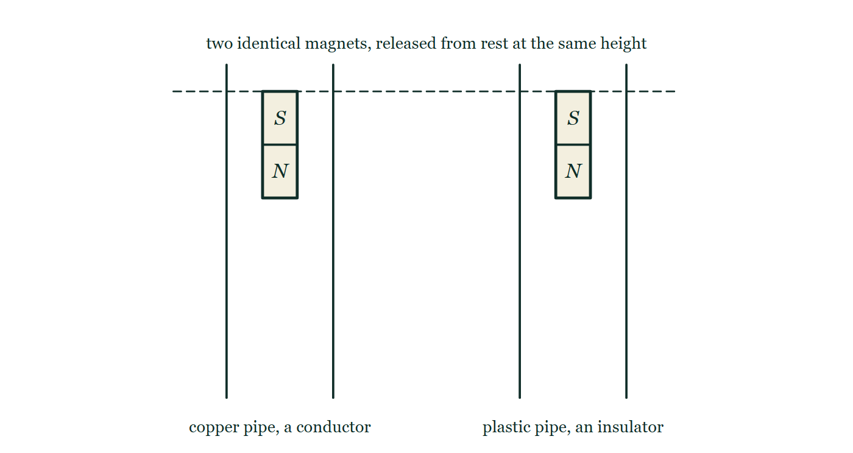
ELECTROMAGNETISM · LENZ'S LAW
GIOPHYSICS LESSON
THINK FIRST
Drop a magnet down a copper pipe. Copper is not magnetic — a magnet will not stick to it. So why does the magnet take seconds to fall a metre?
Take answers before you click — the point is the commitment
Drop the same magnet down an identical plastic pipe and it is out of the bottom in the 0.45 s that free fall allows. Nothing is touching the magnet in either case.
THE ANSWER
Because a falling magnet changes the flux through every ring of copper it passes, and each ring answers with a current that opposes the change — repelling the magnet as it comes and dragging on it as it goes. Copper ignores a magnet at rest, but it fights one that moves. The gravitational energy the magnet does not turn into speed comes out as heat in the pipe.
Two vertical pipes side by side, one copper and one plastic, with a dashed release line ruled across both of them. An identical magnet is held at that line inside each pipe, neither yet released, so the two are drawn at exactly the same height and nothing on the page says which will win.
The live version of this figure — click here
Electromagnetism — Lenz's Law. Built by GioPhysics from the lesson's own copy; nothing on these slides is re-authored.
3 / 30
Notes:
[Phase] Starter: Recall what this lesson stands on (minutes 0–5 of 45)
[Hook] Drop a magnet down a copper pipe. Copper is not magnetic — a magnet will not stick to it. So why does the magnet take seconds to fall a metre? Drop the same magnet down an identical plastic pipe and it is out of the bottom in the 0.45 s that free fall allows. Nothing is touching the magnet in either case.
[Answer] Because a falling magnet changes the flux through every ring of copper it passes, and each ring answers with a current that opposes the change — repelling the magnet as it comes and dragging on it as it goes. Copper ignores a magnet at rest, but it fights one that moves. The gravitational energy the magnet does not turn into speed comes out as heat in the pipe.
[Figure] Two vertical pipes side by side, one copper and one plastic, with a dashed release line ruled across both of them. An identical magnet is held at that line inside each pipe, neither yet released, so the two are drawn at exactly the same height and nothing on the page says which will win.

Slide 4
ELECTROMAGNETISM · LENZ'S LAW
GIOPHYSICS LESSON
EXPLAINED SIMPLY
In one sentence
Introduce the idea — The big idea and the definition
Lenz's law: an induced current flows in the direction that opposes the change in flux producing it.
Electromagnetism — Lenz's Law. Built by GioPhysics from the lesson's own copy; nothing on these slides is re-authored.
4 / 30
Notes:
[Phase] Introduce the idea: The big idea and the definition (minutes 5–13 of 45)
[Definition] Lenz's law: an induced current flows in the direction that opposes the change in flux producing it.

Slide 5
ELECTROMAGNETISM · LENZ'S LAW
GIOPHYSICS LESSON
EXPLAINED SIMPLY
What that looks like
Introduce the idea — The big idea and the definition
FOR EXAMPLE
Drop a magnet down a copper pipe: induced eddy currents oppose its fall, and it drifts down in slow motion.
Electromagnetism — Lenz's Law. Built by GioPhysics from the lesson's own copy; nothing on these slides is re-authored.
5 / 30
Notes:
[Phase] Introduce the idea: The big idea and the definition (minutes 5–13 of 45)
[Worked illustration] Drop a magnet down a copper pipe: induced eddy currents oppose its fall, and it drifts down in slow motion.

Slide 6
ELECTROMAGNETISM · LENZ'S LAW
GIOPHYSICS LESSON
THE BIG IDEA
Nature opposes the change
Introduce the idea — The big idea and the definition
The induced current makes its own magnetic field, directed to fight the flux change: push a north pole toward a coil and the coil's face turns north to repel it. You must do work against that opposition — which is exactly where the electrical energy comes from.
Electromagnetism — Lenz's Law. Built by GioPhysics from the lesson's own copy; nothing on these slides is re-authored.
6 / 30
Notes:
[Phase] Introduce the idea: The big idea and the definition (minutes 5–13 of 45)
[Big idea] The induced current makes its own magnetic field, directed to fight the flux change: push a north pole toward a coil and the coil's face turns north to repel it. You must do work against that opposition — which is exactly where the electrical energy comes from.

Slide 7
ELECTROMAGNETISM · LENZ'S LAW
GIOPHYSICS LESSON
THE PHYSICS · 1 OF 3
Using it
Build the model — The formulae, one at a time, in plain English
Decide how the flux is changing, point the induced field to oppose it, then use the grip rule to read the current direction around the coil.
Electromagnetism — Lenz's Law. Built by GioPhysics from the lesson's own copy; nothing on these slides is re-authored.
7 / 30
Notes:
[Phase] Build the model: The formulae, one at a time, in plain English (minutes 13–22 of 45)
[Section] Decide how the flux is changing, point the induced field to oppose it, then use the grip rule to read the current direction around the coil.

Slide 8
ELECTROMAGNETISM · LENZ'S LAW
GIOPHYSICS LESSON
THE PHYSICS · 2 OF 3
Approach vs retreat
Build the model — The formulae, one at a time, in plain English
Magnet approaching: coil face repels (like pole). Magnet leaving: coil face attracts (unlike pole). The coil always resists the motion.
Electromagnetism — Lenz's Law. Built by GioPhysics from the lesson's own copy; nothing on these slides is re-authored.
8 / 30
Notes:
[Phase] Build the model: The formulae, one at a time, in plain English (minutes 13–22 of 45)
[Section] Magnet approaching: coil face repels (like pole). Magnet leaving: coil face attracts (unlike pole). The coil always resists the motion.

Slide 9
ELECTROMAGNETISM · LENZ'S LAW
GIOPHYSICS LESSON
THE PHYSICS · 3 OF 3
Why it must be so
Build the model — The formulae, one at a time, in plain English
If induction aided the change, the current would grow its own cause forever — free energy. Opposition is conservation of energy in disguise.
Electromagnetism — Lenz's Law. Built by GioPhysics from the lesson's own copy; nothing on these slides is re-authored.
9 / 30
Notes:
[Phase] Build the model: The formulae, one at a time, in plain English (minutes 13–22 of 45)
[Section] If induction aided the change, the current would grow its own cause forever — free energy. Opposition is conservation of energy in disguise.

Slide 10
ELECTROMAGNETISM · LENZ'S LAW
GIOPHYSICS LESSON
FORMULA 1 OF 3
Lenz's law
Build the model — The formulae, one at a time, in plain English
induced effect opposes its cause
The minus sign in Faraday's law
IN PLAIN ENGLISH
The induced current's own field pushes back against whatever flux change created it — approach is repelled, retreat is attracted.
Electromagnetism — Lenz's Law. Built by GioPhysics from the lesson's own copy; nothing on these slides is re-authored.
10 / 30
Notes:
[Phase] Build the model: The formulae, one at a time, in plain English (minutes 13–22 of 45)
[Formula] Lenz's law: induced effect opposes its cause
[In plain English] The induced current's own field pushes back against whatever flux change created it — approach is repelled, retreat is attracted.
[Note] The minus sign in Faraday's law

Slide 11
ELECTROMAGNETISM · LENZ'S LAW
GIOPHYSICS LESSON
FORMULA 2 OF 3
Energy account
Build the model — The formulae, one at a time, in plain English
W done against opposition = E generated
Conservation of energy
IN PLAIN ENGLISH
The electrical energy out equals the extra mechanical work done pushing against the induced opposition — nothing is free.
Electromagnetism — Lenz's Law. Built by GioPhysics from the lesson's own copy; nothing on these slides is re-authored.
11 / 30
Notes:
[Phase] Build the model: The formulae, one at a time, in plain English (minutes 13–22 of 45)
[Formula] Energy account: W done against opposition = E generated
[In plain English] The electrical energy out equals the extra mechanical work done pushing against the induced opposition — nothing is free.
[Note] Conservation of energy

Slide 12
ELECTROMAGNETISM · LENZ'S LAW
GIOPHYSICS LESSON
FORMULA 3 OF 3
Eddy currents
Build the model — The formulae, one at a time, in plain English
loops induced in bulk metal
Braking, damping, induction heating
IN PLAIN ENGLISH
Solid conductors host swirling induced currents that oppose motion through fields — used deliberately in magnetic brakes and induction hobs.
Electromagnetism — Lenz's Law. Built by GioPhysics from the lesson's own copy; nothing on these slides is re-authored.
12 / 30
Notes:
[Phase] Build the model: The formulae, one at a time, in plain English (minutes 13–22 of 45)
[Formula] Eddy currents: loops induced in bulk metal
[In plain English] Solid conductors host swirling induced currents that oppose motion through fields — used deliberately in magnetic brakes and induction hobs.
[Note] Braking, damping, induction heating

Slide 13
ELECTROMAGNETISM · LENZ'S LAW
GIOPHYSICS LESSON
WATCH OUT
The common trap
Check and misconception — The quick check and the trap
The induced current does not always flow the same way for a given magnet — it reverses when the magnet's motion reverses, because it opposes the change, not the magnet.
Electromagnetism — Lenz's Law. Built by GioPhysics from the lesson's own copy; nothing on these slides is re-authored.
13 / 30
Notes:
[Phase] Check and misconception: The quick check and the trap (minutes 35–41 of 45)
[Misconception] The induced current does not always flow the same way for a given magnet — it reverses when the magnet's motion reverses, because it opposes the change, not the magnet.

Slide 14
ELECTROMAGNETISM · LENZ'S LAW
GIOPHYSICS LESSON
WORKED EXAMPLE 1 OF 2 · EASY
The question
Easy
Worked examples — I do, we do — one step revealed at a time
A magnet's north pole is pushed toward a coil. What pole does the near face of the coil become?
Electromagnetism — Lenz's Law. Built by GioPhysics from the lesson's own copy; nothing on these slides is re-authored.
14 / 30
Notes:
[Phase] Worked examples: I do, we do — one step revealed at a time (minutes 22–35 of 45)
[Question] A magnet's north pole is pushed toward a coil. What pole does the near face of the coil become?
[Answer] North — it repels the incomer

Slide 15
ELECTROMAGNETISM · LENZ'S LAW
GIOPHYSICS LESSON
WORKED EXAMPLE 1 OF 2 · EASY · THE WORKING
How to solve it
Easy
Worked examples — I do, we do — one step revealed at a time
A magnet's north pole is pushed toward a coil. What pole does the near face of the coil become?
1.
The coil opposes the approach.
2.
Its near face becomes a north pole, repelling the magnet.
Electromagnetism — Lenz's Law. Built by GioPhysics from the lesson's own copy; nothing on these slides is re-authored.
15 / 30
Notes:
[Phase] Worked examples: I do, we do — one step revealed at a time (minutes 22–35 of 45)
[Reveal] One click per step. The class works each line before the next appears.
[Step 1] The coil opposes the approach.
[Step 2] Its near face becomes a north pole, repelling the magnet.

Slide 16
ELECTROMAGNETISM · LENZ'S LAW
GIOPHYSICS LESSON
WORKED EXAMPLE 1 OF 2 · EASY
Answer
Easy
Worked examples — I do, we do — one step revealed at a time
North — it repels the incomer
Electromagnetism — Lenz's Law. Built by GioPhysics from the lesson's own copy; nothing on these slides is re-authored.
16 / 30
Notes:
[Phase] Worked examples: I do, we do — one step revealed at a time (minutes 22–35 of 45)
[Answer] North — it repels the incomer

Slide 17
ELECTROMAGNETISM · LENZ'S LAW
GIOPHYSICS LESSON
WORKED EXAMPLE 2 OF 2 · MEDIUM
The question
Medium
Worked examples — I do, we do — one step revealed at a time
A magnet falls through a vertical copper tube. Explain, step by step, why it falls slower than in free air.
Electromagnetism — Lenz's Law. Built by GioPhysics from the lesson's own copy; nothing on these slides is re-authored.
17 / 30
Notes:
[Phase] Worked examples: I do, we do — one step revealed at a time (minutes 22–35 of 45)
[Question] A magnet falls through a vertical copper tube. Explain, step by step, why it falls slower than in free air.
[Answer] Induced eddy currents oppose the fall from both sides — the magnet descends at a slow terminal speed

Slide 18
ELECTROMAGNETISM · LENZ'S LAW
GIOPHYSICS LESSON
WORKED EXAMPLE 2 OF 2 · MEDIUM · THE WORKING
How to solve it
Medium
Worked examples — I do, we do — one step revealed at a time
A magnet falls through a vertical copper tube. Explain, step by step, why it falls slower than in free air.
1.
The approaching magnet raises flux in the tube wall below it, inducing eddy currents whose field repels it.
2.
Above, flux is falling, so currents there attract it back.
3.
Both oppositions act against the motion; the lost gravitational energy heats the copper.
Electromagnetism — Lenz's Law. Built by GioPhysics from the lesson's own copy; nothing on these slides is re-authored.
18 / 30
Notes:
[Phase] Worked examples: I do, we do — one step revealed at a time (minutes 22–35 of 45)
[Reveal] One click per step. The class works each line before the next appears.
[Step 1] The approaching magnet raises flux in the tube wall below it, inducing eddy currents whose field repels it.
[Step 2] Above, flux is falling, so currents there attract it back.
[Step 3] Both oppositions act against the motion; the lost gravitational energy heats the copper.

Slide 19
ELECTROMAGNETISM · LENZ'S LAW
GIOPHYSICS LESSON
WORKED EXAMPLE 2 OF 2 · MEDIUM
Answer
Medium
Worked examples — I do, we do — one step revealed at a time
Induced eddy currents oppose the fall from both sides — the magnet descends at a slow terminal speed
Electromagnetism — Lenz's Law. Built by GioPhysics from the lesson's own copy; nothing on these slides is re-authored.
19 / 30
Notes:
[Phase] Worked examples: I do, we do — one step revealed at a time (minutes 22–35 of 45)
[Answer] Induced eddy currents oppose the fall from both sides — the magnet descends at a slow terminal speed

Slide 20
ELECTROMAGNETISM · LENZ'S LAW
GIOPHYSICS LESSON
PREDICT · TAKE THE VOTE
Commit before you are told
Hands up for each option, then click
The two identical magnets are released at the same instant, one down the copper pipe and one down the plastic. Which reaches the floor first?
A They land together — copper is not magnetic, so it cannot touch the magnet
B The one in the plastic pipe, by a long way
C The one in the copper pipe, because copper attracts the magnet
Two vertical pipes side by side, one copper and one plastic, with a dashed release line ruled across both of them. An identical magnet is held at that line inside each pipe, neither yet released, so the two are drawn at exactly the same height and nothing on the page says which will win.
The live version of this figure — click here
Electromagnetism — Lenz's Law. Built by GioPhysics from the lesson's own copy; nothing on these slides is re-authored.
20 / 30
Notes:
[Phase] Build the model: The formulae, one at a time, in plain English (minutes 13–22 of 45)
[Predict] The two identical magnets are released at the same instant, one down the copper pipe and one down the plastic. Which reaches the floor first?
[Options] A They land together — copper is not magnetic, so it cannot touch the magnet B The one in the plastic pipe, by a long way C The one in the copper pipe, because copper attracts the magnet
[Figure] Two vertical pipes side by side, one copper and one plastic, with a dashed release line ruled across both of them. An identical magnet is held at that line inside each pipe, neither yet released, so the two are drawn at exactly the same height and nothing on the page says which will win.

Slide 21
ELECTROMAGNETISM · LENZ'S LAW
GIOPHYSICS LESSON
PREDICT · THE OUTCOME
What actually happens
Ask the room who changed their mind, and why
B The one in the plastic pipe, by a long way
WHY
Copper really is unattracted to a magnet held still against it, and that is precisely what makes the first answer so tempting. Motion is the entire difference. As a magnet falls, the flux through each ring of copper around it first rises and then falls, and Lenz's law says every ring drives a current that opposes what is being done to it — repelling the magnet approaching from above, holding on to it as it leaves below. The plastic pipe has no rings that can carry a current, so nothing opposes anything and the magnet simply falls at g.
Electromagnetism — Lenz's Law. Built by GioPhysics from the lesson's own copy; nothing on these slides is re-authored.
21 / 30
Notes:
[Phase] Build the model: The formulae, one at a time, in plain English (minutes 13–22 of 45)
[Answer] B — The one in the plastic pipe, by a long way. Copper really is unattracted to a magnet held still against it, and that is precisely what makes the first answer so tempting. Motion is the entire difference. As a magnet falls, the flux through each ring of copper around it first rises and then falls, and Lenz's law says every ring drives a current that opposes what is being done to it — repelling the magnet approaching from above, holding on to it as it leaves below. The plastic pipe has no rings that can carry a current, so nothing opposes anything and the magnet simply falls at g.

Slide 22
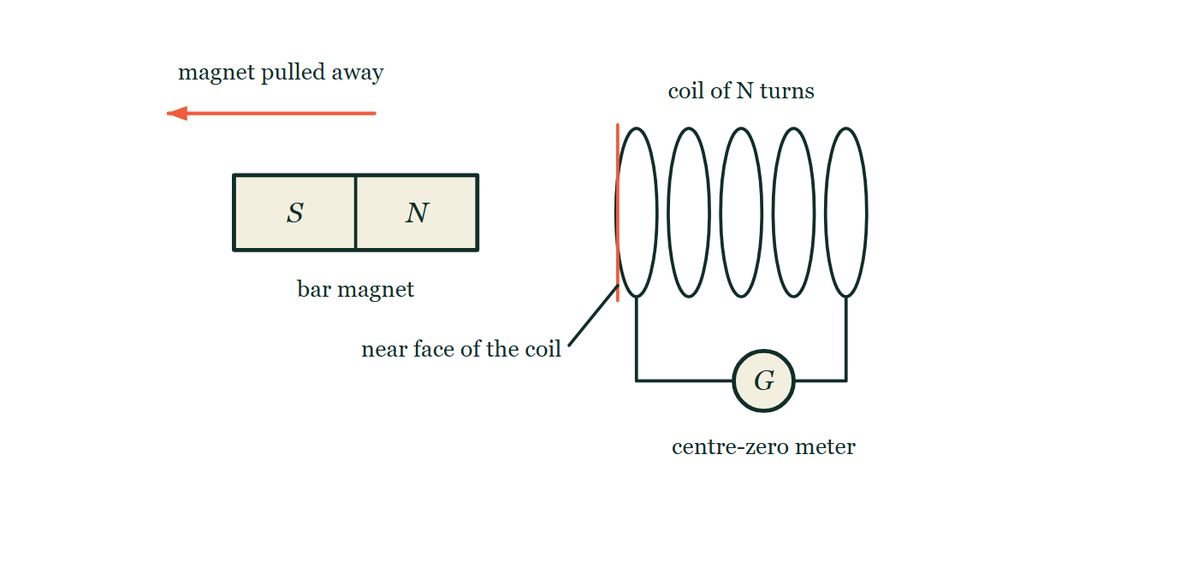
ELECTROMAGNETISM · LENZ'S LAW
GIOPHYSICS LESSON
QUICK CHECK
Decide before the answer goes up
Check and misconception — The quick check and the trap
A north pole is pulled away from a coil's face. That face becomes…
A
A north pole
B
A south pole
C
Unmagnetised
A bar magnet with its north pole facing a coil of five turns, and an arrow above showing the magnet being pulled away from it. The coil's near face is picked out with a bold line and a leader labelled near face of the coil, carrying no pole letter, and the coil is wired to a centre-zero meter drawn with no needle.
The live version of this figure — click here
Electromagnetism — Lenz's Law. Built by GioPhysics from the lesson's own copy; nothing on these slides is re-authored.
22 / 30
Notes:
[Phase] Check and misconception: The quick check and the trap (minutes 35–41 of 45)
[Question] A north pole is pulled away from a coil's face. That face becomes…
[Figure] A bar magnet with its north pole facing a coil of five turns, and an arrow above showing the magnet being pulled away from it. The coil's near face is picked out with a bold line and a leader labelled near face of the coil, carrying no pole letter, and the coil is wired to a centre-zero meter drawn with no needle.
[Options] A A north pole B A south pole C Unmagnetised

Slide 23
ELECTROMAGNETISM · LENZ'S LAW
GIOPHYSICS LESSON
QUICK CHECK · THE ANSWER
The answer, and why
Check and misconception — The quick check and the trap
B A south pole
HOW TO GET THERE
The coil opposes the retreat by attracting the leaving north pole — its near face turns south.
WHY THE OTHERS TEMPT
A A north pole is the right answer to the other experiment — the magnet being pushed IN. It is the commonest slip in the whole topic, because "opposes" gets remembered as "repels". The coil opposes the CHANGE, and here the change is the magnet going away.
B Correct. To oppose the retreat the coil has to pull the magnet back, and pulling on a north pole needs a south pole facing it.
C Unmagnetised is true the instant the magnet stops moving, and true at all times if the coil's circuit is broken. While the magnet is actually receding the flux through the coil is falling, so a current flows and the coil is certainly a magnet.
Electromagnetism — Lenz's Law. Built by GioPhysics from the lesson's own copy; nothing on these slides is re-authored.
23 / 30
Notes:
[Phase] Check and misconception: The quick check and the trap (minutes 35–41 of 45)
[Question] A north pole is pulled away from a coil's face. That face becomes…
[Option by option] A: A north pole is the right answer to the other experiment — the magnet being pushed IN. It is the commonest slip in the whole topic, because "opposes" gets remembered as "repels". The coil opposes the CHANGE, and here the change is the magnet going away. B: Correct. To oppose the retreat the coil has to pull the magnet back, and pulling on a north pole needs a south pole facing it. C: Unmagnetised is true the instant the magnet stops moving, and true at all times if the coil's circuit is broken. While the magnet is actually receding the flux through the coil is falling, so a current flows and the coil is certainly a magnet.
[Answer] B — A south pole
[Why] The coil opposes the retreat by attracting the leaving north pole — its near face turns south.
[Reveal] One click for the answer, then one for the reason.

Slide 24
ELECTROMAGNETISM · LENZ'S LAW
GIOPHYSICS LESSON
EXTENSION 1 OF 2 · HARD
The question
Hard
Worked examples — I do, we do — one step revealed at a time
A flat copper sheet swings like a pendulum between magnet poles and stops within a couple of swings. A comb-slotted sheet swings freely. Explain both.
Electromagnetism — Lenz's Law. Built by GioPhysics from the lesson's own copy; nothing on these slides is re-authored.
24 / 30
Notes:
[Phase] Worked examples: I do, we do — one step revealed at a time (minutes 22–35 of 45)
[Question] A flat copper sheet swings like a pendulum between magnet poles and stops within a couple of swings. A comb-slotted sheet swings freely. Explain both.
[Answer] Eddy currents brake the solid sheet; slots break the loops

Slide 25
ELECTROMAGNETISM · LENZ'S LAW
GIOPHYSICS LESSON
EXTENSION 1 OF 2 · HARD · THE WORKING
How to solve it
Hard
Worked examples — I do, we do — one step revealed at a time
A flat copper sheet swings like a pendulum between magnet poles and stops within a couple of swings. A comb-slotted sheet swings freely. Explain both.
1.
The solid sheet hosts large eddy-current loops; by Lenz's law they oppose the motion, braking it and heating the copper.
2.
Slots interrupt the current paths, shrinking the loops and the braking force.
3.
The same physics underlies electromagnetic brakes and laminated transformer cores.
Electromagnetism — Lenz's Law. Built by GioPhysics from the lesson's own copy; nothing on these slides is re-authored.
25 / 30
Notes:
[Phase] Worked examples: I do, we do — one step revealed at a time (minutes 22–35 of 45)
[Reveal] One click per step. The class works each line before the next appears.
[Step 1] The solid sheet hosts large eddy-current loops; by Lenz's law they oppose the motion, braking it and heating the copper.
[Step 2] Slots interrupt the current paths, shrinking the loops and the braking force.
[Step 3] The same physics underlies electromagnetic brakes and laminated transformer cores.

Slide 26
ELECTROMAGNETISM · LENZ'S LAW
GIOPHYSICS LESSON
EXTENSION 1 OF 2 · HARD
Answer
Hard
Worked examples — I do, we do — one step revealed at a time
Eddy currents brake the solid sheet; slots break the loops
Electromagnetism — Lenz's Law. Built by GioPhysics from the lesson's own copy; nothing on these slides is re-authored.
26 / 30
Notes:
[Phase] Worked examples: I do, we do — one step revealed at a time (minutes 22–35 of 45)
[Answer] Eddy currents brake the solid sheet; slots break the loops

Slide 27
ELECTROMAGNETISM · LENZ'S LAW
GIOPHYSICS LESSON
EXTENSION 2 OF 2 · CHALLENGING
The question
Challenging
Worked examples — I do, we do — one step revealed at a time
A bar magnet is dropped through a coil connected to a resistor, versus the same coil open-circuited. Compare the fall in each case and account for the energy.
Electromagnetism — Lenz's Law. Built by GioPhysics from the lesson's own copy; nothing on these slides is re-authored.
27 / 30
Notes:
[Phase] Worked examples: I do, we do — one step revealed at a time (minutes 22–35 of 45)
[Question] A bar magnet is dropped through a coil connected to a resistor, versus the same coil open-circuited. Compare the fall in each case and account for the energy.
[Answer] Closed coil slows the fall; the difference in energy appears as resistor heat

Slide 28
ELECTROMAGNETISM · LENZ'S LAW
GIOPHYSICS LESSON
EXTENSION 2 OF 2 · CHALLENGING · THE WORKING
How to solve it
Challenging
Worked examples — I do, we do — one step revealed at a time
A bar magnet is dropped through a coil connected to a resistor, versus the same coil open-circuited. Compare the fall in each case and account for the energy.
1.
Open circuit: e.m.f. is induced but no current flows — no Lenz opposition, free-fall (tiny radiation aside).
2.
Closed circuit: induced current opposes the motion both entering and leaving — the magnet falls measurably slower.
3.
The lost gravitational energy equals the resistor's I²R heating: the circuit literally harvests the fall.
Electromagnetism — Lenz's Law. Built by GioPhysics from the lesson's own copy; nothing on these slides is re-authored.
28 / 30
Notes:
[Phase] Worked examples: I do, we do — one step revealed at a time (minutes 22–35 of 45)
[Reveal] One click per step. The class works each line before the next appears.
[Step 1] Open circuit: e.m.f. is induced but no current flows — no Lenz opposition, free-fall (tiny radiation aside).
[Step 2] Closed circuit: induced current opposes the motion both entering and leaving — the magnet falls measurably slower.
[Step 3] The lost gravitational energy equals the resistor's I²R heating: the circuit literally harvests the fall.

Slide 29
ELECTROMAGNETISM · LENZ'S LAW
GIOPHYSICS LESSON
EXTENSION 2 OF 2 · CHALLENGING
Answer
Challenging
Worked examples — I do, we do — one step revealed at a time
Closed coil slows the fall; the difference in energy appears as resistor heat
Electromagnetism — Lenz's Law. Built by GioPhysics from the lesson's own copy; nothing on these slides is re-authored.
29 / 30
Notes:
[Phase] Worked examples: I do, we do — one step revealed at a time (minutes 22–35 of 45)
[Answer] Closed coil slows the fall; the difference in energy appears as resistor heat

Slide 30
ELECTROMAGNETISM · LENZ'S LAW
GIOPHYSICS LESSON
ELECTROMAGNETISM
Where to go next
Plenary — What to take away, what to practise next
Next
19.4 Generators & Transformers
https://giophysics.com/chapter-28/generators-transformers/
Lesson
This lesson on giophysics.com
https://giophysics.com/chapter-28/lenzs-law/
Live
The live, interactive version of these slides
https://giophysics.com/chapter-28/presentation/?lesson=lenz
Chapter
All Electromagnetism lessons
https://giophysics.com/chapter-28/
PDF
Download the lesson PDF
https://giophysics.com/downloads/28-3-lenzs-law.pdf
Electromagnetism — Lenz's Law. Built by GioPhysics from the lesson's own copy; nothing on these slides is re-authored.
30 / 30
Notes:
[Phase] Plenary: What to take away, what to practise next (minutes 41–45 of 45)
[Interactive] The graphs and the circuit topology on these slides are frozen. The live version at https://giophysics.com/chapter-28/presentation/?lesson=lenz moves them.

