Slide 1
FORCES · APPLIED DEFINITIONS
GIOPHYSICS LESSON
02 · Forces
Object. Interaction. Arrow. Resultant.
Applied Definitions
A force is an interaction: a push or pull that can change an object’s motion or shape, or create a turning effect.
POSITION
Lesson 1 of 11 in Forces
PLAN
16 slides in the 45-minute core run, about 43.5 minutes of it
LESSON PAGE
https://giophysics.com/chapter-3/applied-definitions/
Built by GioPhysics from the lesson's own page. Every word on these slides is the lesson's; nothing here is re-authored. Teaching material, not an awarding body's document.
Forces — Applied Definitions. Built by GioPhysics from the lesson's own copy; nothing on these slides is re-authored.
1 / 27
Notes:
[Lesson] Forces — Applied Definitions. Lesson 1 of 11.
[Intro] A force is an interaction: a push or pull that can change an object’s motion or shape, or create a turning effect.
[Source] https://giophysics.com/chapter-3/applied-definitions/
[Disclaimer] Built by GioPhysics from the lesson's own page. Every word on these slides is the lesson's; nothing here is re-authored. Teaching material, not an awarding body's document.

Slide 2
FORCES · APPLIED DEFINITIONS
GIOPHYSICS LESSON
WHAT THIS NEEDS
What you already know
Starter — Recall what this lesson stands on
Recall
1.1 Units
https://giophysics.com/chapter-1/units/
Recall
1.2 Vectors
https://giophysics.com/chapter-1/scalar-vector/
Recall
1.4 Acceleration
https://giophysics.com/chapter-1/kinematics-1d-part-2/
Forces — Applied Definitions. Built by GioPhysics from the lesson's own copy; nothing on these slides is re-authored.
2 / 27
Notes:
[Phase] Starter: Recall what this lesson stands on (minutes 0–5 of 45)
[Starter] Recall: 1.1 Units; 1.2 Vectors; 1.4 Acceleration

Slide 3
FORCES · APPLIED DEFINITIONS
GIOPHYSICS LESSON
THINK FIRST
You weigh 600 N on Earth. On the Moon the same scale reads 98 N. How much of you was left behind?
Take answers before you click — the point is the commitment
Nothing was taken out of you on the journey, and it is the same scale, reading the same kind of thing. Yet the number has fallen by a factor of six.
THE ANSWER
None of you. Your mass — 61 kg of it — went to the Moon intact. What changed is g, from 9.8 N/kg to 1.6 N/kg, so the force the ground has to hold you up against is smaller. Weight belongs to the planet you are standing on; mass belongs to you.
Forces — Applied Definitions. Built by GioPhysics from the lesson's own copy; nothing on these slides is re-authored.
3 / 27
Notes:
[Phase] Starter: Recall what this lesson stands on (minutes 0–5 of 45)
[Hook] You weigh 600 N on Earth. On the Moon the same scale reads 98 N. How much of you was left behind? Nothing was taken out of you on the journey, and it is the same scale, reading the same kind of thing. Yet the number has fallen by a factor of six.
[Answer] None of you. Your mass — 61 kg of it — went to the Moon intact. What changed is g, from 9.8 N/kg to 1.6 N/kg, so the force the ground has to hold you up against is smaller. Weight belongs to the planet you are standing on; mass belongs to you.

Slide 4
FORCES · APPLIED DEFINITIONS
GIOPHYSICS LESSON
EXPLAINED SIMPLY
In one sentence
Introduce the idea — The big idea and the definition
A force is a push or pull caused by an interaction, and it can change an object’s motion or shape.
Forces — Applied Definitions. Built by GioPhysics from the lesson's own copy; nothing on these slides is re-authored.
4 / 27
Notes:
[Phase] Introduce the idea: The big idea and the definition (minutes 5–13 of 45)
[Definition] A force is a push or pull caused by an interaction, and it can change an object’s motion or shape.

Slide 5
FORCES · APPLIED DEFINITIONS
GIOPHYSICS LESSON
EXPLAINED SIMPLY
What that looks like
Introduce the idea — The big idea and the definition
FOR EXAMPLE
When a hand pushes a trolley, the hand exerts a forward force that can accelerate the trolley.
Forces — Applied Definitions. Built by GioPhysics from the lesson's own copy; nothing on these slides is re-authored.
5 / 27
Notes:
[Phase] Introduce the idea: The big idea and the definition (minutes 5–13 of 45)
[Worked illustration] When a hand pushes a trolley, the hand exerts a forward force that can accelerate the trolley.

Slide 6
FORCES · APPLIED DEFINITIONS
GIOPHYSICS LESSON
THE BIG IDEA
Object. Interaction. Arrow. Resultant.
Introduce the idea — The big idea and the definition
Forces are vectors. Measure their size in newtons (N), show their direction with arrows, and name the object that experiences each force. Contact forces need touching; non-contact forces act through a field across a gap.
The resultant force is the vector sum of every force acting on the chosen object. Mass measures matter and inertia in kilograms, while weight is the gravitational force on that mass in newtons. A free-body diagram keeps only the chosen object and the forces acting on it.
Forces — Applied Definitions. Built by GioPhysics from the lesson's own copy; nothing on these slides is re-authored.
6 / 27
Notes:
[Phase] Introduce the idea: The big idea and the definition (minutes 5–13 of 45)
[Big idea] Forces are vectors. Measure their size in newtons (N), show their direction with arrows, and name the object that experiences each force. Contact forces need touching; non-contact forces act through a field across a gap. The resultant force is the vector sum of every force acting on the chosen object. Mass measures matter and inertia in kilograms, while weight is the gravitational force on that mass in newtons. A free-body diagram keeps only the chosen object and the forces acting on it.

Slide 7
FORCES · APPLIED DEFINITIONS
GIOPHYSICS LESSON
THE PHYSICS · 1 OF 5
You see a force through its effect.
Build the model — The formulae, one at a time, in plain English
Forces are vectors. Measure their size in newtons (N), show their direction with arrows, and name the object that experiences each force. A force can start or stop motion, speed it up or slow it down, change direction, change shape, or cause a turning effect.
Forces — Applied Definitions. Built by GioPhysics from the lesson's own copy; nothing on these slides is re-authored.
7 / 27
Notes:
[Phase] Build the model: The formulae, one at a time, in plain English (minutes 13–22 of 45)
[Section] Forces are vectors. Measure their size in newtons (N), show their direction with arrows, and name the object that experiences each force. A force can start or stop motion, speed it up or slow it down, change direction, change shape, or cause a turning effect.

Slide 8
FORCES · APPLIED DEFINITIONS
GIOPHYSICS LESSON
THE PHYSICS · 2 OF 5
Contact, or action at a distance?
Build the model — The formulae, one at a time, in plain English
Contact forces need touching. Non-contact forces act through a field across a gap. Friction has two stages: static friction adjusts to prevent slipping, up to a maximum, and kinetic friction acts once the surfaces slide.
Drag depends on the motion: fluid resistance opposes velocity and depends on speed, shape, size, and the fluid. Treat the whole weight as acting at one point, the centre of gravity — suspend the shape from two points and the two plumb lines intersect at it.
Forces — Applied Definitions. Built by GioPhysics from the lesson's own copy; nothing on these slides is re-authored.
8 / 27
Notes:
[Phase] Build the model: The formulae, one at a time, in plain English (minutes 13–22 of 45)
[Section] Contact forces need touching. Non-contact forces act through a field across a gap. Friction has two stages: static friction adjusts to prevent slipping, up to a maximum, and kinetic friction acts once the surfaces slide. Drag depends on the motion: fluid resistance opposes velocity and depends on speed, shape, size, and the fluid. Treat the whole weight as acting at one point, the centre of gravity — suspend the shape from two points and the two plumb lines intersect at it.

Slide 9
FORCES · APPLIED DEFINITIONS
GIOPHYSICS LESSON
THE PHYSICS · 3 OF 5
One object. Two pulls. One result.
Build the model — The formulae, one at a time, in plain English
The resultant force is the vector sum of every force acting on the chosen object. When the resultant is zero the velocity does not change; otherwise the resultant points one way and the object accelerates that way.
Forces — Applied Definitions. Built by GioPhysics from the lesson's own copy; nothing on these slides is re-authored.
9 / 27
Notes:
[Phase] Build the model: The formulae, one at a time, in plain English (minutes 13–22 of 45)
[Section] The resultant force is the vector sum of every force acting on the chosen object. When the resultant is zero the velocity does not change; otherwise the resultant points one way and the object accelerates that way.

Slide 10
FORCES · APPLIED DEFINITIONS
GIOPHYSICS LESSON
THE PHYSICS · 4 OF 5
Mass stays. Weight follows gravity.
Build the model — The formulae, one at a time, in plain English
Mass measures matter and inertia in kilograms. Weight is the gravitational force on that mass in newtons. The same mass has a different weight on the Moon at 1.6 N/kg, Mars at 3.7 N/kg, Earth at 9.8 N/kg, and Jupiter at 24.8 N/kg.
Forces — Applied Definitions. Built by GioPhysics from the lesson's own copy; nothing on these slides is re-authored.
10 / 27
Notes:
[Phase] Build the model: The formulae, one at a time, in plain English (minutes 13–22 of 45)
[Section] Mass measures matter and inertia in kilograms. Weight is the gravitational force on that mass in newtons. The same mass has a different weight on the Moon at 1.6 N/kg, Mars at 3.7 N/kg, Earth at 9.8 N/kg, and Jupiter at 24.8 N/kg.

Slide 11
FORCES · APPLIED DEFINITIONS
GIOPHYSICS LESSON
THE PHYSICS · 5 OF 5
Isolate the object before solving.
Build the model — The formulae, one at a time, in plain English
A free-body diagram keeps only the chosen object and the forces acting on it. Choose one object and replace it with a simple box or dot. Find every external interaction, including only forces acting on that object.
Draw and label arrows: arrow direction shows force direction, and length can show relative size. Keep components separate — resolve angled forces after the free-body diagram is complete.
Forces — Applied Definitions. Built by GioPhysics from the lesson's own copy; nothing on these slides is re-authored.
11 / 27
Notes:
[Phase] Build the model: The formulae, one at a time, in plain English (minutes 13–22 of 45)
[Section] A free-body diagram keeps only the chosen object and the forces acting on it. Choose one object and replace it with a simple box or dot. Find every external interaction, including only forces acting on that object. Draw and label arrows: arrow direction shows force direction, and length can show relative size. Keep components separate — resolve angled forces after the free-body diagram is complete.

Slide 12
FORCES · APPLIED DEFINITIONS
GIOPHYSICS LESSON
FORMULA 1 OF 2
Force
Build the model — The formulae, one at a time, in plain English
force = magnitude + direction
Unit: newton · N
IN PLAIN ENGLISH
An interaction between objects that can also make them turn. Always state magnitude and direction. A force meter or newton meter measures it.
Forces — Applied Definitions. Built by GioPhysics from the lesson's own copy; nothing on these slides is re-authored.
12 / 27
Notes:
[Phase] Build the model: The formulae, one at a time, in plain English (minutes 13–22 of 45)
[Formula] Force: force = magnitude + direction
[In plain English] An interaction between objects that can also make them turn. Always state magnitude and direction. A force meter or newton meter measures it.
[Note] Unit: newton · N

Slide 13
FORCES · APPLIED DEFINITIONS
GIOPHYSICS LESSON
FORMULA 2 OF 2
Weight
Build the model — The formulae, one at a time, in plain English
W = m × g
Same mass · different weight
IN PLAIN ENGLISH
Mass measures matter and inertia in kilograms. Weight is the gravitational force on that mass in newtons.
Forces — Applied Definitions. Built by GioPhysics from the lesson's own copy; nothing on these slides is re-authored.
13 / 27
Notes:
[Phase] Build the model: The formulae, one at a time, in plain English (minutes 13–22 of 45)
[Formula] Weight: W = m × g
[In plain English] Mass measures matter and inertia in kilograms. Weight is the gravitational force on that mass in newtons.
[Note] Same mass · different weight

Slide 14
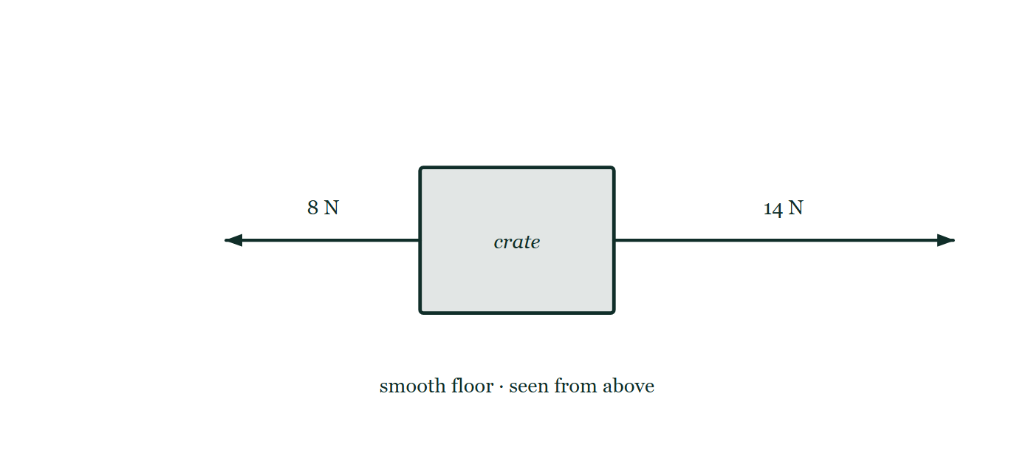
FORCES · APPLIED DEFINITIONS
GIOPHYSICS LESSON
THE PICTURE
One crate, two ropes
Drawn for this lesson
The crate is seen from above with a rope pulling 8 N to the left and a longer arrow pulling 14 N to the right, drawn to scale against each other so the two are visibly unequal.
The live version of this figure — click here
Forces — Applied Definitions. Built by GioPhysics from the lesson's own copy; nothing on these slides is re-authored.
14 / 27
Notes:
[Phase] Build the model: The formulae, one at a time, in plain English (minutes 13–22 of 45)
[Figure] The crate is seen from above with a rope pulling 8 N to the left and a longer arrow pulling 14 N to the right, drawn to scale against each other so the two are visibly unequal.

Slide 15
FORCES · APPLIED DEFINITIONS
GIOPHYSICS LESSON
WATCH OUT
The common trap
Check and misconception — The quick check and the trap
Balanced does not mean “no forces.” It means the forces add to zero, so acceleration is zero. An object may be still or moving at constant velocity.
Forces — Applied Definitions. Built by GioPhysics from the lesson's own copy; nothing on these slides is re-authored.
15 / 27
Notes:
[Phase] Check and misconception: The quick check and the trap (minutes 35–41 of 45)
[Misconception] Balanced does not mean “no forces.” It means the forces add to zero, so acceleration is zero. An object may be still or moving at constant velocity.

Slide 16
FORCES · APPLIED DEFINITIONS
GIOPHYSICS LESSON
WORKED EXAMPLE 1 OF 2 · RESULTANT LAB
The question
Resultant lab
Worked examples — I do, we do — one step revealed at a time
One object is pulled 8 N to the left and 14 N to the right. Find the resultant.
Forces — Applied Definitions. Built by GioPhysics from the lesson's own copy; nothing on these slides is re-authored.
16 / 27
Notes:
[Phase] Worked examples: I do, we do — one step revealed at a time (minutes 22–35 of 45)
[Question] One object is pulled 8 N to the left and 14 N to the right. Find the resultant.
[Answer] Fnet = 6 N → (unbalanced · right)

Slide 17
FORCES · APPLIED DEFINITIONS
GIOPHYSICS LESSON
WORKED EXAMPLE 1 OF 2 · RESULTANT LAB · THE WORKING
How to solve it
Resultant lab
Worked examples — I do, we do — one step revealed at a time
One object is pulled 8 N to the left and 14 N to the right. Find the resultant.
1.
The resultant force is the vector sum of every force acting on the chosen object.
2.
14 N to the right and 8 N to the left leave 6 N to the right.
3.
The 6 N resultant points right, so the object accelerates right.
Forces — Applied Definitions. Built by GioPhysics from the lesson's own copy; nothing on these slides is re-authored.
17 / 27
Notes:
[Phase] Worked examples: I do, we do — one step revealed at a time (minutes 22–35 of 45)
[Reveal] One click per step. The class works each line before the next appears.
[Step 1] The resultant force is the vector sum of every force acting on the chosen object.
[Step 2] 14 N to the right and 8 N to the left leave 6 N to the right.
[Step 3] The 6 N resultant points right, so the object accelerates right.

Slide 18
FORCES · APPLIED DEFINITIONS
GIOPHYSICS LESSON
WORKED EXAMPLE 1 OF 2 · RESULTANT LAB
Answer
Resultant lab
Worked examples — I do, we do — one step revealed at a time
Fnet = 6 N → (unbalanced · right)
Forces — Applied Definitions. Built by GioPhysics from the lesson's own copy; nothing on these slides is re-authored.
18 / 27
Notes:
[Phase] Worked examples: I do, we do — one step revealed at a time (minutes 22–35 of 45)
[Answer] Fnet = 6 N → (unbalanced · right)

Slide 19
FORCES · APPLIED DEFINITIONS
GIOPHYSICS LESSON
WORKED EXAMPLE 2 OF 2 · MASS AND WEIGHT LAB
The question
Mass and weight lab
Worked examples — I do, we do — one step revealed at a time
Find the weight of a 60 kg mass on Earth, where g = 9.8 N/kg.
Forces — Applied Definitions. Built by GioPhysics from the lesson's own copy; nothing on these slides is re-authored.
19 / 27
Notes:
[Phase] Worked examples: I do, we do — one step revealed at a time (minutes 22–35 of 45)
[Question] Find the weight of a 60 kg mass on Earth, where g = 9.8 N/kg.
[Answer] 588 N on Earth

Slide 20
FORCES · APPLIED DEFINITIONS
GIOPHYSICS LESSON
WORKED EXAMPLE 2 OF 2 · MASS AND WEIGHT LAB · THE WORKING
How to solve it
Mass and weight lab
Worked examples — I do, we do — one step revealed at a time
Find the weight of a 60 kg mass on Earth, where g = 9.8 N/kg.
1.
W = m × g.
2.
60 kg × 9.8 N/kg = 588 N.
3.
Mass is unchanged elsewhere; only g changes, so the same 60 kg weighs less on the Moon at 1.6 N/kg and more on Jupiter at 24.8 N/kg.
Forces — Applied Definitions. Built by GioPhysics from the lesson's own copy; nothing on these slides is re-authored.
20 / 27
Notes:
[Phase] Worked examples: I do, we do — one step revealed at a time (minutes 22–35 of 45)
[Reveal] One click per step. The class works each line before the next appears.
[Step 1] W = m × g.
[Step 2] 60 kg × 9.8 N/kg = 588 N.
[Step 3] Mass is unchanged elsewhere; only g changes, so the same 60 kg weighs less on the Moon at 1.6 N/kg and more on Jupiter at 24.8 N/kg.

Slide 21
FORCES · APPLIED DEFINITIONS
GIOPHYSICS LESSON
WORKED EXAMPLE 2 OF 2 · MASS AND WEIGHT LAB
Answer
Mass and weight lab
Worked examples — I do, we do — one step revealed at a time
588 N on Earth
Forces — Applied Definitions. Built by GioPhysics from the lesson's own copy; nothing on these slides is re-authored.
21 / 27
Notes:
[Phase] Worked examples: I do, we do — one step revealed at a time (minutes 22–35 of 45)
[Answer] 588 N on Earth

Slide 22
FORCES · APPLIED DEFINITIONS
GIOPHYSICS LESSON
PREDICT · TAKE THE VOTE
Commit before you are told
Hands up for each option, then click
Slacken the right-hand rope until it too pulls with only 8 N. At that instant the crate is sliding to the right at 2 m/s across the smooth floor. What happens next?
A It stops at once — the forces are balanced now
B It keeps sliding to the right at a steady 2 m/s
C It slows down gradually and then stops
The crate is seen from above with a rope pulling 8 N to the left and a longer arrow pulling 14 N to the right, drawn to scale against each other so the two are visibly unequal.
The live version of this figure — click here
Forces — Applied Definitions. Built by GioPhysics from the lesson's own copy; nothing on these slides is re-authored.
22 / 27
Notes:
[Phase] Build the model: The formulae, one at a time, in plain English (minutes 13–22 of 45)
[Predict] Slacken the right-hand rope until it too pulls with only 8 N. At that instant the crate is sliding to the right at 2 m/s across the smooth floor. What happens next?
[Options] A It stops at once — the forces are balanced now B It keeps sliding to the right at a steady 2 m/s C It slows down gradually and then stops
[Figure] The crate is seen from above with a rope pulling 8 N to the left and a longer arrow pulling 14 N to the right, drawn to scale against each other so the two are visibly unequal.

Slide 23
FORCES · APPLIED DEFINITIONS
GIOPHYSICS LESSON
PREDICT · THE OUTCOME
What actually happens
Ask the room who changed their mind, and why
B It keeps sliding to the right at a steady 2 m/s
WHY
Balanced forces do not mean no motion; they mean no change of motion. With 8 N each way the resultant is zero, so the acceleration is zero — and an acceleration of zero applied to 2 m/s leaves 2 m/s. The floor is smooth, so nothing is left to take the speed away. Stopping would require a resultant pointing backwards, and the drawing has none.
Forces — Applied Definitions. Built by GioPhysics from the lesson's own copy; nothing on these slides is re-authored.
23 / 27
Notes:
[Phase] Build the model: The formulae, one at a time, in plain English (minutes 13–22 of 45)
[Answer] B — It keeps sliding to the right at a steady 2 m/s. Balanced forces do not mean no motion; they mean no change of motion. With 8 N each way the resultant is zero, so the acceleration is zero — and an acceleration of zero applied to 2 m/s leaves 2 m/s. The floor is smooth, so nothing is left to take the speed away. Stopping would require a resultant pointing backwards, and the drawing has none.

Slide 24
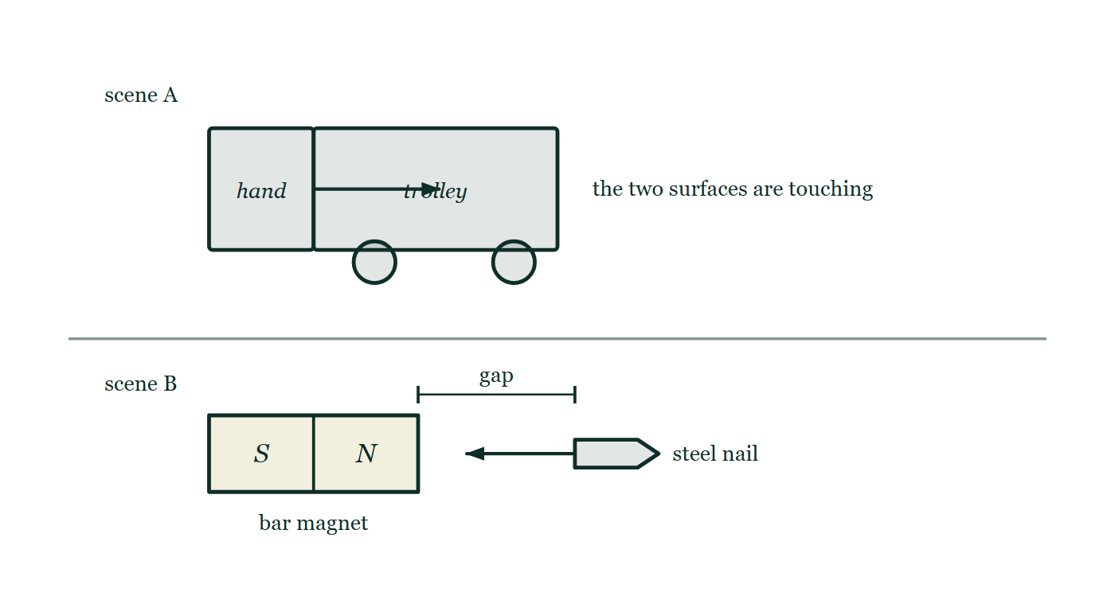
FORCES · APPLIED DEFINITIONS
GIOPHYSICS LESSON
QUICK CHECK
Decide before the answer goes up
Check and misconception — The quick check and the trap
A hand pushes a shopping trolley. Is the main force contact or non-contact?
A
contact
B
non-contact
Two scenes stacked: a hand in contact with a trolley pushing it along, and below it a bar magnet pulling a steel nail towards itself across a measured gap with nothing in between.
The live version of this figure — click here
Forces — Applied Definitions. Built by GioPhysics from the lesson's own copy; nothing on these slides is re-authored.
24 / 27
Notes:
[Phase] Check and misconception: The quick check and the trap (minutes 35–41 of 45)
[Question] A hand pushes a shopping trolley. Is the main force contact or non-contact?
[Figure] Two scenes stacked: a hand in contact with a trolley pushing it along, and below it a bar magnet pulling a steel nail towards itself across a measured gap with nothing in between.
[Options] A contact B non-contact

Slide 25
FORCES · APPLIED DEFINITIONS
GIOPHYSICS LESSON
QUICK CHECK · THE ANSWER
The answer, and why
Check and misconception — The quick check and the trap
A contact
HOW TO GET THERE
The hand must touch the trolley to push it. Ask: must the two objects touch for this force to act?
WHY THE OTHERS TEMPT
A Correct. The hand and the handle are touching, and that is the whole test: take the touching away and the push goes with it.
B A non-contact force reaches across a gap through a field — gravity, magnetism, electrostatics — which is scene B in the drawing, not scene A. Lift the hand a centimetre clear of the handle and the trolley stops being pushed, which a magnet and a nail would not do.
Forces — Applied Definitions. Built by GioPhysics from the lesson's own copy; nothing on these slides is re-authored.
25 / 27
Notes:
[Phase] Check and misconception: The quick check and the trap (minutes 35–41 of 45)
[Question] A hand pushes a shopping trolley. Is the main force contact or non-contact?
[Option by option] A: Correct. The hand and the handle are touching, and that is the whole test: take the touching away and the push goes with it. B: A non-contact force reaches across a gap through a field — gravity, magnetism, electrostatics — which is scene B in the drawing, not scene A. Lift the hand a centimetre clear of the handle and the trolley stops being pushed, which a magnet and a nail would not do.
[Answer] A — contact
[Why] The hand must touch the trolley to push it. Ask: must the two objects touch for this force to act?
[Reveal] One click for the answer, then one for the reason.

Slide 26
FORCES · APPLIED DEFINITIONS
GIOPHYSICS LESSON
EXTENSION
No harder example in this lesson
Worked examples — I do, we do — one step revealed at a time
This lesson sets no Hard or Challenging example. The extension for a class that has finished early is the next lesson, or the practice paper questions the figures came from.
Forces — Applied Definitions. Built by GioPhysics from the lesson's own copy; nothing on these slides is re-authored.
26 / 27
Notes:
[Phase] Worked examples: I do, we do — one step revealed at a time (minutes 22–35 of 45)
[Extension] The lesson record carries no Hard or Challenging example.

Slide 27
FORCES · APPLIED DEFINITIONS
GIOPHYSICS LESSON
FORCES
Where to go next
Plenary — What to take away, what to practise next
Next
2.2 Newton’s Laws of Motion
https://giophysics.com/chapter-3/newtons-laws-of-motion/
Lesson
This lesson on giophysics.com
https://giophysics.com/chapter-3/applied-definitions/
Live
The live, interactive version of these slides
https://giophysics.com/chapter-3/presentation/?lesson=definitions
Chapter
All Forces lessons
https://giophysics.com/chapter-3/
PDF
Download the lesson PDF
https://giophysics.com/downloads/3-1-applied-definitions.pdf
Forces — Applied Definitions. Built by GioPhysics from the lesson's own copy; nothing on these slides is re-authored.
27 / 27
Notes:
[Phase] Plenary: What to take away, what to practise next (minutes 41–45 of 45)
[Interactive] The graphs and the circuit topology on these slides are frozen. The live version at https://giophysics.com/chapter-3/presentation/?lesson=definitions moves them.

