Slide 1
FORCES · FRICTION FORCES
GIOPHYSICS LESSON
02 · Forces
Direction. Normal force. Regime. Resultant.
Friction Forces
Friction responds before an object slides, then follows a simpler kinetic rule once the surfaces move past each other.
POSITION
Lesson 4 of 11 in Forces
PLAN
16 slides in the 45-minute core run, about 45 minutes of it
LESSON PAGE
https://giophysics.com/chapter-3/friction-forces/
Built by GioPhysics from the lesson's own page. Every word on these slides is the lesson's; nothing here is re-authored. Teaching material, not an awarding body's document.
Forces — Friction Forces. Built by GioPhysics from the lesson's own copy; nothing on these slides is re-authored.
1 / 33
Notes:
[Lesson] Forces — Friction Forces. Lesson 4 of 11.
[Intro] Friction responds before an object slides, then follows a simpler kinetic rule once the surfaces move past each other.
[Source] https://giophysics.com/chapter-3/friction-forces/
[Disclaimer] Built by GioPhysics from the lesson's own page. Every word on these slides is the lesson's; nothing here is re-authored. Teaching material, not an awarding body's document.

Slide 2
FORCES · FRICTION FORCES
GIOPHYSICS LESSON
WHAT THIS NEEDS
What you already know
Starter — Recall what this lesson stands on
Recall
1.5 Kinematics 2D
https://giophysics.com/chapter-1/kinematics-2d/
Recall
2.3 Applied, Weight & Normal
https://giophysics.com/chapter-3/applied-weight-normal-forces/
Recall
2.2 Newton’s Laws
https://giophysics.com/chapter-3/newtons-laws-of-motion/
Forces — Friction Forces. Built by GioPhysics from the lesson's own copy; nothing on these slides is re-authored.
2 / 33
Notes:
[Phase] Starter: Recall what this lesson stands on (minutes 0–5 of 45)
[Starter] Recall: 1.5 Kinematics 2D; 2.3 Applied, Weight & Normal; 2.2 Newton’s Laws

Slide 3
FORCES · FRICTION FORCES
GIOPHYSICS LESSON
THINK FIRST
A car pulls away from the lights. Which way does friction act on its driving wheels?
Take answers before you click — the point is the commitment
Everyone knows friction opposes motion, and the car is very definitely moving forwards.
THE ANSWER
Forwards — the same way as the car. The tyre pushes backwards on the road where it grips, so the road pushes forwards on the tyre, and that forward push is the only thing accelerating the car. Friction opposes relative sliding between the surfaces, not the object's journey. Take it away and the car does not carry serenely on; the wheels spin and it goes nowhere.
Forces — Friction Forces. Built by GioPhysics from the lesson's own copy; nothing on these slides is re-authored.
3 / 33
Notes:
[Phase] Starter: Recall what this lesson stands on (minutes 0–5 of 45)
[Hook] A car pulls away from the lights. Which way does friction act on its driving wheels? Everyone knows friction opposes motion, and the car is very definitely moving forwards.
[Answer] Forwards — the same way as the car. The tyre pushes backwards on the road where it grips, so the road pushes forwards on the tyre, and that forward push is the only thing accelerating the car. Friction opposes relative sliding between the surfaces, not the object's journey. Take it away and the car does not carry serenely on; the wheels spin and it goes nowhere.

Slide 4
FORCES · FRICTION FORCES
GIOPHYSICS LESSON
EXPLAINED SIMPLY
In one sentence
Introduce the idea — The big idea and the definition
Friction is a contact force parallel to a surface that opposes sliding or attempted sliding.
Forces — Friction Forces. Built by GioPhysics from the lesson's own copy; nothing on these slides is re-authored.
4 / 33
Notes:
[Phase] Introduce the idea: The big idea and the definition (minutes 5–13 of 45)
[Definition] Friction is a contact force parallel to a surface that opposes sliding or attempted sliding.

Slide 5
FORCES · FRICTION FORCES
GIOPHYSICS LESSON
EXPLAINED SIMPLY
What that looks like
Introduce the idea — The big idea and the definition
FOR EXAMPLE
A crate stays still while a small push is balanced by static friction; once it slides, kinetic friction opposes the motion.
Forces — Friction Forces. Built by GioPhysics from the lesson's own copy; nothing on these slides is re-authored.
5 / 33
Notes:
[Phase] Introduce the idea: The big idea and the definition (minutes 5–13 of 45)
[Worked illustration] A crate stays still while a small push is balanced by static friction; once it slides, kinetic friction opposes the motion.

Slide 6
FORCES · FRICTION FORCES
GIOPHYSICS LESSON
THE BIG IDEA
Direction. Normal force. Regime. Resultant.
Introduce the idea — The big idea and the definition
The normal force sets the scale, while the coefficient describes the interacting surfaces in this simplified dry-friction model. Static friction adjusts to prevent relative sliding, and equality occurs only at the threshold of motion. Limiting friction is the largest static friction possible just before slipping begins.
Kinetic friction acts during sliding, and usually μk is smaller than μs. On a slope, choose x along the slope and y perpendicular to it: this turns one two-dimensional force diagram into two simple component equations.
Forces — Friction Forces. Built by GioPhysics from the lesson's own copy; nothing on these slides is re-authored.
6 / 33
Notes:
[Phase] Introduce the idea: The big idea and the definition (minutes 5–13 of 45)
[Big idea] The normal force sets the scale, while the coefficient describes the interacting surfaces in this simplified dry-friction model. Static friction adjusts to prevent relative sliding, and equality occurs only at the threshold of motion. Limiting friction is the largest static friction possible just before slipping begins. Kinetic friction acts during sliding, and usually μk is smaller than μs. On a slope, choose x along the slope and y perpendicular to it: this turns one two-dimensional force diagram into two simple component equations.

Slide 7
FORCES · FRICTION FORCES
GIOPHYSICS LESSON
THE PHYSICS · 1 OF 4
Friction supplies what is needed—up to a limit.
Build the model — The formulae, one at a time, in plain English
The normal force sets the scale, while the coefficient describes the interacting surfaces in this simplified dry-friction model.
Forces — Friction Forces. Built by GioPhysics from the lesson's own copy; nothing on these slides is re-authored.
7 / 33
Notes:
[Phase] Build the model: The formulae, one at a time, in plain English (minutes 13–22 of 45)
[Section] The normal force sets the scale, while the coefficient describes the interacting surfaces in this simplified dry-friction model.

Slide 8
FORCES · FRICTION FORCES
GIOPHYSICS LESSON
THE PHYSICS · 2 OF 4
Resolve weight, then test the static limit.
Build the model — The formulae, one at a time, in plain English
Choose x along the slope and y perpendicular to it. This turns one two-dimensional force diagram into two simple component equations. While the needed friction is below the limit, Fnet = 0 and the block remains at rest; past the threshold angle, static friction is insufficient, kinetic friction acts, and the block accelerates down the slope.
Forces — Friction Forces. Built by GioPhysics from the lesson's own copy; nothing on these slides is re-authored.
8 / 33
Notes:
[Phase] Build the model: The formulae, one at a time, in plain English (minutes 13–22 of 45)
[Section] Choose x along the slope and y perpendicular to it. This turns one two-dimensional force diagram into two simple component equations. While the needed friction is below the limit, Fnet = 0 and the block remains at rest; past the threshold angle, static friction is insufficient, kinetic friction acts, and the block accelerates down the slope.

Slide 9
FORCES · FRICTION FORCES
GIOPHYSICS LESSON
THE PHYSICS · 3 OF 4
Static friction follows the demand, then kinetic friction takes over.
Build the model — The formulae, one at a time, in plain English
In a separate level-surface experiment, increase a horizontal pull. The object remains still until the requested friction reaches its static maximum.
Here FN = mg. Beyond the threshold the surfaces slide and the model changes to kinetic friction.
Forces — Friction Forces. Built by GioPhysics from the lesson's own copy; nothing on these slides is re-authored.
9 / 33
Notes:
[Phase] Build the model: The formulae, one at a time, in plain English (minutes 13–22 of 45)
[Section] In a separate level-surface experiment, increase a horizontal pull. The object remains still until the requested friction reaches its static maximum. Here FN = mg. Beyond the threshold the surfaces slide and the model changes to kinetic friction.

Slide 10
FORCES · FRICTION FORCES
GIOPHYSICS LESSON
THE PHYSICS · 4 OF 4
Use the model—and know what it leaves out.
Build the model — The formulae, one at a time, in plain English
Dry-friction coefficients are useful approximations. Real surfaces, speed, temperature, lubrication, and deformation can change the interaction.
Forces — Friction Forces. Built by GioPhysics from the lesson's own copy; nothing on these slides is re-authored.
10 / 33
Notes:
[Phase] Build the model: The formulae, one at a time, in plain English (minutes 13–22 of 45)
[Section] Dry-friction coefficients are useful approximations. Real surfaces, speed, temperature, lubrication, and deformation can change the interaction.

Slide 11
FORCES · FRICTION FORCES
GIOPHYSICS LESSON
FORMULA 1 OF 3
Static friction
Build the model — The formulae, one at a time, in plain English
0 ≤ fs ≤ μsFN
Equality occurs only at the threshold of motion
IN PLAIN ENGLISH
It adjusts to prevent relative sliding. Equality occurs only at the threshold of motion.
Forces — Friction Forces. Built by GioPhysics from the lesson's own copy; nothing on these slides is re-authored.
11 / 33
Notes:
[Phase] Build the model: The formulae, one at a time, in plain English (minutes 13–22 of 45)
[Formula] Static friction: 0 ≤ fs ≤ μsFN
[In plain English] It adjusts to prevent relative sliding. Equality occurs only at the threshold of motion.
[Note] Equality occurs only at the threshold of motion

Slide 12
FORCES · FRICTION FORCES
GIOPHYSICS LESSON
FORMULA 2 OF 3
Limiting friction
Build the model — The formulae, one at a time, in plain English
fs,max = μsFN
The value just before slipping begins
IN PLAIN ENGLISH
The largest static friction possible just before slipping begins.
Forces — Friction Forces. Built by GioPhysics from the lesson's own copy; nothing on these slides is re-authored.
12 / 33
Notes:
[Phase] Build the model: The formulae, one at a time, in plain English (minutes 13–22 of 45)
[Formula] Limiting friction: fs,max = μsFN
[In plain English] The largest static friction possible just before slipping begins.
[Note] The value just before slipping begins

Slide 13
FORCES · FRICTION FORCES
GIOPHYSICS LESSON
FORMULA 3 OF 3
Kinetic friction
Build the model — The formulae, one at a time, in plain English
fk = μkFN
Usually μk is smaller than μs
IN PLAIN ENGLISH
It acts during sliding. Usually μk is smaller than μs.
Forces — Friction Forces. Built by GioPhysics from the lesson's own copy; nothing on these slides is re-authored.
13 / 33
Notes:
[Phase] Build the model: The formulae, one at a time, in plain English (minutes 13–22 of 45)
[Formula] Kinetic friction: fk = μkFN
[In plain English] It acts during sliding. Usually μk is smaller than μs.
[Note] Usually μk is smaller than μs

Slide 14
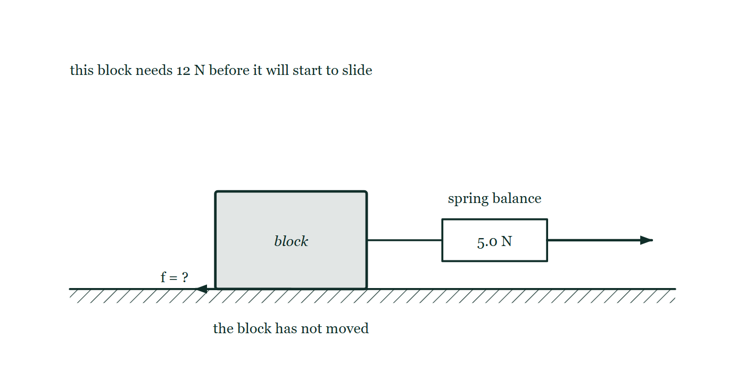
FORCES · FRICTION FORCES
GIOPHYSICS LESSON
THE PICTURE
Friction supplies what is asked of it
Drawn for this lesson
A block that has not moved, pulled sideways through a spring balance reading 5.0 N, with a note that this block needs 12 N before it will slide and the friction arrow at its base left unmarked.
The live version of this figure — click here
Forces — Friction Forces. Built by GioPhysics from the lesson's own copy; nothing on these slides is re-authored.
14 / 33
Notes:
[Phase] Build the model: The formulae, one at a time, in plain English (minutes 13–22 of 45)
[Figure] A block that has not moved, pulled sideways through a spring balance reading 5.0 N, with a note that this block needs 12 N before it will slide and the friction arrow at its base left unmarked.

Slide 15
FORCES · FRICTION FORCES
GIOPHYSICS LESSON
WATCH OUT
The common trap
Check and misconception — The quick check and the trap
Direction test: friction opposes relative sliding—or the tendency to slide—not necessarily the object’s overall velocity. A driven car, for example, can receive forward static friction from the road.
Forces — Friction Forces. Built by GioPhysics from the lesson's own copy; nothing on these slides is re-authored.
15 / 33
Notes:
[Phase] Check and misconception: The quick check and the trap (minutes 35–41 of 45)
[Misconception] Direction test: friction opposes relative sliding—or the tendency to slide—not necessarily the object’s overall velocity. A driven car, for example, can receive forward static friction from the road.

Slide 16
FORCES · FRICTION FORCES
GIOPHYSICS LESSON
WORKED EXAMPLE 1 OF 4 · FIND ΜS
The question
find μs
Worked examples — I do, we do — one step revealed at a time
Tilt-table measurement.
Forces — Friction Forces. Built by GioPhysics from the lesson's own copy; nothing on these slides is re-authored.
16 / 33
Notes:
[Phase] Worked examples: I do, we do — one step revealed at a time (minutes 22–35 of 45)
[Question] Tilt-table measurement.
[Answer] μs = tan θ

Slide 17
FORCES · FRICTION FORCES
GIOPHYSICS LESSON
WORKED EXAMPLE 1 OF 4 · FIND ΜS · THE WORKING
How to solve it
find μs
Worked examples — I do, we do — one step revealed at a time
Tilt-table measurement.
1.
At the instant sliding begins, mg sin θ = μs mg cos θ.
2.
Therefore μs = tan θ. Mass cancels from this ideal model.
Forces — Friction Forces. Built by GioPhysics from the lesson's own copy; nothing on these slides is re-authored.
17 / 33
Notes:
[Phase] Worked examples: I do, we do — one step revealed at a time (minutes 22–35 of 45)
[Reveal] One click per step. The class works each line before the next appears.
[Step 1] At the instant sliding begins, mg sin θ = μs mg cos θ.
[Step 2] Therefore μs = tan θ. Mass cancels from this ideal model.

Slide 18
FORCES · FRICTION FORCES
GIOPHYSICS LESSON
WORKED EXAMPLE 1 OF 4 · FIND ΜS
Answer
find μs
Worked examples — I do, we do — one step revealed at a time
μs = tan θ
Forces — Friction Forces. Built by GioPhysics from the lesson's own copy; nothing on these slides is re-authored.
18 / 33
Notes:
[Phase] Worked examples: I do, we do — one step revealed at a time (minutes 22–35 of 45)
[Answer] μs = tan θ

Slide 19
FORCES · FRICTION FORCES
GIOPHYSICS LESSON
WORKED EXAMPLE 2 OF 4 · STATIC TRACTION
The question
static traction
Worked examples — I do, we do — one step revealed at a time
Car climbing a steep hill.
Forces — Friction Forces. Built by GioPhysics from the lesson's own copy; nothing on these slides is re-authored.
19 / 33
Notes:
[Phase] Worked examples: I do, we do — one step revealed at a time (minutes 22–35 of 45)
[Question] Car climbing a steep hill.
[Answer] tan θ ≤ μs

Slide 20
FORCES · FRICTION FORCES
GIOPHYSICS LESSON
WORKED EXAMPLE 2 OF 4 · STATIC TRACTION · THE WORKING
How to solve it
static traction
Worked examples — I do, we do — one step revealed at a time
Car climbing a steep hill.
1.
The road pushes the driven tyre uphill through static friction.
2.
At rest or constant speed, avoiding slip requires mg sin θ ≤ μs mg cos θ, or tan θ ≤ μs.
Forces — Friction Forces. Built by GioPhysics from the lesson's own copy; nothing on these slides is re-authored.
20 / 33
Notes:
[Phase] Worked examples: I do, we do — one step revealed at a time (minutes 22–35 of 45)
[Reveal] One click per step. The class works each line before the next appears.
[Step 1] The road pushes the driven tyre uphill through static friction.
[Step 2] At rest or constant speed, avoiding slip requires mg sin θ ≤ μs mg cos θ, or tan θ ≤ μs.

Slide 21
FORCES · FRICTION FORCES
GIOPHYSICS LESSON
WORKED EXAMPLE 2 OF 4 · STATIC TRACTION
Answer
static traction
Worked examples — I do, we do — one step revealed at a time
tan θ ≤ μs
Forces — Friction Forces. Built by GioPhysics from the lesson's own copy; nothing on these slides is re-authored.
21 / 33
Notes:
[Phase] Worked examples: I do, we do — one step revealed at a time (minutes 22–35 of 45)
[Answer] tan θ ≤ μs

Slide 22
FORCES · FRICTION FORCES
GIOPHYSICS LESSON
WORKED EXAMPLE 3 OF 4 · IDEAL DRY-FRICTION MODEL
The question
ideal dry-friction model
Worked examples — I do, we do — one step revealed at a time
Why apparent contact area is absent.
Forces — Friction Forces. Built by GioPhysics from the lesson's own copy; nothing on these slides is re-authored.
22 / 33
Notes:
[Phase] Worked examples: I do, we do — one step revealed at a time (minutes 22–35 of 45)
[Question] Why apparent contact area is absent.
[Answer] The model uses normal force, not visible area

Slide 23
FORCES · FRICTION FORCES
GIOPHYSICS LESSON
WORKED EXAMPLE 3 OF 4 · IDEAL DRY-FRICTION MODEL · THE WORKING
How to solve it
ideal dry-friction model
Worked examples — I do, we do — one step revealed at a time
Why apparent contact area is absent.
1.
Microscopic contact occurs at tiny high points.
2.
A larger visible area does not automatically create more true microscopic contact, so the basic model uses normal force rather than visible area.
Forces — Friction Forces. Built by GioPhysics from the lesson's own copy; nothing on these slides is re-authored.
23 / 33
Notes:
[Phase] Worked examples: I do, we do — one step revealed at a time (minutes 22–35 of 45)
[Reveal] One click per step. The class works each line before the next appears.
[Step 1] Microscopic contact occurs at tiny high points.
[Step 2] A larger visible area does not automatically create more true microscopic contact, so the basic model uses normal force rather than visible area.

Slide 24
FORCES · FRICTION FORCES
GIOPHYSICS LESSON
WORKED EXAMPLE 3 OF 4 · IDEAL DRY-FRICTION MODEL
Answer
ideal dry-friction model
Worked examples — I do, we do — one step revealed at a time
The model uses normal force, not visible area
Forces — Friction Forces. Built by GioPhysics from the lesson's own copy; nothing on these slides is re-authored.
24 / 33
Notes:
[Phase] Worked examples: I do, we do — one step revealed at a time (minutes 22–35 of 45)
[Answer] The model uses normal force, not visible area

Slide 25
FORCES · FRICTION FORCES
GIOPHYSICS LESSON
WORKED EXAMPLE 4 OF 4 · MOTION ALONG THE SLOPE
The question
motion along the slope
Worked examples — I do, we do — one step revealed at a time
From force to kinematics.
Forces — Friction Forces. Built by GioPhysics from the lesson's own copy; nothing on these slides is re-authored.
25 / 33
Notes:
[Phase] Worked examples: I do, we do — one step revealed at a time (minutes 22–35 of 45)
[Question] From force to kinematics.
[Answer] v = u + at and s = ut + ½at² along the slope

Slide 26
FORCES · FRICTION FORCES
GIOPHYSICS LESSON
WORKED EXAMPLE 4 OF 4 · MOTION ALONG THE SLOPE · THE WORKING
How to solve it
motion along the slope
Worked examples — I do, we do — one step revealed at a time
From force to kinematics.
1.
Once the net down-slope force gives a constant acceleration, use the motion equations along that axis: v = u + at and s = ut + ½at².
2.
The perpendicular acceleration remains zero while contact is maintained.
Forces — Friction Forces. Built by GioPhysics from the lesson's own copy; nothing on these slides is re-authored.
26 / 33
Notes:
[Phase] Worked examples: I do, we do — one step revealed at a time (minutes 22–35 of 45)
[Reveal] One click per step. The class works each line before the next appears.
[Step 1] Once the net down-slope force gives a constant acceleration, use the motion equations along that axis: v = u + at and s = ut + ½at².
[Step 2] The perpendicular acceleration remains zero while contact is maintained.

Slide 27
FORCES · FRICTION FORCES
GIOPHYSICS LESSON
WORKED EXAMPLE 4 OF 4 · MOTION ALONG THE SLOPE
Answer
motion along the slope
Worked examples — I do, we do — one step revealed at a time
v = u + at and s = ut + ½at² along the slope
Forces — Friction Forces. Built by GioPhysics from the lesson's own copy; nothing on these slides is re-authored.
27 / 33
Notes:
[Phase] Worked examples: I do, we do — one step revealed at a time (minutes 22–35 of 45)
[Answer] v = u + at and s = ut + ½at² along the slope

Slide 28
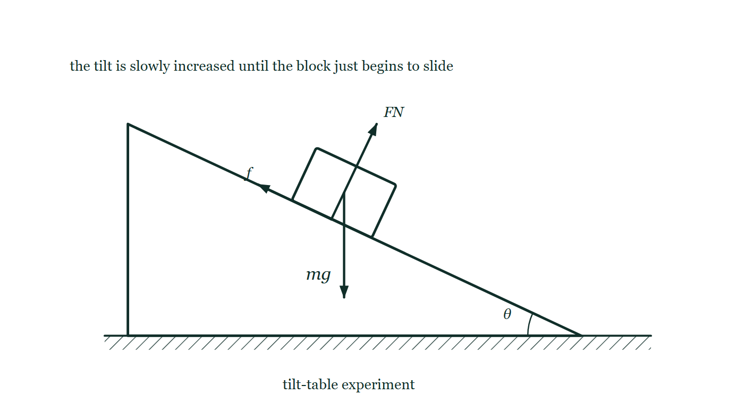
FORCES · FRICTION FORCES
GIOPHYSICS LESSON
PREDICT · TAKE THE VOTE
Commit before you are told
Hands up for each option, then click
Two blocks of the same material sit on the tilt table, one twice the mass of the other. The table is tilted slowly. Which slides first?
A The lighter block
B The heavier block
C They begin to slide at the same angle
A block on a table being tilted slowly through an angle θ, with the normal force and the friction both drawn at the contact surface and the weight drawn from the centre of the block.
The live version of this figure — click here
Forces — Friction Forces. Built by GioPhysics from the lesson's own copy; nothing on these slides is re-authored.
28 / 33
Notes:
[Phase] Build the model: The formulae, one at a time, in plain English (minutes 13–22 of 45)
[Predict] Two blocks of the same material sit on the tilt table, one twice the mass of the other. The table is tilted slowly. Which slides first?
[Options] A The lighter block B The heavier block C They begin to slide at the same angle
[Figure] A block on a table being tilted slowly through an angle θ, with the normal force and the friction both drawn at the contact surface and the weight drawn from the centre of the block.

Slide 29
FORCES · FRICTION FORCES
GIOPHYSICS LESSON
PREDICT · THE OUTCOME
What actually happens
Ask the room who changed their mind, and why
C They begin to slide at the same angle
WHY
At the instant of slipping the down-slope pull mg sin θ has just beaten the limiting friction μs mg cos θ. Both sides carry the same mg, so it cancels: the condition is tan θ = μs, and mass is nowhere in it. The heavier block is pulled harder down the slope, and gripped harder in exactly the same proportion. This is why a tilt table measures μs and never needs the block weighed.
Forces — Friction Forces. Built by GioPhysics from the lesson's own copy; nothing on these slides is re-authored.
29 / 33
Notes:
[Phase] Build the model: The formulae, one at a time, in plain English (minutes 13–22 of 45)
[Answer] C — They begin to slide at the same angle. At the instant of slipping the down-slope pull mg sin θ has just beaten the limiting friction μs mg cos θ. Both sides carry the same mg, so it cancels: the condition is tan θ = μs, and mass is nowhere in it. The heavier block is pulled harder down the slope, and gripped harder in exactly the same proportion. This is why a tilt table measures μs and never needs the block weighed.

Slide 30
FORCES · FRICTION FORCES
GIOPHYSICS LESSON
QUICK CHECK
Decide before the answer goes up
Check and misconception — The quick check and the trap
A box is resting while a small horizontal force acts. Must its static friction equal μsFN?
A
yes
B
no
Forces — Friction Forces. Built by GioPhysics from the lesson's own copy; nothing on these slides is re-authored.
30 / 33
Notes:
[Phase] Check and misconception: The quick check and the trap (minutes 35–41 of 45)
[Question] A box is resting while a small horizontal force acts. Must its static friction equal μsFN?
[Options] A yes B no

Slide 31
FORCES · FRICTION FORCES
GIOPHYSICS LESSON
QUICK CHECK · THE ANSWER
The answer, and why
Check and misconception — The quick check and the trap
B no
HOW TO GET THERE
Static friction matches the force needed to prevent sliding, up to μsFN. Equality occurs only at the threshold of slipping — μsFN is a maximum, not the default value.
WHY THE OTHERS TEMPT
A μsFN is the number the formula sheet offers, so it looks like the value of static friction rather than its ceiling. Try it: the block would be shoved backwards by a friction larger than the 5.0 N pulling it, and the drawing says it has not moved at all.
B Correct. Static friction supplies exactly what is needed to prevent sliding and no more — 5.0 N of pull, 5.0 N of friction. Only at the threshold, 12 N for this block, has it run out of room, and that is the one moment when f = μsFN.
Forces — Friction Forces. Built by GioPhysics from the lesson's own copy; nothing on these slides is re-authored.
31 / 33
Notes:
[Phase] Check and misconception: The quick check and the trap (minutes 35–41 of 45)
[Question] A box is resting while a small horizontal force acts. Must its static friction equal μsFN?
[Option by option] A: μsFN is the number the formula sheet offers, so it looks like the value of static friction rather than its ceiling. Try it: the block would be shoved backwards by a friction larger than the 5.0 N pulling it, and the drawing says it has not moved at all. B: Correct. Static friction supplies exactly what is needed to prevent sliding and no more — 5.0 N of pull, 5.0 N of friction. Only at the threshold, 12 N for this block, has it run out of room, and that is the one moment when f = μsFN.
[Answer] B — no
[Why] Static friction matches the force needed to prevent sliding, up to μsFN. Equality occurs only at the threshold of slipping — μsFN is a maximum, not the default value.
[Reveal] One click for the answer, then one for the reason.

Slide 32
FORCES · FRICTION FORCES
GIOPHYSICS LESSON
EXTENSION
No harder example in this lesson
Worked examples — I do, we do — one step revealed at a time
This lesson sets no Hard or Challenging example. The extension for a class that has finished early is the next lesson, or the practice paper questions the figures came from.
Forces — Friction Forces. Built by GioPhysics from the lesson's own copy; nothing on these slides is re-authored.
32 / 33
Notes:
[Phase] Worked examples: I do, we do — one step revealed at a time (minutes 22–35 of 45)
[Extension] The lesson record carries no Hard or Challenging example.

Slide 33
FORCES · FRICTION FORCES
GIOPHYSICS LESSON
FORCES
Where to go next
Plenary — What to take away, what to practise next
Next
2.5 Tension Forces
https://giophysics.com/chapter-3/tension-forces/
Lesson
This lesson on giophysics.com
https://giophysics.com/chapter-3/friction-forces/
Live
The live, interactive version of these slides
https://giophysics.com/chapter-3/presentation/?lesson=friction
Chapter
All Forces lessons
https://giophysics.com/chapter-3/
PDF
Download the lesson PDF
https://giophysics.com/downloads/3-4-friction-forces.pdf
Forces — Friction Forces. Built by GioPhysics from the lesson's own copy; nothing on these slides is re-authored.
33 / 33
Notes:
[Phase] Plenary: What to take away, what to practise next (minutes 41–45 of 45)
[Interactive] The graphs and the circuit topology on these slides are frozen. The live version at https://giophysics.com/chapter-3/presentation/?lesson=friction moves them.

