Slide 1
FORCES · NEWTON’S LAW OF UNIVERSAL GRAVITATION
GIOPHYSICS LESSON
02 · Forces
Masses. Center distance. Inverse square. Direction.
Newton’s Law of Universal Gravitation
Every mass attracts every other mass. More mass strengthens the interaction; more separation weakens it by the square.
POSITION
Lesson 7 of 11 in Forces
PLAN
15 slides in the 45-minute core run, about 43 minutes of it
LESSON PAGE
https://giophysics.com/chapter-3/universal-gravitation/
Built by GioPhysics from the lesson's own page. Every word on these slides is the lesson's; nothing here is re-authored. Teaching material, not an awarding body's document.
Forces — Newton’s Law of Universal Gravitation. Built by GioPhysics from the lesson's own copy; nothing on these slides is re-authored.
1 / 36
Notes:
[Lesson] Forces — Newton’s Law of Universal Gravitation. Lesson 7 of 11.
[Intro] Every mass attracts every other mass. More mass strengthens the interaction; more separation weakens it by the square.
[Source] https://giophysics.com/chapter-3/universal-gravitation/
[Disclaimer] Built by GioPhysics from the lesson's own page. Every word on these slides is the lesson's; nothing here is re-authored. Teaching material, not an awarding body's document.

Slide 2
FORCES · NEWTON’S LAW OF UNIVERSAL GRAVITATION
GIOPHYSICS LESSON
WHAT THIS NEEDS
What you already know
Starter — Recall what this lesson stands on
Recall
2.3 Weight & Normal
https://giophysics.com/chapter-3/applied-weight-normal-forces/
Recall
2.6 Free-Body Diagrams
https://giophysics.com/chapter-3/free-body-diagrams-net-forces/
Recall
1.2 Vectors
https://giophysics.com/chapter-1/scalar-vector/
Forces — Newton’s Law of Universal Gravitation. Built by GioPhysics from the lesson's own copy; nothing on these slides is re-authored.
2 / 36
Notes:
[Phase] Starter: Recall what this lesson stands on (minutes 0–5 of 45)
[Starter] Recall: 2.3 Weight & Normal; 2.6 Free-Body Diagrams; 1.2 Vectors

Slide 3
FORCES · NEWTON’S LAW OF UNIVERSAL GRAVITATION
GIOPHYSICS LESSON
THINK FIRST
Astronauts float around inside the space station, 400 km up. How much weaker is Earth's gravity out there?
Take answers before you click — the point is the commitment
They drift, they push off walls, they let a spanner go and it stays put beside them. Everything about the footage says gravity has stopped.
THE ANSWER
About eleven per cent weaker — that is all. At 6771 km from the centre instead of 6371, the field is (6371/6771)² of its surface value, roughly 8.7 N/kg. They float because they and the station are falling around the Earth together, so nothing is pressing on them. Weightless means unsupported, not ungoverned.
Forces — Newton’s Law of Universal Gravitation. Built by GioPhysics from the lesson's own copy; nothing on these slides is re-authored.
3 / 36
Notes:
[Phase] Starter: Recall what this lesson stands on (minutes 0–5 of 45)
[Hook] Astronauts float around inside the space station, 400 km up. How much weaker is Earth's gravity out there? They drift, they push off walls, they let a spanner go and it stays put beside them. Everything about the footage says gravity has stopped.
[Answer] About eleven per cent weaker — that is all. At 6771 km from the centre instead of 6371, the field is (6371/6771)² of its surface value, roughly 8.7 N/kg. They float because they and the station are falling around the Earth together, so nothing is pressing on them. Weightless means unsupported, not ungoverned.

Slide 4
FORCES · NEWTON’S LAW OF UNIVERSAL GRAVITATION
GIOPHYSICS LESSON
EXPLAINED SIMPLY
In one sentence
Introduce the idea — The big idea and the definition
Universal gravitation is the attractive force between any two masses.
Forces — Newton’s Law of Universal Gravitation. Built by GioPhysics from the lesson's own copy; nothing on these slides is re-authored.
4 / 36
Notes:
[Phase] Introduce the idea: The big idea and the definition (minutes 5–13 of 45)
[Definition] Universal gravitation is the attractive force between any two masses.

Slide 5
FORCES · NEWTON’S LAW OF UNIVERSAL GRAVITATION
GIOPHYSICS LESSON
EXPLAINED SIMPLY
What that looks like
Introduce the idea — The big idea and the definition
FOR EXAMPLE
Earth and a satellite attract each other; increasing their separation weakens the force according to 1/r².
Forces — Newton’s Law of Universal Gravitation. Built by GioPhysics from the lesson's own copy; nothing on these slides is re-authored.
5 / 36
Notes:
[Phase] Introduce the idea: The big idea and the definition (minutes 5–13 of 45)
[Worked illustration] Earth and a satellite attract each other; increasing their separation weakens the force according to 1/r².

Slide 6
FORCES · NEWTON’S LAW OF UNIVERSAL GRAVITATION
GIOPHYSICS LESSON
THE BIG IDEA
Masses. Center distance. Inverse square. Direction.
Introduce the idea — The big idea and the definition
The distance r is measured from center to center. For spherical bodies observed from outside, each body acts as if its mass were concentrated at its center. Double either mass and the gravitational force doubles; double both masses and the force becomes four times larger.
Double the center-to-center distance and the force becomes one quarter as large. The forces on the two bodies are equal and opposite, yet different masses still have different accelerations because a = F/m. Near a planet’s surface, GM/R² is nearly constant, so the universal law becomes the familiar weight model W = mg.
Forces — Newton’s Law of Universal Gravitation. Built by GioPhysics from the lesson's own copy; nothing on these slides is re-authored.
6 / 36
Notes:
[Phase] Introduce the idea: The big idea and the definition (minutes 5–13 of 45)
[Big idea] The distance r is measured from center to center. For spherical bodies observed from outside, each body acts as if its mass were concentrated at its center. Double either mass and the gravitational force doubles; double both masses and the force becomes four times larger. Double the center-to-center distance and the force becomes one quarter as large. The forces on the two bodies are equal and opposite, yet different masses still have different accelerations because a = F/m. Near a planet’s surface, GM/R² is nearly constant, so the universal law becomes the familiar weight model W = mg.

Slide 7
FORCES · NEWTON’S LAW OF UNIVERSAL GRAVITATION
GIOPHYSICS LESSON
THE PHYSICS · 1 OF 4
Multiply the masses. Divide by distance squared.
Build the model — The formulae, one at a time, in plain English
The distance r is measured from center to center. For spherical bodies observed from outside, each body acts as if its mass were concentrated at its center.
Forces — Newton’s Law of Universal Gravitation. Built by GioPhysics from the lesson's own copy; nothing on these slides is re-authored.
7 / 36
Notes:
[Phase] Build the model: The formulae, one at a time, in plain English (minutes 13–22 of 45)
[Section] The distance r is measured from center to center. For spherical bodies observed from outside, each body acts as if its mass were concentrated at its center.

Slide 8
FORCES · NEWTON’S LAW OF UNIVERSAL GRAVITATION
GIOPHYSICS LESSON
THE PHYSICS · 2 OF 4
Change mass and distance independently.
Build the model — The formulae, one at a time, in plain English
The source mass is measured in Earth masses and distance in Earth radii. The smaller object’s mass changes the force but not its gravitational acceleration. Both bodies feel the same force; the object accelerates more because the same force is divided by a much smaller mass.
Forces — Newton’s Law of Universal Gravitation. Built by GioPhysics from the lesson's own copy; nothing on these slides is re-authored.
8 / 36
Notes:
[Phase] Build the model: The formulae, one at a time, in plain English (minutes 13–22 of 45)
[Section] The source mass is measured in Earth masses and distance in Earth radii. The smaller object’s mass changes the force but not its gravitational acceleration. Both bodies feel the same force; the object accelerates more because the same force is divided by a much smaller mass.

Slide 9
FORCES · NEWTON’S LAW OF UNIVERSAL GRAVITATION
GIOPHYSICS LESSON
THE PHYSICS · 3 OF 4
Distance wins quickly because it is squared.
Build the model — The formulae, one at a time, in plain English
The graph holds source mass fixed and compares gravitational field strength at selected distances. Object mass is absent because it cancels from a = F/m.
At 2 radii, field strength is 1/4 of its value at 1 radius. At 10 radii, it is only 1/100.
Forces — Newton’s Law of Universal Gravitation. Built by GioPhysics from the lesson's own copy; nothing on these slides is re-authored.
9 / 36
Notes:
[Phase] Build the model: The formulae, one at a time, in plain English (minutes 13–22 of 45)
[Section] The graph holds source mass fixed and compares gravitational field strength at selected distances. Object mass is absent because it cancels from a = F/m. At 2 radii, field strength is 1/4 of its value at 1 radius. At 10 radii, it is only 1/100.

Slide 10
FORCES · NEWTON’S LAW OF UNIVERSAL GRAVITATION
GIOPHYSICS LESSON
THE PHYSICS · 4 OF 4
Weight, free fall, and orbit are one interaction.
Build the model — The formulae, one at a time, in plain English
Near a planet’s surface, GM/R² is nearly constant, so the universal law becomes the familiar weight model W = mg.
Forces — Newton’s Law of Universal Gravitation. Built by GioPhysics from the lesson's own copy; nothing on these slides is re-authored.
10 / 36
Notes:
[Phase] Build the model: The formulae, one at a time, in plain English (minutes 13–22 of 45)
[Section] Near a planet’s surface, GM/R² is nearly constant, so the universal law becomes the familiar weight model W = mg.

Slide 11
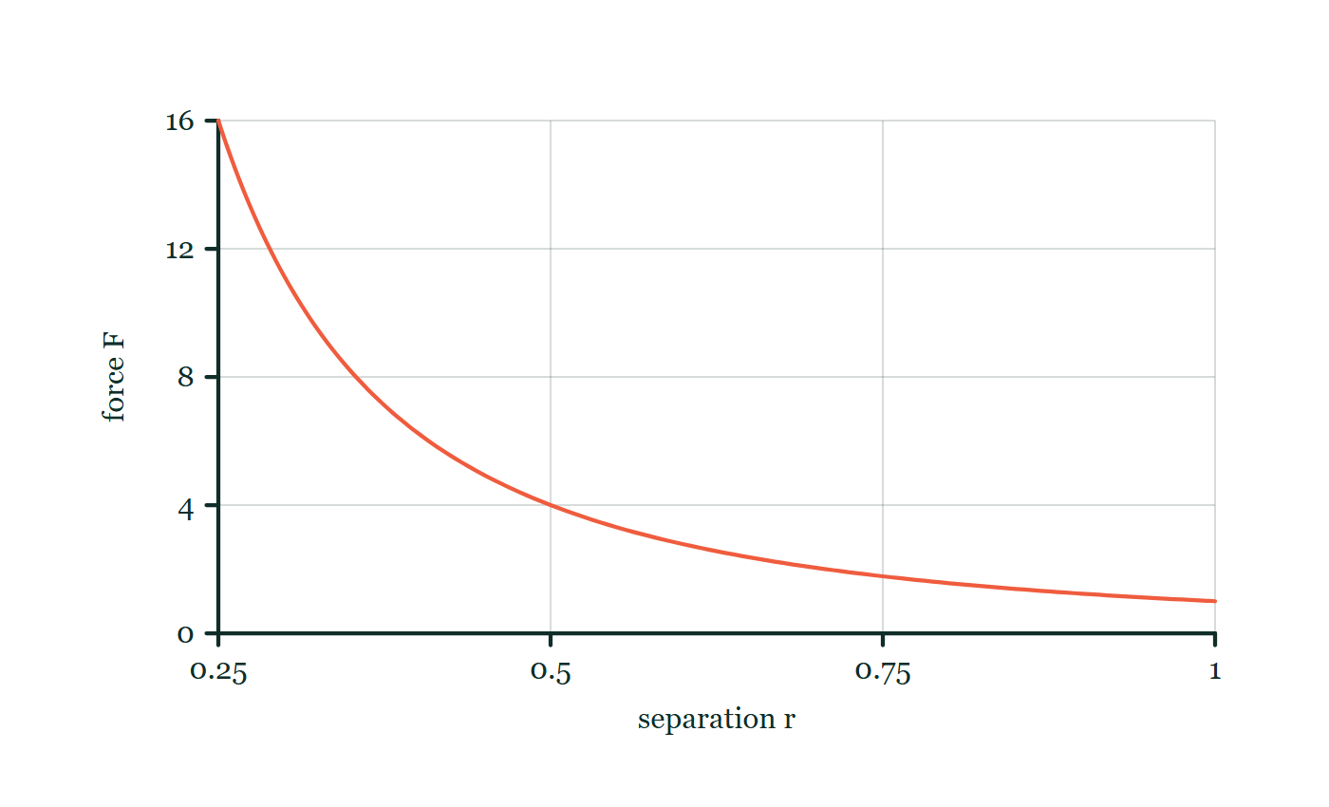
FORCES · NEWTON’S LAW OF UNIVERSAL GRAVITATION
GIOPHYSICS LESSON
FORMULA 1 OF 4
Universal gravitation
Build the model — The formulae, one at a time, in plain English
F = Gm₁m₂/r²
r is the center-to-center distance
IN PLAIN ENGLISH
For spherical bodies observed from outside, each body acts as if its mass were concentrated at its center.
Gravity with distance
Move this graph on the live version — click here
Forces — Newton’s Law of Universal Gravitation. Built by GioPhysics from the lesson's own copy; nothing on these slides is re-authored.
11 / 36
Notes:
[Phase] Build the model: The formulae, one at a time, in plain English (minutes 13–22 of 45)
[Formula] Universal gravitation: F = Gm₁m₂/r²
[In plain English] For spherical bodies observed from outside, each body acts as if its mass were concentrated at its center.
[Note] r is the center-to-center distance
[Graph] Gravity with distance. With both masses fixed, doubling centre-to-centre distance reduces gravitational force to one quarter.
[Axes] Horizontal: separation r. Vertical: force F. Values are normalised — the graph teaches the shape, not a measurement.

Slide 12
FORCES · NEWTON’S LAW OF UNIVERSAL GRAVITATION
GIOPHYSICS LESSON
FORMULA 2 OF 4
Mass dependence
Build the model — The formulae, one at a time, in plain English
F ∝ m₁m₂
Double both masses and the force becomes four times larger
IN PLAIN ENGLISH
Double either mass and the gravitational force doubles.
Forces — Newton’s Law of Universal Gravitation. Built by GioPhysics from the lesson's own copy; nothing on these slides is re-authored.
12 / 36
Notes:
[Phase] Build the model: The formulae, one at a time, in plain English (minutes 13–22 of 45)
[Formula] Mass dependence: F ∝ m₁m₂
[In plain English] Double either mass and the gravitational force doubles.
[Note] Double both masses and the force becomes four times larger

Slide 13
FORCES · NEWTON’S LAW OF UNIVERSAL GRAVITATION
GIOPHYSICS LESSON
FORMULA 3 OF 4
Distance dependence
Build the model — The formulae, one at a time, in plain English
F ∝ 1/r²
At 2 radii the field is 1/4; at 10 radii it is only 1/100
IN PLAIN ENGLISH
Double the center-to-center distance and the force becomes one quarter as large.
Forces — Newton’s Law of Universal Gravitation. Built by GioPhysics from the lesson's own copy; nothing on these slides is re-authored.
13 / 36
Notes:
[Phase] Build the model: The formulae, one at a time, in plain English (minutes 13–22 of 45)
[Formula] Distance dependence: F ∝ 1/r²
[In plain English] Double the center-to-center distance and the force becomes one quarter as large.
[Note] At 2 radii the field is 1/4; at 10 radii it is only 1/100

Slide 14
FORCES · NEWTON’S LAW OF UNIVERSAL GRAVITATION
GIOPHYSICS LESSON
FORMULA 4 OF 4
Interaction pair
Build the model — The formulae, one at a time, in plain English
|F₁₂| = |F₂₁|
Equal forces · different accelerations
IN PLAIN ENGLISH
The forces are equal and opposite. Different masses still have different accelerations because a = F/m.
Forces — Newton’s Law of Universal Gravitation. Built by GioPhysics from the lesson's own copy; nothing on these slides is re-authored.
14 / 36
Notes:
[Phase] Build the model: The formulae, one at a time, in plain English (minutes 13–22 of 45)
[Formula] Interaction pair: |F₁₂| = |F₂₁|
[In plain English] The forces are equal and opposite. Different masses still have different accelerations because a = F/m.
[Note] Equal forces · different accelerations

Slide 15
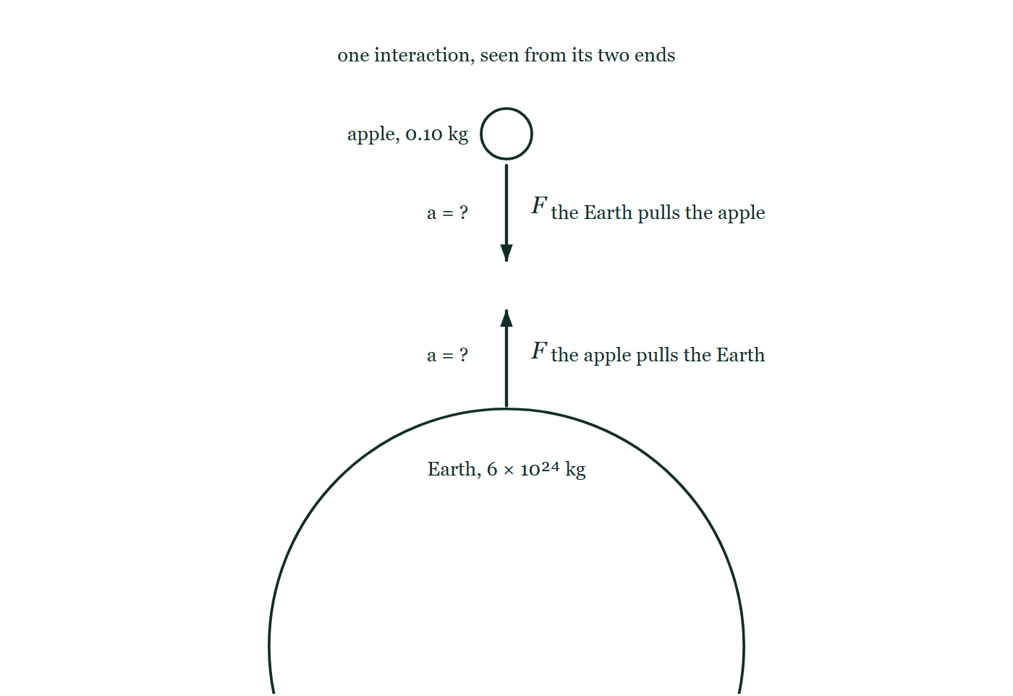
FORCES · NEWTON’S LAW OF UNIVERSAL GRAVITATION
GIOPHYSICS LESSON
THE PICTURE
Both ends of one interaction
Drawn for this lesson
An apple of 0.10 kg hangs above an Earth of 6 × 10²⁴ kg, with two force arrows of identical length between them — one down onto the apple, one up off the Earth's surface — and the acceleration beside each left as a = ?
The live version of this figure — click here
Forces — Newton’s Law of Universal Gravitation. Built by GioPhysics from the lesson's own copy; nothing on these slides is re-authored.
15 / 36
Notes:
[Phase] Build the model: The formulae, one at a time, in plain English (minutes 13–22 of 45)
[Figure] An apple of 0.10 kg hangs above an Earth of 6 × 10²⁴ kg, with two force arrows of identical length between them — one down onto the apple, one up off the Earth's surface — and the acceleration beside each left as a = ?

Slide 16
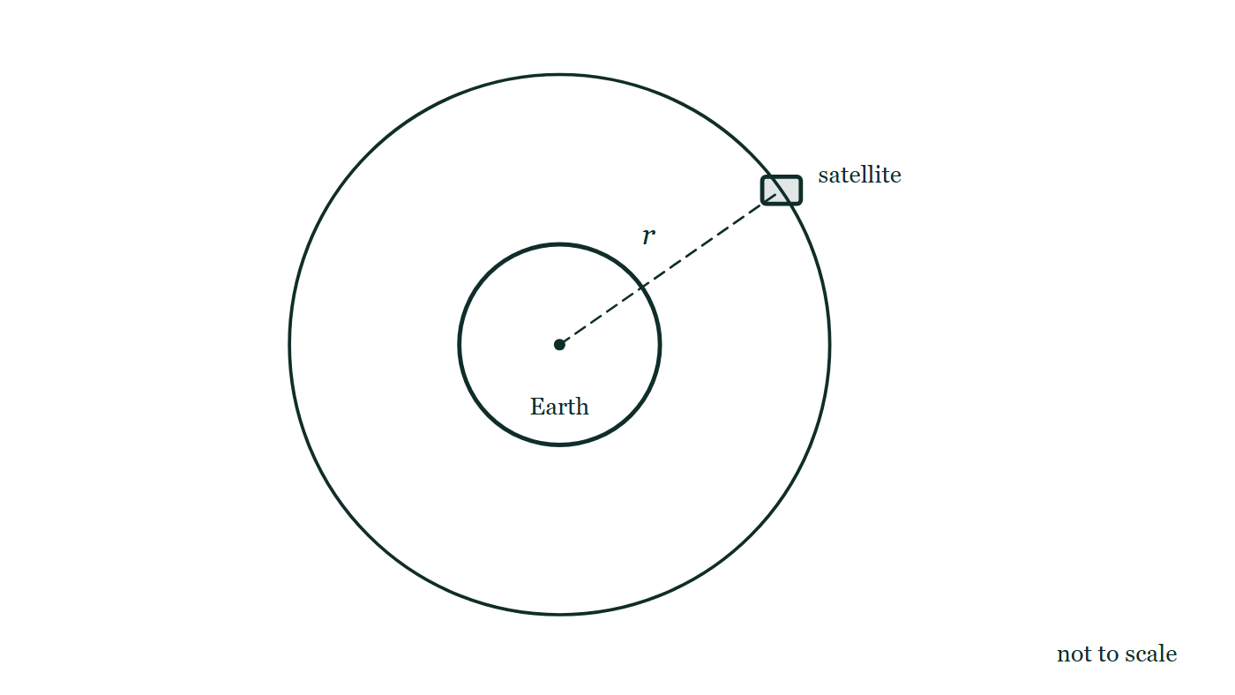
FORCES · NEWTON’S LAW OF UNIVERSAL GRAVITATION
GIOPHYSICS LESSON
FIGURE 1 OF 2
Fig. 7.1 — A Level · Topics 12–25
Drawn for question 7 of that paper · syllabus 12, 13
The Earth is drawn as a circle, labelled, with a dot marking its centre. A second, larger circle drawn concentric with it is the satellite's circular orbit. The satellite itself is a small block sitting on that larger circle, above and to the right of the Earth, and a dashed straight line runs from the dot at the centre of the Earth out to the satellite, labelled r. The figure is marked not to scale.
See the question this was drawn for — click here
Forces — Newton’s Law of Universal Gravitation. Built by GioPhysics from the lesson's own copy; nothing on these slides is re-authored.
16 / 36
Notes:
[Phase] Build the model: The formulae, one at a time, in plain English (minutes 13–22 of 45)
[Figure] Fig. 7.1. The Earth is drawn as a circle, labelled, with a dot marking its centre. A second, larger circle drawn concentric with it is the satellite's circular orbit. The satellite itself is a small block sitting on that larger circle, above and to the right of the Earth, and a dashed straight line runs from the dot at the centre of the Earth out to the satellite, labelled r. The figure is marked not to scale.
[Where it came from] A Level · Topics 12–25, question 7; syllabus 12, 13.

Slide 17
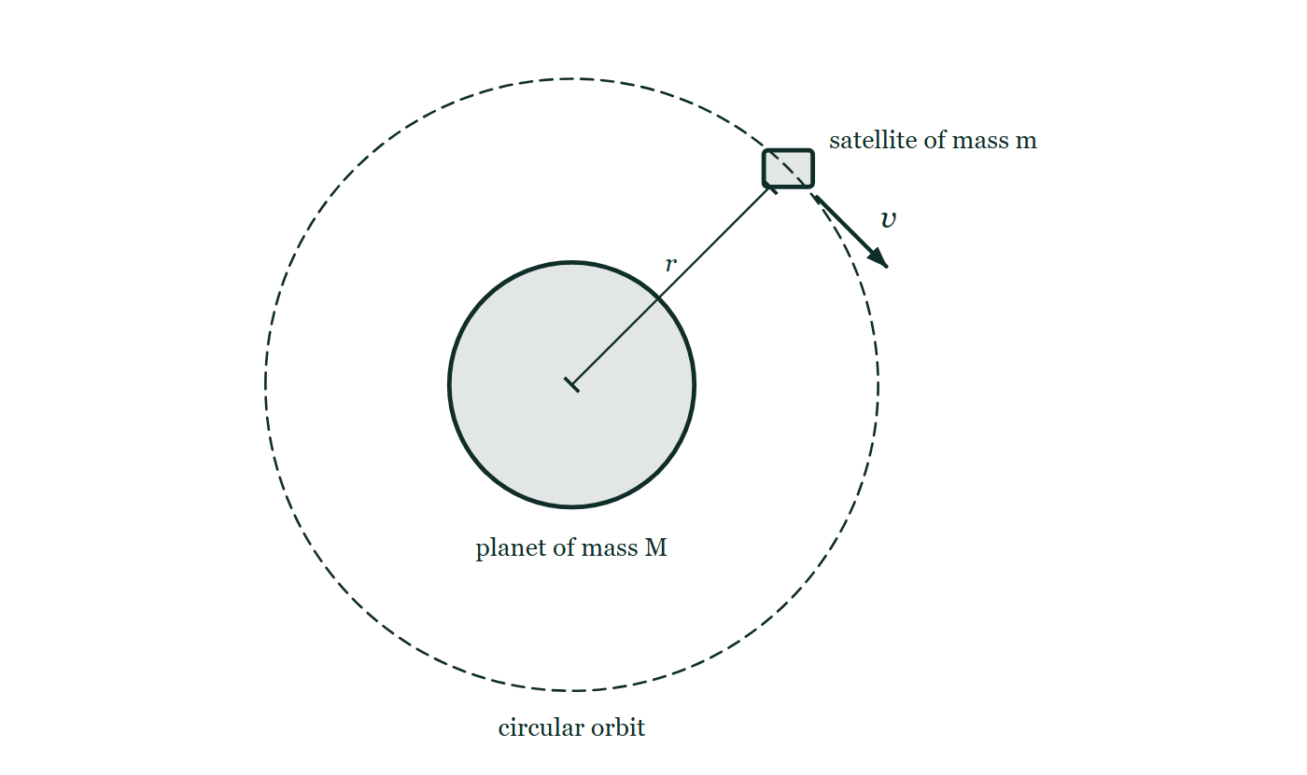
FORCES · NEWTON’S LAW OF UNIVERSAL GRAVITATION
GIOPHYSICS LESSON
FIGURE 2 OF 2
Figure 2 — IB Theme D · Fields
Drawn for question 4 of that paper · syllabus D.1
A planet is drawn as a large shaded circle labelled 'planet of mass M'. A dashed circle, concentric with the planet and well outside it, is labelled 'circular orbit'. A small rectangle sitting on the dashed circle, above and to the right of the planet, is labelled 'satellite of mass m'. A short arrow from the satellite, drawn along the tangent to the orbit and labelled v, shows the direction in which it travels. A line runs from the centre of the planet out to the satellite and is labelled r.
See the question this was drawn for — click here
Forces — Newton’s Law of Universal Gravitation. Built by GioPhysics from the lesson's own copy; nothing on these slides is re-authored.
17 / 36
Notes:
[Phase] Build the model: The formulae, one at a time, in plain English (minutes 13–22 of 45)
[Figure] Figure 2. A planet is drawn as a large shaded circle labelled 'planet of mass M'. A dashed circle, concentric with the planet and well outside it, is labelled 'circular orbit'. A small rectangle sitting on the dashed circle, above and to the right of the planet, is labelled 'satellite of mass m'. A short arrow from the satellite, drawn along the tangent to the orbit and labelled v, shows the direction in which it travels. A line runs from the centre of the planet out to the satellite and is labelled r.
[Where it came from] IB Theme D · Fields, question 4; syllabus D.1.

Slide 18
FORCES · NEWTON’S LAW OF UNIVERSAL GRAVITATION
GIOPHYSICS LESSON
WATCH OUT
The common trap
Check and misconception — The quick check and the trap
Universal gravity is always attractive. The force on each mass points toward the other mass. A larger body does not pull harder on a smaller body than the smaller body pulls on it.
Forces — Newton’s Law of Universal Gravitation. Built by GioPhysics from the lesson's own copy; nothing on these slides is re-authored.
18 / 36
Notes:
[Phase] Check and misconception: The quick check and the trap (minutes 35–41 of 45)
[Misconception] Universal gravity is always attractive. The force on each mass points toward the other mass. A larger body does not pull harder on a smaller body than the smaller body pulls on it.

Slide 19
FORCES · NEWTON’S LAW OF UNIVERSAL GRAVITATION
GIOPHYSICS LESSON
WORKED EXAMPLE 1 OF 4 · OBJECT MASS CANCELS
The question
object mass cancels
Worked examples — I do, we do — one step revealed at a time
Why all masses fall with the same g.
Forces — Newton’s Law of Universal Gravitation. Built by GioPhysics from the lesson's own copy; nothing on these slides is re-authored.
19 / 36
Notes:
[Phase] Worked examples: I do, we do — one step revealed at a time (minutes 22–35 of 45)
[Question] Why all masses fall with the same g.
[Answer] a = GM/r², independent of the falling mass

Slide 20
FORCES · NEWTON’S LAW OF UNIVERSAL GRAVITATION
GIOPHYSICS LESSON
WORKED EXAMPLE 1 OF 4 · OBJECT MASS CANCELS · THE WORKING
How to solve it
object mass cancels
Worked examples — I do, we do — one step revealed at a time
Why all masses fall with the same g.
1.
Gravity gives F = GMm/r².
2.
Dividing by the falling mass gives a = F/m = GM/r².
3.
Without air resistance, the object’s own mass no longer appears.
Forces — Newton’s Law of Universal Gravitation. Built by GioPhysics from the lesson's own copy; nothing on these slides is re-authored.
20 / 36
Notes:
[Phase] Worked examples: I do, we do — one step revealed at a time (minutes 22–35 of 45)
[Reveal] One click per step. The class works each line before the next appears.
[Step 1] Gravity gives F = GMm/r².
[Step 2] Dividing by the falling mass gives a = F/m = GM/r².
[Step 3] Without air resistance, the object’s own mass no longer appears.

Slide 21
FORCES · NEWTON’S LAW OF UNIVERSAL GRAVITATION
GIOPHYSICS LESSON
WORKED EXAMPLE 1 OF 4 · OBJECT MASS CANCELS
Answer
object mass cancels
Worked examples — I do, we do — one step revealed at a time
a = GM/r², independent of the falling mass
Forces — Newton’s Law of Universal Gravitation. Built by GioPhysics from the lesson's own copy; nothing on these slides is re-authored.
21 / 36
Notes:
[Phase] Worked examples: I do, we do — one step revealed at a time (minutes 22–35 of 45)
[Answer] a = GM/r², independent of the falling mass

Slide 22
FORCES · NEWTON’S LAW OF UNIVERSAL GRAVITATION
GIOPHYSICS LESSON
WORKED EXAMPLE 2 OF 4 · INVERSE-SQUARE SCALE
The question
inverse-square scale
Worked examples — I do, we do — one step revealed at a time
The Moon is about 60 Earth radii away.
Forces — Newton’s Law of Universal Gravitation. Built by GioPhysics from the lesson's own copy; nothing on these slides is re-authored.
22 / 36
Notes:
[Phase] Worked examples: I do, we do — one step revealed at a time (minutes 22–35 of 45)
[Question] The Moon is about 60 Earth radii away.
[Answer] 1/3600 of the near-surface field

Slide 23
FORCES · NEWTON’S LAW OF UNIVERSAL GRAVITATION
GIOPHYSICS LESSON
WORKED EXAMPLE 2 OF 4 · INVERSE-SQUARE SCALE · THE WORKING
How to solve it
inverse-square scale
Worked examples — I do, we do — one step revealed at a time
The Moon is about 60 Earth radii away.
1.
At 60 times the distance, Earth’s field is 1/60² = 1/3600 of its near-surface value.
2.
Gravity is weaker there, not absent.
Forces — Newton’s Law of Universal Gravitation. Built by GioPhysics from the lesson's own copy; nothing on these slides is re-authored.
23 / 36
Notes:
[Phase] Worked examples: I do, we do — one step revealed at a time (minutes 22–35 of 45)
[Reveal] One click per step. The class works each line before the next appears.
[Step 1] At 60 times the distance, Earth’s field is 1/60² = 1/3600 of its near-surface value.
[Step 2] Gravity is weaker there, not absent.

Slide 24
FORCES · NEWTON’S LAW OF UNIVERSAL GRAVITATION
GIOPHYSICS LESSON
WORKED EXAMPLE 2 OF 4 · INVERSE-SQUARE SCALE
Answer
inverse-square scale
Worked examples — I do, we do — one step revealed at a time
1/3600 of the near-surface field
Forces — Newton’s Law of Universal Gravitation. Built by GioPhysics from the lesson's own copy; nothing on these slides is re-authored.
24 / 36
Notes:
[Phase] Worked examples: I do, we do — one step revealed at a time (minutes 22–35 of 45)
[Answer] 1/3600 of the near-surface field

Slide 25
FORCES · NEWTON’S LAW OF UNIVERSAL GRAVITATION
GIOPHYSICS LESSON
WORKED EXAMPLE 3 OF 4 · SUPPORT FORCE IS ZERO
The question
support force is zero
Worked examples — I do, we do — one step revealed at a time
What “weightless” means in orbit.
Forces — Newton’s Law of Universal Gravitation. Built by GioPhysics from the lesson's own copy; nothing on these slides is re-authored.
25 / 36
Notes:
[Phase] Worked examples: I do, we do — one step revealed at a time (minutes 22–35 of 45)
[Question] What “weightless” means in orbit.
[Answer] FN = 0 — gravity still acts

Slide 26
FORCES · NEWTON’S LAW OF UNIVERSAL GRAVITATION
GIOPHYSICS LESSON
WORKED EXAMPLE 3 OF 4 · SUPPORT FORCE IS ZERO · THE WORKING
How to solve it
support force is zero
Worked examples — I do, we do — one step revealed at a time
What “weightless” means in orbit.
1.
An orbiting astronaut and spacecraft fall together.
2.
Gravity still provides their acceleration, but no surface supports the astronaut, so the felt normal force is FN = 0.
Forces — Newton’s Law of Universal Gravitation. Built by GioPhysics from the lesson's own copy; nothing on these slides is re-authored.
26 / 36
Notes:
[Phase] Worked examples: I do, we do — one step revealed at a time (minutes 22–35 of 45)
[Reveal] One click per step. The class works each line before the next appears.
[Step 1] An orbiting astronaut and spacecraft fall together.
[Step 2] Gravity still provides their acceleration, but no surface supports the astronaut, so the felt normal force is FN = 0.

Slide 27
FORCES · NEWTON’S LAW OF UNIVERSAL GRAVITATION
GIOPHYSICS LESSON
WORKED EXAMPLE 3 OF 4 · SUPPORT FORCE IS ZERO
Answer
support force is zero
Worked examples — I do, we do — one step revealed at a time
FN = 0 — gravity still acts
Forces — Newton’s Law of Universal Gravitation. Built by GioPhysics from the lesson's own copy; nothing on these slides is re-authored.
27 / 36
Notes:
[Phase] Worked examples: I do, we do — one step revealed at a time (minutes 22–35 of 45)
[Answer] FN = 0 — gravity still acts

Slide 28
FORCES · NEWTON’S LAW OF UNIVERSAL GRAVITATION
GIOPHYSICS LESSON
WORKED EXAMPLE 4 OF 4 · VECTOR ADDITION
The question
vector addition
Worked examples — I do, we do — one step revealed at a time
More than one source mass.
Forces — Newton’s Law of Universal Gravitation. Built by GioPhysics from the lesson's own copy; nothing on these slides is re-authored.
28 / 36
Notes:
[Phase] Worked examples: I do, we do — one step revealed at a time (minutes 22–35 of 45)
[Question] More than one source mass.
[Answer] Add the force vectors, not the magnitudes

Slide 29
FORCES · NEWTON’S LAW OF UNIVERSAL GRAVITATION
GIOPHYSICS LESSON
WORKED EXAMPLE 4 OF 4 · VECTOR ADDITION · THE WORKING
How to solve it
vector addition
Worked examples — I do, we do — one step revealed at a time
More than one source mass.
1.
Calculate each gravitational force separately, including its direction, then add the force vectors.
2.
Magnitudes alone cannot decide the resultant.
Forces — Newton’s Law of Universal Gravitation. Built by GioPhysics from the lesson's own copy; nothing on these slides is re-authored.
29 / 36
Notes:
[Phase] Worked examples: I do, we do — one step revealed at a time (minutes 22–35 of 45)
[Reveal] One click per step. The class works each line before the next appears.
[Step 1] Calculate each gravitational force separately, including its direction, then add the force vectors.
[Step 2] Magnitudes alone cannot decide the resultant.

Slide 30
FORCES · NEWTON’S LAW OF UNIVERSAL GRAVITATION
GIOPHYSICS LESSON
WORKED EXAMPLE 4 OF 4 · VECTOR ADDITION
Answer
vector addition
Worked examples — I do, we do — one step revealed at a time
Add the force vectors, not the magnitudes
Forces — Newton’s Law of Universal Gravitation. Built by GioPhysics from the lesson's own copy; nothing on these slides is re-authored.
30 / 36
Notes:
[Phase] Worked examples: I do, we do — one step revealed at a time (minutes 22–35 of 45)
[Answer] Add the force vectors, not the magnitudes

Slide 31
FORCES · NEWTON’S LAW OF UNIVERSAL GRAVITATION
GIOPHYSICS LESSON
PREDICT · TAKE THE VOTE
Commit before you are told
Hands up for each option, then click
You let go of an apple and it falls to the Earth. Does the Earth move towards the apple?
A No — the Earth is far too massive for the apple to move it
B Yes, but by an amount far too small to measure
C Yes, and by exactly the distance the apple falls, since the forces are equal
An apple of 0.10 kg hangs above an Earth of 6 × 10²⁴ kg, with two force arrows of identical length between them — one down onto the apple, one up off the Earth's surface — and the acceleration beside each left as a = ?
The live version of this figure — click here
Forces — Newton’s Law of Universal Gravitation. Built by GioPhysics from the lesson's own copy; nothing on these slides is re-authored.
31 / 36
Notes:
[Phase] Build the model: The formulae, one at a time, in plain English (minutes 13–22 of 45)
[Predict] You let go of an apple and it falls to the Earth. Does the Earth move towards the apple?
[Options] A No — the Earth is far too massive for the apple to move it B Yes, but by an amount far too small to measure C Yes, and by exactly the distance the apple falls, since the forces are equal
[Figure] An apple of 0.10 kg hangs above an Earth of 6 × 10²⁴ kg, with two force arrows of identical length between them — one down onto the apple, one up off the Earth's surface — and the acceleration beside each left as a = ?

Slide 32
FORCES · NEWTON’S LAW OF UNIVERSAL GRAVITATION
GIOPHYSICS LESSON
PREDICT · THE OUTCOME
What actually happens
Ask the room who changed their mind, and why
B Yes, but by an amount far too small to measure
WHY
The apple pulls the Earth with precisely the force the Earth pulls the apple — the same interaction, seen from the two ends. What differs is a = F/m. Divide that force by the apple's 0.1 kg and you get 9.8 m/s²; divide it by the Earth's 6 × 10²⁴ kg and you get something around 10⁻²⁵ m/s². The Earth does move. It moves less than the width of a nucleus, which is why nobody has ever had to allow for it.
Forces — Newton’s Law of Universal Gravitation. Built by GioPhysics from the lesson's own copy; nothing on these slides is re-authored.
32 / 36
Notes:
[Phase] Build the model: The formulae, one at a time, in plain English (minutes 13–22 of 45)
[Answer] B — Yes, but by an amount far too small to measure. The apple pulls the Earth with precisely the force the Earth pulls the apple — the same interaction, seen from the two ends. What differs is a = F/m. Divide that force by the apple's 0.1 kg and you get 9.8 m/s²; divide it by the Earth's 6 × 10²⁴ kg and you get something around 10⁻²⁵ m/s². The Earth does move. It moves less than the width of a nucleus, which is why nobody has ever had to allow for it.

Slide 33
FORCES · NEWTON’S LAW OF UNIVERSAL GRAVITATION
GIOPHYSICS LESSON
QUICK CHECK
Decide before the answer goes up
Check and misconception — The quick check and the trap
Does Earth feel the same size gravitational force that it exerts on an orbiting object?
A
yes
B
no
Forces — Newton’s Law of Universal Gravitation. Built by GioPhysics from the lesson's own copy; nothing on these slides is re-authored.
33 / 36
Notes:
[Phase] Check and misconception: The quick check and the trap (minutes 35–41 of 45)
[Question] Does Earth feel the same size gravitational force that it exerts on an orbiting object?
[Options] A yes B no

Slide 34
FORCES · NEWTON’S LAW OF UNIVERSAL GRAVITATION
GIOPHYSICS LESSON
QUICK CHECK · THE ANSWER
The answer, and why
Check and misconception — The quick check and the trap
A yes
HOW TO GET THERE
The forces are equal and opposite. Earth’s acceleration is much smaller because its mass is enormous. Newton’s third law applies to gravitation too: equal force, different a = F/m.
WHY THE OTHERS TEMPT
A Correct. It is one interaction and it has two ends, so the magnitudes match exactly. The Earth's response is invisible only because a = F/m divides that same force by a mass 10²⁵ times larger.
B The idea that a bigger body pulls harder is the natural one, and everything you have seen agrees with it — the small object is always the one that visibly moves. That is the acceleration talking, not the force. F = Gm₁m₂/r² has both masses multiplied together in it, so the expression cannot come out differently depending on which body you ask about.
Forces — Newton’s Law of Universal Gravitation. Built by GioPhysics from the lesson's own copy; nothing on these slides is re-authored.
34 / 36
Notes:
[Phase] Check and misconception: The quick check and the trap (minutes 35–41 of 45)
[Question] Does Earth feel the same size gravitational force that it exerts on an orbiting object?
[Option by option] A: Correct. It is one interaction and it has two ends, so the magnitudes match exactly. The Earth's response is invisible only because a = F/m divides that same force by a mass 10²⁵ times larger. B: The idea that a bigger body pulls harder is the natural one, and everything you have seen agrees with it — the small object is always the one that visibly moves. That is the acceleration talking, not the force. F = Gm₁m₂/r² has both masses multiplied together in it, so the expression cannot come out differently depending on which body you ask about.
[Answer] A — yes
[Why] The forces are equal and opposite. Earth’s acceleration is much smaller because its mass is enormous. Newton’s third law applies to gravitation too: equal force, different a = F/m.
[Reveal] One click for the answer, then one for the reason.

Slide 35
FORCES · NEWTON’S LAW OF UNIVERSAL GRAVITATION
GIOPHYSICS LESSON
EXTENSION
No harder example in this lesson
Worked examples — I do, we do — one step revealed at a time
This lesson sets no Hard or Challenging example. The extension for a class that has finished early is the next lesson, or the practice paper questions the figures came from.
Forces — Newton’s Law of Universal Gravitation. Built by GioPhysics from the lesson's own copy; nothing on these slides is re-authored.
35 / 36
Notes:
[Phase] Worked examples: I do, we do — one step revealed at a time (minutes 22–35 of 45)
[Extension] The lesson record carries no Hard or Challenging example.

Slide 36
FORCES · NEWTON’S LAW OF UNIVERSAL GRAVITATION
GIOPHYSICS LESSON
FORCES
Where to go next
Plenary — What to take away, what to practise next
Next
2.8 Moments of Force
https://giophysics.com/chapter-3/moments-of-force/
Lesson
This lesson on giophysics.com
https://giophysics.com/chapter-3/universal-gravitation/
Live
The live, interactive version of these slides
https://giophysics.com/chapter-3/presentation/?lesson=gravitation
Chapter
All Forces lessons
https://giophysics.com/chapter-3/
PDF
Download the lesson PDF
https://giophysics.com/downloads/3-7-newtons-law-of-universal-gravitation.pdf
Forces — Newton’s Law of Universal Gravitation. Built by GioPhysics from the lesson's own copy; nothing on these slides is re-authored.
36 / 36
Notes:
[Phase] Plenary: What to take away, what to practise next (minutes 41–45 of 45)
[Interactive] The graphs and the circuit topology on these slides are frozen. The live version at https://giophysics.com/chapter-3/presentation/?lesson=gravitation moves them.

