Slide 1
FORCES · NEWTON’S LAWS OF MOTION
GIOPHYSICS LESSON
02 · Forces
Keep motion, resultants, and interactions connected.
Newton’s Laws of Motion
Three laws connect the forces on an object to what its velocity does next.
POSITION
Lesson 2 of 11 in Forces
PLAN
16 slides in the 45-minute core run, about 45 minutes of it
LESSON PAGE
https://giophysics.com/chapter-3/newtons-laws-of-motion/
Built by GioPhysics from the lesson's own page. Every word on these slides is the lesson's; nothing here is re-authored. Teaching material, not an awarding body's document.
Forces — Newton’s Laws of Motion. Built by GioPhysics from the lesson's own copy; nothing on these slides is re-authored.
1 / 35
Notes:
[Lesson] Forces — Newton’s Laws of Motion. Lesson 2 of 11.
[Intro] Three laws connect the forces on an object to what its velocity does next.
[Source] https://giophysics.com/chapter-3/newtons-laws-of-motion/
[Disclaimer] Built by GioPhysics from the lesson's own page. Every word on these slides is the lesson's; nothing here is re-authored. Teaching material, not an awarding body's document.

Slide 2
FORCES · NEWTON’S LAWS OF MOTION
GIOPHYSICS LESSON
WHAT THIS NEEDS
What you already know
Starter — Recall what this lesson stands on
Recall
2.1 Force definitions
https://giophysics.com/chapter-3/applied-definitions/
Recall
1.2 Vectors
https://giophysics.com/chapter-1/scalar-vector/
Recall
1.4 Acceleration
https://giophysics.com/chapter-1/kinematics-1d-part-2/
Forces — Newton’s Laws of Motion. Built by GioPhysics from the lesson's own copy; nothing on these slides is re-authored.
2 / 35
Notes:
[Phase] Starter: Recall what this lesson stands on (minutes 0–5 of 45)
[Starter] Recall: 2.1 Force definitions; 1.2 Vectors; 1.4 Acceleration

Slide 3
FORCES · NEWTON’S LAWS OF MOTION
GIOPHYSICS LESSON
THINK FIRST
A fly hits the windscreen of a lorry doing 60 mph. Which of the two felt the bigger force?
Take answers before you click — the point is the commitment
One of them is destroyed and the other does not notice. Everything about the outcome says the lorry won.
THE ANSWER
Neither — the two forces are exactly equal and exactly opposite, because they are the same interaction seen from two ends. What differs is a = F/m: the same force divided by a fly's mass is an enormous acceleration, and divided by 40 tonnes it is nothing. The lorry did not hit harder; it merely had more mass to spread the same force over.
Forces — Newton’s Laws of Motion. Built by GioPhysics from the lesson's own copy; nothing on these slides is re-authored.
3 / 35
Notes:
[Phase] Starter: Recall what this lesson stands on (minutes 0–5 of 45)
[Hook] A fly hits the windscreen of a lorry doing 60 mph. Which of the two felt the bigger force? One of them is destroyed and the other does not notice. Everything about the outcome says the lorry won.
[Answer] Neither — the two forces are exactly equal and exactly opposite, because they are the same interaction seen from two ends. What differs is a = F/m: the same force divided by a fly's mass is an enormous acceleration, and divided by 40 tonnes it is nothing. The lorry did not hit harder; it merely had more mass to spread the same force over.

Slide 4
FORCES · NEWTON’S LAWS OF MOTION
GIOPHYSICS LESSON
EXPLAINED SIMPLY
In one sentence
Introduce the idea — The big idea and the definition
Newton’s laws connect forces to changes in motion and describe the equal-and-opposite forces in an interaction.
Forces — Newton’s Laws of Motion. Built by GioPhysics from the lesson's own copy; nothing on these slides is re-authored.
4 / 35
Notes:
[Phase] Introduce the idea: The big idea and the definition (minutes 5–13 of 45)
[Definition] Newton’s laws connect forces to changes in motion and describe the equal-and-opposite forces in an interaction.

Slide 5
FORCES · NEWTON’S LAWS OF MOTION
GIOPHYSICS LESSON
EXPLAINED SIMPLY
What that looks like
Introduce the idea — The big idea and the definition
FOR EXAMPLE
A harder push gives the same shopping cart a larger acceleration, while the cart pushes back on the hand.
Forces — Newton’s Laws of Motion. Built by GioPhysics from the lesson's own copy; nothing on these slides is re-authored.
5 / 35
Notes:
[Phase] Introduce the idea: The big idea and the definition (minutes 5–13 of 45)
[Worked illustration] A harder push gives the same shopping cart a larger acceleration, while the cart pushes back on the hand.

Slide 6
FORCES · NEWTON’S LAWS OF MOTION
GIOPHYSICS LESSON
THE BIG IDEA
Keep motion, resultants, and interactions connected.
Introduce the idea — The big idea and the definition
An object remains at rest, or continues at constant velocity in a straight line, unless an unbalanced external force acts on it. Acceleration is directly proportional to the resultant force, inversely proportional to mass for a fixed resultant, and points in the same direction as that force.
When object A exerts a force on object B, object B simultaneously exerts an equal-magnitude force in the opposite direction on object A. The first law describes unchanged motion, the second predicts the change, and the third connects the two interacting objects.
Forces — Newton’s Laws of Motion. Built by GioPhysics from the lesson's own copy; nothing on these slides is re-authored.
6 / 35
Notes:
[Phase] Introduce the idea: The big idea and the definition (minutes 5–13 of 45)
[Big idea] An object remains at rest, or continues at constant velocity in a straight line, unless an unbalanced external force acts on it. Acceleration is directly proportional to the resultant force, inversely proportional to mass for a fixed resultant, and points in the same direction as that force. When object A exerts a force on object B, object B simultaneously exerts an equal-magnitude force in the opposite direction on object A. The first law describes unchanged motion, the second predicts the change, and the third connects the two interacting objects.

Slide 7
FORCES · NEWTON’S LAWS OF MOTION
GIOPHYSICS LESSON
THE PHYSICS · 1 OF 4
Choose a law. Follow the interaction.
Build the model — The formulae, one at a time, in plain English
The first law describes unchanged motion, the second predicts the change, and the third connects the two interacting objects.
Forces — Newton’s Laws of Motion. Built by GioPhysics from the lesson's own copy; nothing on these slides is re-authored.
7 / 35
Notes:
[Phase] Build the model: The formulae, one at a time, in plain English (minutes 13–22 of 45)
[Section] The first law describes unchanged motion, the second predicts the change, and the third connects the two interacting objects.

Slide 8
FORCES · NEWTON’S LAWS OF MOTION
GIOPHYSICS LESSON
THE PHYSICS · 2 OF 4
Change the force. Change the motion.
Build the model — The formulae, one at a time, in plain English
Add every horizontal force with its sign, then divide the resultant by mass. At a fixed mass, net force and acceleration rise in direct proportion: the values start together at zero and grow in the same ratio. Double Fnet and acceleration doubles; double the mass and acceleration halves; the direction of the acceleration is the direction of Fnet.
Forces — Newton’s Laws of Motion. Built by GioPhysics from the lesson's own copy; nothing on these slides is re-authored.
8 / 35
Notes:
[Phase] Build the model: The formulae, one at a time, in plain English (minutes 13–22 of 45)
[Section] Add every horizontal force with its sign, then divide the resultant by mass. At a fixed mass, net force and acceleration rise in direct proportion: the values start together at zero and grow in the same ratio. Double Fnet and acceleration doubles; double the mass and acceleration halves; the direction of the acceleration is the direction of Fnet.

Slide 9
FORCES · NEWTON’S LAWS OF MOTION
GIOPHYSICS LESSON
THE PHYSICS · 3 OF 4
Draw first. Calculate second.
Build the model — The formulae, one at a time, in plain English
Complex systems become manageable when every step answers one clear question. Select one object, or a whole connected system. Draw a free-body diagram of external forces only.
Choose axes: pick a positive direction and resolve angled vectors. Add: calculate the signed resultant in each direction. Apply Fnet = ma, then check the unit and direction.
Forces — Newton’s Laws of Motion. Built by GioPhysics from the lesson's own copy; nothing on these slides is re-authored.
9 / 35
Notes:
[Phase] Build the model: The formulae, one at a time, in plain English (minutes 13–22 of 45)
[Section] Complex systems become manageable when every step answers one clear question. Select one object, or a whole connected system. Draw a free-body diagram of external forces only. Choose axes: pick a positive direction and resolve angled vectors. Add: calculate the signed resultant in each direction. Apply Fnet = ma, then check the unit and direction.

Slide 10
FORCES · NEWTON’S LAWS OF MOTION
GIOPHYSICS LESSON
THE PHYSICS · 4 OF 4
Every force belongs to an interaction.
Build the model — The formulae, one at a time, in plain English
The two forces are equal, opposite, simultaneous, and placed on different objects: equal magnitude, opposite direction, same interaction, different objects. Your foot pushes the ground backward and the ground pushes you forward; hands push water backward and the water pushes the swimmer forward; a rocket pushes exhaust backward and the exhaust pushes the rocket forward, even in space.
Forces — Newton’s Laws of Motion. Built by GioPhysics from the lesson's own copy; nothing on these slides is re-authored.
10 / 35
Notes:
[Phase] Build the model: The formulae, one at a time, in plain English (minutes 13–22 of 45)
[Section] The two forces are equal, opposite, simultaneous, and placed on different objects: equal magnitude, opposite direction, same interaction, different objects. Your foot pushes the ground backward and the ground pushes you forward; hands push water backward and the water pushes the swimmer forward; a rocket pushes exhaust backward and the exhaust pushes the rocket forward, even in space.

Slide 11
FORCES · NEWTON’S LAWS OF MOTION
GIOPHYSICS LESSON
FORMULA 1 OF 3
Inertia
Build the model — The formulae, one at a time, in plain English
Fnet = 0 → a = 0 → velocity is constant
Newton’s first law
IN PLAIN ENGLISH
Zero resultant does not always mean zero velocity. It means no change in velocity.
Forces — Newton’s Laws of Motion. Built by GioPhysics from the lesson's own copy; nothing on these slides is re-authored.
11 / 35
Notes:
[Phase] Build the model: The formulae, one at a time, in plain English (minutes 13–22 of 45)
[Formula] Inertia: Fnet = 0 → a = 0 → velocity is constant
[In plain English] Zero resultant does not always mean zero velocity. It means no change in velocity.
[Note] Newton’s first law

Slide 12
FORCES · NEWTON’S LAWS OF MOTION
GIOPHYSICS LESSON
FORMULA 2 OF 3
Acceleration
Build the model — The formulae, one at a time, in plain English
Fnet = ma
Newton’s second law
IN PLAIN ENGLISH
Double the net force and acceleration doubles. Double the mass and acceleration halves.
Forces — Newton’s Laws of Motion. Built by GioPhysics from the lesson's own copy; nothing on these slides is re-authored.
12 / 35
Notes:
[Phase] Build the model: The formulae, one at a time, in plain English (minutes 13–22 of 45)
[Formula] Acceleration: Fnet = ma
[In plain English] Double the net force and acceleration doubles. Double the mass and acceleration halves.
[Note] Newton’s second law

Slide 13
FORCES · NEWTON’S LAWS OF MOTION
GIOPHYSICS LESSON
FORMULA 3 OF 3
Interaction pairs
Build the model — The formulae, one at a time, in plain English
FA on B = −FB on A
Newton’s third law
IN PLAIN ENGLISH
The pair acts on different objects, so the two forces do not cancel on one free-body diagram.
Forces — Newton’s Laws of Motion. Built by GioPhysics from the lesson's own copy; nothing on these slides is re-authored.
13 / 35
Notes:
[Phase] Build the model: The formulae, one at a time, in plain English (minutes 13–22 of 45)
[Formula] Interaction pairs: FA on B = −FB on A
[In plain English] The pair acts on different objects, so the two forces do not cancel on one free-body diagram.
[Note] Newton’s third law

Slide 14
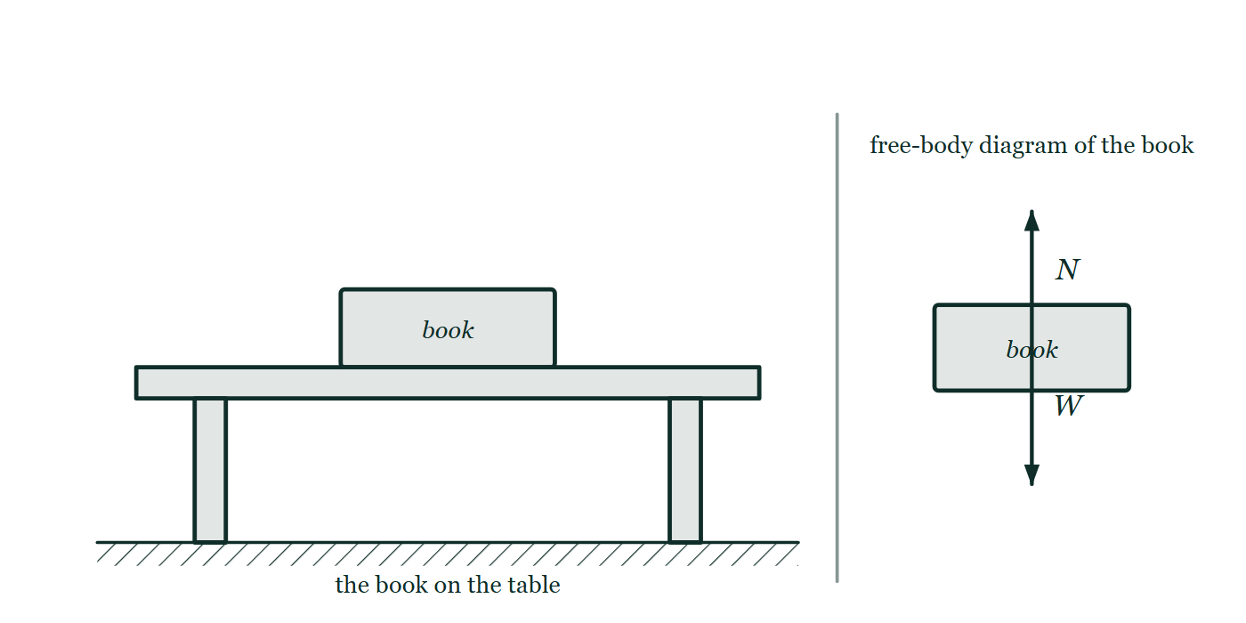
FORCES · NEWTON’S LAWS OF MOTION
GIOPHYSICS LESSON
THE PICTURE
The book, and the book alone
Drawn for this lesson
The scene on the left shows a book resting on a table; on the right the same book stands alone with two arrows leaving its centre, one up labelled N and one down labelled W, and the table gone.
The live version of this figure — click here
Forces — Newton’s Laws of Motion. Built by GioPhysics from the lesson's own copy; nothing on these slides is re-authored.
14 / 35
Notes:
[Phase] Build the model: The formulae, one at a time, in plain English (minutes 13–22 of 45)
[Figure] The scene on the left shows a book resting on a table; on the right the same book stands alone with two arrows leaving its centre, one up labelled N and one down labelled W, and the table gone.

Slide 15
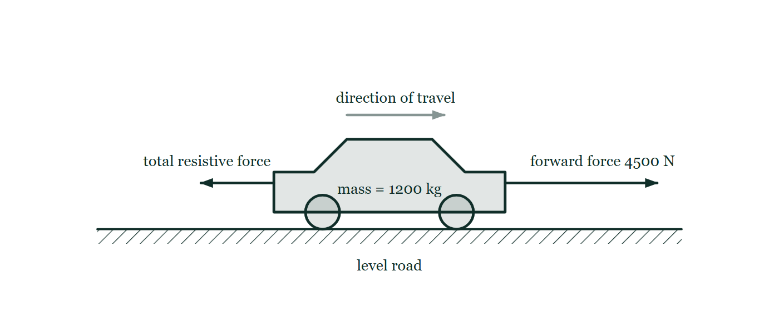
FORCES · NEWTON’S LAWS OF MOTION
GIOPHYSICS LESSON
FIGURE 1 OF 2
Fig. 7.1 — IGCSE Topic 1 · Motion, forces and energy
Drawn for question 7 of that paper · syllabus 1.2, 1.5.1
A car on a straight, level road, labelled mass = 1200 kg, with a faint arrow above it showing the direction of travel to the right. A long horizontal arrow points forwards from the front of the car and is labelled forward force 4500 N. A shorter horizontal arrow points backwards from the rear of the car and is labelled total resistive force, with no value given.
See the question this was drawn for — click here
Forces — Newton’s Laws of Motion. Built by GioPhysics from the lesson's own copy; nothing on these slides is re-authored.
15 / 35
Notes:
[Phase] Build the model: The formulae, one at a time, in plain English (minutes 13–22 of 45)
[Figure] Fig. 7.1. A car on a straight, level road, labelled mass = 1200 kg, with a faint arrow above it showing the direction of travel to the right. A long horizontal arrow points forwards from the front of the car and is labelled forward force 4500 N. A shorter horizontal arrow points backwards from the rear of the car and is labelled total resistive force, with no value given.
[Where it came from] IGCSE Topic 1 · Motion, forces and energy, question 7; syllabus 1.2, 1.5.1.

Slide 16
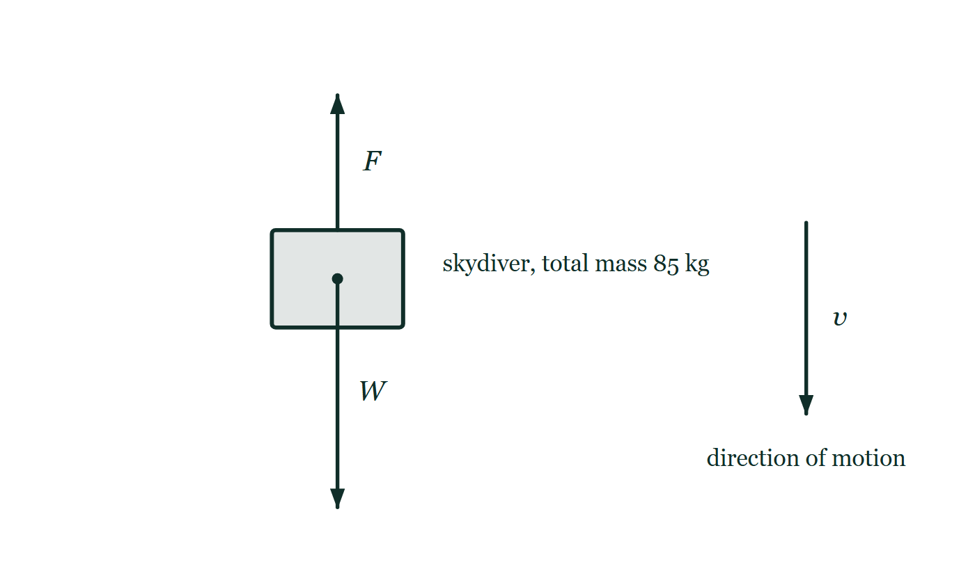
FORCES · NEWTON’S LAWS OF MOTION
GIOPHYSICS LESSON
FIGURE 2 OF 2
Fig. 7.1 — A Level AS · Topics 1–11
Drawn for question 7 of that paper · syllabus 2, 3, 4
The falling skydiver is drawn as a block with a dot at her centre of mass, labelled as having a total mass of 85 kg. A long arrow labelled W starts at that dot and points vertically downwards. A shorter arrow labelled F starts at her upper surface and points vertically upwards. To one side, a separate arrow labelled v points downwards to show her direction of motion.
See the question this was drawn for — click here
Forces — Newton’s Laws of Motion. Built by GioPhysics from the lesson's own copy; nothing on these slides is re-authored.
16 / 35
Notes:
[Phase] Build the model: The formulae, one at a time, in plain English (minutes 13–22 of 45)
[Figure] Fig. 7.1. The falling skydiver is drawn as a block with a dot at her centre of mass, labelled as having a total mass of 85 kg. A long arrow labelled W starts at that dot and points vertically downwards. A shorter arrow labelled F starts at her upper surface and points vertically upwards. To one side, a separate arrow labelled v points downwards to show her direction of motion.
[Where it came from] A Level AS · Topics 1–11, question 7; syllabus 2, 3, 4.

Slide 17
FORCES · NEWTON’S LAWS OF MOTION
GIOPHYSICS LESSON
WORKED EXAMPLE 1 OF 4 · MOTION → FORCE
The question
motion → force
Worked examples — I do, we do — one step revealed at a time
Braking car — a 1500 kg car stops from 20 m/s in 50 m.
Forces — Newton’s Laws of Motion. Built by GioPhysics from the lesson's own copy; nothing on these slides is re-authored.
17 / 35
Notes:
[Phase] Worked examples: I do, we do — one step revealed at a time (minutes 22–35 of 45)
[Question] Braking car — a 1500 kg car stops from 20 m/s in 50 m.
[Answer] Fnet = −6000 N, opposite the motion

Slide 18
FORCES · NEWTON’S LAWS OF MOTION
GIOPHYSICS LESSON
WORKED EXAMPLE 1 OF 4 · MOTION → FORCE · THE WORKING
How to solve it
motion → force
Worked examples — I do, we do — one step revealed at a time
Braking car — a 1500 kg car stops from 20 m/s in 50 m.
1.
First use v² = u² + 2as to find a = −4 m/s².
2.
Then Fnet = ma gives −6000 N, opposite the motion.
Forces — Newton’s Laws of Motion. Built by GioPhysics from the lesson's own copy; nothing on these slides is re-authored.
18 / 35
Notes:
[Phase] Worked examples: I do, we do — one step revealed at a time (minutes 22–35 of 45)
[Reveal] One click per step. The class works each line before the next appears.
[Step 1] First use v² = u² + 2as to find a = −4 m/s².
[Step 2] Then Fnet = ma gives −6000 N, opposite the motion.

Slide 19
FORCES · NEWTON’S LAWS OF MOTION
GIOPHYSICS LESSON
WORKED EXAMPLE 1 OF 4 · MOTION → FORCE
Answer
motion → force
Worked examples — I do, we do — one step revealed at a time
Fnet = −6000 N, opposite the motion
Forces — Newton’s Laws of Motion. Built by GioPhysics from the lesson's own copy; nothing on these slides is re-authored.
19 / 35
Notes:
[Phase] Worked examples: I do, we do — one step revealed at a time (minutes 22–35 of 45)
[Answer] Fnet = −6000 N, opposite the motion

Slide 20
FORCES · NEWTON’S LAWS OF MOTION
GIOPHYSICS LESSON
WORKED EXAMPLE 2 OF 4 · CHOOSE A SYSTEM
The question
choose a system
Worked examples — I do, we do — one step revealed at a time
Two linked boxes — smooth-table masses of 12 kg and 10 kg are pulled by 40 N.
Forces — Newton’s Laws of Motion. Built by GioPhysics from the lesson's own copy; nothing on these slides is re-authored.
20 / 35
Notes:
[Phase] Worked examples: I do, we do — one step revealed at a time (minutes 22–35 of 45)
[Question] Two linked boxes — smooth-table masses of 12 kg and 10 kg are pulled by 40 N.
[Answer] a = 1.82 m/s²; T = 21.8 N

Slide 21
FORCES · NEWTON’S LAWS OF MOTION
GIOPHYSICS LESSON
WORKED EXAMPLE 2 OF 4 · CHOOSE A SYSTEM · THE WORKING
How to solve it
choose a system
Worked examples — I do, we do — one step revealed at a time
Two linked boxes — smooth-table masses of 12 kg and 10 kg are pulled by 40 N.
1.
Treat both boxes as a 22 kg system, with the 40 N pull applied to the 10 kg box: a = 40/22 = 1.82 m/s².
2.
For the 12 kg box alone, the cord tension is T = 12a = 21.8 N.
Forces — Newton’s Laws of Motion. Built by GioPhysics from the lesson's own copy; nothing on these slides is re-authored.
21 / 35
Notes:
[Phase] Worked examples: I do, we do — one step revealed at a time (minutes 22–35 of 45)
[Reveal] One click per step. The class works each line before the next appears.
[Step 1] Treat both boxes as a 22 kg system, with the 40 N pull applied to the 10 kg box: a = 40/22 = 1.82 m/s².
[Step 2] For the 12 kg box alone, the cord tension is T = 12a = 21.8 N.

Slide 22
FORCES · NEWTON’S LAWS OF MOTION
GIOPHYSICS LESSON
WORKED EXAMPLE 2 OF 4 · CHOOSE A SYSTEM
Answer
choose a system
Worked examples — I do, we do — one step revealed at a time
a = 1.82 m/s²; T = 21.8 N
Forces — Newton’s Laws of Motion. Built by GioPhysics from the lesson's own copy; nothing on these slides is re-authored.
22 / 35
Notes:
[Phase] Worked examples: I do, we do — one step revealed at a time (minutes 22–35 of 45)
[Answer] a = 1.82 m/s²; T = 21.8 N

Slide 23
FORCES · NEWTON’S LAWS OF MOTION
GIOPHYSICS LESSON
WORKED EXAMPLE 3 OF 4 · APPARENT WEIGHT
The question
apparent weight
Worked examples — I do, we do — one step revealed at a time
Accelerating lift — a 65 kg person accelerates downward at 0.2g.
Forces — Newton’s Laws of Motion. Built by GioPhysics from the lesson's own copy; nothing on these slides is re-authored.
23 / 35
Notes:
[Phase] Worked examples: I do, we do — one step revealed at a time (minutes 22–35 of 45)
[Question] Accelerating lift — a 65 kg person accelerates downward at 0.2g.
[Answer] N = 510 N — the scale displays about 52 kg

Slide 24
FORCES · NEWTON’S LAWS OF MOTION
GIOPHYSICS LESSON
WORKED EXAMPLE 3 OF 4 · APPARENT WEIGHT · THE WORKING
How to solve it
apparent weight
Worked examples — I do, we do — one step revealed at a time
Accelerating lift — a 65 kg person accelerates downward at 0.2g.
1.
The scale’s normal force is N = 0.8mg = 510 N, so it displays about 52 kg.
2.
At constant velocity, acceleration is zero and it displays 65 kg.
Forces — Newton’s Laws of Motion. Built by GioPhysics from the lesson's own copy; nothing on these slides is re-authored.
24 / 35
Notes:
[Phase] Worked examples: I do, we do — one step revealed at a time (minutes 22–35 of 45)
[Reveal] One click per step. The class works each line before the next appears.
[Step 1] The scale’s normal force is N = 0.8mg = 510 N, so it displays about 52 kg.
[Step 2] At constant velocity, acceleration is zero and it displays 65 kg.

Slide 25
FORCES · NEWTON’S LAWS OF MOTION
GIOPHYSICS LESSON
WORKED EXAMPLE 3 OF 4 · APPARENT WEIGHT
Answer
apparent weight
Worked examples — I do, we do — one step revealed at a time
N = 510 N — the scale displays about 52 kg
Forces — Newton’s Laws of Motion. Built by GioPhysics from the lesson's own copy; nothing on these slides is re-authored.
25 / 35
Notes:
[Phase] Worked examples: I do, we do — one step revealed at a time (minutes 22–35 of 45)
[Answer] N = 510 N — the scale displays about 52 kg

Slide 26
FORCES · NEWTON’S LAWS OF MOTION
GIOPHYSICS LESSON
WORKED EXAMPLE 4 OF 4 · CHOOSE HELPFUL AXES
The question
choose helpful axes
Worked examples — I do, we do — one step revealed at a time
Box on an incline.
Forces — Newton’s Laws of Motion. Built by GioPhysics from the lesson's own copy; nothing on these slides is re-authored.
26 / 35
Notes:
[Phase] Worked examples: I do, we do — one step revealed at a time (minutes 22–35 of 45)
[Question] Box on an incline.
[Answer] a = g sin θ on a smooth slope

Slide 27
FORCES · NEWTON’S LAWS OF MOTION
GIOPHYSICS LESSON
WORKED EXAMPLE 4 OF 4 · CHOOSE HELPFUL AXES · THE WORKING
How to solve it
choose helpful axes
Worked examples — I do, we do — one step revealed at a time
Box on an incline.
1.
Put the x-axis along the slope and the y-axis perpendicular to it.
2.
Weight contributes mg sin θ down the slope and mg cos θ into it.
3.
On a smooth slope, a = g sin θ.
4.
If the box slides or tends to slide down a rough slope, friction acts up the slope and reduces that acceleration.
Forces — Newton’s Laws of Motion. Built by GioPhysics from the lesson's own copy; nothing on these slides is re-authored.
27 / 35
Notes:
[Phase] Worked examples: I do, we do — one step revealed at a time (minutes 22–35 of 45)
[Reveal] One click per step. The class works each line before the next appears.
[Step 1] Put the x-axis along the slope and the y-axis perpendicular to it.
[Step 2] Weight contributes mg sin θ down the slope and mg cos θ into it.
[Step 3] On a smooth slope, a = g sin θ.
[Step 4] If the box slides or tends to slide down a rough slope, friction acts up the slope and reduces that acceleration.

Slide 28
FORCES · NEWTON’S LAWS OF MOTION
GIOPHYSICS LESSON
WORKED EXAMPLE 4 OF 4 · CHOOSE HELPFUL AXES
Answer
choose helpful axes
Worked examples — I do, we do — one step revealed at a time
a = g sin θ on a smooth slope
Forces — Newton’s Laws of Motion. Built by GioPhysics from the lesson's own copy; nothing on these slides is re-authored.
28 / 35
Notes:
[Phase] Worked examples: I do, we do — one step revealed at a time (minutes 22–35 of 45)
[Answer] a = g sin θ on a smooth slope

Slide 29
FORCES · NEWTON’S LAWS OF MOTION
GIOPHYSICS LESSON
SPOT THE MISTAKE
One line here is wrong
The whole working is up — find the bad line before you click
1.
A 1500 kg car stops from 20 m/s in 50 m. Find the net force on it.
2.
Taking the direction of travel as positive: u = 20 m/s, v = 0, s = 50 m
3.
v² = u² + 2as, so a = (v² − u²) / 2s
4.
a = (20² − 0) / (2 × 50) = +4.0 m/s²
5.
Fnet = ma = 1500 × 4.0 = +6000 N, in the direction of travel
LINE 4 IS WRONG
The rearrangement on the line above is right and the substitution under it is back to front: v is the final velocity, which is zero, and u is the 20 m/s. Writing 20² on top is the reflex of putting the number you were given where the number should go. The physics catches it a line later — a positive acceleration on a car that is stopping, and a driving force pointing the way it is already travelling.
IT SHOULD SAY
a = (0 − 20²) / (2 × 50) = −4.0 m/s², so Fnet = −6000 N, opposite the motion
Forces — Newton’s Laws of Motion. Built by GioPhysics from the lesson's own copy; nothing on these slides is re-authored.
29 / 35
Notes:
[Phase] Worked examples: I do, we do — one step revealed at a time (minutes 22–35 of 45)
[Spot the mistake] The working is complete and one line of it is wrong. Let the room hunt: one click names the line, a second shows it done correctly.
[Line 4 is wrong] The rearrangement on the line above is right and the substitution under it is back to front: v is the final velocity, which is zero, and u is the 20 m/s. Writing 20² on top is the reflex of putting the number you were given where the number should go. The physics catches it a line later — a positive acceleration on a car that is stopping, and a driving force pointing the way it is already travelling.
[It should say] a = (0 − 20²) / (2 × 50) = −4.0 m/s², so Fnet = −6000 N, opposite the motion

Slide 30
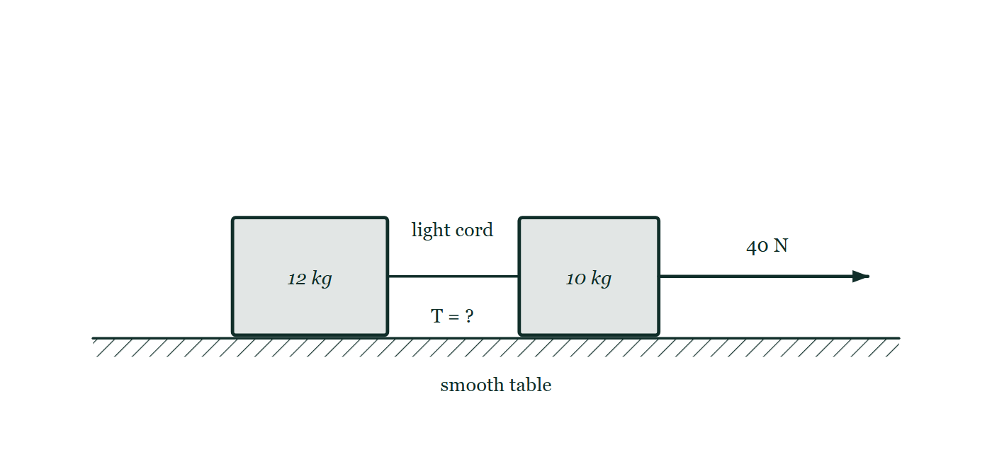
FORCES · NEWTON’S LAWS OF MOTION
GIOPHYSICS LESSON
PREDICT · TAKE THE VOTE
Commit before you are told
Hands up for each option, then click
The 40 N pull acts on the 10 kg box, which drags the 12 kg box behind it through the cord. What does the cord's tension come to?
A 40 N — the pull is handed straight along the cord
B 21.8 N
C 18.2 N
A 12 kg box and a 10 kg box on a smooth table joined by a light cord, with a 40 N arrow pulling the 10 kg box away from the pair and the cord's tension marked only with a question mark.
The live version of this figure — click here
Forces — Newton’s Laws of Motion. Built by GioPhysics from the lesson's own copy; nothing on these slides is re-authored.
30 / 35
Notes:
[Phase] Build the model: The formulae, one at a time, in plain English (minutes 13–22 of 45)
[Predict] The 40 N pull acts on the 10 kg box, which drags the 12 kg box behind it through the cord. What does the cord's tension come to?
[Options] A 40 N — the pull is handed straight along the cord B 21.8 N C 18.2 N
[Figure] A 12 kg box and a 10 kg box on a smooth table joined by a light cord, with a 40 N arrow pulling the 10 kg box away from the pair and the cord's tension marked only with a question mark.

Slide 31
FORCES · NEWTON’S LAWS OF MOTION
GIOPHYSICS LESSON
PREDICT · THE OUTCOME
What actually happens
Ask the room who changed their mind, and why
B 21.8 N
WHY
The cord's only job is to accelerate the 12 kg box. Take the pair as one 22 kg system first: a = 40/22 = 1.82 m/s². Then look at the 12 kg box on its own — the cord is the only horizontal force on it, so T = 12 × 1.82 = 21.8 N. A cord does not pass a force through unchanged unless there is no mass in front of it.
Forces — Newton’s Laws of Motion. Built by GioPhysics from the lesson's own copy; nothing on these slides is re-authored.
31 / 35
Notes:
[Phase] Build the model: The formulae, one at a time, in plain English (minutes 13–22 of 45)
[Answer] B — 21.8 N. The cord's only job is to accelerate the 12 kg box. Take the pair as one 22 kg system first: a = 40/22 = 1.82 m/s². Then look at the 12 kg box on its own — the cord is the only horizontal force on it, so T = 12 × 1.82 = 21.8 N. A cord does not pass a force through unchanged unless there is no mass in front of it.

Slide 32
FORCES · NEWTON’S LAWS OF MOTION
GIOPHYSICS LESSON
QUICK CHECK
Decide before the answer goes up
Check and misconception — The quick check and the trap
A book rests on a horizontal table with no other vertical forces. Its downward weight and the table’s upward normal force are equal. Are they a third-law pair?
A
yes
B
no
Forces — Newton’s Laws of Motion. Built by GioPhysics from the lesson's own copy; nothing on these slides is re-authored.
32 / 35
Notes:
[Phase] Check and misconception: The quick check and the trap (minutes 35–41 of 45)
[Question] A book rests on a horizontal table with no other vertical forces. Its downward weight and the table’s upward normal force are equal. Are they a third-law pair?
[Options] A yes B no

Slide 33
FORCES · NEWTON’S LAWS OF MOTION
GIOPHYSICS LESSON
QUICK CHECK · THE ANSWER
The answer, and why
Check and misconception — The quick check and the trap
B no
HOW TO GET THERE
Both forces act on the book, so they can balance but are not a third-law pair. The normal force pairs with the book pushing the table; the weight pairs with the book pulling Earth gravitationally.
WHY THE OTHERS TEMPT
A Equal in size, opposite in direction, acting at the same instant — that is three of the four marks of a third-law pair, which is exactly what makes this the popular answer. The fourth is where it fails: look at the free-body diagram and both arrows start on the book. A pair is split between two objects, one force each.
B Correct. Both forces act on the book, so they balance without being partners. The table's push on the book is paired with the book's push on the table; the book's weight is paired with the book's own gravitational pull on the Earth.
Forces — Newton’s Laws of Motion. Built by GioPhysics from the lesson's own copy; nothing on these slides is re-authored.
33 / 35
Notes:
[Phase] Check and misconception: The quick check and the trap (minutes 35–41 of 45)
[Question] A book rests on a horizontal table with no other vertical forces. Its downward weight and the table’s upward normal force are equal. Are they a third-law pair?
[Option by option] A: Equal in size, opposite in direction, acting at the same instant — that is three of the four marks of a third-law pair, which is exactly what makes this the popular answer. The fourth is where it fails: look at the free-body diagram and both arrows start on the book. A pair is split between two objects, one force each. B: Correct. Both forces act on the book, so they balance without being partners. The table's push on the book is paired with the book's push on the table; the book's weight is paired with the book's own gravitational pull on the Earth.
[Answer] B — no
[Why] Both forces act on the book, so they can balance but are not a third-law pair. The normal force pairs with the book pushing the table; the weight pairs with the book pulling Earth gravitationally.
[Reveal] One click for the answer, then one for the reason.

Slide 34
FORCES · NEWTON’S LAWS OF MOTION
GIOPHYSICS LESSON
EXTENSION
No harder example in this lesson
Worked examples — I do, we do — one step revealed at a time
This lesson sets no Hard or Challenging example. The extension for a class that has finished early is the next lesson, or the practice paper questions the figures came from.
Forces — Newton’s Laws of Motion. Built by GioPhysics from the lesson's own copy; nothing on these slides is re-authored.
34 / 35
Notes:
[Phase] Worked examples: I do, we do — one step revealed at a time (minutes 22–35 of 45)
[Extension] The lesson record carries no Hard or Challenging example.

Slide 35
FORCES · NEWTON’S LAWS OF MOTION
GIOPHYSICS LESSON
FORCES
Where to go next
Plenary — What to take away, what to practise next
Next
2.3 Applied, Weight and Normal Forces
https://giophysics.com/chapter-3/applied-weight-normal-forces/
Lesson
This lesson on giophysics.com
https://giophysics.com/chapter-3/newtons-laws-of-motion/
Live
The live, interactive version of these slides
https://giophysics.com/chapter-3/presentation/?lesson=laws
Chapter
All Forces lessons
https://giophysics.com/chapter-3/
PDF
Download the lesson PDF
https://giophysics.com/downloads/3-2-newtons-laws-of-motion.pdf
Forces — Newton’s Laws of Motion. Built by GioPhysics from the lesson's own copy; nothing on these slides is re-authored.
35 / 35
Notes:
[Phase] Plenary: What to take away, what to practise next (minutes 41–45 of 45)
[Interactive] The graphs and the circuit topology on these slides are frozen. The live version at https://giophysics.com/chapter-3/presentation/?lesson=laws moves them.

