Slide 1
FORCES · TENSION FORCES
GIOPHYSICS LESSON
02 · Forces
Follow the cord. Resolve the components. Choose the system.
Tension Forces
A taut cord pulls along its own length. Its components can support a load, redirect a force, or connect objects into one motion system.
POSITION
Lesson 5 of 11 in Forces
PLAN
16 slides in the 45-minute core run, about 45 minutes of it
LESSON PAGE
https://giophysics.com/chapter-3/tension-forces/
Built by GioPhysics from the lesson's own page. Every word on these slides is the lesson's; nothing here is re-authored. Teaching material, not an awarding body's document.
Forces — Tension Forces. Built by GioPhysics from the lesson's own copy; nothing on these slides is re-authored.
1 / 31
Notes:
[Lesson] Forces — Tension Forces. Lesson 5 of 11.
[Intro] A taut cord pulls along its own length. Its components can support a load, redirect a force, or connect objects into one motion system.
[Source] https://giophysics.com/chapter-3/tension-forces/
[Disclaimer] Built by GioPhysics from the lesson's own page. Every word on these slides is the lesson's; nothing here is re-authored. Teaching material, not an awarding body's document.

Slide 2
FORCES · TENSION FORCES
GIOPHYSICS LESSON
WHAT THIS NEEDS
What you already know
Starter — Recall what this lesson stands on
Recall
1.5 Kinematics 2D
https://giophysics.com/chapter-1/kinematics-2d/
Recall
2.3 Applied, Weight & Normal
https://giophysics.com/chapter-3/applied-weight-normal-forces/
Recall
2.2 Newton’s Laws
https://giophysics.com/chapter-3/newtons-laws-of-motion/
Forces — Tension Forces. Built by GioPhysics from the lesson's own copy; nothing on these slides is re-authored.
2 / 31
Notes:
[Phase] Starter: Recall what this lesson stands on (minutes 0–5 of 45)
[Starter] Recall: 1.5 Kinematics 2D; 2.3 Applied, Weight & Normal; 2.2 Newton’s Laws

Slide 3
FORCES · TENSION FORCES
GIOPHYSICS LESSON
THINK FIRST
One person pulls a rope tied to a wall with 200 N. Then two people pull the same rope, one at each end, with 200 N each. What does the rope's tension read now?
Take answers before you click — the point is the commitment
Twice the people, twice the pulling, and the rope is stretched between them rather than tied to anything.
THE ANSWER
200 N, both times. The wall was never a spectator — it was already pulling back with 200 N, which is what made the rope taut. Replacing it with a person changes who is doing the pulling and nothing else. A rope's tension is the force it transmits along itself, not the total of everything attached to it.
Forces — Tension Forces. Built by GioPhysics from the lesson's own copy; nothing on these slides is re-authored.
3 / 31
Notes:
[Phase] Starter: Recall what this lesson stands on (minutes 0–5 of 45)
[Hook] One person pulls a rope tied to a wall with 200 N. Then two people pull the same rope, one at each end, with 200 N each. What does the rope's tension read now? Twice the people, twice the pulling, and the rope is stretched between them rather than tied to anything.
[Answer] 200 N, both times. The wall was never a spectator — it was already pulling back with 200 N, which is what made the rope taut. Replacing it with a person changes who is doing the pulling and nothing else. A rope's tension is the force it transmits along itself, not the total of everything attached to it.

Slide 4
FORCES · TENSION FORCES
GIOPHYSICS LESSON
EXPLAINED SIMPLY
In one sentence
Introduce the idea — The big idea and the definition
Tension is the pulling force transmitted along a taut rope, string, or cable.
Forces — Tension Forces. Built by GioPhysics from the lesson's own copy; nothing on these slides is re-authored.
4 / 31
Notes:
[Phase] Introduce the idea: The big idea and the definition (minutes 5–13 of 45)
[Definition] Tension is the pulling force transmitted along a taut rope, string, or cable.

Slide 5
FORCES · TENSION FORCES
GIOPHYSICS LESSON
EXPLAINED SIMPLY
What that looks like
Introduce the idea — The big idea and the definition
FOR EXAMPLE
A cable holding a hanging lamp pulls upward on the lamp along the direction of the cable.
Forces — Tension Forces. Built by GioPhysics from the lesson's own copy; nothing on these slides is re-authored.
5 / 31
Notes:
[Phase] Introduce the idea: The big idea and the definition (minutes 5–13 of 45)
[Worked illustration] A cable holding a hanging lamp pulls upward on the lamp along the direction of the cable.

Slide 6
FORCES · TENSION FORCES
GIOPHYSICS LESSON
THE BIG IDEA
Follow the cord. Resolve the components. Choose the system.
Introduce the idea — The big idea and the definition
Draw a separate tension arrow at every cord contact. The arrow lies along the cord, even when the cord is angled. A flexible cord pulls; it does not push, and the force on the object points away from it along the taut cord.
A massless cord over an ideal pulley has one tension magnitude, while real massive cords and imperfect pulleys can differ. Tension equals weight only in a particular balanced vertical case, because acceleration changes the required tension. Two boxes joined by a light cord have the same acceleration magnitude while the cord stays taut.
Forces — Tension Forces. Built by GioPhysics from the lesson's own copy; nothing on these slides is re-authored.
6 / 31
Notes:
[Phase] Introduce the idea: The big idea and the definition (minutes 5–13 of 45)
[Big idea] Draw a separate tension arrow at every cord contact. The arrow lies along the cord, even when the cord is angled. A flexible cord pulls; it does not push, and the force on the object points away from it along the taut cord. A massless cord over an ideal pulley has one tension magnitude, while real massive cords and imperfect pulleys can differ. Tension equals weight only in a particular balanced vertical case, because acceleration changes the required tension. Two boxes joined by a light cord have the same acceleration magnitude while the cord stays taut.

Slide 7
FORCES · TENSION FORCES
GIOPHYSICS LESSON
THE PHYSICS · 1 OF 4
Tension pulls away from the chosen object.
Build the model — The formulae, one at a time, in plain English
Draw a separate tension arrow at every cord contact. The arrow lies along the cord, even when the cord is angled. A massless cord over an ideal pulley has one tension magnitude; real massive cords and imperfect pulleys can differ.
Forces — Tension Forces. Built by GioPhysics from the lesson's own copy; nothing on these slides is re-authored.
7 / 31
Notes:
[Phase] Build the model: The formulae, one at a time, in plain English (minutes 13–22 of 45)
[Section] Draw a separate tension arrow at every cord contact. The arrow lies along the cord, even when the cord is angled. A massless cord over an ideal pulley has one tension magnitude; real massive cords and imperfect pulleys can differ.

Slide 8
FORCES · TENSION FORCES
GIOPHYSICS LESSON
THE PHYSICS · 2 OF 4
Two vertical components support the load.
Build the model — The formulae, one at a time, in plain English
Each cable is at angle θ above the horizontal. The horizontal components cancel; the two vertical components add to weight. Small angles make the cables nearly horizontal, and they then need a much larger tension to create enough upward component.
Forces — Tension Forces. Built by GioPhysics from the lesson's own copy; nothing on these slides is re-authored.
8 / 31
Notes:
[Phase] Build the model: The formulae, one at a time, in plain English (minutes 13–22 of 45)
[Section] Each cable is at angle θ above the horizontal. The horizontal components cancel; the two vertical components add to weight. Small angles make the cables nearly horizontal, and they then need a much larger tension to create enough upward component.

Slide 9
FORCES · TENSION FORCES
GIOPHYSICS LESSON
THE PHYSICS · 3 OF 4
Near-horizontal cables carry surprisingly large tension.
Build the model — The formulae, one at a time, in plain English
The vertical support needed is fixed at the load’s weight. Changing cable angle changes how much total tension is needed to supply that vertical component.
At 30°, each cable tension equals the full weight. At steeper angles, less total tension is needed; at shallow angles, tension grows rapidly.
Forces — Tension Forces. Built by GioPhysics from the lesson's own copy; nothing on these slides is re-authored.
9 / 31
Notes:
[Phase] Build the model: The formulae, one at a time, in plain English (minutes 13–22 of 45)
[Section] The vertical support needed is fixed at the load’s weight. Changing cable angle changes how much total tension is needed to supply that vertical component. At 30°, each cable tension equals the full weight. At steeper angles, less total tension is needed; at shallow angles, tension grows rapidly.

Slide 10
FORCES · TENSION FORCES
GIOPHYSICS LESSON
THE PHYSICS · 4 OF 4
Find the shared acceleration before the internal tension.
Build the model — The formulae, one at a time, in plain English
Two boxes joined by a light cord have the same acceleration magnitude while the cord stays taut. The cord tension is internal when both boxes are treated as one system, so it cancels from the whole-system equation.
Forces — Tension Forces. Built by GioPhysics from the lesson's own copy; nothing on these slides is re-authored.
10 / 31
Notes:
[Phase] Build the model: The formulae, one at a time, in plain English (minutes 13–22 of 45)
[Section] Two boxes joined by a light cord have the same acceleration magnitude while the cord stays taut. The cord tension is internal when both boxes are treated as one system, so it cancels from the whole-system equation.

Slide 11
FORCES · TENSION FORCES
GIOPHYSICS LESSON
FORMULA 1 OF 4
Direction
Build the model — The formulae, one at a time, in plain English
T follows the cord
A flexible cord pulls; it does not push
IN PLAIN ENGLISH
The force on the object points away from it along the taut cord. Draw a separate tension arrow at every cord contact.
Forces — Tension Forces. Built by GioPhysics from the lesson's own copy; nothing on these slides is re-authored.
11 / 31
Notes:
[Phase] Build the model: The formulae, one at a time, in plain English (minutes 13–22 of 45)
[Formula] Direction: T follows the cord
[In plain English] The force on the object points away from it along the taut cord. Draw a separate tension arrow at every cord contact.
[Note] A flexible cord pulls; it does not push

Slide 12
FORCES · TENSION FORCES
GIOPHYSICS LESSON
FORMULA 2 OF 4
Symmetric cable support
Build the model — The formulae, one at a time, in plain English
2T sin θ = mg → T = mg / (2 sin θ)
The equal horizontal components cancel
IN PLAIN ENGLISH
Each cable is at angle θ above the horizontal. The horizontal components cancel; the two vertical components add to weight.
Forces — Tension Forces. Built by GioPhysics from the lesson's own copy; nothing on these slides is re-authored.
12 / 31
Notes:
[Phase] Build the model: The formulae, one at a time, in plain English (minutes 13–22 of 45)
[Formula] Symmetric cable support: 2T sin θ = mg → T = mg / (2 sin θ)
[In plain English] Each cable is at angle θ above the horizontal. The horizontal components cancel; the two vertical components add to weight.
[Note] The equal horizontal components cancel

Slide 13
FORCES · TENSION FORCES
GIOPHYSICS LESSON
FORMULA 3 OF 4
One vertical cord
Build the model — The formulae, one at a time, in plain English
T = m(g + a) up · T = m(g − a) down
T = mg only when the vertical resultant is zero
IN PLAIN ENGLISH
Tension equals weight only in a particular balanced vertical case. Acceleration changes the required tension.
Forces — Tension Forces. Built by GioPhysics from the lesson's own copy; nothing on these slides is re-authored.
13 / 31
Notes:
[Phase] Build the model: The formulae, one at a time, in plain English (minutes 13–22 of 45)
[Formula] One vertical cord: T = m(g + a) up · T = m(g − a) down
[In plain English] Tension equals weight only in a particular balanced vertical case. Acceleration changes the required tension.
[Note] T = mg only when the vertical resultant is zero

Slide 14
FORCES · TENSION FORCES
GIOPHYSICS LESSON
FORMULA 4 OF 4
Connected objects
Build the model — The formulae, one at a time, in plain English
a = F / (mA + mB) · T = mA a
Same acceleration magnitude while the cord stays taut
IN PLAIN ENGLISH
The cord tension is internal when both boxes are treated as one system, so it cancels from the whole-system equation.
Forces — Tension Forces. Built by GioPhysics from the lesson's own copy; nothing on these slides is re-authored.
14 / 31
Notes:
[Phase] Build the model: The formulae, one at a time, in plain English (minutes 13–22 of 45)
[Formula] Connected objects: a = F / (mA + mB) · T = mA a
[In plain English] The cord tension is internal when both boxes are treated as one system, so it cancels from the whole-system equation.
[Note] Same acceleration magnitude while the cord stays taut

Slide 15
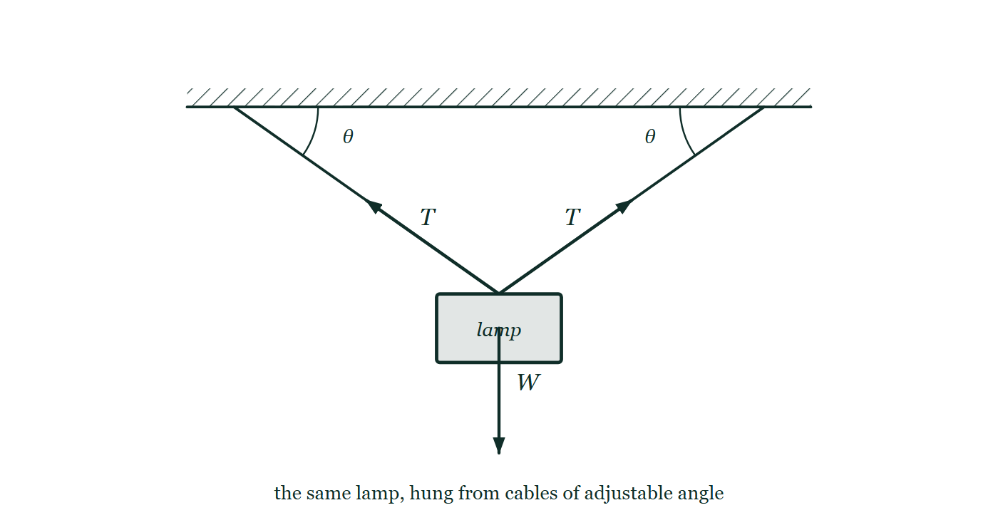
FORCES · TENSION FORCES
GIOPHYSICS LESSON
THE PICTURE
Two cables, one lamp
Drawn for this lesson
A lamp hung from two cables that leave the ceiling at equal angles θ, with a tension arrow drawn along each cable from the point they are tied and the lamp's weight drawn straight down.
The live version of this figure — click here
Forces — Tension Forces. Built by GioPhysics from the lesson's own copy; nothing on these slides is re-authored.
15 / 31
Notes:
[Phase] Build the model: The formulae, one at a time, in plain English (minutes 13–22 of 45)
[Figure] A lamp hung from two cables that leave the ceiling at equal angles θ, with a tension arrow drawn along each cable from the point they are tied and the lamp's weight drawn straight down.

Slide 16
FORCES · TENSION FORCES
GIOPHYSICS LESSON
WATCH OUT
The common trap
Check and misconception — The quick check and the trap
Tension is not automatically mg. For one vertical cord, upward acceleration gives T = m(g + a); downward acceleration gives T = m(g − a).
Forces — Tension Forces. Built by GioPhysics from the lesson's own copy; nothing on these slides is re-authored.
16 / 31
Notes:
[Phase] Check and misconception: The quick check and the trap (minutes 35–41 of 45)
[Misconception] Tension is not automatically mg. For one vertical cord, upward acceleration gives T = m(g + a); downward acceleration gives T = m(g − a).

Slide 17
FORCES · TENSION FORCES
GIOPHYSICS LESSON
WORKED EXAMPLE 1 OF 3 · SMOOTH TABLE
The question
smooth table
Worked examples — I do, we do — one step revealed at a time
12 kg and 10 kg boxes pulled by 40 N.
Forces — Tension Forces. Built by GioPhysics from the lesson's own copy; nothing on these slides is re-authored.
17 / 31
Notes:
[Phase] Worked examples: I do, we do — one step revealed at a time (minutes 22–35 of 45)
[Question] 12 kg and 10 kg boxes pulled by 40 N.
[Answer] a = 1.82 m/s²; T = 21.8 N

Slide 18
FORCES · TENSION FORCES
GIOPHYSICS LESSON
WORKED EXAMPLE 1 OF 3 · SMOOTH TABLE · THE WORKING
How to solve it
smooth table
Worked examples — I do, we do — one step revealed at a time
12 kg and 10 kg boxes pulled by 40 N.
1.
Treat both boxes as 22 kg: a = 40/22 = 1.82 m/s².
2.
If the 40 N pull acts on the 10 kg box, the cord accelerates the 12 kg box, so T = 12a = 21.8 N.
Forces — Tension Forces. Built by GioPhysics from the lesson's own copy; nothing on these slides is re-authored.
18 / 31
Notes:
[Phase] Worked examples: I do, we do — one step revealed at a time (minutes 22–35 of 45)
[Reveal] One click per step. The class works each line before the next appears.
[Step 1] Treat both boxes as 22 kg: a = 40/22 = 1.82 m/s².
[Step 2] If the 40 N pull acts on the 10 kg box, the cord accelerates the 12 kg box, so T = 12a = 21.8 N.

Slide 19
FORCES · TENSION FORCES
GIOPHYSICS LESSON
WORKED EXAMPLE 1 OF 3 · SMOOTH TABLE
Answer
smooth table
Worked examples — I do, we do — one step revealed at a time
a = 1.82 m/s²; T = 21.8 N
Forces — Tension Forces. Built by GioPhysics from the lesson's own copy; nothing on these slides is re-authored.
19 / 31
Notes:
[Phase] Worked examples: I do, we do — one step revealed at a time (minutes 22–35 of 45)
[Answer] a = 1.82 m/s²; T = 21.8 N

Slide 20
FORCES · TENSION FORCES
GIOPHYSICS LESSON
WORKED EXAMPLE 2 OF 3 · THREE-FORCE EQUILIBRIUM
The question
three-force equilibrium
Worked examples — I do, we do — one step revealed at a time
Knot with a horizontal and angled cord.
Forces — Tension Forces. Built by GioPhysics from the lesson's own copy; nothing on these slides is re-authored.
20 / 31
Notes:
[Phase] Worked examples: I do, we do — one step revealed at a time (minutes 22–35 of 45)
[Question] Knot with a horizontal and angled cord.
[Answer] Mg cot θ

Slide 21
FORCES · TENSION FORCES
GIOPHYSICS LESSON
WORKED EXAMPLE 2 OF 3 · THREE-FORCE EQUILIBRIUM · THE WORKING
How to solve it
three-force equilibrium
Worked examples — I do, we do — one step revealed at a time
Knot with a horizontal and angled cord.
1.
If the angled cord is θ below horizontal and the hanging load has weight Mg, its vertical component must equal Mg.
2.
The horizontal cord tension is therefore Mg cot θ.
Forces — Tension Forces. Built by GioPhysics from the lesson's own copy; nothing on these slides is re-authored.
21 / 31
Notes:
[Phase] Worked examples: I do, we do — one step revealed at a time (minutes 22–35 of 45)
[Reveal] One click per step. The class works each line before the next appears.
[Step 1] If the angled cord is θ below horizontal and the hanging load has weight Mg, its vertical component must equal Mg.
[Step 2] The horizontal cord tension is therefore Mg cot θ.

Slide 22
FORCES · TENSION FORCES
GIOPHYSICS LESSON
WORKED EXAMPLE 2 OF 3 · THREE-FORCE EQUILIBRIUM
Answer
three-force equilibrium
Worked examples — I do, we do — one step revealed at a time
Mg cot θ
Forces — Tension Forces. Built by GioPhysics from the lesson's own copy; nothing on these slides is re-authored.
22 / 31
Notes:
[Phase] Worked examples: I do, we do — one step revealed at a time (minutes 22–35 of 45)
[Answer] Mg cot θ

Slide 23
FORCES · TENSION FORCES
GIOPHYSICS LESSON
WORKED EXAMPLE 3 OF 3 · TWO HANGING MASSES
The question
two hanging masses
Worked examples — I do, we do — one step revealed at a time
Atwood machine.
Forces — Tension Forces. Built by GioPhysics from the lesson's own copy; nothing on these slides is re-authored.
23 / 31
Notes:
[Phase] Worked examples: I do, we do — one step revealed at a time (minutes 22–35 of 45)
[Question] Atwood machine.
[Answer] a = (m₂ − m₁)g/(m₁ + m₂)

Slide 24
FORCES · TENSION FORCES
GIOPHYSICS LESSON
WORKED EXAMPLE 3 OF 3 · TWO HANGING MASSES · THE WORKING
How to solve it
two hanging masses
Worked examples — I do, we do — one step revealed at a time
Atwood machine.
1.
For an ideal pulley with m₂ > m₁, a = (m₂ − m₁)g/(m₁ + m₂).
2.
Then use either mass to find the common cord tension.
Forces — Tension Forces. Built by GioPhysics from the lesson's own copy; nothing on these slides is re-authored.
24 / 31
Notes:
[Phase] Worked examples: I do, we do — one step revealed at a time (minutes 22–35 of 45)
[Reveal] One click per step. The class works each line before the next appears.
[Step 1] For an ideal pulley with m₂ > m₁, a = (m₂ − m₁)g/(m₁ + m₂).
[Step 2] Then use either mass to find the common cord tension.

Slide 25
FORCES · TENSION FORCES
GIOPHYSICS LESSON
WORKED EXAMPLE 3 OF 3 · TWO HANGING MASSES
Answer
two hanging masses
Worked examples — I do, we do — one step revealed at a time
a = (m₂ − m₁)g/(m₁ + m₂)
Forces — Tension Forces. Built by GioPhysics from the lesson's own copy; nothing on these slides is re-authored.
25 / 31
Notes:
[Phase] Worked examples: I do, we do — one step revealed at a time (minutes 22–35 of 45)
[Answer] a = (m₂ − m₁)g/(m₁ + m₂)

Slide 26
FORCES · TENSION FORCES
GIOPHYSICS LESSON
PREDICT · TAKE THE VOTE
Commit before you are told
Hands up for each option, then click
The two cables are lowered towards horizontal, still carrying the same lamp. What happens to the tension in each cable?
A It falls — the cables are barely doing any lifting now
B It stays at half the lamp's weight, since there are two of them
C It grows, and without limit as they approach horizontal
A lamp hung from two cables that leave the ceiling at equal angles θ, with a tension arrow drawn along each cable from the point they are tied and the lamp's weight drawn straight down.
The live version of this figure — click here
Forces — Tension Forces. Built by GioPhysics from the lesson's own copy; nothing on these slides is re-authored.
26 / 31
Notes:
[Phase] Build the model: The formulae, one at a time, in plain English (minutes 13–22 of 45)
[Predict] The two cables are lowered towards horizontal, still carrying the same lamp. What happens to the tension in each cable?
[Options] A It falls — the cables are barely doing any lifting now B It stays at half the lamp's weight, since there are two of them C It grows, and without limit as they approach horizontal
[Figure] A lamp hung from two cables that leave the ceiling at equal angles θ, with a tension arrow drawn along each cable from the point they are tied and the lamp's weight drawn straight down.

Slide 27
FORCES · TENSION FORCES
GIOPHYSICS LESSON
PREDICT · THE OUTCOME
What actually happens
Ask the room who changed their mind, and why
C It grows, and without limit as they approach horizontal
WHY
The vertical job never changes: between them the two cables must supply the lamp's whole weight, so 2T sin θ = mg however they are hung. As θ shrinks, sin θ shrinks with it, and T = mg / (2 sin θ) climbs. At 30° each cable already carries the full weight of the lamp. This is why no washing line, however tight, is ever perfectly straight — a truly horizontal cable would need infinite tension.
Forces — Tension Forces. Built by GioPhysics from the lesson's own copy; nothing on these slides is re-authored.
27 / 31
Notes:
[Phase] Build the model: The formulae, one at a time, in plain English (minutes 13–22 of 45)
[Answer] C — It grows, and without limit as they approach horizontal. The vertical job never changes: between them the two cables must supply the lamp's whole weight, so 2T sin θ = mg however they are hung. As θ shrinks, sin θ shrinks with it, and T = mg / (2 sin θ) climbs. At 30° each cable already carries the full weight of the lamp. This is why no washing line, however tight, is ever perfectly straight — a truly horizontal cable would need infinite tension.

Slide 28
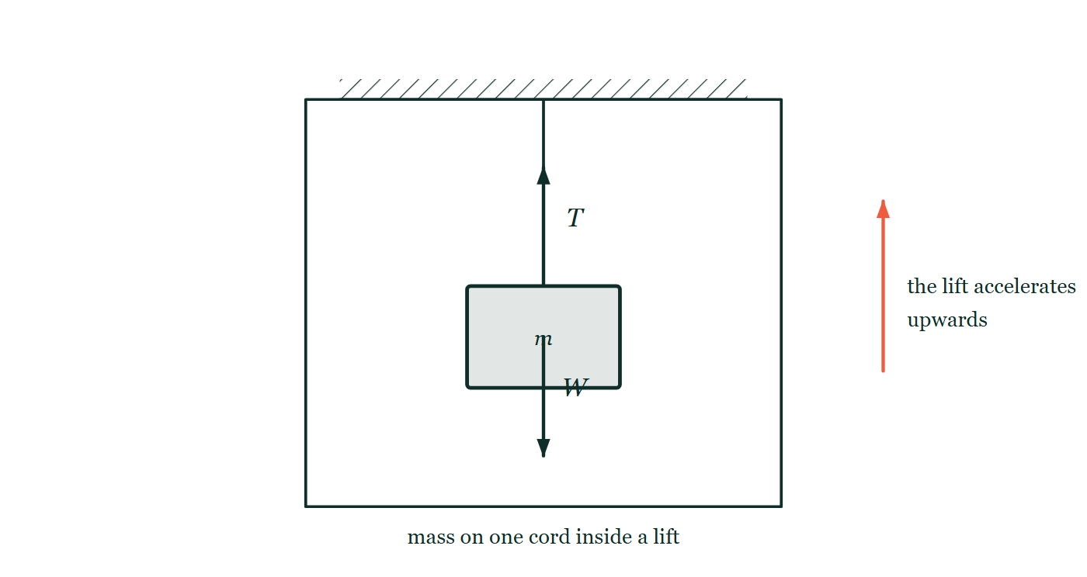
FORCES · TENSION FORCES
GIOPHYSICS LESSON
QUICK CHECK
Decide before the answer goes up
Check and misconception — The quick check and the trap
A mass hangs from one vertical cord. Is the tension always equal to its weight?
A
yes
B
no
A mass hanging from a single vertical cord inside a lift cabin, with the tension arrow up and the weight arrow down drawn the same length, and the lift's upward acceleration marked outside the cabin.
The live version of this figure — click here
Forces — Tension Forces. Built by GioPhysics from the lesson's own copy; nothing on these slides is re-authored.
28 / 31
Notes:
[Phase] Check and misconception: The quick check and the trap (minutes 35–41 of 45)
[Question] A mass hangs from one vertical cord. Is the tension always equal to its weight?
[Figure] A mass hanging from a single vertical cord inside a lift cabin, with the tension arrow up and the weight arrow down drawn the same length, and the lift's upward acceleration marked outside the cabin.
[Options] A yes B no

Slide 29
FORCES · TENSION FORCES
GIOPHYSICS LESSON
QUICK CHECK · THE ANSWER
The answer, and why
Check and misconception — The quick check and the trap
B no
HOW TO GET THERE
T = mg only when the vertical resultant is zero. Acceleration or additional forces change the tension — use T − mg = ma with upward chosen positive.
WHY THE OTHERS TEMPT
A It is true whenever the mass hangs still or moves at a steady speed, which is most of the ropes anyone has met, and that is why it feels like a rule. It is a special case: it holds only when the vertical resultant is zero.
B Correct. Use T − mg = ma with upward positive. Accelerating up needs T = m(g + a); accelerating down needs T = m(g − a); and in free fall, with a = g, the cord goes slack at T = 0.
Forces — Tension Forces. Built by GioPhysics from the lesson's own copy; nothing on these slides is re-authored.
29 / 31
Notes:
[Phase] Check and misconception: The quick check and the trap (minutes 35–41 of 45)
[Question] A mass hangs from one vertical cord. Is the tension always equal to its weight?
[Option by option] A: It is true whenever the mass hangs still or moves at a steady speed, which is most of the ropes anyone has met, and that is why it feels like a rule. It is a special case: it holds only when the vertical resultant is zero. B: Correct. Use T − mg = ma with upward positive. Accelerating up needs T = m(g + a); accelerating down needs T = m(g − a); and in free fall, with a = g, the cord goes slack at T = 0.
[Answer] B — no
[Why] T = mg only when the vertical resultant is zero. Acceleration or additional forces change the tension — use T − mg = ma with upward chosen positive.
[Reveal] One click for the answer, then one for the reason.

Slide 30
FORCES · TENSION FORCES
GIOPHYSICS LESSON
EXTENSION
No harder example in this lesson
Worked examples — I do, we do — one step revealed at a time
This lesson sets no Hard or Challenging example. The extension for a class that has finished early is the next lesson, or the practice paper questions the figures came from.
Forces — Tension Forces. Built by GioPhysics from the lesson's own copy; nothing on these slides is re-authored.
30 / 31
Notes:
[Phase] Worked examples: I do, we do — one step revealed at a time (minutes 22–35 of 45)
[Extension] The lesson record carries no Hard or Challenging example.

Slide 31
FORCES · TENSION FORCES
GIOPHYSICS LESSON
FORCES
Where to go next
Plenary — What to take away, what to practise next
Next
2.6 Free-Body Diagrams
https://giophysics.com/chapter-3/free-body-diagrams-net-forces/
Lesson
This lesson on giophysics.com
https://giophysics.com/chapter-3/tension-forces/
Live
The live, interactive version of these slides
https://giophysics.com/chapter-3/presentation/?lesson=tension
Chapter
All Forces lessons
https://giophysics.com/chapter-3/
PDF
Download the lesson PDF
https://giophysics.com/downloads/3-5-tension-forces.pdf
Forces — Tension Forces. Built by GioPhysics from the lesson's own copy; nothing on these slides is re-authored.
31 / 31
Notes:
[Phase] Plenary: What to take away, what to practise next (minutes 41–45 of 45)
[Interactive] The graphs and the circuit topology on these slides are frozen. The live version at https://giophysics.com/chapter-3/presentation/?lesson=tension moves them.

