Slide 1
FORCES · APPLIED, WEIGHT AND NORMAL FORCES
GIOPHYSICS LESSON
02 · Forces
Source. Direction. Components. Resultant.
Applied, Weight and Normal Forces
Three familiar arrows can point in different directions. Resolve them first, then let the resultant predict the acceleration.
POSITION
Lesson 3 of 11 in Forces
PLAN
15 slides in the 45-minute core run, about 43 minutes of it
LESSON PAGE
https://giophysics.com/chapter-3/applied-weight-normal-forces/
Built by GioPhysics from the lesson's own page. Every word on these slides is the lesson's; nothing here is re-authored. Teaching material, not an awarding body's document.
Forces — Applied, Weight and Normal Forces. Built by GioPhysics from the lesson's own copy; nothing on these slides is re-authored.
1 / 33
Notes:
[Lesson] Forces — Applied, Weight and Normal Forces. Lesson 3 of 11.
[Intro] Three familiar arrows can point in different directions. Resolve them first, then let the resultant predict the acceleration.
[Source] https://giophysics.com/chapter-3/applied-weight-normal-forces/
[Disclaimer] Built by GioPhysics from the lesson's own page. Every word on these slides is the lesson's; nothing here is re-authored. Teaching material, not an awarding body's document.

Slide 2
FORCES · APPLIED, WEIGHT AND NORMAL FORCES
GIOPHYSICS LESSON
WHAT THIS NEEDS
What you already know
Starter — Recall what this lesson stands on
Recall
1.5 Kinematics 2D
https://giophysics.com/chapter-1/kinematics-2d/
Recall
2.1 Applied Definitions
https://giophysics.com/chapter-3/applied-definitions/
Recall
2.2 Newton’s Laws
https://giophysics.com/chapter-3/newtons-laws-of-motion/
Forces — Applied, Weight and Normal Forces. Built by GioPhysics from the lesson's own copy; nothing on these slides is re-authored.
2 / 33
Notes:
[Phase] Starter: Recall what this lesson stands on (minutes 0–5 of 45)
[Starter] Recall: 1.5 Kinematics 2D; 2.1 Applied Definitions; 2.2 Newton’s Laws

Slide 3
FORCES · APPLIED, WEIGHT AND NORMAL FORCES
GIOPHYSICS LESSON
THINK FIRST
You are standing on bathroom scales in a lift. It sets off upwards. Have you got heavier?
Take answers before you click — the point is the commitment
The needle jumps for a couple of seconds, settles back to your usual number for the ride, and dips as the lift slows into the top floor.
THE ANSWER
No. Your mass is unchanged and so is your weight, mg — the Earth has not moved. What the scales read is the normal force, the push of the floor on you, and while you are accelerating upwards the floor has to do more than hold you: it has to hold you and change your velocity. The scale never measured weight; it measured the surface.
Forces — Applied, Weight and Normal Forces. Built by GioPhysics from the lesson's own copy; nothing on these slides is re-authored.
3 / 33
Notes:
[Phase] Starter: Recall what this lesson stands on (minutes 0–5 of 45)
[Hook] You are standing on bathroom scales in a lift. It sets off upwards. Have you got heavier? The needle jumps for a couple of seconds, settles back to your usual number for the ride, and dips as the lift slows into the top floor.
[Answer] No. Your mass is unchanged and so is your weight, mg — the Earth has not moved. What the scales read is the normal force, the push of the floor on you, and while you are accelerating upwards the floor has to do more than hold you: it has to hold you and change your velocity. The scale never measured weight; it measured the surface.

Slide 4
FORCES · APPLIED, WEIGHT AND NORMAL FORCES
GIOPHYSICS LESSON
EXPLAINED SIMPLY
In one sentence
Introduce the idea — The big idea and the definition
An applied force is supplied by an agent, weight is gravity’s pull, and a normal force is a surface’s perpendicular support.
Forces — Applied, Weight and Normal Forces. Built by GioPhysics from the lesson's own copy; nothing on these slides is re-authored.
4 / 33
Notes:
[Phase] Introduce the idea: The big idea and the definition (minutes 5–13 of 45)
[Definition] An applied force is supplied by an agent, weight is gravity’s pull, and a normal force is a surface’s perpendicular support.

Slide 5
FORCES · APPLIED, WEIGHT AND NORMAL FORCES
GIOPHYSICS LESSON
EXPLAINED SIMPLY
What that looks like
Introduce the idea — The big idea and the definition
FOR EXAMPLE
For a book pushed across a table, the hand pushes forward, Earth pulls downward, and the table pushes upward.
Forces — Applied, Weight and Normal Forces. Built by GioPhysics from the lesson's own copy; nothing on these slides is re-authored.
5 / 33
Notes:
[Phase] Introduce the idea: The big idea and the definition (minutes 5–13 of 45)
[Worked illustration] For a book pushed across a table, the hand pushes forward, Earth pulls downward, and the table pushes upward.

Slide 6
FORCES · APPLIED, WEIGHT AND NORMAL FORCES
GIOPHYSICS LESSON
THE BIG IDEA
Source. Direction. Components. Resultant.
Introduce the idea — The big idea and the definition
A force belongs to an interaction. Its direction comes from that interaction, not from the object’s direction of travel. An applied force is a direct push or pull, and at an angle it has horizontal and vertical components.
Weight is Earth’s gravitational pull, pointing vertically downward near the surface. A normal force is a contact force made by a surface: it is perpendicular to that surface and cannot pull. This is the same component method used in two-dimensional kinematics — here the components determine acceleration rather than velocity.
Forces — Applied, Weight and Normal Forces. Built by GioPhysics from the lesson's own copy; nothing on these slides is re-authored.
6 / 33
Notes:
[Phase] Introduce the idea: The big idea and the definition (minutes 5–13 of 45)
[Big idea] A force belongs to an interaction. Its direction comes from that interaction, not from the object’s direction of travel. An applied force is a direct push or pull, and at an angle it has horizontal and vertical components. Weight is Earth’s gravitational pull, pointing vertically downward near the surface. A normal force is a contact force made by a surface: it is perpendicular to that surface and cannot pull. This is the same component method used in two-dimensional kinematics — here the components determine acceleration rather than velocity.

Slide 7
FORCES · APPLIED, WEIGHT AND NORMAL FORCES
GIOPHYSICS LESSON
THE PHYSICS · 1 OF 4
Name each arrow before using an equation.
Build the model — The formulae, one at a time, in plain English
A force belongs to an interaction. Its direction comes from that interaction, not from the object’s direction of travel. An applied force is a direct push or pull; at an angle, it has horizontal and vertical components.
Weight is Earth’s gravitational pull, pointing vertically downward near the surface. A normal force is a contact force made by a surface: it is perpendicular to that surface and cannot pull.
Forces — Applied, Weight and Normal Forces. Built by GioPhysics from the lesson's own copy; nothing on these slides is re-authored.
7 / 33
Notes:
[Phase] Build the model: The formulae, one at a time, in plain English (minutes 13–22 of 45)
[Section] A force belongs to an interaction. Its direction comes from that interaction, not from the object’s direction of travel. An applied force is a direct push or pull; at an angle, it has horizontal and vertical components. Weight is Earth’s gravitational pull, pointing vertically downward near the surface. A normal force is a contact force made by a surface: it is perpendicular to that surface and cannot pull.

Slide 8
FORCES · APPLIED, WEIGHT AND NORMAL FORCES
GIOPHYSICS LESSON
THE PHYSICS · 2 OF 4
Split the angled pull into x and y.
Build the model — The formulae, one at a time, in plain English
This is the same component method used in two-dimensional kinematics. Here the components determine acceleration rather than velocity. Positive angles pull upward; negative angles push downward.
Forces — Applied, Weight and Normal Forces. Built by GioPhysics from the lesson's own copy; nothing on these slides is re-authored.
8 / 33
Notes:
[Phase] Build the model: The formulae, one at a time, in plain English (minutes 13–22 of 45)
[Section] This is the same component method used in two-dimensional kinematics. Here the components determine acceleration rather than velocity. Positive angles pull upward; negative angles push downward.

Slide 9
FORCES · APPLIED, WEIGHT AND NORMAL FORCES
GIOPHYSICS LESSON
THE PHYSICS · 3 OF 4
Pulling upward unloads the surface.
Build the model — The formulae, one at a time, in plain English
Keep mass and applied-force size fixed. As the pull rotates upward, its vertical component grows and the surface supplies less support.
A downward push increases the normal force. Once the upward component reaches weight, the object leaves the surface and the normal force stays at zero.
Forces — Applied, Weight and Normal Forces. Built by GioPhysics from the lesson's own copy; nothing on these slides is re-authored.
9 / 33
Notes:
[Phase] Build the model: The formulae, one at a time, in plain English (minutes 13–22 of 45)
[Section] Keep mass and applied-force size fixed. As the pull rotates upward, its vertical component grows and the surface supplies less support. A downward push increases the normal force. Once the upward component reaches weight, the object leaves the surface and the normal force stays at zero.

Slide 10
FORCES · APPLIED, WEIGHT AND NORMAL FORCES
GIOPHYSICS LESSON
THE PHYSICS · 4 OF 4
Four scenes, one component method.
Build the model — The formulae, one at a time, in plain English
Choose axes that match the surface, write one force equation per axis, and only then connect acceleration to the motion.
Forces — Applied, Weight and Normal Forces. Built by GioPhysics from the lesson's own copy; nothing on these slides is re-authored.
10 / 33
Notes:
[Phase] Build the model: The formulae, one at a time, in plain English (minutes 13–22 of 45)
[Section] Choose axes that match the surface, write one force equation per axis, and only then connect acceleration to the motion.

Slide 11
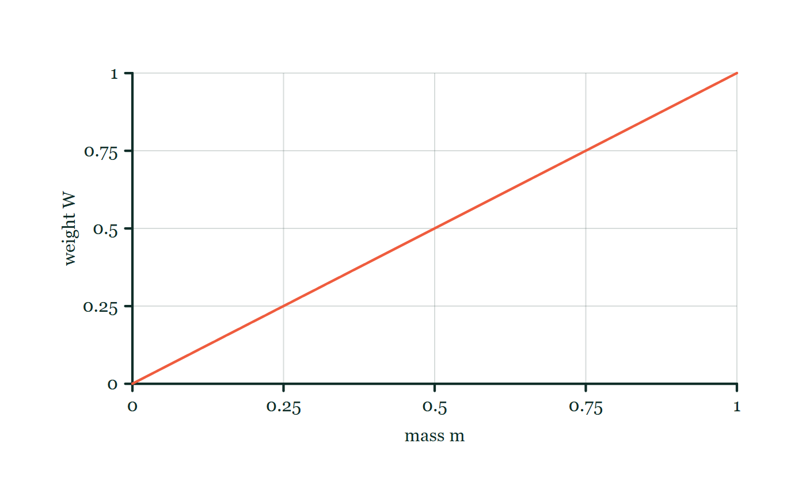
FORCES · APPLIED, WEIGHT AND NORMAL FORCES
GIOPHYSICS LESSON
FORMULA 1 OF 3
Weight
Build the model — The formulae, one at a time, in plain English
W = mg
Vertically downward near the surface
IN PLAIN ENGLISH
Earth’s gravitational pull. Near the surface, it points vertically downward.
Weight–mass explorer
Move this graph on the live version — click here
Forces — Applied, Weight and Normal Forces. Built by GioPhysics from the lesson's own copy; nothing on these slides is re-authored.
11 / 33
Notes:
[Phase] Build the model: The formulae, one at a time, in plain English (minutes 13–22 of 45)
[Formula] Weight: W = mg
[In plain English] Earth’s gravitational pull. Near the surface, it points vertically downward.
[Note] Vertically downward near the surface
[Graph] Weight–mass explorer. At one location, gravitational field strength g is fixed, so weight is directly proportional to mass.
[Axes] Horizontal: mass m. Vertical: weight W. Values are normalised — the graph teaches the shape, not a measurement.

Slide 12
FORCES · APPLIED, WEIGHT AND NORMAL FORCES
GIOPHYSICS LESSON
FORMULA 2 OF 3
Components of an angled pull
Build the model — The formulae, one at a time, in plain English
Fₓ = F cos θ · Fᵧ = F sin θ
Positive angles pull upward; negative angles push downward
IN PLAIN ENGLISH
A direct push or pull. At an angle, it has horizontal and vertical components. This is the same component method used in two-dimensional kinematics; here the components determine acceleration rather than velocity.
Forces — Applied, Weight and Normal Forces. Built by GioPhysics from the lesson's own copy; nothing on these slides is re-authored.
12 / 33
Notes:
[Phase] Build the model: The formulae, one at a time, in plain English (minutes 13–22 of 45)
[Formula] Components of an angled pull: Fₓ = F cos θ · Fᵧ = F sin θ
[In plain English] A direct push or pull. At an angle, it has horizontal and vertical components. This is the same component method used in two-dimensional kinematics; here the components determine acceleration rather than velocity.
[Note] Positive angles pull upward; negative angles push downward

Slide 13
FORCES · APPLIED, WEIGHT AND NORMAL FORCES
GIOPHYSICS LESSON
FORMULA 3 OF 3
Normal force
Build the model — The formulae, one at a time, in plain English
FN = mg − F sin θ
FN ⟂ surface, and it cannot pull
IN PLAIN ENGLISH
Vertical acceleration is zero while contact remains. Once the upward component exceeds weight, contact is lost, FN = 0, and the object accelerates upward.
Forces — Applied, Weight and Normal Forces. Built by GioPhysics from the lesson's own copy; nothing on these slides is re-authored.
13 / 33
Notes:
[Phase] Build the model: The formulae, one at a time, in plain English (minutes 13–22 of 45)
[Formula] Normal force: FN = mg − F sin θ
[In plain English] Vertical acceleration is zero while contact remains. Once the upward component exceeds weight, contact is lost, FN = 0, and the object accelerates upward.
[Note] FN ⟂ surface, and it cannot pull

Slide 14
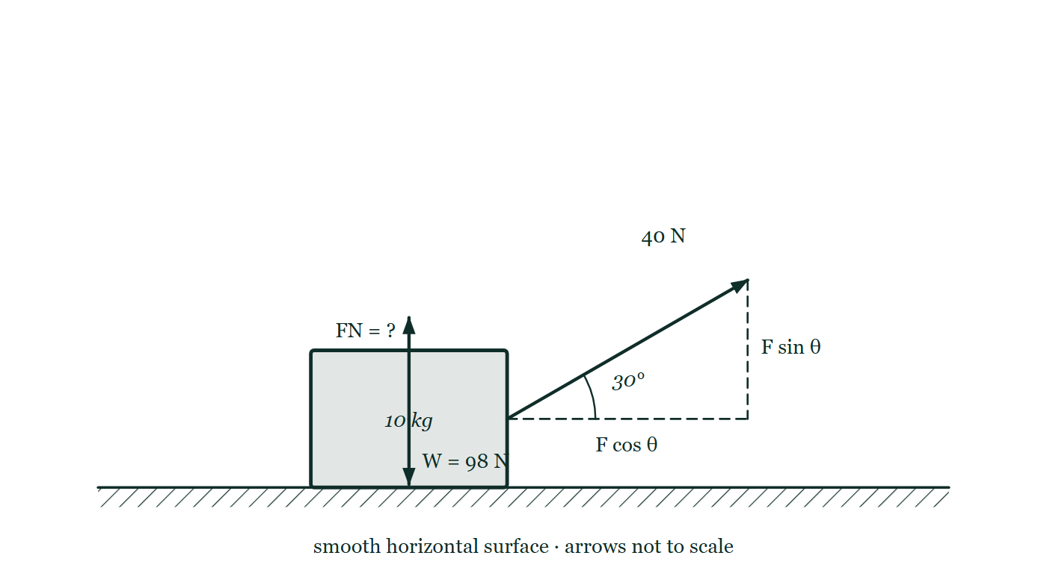
FORCES · APPLIED, WEIGHT AND NORMAL FORCES
GIOPHYSICS LESSON
THE PICTURE
Pulling at an angle unloads the surface
Drawn for this lesson
A 10 kg box on a smooth horizontal surface with a 40 N rope leaving it at 30° above the horizontal, the two components dashed in at the arrow's tip, the weight marked 98 N and the surface's push marked only as a question.
The live version of this figure — click here
Forces — Applied, Weight and Normal Forces. Built by GioPhysics from the lesson's own copy; nothing on these slides is re-authored.
14 / 33
Notes:
[Phase] Build the model: The formulae, one at a time, in plain English (minutes 13–22 of 45)
[Figure] A 10 kg box on a smooth horizontal surface with a 40 N rope leaving it at 30° above the horizontal, the two components dashed in at the arrow's tip, the weight marked 98 N and the surface's push marked only as a question.

Slide 15
FORCES · APPLIED, WEIGHT AND NORMAL FORCES
GIOPHYSICS LESSON
WATCH OUT
The common trap
Check and misconception — The quick check and the trap
Normal force does not automatically equal weight. It changes when another force has a perpendicular component, when the surface is tilted, or when the object accelerates perpendicular to the surface.
Forces — Applied, Weight and Normal Forces. Built by GioPhysics from the lesson's own copy; nothing on these slides is re-authored.
15 / 33
Notes:
[Phase] Check and misconception: The quick check and the trap (minutes 35–41 of 45)
[Misconception] Normal force does not automatically equal weight. It changes when another force has a perpendicular component, when the surface is tilted, or when the object accelerates perpendicular to the surface.

Slide 16
FORCES · APPLIED, WEIGHT AND NORMAL FORCES
GIOPHYSICS LESSON
WORKED EXAMPLE 1 OF 4 · SMOOTH HORIZONTAL SURFACE
The question
smooth horizontal surface
Worked examples — I do, we do — one step revealed at a time
A 40 N pull at 30° on a 10 kg box.
Forces — Applied, Weight and Normal Forces. Built by GioPhysics from the lesson's own copy; nothing on these slides is re-authored.
16 / 33
Notes:
[Phase] Worked examples: I do, we do — one step revealed at a time (minutes 22–35 of 45)
[Question] A 40 N pull at 30° on a 10 kg box.
[Answer] FN = 78 N; aₓ = 3.46 m/s²

Slide 17
FORCES · APPLIED, WEIGHT AND NORMAL FORCES
GIOPHYSICS LESSON
WORKED EXAMPLE 1 OF 4 · SMOOTH HORIZONTAL SURFACE · THE WORKING
How to solve it
smooth horizontal surface
Worked examples — I do, we do — one step revealed at a time
A 40 N pull at 30° on a 10 kg box.
1.
The components are Fₓ = 40 cos 30° = 34.6 N and Fᵧ = 40 sin 30° = 20 N.
2.
Therefore FN = 98 − 20 = 78 N and aₓ = 34.6/10 = 3.46 m/s².
Forces — Applied, Weight and Normal Forces. Built by GioPhysics from the lesson's own copy; nothing on these slides is re-authored.
17 / 33
Notes:
[Phase] Worked examples: I do, we do — one step revealed at a time (minutes 22–35 of 45)
[Reveal] One click per step. The class works each line before the next appears.
[Step 1] The components are Fₓ = 40 cos 30° = 34.6 N and Fᵧ = 40 sin 30° = 20 N.
[Step 2] Therefore FN = 98 − 20 = 78 N and aₓ = 34.6/10 = 3.46 m/s².

Slide 18
FORCES · APPLIED, WEIGHT AND NORMAL FORCES
GIOPHYSICS LESSON
WORKED EXAMPLE 1 OF 4 · SMOOTH HORIZONTAL SURFACE
Answer
smooth horizontal surface
Worked examples — I do, we do — one step revealed at a time
FN = 78 N; aₓ = 3.46 m/s²
Forces — Applied, Weight and Normal Forces. Built by GioPhysics from the lesson's own copy; nothing on these slides is re-authored.
18 / 33
Notes:
[Phase] Worked examples: I do, we do — one step revealed at a time (minutes 22–35 of 45)
[Answer] FN = 78 N; aₓ = 3.46 m/s²

Slide 19
FORCES · APPLIED, WEIGHT AND NORMAL FORCES
GIOPHYSICS LESSON
WORKED EXAMPLE 2 OF 4 · CONTACT TEST
The question
contact test
Worked examples — I do, we do — one step revealed at a time
A 100 N upward pull on a 10 kg box.
Forces — Applied, Weight and Normal Forces. Built by GioPhysics from the lesson's own copy; nothing on these slides is re-authored.
19 / 33
Notes:
[Phase] Worked examples: I do, we do — one step revealed at a time (minutes 22–35 of 45)
[Question] A 100 N upward pull on a 10 kg box.
[Answer] FN = 0; aᵧ = 0.20 m/s² upward

Slide 20
FORCES · APPLIED, WEIGHT AND NORMAL FORCES
GIOPHYSICS LESSON
WORKED EXAMPLE 2 OF 4 · CONTACT TEST · THE WORKING
How to solve it
contact test
Worked examples — I do, we do — one step revealed at a time
A 100 N upward pull on a 10 kg box.
1.
Weight is 98 N. The pull is 2 N larger, so the box loses contact.
2.
FN = 0 and aᵧ = (100 − 98)/10 = 0.20 m/s² upward.
Forces — Applied, Weight and Normal Forces. Built by GioPhysics from the lesson's own copy; nothing on these slides is re-authored.
20 / 33
Notes:
[Phase] Worked examples: I do, we do — one step revealed at a time (minutes 22–35 of 45)
[Reveal] One click per step. The class works each line before the next appears.
[Step 1] Weight is 98 N. The pull is 2 N larger, so the box loses contact.
[Step 2] FN = 0 and aᵧ = (100 − 98)/10 = 0.20 m/s² upward.

Slide 21
FORCES · APPLIED, WEIGHT AND NORMAL FORCES
GIOPHYSICS LESSON
WORKED EXAMPLE 2 OF 4 · CONTACT TEST
Answer
contact test
Worked examples — I do, we do — one step revealed at a time
FN = 0; aᵧ = 0.20 m/s² upward
Forces — Applied, Weight and Normal Forces. Built by GioPhysics from the lesson's own copy; nothing on these slides is re-authored.
21 / 33
Notes:
[Phase] Worked examples: I do, we do — one step revealed at a time (minutes 22–35 of 45)
[Answer] FN = 0; aᵧ = 0.20 m/s² upward

Slide 22
FORCES · APPLIED, WEIGHT AND NORMAL FORCES
GIOPHYSICS LESSON
WORKED EXAMPLE 3 OF 4 · ROTATE THE AXES
The question
rotate the axes
Worked examples — I do, we do — one step revealed at a time
Object on an incline.
Forces — Applied, Weight and Normal Forces. Built by GioPhysics from the lesson's own copy; nothing on these slides is re-authored.
22 / 33
Notes:
[Phase] Worked examples: I do, we do — one step revealed at a time (minutes 22–35 of 45)
[Question] Object on an incline.
[Answer] FN = mg cos β

Slide 23
FORCES · APPLIED, WEIGHT AND NORMAL FORCES
GIOPHYSICS LESSON
WORKED EXAMPLE 3 OF 4 · ROTATE THE AXES · THE WORKING
How to solve it
rotate the axes
Worked examples — I do, we do — one step revealed at a time
Object on an incline.
1.
Choose x along the slope and y perpendicular to it.
2.
Weight then becomes mg sin β down the slope and mg cos β into the surface.
3.
With no other perpendicular force, FN = mg cos β.
Forces — Applied, Weight and Normal Forces. Built by GioPhysics from the lesson's own copy; nothing on these slides is re-authored.
23 / 33
Notes:
[Phase] Worked examples: I do, we do — one step revealed at a time (minutes 22–35 of 45)
[Reveal] One click per step. The class works each line before the next appears.
[Step 1] Choose x along the slope and y perpendicular to it.
[Step 2] Weight then becomes mg sin β down the slope and mg cos β into the surface.
[Step 3] With no other perpendicular force, FN = mg cos β.

Slide 24
FORCES · APPLIED, WEIGHT AND NORMAL FORCES
GIOPHYSICS LESSON
WORKED EXAMPLE 3 OF 4 · ROTATE THE AXES
Answer
rotate the axes
Worked examples — I do, we do — one step revealed at a time
FN = mg cos β
Forces — Applied, Weight and Normal Forces. Built by GioPhysics from the lesson's own copy; nothing on these slides is re-authored.
24 / 33
Notes:
[Phase] Worked examples: I do, we do — one step revealed at a time (minutes 22–35 of 45)
[Answer] FN = mg cos β

Slide 25
FORCES · APPLIED, WEIGHT AND NORMAL FORCES
GIOPHYSICS LESSON
WORKED EXAMPLE 4 OF 4 · APPARENT WEIGHT
The question
apparent weight
Worked examples — I do, we do — one step revealed at a time
A 65 kg passenger accelerating downward at 0.2g.
Forces — Applied, Weight and Normal Forces. Built by GioPhysics from the lesson's own copy; nothing on these slides is re-authored.
25 / 33
Notes:
[Phase] Worked examples: I do, we do — one step revealed at a time (minutes 22–35 of 45)
[Question] A 65 kg passenger accelerating downward at 0.2g.
[Answer] FN = 510 N — about 52 kg on the display

Slide 26
FORCES · APPLIED, WEIGHT AND NORMAL FORCES
GIOPHYSICS LESSON
WORKED EXAMPLE 4 OF 4 · APPARENT WEIGHT · THE WORKING
How to solve it
apparent weight
Worked examples — I do, we do — one step revealed at a time
A 65 kg passenger accelerating downward at 0.2g.
1.
The scale measures normal force, not weight.
2.
FN = m(g − 0.2g), so it reads 510 N, or about 52 kg on a mass-calibrated display.
3.
In free fall, the support force becomes zero even though gravity still acts: this is apparent weightlessness.
Forces — Applied, Weight and Normal Forces. Built by GioPhysics from the lesson's own copy; nothing on these slides is re-authored.
26 / 33
Notes:
[Phase] Worked examples: I do, we do — one step revealed at a time (minutes 22–35 of 45)
[Reveal] One click per step. The class works each line before the next appears.
[Step 1] The scale measures normal force, not weight.
[Step 2] FN = m(g − 0.2g), so it reads 510 N, or about 52 kg on a mass-calibrated display.
[Step 3] In free fall, the support force becomes zero even though gravity still acts: this is apparent weightlessness.

Slide 27
FORCES · APPLIED, WEIGHT AND NORMAL FORCES
GIOPHYSICS LESSON
WORKED EXAMPLE 4 OF 4 · APPARENT WEIGHT
Answer
apparent weight
Worked examples — I do, we do — one step revealed at a time
FN = 510 N — about 52 kg on the display
Forces — Applied, Weight and Normal Forces. Built by GioPhysics from the lesson's own copy; nothing on these slides is re-authored.
27 / 33
Notes:
[Phase] Worked examples: I do, we do — one step revealed at a time (minutes 22–35 of 45)
[Answer] FN = 510 N — about 52 kg on the display

Slide 28
FORCES · APPLIED, WEIGHT AND NORMAL FORCES
GIOPHYSICS LESSON
PREDICT · TAKE THE VOTE
Commit before you are told
Hands up for each option, then click
The rope pulls the 10 kg box with 40 N at 30° above the horizontal. The box stays on the surface. What is the surface pushing up with?
A 98 N — the weight has not changed
B 78 N
C 118 N
A 10 kg box on a smooth horizontal surface with a 40 N rope leaving it at 30° above the horizontal, the two components dashed in at the arrow's tip, the weight marked 98 N and the surface's push marked only as a question.
The live version of this figure — click here
Forces — Applied, Weight and Normal Forces. Built by GioPhysics from the lesson's own copy; nothing on these slides is re-authored.
28 / 33
Notes:
[Phase] Build the model: The formulae, one at a time, in plain English (minutes 13–22 of 45)
[Predict] The rope pulls the 10 kg box with 40 N at 30° above the horizontal. The box stays on the surface. What is the surface pushing up with?
[Options] A 98 N — the weight has not changed B 78 N C 118 N
[Figure] A 10 kg box on a smooth horizontal surface with a 40 N rope leaving it at 30° above the horizontal, the two components dashed in at the arrow's tip, the weight marked 98 N and the surface's push marked only as a question.

Slide 29
FORCES · APPLIED, WEIGHT AND NORMAL FORCES
GIOPHYSICS LESSON
PREDICT · THE OUTCOME
What actually happens
Ask the room who changed their mind, and why
B 78 N
WHY
The rope is doing part of the surface's job. Its vertical component is 40 sin 30° = 20 N upward, so the surface only has to make up the difference: FN = 98 − 20 = 78 N. 118 N comes from adding that 20 N instead of subtracting it, which would mean the rope was pressing the box down. And 98 N is the answer only when nothing else has a vertical component — the normal force is what the surface supplies, not a property the box carries around.
Forces — Applied, Weight and Normal Forces. Built by GioPhysics from the lesson's own copy; nothing on these slides is re-authored.
29 / 33
Notes:
[Phase] Build the model: The formulae, one at a time, in plain English (minutes 13–22 of 45)
[Answer] B — 78 N. The rope is doing part of the surface's job. Its vertical component is 40 sin 30° = 20 N upward, so the surface only has to make up the difference: FN = 98 − 20 = 78 N. 118 N comes from adding that 20 N instead of subtracting it, which would mean the rope was pressing the box down. And 98 N is the answer only when nothing else has a vertical component — the normal force is what the surface supplies, not a property the box carries around.

Slide 30
FORCES · APPLIED, WEIGHT AND NORMAL FORCES
GIOPHYSICS LESSON
QUICK CHECK
Decide before the answer goes up
Check and misconception — The quick check and the trap
A book rests on a horizontal table. Are its weight and normal force a third-law pair?
A
yes
B
no
Forces — Applied, Weight and Normal Forces. Built by GioPhysics from the lesson's own copy; nothing on these slides is re-authored.
30 / 33
Notes:
[Phase] Check and misconception: The quick check and the trap (minutes 35–41 of 45)
[Question] A book rests on a horizontal table. Are its weight and normal force a third-law pair?
[Options] A yes B no

Slide 31
FORCES · APPLIED, WEIGHT AND NORMAL FORCES
GIOPHYSICS LESSON
QUICK CHECK · THE ANSWER
The answer, and why
Check and misconception — The quick check and the trap
B no
HOW TO GET THERE
Both forces act on the book. Weight pairs with the book’s gravitational pull on Earth; normal pairs with the book pushing the table. A third-law pair must act on two different objects.
WHY THE OTHERS TEMPT
A They are equal and opposite here, which is the whole reason this keeps being chosen. But that equality is an accident of this particular table: tilt it, or pull upward on the book, and the two numbers come apart at once while the third-law pairing would not change at all.
B Correct. Both act on the book. Weight pairs with the book's gravitational pull on the Earth; the normal force pairs with the book pressing down on the table. Two objects, one force each — that is the test.
Forces — Applied, Weight and Normal Forces. Built by GioPhysics from the lesson's own copy; nothing on these slides is re-authored.
31 / 33
Notes:
[Phase] Check and misconception: The quick check and the trap (minutes 35–41 of 45)
[Question] A book rests on a horizontal table. Are its weight and normal force a third-law pair?
[Option by option] A: They are equal and opposite here, which is the whole reason this keeps being chosen. But that equality is an accident of this particular table: tilt it, or pull upward on the book, and the two numbers come apart at once while the third-law pairing would not change at all. B: Correct. Both act on the book. Weight pairs with the book's gravitational pull on the Earth; the normal force pairs with the book pressing down on the table. Two objects, one force each — that is the test.
[Answer] B — no
[Why] Both forces act on the book. Weight pairs with the book’s gravitational pull on Earth; normal pairs with the book pushing the table. A third-law pair must act on two different objects.
[Reveal] One click for the answer, then one for the reason.

Slide 32
FORCES · APPLIED, WEIGHT AND NORMAL FORCES
GIOPHYSICS LESSON
EXTENSION
No harder example in this lesson
Worked examples — I do, we do — one step revealed at a time
This lesson sets no Hard or Challenging example. The extension for a class that has finished early is the next lesson, or the practice paper questions the figures came from.
Forces — Applied, Weight and Normal Forces. Built by GioPhysics from the lesson's own copy; nothing on these slides is re-authored.
32 / 33
Notes:
[Phase] Worked examples: I do, we do — one step revealed at a time (minutes 22–35 of 45)
[Extension] The lesson record carries no Hard or Challenging example.

Slide 33
FORCES · APPLIED, WEIGHT AND NORMAL FORCES
GIOPHYSICS LESSON
FORCES
Where to go next
Plenary — What to take away, what to practise next
Next
2.4 Friction Forces
https://giophysics.com/chapter-3/friction-forces/
Lesson
This lesson on giophysics.com
https://giophysics.com/chapter-3/applied-weight-normal-forces/
Live
The live, interactive version of these slides
https://giophysics.com/chapter-3/presentation/?lesson=weight
Chapter
All Forces lessons
https://giophysics.com/chapter-3/
PDF
Download the lesson PDF
https://giophysics.com/downloads/3-3-applied-weight-normal-forces.pdf
Forces — Applied, Weight and Normal Forces. Built by GioPhysics from the lesson's own copy; nothing on these slides is re-authored.
33 / 33
Notes:
[Phase] Plenary: What to take away, what to practise next (minutes 41–45 of 45)
[Interactive] The graphs and the circuit topology on these slides are frozen. The live version at https://giophysics.com/chapter-3/presentation/?lesson=weight moves them.

