Slide 1
ELECTRICITY & MAGNETISM · ELECTRIC CELLS
GIOPHYSICS LESSON
20 · Electricity & Magnetism
The chemistry that pushes charge
Electric Cells
A cell converts chemical energy into electrical energy — but some is spent inside the cell itself. E.m.f., internal resistance, and the discharge curve together tell the full story of a battery’s working life.
POSITION
Lesson 3 of 7 in Electricity & Magnetism
PLAN
16 slides in the 45-minute core run, about 43.5 minutes of it
LESSON PAGE
https://giophysics.com/chapter-39/electric-cells/
Built by GioPhysics from the lesson's own page. Every word on these slides is the lesson's; nothing here is re-authored. Teaching material, not an awarding body's document.
Electricity & Magnetism — Electric Cells. Built by GioPhysics from the lesson's own copy; nothing on these slides is re-authored.
1 / 33
Notes:
[Lesson] Electricity & Magnetism — Electric Cells. Lesson 3 of 7.
[Intro] A cell converts chemical energy into electrical energy — but some is spent inside the cell itself. E.m.f., internal resistance, and the discharge curve together tell the full story of a battery’s working life.
[Source] https://giophysics.com/chapter-39/electric-cells/
[Disclaimer] Built by GioPhysics from the lesson's own page. Every word on these slides is the lesson's; nothing here is re-authored. Teaching material, not an awarding body's document.

Slide 2
ELECTRICITY & MAGNETISM · ELECTRIC CELLS
GIOPHYSICS LESSON
WHAT THIS NEEDS
What you already know
Starter — Recall what this lesson stands on
Recall
Potential difference
https://giophysics.com/chapter-22/voltage-potential-difference/
Recall
E.m.f. & internal resistance
https://giophysics.com/chapter-23/emf-internal-resistance/
Electricity & Magnetism — Electric Cells. Built by GioPhysics from the lesson's own copy; nothing on these slides is re-authored.
2 / 33
Notes:
[Phase] Starter: Recall what this lesson stands on (minutes 0–5 of 45)
[Starter] Recall: Potential difference; E.m.f. & internal resistance

Slide 3
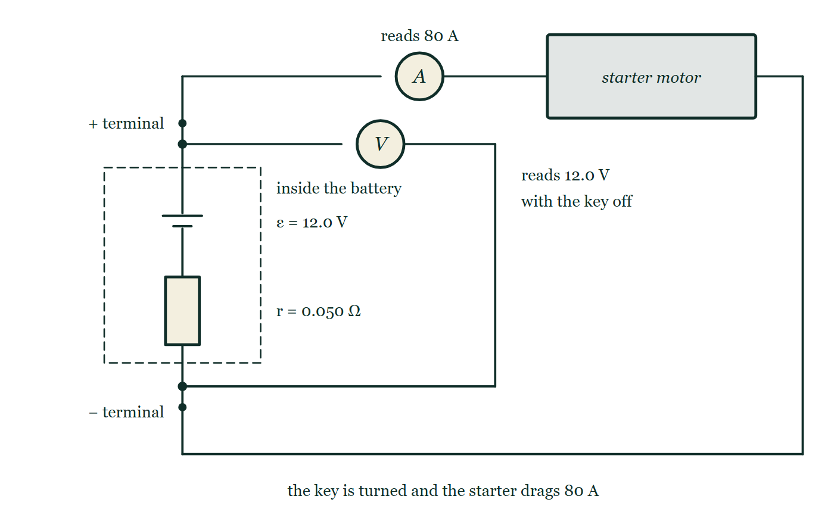
ELECTRICITY & MAGNETISM · ELECTRIC CELLS
GIOPHYSICS LESSON
THINK FIRST
You turn the key, the headlights dim for a second, and the engine starts. Is the battery going flat?
Take answers before you click — the point is the commitment
The battery is a month old. Its label says 12 V, and a meter across its terminals reads 12.0 V with everything switched off.
THE ANSWER
No — it is perfectly healthy. The starter draws about 80 A through the battery's own internal resistance of 0.050 Ω, so 80 × 0.050 = 4.0 V is dropped inside the battery and the terminals sag to 8.0 V. The instant the starter lets go, the current falls and the 12 V comes straight back.
A dashed outline round the cell and a resistor marked r = 0.050 Ω shows what is inside a 12.0 V car battery; two terminal posts leave it, an ammeter in the external loop reads 80 A into a starter motor, and a voltmeter is connected straight across the two terminals with nothing written on its face.
The live version of this figure — click here
Electricity & Magnetism — Electric Cells. Built by GioPhysics from the lesson's own copy; nothing on these slides is re-authored.
3 / 33
Notes:
[Phase] Starter: Recall what this lesson stands on (minutes 0–5 of 45)
[Hook] You turn the key, the headlights dim for a second, and the engine starts. Is the battery going flat? The battery is a month old. Its label says 12 V, and a meter across its terminals reads 12.0 V with everything switched off.
[Answer] No — it is perfectly healthy. The starter draws about 80 A through the battery's own internal resistance of 0.050 Ω, so 80 × 0.050 = 4.0 V is dropped inside the battery and the terminals sag to 8.0 V. The instant the starter lets go, the current falls and the 12 V comes straight back.
[Figure] A dashed outline round the cell and a resistor marked r = 0.050 Ω shows what is inside a 12.0 V car battery; two terminal posts leave it, an ammeter in the external loop reads 80 A into a starter motor, and a voltmeter is connected straight across the two terminals with nothing written on its face.

Slide 4
ELECTRICITY & MAGNETISM · ELECTRIC CELLS
GIOPHYSICS LESSON
EXPLAINED SIMPLY
In one sentence
Introduce the idea — The big idea and the definition
The e.m.f. of a cell is the chemical energy converted to electrical energy per unit charge; the terminal p.d. is the e.m.f. minus the voltage lost across the cell’s own internal resistance.
Electricity & Magnetism — Electric Cells. Built by GioPhysics from the lesson's own copy; nothing on these slides is re-authored.
4 / 33
Notes:
[Phase] Introduce the idea: The big idea and the definition (minutes 5–13 of 45)
[Definition] The e.m.f. of a cell is the chemical energy converted to electrical energy per unit charge; the terminal p.d. is the e.m.f. minus the voltage lost across the cell’s own internal resistance.

Slide 5
ELECTRICITY & MAGNETISM · ELECTRIC CELLS
GIOPHYSICS LESSON
EXPLAINED SIMPLY
What that looks like
Introduce the idea — The big idea and the definition
FOR EXAMPLE
A 1.6 V cell reads 1.6 V unloaded, but only 1.5 V while driving a 330 Ω resistor — the missing 0.1 V is dropped across its internal resistance.
Electricity & Magnetism — Electric Cells. Built by GioPhysics from the lesson's own copy; nothing on these slides is re-authored.
5 / 33
Notes:
[Phase] Introduce the idea: The big idea and the definition (minutes 5–13 of 45)
[Worked illustration] A 1.6 V cell reads 1.6 V unloaded, but only 1.5 V while driving a 330 Ω resistor — the missing 0.1 V is dropped across its internal resistance.

Slide 6
ELECTRICITY & MAGNETISM · ELECTRIC CELLS
GIOPHYSICS LESSON
THE BIG IDEA
The chemistry that pushes charge
Introduce the idea — The big idea and the definition
The e.m.f. ε is the energy the cell gives each coulomb. The terminal p.d. is what survives after the internal resistance r takes its share: ε = I(R + r), so V = ε − Ir. A discharging cell drops quickly at first, holds a long steady plateau, then falls fast to zero — and its capacity in ampere-hours says how much charge it can deliver before that final drop.
Electricity & Magnetism — Electric Cells. Built by GioPhysics from the lesson's own copy; nothing on these slides is re-authored.
6 / 33
Notes:
[Phase] Introduce the idea: The big idea and the definition (minutes 5–13 of 45)
[Big idea] The e.m.f. ε is the energy the cell gives each coulomb. The terminal p.d. is what survives after the internal resistance r takes its share: ε = I(R + r), so V = ε − Ir. A discharging cell drops quickly at first, holds a long steady plateau, then falls fast to zero — and its capacity in ampere-hours says how much charge it can deliver before that final drop.

Slide 7
ELECTRICITY & MAGNETISM · ELECTRIC CELLS
GIOPHYSICS LESSON
THE PHYSICS · 1 OF 3
Primary and secondary
Build the model — The formulae, one at a time, in plain English
A primary cell runs its chemical reaction once and is done. A secondary cell can be recharged: driving current backwards through it reverses the chemistry and stores the energy again.
Electricity & Magnetism — Electric Cells. Built by GioPhysics from the lesson's own copy; nothing on these slides is re-authored.
7 / 33
Notes:
[Phase] Build the model: The formulae, one at a time, in plain English (minutes 13–22 of 45)
[Section] A primary cell runs its chemical reaction once and is done. A secondary cell can be recharged: driving current backwards through it reverses the chemistry and stores the energy again.

Slide 8
ELECTRICITY & MAGNETISM · ELECTRIC CELLS
GIOPHYSICS LESSON
THE PHYSICS · 2 OF 3
The discharge curve
Build the model — The formulae, one at a time, in plain English
Terminal p.d. against time shows a quick initial dip, a long stable plateau, then a rapid fall to zero. Devices are designed around the plateau voltage — the flat middle is the battery’s useful life.
Electricity & Magnetism — Electric Cells. Built by GioPhysics from the lesson's own copy; nothing on these slides is re-authored.
8 / 33
Notes:
[Phase] Build the model: The formulae, one at a time, in plain English (minutes 13–22 of 45)
[Section] Terminal p.d. against time shows a quick initial dip, a long stable plateau, then a rapid fall to zero. Devices are designed around the plateau voltage — the flat middle is the battery’s useful life.

Slide 9
ELECTRICITY & MAGNETISM · ELECTRIC CELLS
GIOPHYSICS LESSON
THE PHYSICS · 3 OF 3
Measuring r
Build the model — The formulae, one at a time, in plain English
Read the unloaded voltage (that is ε, since I = 0), connect a known load, and read again. The lost volts divided by the current gives the internal resistance.
Electricity & Magnetism — Electric Cells. Built by GioPhysics from the lesson's own copy; nothing on these slides is re-authored.
9 / 33
Notes:
[Phase] Build the model: The formulae, one at a time, in plain English (minutes 13–22 of 45)
[Section] Read the unloaded voltage (that is ε, since I = 0), connect a known load, and read again. The lost volts divided by the current gives the internal resistance.

Slide 10
ELECTRICITY & MAGNETISM · ELECTRIC CELLS
GIOPHYSICS LESSON
FORMULA 1 OF 4
The e.m.f. relationship
Build the model — The formulae, one at a time, in plain English
ε = I(R + r)
R = external load, r = internal resistance
IN PLAIN ENGLISH
The energy each coulomb carries splits between the load outside the cell and the resistance inside it.
Electricity & Magnetism — Electric Cells. Built by GioPhysics from the lesson's own copy; nothing on these slides is re-authored.
10 / 33
Notes:
[Phase] Build the model: The formulae, one at a time, in plain English (minutes 13–22 of 45)
[Formula] The e.m.f. relationship: ε = I(R + r)
[In plain English] The energy each coulomb carries splits between the load outside the cell and the resistance inside it.
[Note] R = external load, r = internal resistance

Slide 11
ELECTRICITY & MAGNETISM · ELECTRIC CELLS
GIOPHYSICS LESSON
FORMULA 2 OF 4
Terminal p.d.
Build the model — The formulae, one at a time, in plain English
V = ε − Ir
Equals ε only when I = 0
IN PLAIN ENGLISH
The harder you work the cell, the more volts are lost inside it — the terminal reading sags as the current grows.
Electricity & Magnetism — Electric Cells. Built by GioPhysics from the lesson's own copy; nothing on these slides is re-authored.
11 / 33
Notes:
[Phase] Build the model: The formulae, one at a time, in plain English (minutes 13–22 of 45)
[Formula] Terminal p.d.: V = ε − Ir
[In plain English] The harder you work the cell, the more volts are lost inside it — the terminal reading sags as the current grows.
[Note] Equals ε only when I = 0

Slide 12
ELECTRICITY & MAGNETISM · ELECTRIC CELLS
GIOPHYSICS LESSON
FORMULA 3 OF 4
Internal heating
Build the model — The formulae, one at a time, in plain English
P = I²r
Why hard-worked batteries get hot
IN PLAIN ENGLISH
Heat generated inside the cell grows with the square of the current — double the demand and the cell warms four times as fast.
Electricity & Magnetism — Electric Cells. Built by GioPhysics from the lesson's own copy; nothing on these slides is re-authored.
12 / 33
Notes:
[Phase] Build the model: The formulae, one at a time, in plain English (minutes 13–22 of 45)
[Formula] Internal heating: P = I²r
[In plain English] Heat generated inside the cell grows with the square of the current — double the demand and the cell warms four times as fast.
[Note] Why hard-worked batteries get hot

Slide 13
ELECTRICITY & MAGNETISM · ELECTRIC CELLS
GIOPHYSICS LESSON
FORMULA 4 OF 4
Capacity
Build the model — The formulae, one at a time, in plain English
Q = It, 1 A·h = 3600 C
A 2 A·h cell supplies 2 A for one hour
IN PLAIN ENGLISH
Capacity is stored charge, not energy: it tells you how long the cell can hold a given current before running dry.
Electricity & Magnetism — Electric Cells. Built by GioPhysics from the lesson's own copy; nothing on these slides is re-authored.
13 / 33
Notes:
[Phase] Build the model: The formulae, one at a time, in plain English (minutes 13–22 of 45)
[Formula] Capacity: Q = It, 1 A·h = 3600 C
[In plain English] Capacity is stored charge, not energy: it tells you how long the cell can hold a given current before running dry.
[Note] A 2 A·h cell supplies 2 A for one hour

Slide 14
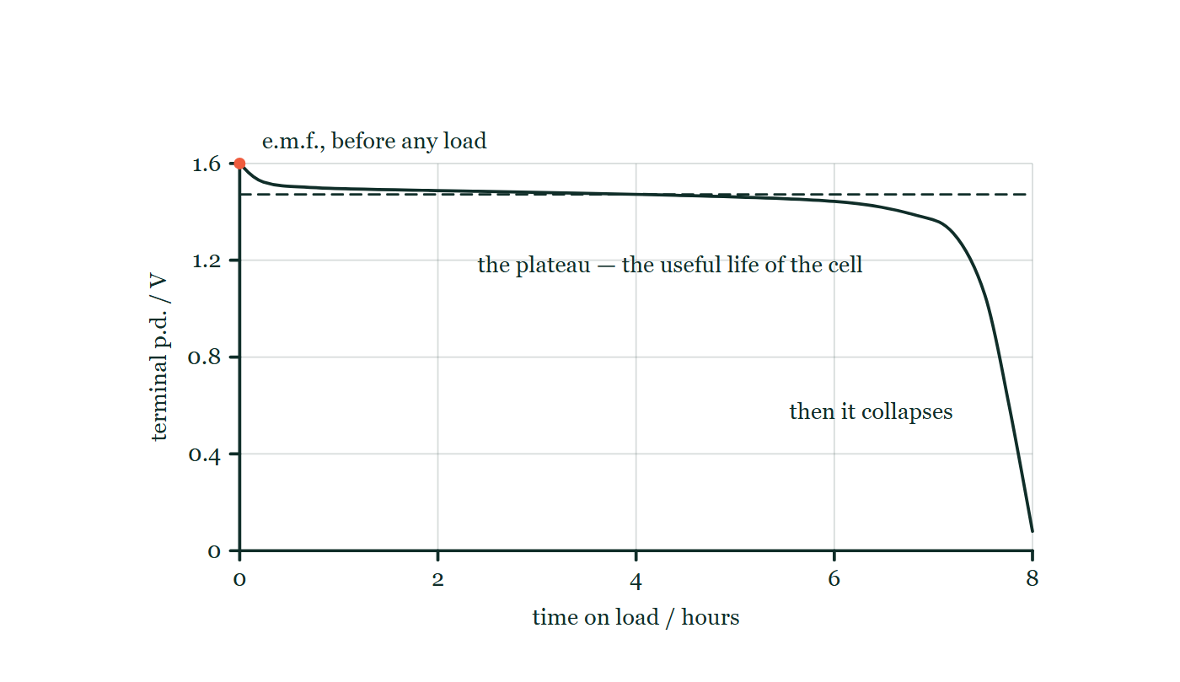
ELECTRICITY & MAGNETISM · ELECTRIC CELLS
GIOPHYSICS LESSON
THE PICTURE
A cell's whole working life
Drawn for this lesson
Terminal p.d. plotted against hours of discharge: a sharp initial dip from the open-circuit value, then a long almost level plateau drawn against a dashed line at the plateau voltage, then a steep collapse to zero at the right-hand edge of the graph.
The live version of this figure — click here
Electricity & Magnetism — Electric Cells. Built by GioPhysics from the lesson's own copy; nothing on these slides is re-authored.
14 / 33
Notes:
[Phase] Build the model: The formulae, one at a time, in plain English (minutes 13–22 of 45)
[Figure] Terminal p.d. plotted against hours of discharge: a sharp initial dip from the open-circuit value, then a long almost level plateau drawn against a dashed line at the plateau voltage, then a steep collapse to zero at the right-hand edge of the graph.

Slide 15
ELECTRICITY & MAGNETISM · ELECTRIC CELLS
GIOPHYSICS LESSON
WATCH OUT
The common trap
Check and misconception — The quick check and the trap
E.m.f. is not a force — it is energy per unit charge, measured in volts. And a voltmeter across a battery reads the e.m.f. only when no current flows; under load it always reads less, because Ir volts are lost inside the cell.
Electricity & Magnetism — Electric Cells. Built by GioPhysics from the lesson's own copy; nothing on these slides is re-authored.
15 / 33
Notes:
[Phase] Check and misconception: The quick check and the trap (minutes 35–41 of 45)
[Misconception] E.m.f. is not a force — it is energy per unit charge, measured in volts. And a voltmeter across a battery reads the e.m.f. only when no current flows; under load it always reads less, because Ir volts are lost inside the cell.

Slide 16
ELECTRICITY & MAGNETISM · ELECTRIC CELLS
GIOPHYSICS LESSON
WORKED EXAMPLE 1 OF 2 · EASY
The question
Easy
Worked examples — I do, we do — one step revealed at a time
A cell reads 1.6 V unloaded and 1.5 V across a 330 Ω resistor. Find the current and the internal resistance.
Electricity & Magnetism — Electric Cells. Built by GioPhysics from the lesson's own copy; nothing on these slides is re-authored.
16 / 33
Notes:
[Phase] Worked examples: I do, we do — one step revealed at a time (minutes 22–35 of 45)
[Question] A cell reads 1.6 V unloaded and 1.5 V across a 330 Ω resistor. Find the current and the internal resistance.
[Answer] I ≈ 4.5 mA; r ≈ 22 Ω

Slide 17
ELECTRICITY & MAGNETISM · ELECTRIC CELLS
GIOPHYSICS LESSON
WORKED EXAMPLE 1 OF 2 · EASY · THE WORKING
How to solve it
Easy
Worked examples — I do, we do — one step revealed at a time
A cell reads 1.6 V unloaded and 1.5 V across a 330 Ω resistor. Find the current and the internal resistance.
1.
I = V/R = 1.5 ÷ 330 ≈ 4.5 mA.
2.
Lost volts = 1.6 − 1.5 = 0.1 V.
3.
r = 0.1 ÷ 4.5 × 10⁻³ ≈ 22 Ω.
Electricity & Magnetism — Electric Cells. Built by GioPhysics from the lesson's own copy; nothing on these slides is re-authored.
17 / 33
Notes:
[Phase] Worked examples: I do, we do — one step revealed at a time (minutes 22–35 of 45)
[Reveal] One click per step. The class works each line before the next appears.
[Step 1] I = V/R = 1.5 ÷ 330 ≈ 4.5 mA.
[Step 2] Lost volts = 1.6 − 1.5 = 0.1 V.
[Step 3] r = 0.1 ÷ 4.5 × 10⁻³ ≈ 22 Ω.

Slide 18
ELECTRICITY & MAGNETISM · ELECTRIC CELLS
GIOPHYSICS LESSON
WORKED EXAMPLE 1 OF 2 · EASY
Answer
Easy
Worked examples — I do, we do — one step revealed at a time
I ≈ 4.5 mA; r ≈ 22 Ω
Electricity & Magnetism — Electric Cells. Built by GioPhysics from the lesson's own copy; nothing on these slides is re-authored.
18 / 33
Notes:
[Phase] Worked examples: I do, we do — one step revealed at a time (minutes 22–35 of 45)
[Answer] I ≈ 4.5 mA; r ≈ 22 Ω

Slide 19
ELECTRICITY & MAGNETISM · ELECTRIC CELLS
GIOPHYSICS LESSON
WORKED EXAMPLE 2 OF 2 · MEDIUM
The question
Medium
Worked examples — I do, we do — one step revealed at a time
A car battery has ε = 12.0 V and r = 0.050 Ω. The starter motor draws 80 A. Find the terminal p.d. and the heat rate inside the battery.
Electricity & Magnetism — Electric Cells. Built by GioPhysics from the lesson's own copy; nothing on these slides is re-authored.
19 / 33
Notes:
[Phase] Worked examples: I do, we do — one step revealed at a time (minutes 22–35 of 45)
[Question] A car battery has ε = 12.0 V and r = 0.050 Ω. The starter motor draws 80 A. Find the terminal p.d. and the heat rate inside the battery.
[Answer] V = 8.0 V; 320 W of internal heating

Slide 20
ELECTRICITY & MAGNETISM · ELECTRIC CELLS
GIOPHYSICS LESSON
WORKED EXAMPLE 2 OF 2 · MEDIUM · THE WORKING
How to solve it
Medium
Worked examples — I do, we do — one step revealed at a time
A car battery has ε = 12.0 V and r = 0.050 Ω. The starter motor draws 80 A. Find the terminal p.d. and the heat rate inside the battery.
1.
V = ε − Ir = 12.0 − 80 × 0.050 = 8.0 V — which is why the headlights dim while cranking.
2.
P = I²r = 80² × 0.050 = 320 W of heat inside the battery.
Electricity & Magnetism — Electric Cells. Built by GioPhysics from the lesson's own copy; nothing on these slides is re-authored.
20 / 33
Notes:
[Phase] Worked examples: I do, we do — one step revealed at a time (minutes 22–35 of 45)
[Reveal] One click per step. The class works each line before the next appears.
[Step 1] V = ε − Ir = 12.0 − 80 × 0.050 = 8.0 V — which is why the headlights dim while cranking.
[Step 2] P = I²r = 80² × 0.050 = 320 W of heat inside the battery.

Slide 21
ELECTRICITY & MAGNETISM · ELECTRIC CELLS
GIOPHYSICS LESSON
WORKED EXAMPLE 2 OF 2 · MEDIUM
Answer
Medium
Worked examples — I do, we do — one step revealed at a time
V = 8.0 V; 320 W of internal heating
Electricity & Magnetism — Electric Cells. Built by GioPhysics from the lesson's own copy; nothing on these slides is re-authored.
21 / 33
Notes:
[Phase] Worked examples: I do, we do — one step revealed at a time (minutes 22–35 of 45)
[Answer] V = 8.0 V; 320 W of internal heating

Slide 22
ELECTRICITY & MAGNETISM · ELECTRIC CELLS
GIOPHYSICS LESSON
SPOT THE MISTAKE
One line here is wrong
The whole working is up — find the bad line before you click
1.
A cell reads 1.6 V unloaded and 1.5 V across a 330 Ω resistor. Find its internal resistance.
2.
No current flows when it is unloaded, so ε = 1.6 V
3.
Current in the circuit: I = ε/R = 1.6 ÷ 330 = 4.85 mA
4.
Lost volts = 1.6 − 1.5 = 0.1 V
5.
r = 0.1 ÷ 4.85 × 10⁻³ ≈ 21 Ω
LINE 3 IS WRONG
The 330 Ω resistor never sees 1.6 V. It sees the terminal p.d., 1.5 V, which is what the meter is reading while the current flows. Dividing the e.m.f. by the external resistance alone quietly assumes r = 0 — the very quantity being measured — and it always biases the answer downwards. Here it is a 7% error; on a cell with a large internal resistance the same step collapses completely.
IT SHOULD SAY
Current in the circuit: I = V/R = 1.5 ÷ 330 = 4.55 mA, so r = 0.1 ÷ 4.55 × 10⁻³ ≈ 22 Ω
Electricity & Magnetism — Electric Cells. Built by GioPhysics from the lesson's own copy; nothing on these slides is re-authored.
22 / 33
Notes:
[Phase] Worked examples: I do, we do — one step revealed at a time (minutes 22–35 of 45)
[Spot the mistake] The working is complete and one line of it is wrong. Let the room hunt: one click names the line, a second shows it done correctly.
[Line 3 is wrong] The 330 Ω resistor never sees 1.6 V. It sees the terminal p.d., 1.5 V, which is what the meter is reading while the current flows. Dividing the e.m.f. by the external resistance alone quietly assumes r = 0 — the very quantity being measured — and it always biases the answer downwards. Here it is a 7% error; on a cell with a large internal resistance the same step collapses completely.
[It should say] Current in the circuit: I = V/R = 1.5 ÷ 330 = 4.55 mA, so r = 0.1 ÷ 4.55 × 10⁻³ ≈ 22 Ω

Slide 23
ELECTRICITY & MAGNETISM · ELECTRIC CELLS
GIOPHYSICS LESSON
PREDICT · TAKE THE VOTE
Commit before you are told
Hands up for each option, then click
The voltmeter read 12.0 V with the key off. What does it read while the starter is dragging 80 A?
A Still 12.0 V — a voltmeter across a battery reads its e.m.f.
B 8.0 V
C More than 12.0 V, because the motor is pulling hard on the chemistry
A dashed outline round the cell and a resistor marked r = 0.050 Ω shows what is inside a 12.0 V car battery; two terminal posts leave it, an ammeter in the external loop reads 80 A into a starter motor, and a voltmeter is connected straight across the two terminals with nothing written on its face.
The live version of this figure — click here
Electricity & Magnetism — Electric Cells. Built by GioPhysics from the lesson's own copy; nothing on these slides is re-authored.
23 / 33
Notes:
[Phase] Build the model: The formulae, one at a time, in plain English (minutes 13–22 of 45)
[Predict] The voltmeter read 12.0 V with the key off. What does it read while the starter is dragging 80 A?
[Options] A Still 12.0 V — a voltmeter across a battery reads its e.m.f. B 8.0 V C More than 12.0 V, because the motor is pulling hard on the chemistry
[Figure] A dashed outline round the cell and a resistor marked r = 0.050 Ω shows what is inside a 12.0 V car battery; two terminal posts leave it, an ammeter in the external loop reads 80 A into a starter motor, and a voltmeter is connected straight across the two terminals with nothing written on its face.

Slide 24
ELECTRICITY & MAGNETISM · ELECTRIC CELLS
GIOPHYSICS LESSON
PREDICT · THE OUTCOME
What actually happens
Ask the room who changed their mind, and why
B 8.0 V
WHY
The e.m.f. really has not changed: the chemistry still hands 12.0 J to every coulomb. But the voltmeter is not connected to the chemistry — it is connected to the terminals, and between the two sits r. At 80 A that resistance eats Ir = 80 × 0.050 = 4.0 V before anything reaches the outside world, so the terminals offer 8.0 V. A voltmeter reads the e.m.f. only when the current is zero, which is exactly the reading it gave with the key off.
Electricity & Magnetism — Electric Cells. Built by GioPhysics from the lesson's own copy; nothing on these slides is re-authored.
24 / 33
Notes:
[Phase] Build the model: The formulae, one at a time, in plain English (minutes 13–22 of 45)
[Answer] B — 8.0 V. The e.m.f. really has not changed: the chemistry still hands 12.0 J to every coulomb. But the voltmeter is not connected to the chemistry — it is connected to the terminals, and between the two sits r. At 80 A that resistance eats Ir = 80 × 0.050 = 4.0 V before anything reaches the outside world, so the terminals offer 8.0 V. A voltmeter reads the e.m.f. only when the current is zero, which is exactly the reading it gave with the key off.

Slide 25
ELECTRICITY & MAGNETISM · ELECTRIC CELLS
GIOPHYSICS LESSON
QUICK CHECK
Decide before the answer goes up
Check and misconception — The quick check and the trap
A cell of e.m.f. 12 V and internal resistance 0.50 Ω supplies 4.0 A. What is its terminal p.d.?
A
10 V
B
12 V
C
14 V
Electricity & Magnetism — Electric Cells. Built by GioPhysics from the lesson's own copy; nothing on these slides is re-authored.
25 / 33
Notes:
[Phase] Check and misconception: The quick check and the trap (minutes 35–41 of 45)
[Question] A cell of e.m.f. 12 V and internal resistance 0.50 Ω supplies 4.0 A. What is its terminal p.d.?
[Options] A 10 V B 12 V C 14 V

Slide 26
ELECTRICITY & MAGNETISM · ELECTRIC CELLS
GIOPHYSICS LESSON
QUICK CHECK · THE ANSWER
The answer, and why
Check and misconception — The quick check and the trap
A 10 V
HOW TO GET THERE
V = ε − Ir = 12 − 4.0 × 0.50 = 10 V — two volts are dropped inside the cell.
WHY THE OTHERS TEMPT
A Correct. V = ε − Ir = 12 − 4.0 × 0.50 = 10 V; the missing 2 V is spent inside the cell, as 8 W of heat in its own resistance.
B 12 V is the e.m.f., and the terminals offer that only at zero current. The moment 4.0 A is drawn, Ir volts have already been used up inside the cell before the terminals are reached.
C 14 V is 12 + 2 — the internal drop added instead of subtracted. Internal resistance is resistance, so it can only take voltage away. A cell that handed back extra volts as you loaded it would be a source of free energy.
Electricity & Magnetism — Electric Cells. Built by GioPhysics from the lesson's own copy; nothing on these slides is re-authored.
26 / 33
Notes:
[Phase] Check and misconception: The quick check and the trap (minutes 35–41 of 45)
[Question] A cell of e.m.f. 12 V and internal resistance 0.50 Ω supplies 4.0 A. What is its terminal p.d.?
[Option by option] A: Correct. V = ε − Ir = 12 − 4.0 × 0.50 = 10 V; the missing 2 V is spent inside the cell, as 8 W of heat in its own resistance. B: 12 V is the e.m.f., and the terminals offer that only at zero current. The moment 4.0 A is drawn, Ir volts have already been used up inside the cell before the terminals are reached. C: 14 V is 12 + 2 — the internal drop added instead of subtracted. Internal resistance is resistance, so it can only take voltage away. A cell that handed back extra volts as you loaded it would be a source of free energy.
[Answer] A — 10 V
[Why] V = ε − Ir = 12 − 4.0 × 0.50 = 10 V — two volts are dropped inside the cell.
[Reveal] One click for the answer, then one for the reason.

Slide 27
ELECTRICITY & MAGNETISM · ELECTRIC CELLS
GIOPHYSICS LESSON
EXTENSION 1 OF 2 · HARD
The question
Hard
Worked examples — I do, we do — one step revealed at a time
A 2.0 A·h cell holds a plateau of 1.5 V while supplying 250 mA. How long does it last, and how much energy does it deliver?
Electricity & Magnetism — Electric Cells. Built by GioPhysics from the lesson's own copy; nothing on these slides is re-authored.
27 / 33
Notes:
[Phase] Worked examples: I do, we do — one step revealed at a time (minutes 22–35 of 45)
[Question] A 2.0 A·h cell holds a plateau of 1.5 V while supplying 250 mA. How long does it last, and how much energy does it deliver?
[Answer] 8.0 h; ≈ 11 kJ

Slide 28
ELECTRICITY & MAGNETISM · ELECTRIC CELLS
GIOPHYSICS LESSON
EXTENSION 1 OF 2 · HARD · THE WORKING
How to solve it
Hard
Worked examples — I do, we do — one step revealed at a time
A 2.0 A·h cell holds a plateau of 1.5 V while supplying 250 mA. How long does it last, and how much energy does it deliver?
1.
t = capacity ÷ current = 2.0 ÷ 0.250 = 8.0 h.
2.
Charge Q = 2.0 A·h = 2.0 × 3600 = 7200 C.
3.
E = QV = 7200 × 1.5 = 10 800 J ≈ 11 kJ.
Electricity & Magnetism — Electric Cells. Built by GioPhysics from the lesson's own copy; nothing on these slides is re-authored.
28 / 33
Notes:
[Phase] Worked examples: I do, we do — one step revealed at a time (minutes 22–35 of 45)
[Reveal] One click per step. The class works each line before the next appears.
[Step 1] t = capacity ÷ current = 2.0 ÷ 0.250 = 8.0 h.
[Step 2] Charge Q = 2.0 A·h = 2.0 × 3600 = 7200 C.
[Step 3] E = QV = 7200 × 1.5 = 10 800 J ≈ 11 kJ.

Slide 29
ELECTRICITY & MAGNETISM · ELECTRIC CELLS
GIOPHYSICS LESSON
EXTENSION 1 OF 2 · HARD
Answer
Hard
Worked examples — I do, we do — one step revealed at a time
8.0 h; ≈ 11 kJ
Electricity & Magnetism — Electric Cells. Built by GioPhysics from the lesson's own copy; nothing on these slides is re-authored.
29 / 33
Notes:
[Phase] Worked examples: I do, we do — one step revealed at a time (minutes 22–35 of 45)
[Answer] 8.0 h; ≈ 11 kJ

Slide 30
ELECTRICITY & MAGNETISM · ELECTRIC CELLS
GIOPHYSICS LESSON
EXTENSION 2 OF 2 · CHALLENGING
The question
Challenging
Worked examples — I do, we do — one step revealed at a time
A cell drives 2.0 A through a 4.0 Ω load, and 4.0 A when the load is swapped for 1.5 Ω. Find its e.m.f. and internal resistance.
Electricity & Magnetism — Electric Cells. Built by GioPhysics from the lesson's own copy; nothing on these slides is re-authored.
30 / 33
Notes:
[Phase] Worked examples: I do, we do — one step revealed at a time (minutes 22–35 of 45)
[Question] A cell drives 2.0 A through a 4.0 Ω load, and 4.0 A when the load is swapped for 1.5 Ω. Find its e.m.f. and internal resistance.
[Answer] r = 1.0 Ω, ε = 10 V

Slide 31
ELECTRICITY & MAGNETISM · ELECTRIC CELLS
GIOPHYSICS LESSON
EXTENSION 2 OF 2 · CHALLENGING · THE WORKING
How to solve it
Challenging
Worked examples — I do, we do — one step revealed at a time
A cell drives 2.0 A through a 4.0 Ω load, and 4.0 A when the load is swapped for 1.5 Ω. Find its e.m.f. and internal resistance.
1.
ε = I(R + r) both times: ε = 2.0(4.0 + r) and ε = 4.0(1.5 + r).
2.
So 8.0 + 2.0r = 6.0 + 4.0r → r = 1.0 Ω.
3.
ε = 2.0 × (4.0 + 1.0) = 10 V. Check: 4.0 × (1.5 + 1.0) = 10 V ✓.
Electricity & Magnetism — Electric Cells. Built by GioPhysics from the lesson's own copy; nothing on these slides is re-authored.
31 / 33
Notes:
[Phase] Worked examples: I do, we do — one step revealed at a time (minutes 22–35 of 45)
[Reveal] One click per step. The class works each line before the next appears.
[Step 1] ε = I(R + r) both times: ε = 2.0(4.0 + r) and ε = 4.0(1.5 + r).
[Step 2] So 8.0 + 2.0r = 6.0 + 4.0r → r = 1.0 Ω.
[Step 3] ε = 2.0 × (4.0 + 1.0) = 10 V. Check: 4.0 × (1.5 + 1.0) = 10 V ✓.

Slide 32
ELECTRICITY & MAGNETISM · ELECTRIC CELLS
GIOPHYSICS LESSON
EXTENSION 2 OF 2 · CHALLENGING
Answer
Challenging
Worked examples — I do, we do — one step revealed at a time
r = 1.0 Ω, ε = 10 V
Electricity & Magnetism — Electric Cells. Built by GioPhysics from the lesson's own copy; nothing on these slides is re-authored.
32 / 33
Notes:
[Phase] Worked examples: I do, we do — one step revealed at a time (minutes 22–35 of 45)
[Answer] r = 1.0 Ω, ε = 10 V

Slide 33
ELECTRICITY & MAGNETISM · ELECTRIC CELLS
GIOPHYSICS LESSON
ELECTRICITY & MAGNETISM
Where to go next
Plenary — What to take away, what to practise next
Next
20.4 Magnetic Effects of Currents
https://giophysics.com/chapter-39/magnetic-effects/
Lesson
This lesson on giophysics.com
https://giophysics.com/chapter-39/electric-cells/
Live
The live, interactive version of these slides
https://giophysics.com/chapter-39/presentation/?lesson=cells
Chapter
All Electricity & Magnetism lessons
https://giophysics.com/chapter-39/
PDF
Download the lesson PDF
https://giophysics.com/downloads/39-3-electric-cells.pdf
Electricity & Magnetism — Electric Cells. Built by GioPhysics from the lesson's own copy; nothing on these slides is re-authored.
33 / 33
Notes:
[Phase] Plenary: What to take away, what to practise next (minutes 41–45 of 45)
[Interactive] The graphs and the circuit topology on these slides are frozen. The live version at https://giophysics.com/chapter-39/presentation/?lesson=cells moves them.

