Slide 1
ELECTRICITY & MAGNETISM · FIELDS DRIVING CURRENT
GIOPHYSICS LESSON
20 · Electricity & Magnetism
What pushes the charge along
Fields Driving Current
Flip a switch and the lamp lights at once — yet each electron crawls along at a fraction of a millimetre per second. An electric field inside the wire pushes every charge at the same moment, and I = nAvq counts the result.
POSITION
Lesson 1 of 7 in Electricity & Magnetism
PLAN
16 slides in the 45-minute core run, about 44.5 minutes of it
LESSON PAGE
https://giophysics.com/chapter-39/fields-driving-current/
Built by GioPhysics from the lesson's own page. Every word on these slides is the lesson's; nothing here is re-authored. Teaching material, not an awarding body's document.
Electricity & Magnetism — Fields Driving Current. Built by GioPhysics from the lesson's own copy; nothing on these slides is re-authored.
1 / 31
Notes:
[Lesson] Electricity & Magnetism — Fields Driving Current. Lesson 1 of 7.
[Intro] Flip a switch and the lamp lights at once — yet each electron crawls along at a fraction of a millimetre per second. An electric field inside the wire pushes every charge at the same moment, and I = nAvq counts the result.
[Source] https://giophysics.com/chapter-39/fields-driving-current/
[Disclaimer] Built by GioPhysics from the lesson's own page. Every word on these slides is the lesson's; nothing here is re-authored. Teaching material, not an awarding body's document.

Slide 2
ELECTRICITY & MAGNETISM · FIELDS DRIVING CURRENT
GIOPHYSICS LESSON
WHAT THIS NEEDS
What you already know
Starter — Recall what this lesson stands on
Recall
Current & charge
https://giophysics.com/chapter-22/electric-current-charge/
Recall
Electric fields
https://giophysics.com/chapter-20/electric-field-lines-direction/
Electricity & Magnetism — Fields Driving Current. Built by GioPhysics from the lesson's own copy; nothing on these slides is re-authored.
2 / 31
Notes:
[Phase] Starter: Recall what this lesson stands on (minutes 0–5 of 45)
[Starter] Recall: Current & charge; Electric fields

Slide 3
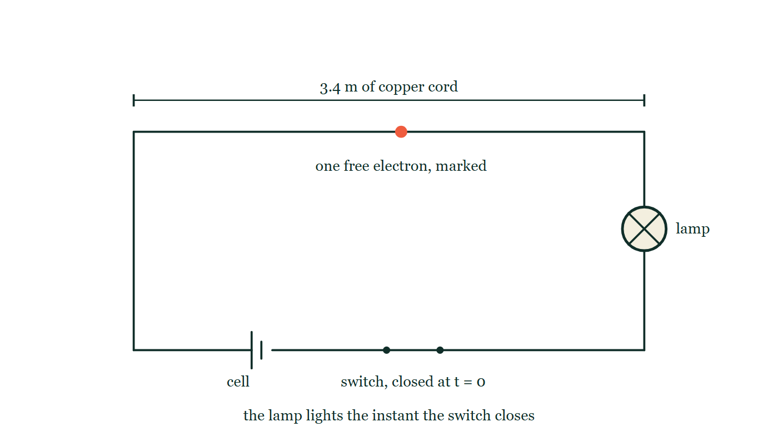
ELECTRICITY & MAGNETISM · FIELDS DRIVING CURRENT
GIOPHYSICS LESSON
THINK FIRST
You close the switch and the lamp lights at once. How long does one electron take to get from the switch to the lamp?
Take answers before you click — the point is the commitment
The cord is 3.4 m of ordinary copper lamp flex carrying 2.0 A. The light appears the instant your finger moves — no perceptible delay at all.
THE ANSWER
About six and a half hours. The electron drifts at roughly 0.15 mm/s. What crosses the circuit instantly is the electric field, at close to the speed of light, and it starts every electron moving at once — including the ones already sitting in the filament. Nothing has to arrive from the switch for the lamp to light.
A single loop: cell, closed switch, then 3.4 m of copper cord dimensioned along the top of the circuit, and a filament lamp on the far side. One free electron is picked out as a solid dot partway along the cord, with no arrow on it to say how fast or how far it has moved.
The live version of this figure — click here
Electricity & Magnetism — Fields Driving Current. Built by GioPhysics from the lesson's own copy; nothing on these slides is re-authored.
3 / 31
Notes:
[Phase] Starter: Recall what this lesson stands on (minutes 0–5 of 45)
[Hook] You close the switch and the lamp lights at once. How long does one electron take to get from the switch to the lamp? The cord is 3.4 m of ordinary copper lamp flex carrying 2.0 A. The light appears the instant your finger moves — no perceptible delay at all.
[Answer] About six and a half hours. The electron drifts at roughly 0.15 mm/s. What crosses the circuit instantly is the electric field, at close to the speed of light, and it starts every electron moving at once — including the ones already sitting in the filament. Nothing has to arrive from the switch for the lamp to light.
[Figure] A single loop: cell, closed switch, then 3.4 m of copper cord dimensioned along the top of the circuit, and a filament lamp on the far side. One free electron is picked out as a solid dot partway along the cord, with no arrow on it to say how fast or how far it has moved.

Slide 4
ELECTRICITY & MAGNETISM · FIELDS DRIVING CURRENT
GIOPHYSICS LESSON
EXPLAINED SIMPLY
In one sentence
Introduce the idea — The big idea and the definition
Electric current is the rate at which charge passes a point; it flows because a potential difference maintains an electric field inside the conductor that pushes the free charges along.
Electricity & Magnetism — Fields Driving Current. Built by GioPhysics from the lesson's own copy; nothing on these slides is re-authored.
4 / 31
Notes:
[Phase] Introduce the idea: The big idea and the definition (minutes 5–13 of 45)
[Definition] Electric current is the rate at which charge passes a point; it flows because a potential difference maintains an electric field inside the conductor that pushes the free charges along.

Slide 5
ELECTRICITY & MAGNETISM · FIELDS DRIVING CURRENT
GIOPHYSICS LESSON
EXPLAINED SIMPLY
What that looks like
Introduce the idea — The big idea and the definition
FOR EXAMPLE
A 20 A household supply moves 20 coulombs past the meter every second — about 1.3 × 10²⁰ electrons.
Electricity & Magnetism — Fields Driving Current. Built by GioPhysics from the lesson's own copy; nothing on these slides is re-authored.
5 / 31
Notes:
[Phase] Introduce the idea: The big idea and the definition (minutes 5–13 of 45)
[Worked illustration] A 20 A household supply moves 20 coulombs past the meter every second — about 1.3 × 10²⁰ electrons.

Slide 6
ELECTRICITY & MAGNETISM · FIELDS DRIVING CURRENT
GIOPHYSICS LESSON
THE BIG IDEA
What pushes the charge along
Introduce the idea — The big idea and the definition
A cell maintains a potential difference, and that p.d. keeps an electric field alive inside the wire. The field pushes on every free electron at once, so the whole circuit responds together even though each electron only drifts. The current is I = nAvq: carrier density, times cross-sectional area, times drift speed, times the charge on each carrier.
Electricity & Magnetism — Fields Driving Current. Built by GioPhysics from the lesson's own copy; nothing on these slides is re-authored.
6 / 31
Notes:
[Phase] Introduce the idea: The big idea and the definition (minutes 5–13 of 45)
[Big idea] A cell maintains a potential difference, and that p.d. keeps an electric field alive inside the wire. The field pushes on every free electron at once, so the whole circuit responds together even though each electron only drifts. The current is I = nAvq: carrier density, times cross-sectional area, times drift speed, times the charge on each carrier.

Slide 7
ELECTRICITY & MAGNETISM · FIELDS DRIVING CURRENT
GIOPHYSICS LESSON
THE PHYSICS · 1 OF 3
A field inside a conductor
Build the model — The formulae, one at a time, in plain English
An isolated conductor has no internal field. Connect a cell and the p.d. across the wire maintains one — every free electron feels the push almost simultaneously, which is why the lamp lights the instant you close the switch.
Electricity & Magnetism — Fields Driving Current. Built by GioPhysics from the lesson's own copy; nothing on these slides is re-authored.
7 / 31
Notes:
[Phase] Build the model: The formulae, one at a time, in plain English (minutes 13–22 of 45)
[Section] An isolated conductor has no internal field. Connect a cell and the p.d. across the wire maintains one — every free electron feels the push almost simultaneously, which is why the lamp lights the instant you close the switch.

Slide 8
ELECTRICITY & MAGNETISM · FIELDS DRIVING CURRENT
GIOPHYSICS LESSON
THE PHYSICS · 2 OF 3
Drift, not sprint
Build the model — The formulae, one at a time, in plain English
Free electrons already fly about at enormous random speeds, colliding constantly with the lattice. The field adds only a tiny net crawl toward the positive terminal — the drift velocity, typically well under a millimetre per second.
Electricity & Magnetism — Fields Driving Current. Built by GioPhysics from the lesson's own copy; nothing on these slides is re-authored.
8 / 31
Notes:
[Phase] Build the model: The formulae, one at a time, in plain English (minutes 13–22 of 45)
[Section] Free electrons already fly about at enormous random speeds, colliding constantly with the lattice. The field adds only a tiny net crawl toward the positive terminal — the drift velocity, typically well under a millimetre per second.

Slide 9
ELECTRICITY & MAGNETISM · FIELDS DRIVING CURRENT
GIOPHYSICS LESSON
THE PHYSICS · 3 OF 3
Conventional current vs electron flow
Build the model — The formulae, one at a time, in plain English
Franklin guessed the moving charge was positive, so circuit diagrams show conventional current from + to −. The electrons actually drift the other way. Both descriptions give identical physics — only the arrow labels differ.
Electricity & Magnetism — Fields Driving Current. Built by GioPhysics from the lesson's own copy; nothing on these slides is re-authored.
9 / 31
Notes:
[Phase] Build the model: The formulae, one at a time, in plain English (minutes 13–22 of 45)
[Section] Franklin guessed the moving charge was positive, so circuit diagrams show conventional current from + to −. The electrons actually drift the other way. Both descriptions give identical physics — only the arrow labels differ.

Slide 10
ELECTRICITY & MAGNETISM · FIELDS DRIVING CURRENT
GIOPHYSICS LESSON
FORMULA 1 OF 3
Current
Build the model — The formulae, one at a time, in plain English
I = Δq/Δt
One ampere is one coulomb per second
IN PLAIN ENGLISH
Stand at one point of the circuit and count the charge crossing each second — that count is the current.
Electricity & Magnetism — Fields Driving Current. Built by GioPhysics from the lesson's own copy; nothing on these slides is re-authored.
10 / 31
Notes:
[Phase] Build the model: The formulae, one at a time, in plain English (minutes 13–22 of 45)
[Formula] Current: I = Δq/Δt
[In plain English] Stand at one point of the circuit and count the charge crossing each second — that count is the current.
[Note] One ampere is one coulomb per second

Slide 11
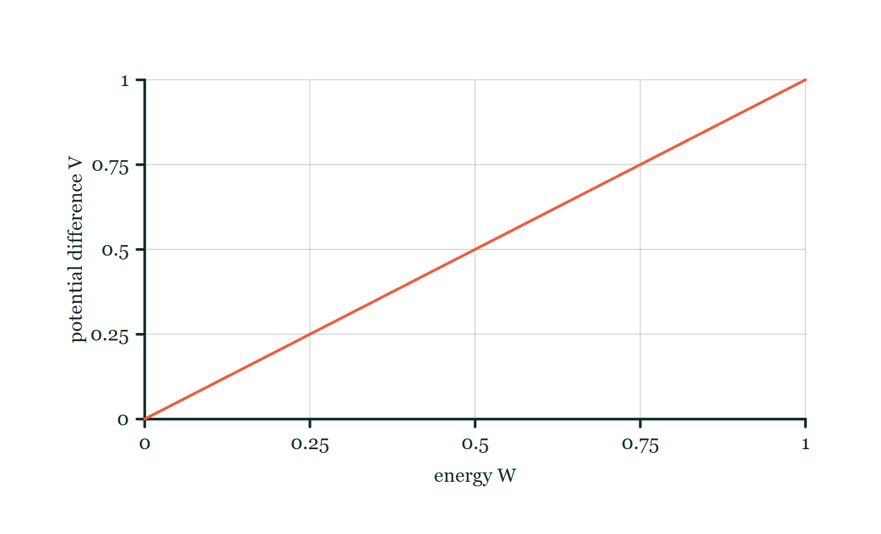
ELECTRICITY & MAGNETISM · FIELDS DRIVING CURRENT
GIOPHYSICS LESSON
FORMULA 2 OF 3
The driving p.d.
Build the model — The formulae, one at a time, in plain English
V = W/q
Volts are joules per coulomb
IN PLAIN ENGLISH
The potential difference is the energy handed to each coulomb — it is what keeps the field, and the push, alive.
Energy-per-charge explorer
Move this graph on the live version — click here
Electricity & Magnetism — Fields Driving Current. Built by GioPhysics from the lesson's own copy; nothing on these slides is re-authored.
11 / 31
Notes:
[Phase] Build the model: The formulae, one at a time, in plain English (minutes 13–22 of 45)
[Formula] The driving p.d.: V = W/q
[In plain English] The potential difference is the energy handed to each coulomb — it is what keeps the field, and the push, alive.
[Note] Volts are joules per coulomb
[Graph] Energy-per-charge explorer. For a fixed charge, potential difference is directly proportional to transferred energy.
[Axes] Horizontal: energy W. Vertical: potential difference V. Values are normalised — the graph teaches the shape, not a measurement.

Slide 12
ELECTRICITY & MAGNETISM · FIELDS DRIVING CURRENT
GIOPHYSICS LESSON
FORMULA 3 OF 3
Drift speed
Build the model — The formulae, one at a time, in plain English
I = nAvq
n = carriers per m³, A = cross-section
IN PLAIN ENGLISH
Current is how many carriers there are, times how much room they have, times how fast they drift, times the charge each one carries.
Electricity & Magnetism — Fields Driving Current. Built by GioPhysics from the lesson's own copy; nothing on these slides is re-authored.
12 / 31
Notes:
[Phase] Build the model: The formulae, one at a time, in plain English (minutes 13–22 of 45)
[Formula] Drift speed: I = nAvq
[In plain English] Current is how many carriers there are, times how much room they have, times how fast they drift, times the charge each one carries.
[Note] n = carriers per m³, A = cross-section

Slide 13
ELECTRICITY & MAGNETISM · FIELDS DRIVING CURRENT
GIOPHYSICS LESSON
WATCH OUT
The common trap
Check and misconception — The quick check and the trap
Electrons do not race round the circuit at the speed of light. The electric field is established through the circuit almost instantly, but each electron drifts at fractions of a millimetre per second — closing the switch starts every charge moving at once; it does not send one fast messenger.
Electricity & Magnetism — Fields Driving Current. Built by GioPhysics from the lesson's own copy; nothing on these slides is re-authored.
13 / 31
Notes:
[Phase] Check and misconception: The quick check and the trap (minutes 35–41 of 45)
[Misconception] Electrons do not race round the circuit at the speed of light. The electric field is established through the circuit almost instantly, but each electron drifts at fractions of a millimetre per second — closing the switch starts every charge moving at once; it does not send one fast messenger.

Slide 14
ELECTRICITY & MAGNETISM · FIELDS DRIVING CURRENT
GIOPHYSICS LESSON
WORKED EXAMPLE 1 OF 2 · EASY
The question
Easy
Worked examples — I do, we do — one step revealed at a time
A phone charger delivers 0.50 A for 120 s. How much charge flows, and how many electrons is that?
Electricity & Magnetism — Fields Driving Current. Built by GioPhysics from the lesson's own copy; nothing on these slides is re-authored.
14 / 31
Notes:
[Phase] Worked examples: I do, we do — one step revealed at a time (minutes 22–35 of 45)
[Question] A phone charger delivers 0.50 A for 120 s. How much charge flows, and how many electrons is that?
[Answer] 60 C ≈ 3.8 × 10²⁰ electrons

Slide 15
ELECTRICITY & MAGNETISM · FIELDS DRIVING CURRENT
GIOPHYSICS LESSON
WORKED EXAMPLE 1 OF 2 · EASY · THE WORKING
How to solve it
Easy
Worked examples — I do, we do — one step revealed at a time
A phone charger delivers 0.50 A for 120 s. How much charge flows, and how many electrons is that?
1.
q = It = 0.50 × 120 = 60 C.
2.
Number of electrons = 60 ÷ 1.60 × 10⁻¹⁹ ≈ 3.8 × 10²⁰.
Electricity & Magnetism — Fields Driving Current. Built by GioPhysics from the lesson's own copy; nothing on these slides is re-authored.
15 / 31
Notes:
[Phase] Worked examples: I do, we do — one step revealed at a time (minutes 22–35 of 45)
[Reveal] One click per step. The class works each line before the next appears.
[Step 1] q = It = 0.50 × 120 = 60 C.
[Step 2] Number of electrons = 60 ÷ 1.60 × 10⁻¹⁹ ≈ 3.8 × 10²⁰.

Slide 16
ELECTRICITY & MAGNETISM · FIELDS DRIVING CURRENT
GIOPHYSICS LESSON
WORKED EXAMPLE 1 OF 2 · EASY
Answer
Easy
Worked examples — I do, we do — one step revealed at a time
60 C ≈ 3.8 × 10²⁰ electrons
Electricity & Magnetism — Fields Driving Current. Built by GioPhysics from the lesson's own copy; nothing on these slides is re-authored.
16 / 31
Notes:
[Phase] Worked examples: I do, we do — one step revealed at a time (minutes 22–35 of 45)
[Answer] 60 C ≈ 3.8 × 10²⁰ electrons

Slide 17
ELECTRICITY & MAGNETISM · FIELDS DRIVING CURRENT
GIOPHYSICS LESSON
WORKED EXAMPLE 2 OF 2 · MEDIUM
The question
Medium
Worked examples — I do, we do — one step revealed at a time
A 2.5 mm diameter wire carries 1.5 A. The free-electron density is 5.0 × 10²⁶ m⁻³. Find the drift velocity.
Electricity & Magnetism — Fields Driving Current. Built by GioPhysics from the lesson's own copy; nothing on these slides is re-authored.
17 / 31
Notes:
[Phase] Worked examples: I do, we do — one step revealed at a time (minutes 22–35 of 45)
[Question] A 2.5 mm diameter wire carries 1.5 A. The free-electron density is 5.0 × 10²⁶ m⁻³. Find the drift velocity.
[Answer] v ≈ 3.8 mm/s

Slide 18
ELECTRICITY & MAGNETISM · FIELDS DRIVING CURRENT
GIOPHYSICS LESSON
WORKED EXAMPLE 2 OF 2 · MEDIUM · THE WORKING
How to solve it
Medium
Worked examples — I do, we do — one step revealed at a time
A 2.5 mm diameter wire carries 1.5 A. The free-electron density is 5.0 × 10²⁶ m⁻³. Find the drift velocity.
1.
A = πd²/4 = π(2.5 × 10⁻³)²/4 = 4.9 × 10⁻⁶ m².
2.
v = I/(nAq) = 1.5 ÷ (5.0 × 10²⁶ × 4.9 × 10⁻⁶ × 1.6 × 10⁻¹⁹).
3.
v ≈ 3.8 × 10⁻³ m/s — about 4 mm every second.
Electricity & Magnetism — Fields Driving Current. Built by GioPhysics from the lesson's own copy; nothing on these slides is re-authored.
18 / 31
Notes:
[Phase] Worked examples: I do, we do — one step revealed at a time (minutes 22–35 of 45)
[Reveal] One click per step. The class works each line before the next appears.
[Step 1] A = πd²/4 = π(2.5 × 10⁻³)²/4 = 4.9 × 10⁻⁶ m².
[Step 2] v = I/(nAq) = 1.5 ÷ (5.0 × 10²⁶ × 4.9 × 10⁻⁶ × 1.6 × 10⁻¹⁹).
[Step 3] v ≈ 3.8 × 10⁻³ m/s — about 4 mm every second.

Slide 19
ELECTRICITY & MAGNETISM · FIELDS DRIVING CURRENT
GIOPHYSICS LESSON
WORKED EXAMPLE 2 OF 2 · MEDIUM
Answer
Medium
Worked examples — I do, we do — one step revealed at a time
v ≈ 3.8 mm/s
Electricity & Magnetism — Fields Driving Current. Built by GioPhysics from the lesson's own copy; nothing on these slides is re-authored.
19 / 31
Notes:
[Phase] Worked examples: I do, we do — one step revealed at a time (minutes 22–35 of 45)
[Answer] v ≈ 3.8 mm/s

Slide 20
ELECTRICITY & MAGNETISM · FIELDS DRIVING CURRENT
GIOPHYSICS LESSON
SPOT THE MISTAKE
One line here is wrong
The whole working is up — find the bad line before you click
1.
A wire of diameter 2.5 mm carries 1.5 A. With n = 5.0 × 10²⁶ m⁻³, find the drift velocity.
2.
Cross-sectional area: A = πr² with r = 2.5 × 10⁻³ m
3.
A = π × (2.5 × 10⁻³)² = 2.0 × 10⁻⁵ m²
4.
v = I/(nAq) = 1.5 ÷ (5.0 × 10²⁶ × 2.0 × 10⁻⁵ × 1.6 × 10⁻¹⁹)
5.
v = 9.4 × 10⁻⁴ m/s
LINE 2 IS WRONG
2.5 mm is the diameter, and it has been used as the radius. Wire is always specified by diameter, formulae are always written with radius, and the substitution passes unnoticed because both are lengths in the right units. The area comes out four times too big, so the drift velocity comes out four times too small — and nothing about 0.94 mm/s looks wrong on the page.
IT SHOULD SAY
Cross-sectional area: A = πd²/4 = π × (2.5 × 10⁻³)² ÷ 4 = 4.9 × 10⁻⁶ m², giving v ≈ 3.8 mm/s
Electricity & Magnetism — Fields Driving Current. Built by GioPhysics from the lesson's own copy; nothing on these slides is re-authored.
20 / 31
Notes:
[Phase] Worked examples: I do, we do — one step revealed at a time (minutes 22–35 of 45)
[Spot the mistake] The working is complete and one line of it is wrong. Let the room hunt: one click names the line, a second shows it done correctly.
[Line 2 is wrong] 2.5 mm is the diameter, and it has been used as the radius. Wire is always specified by diameter, formulae are always written with radius, and the substitution passes unnoticed because both are lengths in the right units. The area comes out four times too big, so the drift velocity comes out four times too small — and nothing about 0.94 mm/s looks wrong on the page.
[It should say] Cross-sectional area: A = πd²/4 = π × (2.5 × 10⁻³)² ÷ 4 = 4.9 × 10⁻⁶ m², giving v ≈ 3.8 mm/s

Slide 21
ELECTRICITY & MAGNETISM · FIELDS DRIVING CURRENT
GIOPHYSICS LESSON
PREDICT · TAKE THE VOTE
Commit before you are told
Hands up for each option, then click
A hundredth of a second after the switch closes, where is the marked electron?
A At the lamp — it crossed the 3.4 m almost instantly, which is why the light is instant
B About a thousandth of a millimetre further along, like every other electron in the cord
C Exactly where it was; electrons only start once the field has finished crossing the wire
A single loop: cell, closed switch, then 3.4 m of copper cord dimensioned along the top of the circuit, and a filament lamp on the far side. One free electron is picked out as a solid dot partway along the cord, with no arrow on it to say how fast or how far it has moved.
The live version of this figure — click here
Electricity & Magnetism — Fields Driving Current. Built by GioPhysics from the lesson's own copy; nothing on these slides is re-authored.
21 / 31
Notes:
[Phase] Build the model: The formulae, one at a time, in plain English (minutes 13–22 of 45)
[Predict] A hundredth of a second after the switch closes, where is the marked electron?
[Options] A At the lamp — it crossed the 3.4 m almost instantly, which is why the light is instant B About a thousandth of a millimetre further along, like every other electron in the cord C Exactly where it was; electrons only start once the field has finished crossing the wire
[Figure] A single loop: cell, closed switch, then 3.4 m of copper cord dimensioned along the top of the circuit, and a filament lamp on the far side. One free electron is picked out as a solid dot partway along the cord, with no arrow on it to say how fast or how far it has moved.

Slide 22
ELECTRICITY & MAGNETISM · FIELDS DRIVING CURRENT
GIOPHYSICS LESSON
PREDICT · THE OUTCOME
What actually happens
Ask the room who changed their mind, and why
B About a thousandth of a millimetre further along, like every other electron in the cord
WHY
Two different things travel here at wildly different speeds, and the lesson is to keep them apart. The field is established through the whole cord in nanoseconds; the electrons respond to it by crawling. At a drift speed of 0.15 mm/s, a hundredth of a second moves the marked electron about 1.5 μm — far less than the width of a hair, and it is the same for every electron in the circuit at the same instant.
Electricity & Magnetism — Fields Driving Current. Built by GioPhysics from the lesson's own copy; nothing on these slides is re-authored.
22 / 31
Notes:
[Phase] Build the model: The formulae, one at a time, in plain English (minutes 13–22 of 45)
[Answer] B — About a thousandth of a millimetre further along, like every other electron in the cord. Two different things travel here at wildly different speeds, and the lesson is to keep them apart. The field is established through the whole cord in nanoseconds; the electrons respond to it by crawling. At a drift speed of 0.15 mm/s, a hundredth of a second moves the marked electron about 1.5 μm — far less than the width of a hair, and it is the same for every electron in the circuit at the same instant.

Slide 23
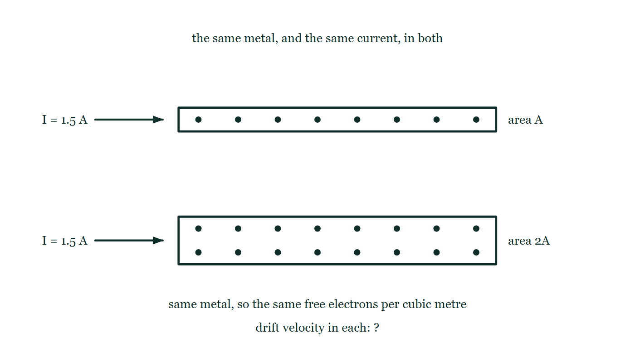
ELECTRICITY & MAGNETISM · FIELDS DRIVING CURRENT
GIOPHYSICS LESSON
QUICK CHECK
Decide before the answer goes up
Check and misconception — The quick check and the trap
A wire is swapped for one of twice the cross-sectional area, carrying the same current with the same carrier density. What happens to the drift velocity?
A
It doubles
B
It halves
C
It stays the same
Two wires of the same metal drawn in section, one above the other: the upper is one unit deep with eight carriers spaced along it, the lower is twice as deep with sixteen carriers at the same spacing. An identical current arrow labelled 1.5 A enters each from the left, and neither carries a drift arrow.
The live version of this figure — click here
Electricity & Magnetism — Fields Driving Current. Built by GioPhysics from the lesson's own copy; nothing on these slides is re-authored.
23 / 31
Notes:
[Phase] Check and misconception: The quick check and the trap (minutes 35–41 of 45)
[Question] A wire is swapped for one of twice the cross-sectional area, carrying the same current with the same carrier density. What happens to the drift velocity?
[Figure] Two wires of the same metal drawn in section, one above the other: the upper is one unit deep with eight carriers spaced along it, the lower is twice as deep with sixteen carriers at the same spacing. An identical current arrow labelled 1.5 A enters each from the left, and neither carries a drift arrow.
[Options] A It doubles B It halves C It stays the same

Slide 24
ELECTRICITY & MAGNETISM · FIELDS DRIVING CURRENT
GIOPHYSICS LESSON
QUICK CHECK · THE ANSWER
The answer, and why
Check and misconception — The quick check and the trap
B It halves
HOW TO GET THERE
I = nAvq with I, n and q fixed: doubling A means v must halve to carry the same current.
WHY THE OTHERS TEMPT
A This reads I = nAvq as though v followed A upward. Widen a pipe and the same flow needs less speed, not more — if A and v both doubled the wire would be carrying twice the current, and the question fixed the current.
B Correct. With I, n and q all fixed, I = nAvq makes v inversely proportional to A: twice the room, half the crawl.
C This is what would happen to the current if the drift speed were held fixed and the area doubled — twice as many carriers crossing each second, so twice the current. But the current is what was held fixed here, so something else has to give, and the only thing left is v.
Electricity & Magnetism — Fields Driving Current. Built by GioPhysics from the lesson's own copy; nothing on these slides is re-authored.
24 / 31
Notes:
[Phase] Check and misconception: The quick check and the trap (minutes 35–41 of 45)
[Question] A wire is swapped for one of twice the cross-sectional area, carrying the same current with the same carrier density. What happens to the drift velocity?
[Option by option] A: This reads I = nAvq as though v followed A upward. Widen a pipe and the same flow needs less speed, not more — if A and v both doubled the wire would be carrying twice the current, and the question fixed the current. B: Correct. With I, n and q all fixed, I = nAvq makes v inversely proportional to A: twice the room, half the crawl. C: This is what would happen to the current if the drift speed were held fixed and the area doubled — twice as many carriers crossing each second, so twice the current. But the current is what was held fixed here, so something else has to give, and the only thing left is v.
[Answer] B — It halves
[Why] I = nAvq with I, n and q fixed: doubling A means v must halve to carry the same current.
[Reveal] One click for the answer, then one for the reason.

Slide 25
ELECTRICITY & MAGNETISM · FIELDS DRIVING CURRENT
GIOPHYSICS LESSON
EXTENSION 1 OF 2 · HARD
The question
Hard
Worked examples — I do, we do — one step revealed at a time
Copper has n = 8.5 × 10²⁸ m⁻³. A 1.0 mm² lamp cord carries 2.0 A. Find the drift velocity, and how long one electron takes to travel the 3.4 m to the lamp.
Electricity & Magnetism — Fields Driving Current. Built by GioPhysics from the lesson's own copy; nothing on these slides is re-authored.
25 / 31
Notes:
[Phase] Worked examples: I do, we do — one step revealed at a time (minutes 22–35 of 45)
[Question] Copper has n = 8.5 × 10²⁸ m⁻³. A 1.0 mm² lamp cord carries 2.0 A. Find the drift velocity, and how long one electron takes to travel the 3.4 m to the lamp.
[Answer] v ≈ 0.15 mm/s; ≈ 6.4 h — but the lamp is instant

Slide 26
ELECTRICITY & MAGNETISM · FIELDS DRIVING CURRENT
GIOPHYSICS LESSON
EXTENSION 1 OF 2 · HARD · THE WORKING
How to solve it
Hard
Worked examples — I do, we do — one step revealed at a time
Copper has n = 8.5 × 10²⁸ m⁻³. A 1.0 mm² lamp cord carries 2.0 A. Find the drift velocity, and how long one electron takes to travel the 3.4 m to the lamp.
1.
v = I/(nAq) = 2.0 ÷ (8.5 × 10²⁸ × 1.0 × 10⁻⁶ × 1.6 × 10⁻¹⁹) ≈ 1.5 × 10⁻⁴ m/s.
2.
t = d/v = 3.4 ÷ 1.5 × 10⁻⁴ ≈ 2.3 × 10⁴ s ≈ 6.4 hours.
3.
Yet the lamp lights instantly — the field starts every electron in the cord moving at once.
Electricity & Magnetism — Fields Driving Current. Built by GioPhysics from the lesson's own copy; nothing on these slides is re-authored.
26 / 31
Notes:
[Phase] Worked examples: I do, we do — one step revealed at a time (minutes 22–35 of 45)
[Reveal] One click per step. The class works each line before the next appears.
[Step 1] v = I/(nAq) = 2.0 ÷ (8.5 × 10²⁸ × 1.0 × 10⁻⁶ × 1.6 × 10⁻¹⁹) ≈ 1.5 × 10⁻⁴ m/s.
[Step 2] t = d/v = 3.4 ÷ 1.5 × 10⁻⁴ ≈ 2.3 × 10⁴ s ≈ 6.4 hours.
[Step 3] Yet the lamp lights instantly — the field starts every electron in the cord moving at once.

Slide 27
ELECTRICITY & MAGNETISM · FIELDS DRIVING CURRENT
GIOPHYSICS LESSON
EXTENSION 1 OF 2 · HARD
Answer
Hard
Worked examples — I do, we do — one step revealed at a time
v ≈ 0.15 mm/s; ≈ 6.4 h — but the lamp is instant
Electricity & Magnetism — Fields Driving Current. Built by GioPhysics from the lesson's own copy; nothing on these slides is re-authored.
27 / 31
Notes:
[Phase] Worked examples: I do, we do — one step revealed at a time (minutes 22–35 of 45)
[Answer] v ≈ 0.15 mm/s; ≈ 6.4 h — but the lamp is instant

Slide 28
ELECTRICITY & MAGNETISM · FIELDS DRIVING CURRENT
GIOPHYSICS LESSON
EXTENSION 2 OF 2 · CHALLENGING
The question
Challenging
Worked examples — I do, we do — one step revealed at a time
An electron is accelerated from rest through a p.d. of 25.0 V. Find the work done in electronvolts and joules, and the electron’s final speed.
Electricity & Magnetism — Fields Driving Current. Built by GioPhysics from the lesson's own copy; nothing on these slides is re-authored.
28 / 31
Notes:
[Phase] Worked examples: I do, we do — one step revealed at a time (minutes 22–35 of 45)
[Question] An electron is accelerated from rest through a p.d. of 25.0 V. Find the work done in electronvolts and joules, and the electron’s final speed.
[Answer] 25 eV = 4.0 × 10⁻¹⁸ J; v ≈ 3.0 × 10⁶ m/s

Slide 29
ELECTRICITY & MAGNETISM · FIELDS DRIVING CURRENT
GIOPHYSICS LESSON
EXTENSION 2 OF 2 · CHALLENGING · THE WORKING
How to solve it
Challenging
Worked examples — I do, we do — one step revealed at a time
An electron is accelerated from rest through a p.d. of 25.0 V. Find the work done in electronvolts and joules, and the electron’s final speed.
1.
By definition W = qV = 25.0 eV — the electronvolt makes this step trivial.
2.
In joules: W = 25.0 × 1.60 × 10⁻¹⁹ = 4.0 × 10⁻¹⁸ J.
3.
½mv² = W → v = √(2 × 4.0 × 10⁻¹⁸ ÷ 9.11 × 10⁻³¹) ≈ 3.0 × 10⁶ m/s — about 1% of the speed of light.
Electricity & Magnetism — Fields Driving Current. Built by GioPhysics from the lesson's own copy; nothing on these slides is re-authored.
29 / 31
Notes:
[Phase] Worked examples: I do, we do — one step revealed at a time (minutes 22–35 of 45)
[Reveal] One click per step. The class works each line before the next appears.
[Step 1] By definition W = qV = 25.0 eV — the electronvolt makes this step trivial.
[Step 2] In joules: W = 25.0 × 1.60 × 10⁻¹⁹ = 4.0 × 10⁻¹⁸ J.
[Step 3] ½mv² = W → v = √(2 × 4.0 × 10⁻¹⁸ ÷ 9.11 × 10⁻³¹) ≈ 3.0 × 10⁶ m/s — about 1% of the speed of light.

Slide 30
ELECTRICITY & MAGNETISM · FIELDS DRIVING CURRENT
GIOPHYSICS LESSON
EXTENSION 2 OF 2 · CHALLENGING
Answer
Challenging
Worked examples — I do, we do — one step revealed at a time
25 eV = 4.0 × 10⁻¹⁸ J; v ≈ 3.0 × 10⁶ m/s
Electricity & Magnetism — Fields Driving Current. Built by GioPhysics from the lesson's own copy; nothing on these slides is re-authored.
30 / 31
Notes:
[Phase] Worked examples: I do, we do — one step revealed at a time (minutes 22–35 of 45)
[Answer] 25 eV = 4.0 × 10⁻¹⁸ J; v ≈ 3.0 × 10⁶ m/s

Slide 31
ELECTRICITY & MAGNETISM · FIELDS DRIVING CURRENT
GIOPHYSICS LESSON
ELECTRICITY & MAGNETISM
Where to go next
Plenary — What to take away, what to practise next
Next
20.2 The Heating Effect
https://giophysics.com/chapter-39/heating-effect/
Lesson
This lesson on giophysics.com
https://giophysics.com/chapter-39/fields-driving-current/
Live
The live, interactive version of these slides
https://giophysics.com/chapter-39/presentation/?lesson=fields
Chapter
All Electricity & Magnetism lessons
https://giophysics.com/chapter-39/
PDF
Download the lesson PDF
https://giophysics.com/downloads/39-1-fields-driving-current.pdf
Electricity & Magnetism — Fields Driving Current. Built by GioPhysics from the lesson's own copy; nothing on these slides is re-authored.
31 / 31
Notes:
[Phase] Plenary: What to take away, what to practise next (minutes 41–45 of 45)
[Interactive] The graphs and the circuit topology on these slides are frozen. The live version at https://giophysics.com/chapter-39/presentation/?lesson=fields moves them.

