Slide 1
ELECTRICITY & MAGNETISM · THE HEATING EFFECT
GIOPHYSICS LESSON
20 · Electricity & Magnetism
Where the energy goes
The Heating Effect
Push current through a resistance and electrical energy becomes heat — the working principle of kettles, toasters, filament lamps, and the fuse that saves the wiring when something goes wrong.
POSITION
Lesson 2 of 7 in Electricity & Magnetism
PLAN
16 slides in the 45-minute core run, about 44.5 minutes of it
LESSON PAGE
https://giophysics.com/chapter-39/heating-effect/
Built by GioPhysics from the lesson's own page. Every word on these slides is the lesson's; nothing here is re-authored. Teaching material, not an awarding body's document.
Electricity & Magnetism — The Heating Effect. Built by GioPhysics from the lesson's own copy; nothing on these slides is re-authored.
1 / 31
Notes:
[Lesson] Electricity & Magnetism — The Heating Effect. Lesson 2 of 7.
[Intro] Push current through a resistance and electrical energy becomes heat — the working principle of kettles, toasters, filament lamps, and the fuse that saves the wiring when something goes wrong.
[Source] https://giophysics.com/chapter-39/heating-effect/
[Disclaimer] Built by GioPhysics from the lesson's own page. Every word on these slides is the lesson's; nothing here is re-authored. Teaching material, not an awarding body's document.

Slide 2
ELECTRICITY & MAGNETISM · THE HEATING EFFECT
GIOPHYSICS LESSON
WHAT THIS NEEDS
What you already know
Starter — Recall what this lesson stands on
Recall
Electric power
https://giophysics.com/chapter-22/electric-power/
Recall
Ohm’s law
https://giophysics.com/chapter-22/resistance-ohms-law/
Electricity & Magnetism — The Heating Effect. Built by GioPhysics from the lesson's own copy; nothing on these slides is re-authored.
2 / 31
Notes:
[Phase] Starter: Recall what this lesson stands on (minutes 0–5 of 45)
[Starter] Recall: Electric power; Ohm’s law

Slide 3
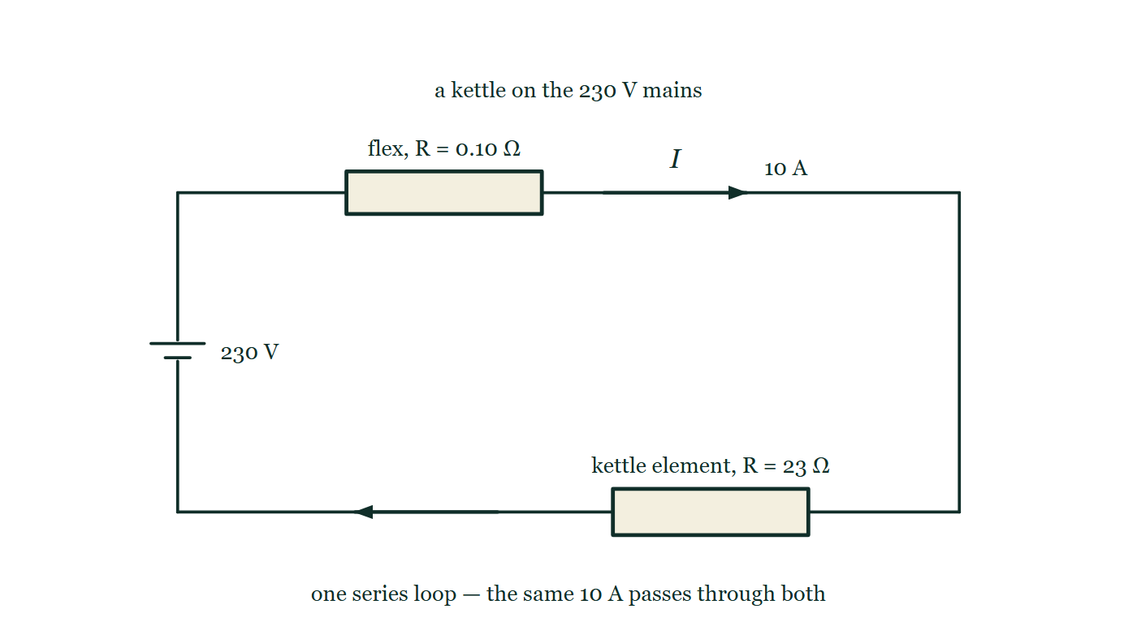
ELECTRICITY & MAGNETISM · THE HEATING EFFECT
GIOPHYSICS LESSON
THINK FIRST
The kettle element glows and the flex feeding it stays cool. They carry exactly the same current — so why?
Take answers before you click — the point is the commitment
Element and flex are in series, which means the same 10 A passes through both of them, second by second, all the way to the boil.
THE ANSWER
Because P = I²R sends the power wherever the resistance is. The same 10 A meets 23 Ω in the element and about 0.10 Ω in the flex, so the element takes 2300 W and the flex takes 10 W. Current is shared in a series circuit; heating is not.
A single series loop from a 230 V supply: the flex drawn as a resistor marked 0.10 Ω in the top wire, and the kettle element drawn as a resistor marked 23 Ω down the right-hand side, with the same 10 A current arrow on the wire before and after them. Nothing on the figure says which one gets hot.
The live version of this figure — click here
Electricity & Magnetism — The Heating Effect. Built by GioPhysics from the lesson's own copy; nothing on these slides is re-authored.
3 / 31
Notes:
[Phase] Starter: Recall what this lesson stands on (minutes 0–5 of 45)
[Hook] The kettle element glows and the flex feeding it stays cool. They carry exactly the same current — so why? Element and flex are in series, which means the same 10 A passes through both of them, second by second, all the way to the boil.
[Answer] Because P = I²R sends the power wherever the resistance is. The same 10 A meets 23 Ω in the element and about 0.10 Ω in the flex, so the element takes 2300 W and the flex takes 10 W. Current is shared in a series circuit; heating is not.
[Figure] A single series loop from a 230 V supply: the flex drawn as a resistor marked 0.10 Ω in the top wire, and the kettle element drawn as a resistor marked 23 Ω down the right-hand side, with the same 10 A current arrow on the wire before and after them. Nothing on the figure says which one gets hot.

Slide 4
ELECTRICITY & MAGNETISM · THE HEATING EFFECT
GIOPHYSICS LESSON
EXPLAINED SIMPLY
In one sentence
Introduce the idea — The big idea and the definition
The heating effect is the conversion of electrical energy into thermal energy, at rate P = IV, wherever current flows through resistance.
Electricity & Magnetism — The Heating Effect. Built by GioPhysics from the lesson's own copy; nothing on these slides is re-authored.
4 / 31
Notes:
[Phase] Introduce the idea: The big idea and the definition (minutes 5–13 of 45)
[Definition] The heating effect is the conversion of electrical energy into thermal energy, at rate P = IV, wherever current flows through resistance.

Slide 5
ELECTRICITY & MAGNETISM · THE HEATING EFFECT
GIOPHYSICS LESSON
EXPLAINED SIMPLY
What that looks like
Introduce the idea — The big idea and the definition
FOR EXAMPLE
A 2300 W kettle on a 230 V supply draws 10 A — every second it turns 2300 J of electrical energy into heat in the element.
Electricity & Magnetism — The Heating Effect. Built by GioPhysics from the lesson's own copy; nothing on these slides is re-authored.
5 / 31
Notes:
[Phase] Introduce the idea: The big idea and the definition (minutes 5–13 of 45)
[Worked illustration] A 2300 W kettle on a 230 V supply draws 10 A — every second it turns 2300 J of electrical energy into heat in the element.

Slide 6
ELECTRICITY & MAGNETISM · THE HEATING EFFECT
GIOPHYSICS LESSON
THE BIG IDEA
Where the energy goes
Introduce the idea — The big idea and the definition
Drifting electrons collide with the lattice and hand over energy, so the conductor warms. The rate is P = IV — rewritten as I²R or V²/R using Ohm’s law. Over time the energy is E = Pt, counted by the electricity meter in kilowatt-hours, and every cable and fuse is rated by the current it can carry before it overheats.
Electricity & Magnetism — The Heating Effect. Built by GioPhysics from the lesson's own copy; nothing on these slides is re-authored.
6 / 31
Notes:
[Phase] Introduce the idea: The big idea and the definition (minutes 5–13 of 45)
[Big idea] Drifting electrons collide with the lattice and hand over energy, so the conductor warms. The rate is P = IV — rewritten as I²R or V²/R using Ohm’s law. Over time the energy is E = Pt, counted by the electricity meter in kilowatt-hours, and every cable and fuse is rated by the current it can carry before it overheats.

Slide 7
ELECTRICITY & MAGNETISM · THE HEATING EFFECT
GIOPHYSICS LESSON
THE PHYSICS · 1 OF 3
Why current heats a wire
Build the model — The formulae, one at a time, in plain English
Every collision between a drifting electron and a lattice ion turns a little electrical energy into vibration. Billions of collisions per second raise the temperature — useful in an element, wasteful in a cable.
Electricity & Magnetism — The Heating Effect. Built by GioPhysics from the lesson's own copy; nothing on these slides is re-authored.
7 / 31
Notes:
[Phase] Build the model: The formulae, one at a time, in plain English (minutes 13–22 of 45)
[Section] Every collision between a drifting electron and a lattice ion turns a little electrical energy into vibration. Billions of collisions per second raise the temperature — useful in an element, wasteful in a cable.

Slide 8
ELECTRICITY & MAGNETISM · THE HEATING EFFECT
GIOPHYSICS LESSON
THE PHYSICS · 2 OF 3
Filament lamps are non-ohmic
Build the model — The formulae, one at a time, in plain English
A metal wire at constant temperature obeys Ohm’s law. A filament does not: more current makes it hotter, and a hotter metal resists more, so its V–I graph curves upward as R climbs.
Electricity & Magnetism — The Heating Effect. Built by GioPhysics from the lesson's own copy; nothing on these slides is re-authored.
8 / 31
Notes:
[Phase] Build the model: The formulae, one at a time, in plain English (minutes 13–22 of 45)
[Section] A metal wire at constant temperature obeys Ohm’s law. A filament does not: more current makes it hotter, and a hotter metal resists more, so its V–I graph curves upward as R climbs.

Slide 9
ELECTRICITY & MAGNETISM · THE HEATING EFFECT
GIOPHYSICS LESSON
THE PHYSICS · 3 OF 3
Fuses and wire ratings
Build the model — The formulae, one at a time, in plain English
Cables have a maximum safe current — beyond it the insulation overheats. The fuse is the deliberate weak point: it melts first, breaking the circuit before the wiring does.
Electricity & Magnetism — The Heating Effect. Built by GioPhysics from the lesson's own copy; nothing on these slides is re-authored.
9 / 31
Notes:
[Phase] Build the model: The formulae, one at a time, in plain English (minutes 13–22 of 45)
[Section] Cables have a maximum safe current — beyond it the insulation overheats. The fuse is the deliberate weak point: it melts first, breaking the circuit before the wiring does.

Slide 10
ELECTRICITY & MAGNETISM · THE HEATING EFFECT
GIOPHYSICS LESSON
FORMULA 1 OF 3
Power
Build the model — The formulae, one at a time, in plain English
P = IV = I²R = V²/R
Three forms of the same statement
IN PLAIN ENGLISH
Pick the form that matches what you know: current and voltage, current and resistance, or voltage and resistance.
Electricity & Magnetism — The Heating Effect. Built by GioPhysics from the lesson's own copy; nothing on these slides is re-authored.
10 / 31
Notes:
[Phase] Build the model: The formulae, one at a time, in plain English (minutes 13–22 of 45)
[Formula] Power: P = IV = I²R = V²/R
[In plain English] Pick the form that matches what you know: current and voltage, current and resistance, or voltage and resistance.
[Note] Three forms of the same statement

Slide 11
ELECTRICITY & MAGNETISM · THE HEATING EFFECT
GIOPHYSICS LESSON
FORMULA 2 OF 3
Energy
Build the model — The formulae, one at a time, in plain English
E = Pt
1 kWh = 3.6 × 10⁶ J
IN PLAIN ENGLISH
Meters count kilowatt-hours because joules are inconveniently small — one kWh is a 1 kW appliance running for an hour.
Electricity & Magnetism — The Heating Effect. Built by GioPhysics from the lesson's own copy; nothing on these slides is re-authored.
11 / 31
Notes:
[Phase] Build the model: The formulae, one at a time, in plain English (minutes 13–22 of 45)
[Formula] Energy: E = Pt
[In plain English] Meters count kilowatt-hours because joules are inconveniently small — one kWh is a 1 kW appliance running for an hour.
[Note] 1 kWh = 3.6 × 10⁶ J

Slide 12
ELECTRICITY & MAGNETISM · THE HEATING EFFECT
GIOPHYSICS LESSON
FORMULA 3 OF 3
Working current
Build the model — The formulae, one at a time, in plain English
I = P/V
Choose the fuse just above this
IN PLAIN ENGLISH
A fuse is a thin wire that melts if the current climbs too high — pick the rating just above the appliance’s normal draw.
Electricity & Magnetism — The Heating Effect. Built by GioPhysics from the lesson's own copy; nothing on these slides is re-authored.
12 / 31
Notes:
[Phase] Build the model: The formulae, one at a time, in plain English (minutes 13–22 of 45)
[Formula] Working current: I = P/V
[In plain English] A fuse is a thin wire that melts if the current climbs too high — pick the rating just above the appliance’s normal draw.
[Note] Choose the fuse just above this

Slide 13
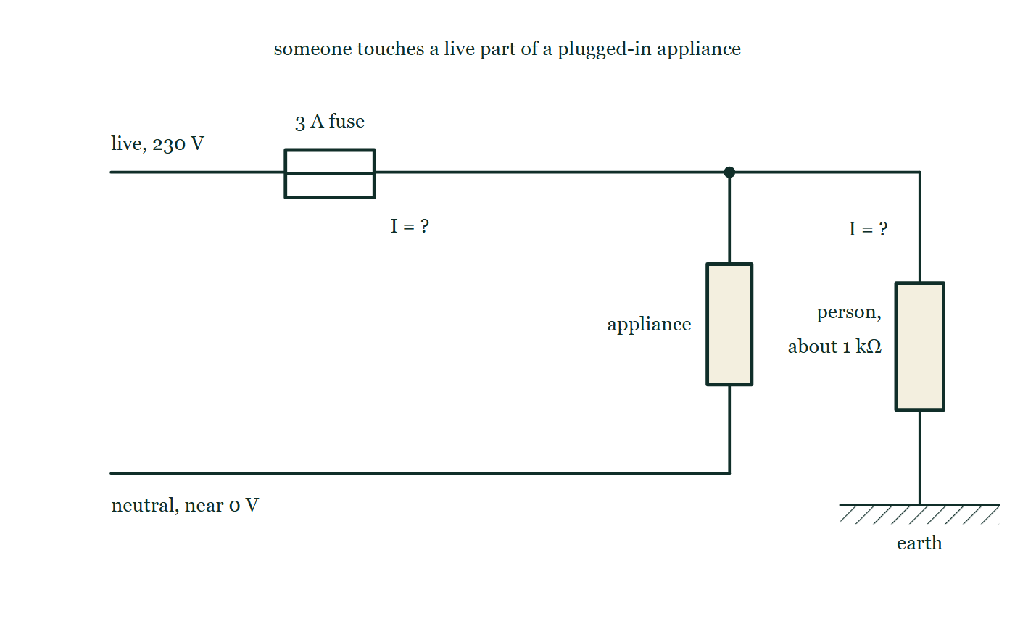
ELECTRICITY & MAGNETISM · THE HEATING EFFECT
GIOPHYSICS LESSON
THE PICTURE
What the fuse can and cannot see
Drawn for this lesson
The live wire runs from the supply through a 3 A fuse, drawn as a thin wire inside a small open rectangle, and on to an appliance; a branch leaves the live wire at a junction and passes down through a resistor labelled as a person of about 1 kΩ to hatched earth. Both currents are marked only with question marks.
The live version of this figure — click here
Electricity & Magnetism — The Heating Effect. Built by GioPhysics from the lesson's own copy; nothing on these slides is re-authored.
13 / 31
Notes:
[Phase] Build the model: The formulae, one at a time, in plain English (minutes 13–22 of 45)
[Figure] The live wire runs from the supply through a 3 A fuse, drawn as a thin wire inside a small open rectangle, and on to an appliance; a branch leaves the live wire at a junction and passes down through a resistor labelled as a person of about 1 kΩ to hatched earth. Both currents are marked only with question marks.

Slide 14
ELECTRICITY & MAGNETISM · THE HEATING EFFECT
GIOPHYSICS LESSON
WATCH OUT
The common trap
Check and misconception — The quick check and the trap
A fuse does not protect you from electric shock — it melts to protect the wiring from overheating. It blows only when the current is well above its rating, and even a small fuse passes far more than the few tens of milliamps that can injure a person.
Electricity & Magnetism — The Heating Effect. Built by GioPhysics from the lesson's own copy; nothing on these slides is re-authored.
14 / 31
Notes:
[Phase] Check and misconception: The quick check and the trap (minutes 35–41 of 45)
[Misconception] A fuse does not protect you from electric shock — it melts to protect the wiring from overheating. It blows only when the current is well above its rating, and even a small fuse passes far more than the few tens of milliamps that can injure a person.

Slide 15
ELECTRICITY & MAGNETISM · THE HEATING EFFECT
GIOPHYSICS LESSON
WORKED EXAMPLE 1 OF 2 · EASY
The question
Easy
Worked examples — I do, we do — one step revealed at a time
A kettle is rated 2300 W at 230 V. Find the current it draws and the resistance of its element.
Electricity & Magnetism — The Heating Effect. Built by GioPhysics from the lesson's own copy; nothing on these slides is re-authored.
15 / 31
Notes:
[Phase] Worked examples: I do, we do — one step revealed at a time (minutes 22–35 of 45)
[Question] A kettle is rated 2300 W at 230 V. Find the current it draws and the resistance of its element.
[Answer] I = 10 A, R = 23 Ω

Slide 16
ELECTRICITY & MAGNETISM · THE HEATING EFFECT
GIOPHYSICS LESSON
WORKED EXAMPLE 1 OF 2 · EASY · THE WORKING
How to solve it
Easy
Worked examples — I do, we do — one step revealed at a time
A kettle is rated 2300 W at 230 V. Find the current it draws and the resistance of its element.
1.
I = P/V = 2300 ÷ 230 = 10 A.
2.
R = V/I = 230 ÷ 10 = 23 Ω.
Electricity & Magnetism — The Heating Effect. Built by GioPhysics from the lesson's own copy; nothing on these slides is re-authored.
16 / 31
Notes:
[Phase] Worked examples: I do, we do — one step revealed at a time (minutes 22–35 of 45)
[Reveal] One click per step. The class works each line before the next appears.
[Step 1] I = P/V = 2300 ÷ 230 = 10 A.
[Step 2] R = V/I = 230 ÷ 10 = 23 Ω.

Slide 17
ELECTRICITY & MAGNETISM · THE HEATING EFFECT
GIOPHYSICS LESSON
WORKED EXAMPLE 1 OF 2 · EASY
Answer
Easy
Worked examples — I do, we do — one step revealed at a time
I = 10 A, R = 23 Ω
Electricity & Magnetism — The Heating Effect. Built by GioPhysics from the lesson's own copy; nothing on these slides is re-authored.
17 / 31
Notes:
[Phase] Worked examples: I do, we do — one step revealed at a time (minutes 22–35 of 45)
[Answer] I = 10 A, R = 23 Ω

Slide 18
ELECTRICITY & MAGNETISM · THE HEATING EFFECT
GIOPHYSICS LESSON
WORKED EXAMPLE 2 OF 2 · MEDIUM
The question
Medium
Worked examples — I do, we do — one step revealed at a time
A 2.0 kW heater runs 3.0 hours a day. Electricity costs $0.15 per kWh. Find the daily energy use and the cost for a 30-day month.
Electricity & Magnetism — The Heating Effect. Built by GioPhysics from the lesson's own copy; nothing on these slides is re-authored.
18 / 31
Notes:
[Phase] Worked examples: I do, we do — one step revealed at a time (minutes 22–35 of 45)
[Question] A 2.0 kW heater runs 3.0 hours a day. Electricity costs $0.15 per kWh. Find the daily energy use and the cost for a 30-day month.
[Answer] 6.0 kWh/day; $27 per month

Slide 19
ELECTRICITY & MAGNETISM · THE HEATING EFFECT
GIOPHYSICS LESSON
WORKED EXAMPLE 2 OF 2 · MEDIUM · THE WORKING
How to solve it
Medium
Worked examples — I do, we do — one step revealed at a time
A 2.0 kW heater runs 3.0 hours a day. Electricity costs $0.15 per kWh. Find the daily energy use and the cost for a 30-day month.
1.
E = Pt = 2.0 × 3.0 = 6.0 kWh per day.
2.
Daily cost = 6.0 × 0.15 = $0.90.
3.
Monthly cost = 0.90 × 30 = $27.
Electricity & Magnetism — The Heating Effect. Built by GioPhysics from the lesson's own copy; nothing on these slides is re-authored.
19 / 31
Notes:
[Phase] Worked examples: I do, we do — one step revealed at a time (minutes 22–35 of 45)
[Reveal] One click per step. The class works each line before the next appears.
[Step 1] E = Pt = 2.0 × 3.0 = 6.0 kWh per day.
[Step 2] Daily cost = 6.0 × 0.15 = $0.90.
[Step 3] Monthly cost = 0.90 × 30 = $27.

Slide 20
ELECTRICITY & MAGNETISM · THE HEATING EFFECT
GIOPHYSICS LESSON
WORKED EXAMPLE 2 OF 2 · MEDIUM
Answer
Medium
Worked examples — I do, we do — one step revealed at a time
6.0 kWh/day; $27 per month
Electricity & Magnetism — The Heating Effect. Built by GioPhysics from the lesson's own copy; nothing on these slides is re-authored.
20 / 31
Notes:
[Phase] Worked examples: I do, we do — one step revealed at a time (minutes 22–35 of 45)
[Answer] 6.0 kWh/day; $27 per month

Slide 21
ELECTRICITY & MAGNETISM · THE HEATING EFFECT
GIOPHYSICS LESSON
PREDICT · TAKE THE VOTE
Commit before you are told
Hands up for each option, then click
Someone touches a live part with wet hands and 230 mA passes through them to earth. What does the 3 A fuse do?
A Melts at once — protecting people is what a fuse is for
B Nothing at all: 0.23 A is nowhere near its 3 A rating
C Melts, but a few seconds too late to help
The live wire runs from the supply through a 3 A fuse, drawn as a thin wire inside a small open rectangle, and on to an appliance; a branch leaves the live wire at a junction and passes down through a resistor labelled as a person of about 1 kΩ to hatched earth. Both currents are marked only with question marks.
The live version of this figure — click here
Electricity & Magnetism — The Heating Effect. Built by GioPhysics from the lesson's own copy; nothing on these slides is re-authored.
21 / 31
Notes:
[Phase] Build the model: The formulae, one at a time, in plain English (minutes 13–22 of 45)
[Predict] Someone touches a live part with wet hands and 230 mA passes through them to earth. What does the 3 A fuse do?
[Options] A Melts at once — protecting people is what a fuse is for B Nothing at all: 0.23 A is nowhere near its 3 A rating C Melts, but a few seconds too late to help
[Figure] The live wire runs from the supply through a 3 A fuse, drawn as a thin wire inside a small open rectangle, and on to an appliance; a branch leaves the live wire at a junction and passes down through a resistor labelled as a person of about 1 kΩ to hatched earth. Both currents are marked only with question marks.

Slide 22
ELECTRICITY & MAGNETISM · THE HEATING EFFECT
GIOPHYSICS LESSON
PREDICT · THE OUTCOME
What actually happens
Ask the room who changed their mind, and why
B Nothing at all: 0.23 A is nowhere near its 3 A rating
WHY
A fuse is a piece of wire chosen to melt at a stated number of amperes, and it cannot tell what the amperes are doing. 230 mA is about a thirteenth of what this fuse needs, so it sees a perfectly ordinary load and stays intact all day — while several times the fatal current runs through a person. A fuse is there to stop the cable overheating. What guards a person is the earth wire, which turns a fault into hundreds of amperes the fuse cannot ignore, and the RCD, which trips on a 30 mA imbalance in about 30 ms.
Electricity & Magnetism — The Heating Effect. Built by GioPhysics from the lesson's own copy; nothing on these slides is re-authored.
22 / 31
Notes:
[Phase] Build the model: The formulae, one at a time, in plain English (minutes 13–22 of 45)
[Answer] B — Nothing at all: 0.23 A is nowhere near its 3 A rating. A fuse is a piece of wire chosen to melt at a stated number of amperes, and it cannot tell what the amperes are doing. 230 mA is about a thirteenth of what this fuse needs, so it sees a perfectly ordinary load and stays intact all day — while several times the fatal current runs through a person. A fuse is there to stop the cable overheating. What guards a person is the earth wire, which turns a fault into hundreds of amperes the fuse cannot ignore, and the RCD, which trips on a 30 mA imbalance in about 30 ms.

Slide 23
ELECTRICITY & MAGNETISM · THE HEATING EFFECT
GIOPHYSICS LESSON
QUICK CHECK
Decide before the answer goes up
Check and misconception — The quick check and the trap
The current through a fixed resistor is doubled. What happens to the heating power?
A
It doubles
B
It quadruples
C
It halves
Electricity & Magnetism — The Heating Effect. Built by GioPhysics from the lesson's own copy; nothing on these slides is re-authored.
23 / 31
Notes:
[Phase] Check and misconception: The quick check and the trap (minutes 35–41 of 45)
[Question] The current through a fixed resistor is doubled. What happens to the heating power?
[Options] A It doubles B It quadruples C It halves

Slide 24
ELECTRICITY & MAGNETISM · THE HEATING EFFECT
GIOPHYSICS LESSON
QUICK CHECK · THE ANSWER
The answer, and why
Check and misconception — The quick check and the trap
B It quadruples
HOW TO GET THERE
P = I²R — with R fixed, doubling the current multiplies the power by four.
WHY THE OTHERS TEMPT
A This is P = IV with V held still while I doubles. But the resistor is fixed, so V is not free: doubling the current through it also doubles the voltage across it, and the two doublings multiply into a factor of four.
B Correct. P = I²R with R fixed, so 2² = 4 — twice the current is four times the heat.
C Nothing goes down here. This looks like reading V²/R with the resistance doubled instead of the current — but R is exactly what was held fixed, and more current through a resistance always means more heating, never less.
Electricity & Magnetism — The Heating Effect. Built by GioPhysics from the lesson's own copy; nothing on these slides is re-authored.
24 / 31
Notes:
[Phase] Check and misconception: The quick check and the trap (minutes 35–41 of 45)
[Question] The current through a fixed resistor is doubled. What happens to the heating power?
[Option by option] A: This is P = IV with V held still while I doubles. But the resistor is fixed, so V is not free: doubling the current through it also doubles the voltage across it, and the two doublings multiply into a factor of four. B: Correct. P = I²R with R fixed, so 2² = 4 — twice the current is four times the heat. C: Nothing goes down here. This looks like reading V²/R with the resistance doubled instead of the current — but R is exactly what was held fixed, and more current through a resistance always means more heating, never less.
[Answer] B — It quadruples
[Why] P = I²R — with R fixed, doubling the current multiplies the power by four.
[Reveal] One click for the answer, then one for the reason.

Slide 25
ELECTRICITY & MAGNETISM · THE HEATING EFFECT
GIOPHYSICS LESSON
EXTENSION 1 OF 2 · HARD
The question
Hard
Worked examples — I do, we do — one step revealed at a time
A filament lamp passes 0.5 mA at 0.08 V, and 1.5 mA at 0.60 V. Find its resistance at each current, and explain the change.
Electricity & Magnetism — The Heating Effect. Built by GioPhysics from the lesson's own copy; nothing on these slides is re-authored.
25 / 31
Notes:
[Phase] Worked examples: I do, we do — one step revealed at a time (minutes 22–35 of 45)
[Question] A filament lamp passes 0.5 mA at 0.08 V, and 1.5 mA at 0.60 V. Find its resistance at each current, and explain the change.
[Answer] 160 Ω, then 400 Ω — resistance climbs with temperature

Slide 26
ELECTRICITY & MAGNETISM · THE HEATING EFFECT
GIOPHYSICS LESSON
EXTENSION 1 OF 2 · HARD · THE WORKING
How to solve it
Hard
Worked examples — I do, we do — one step revealed at a time
A filament lamp passes 0.5 mA at 0.08 V, and 1.5 mA at 0.60 V. Find its resistance at each current, and explain the change.
1.
At 0.5 mA: R = V/I = 0.08 ÷ 0.5 × 10⁻³ = 160 Ω.
2.
At 1.5 mA: R = 0.60 ÷ 1.5 × 10⁻³ = 400 Ω.
3.
More current heats the filament, and a hotter metal has higher resistance — the lamp is non-ohmic.
Electricity & Magnetism — The Heating Effect. Built by GioPhysics from the lesson's own copy; nothing on these slides is re-authored.
26 / 31
Notes:
[Phase] Worked examples: I do, we do — one step revealed at a time (minutes 22–35 of 45)
[Reveal] One click per step. The class works each line before the next appears.
[Step 1] At 0.5 mA: R = V/I = 0.08 ÷ 0.5 × 10⁻³ = 160 Ω.
[Step 2] At 1.5 mA: R = 0.60 ÷ 1.5 × 10⁻³ = 400 Ω.
[Step 3] More current heats the filament, and a hotter metal has higher resistance — the lamp is non-ohmic.

Slide 27
ELECTRICITY & MAGNETISM · THE HEATING EFFECT
GIOPHYSICS LESSON
EXTENSION 1 OF 2 · HARD
Answer
Hard
Worked examples — I do, we do — one step revealed at a time
160 Ω, then 400 Ω — resistance climbs with temperature
Electricity & Magnetism — The Heating Effect. Built by GioPhysics from the lesson's own copy; nothing on these slides is re-authored.
27 / 31
Notes:
[Phase] Worked examples: I do, we do — one step revealed at a time (minutes 22–35 of 45)
[Answer] 160 Ω, then 400 Ω — resistance climbs with temperature

Slide 28
ELECTRICITY & MAGNETISM · THE HEATING EFFECT
GIOPHYSICS LESSON
EXTENSION 2 OF 2 · CHALLENGING
The question
Challenging
Worked examples — I do, we do — one step revealed at a time
A 1.8 kW washing machine runs on 230 V. Choose the right fuse (3 A, 5 A or 13 A), then find the heat wasted in its 0.10 Ω supply cable.
Electricity & Magnetism — The Heating Effect. Built by GioPhysics from the lesson's own copy; nothing on these slides is re-authored.
28 / 31
Notes:
[Phase] Worked examples: I do, we do — one step revealed at a time (minutes 22–35 of 45)
[Question] A 1.8 kW washing machine runs on 230 V. Choose the right fuse (3 A, 5 A or 13 A), then find the heat wasted in its 0.10 Ω supply cable.
[Answer] 13 A fuse; ≈ 6.1 W lost in the cable

Slide 29
ELECTRICITY & MAGNETISM · THE HEATING EFFECT
GIOPHYSICS LESSON
EXTENSION 2 OF 2 · CHALLENGING · THE WORKING
How to solve it
Challenging
Worked examples — I do, we do — one step revealed at a time
A 1.8 kW washing machine runs on 230 V. Choose the right fuse (3 A, 5 A or 13 A), then find the heat wasted in its 0.10 Ω supply cable.
1.
I = P/V = 1800 ÷ 230 ≈ 7.8 A — above 5 A, so fit the 13 A fuse.
2.
Cable heating: P = I²R = 7.8² × 0.10 ≈ 6.1 W.
3.
That 6 W warms the cable, not the wash — thick cables keep R, and this waste, small.
Electricity & Magnetism — The Heating Effect. Built by GioPhysics from the lesson's own copy; nothing on these slides is re-authored.
29 / 31
Notes:
[Phase] Worked examples: I do, we do — one step revealed at a time (minutes 22–35 of 45)
[Reveal] One click per step. The class works each line before the next appears.
[Step 1] I = P/V = 1800 ÷ 230 ≈ 7.8 A — above 5 A, so fit the 13 A fuse.
[Step 2] Cable heating: P = I²R = 7.8² × 0.10 ≈ 6.1 W.
[Step 3] That 6 W warms the cable, not the wash — thick cables keep R, and this waste, small.

Slide 30
ELECTRICITY & MAGNETISM · THE HEATING EFFECT
GIOPHYSICS LESSON
EXTENSION 2 OF 2 · CHALLENGING
Answer
Challenging
Worked examples — I do, we do — one step revealed at a time
13 A fuse; ≈ 6.1 W lost in the cable
Electricity & Magnetism — The Heating Effect. Built by GioPhysics from the lesson's own copy; nothing on these slides is re-authored.
30 / 31
Notes:
[Phase] Worked examples: I do, we do — one step revealed at a time (minutes 22–35 of 45)
[Answer] 13 A fuse; ≈ 6.1 W lost in the cable

Slide 31
ELECTRICITY & MAGNETISM · THE HEATING EFFECT
GIOPHYSICS LESSON
ELECTRICITY & MAGNETISM
Where to go next
Plenary — What to take away, what to practise next
Next
20.3 Electric Cells
https://giophysics.com/chapter-39/electric-cells/
Lesson
This lesson on giophysics.com
https://giophysics.com/chapter-39/heating-effect/
Live
The live, interactive version of these slides
https://giophysics.com/chapter-39/presentation/?lesson=heating
Chapter
All Electricity & Magnetism lessons
https://giophysics.com/chapter-39/
PDF
Download the lesson PDF
https://giophysics.com/downloads/39-2-heating-effect.pdf
Electricity & Magnetism — The Heating Effect. Built by GioPhysics from the lesson's own copy; nothing on these slides is re-authored.
31 / 31
Notes:
[Phase] Plenary: What to take away, what to practise next (minutes 41–45 of 45)
[Interactive] The graphs and the circuit topology on these slides are frozen. The live version at https://giophysics.com/chapter-39/presentation/?lesson=heating moves them.

