Slide 1
ELECTRICITY & MAGNETISM · MAGNETIC EFFECTS OF CURRENTS
GIOPHYSICS LESSON
20 · Electricity & Magnetism
Every current makes a field
Magnetic Effects of Currents
Wrap your right hand round a wire and your fingers trace circles of magnetic field. Coil the wire into a solenoid and those circles organise into a bar-magnet field you can switch on, reverse, and strengthen at will.
POSITION
Lesson 4 of 7 in Electricity & Magnetism
PLAN
16 slides in the 45-minute core run, about 44.5 minutes of it
LESSON PAGE
https://giophysics.com/chapter-39/magnetic-effects/
Built by GioPhysics from the lesson's own page. Every word on these slides is the lesson's; nothing here is re-authored. Teaching material, not an awarding body's document.
Electricity & Magnetism — Magnetic Effects of Currents. Built by GioPhysics from the lesson's own copy; nothing on these slides is re-authored.
1 / 31
Notes:
[Lesson] Electricity & Magnetism — Magnetic Effects of Currents. Lesson 4 of 7.
[Intro] Wrap your right hand round a wire and your fingers trace circles of magnetic field. Coil the wire into a solenoid and those circles organise into a bar-magnet field you can switch on, reverse, and strengthen at will.
[Source] https://giophysics.com/chapter-39/magnetic-effects/
[Disclaimer] Built by GioPhysics from the lesson's own page. Every word on these slides is the lesson's; nothing here is re-authored. Teaching material, not an awarding body's document.

Slide 2
ELECTRICITY & MAGNETISM · MAGNETIC EFFECTS OF CURRENTS
GIOPHYSICS LESSON
WHAT THIS NEEDS
What you already know
Starter — Recall what this lesson stands on
Recall
Magnets & field lines
https://giophysics.com/chapter-27/magnets-magnetic-fields/
Recall
Currents make fields
https://giophysics.com/chapter-27/currents-magnetic-fields/
Electricity & Magnetism — Magnetic Effects of Currents. Built by GioPhysics from the lesson's own copy; nothing on these slides is re-authored.
2 / 31
Notes:
[Phase] Starter: Recall what this lesson stands on (minutes 0–5 of 45)
[Starter] Recall: Magnets & field lines; Currents make fields

Slide 3
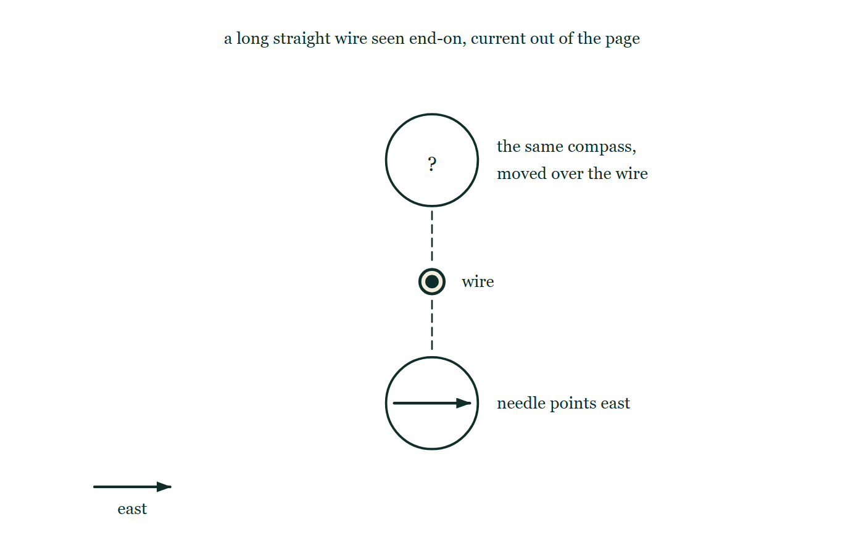
ELECTRICITY & MAGNETISM · MAGNETIC EFFECTS OF CURRENTS
GIOPHYSICS LESSON
THINK FIRST
A compass under a live wire swings to point east. You slide it up and over the wire without turning it. What does it read now?
Take answers before you click — the point is the commitment
Same wire, same current, same compass, never rotated — only lifted from under the wire to above it.
THE ANSWER
West. Exactly reversed. The field lines are closed circles centred on the wire, so on the top of the circle the field runs the opposite way from the bottom. Nothing about the wire changed; the compass simply moved to the other side of a loop.
A long straight wire seen end-on as a dot in a circle, current coming out of the page. A compass below it has its needle drawn pointing east; an identical compass directly above it has a blank face with a question mark on it, and a scale arrow at the corner fixes which way east is.
The live version of this figure — click here
Electricity & Magnetism — Magnetic Effects of Currents. Built by GioPhysics from the lesson's own copy; nothing on these slides is re-authored.
3 / 31
Notes:
[Phase] Starter: Recall what this lesson stands on (minutes 0–5 of 45)
[Hook] A compass under a live wire swings to point east. You slide it up and over the wire without turning it. What does it read now? Same wire, same current, same compass, never rotated — only lifted from under the wire to above it.
[Answer] West. Exactly reversed. The field lines are closed circles centred on the wire, so on the top of the circle the field runs the opposite way from the bottom. Nothing about the wire changed; the compass simply moved to the other side of a loop.
[Figure] A long straight wire seen end-on as a dot in a circle, current coming out of the page. A compass below it has its needle drawn pointing east; an identical compass directly above it has a blank face with a question mark on it, and a scale arrow at the corner fixes which way east is.

Slide 4
ELECTRICITY & MAGNETISM · MAGNETIC EFFECTS OF CURRENTS
GIOPHYSICS LESSON
EXPLAINED SIMPLY
In one sentence
Introduce the idea — The big idea and the definition
Around every electric current there is a magnetic field; for a straight wire the field lines are circles centred on the wire.
Electricity & Magnetism — Magnetic Effects of Currents. Built by GioPhysics from the lesson's own copy; nothing on these slides is re-authored.
4 / 31
Notes:
[Phase] Introduce the idea: The big idea and the definition (minutes 5–13 of 45)
[Definition] Around every electric current there is a magnetic field; for a straight wire the field lines are circles centred on the wire.

Slide 5
ELECTRICITY & MAGNETISM · MAGNETIC EFFECTS OF CURRENTS
GIOPHYSICS LESSON
EXPLAINED SIMPLY
What that looks like
Introduce the idea — The big idea and the definition
FOR EXAMPLE
Compasses placed around a vertical wire swing into a circle the moment current flows — and swing the other way round when the current reverses.
Electricity & Magnetism — Magnetic Effects of Currents. Built by GioPhysics from the lesson's own copy; nothing on these slides is re-authored.
5 / 31
Notes:
[Phase] Introduce the idea: The big idea and the definition (minutes 5–13 of 45)
[Worked illustration] Compasses placed around a vertical wire swing into a circle the moment current flows — and swing the other way round when the current reverses.

Slide 6
ELECTRICITY & MAGNETISM · MAGNETIC EFFECTS OF CURRENTS
GIOPHYSICS LESSON
THE BIG IDEA
Every current makes a field
Introduce the idea — The big idea and the definition
A current creates a magnetic field that circles the wire — closed loops with no poles and no ends. The right-hand grip rule gives the direction. Bending the wire into a loop concentrates the field; a solenoid stacks many loops into a strong, uniform interior field; and an iron core multiplies it into an electromagnet strong enough to lift cars or switch circuits.
Electricity & Magnetism — Magnetic Effects of Currents. Built by GioPhysics from the lesson's own copy; nothing on these slides is re-authored.
6 / 31
Notes:
[Phase] Introduce the idea: The big idea and the definition (minutes 5–13 of 45)
[Big idea] A current creates a magnetic field that circles the wire — closed loops with no poles and no ends. The right-hand grip rule gives the direction. Bending the wire into a loop concentrates the field; a solenoid stacks many loops into a strong, uniform interior field; and an iron core multiplies it into an electromagnet strong enough to lift cars or switch circuits.

Slide 7
ELECTRICITY & MAGNETISM · MAGNETIC EFFECTS OF CURRENTS
GIOPHYSICS LESSON
THE PHYSICS · 1 OF 3
Right-hand grip
Build the model — The formulae, one at a time, in plain English
For a wire: thumb along the conventional current, fingers curl in the field direction. For a solenoid: fingers curl with the current in the loops, and the thumb points out of the north pole.
Electricity & Magnetism — Magnetic Effects of Currents. Built by GioPhysics from the lesson's own copy; nothing on these slides is re-authored.
7 / 31
Notes:
[Phase] Build the model: The formulae, one at a time, in plain English (minutes 13–22 of 45)
[Section] For a wire: thumb along the conventional current, fingers curl in the field direction. For a solenoid: fingers curl with the current in the loops, and the thumb points out of the north pole.

Slide 8
ELECTRICITY & MAGNETISM · MAGNETIC EFFECTS OF CURRENTS
GIOPHYSICS LESSON
THE PHYSICS · 2 OF 3
Electromagnets
Build the model — The formulae, one at a time, in plain English
A solenoid with a soft iron core is a magnet with a switch: turn the current off and the field collapses, reverse the current and the poles swap, raise the current and it strengthens — scrapyard cranes, door locks, and MRI machines all rely on this.
Electricity & Magnetism — Magnetic Effects of Currents. Built by GioPhysics from the lesson's own copy; nothing on these slides is re-authored.
8 / 31
Notes:
[Phase] Build the model: The formulae, one at a time, in plain English (minutes 13–22 of 45)
[Section] A solenoid with a soft iron core is a magnet with a switch: turn the current off and the field collapses, reverse the current and the poles swap, raise the current and it strengthens — scrapyard cranes, door locks, and MRI machines all rely on this.

Slide 9
ELECTRICITY & MAGNETISM · MAGNETIC EFFECTS OF CURRENTS
GIOPHYSICS LESSON
THE PHYSICS · 3 OF 3
Relays
Build the model — The formulae, one at a time, in plain English
A relay uses a small current to energise an electromagnet, which pulls a switch closed in a second, higher-power circuit. A low-power signal — a thermostat, a car key — safely controls a heavy current it never touches.
Electricity & Magnetism — Magnetic Effects of Currents. Built by GioPhysics from the lesson's own copy; nothing on these slides is re-authored.
9 / 31
Notes:
[Phase] Build the model: The formulae, one at a time, in plain English (minutes 13–22 of 45)
[Section] A relay uses a small current to energise an electromagnet, which pulls a switch closed in a second, higher-power circuit. A low-power signal — a thermostat, a car key — safely controls a heavy current it never touches.

Slide 10
ELECTRICITY & MAGNETISM · MAGNETIC EFFECTS OF CURRENTS
GIOPHYSICS LESSON
FORMULA 1 OF 3
Straight wire
Build the model — The formulae, one at a time, in plain English
B = μ₀I/(2πd)
μ₀ = 4π × 10⁻⁷ T·m/A
IN PLAIN ENGLISH
The field weakens with distance from the wire and strengthens with the current — double the current, double the field.
Electricity & Magnetism — Magnetic Effects of Currents. Built by GioPhysics from the lesson's own copy; nothing on these slides is re-authored.
10 / 31
Notes:
[Phase] Build the model: The formulae, one at a time, in plain English (minutes 13–22 of 45)
[Formula] Straight wire: B = μ₀I/(2πd)
[In plain English] The field weakens with distance from the wire and strengthens with the current — double the current, double the field.
[Note] μ₀ = 4π × 10⁻⁷ T·m/A

Slide 11
ELECTRICITY & MAGNETISM · MAGNETIC EFFECTS OF CURRENTS
GIOPHYSICS LESSON
FORMULA 2 OF 3
Centre of a flat loop
Build the model — The formulae, one at a time, in plain English
B = μ₀I/(2R)
π times the straight-wire value at the same distance
IN PLAIN ENGLISH
Bending the wire into a circle wraps its whole field around one central point — the loop concentrates what the straight wire spreads out.
Electricity & Magnetism — Magnetic Effects of Currents. Built by GioPhysics from the lesson's own copy; nothing on these slides is re-authored.
11 / 31
Notes:
[Phase] Build the model: The formulae, one at a time, in plain English (minutes 13–22 of 45)
[Formula] Centre of a flat loop: B = μ₀I/(2R)
[In plain English] Bending the wire into a circle wraps its whole field around one central point — the loop concentrates what the straight wire spreads out.
[Note] π times the straight-wire value at the same distance

Slide 12
ELECTRICITY & MAGNETISM · MAGNETIC EFFECTS OF CURRENTS
GIOPHYSICS LESSON
FORMULA 3 OF 3
Inside a solenoid
Build the model — The formulae, one at a time, in plain English
B = μ₀nI
n = turns per metre of length
IN PLAIN ENGLISH
Every extra turn per metre and every extra ampere adds field — and an iron core can multiply the result hundreds of times.
Electricity & Magnetism — Magnetic Effects of Currents. Built by GioPhysics from the lesson's own copy; nothing on these slides is re-authored.
12 / 31
Notes:
[Phase] Build the model: The formulae, one at a time, in plain English (minutes 13–22 of 45)
[Formula] Inside a solenoid: B = μ₀nI
[In plain English] Every extra turn per metre and every extra ampere adds field — and an iron core can multiply the result hundreds of times.
[Note] n = turns per metre of length

Slide 13
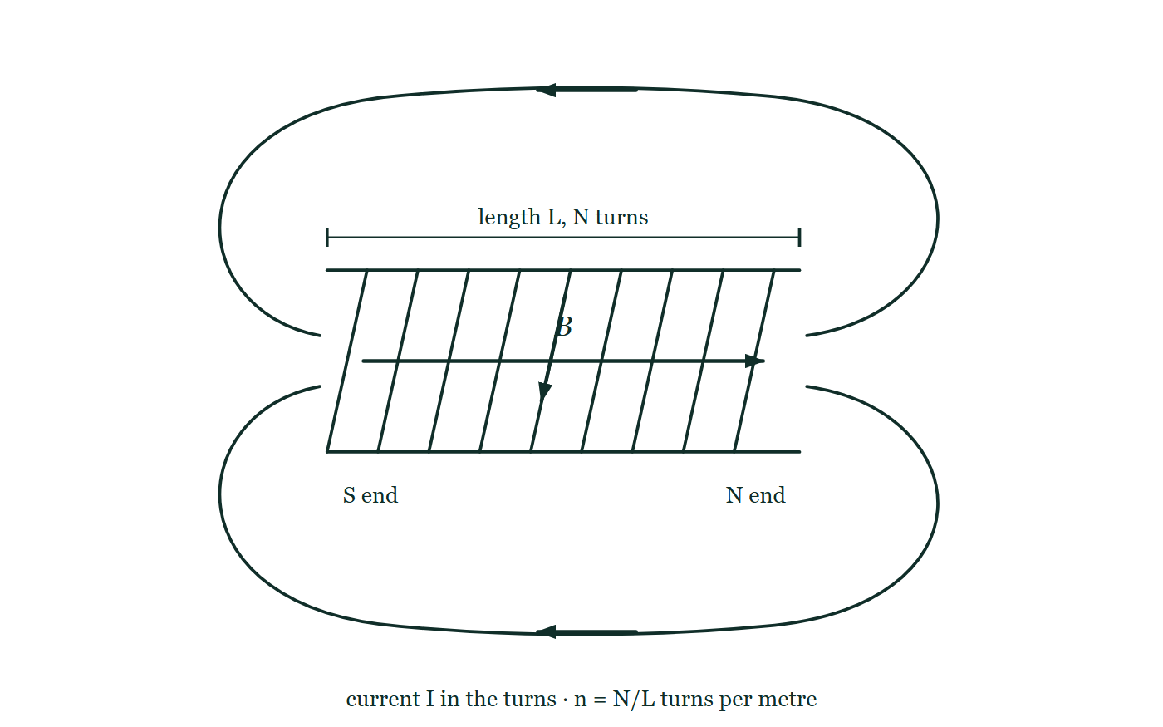
ELECTRICITY & MAGNETISM · MAGNETIC EFFECTS OF CURRENTS
GIOPHYSICS LESSON
THE PICTURE
Field lines with nowhere to end
Drawn for this lesson
A solenoid drawn as a coil of slanted turns closed top and bottom, its length dimensioned and marked N turns, with straight field arrows running left to right inside it and two large field lines looping out of the right-hand end, round the outside and back into the left-hand end.
The live version of this figure — click here
Electricity & Magnetism — Magnetic Effects of Currents. Built by GioPhysics from the lesson's own copy; nothing on these slides is re-authored.
13 / 31
Notes:
[Phase] Build the model: The formulae, one at a time, in plain English (minutes 13–22 of 45)
[Figure] A solenoid drawn as a coil of slanted turns closed top and bottom, its length dimensioned and marked N turns, with straight field arrows running left to right inside it and two large field lines looping out of the right-hand end, round the outside and back into the left-hand end.

Slide 14
ELECTRICITY & MAGNETISM · MAGNETIC EFFECTS OF CURRENTS
GIOPHYSICS LESSON
WATCH OUT
The common trap
Check and misconception — The quick check and the trap
Magnetic field lines around a current never start or stop — they are closed circles. Electric field lines begin on positive charge and end on negative charge, but there are no magnetic monopoles for field lines to terminate on: every north comes with a south.
Electricity & Magnetism — Magnetic Effects of Currents. Built by GioPhysics from the lesson's own copy; nothing on these slides is re-authored.
14 / 31
Notes:
[Phase] Check and misconception: The quick check and the trap (minutes 35–41 of 45)
[Misconception] Magnetic field lines around a current never start or stop — they are closed circles. Electric field lines begin on positive charge and end on negative charge, but there are no magnetic monopoles for field lines to terminate on: every north comes with a south.

Slide 15
ELECTRICITY & MAGNETISM · MAGNETIC EFFECTS OF CURRENTS
GIOPHYSICS LESSON
WORKED EXAMPLE 1 OF 2 · EASY
The question
Easy
Worked examples — I do, we do — one step revealed at a time
Find the magnetic flux density 1.0 cm from a straight wire carrying 25 A.
Electricity & Magnetism — Magnetic Effects of Currents. Built by GioPhysics from the lesson's own copy; nothing on these slides is re-authored.
15 / 31
Notes:
[Phase] Worked examples: I do, we do — one step revealed at a time (minutes 22–35 of 45)
[Question] Find the magnetic flux density 1.0 cm from a straight wire carrying 25 A.
[Answer] 5.0 × 10⁻⁴ T

Slide 16
ELECTRICITY & MAGNETISM · MAGNETIC EFFECTS OF CURRENTS
GIOPHYSICS LESSON
WORKED EXAMPLE 1 OF 2 · EASY · THE WORKING
How to solve it
Easy
Worked examples — I do, we do — one step revealed at a time
Find the magnetic flux density 1.0 cm from a straight wire carrying 25 A.
1.
B = μ₀I/(2πd) = (4π × 10⁻⁷ × 25) ÷ (2π × 0.010).
2.
B = 5.0 × 10⁻⁴ T.
Electricity & Magnetism — Magnetic Effects of Currents. Built by GioPhysics from the lesson's own copy; nothing on these slides is re-authored.
16 / 31
Notes:
[Phase] Worked examples: I do, we do — one step revealed at a time (minutes 22–35 of 45)
[Reveal] One click per step. The class works each line before the next appears.
[Step 1] B = μ₀I/(2πd) = (4π × 10⁻⁷ × 25) ÷ (2π × 0.010).
[Step 2] B = 5.0 × 10⁻⁴ T.

Slide 17
ELECTRICITY & MAGNETISM · MAGNETIC EFFECTS OF CURRENTS
GIOPHYSICS LESSON
WORKED EXAMPLE 1 OF 2 · EASY
Answer
Easy
Worked examples — I do, we do — one step revealed at a time
5.0 × 10⁻⁴ T
Electricity & Magnetism — Magnetic Effects of Currents. Built by GioPhysics from the lesson's own copy; nothing on these slides is re-authored.
17 / 31
Notes:
[Phase] Worked examples: I do, we do — one step revealed at a time (minutes 22–35 of 45)
[Answer] 5.0 × 10⁻⁴ T

Slide 18
ELECTRICITY & MAGNETISM · MAGNETIC EFFECTS OF CURRENTS
GIOPHYSICS LESSON
WORKED EXAMPLE 2 OF 2 · MEDIUM
The question
Medium
Worked examples — I do, we do — one step revealed at a time
The same 25 A now flows round a flat loop of radius 1.0 cm. Find the field at the centre and compare it with the straight wire.
Electricity & Magnetism — Magnetic Effects of Currents. Built by GioPhysics from the lesson's own copy; nothing on these slides is re-authored.
18 / 31
Notes:
[Phase] Worked examples: I do, we do — one step revealed at a time (minutes 22–35 of 45)
[Question] The same 25 A now flows round a flat loop of radius 1.0 cm. Find the field at the centre and compare it with the straight wire.
[Answer] ≈ 1.6 × 10⁻³ T, π times stronger

Slide 19
ELECTRICITY & MAGNETISM · MAGNETIC EFFECTS OF CURRENTS
GIOPHYSICS LESSON
WORKED EXAMPLE 2 OF 2 · MEDIUM · THE WORKING
How to solve it
Medium
Worked examples — I do, we do — one step revealed at a time
The same 25 A now flows round a flat loop of radius 1.0 cm. Find the field at the centre and compare it with the straight wire.
1.
B = μ₀I/(2R) = (4π × 10⁻⁷ × 25) ÷ (2 × 0.010).
2.
B ≈ 1.6 × 10⁻³ T.
3.
That is π times the straight-wire value — the loop wraps its field around one point.
Electricity & Magnetism — Magnetic Effects of Currents. Built by GioPhysics from the lesson's own copy; nothing on these slides is re-authored.
19 / 31
Notes:
[Phase] Worked examples: I do, we do — one step revealed at a time (minutes 22–35 of 45)
[Reveal] One click per step. The class works each line before the next appears.
[Step 1] B = μ₀I/(2R) = (4π × 10⁻⁷ × 25) ÷ (2 × 0.010).
[Step 2] B ≈ 1.6 × 10⁻³ T.
[Step 3] That is π times the straight-wire value — the loop wraps its field around one point.

Slide 20
ELECTRICITY & MAGNETISM · MAGNETIC EFFECTS OF CURRENTS
GIOPHYSICS LESSON
WORKED EXAMPLE 2 OF 2 · MEDIUM
Answer
Medium
Worked examples — I do, we do — one step revealed at a time
≈ 1.6 × 10⁻³ T, π times stronger
Electricity & Magnetism — Magnetic Effects of Currents. Built by GioPhysics from the lesson's own copy; nothing on these slides is re-authored.
20 / 31
Notes:
[Phase] Worked examples: I do, we do — one step revealed at a time (minutes 22–35 of 45)
[Answer] ≈ 1.6 × 10⁻³ T, π times stronger

Slide 21
ELECTRICITY & MAGNETISM · MAGNETIC EFFECTS OF CURRENTS
GIOPHYSICS LESSON
PREDICT · TAKE THE VOTE
Commit before you are told
Hands up for each option, then click
Follow the field line that passes through the lower compass. Where does it start and where does it end?
A It starts at the wire's north pole and ends at its south pole
B It starts on the wire and runs outwards for ever, like an electric field line from a charge
C It does not start or end anywhere — it closes on itself, a circle round the wire
A long straight wire seen end-on as a dot in a circle, current coming out of the page. A compass below it has its needle drawn pointing east; an identical compass directly above it has a blank face with a question mark on it, and a scale arrow at the corner fixes which way east is.
The live version of this figure — click here
Electricity & Magnetism — Magnetic Effects of Currents. Built by GioPhysics from the lesson's own copy; nothing on these slides is re-authored.
21 / 31
Notes:
[Phase] Build the model: The formulae, one at a time, in plain English (minutes 13–22 of 45)
[Predict] Follow the field line that passes through the lower compass. Where does it start and where does it end?
[Options] A It starts at the wire's north pole and ends at its south pole B It starts on the wire and runs outwards for ever, like an electric field line from a charge C It does not start or end anywhere — it closes on itself, a circle round the wire
[Figure] A long straight wire seen end-on as a dot in a circle, current coming out of the page. A compass below it has its needle drawn pointing east; an identical compass directly above it has a blank face with a question mark on it, and a scale arrow at the corner fixes which way east is.

Slide 22
ELECTRICITY & MAGNETISM · MAGNETIC EFFECTS OF CURRENTS
GIOPHYSICS LESSON
PREDICT · THE OUTCOME
What actually happens
Ask the room who changed their mind, and why
C It does not start or end anywhere — it closes on itself, a circle round the wire
WHY
A straight wire has no poles at all: nothing on it is a north end or a south end, so there is nothing for a line to leave from or arrive at. And field lines do not radiate outwards either — that is the electric field of a charged wire, a different picture that gets borrowed here because it was met first. Magnetic field lines are always closed loops, because no isolated magnetic pole has ever been found for one to terminate on.
Electricity & Magnetism — Magnetic Effects of Currents. Built by GioPhysics from the lesson's own copy; nothing on these slides is re-authored.
22 / 31
Notes:
[Phase] Build the model: The formulae, one at a time, in plain English (minutes 13–22 of 45)
[Answer] C — It does not start or end anywhere — it closes on itself, a circle round the wire. A straight wire has no poles at all: nothing on it is a north end or a south end, so there is nothing for a line to leave from or arrive at. And field lines do not radiate outwards either — that is the electric field of a charged wire, a different picture that gets borrowed here because it was met first. Magnetic field lines are always closed loops, because no isolated magnetic pole has ever been found for one to terminate on.

Slide 23
ELECTRICITY & MAGNETISM · MAGNETIC EFFECTS OF CURRENTS
GIOPHYSICS LESSON
QUICK CHECK
Decide before the answer goes up
Check and misconception — The quick check and the trap
The current in a solenoid is doubled and its turns per metre are halved. The field inside…
A
Doubles
B
Halves
C
Stays the same
Electricity & Magnetism — Magnetic Effects of Currents. Built by GioPhysics from the lesson's own copy; nothing on these slides is re-authored.
23 / 31
Notes:
[Phase] Check and misconception: The quick check and the trap (minutes 35–41 of 45)
[Question] The current in a solenoid is doubled and its turns per metre are halved. The field inside…
[Options] A Doubles B Halves C Stays the same

Slide 24
ELECTRICITY & MAGNETISM · MAGNETIC EFFECTS OF CURRENTS
GIOPHYSICS LESSON
QUICK CHECK · THE ANSWER
The answer, and why
Check and misconception — The quick check and the trap
C Stays the same
HOW TO GET THERE
B = μ₀nI — halving n and doubling I leaves the product nI, and so the field, unchanged.
WHY THE OTHERS TEMPT
A This follows the doubling of the current and drops the halving of the turns. B = μ₀nI depends on the product, so a change in one factor is only half the story.
B This tracks the turns and drops the current. Halving n on its own would indeed halve the field — but the current was doubled in the same breath.
C Correct. B = μ₀nI contains only the product nI, so 2I with n/2 gives the same field. The same coil wound half as tightly and driven twice as hard is magnetically identical.
Electricity & Magnetism — Magnetic Effects of Currents. Built by GioPhysics from the lesson's own copy; nothing on these slides is re-authored.
24 / 31
Notes:
[Phase] Check and misconception: The quick check and the trap (minutes 35–41 of 45)
[Question] The current in a solenoid is doubled and its turns per metre are halved. The field inside…
[Option by option] A: This follows the doubling of the current and drops the halving of the turns. B = μ₀nI depends on the product, so a change in one factor is only half the story. B: This tracks the turns and drops the current. Halving n on its own would indeed halve the field — but the current was doubled in the same breath. C: Correct. B = μ₀nI contains only the product nI, so 2I with n/2 gives the same field. The same coil wound half as tightly and driven twice as hard is magnetically identical.
[Answer] C — Stays the same
[Why] B = μ₀nI — halving n and doubling I leaves the product nI, and so the field, unchanged.
[Reveal] One click for the answer, then one for the reason.

Slide 25
ELECTRICITY & MAGNETISM · MAGNETIC EFFECTS OF CURRENTS
GIOPHYSICS LESSON
EXTENSION 1 OF 2 · HARD
The question
Hard
Worked examples — I do, we do — one step revealed at a time
A solenoid has 1200 turns wound on a 0.30 m tube and carries 2.5 A. Find the field inside, and estimate it with an iron core that multiplies the field 200 times.
Electricity & Magnetism — Magnetic Effects of Currents. Built by GioPhysics from the lesson's own copy; nothing on these slides is re-authored.
25 / 31
Notes:
[Phase] Worked examples: I do, we do — one step revealed at a time (minutes 22–35 of 45)
[Question] A solenoid has 1200 turns wound on a 0.30 m tube and carries 2.5 A. Find the field inside, and estimate it with an iron core that multiplies the field 200 times.
[Answer] ≈ 13 mT air-cored; ≈ 2.5 T with iron

Slide 26
ELECTRICITY & MAGNETISM · MAGNETIC EFFECTS OF CURRENTS
GIOPHYSICS LESSON
EXTENSION 1 OF 2 · HARD · THE WORKING
How to solve it
Hard
Worked examples — I do, we do — one step revealed at a time
A solenoid has 1200 turns wound on a 0.30 m tube and carries 2.5 A. Find the field inside, and estimate it with an iron core that multiplies the field 200 times.
1.
n = 1200 ÷ 0.30 = 4000 turns per metre.
2.
B = μ₀nI = 4π × 10⁻⁷ × 4000 × 2.5 ≈ 1.3 × 10⁻² T.
3.
With the iron core: ≈ 200 × 13 mT ≈ 2.5 T — electromagnet territory.
Electricity & Magnetism — Magnetic Effects of Currents. Built by GioPhysics from the lesson's own copy; nothing on these slides is re-authored.
26 / 31
Notes:
[Phase] Worked examples: I do, we do — one step revealed at a time (minutes 22–35 of 45)
[Reveal] One click per step. The class works each line before the next appears.
[Step 1] n = 1200 ÷ 0.30 = 4000 turns per metre.
[Step 2] B = μ₀nI = 4π × 10⁻⁷ × 4000 × 2.5 ≈ 1.3 × 10⁻² T.
[Step 3] With the iron core: ≈ 200 × 13 mT ≈ 2.5 T — electromagnet territory.

Slide 27
ELECTRICITY & MAGNETISM · MAGNETIC EFFECTS OF CURRENTS
GIOPHYSICS LESSON
EXTENSION 1 OF 2 · HARD
Answer
Hard
Worked examples — I do, we do — one step revealed at a time
≈ 13 mT air-cored; ≈ 2.5 T with iron
Electricity & Magnetism — Magnetic Effects of Currents. Built by GioPhysics from the lesson's own copy; nothing on these slides is re-authored.
27 / 31
Notes:
[Phase] Worked examples: I do, we do — one step revealed at a time (minutes 22–35 of 45)
[Answer] ≈ 13 mT air-cored; ≈ 2.5 T with iron

Slide 28
ELECTRICITY & MAGNETISM · MAGNETIC EFFECTS OF CURRENTS
GIOPHYSICS LESSON
EXTENSION 2 OF 2 · CHALLENGING
The question
Challenging
Worked examples — I do, we do — one step revealed at a time
Earth’s field is about 5.0 × 10⁻⁵ T. How close to a straight cable carrying 25 A does the cable’s field equal Earth’s — and why does this matter for a compass?
Electricity & Magnetism — Magnetic Effects of Currents. Built by GioPhysics from the lesson's own copy; nothing on these slides is re-authored.
28 / 31
Notes:
[Phase] Worked examples: I do, we do — one step revealed at a time (minutes 22–35 of 45)
[Question] Earth’s field is about 5.0 × 10⁻⁵ T. How close to a straight cable carrying 25 A does the cable’s field equal Earth’s — and why does this matter for a compass?
[Answer] d = 0.10 m — compasses lie near live cables

Slide 29
ELECTRICITY & MAGNETISM · MAGNETIC EFFECTS OF CURRENTS
GIOPHYSICS LESSON
EXTENSION 2 OF 2 · CHALLENGING · THE WORKING
How to solve it
Challenging
Worked examples — I do, we do — one step revealed at a time
Earth’s field is about 5.0 × 10⁻⁵ T. How close to a straight cable carrying 25 A does the cable’s field equal Earth’s — and why does this matter for a compass?
1.
Set μ₀I/(2πd) = 5.0 × 10⁻⁵ and solve for d.
2.
d = μ₀I/(2πB) = (2 × 10⁻⁷ × 25) ÷ 5.0 × 10⁻⁵ = 0.10 m.
3.
Within about 10 cm of the cable a compass is steered more by the current than by the planet.
Electricity & Magnetism — Magnetic Effects of Currents. Built by GioPhysics from the lesson's own copy; nothing on these slides is re-authored.
29 / 31
Notes:
[Phase] Worked examples: I do, we do — one step revealed at a time (minutes 22–35 of 45)
[Reveal] One click per step. The class works each line before the next appears.
[Step 1] Set μ₀I/(2πd) = 5.0 × 10⁻⁵ and solve for d.
[Step 2] d = μ₀I/(2πB) = (2 × 10⁻⁷ × 25) ÷ 5.0 × 10⁻⁵ = 0.10 m.
[Step 3] Within about 10 cm of the cable a compass is steered more by the current than by the planet.

Slide 30
ELECTRICITY & MAGNETISM · MAGNETIC EFFECTS OF CURRENTS
GIOPHYSICS LESSON
EXTENSION 2 OF 2 · CHALLENGING
Answer
Challenging
Worked examples — I do, we do — one step revealed at a time
d = 0.10 m — compasses lie near live cables
Electricity & Magnetism — Magnetic Effects of Currents. Built by GioPhysics from the lesson's own copy; nothing on these slides is re-authored.
30 / 31
Notes:
[Phase] Worked examples: I do, we do — one step revealed at a time (minutes 22–35 of 45)
[Answer] d = 0.10 m — compasses lie near live cables

Slide 31
ELECTRICITY & MAGNETISM · MAGNETIC EFFECTS OF CURRENTS
GIOPHYSICS LESSON
ELECTRICITY & MAGNETISM
Where to go next
Plenary — What to take away, what to practise next
Next
20.5 The Motor Effect
https://giophysics.com/chapter-39/the-motor-effect/
Lesson
This lesson on giophysics.com
https://giophysics.com/chapter-39/magnetic-effects/
Live
The live, interactive version of these slides
https://giophysics.com/chapter-39/presentation/?lesson=magnetic
Chapter
All Electricity & Magnetism lessons
https://giophysics.com/chapter-39/
PDF
Download the lesson PDF
https://giophysics.com/downloads/39-4-magnetic-effects.pdf
Electricity & Magnetism — Magnetic Effects of Currents. Built by GioPhysics from the lesson's own copy; nothing on these slides is re-authored.
31 / 31
Notes:
[Phase] Plenary: What to take away, what to practise next (minutes 41–45 of 45)
[Interactive] The graphs and the circuit topology on these slides are frozen. The live version at https://giophysics.com/chapter-39/presentation/?lesson=magnetic moves them.

