Slide 1
ELECTRICITY & MAGNETISM · THE MOTOR EFFECT
GIOPHYSICS LESSON
20 · Electricity & Magnetism
Fields push on currents
The Motor Effect
Put a current-carrying wire across a magnetic field and the field pushes it sideways — F = BIL sinθ. Arrange two sides of a coil, add a commutator, and that sideways push becomes a motor.
POSITION
Lesson 5 of 7 in Electricity & Magnetism
PLAN
16 slides in the 45-minute core run, about 43.5 minutes of it
LESSON PAGE
https://giophysics.com/chapter-39/the-motor-effect/
Built by GioPhysics from the lesson's own page. Every word on these slides is the lesson's; nothing here is re-authored. Teaching material, not an awarding body's document.
Electricity & Magnetism — The Motor Effect. Built by GioPhysics from the lesson's own copy; nothing on these slides is re-authored.
1 / 32
Notes:
[Lesson] Electricity & Magnetism — The Motor Effect. Lesson 5 of 7.
[Intro] Put a current-carrying wire across a magnetic field and the field pushes it sideways — F = BIL sinθ. Arrange two sides of a coil, add a commutator, and that sideways push becomes a motor.
[Source] https://giophysics.com/chapter-39/the-motor-effect/
[Disclaimer] Built by GioPhysics from the lesson's own page. Every word on these slides is the lesson's; nothing here is re-authored. Teaching material, not an awarding body's document.

Slide 2
ELECTRICITY & MAGNETISM · THE MOTOR EFFECT
GIOPHYSICS LESSON
WHAT THIS NEEDS
What you already know
Starter — Recall what this lesson stands on
Recall
Magnetic effects of currents
https://giophysics.com/chapter-39/magnetic-effects/
Recall
Force on currents
https://giophysics.com/chapter-27/force-on-currents/
Electricity & Magnetism — The Motor Effect. Built by GioPhysics from the lesson's own copy; nothing on these slides is re-authored.
2 / 32
Notes:
[Phase] Starter: Recall what this lesson stands on (minutes 0–5 of 45)
[Starter] Recall: Magnetic effects of currents; Force on currents

Slide 3
ELECTRICITY & MAGNETISM · THE MOTOR EFFECT
GIOPHYSICS LESSON
THINK FIRST
An electron is fired into a magnetic field and comes out travelling at right angles to the way it went in. Which is faster — the electron going in, or the electron coming out?
Take answers before you click — the point is the commitment
It entered at 2.0 × 10⁷ m/s. Inside the field its path curved steadily round until it left through the side, moving in a completely different direction.
THE ANSWER
Neither. Both are 2.0 × 10⁷ m/s. The magnetic force is perpendicular to the velocity at every instant, so it can only steer — never speed up, never slow down. That is exactly why the path is a circle and not a spiral, and it is why a magnetic field does no work on a moving charge.
Electricity & Magnetism — The Motor Effect. Built by GioPhysics from the lesson's own copy; nothing on these slides is re-authored.
3 / 32
Notes:
[Phase] Starter: Recall what this lesson stands on (minutes 0–5 of 45)
[Hook] An electron is fired into a magnetic field and comes out travelling at right angles to the way it went in. Which is faster — the electron going in, or the electron coming out? It entered at 2.0 × 10⁷ m/s. Inside the field its path curved steadily round until it left through the side, moving in a completely different direction.
[Answer] Neither. Both are 2.0 × 10⁷ m/s. The magnetic force is perpendicular to the velocity at every instant, so it can only steer — never speed up, never slow down. That is exactly why the path is a circle and not a spiral, and it is why a magnetic field does no work on a moving charge.

Slide 4
ELECTRICITY & MAGNETISM · THE MOTOR EFFECT
GIOPHYSICS LESSON
EXPLAINED SIMPLY
In one sentence
Introduce the idea — The big idea and the definition
The motor effect is the force on a current-carrying conductor in a magnetic field — largest when current and field are perpendicular, zero when they are parallel.
Electricity & Magnetism — The Motor Effect. Built by GioPhysics from the lesson's own copy; nothing on these slides is re-authored.
4 / 32
Notes:
[Phase] Introduce the idea: The big idea and the definition (minutes 5–13 of 45)
[Definition] The motor effect is the force on a current-carrying conductor in a magnetic field — largest when current and field are perpendicular, zero when they are parallel.

Slide 5
ELECTRICITY & MAGNETISM · THE MOTOR EFFECT
GIOPHYSICS LESSON
EXPLAINED SIMPLY
What that looks like
Introduce the idea — The big idea and the definition
FOR EXAMPLE
A wire resting between magnet poles jumps the instant current flows — reverse either the current or the field and it jumps the other way.
Electricity & Magnetism — The Motor Effect. Built by GioPhysics from the lesson's own copy; nothing on these slides is re-authored.
5 / 32
Notes:
[Phase] Introduce the idea: The big idea and the definition (minutes 5–13 of 45)
[Worked illustration] A wire resting between magnet poles jumps the instant current flows — reverse either the current or the field and it jumps the other way.

Slide 6
ELECTRICITY & MAGNETISM · THE MOTOR EFFECT
GIOPHYSICS LESSON
THE BIG IDEA
Fields push on currents
Introduce the idea — The big idea and the definition
A magnetic field exerts a force on moving charge: F = qvB sinθ for one charge, F = BIL sinθ for a wire full of them. The force is perpendicular to both the current and the field — Fleming’s left hand gives its direction. The two sides of a coil feel opposite forces, making a turning pair, and the commutator swaps the connections every half turn so the coil keeps turning the same way.
Electricity & Magnetism — The Motor Effect. Built by GioPhysics from the lesson's own copy; nothing on these slides is re-authored.
6 / 32
Notes:
[Phase] Introduce the idea: The big idea and the definition (minutes 5–13 of 45)
[Big idea] A magnetic field exerts a force on moving charge: F = qvB sinθ for one charge, F = BIL sinθ for a wire full of them. The force is perpendicular to both the current and the field — Fleming’s left hand gives its direction. The two sides of a coil feel opposite forces, making a turning pair, and the commutator swaps the connections every half turn so the coil keeps turning the same way.

Slide 7
ELECTRICITY & MAGNETISM · THE MOTOR EFFECT
GIOPHYSICS LESSON
THE PHYSICS · 1 OF 3
Direction rules
Build the model — The formulae, one at a time, in plain English
Fleming’s left hand: First finger along the Field, seCond finger along the Current, and the thuMb gives the Motion. The force is perpendicular to both — swap current or field and the force flips.
Electricity & Magnetism — The Motor Effect. Built by GioPhysics from the lesson's own copy; nothing on these slides is re-authored.
7 / 32
Notes:
[Phase] Build the model: The formulae, one at a time, in plain English (minutes 13–22 of 45)
[Section] Fleming’s left hand: First finger along the Field, seCond finger along the Current, and the thuMb gives the Motion. The force is perpendicular to both — swap current or field and the force flips.

Slide 8
ELECTRICITY & MAGNETISM · THE MOTOR EFFECT
GIOPHYSICS LESSON
THE PHYSICS · 2 OF 3
Why charges circle
Build the model — The formulae, one at a time, in plain English
The force on a free charge is always perpendicular to its velocity, so it changes direction but never speed: uniform circular motion with r = mv/(qB). Mass spectrometers, particle detectors, and the aurora all run on this.
Electricity & Magnetism — The Motor Effect. Built by GioPhysics from the lesson's own copy; nothing on these slides is re-authored.
8 / 32
Notes:
[Phase] Build the model: The formulae, one at a time, in plain English (minutes 13–22 of 45)
[Section] The force on a free charge is always perpendicular to its velocity, so it changes direction but never speed: uniform circular motion with r = mv/(qB). Mass spectrometers, particle detectors, and the aurora all run on this.

Slide 9
ELECTRICITY & MAGNETISM · THE MOTOR EFFECT
GIOPHYSICS LESSON
THE PHYSICS · 3 OF 3
The dc motor
Build the model — The formulae, one at a time, in plain English
The coil’s two sides carry current in opposite directions, so the field pushes one up and one down — a torque. After half a turn the split-ring commutator swaps the connections, keeping the torque in the same rotational sense.
Electricity & Magnetism — The Motor Effect. Built by GioPhysics from the lesson's own copy; nothing on these slides is re-authored.
9 / 32
Notes:
[Phase] Build the model: The formulae, one at a time, in plain English (minutes 13–22 of 45)
[Section] The coil’s two sides carry current in opposite directions, so the field pushes one up and one down — a torque. After half a turn the split-ring commutator swaps the connections, keeping the torque in the same rotational sense.

Slide 10
ELECTRICITY & MAGNETISM · THE MOTOR EFFECT
GIOPHYSICS LESSON
FORMULA 1 OF 3
Force on a wire
Build the model — The formulae, one at a time, in plain English
F = BIL sinθ
θ between current and field
IN PLAIN ENGLISH
More field, more current, or more wire in the field all mean more force — and only the component of the field across the wire counts.
Electricity & Magnetism — The Motor Effect. Built by GioPhysics from the lesson's own copy; nothing on these slides is re-authored.
10 / 32
Notes:
[Phase] Build the model: The formulae, one at a time, in plain English (minutes 13–22 of 45)
[Formula] Force on a wire: F = BIL sinθ
[In plain English] More field, more current, or more wire in the field all mean more force — and only the component of the field across the wire counts.
[Note] θ between current and field

Slide 11
ELECTRICITY & MAGNETISM · THE MOTOR EFFECT
GIOPHYSICS LESSON
FORMULA 2 OF 3
Force on a moving charge
Build the model — The formulae, one at a time, in plain English
F = qvB sinθ
Circular motion with r = mv/(qB)
IN PLAIN ENGLISH
A single charge feels the same kind of push. Always perpendicular to the velocity, it bends the path into a circle without changing the speed.
Electricity & Magnetism — The Motor Effect. Built by GioPhysics from the lesson's own copy; nothing on these slides is re-authored.
11 / 32
Notes:
[Phase] Build the model: The formulae, one at a time, in plain English (minutes 13–22 of 45)
[Formula] Force on a moving charge: F = qvB sinθ
[In plain English] A single charge feels the same kind of push. Always perpendicular to the velocity, it bends the path into a circle without changing the speed.
[Note] Circular motion with r = mv/(qB)

Slide 12
ELECTRICITY & MAGNETISM · THE MOTOR EFFECT
GIOPHYSICS LESSON
FORMULA 3 OF 3
Turning a coil
Build the model — The formulae, one at a time, in plain English
τ(max) = NBIA
N turns, coil area A
IN PLAIN ENGLISH
Opposite forces on the two sides of a coil make a turning effect — greatest when the coil’s plane lies along the field.
Electricity & Magnetism — The Motor Effect. Built by GioPhysics from the lesson's own copy; nothing on these slides is re-authored.
12 / 32
Notes:
[Phase] Build the model: The formulae, one at a time, in plain English (minutes 13–22 of 45)
[Formula] Turning a coil: τ(max) = NBIA
[In plain English] Opposite forces on the two sides of a coil make a turning effect — greatest when the coil’s plane lies along the field.
[Note] N turns, coil area A

Slide 13
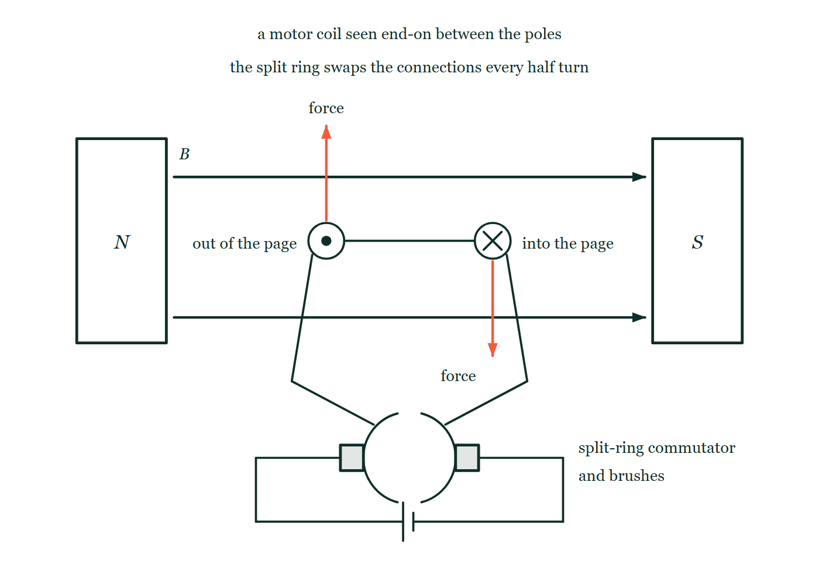
ELECTRICITY & MAGNETISM · THE MOTOR EFFECT
GIOPHYSICS LESSON
THE PICTURE
Why the coil keeps turning one way
Drawn for this lesson
A motor coil seen end-on between a north pole on the left and a south pole on the right, field arrows running left to right: one side of the coil carries current out of the page and is pushed upward, the other carries it into the page and is pushed downward, and below them a split ring with two brushes feeds the coil from a cell.
The live version of this figure — click here
Electricity & Magnetism — The Motor Effect. Built by GioPhysics from the lesson's own copy; nothing on these slides is re-authored.
13 / 32
Notes:
[Phase] Build the model: The formulae, one at a time, in plain English (minutes 13–22 of 45)
[Figure] A motor coil seen end-on between a north pole on the left and a south pole on the right, field arrows running left to right: one side of the coil carries current out of the page and is pushed upward, the other carries it into the page and is pushed downward, and below them a split ring with two brushes feeds the coil from a cell.

Slide 14
ELECTRICITY & MAGNETISM · THE MOTOR EFFECT
GIOPHYSICS LESSON
WATCH OUT
The common trap
Check and misconception — The quick check and the trap
The magnetic force never does work on a moving charge — it is always perpendicular to the velocity, so it changes direction, not speed. A motor does deliver work, but that energy comes from the electrical supply pushing the current, not from the magnet, which is never used up.
Electricity & Magnetism — The Motor Effect. Built by GioPhysics from the lesson's own copy; nothing on these slides is re-authored.
14 / 32
Notes:
[Phase] Check and misconception: The quick check and the trap (minutes 35–41 of 45)
[Misconception] The magnetic force never does work on a moving charge — it is always perpendicular to the velocity, so it changes direction, not speed. A motor does deliver work, but that energy comes from the electrical supply pushing the current, not from the magnet, which is never used up.

Slide 15
ELECTRICITY & MAGNETISM · THE MOTOR EFFECT
GIOPHYSICS LESSON
WORKED EXAMPLE 1 OF 2 · EASY
The question
Easy
Worked examples — I do, we do — one step revealed at a time
A 25 m power line carries 15 A at right angles to a field of 0.076 T. Find the force on it.
Electricity & Magnetism — The Motor Effect. Built by GioPhysics from the lesson's own copy; nothing on these slides is re-authored.
15 / 32
Notes:
[Phase] Worked examples: I do, we do — one step revealed at a time (minutes 22–35 of 45)
[Question] A 25 m power line carries 15 A at right angles to a field of 0.076 T. Find the force on it.
[Answer] ≈ 29 N

Slide 16
ELECTRICITY & MAGNETISM · THE MOTOR EFFECT
GIOPHYSICS LESSON
WORKED EXAMPLE 1 OF 2 · EASY · THE WORKING
How to solve it
Easy
Worked examples — I do, we do — one step revealed at a time
A 25 m power line carries 15 A at right angles to a field of 0.076 T. Find the force on it.
1.
F = BIL sinθ with θ = 90°.
2.
F = 0.076 × 15 × 25 ≈ 29 N.
Electricity & Magnetism — The Motor Effect. Built by GioPhysics from the lesson's own copy; nothing on these slides is re-authored.
16 / 32
Notes:
[Phase] Worked examples: I do, we do — one step revealed at a time (minutes 22–35 of 45)
[Reveal] One click per step. The class works each line before the next appears.
[Step 1] F = BIL sinθ with θ = 90°.
[Step 2] F = 0.076 × 15 × 25 ≈ 29 N.

Slide 17
ELECTRICITY & MAGNETISM · THE MOTOR EFFECT
GIOPHYSICS LESSON
WORKED EXAMPLE 1 OF 2 · EASY
Answer
Easy
Worked examples — I do, we do — one step revealed at a time
≈ 29 N
Electricity & Magnetism — The Motor Effect. Built by GioPhysics from the lesson's own copy; nothing on these slides is re-authored.
17 / 32
Notes:
[Phase] Worked examples: I do, we do — one step revealed at a time (minutes 22–35 of 45)
[Answer] ≈ 29 N

Slide 18
ELECTRICITY & MAGNETISM · THE MOTOR EFFECT
GIOPHYSICS LESSON
WORKED EXAMPLE 2 OF 2 · MEDIUM
The question
Medium
Worked examples — I do, we do — one step revealed at a time
A 25 μC charge travels at 150 m/s perpendicular to a 0.050 T field. Find the force on it, and state what the force changes.
Electricity & Magnetism — The Motor Effect. Built by GioPhysics from the lesson's own copy; nothing on these slides is re-authored.
18 / 32
Notes:
[Phase] Worked examples: I do, we do — one step revealed at a time (minutes 22–35 of 45)
[Question] A 25 μC charge travels at 150 m/s perpendicular to a 0.050 T field. Find the force on it, and state what the force changes.
[Answer] ≈ 1.9 × 10⁻⁴ N, deflecting the charge into a curve

Slide 19
ELECTRICITY & MAGNETISM · THE MOTOR EFFECT
GIOPHYSICS LESSON
WORKED EXAMPLE 2 OF 2 · MEDIUM · THE WORKING
How to solve it
Medium
Worked examples — I do, we do — one step revealed at a time
A 25 μC charge travels at 150 m/s perpendicular to a 0.050 T field. Find the force on it, and state what the force changes.
1.
F = qvB = 25 × 10⁻⁶ × 150 × 0.050.
2.
F ≈ 1.9 × 10⁻⁴ N.
3.
The force is perpendicular to v — it bends the path but leaves the speed alone.
Electricity & Magnetism — The Motor Effect. Built by GioPhysics from the lesson's own copy; nothing on these slides is re-authored.
19 / 32
Notes:
[Phase] Worked examples: I do, we do — one step revealed at a time (minutes 22–35 of 45)
[Reveal] One click per step. The class works each line before the next appears.
[Step 1] F = qvB = 25 × 10⁻⁶ × 150 × 0.050.
[Step 2] F ≈ 1.9 × 10⁻⁴ N.
[Step 3] The force is perpendicular to v — it bends the path but leaves the speed alone.

Slide 20
ELECTRICITY & MAGNETISM · THE MOTOR EFFECT
GIOPHYSICS LESSON
WORKED EXAMPLE 2 OF 2 · MEDIUM
Answer
Medium
Worked examples — I do, we do — one step revealed at a time
≈ 1.9 × 10⁻⁴ N, deflecting the charge into a curve
Electricity & Magnetism — The Motor Effect. Built by GioPhysics from the lesson's own copy; nothing on these slides is re-authored.
20 / 32
Notes:
[Phase] Worked examples: I do, we do — one step revealed at a time (minutes 22–35 of 45)
[Answer] ≈ 1.9 × 10⁻⁴ N, deflecting the charge into a curve

Slide 21
ELECTRICITY & MAGNETISM · THE MOTOR EFFECT
GIOPHYSICS LESSON
SPOT THE MISTAKE
One line here is wrong
The whole working is up — find the bad line before you click
1.
A coil of 50 turns measures 3.0 cm by 2.0 cm, sits in a 0.25 T field and carries 1.5 A. Find the force on each long side.
2.
The long sides are the 3.0 cm ones, and they lie across the field.
3.
F = NBIL
4.
F = 50 × 0.25 × 1.5 × 3.0
5.
F = 56 N on each side
LINE 4 IS WRONG
The length is still in centimetres. Every other quantity on that line is already in SI — teslas, amperes, a pure count of turns — so nothing looks out of place, and 56 N is a believable-sounding force for a motor. The units are the check: B I L is T·A·m, and a tesla is N/(A·m), so the metre has to be a metre or the newtons never appear.
IT SHOULD SAY
F = 50 × 0.25 × 1.5 × 0.030 = 0.56 N on each side
Electricity & Magnetism — The Motor Effect. Built by GioPhysics from the lesson's own copy; nothing on these slides is re-authored.
21 / 32
Notes:
[Phase] Worked examples: I do, we do — one step revealed at a time (minutes 22–35 of 45)
[Spot the mistake] The working is complete and one line of it is wrong. Let the room hunt: one click names the line, a second shows it done correctly.
[Line 4 is wrong] The length is still in centimetres. Every other quantity on that line is already in SI — teslas, amperes, a pure count of turns — so nothing looks out of place, and 56 N is a believable-sounding force for a motor. The units are the check: B I L is T·A·m, and a tesla is N/(A·m), so the metre has to be a metre or the newtons never appear.
[It should say] F = 50 × 0.25 × 1.5 × 0.030 = 0.56 N on each side

Slide 22
ELECTRICITY & MAGNETISM · THE MOTOR EFFECT
GIOPHYSICS LESSON
PREDICT · TAKE THE VOTE
Commit before you are told
Hands up for each option, then click
The motor runs for an hour and lifts a heavy load. What has been used up?
A The magnets — they will be measurably weaker by the end of the hour
B Nothing; once the coil is turning it keeps itself going
C Energy from the electrical supply — the magnets are exactly as strong as they were
A motor coil seen end-on between a north pole on the left and a south pole on the right, field arrows running left to right: one side of the coil carries current out of the page and is pushed upward, the other carries it into the page and is pushed downward, and below them a split ring with two brushes feeds the coil from a cell.
The live version of this figure — click here
Electricity & Magnetism — The Motor Effect. Built by GioPhysics from the lesson's own copy; nothing on these slides is re-authored.
22 / 32
Notes:
[Phase] Build the model: The formulae, one at a time, in plain English (minutes 13–22 of 45)
[Predict] The motor runs for an hour and lifts a heavy load. What has been used up?
[Options] A The magnets — they will be measurably weaker by the end of the hour B Nothing; once the coil is turning it keeps itself going C Energy from the electrical supply — the magnets are exactly as strong as they were
[Figure] A motor coil seen end-on between a north pole on the left and a south pole on the right, field arrows running left to right: one side of the coil carries current out of the page and is pushed upward, the other carries it into the page and is pushed downward, and below them a split ring with two brushes feeds the coil from a cell.

Slide 23
ELECTRICITY & MAGNETISM · THE MOTOR EFFECT
GIOPHYSICS LESSON
PREDICT · THE OUTCOME
What actually happens
Ask the room who changed their mind, and why
C Energy from the electrical supply — the magnets are exactly as strong as they were
WHY
Trace the energy rather than the pushing. The magnetic force acts at right angles to each drifting charge's motion, so it does no work on the charges — what it does is shove the wire sideways. As the wire moves, the field induces a voltage in the coil that opposes the current, and the supply has to push harder to keep that current flowing. The extra electrical work the supply does is precisely the work that lifts the load. The magnet steers the energy; it never provides any, and it is not consumed.
Electricity & Magnetism — The Motor Effect. Built by GioPhysics from the lesson's own copy; nothing on these slides is re-authored.
23 / 32
Notes:
[Phase] Build the model: The formulae, one at a time, in plain English (minutes 13–22 of 45)
[Answer] C — Energy from the electrical supply — the magnets are exactly as strong as they were. Trace the energy rather than the pushing. The magnetic force acts at right angles to each drifting charge's motion, so it does no work on the charges — what it does is shove the wire sideways. As the wire moves, the field induces a voltage in the coil that opposes the current, and the supply has to push harder to keep that current flowing. The extra electrical work the supply does is precisely the work that lifts the load. The magnet steers the energy; it never provides any, and it is not consumed.

Slide 24
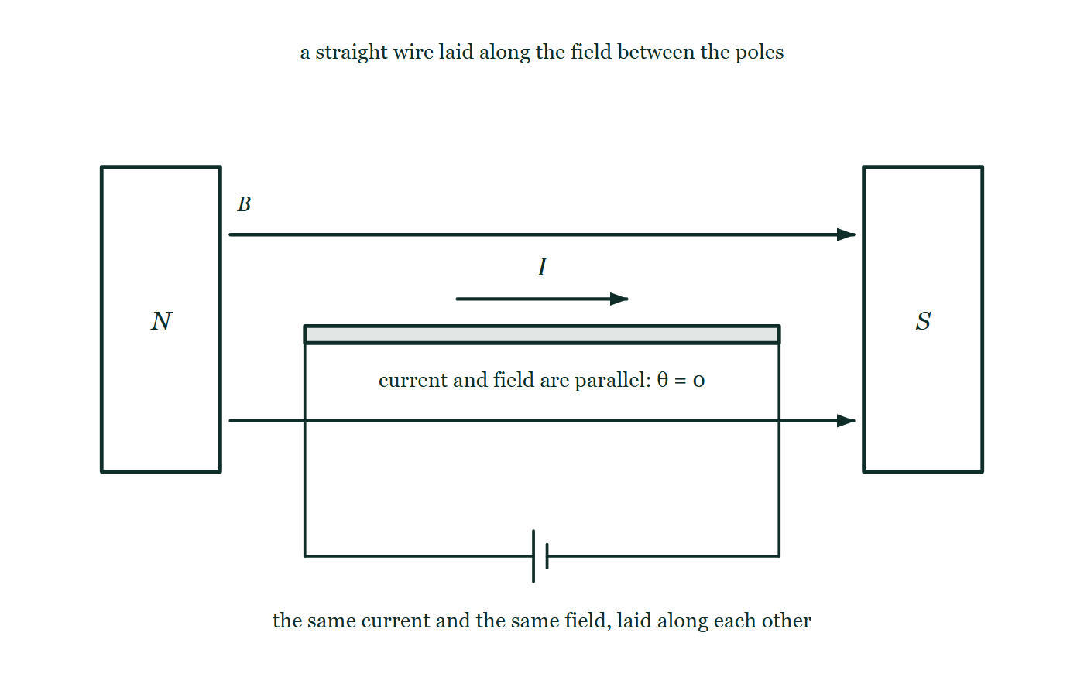
ELECTRICITY & MAGNETISM · THE MOTOR EFFECT
GIOPHYSICS LESSON
QUICK CHECK
Decide before the answer goes up
Check and misconception — The quick check and the trap
A wire carries current parallel to a magnetic field. The magnetic force on it is…
A
Maximum
B
Zero
C
Half of maximum
A straight conductor stretched horizontally through the gap between a north and a south pole, its leads dropping vertically to a cell below, with the current arrow on the conductor and the two field arrows above and below it all pointing the same way, and the angle between them marked θ = 0.
The live version of this figure — click here
Electricity & Magnetism — The Motor Effect. Built by GioPhysics from the lesson's own copy; nothing on these slides is re-authored.
24 / 32
Notes:
[Phase] Check and misconception: The quick check and the trap (minutes 35–41 of 45)
[Question] A wire carries current parallel to a magnetic field. The magnetic force on it is…
[Figure] A straight conductor stretched horizontally through the gap between a north and a south pole, its leads dropping vertically to a cell below, with the current arrow on the conductor and the two field arrows above and below it all pointing the same way, and the angle between them marked θ = 0.
[Options] A Maximum B Zero C Half of maximum

Slide 25
ELECTRICITY & MAGNETISM · THE MOTOR EFFECT
GIOPHYSICS LESSON
QUICK CHECK · THE ANSWER
The answer, and why
Check and misconception — The quick check and the trap
B Zero
HOW TO GET THERE
F = BIL sinθ — with θ = 0 the sine is zero, so a wire along the field feels no force at all.
WHY THE OTHERS TEMPT
A Maximum is the θ = 90° case — the arrangement almost every textbook figure draws, with the current cutting straight across the field lines, which is why it is the answer that arrives first. Laying the current along the field is the opposite extreme of the same formula.
B Correct. F = BIL sin θ with θ = 0 gives sin 0 = 0: a current running along the field lines feels nothing at all.
C Half of maximum happens at θ = 30°, since sin 30° = 0.5 — and note that 45° gives 0.71 of the maximum, not half. Sine is not proportional to the angle, and at 0° it is genuinely zero rather than merely small.
Electricity & Magnetism — The Motor Effect. Built by GioPhysics from the lesson's own copy; nothing on these slides is re-authored.
25 / 32
Notes:
[Phase] Check and misconception: The quick check and the trap (minutes 35–41 of 45)
[Question] A wire carries current parallel to a magnetic field. The magnetic force on it is…
[Option by option] A: Maximum is the θ = 90° case — the arrangement almost every textbook figure draws, with the current cutting straight across the field lines, which is why it is the answer that arrives first. Laying the current along the field is the opposite extreme of the same formula. B: Correct. F = BIL sin θ with θ = 0 gives sin 0 = 0: a current running along the field lines feels nothing at all. C: Half of maximum happens at θ = 30°, since sin 30° = 0.5 — and note that 45° gives 0.71 of the maximum, not half. Sine is not proportional to the angle, and at 0° it is genuinely zero rather than merely small.
[Answer] B — Zero
[Why] F = BIL sinθ — with θ = 0 the sine is zero, so a wire along the field feels no force at all.
[Reveal] One click for the answer, then one for the reason.

Slide 26
ELECTRICITY & MAGNETISM · THE MOTOR EFFECT
GIOPHYSICS LESSON
EXTENSION 1 OF 2 · HARD
The question
Hard
Worked examples — I do, we do — one step revealed at a time
An electron moves at 2.0 × 10⁷ m/s perpendicular to a 3.0 mT field. Find the radius of its circular path.
Electricity & Magnetism — The Motor Effect. Built by GioPhysics from the lesson's own copy; nothing on these slides is re-authored.
26 / 32
Notes:
[Phase] Worked examples: I do, we do — one step revealed at a time (minutes 22–35 of 45)
[Question] An electron moves at 2.0 × 10⁷ m/s perpendicular to a 3.0 mT field. Find the radius of its circular path.
[Answer] r ≈ 3.8 cm

Slide 27
ELECTRICITY & MAGNETISM · THE MOTOR EFFECT
GIOPHYSICS LESSON
EXTENSION 1 OF 2 · HARD · THE WORKING
How to solve it
Hard
Worked examples — I do, we do — one step revealed at a time
An electron moves at 2.0 × 10⁷ m/s perpendicular to a 3.0 mT field. Find the radius of its circular path.
1.
r = mv/(qB) = (9.11 × 10⁻³¹ × 2.0 × 10⁷) ÷ (1.60 × 10⁻¹⁹ × 3.0 × 10⁻³).
2.
r = 1.82 × 10⁻²³ ÷ 4.8 × 10⁻²² ≈ 0.038 m.
3.
About 3.8 cm — a lab-bench circle, and the working scale of a mass spectrometer.
Electricity & Magnetism — The Motor Effect. Built by GioPhysics from the lesson's own copy; nothing on these slides is re-authored.
27 / 32
Notes:
[Phase] Worked examples: I do, we do — one step revealed at a time (minutes 22–35 of 45)
[Reveal] One click per step. The class works each line before the next appears.
[Step 1] r = mv/(qB) = (9.11 × 10⁻³¹ × 2.0 × 10⁷) ÷ (1.60 × 10⁻¹⁹ × 3.0 × 10⁻³).
[Step 2] r = 1.82 × 10⁻²³ ÷ 4.8 × 10⁻²² ≈ 0.038 m.
[Step 3] About 3.8 cm — a lab-bench circle, and the working scale of a mass spectrometer.

Slide 28
ELECTRICITY & MAGNETISM · THE MOTOR EFFECT
GIOPHYSICS LESSON
EXTENSION 1 OF 2 · HARD
Answer
Hard
Worked examples — I do, we do — one step revealed at a time
r ≈ 3.8 cm
Electricity & Magnetism — The Motor Effect. Built by GioPhysics from the lesson's own copy; nothing on these slides is re-authored.
28 / 32
Notes:
[Phase] Worked examples: I do, we do — one step revealed at a time (minutes 22–35 of 45)
[Answer] r ≈ 3.8 cm

Slide 29
ELECTRICITY & MAGNETISM · THE MOTOR EFFECT
GIOPHYSICS LESSON
EXTENSION 2 OF 2 · CHALLENGING
The question
Challenging
Worked examples — I do, we do — one step revealed at a time
A motor coil has 50 turns, measures 3.0 cm by 2.0 cm, sits in a 0.25 T field and carries 1.5 A. Find the force on each long side and the maximum torque, and explain the commutator’s job.
Electricity & Magnetism — The Motor Effect. Built by GioPhysics from the lesson's own copy; nothing on these slides is re-authored.
29 / 32
Notes:
[Phase] Worked examples: I do, we do — one step revealed at a time (minutes 22–35 of 45)
[Question] A motor coil has 50 turns, measures 3.0 cm by 2.0 cm, sits in a 0.25 T field and carries 1.5 A. Find the force on each long side and the maximum torque, and explain the commutator’s job.
[Answer] F ≈ 0.56 N per side; τ(max) ≈ 1.1 × 10⁻² N·m

Slide 30
ELECTRICITY & MAGNETISM · THE MOTOR EFFECT
GIOPHYSICS LESSON
EXTENSION 2 OF 2 · CHALLENGING · THE WORKING
How to solve it
Challenging
Worked examples — I do, we do — one step revealed at a time
A motor coil has 50 turns, measures 3.0 cm by 2.0 cm, sits in a 0.25 T field and carries 1.5 A. Find the force on each long side and the maximum torque, and explain the commutator’s job.
1.
Each long side: F = NBIL = 50 × 0.25 × 1.5 × 0.030 ≈ 0.56 N.
2.
τ(max) = NBIA = 50 × 0.25 × 1.5 × 6.0 × 10⁻⁴ ≈ 1.1 × 10⁻² N·m.
3.
Without the commutator the torque would reverse every half turn; the split ring swaps the connections at exactly that moment, so the coil keeps spinning one way.
Electricity & Magnetism — The Motor Effect. Built by GioPhysics from the lesson's own copy; nothing on these slides is re-authored.
30 / 32
Notes:
[Phase] Worked examples: I do, we do — one step revealed at a time (minutes 22–35 of 45)
[Reveal] One click per step. The class works each line before the next appears.
[Step 1] Each long side: F = NBIL = 50 × 0.25 × 1.5 × 0.030 ≈ 0.56 N.
[Step 2] τ(max) = NBIA = 50 × 0.25 × 1.5 × 6.0 × 10⁻⁴ ≈ 1.1 × 10⁻² N·m.
[Step 3] Without the commutator the torque would reverse every half turn; the split ring swaps the connections at exactly that moment, so the coil keeps spinning one way.

Slide 31
ELECTRICITY & MAGNETISM · THE MOTOR EFFECT
GIOPHYSICS LESSON
EXTENSION 2 OF 2 · CHALLENGING
Answer
Challenging
Worked examples — I do, we do — one step revealed at a time
F ≈ 0.56 N per side; τ(max) ≈ 1.1 × 10⁻² N·m
Electricity & Magnetism — The Motor Effect. Built by GioPhysics from the lesson's own copy; nothing on these slides is re-authored.
31 / 32
Notes:
[Phase] Worked examples: I do, we do — one step revealed at a time (minutes 22–35 of 45)
[Answer] F ≈ 0.56 N per side; τ(max) ≈ 1.1 × 10⁻² N·m

Slide 32
ELECTRICITY & MAGNETISM · THE MOTOR EFFECT
GIOPHYSICS LESSON
ELECTRICITY & MAGNETISM
Where to go next
Plenary — What to take away, what to practise next
Next
20.6 Electricity & Magnetism Calculus
https://giophysics.com/chapter-39/em-calculus/
Lesson
This lesson on giophysics.com
https://giophysics.com/chapter-39/the-motor-effect/
Live
The live, interactive version of these slides
https://giophysics.com/chapter-39/presentation/?lesson=motor
Chapter
All Electricity & Magnetism lessons
https://giophysics.com/chapter-39/
PDF
Download the lesson PDF
https://giophysics.com/downloads/39-5-the-motor-effect.pdf
Electricity & Magnetism — The Motor Effect. Built by GioPhysics from the lesson's own copy; nothing on these slides is re-authored.
32 / 32
Notes:
[Phase] Plenary: What to take away, what to practise next (minutes 41–45 of 45)
[Interactive] The graphs and the circuit topology on these slides are frozen. The live version at https://giophysics.com/chapter-39/presentation/?lesson=motor moves them.

