Slide 1
ELECTRICITY & MAGNETISM · ELECTRICAL SAFETY
GIOPHYSICS LESSON
20 · Electricity & Magnetism
Fuses guard the cable, RCDs guard you
Electrical Safety
Mains electricity is the one part of the course that can hurt you. Three wires, a fuse in the right place, an earthed metal case and an RCD make up a layered system designed so that when something goes wrong, the supply is cut before the cable burns or the person is harmed.
POSITION
Lesson 7 of 7 in Electricity & Magnetism
PLAN
15 slides in the 45-minute core run, about 43.5 minutes of it
LESSON PAGE
https://giophysics.com/chapter-39/electrical-safety/
Built by GioPhysics from the lesson's own page. Every word on these slides is the lesson's; nothing here is re-authored. Teaching material, not an awarding body's document.
Electricity & Magnetism — Electrical Safety. Built by GioPhysics from the lesson's own copy; nothing on these slides is re-authored.
1 / 35
Notes:
[Lesson] Electricity & Magnetism — Electrical Safety. Lesson 7 of 7.
[Intro] Mains electricity is the one part of the course that can hurt you. Three wires, a fuse in the right place, an earthed metal case and an RCD make up a layered system designed so that when something goes wrong, the supply is cut before the cable burns or the person is harmed.
[Source] https://giophysics.com/chapter-39/electrical-safety/
[Disclaimer] Built by GioPhysics from the lesson's own page. Every word on these slides is the lesson's; nothing here is re-authored. Teaching material, not an awarding body's document.

Slide 2
ELECTRICITY & MAGNETISM · ELECTRICAL SAFETY
GIOPHYSICS LESSON
WHAT THIS NEEDS
What you already know
Starter — Recall what this lesson stands on
Recall
The heating effect & fuses
https://giophysics.com/chapter-39/heating-effect/
Recall
Electric power
https://giophysics.com/chapter-22/electric-power/
Electricity & Magnetism — Electrical Safety. Built by GioPhysics from the lesson's own copy; nothing on these slides is re-authored.
2 / 35
Notes:
[Phase] Starter: Recall what this lesson stands on (minutes 0–5 of 45)
[Starter] Recall: The heating effect & fuses; Electric power

Slide 3
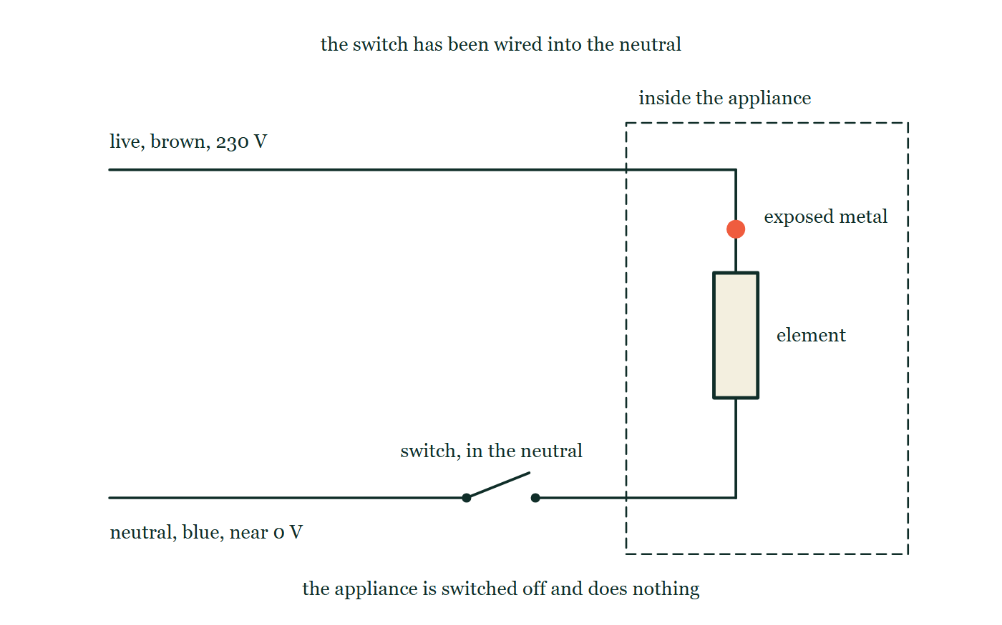
ELECTRICITY & MAGNETISM · ELECTRICAL SAFETY
GIOPHYSICS LESSON
THINK FIRST
A heater is switched off at its own switch. Somebody opens the case, touches a terminal inside, and is killed. How?
Take answers before you click — the point is the commitment
The switch worked perfectly. The heater was cold and completely dead, and the person checked that it was off before opening it.
THE ANSWER
The switch had been fitted into the neutral wire instead of the live one. Breaking the neutral stops the current, so the appliance behaves exactly as it should — but every conductor inside it stays connected to the 230 V live, waiting for a path to earth. Off is not the same as dead. The switch and the fuse both belong in the live wire.
An appliance inside a dashed outline: the brown live wire runs unbroken from the supply into it and down to the element, while the switch — drawn open — sits in the blue neutral wire on the return side. A picked-out dot on the live conductor inside the case marks exposed metal, and the caption under the circuit says the appliance is off.
The live version of this figure — click here
Electricity & Magnetism — Electrical Safety. Built by GioPhysics from the lesson's own copy; nothing on these slides is re-authored.
3 / 35
Notes:
[Phase] Starter: Recall what this lesson stands on (minutes 0–5 of 45)
[Hook] A heater is switched off at its own switch. Somebody opens the case, touches a terminal inside, and is killed. How? The switch worked perfectly. The heater was cold and completely dead, and the person checked that it was off before opening it.
[Answer] The switch had been fitted into the neutral wire instead of the live one. Breaking the neutral stops the current, so the appliance behaves exactly as it should — but every conductor inside it stays connected to the 230 V live, waiting for a path to earth. Off is not the same as dead. The switch and the fuse both belong in the live wire.
[Figure] An appliance inside a dashed outline: the brown live wire runs unbroken from the supply into it and down to the element, while the switch — drawn open — sits in the blue neutral wire on the return side. A picked-out dot on the live conductor inside the case marks exposed metal, and the caption under the circuit says the appliance is off.

Slide 4
ELECTRICITY & MAGNETISM · ELECTRICAL SAFETY
GIOPHYSICS LESSON
EXPLAINED SIMPLY
In one sentence
Introduce the idea — The big idea and the definition
Electrical safety is the layered system of live, neutral and earth wires, fuses and circuit breakers, earthed cases, double insulation and RCDs that cuts off the supply when a fault current flows — the fuse protecting the cable, the earth wire and RCD protecting the person.
Electricity & Magnetism — Electrical Safety. Built by GioPhysics from the lesson's own copy; nothing on these slides is re-authored.
4 / 35
Notes:
[Phase] Introduce the idea: The big idea and the definition (minutes 5–13 of 45)
[Definition] Electrical safety is the layered system of live, neutral and earth wires, fuses and circuit breakers, earthed cases, double insulation and RCDs that cuts off the supply when a fault current flows — the fuse protecting the cable, the earth wire and RCD protecting the person.

Slide 5
ELECTRICITY & MAGNETISM · ELECTRICAL SAFETY
GIOPHYSICS LESSON
EXPLAINED SIMPLY
What that looks like
Introduce the idea — The big idea and the definition
FOR EXAMPLE
A 2.2 kW kettle draws I = 2200 ÷ 230 ≈ 9.6 A, so its plug carries a 13 A fuse — the smallest standard rating above the normal current.
Electricity & Magnetism — Electrical Safety. Built by GioPhysics from the lesson's own copy; nothing on these slides is re-authored.
5 / 35
Notes:
[Phase] Introduce the idea: The big idea and the definition (minutes 5–13 of 45)
[Worked illustration] A 2.2 kW kettle draws I = 2200 ÷ 230 ≈ 9.6 A, so its plug carries a 13 A fuse — the smallest standard rating above the normal current.

Slide 6
ELECTRICITY & MAGNETISM · ELECTRICAL SAFETY
GIOPHYSICS LESSON
THE BIG IDEA
Fuses guard the cable, RCDs guard you
Introduce the idea — The big idea and the definition
Mains power arrives on the brown live wire, which swings to 230 V, and returns on the blue neutral wire, held near 0 V. The striped green-and-yellow earth wire carries no current at all — until a fault gives it a job. The switch and the fuse both sit in the live wire, so switching off or blowing the fuse leaves the whole appliance dead instead of waiting at 230 V.
The fuse rating is chosen just above the working current I = P/V, so it ignores normal use but melts before the cable overheats. Earthing a metal case turns a live-to-case fault into an enormous current that blows the fuse at once — while the person’s real guardian is the RCD, which compares live and neutral currents and disconnects within milliseconds when even 30 mA goes missing through a body.
Electricity & Magnetism — Electrical Safety. Built by GioPhysics from the lesson's own copy; nothing on these slides is re-authored.
6 / 35
Notes:
[Phase] Introduce the idea: The big idea and the definition (minutes 5–13 of 45)
[Big idea] Mains power arrives on the brown live wire, which swings to 230 V, and returns on the blue neutral wire, held near 0 V. The striped green-and-yellow earth wire carries no current at all — until a fault gives it a job. The switch and the fuse both sit in the live wire, so switching off or blowing the fuse leaves the whole appliance dead instead of waiting at 230 V. The fuse rating is chosen just above the working current I = P/V, so it ignores normal use but melts before the cable overheats. Earthing a metal case turns a live-to-case fault into an enormous current that blows the fuse at once — while the person’s real guardian is the RCD, which compares live and neutral currents and disconnects within milliseconds when even 30 mA goes missing through a body.

Slide 7
ELECTRICITY & MAGNETISM · ELECTRICAL SAFETY
GIOPHYSICS LESSON
THE PHYSICS · 1 OF 4
Live, neutral and earth
Build the model — The formulae, one at a time, in plain English
The brown live wire delivers the energy at 230 V; the blue neutral completes the loop near earth potential; the green-and-yellow earth wire ties the metal case to the ground and normally carries nothing. Switch and fuse go in the live wire: break the live and the appliance is completely dead — break the neutral instead and everything inside still sits at 230 V.
Electricity & Magnetism — Electrical Safety. Built by GioPhysics from the lesson's own copy; nothing on these slides is re-authored.
7 / 35
Notes:
[Phase] Build the model: The formulae, one at a time, in plain English (minutes 13–22 of 45)
[Section] The brown live wire delivers the energy at 230 V; the blue neutral completes the loop near earth potential; the green-and-yellow earth wire ties the metal case to the ground and normally carries nothing. Switch and fuse go in the live wire: break the live and the appliance is completely dead — break the neutral instead and everything inside still sits at 230 V.

Slide 8
ELECTRICITY & MAGNETISM · ELECTRICAL SAFETY
GIOPHYSICS LESSON
THE PHYSICS · 2 OF 4
The everyday hazards
Build the model — The formulae, one at a time, in plain English
Damaged insulation exposes the live conductor. Overloaded sockets and multiway adaptors push a flex past its rated current until the insulation overheats.
Damp conditions slash the resistance between a live part and a hand. Each hazard is a low-resistance path forming where none should exist.
Electricity & Magnetism — Electrical Safety. Built by GioPhysics from the lesson's own copy; nothing on these slides is re-authored.
8 / 35
Notes:
[Phase] Build the model: The formulae, one at a time, in plain English (minutes 13–22 of 45)
[Section] Damaged insulation exposes the live conductor. Overloaded sockets and multiway adaptors push a flex past its rated current until the insulation overheats. Damp conditions slash the resistance between a live part and a hand. Each hazard is a low-resistance path forming where none should exist.

Slide 9
ELECTRICITY & MAGNETISM · ELECTRICAL SAFETY
GIOPHYSICS LESSON
THE PHYSICS · 3 OF 4
Earthing and the fuse
Build the model — The formulae, one at a time, in plain English
A fuse melts to save the cable from overheating — it acts on amperes, not on people. Earthing recruits it for safety: if the live wire touches an earthed case, the fault current is hundreds of amperes, the fuse blows instantly, and the case never stays live. Without the earth wire, the case simply waits at 230 V.
Electricity & Magnetism — Electrical Safety. Built by GioPhysics from the lesson's own copy; nothing on these slides is re-authored.
9 / 35
Notes:
[Phase] Build the model: The formulae, one at a time, in plain English (minutes 13–22 of 45)
[Section] A fuse melts to save the cable from overheating — it acts on amperes, not on people. Earthing recruits it for safety: if the live wire touches an earthed case, the fault current is hundreds of amperes, the fuse blows instantly, and the case never stays live. Without the earth wire, the case simply waits at 230 V.

Slide 10
ELECTRICITY & MAGNETISM · ELECTRICAL SAFETY
GIOPHYSICS LESSON
THE PHYSICS · 4 OF 4
Double insulation and RCDs
Build the model — The formulae, one at a time, in plain English
A double-insulated appliance has a plastic casing that can never become live, so its two-core flex needs no earth wire at all. The RCD guards the person directly: it compares live and neutral currents and trips on a 30 mA imbalance within about 30 ms — sensitive and fast enough to matter to a heartbeat, which no fuse can ever be.
Electricity & Magnetism — Electrical Safety. Built by GioPhysics from the lesson's own copy; nothing on these slides is re-authored.
10 / 35
Notes:
[Phase] Build the model: The formulae, one at a time, in plain English (minutes 13–22 of 45)
[Section] A double-insulated appliance has a plastic casing that can never become live, so its two-core flex needs no earth wire at all. The RCD guards the person directly: it compares live and neutral currents and trips on a 30 mA imbalance within about 30 ms — sensitive and fast enough to matter to a heartbeat, which no fuse can ever be.

Slide 11
ELECTRICITY & MAGNETISM · ELECTRICAL SAFETY
GIOPHYSICS LESSON
FORMULA 1 OF 4
Choosing a fuse
Build the model — The formulae, one at a time, in plain English
I = P/V
Rating just above the working current
IN PLAIN ENGLISH
Work out the appliance’s normal current first — the fuse must sit just above it, so it ignores everyday use but melts on a fault.
Electricity & Magnetism — Electrical Safety. Built by GioPhysics from the lesson's own copy; nothing on these slides is re-authored.
11 / 35
Notes:
[Phase] Build the model: The formulae, one at a time, in plain English (minutes 13–22 of 45)
[Formula] Choosing a fuse: I = P/V
[In plain English] Work out the appliance’s normal current first — the fuse must sit just above it, so it ignores everyday use but melts on a fault.
[Note] Rating just above the working current

Slide 12
ELECTRICITY & MAGNETISM · ELECTRICAL SAFETY
GIOPHYSICS LESSON
FORMULA 2 OF 4
Earth-fault current
Build the model — The formulae, one at a time, in plain English
I = V/R(earth)
A 0.2 Ω path gives about 1150 A
IN PLAIN ENGLISH
A live-to-case fault meets the low-resistance earth path, and the enormous current melts the fuse in milliseconds — the case goes dead.
Electricity & Magnetism — Electrical Safety. Built by GioPhysics from the lesson's own copy; nothing on these slides is re-authored.
12 / 35
Notes:
[Phase] Build the model: The formulae, one at a time, in plain English (minutes 13–22 of 45)
[Formula] Earth-fault current: I = V/R(earth)
[In plain English] A live-to-case fault meets the low-resistance earth path, and the enormous current melts the fuse in milliseconds — the case goes dead.
[Note] A 0.2 Ω path gives about 1150 A

Slide 13
ELECTRICITY & MAGNETISM · ELECTRICAL SAFETY
GIOPHYSICS LESSON
FORMULA 3 OF 4
Current through a body
Build the model — The formulae, one at a time, in plain English
I = V/R(body)
Dry skin ~100 kΩ, wet skin ~1 kΩ
IN PLAIN ENGLISH
The same 230 V drives about 2 mA through dry skin but hundreds of milliamps through wet skin — it is the current, not the voltage, that injures.
Electricity & Magnetism — Electrical Safety. Built by GioPhysics from the lesson's own copy; nothing on these slides is re-authored.
13 / 35
Notes:
[Phase] Build the model: The formulae, one at a time, in plain English (minutes 13–22 of 45)
[Formula] Current through a body: I = V/R(body)
[In plain English] The same 230 V drives about 2 mA through dry skin but hundreds of milliamps through wet skin — it is the current, not the voltage, that injures.
[Note] Dry skin ~100 kΩ, wet skin ~1 kΩ

Slide 14
ELECTRICITY & MAGNETISM · ELECTRICAL SAFETY
GIOPHYSICS LESSON
FORMULA 4 OF 4
RCD trip condition
Build the model — The formulae, one at a time, in plain English
I(live) − I(neutral) ≥ 30 mA
Disconnects within about 30 ms
IN PLAIN ENGLISH
Current escaping to earth through a person never returns along the neutral — the RCD senses the imbalance and opens the circuit in milliseconds.
Electricity & Magnetism — Electrical Safety. Built by GioPhysics from the lesson's own copy; nothing on these slides is re-authored.
14 / 35
Notes:
[Phase] Build the model: The formulae, one at a time, in plain English (minutes 13–22 of 45)
[Formula] RCD trip condition: I(live) − I(neutral) ≥ 30 mA
[In plain English] Current escaping to earth through a person never returns along the neutral — the RCD senses the imbalance and opens the circuit in milliseconds.
[Note] Disconnects within about 30 ms

Slide 15
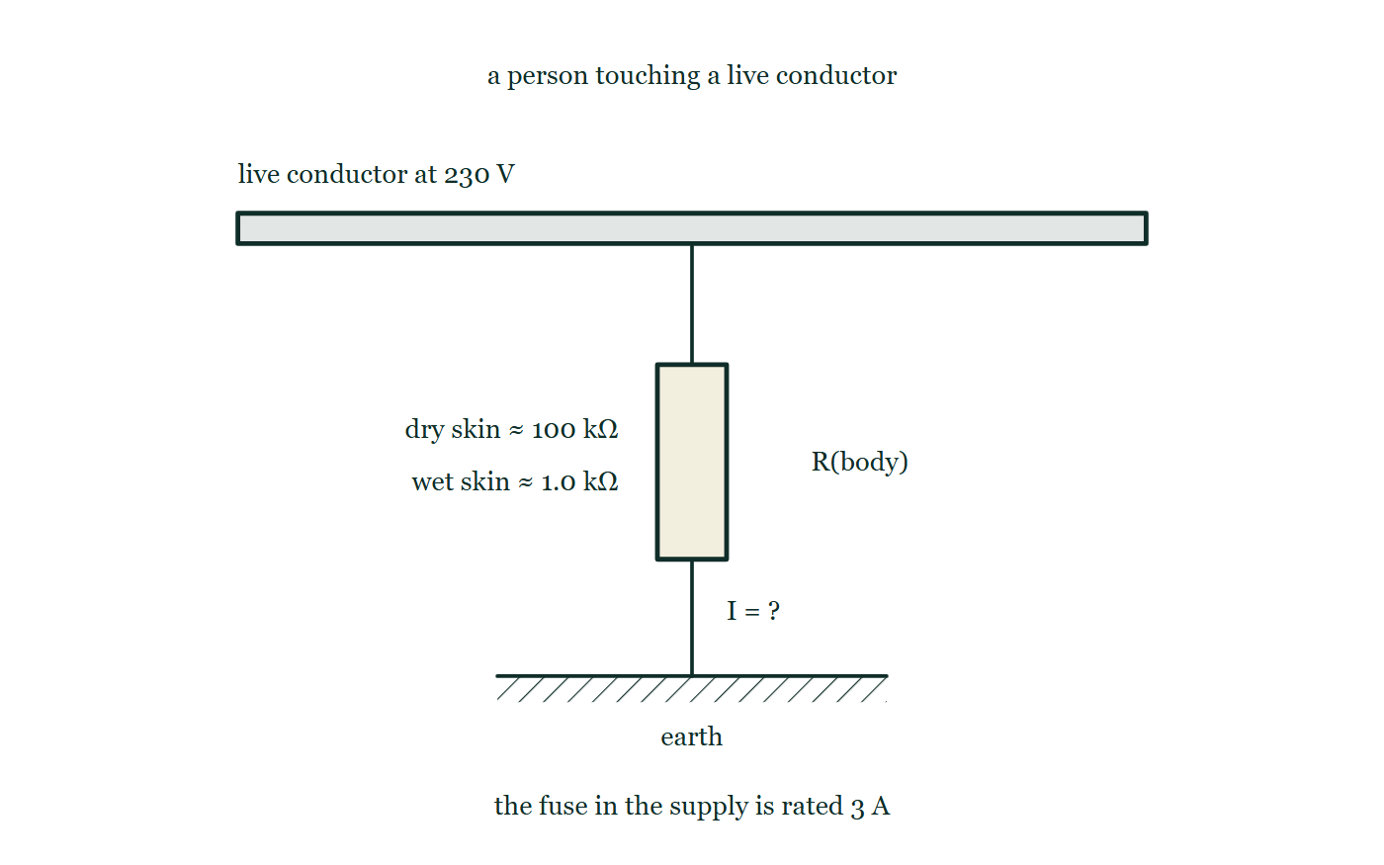
ELECTRICITY & MAGNETISM · ELECTRICAL SAFETY
GIOPHYSICS LESSON
THE PICTURE
One voltage, two people
Drawn for this lesson
A live conductor at 230 V drawn as a bar across the top, with a path from it down through a resistor labelled as the body to hatched earth below. Beside the body two resistances are listed, about 100 kΩ dry and about 1.0 kΩ wet, and the current through it is marked only as a question mark.
The live version of this figure — click here
Electricity & Magnetism — Electrical Safety. Built by GioPhysics from the lesson's own copy; nothing on these slides is re-authored.
15 / 35
Notes:
[Phase] Build the model: The formulae, one at a time, in plain English (minutes 13–22 of 45)
[Figure] A live conductor at 230 V drawn as a bar across the top, with a path from it down through a resistor labelled as the body to hatched earth below. Beside the body two resistances are listed, about 100 kΩ dry and about 1.0 kΩ wet, and the current through it is marked only as a question mark.

Slide 16
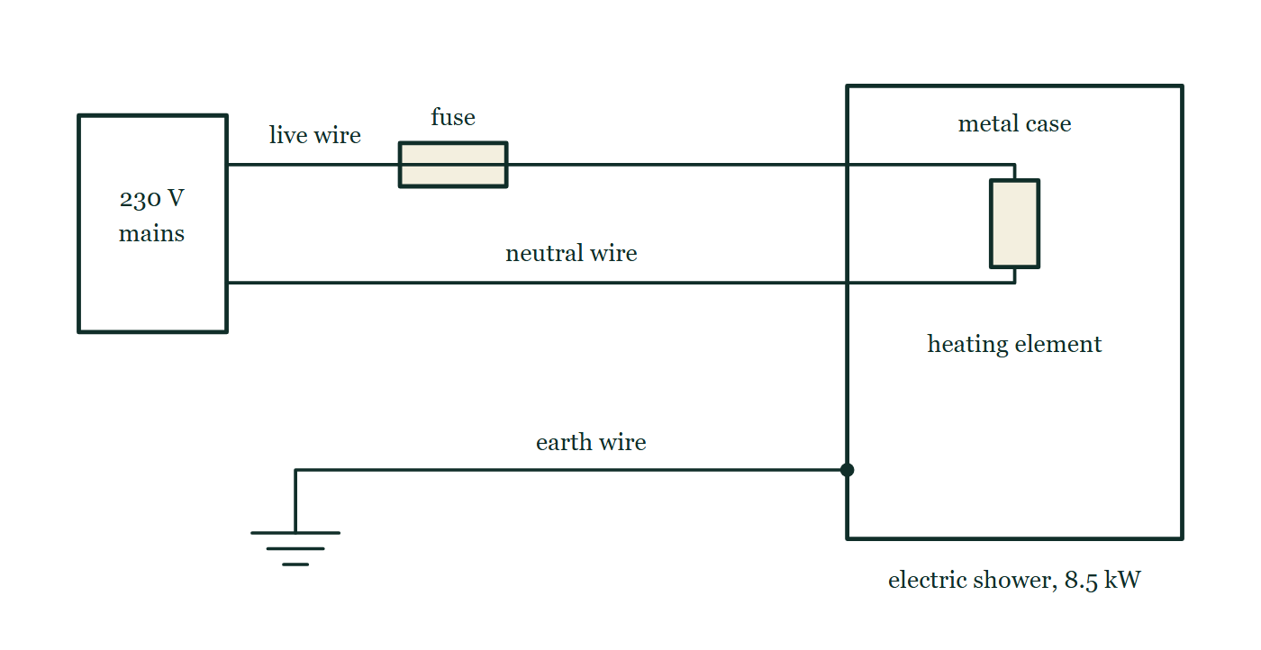
ELECTRICITY & MAGNETISM · ELECTRICAL SAFETY
GIOPHYSICS LESSON
FIGURE
Fig. 9.1 — IGCSE Topic 4 · Electricity and magnetism
Drawn for question 9 of that paper · syllabus 4.4
A wiring diagram of the electric shower. A box on the left marked 230 V mains has two wires leaving it: the live wire, which passes through a fuse drawn as a small rectangle with a line through it, and the neutral wire, which runs straight across. Both enter the outline of the shower, where they are joined to each other by the heating element. The shower's outline is labelled metal case and the appliance is marked 8.5 kW. A third wire, the earth wire, runs from an earth symbol of three shortening horizontal bars across to the metal case, meeting it at a solid connecting dot.
See the question this was drawn for — click here
Electricity & Magnetism — Electrical Safety. Built by GioPhysics from the lesson's own copy; nothing on these slides is re-authored.
16 / 35
Notes:
[Phase] Build the model: The formulae, one at a time, in plain English (minutes 13–22 of 45)
[Figure] Fig. 9.1. A wiring diagram of the electric shower. A box on the left marked 230 V mains has two wires leaving it: the live wire, which passes through a fuse drawn as a small rectangle with a line through it, and the neutral wire, which runs straight across. Both enter the outline of the shower, where they are joined to each other by the heating element. The shower's outline is labelled metal case and the appliance is marked 8.5 kW. A third wire, the earth wire, runs from an earth symbol of three shortening horizontal bars across to the metal case, meeting it at a solid connecting dot.
[Where it came from] IGCSE Topic 4 · Electricity and magnetism, question 9; syllabus 4.4.

Slide 17
ELECTRICITY & MAGNETISM · ELECTRICAL SAFETY
GIOPHYSICS LESSON
WATCH OUT
The common trap
Check and misconception — The quick check and the trap
A switch or fuse in the neutral wire looks fine — the appliance still turns on and off — but every conductor inside remains connected to the live 230 V, waiting for a path through you. Both belong in the live wire. And it is current, not voltage, that injures: the same 230 V is a faint tingle through dry skin and a fatal shock through wet skin.
Electricity & Magnetism — Electrical Safety. Built by GioPhysics from the lesson's own copy; nothing on these slides is re-authored.
17 / 35
Notes:
[Phase] Check and misconception: The quick check and the trap (minutes 35–41 of 45)
[Misconception] A switch or fuse in the neutral wire looks fine — the appliance still turns on and off — but every conductor inside remains connected to the live 230 V, waiting for a path through you. Both belong in the live wire. And it is current, not voltage, that injures: the same 230 V is a faint tingle through dry skin and a fatal shock through wet skin.

Slide 18
ELECTRICITY & MAGNETISM · ELECTRICAL SAFETY
GIOPHYSICS LESSON
WORKED EXAMPLE 1 OF 2 · EASY
The question
Easy
Worked examples — I do, we do — one step revealed at a time
A 2.2 kW kettle runs on the 230 V mains. Choose its fuse from the standard ratings 3 A, 5 A and 13 A.
Electricity & Magnetism — Electrical Safety. Built by GioPhysics from the lesson's own copy; nothing on these slides is re-authored.
18 / 35
Notes:
[Phase] Worked examples: I do, we do — one step revealed at a time (minutes 22–35 of 45)
[Question] A 2.2 kW kettle runs on the 230 V mains. Choose its fuse from the standard ratings 3 A, 5 A and 13 A.
[Answer] 13 A fuse (normal current ≈ 9.6 A)

Slide 19
ELECTRICITY & MAGNETISM · ELECTRICAL SAFETY
GIOPHYSICS LESSON
WORKED EXAMPLE 1 OF 2 · EASY · THE WORKING
How to solve it
Easy
Worked examples — I do, we do — one step revealed at a time
A 2.2 kW kettle runs on the 230 V mains. Choose its fuse from the standard ratings 3 A, 5 A and 13 A.
1.
I = P/V = 2200 ÷ 230 ≈ 9.6 A.
2.
3 A and 5 A would melt the moment the kettle is switched on.
3.
The smallest rating above 9.6 A is 13 A — small enough to melt on a fault, large enough to ignore normal use.
Electricity & Magnetism — Electrical Safety. Built by GioPhysics from the lesson's own copy; nothing on these slides is re-authored.
19 / 35
Notes:
[Phase] Worked examples: I do, we do — one step revealed at a time (minutes 22–35 of 45)
[Reveal] One click per step. The class works each line before the next appears.
[Step 1] I = P/V = 2200 ÷ 230 ≈ 9.6 A.
[Step 2] 3 A and 5 A would melt the moment the kettle is switched on.
[Step 3] The smallest rating above 9.6 A is 13 A — small enough to melt on a fault, large enough to ignore normal use.

Slide 20
ELECTRICITY & MAGNETISM · ELECTRICAL SAFETY
GIOPHYSICS LESSON
WORKED EXAMPLE 1 OF 2 · EASY
Answer
Easy
Worked examples — I do, we do — one step revealed at a time
13 A fuse (normal current ≈ 9.6 A)
Electricity & Magnetism — Electrical Safety. Built by GioPhysics from the lesson's own copy; nothing on these slides is re-authored.
20 / 35
Notes:
[Phase] Worked examples: I do, we do — one step revealed at a time (minutes 22–35 of 45)
[Answer] 13 A fuse (normal current ≈ 9.6 A)

Slide 21
ELECTRICITY & MAGNETISM · ELECTRICAL SAFETY
GIOPHYSICS LESSON
WORKED EXAMPLE 2 OF 2 · MEDIUM
The question
Medium
Worked examples — I do, we do — one step revealed at a time
A 60 W lamp has thin flex safely rated 3 A, but its plug holds a 13 A fuse. A partial fault draws 5.0 A through the cord, which has resistance 0.50 Ω. Show why the fuse never acts, and what happens to the cord.
Electricity & Magnetism — Electrical Safety. Built by GioPhysics from the lesson's own copy; nothing on these slides is re-authored.
21 / 35
Notes:
[Phase] Worked examples: I do, we do — one step revealed at a time (minutes 22–35 of 45)
[Question] A 60 W lamp has thin flex safely rated 3 A, but its plug holds a 13 A fuse. A partial fault draws 5.0 A through the cord, which has resistance 0.50 Ω. Show why the fuse never acts, and what happens to the cord.
[Answer] 12.5 W cooks the 3 A cord; the 13 A fuse never blows — a 3 A fuse would

Slide 22
ELECTRICITY & MAGNETISM · ELECTRICAL SAFETY
GIOPHYSICS LESSON
WORKED EXAMPLE 2 OF 2 · MEDIUM · THE WORKING
How to solve it
Medium
Worked examples — I do, we do — one step revealed at a time
A 60 W lamp has thin flex safely rated 3 A, but its plug holds a 13 A fuse. A partial fault draws 5.0 A through the cord, which has resistance 0.50 Ω. Show why the fuse never acts, and what happens to the cord.
1.
Normal current: I = 60 ÷ 230 ≈ 0.26 A — the cord runs cool, and the right fuse is 3 A, matching the flex's own 3 A rating.
2.
Heat in the cord normally: P = I²R = 0.26² × 0.50 ≈ 0.03 W. During the fault: 5.0² × 0.50 = 12.5 W — about 370 times more, cooking the insulation along its length.
3.
The 13 A fuse sees 5.0 A as a perfectly normal current and never melts; a 3 A fuse would have blown at once.
4.
A fuse only protects a cable it is matched to — an oversized fuse protects nothing.
Electricity & Magnetism — Electrical Safety. Built by GioPhysics from the lesson's own copy; nothing on these slides is re-authored.
22 / 35
Notes:
[Phase] Worked examples: I do, we do — one step revealed at a time (minutes 22–35 of 45)
[Reveal] One click per step. The class works each line before the next appears.
[Step 1] Normal current: I = 60 ÷ 230 ≈ 0.26 A — the cord runs cool, and the right fuse is 3 A, matching the flex's own 3 A rating.
[Step 2] Heat in the cord normally: P = I²R = 0.26² × 0.50 ≈ 0.03 W. During the fault: 5.0² × 0.50 = 12.5 W — about 370 times more, cooking the insulation along its length.
[Step 3] The 13 A fuse sees 5.0 A as a perfectly normal current and never melts; a 3 A fuse would have blown at once.
[Step 4] A fuse only protects a cable it is matched to — an oversized fuse protects nothing.

Slide 23
ELECTRICITY & MAGNETISM · ELECTRICAL SAFETY
GIOPHYSICS LESSON
WORKED EXAMPLE 2 OF 2 · MEDIUM
Answer
Medium
Worked examples — I do, we do — one step revealed at a time
12.5 W cooks the 3 A cord; the 13 A fuse never blows — a 3 A fuse would
Electricity & Magnetism — Electrical Safety. Built by GioPhysics from the lesson's own copy; nothing on these slides is re-authored.
23 / 35
Notes:
[Phase] Worked examples: I do, we do — one step revealed at a time (minutes 22–35 of 45)
[Answer] 12.5 W cooks the 3 A cord; the 13 A fuse never blows — a 3 A fuse would

Slide 24
ELECTRICITY & MAGNETISM · ELECTRICAL SAFETY
GIOPHYSICS LESSON
SPOT THE MISTAKE
One line here is wrong
The whole working is up — find the bad line before you click
1.
A 2.2 kW kettle runs on 230 V mains. Choose its fuse from the standard 3 A, 5 A and 13 A.
2.
Working current: I = P/V
3.
I = 2200 ÷ 230 ≈ 9.6 A
4.
The fuse must sit below the working current so that it melts quickly, so fit the 5 A.
5.
Answer: a 5 A fuse.
LINE 4 IS WRONG
The rule has been remembered backwards. A fuse below the working current melts the instant the kettle is switched on, every time — the appliance simply never works. The rating goes just above the normal current: high enough to ignore everyday use, low enough to melt before the flex overheats. Here that means the 13 A, because 9.6 A has already ruled out the 3 A and the 5 A.
IT SHOULD SAY
The fuse must sit just above the working current, so fit the 13 A.
Electricity & Magnetism — Electrical Safety. Built by GioPhysics from the lesson's own copy; nothing on these slides is re-authored.
24 / 35
Notes:
[Phase] Worked examples: I do, we do — one step revealed at a time (minutes 22–35 of 45)
[Spot the mistake] The working is complete and one line of it is wrong. Let the room hunt: one click names the line, a second shows it done correctly.
[Line 4 is wrong] The rule has been remembered backwards. A fuse below the working current melts the instant the kettle is switched on, every time — the appliance simply never works. The rating goes just above the normal current: high enough to ignore everyday use, low enough to melt before the flex overheats. Here that means the 13 A, because 9.6 A has already ruled out the 3 A and the 5 A.
[It should say] The fuse must sit just above the working current, so fit the 13 A.

Slide 25
ELECTRICITY & MAGNETISM · ELECTRICAL SAFETY
GIOPHYSICS LESSON
PREDICT · TAKE THE VOTE
Commit before you are told
Hands up for each option, then click
The same 230 V, the same person, twice over. Which of the two shocks is the dangerous one?
A Both equally — 230 V is 230 V, whatever the hands are like
B Neither: the fuse in the supply cuts off long before either shock matters
C The wet one — 230 mA against 2.3 mA
A live conductor at 230 V drawn as a bar across the top, with a path from it down through a resistor labelled as the body to hatched earth below. Beside the body two resistances are listed, about 100 kΩ dry and about 1.0 kΩ wet, and the current through it is marked only as a question mark.
The live version of this figure — click here
Electricity & Magnetism — Electrical Safety. Built by GioPhysics from the lesson's own copy; nothing on these slides is re-authored.
25 / 35
Notes:
[Phase] Build the model: The formulae, one at a time, in plain English (minutes 13–22 of 45)
[Predict] The same 230 V, the same person, twice over. Which of the two shocks is the dangerous one?
[Options] A Both equally — 230 V is 230 V, whatever the hands are like B Neither: the fuse in the supply cuts off long before either shock matters C The wet one — 230 mA against 2.3 mA
[Figure] A live conductor at 230 V drawn as a bar across the top, with a path from it down through a resistor labelled as the body to hatched earth below. Beside the body two resistances are listed, about 100 kΩ dry and about 1.0 kΩ wet, and the current through it is marked only as a question mark.

Slide 26
ELECTRICITY & MAGNETISM · ELECTRICAL SAFETY
GIOPHYSICS LESSON
PREDICT · THE OUTCOME
What actually happens
Ask the room who changed their mind, and why
C The wet one — 230 mA against 2.3 mA
WHY
Voltage is only half the story; what passes through a body is set by that body's resistance. Dry skin at about 100 kΩ passes 230 ÷ 100 000 = 2.3 mA, which is a nasty tingle. Wet skin at about 1.0 kΩ passes 230 mA, several times the roughly 50 mA that can stop a heart. And no fuse helps with either: the smallest standard fuse needs 3000 mA before it melts, so it sees a lethal shock as an unremarkable load. Only an RCD, watching for a 30 mA difference between live and neutral, reacts in time.
Electricity & Magnetism — Electrical Safety. Built by GioPhysics from the lesson's own copy; nothing on these slides is re-authored.
26 / 35
Notes:
[Phase] Build the model: The formulae, one at a time, in plain English (minutes 13–22 of 45)
[Answer] C — The wet one — 230 mA against 2.3 mA. Voltage is only half the story; what passes through a body is set by that body's resistance. Dry skin at about 100 kΩ passes 230 ÷ 100 000 = 2.3 mA, which is a nasty tingle. Wet skin at about 1.0 kΩ passes 230 mA, several times the roughly 50 mA that can stop a heart. And no fuse helps with either: the smallest standard fuse needs 3000 mA before it melts, so it sees a lethal shock as an unremarkable load. Only an RCD, watching for a 30 mA difference between live and neutral, reacts in time.

Slide 27
ELECTRICITY & MAGNETISM · ELECTRICAL SAFETY
GIOPHYSICS LESSON
QUICK CHECK
Decide before the answer goes up
Check and misconception — The quick check and the trap
The flex of a double-insulated hair dryer contains only two wires. Which wire is missing, and why is that safe?
A
The neutral — the case completes the circuit
B
The earth — the plastic case can never become live
C
The live — the dryer runs on neutral alone
Electricity & Magnetism — Electrical Safety. Built by GioPhysics from the lesson's own copy; nothing on these slides is re-authored.
27 / 35
Notes:
[Phase] Check and misconception: The quick check and the trap (minutes 35–41 of 45)
[Question] The flex of a double-insulated hair dryer contains only two wires. Which wire is missing, and why is that safe?
[Options] A The neutral — the case completes the circuit B The earth — the plastic case can never become live C The live — the dryer runs on neutral alone

Slide 28
ELECTRICITY & MAGNETISM · ELECTRICAL SAFETY
GIOPHYSICS LESSON
QUICK CHECK · THE ANSWER
The answer, and why
Check and misconception — The quick check and the trap
B The earth — the plastic case can never become live
HOW TO GET THERE
Double insulation means no exposed metal can ever connect to the live wire, so there is nothing for an earth wire to protect — the flex carries live and neutral only.
WHY THE OTHERS TEMPT
A A case that carried the return current would be a case at working current all day long — the opposite of safe. Neutral is one of the two wires that must be present: without it there is no complete circuit and the dryer does not run at all.
B Correct. The earth wire's only job is to give a live-to-case fault a low-resistance path so the fuse blows at once. A plastic case can never become live, so there is nothing for it to protect.
C Nothing runs on the neutral alone. It sits at close to 0 V, and a current needs a potential difference — two different potentials, not one. Take the live away and there is no p.d. across the element and no current whatever.
Electricity & Magnetism — Electrical Safety. Built by GioPhysics from the lesson's own copy; nothing on these slides is re-authored.
28 / 35
Notes:
[Phase] Check and misconception: The quick check and the trap (minutes 35–41 of 45)
[Question] The flex of a double-insulated hair dryer contains only two wires. Which wire is missing, and why is that safe?
[Option by option] A: A case that carried the return current would be a case at working current all day long — the opposite of safe. Neutral is one of the two wires that must be present: without it there is no complete circuit and the dryer does not run at all. B: Correct. The earth wire's only job is to give a live-to-case fault a low-resistance path so the fuse blows at once. A plastic case can never become live, so there is nothing for it to protect. C: Nothing runs on the neutral alone. It sits at close to 0 V, and a current needs a potential difference — two different potentials, not one. Take the live away and there is no p.d. across the element and no current whatever.
[Answer] B — The earth — the plastic case can never become live
[Why] Double insulation means no exposed metal can ever connect to the live wire, so there is nothing for an earth wire to protect — the flex carries live and neutral only.
[Reveal] One click for the answer, then one for the reason.

Slide 29
ELECTRICITY & MAGNETISM · ELECTRICAL SAFETY
GIOPHYSICS LESSON
EXTENSION 1 OF 2 · HARD
The question
Hard
Worked examples — I do, we do — one step revealed at a time
Inside a 2.0 kW washing machine the live wire frays and touches the earthed metal case. The earth path has resistance 0.20 Ω. Find the fault current and explain the sequence that follows.
Electricity & Magnetism — Electrical Safety. Built by GioPhysics from the lesson's own copy; nothing on these slides is re-authored.
29 / 35
Notes:
[Phase] Worked examples: I do, we do — one step revealed at a time (minutes 22–35 of 45)
[Question] Inside a 2.0 kW washing machine the live wire frays and touches the earthed metal case. The earth path has resistance 0.20 Ω. Find the fault current and explain the sequence that follows.
[Answer] I = 1150 A — the fuse blows in milliseconds and the case goes dead

Slide 30
ELECTRICITY & MAGNETISM · ELECTRICAL SAFETY
GIOPHYSICS LESSON
EXTENSION 1 OF 2 · HARD · THE WORKING
How to solve it
Hard
Worked examples — I do, we do — one step revealed at a time
Inside a 2.0 kW washing machine the live wire frays and touches the earthed metal case. The earth path has resistance 0.20 Ω. Find the fault current and explain the sequence that follows.
1.
Fault current: I = V/R = 230 ÷ 0.20 = 1150 A.
2.
That is nearly ninety times the 13 A fuse rating — the fuse wire melts in a few milliseconds.
3.
The live side is disconnected, so the case never stays at 230 V and the machine simply goes dead.
4.
Without the earth wire the case would wait at 230 V: a touching person draws only ≈ 0.1 A, which the 13 A fuse ignores completely.
Electricity & Magnetism — Electrical Safety. Built by GioPhysics from the lesson's own copy; nothing on these slides is re-authored.
30 / 35
Notes:
[Phase] Worked examples: I do, we do — one step revealed at a time (minutes 22–35 of 45)
[Reveal] One click per step. The class works each line before the next appears.
[Step 1] Fault current: I = V/R = 230 ÷ 0.20 = 1150 A.
[Step 2] That is nearly ninety times the 13 A fuse rating — the fuse wire melts in a few milliseconds.
[Step 3] The live side is disconnected, so the case never stays at 230 V and the machine simply goes dead.
[Step 4] Without the earth wire the case would wait at 230 V: a touching person draws only ≈ 0.1 A, which the 13 A fuse ignores completely.

Slide 31
ELECTRICITY & MAGNETISM · ELECTRICAL SAFETY
GIOPHYSICS LESSON
EXTENSION 1 OF 2 · HARD
Answer
Hard
Worked examples — I do, we do — one step revealed at a time
I = 1150 A — the fuse blows in milliseconds and the case goes dead
Electricity & Magnetism — Electrical Safety. Built by GioPhysics from the lesson's own copy; nothing on these slides is re-authored.
31 / 35
Notes:
[Phase] Worked examples: I do, we do — one step revealed at a time (minutes 22–35 of 45)
[Answer] I = 1150 A — the fuse blows in milliseconds and the case goes dead

Slide 32
ELECTRICITY & MAGNETISM · ELECTRICAL SAFETY
GIOPHYSICS LESSON
EXTENSION 2 OF 2 · CHALLENGING
The question
Challenging
Worked examples — I do, we do — one step revealed at a time
A person touches a live 230 V conductor. Dry skin gives a body resistance of about 100 kΩ, wet skin about 1.0 kΩ; sustained currents above roughly 50 mA can be fatal. Compare the two currents, show why no fuse helps, and find the charge that passes before a 30 mA RCD trips in 30 ms.
Electricity & Magnetism — Electrical Safety. Built by GioPhysics from the lesson's own copy; nothing on these slides is re-authored.
32 / 35
Notes:
[Phase] Worked examples: I do, we do — one step revealed at a time (minutes 22–35 of 45)
[Question] A person touches a live 230 V conductor. Dry skin gives a body resistance of about 100 kΩ, wet skin about 1.0 kΩ; sustained currents above roughly 50 mA can be fatal. Compare the two currents, show why no fuse helps, and find the charge that passes before a 30 mA RCD trips in 30 ms.
[Answer] 2.3 mA dry, 230 mA wet; only the RCD acts — ≈ 7 mC before it trips

Slide 33
ELECTRICITY & MAGNETISM · ELECTRICAL SAFETY
GIOPHYSICS LESSON
EXTENSION 2 OF 2 · CHALLENGING · THE WORKING
How to solve it
Challenging
Worked examples — I do, we do — one step revealed at a time
A person touches a live 230 V conductor. Dry skin gives a body resistance of about 100 kΩ, wet skin about 1.0 kΩ; sustained currents above roughly 50 mA can be fatal. Compare the two currents, show why no fuse helps, and find the charge that passes before a 30 mA RCD trips in 30 ms.
1.
Dry: I = 230 ÷ 100 000 = 2.3 mA — an unpleasant tingle, below the danger level.
2.
Wet: I = 230 ÷ 1000 = 230 mA — several times the ≈ 50 mA fatal threshold. Damp conditions are the difference between the two.
3.
Even the smallest 3 A fuse needs 3000 mA to melt — it can never react to a 230 mA shock.
4.
The RCD trips on the 30 mA imbalance within about 30 ms: q = It ≈ 0.23 × 0.030 ≈ 7 mC passes — a violent jolt, but a survivable one.
Electricity & Magnetism — Electrical Safety. Built by GioPhysics from the lesson's own copy; nothing on these slides is re-authored.
33 / 35
Notes:
[Phase] Worked examples: I do, we do — one step revealed at a time (minutes 22–35 of 45)
[Reveal] One click per step. The class works each line before the next appears.
[Step 1] Dry: I = 230 ÷ 100 000 = 2.3 mA — an unpleasant tingle, below the danger level.
[Step 2] Wet: I = 230 ÷ 1000 = 230 mA — several times the ≈ 50 mA fatal threshold. Damp conditions are the difference between the two.
[Step 3] Even the smallest 3 A fuse needs 3000 mA to melt — it can never react to a 230 mA shock.
[Step 4] The RCD trips on the 30 mA imbalance within about 30 ms: q = It ≈ 0.23 × 0.030 ≈ 7 mC passes — a violent jolt, but a survivable one.

Slide 34
ELECTRICITY & MAGNETISM · ELECTRICAL SAFETY
GIOPHYSICS LESSON
EXTENSION 2 OF 2 · CHALLENGING
Answer
Challenging
Worked examples — I do, we do — one step revealed at a time
2.3 mA dry, 230 mA wet; only the RCD acts — ≈ 7 mC before it trips
Electricity & Magnetism — Electrical Safety. Built by GioPhysics from the lesson's own copy; nothing on these slides is re-authored.
34 / 35
Notes:
[Phase] Worked examples: I do, we do — one step revealed at a time (minutes 22–35 of 45)
[Answer] 2.3 mA dry, 230 mA wet; only the RCD acts — ≈ 7 mC before it trips

Slide 35
ELECTRICITY & MAGNETISM · ELECTRICAL SAFETY
GIOPHYSICS LESSON
ELECTRICITY & MAGNETISM
Where to go next
Plenary — What to take away, what to practise next
Lesson
This lesson on giophysics.com
https://giophysics.com/chapter-39/electrical-safety/
Live
The live, interactive version of these slides
https://giophysics.com/chapter-39/presentation/?lesson=safety
Chapter
All Electricity & Magnetism lessons
https://giophysics.com/chapter-39/
PDF
Download the lesson PDF
https://giophysics.com/downloads/39-7-electrical-safety.pdf
Electricity & Magnetism — Electrical Safety. Built by GioPhysics from the lesson's own copy; nothing on these slides is re-authored.
35 / 35
Notes:
[Phase] Plenary: What to take away, what to practise next (minutes 41–45 of 45)
[Interactive] The graphs and the circuit topology on these slides are frozen. The live version at https://giophysics.com/chapter-39/presentation/?lesson=safety moves them.

