Slide 1
THERMAL PHYSICS · TEMPERATURE & INTERNAL ENERGY
GIOPHYSICS LESSON
21 · Thermal Physics
Hot, cold, and the energy inside
Temperature & Internal Energy
A metal bench and a wooden one sit at the same temperature on a cold morning, yet the metal feels colder. Temperature, heat, and internal energy are three different things — and thermal physics starts by telling them apart.
POSITION
Lesson 1 of 6 in Thermal Physics
PLAN
15 slides in the 45-minute core run, about 43 minutes of it
LESSON PAGE
https://giophysics.com/chapter-40/thermal-concepts/
Built by GioPhysics from the lesson's own page. Every word on these slides is the lesson's; nothing here is re-authored. Teaching material, not an awarding body's document.
Thermal Physics — Temperature & Internal Energy. Built by GioPhysics from the lesson's own copy; nothing on these slides is re-authored.
1 / 37
Notes:
[Lesson] Thermal Physics — Temperature & Internal Energy. Lesson 1 of 6.
[Intro] A metal bench and a wooden one sit at the same temperature on a cold morning, yet the metal feels colder. Temperature, heat, and internal energy are three different things — and thermal physics starts by telling them apart.
[Source] https://giophysics.com/chapter-40/thermal-concepts/
[Disclaimer] Built by GioPhysics from the lesson's own page. Every word on these slides is the lesson's; nothing here is re-authored. Teaching material, not an awarding body's document.

Slide 2
THERMAL PHYSICS · TEMPERATURE & INTERNAL ENERGY
GIOPHYSICS LESSON
WHAT THIS NEEDS
What you already know
Starter — Recall what this lesson stands on
Recall
Kinetic energy
https://giophysics.com/chapter-6/kinetic-energy/
Recall
Energy conservation
https://giophysics.com/chapter-6/energy-conversion-conservation/
Thermal Physics — Temperature & Internal Energy. Built by GioPhysics from the lesson's own copy; nothing on these slides is re-authored.
2 / 37
Notes:
[Phase] Starter: Recall what this lesson stands on (minutes 0–5 of 45)
[Starter] Recall: Kinetic energy; Energy conservation

Slide 3
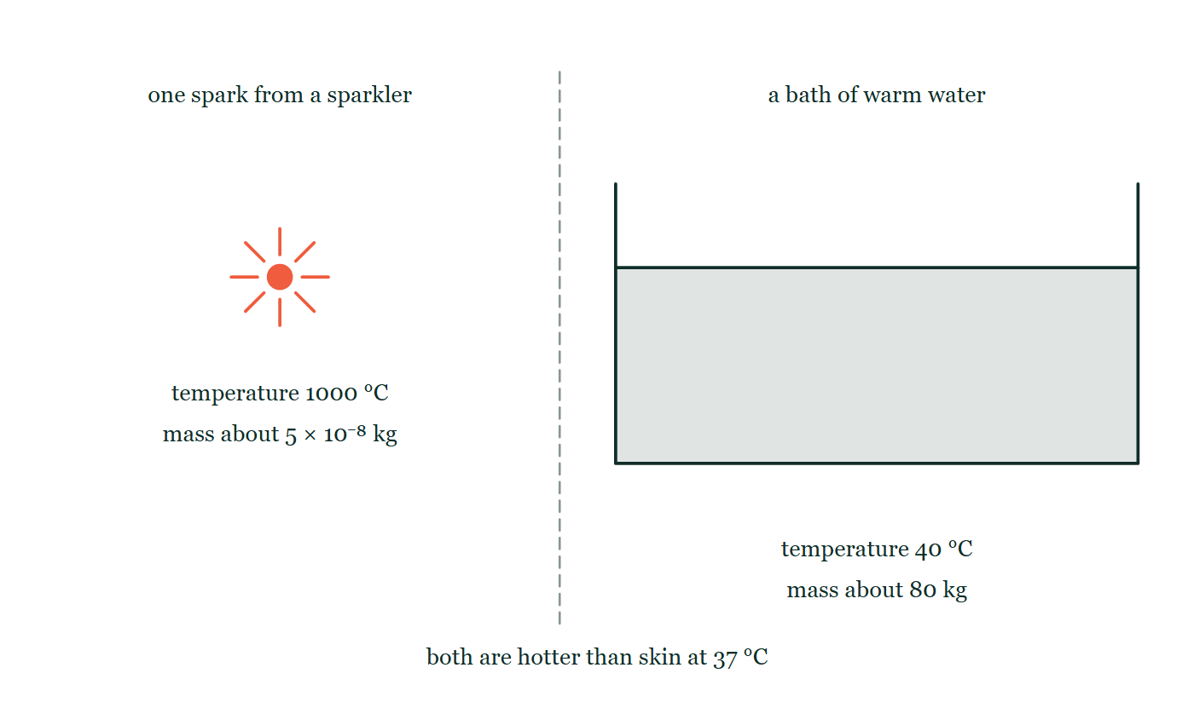
THERMAL PHYSICS · TEMPERATURE & INTERNAL ENERGY
GIOPHYSICS LESSON
THINK FIRST
A sparkler throws sparks at 1000 °C onto your hand and you barely notice. A bath at 40 °C would scald you. Why?
Take answers before you click — the point is the commitment
Both are far hotter than skin. The spark is twenty-five times further above body temperature than the bathwater is, and it lands directly on you.
THE ANSWER
Because temperature is per molecule and energy is a total. One spark weighs about 5 × 10⁻⁸ kg, so however energetic each of its molecules is, there are almost none of them and it has essentially no energy to give. The bath has 80 kg of molecules, each carrying less — and vastly more of them.
One spark from a sparkler drawn as a small radiating dot on the left, with its 1000 °C and its mass of about 5 × 10⁻⁸ kg printed beneath it; across a dashed divider on the right, a bath of water drawn many times wider, at 40 °C and about 80 kg.
The live version of this figure — click here
Thermal Physics — Temperature & Internal Energy. Built by GioPhysics from the lesson's own copy; nothing on these slides is re-authored.
3 / 37
Notes:
[Phase] Starter: Recall what this lesson stands on (minutes 0–5 of 45)
[Hook] A sparkler throws sparks at 1000 °C onto your hand and you barely notice. A bath at 40 °C would scald you. Why? Both are far hotter than skin. The spark is twenty-five times further above body temperature than the bathwater is, and it lands directly on you.
[Answer] Because temperature is per molecule and energy is a total. One spark weighs about 5 × 10⁻⁸ kg, so however energetic each of its molecules is, there are almost none of them and it has essentially no energy to give. The bath has 80 kg of molecules, each carrying less — and vastly more of them.
[Figure] One spark from a sparkler drawn as a small radiating dot on the left, with its 1000 °C and its mass of about 5 × 10⁻⁸ kg printed beneath it; across a dashed divider on the right, a bath of water drawn many times wider, at 40 °C and about 80 kg.

Slide 4
THERMAL PHYSICS · TEMPERATURE & INTERNAL ENERGY
GIOPHYSICS LESSON
EXPLAINED SIMPLY
In one sentence
Introduce the idea — The big idea and the definition
Temperature measures the average kinetic energy per molecule; internal energy is the total kinetic plus potential energy of all the molecules; heat is the energy that flows between objects at different temperatures.
Thermal Physics — Temperature & Internal Energy. Built by GioPhysics from the lesson's own copy; nothing on these slides is re-authored.
4 / 37
Notes:
[Phase] Introduce the idea: The big idea and the definition (minutes 5–13 of 45)
[Definition] Temperature measures the average kinetic energy per molecule; internal energy is the total kinetic plus potential energy of all the molecules; heat is the energy that flows between objects at different temperatures.

Slide 5
THERMAL PHYSICS · TEMPERATURE & INTERNAL ENERGY
GIOPHYSICS LESSON
EXPLAINED SIMPLY
What that looks like
Introduce the idea — The big idea and the definition
FOR EXAMPLE
A sparkler spark at 1000 °C carries far less energy than a bathtub of warm water — the spark has a high temperature but only a few molecules.
Thermal Physics — Temperature & Internal Energy. Built by GioPhysics from the lesson's own copy; nothing on these slides is re-authored.
5 / 37
Notes:
[Phase] Introduce the idea: The big idea and the definition (minutes 5–13 of 45)
[Worked illustration] A sparkler spark at 1000 °C carries far less energy than a bathtub of warm water — the spark has a high temperature but only a few molecules.

Slide 6
THERMAL PHYSICS · TEMPERATURE & INTERNAL ENERGY
GIOPHYSICS LESSON
THE BIG IDEA
Hot, cold, and the energy inside
Introduce the idea — The big idea and the definition
Temperature measures the average random kinetic energy of molecules. Heat is energy in transit from a hotter object to a colder one. Two objects in contact exchange heat until their temperatures match — thermal equilibrium.
Internal energy is the whole store: the kinetic energy of molecular motion plus the potential energy held in intermolecular bonds. The kelvin scale starts at absolute zero, where that molecular motion is at its minimum.
Thermal Physics — Temperature & Internal Energy. Built by GioPhysics from the lesson's own copy; nothing on these slides is re-authored.
6 / 37
Notes:
[Phase] Introduce the idea: The big idea and the definition (minutes 5–13 of 45)
[Big idea] Temperature measures the average random kinetic energy of molecules. Heat is energy in transit from a hotter object to a colder one. Two objects in contact exchange heat until their temperatures match — thermal equilibrium. Internal energy is the whole store: the kinetic energy of molecular motion plus the potential energy held in intermolecular bonds. The kelvin scale starts at absolute zero, where that molecular motion is at its minimum.

Slide 7
THERMAL PHYSICS · TEMPERATURE & INTERNAL ENERGY
GIOPHYSICS LESSON
THE PHYSICS · 1 OF 5
Solids, liquids, gases
Build the model — The formulae, one at a time, in plain English
In a solid the molecules only vibrate about fixed positions. In a liquid some bonds are broken and molecules move about within a fixed volume.
In a gas most bonds are broken and the molecules fly freely. Melting and boiling are bond-breaking steps between these arrangements.
Thermal Physics — Temperature & Internal Energy. Built by GioPhysics from the lesson's own copy; nothing on these slides is re-authored.
7 / 37
Notes:
[Phase] Build the model: The formulae, one at a time, in plain English (minutes 13–22 of 45)
[Section] In a solid the molecules only vibrate about fixed positions. In a liquid some bonds are broken and molecules move about within a fixed volume. In a gas most bonds are broken and the molecules fly freely. Melting and boiling are bond-breaking steps between these arrangements.

Slide 8
THERMAL PHYSICS · TEMPERATURE & INTERNAL ENERGY
GIOPHYSICS LESSON
THE PHYSICS · 2 OF 5
Why absolute zero exists
Build the model — The formulae, one at a time, in plain English
Cool a fixed volume of gas and its pressure falls along a straight line. Extrapolate, and every gas — whatever its type — reaches zero pressure at the same temperature: −273 °C. Since pressure cannot go below zero, no temperature can sit below this point.
Thermal Physics — Temperature & Internal Energy. Built by GioPhysics from the lesson's own copy; nothing on these slides is re-authored.
8 / 37
Notes:
[Phase] Build the model: The formulae, one at a time, in plain English (minutes 13–22 of 45)
[Section] Cool a fixed volume of gas and its pressure falls along a straight line. Extrapolate, and every gas — whatever its type — reaches zero pressure at the same temperature: −273 °C. Since pressure cannot go below zero, no temperature can sit below this point.

Slide 9
THERMAL PHYSICS · TEMPERATURE & INTERNAL ENERGY
GIOPHYSICS LESSON
THE PHYSICS · 3 OF 5
What a thermometer reads
Build the model — The formulae, one at a time, in plain English
A thermometer left in contact with an object reaches thermal equilibrium with it, and its reading tracks the object’s average molecular kinetic energy. It reads the KE part of internal energy — the PE part hides from it, which matters during melting and boiling.
Thermal Physics — Temperature & Internal Energy. Built by GioPhysics from the lesson's own copy; nothing on these slides is re-authored.
9 / 37
Notes:
[Phase] Build the model: The formulae, one at a time, in plain English (minutes 13–22 of 45)
[Section] A thermometer left in contact with an object reaches thermal equilibrium with it, and its reading tracks the object’s average molecular kinetic energy. It reads the KE part of internal energy — the PE part hides from it, which matters during melting and boiling.

Slide 10
THERMAL PHYSICS · TEMPERATURE & INTERNAL ENERGY
GIOPHYSICS LESSON
THE PHYSICS · 4 OF 5
Heating makes things bigger
Build the model — The formulae, one at a time, in plain English
Almost everything expands when heated. Give the particles more energy and they vibrate or fly about more vigorously, so on average they sit a little further apart and the same mass takes up more volume.
How much further depends on what holds them: a gas expands most, because nothing but the container restrains it; a liquid expands far less, its particles still touching; a solid least of all, every atom locked into the lattice and able only to vibrate more widely about the same site. Gases most, liquids next, solids least — and the reason is the strength of the bonds, not the size of the temperature rise.
Thermal Physics — Temperature & Internal Energy. Built by GioPhysics from the lesson's own copy; nothing on these slides is re-authored.
10 / 37
Notes:
[Phase] Build the model: The formulae, one at a time, in plain English (minutes 13–22 of 45)
[Section] Almost everything expands when heated. Give the particles more energy and they vibrate or fly about more vigorously, so on average they sit a little further apart and the same mass takes up more volume. How much further depends on what holds them: a gas expands most, because nothing but the container restrains it; a liquid expands far less, its particles still touching; a solid least of all, every atom locked into the lattice and able only to vibrate more widely about the same site. Gases most, liquids next, solids least — and the reason is the strength of the bonds, not the size of the temperature rise.

Slide 11
THERMAL PHYSICS · TEMPERATURE & INTERNAL ENERGY
GIOPHYSICS LESSON
THE PHYSICS · 5 OF 5
Designing for expansion
Build the model — The formulae, one at a time, in plain English
Engineers leave room for it rather than fight it. Railway lines are laid with gaps between sections, a bridge deck ends in a toothed expansion joint and sits on rollers, and overhead cables are strung with a deliberate sag that takes up the slack in winter. A bimetallic strip puts the effect to work: two metals that expand by different amounts are bonded together, so heating bends the strip towards the metal that expands less, and that bend can open or close a circuit in a thermostat or a fire alarm.
Thermal Physics — Temperature & Internal Energy. Built by GioPhysics from the lesson's own copy; nothing on these slides is re-authored.
11 / 37
Notes:
[Phase] Build the model: The formulae, one at a time, in plain English (minutes 13–22 of 45)
[Section] Engineers leave room for it rather than fight it. Railway lines are laid with gaps between sections, a bridge deck ends in a toothed expansion joint and sits on rollers, and overhead cables are strung with a deliberate sag that takes up the slack in winter. A bimetallic strip puts the effect to work: two metals that expand by different amounts are bonded together, so heating bends the strip towards the metal that expands less, and that bend can open or close a circuit in a thermostat or a fire alarm.

Slide 12
THERMAL PHYSICS · TEMPERATURE & INTERNAL ENERGY
GIOPHYSICS LESSON
FORMULA 1 OF 3
Kelvin and Celsius
Build the model — The formulae, one at a time, in plain English
T(K) = T(°C) + 273
No degree symbol on kelvin temperatures
IN PLAIN ENGLISH
The two scales use the same size of step — kelvin just starts counting at absolute zero, −273 °C, instead of at the freezing point of water.
Thermal Physics — Temperature & Internal Energy. Built by GioPhysics from the lesson's own copy; nothing on these slides is re-authored.
12 / 37
Notes:
[Phase] Build the model: The formulae, one at a time, in plain English (minutes 13–22 of 45)
[Formula] Kelvin and Celsius: T(K) = T(°C) + 273
[In plain English] The two scales use the same size of step — kelvin just starts counting at absolute zero, −273 °C, instead of at the freezing point of water.
[Note] No degree symbol on kelvin temperatures

Slide 13
THERMAL PHYSICS · TEMPERATURE & INTERNAL ENERGY
GIOPHYSICS LESSON
FORMULA 2 OF 3
Internal energy
Build the model — The formulae, one at a time, in plain English
E(int) = E(K) + E(P)
Random molecular KE + intermolecular PE
IN PLAIN ENGLISH
Heating a substance can speed its molecules up (more KE) or pull them further apart against their bonds (more PE) — internal energy counts both.
Thermal Physics — Temperature & Internal Energy. Built by GioPhysics from the lesson's own copy; nothing on these slides is re-authored.
13 / 37
Notes:
[Phase] Build the model: The formulae, one at a time, in plain English (minutes 13–22 of 45)
[Formula] Internal energy: E(int) = E(K) + E(P)
[In plain English] Heating a substance can speed its molecules up (more KE) or pull them further apart against their bonds (more PE) — internal energy counts both.
[Note] Random molecular KE + intermolecular PE

Slide 14
THERMAL PHYSICS · TEMPERATURE & INTERNAL ENERGY
GIOPHYSICS LESSON
FORMULA 3 OF 3
Thermal equilibrium
Build the model — The formulae, one at a time, in plain English
heat flows until T(A) = T(B)
Net flow is always hot → cold
IN PLAIN ENGLISH
Touching objects trade energy until their temperatures equalise; after that the net flow is zero. This is what a thermometer relies on.
Thermal Physics — Temperature & Internal Energy. Built by GioPhysics from the lesson's own copy; nothing on these slides is re-authored.
14 / 37
Notes:
[Phase] Build the model: The formulae, one at a time, in plain English (minutes 13–22 of 45)
[Formula] Thermal equilibrium: heat flows until T(A) = T(B)
[In plain English] Touching objects trade energy until their temperatures equalise; after that the net flow is zero. This is what a thermometer relies on.
[Note] Net flow is always hot → cold

Slide 15
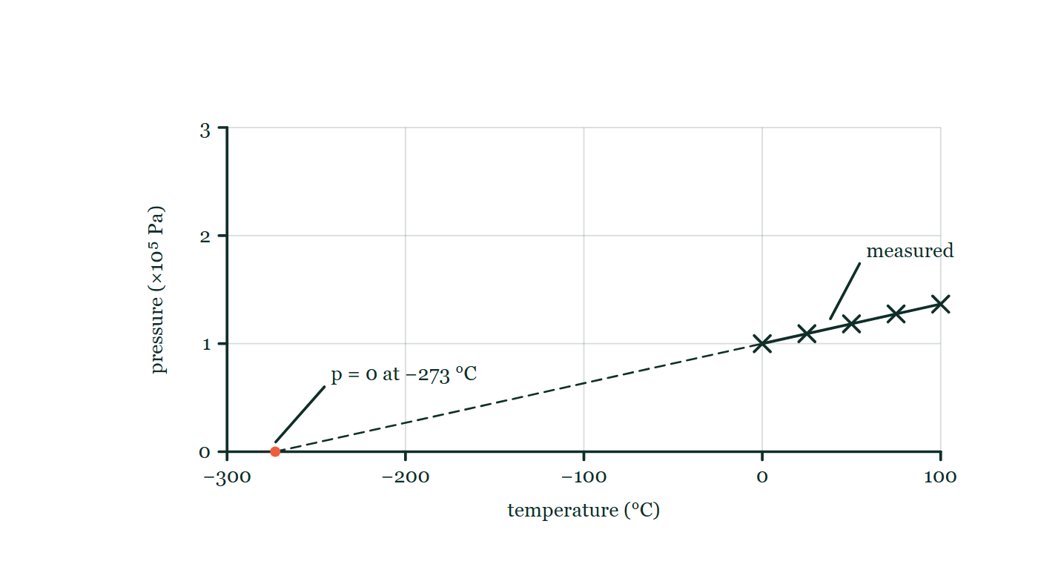
THERMAL PHYSICS · TEMPERATURE & INTERNAL ENERGY
GIOPHYSICS LESSON
THE PICTURE
Where the line runs out
Drawn for this lesson
Pressure of a fixed volume of gas plotted against temperature in Celsius: five measured readings marked as crosses, all above the freezing point of water and joined by a solid line, with a dashed continuation running down and to the left to meet zero pressure at −273 °C.
The live version of this figure — click here
Thermal Physics — Temperature & Internal Energy. Built by GioPhysics from the lesson's own copy; nothing on these slides is re-authored.
15 / 37
Notes:
[Phase] Build the model: The formulae, one at a time, in plain English (minutes 13–22 of 45)
[Figure] Pressure of a fixed volume of gas plotted against temperature in Celsius: five measured readings marked as crosses, all above the freezing point of water and joined by a solid line, with a dashed continuation running down and to the left to meet zero pressure at −273 °C.

Slide 16
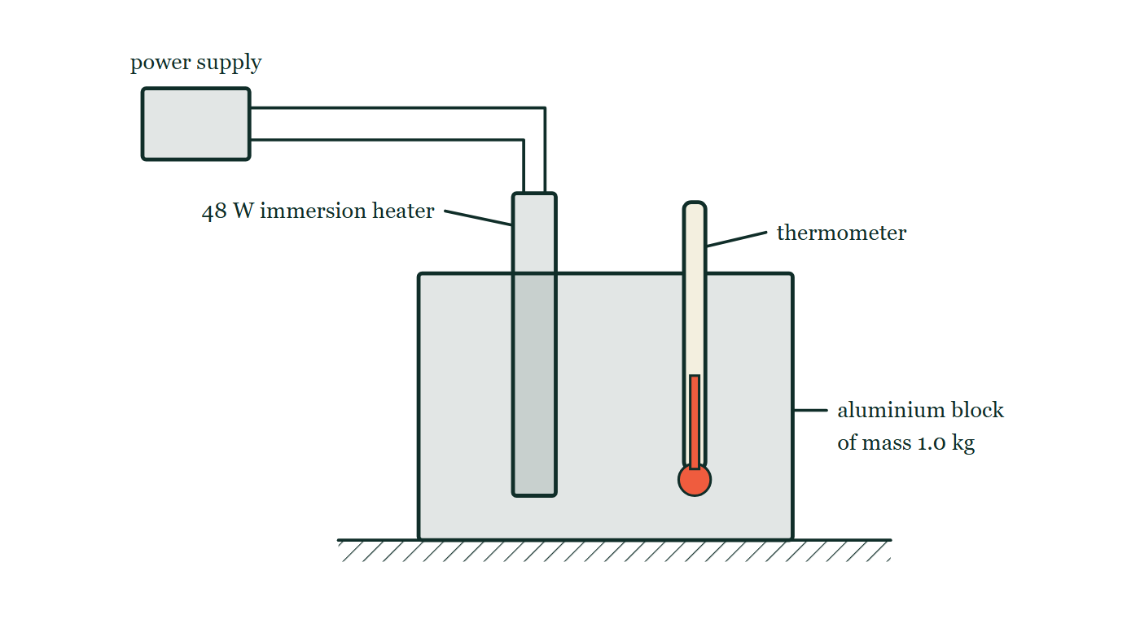
THERMAL PHYSICS · TEMPERATURE & INTERNAL ENERGY
GIOPHYSICS LESSON
FIGURE 1 OF 3
Fig. 10.1 — IGCSE Topic 2 · Thermal physics
Drawn for question 10 of that paper · syllabus 2.2
The apparatus is seen from the side. A rectangular aluminium block of mass 1.0 kg stands on the bench. A 48 W electric immersion heater is pushed down into a narrow hole drilled near one side of the block, and a thermometer is pushed down into a second narrow hole near the other side, its bulb reaching well inside the block. Two leads run from the top of the heater across to a power supply standing beside the apparatus.
See the question this was drawn for — click here
Thermal Physics — Temperature & Internal Energy. Built by GioPhysics from the lesson's own copy; nothing on these slides is re-authored.
16 / 37
Notes:
[Phase] Build the model: The formulae, one at a time, in plain English (minutes 13–22 of 45)
[Figure] Fig. 10.1. The apparatus is seen from the side. A rectangular aluminium block of mass 1.0 kg stands on the bench. A 48 W electric immersion heater is pushed down into a narrow hole drilled near one side of the block, and a thermometer is pushed down into a second narrow hole near the other side, its bulb reaching well inside the block. Two leads run from the top of the heater across to a power supply standing beside the apparatus.
[Where it came from] IGCSE Topic 2 · Thermal physics, question 10; syllabus 2.2.

Slide 17
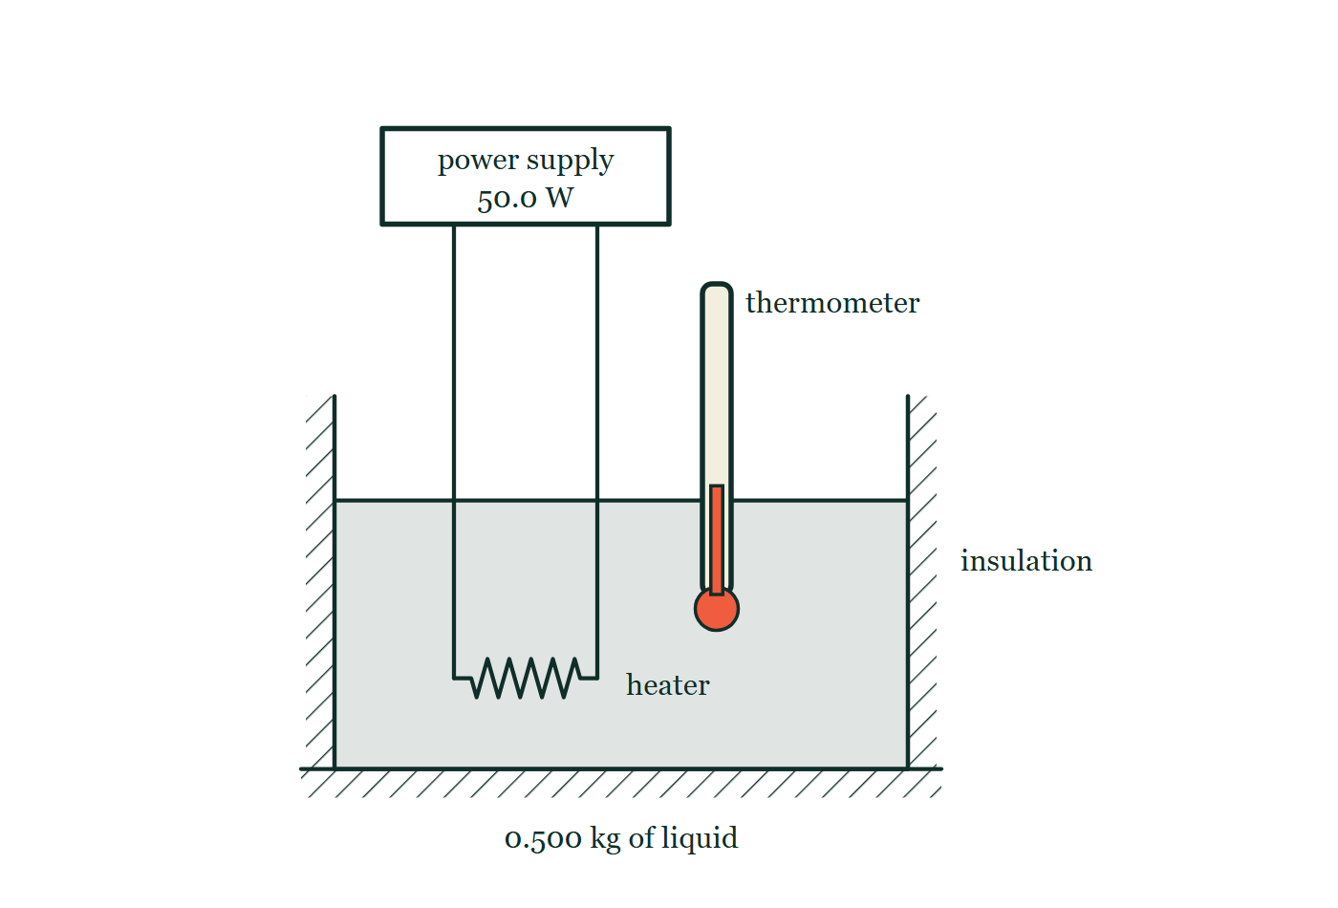
THERMAL PHYSICS · TEMPERATURE & INTERNAL ENERGY
GIOPHYSICS LESSON
FIGURE 2 OF 3
Figure 2 — IB Theme B · The particulate nature of matter
Drawn for question 7 of that paper · syllabus B.1
Section through the apparatus. A container holding the liquid, labelled 0.500 kg of liquid, is surrounded on its sides and base by hatched insulation. A coiled heating element is immersed near the bottom of the liquid, and its two leads run up out of the open top of the container to a box labelled power supply, 50.0 W. A thermometer stands in the liquid with its bulb well below the surface and its stem projecting above the container.
See the question this was drawn for — click here
Thermal Physics — Temperature & Internal Energy. Built by GioPhysics from the lesson's own copy; nothing on these slides is re-authored.
17 / 37
Notes:
[Phase] Build the model: The formulae, one at a time, in plain English (minutes 13–22 of 45)
[Figure] Figure 2. Section through the apparatus. A container holding the liquid, labelled 0.500 kg of liquid, is surrounded on its sides and base by hatched insulation. A coiled heating element is immersed near the bottom of the liquid, and its two leads run up out of the open top of the container to a box labelled power supply, 50.0 W. A thermometer stands in the liquid with its bulb well below the surface and its stem projecting above the container.
[Where it came from] IB Theme B · The particulate nature of matter, question 7; syllabus B.1.

Slide 18
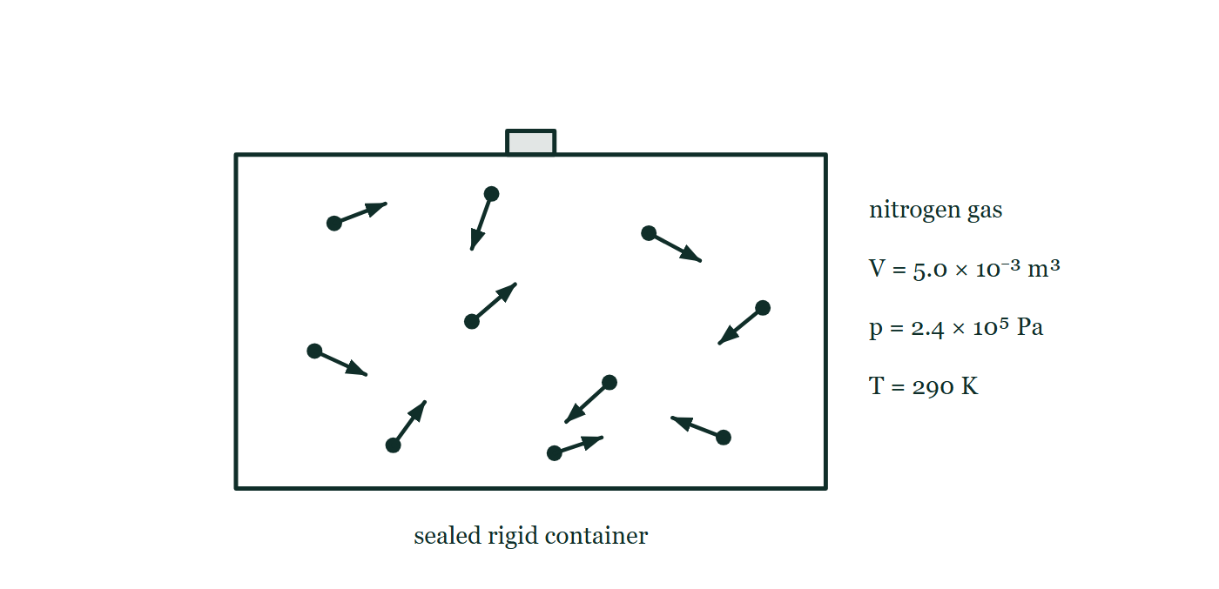
THERMAL PHYSICS · TEMPERATURE & INTERNAL ENERGY
GIOPHYSICS LESSON
FIGURE 3 OF 3
Figure 3 — IB Theme B · The particulate nature of matter
Drawn for question 8 of that paper · syllabus B.1, B.3
A rectangular container with thick walls and a stopper in its top is labelled sealed rigid container. Inside, ten molecules are drawn as dots, each carrying a short arrow of its own direction and length so that the molecules are moving randomly, several of them towards the walls. To the right of the container stand the labels nitrogen gas, V = 5.0 × 10⁻³ m³, p = 2.4 × 10⁵ Pa and T = 290 K.
See the question this was drawn for — click here
Thermal Physics — Temperature & Internal Energy. Built by GioPhysics from the lesson's own copy; nothing on these slides is re-authored.
18 / 37
Notes:
[Phase] Build the model: The formulae, one at a time, in plain English (minutes 13–22 of 45)
[Figure] Figure 3. A rectangular container with thick walls and a stopper in its top is labelled sealed rigid container. Inside, ten molecules are drawn as dots, each carrying a short arrow of its own direction and length so that the molecules are moving randomly, several of them towards the walls. To the right of the container stand the labels nitrogen gas, V = 5.0 × 10⁻³ m³, p = 2.4 × 10⁵ Pa and T = 290 K.
[Where it came from] IB Theme B · The particulate nature of matter, question 8; syllabus B.1, B.3.

Slide 19
THERMAL PHYSICS · TEMPERATURE & INTERNAL ENERGY
GIOPHYSICS LESSON
WATCH OUT
The common trap
Check and misconception — The quick check and the trap
Heat and temperature are not the same thing. Temperature is an average per molecule; heat is a total amount of energy in transit. A cup of water at 90 °C is hotter than a swimming pool at 30 °C, but the pool holds vastly more internal energy — and heat still flows from cup to pool, never the other way.
Thermal Physics — Temperature & Internal Energy. Built by GioPhysics from the lesson's own copy; nothing on these slides is re-authored.
19 / 37
Notes:
[Phase] Check and misconception: The quick check and the trap (minutes 35–41 of 45)
[Misconception] Heat and temperature are not the same thing. Temperature is an average per molecule; heat is a total amount of energy in transit. A cup of water at 90 °C is hotter than a swimming pool at 30 °C, but the pool holds vastly more internal energy — and heat still flows from cup to pool, never the other way.

Slide 20
THERMAL PHYSICS · TEMPERATURE & INTERNAL ENERGY
GIOPHYSICS LESSON
WORKED EXAMPLE 1 OF 2 · EASY
The question
Easy
Worked examples — I do, we do — one step revealed at a time
Convert 25 °C to kelvin, and 100 K to Celsius.
Thermal Physics — Temperature & Internal Energy. Built by GioPhysics from the lesson's own copy; nothing on these slides is re-authored.
20 / 37
Notes:
[Phase] Worked examples: I do, we do — one step revealed at a time (minutes 22–35 of 45)
[Question] Convert 25 °C to kelvin, and 100 K to Celsius.
[Answer] 298 K; −173 °C

Slide 21
THERMAL PHYSICS · TEMPERATURE & INTERNAL ENERGY
GIOPHYSICS LESSON
WORKED EXAMPLE 1 OF 2 · EASY · THE WORKING
How to solve it
Easy
Worked examples — I do, we do — one step revealed at a time
Convert 25 °C to kelvin, and 100 K to Celsius.
1.
T(K) = 25 + 273 = 298 K.
2.
T(°C) = 100 − 273 = −173 °C.
Thermal Physics — Temperature & Internal Energy. Built by GioPhysics from the lesson's own copy; nothing on these slides is re-authored.
21 / 37
Notes:
[Phase] Worked examples: I do, we do — one step revealed at a time (minutes 22–35 of 45)
[Reveal] One click per step. The class works each line before the next appears.
[Step 1] T(K) = 25 + 273 = 298 K.
[Step 2] T(°C) = 100 − 273 = −173 °C.

Slide 22
THERMAL PHYSICS · TEMPERATURE & INTERNAL ENERGY
GIOPHYSICS LESSON
WORKED EXAMPLE 1 OF 2 · EASY
Answer
Easy
Worked examples — I do, we do — one step revealed at a time
298 K; −173 °C
Thermal Physics — Temperature & Internal Energy. Built by GioPhysics from the lesson's own copy; nothing on these slides is re-authored.
22 / 37
Notes:
[Phase] Worked examples: I do, we do — one step revealed at a time (minutes 22–35 of 45)
[Answer] 298 K; −173 °C

Slide 23
THERMAL PHYSICS · TEMPERATURE & INTERNAL ENERGY
GIOPHYSICS LESSON
WORKED EXAMPLE 2 OF 2 · MEDIUM
The question
Medium
Worked examples — I do, we do — one step revealed at a time
100 g of water at 90 °C is mixed with 200 g of water at 30 °C in an insulated cup. Find the equilibrium temperature.
Thermal Physics — Temperature & Internal Energy. Built by GioPhysics from the lesson's own copy; nothing on these slides is re-authored.
23 / 37
Notes:
[Phase] Worked examples: I do, we do — one step revealed at a time (minutes 22–35 of 45)
[Question] 100 g of water at 90 °C is mixed with 200 g of water at 30 °C in an insulated cup. Find the equilibrium temperature.
[Answer] 50 °C

Slide 24
THERMAL PHYSICS · TEMPERATURE & INTERNAL ENERGY
GIOPHYSICS LESSON
WORKED EXAMPLE 2 OF 2 · MEDIUM · THE WORKING
How to solve it
Medium
Worked examples — I do, we do — one step revealed at a time
100 g of water at 90 °C is mixed with 200 g of water at 30 °C in an insulated cup. Find the equilibrium temperature.
1.
Same substance, so the specific heat cancels: heat lost = heat gained.
2.
0.100 × (90 − T) = 0.200 × (T − 30).
3.
9 − 0.1T = 0.2T − 6 → 0.3T = 15 → T = 50 °C.
Thermal Physics — Temperature & Internal Energy. Built by GioPhysics from the lesson's own copy; nothing on these slides is re-authored.
24 / 37
Notes:
[Phase] Worked examples: I do, we do — one step revealed at a time (minutes 22–35 of 45)
[Reveal] One click per step. The class works each line before the next appears.
[Step 1] Same substance, so the specific heat cancels: heat lost = heat gained.
[Step 2] 0.100 × (90 − T) = 0.200 × (T − 30).
[Step 3] 9 − 0.1T = 0.2T − 6 → 0.3T = 15 → T = 50 °C.

Slide 25
THERMAL PHYSICS · TEMPERATURE & INTERNAL ENERGY
GIOPHYSICS LESSON
WORKED EXAMPLE 2 OF 2 · MEDIUM
Answer
Medium
Worked examples — I do, we do — one step revealed at a time
50 °C
Thermal Physics — Temperature & Internal Energy. Built by GioPhysics from the lesson's own copy; nothing on these slides is re-authored.
25 / 37
Notes:
[Phase] Worked examples: I do, we do — one step revealed at a time (minutes 22–35 of 45)
[Answer] 50 °C

Slide 26
THERMAL PHYSICS · TEMPERATURE & INTERNAL ENERGY
GIOPHYSICS LESSON
SPOT THE MISTAKE
One line here is wrong
The whole working is up — find the bad line before you click
1.
The average molecular kinetic energy of a gas is proportional to its kelvin temperature. At what Celsius temperature is it double its value at 27 °C?
2.
Doubling the kinetic energy means doubling the temperature.
3.
2 × 27 = 54
4.
So the answer is 54 °C.
LINE 3 IS WRONG
The doubling has been done on the Celsius scale, whose zero is the freezing point of water and not a true zero of anything. Ratios only mean something on a scale that starts where the quantity does. 27 °C is 300 K; double is 600 K, which is 327 °C. The giveaway is that the same working in Fahrenheit would give a third answer for the same piece of physics.
IT SHOULD SAY
27 °C is 300 K, so double is 600 K — that is 600 − 273 = 327 °C.
Thermal Physics — Temperature & Internal Energy. Built by GioPhysics from the lesson's own copy; nothing on these slides is re-authored.
26 / 37
Notes:
[Phase] Worked examples: I do, we do — one step revealed at a time (minutes 22–35 of 45)
[Spot the mistake] The working is complete and one line of it is wrong. Let the room hunt: one click names the line, a second shows it done correctly.
[Line 3 is wrong] The doubling has been done on the Celsius scale, whose zero is the freezing point of water and not a true zero of anything. Ratios only mean something on a scale that starts where the quantity does. 27 °C is 300 K; double is 600 K, which is 327 °C. The giveaway is that the same working in Fahrenheit would give a third answer for the same piece of physics.
[It should say] 27 °C is 300 K, so double is 600 K — that is 600 − 273 = 327 °C.

Slide 27
THERMAL PHYSICS · TEMPERATURE & INTERNAL ENERGY
GIOPHYSICS LESSON
PREDICT · TAKE THE VOTE
Commit before you are told
Hands up for each option, then click
Which of these two holds more internal energy — the 1000 °C spark, or the 40 °C bath?
A The spark, by a long way — it is twenty-five times hotter
B The bath
C They must be the same; temperature is what energy means
One spark from a sparkler drawn as a small radiating dot on the left, with its 1000 °C and its mass of about 5 × 10⁻⁸ kg printed beneath it; across a dashed divider on the right, a bath of water drawn many times wider, at 40 °C and about 80 kg.
The live version of this figure — click here
Thermal Physics — Temperature & Internal Energy. Built by GioPhysics from the lesson's own copy; nothing on these slides is re-authored.
27 / 37
Notes:
[Phase] Build the model: The formulae, one at a time, in plain English (minutes 13–22 of 45)
[Predict] Which of these two holds more internal energy — the 1000 °C spark, or the 40 °C bath?
[Options] A The spark, by a long way — it is twenty-five times hotter B The bath C They must be the same; temperature is what energy means
[Figure] One spark from a sparkler drawn as a small radiating dot on the left, with its 1000 °C and its mass of about 5 × 10⁻⁸ kg printed beneath it; across a dashed divider on the right, a bath of water drawn many times wider, at 40 °C and about 80 kg.

Slide 28
THERMAL PHYSICS · TEMPERATURE & INTERNAL ENERGY
GIOPHYSICS LESSON
PREDICT · THE OUTCOME
What actually happens
Ask the room who changed their mind, and why
B The bath
WHY
Internal energy is the total kinetic and potential energy of every molecule in the object, so the count matters as much as the temperature does. The spark's molecules are individually far more energetic, but there are about a billion billion times fewer of them. Temperature is an average; internal energy is a sum, and the two answer different questions about the same object.
Thermal Physics — Temperature & Internal Energy. Built by GioPhysics from the lesson's own copy; nothing on these slides is re-authored.
28 / 37
Notes:
[Phase] Build the model: The formulae, one at a time, in plain English (minutes 13–22 of 45)
[Answer] B — The bath. Internal energy is the total kinetic and potential energy of every molecule in the object, so the count matters as much as the temperature does. The spark's molecules are individually far more energetic, but there are about a billion billion times fewer of them. Temperature is an average; internal energy is a sum, and the two answer different questions about the same object.

Slide 29
THERMAL PHYSICS · TEMPERATURE & INTERNAL ENERGY
GIOPHYSICS LESSON
QUICK CHECK
Decide before the answer goes up
Check and misconception — The quick check and the trap
What is 27 °C on the kelvin scale?
A
300 K
B
−246 K
C
327 K
Thermal Physics — Temperature & Internal Energy. Built by GioPhysics from the lesson's own copy; nothing on these slides is re-authored.
29 / 37
Notes:
[Phase] Check and misconception: The quick check and the trap (minutes 35–41 of 45)
[Question] What is 27 °C on the kelvin scale?
[Options] A 300 K B −246 K C 327 K

Slide 30
THERMAL PHYSICS · TEMPERATURE & INTERNAL ENERGY
GIOPHYSICS LESSON
QUICK CHECK · THE ANSWER
The answer, and why
Check and misconception — The quick check and the trap
A 300 K
HOW TO GET THERE
T(K) = T(°C) + 273 = 27 + 273 = 300 K.
WHY THE OTHERS TEMPT
A Correct. T(K) = T(°C) + 273 = 300 K — and it is written 300 K, with no degree sign on a kelvin temperature.
B This is 27 − 273, the conversion run backwards. Kelvin counts upwards from a point 273 below the freezing point of water, so every everyday Celsius temperature turns into a larger kelvin number. A negative kelvin temperature does not exist at all.
C 327 is 27 + 300 — the round number reached for instead of 273. It is worth being fussy about: in a gas-law ratio the difference between 300 K and 327 K is 9%, which is more than the whole tolerance of a typical answer.
Thermal Physics — Temperature & Internal Energy. Built by GioPhysics from the lesson's own copy; nothing on these slides is re-authored.
30 / 37
Notes:
[Phase] Check and misconception: The quick check and the trap (minutes 35–41 of 45)
[Question] What is 27 °C on the kelvin scale?
[Option by option] A: Correct. T(K) = T(°C) + 273 = 300 K — and it is written 300 K, with no degree sign on a kelvin temperature. B: This is 27 − 273, the conversion run backwards. Kelvin counts upwards from a point 273 below the freezing point of water, so every everyday Celsius temperature turns into a larger kelvin number. A negative kelvin temperature does not exist at all. C: 327 is 27 + 300 — the round number reached for instead of 273. It is worth being fussy about: in a gas-law ratio the difference between 300 K and 327 K is 9%, which is more than the whole tolerance of a typical answer.
[Answer] A — 300 K
[Why] T(K) = T(°C) + 273 = 27 + 273 = 300 K.
[Reveal] One click for the answer, then one for the reason.

Slide 31
THERMAL PHYSICS · TEMPERATURE & INTERNAL ENERGY
GIOPHYSICS LESSON
EXTENSION 1 OF 2 · HARD
The question
Hard
Worked examples — I do, we do — one step revealed at a time
The average molecular kinetic energy of a gas is proportional to its kelvin temperature. At what Celsius temperature is the average KE double its value at 27 °C?
Thermal Physics — Temperature & Internal Energy. Built by GioPhysics from the lesson's own copy; nothing on these slides is re-authored.
31 / 37
Notes:
[Phase] Worked examples: I do, we do — one step revealed at a time (minutes 22–35 of 45)
[Question] The average molecular kinetic energy of a gas is proportional to its kelvin temperature. At what Celsius temperature is the average KE double its value at 27 °C?
[Answer] 327 °C (600 K)

Slide 32
THERMAL PHYSICS · TEMPERATURE & INTERNAL ENERGY
GIOPHYSICS LESSON
EXTENSION 1 OF 2 · HARD · THE WORKING
How to solve it
Hard
Worked examples — I do, we do — one step revealed at a time
The average molecular kinetic energy of a gas is proportional to its kelvin temperature. At what Celsius temperature is the average KE double its value at 27 °C?
1.
27 °C = 300 K.
2.
Double the KE needs double the kelvin temperature: 600 K.
3.
600 − 273 = 327 °C — not 54 °C. Doubling must be done in kelvin.
Thermal Physics — Temperature & Internal Energy. Built by GioPhysics from the lesson's own copy; nothing on these slides is re-authored.
32 / 37
Notes:
[Phase] Worked examples: I do, we do — one step revealed at a time (minutes 22–35 of 45)
[Reveal] One click per step. The class works each line before the next appears.
[Step 1] 27 °C = 300 K.
[Step 2] Double the KE needs double the kelvin temperature: 600 K.
[Step 3] 600 − 273 = 327 °C — not 54 °C. Doubling must be done in kelvin.

Slide 33
THERMAL PHYSICS · TEMPERATURE & INTERNAL ENERGY
GIOPHYSICS LESSON
EXTENSION 1 OF 2 · HARD
Answer
Hard
Worked examples — I do, we do — one step revealed at a time
327 °C (600 K)
Thermal Physics — Temperature & Internal Energy. Built by GioPhysics from the lesson's own copy; nothing on these slides is re-authored.
33 / 37
Notes:
[Phase] Worked examples: I do, we do — one step revealed at a time (minutes 22–35 of 45)
[Answer] 327 °C (600 K)

Slide 34
THERMAL PHYSICS · TEMPERATURE & INTERNAL ENERGY
GIOPHYSICS LESSON
EXTENSION 2 OF 2 · CHALLENGING
The question
Challenging
Worked examples — I do, we do — one step revealed at a time
A 2.0 kg steel block (c = 450 J kg⁻¹ K⁻¹) at 100 °C is clamped to a 1.0 kg aluminium block (c = 900 J kg⁻¹ K⁻¹) at 10 °C, insulated from everything else. Find the equilibrium temperature and the heat that flows.
Thermal Physics — Temperature & Internal Energy. Built by GioPhysics from the lesson's own copy; nothing on these slides is re-authored.
34 / 37
Notes:
[Phase] Worked examples: I do, we do — one step revealed at a time (minutes 22–35 of 45)
[Question] A 2.0 kg steel block (c = 450 J kg⁻¹ K⁻¹) at 100 °C is clamped to a 1.0 kg aluminium block (c = 900 J kg⁻¹ K⁻¹) at 10 °C, insulated from everything else. Find the equilibrium temperature and the heat that flows.
[Answer] 55 °C; about 41 kJ transferred

Slide 35
THERMAL PHYSICS · TEMPERATURE & INTERNAL ENERGY
GIOPHYSICS LESSON
EXTENSION 2 OF 2 · CHALLENGING · THE WORKING
How to solve it
Challenging
Worked examples — I do, we do — one step revealed at a time
A 2.0 kg steel block (c = 450 J kg⁻¹ K⁻¹) at 100 °C is clamped to a 1.0 kg aluminium block (c = 900 J kg⁻¹ K⁻¹) at 10 °C, insulated from everything else. Find the equilibrium temperature and the heat that flows.
1.
Heat lost by steel = heat gained by aluminium: 2.0 × 450 × (100 − T) = 1.0 × 900 × (T − 10).
2.
900(100 − T) = 900(T − 10) → 100 − T = T − 10 → T = 55 °C.
3.
Q = 900 × (100 − 55) = 40 500 J ≈ 41 kJ flows from steel to aluminium — and the same 40 500 J arrives, confirming the bookkeeping.
Thermal Physics — Temperature & Internal Energy. Built by GioPhysics from the lesson's own copy; nothing on these slides is re-authored.
35 / 37
Notes:
[Phase] Worked examples: I do, we do — one step revealed at a time (minutes 22–35 of 45)
[Reveal] One click per step. The class works each line before the next appears.
[Step 1] Heat lost by steel = heat gained by aluminium: 2.0 × 450 × (100 − T) = 1.0 × 900 × (T − 10).
[Step 2] 900(100 − T) = 900(T − 10) → 100 − T = T − 10 → T = 55 °C.
[Step 3] Q = 900 × (100 − 55) = 40 500 J ≈ 41 kJ flows from steel to aluminium — and the same 40 500 J arrives, confirming the bookkeeping.

Slide 36
THERMAL PHYSICS · TEMPERATURE & INTERNAL ENERGY
GIOPHYSICS LESSON
EXTENSION 2 OF 2 · CHALLENGING
Answer
Challenging
Worked examples — I do, we do — one step revealed at a time
55 °C; about 41 kJ transferred
Thermal Physics — Temperature & Internal Energy. Built by GioPhysics from the lesson's own copy; nothing on these slides is re-authored.
36 / 37
Notes:
[Phase] Worked examples: I do, we do — one step revealed at a time (minutes 22–35 of 45)
[Answer] 55 °C; about 41 kJ transferred

Slide 37
THERMAL PHYSICS · TEMPERATURE & INTERNAL ENERGY
GIOPHYSICS LESSON
THERMAL PHYSICS
Where to go next
Plenary — What to take away, what to practise next
Next
21.2 Specific Heat & Latent Heat
https://giophysics.com/chapter-40/specific-heat-latent-heat/
Lesson
This lesson on giophysics.com
https://giophysics.com/chapter-40/thermal-concepts/
Live
The live, interactive version of these slides
https://giophysics.com/chapter-40/presentation/?lesson=concepts
Chapter
All Thermal Physics lessons
https://giophysics.com/chapter-40/
PDF
Download the lesson PDF
https://giophysics.com/downloads/40-1-thermal-concepts.pdf
Thermal Physics — Temperature & Internal Energy. Built by GioPhysics from the lesson's own copy; nothing on these slides is re-authored.
37 / 37
Notes:
[Phase] Plenary: What to take away, what to practise next (minutes 41–45 of 45)
[Interactive] The graphs and the circuit topology on these slides are frozen. The live version at https://giophysics.com/chapter-40/presentation/?lesson=concepts moves them.

