Slide 1
THERMAL PHYSICS · THE GAS LAWS
GIOPHYSICS LESSON
21 · Thermal Physics
One equation, three named laws
The Gas Laws
Boyle, Charles, and the pressure law were each discovered separately, one careful experiment at a time. All three are slices of a single equation of state: pV = nRT.
POSITION
Lesson 4 of 6 in Thermal Physics
PLAN
16 slides in the 45-minute core run, about 44.5 minutes of it
LESSON PAGE
https://giophysics.com/chapter-40/gas-laws/
Built by GioPhysics from the lesson's own page. Every word on these slides is the lesson's; nothing here is re-authored. Teaching material, not an awarding body's document.
Thermal Physics — The Gas Laws. Built by GioPhysics from the lesson's own copy; nothing on these slides is re-authored.
1 / 33
Notes:
[Lesson] Thermal Physics — The Gas Laws. Lesson 4 of 6.
[Intro] Boyle, Charles, and the pressure law were each discovered separately, one careful experiment at a time. All three are slices of a single equation of state: pV = nRT.
[Source] https://giophysics.com/chapter-40/gas-laws/
[Disclaimer] Built by GioPhysics from the lesson's own page. Every word on these slides is the lesson's; nothing here is re-authored. Teaching material, not an awarding body's document.

Slide 2
THERMAL PHYSICS · THE GAS LAWS
GIOPHYSICS LESSON
WHAT THIS NEEDS
What you already know
Starter — Recall what this lesson stands on
Recall
Kinetic theory
https://giophysics.com/chapter-40/kinetic-theory/
Recall
Pressure in fluids
https://giophysics.com/chapter-13/pressure-fluids/
Thermal Physics — The Gas Laws. Built by GioPhysics from the lesson's own copy; nothing on these slides is re-authored.
2 / 33
Notes:
[Phase] Starter: Recall what this lesson stands on (minutes 0–5 of 45)
[Starter] Recall: Kinetic theory; Pressure in fluids

Slide 3
THERMAL PHYSICS · THE GAS LAWS
GIOPHYSICS LESSON
THINK FIRST
A sealed packet of crisps is taken up a mountain pass and arrives tight as a drum. Nobody put any air into it. What got bigger?
Take answers before you click — the point is the commitment
The packet is completely sealed, so the amount of gas inside has not changed by a single molecule — and it is noticeably colder up there, which ought to shrink it.
THE ANSWER
Its volume. The atmosphere pressing in from outside has dropped to about four fifths of its sea-level value, so the trapped gas expands until it pushes back just as hard. That is Boyle's law done by the weather, and it beats the cooling: the pressure effect is worth about +27% and the cooling only −4%.
Thermal Physics — The Gas Laws. Built by GioPhysics from the lesson's own copy; nothing on these slides is re-authored.
3 / 33
Notes:
[Phase] Starter: Recall what this lesson stands on (minutes 0–5 of 45)
[Hook] A sealed packet of crisps is taken up a mountain pass and arrives tight as a drum. Nobody put any air into it. What got bigger? The packet is completely sealed, so the amount of gas inside has not changed by a single molecule — and it is noticeably colder up there, which ought to shrink it.
[Answer] Its volume. The atmosphere pressing in from outside has dropped to about four fifths of its sea-level value, so the trapped gas expands until it pushes back just as hard. That is Boyle's law done by the weather, and it beats the cooling: the pressure effect is worth about +27% and the cooling only −4%.

Slide 4
THERMAL PHYSICS · THE GAS LAWS
GIOPHYSICS LESSON
EXPLAINED SIMPLY
In one sentence
Introduce the idea — The big idea and the definition
The equation of state pV = nRT links pressure, volume, amount, and kelvin temperature for an ideal gas; each named gas law is the same equation with one variable held fixed.
Thermal Physics — The Gas Laws. Built by GioPhysics from the lesson's own copy; nothing on these slides is re-authored.
4 / 33
Notes:
[Phase] Introduce the idea: The big idea and the definition (minutes 5–13 of 45)
[Definition] The equation of state pV = nRT links pressure, volume, amount, and kelvin temperature for an ideal gas; each named gas law is the same equation with one variable held fixed.

Slide 5
THERMAL PHYSICS · THE GAS LAWS
GIOPHYSICS LESSON
EXPLAINED SIMPLY
What that looks like
Introduce the idea — The big idea and the definition
FOR EXAMPLE
Seal a syringe and halve its volume slowly: the trapped air’s pressure doubles — Boyle’s law, the constant-temperature slice of pV = nRT.
Thermal Physics — The Gas Laws. Built by GioPhysics from the lesson's own copy; nothing on these slides is re-authored.
5 / 33
Notes:
[Phase] Introduce the idea: The big idea and the definition (minutes 5–13 of 45)
[Worked illustration] Seal a syringe and halve its volume slowly: the trapped air’s pressure doubles — Boyle’s law, the constant-temperature slice of pV = nRT.

Slide 6
THERMAL PHYSICS · THE GAS LAWS
GIOPHYSICS LESSON
THE BIG IDEA
One equation, three named laws
Introduce the idea — The big idea and the definition
For an ideal gas the four state variables — pressure, volume, moles, and kelvin temperature — obey pV = nRT with R = 8.31 J mol⁻¹ K⁻¹. Hold T constant and you get Boyle’s law, pV = constant, drawn as isotherms on a p–V diagram. Hold p constant and V ∝ T (Charles).
Hold V constant and p ∝ T (the pressure law). The mole count n comes from n = N/N(A) or from mass over molar mass — the chemistry that lets one equation describe any gas.
Thermal Physics — The Gas Laws. Built by GioPhysics from the lesson's own copy; nothing on these slides is re-authored.
6 / 33
Notes:
[Phase] Introduce the idea: The big idea and the definition (minutes 5–13 of 45)
[Big idea] For an ideal gas the four state variables — pressure, volume, moles, and kelvin temperature — obey pV = nRT with R = 8.31 J mol⁻¹ K⁻¹. Hold T constant and you get Boyle’s law, pV = constant, drawn as isotherms on a p–V diagram. Hold p constant and V ∝ T (Charles). Hold V constant and p ∝ T (the pressure law). The mole count n comes from n = N/N(A) or from mass over molar mass — the chemistry that lets one equation describe any gas.

Slide 7
THERMAL PHYSICS · THE GAS LAWS
GIOPHYSICS LESSON
THE PHYSICS · 1 OF 3
Why the slices work
Build the model — The formulae, one at a time, in plain English
Rearrange pV = nRT with n fixed. Constant T: pV = nRT = constant.
Constant p: V = (nR/p)T, a straight line through absolute zero. Constant V: p = (nR/V)T, another straight line — the very graph that revealed −273 °C in the first place.
Thermal Physics — The Gas Laws. Built by GioPhysics from the lesson's own copy; nothing on these slides is re-authored.
7 / 33
Notes:
[Phase] Build the model: The formulae, one at a time, in plain English (minutes 13–22 of 45)
[Section] Rearrange pV = nRT with n fixed. Constant T: pV = nRT = constant. Constant p: V = (nR/p)T, a straight line through absolute zero. Constant V: p = (nR/V)T, another straight line — the very graph that revealed −273 °C in the first place.

Slide 8
THERMAL PHYSICS · THE GAS LAWS
GIOPHYSICS LESSON
THE PHYSICS · 2 OF 3
Isotherms on the p–V diagram
Build the model — The formulae, one at a time, in plain English
Each temperature draws its own hyperbola. A gas changing state moves along a path between them: along one isotherm if compressed slowly at fixed temperature, across isotherms if heated or cooled. The area under a p–V path will become the work done — the door to thermodynamics.
Thermal Physics — The Gas Laws. Built by GioPhysics from the lesson's own copy; nothing on these slides is re-authored.
8 / 33
Notes:
[Phase] Build the model: The formulae, one at a time, in plain English (minutes 13–22 of 45)
[Section] Each temperature draws its own hyperbola. A gas changing state moves along a path between them: along one isotherm if compressed slowly at fixed temperature, across isotherms if heated or cooled. The area under a p–V path will become the work done — the door to thermodynamics.

Slide 9
THERMAL PHYSICS · THE GAS LAWS
GIOPHYSICS LESSON
THE PHYSICS · 3 OF 3
Moles and molar mass
Build the model — The formulae, one at a time, in plain English
A mole is a counted amount: 6.02 × 10²³ particles, with a mass in grams equal to the molar mass. Water’s M is 18 g mol⁻¹, so 18 g of water is one mole — 6.02 × 10²³ molecules, ready to substitute as n in the equation of state.
Thermal Physics — The Gas Laws. Built by GioPhysics from the lesson's own copy; nothing on these slides is re-authored.
9 / 33
Notes:
[Phase] Build the model: The formulae, one at a time, in plain English (minutes 13–22 of 45)
[Section] A mole is a counted amount: 6.02 × 10²³ particles, with a mass in grams equal to the molar mass. Water’s M is 18 g mol⁻¹, so 18 g of water is one mole — 6.02 × 10²³ molecules, ready to substitute as n in the equation of state.

Slide 10
THERMAL PHYSICS · THE GAS LAWS
GIOPHYSICS LESSON
FORMULA 1 OF 3
Equation of state
Build the model — The formulae, one at a time, in plain English
pV = nRT
R = 8.31 J mol⁻¹ K⁻¹; T in kelvin
IN PLAIN ENGLISH
Four state variables, one relation. Fix any two and the other pair must trade off to keep the equation true.
Thermal Physics — The Gas Laws. Built by GioPhysics from the lesson's own copy; nothing on these slides is re-authored.
10 / 33
Notes:
[Phase] Build the model: The formulae, one at a time, in plain English (minutes 13–22 of 45)
[Formula] Equation of state: pV = nRT
[In plain English] Four state variables, one relation. Fix any two and the other pair must trade off to keep the equation true.
[Note] R = 8.31 J mol⁻¹ K⁻¹; T in kelvin

Slide 11
THERMAL PHYSICS · THE GAS LAWS
GIOPHYSICS LESSON
FORMULA 2 OF 3
Counting molecules
Build the model — The formulae, one at a time, in plain English
n = N/N(A) = m/M
N(A) = 6.02 × 10²³ mol⁻¹
IN PLAIN ENGLISH
Moles convert between the molecular count N and the mass on your balance: one mole of any substance holds Avogadro’s number of molecules and weighs its molar mass M.
Thermal Physics — The Gas Laws. Built by GioPhysics from the lesson's own copy; nothing on these slides is re-authored.
11 / 33
Notes:
[Phase] Build the model: The formulae, one at a time, in plain English (minutes 13–22 of 45)
[Formula] Counting molecules: n = N/N(A) = m/M
[In plain English] Moles convert between the molecular count N and the mass on your balance: one mole of any substance holds Avogadro’s number of molecules and weighs its molar mass M.
[Note] N(A) = 6.02 × 10²³ mol⁻¹

Slide 12
THERMAL PHYSICS · THE GAS LAWS
GIOPHYSICS LESSON
FORMULA 3 OF 3
The three slices
Build the model — The formulae, one at a time, in plain English
pV const · V ∝ T · p ∝ T
Fixed T (Boyle) · fixed p (Charles) · fixed V
IN PLAIN ENGLISH
Each named law holds one variable still. On a p–V diagram the fixed-T curves are hyperbolas called isotherms — hotter isotherms sit further from the origin.
Thermal Physics — The Gas Laws. Built by GioPhysics from the lesson's own copy; nothing on these slides is re-authored.
12 / 33
Notes:
[Phase] Build the model: The formulae, one at a time, in plain English (minutes 13–22 of 45)
[Formula] The three slices: pV const · V ∝ T · p ∝ T
[In plain English] Each named law holds one variable still. On a p–V diagram the fixed-T curves are hyperbolas called isotherms — hotter isotherms sit further from the origin.
[Note] Fixed T (Boyle) · fixed p (Charles) · fixed V

Slide 13
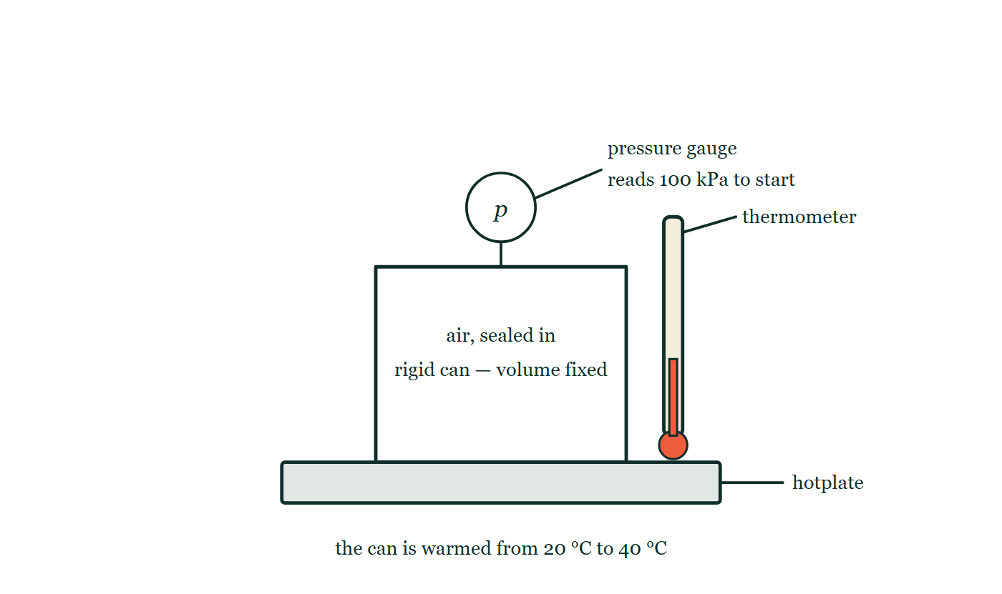
THERMAL PHYSICS · THE GAS LAWS
GIOPHYSICS LESSON
THE PICTURE
A sealed can on a hotplate
Drawn for this lesson
A steel can of air standing on a hotplate, drawn with square corners and no bulge anywhere, a pressure gauge on top reading 100 kPa to start and a thermometer beside it, under a caption saying the can is warmed from 20 °C to 40 °C.
The live version of this figure — click here
Thermal Physics — The Gas Laws. Built by GioPhysics from the lesson's own copy; nothing on these slides is re-authored.
13 / 33
Notes:
[Phase] Build the model: The formulae, one at a time, in plain English (minutes 13–22 of 45)
[Figure] A steel can of air standing on a hotplate, drawn with square corners and no bulge anywhere, a pressure gauge on top reading 100 kPa to start and a thermometer beside it, under a caption saying the can is warmed from 20 °C to 40 °C.

Slide 14
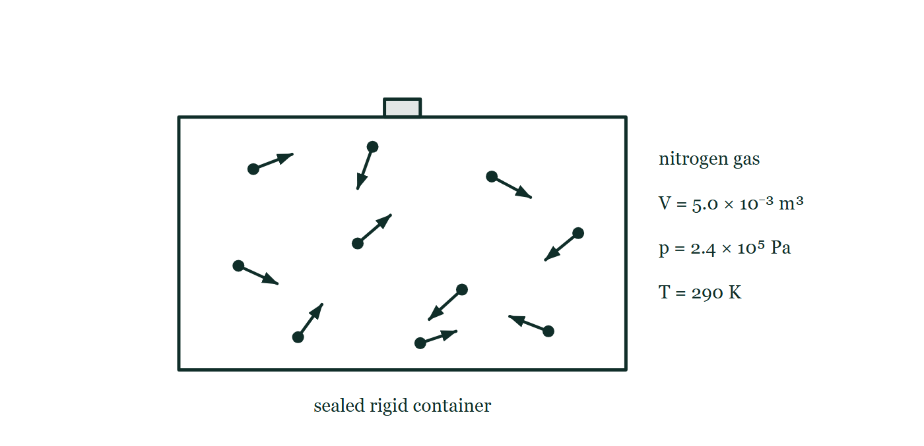
THERMAL PHYSICS · THE GAS LAWS
GIOPHYSICS LESSON
FIGURE
Figure 3 — IB Theme B · The particulate nature of matter
Drawn for question 8 of that paper · syllabus B.1, B.3
A rectangular container with thick walls and a stopper in its top is labelled sealed rigid container. Inside, ten molecules are drawn as dots, each carrying a short arrow of its own direction and length so that the molecules are moving randomly, several of them towards the walls. To the right of the container stand the labels nitrogen gas, V = 5.0 × 10⁻³ m³, p = 2.4 × 10⁵ Pa and T = 290 K.
See the question this was drawn for — click here
Thermal Physics — The Gas Laws. Built by GioPhysics from the lesson's own copy; nothing on these slides is re-authored.
14 / 33
Notes:
[Phase] Build the model: The formulae, one at a time, in plain English (minutes 13–22 of 45)
[Figure] Figure 3. A rectangular container with thick walls and a stopper in its top is labelled sealed rigid container. Inside, ten molecules are drawn as dots, each carrying a short arrow of its own direction and length so that the molecules are moving randomly, several of them towards the walls. To the right of the container stand the labels nitrogen gas, V = 5.0 × 10⁻³ m³, p = 2.4 × 10⁵ Pa and T = 290 K.
[Where it came from] IB Theme B · The particulate nature of matter, question 8; syllabus B.1, B.3.

Slide 15
THERMAL PHYSICS · THE GAS LAWS
GIOPHYSICS LESSON
WATCH OUT
The common trap
Check and misconception — The quick check and the trap
Gas-law temperatures must be in kelvin. Heating a sealed can from 20 °C to 40 °C does not double its pressure — 293 K to 313 K is only a 7% rise. Doubling on the Celsius scale means nothing physically, because 0 °C is not a true zero.
Thermal Physics — The Gas Laws. Built by GioPhysics from the lesson's own copy; nothing on these slides is re-authored.
15 / 33
Notes:
[Phase] Check and misconception: The quick check and the trap (minutes 35–41 of 45)
[Misconception] Gas-law temperatures must be in kelvin. Heating a sealed can from 20 °C to 40 °C does not double its pressure — 293 K to 313 K is only a 7% rise. Doubling on the Celsius scale means nothing physically, because 0 °C is not a true zero.

Slide 16
THERMAL PHYSICS · THE GAS LAWS
GIOPHYSICS LESSON
WORKED EXAMPLE 1 OF 2 · EASY
The question
Easy
Worked examples — I do, we do — one step revealed at a time
A gas occupies 6.0 L at 100 kPa. It is compressed to 2.0 L at constant temperature. Find the new pressure.
Thermal Physics — The Gas Laws. Built by GioPhysics from the lesson's own copy; nothing on these slides is re-authored.
16 / 33
Notes:
[Phase] Worked examples: I do, we do — one step revealed at a time (minutes 22–35 of 45)
[Question] A gas occupies 6.0 L at 100 kPa. It is compressed to 2.0 L at constant temperature. Find the new pressure.
[Answer] 300 kPa

Slide 17
THERMAL PHYSICS · THE GAS LAWS
GIOPHYSICS LESSON
WORKED EXAMPLE 1 OF 2 · EASY · THE WORKING
How to solve it
Easy
Worked examples — I do, we do — one step revealed at a time
A gas occupies 6.0 L at 100 kPa. It is compressed to 2.0 L at constant temperature. Find the new pressure.
1.
Boyle’s law: p₁V₁ = p₂V₂.
2.
p₂ = 100 × 6.0 ÷ 2.0 = 300 kPa.
Thermal Physics — The Gas Laws. Built by GioPhysics from the lesson's own copy; nothing on these slides is re-authored.
17 / 33
Notes:
[Phase] Worked examples: I do, we do — one step revealed at a time (minutes 22–35 of 45)
[Reveal] One click per step. The class works each line before the next appears.
[Step 1] Boyle’s law: p₁V₁ = p₂V₂.
[Step 2] p₂ = 100 × 6.0 ÷ 2.0 = 300 kPa.

Slide 18
THERMAL PHYSICS · THE GAS LAWS
GIOPHYSICS LESSON
WORKED EXAMPLE 1 OF 2 · EASY
Answer
Easy
Worked examples — I do, we do — one step revealed at a time
300 kPa
Thermal Physics — The Gas Laws. Built by GioPhysics from the lesson's own copy; nothing on these slides is re-authored.
18 / 33
Notes:
[Phase] Worked examples: I do, we do — one step revealed at a time (minutes 22–35 of 45)
[Answer] 300 kPa

Slide 19
THERMAL PHYSICS · THE GAS LAWS
GIOPHYSICS LESSON
WORKED EXAMPLE 2 OF 2 · MEDIUM
The question
Medium
Worked examples — I do, we do — one step revealed at a time
A cylinder holds gas at p = 2.0 × 10⁷ Pa in V = 2.0 × 10⁻² m³ at 17 °C. How many moles — and how many molecules — does it contain?
Thermal Physics — The Gas Laws. Built by GioPhysics from the lesson's own copy; nothing on these slides is re-authored.
19 / 33
Notes:
[Phase] Worked examples: I do, we do — one step revealed at a time (minutes 22–35 of 45)
[Question] A cylinder holds gas at p = 2.0 × 10⁷ Pa in V = 2.0 × 10⁻² m³ at 17 °C. How many moles — and how many molecules — does it contain?
[Answer] ≈ 170 mol ≈ 1.0 × 10²⁶ molecules

Slide 20
THERMAL PHYSICS · THE GAS LAWS
GIOPHYSICS LESSON
WORKED EXAMPLE 2 OF 2 · MEDIUM · THE WORKING
How to solve it
Medium
Worked examples — I do, we do — one step revealed at a time
A cylinder holds gas at p = 2.0 × 10⁷ Pa in V = 2.0 × 10⁻² m³ at 17 °C. How many moles — and how many molecules — does it contain?
1.
T = 17 + 273 = 290 K.
2.
n = pV/RT = (2.0 × 10⁷ × 2.0 × 10⁻²) ÷ (8.31 × 290) = 4.0 × 10⁵ ÷ 2410 ≈ 170 mol.
3.
N = nN(A) = 170 × 6.02 × 10²³ ≈ 1.0 × 10²⁶ molecules.
Thermal Physics — The Gas Laws. Built by GioPhysics from the lesson's own copy; nothing on these slides is re-authored.
20 / 33
Notes:
[Phase] Worked examples: I do, we do — one step revealed at a time (minutes 22–35 of 45)
[Reveal] One click per step. The class works each line before the next appears.
[Step 1] T = 17 + 273 = 290 K.
[Step 2] n = pV/RT = (2.0 × 10⁷ × 2.0 × 10⁻²) ÷ (8.31 × 290) = 4.0 × 10⁵ ÷ 2410 ≈ 170 mol.
[Step 3] N = nN(A) = 170 × 6.02 × 10²³ ≈ 1.0 × 10²⁶ molecules.

Slide 21
THERMAL PHYSICS · THE GAS LAWS
GIOPHYSICS LESSON
WORKED EXAMPLE 2 OF 2 · MEDIUM
Answer
Medium
Worked examples — I do, we do — one step revealed at a time
≈ 170 mol ≈ 1.0 × 10²⁶ molecules
Thermal Physics — The Gas Laws. Built by GioPhysics from the lesson's own copy; nothing on these slides is re-authored.
21 / 33
Notes:
[Phase] Worked examples: I do, we do — one step revealed at a time (minutes 22–35 of 45)
[Answer] ≈ 170 mol ≈ 1.0 × 10²⁶ molecules

Slide 22
THERMAL PHYSICS · THE GAS LAWS
GIOPHYSICS LESSON
SPOT THE MISTAKE
One line here is wrong
The whole working is up — find the bad line before you click
1.
A sealed rigid container holds gas at 6.0 atm and 30 °C. It is heated to 330 °C. Find the new pressure.
2.
Constant volume, so p ∝ T.
3.
p₂ = p₁ × T₂/T₁ = 6.0 × 330/30
4.
p₂ = 66 atm
LINE 3 IS WRONG
The proportionality p ∝ T is only true on a scale whose zero is where the pressure actually reaches zero, and Celsius is not that scale. In kelvin the ratio is 603/303 = 1.99, not 330/30 = 11 — the Celsius version is out by a factor of five and a half here, and it would be out by a different factor for every other pair of temperatures.
IT SHOULD SAY
p₂ = p₁ × T₂/T₁ = 6.0 × 603/303 ≈ 12 atm
Thermal Physics — The Gas Laws. Built by GioPhysics from the lesson's own copy; nothing on these slides is re-authored.
22 / 33
Notes:
[Phase] Worked examples: I do, we do — one step revealed at a time (minutes 22–35 of 45)
[Spot the mistake] The working is complete and one line of it is wrong. Let the room hunt: one click names the line, a second shows it done correctly.
[Line 3 is wrong] The proportionality p ∝ T is only true on a scale whose zero is where the pressure actually reaches zero, and Celsius is not that scale. In kelvin the ratio is 603/303 = 1.99, not 330/30 = 11 — the Celsius version is out by a factor of five and a half here, and it would be out by a different factor for every other pair of temperatures.
[It should say] p₂ = p₁ × T₂/T₁ = 6.0 × 603/303 ≈ 12 atm

Slide 23
THERMAL PHYSICS · THE GAS LAWS
GIOPHYSICS LESSON
PREDICT · TAKE THE VOTE
Commit before you are told
Hands up for each option, then click
The gauge read 100 kPa with the can at 20 °C. The hotplate warms it to 40 °C. What does the gauge read now?
A 200 kPa — the temperature has doubled
B 107 kPa
C 100 kPa — the can is sealed, so nothing can change
A steel can of air standing on a hotplate, drawn with square corners and no bulge anywhere, a pressure gauge on top reading 100 kPa to start and a thermometer beside it, under a caption saying the can is warmed from 20 °C to 40 °C.
The live version of this figure — click here
Thermal Physics — The Gas Laws. Built by GioPhysics from the lesson's own copy; nothing on these slides is re-authored.
23 / 33
Notes:
[Phase] Build the model: The formulae, one at a time, in plain English (minutes 13–22 of 45)
[Predict] The gauge read 100 kPa with the can at 20 °C. The hotplate warms it to 40 °C. What does the gauge read now?
[Options] A 200 kPa — the temperature has doubled B 107 kPa C 100 kPa — the can is sealed, so nothing can change
[Figure] A steel can of air standing on a hotplate, drawn with square corners and no bulge anywhere, a pressure gauge on top reading 100 kPa to start and a thermometer beside it, under a caption saying the can is warmed from 20 °C to 40 °C.

Slide 24
THERMAL PHYSICS · THE GAS LAWS
GIOPHYSICS LESSON
PREDICT · THE OUTCOME
What actually happens
Ask the room who changed their mind, and why
B 107 kPa
WHY
The can is rigid, so V is fixed and p ∝ T — but only with T in kelvin, and in kelvin 20 °C to 40 °C is 293 K to 313 K, a rise of 6.8%, not 100%. The gauge goes to about 107 kPa. Doubling on the Celsius scale means nothing physically, because 0 °C is the freezing point of water and not a true zero; the same sum done in Fahrenheit would give a different answer for the same can.
Thermal Physics — The Gas Laws. Built by GioPhysics from the lesson's own copy; nothing on these slides is re-authored.
24 / 33
Notes:
[Phase] Build the model: The formulae, one at a time, in plain English (minutes 13–22 of 45)
[Answer] B — 107 kPa. The can is rigid, so V is fixed and p ∝ T — but only with T in kelvin, and in kelvin 20 °C to 40 °C is 293 K to 313 K, a rise of 6.8%, not 100%. The gauge goes to about 107 kPa. Doubling on the Celsius scale means nothing physically, because 0 °C is the freezing point of water and not a true zero; the same sum done in Fahrenheit would give a different answer for the same can.

Slide 25
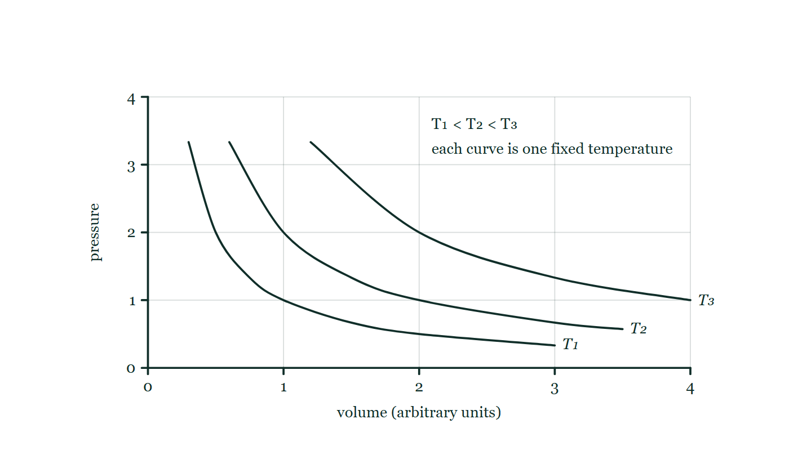
THERMAL PHYSICS · THE GAS LAWS
GIOPHYSICS LESSON
QUICK CHECK
Decide before the answer goes up
Check and misconception — The quick check and the trap
A sealed syringe of gas is halved in volume at constant temperature. Its pressure…
A
Halves
B
Doubles
C
Quadruples
Three isotherms on a pressure–volume diagram, each sampled from pV = constant so that they are genuine hyperbolas, nested with T₁ closest to the origin and T₃ furthest out, and a note that every point on one curve is at the same temperature.
The live version of this figure — click here
Thermal Physics — The Gas Laws. Built by GioPhysics from the lesson's own copy; nothing on these slides is re-authored.
25 / 33
Notes:
[Phase] Check and misconception: The quick check and the trap (minutes 35–41 of 45)
[Question] A sealed syringe of gas is halved in volume at constant temperature. Its pressure…
[Figure] Three isotherms on a pressure–volume diagram, each sampled from pV = constant so that they are genuine hyperbolas, nested with T₁ closest to the origin and T₃ furthest out, and a note that every point on one curve is at the same temperature.
[Options] A Halves B Doubles C Quadruples

Slide 26
THERMAL PHYSICS · THE GAS LAWS
GIOPHYSICS LESSON
QUICK CHECK · THE ANSWER
The answer, and why
Check and misconception — The quick check and the trap
B Doubles
HOW TO GET THERE
Boyle’s law: with T and n fixed, pV is constant — half the volume means double the pressure.
WHY THE OTHERS TEMPT
A This has the pressure following the volume downwards. They move oppositely: pV has to stay constant, so if one halves the other must double.
B Correct. Boyle's law — with T and n fixed, pV is constant, so half the volume is twice the pressure.
C Quadrupling would need the volume quartered, or the volume halved AND the kelvin temperature doubled at the same time. Halving the volume alone gives a factor of two: the relation is p ∝ 1/V, not 1/V².
Thermal Physics — The Gas Laws. Built by GioPhysics from the lesson's own copy; nothing on these slides is re-authored.
26 / 33
Notes:
[Phase] Check and misconception: The quick check and the trap (minutes 35–41 of 45)
[Question] A sealed syringe of gas is halved in volume at constant temperature. Its pressure…
[Option by option] A: This has the pressure following the volume downwards. They move oppositely: pV has to stay constant, so if one halves the other must double. B: Correct. Boyle's law — with T and n fixed, pV is constant, so half the volume is twice the pressure. C: Quadrupling would need the volume quartered, or the volume halved AND the kelvin temperature doubled at the same time. Halving the volume alone gives a factor of two: the relation is p ∝ 1/V, not 1/V².
[Answer] B — Doubles
[Why] Boyle’s law: with T and n fixed, pV is constant — half the volume means double the pressure.
[Reveal] One click for the answer, then one for the reason.

Slide 27
THERMAL PHYSICS · THE GAS LAWS
GIOPHYSICS LESSON
EXTENSION 1 OF 2 · HARD
The question
Hard
Worked examples — I do, we do — one step revealed at a time
A sealed rigid container holds gas at 6.0 atm and 30 °C. It is heated to 330 °C. Find the new pressure.
Thermal Physics — The Gas Laws. Built by GioPhysics from the lesson's own copy; nothing on these slides is re-authored.
27 / 33
Notes:
[Phase] Worked examples: I do, we do — one step revealed at a time (minutes 22–35 of 45)
[Question] A sealed rigid container holds gas at 6.0 atm and 30 °C. It is heated to 330 °C. Find the new pressure.
[Answer] ≈ 12 atm

Slide 28
THERMAL PHYSICS · THE GAS LAWS
GIOPHYSICS LESSON
EXTENSION 1 OF 2 · HARD · THE WORKING
How to solve it
Hard
Worked examples — I do, we do — one step revealed at a time
A sealed rigid container holds gas at 6.0 atm and 30 °C. It is heated to 330 °C. Find the new pressure.
1.
Constant volume: p ∝ T, with T in kelvin.
2.
T₁ = 303 K, T₂ = 603 K.
3.
p₂ = 6.0 × 603 ÷ 303 ≈ 12 atm — the kelvin ratio is 1.99, nowhere near the Celsius ratio of 11.
Thermal Physics — The Gas Laws. Built by GioPhysics from the lesson's own copy; nothing on these slides is re-authored.
28 / 33
Notes:
[Phase] Worked examples: I do, we do — one step revealed at a time (minutes 22–35 of 45)
[Reveal] One click per step. The class works each line before the next appears.
[Step 1] Constant volume: p ∝ T, with T in kelvin.
[Step 2] T₁ = 303 K, T₂ = 603 K.
[Step 3] p₂ = 6.0 × 603 ÷ 303 ≈ 12 atm — the kelvin ratio is 1.99, nowhere near the Celsius ratio of 11.

Slide 29
THERMAL PHYSICS · THE GAS LAWS
GIOPHYSICS LESSON
EXTENSION 1 OF 2 · HARD
Answer
Hard
Worked examples — I do, we do — one step revealed at a time
≈ 12 atm
Thermal Physics — The Gas Laws. Built by GioPhysics from the lesson's own copy; nothing on these slides is re-authored.
29 / 33
Notes:
[Phase] Worked examples: I do, we do — one step revealed at a time (minutes 22–35 of 45)
[Answer] ≈ 12 atm

Slide 30
THERMAL PHYSICS · THE GAS LAWS
GIOPHYSICS LESSON
EXTENSION 2 OF 2 · CHALLENGING
The question
Challenging
Worked examples — I do, we do — one step revealed at a time
Estimate the number of molecules in 1.0 cm³ of room air (101 kPa, 20 °C).
Thermal Physics — The Gas Laws. Built by GioPhysics from the lesson's own copy; nothing on these slides is re-authored.
30 / 33
Notes:
[Phase] Worked examples: I do, we do — one step revealed at a time (minutes 22–35 of 45)
[Question] Estimate the number of molecules in 1.0 cm³ of room air (101 kPa, 20 °C).
[Answer] ≈ 2.5 × 10¹⁹ molecules

Slide 31
THERMAL PHYSICS · THE GAS LAWS
GIOPHYSICS LESSON
EXTENSION 2 OF 2 · CHALLENGING · THE WORKING
How to solve it
Challenging
Worked examples — I do, we do — one step revealed at a time
Estimate the number of molecules in 1.0 cm³ of room air (101 kPa, 20 °C).
1.
V = 1.0 × 10⁻⁶ m³, T = 293 K.
2.
n = pV/RT = (1.01 × 10⁵ × 1.0 × 10⁻⁶) ÷ (8.31 × 293) = 0.101 ÷ 2435 ≈ 4.1 × 10⁻⁵ mol.
3.
N = nN(A) = 4.1 × 10⁻⁵ × 6.02 × 10²³ ≈ 2.5 × 10¹⁹ molecules — in a single sugar-cube of air.
Thermal Physics — The Gas Laws. Built by GioPhysics from the lesson's own copy; nothing on these slides is re-authored.
31 / 33
Notes:
[Phase] Worked examples: I do, we do — one step revealed at a time (minutes 22–35 of 45)
[Reveal] One click per step. The class works each line before the next appears.
[Step 1] V = 1.0 × 10⁻⁶ m³, T = 293 K.
[Step 2] n = pV/RT = (1.01 × 10⁵ × 1.0 × 10⁻⁶) ÷ (8.31 × 293) = 0.101 ÷ 2435 ≈ 4.1 × 10⁻⁵ mol.
[Step 3] N = nN(A) = 4.1 × 10⁻⁵ × 6.02 × 10²³ ≈ 2.5 × 10¹⁹ molecules — in a single sugar-cube of air.

Slide 32
THERMAL PHYSICS · THE GAS LAWS
GIOPHYSICS LESSON
EXTENSION 2 OF 2 · CHALLENGING
Answer
Challenging
Worked examples — I do, we do — one step revealed at a time
≈ 2.5 × 10¹⁹ molecules
Thermal Physics — The Gas Laws. Built by GioPhysics from the lesson's own copy; nothing on these slides is re-authored.
32 / 33
Notes:
[Phase] Worked examples: I do, we do — one step revealed at a time (minutes 22–35 of 45)
[Answer] ≈ 2.5 × 10¹⁹ molecules

Slide 33
THERMAL PHYSICS · THE GAS LAWS
GIOPHYSICS LESSON
THERMAL PHYSICS
Where to go next
Plenary — What to take away, what to practise next
Next
21.5 Molecular Speeds
https://giophysics.com/chapter-40/molecular-speeds/
Lesson
This lesson on giophysics.com
https://giophysics.com/chapter-40/gas-laws/
Live
The live, interactive version of these slides
https://giophysics.com/chapter-40/presentation/?lesson=gasLaws
Chapter
All Thermal Physics lessons
https://giophysics.com/chapter-40/
PDF
Download the lesson PDF
https://giophysics.com/downloads/40-4-gas-laws.pdf
Thermal Physics — The Gas Laws. Built by GioPhysics from the lesson's own copy; nothing on these slides is re-authored.
33 / 33
Notes:
[Phase] Plenary: What to take away, what to practise next (minutes 41–45 of 45)
[Interactive] The graphs and the circuit topology on these slides are frozen. The live version at https://giophysics.com/chapter-40/presentation/?lesson=gasLaws moves them.

