Slide 1
THERMAL PHYSICS · THE KINETIC THEORY OF GASES
GIOPHYSICS LESSON
21 · Thermal Physics
Pressure is molecular drumming
The Kinetic Theory of Gases
A gas is a swarm of molecules in random motion. Model them as tiny elastic spheres and gas pressure becomes nothing but the drumming of collisions on the walls — and temperature becomes their average kinetic energy.
POSITION
Lesson 3 of 6 in Thermal Physics
PLAN
16 slides in the 45-minute core run, about 44.5 minutes of it
LESSON PAGE
https://giophysics.com/chapter-40/kinetic-theory/
Built by GioPhysics from the lesson's own page. Every word on these slides is the lesson's; nothing here is re-authored. Teaching material, not an awarding body's document.
Thermal Physics — The Kinetic Theory of Gases. Built by GioPhysics from the lesson's own copy; nothing on these slides is re-authored.
1 / 33
Notes:
[Lesson] Thermal Physics — The Kinetic Theory of Gases. Lesson 3 of 6.
[Intro] A gas is a swarm of molecules in random motion. Model them as tiny elastic spheres and gas pressure becomes nothing but the drumming of collisions on the walls — and temperature becomes their average kinetic energy.
[Source] https://giophysics.com/chapter-40/kinetic-theory/
[Disclaimer] Built by GioPhysics from the lesson's own page. Every word on these slides is the lesson's; nothing here is re-authored. Teaching material, not an awarding body's document.

Slide 2
THERMAL PHYSICS · THE KINETIC THEORY OF GASES
GIOPHYSICS LESSON
WHAT THIS NEEDS
What you already know
Starter — Recall what this lesson stands on
Recall
Momentum & collisions
https://giophysics.com/chapter-9/conservation-of-momentum/
Recall
Pressure
https://giophysics.com/chapter-13/pressure-solids/
Thermal Physics — The Kinetic Theory of Gases. Built by GioPhysics from the lesson's own copy; nothing on these slides is re-authored.
2 / 33
Notes:
[Phase] Starter: Recall what this lesson stands on (minutes 0–5 of 45)
[Starter] Recall: Momentum & collisions; Pressure

Slide 3
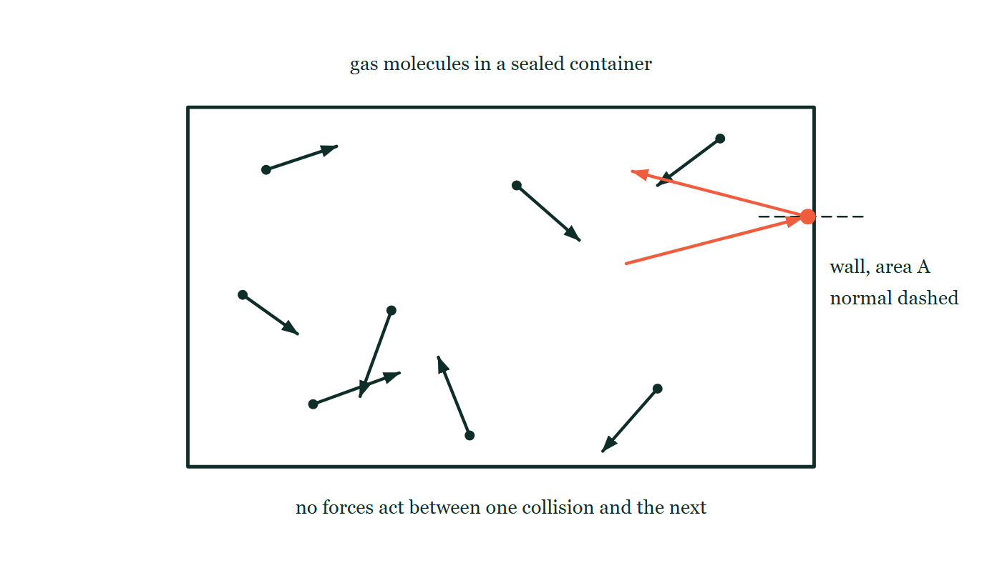
THERMAL PHYSICS · THE KINETIC THEORY OF GASES
GIOPHYSICS LESSON
THINK FIRST
One nitrogen molecule flies past you at 500 m/s. What is its temperature?
Take answers before you click — the point is the commitment
It is an ordinary molecule out of ordinary air, and you know its mass and its speed exactly — so you know its kinetic energy exactly too.
THE ANSWER
It does not have one. Temperature is a property of a crowd: it is what the average kinetic energy of 10²³ molecules works out to, and a single molecule has no average. In the air beside it, molecules are travelling at everything from nearly nothing to several times 500 m/s, and they all share the one temperature between them.
Eight molecules drawn as dots inside a sealed rectangular box, each carrying a velocity arrow of a different length and direction; one picked out in the accent arrives at the right-hand wall and rebounds away from it, with the normal to that wall drawn dashed.
The live version of this figure — click here
Thermal Physics — The Kinetic Theory of Gases. Built by GioPhysics from the lesson's own copy; nothing on these slides is re-authored.
3 / 33
Notes:
[Phase] Starter: Recall what this lesson stands on (minutes 0–5 of 45)
[Hook] One nitrogen molecule flies past you at 500 m/s. What is its temperature? It is an ordinary molecule out of ordinary air, and you know its mass and its speed exactly — so you know its kinetic energy exactly too.
[Answer] It does not have one. Temperature is a property of a crowd: it is what the average kinetic energy of 10²³ molecules works out to, and a single molecule has no average. In the air beside it, molecules are travelling at everything from nearly nothing to several times 500 m/s, and they all share the one temperature between them.
[Figure] Eight molecules drawn as dots inside a sealed rectangular box, each carrying a velocity arrow of a different length and direction; one picked out in the accent arrives at the right-hand wall and rebounds away from it, with the normal to that wall drawn dashed.

Slide 4
THERMAL PHYSICS · THE KINETIC THEORY OF GASES
GIOPHYSICS LESSON
EXPLAINED SIMPLY
In one sentence
Introduce the idea — The big idea and the definition
Kinetic theory explains gas pressure as the total effect of molecular collisions with the walls, and identifies kelvin temperature with the average kinetic energy per molecule.
Thermal Physics — The Kinetic Theory of Gases. Built by GioPhysics from the lesson's own copy; nothing on these slides is re-authored.
4 / 33
Notes:
[Phase] Introduce the idea: The big idea and the definition (minutes 5–13 of 45)
[Definition] Kinetic theory explains gas pressure as the total effect of molecular collisions with the walls, and identifies kelvin temperature with the average kinetic energy per molecule.

Slide 5
THERMAL PHYSICS · THE KINETIC THEORY OF GASES
GIOPHYSICS LESSON
EXPLAINED SIMPLY
What that looks like
Introduce the idea — The big idea and the definition
FOR EXAMPLE
Pump up a bicycle tyre and the extra molecules drum on the walls more often — that busier drumming is the higher pressure you feel resisting the pump.
Thermal Physics — The Kinetic Theory of Gases. Built by GioPhysics from the lesson's own copy; nothing on these slides is re-authored.
5 / 33
Notes:
[Phase] Introduce the idea: The big idea and the definition (minutes 5–13 of 45)
[Worked illustration] Pump up a bicycle tyre and the extra molecules drum on the walls more often — that busier drumming is the higher pressure you feel resisting the pump.

Slide 6
THERMAL PHYSICS · THE KINETIC THEORY OF GASES
GIOPHYSICS LESSON
THE BIG IDEA
Pressure is molecular drumming
Introduce the idea — The big idea and the definition
The kinetic model treats an ideal gas as a huge number of identical molecules of negligible volume, moving randomly, colliding elastically, with no forces between collisions. Each wall collision delivers a little momentum; billions per second smooth into steady pressure, giving pV = ⅓Nm v̄². Matching this to experiment ties temperature directly to motion: the mean kinetic energy per molecule is (3/2)k(B)T, and absolute zero is where that motion reaches its minimum.
Thermal Physics — The Kinetic Theory of Gases. Built by GioPhysics from the lesson's own copy; nothing on these slides is re-authored.
6 / 33
Notes:
[Phase] Introduce the idea: The big idea and the definition (minutes 5–13 of 45)
[Big idea] The kinetic model treats an ideal gas as a huge number of identical molecules of negligible volume, moving randomly, colliding elastically, with no forces between collisions. Each wall collision delivers a little momentum; billions per second smooth into steady pressure, giving pV = ⅓Nm v̄². Matching this to experiment ties temperature directly to motion: the mean kinetic energy per molecule is (3/2)k(B)T, and absolute zero is where that motion reaches its minimum.

Slide 7
THERMAL PHYSICS · THE KINETIC THEORY OF GASES
GIOPHYSICS LESSON
THE PHYSICS · 1 OF 3
The assumptions
Build the model — The formulae, one at a time, in plain English
Very many identical molecules; random motion; molecular volume negligible next to the container; collisions perfectly elastic and instantaneous; no intermolecular forces between collisions. Every result of the model follows from this short list.
Thermal Physics — The Kinetic Theory of Gases. Built by GioPhysics from the lesson's own copy; nothing on these slides is re-authored.
7 / 33
Notes:
[Phase] Build the model: The formulae, one at a time, in plain English (minutes 13–22 of 45)
[Section] Very many identical molecules; random motion; molecular volume negligible next to the container; collisions perfectly elastic and instantaneous; no intermolecular forces between collisions. Every result of the model follows from this short list.

Slide 8
THERMAL PHYSICS · THE KINETIC THEORY OF GASES
GIOPHYSICS LESSON
THE PHYSICS · 2 OF 3
From one bounce to steady pressure
Build the model — The formulae, one at a time, in plain English
A molecule hitting a wall reverses its momentum, so the wall feels a tiny push. One molecule gives a patter; 10²³ give a perfectly smooth force.
Heat the gas and each impact is harder and more frequent — pressure rises. Shrink the box and the walls are hit more often — pressure rises again.
Thermal Physics — The Kinetic Theory of Gases. Built by GioPhysics from the lesson's own copy; nothing on these slides is re-authored.
8 / 33
Notes:
[Phase] Build the model: The formulae, one at a time, in plain English (minutes 13–22 of 45)
[Section] A molecule hitting a wall reverses its momentum, so the wall feels a tiny push. One molecule gives a patter; 10²³ give a perfectly smooth force. Heat the gas and each impact is harder and more frequent — pressure rises. Shrink the box and the walls are hit more often — pressure rises again.

Slide 9
THERMAL PHYSICS · THE KINETIC THEORY OF GASES
GIOPHYSICS LESSON
THE PHYSICS · 3 OF 3
Real gases, ideal model
Build the model — The formulae, one at a time, in plain English
Real molecules do take up space and do attract each other, so the model works best at low pressure, moderate temperature, and low density. Squeeze a real gas hard enough and the intermolecular forces the model ignores let it do something an ideal gas never can: condense into a liquid.
Thermal Physics — The Kinetic Theory of Gases. Built by GioPhysics from the lesson's own copy; nothing on these slides is re-authored.
9 / 33
Notes:
[Phase] Build the model: The formulae, one at a time, in plain English (minutes 13–22 of 45)
[Section] Real molecules do take up space and do attract each other, so the model works best at low pressure, moderate temperature, and low density. Squeeze a real gas hard enough and the intermolecular forces the model ignores let it do something an ideal gas never can: condense into a liquid.

Slide 10
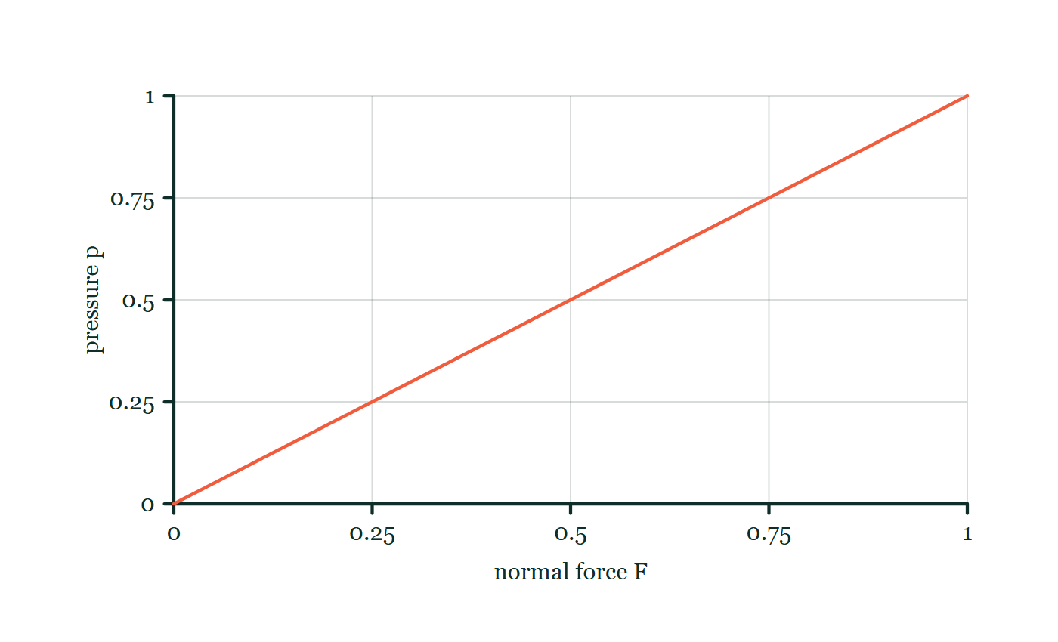
THERMAL PHYSICS · THE KINETIC THEORY OF GASES
GIOPHYSICS LESSON
FORMULA 1 OF 3
Pressure
Build the model — The formulae, one at a time, in plain English
p = F/A
Units N m⁻² = pascal (Pa)
IN PLAIN ENGLISH
Pressure is force spread over area. For a gas the force is supplied by molecular impacts on the wall.
Pressure–force explorer
Move this graph on the live version — click here
Thermal Physics — The Kinetic Theory of Gases. Built by GioPhysics from the lesson's own copy; nothing on these slides is re-authored.
10 / 33
Notes:
[Phase] Build the model: The formulae, one at a time, in plain English (minutes 13–22 of 45)
[Formula] Pressure: p = F/A
[In plain English] Pressure is force spread over area. For a gas the force is supplied by molecular impacts on the wall.
[Note] Units N m⁻² = pascal (Pa)
[Graph] Pressure–force explorer. For a fixed contact area, pressure rises in direct proportion to the normal force.
[Axes] Horizontal: normal force F. Vertical: pressure p. Values are normalised — the graph teaches the shape, not a measurement.

Slide 11
THERMAL PHYSICS · THE KINETIC THEORY OF GASES
GIOPHYSICS LESSON
FORMULA 2 OF 3
Pressure from collisions
Build the model — The formulae, one at a time, in plain English
pV = ⅓Nm v̄²
N molecules of mass m, mean square speed v̄²
IN PLAIN ENGLISH
Adding up the momentum delivered by every molecule bouncing off the walls gives this — pressure rises with more molecules, faster molecules, or a smaller box.
Thermal Physics — The Kinetic Theory of Gases. Built by GioPhysics from the lesson's own copy; nothing on these slides is re-authored.
11 / 33
Notes:
[Phase] Build the model: The formulae, one at a time, in plain English (minutes 13–22 of 45)
[Formula] Pressure from collisions: pV = ⅓Nm v̄²
[In plain English] Adding up the momentum delivered by every molecule bouncing off the walls gives this — pressure rises with more molecules, faster molecules, or a smaller box.
[Note] N molecules of mass m, mean square speed v̄²

Slide 12
THERMAL PHYSICS · THE KINETIC THEORY OF GASES
GIOPHYSICS LESSON
FORMULA 3 OF 3
Temperature is kinetic energy
Build the model — The formulae, one at a time, in plain English
Ē(K) = (3/2)k(B)T
k(B) = 1.38 × 10⁻²³ J K⁻¹
IN PLAIN ENGLISH
The mean kinetic energy per molecule depends only on kelvin temperature — not on the gas. Halve the temperature and the mean KE halves; at absolute zero it reaches its minimum.
Thermal Physics — The Kinetic Theory of Gases. Built by GioPhysics from the lesson's own copy; nothing on these slides is re-authored.
12 / 33
Notes:
[Phase] Build the model: The formulae, one at a time, in plain English (minutes 13–22 of 45)
[Formula] Temperature is kinetic energy: Ē(K) = (3/2)k(B)T
[In plain English] The mean kinetic energy per molecule depends only on kelvin temperature — not on the gas. Halve the temperature and the mean KE halves; at absolute zero it reaches its minimum.
[Note] k(B) = 1.38 × 10⁻²³ J K⁻¹

Slide 13
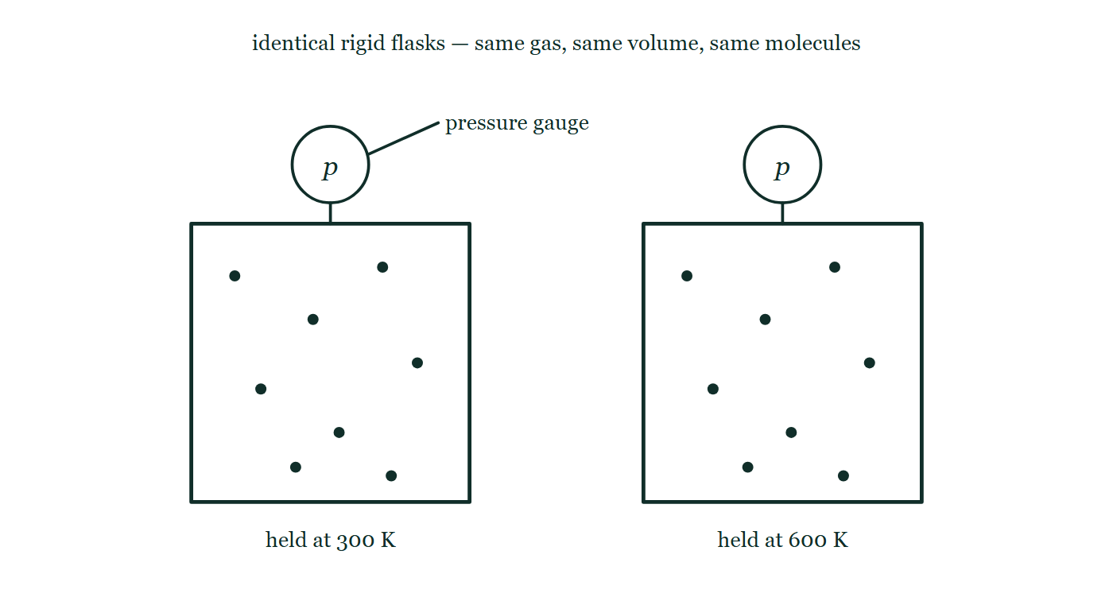
THERMAL PHYSICS · THE KINETIC THEORY OF GASES
GIOPHYSICS LESSON
THE PICTURE
Two flasks, one difference
Drawn for this lesson
Two identical rigid flasks side by side, each with a pressure gauge mounted on top whose face is blank, holding the same eight molecules drawn in the same eight positions; the left is labelled as held at 300 K and the right at 600 K.
The live version of this figure — click here
Thermal Physics — The Kinetic Theory of Gases. Built by GioPhysics from the lesson's own copy; nothing on these slides is re-authored.
13 / 33
Notes:
[Phase] Build the model: The formulae, one at a time, in plain English (minutes 13–22 of 45)
[Figure] Two identical rigid flasks side by side, each with a pressure gauge mounted on top whose face is blank, holding the same eight molecules drawn in the same eight positions; the left is labelled as held at 300 K and the right at 600 K.

Slide 14
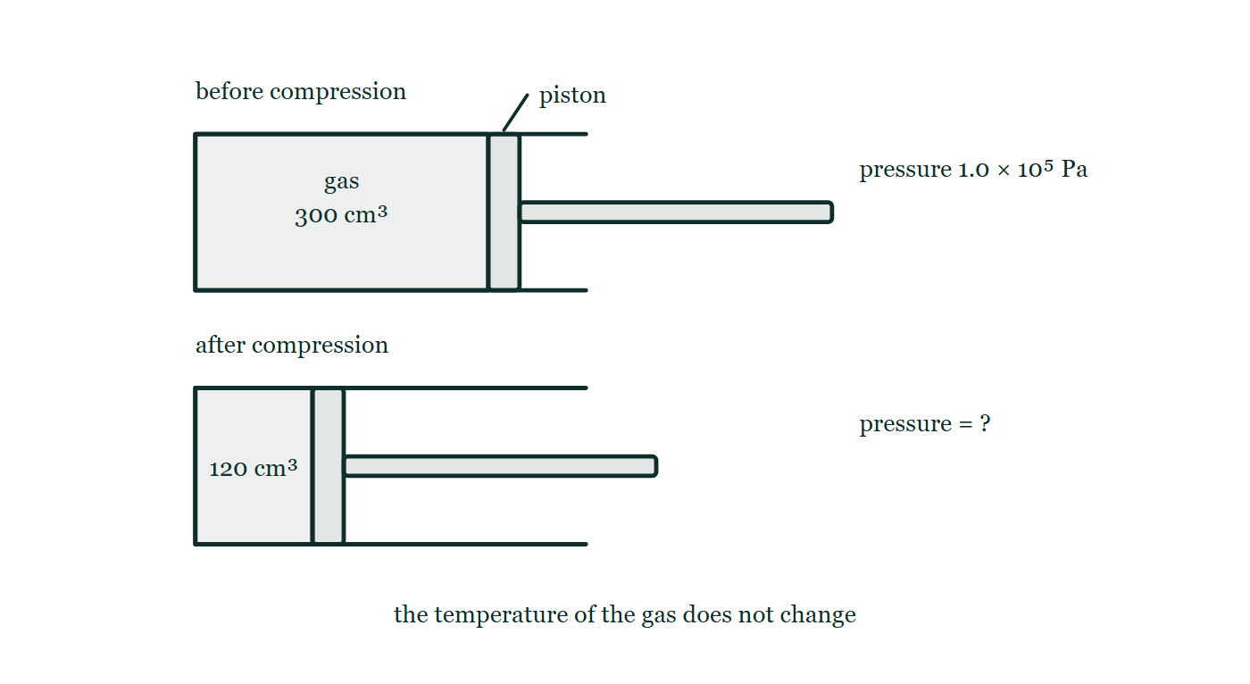
THERMAL PHYSICS · THE KINETIC THEORY OF GASES
GIOPHYSICS LESSON
FIGURE 1 OF 2
Fig. 2.1 — IGCSE Topic 2 · Thermal physics
Drawn for question 2 of that paper · syllabus 2.1
Two horizontal cylinders are drawn one above the other, each closed at the left-hand end and fitted with a piston on a rod that comes out through the open right-hand end. In the upper cylinder, labelled before compression, the trapped gas fills a column marked 300 cm³ and the pressure beside it is given as 1.0 × 10⁵ Pa. In the lower cylinder, labelled after compression, the piston has been pushed further in so that the gas column is marked 120 cm³, and the pressure beside it is left as a question mark. A note below states that the temperature of the gas does not change.
See the question this was drawn for — click here
Thermal Physics — The Kinetic Theory of Gases. Built by GioPhysics from the lesson's own copy; nothing on these slides is re-authored.
14 / 33
Notes:
[Phase] Build the model: The formulae, one at a time, in plain English (minutes 13–22 of 45)
[Figure] Fig. 2.1. Two horizontal cylinders are drawn one above the other, each closed at the left-hand end and fitted with a piston on a rod that comes out through the open right-hand end. In the upper cylinder, labelled before compression, the trapped gas fills a column marked 300 cm³ and the pressure beside it is given as 1.0 × 10⁵ Pa. In the lower cylinder, labelled after compression, the piston has been pushed further in so that the gas column is marked 120 cm³, and the pressure beside it is left as a question mark. A note below states that the temperature of the gas does not change.
[Where it came from] IGCSE Topic 2 · Thermal physics, question 2; syllabus 2.1.

Slide 15
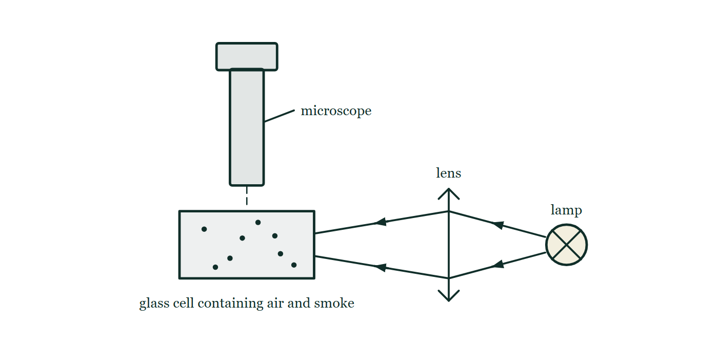
THERMAL PHYSICS · THE KINETIC THEORY OF GASES
GIOPHYSICS LESSON
FIGURE 2 OF 2
Fig. 7.1 — IGCSE Topic 2 · Thermal physics
Drawn for question 7 of that paper · syllabus 2.1
The apparatus is seen from the side. A small glass cell containing air and a scattering of smoke particles stands in the middle of the drawing. To the right, a lamp shines light through a converging lens, which brings the beam together inside the cell. Directly above the cell stands a microscope, its tube vertical and its lower end pointing straight down into the cell, so that the illuminated particles are viewed from above.
See the question this was drawn for — click here
Thermal Physics — The Kinetic Theory of Gases. Built by GioPhysics from the lesson's own copy; nothing on these slides is re-authored.
15 / 33
Notes:
[Phase] Build the model: The formulae, one at a time, in plain English (minutes 13–22 of 45)
[Figure] Fig. 7.1. The apparatus is seen from the side. A small glass cell containing air and a scattering of smoke particles stands in the middle of the drawing. To the right, a lamp shines light through a converging lens, which brings the beam together inside the cell. Directly above the cell stands a microscope, its tube vertical and its lower end pointing straight down into the cell, so that the illuminated particles are viewed from above.
[Where it came from] IGCSE Topic 2 · Thermal physics, question 7; syllabus 2.1.

Slide 16
THERMAL PHYSICS · THE KINETIC THEORY OF GASES
GIOPHYSICS LESSON
WATCH OUT
The common trap
Check and misconception — The quick check and the trap
Temperature belongs to the crowd, not to any single molecule. The molecules of a gas at one temperature travel at wildly different speeds, and a single molecule has no temperature at all — (3/2)k(B)T is an average over an enormous population.
Thermal Physics — The Kinetic Theory of Gases. Built by GioPhysics from the lesson's own copy; nothing on these slides is re-authored.
16 / 33
Notes:
[Phase] Check and misconception: The quick check and the trap (minutes 35–41 of 45)
[Misconception] Temperature belongs to the crowd, not to any single molecule. The molecules of a gas at one temperature travel at wildly different speeds, and a single molecule has no temperature at all — (3/2)k(B)T is an average over an enormous population.

Slide 17
THERMAL PHYSICS · THE KINETIC THEORY OF GASES
GIOPHYSICS LESSON
WORKED EXAMPLE 1 OF 2 · EASY
The question
Easy
Worked examples — I do, we do — one step revealed at a time
Find the mean kinetic energy of a gas molecule at 300 K.
Thermal Physics — The Kinetic Theory of Gases. Built by GioPhysics from the lesson's own copy; nothing on these slides is re-authored.
17 / 33
Notes:
[Phase] Worked examples: I do, we do — one step revealed at a time (minutes 22–35 of 45)
[Question] Find the mean kinetic energy of a gas molecule at 300 K.
[Answer] 6.2 × 10⁻²¹ J

Slide 18
THERMAL PHYSICS · THE KINETIC THEORY OF GASES
GIOPHYSICS LESSON
WORKED EXAMPLE 1 OF 2 · EASY · THE WORKING
How to solve it
Easy
Worked examples — I do, we do — one step revealed at a time
Find the mean kinetic energy of a gas molecule at 300 K.
1.
Ē(K) = (3/2)k(B)T = 1.5 × 1.38 × 10⁻²³ × 300.
2.
Ē(K) = 6.2 × 10⁻²¹ J.
Thermal Physics — The Kinetic Theory of Gases. Built by GioPhysics from the lesson's own copy; nothing on these slides is re-authored.
18 / 33
Notes:
[Phase] Worked examples: I do, we do — one step revealed at a time (minutes 22–35 of 45)
[Reveal] One click per step. The class works each line before the next appears.
[Step 1] Ē(K) = (3/2)k(B)T = 1.5 × 1.38 × 10⁻²³ × 300.
[Step 2] Ē(K) = 6.2 × 10⁻²¹ J.

Slide 19
THERMAL PHYSICS · THE KINETIC THEORY OF GASES
GIOPHYSICS LESSON
WORKED EXAMPLE 1 OF 2 · EASY
Answer
Easy
Worked examples — I do, we do — one step revealed at a time
6.2 × 10⁻²¹ J
Thermal Physics — The Kinetic Theory of Gases. Built by GioPhysics from the lesson's own copy; nothing on these slides is re-authored.
19 / 33
Notes:
[Phase] Worked examples: I do, we do — one step revealed at a time (minutes 22–35 of 45)
[Answer] 6.2 × 10⁻²¹ J

Slide 20
THERMAL PHYSICS · THE KINETIC THEORY OF GASES
GIOPHYSICS LESSON
WORKED EXAMPLE 2 OF 2 · MEDIUM
The question
Medium
Worked examples — I do, we do — one step revealed at a time
A 150 kg man stands on one foot of area 9.0 cm × 10 cm on thin ice. Find the pressure. (g = 10 m s⁻²)
Thermal Physics — The Kinetic Theory of Gases. Built by GioPhysics from the lesson's own copy; nothing on these slides is re-authored.
20 / 33
Notes:
[Phase] Worked examples: I do, we do — one step revealed at a time (minutes 22–35 of 45)
[Question] A 150 kg man stands on one foot of area 9.0 cm × 10 cm on thin ice. Find the pressure. (g = 10 m s⁻²)
[Answer] ≈ 1.7 × 10⁵ Pa

Slide 21
THERMAL PHYSICS · THE KINETIC THEORY OF GASES
GIOPHYSICS LESSON
WORKED EXAMPLE 2 OF 2 · MEDIUM · THE WORKING
How to solve it
Medium
Worked examples — I do, we do — one step revealed at a time
A 150 kg man stands on one foot of area 9.0 cm × 10 cm on thin ice. Find the pressure. (g = 10 m s⁻²)
1.
F = mg = 150 × 10 = 1500 N.
2.
A = 0.090 × 0.10 = 0.0090 m².
3.
p = F/A = 1500 ÷ 0.0090 ≈ 1.7 × 10⁵ Pa — nearly two atmospheres.
Thermal Physics — The Kinetic Theory of Gases. Built by GioPhysics from the lesson's own copy; nothing on these slides is re-authored.
21 / 33
Notes:
[Phase] Worked examples: I do, we do — one step revealed at a time (minutes 22–35 of 45)
[Reveal] One click per step. The class works each line before the next appears.
[Step 1] F = mg = 150 × 10 = 1500 N.
[Step 2] A = 0.090 × 0.10 = 0.0090 m².
[Step 3] p = F/A = 1500 ÷ 0.0090 ≈ 1.7 × 10⁵ Pa — nearly two atmospheres.

Slide 22
THERMAL PHYSICS · THE KINETIC THEORY OF GASES
GIOPHYSICS LESSON
WORKED EXAMPLE 2 OF 2 · MEDIUM
Answer
Medium
Worked examples — I do, we do — one step revealed at a time
≈ 1.7 × 10⁵ Pa
Thermal Physics — The Kinetic Theory of Gases. Built by GioPhysics from the lesson's own copy; nothing on these slides is re-authored.
22 / 33
Notes:
[Phase] Worked examples: I do, we do — one step revealed at a time (minutes 22–35 of 45)
[Answer] ≈ 1.7 × 10⁵ Pa

Slide 23
THERMAL PHYSICS · THE KINETIC THEORY OF GASES
GIOPHYSICS LESSON
PREDICT · TAKE THE VOTE
Commit before you are told
Hands up for each option, then click
The right-hand flask is at twice the kelvin temperature of the left. Both gauge faces are covered. Which statement is true?
A Every molecule on the right moves twice as fast, and the gauge reads twice as much
B The molecules on the right have twice the mean kinetic energy, and the gauge reads twice as much
C Nothing differs — the flasks are sealed and rigid, so the gauges must agree
Two identical rigid flasks side by side, each with a pressure gauge mounted on top whose face is blank, holding the same eight molecules drawn in the same eight positions; the left is labelled as held at 300 K and the right at 600 K.
The live version of this figure — click here
Thermal Physics — The Kinetic Theory of Gases. Built by GioPhysics from the lesson's own copy; nothing on these slides is re-authored.
23 / 33
Notes:
[Phase] Build the model: The formulae, one at a time, in plain English (minutes 13–22 of 45)
[Predict] The right-hand flask is at twice the kelvin temperature of the left. Both gauge faces are covered. Which statement is true?
[Options] A Every molecule on the right moves twice as fast, and the gauge reads twice as much B The molecules on the right have twice the mean kinetic energy, and the gauge reads twice as much C Nothing differs — the flasks are sealed and rigid, so the gauges must agree
[Figure] Two identical rigid flasks side by side, each with a pressure gauge mounted on top whose face is blank, holding the same eight molecules drawn in the same eight positions; the left is labelled as held at 300 K and the right at 600 K.

Slide 24
THERMAL PHYSICS · THE KINETIC THEORY OF GASES
GIOPHYSICS LESSON
PREDICT · THE OUTCOME
What actually happens
Ask the room who changed their mind, and why
B The molecules on the right have twice the mean kinetic energy, and the gauge reads twice as much
WHY
Two separate claims, and only one of them survives. Doubling T doubles Ē(K) = (3/2)k(B)T, but that is a mean over the whole population: inside each flask the speeds are spread right across a distribution, no single molecule has a temperature, and nothing doubled in step. The gauge, though, really does double. With V and N fixed, pV = Nk(B)T makes p proportional to T — the impacts are both harder and more frequent, and those two effects multiply.
Thermal Physics — The Kinetic Theory of Gases. Built by GioPhysics from the lesson's own copy; nothing on these slides is re-authored.
24 / 33
Notes:
[Phase] Build the model: The formulae, one at a time, in plain English (minutes 13–22 of 45)
[Answer] B — The molecules on the right have twice the mean kinetic energy, and the gauge reads twice as much. Two separate claims, and only one of them survives. Doubling T doubles Ē(K) = (3/2)k(B)T, but that is a mean over the whole population: inside each flask the speeds are spread right across a distribution, no single molecule has a temperature, and nothing doubled in step. The gauge, though, really does double. With V and N fixed, pV = Nk(B)T makes p proportional to T — the impacts are both harder and more frequent, and those two effects multiply.

Slide 25
THERMAL PHYSICS · THE KINETIC THEORY OF GASES
GIOPHYSICS LESSON
QUICK CHECK
Decide before the answer goes up
Check and misconception — The quick check and the trap
The kelvin temperature of an ideal gas is doubled. The mean kinetic energy per molecule…
A
Doubles
B
Quadruples
C
Stays the same
Thermal Physics — The Kinetic Theory of Gases. Built by GioPhysics from the lesson's own copy; nothing on these slides is re-authored.
25 / 33
Notes:
[Phase] Check and misconception: The quick check and the trap (minutes 35–41 of 45)
[Question] The kelvin temperature of an ideal gas is doubled. The mean kinetic energy per molecule…
[Options] A Doubles B Quadruples C Stays the same

Slide 26
THERMAL PHYSICS · THE KINETIC THEORY OF GASES
GIOPHYSICS LESSON
QUICK CHECK · THE ANSWER
The answer, and why
Check and misconception — The quick check and the trap
A Doubles
HOW TO GET THERE
Ē(K) = (3/2)k(B)T is directly proportional to kelvin temperature — double T, double the mean KE.
WHY THE OTHERS TEMPT
A Correct. Ē(K) = (3/2)k(B)T is a straight proportionality with kelvin temperature, so doubling one doubles the other.
B Quadrupling is what happens if the SPEEDS double, since kinetic energy goes as v². But it is the temperature that was doubled here, and temperature tracks the energy rather than the speed — the speeds only rise by √2.
C This would make temperature and molecular energy independent of each other, and then a thermometer could not work at all: what a thermometer reads is precisely the average kinetic energy its own molecules settle at in equilibrium with yours.
Thermal Physics — The Kinetic Theory of Gases. Built by GioPhysics from the lesson's own copy; nothing on these slides is re-authored.
26 / 33
Notes:
[Phase] Check and misconception: The quick check and the trap (minutes 35–41 of 45)
[Question] The kelvin temperature of an ideal gas is doubled. The mean kinetic energy per molecule…
[Option by option] A: Correct. Ē(K) = (3/2)k(B)T is a straight proportionality with kelvin temperature, so doubling one doubles the other. B: Quadrupling is what happens if the SPEEDS double, since kinetic energy goes as v². But it is the temperature that was doubled here, and temperature tracks the energy rather than the speed — the speeds only rise by √2. C: This would make temperature and molecular energy independent of each other, and then a thermometer could not work at all: what a thermometer reads is precisely the average kinetic energy its own molecules settle at in equilibrium with yours.
[Answer] A — Doubles
[Why] Ē(K) = (3/2)k(B)T is directly proportional to kelvin temperature — double T, double the mean KE.
[Reveal] One click for the answer, then one for the reason.

Slide 27
THERMAL PHYSICS · THE KINETIC THEORY OF GASES
GIOPHYSICS LESSON
EXTENSION 1 OF 2 · HARD
The question
Hard
Worked examples — I do, we do — one step revealed at a time
2.50 mol of hydrogen is held at 175 °C. Find the mean kinetic energy per molecule and the total internal energy of the gas.
Thermal Physics — The Kinetic Theory of Gases. Built by GioPhysics from the lesson's own copy; nothing on these slides is re-authored.
27 / 33
Notes:
[Phase] Worked examples: I do, we do — one step revealed at a time (minutes 22–35 of 45)
[Question] 2.50 mol of hydrogen is held at 175 °C. Find the mean kinetic energy per molecule and the total internal energy of the gas.
[Answer] 9.3 × 10⁻²¹ J per molecule; ≈ 1.4 × 10⁴ J in total

Slide 28
THERMAL PHYSICS · THE KINETIC THEORY OF GASES
GIOPHYSICS LESSON
EXTENSION 1 OF 2 · HARD · THE WORKING
How to solve it
Hard
Worked examples — I do, we do — one step revealed at a time
2.50 mol of hydrogen is held at 175 °C. Find the mean kinetic energy per molecule and the total internal energy of the gas.
1.
T = 175 + 273 = 448 K. Ē(K) = 1.5 × 1.38 × 10⁻²³ × 448 = 9.27 × 10⁻²¹ J.
2.
N = nN(A) = 2.50 × 6.02 × 10²³ = 1.51 × 10²⁴ molecules.
3.
E(int) = N × Ē(K) = 1.51 × 10²⁴ × 9.27 × 10⁻²¹ ≈ 1.4 × 10⁴ J — for an ideal gas it is all kinetic.
Thermal Physics — The Kinetic Theory of Gases. Built by GioPhysics from the lesson's own copy; nothing on these slides is re-authored.
28 / 33
Notes:
[Phase] Worked examples: I do, we do — one step revealed at a time (minutes 22–35 of 45)
[Reveal] One click per step. The class works each line before the next appears.
[Step 1] T = 175 + 273 = 448 K. Ē(K) = 1.5 × 1.38 × 10⁻²³ × 448 = 9.27 × 10⁻²¹ J.
[Step 2] N = nN(A) = 2.50 × 6.02 × 10²³ = 1.51 × 10²⁴ molecules.
[Step 3] E(int) = N × Ē(K) = 1.51 × 10²⁴ × 9.27 × 10⁻²¹ ≈ 1.4 × 10⁴ J — for an ideal gas it is all kinetic.

Slide 29
THERMAL PHYSICS · THE KINETIC THEORY OF GASES
GIOPHYSICS LESSON
EXTENSION 1 OF 2 · HARD
Answer
Hard
Worked examples — I do, we do — one step revealed at a time
9.3 × 10⁻²¹ J per molecule; ≈ 1.4 × 10⁴ J in total
Thermal Physics — The Kinetic Theory of Gases. Built by GioPhysics from the lesson's own copy; nothing on these slides is re-authored.
29 / 33
Notes:
[Phase] Worked examples: I do, we do — one step revealed at a time (minutes 22–35 of 45)
[Answer] 9.3 × 10⁻²¹ J per molecule; ≈ 1.4 × 10⁴ J in total

Slide 30
THERMAL PHYSICS · THE KINETIC THEORY OF GASES
GIOPHYSICS LESSON
EXTENSION 2 OF 2 · CHALLENGING
The question
Challenging
Worked examples — I do, we do — one step revealed at a time
A container of volume 0.50 m³ holds 1.0 × 10²⁵ molecules at 300 K. Use pV = Nk(B)T to find the pressure, and compare it with the atmosphere.
Thermal Physics — The Kinetic Theory of Gases. Built by GioPhysics from the lesson's own copy; nothing on these slides is re-authored.
30 / 33
Notes:
[Phase] Worked examples: I do, we do — one step revealed at a time (minutes 22–35 of 45)
[Question] A container of volume 0.50 m³ holds 1.0 × 10²⁵ molecules at 300 K. Use pV = Nk(B)T to find the pressure, and compare it with the atmosphere.
[Answer] ≈ 8.3 × 10⁴ Pa, roughly 0.8 atm

Slide 31
THERMAL PHYSICS · THE KINETIC THEORY OF GASES
GIOPHYSICS LESSON
EXTENSION 2 OF 2 · CHALLENGING · THE WORKING
How to solve it
Challenging
Worked examples — I do, we do — one step revealed at a time
A container of volume 0.50 m³ holds 1.0 × 10²⁵ molecules at 300 K. Use pV = Nk(B)T to find the pressure, and compare it with the atmosphere.
1.
p = Nk(B)T / V.
2.
p = (1.0 × 10²⁵ × 1.38 × 10⁻²³ × 300) ÷ 0.50 = 41 400 ÷ 0.50.
3.
p ≈ 8.3 × 10⁴ Pa — about 82% of atmospheric pressure (1.0 × 10⁵ Pa).
Thermal Physics — The Kinetic Theory of Gases. Built by GioPhysics from the lesson's own copy; nothing on these slides is re-authored.
31 / 33
Notes:
[Phase] Worked examples: I do, we do — one step revealed at a time (minutes 22–35 of 45)
[Reveal] One click per step. The class works each line before the next appears.
[Step 1] p = Nk(B)T / V.
[Step 2] p = (1.0 × 10²⁵ × 1.38 × 10⁻²³ × 300) ÷ 0.50 = 41 400 ÷ 0.50.
[Step 3] p ≈ 8.3 × 10⁴ Pa — about 82% of atmospheric pressure (1.0 × 10⁵ Pa).

Slide 32
THERMAL PHYSICS · THE KINETIC THEORY OF GASES
GIOPHYSICS LESSON
EXTENSION 2 OF 2 · CHALLENGING
Answer
Challenging
Worked examples — I do, we do — one step revealed at a time
≈ 8.3 × 10⁴ Pa, roughly 0.8 atm
Thermal Physics — The Kinetic Theory of Gases. Built by GioPhysics from the lesson's own copy; nothing on these slides is re-authored.
32 / 33
Notes:
[Phase] Worked examples: I do, we do — one step revealed at a time (minutes 22–35 of 45)
[Answer] ≈ 8.3 × 10⁴ Pa, roughly 0.8 atm

Slide 33
THERMAL PHYSICS · THE KINETIC THEORY OF GASES
GIOPHYSICS LESSON
THERMAL PHYSICS
Where to go next
Plenary — What to take away, what to practise next
Next
21.4 The Gas Laws
https://giophysics.com/chapter-40/gas-laws/
Lesson
This lesson on giophysics.com
https://giophysics.com/chapter-40/kinetic-theory/
Live
The live, interactive version of these slides
https://giophysics.com/chapter-40/presentation/?lesson=kinetic
Chapter
All Thermal Physics lessons
https://giophysics.com/chapter-40/
PDF
Download the lesson PDF
https://giophysics.com/downloads/40-3-kinetic-theory.pdf
Thermal Physics — The Kinetic Theory of Gases. Built by GioPhysics from the lesson's own copy; nothing on these slides is re-authored.
33 / 33
Notes:
[Phase] Plenary: What to take away, what to practise next (minutes 41–45 of 45)
[Interactive] The graphs and the circuit topology on these slides are frozen. The live version at https://giophysics.com/chapter-40/presentation/?lesson=kinetic moves them.

