Slide 1
THERMAL PHYSICS · MOLECULAR SPEEDS
GIOPHYSICS LESSON
21 · Thermal Physics
A crowd of speeds, not one
Molecular Speeds
Air molecules around you average about 500 m/s, but no single speed describes them all. The Maxwell–Boltzmann distribution maps the whole crowd — and its fast tail explains why hydrogen leaks out of atmospheres.
POSITION
Lesson 5 of 6 in Thermal Physics
PLAN
15 slides in the 45-minute core run, about 43 minutes of it
LESSON PAGE
https://giophysics.com/chapter-40/molecular-speeds/
Built by GioPhysics from the lesson's own page. Every word on these slides is the lesson's; nothing here is re-authored. Teaching material, not an awarding body's document.
Thermal Physics — Molecular Speeds. Built by GioPhysics from the lesson's own copy; nothing on these slides is re-authored.
1 / 31
Notes:
[Lesson] Thermal Physics — Molecular Speeds. Lesson 5 of 6.
[Intro] Air molecules around you average about 500 m/s, but no single speed describes them all. The Maxwell–Boltzmann distribution maps the whole crowd — and its fast tail explains why hydrogen leaks out of atmospheres.
[Source] https://giophysics.com/chapter-40/molecular-speeds/
[Disclaimer] Built by GioPhysics from the lesson's own page. Every word on these slides is the lesson's; nothing here is re-authored. Teaching material, not an awarding body's document.

Slide 2
THERMAL PHYSICS · MOLECULAR SPEEDS
GIOPHYSICS LESSON
WHAT THIS NEEDS
What you already know
Starter — Recall what this lesson stands on
Recall
Kinetic theory
https://giophysics.com/chapter-40/kinetic-theory/
Recall
The gas laws
https://giophysics.com/chapter-40/gas-laws/
Thermal Physics — Molecular Speeds. Built by GioPhysics from the lesson's own copy; nothing on these slides is re-authored.
2 / 31
Notes:
[Phase] Starter: Recall what this lesson stands on (minutes 0–5 of 45)
[Starter] Recall: Kinetic theory; The gas laws

Slide 3
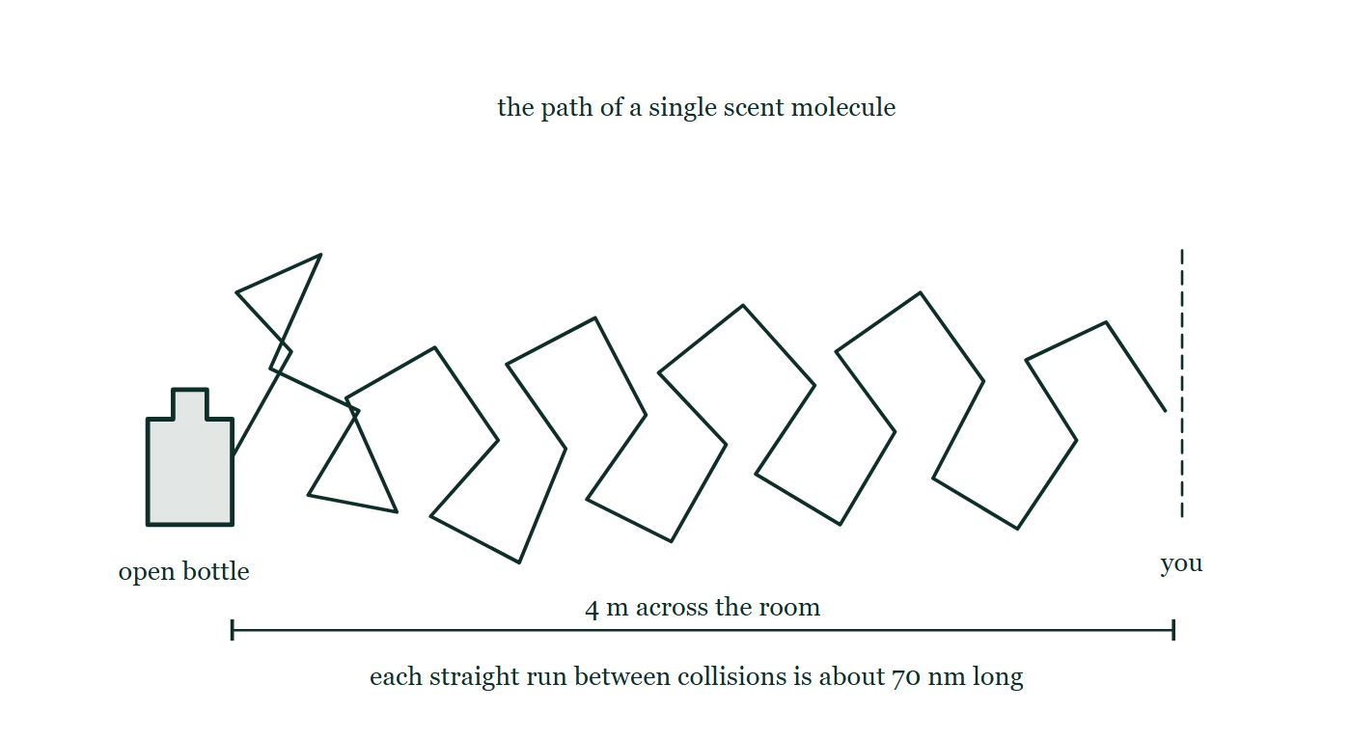
THERMAL PHYSICS · MOLECULAR SPEEDS
GIOPHYSICS LESSON
THINK FIRST
Air molecules are going past you at about 500 m/s. Someone opens a bottle of perfume 4 m away. Why does it take minutes to reach you?
Take answers before you click — the point is the commitment
At 500 m/s a molecule would cross those four metres in eight milliseconds. In practice you smell it after a couple of minutes, and it arrives gradually rather than all at once.
THE ANSWER
Because it does not travel in a straight line. Each molecule collides billions of times a second and staggers off in a new direction every time — a random walk of 70 nm steps. Progress across the room grows with the square root of the time, not with the time, so fast molecules still spread slowly.
The path of one scent molecule from an open bottle across a room to a person 4 m away, drawn as more than thirty straight runs each ending in a sharp change of direction, under a note that each real run between collisions is about 70 nm long.
The live version of this figure — click here
Thermal Physics — Molecular Speeds. Built by GioPhysics from the lesson's own copy; nothing on these slides is re-authored.
3 / 31
Notes:
[Phase] Starter: Recall what this lesson stands on (minutes 0–5 of 45)
[Hook] Air molecules are going past you at about 500 m/s. Someone opens a bottle of perfume 4 m away. Why does it take minutes to reach you? At 500 m/s a molecule would cross those four metres in eight milliseconds. In practice you smell it after a couple of minutes, and it arrives gradually rather than all at once.
[Answer] Because it does not travel in a straight line. Each molecule collides billions of times a second and staggers off in a new direction every time — a random walk of 70 nm steps. Progress across the room grows with the square root of the time, not with the time, so fast molecules still spread slowly.
[Figure] The path of one scent molecule from an open bottle across a room to a person 4 m away, drawn as more than thirty straight runs each ending in a sharp change of direction, under a note that each real run between collisions is about 70 nm long.

Slide 4
THERMAL PHYSICS · MOLECULAR SPEEDS
GIOPHYSICS LESSON
EXPLAINED SIMPLY
In one sentence
Introduce the idea — The big idea and the definition
Gas molecules share one temperature but many speeds; v(rms) = √(3kT/m) sets the typical speed, and the Maxwell–Boltzmann curve shows how the rest spread around it.
Thermal Physics — Molecular Speeds. Built by GioPhysics from the lesson's own copy; nothing on these slides is re-authored.
4 / 31
Notes:
[Phase] Introduce the idea: The big idea and the definition (minutes 5–13 of 45)
[Definition] Gas molecules share one temperature but many speeds; v(rms) = √(3kT/m) sets the typical speed, and the Maxwell–Boltzmann curve shows how the rest spread around it.

Slide 5
THERMAL PHYSICS · MOLECULAR SPEEDS
GIOPHYSICS LESSON
EXPLAINED SIMPLY
What that looks like
Introduce the idea — The big idea and the definition
FOR EXAMPLE
At room temperature hydrogen molecules average nearly 1900 m/s — four times faster than oxygen at the same temperature, because they are sixteen times lighter.
Thermal Physics — Molecular Speeds. Built by GioPhysics from the lesson's own copy; nothing on these slides is re-authored.
5 / 31
Notes:
[Phase] Introduce the idea: The big idea and the definition (minutes 5–13 of 45)
[Worked illustration] At room temperature hydrogen molecules average nearly 1900 m/s — four times faster than oxygen at the same temperature, because they are sixteen times lighter.

Slide 6
THERMAL PHYSICS · MOLECULAR SPEEDS
GIOPHYSICS LESSON
THE BIG IDEA
A crowd of speeds, not one
Introduce the idea — The big idea and the definition
At temperature T every gas has the same mean kinetic energy per molecule, so lighter molecules must move faster: v(rms) = √(3kT/m) = √(3RT/M). Speeds spread across the Maxwell–Boltzmann distribution — a skewed hill with a most-probable peak and a long fast tail.
Heating flattens the hill and shifts it right; heavier gases bunch it left. Molecules in the tail can exceed escape velocity, which is why light gases bleed away from planets, and why gases diffuse and evaporate at all.
Thermal Physics — Molecular Speeds. Built by GioPhysics from the lesson's own copy; nothing on these slides is re-authored.
6 / 31
Notes:
[Phase] Introduce the idea: The big idea and the definition (minutes 5–13 of 45)
[Big idea] At temperature T every gas has the same mean kinetic energy per molecule, so lighter molecules must move faster: v(rms) = √(3kT/m) = √(3RT/M). Speeds spread across the Maxwell–Boltzmann distribution — a skewed hill with a most-probable peak and a long fast tail. Heating flattens the hill and shifts it right; heavier gases bunch it left. Molecules in the tail can exceed escape velocity, which is why light gases bleed away from planets, and why gases diffuse and evaporate at all.

Slide 7
THERMAL PHYSICS · MOLECULAR SPEEDS
GIOPHYSICS LESSON
THE PHYSICS · 1 OF 3
The shape of the crowd
Build the model — The formulae, one at a time, in plain English
No molecule can have negative speed, so the curve starts at zero, climbs to the most probable speed, and falls away slowly. The mean speed and v(rms) both sit slightly to the right of the peak. Heating stretches the whole curve rightward and flattens it — same number of molecules, spread over more speeds.
Thermal Physics — Molecular Speeds. Built by GioPhysics from the lesson's own copy; nothing on these slides is re-authored.
7 / 31
Notes:
[Phase] Build the model: The formulae, one at a time, in plain English (minutes 13–22 of 45)
[Section] No molecule can have negative speed, so the curve starts at zero, climbs to the most probable speed, and falls away slowly. The mean speed and v(rms) both sit slightly to the right of the peak. Heating stretches the whole curve rightward and flattens it — same number of molecules, spread over more speeds.

Slide 8
THERMAL PHYSICS · MOLECULAR SPEEDS
GIOPHYSICS LESSON
THE PHYSICS · 2 OF 3
Why light gases escape
Build the model — The formulae, one at a time, in plain English
Earth’s escape speed is 11.2 km/s. No gas’s average comes close, but the distribution’s tail always holds a few molecules above any speed. For hydrogen and helium the tail is far enough right that the leak is significant over geological time — Earth kept its nitrogen and oxygen but lost nearly all its free hydrogen and helium.
Thermal Physics — Molecular Speeds. Built by GioPhysics from the lesson's own copy; nothing on these slides is re-authored.
8 / 31
Notes:
[Phase] Build the model: The formulae, one at a time, in plain English (minutes 13–22 of 45)
[Section] Earth’s escape speed is 11.2 km/s. No gas’s average comes close, but the distribution’s tail always holds a few molecules above any speed. For hydrogen and helium the tail is far enough right that the leak is significant over geological time — Earth kept its nitrogen and oxygen but lost nearly all its free hydrogen and helium.

Slide 9
THERMAL PHYSICS · MOLECULAR SPEEDS
GIOPHYSICS LESSON
THE PHYSICS · 3 OF 3
Diffusion is a drunkard’s walk
Build the model — The formulae, one at a time, in plain English
If molecules move at hundreds of metres per second, why does a smell take minutes to cross a room? Because each molecule collides billions of times per second, staggering in a random walk. Progress scales with the square root of time — fast molecules, slow spreading.
Thermal Physics — Molecular Speeds. Built by GioPhysics from the lesson's own copy; nothing on these slides is re-authored.
9 / 31
Notes:
[Phase] Build the model: The formulae, one at a time, in plain English (minutes 13–22 of 45)
[Section] If molecules move at hundreds of metres per second, why does a smell take minutes to cross a room? Because each molecule collides billions of times per second, staggering in a random walk. Progress scales with the square root of time — fast molecules, slow spreading.

Slide 10
THERMAL PHYSICS · MOLECULAR SPEEDS
GIOPHYSICS LESSON
FORMULA 1 OF 3
Root-mean-square speed
Build the model — The formulae, one at a time, in plain English
v(rms) = √(3kT/m) = √(3RT/M)
m per molecule; M per mole
IN PLAIN ENGLISH
Set (3/2)kT equal to ½mv̄² and solve: the typical speed grows with the square root of temperature and shrinks with the square root of mass.
Thermal Physics — Molecular Speeds. Built by GioPhysics from the lesson's own copy; nothing on these slides is re-authored.
10 / 31
Notes:
[Phase] Build the model: The formulae, one at a time, in plain English (minutes 13–22 of 45)
[Formula] Root-mean-square speed: v(rms) = √(3kT/m) = √(3RT/M)
[In plain English] Set (3/2)kT equal to ½mv̄² and solve: the typical speed grows with the square root of temperature and shrinks with the square root of mass.
[Note] m per molecule; M per mole

Slide 11
THERMAL PHYSICS · MOLECULAR SPEEDS
GIOPHYSICS LESSON
FORMULA 2 OF 3
Same T, same mean KE
Build the model — The formulae, one at a time, in plain English
½m v̄² = (3/2)kT for every gas
Light molecules are fast, heavy ones slow
IN PLAIN ENGLISH
Mix two gases at one temperature and their mean kinetic energies match exactly — so the speed ratio is the inverse square root of the mass ratio.
Thermal Physics — Molecular Speeds. Built by GioPhysics from the lesson's own copy; nothing on these slides is re-authored.
11 / 31
Notes:
[Phase] Build the model: The formulae, one at a time, in plain English (minutes 13–22 of 45)
[Formula] Same T, same mean KE: ½m v̄² = (3/2)kT for every gas
[In plain English] Mix two gases at one temperature and their mean kinetic energies match exactly — so the speed ratio is the inverse square root of the mass ratio.
[Note] Light molecules are fast, heavy ones slow

Slide 12
THERMAL PHYSICS · MOLECULAR SPEEDS
GIOPHYSICS LESSON
FORMULA 3 OF 3
The distribution
Build the model — The formulae, one at a time, in plain English
Maxwell–Boltzmann curve
Peak = most probable speed; long fast tail
IN PLAIN ENGLISH
Not a bell curve: it rises from zero, peaks, and trails off with a long tail of rare, very fast molecules — the tail that drives evaporation and atmospheric escape.
Thermal Physics — Molecular Speeds. Built by GioPhysics from the lesson's own copy; nothing on these slides is re-authored.
12 / 31
Notes:
[Phase] Build the model: The formulae, one at a time, in plain English (minutes 13–22 of 45)
[Formula] The distribution: Maxwell–Boltzmann curve
[In plain English] Not a bell curve: it rises from zero, peaks, and trails off with a long tail of rare, very fast molecules — the tail that drives evaporation and atmospheric escape.
[Note] Peak = most probable speed; long fast tail

Slide 13
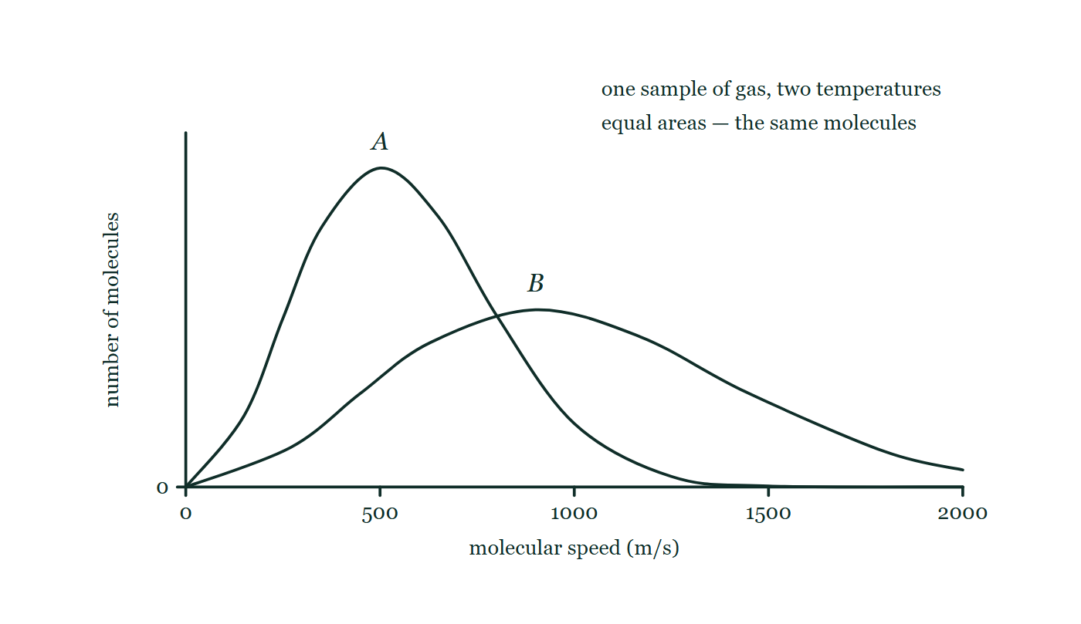
THERMAL PHYSICS · MOLECULAR SPEEDS
GIOPHYSICS LESSON
THE PICTURE
Two curves, one sample
Drawn for this lesson
Two Maxwell–Boltzmann speed distributions for the same sample of gas drawn on one pair of axes and labelled only A and B: A is taller and peaks near 500 m/s, B is lower and broader with a tail running past 2000 m/s, and the two enclose equal areas.
The live version of this figure — click here
Thermal Physics — Molecular Speeds. Built by GioPhysics from the lesson's own copy; nothing on these slides is re-authored.
13 / 31
Notes:
[Phase] Build the model: The formulae, one at a time, in plain English (minutes 13–22 of 45)
[Figure] Two Maxwell–Boltzmann speed distributions for the same sample of gas drawn on one pair of axes and labelled only A and B: A is taller and peaks near 500 m/s, B is lower and broader with a tail running past 2000 m/s, and the two enclose equal areas.

Slide 14
THERMAL PHYSICS · MOLECULAR SPEEDS
GIOPHYSICS LESSON
WATCH OUT
The common trap
Check and misconception — The quick check and the trap
v(rms) is not the speed every molecule has, and it is not even the most common speed — it sits above the peak of the distribution. At any instant some molecules are nearly at rest and a rare few travel several times faster than v(rms). Temperature fixes the shape of the crowd, never a single speed.
Thermal Physics — Molecular Speeds. Built by GioPhysics from the lesson's own copy; nothing on these slides is re-authored.
14 / 31
Notes:
[Phase] Check and misconception: The quick check and the trap (minutes 35–41 of 45)
[Misconception] v(rms) is not the speed every molecule has, and it is not even the most common speed — it sits above the peak of the distribution. At any instant some molecules are nearly at rest and a rare few travel several times faster than v(rms). Temperature fixes the shape of the crowd, never a single speed.

Slide 15
THERMAL PHYSICS · MOLECULAR SPEEDS
GIOPHYSICS LESSON
WORKED EXAMPLE 1 OF 2 · EASY
The question
Easy
Worked examples — I do, we do — one step revealed at a time
Find v(rms) for nitrogen (M = 0.028 kg/mol) at 300 K.
Thermal Physics — Molecular Speeds. Built by GioPhysics from the lesson's own copy; nothing on these slides is re-authored.
15 / 31
Notes:
[Phase] Worked examples: I do, we do — one step revealed at a time (minutes 22–35 of 45)
[Question] Find v(rms) for nitrogen (M = 0.028 kg/mol) at 300 K.
[Answer] ≈ 520 m/s

Slide 16
THERMAL PHYSICS · MOLECULAR SPEEDS
GIOPHYSICS LESSON
WORKED EXAMPLE 1 OF 2 · EASY · THE WORKING
How to solve it
Easy
Worked examples — I do, we do — one step revealed at a time
Find v(rms) for nitrogen (M = 0.028 kg/mol) at 300 K.
1.
v(rms) = √(3RT/M) = √(3 × 8.31 × 300 ÷ 0.028).
2.
= √(7479 ÷ 0.028) = √267 000 ≈ 520 m/s.
Thermal Physics — Molecular Speeds. Built by GioPhysics from the lesson's own copy; nothing on these slides is re-authored.
16 / 31
Notes:
[Phase] Worked examples: I do, we do — one step revealed at a time (minutes 22–35 of 45)
[Reveal] One click per step. The class works each line before the next appears.
[Step 1] v(rms) = √(3RT/M) = √(3 × 8.31 × 300 ÷ 0.028).
[Step 2] = √(7479 ÷ 0.028) = √267 000 ≈ 520 m/s.

Slide 17
THERMAL PHYSICS · MOLECULAR SPEEDS
GIOPHYSICS LESSON
WORKED EXAMPLE 1 OF 2 · EASY
Answer
Easy
Worked examples — I do, we do — one step revealed at a time
≈ 520 m/s
Thermal Physics — Molecular Speeds. Built by GioPhysics from the lesson's own copy; nothing on these slides is re-authored.
17 / 31
Notes:
[Phase] Worked examples: I do, we do — one step revealed at a time (minutes 22–35 of 45)
[Answer] ≈ 520 m/s

Slide 18
THERMAL PHYSICS · MOLECULAR SPEEDS
GIOPHYSICS LESSON
WORKED EXAMPLE 2 OF 2 · MEDIUM
The question
Medium
Worked examples — I do, we do — one step revealed at a time
Find v(rms) for hydrogen (M = 0.0020 kg/mol) at 300 K, and compare it with nitrogen’s.
Thermal Physics — Molecular Speeds. Built by GioPhysics from the lesson's own copy; nothing on these slides is re-authored.
18 / 31
Notes:
[Phase] Worked examples: I do, we do — one step revealed at a time (minutes 22–35 of 45)
[Question] Find v(rms) for hydrogen (M = 0.0020 kg/mol) at 300 K, and compare it with nitrogen’s.
[Answer] ≈ 1900 m/s, about 3.7× nitrogen’s speed

Slide 19
THERMAL PHYSICS · MOLECULAR SPEEDS
GIOPHYSICS LESSON
WORKED EXAMPLE 2 OF 2 · MEDIUM · THE WORKING
How to solve it
Medium
Worked examples — I do, we do — one step revealed at a time
Find v(rms) for hydrogen (M = 0.0020 kg/mol) at 300 K, and compare it with nitrogen’s.
1.
v(rms) = √(7479 ÷ 0.0020) = √3 740 000 ≈ 1900 m/s.
2.
Ratio to nitrogen: √(28 ÷ 2) = √14 ≈ 3.7.
3.
Same temperature, same mean KE — hydrogen is simply 14 times lighter, hence √14 times faster.
Thermal Physics — Molecular Speeds. Built by GioPhysics from the lesson's own copy; nothing on these slides is re-authored.
19 / 31
Notes:
[Phase] Worked examples: I do, we do — one step revealed at a time (minutes 22–35 of 45)
[Reveal] One click per step. The class works each line before the next appears.
[Step 1] v(rms) = √(7479 ÷ 0.0020) = √3 740 000 ≈ 1900 m/s.
[Step 2] Ratio to nitrogen: √(28 ÷ 2) = √14 ≈ 3.7.
[Step 3] Same temperature, same mean KE — hydrogen is simply 14 times lighter, hence √14 times faster.

Slide 20
THERMAL PHYSICS · MOLECULAR SPEEDS
GIOPHYSICS LESSON
WORKED EXAMPLE 2 OF 2 · MEDIUM
Answer
Medium
Worked examples — I do, we do — one step revealed at a time
≈ 1900 m/s, about 3.7× nitrogen’s speed
Thermal Physics — Molecular Speeds. Built by GioPhysics from the lesson's own copy; nothing on these slides is re-authored.
20 / 31
Notes:
[Phase] Worked examples: I do, we do — one step revealed at a time (minutes 22–35 of 45)
[Answer] ≈ 1900 m/s, about 3.7× nitrogen’s speed

Slide 21
THERMAL PHYSICS · MOLECULAR SPEEDS
GIOPHYSICS LESSON
PREDICT · TAKE THE VOTE
Commit before you are told
Hands up for each option, then click
A is the tall narrow curve and B the low broad one. Which is at the higher temperature?
A A — its peak is higher, so its molecules have more energy
B B
C Neither; the areas are equal, so it is one sample at one temperature
Two Maxwell–Boltzmann speed distributions for the same sample of gas drawn on one pair of axes and labelled only A and B: A is taller and peaks near 500 m/s, B is lower and broader with a tail running past 2000 m/s, and the two enclose equal areas.
The live version of this figure — click here
Thermal Physics — Molecular Speeds. Built by GioPhysics from the lesson's own copy; nothing on these slides is re-authored.
21 / 31
Notes:
[Phase] Build the model: The formulae, one at a time, in plain English (minutes 13–22 of 45)
[Predict] A is the tall narrow curve and B the low broad one. Which is at the higher temperature?
[Options] A A — its peak is higher, so its molecules have more energy B B C Neither; the areas are equal, so it is one sample at one temperature
[Figure] Two Maxwell–Boltzmann speed distributions for the same sample of gas drawn on one pair of axes and labelled only A and B: A is taller and peaks near 500 m/s, B is lower and broader with a tail running past 2000 m/s, and the two enclose equal areas.

Slide 22
THERMAL PHYSICS · MOLECULAR SPEEDS
GIOPHYSICS LESSON
PREDICT · THE OUTCOME
What actually happens
Ask the room who changed their mind, and why
B B
WHY
The height of a peak says how MANY molecules share the commonest speed, not how fast they are going. Heating adds no molecules — that is why the two curves enclose equal areas, the same sample counted twice — it spreads the ones you have over a wider range of speeds, flattening the peak and stretching the tail to the right. B is the hotter. And notice that no single speed describes either curve: even on the cold one, molecules range from nearly stationary to several times the typical speed.
Thermal Physics — Molecular Speeds. Built by GioPhysics from the lesson's own copy; nothing on these slides is re-authored.
22 / 31
Notes:
[Phase] Build the model: The formulae, one at a time, in plain English (minutes 13–22 of 45)
[Answer] B — B. The height of a peak says how MANY molecules share the commonest speed, not how fast they are going. Heating adds no molecules — that is why the two curves enclose equal areas, the same sample counted twice — it spreads the ones you have over a wider range of speeds, flattening the peak and stretching the tail to the right. B is the hotter. And notice that no single speed describes either curve: even on the cold one, molecules range from nearly stationary to several times the typical speed.

Slide 23
THERMAL PHYSICS · MOLECULAR SPEEDS
GIOPHYSICS LESSON
QUICK CHECK
Decide before the answer goes up
Check and misconception — The quick check and the trap
Oxygen (M = 32 g/mol) and hydrogen (M = 2 g/mol) are mixed at the same temperature. Which molecules have the greater mean kinetic energy?
A
The hydrogen molecules
B
The oxygen molecules
C
Neither — the mean KE is the same; hydrogen is just 4× faster
Thermal Physics — Molecular Speeds. Built by GioPhysics from the lesson's own copy; nothing on these slides is re-authored.
23 / 31
Notes:
[Phase] Check and misconception: The quick check and the trap (minutes 35–41 of 45)
[Question] Oxygen (M = 32 g/mol) and hydrogen (M = 2 g/mol) are mixed at the same temperature. Which molecules have the greater mean kinetic energy?
[Options] A The hydrogen molecules B The oxygen molecules C Neither — the mean KE is the same; hydrogen is just 4× faster

Slide 24
THERMAL PHYSICS · MOLECULAR SPEEDS
GIOPHYSICS LESSON
QUICK CHECK · THE ANSWER
The answer, and why
Check and misconception — The quick check and the trap
C Neither — the mean KE is the same; hydrogen is just 4× faster
HOW TO GET THERE
Mean KE depends only on temperature. Equal KE with 16× less mass makes hydrogen √16 = 4 times faster.
WHY THE OTHERS TEMPT
A The hydrogen molecules really are the fast ones, four times faster than the oxygen. But kinetic energy is ½mv², and they are sixteen times lighter: the four in the speed is squared to sixteen and then exactly cancelled by the sixteenth of the mass.
B Heavier is not the same as more energetic. Each oxygen molecule carries sixteen times the mass but moves four times more slowly, and ½mv² comes out identical.
C Correct. Mean kinetic energy is (3/2)k(B)T and depends on nothing but temperature — mix any two gases at one temperature and their mean molecular kinetic energies match exactly.
Thermal Physics — Molecular Speeds. Built by GioPhysics from the lesson's own copy; nothing on these slides is re-authored.
24 / 31
Notes:
[Phase] Check and misconception: The quick check and the trap (minutes 35–41 of 45)
[Question] Oxygen (M = 32 g/mol) and hydrogen (M = 2 g/mol) are mixed at the same temperature. Which molecules have the greater mean kinetic energy?
[Option by option] A: The hydrogen molecules really are the fast ones, four times faster than the oxygen. But kinetic energy is ½mv², and they are sixteen times lighter: the four in the speed is squared to sixteen and then exactly cancelled by the sixteenth of the mass. B: Heavier is not the same as more energetic. Each oxygen molecule carries sixteen times the mass but moves four times more slowly, and ½mv² comes out identical. C: Correct. Mean kinetic energy is (3/2)k(B)T and depends on nothing but temperature — mix any two gases at one temperature and their mean molecular kinetic energies match exactly.
[Answer] C — Neither — the mean KE is the same; hydrogen is just 4× faster
[Why] Mean KE depends only on temperature. Equal KE with 16× less mass makes hydrogen √16 = 4 times faster.
[Reveal] One click for the answer, then one for the reason.

Slide 25
THERMAL PHYSICS · MOLECULAR SPEEDS
GIOPHYSICS LESSON
EXTENSION 1 OF 2 · HARD
The question
Hard
Worked examples — I do, we do — one step revealed at a time
At what temperature would helium’s v(rms) (M = 0.0040 kg/mol) equal Earth’s escape speed of 11.2 km/s? What does the answer tell you about atmospheric escape?
Thermal Physics — Molecular Speeds. Built by GioPhysics from the lesson's own copy; nothing on these slides is re-authored.
25 / 31
Notes:
[Phase] Worked examples: I do, we do — one step revealed at a time (minutes 22–35 of 45)
[Question] At what temperature would helium’s v(rms) (M = 0.0040 kg/mol) equal Earth’s escape speed of 11.2 km/s? What does the answer tell you about atmospheric escape?
[Answer] ≈ 20 000 K — escape happens through the tail, not the average

Slide 26
THERMAL PHYSICS · MOLECULAR SPEEDS
GIOPHYSICS LESSON
EXTENSION 1 OF 2 · HARD · THE WORKING
How to solve it
Hard
Worked examples — I do, we do — one step revealed at a time
At what temperature would helium’s v(rms) (M = 0.0040 kg/mol) equal Earth’s escape speed of 11.2 km/s? What does the answer tell you about atmospheric escape?
1.
T = Mv²/(3R) = 0.0040 × (1.12 × 10⁴)² ÷ (3 × 8.31).
2.
= 0.0040 × 1.25 × 10⁸ ÷ 24.9 ≈ 2.0 × 10⁴ K.
3.
No such temperature exists on Earth — yet helium still escapes, because the distribution’s fast tail always holds a few molecules above 11.2 km/s. Averages stay; tails leak.
Thermal Physics — Molecular Speeds. Built by GioPhysics from the lesson's own copy; nothing on these slides is re-authored.
26 / 31
Notes:
[Phase] Worked examples: I do, we do — one step revealed at a time (minutes 22–35 of 45)
[Reveal] One click per step. The class works each line before the next appears.
[Step 1] T = Mv²/(3R) = 0.0040 × (1.12 × 10⁴)² ÷ (3 × 8.31).
[Step 2] = 0.0040 × 1.25 × 10⁸ ÷ 24.9 ≈ 2.0 × 10⁴ K.
[Step 3] No such temperature exists on Earth — yet helium still escapes, because the distribution’s fast tail always holds a few molecules above 11.2 km/s. Averages stay; tails leak.

Slide 27
THERMAL PHYSICS · MOLECULAR SPEEDS
GIOPHYSICS LESSON
EXTENSION 1 OF 2 · HARD
Answer
Hard
Worked examples — I do, we do — one step revealed at a time
≈ 20 000 K — escape happens through the tail, not the average
Thermal Physics — Molecular Speeds. Built by GioPhysics from the lesson's own copy; nothing on these slides is re-authored.
27 / 31
Notes:
[Phase] Worked examples: I do, we do — one step revealed at a time (minutes 22–35 of 45)
[Answer] ≈ 20 000 K — escape happens through the tail, not the average

Slide 28
THERMAL PHYSICS · MOLECULAR SPEEDS
GIOPHYSICS LESSON
EXTENSION 2 OF 2 · CHALLENGING
The question
Challenging
Worked examples — I do, we do — one step revealed at a time
Uranium enrichment once relied on diffusing UF₆ gas: ²³⁵UF₆ has molar mass 349, ²³⁸UF₆ has 352. Find the ratio of their rms speeds at equal temperature.
Thermal Physics — Molecular Speeds. Built by GioPhysics from the lesson's own copy; nothing on these slides is re-authored.
28 / 31
Notes:
[Phase] Worked examples: I do, we do — one step revealed at a time (minutes 22–35 of 45)
[Question] Uranium enrichment once relied on diffusing UF₆ gas: ²³⁵UF₆ has molar mass 349, ²³⁸UF₆ has 352. Find the ratio of their rms speeds at equal temperature.
[Answer] ≈ 1.0043 — a 0.43% difference, exploited over thousands of stages

Slide 29
THERMAL PHYSICS · MOLECULAR SPEEDS
GIOPHYSICS LESSON
EXTENSION 2 OF 2 · CHALLENGING · THE WORKING
How to solve it
Challenging
Worked examples — I do, we do — one step revealed at a time
Uranium enrichment once relied on diffusing UF₆ gas: ²³⁵UF₆ has molar mass 349, ²³⁸UF₆ has 352. Find the ratio of their rms speeds at equal temperature.
1.
Equal T means equal mean KE, so v ∝ 1/√M.
2.
v(235)/v(238) = √(352 ÷ 349) = √1.0086.
3.
≈ 1.0043 — a 0.43% speed advantage, so the lighter isotope diffuses slightly faster. Thousands of repeated stages turned that whisker into a separation.
Thermal Physics — Molecular Speeds. Built by GioPhysics from the lesson's own copy; nothing on these slides is re-authored.
29 / 31
Notes:
[Phase] Worked examples: I do, we do — one step revealed at a time (minutes 22–35 of 45)
[Reveal] One click per step. The class works each line before the next appears.
[Step 1] Equal T means equal mean KE, so v ∝ 1/√M.
[Step 2] v(235)/v(238) = √(352 ÷ 349) = √1.0086.
[Step 3] ≈ 1.0043 — a 0.43% speed advantage, so the lighter isotope diffuses slightly faster. Thousands of repeated stages turned that whisker into a separation.

Slide 30
THERMAL PHYSICS · MOLECULAR SPEEDS
GIOPHYSICS LESSON
EXTENSION 2 OF 2 · CHALLENGING
Answer
Challenging
Worked examples — I do, we do — one step revealed at a time
≈ 1.0043 — a 0.43% difference, exploited over thousands of stages
Thermal Physics — Molecular Speeds. Built by GioPhysics from the lesson's own copy; nothing on these slides is re-authored.
30 / 31
Notes:
[Phase] Worked examples: I do, we do — one step revealed at a time (minutes 22–35 of 45)
[Answer] ≈ 1.0043 — a 0.43% difference, exploited over thousands of stages

Slide 31
THERMAL PHYSICS · MOLECULAR SPEEDS
GIOPHYSICS LESSON
THERMAL PHYSICS
Where to go next
Plenary — What to take away, what to practise next
Next
21.6 Thermal Calculus
https://giophysics.com/chapter-40/thermal-calculus/
Lesson
This lesson on giophysics.com
https://giophysics.com/chapter-40/molecular-speeds/
Live
The live, interactive version of these slides
https://giophysics.com/chapter-40/presentation/?lesson=speeds
Chapter
All Thermal Physics lessons
https://giophysics.com/chapter-40/
PDF
Download the lesson PDF
https://giophysics.com/downloads/40-5-molecular-speeds.pdf
Thermal Physics — Molecular Speeds. Built by GioPhysics from the lesson's own copy; nothing on these slides is re-authored.
31 / 31
Notes:
[Phase] Plenary: What to take away, what to practise next (minutes 41–45 of 45)
[Interactive] The graphs and the circuit topology on these slides are frozen. The live version at https://giophysics.com/chapter-40/presentation/?lesson=speeds moves them.

