Slide 1
THERMODYNAMICS · THE FIRST LAW & GAS PROCESSES
GIOPHYSICS LESSON
22 · Thermodynamics
Energy bookkeeping for a gas
The First Law & Gas Processes
Squeeze a gas, heat a gas, let a gas push a piston — every change obeys one budget line: ΔU = Q − W. The p–V diagram turns that budget into a picture, and the area under the curve is the work.
POSITION
Lesson 1 of 6 in Thermodynamics
PLAN
16 slides in the 45-minute core run, about 44.5 minutes of it
LESSON PAGE
https://giophysics.com/chapter-41/first-law-gas-processes/
Built by GioPhysics from the lesson's own page. Every word on these slides is the lesson's; nothing here is re-authored. Teaching material, not an awarding body's document.
Thermodynamics — The First Law & Gas Processes. Built by GioPhysics from the lesson's own copy; nothing on these slides is re-authored.
1 / 33
Notes:
[Lesson] Thermodynamics — The First Law & Gas Processes. Lesson 1 of 6.
[Intro] Squeeze a gas, heat a gas, let a gas push a piston — every change obeys one budget line: ΔU = Q − W. The p–V diagram turns that budget into a picture, and the area under the curve is the work.
[Source] https://giophysics.com/chapter-41/first-law-gas-processes/
[Disclaimer] Built by GioPhysics from the lesson's own page. Every word on these slides is the lesson's; nothing here is re-authored. Teaching material, not an awarding body's document.

Slide 2
THERMODYNAMICS · THE FIRST LAW & GAS PROCESSES
GIOPHYSICS LESSON
WHAT THIS NEEDS
What you already know
Starter — Recall what this lesson stands on
Recall
Energy conservation
https://giophysics.com/chapter-6/energy-conversion-conservation/
Recall
Work
https://giophysics.com/chapter-5/work/
Thermodynamics — The First Law & Gas Processes. Built by GioPhysics from the lesson's own copy; nothing on these slides is re-authored.
2 / 33
Notes:
[Phase] Starter: Recall what this lesson stands on (minutes 0–5 of 45)
[Starter] Recall: Energy conservation; Work

Slide 3
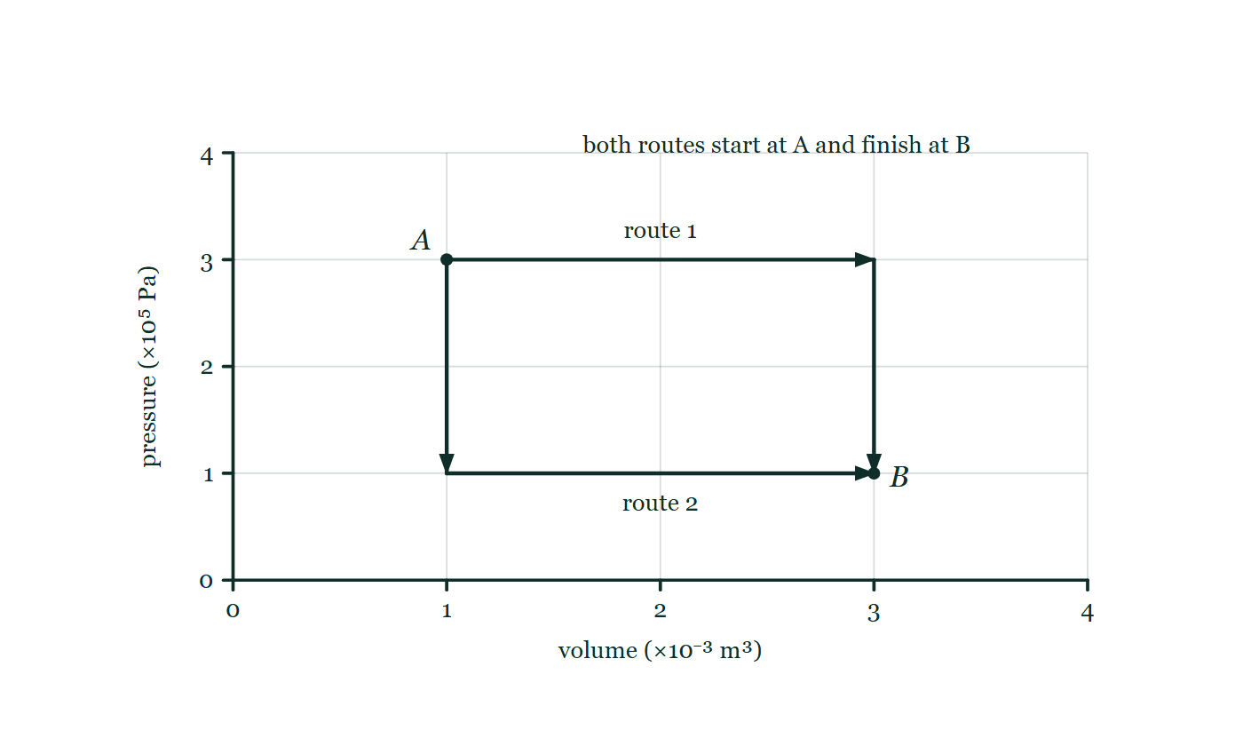
THERMODYNAMICS · THE FIRST LAW & GAS PROCESSES
GIOPHYSICS LESSON
THINK FIRST
Two routes take the same gas from state A to state B. Along one of them the gas does more work. Which route needed more heat?
Take answers before you click — the point is the commitment
Same starting pressure and volume, same finishing pressure and volume, same gas. Only the path between them differs — one expands first and then cools, the other cools first and then expands.
THE ANSWER
The one that did more work. Internal energy depends only on where the gas is on the diagram, so ΔU is identical along both routes; the first law then forces Q = ΔU + W, and the route with the bigger W had to be fed the bigger Q. Heat and work depend on the road taken. That is why 'the heat in the gas' is a phrase with no meaning.
A pressure–volume diagram carrying two routes between the same pair of states: from A one goes right along the top at constant pressure and then straight down to B, the other drops straight down from A and then runs right along the bottom to B. Neither region beneath them is shaded.
The live version of this figure — click here
Thermodynamics — The First Law & Gas Processes. Built by GioPhysics from the lesson's own copy; nothing on these slides is re-authored.
3 / 33
Notes:
[Phase] Starter: Recall what this lesson stands on (minutes 0–5 of 45)
[Hook] Two routes take the same gas from state A to state B. Along one of them the gas does more work. Which route needed more heat? Same starting pressure and volume, same finishing pressure and volume, same gas. Only the path between them differs — one expands first and then cools, the other cools first and then expands.
[Answer] The one that did more work. Internal energy depends only on where the gas is on the diagram, so ΔU is identical along both routes; the first law then forces Q = ΔU + W, and the route with the bigger W had to be fed the bigger Q. Heat and work depend on the road taken. That is why 'the heat in the gas' is a phrase with no meaning.
[Figure] A pressure–volume diagram carrying two routes between the same pair of states: from A one goes right along the top at constant pressure and then straight down to B, the other drops straight down from A and then runs right along the bottom to B. Neither region beneath them is shaded.

Slide 4
THERMODYNAMICS · THE FIRST LAW & GAS PROCESSES
GIOPHYSICS LESSON
EXPLAINED SIMPLY
In one sentence
Introduce the idea — The big idea and the definition
The first law of thermodynamics says the change in a gas's internal energy equals the heat put in minus the work the gas does: ΔU = Q − W.
Thermodynamics — The First Law & Gas Processes. Built by GioPhysics from the lesson's own copy; nothing on these slides is re-authored.
4 / 33
Notes:
[Phase] Introduce the idea: The big idea and the definition (minutes 5–13 of 45)
[Definition] The first law of thermodynamics says the change in a gas's internal energy equals the heat put in minus the work the gas does: ΔU = Q − W.

Slide 5
THERMODYNAMICS · THE FIRST LAW & GAS PROCESSES
GIOPHYSICS LESSON
EXPLAINED SIMPLY
What that looks like
Introduce the idea — The big idea and the definition
FOR EXAMPLE
A gas absorbs 500 J of heat and pushes a piston with 200 J of work — its internal energy rises by exactly 300 J, never more, never less.
Thermodynamics — The First Law & Gas Processes. Built by GioPhysics from the lesson's own copy; nothing on these slides is re-authored.
5 / 33
Notes:
[Phase] Introduce the idea: The big idea and the definition (minutes 5–13 of 45)
[Worked illustration] A gas absorbs 500 J of heat and pushes a piston with 200 J of work — its internal energy rises by exactly 300 J, never more, never less.

Slide 6
THERMODYNAMICS · THE FIRST LAW & GAS PROCESSES
GIOPHYSICS LESSON
THE BIG IDEA
Energy bookkeeping for a gas
Introduce the idea — The big idea and the definition
A gas holds internal energy U. Heat flowing in raises it; work done by the gas spends it: ΔU = Q − W.
On a p–V diagram the work done by the gas is the area under the path, so different routes between the same two states cost different amounts of heat. Four special processes — constant pressure, constant volume, constant temperature, and no heat flow — cover almost every problem.
Thermodynamics — The First Law & Gas Processes. Built by GioPhysics from the lesson's own copy; nothing on these slides is re-authored.
6 / 33
Notes:
[Phase] Introduce the idea: The big idea and the definition (minutes 5–13 of 45)
[Big idea] A gas holds internal energy U. Heat flowing in raises it; work done by the gas spends it: ΔU = Q − W. On a p–V diagram the work done by the gas is the area under the path, so different routes between the same two states cost different amounts of heat. Four special processes — constant pressure, constant volume, constant temperature, and no heat flow — cover almost every problem.

Slide 7
THERMODYNAMICS · THE FIRST LAW & GAS PROCESSES
GIOPHYSICS LESSON
THE PHYSICS · 1 OF 3
U is a state variable — Q and W are not
Build the model — The formulae, one at a time, in plain English
The internal energy of an ideal gas depends only on where you are on the p–V diagram (in fact only on T). Heat and work depend on the route taken between two states, which is why 'the heat in the gas' is a meaningless phrase.
Thermodynamics — The First Law & Gas Processes. Built by GioPhysics from the lesson's own copy; nothing on these slides is re-authored.
7 / 33
Notes:
[Phase] Build the model: The formulae, one at a time, in plain English (minutes 13–22 of 45)
[Section] The internal energy of an ideal gas depends only on where you are on the p–V diagram (in fact only on T). Heat and work depend on the route taken between two states, which is why 'the heat in the gas' is a meaningless phrase.

Slide 8
THERMODYNAMICS · THE FIRST LAW & GAS PROCESSES
GIOPHYSICS LESSON
THE PHYSICS · 2 OF 3
Reading the four paths
Build the model — The formulae, one at a time, in plain English
On the p–V diagram an isobaric process is a horizontal line, an isochoric one is vertical, an isotherm is the curve pV = constant, and an adiabat is a steeper curve pV^γ = constant. Steeper because compression work heats the gas instead of leaking away.
Thermodynamics — The First Law & Gas Processes. Built by GioPhysics from the lesson's own copy; nothing on these slides is re-authored.
8 / 33
Notes:
[Phase] Build the model: The formulae, one at a time, in plain English (minutes 13–22 of 45)
[Section] On the p–V diagram an isobaric process is a horizontal line, an isochoric one is vertical, an isotherm is the curve pV = constant, and an adiabat is a steeper curve pV^γ = constant. Steeper because compression work heats the gas instead of leaking away.

Slide 9
THERMODYNAMICS · THE FIRST LAW & GAS PROCESSES
GIOPHYSICS LESSON
THE PHYSICS · 3 OF 3
Adiabatic means insulated — or fast
Build the model — The formulae, one at a time, in plain English
Adiabatic is Greek for 'nothing gets through': no heat enters or leaves, so ΔU = −W. Compressing air in a bicycle pump warms it; air rising and expanding in the atmosphere cools. Rapid processes are nearly adiabatic because heat has no time to flow.
Thermodynamics — The First Law & Gas Processes. Built by GioPhysics from the lesson's own copy; nothing on these slides is re-authored.
9 / 33
Notes:
[Phase] Build the model: The formulae, one at a time, in plain English (minutes 13–22 of 45)
[Section] Adiabatic is Greek for 'nothing gets through': no heat enters or leaves, so ΔU = −W. Compressing air in a bicycle pump warms it; air rising and expanding in the atmosphere cools. Rapid processes are nearly adiabatic because heat has no time to flow.

Slide 10
THERMODYNAMICS · THE FIRST LAW & GAS PROCESSES
GIOPHYSICS LESSON
FORMULA 1 OF 3
First law
Build the model — The formulae, one at a time, in plain English
ΔU = Q − W
Q = heat into the gas; W = work done by the gas
IN PLAIN ENGLISH
Internal energy is a bank balance: heat in is a deposit, work done by the gas is a withdrawal. The signs matter — work done on the gas counts as a deposit.
Thermodynamics — The First Law & Gas Processes. Built by GioPhysics from the lesson's own copy; nothing on these slides is re-authored.
10 / 33
Notes:
[Phase] Build the model: The formulae, one at a time, in plain English (minutes 13–22 of 45)
[Formula] First law: ΔU = Q − W
[In plain English] Internal energy is a bank balance: heat in is a deposit, work done by the gas is a withdrawal. The signs matter — work done on the gas counts as a deposit.
[Note] Q = heat into the gas; W = work done by the gas

Slide 11
THERMODYNAMICS · THE FIRST LAW & GAS PROCESSES
GIOPHYSICS LESSON
FORMULA 2 OF 3
Work from the graph
Build the model — The formulae, one at a time, in plain English
W = area under the p–V curve
Constant pressure: W = pΔV
IN PLAIN ENGLISH
A piston of area A pushed a distance d does work pA·d = pΔV. Add up the strips under any curve and the area is the work — different paths, different work.
Thermodynamics — The First Law & Gas Processes. Built by GioPhysics from the lesson's own copy; nothing on these slides is re-authored.
11 / 33
Notes:
[Phase] Build the model: The formulae, one at a time, in plain English (minutes 13–22 of 45)
[Formula] Work from the graph: W = area under the p–V curve
[In plain English] A piston of area A pushed a distance d does work pA·d = pΔV. Add up the strips under any curve and the area is the work — different paths, different work.
[Note] Constant pressure: W = pΔV

Slide 12
THERMODYNAMICS · THE FIRST LAW & GAS PROCESSES
GIOPHYSICS LESSON
FORMULA 3 OF 3
The four processes
Build the model — The formulae, one at a time, in plain English
isobaric · isochoric · isothermal · adiabatic
p fixed · V fixed (W = 0) · T fixed (ΔU = 0) · Q = 0
IN PLAIN ENGLISH
Each process pins one quantity: isobaric holds pressure, isochoric holds volume so no work is done, isothermal holds temperature so internal energy is unchanged, adiabatic lets no heat through.
Thermodynamics — The First Law & Gas Processes. Built by GioPhysics from the lesson's own copy; nothing on these slides is re-authored.
12 / 33
Notes:
[Phase] Build the model: The formulae, one at a time, in plain English (minutes 13–22 of 45)
[Formula] The four processes: isobaric · isochoric · isothermal · adiabatic
[In plain English] Each process pins one quantity: isobaric holds pressure, isochoric holds volume so no work is done, isothermal holds temperature so internal energy is unchanged, adiabatic lets no heat through.
[Note] p fixed · V fixed (W = 0) · T fixed (ΔU = 0) · Q = 0

Slide 13
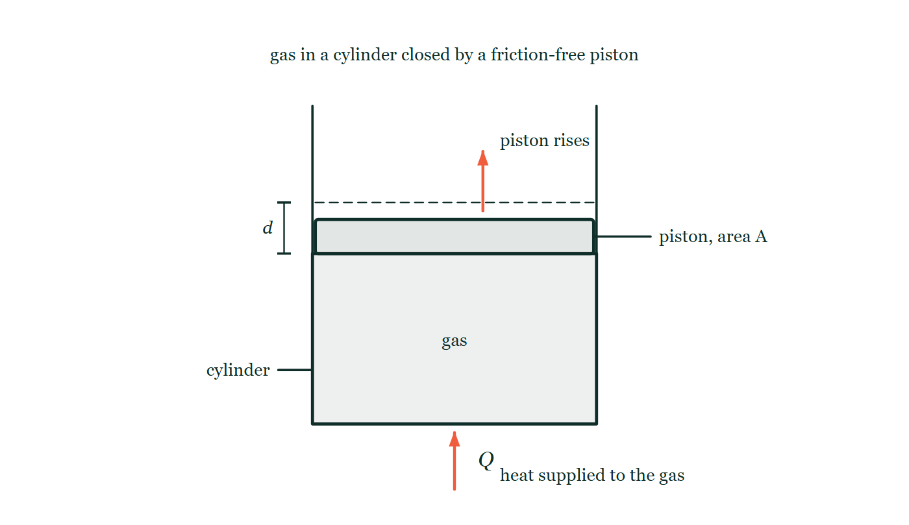
THERMODYNAMICS · THE FIRST LAW & GAS PROCESSES
GIOPHYSICS LESSON
THE PICTURE
Heat in at the bottom, work out at the top
Drawn for this lesson
Gas sealed in a vertical cylinder by a friction-free piston of area A: a heat arrow enters at the base, and the piston is drawn risen by a dimensioned distance d above a dashed line marking where it used to sit. No temperature is written anywhere on the figure.
The live version of this figure — click here
Thermodynamics — The First Law & Gas Processes. Built by GioPhysics from the lesson's own copy; nothing on these slides is re-authored.
13 / 33
Notes:
[Phase] Build the model: The formulae, one at a time, in plain English (minutes 13–22 of 45)
[Figure] Gas sealed in a vertical cylinder by a friction-free piston of area A: a heat arrow enters at the base, and the piston is drawn risen by a dimensioned distance d above a dashed line marking where it used to sit. No temperature is written anywhere on the figure.

Slide 14
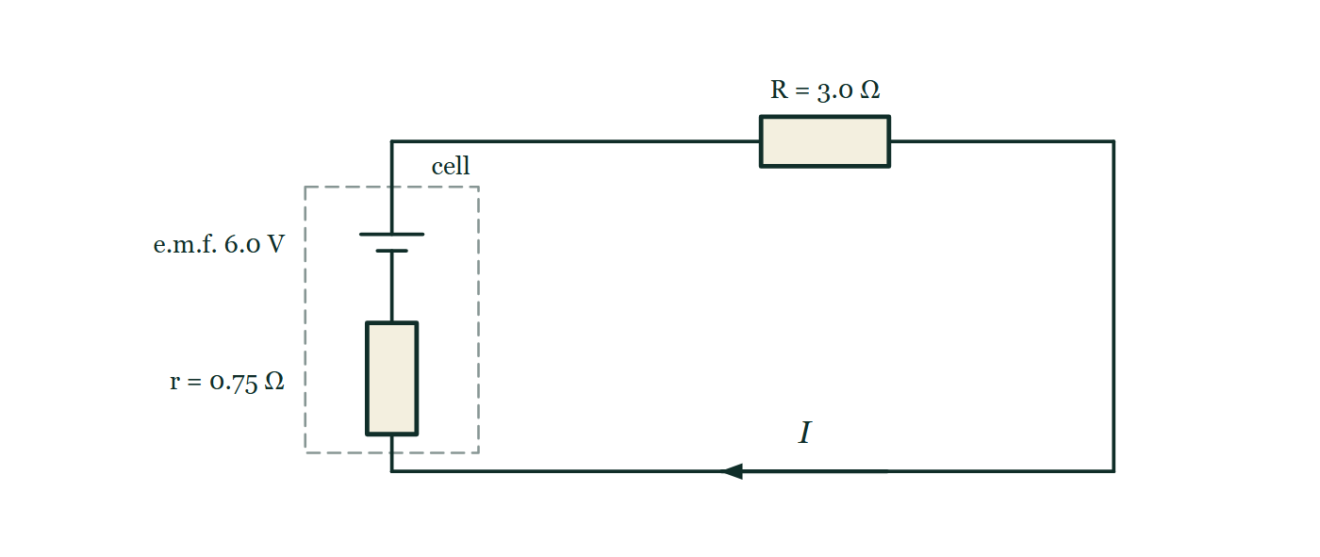
THERMODYNAMICS · THE FIRST LAW & GAS PROCESSES
GIOPHYSICS LESSON
FIGURE
Figure 4 — IB Theme B · The particulate nature of matter
Drawn for question 10 of that paper · syllabus B.4, B.5
Circuit diagram of a single series loop. On the left a dashed boundary encloses the cell itself: a cell symbol with its long positive plate uppermost, labelled e.m.f. 6.0 V, in series with a resistor labelled r = 0.75 Ω. The two terminals cross the dashed boundary and the loop continues round to a resistor in the upper wire labelled R = 3.0 Ω. An arrow on the lower wire, labelled I, marks the direction of the conventional current.
See the question this was drawn for — click here
Thermodynamics — The First Law & Gas Processes. Built by GioPhysics from the lesson's own copy; nothing on these slides is re-authored.
14 / 33
Notes:
[Phase] Build the model: The formulae, one at a time, in plain English (minutes 13–22 of 45)
[Figure] Figure 4. Circuit diagram of a single series loop. On the left a dashed boundary encloses the cell itself: a cell symbol with its long positive plate uppermost, labelled e.m.f. 6.0 V, in series with a resistor labelled r = 0.75 Ω. The two terminals cross the dashed boundary and the loop continues round to a resistor in the upper wire labelled R = 3.0 Ω. An arrow on the lower wire, labelled I, marks the direction of the conventional current.
[Where it came from] IB Theme B · The particulate nature of matter, question 10; syllabus B.4, B.5.

Slide 15
THERMODYNAMICS · THE FIRST LAW & GAS PROCESSES
GIOPHYSICS LESSON
WATCH OUT
The common trap
Check and misconception — The quick check and the trap
Adding heat does not always raise the temperature. In an isothermal expansion the gas absorbs heat continuously while its temperature stays fixed — every joule of heat leaves again immediately as work on the piston. Heat is energy in transit, not a fluid stored in the gas.
Thermodynamics — The First Law & Gas Processes. Built by GioPhysics from the lesson's own copy; nothing on these slides is re-authored.
15 / 33
Notes:
[Phase] Check and misconception: The quick check and the trap (minutes 35–41 of 45)
[Misconception] Adding heat does not always raise the temperature. In an isothermal expansion the gas absorbs heat continuously while its temperature stays fixed — every joule of heat leaves again immediately as work on the piston. Heat is energy in transit, not a fluid stored in the gas.

Slide 16
THERMODYNAMICS · THE FIRST LAW & GAS PROCESSES
GIOPHYSICS LESSON
WORKED EXAMPLE 1 OF 2 · EASY
The question
Easy
Worked examples — I do, we do — one step revealed at a time
A gas absorbs 500 J of heat and does 200 J of work on a piston. Find the change in its internal energy.
Thermodynamics — The First Law & Gas Processes. Built by GioPhysics from the lesson's own copy; nothing on these slides is re-authored.
16 / 33
Notes:
[Phase] Worked examples: I do, we do — one step revealed at a time (minutes 22–35 of 45)
[Question] A gas absorbs 500 J of heat and does 200 J of work on a piston. Find the change in its internal energy.
[Answer] ΔU = +300 J

Slide 17
THERMODYNAMICS · THE FIRST LAW & GAS PROCESSES
GIOPHYSICS LESSON
WORKED EXAMPLE 1 OF 2 · EASY · THE WORKING
How to solve it
Easy
Worked examples — I do, we do — one step revealed at a time
A gas absorbs 500 J of heat and does 200 J of work on a piston. Find the change in its internal energy.
1.
First law: ΔU = Q − W.
2.
ΔU = 500 − 200 = 300 J.
Thermodynamics — The First Law & Gas Processes. Built by GioPhysics from the lesson's own copy; nothing on these slides is re-authored.
17 / 33
Notes:
[Phase] Worked examples: I do, we do — one step revealed at a time (minutes 22–35 of 45)
[Reveal] One click per step. The class works each line before the next appears.
[Step 1] First law: ΔU = Q − W.
[Step 2] ΔU = 500 − 200 = 300 J.

Slide 18
THERMODYNAMICS · THE FIRST LAW & GAS PROCESSES
GIOPHYSICS LESSON
WORKED EXAMPLE 1 OF 2 · EASY
Answer
Easy
Worked examples — I do, we do — one step revealed at a time
ΔU = +300 J
Thermodynamics — The First Law & Gas Processes. Built by GioPhysics from the lesson's own copy; nothing on these slides is re-authored.
18 / 33
Notes:
[Phase] Worked examples: I do, we do — one step revealed at a time (minutes 22–35 of 45)
[Answer] ΔU = +300 J

Slide 19
THERMODYNAMICS · THE FIRST LAW & GAS PROCESSES
GIOPHYSICS LESSON
WORKED EXAMPLE 2 OF 2 · MEDIUM
The question
Medium
Worked examples — I do, we do — one step revealed at a time
A gas at a constant pressure of 1.0 × 10⁵ Pa expands from 2.0 × 10⁻³ m³ to 5.0 × 10⁻³ m³ while absorbing 750 J of heat. Find the work done by the gas and the change in internal energy.
Thermodynamics — The First Law & Gas Processes. Built by GioPhysics from the lesson's own copy; nothing on these slides is re-authored.
19 / 33
Notes:
[Phase] Worked examples: I do, we do — one step revealed at a time (minutes 22–35 of 45)
[Question] A gas at a constant pressure of 1.0 × 10⁵ Pa expands from 2.0 × 10⁻³ m³ to 5.0 × 10⁻³ m³ while absorbing 750 J of heat. Find the work done by the gas and the change in internal energy.
[Answer] W = 300 J; ΔU = +450 J

Slide 20
THERMODYNAMICS · THE FIRST LAW & GAS PROCESSES
GIOPHYSICS LESSON
WORKED EXAMPLE 2 OF 2 · MEDIUM · THE WORKING
How to solve it
Medium
Worked examples — I do, we do — one step revealed at a time
A gas at a constant pressure of 1.0 × 10⁵ Pa expands from 2.0 × 10⁻³ m³ to 5.0 × 10⁻³ m³ while absorbing 750 J of heat. Find the work done by the gas and the change in internal energy.
1.
Isobaric work: W = pΔV = 1.0 × 10⁵ × 3.0 × 10⁻³ = 300 J.
2.
First law: ΔU = Q − W = 750 − 300.
3.
ΔU = 450 J — the rest of the heat became piston work.
Thermodynamics — The First Law & Gas Processes. Built by GioPhysics from the lesson's own copy; nothing on these slides is re-authored.
20 / 33
Notes:
[Phase] Worked examples: I do, we do — one step revealed at a time (minutes 22–35 of 45)
[Reveal] One click per step. The class works each line before the next appears.
[Step 1] Isobaric work: W = pΔV = 1.0 × 10⁵ × 3.0 × 10⁻³ = 300 J.
[Step 2] First law: ΔU = Q − W = 750 − 300.
[Step 3] ΔU = 450 J — the rest of the heat became piston work.

Slide 21
THERMODYNAMICS · THE FIRST LAW & GAS PROCESSES
GIOPHYSICS LESSON
WORKED EXAMPLE 2 OF 2 · MEDIUM
Answer
Medium
Worked examples — I do, we do — one step revealed at a time
W = 300 J; ΔU = +450 J
Thermodynamics — The First Law & Gas Processes. Built by GioPhysics from the lesson's own copy; nothing on these slides is re-authored.
21 / 33
Notes:
[Phase] Worked examples: I do, we do — one step revealed at a time (minutes 22–35 of 45)
[Answer] W = 300 J; ΔU = +450 J

Slide 22
THERMODYNAMICS · THE FIRST LAW & GAS PROCESSES
GIOPHYSICS LESSON
SPOT THE MISTAKE
One line here is wrong
The whole working is up — find the bad line before you click
1.
An insulated cylinder holds a gas. A piston does 300 J of work on the gas. Find ΔU.
2.
Insulated, so Q = 0.
3.
First law: ΔU = Q − W = 0 − 300 = −300 J
4.
So the gas cools.
LINE 3 IS WRONG
In ΔU = Q − W, the W is work done BY the gas. Here the work was done ON the gas, so W = −300 J and ΔU = 0 − (−300) = +300 J. It is the commonest sign slip in the subject, and the physical check takes two seconds: squeezing an insulated gas makes it hotter, as five strokes of a bicycle pump will demonstrate against the palm of your hand.
IT SHOULD SAY
First law: the gas does W = −300 J of work, so ΔU = 0 − (−300) = +300 J and the gas warms.
Thermodynamics — The First Law & Gas Processes. Built by GioPhysics from the lesson's own copy; nothing on these slides is re-authored.
22 / 33
Notes:
[Phase] Worked examples: I do, we do — one step revealed at a time (minutes 22–35 of 45)
[Spot the mistake] The working is complete and one line of it is wrong. Let the room hunt: one click names the line, a second shows it done correctly.
[Line 3 is wrong] In ΔU = Q − W, the W is work done BY the gas. Here the work was done ON the gas, so W = −300 J and ΔU = 0 − (−300) = +300 J. It is the commonest sign slip in the subject, and the physical check takes two seconds: squeezing an insulated gas makes it hotter, as five strokes of a bicycle pump will demonstrate against the palm of your hand.
[It should say] First law: the gas does W = −300 J of work, so ΔU = 0 − (−300) = +300 J and the gas warms.

Slide 23
THERMODYNAMICS · THE FIRST LAW & GAS PROCESSES
GIOPHYSICS LESSON
PREDICT · TAKE THE VOTE
Commit before you are told
Hands up for each option, then click
Heat is supplied at the base and the piston rises. What has happened to the gas's temperature?
A It must have risen — heat went in, and heat is what makes things hot
B It could have risen, fallen, or stayed exactly the same
C It must have fallen, because the gas spent energy pushing the piston
Gas sealed in a vertical cylinder by a friction-free piston of area A: a heat arrow enters at the base, and the piston is drawn risen by a dimensioned distance d above a dashed line marking where it used to sit. No temperature is written anywhere on the figure.
The live version of this figure — click here
Thermodynamics — The First Law & Gas Processes. Built by GioPhysics from the lesson's own copy; nothing on these slides is re-authored.
23 / 33
Notes:
[Phase] Build the model: The formulae, one at a time, in plain English (minutes 13–22 of 45)
[Predict] Heat is supplied at the base and the piston rises. What has happened to the gas's temperature?
[Options] A It must have risen — heat went in, and heat is what makes things hot B It could have risen, fallen, or stayed exactly the same C It must have fallen, because the gas spent energy pushing the piston
[Figure] Gas sealed in a vertical cylinder by a friction-free piston of area A: a heat arrow enters at the base, and the piston is drawn risen by a dimensioned distance d above a dashed line marking where it used to sit. No temperature is written anywhere on the figure.

Slide 24
THERMODYNAMICS · THE FIRST LAW & GAS PROCESSES
GIOPHYSICS LESSON
PREDICT · THE OUTCOME
What actually happens
Ask the room who changed their mind, and why
B It could have risen, fallen, or stayed exactly the same
WHY
ΔU = Q − W has two terms and both of them are live here: heat is arriving and the gas is doing work on the piston as it goes. Which wins depends on how much the piston takes. Hold the cylinder on an isotherm and every joule of Q leaves again as W, so ΔU is exactly zero and the thermometer never moves while the heating goes on all day. Adding heat and raising temperature are different events that usually, but not always, happen together.
Thermodynamics — The First Law & Gas Processes. Built by GioPhysics from the lesson's own copy; nothing on these slides is re-authored.
24 / 33
Notes:
[Phase] Build the model: The formulae, one at a time, in plain English (minutes 13–22 of 45)
[Answer] B — It could have risen, fallen, or stayed exactly the same. ΔU = Q − W has two terms and both of them are live here: heat is arriving and the gas is doing work on the piston as it goes. Which wins depends on how much the piston takes. Hold the cylinder on an isotherm and every joule of Q leaves again as W, so ΔU is exactly zero and the thermometer never moves while the heating goes on all day. Adding heat and raising temperature are different events that usually, but not always, happen together.

Slide 25
THERMODYNAMICS · THE FIRST LAW & GAS PROCESSES
GIOPHYSICS LESSON
QUICK CHECK
Decide before the answer goes up
Check and misconception — The quick check and the trap
An ideal gas expands isothermally, doing 400 J of work on the piston. How much heat flows into the gas?
A
0 J — no temperature change means no heat
B
400 J
C
More than 400 J
Thermodynamics — The First Law & Gas Processes. Built by GioPhysics from the lesson's own copy; nothing on these slides is re-authored.
25 / 33
Notes:
[Phase] Check and misconception: The quick check and the trap (minutes 35–41 of 45)
[Question] An ideal gas expands isothermally, doing 400 J of work on the piston. How much heat flows into the gas?
[Options] A 0 J — no temperature change means no heat B 400 J C More than 400 J

Slide 26
THERMODYNAMICS · THE FIRST LAW & GAS PROCESSES
GIOPHYSICS LESSON
QUICK CHECK · THE ANSWER
The answer, and why
Check and misconception — The quick check and the trap
B 400 J
HOW TO GET THERE
Isothermal means T — and so U — is unchanged: ΔU = 0, and the first law gives Q = W = 400 J. Every joule of heat in becomes work out.
WHY THE OTHERS TEMPT
A This reads 'no temperature change' as 'no heat'. Isothermal means ΔU = 0, not Q = 0 — the gas sits against a reservoir that feeds it heat exactly as fast as the piston removes it. Q = 0 is the adiabatic case, and there the gas would cool as it expanded.
B Correct. Isothermal means ΔU = 0, so ΔU = Q − W gives Q = W = 400 J: every joule in becomes a joule out.
C More than 400 J would have to end up somewhere, and there is nowhere left. The internal energy did not change and the piston received exactly 400 J. For an ideal gas U depends only on T, so a fixed temperature is a fixed U and the books balance to the joule.
Thermodynamics — The First Law & Gas Processes. Built by GioPhysics from the lesson's own copy; nothing on these slides is re-authored.
26 / 33
Notes:
[Phase] Check and misconception: The quick check and the trap (minutes 35–41 of 45)
[Question] An ideal gas expands isothermally, doing 400 J of work on the piston. How much heat flows into the gas?
[Option by option] A: This reads 'no temperature change' as 'no heat'. Isothermal means ΔU = 0, not Q = 0 — the gas sits against a reservoir that feeds it heat exactly as fast as the piston removes it. Q = 0 is the adiabatic case, and there the gas would cool as it expanded. B: Correct. Isothermal means ΔU = 0, so ΔU = Q − W gives Q = W = 400 J: every joule in becomes a joule out. C: More than 400 J would have to end up somewhere, and there is nowhere left. The internal energy did not change and the piston received exactly 400 J. For an ideal gas U depends only on T, so a fixed temperature is a fixed U and the books balance to the joule.
[Answer] B — 400 J
[Why] Isothermal means T — and so U — is unchanged: ΔU = 0, and the first law gives Q = W = 400 J. Every joule of heat in becomes work out.
[Reveal] One click for the answer, then one for the reason.

Slide 27
THERMODYNAMICS · THE FIRST LAW & GAS PROCESSES
GIOPHYSICS LESSON
EXTENSION 1 OF 2 · HARD
The question
Hard
Worked examples — I do, we do — one step revealed at a time
A gas is first heated at constant volume with 400 J of heat, then expands at a constant 2.0 × 10⁵ Pa from 1.0 × 10⁻³ m³ to 2.5 × 10⁻³ m³ while absorbing another 750 J. Find the total work done and the total change in internal energy.
Thermodynamics — The First Law & Gas Processes. Built by GioPhysics from the lesson's own copy; nothing on these slides is re-authored.
27 / 33
Notes:
[Phase] Worked examples: I do, we do — one step revealed at a time (minutes 22–35 of 45)
[Question] A gas is first heated at constant volume with 400 J of heat, then expands at a constant 2.0 × 10⁵ Pa from 1.0 × 10⁻³ m³ to 2.5 × 10⁻³ m³ while absorbing another 750 J. Find the total work done and the total change in internal energy.
[Answer] W = 300 J; ΔU = +850 J

Slide 28
THERMODYNAMICS · THE FIRST LAW & GAS PROCESSES
GIOPHYSICS LESSON
EXTENSION 1 OF 2 · HARD · THE WORKING
How to solve it
Hard
Worked examples — I do, we do — one step revealed at a time
A gas is first heated at constant volume with 400 J of heat, then expands at a constant 2.0 × 10⁵ Pa from 1.0 × 10⁻³ m³ to 2.5 × 10⁻³ m³ while absorbing another 750 J. Find the total work done and the total change in internal energy.
1.
Isochoric leg: V fixed, so W₁ = 0 and ΔU₁ = Q₁ = 400 J.
2.
Isobaric leg: W₂ = pΔV = 2.0 × 10⁵ × 1.5 × 10⁻³ = 300 J; ΔU₂ = 750 − 300 = 450 J.
3.
Totals: W = 0 + 300 = 300 J; ΔU = 400 + 450 = 850 J.
Thermodynamics — The First Law & Gas Processes. Built by GioPhysics from the lesson's own copy; nothing on these slides is re-authored.
28 / 33
Notes:
[Phase] Worked examples: I do, we do — one step revealed at a time (minutes 22–35 of 45)
[Reveal] One click per step. The class works each line before the next appears.
[Step 1] Isochoric leg: V fixed, so W₁ = 0 and ΔU₁ = Q₁ = 400 J.
[Step 2] Isobaric leg: W₂ = pΔV = 2.0 × 10⁵ × 1.5 × 10⁻³ = 300 J; ΔU₂ = 750 − 300 = 450 J.
[Step 3] Totals: W = 0 + 300 = 300 J; ΔU = 400 + 450 = 850 J.

Slide 29
THERMODYNAMICS · THE FIRST LAW & GAS PROCESSES
GIOPHYSICS LESSON
EXTENSION 1 OF 2 · HARD
Answer
Hard
Worked examples — I do, we do — one step revealed at a time
W = 300 J; ΔU = +850 J
Thermodynamics — The First Law & Gas Processes. Built by GioPhysics from the lesson's own copy; nothing on these slides is re-authored.
29 / 33
Notes:
[Phase] Worked examples: I do, we do — one step revealed at a time (minutes 22–35 of 45)
[Answer] W = 300 J; ΔU = +850 J

Slide 30
THERMODYNAMICS · THE FIRST LAW & GAS PROCESSES
GIOPHYSICS LESSON
EXTENSION 2 OF 2 · CHALLENGING
The question
Challenging
Worked examples — I do, we do — one step revealed at a time
An insulated cylinder holds 0.080 mol of monatomic ideal gas (U = 3/2 nRT). A piston compresses it, doing 300 J of work on the gas. Find ΔU and the temperature rise.
Thermodynamics — The First Law & Gas Processes. Built by GioPhysics from the lesson's own copy; nothing on these slides is re-authored.
30 / 33
Notes:
[Phase] Worked examples: I do, we do — one step revealed at a time (minutes 22–35 of 45)
[Question] An insulated cylinder holds 0.080 mol of monatomic ideal gas (U = 3/2 nRT). A piston compresses it, doing 300 J of work on the gas. Find ΔU and the temperature rise.
[Answer] ΔU = +300 J; ΔT ≈ 300 K

Slide 31
THERMODYNAMICS · THE FIRST LAW & GAS PROCESSES
GIOPHYSICS LESSON
EXTENSION 2 OF 2 · CHALLENGING · THE WORKING
How to solve it
Challenging
Worked examples — I do, we do — one step revealed at a time
An insulated cylinder holds 0.080 mol of monatomic ideal gas (U = 3/2 nRT). A piston compresses it, doing 300 J of work on the gas. Find ΔU and the temperature rise.
1.
Adiabatic: Q = 0. Work done BY the gas is −300 J, so ΔU = Q − W = 0 − (−300) = +300 J.
2.
For a monatomic gas ΔU = 3/2 nRΔT, so ΔT = 300 ÷ (1.5 × 0.080 × 8.31).
3.
ΔT = 300 ÷ 0.997 ≈ 300 K — squeezing an insulated gas heats it dramatically.
Thermodynamics — The First Law & Gas Processes. Built by GioPhysics from the lesson's own copy; nothing on these slides is re-authored.
31 / 33
Notes:
[Phase] Worked examples: I do, we do — one step revealed at a time (minutes 22–35 of 45)
[Reveal] One click per step. The class works each line before the next appears.
[Step 1] Adiabatic: Q = 0. Work done BY the gas is −300 J, so ΔU = Q − W = 0 − (−300) = +300 J.
[Step 2] For a monatomic gas ΔU = 3/2 nRΔT, so ΔT = 300 ÷ (1.5 × 0.080 × 8.31).
[Step 3] ΔT = 300 ÷ 0.997 ≈ 300 K — squeezing an insulated gas heats it dramatically.

Slide 32
THERMODYNAMICS · THE FIRST LAW & GAS PROCESSES
GIOPHYSICS LESSON
EXTENSION 2 OF 2 · CHALLENGING
Answer
Challenging
Worked examples — I do, we do — one step revealed at a time
ΔU = +300 J; ΔT ≈ 300 K
Thermodynamics — The First Law & Gas Processes. Built by GioPhysics from the lesson's own copy; nothing on these slides is re-authored.
32 / 33
Notes:
[Phase] Worked examples: I do, we do — one step revealed at a time (minutes 22–35 of 45)
[Answer] ΔU = +300 J; ΔT ≈ 300 K

Slide 33
THERMODYNAMICS · THE FIRST LAW & GAS PROCESSES
GIOPHYSICS LESSON
THERMODYNAMICS
Where to go next
Plenary — What to take away, what to practise next
Next
22.2 Heat Engines & the Second Law
https://giophysics.com/chapter-41/heat-engines-second-law/
Lesson
This lesson on giophysics.com
https://giophysics.com/chapter-41/first-law-gas-processes/
Live
The live, interactive version of these slides
https://giophysics.com/chapter-41/presentation/?lesson=firstLaw
Chapter
All Thermodynamics lessons
https://giophysics.com/chapter-41/
PDF
Download the lesson PDF
https://giophysics.com/downloads/41-1-first-law-gas-processes.pdf
Thermodynamics — The First Law & Gas Processes. Built by GioPhysics from the lesson's own copy; nothing on these slides is re-authored.
33 / 33
Notes:
[Phase] Plenary: What to take away, what to practise next (minutes 41–45 of 45)
[Interactive] The graphs and the circuit topology on these slides are frozen. The live version at https://giophysics.com/chapter-41/presentation/?lesson=firstLaw moves them.

