Slide 1
THERMODYNAMICS · CONDUCTION, CONVECTION & RADIATION
GIOPHYSICS LESSON
22 · Thermodynamics
Three roads for moving heat
Conduction, Convection & Radiation
Heat travels by conduction through touching matter, by convection in flowing fluids, and by radiation through empty space. The radiation law P = eσAT⁴ runs everything from toasters to the temperature of the Earth.
POSITION
Lesson 4 of 6 in Thermodynamics
PLAN
16 slides in the 45-minute core run, about 44.5 minutes of it
LESSON PAGE
https://giophysics.com/chapter-41/thermal-energy-transfer/
Built by GioPhysics from the lesson's own page. Every word on these slides is the lesson's; nothing here is re-authored. Teaching material, not an awarding body's document.
Thermodynamics — Conduction, Convection & Radiation. Built by GioPhysics from the lesson's own copy; nothing on these slides is re-authored.
1 / 34
Notes:
[Lesson] Thermodynamics — Conduction, Convection & Radiation. Lesson 4 of 6.
[Intro] Heat travels by conduction through touching matter, by convection in flowing fluids, and by radiation through empty space. The radiation law P = eσAT⁴ runs everything from toasters to the temperature of the Earth.
[Source] https://giophysics.com/chapter-41/thermal-energy-transfer/
[Disclaimer] Built by GioPhysics from the lesson's own page. Every word on these slides is the lesson's; nothing here is re-authored. Teaching material, not an awarding body's document.

Slide 2
THERMODYNAMICS · CONDUCTION, CONVECTION & RADIATION
GIOPHYSICS LESSON
WHAT THIS NEEDS
What you already know
Starter — Recall what this lesson stands on
Recall
Electromagnetic waves
https://giophysics.com/chapter-24/electromagnetic-waves/
Recall
The first law
https://giophysics.com/chapter-41/first-law-gas-processes/
Thermodynamics — Conduction, Convection & Radiation. Built by GioPhysics from the lesson's own copy; nothing on these slides is re-authored.
2 / 34
Notes:
[Phase] Starter: Recall what this lesson stands on (minutes 0–5 of 45)
[Starter] Recall: Electromagnetic waves; The first law

Slide 3
THERMODYNAMICS · CONDUCTION, CONVECTION & RADIATION
GIOPHYSICS LESSON
THINK FIRST
A thermal camera photographs you in a pitch-dark room and sees you perfectly. What light is it using?
Take answers before you click — the point is the commitment
There is no lamp, no window and no screen. The camera has no flash and emits nothing at all, and it works just as well with your eyes shut.
THE ANSWER
Your own. Everything above absolute zero radiates, and at skin temperature — about 306 K — Wien's law puts your peak at roughly 9.5 μm, deep in the infrared where eyes are blind and the camera is not. You emit hundreds of watts that way and the room radiates almost as much back, which is why you neither glow nor freeze.
Thermodynamics — Conduction, Convection & Radiation. Built by GioPhysics from the lesson's own copy; nothing on these slides is re-authored.
3 / 34
Notes:
[Phase] Starter: Recall what this lesson stands on (minutes 0–5 of 45)
[Hook] A thermal camera photographs you in a pitch-dark room and sees you perfectly. What light is it using? There is no lamp, no window and no screen. The camera has no flash and emits nothing at all, and it works just as well with your eyes shut.
[Answer] Your own. Everything above absolute zero radiates, and at skin temperature — about 306 K — Wien's law puts your peak at roughly 9.5 μm, deep in the infrared where eyes are blind and the camera is not. You emit hundreds of watts that way and the room radiates almost as much back, which is why you neither glow nor freeze.

Slide 4
THERMODYNAMICS · CONDUCTION, CONVECTION & RADIATION
GIOPHYSICS LESSON
EXPLAINED SIMPLY
In one sentence
Introduce the idea — The big idea and the definition
Thermal energy transfers by conduction (vibrations and electrons passed through matter), convection (bulk flow of heated fluid), and radiation (electromagnetic waves emitted at rate P = eσAT⁴).
Thermodynamics — Conduction, Convection & Radiation. Built by GioPhysics from the lesson's own copy; nothing on these slides is re-authored.
4 / 34
Notes:
[Phase] Introduce the idea: The big idea and the definition (minutes 5–13 of 45)
[Definition] Thermal energy transfers by conduction (vibrations and electrons passed through matter), convection (bulk flow of heated fluid), and radiation (electromagnetic waves emitted at rate P = eσAT⁴).

Slide 5
THERMODYNAMICS · CONDUCTION, CONVECTION & RADIATION
GIOPHYSICS LESSON
EXPLAINED SIMPLY
What that looks like
Introduce the idea — The big idea and the definition
FOR EXAMPLE
A campfire warms you three ways at once: the poker handle conducts, the smoke rises by convection, and your face feels infrared radiation that crossed the air without heating it.
Thermodynamics — Conduction, Convection & Radiation. Built by GioPhysics from the lesson's own copy; nothing on these slides is re-authored.
5 / 34
Notes:
[Phase] Introduce the idea: The big idea and the definition (minutes 5–13 of 45)
[Worked illustration] A campfire warms you three ways at once: the poker handle conducts, the smoke rises by convection, and your face feels infrared radiation that crossed the air without heating it.

Slide 6
THERMODYNAMICS · CONDUCTION, CONVECTION & RADIATION
GIOPHYSICS LESSON
THE BIG IDEA
Three roads for moving heat
Introduce the idea — The big idea and the definition
Conduction passes molecular vibration from atom to atom — fastest in metals, whose free electrons carry heat a hundred times better than insulators. Convection moves the hot material itself, driven by density differences. Radiation needs no medium at all: every body above 0 K emits electromagnetic waves with power P = eσAT⁴, peaking at the Wien wavelength λ(max) = 2.90 × 10⁻³/T.
Thermodynamics — Conduction, Convection & Radiation. Built by GioPhysics from the lesson's own copy; nothing on these slides is re-authored.
6 / 34
Notes:
[Phase] Introduce the idea: The big idea and the definition (minutes 5–13 of 45)
[Big idea] Conduction passes molecular vibration from atom to atom — fastest in metals, whose free electrons carry heat a hundred times better than insulators. Convection moves the hot material itself, driven by density differences. Radiation needs no medium at all: every body above 0 K emits electromagnetic waves with power P = eσAT⁴, peaking at the Wien wavelength λ(max) = 2.90 × 10⁻³/T.

Slide 7
THERMODYNAMICS · CONDUCTION, CONVECTION & RADIATION
GIOPHYSICS LESSON
THE PHYSICS · 1 OF 3
Conduction, up close
Build the model — The formulae, one at a time, in plain English
Hot atoms vibrate harder and shake their neighbours — the jiggle diffuses down the bar. In metals, free electrons sprint ahead of the lattice vibrations, which is why metals feel cold: they conduct your hand's heat away fast. Insulators like wool are mostly trapped air, too confined even for convection.
Thermodynamics — Conduction, Convection & Radiation. Built by GioPhysics from the lesson's own copy; nothing on these slides is re-authored.
7 / 34
Notes:
[Phase] Build the model: The formulae, one at a time, in plain English (minutes 13–22 of 45)
[Section] Hot atoms vibrate harder and shake their neighbours — the jiggle diffuses down the bar. In metals, free electrons sprint ahead of the lattice vibrations, which is why metals feel cold: they conduct your hand's heat away fast. Insulators like wool are mostly trapped air, too confined even for convection.

Slide 8
THERMODYNAMICS · CONDUCTION, CONVECTION & RADIATION
GIOPHYSICS LESSON
THE PHYSICS · 2 OF 3
Radiation balance
Build the model — The formulae, one at a time, in plain English
Everything radiates and absorbs at once; the net exchange with surroundings at temperature T₀ is P(net) = eσA(T⁴ − T₀⁴). An object left in a room settles exactly where absorption equals emission — a good absorber is necessarily a good emitter.
Thermodynamics — Conduction, Convection & Radiation. Built by GioPhysics from the lesson's own copy; nothing on these slides is re-authored.
8 / 34
Notes:
[Phase] Build the model: The formulae, one at a time, in plain English (minutes 13–22 of 45)
[Section] Everything radiates and absorbs at once; the net exchange with surroundings at temperature T₀ is P(net) = eσA(T⁴ − T₀⁴). An object left in a room settles exactly where absorption equals emission — a good absorber is necessarily a good emitter.

Slide 9
THERMODYNAMICS · CONDUCTION, CONVECTION & RADIATION
GIOPHYSICS LESSON
THE PHYSICS · 3 OF 3
The greenhouse effect
Build the model — The formulae, one at a time, in plain English
Sunlight arrives peaked in the visible, where the atmosphere is transparent. The warmed ground re-emits at ~10 μm infrared, which CO₂, H₂O, CH₄ and N₂O molecules absorb — their vibrations resonate at infrared frequencies — and re-radiate in all directions, including back down. The trapped share lifts Earth from a bare-rock −18 °C to the +15 °C we live at.
Thermodynamics — Conduction, Convection & Radiation. Built by GioPhysics from the lesson's own copy; nothing on these slides is re-authored.
9 / 34
Notes:
[Phase] Build the model: The formulae, one at a time, in plain English (minutes 13–22 of 45)
[Section] Sunlight arrives peaked in the visible, where the atmosphere is transparent. The warmed ground re-emits at ~10 μm infrared, which CO₂, H₂O, CH₄ and N₂O molecules absorb — their vibrations resonate at infrared frequencies — and re-radiate in all directions, including back down. The trapped share lifts Earth from a bare-rock −18 °C to the +15 °C we live at.

Slide 10
THERMODYNAMICS · CONDUCTION, CONVECTION & RADIATION
GIOPHYSICS LESSON
FORMULA 1 OF 4
Conduction
Build the model — The formulae, one at a time, in plain English
Q/t = kAΔT/d
k = thermal conductivity; A = area; d = thickness
IN PLAIN ENGLISH
Heat flow is like water down a slope: steeper temperature difference, wider cross-section, and a shorter, more conductive path all raise the flow.
Thermodynamics — Conduction, Convection & Radiation. Built by GioPhysics from the lesson's own copy; nothing on these slides is re-authored.
10 / 34
Notes:
[Phase] Build the model: The formulae, one at a time, in plain English (minutes 13–22 of 45)
[Formula] Conduction: Q/t = kAΔT/d
[In plain English] Heat flow is like water down a slope: steeper temperature difference, wider cross-section, and a shorter, more conductive path all raise the flow.
[Note] k = thermal conductivity; A = area; d = thickness

Slide 11
THERMODYNAMICS · CONDUCTION, CONVECTION & RADIATION
GIOPHYSICS LESSON
FORMULA 2 OF 4
Stefan–Boltzmann
Build the model — The formulae, one at a time, in plain English
P = eσAT⁴
σ = 5.67 × 10⁻⁸ W/m²K⁴; e = emissivity, 0 to 1
IN PLAIN ENGLISH
Radiated power grows as the fourth power of absolute temperature — double T and the power multiplies by 16. A perfect emitter (e = 1) is a black body.
Thermodynamics — Conduction, Convection & Radiation. Built by GioPhysics from the lesson's own copy; nothing on these slides is re-authored.
11 / 34
Notes:
[Phase] Build the model: The formulae, one at a time, in plain English (minutes 13–22 of 45)
[Formula] Stefan–Boltzmann: P = eσAT⁴
[In plain English] Radiated power grows as the fourth power of absolute temperature — double T and the power multiplies by 16. A perfect emitter (e = 1) is a black body.
[Note] σ = 5.67 × 10⁻⁸ W/m²K⁴; e = emissivity, 0 to 1

Slide 12
THERMODYNAMICS · CONDUCTION, CONVECTION & RADIATION
GIOPHYSICS LESSON
FORMULA 3 OF 4
Wien's law
Build the model — The formulae, one at a time, in plain English
λ(max) = 2.90 × 10⁻³/T
Peak wavelength in metres, T in kelvin
IN PLAIN ENGLISH
Hotter bodies glow at shorter wavelengths: the sun (5800 K) peaks at green-yellow 500 nm; you (310 K) peak at invisible 9.4 μm infrared.
Thermodynamics — Conduction, Convection & Radiation. Built by GioPhysics from the lesson's own copy; nothing on these slides is re-authored.
12 / 34
Notes:
[Phase] Build the model: The formulae, one at a time, in plain English (minutes 13–22 of 45)
[Formula] Wien's law: λ(max) = 2.90 × 10⁻³/T
[In plain English] Hotter bodies glow at shorter wavelengths: the sun (5800 K) peaks at green-yellow 500 nm; you (310 K) peak at invisible 9.4 μm infrared.
[Note] Peak wavelength in metres, T in kelvin

Slide 13
THERMODYNAMICS · CONDUCTION, CONVECTION & RADIATION
GIOPHYSICS LESSON
FORMULA 4 OF 4
Albedo
Build the model — The formulae, one at a time, in plain English
albedo = P(scattered)/P(incident)
Earth's mean albedo ≈ 0.30
IN PLAIN ENGLISH
The fraction of arriving sunlight bounced straight back to space. Snow scatters most of it; oceans swallow almost all of it.
Thermodynamics — Conduction, Convection & Radiation. Built by GioPhysics from the lesson's own copy; nothing on these slides is re-authored.
13 / 34
Notes:
[Phase] Build the model: The formulae, one at a time, in plain English (minutes 13–22 of 45)
[Formula] Albedo: albedo = P(scattered)/P(incident)
[In plain English] The fraction of arriving sunlight bounced straight back to space. Snow scatters most of it; oceans swallow almost all of it.
[Note] Earth's mean albedo ≈ 0.30

Slide 14
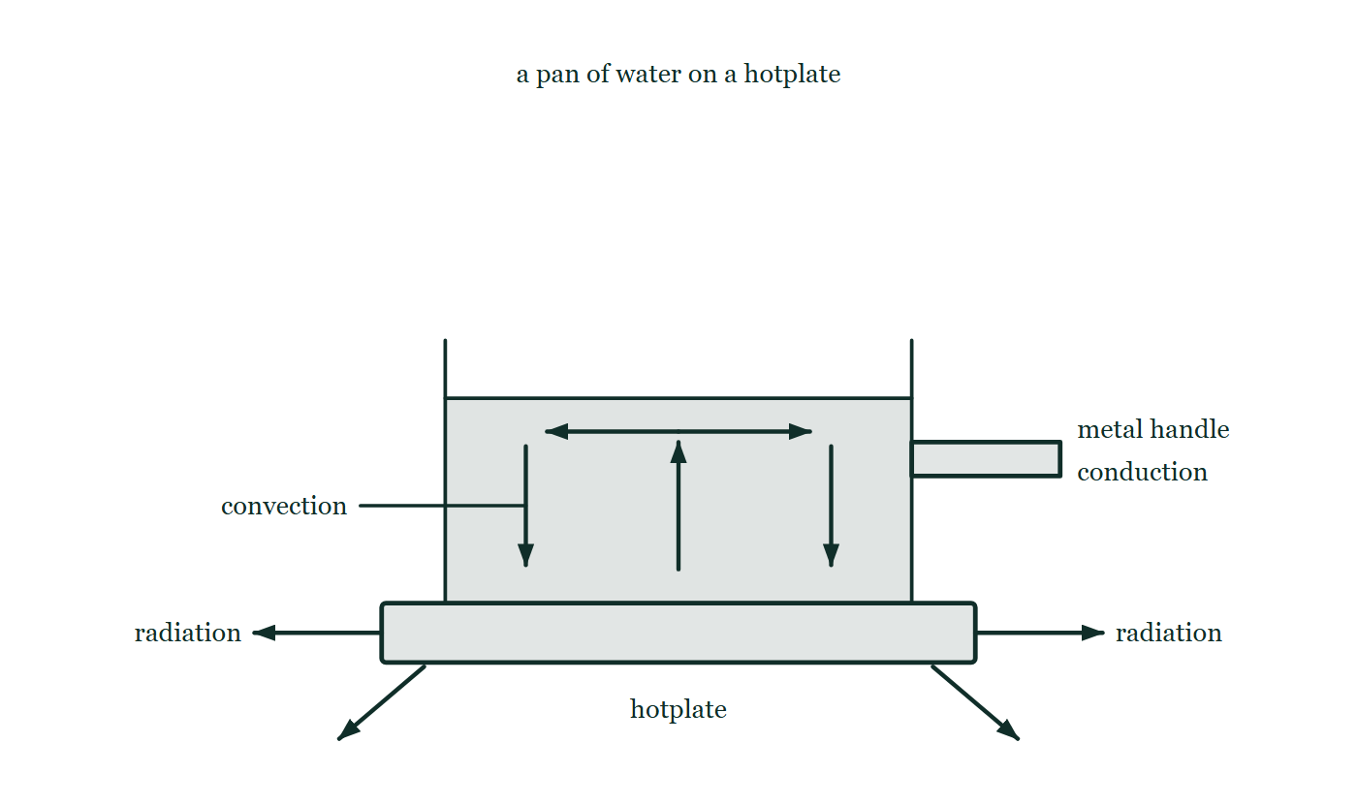
THERMODYNAMICS · CONDUCTION, CONVECTION & RADIATION
GIOPHYSICS LESSON
THE PICTURE
Three roads in one kitchen
Drawn for this lesson
A pan of water on a hotplate: a metal handle sticking out to the right labelled conduction, a loop of arrows inside the water rising in the middle and sinking at the sides labelled convection, and arrows leaving the hotplate sideways and downwards labelled radiation.
The live version of this figure — click here
Thermodynamics — Conduction, Convection & Radiation. Built by GioPhysics from the lesson's own copy; nothing on these slides is re-authored.
14 / 34
Notes:
[Phase] Build the model: The formulae, one at a time, in plain English (minutes 13–22 of 45)
[Figure] A pan of water on a hotplate: a metal handle sticking out to the right labelled conduction, a loop of arrows inside the water rising in the middle and sinking at the sides labelled convection, and arrows leaving the hotplate sideways and downwards labelled radiation.

Slide 15
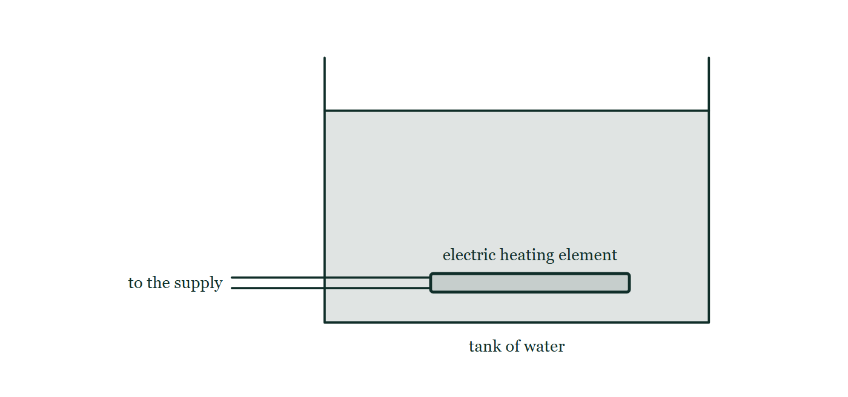
THERMODYNAMICS · CONDUCTION, CONVECTION & RADIATION
GIOPHYSICS LESSON
FIGURE 1 OF 2
Fig. 5.1 — IGCSE Topic 2 · Thermal physics
Drawn for question 5 of that paper · syllabus 2.3
A rectangular open-topped tank holds water to about four-fifths of its depth. A flat electric heating element lies horizontally inside the tank, well below the water surface and a short distance above the tank floor, spanning about half the width of the tank. Two leads run from the left-hand end of the element out through the side wall of the tank to the electricity supply.
See the question this was drawn for — click here
Thermodynamics — Conduction, Convection & Radiation. Built by GioPhysics from the lesson's own copy; nothing on these slides is re-authored.
15 / 34
Notes:
[Phase] Build the model: The formulae, one at a time, in plain English (minutes 13–22 of 45)
[Figure] Fig. 5.1. A rectangular open-topped tank holds water to about four-fifths of its depth. A flat electric heating element lies horizontally inside the tank, well below the water surface and a short distance above the tank floor, spanning about half the width of the tank. Two leads run from the left-hand end of the element out through the side wall of the tank to the electricity supply.
[Where it came from] IGCSE Topic 2 · Thermal physics, question 5; syllabus 2.3.

Slide 16
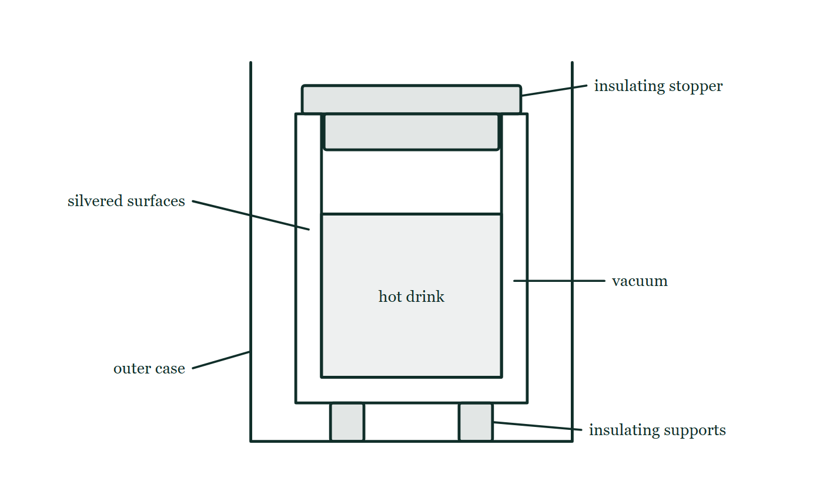
THERMODYNAMICS · CONDUCTION, CONVECTION & RADIATION
GIOPHYSICS LESSON
FIGURE 2 OF 2
Fig. 9.1 — IGCSE Topic 2 · Thermal physics
Drawn for question 9 of that paper · syllabus 2.3
A cut-away view of a vacuum flask. Inside an outer case stands a double-walled glass container, sealed at the neck, with a narrow gap between the two walls that runs down both sides and under the base; the gap is labelled vacuum and the two facing glass surfaces are labelled silvered. Hot drink fills most of the inner container, an insulating stopper closes the neck at the top, and the glass container rests on small insulating supports standing on the floor of the outer case.
See the question this was drawn for — click here
Thermodynamics — Conduction, Convection & Radiation. Built by GioPhysics from the lesson's own copy; nothing on these slides is re-authored.
16 / 34
Notes:
[Phase] Build the model: The formulae, one at a time, in plain English (minutes 13–22 of 45)
[Figure] Fig. 9.1. A cut-away view of a vacuum flask. Inside an outer case stands a double-walled glass container, sealed at the neck, with a narrow gap between the two walls that runs down both sides and under the base; the gap is labelled vacuum and the two facing glass surfaces are labelled silvered. Hot drink fills most of the inner container, an insulating stopper closes the neck at the top, and the glass container rests on small insulating supports standing on the floor of the outer case.
[Where it came from] IGCSE Topic 2 · Thermal physics, question 9; syllabus 2.3.

Slide 17
THERMODYNAMICS · CONDUCTION, CONVECTION & RADIATION
GIOPHYSICS LESSON
WATCH OUT
The common trap
Check and misconception — The quick check and the trap
Radiation is not reserved for glowing-hot objects. Everything above absolute zero radiates — you emit about as much power as a bright light bulb, mostly at 9.4 μm. You don't cool to nothing because the room radiates back; the net flow is what a thermal camera photographs.
Thermodynamics — Conduction, Convection & Radiation. Built by GioPhysics from the lesson's own copy; nothing on these slides is re-authored.
17 / 34
Notes:
[Phase] Check and misconception: The quick check and the trap (minutes 35–41 of 45)
[Misconception] Radiation is not reserved for glowing-hot objects. Everything above absolute zero radiates — you emit about as much power as a bright light bulb, mostly at 9.4 μm. You don't cool to nothing because the room radiates back; the net flow is what a thermal camera photographs.

Slide 18
THERMODYNAMICS · CONDUCTION, CONVECTION & RADIATION
GIOPHYSICS LESSON
WORKED EXAMPLE 1 OF 2 · EASY
The question
Easy
Worked examples — I do, we do — one step revealed at a time
A window pane (k = 0.84 W/m·K) has area 2.0 m² and thickness 4.0 mm, with 15 K between its faces. Find the heat flow through it.
Thermodynamics — Conduction, Convection & Radiation. Built by GioPhysics from the lesson's own copy; nothing on these slides is re-authored.
18 / 34
Notes:
[Phase] Worked examples: I do, we do — one step revealed at a time (minutes 22–35 of 45)
[Question] A window pane (k = 0.84 W/m·K) has area 2.0 m² and thickness 4.0 mm, with 15 K between its faces. Find the heat flow through it.
[Answer] ≈ 6.3 kW

Slide 19
THERMODYNAMICS · CONDUCTION, CONVECTION & RADIATION
GIOPHYSICS LESSON
WORKED EXAMPLE 1 OF 2 · EASY · THE WORKING
How to solve it
Easy
Worked examples — I do, we do — one step revealed at a time
A window pane (k = 0.84 W/m·K) has area 2.0 m² and thickness 4.0 mm, with 15 K between its faces. Find the heat flow through it.
1.
Q/t = kAΔT/d = 0.84 × 2.0 × 15 ÷ 0.004.
2.
Q/t = 25.2 ÷ 0.004 = 6300 W — which is why double glazing traps an insulating air gap.
Thermodynamics — Conduction, Convection & Radiation. Built by GioPhysics from the lesson's own copy; nothing on these slides is re-authored.
19 / 34
Notes:
[Phase] Worked examples: I do, we do — one step revealed at a time (minutes 22–35 of 45)
[Reveal] One click per step. The class works each line before the next appears.
[Step 1] Q/t = kAΔT/d = 0.84 × 2.0 × 15 ÷ 0.004.
[Step 2] Q/t = 25.2 ÷ 0.004 = 6300 W — which is why double glazing traps an insulating air gap.

Slide 20
THERMODYNAMICS · CONDUCTION, CONVECTION & RADIATION
GIOPHYSICS LESSON
WORKED EXAMPLE 1 OF 2 · EASY
Answer
Easy
Worked examples — I do, we do — one step revealed at a time
≈ 6.3 kW
Thermodynamics — Conduction, Convection & Radiation. Built by GioPhysics from the lesson's own copy; nothing on these slides is re-authored.
20 / 34
Notes:
[Phase] Worked examples: I do, we do — one step revealed at a time (minutes 22–35 of 45)
[Answer] ≈ 6.3 kW

Slide 21
THERMODYNAMICS · CONDUCTION, CONVECTION & RADIATION
GIOPHYSICS LESSON
WORKED EXAMPLE 2 OF 2 · MEDIUM
The question
Medium
Worked examples — I do, we do — one step revealed at a time
Use Wien's law to find the peak wavelength of the sun's radiation (surface 5800 K) and of your own (skin ≈ 310 K).
Thermodynamics — Conduction, Convection & Radiation. Built by GioPhysics from the lesson's own copy; nothing on these slides is re-authored.
21 / 34
Notes:
[Phase] Worked examples: I do, we do — one step revealed at a time (minutes 22–35 of 45)
[Question] Use Wien's law to find the peak wavelength of the sun's radiation (surface 5800 K) and of your own (skin ≈ 310 K).
[Answer] Sun ≈ 500 nm; body ≈ 9.4 μm

Slide 22
THERMODYNAMICS · CONDUCTION, CONVECTION & RADIATION
GIOPHYSICS LESSON
WORKED EXAMPLE 2 OF 2 · MEDIUM · THE WORKING
How to solve it
Medium
Worked examples — I do, we do — one step revealed at a time
Use Wien's law to find the peak wavelength of the sun's radiation (surface 5800 K) and of your own (skin ≈ 310 K).
1.
Sun: λ(max) = 2.90 × 10⁻³ ÷ 5800 = 5.0 × 10⁻⁷ m = 500 nm — mid-visible, no coincidence for evolved eyes.
2.
You: λ(max) = 2.90 × 10⁻³ ÷ 310 ≈ 9.4 × 10⁻⁶ m = 9.4 μm.
3.
That is deep infrared — visible to thermal cameras, not to eyes.
Thermodynamics — Conduction, Convection & Radiation. Built by GioPhysics from the lesson's own copy; nothing on these slides is re-authored.
22 / 34
Notes:
[Phase] Worked examples: I do, we do — one step revealed at a time (minutes 22–35 of 45)
[Reveal] One click per step. The class works each line before the next appears.
[Step 1] Sun: λ(max) = 2.90 × 10⁻³ ÷ 5800 = 5.0 × 10⁻⁷ m = 500 nm — mid-visible, no coincidence for evolved eyes.
[Step 2] You: λ(max) = 2.90 × 10⁻³ ÷ 310 ≈ 9.4 × 10⁻⁶ m = 9.4 μm.
[Step 3] That is deep infrared — visible to thermal cameras, not to eyes.

Slide 23
THERMODYNAMICS · CONDUCTION, CONVECTION & RADIATION
GIOPHYSICS LESSON
WORKED EXAMPLE 2 OF 2 · MEDIUM
Answer
Medium
Worked examples — I do, we do — one step revealed at a time
Sun ≈ 500 nm; body ≈ 9.4 μm
Thermodynamics — Conduction, Convection & Radiation. Built by GioPhysics from the lesson's own copy; nothing on these slides is re-authored.
23 / 34
Notes:
[Phase] Worked examples: I do, we do — one step revealed at a time (minutes 22–35 of 45)
[Answer] Sun ≈ 500 nm; body ≈ 9.4 μm

Slide 24
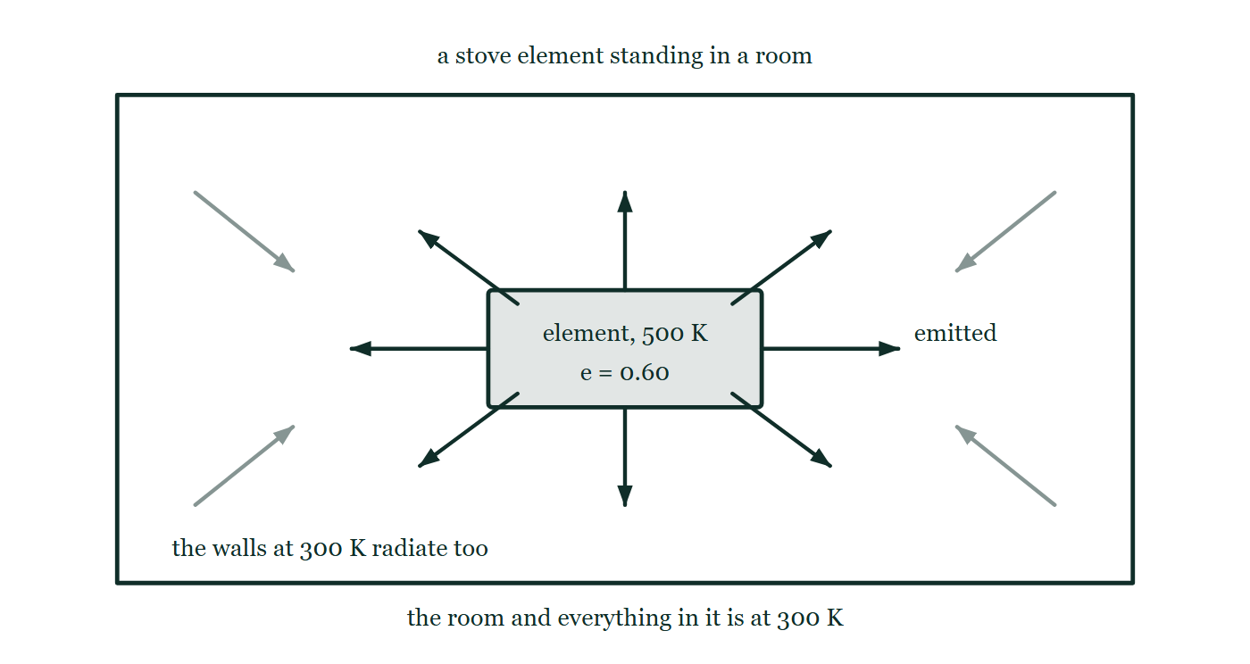
THERMODYNAMICS · CONDUCTION, CONVECTION & RADIATION
GIOPHYSICS LESSON
PREDICT · TAKE THE VOTE
Commit before you are told
Hands up for each option, then click
Switch this element off and let it cool to the room's own 300 K. What is it radiating then?
A Nothing — a cold object does not radiate
B Exactly what it radiated at 500 K; radiation does not depend on temperature
C Less than before, but far from nothing: it emits and absorbs equally, so only the NET is zero
A stove element at 500 K with emissivity 0.60 standing in a room, radiating along eight arrows in every direction, with four fainter arrows arriving back at it from walls marked at 300 K. Neither set of arrows carries a power.
The live version of this figure — click here
Thermodynamics — Conduction, Convection & Radiation. Built by GioPhysics from the lesson's own copy; nothing on these slides is re-authored.
24 / 34
Notes:
[Phase] Build the model: The formulae, one at a time, in plain English (minutes 13–22 of 45)
[Predict] Switch this element off and let it cool to the room's own 300 K. What is it radiating then?
[Options] A Nothing — a cold object does not radiate B Exactly what it radiated at 500 K; radiation does not depend on temperature C Less than before, but far from nothing: it emits and absorbs equally, so only the NET is zero
[Figure] A stove element at 500 K with emissivity 0.60 standing in a room, radiating along eight arrows in every direction, with four fainter arrows arriving back at it from walls marked at 300 K. Neither set of arrows carries a power.

Slide 25
THERMODYNAMICS · CONDUCTION, CONVECTION & RADIATION
GIOPHYSICS LESSON
PREDICT · THE OUTCOME
What actually happens
Ask the room who changed their mind, and why
C Less than before, but far from nothing: it emits and absorbs equally, so only the NET is zero
WHY
P = eσAT⁴ never reaches zero above absolute zero, and at 300 K this element is still radiating about 14 W. What has changed is that the walls at 300 K are sending it back the same 14 W, so nothing accumulates. 'Nothing happening' is two large flows in balance, which is exactly what thermal equilibrium is — and it is why a good absorber must also be a good emitter, or an object left in a room would drift away from the room's temperature all by itself.
Thermodynamics — Conduction, Convection & Radiation. Built by GioPhysics from the lesson's own copy; nothing on these slides is re-authored.
25 / 34
Notes:
[Phase] Build the model: The formulae, one at a time, in plain English (minutes 13–22 of 45)
[Answer] C — Less than before, but far from nothing: it emits and absorbs equally, so only the NET is zero. P = eσAT⁴ never reaches zero above absolute zero, and at 300 K this element is still radiating about 14 W. What has changed is that the walls at 300 K are sending it back the same 14 W, so nothing accumulates. 'Nothing happening' is two large flows in balance, which is exactly what thermal equilibrium is — and it is why a good absorber must also be a good emitter, or an object left in a room would drift away from the room's temperature all by itself.

Slide 26
THERMODYNAMICS · CONDUCTION, CONVECTION & RADIATION
GIOPHYSICS LESSON
QUICK CHECK
Decide before the answer goes up
Check and misconception — The quick check and the trap
A filament's absolute temperature is doubled. By what factor does its radiated power grow?
A
×2
B
×8
C
×16
A stove element at 500 K with emissivity 0.60 standing in a room, radiating along eight arrows in every direction, with four fainter arrows arriving back at it from walls marked at 300 K. Neither set of arrows carries a power.
The live version of this figure — click here
Thermodynamics — Conduction, Convection & Radiation. Built by GioPhysics from the lesson's own copy; nothing on these slides is re-authored.
26 / 34
Notes:
[Phase] Check and misconception: The quick check and the trap (minutes 35–41 of 45)
[Question] A filament's absolute temperature is doubled. By what factor does its radiated power grow?
[Figure] A stove element at 500 K with emissivity 0.60 standing in a room, radiating along eight arrows in every direction, with four fainter arrows arriving back at it from walls marked at 300 K. Neither set of arrows carries a power.
[Options] A ×2 B ×8 C ×16

Slide 27
THERMODYNAMICS · CONDUCTION, CONVECTION & RADIATION
GIOPHYSICS LESSON
QUICK CHECK · THE ANSWER
The answer, and why
Check and misconception — The quick check and the trap
C ×16
HOW TO GET THERE
P ∝ T⁴, so doubling T multiplies the power by 2⁴ = 16 — the fourth power is what makes hot things such fierce radiators.
WHY THE OTHERS TEMPT
A ×2 is the answer if the power were proportional to T. The exponent in P = eσAT⁴ is four, and that exponent is the reason a filament at 2500 K is blinding while the very same wire at 300 K cannot be seen at all.
B ×8 is 2³ — the cube rather than the fourth power. It is an easy slip, because volumes and inverse-square laws have trained the hand to write threes; Stefan–Boltzmann really is a fourth power.
C Correct. P ∝ T⁴, so doubling T multiplies the radiated power by 2⁴ = 16.
Thermodynamics — Conduction, Convection & Radiation. Built by GioPhysics from the lesson's own copy; nothing on these slides is re-authored.
27 / 34
Notes:
[Phase] Check and misconception: The quick check and the trap (minutes 35–41 of 45)
[Question] A filament's absolute temperature is doubled. By what factor does its radiated power grow?
[Option by option] A: ×2 is the answer if the power were proportional to T. The exponent in P = eσAT⁴ is four, and that exponent is the reason a filament at 2500 K is blinding while the very same wire at 300 K cannot be seen at all. B: ×8 is 2³ — the cube rather than the fourth power. It is an easy slip, because volumes and inverse-square laws have trained the hand to write threes; Stefan–Boltzmann really is a fourth power. C: Correct. P ∝ T⁴, so doubling T multiplies the radiated power by 2⁴ = 16.
[Answer] C — ×16
[Why] P ∝ T⁴, so doubling T multiplies the power by 2⁴ = 16 — the fourth power is what makes hot things such fierce radiators.
[Reveal] One click for the answer, then one for the reason.

Slide 28
THERMODYNAMICS · CONDUCTION, CONVECTION & RADIATION
GIOPHYSICS LESSON
EXTENSION 1 OF 2 · HARD
The question
Hard
Worked examples — I do, we do — one step revealed at a time
A stove element (e = 0.60, A = 0.050 m²) sits at 500 K in a 300 K kitchen. Find its emitted power, absorbed power, and net radiated output.
Thermodynamics — Conduction, Convection & Radiation. Built by GioPhysics from the lesson's own copy; nothing on these slides is re-authored.
28 / 34
Notes:
[Phase] Worked examples: I do, we do — one step revealed at a time (minutes 22–35 of 45)
[Question] A stove element (e = 0.60, A = 0.050 m²) sits at 500 K in a 300 K kitchen. Find its emitted power, absorbed power, and net radiated output.
[Answer] ≈ 106 W out, 14 W back in, net ≈ 92 W

Slide 29
THERMODYNAMICS · CONDUCTION, CONVECTION & RADIATION
GIOPHYSICS LESSON
EXTENSION 1 OF 2 · HARD · THE WORKING
How to solve it
Hard
Worked examples — I do, we do — one step revealed at a time
A stove element (e = 0.60, A = 0.050 m²) sits at 500 K in a 300 K kitchen. Find its emitted power, absorbed power, and net radiated output.
1.
Emitted: P = eσAT⁴ = 0.60 × 5.67 × 10⁻⁸ × 0.050 × 500⁴ ≈ 106 W.
2.
Absorbed from the room: same formula with 300⁴ ≈ 13.8 W.
3.
Net: P(net) = eσA(500⁴ − 300⁴) ≈ 106 − 14 = 92 W.
Thermodynamics — Conduction, Convection & Radiation. Built by GioPhysics from the lesson's own copy; nothing on these slides is re-authored.
29 / 34
Notes:
[Phase] Worked examples: I do, we do — one step revealed at a time (minutes 22–35 of 45)
[Reveal] One click per step. The class works each line before the next appears.
[Step 1] Emitted: P = eσAT⁴ = 0.60 × 5.67 × 10⁻⁸ × 0.050 × 500⁴ ≈ 106 W.
[Step 2] Absorbed from the room: same formula with 300⁴ ≈ 13.8 W.
[Step 3] Net: P(net) = eσA(500⁴ − 300⁴) ≈ 106 − 14 = 92 W.

Slide 30
THERMODYNAMICS · CONDUCTION, CONVECTION & RADIATION
GIOPHYSICS LESSON
EXTENSION 1 OF 2 · HARD
Answer
Hard
Worked examples — I do, we do — one step revealed at a time
≈ 106 W out, 14 W back in, net ≈ 92 W
Thermodynamics — Conduction, Convection & Radiation. Built by GioPhysics from the lesson's own copy; nothing on these slides is re-authored.
30 / 34
Notes:
[Phase] Worked examples: I do, we do — one step revealed at a time (minutes 22–35 of 45)
[Answer] ≈ 106 W out, 14 W back in, net ≈ 92 W

Slide 31
THERMODYNAMICS · CONDUCTION, CONVECTION & RADIATION
GIOPHYSICS LESSON
EXTENSION 2 OF 2 · CHALLENGING
The question
Challenging
Worked examples — I do, we do — one step revealed at a time
Sunlight reaches Earth at 1380 W/m² and the planet's albedo is 0.30. Predict Earth's temperature as a bare black-body radiator and compare with the measured 288 K.
Thermodynamics — Conduction, Convection & Radiation. Built by GioPhysics from the lesson's own copy; nothing on these slides is re-authored.
31 / 34
Notes:
[Phase] Worked examples: I do, we do — one step revealed at a time (minutes 22–35 of 45)
[Question] Sunlight reaches Earth at 1380 W/m² and the planet's albedo is 0.30. Predict Earth's temperature as a bare black-body radiator and compare with the measured 288 K.
[Answer] Bare-rock prediction ≈ 255 K; the greenhouse effect supplies the extra 33 K

Slide 32
THERMODYNAMICS · CONDUCTION, CONVECTION & RADIATION
GIOPHYSICS LESSON
EXTENSION 2 OF 2 · CHALLENGING · THE WORKING
How to solve it
Challenging
Worked examples — I do, we do — one step revealed at a time
Sunlight reaches Earth at 1380 W/m² and the planet's albedo is 0.30. Predict Earth's temperature as a bare black-body radiator and compare with the measured 288 K.
1.
Absorbed: the disc facing the sun collects P = 0.70 × 1380 × πR²; the whole sphere radiates σ4πR²T⁴.
2.
Balance: T⁴ = 0.70 × 1380 ÷ (4 × 5.67 × 10⁻⁸) = 4.26 × 10⁹, so T ≈ 255 K = −18 °C.
3.
Earth actually averages 288 K: the 33 K difference is the greenhouse effect — infrared re-radiated downward by CO₂, H₂O, CH₄ and N₂O.
Thermodynamics — Conduction, Convection & Radiation. Built by GioPhysics from the lesson's own copy; nothing on these slides is re-authored.
32 / 34
Notes:
[Phase] Worked examples: I do, we do — one step revealed at a time (minutes 22–35 of 45)
[Reveal] One click per step. The class works each line before the next appears.
[Step 1] Absorbed: the disc facing the sun collects P = 0.70 × 1380 × πR²; the whole sphere radiates σ4πR²T⁴.
[Step 2] Balance: T⁴ = 0.70 × 1380 ÷ (4 × 5.67 × 10⁻⁸) = 4.26 × 10⁹, so T ≈ 255 K = −18 °C.
[Step 3] Earth actually averages 288 K: the 33 K difference is the greenhouse effect — infrared re-radiated downward by CO₂, H₂O, CH₄ and N₂O.

Slide 33
THERMODYNAMICS · CONDUCTION, CONVECTION & RADIATION
GIOPHYSICS LESSON
EXTENSION 2 OF 2 · CHALLENGING
Answer
Challenging
Worked examples — I do, we do — one step revealed at a time
Bare-rock prediction ≈ 255 K; the greenhouse effect supplies the extra 33 K
Thermodynamics — Conduction, Convection & Radiation. Built by GioPhysics from the lesson's own copy; nothing on these slides is re-authored.
33 / 34
Notes:
[Phase] Worked examples: I do, we do — one step revealed at a time (minutes 22–35 of 45)
[Answer] Bare-rock prediction ≈ 255 K; the greenhouse effect supplies the extra 33 K

Slide 34
THERMODYNAMICS · CONDUCTION, CONVECTION & RADIATION
GIOPHYSICS LESSON
THERMODYNAMICS
Where to go next
Plenary — What to take away, what to practise next
Next
22.5 Energy Sources
https://giophysics.com/chapter-41/energy-sources/
Lesson
This lesson on giophysics.com
https://giophysics.com/chapter-41/thermal-energy-transfer/
Live
The live, interactive version of these slides
https://giophysics.com/chapter-41/presentation/?lesson=transfer
Chapter
All Thermodynamics lessons
https://giophysics.com/chapter-41/
PDF
Download the lesson PDF
https://giophysics.com/downloads/41-4-thermal-energy-transfer.pdf
Thermodynamics — Conduction, Convection & Radiation. Built by GioPhysics from the lesson's own copy; nothing on these slides is re-authored.
34 / 34
Notes:
[Phase] Plenary: What to take away, what to practise next (minutes 41–45 of 45)
[Interactive] The graphs and the circuit topology on these slides are frozen. The live version at https://giophysics.com/chapter-41/presentation/?lesson=transfer moves them.

