Slide 1
OSCILLATIONS · DAMPED OSCILLATIONS
GIOPHYSICS LESSON
23 · Oscillations
Every real oscillation dies
Damped Oscillations
Real oscillations die. Friction and drag skim energy off every cycle, and since amplitude is stored energy, the swing shrinks — usually exponentially. How fast it shrinks, and whether it oscillates at all, is a design decision engineers make every day.
POSITION
Lesson 3 of 6 in Oscillations
PLAN
16 slides in the 45-minute core run, about 45 minutes of it
LESSON PAGE
https://giophysics.com/chapter-45/damping/
Built by GioPhysics from the lesson's own page. Every word on these slides is the lesson's; nothing here is re-authored. Teaching material, not an awarding body's document.
Oscillations — Damped Oscillations. Built by GioPhysics from the lesson's own copy; nothing on these slides is re-authored.
1 / 32
Notes:
[Lesson] Oscillations — Damped Oscillations. Lesson 3 of 6.
[Intro] Real oscillations die. Friction and drag skim energy off every cycle, and since amplitude is stored energy, the swing shrinks — usually exponentially. How fast it shrinks, and whether it oscillates at all, is a design decision engineers make every day.
[Source] https://giophysics.com/chapter-45/damping/
[Disclaimer] Built by GioPhysics from the lesson's own page. Every word on these slides is the lesson's; nothing here is re-authored. Teaching material, not an awarding body's document.

Slide 2
OSCILLATIONS · DAMPED OSCILLATIONS
GIOPHYSICS LESSON
WHAT THIS NEEDS
What you already know
Starter — Recall what this lesson stands on
Recall
Energy in SHM
https://giophysics.com/chapter-45/shm-energy/
Recall
Energy conservation
https://giophysics.com/chapter-6/energy-conversion-conservation/
Oscillations — Damped Oscillations. Built by GioPhysics from the lesson's own copy; nothing on these slides is re-authored.
2 / 32
Notes:
[Phase] Starter: Recall what this lesson stands on (minutes 0–5 of 45)
[Starter] Recall: Energy in SHM; Energy conservation

Slide 3
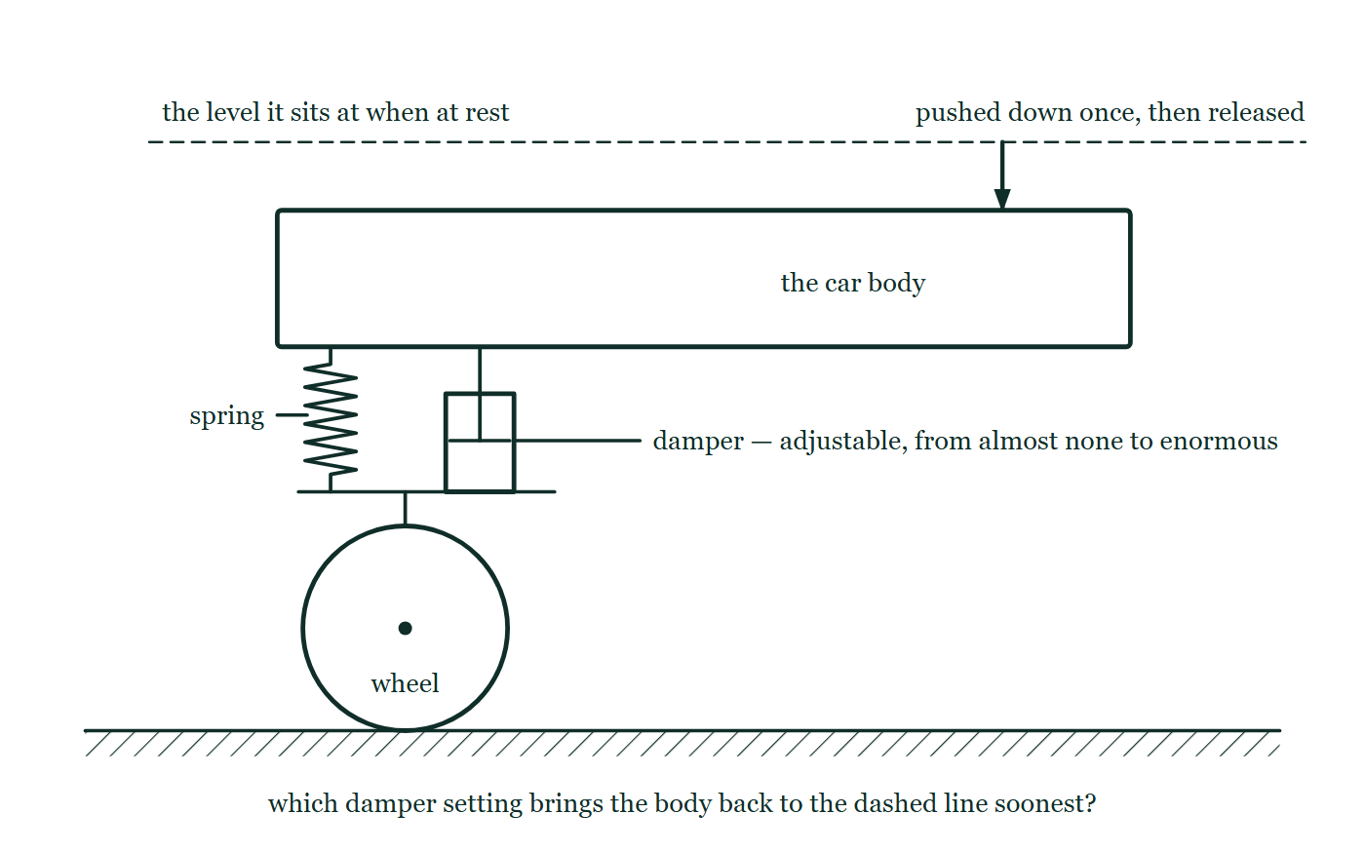
OSCILLATIONS · DAMPED OSCILLATIONS
GIOPHYSICS LESSON
THINK FIRST
Your car bounces twice over every bump. Would the heaviest, stiffest dampers money can buy give the smoothest ride?
Take answers before you click — the point is the commitment
Worn shock absorbers let a car wallow, and everyone knows the fix is better dampers. So the more damping the better — buy the strongest ones in the catalogue.
THE ANSWER
No. Damping speeds the settling up only as far as critical damping; past that the resistive force is so large that the body creeps back to level, and a wheel that cannot follow the road quickly enough loses grip between bumps. The fastest possible return with no overshoot happens at exactly one setting, and going beyond it makes things worse.
One wheel on the road with a coil spring and a damper side by side between the axle arm and the car body, the body drawn already pushed below the dashed line it rests at, and the damper labelled adjustable from almost none to enormous.
The live version of this figure — click here
Oscillations — Damped Oscillations. Built by GioPhysics from the lesson's own copy; nothing on these slides is re-authored.
3 / 32
Notes:
[Phase] Starter: Recall what this lesson stands on (minutes 0–5 of 45)
[Hook] Your car bounces twice over every bump. Would the heaviest, stiffest dampers money can buy give the smoothest ride? Worn shock absorbers let a car wallow, and everyone knows the fix is better dampers. So the more damping the better — buy the strongest ones in the catalogue.
[Answer] No. Damping speeds the settling up only as far as critical damping; past that the resistive force is so large that the body creeps back to level, and a wheel that cannot follow the road quickly enough loses grip between bumps. The fastest possible return with no overshoot happens at exactly one setting, and going beyond it makes things worse.
[Figure] One wheel on the road with a coil spring and a damper side by side between the axle arm and the car body, the body drawn already pushed below the dashed line it rests at, and the damper labelled adjustable from almost none to enormous.

Slide 4
OSCILLATIONS · DAMPED OSCILLATIONS
GIOPHYSICS LESSON
EXPLAINED SIMPLY
In one sentence
Introduce the idea — The big idea and the definition
Damping is the loss of an oscillator’s energy to resistive forces; light damping shrinks the amplitude exponentially, heavy damping prevents oscillation, and critical damping returns the system to equilibrium fastest without overshoot.
Oscillations — Damped Oscillations. Built by GioPhysics from the lesson's own copy; nothing on these slides is re-authored.
4 / 32
Notes:
[Phase] Introduce the idea: The big idea and the definition (minutes 5–13 of 45)
[Definition] Damping is the loss of an oscillator’s energy to resistive forces; light damping shrinks the amplitude exponentially, heavy damping prevents oscillation, and critical damping returns the system to equilibrium fastest without overshoot.

Slide 5
OSCILLATIONS · DAMPED OSCILLATIONS
GIOPHYSICS LESSON
EXPLAINED SIMPLY
What that looks like
Introduce the idea — The big idea and the definition
FOR EXAMPLE
Push down on a car’s corner and let go. Good shock absorbers give one smooth rise back to level — critical damping. Worn ones let the car bounce several times: the damping has gone light.
Oscillations — Damped Oscillations. Built by GioPhysics from the lesson's own copy; nothing on these slides is re-authored.
5 / 32
Notes:
[Phase] Introduce the idea: The big idea and the definition (minutes 5–13 of 45)
[Worked illustration] Push down on a car’s corner and let go. Good shock absorbers give one smooth rise back to level — critical damping. Worn ones let the car bounce several times: the damping has gone light.

Slide 6
OSCILLATIONS · DAMPED OSCILLATIONS
GIOPHYSICS LESSON
THE BIG IDEA
Every real oscillation dies
Introduce the idea — The big idea and the definition
Damping is a resistive force — friction, air drag, fluid in a shock absorber — that opposes the motion and drains the oscillator’s energy. Under light damping the system still oscillates at very nearly its natural frequency while the amplitude decays exponentially: each cycle loses the same fraction of what remains, so the envelope follows A e^(−γt). The Q factor counts roughly how many cycles the oscillation survives — 2π times the energy stored over the energy lost per cycle.
Heavy damping kills the oscillation entirely: the displaced system oozes back without ever crossing equilibrium. Critical damping sits exactly on the boundary — the fastest possible return with no overshoot — and it is what car suspensions and analogue meter needles are tuned for.
Oscillations — Damped Oscillations. Built by GioPhysics from the lesson's own copy; nothing on these slides is re-authored.
6 / 32
Notes:
[Phase] Introduce the idea: The big idea and the definition (minutes 5–13 of 45)
[Big idea] Damping is a resistive force — friction, air drag, fluid in a shock absorber — that opposes the motion and drains the oscillator’s energy. Under light damping the system still oscillates at very nearly its natural frequency while the amplitude decays exponentially: each cycle loses the same fraction of what remains, so the envelope follows A e^(−γt). The Q factor counts roughly how many cycles the oscillation survives — 2π times the energy stored over the energy lost per cycle. Heavy damping kills the oscillation entirely: the displaced system oozes back without ever crossing equilibrium. Critical damping sits exactly on the boundary — the fastest possible return with no overshoot — and it is what car suspensions and analogue meter needles are tuned for.

Slide 7
OSCILLATIONS · DAMPED OSCILLATIONS
GIOPHYSICS LESSON
THE PHYSICS · 1 OF 3
Why the decay is exponential
Build the model — The formulae, one at a time, in plain English
Drag is largest when the motion is fastest, so an energetic oscillation loses energy quickly and a feeble one slowly. Losing a fixed fraction per cycle is the signature of exponential decay — the same mathematics as radioactive half-lives and capacitor discharge. The amplitude never quite reaches zero; it just halves, and halves again.
Oscillations — Damped Oscillations. Built by GioPhysics from the lesson's own copy; nothing on these slides is re-authored.
7 / 32
Notes:
[Phase] Build the model: The formulae, one at a time, in plain English (minutes 13–22 of 45)
[Section] Drag is largest when the motion is fastest, so an energetic oscillation loses energy quickly and a feeble one slowly. Losing a fixed fraction per cycle is the signature of exponential decay — the same mathematics as radioactive half-lives and capacitor discharge. The amplitude never quite reaches zero; it just halves, and halves again.

Slide 8
OSCILLATIONS · DAMPED OSCILLATIONS
GIOPHYSICS LESSON
THE PHYSICS · 2 OF 3
Critical damping is a target, not a failure
Build the model — The formulae, one at a time, in plain English
A car that oscillated after every bump would be undriveable; one with damping far past critical would wallow back so slowly the wheel could leave the road. Critical damping — the least damping that prevents overshoot — returns the suspension to equilibrium in the shortest time. Meter needles, door closers, and building dampers chase the same sweet spot.
Oscillations — Damped Oscillations. Built by GioPhysics from the lesson's own copy; nothing on these slides is re-authored.
8 / 32
Notes:
[Phase] Build the model: The formulae, one at a time, in plain English (minutes 13–22 of 45)
[Section] A car that oscillated after every bump would be undriveable; one with damping far past critical would wallow back so slowly the wheel could leave the road. Critical damping — the least damping that prevents overshoot — returns the suspension to equilibrium in the shortest time. Meter needles, door closers, and building dampers chase the same sweet spot.

Slide 9
OSCILLATIONS · DAMPED OSCILLATIONS
GIOPHYSICS LESSON
THE PHYSICS · 3 OF 3
Energy accounting
Build the model — The formulae, one at a time, in plain English
Since E ∝ A², an envelope that halves the amplitude has quartered the energy. Q makes the accounting portable across systems: it compares energy stored with energy lost per cycle, so a high-Q oscillator (quartz crystal, Q ~ 10⁵) barely notices each cycle’s loss while a low-Q one (a swing dragging its feet, Q ~ a few) is dead within a handful of swings.
Oscillations — Damped Oscillations. Built by GioPhysics from the lesson's own copy; nothing on these slides is re-authored.
9 / 32
Notes:
[Phase] Build the model: The formulae, one at a time, in plain English (minutes 13–22 of 45)
[Section] Since E ∝ A², an envelope that halves the amplitude has quartered the energy. Q makes the accounting portable across systems: it compares energy stored with energy lost per cycle, so a high-Q oscillator (quartz crystal, Q ~ 10⁵) barely notices each cycle’s loss while a low-Q one (a swing dragging its feet, Q ~ a few) is dead within a handful of swings.

Slide 10
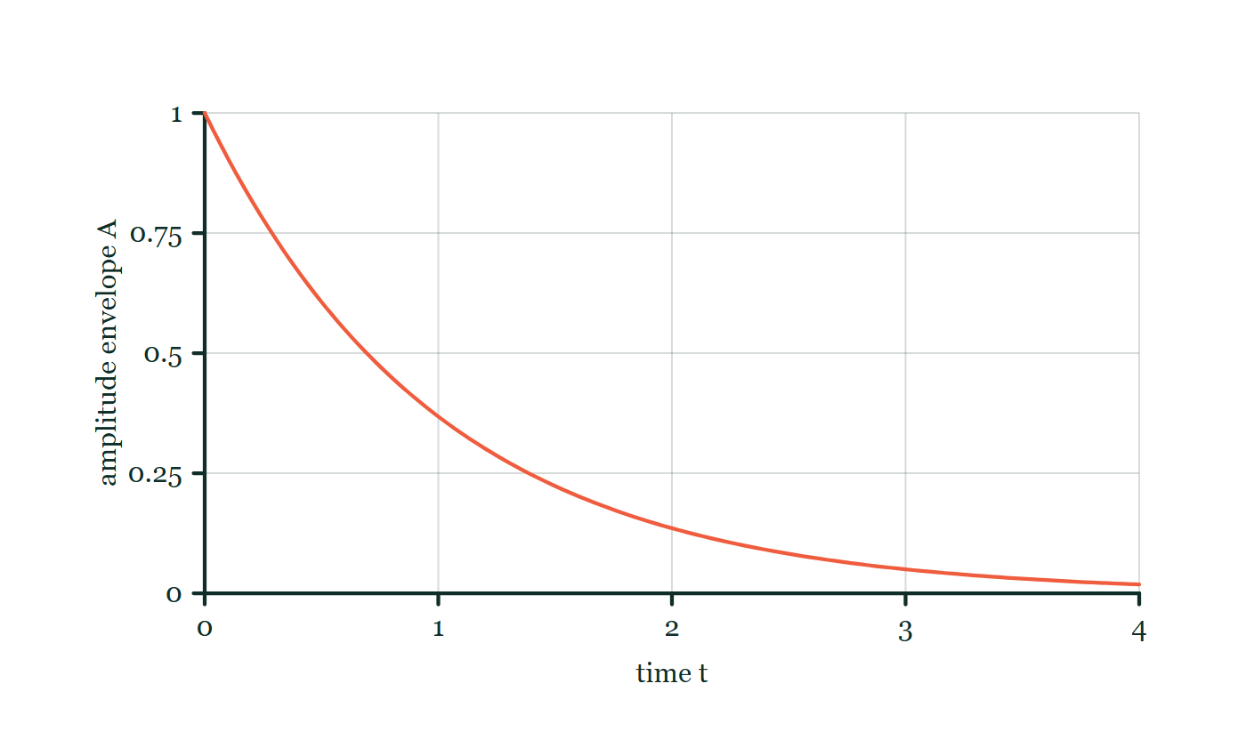
OSCILLATIONS · DAMPED OSCILLATIONS
GIOPHYSICS LESSON
FORMULA 1 OF 3
Exponential envelope
Build the model — The formulae, one at a time, in plain English
A(t) = A₀e^(−γt)
Equal times, equal fractions
IN PLAIN ENGLISH
Light damping removes a fixed fraction of the amplitude per cycle, so the peaks trace a decaying exponential. The oscillation keeps its frequency; only the size dies.
Damping envelope explorer
Move this graph on the live version — click here
Oscillations — Damped Oscillations. Built by GioPhysics from the lesson's own copy; nothing on these slides is re-authored.
10 / 32
Notes:
[Phase] Build the model: The formulae, one at a time, in plain English (minutes 13–22 of 45)
[Formula] Exponential envelope: A(t) = A₀e^(−γt)
[In plain English] Light damping removes a fixed fraction of the amplitude per cycle, so the peaks trace a decaying exponential. The oscillation keeps its frequency; only the size dies.
[Note] Equal times, equal fractions
[Graph] Damping envelope explorer. The oscillation amplitude is bounded by an exponentially decreasing envelope.
[Axes] Horizontal: time t. Vertical: amplitude envelope A. Values are normalised — the graph teaches the shape, not a measurement.

Slide 11
OSCILLATIONS · DAMPED OSCILLATIONS
GIOPHYSICS LESSON
FORMULA 2 OF 3
Quality factor
Build the model — The formulae, one at a time, in plain English
Q = 2π × E stored / E lost per cycle
High Q rings long; low Q dies fast
IN PLAIN ENGLISH
A dimensionless measure of how underdamped a system is — roughly the number of oscillations before the energy is substantially gone. A tuning fork manages thousands; a car suspension is designed for about one.
Oscillations — Damped Oscillations. Built by GioPhysics from the lesson's own copy; nothing on these slides is re-authored.
11 / 32
Notes:
[Phase] Build the model: The formulae, one at a time, in plain English (minutes 13–22 of 45)
[Formula] Quality factor: Q = 2π × E stored / E lost per cycle
[In plain English] A dimensionless measure of how underdamped a system is — roughly the number of oscillations before the energy is substantially gone. A tuning fork manages thousands; a car suspension is designed for about one.
[Note] High Q rings long; low Q dies fast

Slide 12
OSCILLATIONS · DAMPED OSCILLATIONS
GIOPHYSICS LESSON
FORMULA 3 OF 3
Three regimes
Build the model — The formulae, one at a time, in plain English
light · critical · heavy
Oscillates · fastest return · slow creep
IN PLAIN ENGLISH
Light damping: many shrinking cycles. Critical: equilibrium reached quickest with no overshoot. Heavy: no oscillation, just a slow ooze back — more damping past critical makes the return slower, not faster.
Oscillations — Damped Oscillations. Built by GioPhysics from the lesson's own copy; nothing on these slides is re-authored.
12 / 32
Notes:
[Phase] Build the model: The formulae, one at a time, in plain English (minutes 13–22 of 45)
[Formula] Three regimes: light · critical · heavy
[In plain English] Light damping: many shrinking cycles. Critical: equilibrium reached quickest with no overshoot. Heavy: no oscillation, just a slow ooze back — more damping past critical makes the return slower, not faster.
[Note] Oscillates · fastest return · slow creep

Slide 13
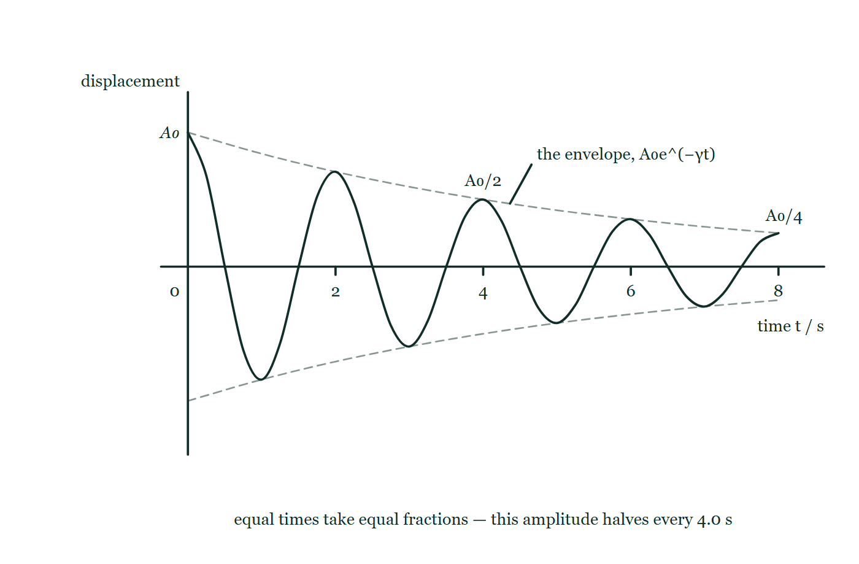
OSCILLATIONS · DAMPED OSCILLATIONS
GIOPHYSICS LESSON
THE PICTURE
Equal times, equal fractions
Drawn for this lesson
A decaying oscillation on a time axis running to 8.0 s, drawn inside a faint dashed envelope, with the crests at 0, 4.0 and 8.0 s marked A₀, A₀/2 and A₀/4 so the same fraction is plainly lost in each four-second stretch.
The live version of this figure — click here
Oscillations — Damped Oscillations. Built by GioPhysics from the lesson's own copy; nothing on these slides is re-authored.
13 / 32
Notes:
[Phase] Build the model: The formulae, one at a time, in plain English (minutes 13–22 of 45)
[Figure] A decaying oscillation on a time axis running to 8.0 s, drawn inside a faint dashed envelope, with the crests at 0, 4.0 and 8.0 s marked A₀, A₀/2 and A₀/4 so the same fraction is plainly lost in each four-second stretch.

Slide 14
OSCILLATIONS · DAMPED OSCILLATIONS
GIOPHYSICS LESSON
WATCH OUT
The common trap
Check and misconception — The quick check and the trap
More damping does not always mean a faster return to rest. Up to critical damping, yes — the oscillation dies sooner.
Past critical, the resistive force is so large that the system creeps back agonisingly slowly. The fastest possible settle is exactly at critical damping, which is why it is an engineering target rather than a maximum.
Oscillations — Damped Oscillations. Built by GioPhysics from the lesson's own copy; nothing on these slides is re-authored.
14 / 32
Notes:
[Phase] Check and misconception: The quick check and the trap (minutes 35–41 of 45)
[Misconception] More damping does not always mean a faster return to rest. Up to critical damping, yes — the oscillation dies sooner. Past critical, the resistive force is so large that the system creeps back agonisingly slowly. The fastest possible settle is exactly at critical damping, which is why it is an engineering target rather than a maximum.

Slide 15
OSCILLATIONS · DAMPED OSCILLATIONS
GIOPHYSICS LESSON
WORKED EXAMPLE 1 OF 2 · EASY
The question
Easy
Worked examples — I do, we do — one step revealed at a time
A pendulum’s amplitude falls from 12 cm to 6 cm in 20 s. Estimate its amplitude after a further 20 s of the same light damping.
Oscillations — Damped Oscillations. Built by GioPhysics from the lesson's own copy; nothing on these slides is re-authored.
15 / 32
Notes:
[Phase] Worked examples: I do, we do — one step revealed at a time (minutes 22–35 of 45)
[Question] A pendulum’s amplitude falls from 12 cm to 6 cm in 20 s. Estimate its amplitude after a further 20 s of the same light damping.
[Answer] ≈ 3 cm

Slide 16
OSCILLATIONS · DAMPED OSCILLATIONS
GIOPHYSICS LESSON
WORKED EXAMPLE 1 OF 2 · EASY · THE WORKING
How to solve it
Easy
Worked examples — I do, we do — one step revealed at a time
A pendulum’s amplitude falls from 12 cm to 6 cm in 20 s. Estimate its amplitude after a further 20 s of the same light damping.
1.
Exponential decay loses the same fraction in equal times.
2.
The first 20 s halved the amplitude, so the next 20 s halves it again: 6 → 3 cm.
Oscillations — Damped Oscillations. Built by GioPhysics from the lesson's own copy; nothing on these slides is re-authored.
16 / 32
Notes:
[Phase] Worked examples: I do, we do — one step revealed at a time (minutes 22–35 of 45)
[Reveal] One click per step. The class works each line before the next appears.
[Step 1] Exponential decay loses the same fraction in equal times.
[Step 2] The first 20 s halved the amplitude, so the next 20 s halves it again: 6 → 3 cm.

Slide 17
OSCILLATIONS · DAMPED OSCILLATIONS
GIOPHYSICS LESSON
WORKED EXAMPLE 1 OF 2 · EASY
Answer
Easy
Worked examples — I do, we do — one step revealed at a time
≈ 3 cm
Oscillations — Damped Oscillations. Built by GioPhysics from the lesson's own copy; nothing on these slides is re-authored.
17 / 32
Notes:
[Phase] Worked examples: I do, we do — one step revealed at a time (minutes 22–35 of 45)
[Answer] ≈ 3 cm

Slide 18
OSCILLATIONS · DAMPED OSCILLATIONS
GIOPHYSICS LESSON
WORKED EXAMPLE 2 OF 2 · MEDIUM
The question
Medium
Worked examples — I do, we do — one step revealed at a time
That same halving costs energy. What fraction of the pendulum’s original energy remains after the full 40 s?
Oscillations — Damped Oscillations. Built by GioPhysics from the lesson's own copy; nothing on these slides is re-authored.
18 / 32
Notes:
[Phase] Worked examples: I do, we do — one step revealed at a time (minutes 22–35 of 45)
[Question] That same halving costs energy. What fraction of the pendulum’s original energy remains after the full 40 s?
[Answer] 1/16 of the original energy (≈ 6%)

Slide 19
OSCILLATIONS · DAMPED OSCILLATIONS
GIOPHYSICS LESSON
WORKED EXAMPLE 2 OF 2 · MEDIUM · THE WORKING
How to solve it
Medium
Worked examples — I do, we do — one step revealed at a time
That same halving costs energy. What fraction of the pendulum’s original energy remains after the full 40 s?
1.
Amplitude after 40 s is 12/4 = 3 cm — a quarter of the start.
2.
E ∝ A², so E/E₀ = (1/4)² = 1/16 ≈ 6%.
3.
Half the energy story hides in the square: modest amplitude decay is savage energy decay.
Oscillations — Damped Oscillations. Built by GioPhysics from the lesson's own copy; nothing on these slides is re-authored.
19 / 32
Notes:
[Phase] Worked examples: I do, we do — one step revealed at a time (minutes 22–35 of 45)
[Reveal] One click per step. The class works each line before the next appears.
[Step 1] Amplitude after 40 s is 12/4 = 3 cm — a quarter of the start.
[Step 2] E ∝ A², so E/E₀ = (1/4)² = 1/16 ≈ 6%.
[Step 3] Half the energy story hides in the square: modest amplitude decay is savage energy decay.

Slide 20
OSCILLATIONS · DAMPED OSCILLATIONS
GIOPHYSICS LESSON
WORKED EXAMPLE 2 OF 2 · MEDIUM
Answer
Medium
Worked examples — I do, we do — one step revealed at a time
1/16 of the original energy (≈ 6%)
Oscillations — Damped Oscillations. Built by GioPhysics from the lesson's own copy; nothing on these slides is re-authored.
20 / 32
Notes:
[Phase] Worked examples: I do, we do — one step revealed at a time (minutes 22–35 of 45)
[Answer] 1/16 of the original energy (≈ 6%)

Slide 21
OSCILLATIONS · DAMPED OSCILLATIONS
GIOPHYSICS LESSON
SPOT THE MISTAKE
One line here is wrong
The whole working is up — find the bad line before you click
1.
A pendulum's amplitude falls from 12 cm to 6 cm in 20 s. What fraction of its energy is left after 40 s of the same damping?
2.
Equal times lose equal fractions, so the next 20 s halves it again: 6 cm → 3 cm.
3.
The amplitude after 40 s is a quarter of what it started at.
4.
Energy is proportional to amplitude, so a quarter of the energy is left.
5.
About 25% remains after 40 s.
LINE 4 IS WRONG
Energy goes as the square of the amplitude, not as the amplitude. This is the single most expensive line in the chapter, because everything before it is right and the answer it produces is comfortably plausible. Squaring turns a modest-looking amplitude decay into a savage energy decay: a quarter of the amplitude is a sixteenth of the energy.
IT SHOULD SAY
Energy is proportional to amplitude squared, so E/E₀ = (¼)² = 1/16, about 6%.
Oscillations — Damped Oscillations. Built by GioPhysics from the lesson's own copy; nothing on these slides is re-authored.
21 / 32
Notes:
[Phase] Worked examples: I do, we do — one step revealed at a time (minutes 22–35 of 45)
[Spot the mistake] The working is complete and one line of it is wrong. Let the room hunt: one click names the line, a second shows it done correctly.
[Line 4 is wrong] Energy goes as the square of the amplitude, not as the amplitude. This is the single most expensive line in the chapter, because everything before it is right and the answer it produces is comfortably plausible. Squaring turns a modest-looking amplitude decay into a savage energy decay: a quarter of the amplitude is a sixteenth of the energy.
[It should say] Energy is proportional to amplitude squared, so E/E₀ = (¼)² = 1/16, about 6%.

Slide 22
OSCILLATIONS · DAMPED OSCILLATIONS
GIOPHYSICS LESSON
PREDICT · TAKE THE VOTE
Commit before you are told
Hands up for each option, then click
The body has been pushed down and released. Which damper setting gets it back to the dashed line in the shortest time?
A The heaviest setting — the most resistance to the motion
B The setting just heavy enough to stop it overshooting
C The lightest setting — the least resistance to the return
One wheel on the road with a coil spring and a damper side by side between the axle arm and the car body, the body drawn already pushed below the dashed line it rests at, and the damper labelled adjustable from almost none to enormous.
The live version of this figure — click here
Oscillations — Damped Oscillations. Built by GioPhysics from the lesson's own copy; nothing on these slides is re-authored.
22 / 32
Notes:
[Phase] Build the model: The formulae, one at a time, in plain English (minutes 13–22 of 45)
[Predict] The body has been pushed down and released. Which damper setting gets it back to the dashed line in the shortest time?
[Options] A The heaviest setting — the most resistance to the motion B The setting just heavy enough to stop it overshooting C The lightest setting — the least resistance to the return
[Figure] One wheel on the road with a coil spring and a damper side by side between the axle arm and the car body, the body drawn already pushed below the dashed line it rests at, and the damper labelled adjustable from almost none to enormous.

Slide 23
OSCILLATIONS · DAMPED OSCILLATIONS
GIOPHYSICS LESSON
PREDICT · THE OUTCOME
What actually happens
Ask the room who changed their mind, and why
B The setting just heavy enough to stop it overshooting
WHY
That setting is critical damping, and it is a boundary rather than a maximum. Lighter than it, the body sails past level and comes back — several times, which is the worn-shock-absorber ride. Heavier than it, the same resistance that prevents the overshoot also fights the return, and the body oozes back slowly. The quickest settle sits exactly on the line between the two, which is why it is an engineering target for suspensions, meter needles and door closers alike.
Oscillations — Damped Oscillations. Built by GioPhysics from the lesson's own copy; nothing on these slides is re-authored.
23 / 32
Notes:
[Phase] Build the model: The formulae, one at a time, in plain English (minutes 13–22 of 45)
[Answer] B — The setting just heavy enough to stop it overshooting. That setting is critical damping, and it is a boundary rather than a maximum. Lighter than it, the body sails past level and comes back — several times, which is the worn-shock-absorber ride. Heavier than it, the same resistance that prevents the overshoot also fights the return, and the body oozes back slowly. The quickest settle sits exactly on the line between the two, which is why it is an engineering target for suspensions, meter needles and door closers alike.

Slide 24
OSCILLATIONS · DAMPED OSCILLATIONS
GIOPHYSICS LESSON
QUICK CHECK
Decide before the answer goes up
Check and misconception — The quick check and the trap
A lightly damped oscillator loses half its amplitude every 4.0 s. After 8.0 s, its energy is…
A
Half the original
B
A quarter of the original
C
A sixteenth of the original
Oscillations — Damped Oscillations. Built by GioPhysics from the lesson's own copy; nothing on these slides is re-authored.
24 / 32
Notes:
[Phase] Check and misconception: The quick check and the trap (minutes 35–41 of 45)
[Question] A lightly damped oscillator loses half its amplitude every 4.0 s. After 8.0 s, its energy is…
[Options] A Half the original B A quarter of the original C A sixteenth of the original

Slide 25
OSCILLATIONS · DAMPED OSCILLATIONS
GIOPHYSICS LESSON
QUICK CHECK · THE ANSWER
The answer, and why
Check and misconception — The quick check and the trap
C A sixteenth of the original
HOW TO GET THERE
After 8 s the amplitude has halved twice: A/4. Energy goes as A², so E = (1/4)² = 1/16 of the original.
WHY THE OTHERS TEMPT
A Half is what the amplitude does in the first 4.0 s — the first halving of the envelope, read as though it were the energy, and with the second four seconds forgotten as well. Two things need doing here: run the halving twice, then square it.
B A quarter is the amplitude after 8.0 s, and the figure marks it as A₀/4. It is the right intermediate step in the wrong units: energy is not amplitude.
C Correct. Two halvings take the amplitude to A₀/4, and energy goes as amplitude squared, so E = (¼)² = 1/16 of what it started with.
Oscillations — Damped Oscillations. Built by GioPhysics from the lesson's own copy; nothing on these slides is re-authored.
25 / 32
Notes:
[Phase] Check and misconception: The quick check and the trap (minutes 35–41 of 45)
[Question] A lightly damped oscillator loses half its amplitude every 4.0 s. After 8.0 s, its energy is…
[Option by option] A: Half is what the amplitude does in the first 4.0 s — the first halving of the envelope, read as though it were the energy, and with the second four seconds forgotten as well. Two things need doing here: run the halving twice, then square it. B: A quarter is the amplitude after 8.0 s, and the figure marks it as A₀/4. It is the right intermediate step in the wrong units: energy is not amplitude. C: Correct. Two halvings take the amplitude to A₀/4, and energy goes as amplitude squared, so E = (¼)² = 1/16 of what it started with.
[Answer] C — A sixteenth of the original
[Why] After 8 s the amplitude has halved twice: A/4. Energy goes as A², so E = (1/4)² = 1/16 of the original.
[Reveal] One click for the answer, then one for the reason.

Slide 26
OSCILLATIONS · DAMPED OSCILLATIONS
GIOPHYSICS LESSON
EXTENSION 1 OF 2 · HARD
The question
Hard
Worked examples — I do, we do — one step revealed at a time
An oscillator stores 0.80 J and loses 0.025 J per cycle. Find its Q factor, and estimate how many cycles pass before the energy falls below half.
Oscillations — Damped Oscillations. Built by GioPhysics from the lesson's own copy; nothing on these slides is re-authored.
26 / 32
Notes:
[Phase] Worked examples: I do, we do — one step revealed at a time (minutes 22–35 of 45)
[Question] An oscillator stores 0.80 J and loses 0.025 J per cycle. Find its Q factor, and estimate how many cycles pass before the energy falls below half.
[Answer] Q ≈ 200; roughly 22 cycles to half energy

Slide 27
OSCILLATIONS · DAMPED OSCILLATIONS
GIOPHYSICS LESSON
EXTENSION 1 OF 2 · HARD · THE WORKING
How to solve it
Hard
Worked examples — I do, we do — one step revealed at a time
An oscillator stores 0.80 J and loses 0.025 J per cycle. Find its Q factor, and estimate how many cycles pass before the energy falls below half.
1.
Q = 2π × E/ΔE = 2π × 0.80/0.025 ≈ 200.
2.
Each cycle keeps the fraction 1 − 1/32 ≈ 0.969.
3.
0.969ⁿ = 0.5 → n ≈ ln 0.5 / ln 0.969 ≈ 22 cycles.
Oscillations — Damped Oscillations. Built by GioPhysics from the lesson's own copy; nothing on these slides is re-authored.
27 / 32
Notes:
[Phase] Worked examples: I do, we do — one step revealed at a time (minutes 22–35 of 45)
[Reveal] One click per step. The class works each line before the next appears.
[Step 1] Q = 2π × E/ΔE = 2π × 0.80/0.025 ≈ 200.
[Step 2] Each cycle keeps the fraction 1 − 1/32 ≈ 0.969.
[Step 3] 0.969ⁿ = 0.5 → n ≈ ln 0.5 / ln 0.969 ≈ 22 cycles.

Slide 28
OSCILLATIONS · DAMPED OSCILLATIONS
GIOPHYSICS LESSON
EXTENSION 1 OF 2 · HARD
Answer
Hard
Worked examples — I do, we do — one step revealed at a time
Q ≈ 200; roughly 22 cycles to half energy
Oscillations — Damped Oscillations. Built by GioPhysics from the lesson's own copy; nothing on these slides is re-authored.
28 / 32
Notes:
[Phase] Worked examples: I do, we do — one step revealed at a time (minutes 22–35 of 45)
[Answer] Q ≈ 200; roughly 22 cycles to half energy

Slide 29
OSCILLATIONS · DAMPED OSCILLATIONS
GIOPHYSICS LESSON
EXTENSION 2 OF 2 · CHALLENGING
The question
Challenging
Worked examples — I do, we do — one step revealed at a time
A 1200 kg car sits on suspension with total stiffness k = 48 000 N m⁻¹. Find the natural frequency, and explain why the dampers are tuned near critical rather than as heavy as possible.
Oscillations — Damped Oscillations. Built by GioPhysics from the lesson's own copy; nothing on these slides is re-authored.
29 / 32
Notes:
[Phase] Worked examples: I do, we do — one step revealed at a time (minutes 22–35 of 45)
[Question] A 1200 kg car sits on suspension with total stiffness k = 48 000 N m⁻¹. Find the natural frequency, and explain why the dampers are tuned near critical rather than as heavy as possible.
[Answer] f ≈ 1.0 Hz; critical damping gives the fastest no-overshoot return, so heavier is worse

Slide 30
OSCILLATIONS · DAMPED OSCILLATIONS
GIOPHYSICS LESSON
EXTENSION 2 OF 2 · CHALLENGING · THE WORKING
How to solve it
Challenging
Worked examples — I do, we do — one step revealed at a time
A 1200 kg car sits on suspension with total stiffness k = 48 000 N m⁻¹. Find the natural frequency, and explain why the dampers are tuned near critical rather than as heavy as possible.
1.
ω₀ = √(k/m) = √(48 000/1200) = √40 ≈ 6.3 rad s⁻¹ → f ≈ 1.0 Hz — the classic ride frequency.
2.
Underdamped: the body would bounce on at 1 Hz after every bump. Overdamped: the wheel returns so slowly it can lose road contact before the next bump.
3.
Critical damping returns the body to level in the shortest time with no overshoot — the design target for shock absorbers.
Oscillations — Damped Oscillations. Built by GioPhysics from the lesson's own copy; nothing on these slides is re-authored.
30 / 32
Notes:
[Phase] Worked examples: I do, we do — one step revealed at a time (minutes 22–35 of 45)
[Reveal] One click per step. The class works each line before the next appears.
[Step 1] ω₀ = √(k/m) = √(48 000/1200) = √40 ≈ 6.3 rad s⁻¹ → f ≈ 1.0 Hz — the classic ride frequency.
[Step 2] Underdamped: the body would bounce on at 1 Hz after every bump. Overdamped: the wheel returns so slowly it can lose road contact before the next bump.
[Step 3] Critical damping returns the body to level in the shortest time with no overshoot — the design target for shock absorbers.

Slide 31
OSCILLATIONS · DAMPED OSCILLATIONS
GIOPHYSICS LESSON
EXTENSION 2 OF 2 · CHALLENGING
Answer
Challenging
Worked examples — I do, we do — one step revealed at a time
f ≈ 1.0 Hz; critical damping gives the fastest no-overshoot return, so heavier is worse
Oscillations — Damped Oscillations. Built by GioPhysics from the lesson's own copy; nothing on these slides is re-authored.
31 / 32
Notes:
[Phase] Worked examples: I do, we do — one step revealed at a time (minutes 22–35 of 45)
[Answer] f ≈ 1.0 Hz; critical damping gives the fastest no-overshoot return, so heavier is worse

Slide 32
OSCILLATIONS · DAMPED OSCILLATIONS
GIOPHYSICS LESSON
OSCILLATIONS
Where to go next
Plenary — What to take away, what to practise next
Next
23.4 Forced Oscillations & Resonance
https://giophysics.com/chapter-45/resonance/
Lesson
This lesson on giophysics.com
https://giophysics.com/chapter-45/damping/
Live
The live, interactive version of these slides
https://giophysics.com/chapter-45/presentation/?lesson=damping
Chapter
All Oscillations lessons
https://giophysics.com/chapter-45/
PDF
Download the lesson PDF
https://giophysics.com/downloads/45-3-damping.pdf
Oscillations — Damped Oscillations. Built by GioPhysics from the lesson's own copy; nothing on these slides is re-authored.
32 / 32
Notes:
[Phase] Plenary: What to take away, what to practise next (minutes 41–45 of 45)
[Interactive] The graphs and the circuit topology on these slides are frozen. The live version at https://giophysics.com/chapter-45/presentation/?lesson=damping moves them.

