Slide 1
OSCILLATIONS · ENERGY IN SHM
GIOPHYSICS LESSON
23 · Oscillations
Kinetic and potential trade places
Energy in SHM
A pendulum trades height for speed and speed for height, over and over, spending the same energy budget forever. In SHM that trade is exact: kinetic and potential energy slosh back and forth while their sum never moves.
POSITION
Lesson 2 of 6 in Oscillations
PLAN
16 slides in the 45-minute core run, about 44.5 minutes of it
LESSON PAGE
https://giophysics.com/chapter-45/shm-energy/
Built by GioPhysics from the lesson's own page. Every word on these slides is the lesson's; nothing here is re-authored. Teaching material, not an awarding body's document.
Oscillations — Energy in SHM. Built by GioPhysics from the lesson's own copy; nothing on these slides is re-authored.
1 / 33
Notes:
[Lesson] Oscillations — Energy in SHM. Lesson 2 of 6.
[Intro] A pendulum trades height for speed and speed for height, over and over, spending the same energy budget forever. In SHM that trade is exact: kinetic and potential energy slosh back and forth while their sum never moves.
[Source] https://giophysics.com/chapter-45/shm-energy/
[Disclaimer] Built by GioPhysics from the lesson's own page. Every word on these slides is the lesson's; nothing here is re-authored. Teaching material, not an awarding body's document.

Slide 2
OSCILLATIONS · ENERGY IN SHM
GIOPHYSICS LESSON
WHAT THIS NEEDS
What you already know
Starter — Recall what this lesson stands on
Recall
Kinetic energy
https://giophysics.com/chapter-6/kinetic-energy/
Recall
Elastic potential energy
https://giophysics.com/chapter-6/elastic-potential-energy/
Oscillations — Energy in SHM. Built by GioPhysics from the lesson's own copy; nothing on these slides is re-authored.
2 / 33
Notes:
[Phase] Starter: Recall what this lesson stands on (minutes 0–5 of 45)
[Starter] Recall: Kinetic energy; Elastic potential energy

Slide 3
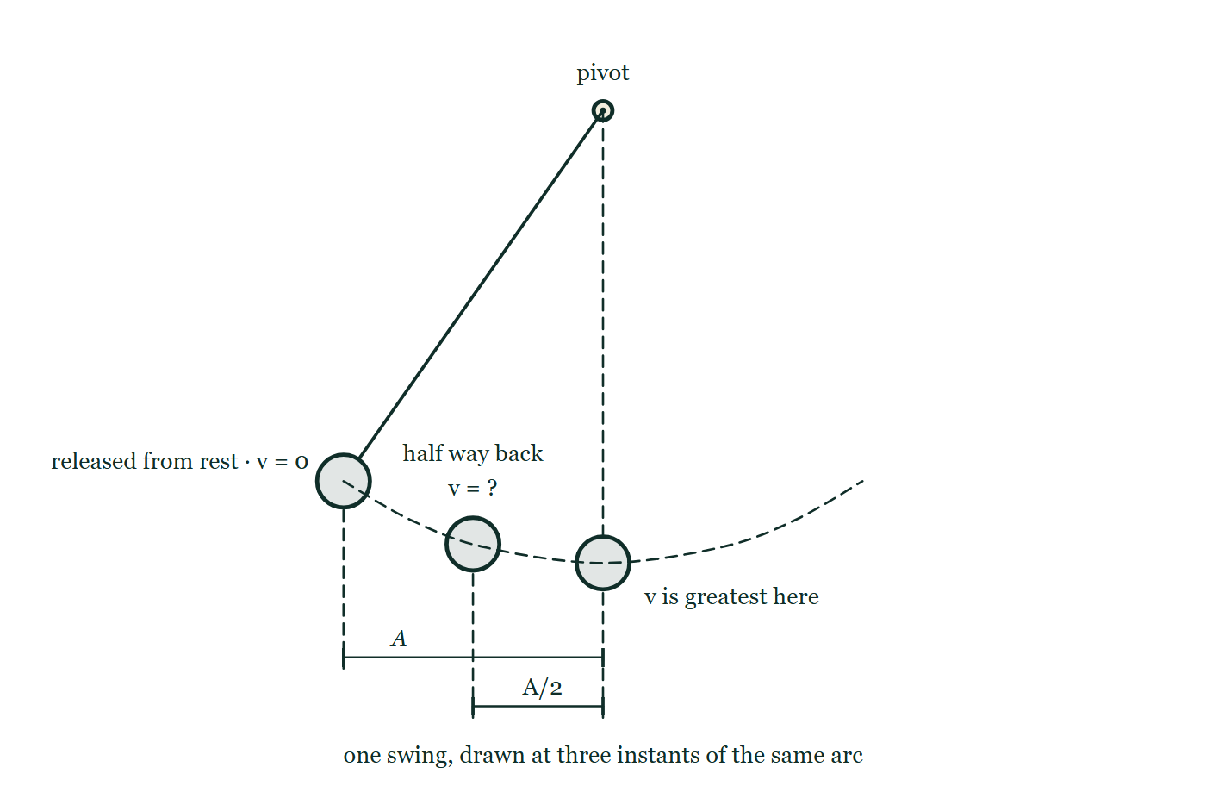
OSCILLATIONS · ENERGY IN SHM
GIOPHYSICS LESSON
THINK FIRST
You pump a swing until the arc is twice as wide. What else has doubled?
Take answers before you click — the point is the commitment
Same swing, same child, same rope. The only thing you changed is how far it goes out on each side, and it plainly goes faster through the bottom than it used to.
THE ANSWER
The top speed, and nothing else. v(max) = ωA is proportional to the amplitude, so twice the arc is twice the speed at the bottom — but the energy you had to put in went as ½mω²A², so it took four times as much. Doubling an oscillation is not a doubling of everything about it.
A pendulum drawn at three points of a single arc: held at the extreme with the velocity marked zero, half way back with the velocity left as a question mark, and at the lowest point of the dashed arc where it is fastest, with A and A/2 dimensioned below.
The live version of this figure — click here
Oscillations — Energy in SHM. Built by GioPhysics from the lesson's own copy; nothing on these slides is re-authored.
3 / 33
Notes:
[Phase] Starter: Recall what this lesson stands on (minutes 0–5 of 45)
[Hook] You pump a swing until the arc is twice as wide. What else has doubled? Same swing, same child, same rope. The only thing you changed is how far it goes out on each side, and it plainly goes faster through the bottom than it used to.
[Answer] The top speed, and nothing else. v(max) = ωA is proportional to the amplitude, so twice the arc is twice the speed at the bottom — but the energy you had to put in went as ½mω²A², so it took four times as much. Doubling an oscillation is not a doubling of everything about it.
[Figure] A pendulum drawn at three points of a single arc: held at the extreme with the velocity marked zero, half way back with the velocity left as a question mark, and at the lowest point of the dashed arc where it is fastest, with A and A/2 dimensioned below.

Slide 4
OSCILLATIONS · ENERGY IN SHM
GIOPHYSICS LESSON
EXPLAINED SIMPLY
In one sentence
Introduce the idea — The big idea and the definition
In SHM the total energy E = ½mω²A² is constant; it is fully potential at the extremes, fully kinetic at the centre, and shared as E(P) = ½mω²x² and E(K) = ½mω²(A² − x²) everywhere in between.
Oscillations — Energy in SHM. Built by GioPhysics from the lesson's own copy; nothing on these slides is re-authored.
4 / 33
Notes:
[Phase] Introduce the idea: The big idea and the definition (minutes 5–13 of 45)
[Definition] In SHM the total energy E = ½mω²A² is constant; it is fully potential at the extremes, fully kinetic at the centre, and shared as E(P) = ½mω²x² and E(K) = ½mω²(A² − x²) everywhere in between.

Slide 5
OSCILLATIONS · ENERGY IN SHM
GIOPHYSICS LESSON
EXPLAINED SIMPLY
What that looks like
Introduce the idea — The big idea and the definition
FOR EXAMPLE
A child on a swing is momentarily still at the top of each arc — all potential energy — and fastest through the bottom, where the store is all kinetic. Nobody adds energy mid-swing; it just changes clothes.
Oscillations — Energy in SHM. Built by GioPhysics from the lesson's own copy; nothing on these slides is re-authored.
5 / 33
Notes:
[Phase] Introduce the idea: The big idea and the definition (minutes 5–13 of 45)
[Worked illustration] A child on a swing is momentarily still at the top of each arc — all potential energy — and fastest through the bottom, where the store is all kinetic. Nobody adds energy mid-swing; it just changes clothes.

Slide 6
OSCILLATIONS · ENERGY IN SHM
GIOPHYSICS LESSON
THE BIG IDEA
Kinetic and potential trade places
Introduce the idea — The big idea and the definition
An undamped oscillator holds a fixed total energy E(T) = ½mω²A². At the extremes the motion pauses and everything is potential energy; through the centre the store is entirely kinetic, with v(max) = ωA. In between, E(P) = ½mω²x² and E(K) = ½mω²(A² − x²) always sum to the same total.
Against displacement the two energies draw a pair of crossed parabolas beneath a flat total line; against time they oscillate at twice the motion’s frequency, since the oscillator passes through maximum speed twice per cycle. Because the total grows with the square of the amplitude, doubling A quadruples the energy stored.
Oscillations — Energy in SHM. Built by GioPhysics from the lesson's own copy; nothing on these slides is re-authored.
6 / 33
Notes:
[Phase] Introduce the idea: The big idea and the definition (minutes 5–13 of 45)
[Big idea] An undamped oscillator holds a fixed total energy E(T) = ½mω²A². At the extremes the motion pauses and everything is potential energy; through the centre the store is entirely kinetic, with v(max) = ωA. In between, E(P) = ½mω²x² and E(K) = ½mω²(A² − x²) always sum to the same total. Against displacement the two energies draw a pair of crossed parabolas beneath a flat total line; against time they oscillate at twice the motion’s frequency, since the oscillator passes through maximum speed twice per cycle. Because the total grows with the square of the amplitude, doubling A quadruples the energy stored.

Slide 7
OSCILLATIONS · ENERGY IN SHM
GIOPHYSICS LESSON
THE PHYSICS · 1 OF 3
Reading the energy–displacement graph
Build the model — The formulae, one at a time, in plain English
Plot energy against x from −A to +A. Potential energy is a parabola with its nose at the origin; kinetic energy is the same parabola flipped, riding under a horizontal line at E(T). Wherever the curves cross, the store is shared equally — at x = ±A/√2, not at half the amplitude.
Oscillations — Energy in SHM. Built by GioPhysics from the lesson's own copy; nothing on these slides is re-authored.
7 / 33
Notes:
[Phase] Build the model: The formulae, one at a time, in plain English (minutes 13–22 of 45)
[Section] Plot energy against x from −A to +A. Potential energy is a parabola with its nose at the origin; kinetic energy is the same parabola flipped, riding under a horizontal line at E(T). Wherever the curves cross, the store is shared equally — at x = ±A/√2, not at half the amplitude.

Slide 8
OSCILLATIONS · ENERGY IN SHM
GIOPHYSICS LESSON
THE PHYSICS · 2 OF 3
Reading the energy–time graph
Build the model — The formulae, one at a time, in plain English
Against time, E(K) and E(P) are humps that alternate perfectly: when one peaks the other touches zero, and their sum draws a flat line. Each energy completes two full humps per oscillation cycle — a detail exam questions love — because speed peaks twice per cycle.
Oscillations — Energy in SHM. Built by GioPhysics from the lesson's own copy; nothing on these slides is re-authored.
8 / 33
Notes:
[Phase] Build the model: The formulae, one at a time, in plain English (minutes 13–22 of 45)
[Section] Against time, E(K) and E(P) are humps that alternate perfectly: when one peaks the other touches zero, and their sum draws a flat line. Each energy completes two full humps per oscillation cycle — a detail exam questions love — because speed peaks twice per cycle.

Slide 9
OSCILLATIONS · ENERGY IN SHM
GIOPHYSICS LESSON
THE PHYSICS · 3 OF 3
Amplitude is stored energy
Build the model — The formulae, one at a time, in plain English
E(T) = ½mω²A² makes the amplitude a direct readout of how much energy the oscillator holds. Feed energy in (pump a swing) and the amplitude climbs; drain it (friction, drag) and the amplitude dies away. The next lesson is entirely about that draining.
Oscillations — Energy in SHM. Built by GioPhysics from the lesson's own copy; nothing on these slides is re-authored.
9 / 33
Notes:
[Phase] Build the model: The formulae, one at a time, in plain English (minutes 13–22 of 45)
[Section] E(T) = ½mω²A² makes the amplitude a direct readout of how much energy the oscillator holds. Feed energy in (pump a swing) and the amplitude climbs; drain it (friction, drag) and the amplitude dies away. The next lesson is entirely about that draining.

Slide 10
OSCILLATIONS · ENERGY IN SHM
GIOPHYSICS LESSON
FORMULA 1 OF 4
Total energy
Build the model — The formulae, one at a time, in plain English
E(T) = ½mω²A²
Constant if no friction or drag
IN PLAIN ENGLISH
Set by the amplitude at launch and never spent. The square on A means twice the amplitude costs four times the energy.
Oscillations — Energy in SHM. Built by GioPhysics from the lesson's own copy; nothing on these slides is re-authored.
10 / 33
Notes:
[Phase] Build the model: The formulae, one at a time, in plain English (minutes 13–22 of 45)
[Formula] Total energy: E(T) = ½mω²A²
[In plain English] Set by the amplitude at launch and never spent. The square on A means twice the amplitude costs four times the energy.
[Note] Constant if no friction or drag

Slide 11
OSCILLATIONS · ENERGY IN SHM
GIOPHYSICS LESSON
FORMULA 2 OF 4
Potential energy
Build the model — The formulae, one at a time, in plain English
E(P) = ½mω²x²
For a spring this is ½kx², since k = mω²
IN PLAIN ENGLISH
Zero at equilibrium, maximum at the extremes — a parabola in x. Whatever stores the energy (spring, gravity), the shape is the same.
Oscillations — Energy in SHM. Built by GioPhysics from the lesson's own copy; nothing on these slides is re-authored.
11 / 33
Notes:
[Phase] Build the model: The formulae, one at a time, in plain English (minutes 13–22 of 45)
[Formula] Potential energy: E(P) = ½mω²x²
[In plain English] Zero at equilibrium, maximum at the extremes — a parabola in x. Whatever stores the energy (spring, gravity), the shape is the same.
[Note] For a spring this is ½kx², since k = mω²

Slide 12
OSCILLATIONS · ENERGY IN SHM
GIOPHYSICS LESSON
FORMULA 3 OF 4
Kinetic energy
Build the model — The formulae, one at a time, in plain English
E(K) = ½mω²(A² − x²)
So v = ω√(A² − x²)
IN PLAIN ENGLISH
The rest of the budget: whatever potential energy has not claimed at displacement x is kinetic. It peaks at the centre where v(max) = ωA.
Oscillations — Energy in SHM. Built by GioPhysics from the lesson's own copy; nothing on these slides is re-authored.
12 / 33
Notes:
[Phase] Build the model: The formulae, one at a time, in plain English (minutes 13–22 of 45)
[Formula] Kinetic energy: E(K) = ½mω²(A² − x²)
[In plain English] The rest of the budget: whatever potential energy has not claimed at displacement x is kinetic. It peaks at the centre where v(max) = ωA.
[Note] So v = ω√(A² − x²)

Slide 13
OSCILLATIONS · ENERGY IN SHM
GIOPHYSICS LESSON
FORMULA 4 OF 4
The exchange
Build the model — The formulae, one at a time, in plain English
E(K) + E(P) = E(T) = const
Energies oscillate at frequency 2f
IN PLAIN ENGLISH
KE and PE trade places twice every cycle — the oscillator sweeps through the centre once going right and once going left — so the energy graphs wiggle at double the motion’s frequency.
Oscillations — Energy in SHM. Built by GioPhysics from the lesson's own copy; nothing on these slides is re-authored.
13 / 33
Notes:
[Phase] Build the model: The formulae, one at a time, in plain English (minutes 13–22 of 45)
[Formula] The exchange: E(K) + E(P) = E(T) = const
[In plain English] KE and PE trade places twice every cycle — the oscillator sweeps through the centre once going right and once going left — so the energy graphs wiggle at double the motion’s frequency.
[Note] Energies oscillate at frequency 2f

Slide 14
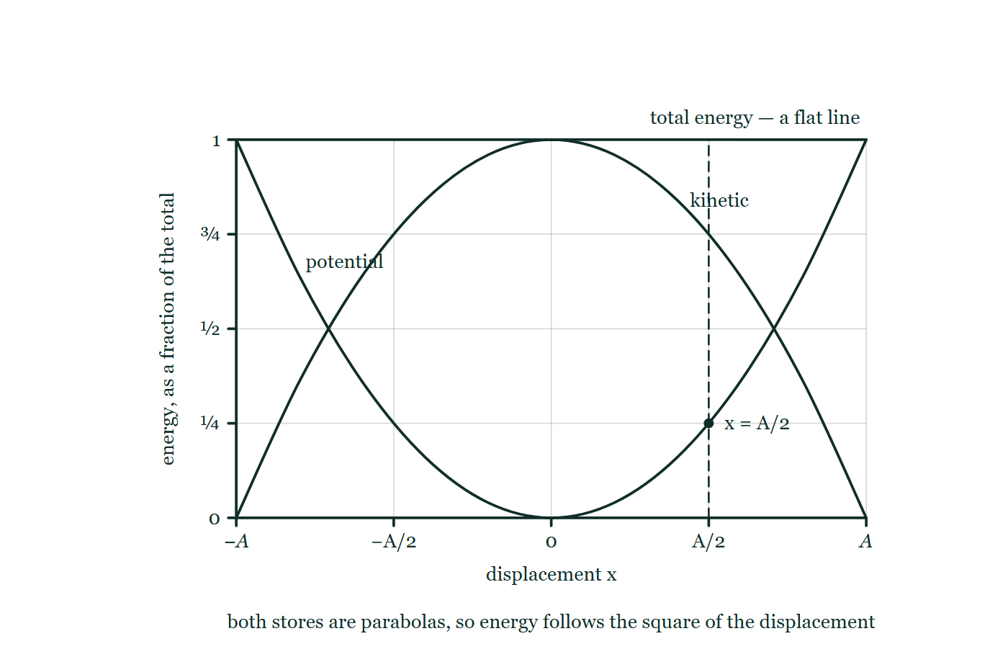
OSCILLATIONS · ENERGY IN SHM
GIOPHYSICS LESSON
THE PICTURE
Two parabolas under a flat line
Drawn for this lesson
Energy against displacement from −A to +A: the potential store as a parabola with its nose on the axis at the centre, the kinetic store as the same parabola inverted, both beneath the flat line of the constant total, with the ordinate at x = A/2 dashed in.
The live version of this figure — click here
Oscillations — Energy in SHM. Built by GioPhysics from the lesson's own copy; nothing on these slides is re-authored.
14 / 33
Notes:
[Phase] Build the model: The formulae, one at a time, in plain English (minutes 13–22 of 45)
[Figure] Energy against displacement from −A to +A: the potential store as a parabola with its nose on the axis at the centre, the kinetic store as the same parabola inverted, both beneath the flat line of the constant total, with the ordinate at x = A/2 dashed in.

Slide 15
OSCILLATIONS · ENERGY IN SHM
GIOPHYSICS LESSON
WATCH OUT
The common trap
Check and misconception — The quick check and the trap
Kinetic energy is not half the total at half the amplitude. At x = A/2 the potential energy is ½mω²(A/2)² — only a quarter of the total — so the kinetic energy is three-quarters. Energy goes with the square of displacement, and the even split happens at x = A/√2 ≈ 0.71A.
Oscillations — Energy in SHM. Built by GioPhysics from the lesson's own copy; nothing on these slides is re-authored.
15 / 33
Notes:
[Phase] Check and misconception: The quick check and the trap (minutes 35–41 of 45)
[Misconception] Kinetic energy is not half the total at half the amplitude. At x = A/2 the potential energy is ½mω²(A/2)² — only a quarter of the total — so the kinetic energy is three-quarters. Energy goes with the square of displacement, and the even split happens at x = A/√2 ≈ 0.71A.

Slide 16
OSCILLATIONS · ENERGY IN SHM
GIOPHYSICS LESSON
WORKED EXAMPLE 1 OF 2 · EASY
The question
Easy
Worked examples — I do, we do — one step revealed at a time
A 0.125 kg mass on a spring has a maximum kinetic energy of 4.0 J. Find its maximum speed.
Oscillations — Energy in SHM. Built by GioPhysics from the lesson's own copy; nothing on these slides is re-authored.
16 / 33
Notes:
[Phase] Worked examples: I do, we do — one step revealed at a time (minutes 22–35 of 45)
[Question] A 0.125 kg mass on a spring has a maximum kinetic energy of 4.0 J. Find its maximum speed.
[Answer] v(max) = 8.0 m s⁻¹

Slide 17
OSCILLATIONS · ENERGY IN SHM
GIOPHYSICS LESSON
WORKED EXAMPLE 1 OF 2 · EASY · THE WORKING
How to solve it
Easy
Worked examples — I do, we do — one step revealed at a time
A 0.125 kg mass on a spring has a maximum kinetic energy of 4.0 J. Find its maximum speed.
1.
The kinetic energy peaks where the speed peaks: E(K,max) = ½mv(max)².
2.
4.0 = ½ × 0.125 × v(max)² → v(max)² = 64 → v(max) = 8.0 m s⁻¹.
Oscillations — Energy in SHM. Built by GioPhysics from the lesson's own copy; nothing on these slides is re-authored.
17 / 33
Notes:
[Phase] Worked examples: I do, we do — one step revealed at a time (minutes 22–35 of 45)
[Reveal] One click per step. The class works each line before the next appears.
[Step 1] The kinetic energy peaks where the speed peaks: E(K,max) = ½mv(max)².
[Step 2] 4.0 = ½ × 0.125 × v(max)² → v(max)² = 64 → v(max) = 8.0 m s⁻¹.

Slide 18
OSCILLATIONS · ENERGY IN SHM
GIOPHYSICS LESSON
WORKED EXAMPLE 1 OF 2 · EASY
Answer
Easy
Worked examples — I do, we do — one step revealed at a time
v(max) = 8.0 m s⁻¹
Oscillations — Energy in SHM. Built by GioPhysics from the lesson's own copy; nothing on these slides is re-authored.
18 / 33
Notes:
[Phase] Worked examples: I do, we do — one step revealed at a time (minutes 22–35 of 45)
[Answer] v(max) = 8.0 m s⁻¹

Slide 19
OSCILLATIONS · ENERGY IN SHM
GIOPHYSICS LESSON
WORKED EXAMPLE 2 OF 2 · MEDIUM
The question
Medium
Worked examples — I do, we do — one step revealed at a time
The same system has amplitude 2.0 cm. Use the total energy to find the spring constant k.
Oscillations — Energy in SHM. Built by GioPhysics from the lesson's own copy; nothing on these slides is re-authored.
19 / 33
Notes:
[Phase] Worked examples: I do, we do — one step revealed at a time (minutes 22–35 of 45)
[Question] The same system has amplitude 2.0 cm. Use the total energy to find the spring constant k.
[Answer] k = 2.0 × 10⁴ N m⁻¹

Slide 20
OSCILLATIONS · ENERGY IN SHM
GIOPHYSICS LESSON
WORKED EXAMPLE 2 OF 2 · MEDIUM · THE WORKING
How to solve it
Medium
Worked examples — I do, we do — one step revealed at a time
The same system has amplitude 2.0 cm. Use the total energy to find the spring constant k.
1.
At x = ±A all the energy is potential: E(T) = ½kA².
2.
The total equals the maximum kinetic energy, 4.0 J.
3.
4.0 = ½ × k × 0.020² → k = 8.0 ÷ 0.00040 = 20 000 N m⁻¹.
Oscillations — Energy in SHM. Built by GioPhysics from the lesson's own copy; nothing on these slides is re-authored.
20 / 33
Notes:
[Phase] Worked examples: I do, we do — one step revealed at a time (minutes 22–35 of 45)
[Reveal] One click per step. The class works each line before the next appears.
[Step 1] At x = ±A all the energy is potential: E(T) = ½kA².
[Step 2] The total equals the maximum kinetic energy, 4.0 J.
[Step 3] 4.0 = ½ × k × 0.020² → k = 8.0 ÷ 0.00040 = 20 000 N m⁻¹.

Slide 21
OSCILLATIONS · ENERGY IN SHM
GIOPHYSICS LESSON
WORKED EXAMPLE 2 OF 2 · MEDIUM
Answer
Medium
Worked examples — I do, we do — one step revealed at a time
k = 2.0 × 10⁴ N m⁻¹
Oscillations — Energy in SHM. Built by GioPhysics from the lesson's own copy; nothing on these slides is re-authored.
21 / 33
Notes:
[Phase] Worked examples: I do, we do — one step revealed at a time (minutes 22–35 of 45)
[Answer] k = 2.0 × 10⁴ N m⁻¹

Slide 22
OSCILLATIONS · ENERGY IN SHM
GIOPHYSICS LESSON
SPOT THE MISTAKE
One line here is wrong
The whole working is up — find the bad line before you click
1.
A 4.0 kg mass on a spring of k = 5.0 N m⁻¹ oscillates with amplitude 2.0 m. Find the total energy and the maximum speed.
2.
At the extremes the store is entirely potential: E = ½kA²
3.
E = ½ × 5.0 × 2.0² = 10 J
4.
At the centre it is entirely kinetic: E = ½mv(max)²
5.
10 = ½ × 4.0 × v(max), so v(max) = 5.0 m s⁻¹
LINE 5 IS WRONG
The speed has not been squared. It is a slip that hides well, because the line above it is written correctly and the arithmetic that follows is faultless — ½ × 4.0 is 2.0, and 10 ÷ 2.0 really is 5.0. The units give it away: joules divided by kilograms is m² s⁻², which is a speed squared, not a speed.
IT SHOULD SAY
10 = ½ × 4.0 × v(max)², so v(max)² = 5.0 and v(max) = 2.2 m s⁻¹
Oscillations — Energy in SHM. Built by GioPhysics from the lesson's own copy; nothing on these slides is re-authored.
22 / 33
Notes:
[Phase] Worked examples: I do, we do — one step revealed at a time (minutes 22–35 of 45)
[Spot the mistake] The working is complete and one line of it is wrong. Let the room hunt: one click names the line, a second shows it done correctly.
[Line 5 is wrong] The speed has not been squared. It is a slip that hides well, because the line above it is written correctly and the arithmetic that follows is faultless — ½ × 4.0 is 2.0, and 10 ÷ 2.0 really is 5.0. The units give it away: joules divided by kilograms is m² s⁻², which is a speed squared, not a speed.
[It should say] 10 = ½ × 4.0 × v(max)², so v(max)² = 5.0 and v(max) = 2.2 m s⁻¹

Slide 23
OSCILLATIONS · ENERGY IN SHM
GIOPHYSICS LESSON
PREDICT · TAKE THE VOTE
Commit before you are told
Hands up for each option, then click
The swing is passing the middle bob in the picture — half way back, at x = A/2. How fast is it moving, as a fraction of its top speed?
A Half of top speed — half the distance back, half the speed
B About 0.71 of top speed
C About 0.87 of top speed
A pendulum drawn at three points of a single arc: held at the extreme with the velocity marked zero, half way back with the velocity left as a question mark, and at the lowest point of the dashed arc where it is fastest, with A and A/2 dimensioned below.
The live version of this figure — click here
Oscillations — Energy in SHM. Built by GioPhysics from the lesson's own copy; nothing on these slides is re-authored.
23 / 33
Notes:
[Phase] Build the model: The formulae, one at a time, in plain English (minutes 13–22 of 45)
[Predict] The swing is passing the middle bob in the picture — half way back, at x = A/2. How fast is it moving, as a fraction of its top speed?
[Options] A Half of top speed — half the distance back, half the speed B About 0.71 of top speed C About 0.87 of top speed
[Figure] A pendulum drawn at three points of a single arc: held at the extreme with the velocity marked zero, half way back with the velocity left as a question mark, and at the lowest point of the dashed arc where it is fastest, with A and A/2 dimensioned below.

Slide 24
OSCILLATIONS · ENERGY IN SHM
GIOPHYSICS LESSON
PREDICT · THE OUTCOME
What actually happens
Ask the room who changed their mind, and why
C About 0.87 of top speed
WHY
v = ω√(A² − x²), so at x = A/2 the bracket is A² − A²/4 = ¾A², and the speed is √(3)/2 = 0.87 of ωA. The swing is nearly at full pelt when it is still half way out, because the potential store at A/2 is only a quarter of the total — the square makes it small. 0.71 is the answer to a different question: that is the speed at x = A/√2, where the two stores are exactly equal.
Oscillations — Energy in SHM. Built by GioPhysics from the lesson's own copy; nothing on these slides is re-authored.
24 / 33
Notes:
[Phase] Build the model: The formulae, one at a time, in plain English (minutes 13–22 of 45)
[Answer] C — About 0.87 of top speed. v = ω√(A² − x²), so at x = A/2 the bracket is A² − A²/4 = ¾A², and the speed is √(3)/2 = 0.87 of ωA. The swing is nearly at full pelt when it is still half way out, because the potential store at A/2 is only a quarter of the total — the square makes it small. 0.71 is the answer to a different question: that is the speed at x = A/√2, where the two stores are exactly equal.

Slide 25
OSCILLATIONS · ENERGY IN SHM
GIOPHYSICS LESSON
QUICK CHECK
Decide before the answer goes up
Check and misconception — The quick check and the trap
A mass oscillates with amplitude A. At displacement x = A/2, what fraction of the total energy is kinetic?
A
Half
B
Three-quarters
C
One-quarter
Oscillations — Energy in SHM. Built by GioPhysics from the lesson's own copy; nothing on these slides is re-authored.
25 / 33
Notes:
[Phase] Check and misconception: The quick check and the trap (minutes 35–41 of 45)
[Question] A mass oscillates with amplitude A. At displacement x = A/2, what fraction of the total energy is kinetic?
[Options] A Half B Three-quarters C One-quarter

Slide 26
OSCILLATIONS · ENERGY IN SHM
GIOPHYSICS LESSON
QUICK CHECK · THE ANSWER
The answer, and why
Check and misconception — The quick check and the trap
B Three-quarters
HOW TO GET THERE
E(P) ∝ x², so at A/2 the potential energy is (1/2)² = 1/4 of the total, leaving 3/4 as kinetic energy.
WHY THE OTHERS TEMPT
A Half would be right if energy went with displacement. It goes with displacement squared, which is what makes the two curves in the figure parabolas rather than straight lines — and a parabola at half its width has climbed only a quarter of its height.
B Correct. E(P) ∝ x², so at x = A/2 the potential store holds (½)² = ¼ of the total, leaving ¾ of it as kinetic energy.
C One-quarter is the potential store at that point, not the kinetic one. The question asks what is left over for motion, and the two must add to the whole: ¼ potential means ¾ kinetic.
Oscillations — Energy in SHM. Built by GioPhysics from the lesson's own copy; nothing on these slides is re-authored.
26 / 33
Notes:
[Phase] Check and misconception: The quick check and the trap (minutes 35–41 of 45)
[Question] A mass oscillates with amplitude A. At displacement x = A/2, what fraction of the total energy is kinetic?
[Option by option] A: Half would be right if energy went with displacement. It goes with displacement squared, which is what makes the two curves in the figure parabolas rather than straight lines — and a parabola at half its width has climbed only a quarter of its height. B: Correct. E(P) ∝ x², so at x = A/2 the potential store holds (½)² = ¼ of the total, leaving ¾ of it as kinetic energy. C: One-quarter is the potential store at that point, not the kinetic one. The question asks what is left over for motion, and the two must add to the whole: ¼ potential means ¾ kinetic.
[Answer] B — Three-quarters
[Why] E(P) ∝ x², so at A/2 the potential energy is (1/2)² = 1/4 of the total, leaving 3/4 as kinetic energy.
[Reveal] One click for the answer, then one for the reason.

Slide 27
OSCILLATIONS · ENERGY IN SHM
GIOPHYSICS LESSON
EXTENSION 1 OF 2 · HARD
The question
Hard
Worked examples — I do, we do — one step revealed at a time
A 4.0 kg mass on a spring (k = 5.0 N m⁻¹) oscillates with amplitude 2.0 m. Find the total energy, the maximum speed, and the speed at x = 1.0 m.
Oscillations — Energy in SHM. Built by GioPhysics from the lesson's own copy; nothing on these slides is re-authored.
27 / 33
Notes:
[Phase] Worked examples: I do, we do — one step revealed at a time (minutes 22–35 of 45)
[Question] A 4.0 kg mass on a spring (k = 5.0 N m⁻¹) oscillates with amplitude 2.0 m. Find the total energy, the maximum speed, and the speed at x = 1.0 m.
[Answer] E(T) = 10 J; v(max) ≈ 2.2 m s⁻¹; v(1.0 m) ≈ 1.9 m s⁻¹

Slide 28
OSCILLATIONS · ENERGY IN SHM
GIOPHYSICS LESSON
EXTENSION 1 OF 2 · HARD · THE WORKING
How to solve it
Hard
Worked examples — I do, we do — one step revealed at a time
A 4.0 kg mass on a spring (k = 5.0 N m⁻¹) oscillates with amplitude 2.0 m. Find the total energy, the maximum speed, and the speed at x = 1.0 m.
1.
E(T) = ½kA² = ½ × 5.0 × 4.0 = 10 J.
2.
½mv(max)² = 10 → v(max) = √(2 × 10 ÷ 4.0) ≈ 2.2 m s⁻¹.
3.
At x = 1.0 m: 10 = ½ × 4.0 × v² + ½ × 5.0 × 1.0² → v² = (10 − 2.5)/2.0 → v ≈ 1.9 m s⁻¹.
Oscillations — Energy in SHM. Built by GioPhysics from the lesson's own copy; nothing on these slides is re-authored.
28 / 33
Notes:
[Phase] Worked examples: I do, we do — one step revealed at a time (minutes 22–35 of 45)
[Reveal] One click per step. The class works each line before the next appears.
[Step 1] E(T) = ½kA² = ½ × 5.0 × 4.0 = 10 J.
[Step 2] ½mv(max)² = 10 → v(max) = √(2 × 10 ÷ 4.0) ≈ 2.2 m s⁻¹.
[Step 3] At x = 1.0 m: 10 = ½ × 4.0 × v² + ½ × 5.0 × 1.0² → v² = (10 − 2.5)/2.0 → v ≈ 1.9 m s⁻¹.

Slide 29
OSCILLATIONS · ENERGY IN SHM
GIOPHYSICS LESSON
EXTENSION 1 OF 2 · HARD
Answer
Hard
Worked examples — I do, we do — one step revealed at a time
E(T) = 10 J; v(max) ≈ 2.2 m s⁻¹; v(1.0 m) ≈ 1.9 m s⁻¹
Oscillations — Energy in SHM. Built by GioPhysics from the lesson's own copy; nothing on these slides is re-authored.
29 / 33
Notes:
[Phase] Worked examples: I do, we do — one step revealed at a time (minutes 22–35 of 45)
[Answer] E(T) = 10 J; v(max) ≈ 2.2 m s⁻¹; v(1.0 m) ≈ 1.9 m s⁻¹

Slide 30
OSCILLATIONS · ENERGY IN SHM
GIOPHYSICS LESSON
EXTENSION 2 OF 2 · CHALLENGING
The question
Challenging
Worked examples — I do, we do — one step revealed at a time
An oscillator’s amplitude is doubled. By what factor do the total energy and the maximum speed change — and where is the kinetic energy equal to the potential energy?
Oscillations — Energy in SHM. Built by GioPhysics from the lesson's own copy; nothing on these slides is re-authored.
30 / 33
Notes:
[Phase] Worked examples: I do, we do — one step revealed at a time (minutes 22–35 of 45)
[Question] An oscillator’s amplitude is doubled. By what factor do the total energy and the maximum speed change — and where is the kinetic energy equal to the potential energy?
[Answer] Energy ×4, v(max) ×2; equal split at x = A/√2 ≈ 0.71A

Slide 31
OSCILLATIONS · ENERGY IN SHM
GIOPHYSICS LESSON
EXTENSION 2 OF 2 · CHALLENGING · THE WORKING
How to solve it
Challenging
Worked examples — I do, we do — one step revealed at a time
An oscillator’s amplitude is doubled. By what factor do the total energy and the maximum speed change — and where is the kinetic energy equal to the potential energy?
1.
E(T) = ½mω²A² ∝ A²: doubling A quadruples the stored energy.
2.
v(max) = ωA ∝ A: the maximum speed only doubles — energy carries the square.
3.
Equal split: ½mω²x² = ½ × ½mω²A² → x² = A²/2 → x = A/√2 ≈ 0.71A, not A/2.
Oscillations — Energy in SHM. Built by GioPhysics from the lesson's own copy; nothing on these slides is re-authored.
31 / 33
Notes:
[Phase] Worked examples: I do, we do — one step revealed at a time (minutes 22–35 of 45)
[Reveal] One click per step. The class works each line before the next appears.
[Step 1] E(T) = ½mω²A² ∝ A²: doubling A quadruples the stored energy.
[Step 2] v(max) = ωA ∝ A: the maximum speed only doubles — energy carries the square.
[Step 3] Equal split: ½mω²x² = ½ × ½mω²A² → x² = A²/2 → x = A/√2 ≈ 0.71A, not A/2.

Slide 32
OSCILLATIONS · ENERGY IN SHM
GIOPHYSICS LESSON
EXTENSION 2 OF 2 · CHALLENGING
Answer
Challenging
Worked examples — I do, we do — one step revealed at a time
Energy ×4, v(max) ×2; equal split at x = A/√2 ≈ 0.71A
Oscillations — Energy in SHM. Built by GioPhysics from the lesson's own copy; nothing on these slides is re-authored.
32 / 33
Notes:
[Phase] Worked examples: I do, we do — one step revealed at a time (minutes 22–35 of 45)
[Answer] Energy ×4, v(max) ×2; equal split at x = A/√2 ≈ 0.71A

Slide 33
OSCILLATIONS · ENERGY IN SHM
GIOPHYSICS LESSON
OSCILLATIONS
Where to go next
Plenary — What to take away, what to practise next
Next
23.3 Damped Oscillations
https://giophysics.com/chapter-45/damping/
Lesson
This lesson on giophysics.com
https://giophysics.com/chapter-45/shm-energy/
Live
The live, interactive version of these slides
https://giophysics.com/chapter-45/presentation/?lesson=energy
Chapter
All Oscillations lessons
https://giophysics.com/chapter-45/
PDF
Download the lesson PDF
https://giophysics.com/downloads/45-2-shm-energy.pdf
Oscillations — Energy in SHM. Built by GioPhysics from the lesson's own copy; nothing on these slides is re-authored.
33 / 33
Notes:
[Phase] Plenary: What to take away, what to practise next (minutes 41–45 of 45)
[Interactive] The graphs and the circuit topology on these slides are frozen. The live version at https://giophysics.com/chapter-45/presentation/?lesson=energy moves them.

