Slide 1
OSCILLATIONS · FORCED OSCILLATIONS & RESONANCE
GIOPHYSICS LESSON
23 · Oscillations
Push in time and the arc grows
Forced Oscillations & Resonance
Push a swing at random moments and little happens. Push in time with its own rhythm and a small effort builds a huge arc. Driving an oscillator at its natural frequency is resonance — the effect that tunes radios, images your body, and has torn bridges apart.
POSITION
Lesson 4 of 6 in Oscillations
PLAN
16 slides in the 45-minute core run, about 44.5 minutes of it
LESSON PAGE
https://giophysics.com/chapter-45/resonance/
Built by GioPhysics from the lesson's own page. Every word on these slides is the lesson's; nothing here is re-authored. Teaching material, not an awarding body's document.
Oscillations — Forced Oscillations & Resonance. Built by GioPhysics from the lesson's own copy; nothing on these slides is re-authored.
1 / 32
Notes:
[Lesson] Oscillations — Forced Oscillations & Resonance. Lesson 4 of 6.
[Intro] Push a swing at random moments and little happens. Push in time with its own rhythm and a small effort builds a huge arc. Driving an oscillator at its natural frequency is resonance — the effect that tunes radios, images your body, and has torn bridges apart.
[Source] https://giophysics.com/chapter-45/resonance/
[Disclaimer] Built by GioPhysics from the lesson's own page. Every word on these slides is the lesson's; nothing here is re-authored. Teaching material, not an awarding body's document.

Slide 2
OSCILLATIONS · FORCED OSCILLATIONS & RESONANCE
GIOPHYSICS LESSON
WHAT THIS NEEDS
What you already know
Starter — Recall what this lesson stands on
Recall
Simple harmonic motion
https://giophysics.com/chapter-45/shm-basics/
Recall
Damped oscillations
https://giophysics.com/chapter-45/damping/
Oscillations — Forced Oscillations & Resonance. Built by GioPhysics from the lesson's own copy; nothing on these slides is re-authored.
2 / 32
Notes:
[Phase] Starter: Recall what this lesson stands on (minutes 0–5 of 45)
[Starter] Recall: Simple harmonic motion; Damped oscillations

Slide 3
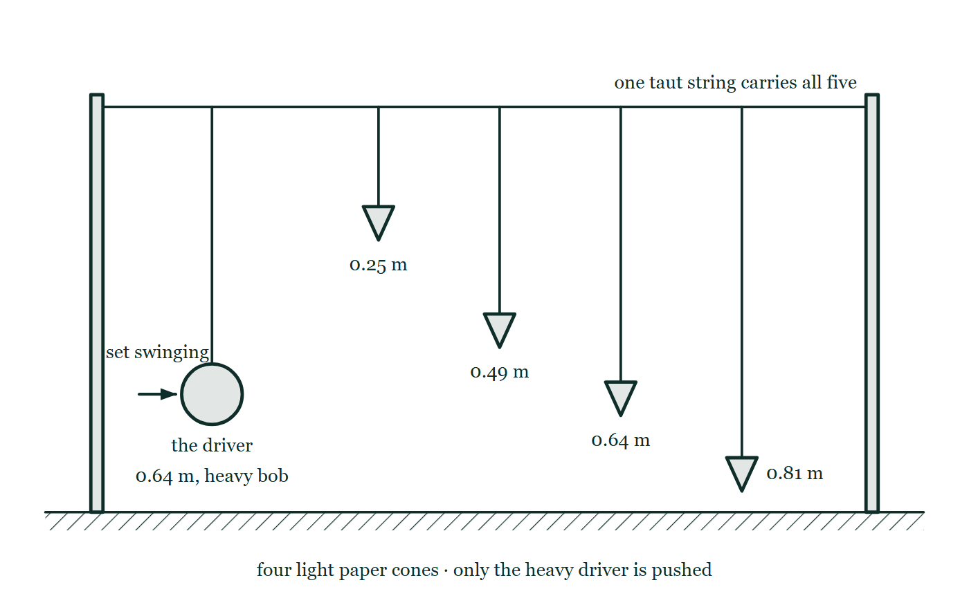
OSCILLATIONS · FORCED OSCILLATIONS & RESONANCE
GIOPHYSICS LESSON
THINK FIRST
A guitar string tuned to 200 Hz is standing next to a speaker droning steadily at 120 Hz. What frequency does the string vibrate at?
Take answers before you click — the point is the commitment
You can feel the string moving if you rest a finger on it. It is definitely being driven — the speaker is the only thing in the room making a sound.
THE ANSWER
120 Hz. A forced oscillator vibrates at whatever frequency it is driven at, full stop. The string's own 200 Hz decides only how large the response is — and at 120 Hz, well off resonance, it is very small indeed. Tune the speaker up to 200 Hz and the frequency of the string would not change by a single hertz; only the amplitude would, dramatically.
Five pendulums hanging dead still from one taut string between two posts: a heavy driver bob 0.64 m down with an arrow about to push it, and four light paper cones of length 0.25 m, 0.49 m, 0.64 m and 0.81 m beside it.
The live version of this figure — click here
Oscillations — Forced Oscillations & Resonance. Built by GioPhysics from the lesson's own copy; nothing on these slides is re-authored.
3 / 32
Notes:
[Phase] Starter: Recall what this lesson stands on (minutes 0–5 of 45)
[Hook] A guitar string tuned to 200 Hz is standing next to a speaker droning steadily at 120 Hz. What frequency does the string vibrate at? You can feel the string moving if you rest a finger on it. It is definitely being driven — the speaker is the only thing in the room making a sound.
[Answer] 120 Hz. A forced oscillator vibrates at whatever frequency it is driven at, full stop. The string's own 200 Hz decides only how large the response is — and at 120 Hz, well off resonance, it is very small indeed. Tune the speaker up to 200 Hz and the frequency of the string would not change by a single hertz; only the amplitude would, dramatically.
[Figure] Five pendulums hanging dead still from one taut string between two posts: a heavy driver bob 0.64 m down with an arrow about to push it, and four light paper cones of length 0.25 m, 0.49 m, 0.64 m and 0.81 m beside it.

Slide 4
OSCILLATIONS · FORCED OSCILLATIONS & RESONANCE
GIOPHYSICS LESSON
EXPLAINED SIMPLY
In one sentence
Introduce the idea — The big idea and the definition
Resonance is the large-amplitude response of an oscillator driven at (or very near) its natural frequency; damping lowers, widens, and slightly shifts the resonance peak.
Oscillations — Forced Oscillations & Resonance. Built by GioPhysics from the lesson's own copy; nothing on these slides is re-authored.
4 / 32
Notes:
[Phase] Introduce the idea: The big idea and the definition (minutes 5–13 of 45)
[Definition] Resonance is the large-amplitude response of an oscillator driven at (or very near) its natural frequency; damping lowers, widens, and slightly shifts the resonance peak.

Slide 5
OSCILLATIONS · FORCED OSCILLATIONS & RESONANCE
GIOPHYSICS LESSON
EXPLAINED SIMPLY
What that looks like
Introduce the idea — The big idea and the definition
FOR EXAMPLE
Pushing a playground swing: time your pushes to its natural period and the arc grows push after push. Push at the wrong rhythm and you fight the swing as often as you help it.
Oscillations — Forced Oscillations & Resonance. Built by GioPhysics from the lesson's own copy; nothing on these slides is re-authored.
5 / 32
Notes:
[Phase] Introduce the idea: The big idea and the definition (minutes 5–13 of 45)
[Worked illustration] Pushing a playground swing: time your pushes to its natural period and the arc grows push after push. Push at the wrong rhythm and you fight the swing as often as you help it.

Slide 6
OSCILLATIONS · FORCED OSCILLATIONS & RESONANCE
GIOPHYSICS LESSON
THE BIG IDEA
Push in time and the arc grows
Introduce the idea — The big idea and the definition
Left alone, a system oscillates at its natural frequency f₀. Drive it with a periodic force at some other frequency and it is forced to respond at the driving frequency — but the amplitude of that response depends dramatically on how close the drive sits to f₀. At resonance, driving frequency ≈ natural frequency, each push arrives in step with the motion, energy transfer is maximal, and the amplitude peaks at a value limited only by damping.
Damping reshapes the whole response curve: light damping gives a tall, narrow spike; heavier damping flattens and widens the peak and nudges it slightly below f₀. Barton’s pendulums show it in one apparatus — of many pendulums sharing a drive, only the one whose length matches the driver responds with a large amplitude.
Oscillations — Forced Oscillations & Resonance. Built by GioPhysics from the lesson's own copy; nothing on these slides is re-authored.
6 / 32
Notes:
[Phase] Introduce the idea: The big idea and the definition (minutes 5–13 of 45)
[Big idea] Left alone, a system oscillates at its natural frequency f₀. Drive it with a periodic force at some other frequency and it is forced to respond at the driving frequency — but the amplitude of that response depends dramatically on how close the drive sits to f₀. At resonance, driving frequency ≈ natural frequency, each push arrives in step with the motion, energy transfer is maximal, and the amplitude peaks at a value limited only by damping. Damping reshapes the whole response curve: light damping gives a tall, narrow spike; heavier damping flattens and widens the peak and nudges it slightly below f₀. Barton’s pendulums show it in one apparatus — of many pendulums sharing a drive, only the one whose length matches the driver responds with a large amplitude.

Slide 7
OSCILLATIONS · FORCED OSCILLATIONS & RESONANCE
GIOPHYSICS LESSON
THE PHYSICS · 1 OF 3
Barton’s pendulums
Build the model — The formulae, one at a time, in plain English
Hang several pendulums of different lengths from one taut string, and drive the string with a heavy pendulum of fixed length. All of them are forced at the driver’s frequency, but only the pendulum whose length — and therefore natural frequency — matches the driver swings with a large amplitude.
The rest barely stir. Resonance is frequency-selective: that selectivity is the point.
Oscillations — Forced Oscillations & Resonance. Built by GioPhysics from the lesson's own copy; nothing on these slides is re-authored.
7 / 32
Notes:
[Phase] Build the model: The formulae, one at a time, in plain English (minutes 13–22 of 45)
[Section] Hang several pendulums of different lengths from one taut string, and drive the string with a heavy pendulum of fixed length. All of them are forced at the driver’s frequency, but only the pendulum whose length — and therefore natural frequency — matches the driver swings with a large amplitude. The rest barely stir. Resonance is frequency-selective: that selectivity is the point.

Slide 8
OSCILLATIONS · FORCED OSCILLATIONS & RESONANCE
GIOPHYSICS LESSON
THE PHYSICS · 2 OF 3
Useful resonance
Build the model — The formulae, one at a time, in plain English
A microwave oven drives water molecules near a frequency they respond to strongly, dumping energy into food. MRI machines drive hydrogen nuclei at their precise resonant frequency in a magnetic field and listen for the reply.
Radio tuning is a resonant circuit picking one broadcast frequency out of the air. Musical instruments are resonators shaped to answer selected frequencies loudly.
Oscillations — Forced Oscillations & Resonance. Built by GioPhysics from the lesson's own copy; nothing on these slides is re-authored.
8 / 32
Notes:
[Phase] Build the model: The formulae, one at a time, in plain English (minutes 13–22 of 45)
[Section] A microwave oven drives water molecules near a frequency they respond to strongly, dumping energy into food. MRI machines drive hydrogen nuclei at their precise resonant frequency in a magnetic field and listen for the reply. Radio tuning is a resonant circuit picking one broadcast frequency out of the air. Musical instruments are resonators shaped to answer selected frequencies loudly.

Slide 9
OSCILLATIONS · FORCED OSCILLATIONS & RESONANCE
GIOPHYSICS LESSON
THE PHYSICS · 3 OF 3
Destructive resonance
Build the model — The formulae, one at a time, in plain English
The Tacoma Narrows bridge tore itself apart in 1940 when wind-driven forces fed energy into a torsional oscillation faster than damping could drain it. London’s Millennium Bridge swayed alarmingly when pedestrians’ footsteps synchronised with its natural sway frequency. The fixes are the physics of Lesson 23.3: add dampers, or shift f₀ away from the driving frequencies the structure will meet.
Oscillations — Forced Oscillations & Resonance. Built by GioPhysics from the lesson's own copy; nothing on these slides is re-authored.
9 / 32
Notes:
[Phase] Build the model: The formulae, one at a time, in plain English (minutes 13–22 of 45)
[Section] The Tacoma Narrows bridge tore itself apart in 1940 when wind-driven forces fed energy into a torsional oscillation faster than damping could drain it. London’s Millennium Bridge swayed alarmingly when pedestrians’ footsteps synchronised with its natural sway frequency. The fixes are the physics of Lesson 23.3: add dampers, or shift f₀ away from the driving frequencies the structure will meet.

Slide 10
OSCILLATIONS · FORCED OSCILLATIONS & RESONANCE
GIOPHYSICS LESSON
FORMULA 1 OF 3
Forced response
Build the model — The formulae, one at a time, in plain English
system oscillates at the driving f
Not at f₀ — the driver dictates the rhythm
IN PLAIN ENGLISH
A forced oscillator surrenders its own frequency and follows the drive. What it keeps is the right to answer with a large or a small amplitude — that depends on how close the drive is to f₀.
Oscillations — Forced Oscillations & Resonance. Built by GioPhysics from the lesson's own copy; nothing on these slides is re-authored.
10 / 32
Notes:
[Phase] Build the model: The formulae, one at a time, in plain English (minutes 13–22 of 45)
[Formula] Forced response: system oscillates at the driving f
[In plain English] A forced oscillator surrenders its own frequency and follows the drive. What it keeps is the right to answer with a large or a small amplitude — that depends on how close the drive is to f₀.
[Note] Not at f₀ — the driver dictates the rhythm

Slide 11
OSCILLATIONS · FORCED OSCILLATIONS & RESONANCE
GIOPHYSICS LESSON
FORMULA 2 OF 3
Resonance condition
Build the model — The formulae, one at a time, in plain English
f(drive) ≈ f₀
Maximum energy transfer
IN PLAIN ENGLISH
When drive and natural frequency match, every push arrives in phase with the velocity and does positive work all cycle. Amplitude climbs until damping losses balance the energy fed in.
Oscillations — Forced Oscillations & Resonance. Built by GioPhysics from the lesson's own copy; nothing on these slides is re-authored.
11 / 32
Notes:
[Phase] Build the model: The formulae, one at a time, in plain English (minutes 13–22 of 45)
[Formula] Resonance condition: f(drive) ≈ f₀
[In plain English] When drive and natural frequency match, every push arrives in phase with the velocity and does positive work all cycle. Amplitude climbs until damping losses balance the energy fed in.
[Note] Maximum energy transfer

Slide 12
OSCILLATIONS · FORCED OSCILLATIONS & RESONANCE
GIOPHYSICS LESSON
FORMULA 3 OF 3
Damping and the curve
Build the model — The formulae, one at a time, in plain English
more damping → lower, wider peak
Peak sits slightly below f₀
IN PLAIN ENGLISH
Light damping: a tall narrow spike — spectacular response but only in a sliver of frequencies. Heavy damping: a low broad hump. The peak amplitude at resonance is roughly Q times the static response.
Oscillations — Forced Oscillations & Resonance. Built by GioPhysics from the lesson's own copy; nothing on these slides is re-authored.
12 / 32
Notes:
[Phase] Build the model: The formulae, one at a time, in plain English (minutes 13–22 of 45)
[Formula] Damping and the curve: more damping → lower, wider peak
[In plain English] Light damping: a tall narrow spike — spectacular response but only in a sliver of frequencies. Heavy damping: a low broad hump. The peak amplitude at resonance is roughly Q times the static response.
[Note] Peak sits slightly below f₀

Slide 13
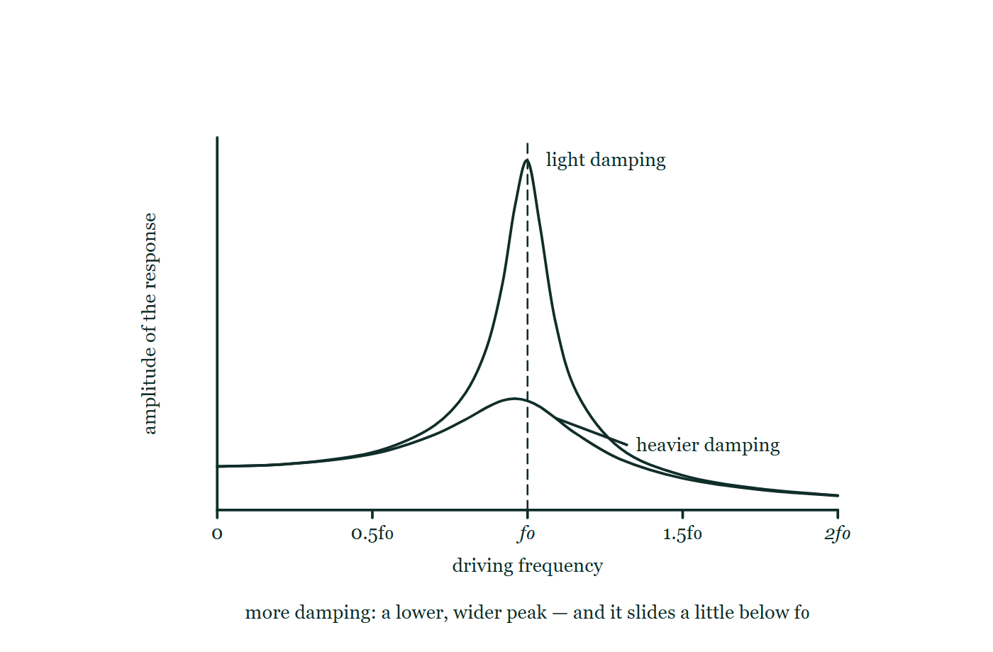
OSCILLATIONS · FORCED OSCILLATIONS & RESONANCE
GIOPHYSICS LESSON
THE PICTURE
The same system, two dampings
Drawn for this lesson
Amplitude against driving frequency from zero to twice the natural frequency, with a tall narrow peak for light damping sitting on the dashed f₀ line and a low broad peak for heavier damping whose maximum lies a little to the left of it.
The live version of this figure — click here
Oscillations — Forced Oscillations & Resonance. Built by GioPhysics from the lesson's own copy; nothing on these slides is re-authored.
13 / 32
Notes:
[Phase] Build the model: The formulae, one at a time, in plain English (minutes 13–22 of 45)
[Figure] Amplitude against driving frequency from zero to twice the natural frequency, with a tall narrow peak for light damping sitting on the dashed f₀ line and a low broad peak for heavier damping whose maximum lies a little to the left of it.

Slide 14
OSCILLATIONS · FORCED OSCILLATIONS & RESONANCE
GIOPHYSICS LESSON
WATCH OUT
The common trap
Check and misconception — The quick check and the trap
A forced oscillator does not vibrate at its natural frequency — it vibrates at the driving frequency, whatever that is. The natural frequency only decides how big the response is. Resonance is not a different kind of motion; it is the special case where the drive happens to match f₀ and the amplitude answer becomes enormous.
Oscillations — Forced Oscillations & Resonance. Built by GioPhysics from the lesson's own copy; nothing on these slides is re-authored.
14 / 32
Notes:
[Phase] Check and misconception: The quick check and the trap (minutes 35–41 of 45)
[Misconception] A forced oscillator does not vibrate at its natural frequency — it vibrates at the driving frequency, whatever that is. The natural frequency only decides how big the response is. Resonance is not a different kind of motion; it is the special case where the drive happens to match f₀ and the amplitude answer becomes enormous.

Slide 15
OSCILLATIONS · FORCED OSCILLATIONS & RESONANCE
GIOPHYSICS LESSON
WORKED EXAMPLE 1 OF 2 · EASY
The question
Easy
Worked examples — I do, we do — one step revealed at a time
A child’s swing has a natural period of 3.0 s. At what frequency should a parent push for the largest amplitude?
Oscillations — Forced Oscillations & Resonance. Built by GioPhysics from the lesson's own copy; nothing on these slides is re-authored.
15 / 32
Notes:
[Phase] Worked examples: I do, we do — one step revealed at a time (minutes 22–35 of 45)
[Question] A child’s swing has a natural period of 3.0 s. At what frequency should a parent push for the largest amplitude?
[Answer] ≈ 0.33 Hz (one push per 3.0 s cycle)

Slide 16
OSCILLATIONS · FORCED OSCILLATIONS & RESONANCE
GIOPHYSICS LESSON
WORKED EXAMPLE 1 OF 2 · EASY · THE WORKING
How to solve it
Easy
Worked examples — I do, we do — one step revealed at a time
A child’s swing has a natural period of 3.0 s. At what frequency should a parent push for the largest amplitude?
1.
Resonance: drive at the natural frequency.
2.
f₀ = 1/T = 1/3.0 ≈ 0.33 Hz — one push every 3.0 s, timed with the swing’s return.
Oscillations — Forced Oscillations & Resonance. Built by GioPhysics from the lesson's own copy; nothing on these slides is re-authored.
16 / 32
Notes:
[Phase] Worked examples: I do, we do — one step revealed at a time (minutes 22–35 of 45)
[Reveal] One click per step. The class works each line before the next appears.
[Step 1] Resonance: drive at the natural frequency.
[Step 2] f₀ = 1/T = 1/3.0 ≈ 0.33 Hz — one push every 3.0 s, timed with the swing’s return.

Slide 17
OSCILLATIONS · FORCED OSCILLATIONS & RESONANCE
GIOPHYSICS LESSON
WORKED EXAMPLE 1 OF 2 · EASY
Answer
Easy
Worked examples — I do, we do — one step revealed at a time
≈ 0.33 Hz (one push per 3.0 s cycle)
Oscillations — Forced Oscillations & Resonance. Built by GioPhysics from the lesson's own copy; nothing on these slides is re-authored.
17 / 32
Notes:
[Phase] Worked examples: I do, we do — one step revealed at a time (minutes 22–35 of 45)
[Answer] ≈ 0.33 Hz (one push per 3.0 s cycle)

Slide 18
OSCILLATIONS · FORCED OSCILLATIONS & RESONANCE
GIOPHYSICS LESSON
WORKED EXAMPLE 2 OF 2 · MEDIUM
The question
Medium
Worked examples — I do, we do — one step revealed at a time
In a Barton’s pendulums demonstration the driver is 0.64 m long. Which of the paper-cone pendulums (0.25 m, 0.49 m, 0.64 m, 0.81 m) responds with the largest amplitude, and why?
Oscillations — Forced Oscillations & Resonance. Built by GioPhysics from the lesson's own copy; nothing on these slides is re-authored.
18 / 32
Notes:
[Phase] Worked examples: I do, we do — one step revealed at a time (minutes 22–35 of 45)
[Question] In a Barton’s pendulums demonstration the driver is 0.64 m long. Which of the paper-cone pendulums (0.25 m, 0.49 m, 0.64 m, 0.81 m) responds with the largest amplitude, and why?
[Answer] The 0.64 m pendulum — its natural frequency matches the driver’s

Slide 19
OSCILLATIONS · FORCED OSCILLATIONS & RESONANCE
GIOPHYSICS LESSON
WORKED EXAMPLE 2 OF 2 · MEDIUM · THE WORKING
How to solve it
Medium
Worked examples — I do, we do — one step revealed at a time
In a Barton’s pendulums demonstration the driver is 0.64 m long. Which of the paper-cone pendulums (0.25 m, 0.49 m, 0.64 m, 0.81 m) responds with the largest amplitude, and why?
1.
Each cone is forced at the driver’s frequency f = (1/2π)√(g/0.64).
2.
Only a pendulum with the same natural frequency — the same length — resonates.
3.
The 0.64 m cone swings large; the others respond weakly, more weakly the further their f₀ from the drive.
Oscillations — Forced Oscillations & Resonance. Built by GioPhysics from the lesson's own copy; nothing on these slides is re-authored.
19 / 32
Notes:
[Phase] Worked examples: I do, we do — one step revealed at a time (minutes 22–35 of 45)
[Reveal] One click per step. The class works each line before the next appears.
[Step 1] Each cone is forced at the driver’s frequency f = (1/2π)√(g/0.64).
[Step 2] Only a pendulum with the same natural frequency — the same length — resonates.
[Step 3] The 0.64 m cone swings large; the others respond weakly, more weakly the further their f₀ from the drive.

Slide 20
OSCILLATIONS · FORCED OSCILLATIONS & RESONANCE
GIOPHYSICS LESSON
WORKED EXAMPLE 2 OF 2 · MEDIUM
Answer
Medium
Worked examples — I do, we do — one step revealed at a time
The 0.64 m pendulum — its natural frequency matches the driver’s
Oscillations — Forced Oscillations & Resonance. Built by GioPhysics from the lesson's own copy; nothing on these slides is re-authored.
20 / 32
Notes:
[Phase] Worked examples: I do, we do — one step revealed at a time (minutes 22–35 of 45)
[Answer] The 0.64 m pendulum — its natural frequency matches the driver’s

Slide 21
OSCILLATIONS · FORCED OSCILLATIONS & RESONANCE
GIOPHYSICS LESSON
SPOT THE MISTAKE
One line here is wrong
The whole working is up — find the bad line before you click
1.
A washing machine drum spins up from rest and the panel shudders at 300 rpm. Find the panel's natural frequency.
2.
The unbalanced drum applies a periodic force once per revolution, so the drive frequency is the rotation rate.
3.
The shudder is resonance, so at that moment f(drive) = f₀.
4.
300 rpm = 300 Hz, so f₀ = 300 Hz.
5.
The panel has a natural frequency of 300 Hz.
LINE 4 IS WRONG
Revolutions per minute is not hertz. Divide by 60 first. It slips through because the physics on the two lines above it is exactly right, so the number feels like it has been earned — and 300 Hz for a sheet-metal panel is not obviously absurd until you notice the drum would have to be doing 18 000 rpm to supply it.
IT SHOULD SAY
300 rpm = 300/60 = 5.0 rev s⁻¹, so f₀ = 5.0 Hz.
Oscillations — Forced Oscillations & Resonance. Built by GioPhysics from the lesson's own copy; nothing on these slides is re-authored.
21 / 32
Notes:
[Phase] Worked examples: I do, we do — one step revealed at a time (minutes 22–35 of 45)
[Spot the mistake] The working is complete and one line of it is wrong. Let the room hunt: one click names the line, a second shows it done correctly.
[Line 4 is wrong] Revolutions per minute is not hertz. Divide by 60 first. It slips through because the physics on the two lines above it is exactly right, so the number feels like it has been earned — and 300 Hz for a sheet-metal panel is not obviously absurd until you notice the drum would have to be doing 18 000 rpm to supply it.
[It should say] 300 rpm = 300/60 = 5.0 rev s⁻¹, so f₀ = 5.0 Hz.

Slide 22
OSCILLATIONS · FORCED OSCILLATIONS & RESONANCE
GIOPHYSICS LESSON
PREDICT · TAKE THE VOTE
Commit before you are told
Hands up for each option, then click
The heavy driver is set swinging. What does the shortest cone — the 0.25 m one — do?
A Swings at its own natural frequency, which is faster than the driver's
B Swings at the driver's frequency, but only feebly
C Stays still, since its length does not match the driver's
Five pendulums hanging dead still from one taut string between two posts: a heavy driver bob 0.64 m down with an arrow about to push it, and four light paper cones of length 0.25 m, 0.49 m, 0.64 m and 0.81 m beside it.
The live version of this figure — click here
Oscillations — Forced Oscillations & Resonance. Built by GioPhysics from the lesson's own copy; nothing on these slides is re-authored.
22 / 32
Notes:
[Phase] Build the model: The formulae, one at a time, in plain English (minutes 13–22 of 45)
[Predict] The heavy driver is set swinging. What does the shortest cone — the 0.25 m one — do?
[Options] A Swings at its own natural frequency, which is faster than the driver's B Swings at the driver's frequency, but only feebly C Stays still, since its length does not match the driver's
[Figure] Five pendulums hanging dead still from one taut string between two posts: a heavy driver bob 0.64 m down with an arrow about to push it, and four light paper cones of length 0.25 m, 0.49 m, 0.64 m and 0.81 m beside it.

Slide 23
OSCILLATIONS · FORCED OSCILLATIONS & RESONANCE
GIOPHYSICS LESSON
PREDICT · THE OUTCOME
What actually happens
Ask the room who changed their mind, and why
B Swings at the driver's frequency, but only feebly
WHY
Every cone hangs from the same string, so every cone is shaken at the driver's frequency and no other — including this one. What changes from cone to cone is only the size of the answer: the 0.64 m cone matches the driver's natural frequency and swings hugely, and the 0.25 m cone, far off it, barely stirs. Frequency comes from the driver; amplitude comes from the match.
Oscillations — Forced Oscillations & Resonance. Built by GioPhysics from the lesson's own copy; nothing on these slides is re-authored.
23 / 32
Notes:
[Phase] Build the model: The formulae, one at a time, in plain English (minutes 13–22 of 45)
[Answer] B — Swings at the driver's frequency, but only feebly. Every cone hangs from the same string, so every cone is shaken at the driver's frequency and no other — including this one. What changes from cone to cone is only the size of the answer: the 0.64 m cone matches the driver's natural frequency and swings hugely, and the 0.25 m cone, far off it, barely stirs. Frequency comes from the driver; amplitude comes from the match.

Slide 24
OSCILLATIONS · FORCED OSCILLATIONS & RESONANCE
GIOPHYSICS LESSON
QUICK CHECK
Decide before the answer goes up
Check and misconception — The quick check and the trap
A machine part with natural frequency 50 Hz is driven at 30 Hz. At what frequency does it vibrate, and what would happen if the drive rose to 50 Hz?
A
It vibrates at 50 Hz now; nothing changes at 50 Hz
B
It vibrates at 30 Hz now; at 50 Hz the amplitude would grow dramatically
C
It vibrates at 20 Hz — the difference of the two frequencies
Oscillations — Forced Oscillations & Resonance. Built by GioPhysics from the lesson's own copy; nothing on these slides is re-authored.
24 / 32
Notes:
[Phase] Check and misconception: The quick check and the trap (minutes 35–41 of 45)
[Question] A machine part with natural frequency 50 Hz is driven at 30 Hz. At what frequency does it vibrate, and what would happen if the drive rose to 50 Hz?
[Options] A It vibrates at 50 Hz now; nothing changes at 50 Hz B It vibrates at 30 Hz now; at 50 Hz the amplitude would grow dramatically C It vibrates at 20 Hz — the difference of the two frequencies

Slide 25
OSCILLATIONS · FORCED OSCILLATIONS & RESONANCE
GIOPHYSICS LESSON
QUICK CHECK · THE ANSWER
The answer, and why
Check and misconception — The quick check and the trap
B It vibrates at 30 Hz now; at 50 Hz the amplitude would grow dramatically
HOW TO GET THERE
A forced oscillator follows the driving frequency (30 Hz). Raising the drive to the natural 50 Hz is the resonance condition — maximum energy transfer and a dramatic amplitude peak.
WHY THE OTHERS TEMPT
A Both halves have it backwards. A driven system does not vibrate at its own natural frequency — that is the frequency it would choose if you left it alone — and reaching 50 Hz is the one change that matters most, since it is the resonance condition.
B Correct. The drive sets the rhythm, so 30 Hz now; and at 50 Hz each push would arrive in step with the motion, energy transfer would peak, and the amplitude would climb to whatever damping allows.
C 20 Hz is the difference of the two frequencies, which is a real and audible quantity — the beat frequency you hear when two waves of nearly equal frequency superpose. It has nothing to do with forced oscillation: nothing in this system vibrates at the difference.
Oscillations — Forced Oscillations & Resonance. Built by GioPhysics from the lesson's own copy; nothing on these slides is re-authored.
25 / 32
Notes:
[Phase] Check and misconception: The quick check and the trap (minutes 35–41 of 45)
[Question] A machine part with natural frequency 50 Hz is driven at 30 Hz. At what frequency does it vibrate, and what would happen if the drive rose to 50 Hz?
[Option by option] A: Both halves have it backwards. A driven system does not vibrate at its own natural frequency — that is the frequency it would choose if you left it alone — and reaching 50 Hz is the one change that matters most, since it is the resonance condition. B: Correct. The drive sets the rhythm, so 30 Hz now; and at 50 Hz each push would arrive in step with the motion, energy transfer would peak, and the amplitude would climb to whatever damping allows. C: 20 Hz is the difference of the two frequencies, which is a real and audible quantity — the beat frequency you hear when two waves of nearly equal frequency superpose. It has nothing to do with forced oscillation: nothing in this system vibrates at the difference.
[Answer] B — It vibrates at 30 Hz now; at 50 Hz the amplitude would grow dramatically
[Why] A forced oscillator follows the driving frequency (30 Hz). Raising the drive to the natural 50 Hz is the resonance condition — maximum energy transfer and a dramatic amplitude peak.
[Reveal] One click for the answer, then one for the reason.

Slide 26
OSCILLATIONS · FORCED OSCILLATIONS & RESONANCE
GIOPHYSICS LESSON
EXTENSION 1 OF 2 · HARD
The question
Hard
Worked examples — I do, we do — one step revealed at a time
A washing machine drum spins up from rest to 1200 rpm. The machine shudders violently near 300 rpm and then runs smooth. Explain, and find the panel’s natural frequency.
Oscillations — Forced Oscillations & Resonance. Built by GioPhysics from the lesson's own copy; nothing on these slides is re-authored.
26 / 32
Notes:
[Phase] Worked examples: I do, we do — one step revealed at a time (minutes 22–35 of 45)
[Question] A washing machine drum spins up from rest to 1200 rpm. The machine shudders violently near 300 rpm and then runs smooth. Explain, and find the panel’s natural frequency.
[Answer] f₀ ≈ 5.0 Hz; the shudder is resonance as the sweeping drive crosses f₀

Slide 27
OSCILLATIONS · FORCED OSCILLATIONS & RESONANCE
GIOPHYSICS LESSON
EXTENSION 1 OF 2 · HARD · THE WORKING
How to solve it
Hard
Worked examples — I do, we do — one step revealed at a time
A washing machine drum spins up from rest to 1200 rpm. The machine shudders violently near 300 rpm and then runs smooth. Explain, and find the panel’s natural frequency.
1.
The unbalanced drum applies a periodic force at its rotation frequency — a driver sweeping upward through frequencies.
2.
At 300 rpm = 5.0 Hz the drive matches the panel’s natural frequency: resonance, big shudder.
3.
Past resonance the drive outruns f₀ and the response falls — accelerating through the resonant band quickly is why the shudder passes.
Oscillations — Forced Oscillations & Resonance. Built by GioPhysics from the lesson's own copy; nothing on these slides is re-authored.
27 / 32
Notes:
[Phase] Worked examples: I do, we do — one step revealed at a time (minutes 22–35 of 45)
[Reveal] One click per step. The class works each line before the next appears.
[Step 1] The unbalanced drum applies a periodic force at its rotation frequency — a driver sweeping upward through frequencies.
[Step 2] At 300 rpm = 5.0 Hz the drive matches the panel’s natural frequency: resonance, big shudder.
[Step 3] Past resonance the drive outruns f₀ and the response falls — accelerating through the resonant band quickly is why the shudder passes.

Slide 28
OSCILLATIONS · FORCED OSCILLATIONS & RESONANCE
GIOPHYSICS LESSON
EXTENSION 1 OF 2 · HARD
Answer
Hard
Worked examples — I do, we do — one step revealed at a time
f₀ ≈ 5.0 Hz; the shudder is resonance as the sweeping drive crosses f₀
Oscillations — Forced Oscillations & Resonance. Built by GioPhysics from the lesson's own copy; nothing on these slides is re-authored.
28 / 32
Notes:
[Phase] Worked examples: I do, we do — one step revealed at a time (minutes 22–35 of 45)
[Answer] f₀ ≈ 5.0 Hz; the shudder is resonance as the sweeping drive crosses f₀

Slide 29
OSCILLATIONS · FORCED OSCILLATIONS & RESONANCE
GIOPHYSICS LESSON
EXTENSION 2 OF 2 · CHALLENGING
The question
Challenging
Worked examples — I do, we do — one step revealed at a time
A lightly damped structure has f₀ = 2.0 Hz and Q ≈ 40. Roughly how much larger is its resonant response than its response to a very slow (near-static) drive of the same force amplitude — and what are an engineer’s two options for taming it?
Oscillations — Forced Oscillations & Resonance. Built by GioPhysics from the lesson's own copy; nothing on these slides is re-authored.
29 / 32
Notes:
[Phase] Worked examples: I do, we do — one step revealed at a time (minutes 22–35 of 45)
[Question] A lightly damped structure has f₀ = 2.0 Hz and Q ≈ 40. Roughly how much larger is its resonant response than its response to a very slow (near-static) drive of the same force amplitude — and what are an engineer’s two options for taming it?
[Answer] ≈ 40× the static response; tame it by adding damping or shifting f₀ away from the drive

Slide 30
OSCILLATIONS · FORCED OSCILLATIONS & RESONANCE
GIOPHYSICS LESSON
EXTENSION 2 OF 2 · CHALLENGING · THE WORKING
How to solve it
Challenging
Worked examples — I do, we do — one step revealed at a time
A lightly damped structure has f₀ = 2.0 Hz and Q ≈ 40. Roughly how much larger is its resonant response than its response to a very slow (near-static) drive of the same force amplitude — and what are an engineer’s two options for taming it?
1.
At resonance the amplitude is amplified by roughly the factor Q ≈ 40 over the static deflection.
2.
Option one: add damping — lowers and widens the peak, cutting the amplification directly (dampers on bridges, shock absorbers).
3.
Option two: detune — stiffen or add mass to shift f₀ away from the frequencies the environment supplies (wind shedding, footfall near 2 Hz).
Oscillations — Forced Oscillations & Resonance. Built by GioPhysics from the lesson's own copy; nothing on these slides is re-authored.
30 / 32
Notes:
[Phase] Worked examples: I do, we do — one step revealed at a time (minutes 22–35 of 45)
[Reveal] One click per step. The class works each line before the next appears.
[Step 1] At resonance the amplitude is amplified by roughly the factor Q ≈ 40 over the static deflection.
[Step 2] Option one: add damping — lowers and widens the peak, cutting the amplification directly (dampers on bridges, shock absorbers).
[Step 3] Option two: detune — stiffen or add mass to shift f₀ away from the frequencies the environment supplies (wind shedding, footfall near 2 Hz).

Slide 31
OSCILLATIONS · FORCED OSCILLATIONS & RESONANCE
GIOPHYSICS LESSON
EXTENSION 2 OF 2 · CHALLENGING
Answer
Challenging
Worked examples — I do, we do — one step revealed at a time
≈ 40× the static response; tame it by adding damping or shifting f₀ away from the drive
Oscillations — Forced Oscillations & Resonance. Built by GioPhysics from the lesson's own copy; nothing on these slides is re-authored.
31 / 32
Notes:
[Phase] Worked examples: I do, we do — one step revealed at a time (minutes 22–35 of 45)
[Answer] ≈ 40× the static response; tame it by adding damping or shifting f₀ away from the drive

Slide 32
OSCILLATIONS · FORCED OSCILLATIONS & RESONANCE
GIOPHYSICS LESSON
OSCILLATIONS
Where to go next
Plenary — What to take away, what to practise next
Next
23.5 Standing Waves
https://giophysics.com/chapter-45/standing-waves/
Lesson
This lesson on giophysics.com
https://giophysics.com/chapter-45/resonance/
Live
The live, interactive version of these slides
https://giophysics.com/chapter-45/presentation/?lesson=resonance
Chapter
All Oscillations lessons
https://giophysics.com/chapter-45/
PDF
Download the lesson PDF
https://giophysics.com/downloads/45-4-resonance.pdf
Oscillations — Forced Oscillations & Resonance. Built by GioPhysics from the lesson's own copy; nothing on these slides is re-authored.
32 / 32
Notes:
[Phase] Plenary: What to take away, what to practise next (minutes 41–45 of 45)
[Interactive] The graphs and the circuit topology on these slides are frozen. The live version at https://giophysics.com/chapter-45/presentation/?lesson=resonance moves them.

