Slide 1
OSCILLATIONS · SIMPLE HARMONIC MOTION
GIOPHYSICS LESSON
23 · Oscillations
One condition defines the motion
Simple Harmonic Motion
A swing, a plucked guitar string, a mass bobbing on a spring — pull any of them away from rest and something pulls them back. When that pull-back grows in exact proportion to the displacement, the motion that follows is the most important oscillation in physics.
POSITION
Lesson 1 of 6 in Oscillations
PLAN
15 slides in the 45-minute core run, about 43 minutes of it
LESSON PAGE
https://giophysics.com/chapter-45/shm-basics/
Built by GioPhysics from the lesson's own page. Every word on these slides is the lesson's; nothing here is re-authored. Teaching material, not an awarding body's document.
Oscillations — Simple Harmonic Motion. Built by GioPhysics from the lesson's own copy; nothing on these slides is re-authored.
1 / 37
Notes:
[Lesson] Oscillations — Simple Harmonic Motion. Lesson 1 of 6.
[Intro] A swing, a plucked guitar string, a mass bobbing on a spring — pull any of them away from rest and something pulls them back. When that pull-back grows in exact proportion to the displacement, the motion that follows is the most important oscillation in physics.
[Source] https://giophysics.com/chapter-45/shm-basics/
[Disclaimer] Built by GioPhysics from the lesson's own page. Every word on these slides is the lesson's; nothing here is re-authored. Teaching material, not an awarding body's document.

Slide 2
OSCILLATIONS · SIMPLE HARMONIC MOTION
GIOPHYSICS LESSON
WHAT THIS NEEDS
What you already know
Starter — Recall what this lesson stands on
Recall
Hooke’s law
https://giophysics.com/chapter-14/hookes-law-extension/
Recall
Newton’s laws
https://giophysics.com/chapter-3/newtons-laws-of-motion/
Oscillations — Simple Harmonic Motion. Built by GioPhysics from the lesson's own copy; nothing on these slides is re-authored.
2 / 37
Notes:
[Phase] Starter: Recall what this lesson stands on (minutes 0–5 of 45)
[Starter] Recall: Hooke’s law; Newton’s laws

Slide 3
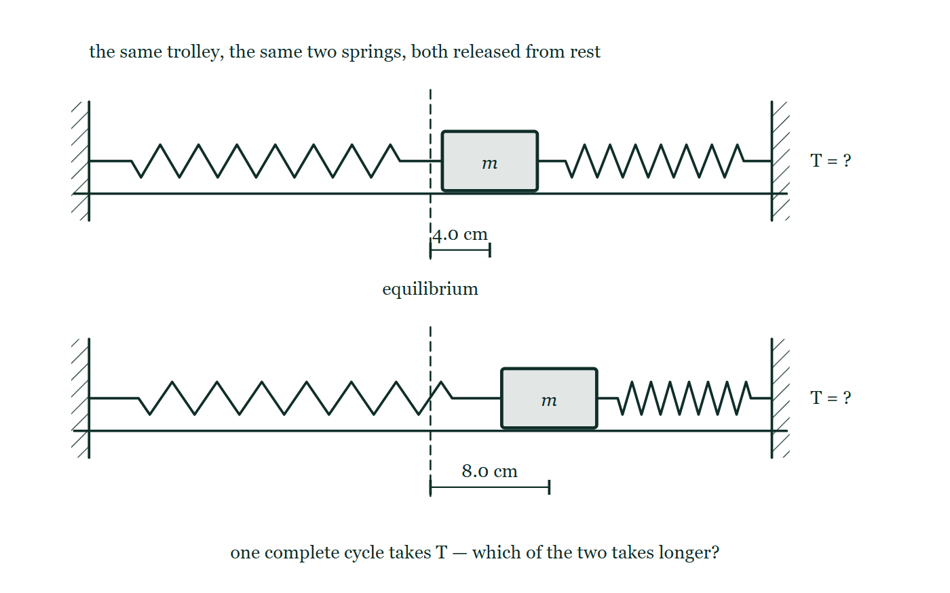
OSCILLATIONS · SIMPLE HARMONIC MOTION
GIOPHYSICS LESSON
THINK FIRST
A grandfather clock swings a wider arc just after it is wound. Why doesn't it run fast for the rest of the week?
Take answers before you click — the point is the commitment
You can watch the arc narrow day by day as the weight descends and friction takes its share. The pendulum is plainly covering less ground by Friday than it did on Monday.
THE ANSWER
Because the period of simple harmonic motion does not depend on the amplitude. A wider swing has further to travel, but it is also pulled back harder at every point of the journey, and the two effects cancel exactly. That is isochronism, and it is why pendulums ran the world's clocks — it does eventually fail, but only at large angles, where the restoring force falls behind.
The same trolley between the same two springs, drawn twice: pulled 4.0 cm to the right of the dashed equilibrium line in the upper picture and 8.0 cm in the lower one, both still held, with the period marked only as a question mark beside each.
The live version of this figure — click here
Oscillations — Simple Harmonic Motion. Built by GioPhysics from the lesson's own copy; nothing on these slides is re-authored.
3 / 37
Notes:
[Phase] Starter: Recall what this lesson stands on (minutes 0–5 of 45)
[Hook] A grandfather clock swings a wider arc just after it is wound. Why doesn't it run fast for the rest of the week? You can watch the arc narrow day by day as the weight descends and friction takes its share. The pendulum is plainly covering less ground by Friday than it did on Monday.
[Answer] Because the period of simple harmonic motion does not depend on the amplitude. A wider swing has further to travel, but it is also pulled back harder at every point of the journey, and the two effects cancel exactly. That is isochronism, and it is why pendulums ran the world's clocks — it does eventually fail, but only at large angles, where the restoring force falls behind.
[Figure] The same trolley between the same two springs, drawn twice: pulled 4.0 cm to the right of the dashed equilibrium line in the upper picture and 8.0 cm in the lower one, both still held, with the period marked only as a question mark beside each.

Slide 4
OSCILLATIONS · SIMPLE HARMONIC MOTION
GIOPHYSICS LESSON
EXPLAINED SIMPLY
In one sentence
Introduce the idea — The big idea and the definition
Simple harmonic motion is any oscillation in which the acceleration is proportional to the displacement from equilibrium and directed back towards it: a = −ω²x.
Oscillations — Simple Harmonic Motion. Built by GioPhysics from the lesson's own copy; nothing on these slides is re-authored.
4 / 37
Notes:
[Phase] Introduce the idea: The big idea and the definition (minutes 5–13 of 45)
[Definition] Simple harmonic motion is any oscillation in which the acceleration is proportional to the displacement from equilibrium and directed back towards it: a = −ω²x.

Slide 5
OSCILLATIONS · SIMPLE HARMONIC MOTION
GIOPHYSICS LESSON
EXPLAINED SIMPLY
What that looks like
Introduce the idea — The big idea and the definition
FOR EXAMPLE
Displace a trolley between two springs by 4 cm and release it: it accelerates back through the centre, overshoots, and repeats — and doubling the pull-back to 8 cm changes the amplitude but not the time per cycle.
Oscillations — Simple Harmonic Motion. Built by GioPhysics from the lesson's own copy; nothing on these slides is re-authored.
5 / 37
Notes:
[Phase] Introduce the idea: The big idea and the definition (minutes 5–13 of 45)
[Worked illustration] Displace a trolley between two springs by 4 cm and release it: it accelerates back through the centre, overshoots, and repeats — and doubling the pull-back to 8 cm changes the amplitude but not the time per cycle.

Slide 6
OSCILLATIONS · SIMPLE HARMONIC MOTION
GIOPHYSICS LESSON
THE BIG IDEA
One condition defines the motion
Introduce the idea — The big idea and the definition
An oscillation is a vibration that repeats. Displacement x is measured from the equilibrium position, and the amplitude A is the largest displacement reached. Simple harmonic motion is the special case defined by one condition: the acceleration is proportional to the displacement and points back at equilibrium, a = −ω²x.
Any restoring force F ∝ −x produces it — Hooke’s law F = −kx gives a mass on a spring a = −(k/m)x, so the spring system is SHM exactly. The motion traces perfect sinusoids, with velocity zero at the extremes and largest at the centre, and its period is set by the system alone: T = 2π√(m/k) for a mass–spring, T = 2π√(L/g) for a small-angle pendulum.
Oscillations — Simple Harmonic Motion. Built by GioPhysics from the lesson's own copy; nothing on these slides is re-authored.
6 / 37
Notes:
[Phase] Introduce the idea: The big idea and the definition (minutes 5–13 of 45)
[Big idea] An oscillation is a vibration that repeats. Displacement x is measured from the equilibrium position, and the amplitude A is the largest displacement reached. Simple harmonic motion is the special case defined by one condition: the acceleration is proportional to the displacement and points back at equilibrium, a = −ω²x. Any restoring force F ∝ −x produces it — Hooke’s law F = −kx gives a mass on a spring a = −(k/m)x, so the spring system is SHM exactly. The motion traces perfect sinusoids, with velocity zero at the extremes and largest at the centre, and its period is set by the system alone: T = 2π√(m/k) for a mass–spring, T = 2π√(L/g) for a small-angle pendulum.

Slide 7
OSCILLATIONS · SIMPLE HARMONIC MOTION
GIOPHYSICS LESSON
THE PHYSICS · 1 OF 4
Restoring forces make SHM
Build the model — The formulae, one at a time, in plain English
Stretch a spring right and it pulls left; compress it left and it pushes right. Hooke’s law F = −kx captures this opposition, and Newton’s second law turns it into a = −(k/m)x — acceleration proportional to minus the displacement. Any force with this shape, whatever its origin, drives simple harmonic motion.
Oscillations — Simple Harmonic Motion. Built by GioPhysics from the lesson's own copy; nothing on these slides is re-authored.
7 / 37
Notes:
[Phase] Build the model: The formulae, one at a time, in plain English (minutes 13–22 of 45)
[Section] Stretch a spring right and it pulls left; compress it left and it pushes right. Hooke’s law F = −kx captures this opposition, and Newton’s second law turns it into a = −(k/m)x — acceleration proportional to minus the displacement. Any force with this shape, whatever its origin, drives simple harmonic motion.

Slide 8
OSCILLATIONS · SIMPLE HARMONIC MOTION
GIOPHYSICS LESSON
THE PHYSICS · 2 OF 4
Three graphs, one motion
Build the model — The formulae, one at a time, in plain English
If x follows a cosine, the velocity is a negative sine and the acceleration a negative cosine. At the extremes the object is momentarily at rest (v = 0) while the acceleration is largest; through the centre the speed peaks at v(max) = ωA while the acceleration passes through zero. The a-graph is always the x-graph flipped upside down — that is a = −ω²x drawn out in time.
Oscillations — Simple Harmonic Motion. Built by GioPhysics from the lesson's own copy; nothing on these slides is re-authored.
8 / 37
Notes:
[Phase] Build the model: The formulae, one at a time, in plain English (minutes 13–22 of 45)
[Section] If x follows a cosine, the velocity is a negative sine and the acceleration a negative cosine. At the extremes the object is momentarily at rest (v = 0) while the acceleration is largest; through the centre the speed peaks at v(max) = ωA while the acceleration passes through zero. The a-graph is always the x-graph flipped upside down — that is a = −ω²x drawn out in time.

Slide 9
OSCILLATIONS · SIMPLE HARMONIC MOTION
GIOPHYSICS LESSON
THE PHYSICS · 3 OF 4
Isochronism — why clocks swing
Build the model — The formulae, one at a time, in plain English
For ideal SHM the period is independent of amplitude: a small swing and a large one take exactly the same time, because a bigger displacement earns a proportionally bigger restoring pull. A pendulum only approximates this at small angles — push it to large angles and the restoring force falls behind, the period stretches, and the isochronism that once ran the world’s clocks slips away.
Oscillations — Simple Harmonic Motion. Built by GioPhysics from the lesson's own copy; nothing on these slides is re-authored.
9 / 37
Notes:
[Phase] Build the model: The formulae, one at a time, in plain English (minutes 13–22 of 45)
[Section] For ideal SHM the period is independent of amplitude: a small swing and a large one take exactly the same time, because a bigger displacement earns a proportionally bigger restoring pull. A pendulum only approximates this at small angles — push it to large angles and the restoring force falls behind, the period stretches, and the isochronism that once ran the world’s clocks slips away.

Slide 10
OSCILLATIONS · SIMPLE HARMONIC MOTION
GIOPHYSICS LESSON
THE PHYSICS · 4 OF 4
Phase difference
Build the model — The formulae, one at a time, in plain English
Two identical oscillators can run at the same T and f yet be out of step. Release one from the right as you release the other from the left and they stay half a cycle apart forever — a phase difference of T/2, or π radians.
Starting one at equilibrium with a push while the other starts stretched gives a quarter-cycle difference. Phase measures where in its cycle each oscillator is.
Oscillations — Simple Harmonic Motion. Built by GioPhysics from the lesson's own copy; nothing on these slides is re-authored.
10 / 37
Notes:
[Phase] Build the model: The formulae, one at a time, in plain English (minutes 13–22 of 45)
[Section] Two identical oscillators can run at the same T and f yet be out of step. Release one from the right as you release the other from the left and they stay half a cycle apart forever — a phase difference of T/2, or π radians. Starting one at equilibrium with a push while the other starts stretched gives a quarter-cycle difference. Phase measures where in its cycle each oscillator is.

Slide 11
OSCILLATIONS · SIMPLE HARMONIC MOTION
GIOPHYSICS LESSON
FORMULA 1 OF 4
Defining condition
Build the model — The formulae, one at a time, in plain English
a = −ω²x
The minus sign is the whole definition
IN PLAIN ENGLISH
Acceleration proportional to displacement, always aimed back at equilibrium. The constant ω is the angular frequency: ω = 2πf = 2π/T.
Oscillations — Simple Harmonic Motion. Built by GioPhysics from the lesson's own copy; nothing on these slides is re-authored.
11 / 37
Notes:
[Phase] Build the model: The formulae, one at a time, in plain English (minutes 13–22 of 45)
[Formula] Defining condition: a = −ω²x
[In plain English] Acceleration proportional to displacement, always aimed back at equilibrium. The constant ω is the angular frequency: ω = 2πf = 2π/T.
[Note] The minus sign is the whole definition

Slide 12
OSCILLATIONS · SIMPLE HARMONIC MOTION
GIOPHYSICS LESSON
FORMULA 2 OF 4
Period and frequency
Build the model — The formulae, one at a time, in plain English
T = 1/f · ω = 2πf
T in seconds per cycle; f in Hz
IN PLAIN ENGLISH
Period is seconds per cycle; frequency is cycles per second — each is the reciprocal of the other. ω counts the cycle in radians: one full cycle is 2π.
Oscillations — Simple Harmonic Motion. Built by GioPhysics from the lesson's own copy; nothing on these slides is re-authored.
12 / 37
Notes:
[Phase] Build the model: The formulae, one at a time, in plain English (minutes 13–22 of 45)
[Formula] Period and frequency: T = 1/f · ω = 2πf
[In plain English] Period is seconds per cycle; frequency is cycles per second — each is the reciprocal of the other. ω counts the cycle in radians: one full cycle is 2π.
[Note] T in seconds per cycle; f in Hz

Slide 13
OSCILLATIONS · SIMPLE HARMONIC MOTION
GIOPHYSICS LESSON
FORMULA 3 OF 4
Mass on a spring
Build the model — The formulae, one at a time, in plain English
T = 2π√(m/k)
Stiffer spring → shorter period
IN PLAIN ENGLISH
A heavier mass is harder to turn around, so T grows with m; a stiffer spring pulls back harder, so T shrinks with k. The amplitude appears nowhere.
Oscillations — Simple Harmonic Motion. Built by GioPhysics from the lesson's own copy; nothing on these slides is re-authored.
13 / 37
Notes:
[Phase] Build the model: The formulae, one at a time, in plain English (minutes 13–22 of 45)
[Formula] Mass on a spring: T = 2π√(m/k)
[In plain English] A heavier mass is harder to turn around, so T grows with m; a stiffer spring pulls back harder, so T shrinks with k. The amplitude appears nowhere.
[Note] Stiffer spring → shorter period

Slide 14
OSCILLATIONS · SIMPLE HARMONIC MOTION
GIOPHYSICS LESSON
FORMULA 4 OF 4
Simple pendulum
Build the model — The formulae, one at a time, in plain English
T = 2π√(L/g)
Small angles only — and no mass in sight
IN PLAIN ENGLISH
Gravity supplies the restoring force, and for small swings it is very nearly proportional to displacement. Longer pendulum, longer period; the mass of the bob cancels out.
Oscillations — Simple Harmonic Motion. Built by GioPhysics from the lesson's own copy; nothing on these slides is re-authored.
14 / 37
Notes:
[Phase] Build the model: The formulae, one at a time, in plain English (minutes 13–22 of 45)
[Formula] Simple pendulum: T = 2π√(L/g)
[In plain English] Gravity supplies the restoring force, and for small swings it is very nearly proportional to displacement. Longer pendulum, longer period; the mass of the bob cancels out.
[Note] Small angles only — and no mass in sight

Slide 15
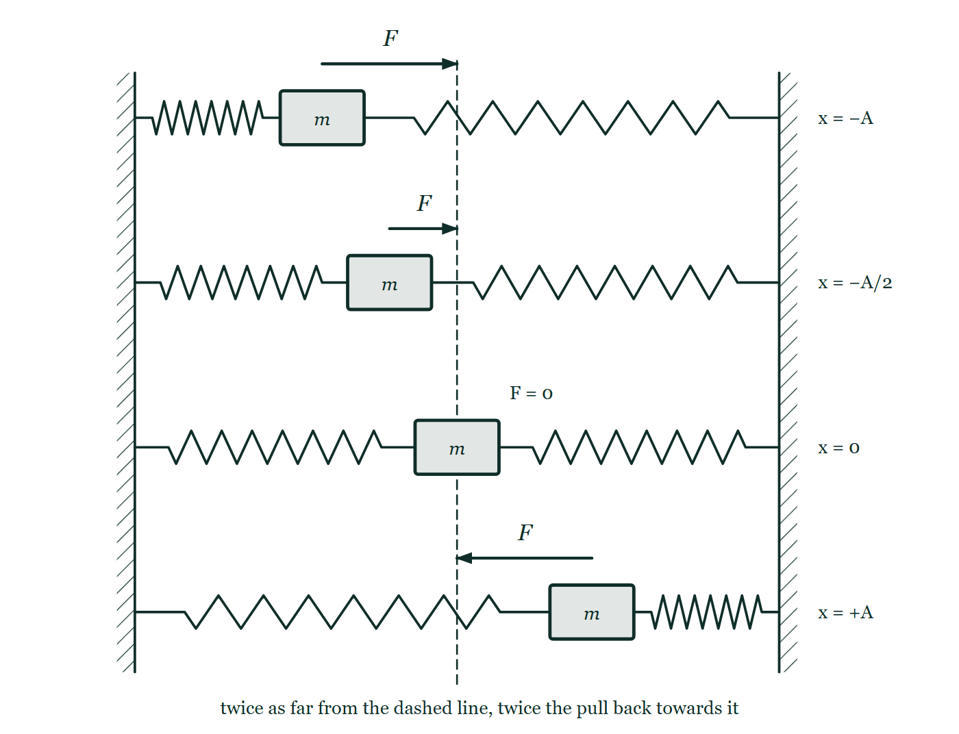
OSCILLATIONS · SIMPLE HARMONIC MOTION
GIOPHYSICS LESSON
THE PICTURE
The pull-back grows with the distance
Drawn for this lesson
The trolley drawn at four displacements from the dashed equilibrium — at −A, at −A/2, at rest in the middle and at +A — with the restoring force above it as an arrow pointing back at the dashed line and drawn at exactly half the length when the displacement is halved.
The live version of this figure — click here
Oscillations — Simple Harmonic Motion. Built by GioPhysics from the lesson's own copy; nothing on these slides is re-authored.
15 / 37
Notes:
[Phase] Build the model: The formulae, one at a time, in plain English (minutes 13–22 of 45)
[Figure] The trolley drawn at four displacements from the dashed equilibrium — at −A, at −A/2, at rest in the middle and at +A — with the restoring force above it as an arrow pointing back at the dashed line and drawn at exactly half the length when the displacement is halved.

Slide 16
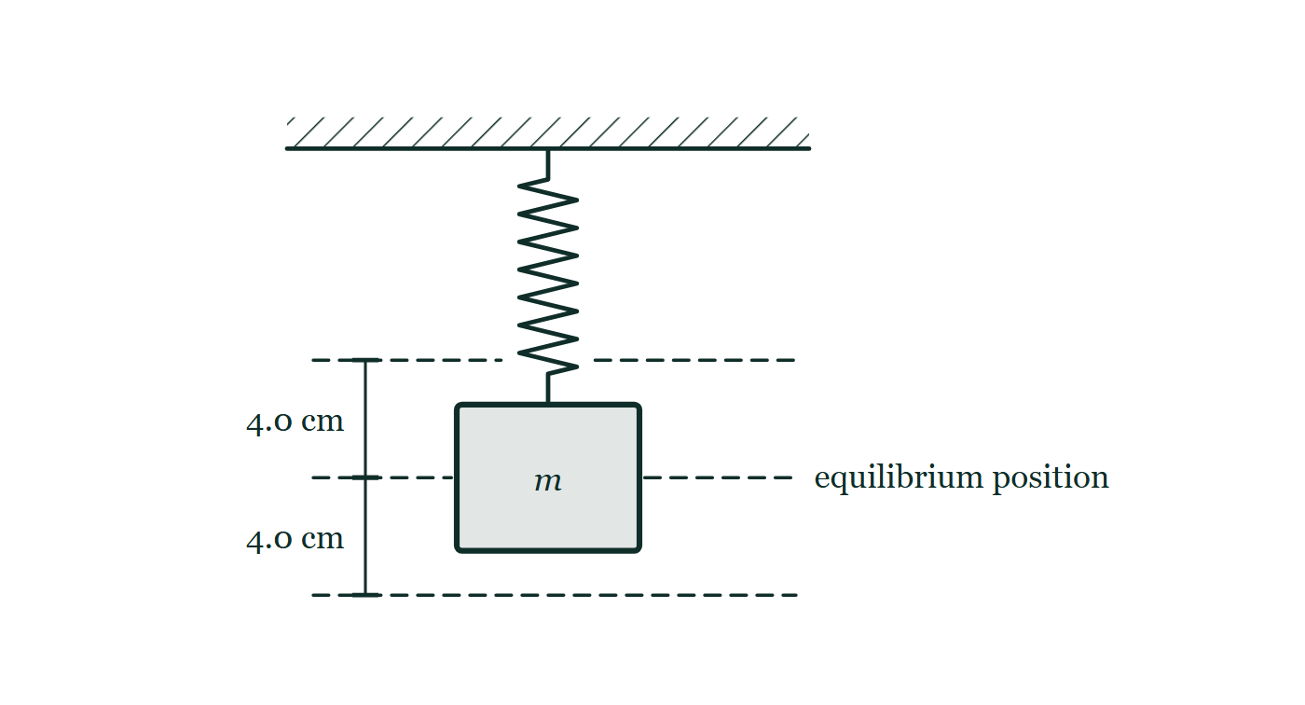
OSCILLATIONS · SIMPLE HARMONIC MOTION
GIOPHYSICS LESSON
FIGURE 1 OF 3
Fig. 9.1 — A Level · Topics 12–25
Drawn for question 9 of that paper · syllabus 17
A spring hangs vertically from a rigid horizontal support drawn with hatching above it, and a block labelled m is attached to the lower end of the spring. A dashed horizontal line level with the centre of the block is labelled equilibrium position. Two further dashed horizontal lines, one above it and one below it, mark the highest and lowest positions the block reaches, and the distance from the equilibrium line to each of them is marked 4.0 cm.
See the question this was drawn for — click here
Oscillations — Simple Harmonic Motion. Built by GioPhysics from the lesson's own copy; nothing on these slides is re-authored.
16 / 37
Notes:
[Phase] Build the model: The formulae, one at a time, in plain English (minutes 13–22 of 45)
[Figure] Fig. 9.1. A spring hangs vertically from a rigid horizontal support drawn with hatching above it, and a block labelled m is attached to the lower end of the spring. A dashed horizontal line level with the centre of the block is labelled equilibrium position. Two further dashed horizontal lines, one above it and one below it, mark the highest and lowest positions the block reaches, and the distance from the equilibrium line to each of them is marked 4.0 cm.
[Where it came from] A Level · Topics 12–25, question 9; syllabus 17.

Slide 17
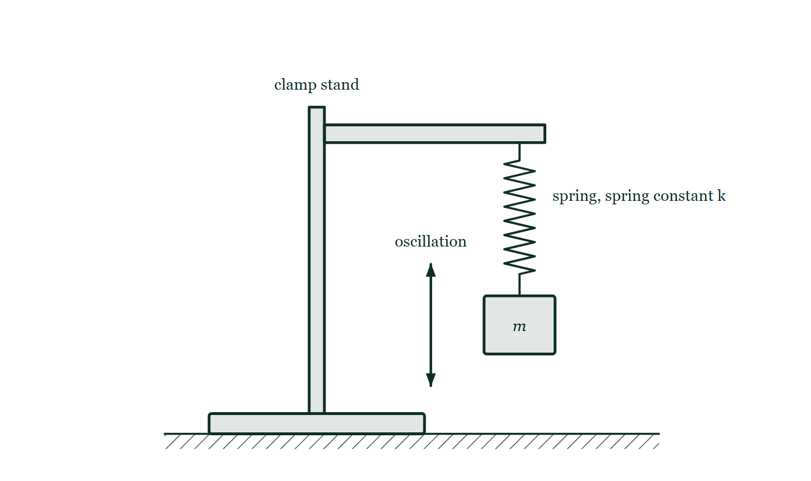
OSCILLATIONS · SIMPLE HARMONIC MOTION
GIOPHYSICS LESSON
FIGURE 2 OF 3
Figure 4 — IB Theme C · Wave behaviour
Drawn for question 7 of that paper · syllabus C.1
Side view of the apparatus on a bench. A vertical rod rises from the heavy base of a clamp stand, and a horizontal clamp arm projects from the top of the rod. A helical spring hangs from the end of the arm and is labelled 'spring, spring constant k'. A rectangular block labelled m hangs from the lower end of the spring. Beside the mass a vertical double-headed arrow labelled 'oscillation' shows that it moves up and down about its hanging position.
See the question this was drawn for — click here
Oscillations — Simple Harmonic Motion. Built by GioPhysics from the lesson's own copy; nothing on these slides is re-authored.
17 / 37
Notes:
[Phase] Build the model: The formulae, one at a time, in plain English (minutes 13–22 of 45)
[Figure] Figure 4. Side view of the apparatus on a bench. A vertical rod rises from the heavy base of a clamp stand, and a horizontal clamp arm projects from the top of the rod. A helical spring hangs from the end of the arm and is labelled 'spring, spring constant k'. A rectangular block labelled m hangs from the lower end of the spring. Beside the mass a vertical double-headed arrow labelled 'oscillation' shows that it moves up and down about its hanging position.
[Where it came from] IB Theme C · Wave behaviour, question 7; syllabus C.1.

Slide 18
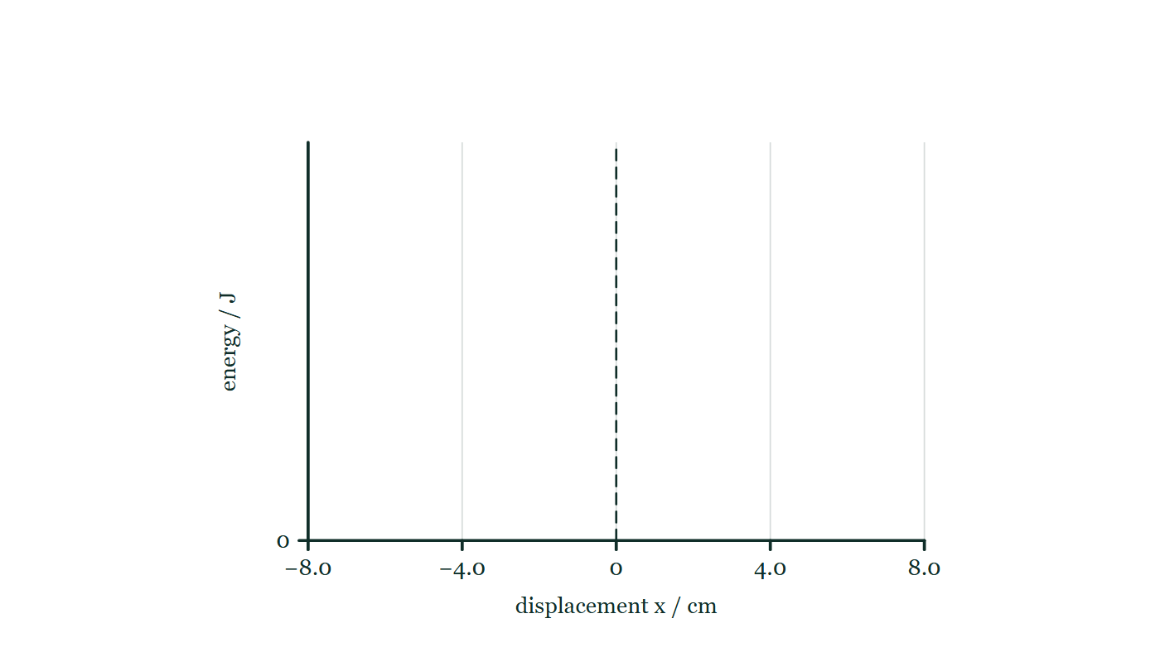
OSCILLATIONS · SIMPLE HARMONIC MOTION
GIOPHYSICS LESSON
FIGURE 3 OF 3
Figure 6 — IB Theme C · Wave behaviour
Drawn for question 10 of that paper · syllabus C.1, C.5
A pair of empty axes provided for the sketch. The horizontal axis is labelled 'displacement x / cm' and is scaled from −8.0 through 0 to +8.0, with faint gridlines at −8.0, −4.0, 0, +4.0 and +8.0 and a dashed vertical line drawn at x = 0. The vertical axis is labelled 'energy / J' and carries only a zero at its foot, so no numerical scale is imposed. No curve of any kind is drawn on the axes.
See the question this was drawn for — click here
Oscillations — Simple Harmonic Motion. Built by GioPhysics from the lesson's own copy; nothing on these slides is re-authored.
18 / 37
Notes:
[Phase] Build the model: The formulae, one at a time, in plain English (minutes 13–22 of 45)
[Figure] Figure 6. A pair of empty axes provided for the sketch. The horizontal axis is labelled 'displacement x / cm' and is scaled from −8.0 through 0 to +8.0, with faint gridlines at −8.0, −4.0, 0, +4.0 and +8.0 and a dashed vertical line drawn at x = 0. The vertical axis is labelled 'energy / J' and carries only a zero at its foot, so no numerical scale is imposed. No curve of any kind is drawn on the axes.
[Where it came from] IB Theme C · Wave behaviour, question 10; syllabus C.1, C.5.

Slide 19
OSCILLATIONS · SIMPLE HARMONIC MOTION
GIOPHYSICS LESSON
WATCH OUT
The common trap
Check and misconception — The quick check and the trap
Amplitude does not set the period. In ideal SHM a louder oscillation — twice the amplitude — covers twice the distance but with proportionally larger accelerations, and the cycle time comes out identical.
The period belongs to the system (m and k, or L and g), not to how hard you started it. And a pendulum’s period does not depend on the mass of its bob at all.
Oscillations — Simple Harmonic Motion. Built by GioPhysics from the lesson's own copy; nothing on these slides is re-authored.
19 / 37
Notes:
[Phase] Check and misconception: The quick check and the trap (minutes 35–41 of 45)
[Misconception] Amplitude does not set the period. In ideal SHM a louder oscillation — twice the amplitude — covers twice the distance but with proportionally larger accelerations, and the cycle time comes out identical. The period belongs to the system (m and k, or L and g), not to how hard you started it. And a pendulum’s period does not depend on the mass of its bob at all.

Slide 20
OSCILLATIONS · SIMPLE HARMONIC MOTION
GIOPHYSICS LESSON
WORKED EXAMPLE 1 OF 2 · EASY
The question
Easy
Worked examples — I do, we do — one step revealed at a time
A mass on a spring completes one full oscillation every 24 s. Find the period and the frequency.
Oscillations — Simple Harmonic Motion. Built by GioPhysics from the lesson's own copy; nothing on these slides is re-authored.
20 / 37
Notes:
[Phase] Worked examples: I do, we do — one step revealed at a time (minutes 22–35 of 45)
[Question] A mass on a spring completes one full oscillation every 24 s. Find the period and the frequency.
[Answer] T = 24 s; f ≈ 0.042 Hz

Slide 21
OSCILLATIONS · SIMPLE HARMONIC MOTION
GIOPHYSICS LESSON
WORKED EXAMPLE 1 OF 2 · EASY · THE WORKING
How to solve it
Easy
Worked examples — I do, we do — one step revealed at a time
A mass on a spring completes one full oscillation every 24 s. Find the period and the frequency.
1.
The period is the time for one cycle: T = 24 s.
2.
f = 1/T = 1/24 ≈ 0.042 Hz — about four hundredths of a cycle each second.
Oscillations — Simple Harmonic Motion. Built by GioPhysics from the lesson's own copy; nothing on these slides is re-authored.
21 / 37
Notes:
[Phase] Worked examples: I do, we do — one step revealed at a time (minutes 22–35 of 45)
[Reveal] One click per step. The class works each line before the next appears.
[Step 1] The period is the time for one cycle: T = 24 s.
[Step 2] f = 1/T = 1/24 ≈ 0.042 Hz — about four hundredths of a cycle each second.

Slide 22
OSCILLATIONS · SIMPLE HARMONIC MOTION
GIOPHYSICS LESSON
WORKED EXAMPLE 1 OF 2 · EASY
Answer
Easy
Worked examples — I do, we do — one step revealed at a time
T = 24 s; f ≈ 0.042 Hz
Oscillations — Simple Harmonic Motion. Built by GioPhysics from the lesson's own copy; nothing on these slides is re-authored.
22 / 37
Notes:
[Phase] Worked examples: I do, we do — one step revealed at a time (minutes 22–35 of 45)
[Answer] T = 24 s; f ≈ 0.042 Hz

Slide 23
OSCILLATIONS · SIMPLE HARMONIC MOTION
GIOPHYSICS LESSON
WORKED EXAMPLE 2 OF 2 · MEDIUM
The question
Medium
Worked examples — I do, we do — one step revealed at a time
A spring of constant k = 125 N m⁻¹ carries a 5.0 kg mass. Show that a = −25x, and find the acceleration at x = −2.0 m.
Oscillations — Simple Harmonic Motion. Built by GioPhysics from the lesson's own copy; nothing on these slides is re-authored.
23 / 37
Notes:
[Phase] Worked examples: I do, we do — one step revealed at a time (minutes 22–35 of 45)
[Question] A spring of constant k = 125 N m⁻¹ carries a 5.0 kg mass. Show that a = −25x, and find the acceleration at x = −2.0 m.
[Answer] a = −25x; a = +50 m s⁻² at x = −2.0 m

Slide 24
OSCILLATIONS · SIMPLE HARMONIC MOTION
GIOPHYSICS LESSON
WORKED EXAMPLE 2 OF 2 · MEDIUM · THE WORKING
How to solve it
Medium
Worked examples — I do, we do — one step revealed at a time
A spring of constant k = 125 N m⁻¹ carries a 5.0 kg mass. Show that a = −25x, and find the acceleration at x = −2.0 m.
1.
Hooke’s law F = −kx with Newton’s second law F = ma gives a = −(k/m)x.
2.
a = −(125/5.0)x = −25x — acceleration proportional to minus displacement, so this is SHM with ω² = 25.
3.
At x = −2.0 m: a = −25 × (−2.0) = +50 m s⁻² — displaced left, accelerating right, back towards equilibrium.
Oscillations — Simple Harmonic Motion. Built by GioPhysics from the lesson's own copy; nothing on these slides is re-authored.
24 / 37
Notes:
[Phase] Worked examples: I do, we do — one step revealed at a time (minutes 22–35 of 45)
[Reveal] One click per step. The class works each line before the next appears.
[Step 1] Hooke’s law F = −kx with Newton’s second law F = ma gives a = −(k/m)x.
[Step 2] a = −(125/5.0)x = −25x — acceleration proportional to minus displacement, so this is SHM with ω² = 25.
[Step 3] At x = −2.0 m: a = −25 × (−2.0) = +50 m s⁻² — displaced left, accelerating right, back towards equilibrium.

Slide 25
OSCILLATIONS · SIMPLE HARMONIC MOTION
GIOPHYSICS LESSON
WORKED EXAMPLE 2 OF 2 · MEDIUM
Answer
Medium
Worked examples — I do, we do — one step revealed at a time
a = −25x; a = +50 m s⁻² at x = −2.0 m
Oscillations — Simple Harmonic Motion. Built by GioPhysics from the lesson's own copy; nothing on these slides is re-authored.
25 / 37
Notes:
[Phase] Worked examples: I do, we do — one step revealed at a time (minutes 22–35 of 45)
[Answer] a = −25x; a = +50 m s⁻² at x = −2.0 m

Slide 26
OSCILLATIONS · SIMPLE HARMONIC MOTION
GIOPHYSICS LESSON
SPOT THE MISTAKE
One line here is wrong
The whole working is up — find the bad line before you click
1.
Find the length of a simple pendulum with a period of 2.0 s. Take g = 9.81 m s⁻².
2.
T = 2π√(L/g)
3.
√(L/g) = T/2π = 2.0 / 6.283 = 0.318
4.
L/g = 0.318, so L = 0.318 × 9.81 = 3.1 m
5.
A pendulum 3.1 m long beats seconds.
LINE 4 IS WRONG
The square root was never undone. 0.318 is √(L/g), not L/g, so it has to be squared before g goes anywhere near it. The line is easy to lose because 0.318 looks like a finished number, and 3.1 m looks like a perfectly reasonable pendulum. The check is the answer itself: a seconds pendulum is famously about a metre long, which is why it was once a candidate for defining the metre.
IT SHOULD SAY
L/g = 0.318² = 0.101, so L = 0.101 × 9.81 = 0.99 m
Oscillations — Simple Harmonic Motion. Built by GioPhysics from the lesson's own copy; nothing on these slides is re-authored.
26 / 37
Notes:
[Phase] Worked examples: I do, we do — one step revealed at a time (minutes 22–35 of 45)
[Spot the mistake] The working is complete and one line of it is wrong. Let the room hunt: one click names the line, a second shows it done correctly.
[Line 4 is wrong] The square root was never undone. 0.318 is √(L/g), not L/g, so it has to be squared before g goes anywhere near it. The line is easy to lose because 0.318 looks like a finished number, and 3.1 m looks like a perfectly reasonable pendulum. The check is the answer itself: a seconds pendulum is famously about a metre long, which is why it was once a candidate for defining the metre.
[It should say] L/g = 0.318² = 0.101, so L = 0.101 × 9.81 = 0.99 m

Slide 27
OSCILLATIONS · SIMPLE HARMONIC MOTION
GIOPHYSICS LESSON
PREDICT · TAKE THE VOTE
Commit before you are told
Hands up for each option, then click
Both trolleys are released at the same instant. Which one completes a full cycle first?
A The 4.0 cm one — it has half as far to travel
B The 8.0 cm one — it starts with twice the pull
C They complete the cycle together
The same trolley between the same two springs, drawn twice: pulled 4.0 cm to the right of the dashed equilibrium line in the upper picture and 8.0 cm in the lower one, both still held, with the period marked only as a question mark beside each.
The live version of this figure — click here
Oscillations — Simple Harmonic Motion. Built by GioPhysics from the lesson's own copy; nothing on these slides is re-authored.
27 / 37
Notes:
[Phase] Build the model: The formulae, one at a time, in plain English (minutes 13–22 of 45)
[Predict] Both trolleys are released at the same instant. Which one completes a full cycle first?
[Options] A The 4.0 cm one — it has half as far to travel B The 8.0 cm one — it starts with twice the pull C They complete the cycle together
[Figure] The same trolley between the same two springs, drawn twice: pulled 4.0 cm to the right of the dashed equilibrium line in the upper picture and 8.0 cm in the lower one, both still held, with the period marked only as a question mark beside each.

Slide 28
OSCILLATIONS · SIMPLE HARMONIC MOTION
GIOPHYSICS LESSON
PREDICT · THE OUTCOME
What actually happens
Ask the room who changed their mind, and why
C They complete the cycle together
WHY
Both effects the first two answers name are real, and they are the same size. The 8.0 cm trolley has twice the distance to cover, and it is released with twice the spring force, so twice the acceleration, at every matching point of the journey. Double the distance at double the pace takes the same time. T = 2π√(m/k) has no A in it anywhere: the period belongs to the trolley and its springs, not to how hard you pulled.
Oscillations — Simple Harmonic Motion. Built by GioPhysics from the lesson's own copy; nothing on these slides is re-authored.
28 / 37
Notes:
[Phase] Build the model: The formulae, one at a time, in plain English (minutes 13–22 of 45)
[Answer] C — They complete the cycle together. Both effects the first two answers name are real, and they are the same size. The 8.0 cm trolley has twice the distance to cover, and it is released with twice the spring force, so twice the acceleration, at every matching point of the journey. Double the distance at double the pace takes the same time. T = 2π√(m/k) has no A in it anywhere: the period belongs to the trolley and its springs, not to how hard you pulled.

Slide 29
OSCILLATIONS · SIMPLE HARMONIC MOTION
GIOPHYSICS LESSON
QUICK CHECK
Decide before the answer goes up
Check and misconception — The quick check and the trap
At the extreme ends of a simple harmonic oscillation, the object has…
A
Maximum speed and zero acceleration
B
Zero speed and maximum acceleration
C
Zero speed and zero acceleration
Oscillations — Simple Harmonic Motion. Built by GioPhysics from the lesson's own copy; nothing on these slides is re-authored.
29 / 37
Notes:
[Phase] Check and misconception: The quick check and the trap (minutes 35–41 of 45)
[Question] At the extreme ends of a simple harmonic oscillation, the object has…
[Options] A Maximum speed and zero acceleration B Zero speed and maximum acceleration C Zero speed and zero acceleration

Slide 30
OSCILLATIONS · SIMPLE HARMONIC MOTION
GIOPHYSICS LESSON
QUICK CHECK · THE ANSWER
The answer, and why
Check and misconception — The quick check and the trap
B Zero speed and maximum acceleration
HOW TO GET THERE
At x = ±A the object momentarily stops, but a = −ω²x is largest there — that maximum pull-back is what turns the motion around.
WHY THE OTHERS TEMPT
A Maximum speed and zero acceleration is the exact description of the centre, where the springs are at their natural length and the trolley is flying through. It is the opposite end of the motion from the one asked about — which is why this option is so easy to pick when reading quickly.
B Correct. At x = ±A the trolley has stopped for an instant, and a = −ω²x is at its largest there. That maximum pull-back is precisely what turns the motion around.
C Half of this is right: the speed really is zero. But zero velocity and zero acceleration are different statements — a body can be at rest and still be having its velocity changed, and here the spring is stretched to its limit and pulling hardest of all.
Oscillations — Simple Harmonic Motion. Built by GioPhysics from the lesson's own copy; nothing on these slides is re-authored.
30 / 37
Notes:
[Phase] Check and misconception: The quick check and the trap (minutes 35–41 of 45)
[Question] At the extreme ends of a simple harmonic oscillation, the object has…
[Option by option] A: Maximum speed and zero acceleration is the exact description of the centre, where the springs are at their natural length and the trolley is flying through. It is the opposite end of the motion from the one asked about — which is why this option is so easy to pick when reading quickly. B: Correct. At x = ±A the trolley has stopped for an instant, and a = −ω²x is at its largest there. That maximum pull-back is precisely what turns the motion around. C: Half of this is right: the speed really is zero. But zero velocity and zero acceleration are different statements — a body can be at rest and still be having its velocity changed, and here the spring is stretched to its limit and pulling hardest of all.
[Answer] B — Zero speed and maximum acceleration
[Why] At x = ±A the object momentarily stops, but a = −ω²x is largest there — that maximum pull-back is what turns the motion around.
[Reveal] One click for the answer, then one for the reason.

Slide 31
OSCILLATIONS · SIMPLE HARMONIC MOTION
GIOPHYSICS LESSON
EXTENSION 1 OF 2 · HARD
The question
Hard
Worked examples — I do, we do — one step revealed at a time
Find the length of a simple pendulum with a period of exactly 2.0 s (a ‘seconds pendulum’), taking g = 9.81 m s⁻².
Oscillations — Simple Harmonic Motion. Built by GioPhysics from the lesson's own copy; nothing on these slides is re-authored.
31 / 37
Notes:
[Phase] Worked examples: I do, we do — one step revealed at a time (minutes 22–35 of 45)
[Question] Find the length of a simple pendulum with a period of exactly 2.0 s (a ‘seconds pendulum’), taking g = 9.81 m s⁻².
[Answer] L ≈ 0.99 m

Slide 32
OSCILLATIONS · SIMPLE HARMONIC MOTION
GIOPHYSICS LESSON
EXTENSION 1 OF 2 · HARD · THE WORKING
How to solve it
Hard
Worked examples — I do, we do — one step revealed at a time
Find the length of a simple pendulum with a period of exactly 2.0 s (a ‘seconds pendulum’), taking g = 9.81 m s⁻².
1.
T = 2π√(L/g) → L = gT²/(4π²).
2.
L = 9.81 × 4.0 ÷ 39.48 ≈ 0.99 m.
3.
Almost exactly one metre — a historical candidate for defining the metre itself.
Oscillations — Simple Harmonic Motion. Built by GioPhysics from the lesson's own copy; nothing on these slides is re-authored.
32 / 37
Notes:
[Phase] Worked examples: I do, we do — one step revealed at a time (minutes 22–35 of 45)
[Reveal] One click per step. The class works each line before the next appears.
[Step 1] T = 2π√(L/g) → L = gT²/(4π²).
[Step 2] L = 9.81 × 4.0 ÷ 39.48 ≈ 0.99 m.
[Step 3] Almost exactly one metre — a historical candidate for defining the metre itself.

Slide 33
OSCILLATIONS · SIMPLE HARMONIC MOTION
GIOPHYSICS LESSON
EXTENSION 1 OF 2 · HARD
Answer
Hard
Worked examples — I do, we do — one step revealed at a time
L ≈ 0.99 m
Oscillations — Simple Harmonic Motion. Built by GioPhysics from the lesson's own copy; nothing on these slides is re-authored.
33 / 37
Notes:
[Phase] Worked examples: I do, we do — one step revealed at a time (minutes 22–35 of 45)
[Answer] L ≈ 0.99 m

Slide 34
OSCILLATIONS · SIMPLE HARMONIC MOTION
GIOPHYSICS LESSON
EXTENSION 2 OF 2 · CHALLENGING
The question
Challenging
Worked examples — I do, we do — one step revealed at a time
A 0.50 kg mass on a spring (k = 80 N m⁻¹) oscillates with amplitude 6.0 cm. Find ω, the period, the maximum speed, and the maximum acceleration.
Oscillations — Simple Harmonic Motion. Built by GioPhysics from the lesson's own copy; nothing on these slides is re-authored.
34 / 37
Notes:
[Phase] Worked examples: I do, we do — one step revealed at a time (minutes 22–35 of 45)
[Question] A 0.50 kg mass on a spring (k = 80 N m⁻¹) oscillates with amplitude 6.0 cm. Find ω, the period, the maximum speed, and the maximum acceleration.
[Answer] ω ≈ 12.6 rad s⁻¹, T ≈ 0.50 s, v(max) ≈ 0.76 m s⁻¹, a(max) = 9.6 m s⁻²

Slide 35
OSCILLATIONS · SIMPLE HARMONIC MOTION
GIOPHYSICS LESSON
EXTENSION 2 OF 2 · CHALLENGING · THE WORKING
How to solve it
Challenging
Worked examples — I do, we do — one step revealed at a time
A 0.50 kg mass on a spring (k = 80 N m⁻¹) oscillates with amplitude 6.0 cm. Find ω, the period, the maximum speed, and the maximum acceleration.
1.
ω = √(k/m) = √(80/0.50) = √160 ≈ 12.6 rad s⁻¹, so T = 2π/ω ≈ 0.50 s.
2.
v(max) = ωA = 12.6 × 0.060 ≈ 0.76 m s⁻¹, reached passing through equilibrium.
3.
a(max) = ω²A = 160 × 0.060 = 9.6 m s⁻², reached at the extremes — nearly one g of pull-back.
Oscillations — Simple Harmonic Motion. Built by GioPhysics from the lesson's own copy; nothing on these slides is re-authored.
35 / 37
Notes:
[Phase] Worked examples: I do, we do — one step revealed at a time (minutes 22–35 of 45)
[Reveal] One click per step. The class works each line before the next appears.
[Step 1] ω = √(k/m) = √(80/0.50) = √160 ≈ 12.6 rad s⁻¹, so T = 2π/ω ≈ 0.50 s.
[Step 2] v(max) = ωA = 12.6 × 0.060 ≈ 0.76 m s⁻¹, reached passing through equilibrium.
[Step 3] a(max) = ω²A = 160 × 0.060 = 9.6 m s⁻², reached at the extremes — nearly one g of pull-back.

Slide 36
OSCILLATIONS · SIMPLE HARMONIC MOTION
GIOPHYSICS LESSON
EXTENSION 2 OF 2 · CHALLENGING
Answer
Challenging
Worked examples — I do, we do — one step revealed at a time
ω ≈ 12.6 rad s⁻¹, T ≈ 0.50 s, v(max) ≈ 0.76 m s⁻¹, a(max) = 9.6 m s⁻²
Oscillations — Simple Harmonic Motion. Built by GioPhysics from the lesson's own copy; nothing on these slides is re-authored.
36 / 37
Notes:
[Phase] Worked examples: I do, we do — one step revealed at a time (minutes 22–35 of 45)
[Answer] ω ≈ 12.6 rad s⁻¹, T ≈ 0.50 s, v(max) ≈ 0.76 m s⁻¹, a(max) = 9.6 m s⁻²

Slide 37
OSCILLATIONS · SIMPLE HARMONIC MOTION
GIOPHYSICS LESSON
OSCILLATIONS
Where to go next
Plenary — What to take away, what to practise next
Next
23.2 Energy in SHM
https://giophysics.com/chapter-45/shm-energy/
Lesson
This lesson on giophysics.com
https://giophysics.com/chapter-45/shm-basics/
Live
The live, interactive version of these slides
https://giophysics.com/chapter-45/presentation/?lesson=shm
Chapter
All Oscillations lessons
https://giophysics.com/chapter-45/
PDF
Download the lesson PDF
https://giophysics.com/downloads/45-1-shm-basics.pdf
Oscillations — Simple Harmonic Motion. Built by GioPhysics from the lesson's own copy; nothing on these slides is re-authored.
37 / 37
Notes:
[Phase] Plenary: What to take away, what to practise next (minutes 41–45 of 45)
[Interactive] The graphs and the circuit topology on these slides are frozen. The live version at https://giophysics.com/chapter-45/presentation/?lesson=shm moves them.

